Slide 1
Phase transitions in turbulence
Coherence and fluctuations: turbulence as quantum phenomenon
N. Vladimirova,
G. Falkovich, S. Derevyanko
Heidelberg , June 21, 2012

Slide 2
We expect from turbulence
fragmentation, mixing and loss of coherence.
However,
an inverse turbulent cascade proceeds
from small to large scales
and brings some self-organization
and eventually appearance of
a coherent system-size condensate.

Slide 3
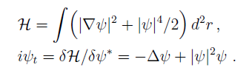


Gross-Pitaevsky model – nonlinear Schrodinger equation

Slide 4
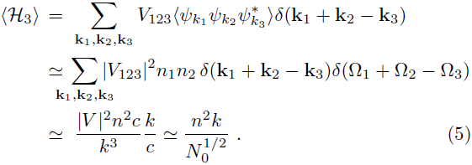


Slide 5

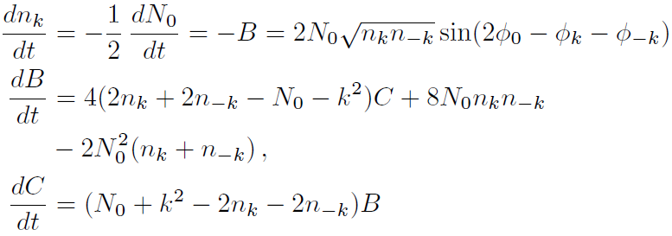



Slide 6


Optical turbulence
Two integrals of motion
– two cascades
With cold atoms one needs to supply constantly high-momentum atoms and simultaneously cool the system to preserve the energy .
Inverse
cascade
k

Slide 7
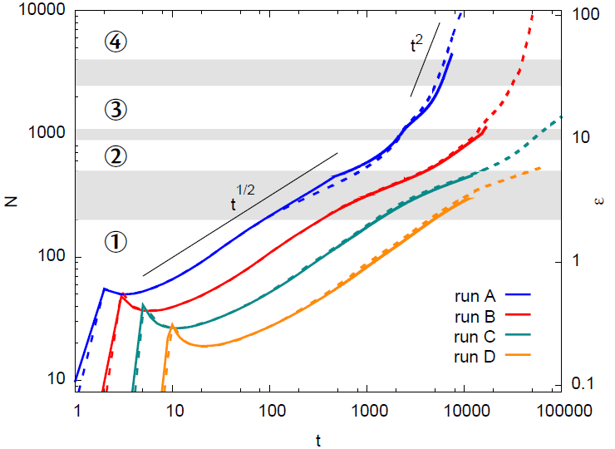


Slide 8
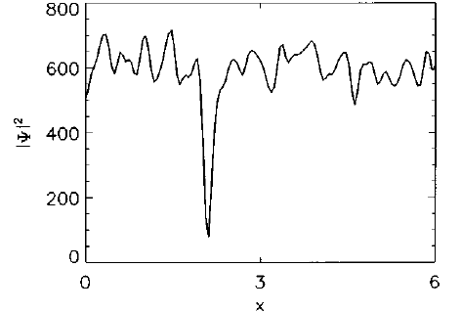
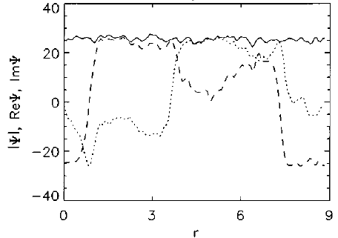
Condensate growth

Slide 9
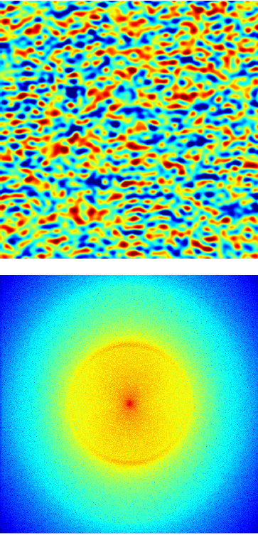
Early stage of condensate growth
Field amplitude in space
Fourier spectrum

Slide 10
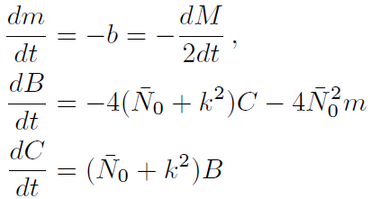

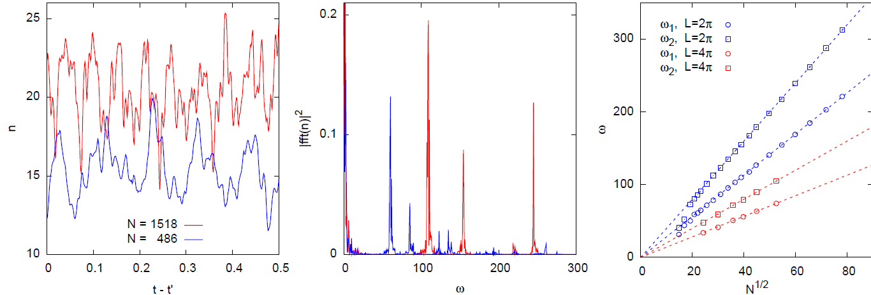
Collective oscillations

Slide 11
The surprises start
And then

Slide 12
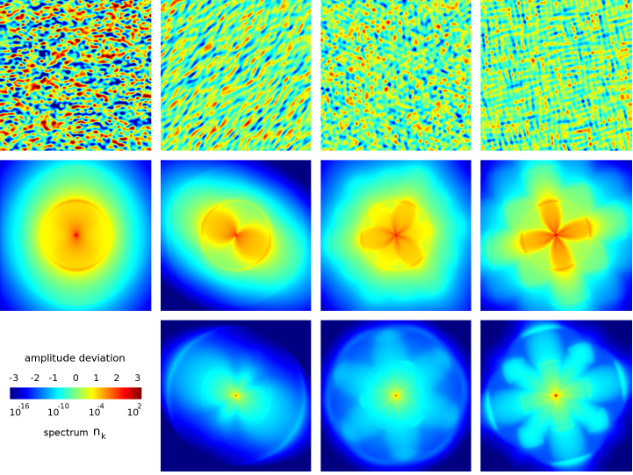

Slide 13
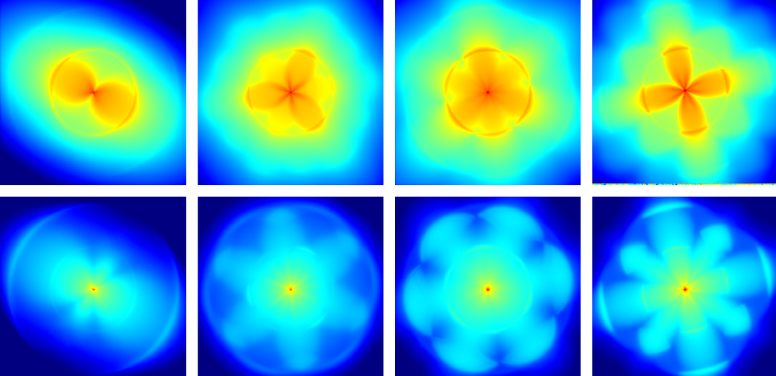
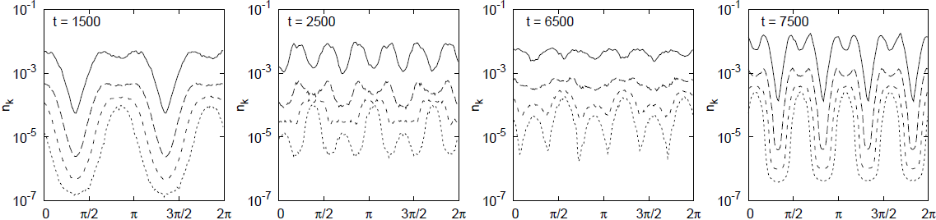

Slide 14
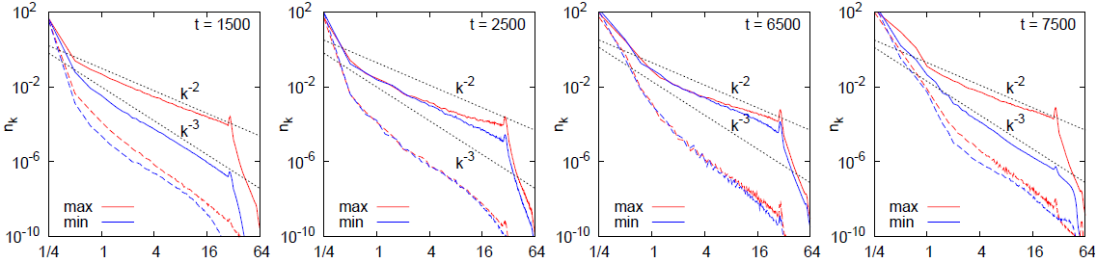
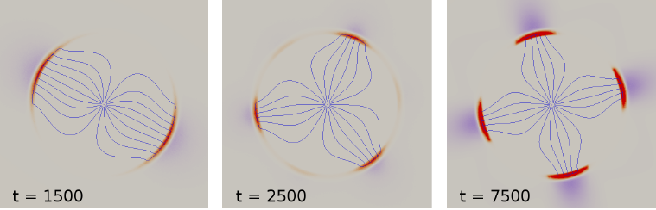
Spectra
Flux lines in Fourier space

Slide 15
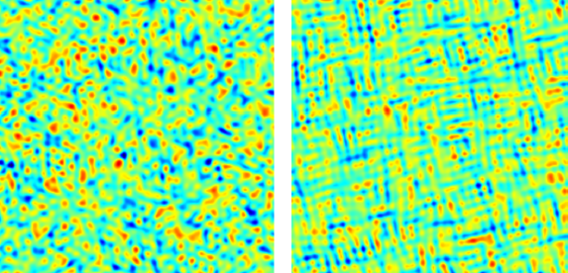
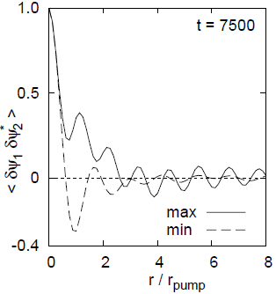
Hexatic phase?
Correlation function
of the over-condensate fluctuations

Slide 16
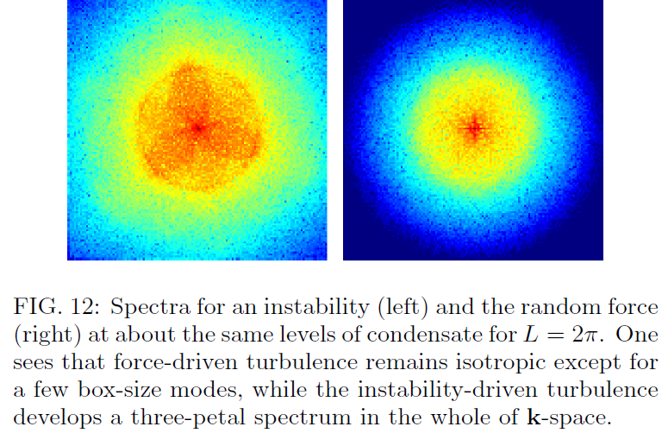

Slide 17


Slide 18
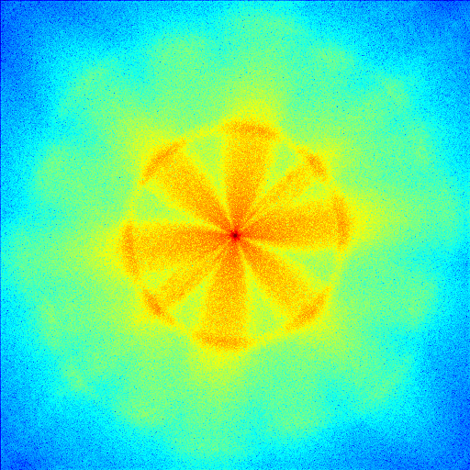

Slide 19
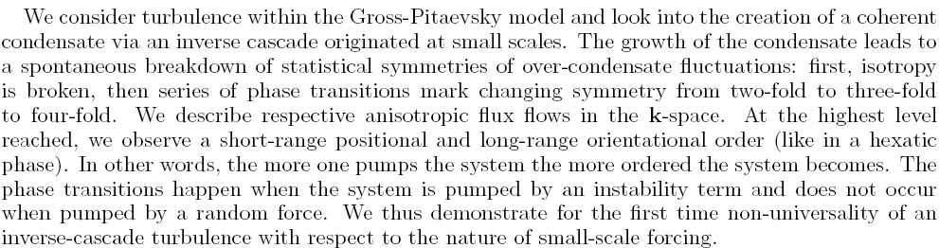
Conclusion

Slide 20
Condensation in turbulence

Slide 21
V. E. Zakharov, V. S. L'vov, G. Falkovich, Kolmogorov Spectra of Turbulence, Springer, Berlin, 1992
http://www.weizmann.ac.il/home/fnfal/papers/book.html

Slide 22
