Slide 1
Massive Stable Particles
Aafke Kraan
INFN Pisa
Bad Honnef, 18 September 2012

Slide 2
Contents
Introduction: theory scenarios
Modelling production of stable massive particles
Interactions of stable massive particles in matter
Searching for stable massive particles in CMS
Searching for stable massive particles in ATLAS
Summary

Slide 3
Stable Massive Particles
Stable Massive Particle (SMP): a particle which can directly be detected at a collider experiment through their interactions in matter
MANY theory models incorporating Stable Massive Particle:
Supersymmetry (SUSY)
  Gauge-Mediated Supersymmetry Breaking
  Split SUSY
  SUSY string models
Other models
  Extra dimensions
  Leptoquarks
  Hidden valley
  ...
  MANY models with MANY different signatures that experimentalists
  have to deal with!
See next! See also lecture by Wacker and Cavanaugh
Just quickly glance... sorry...

Slide 4
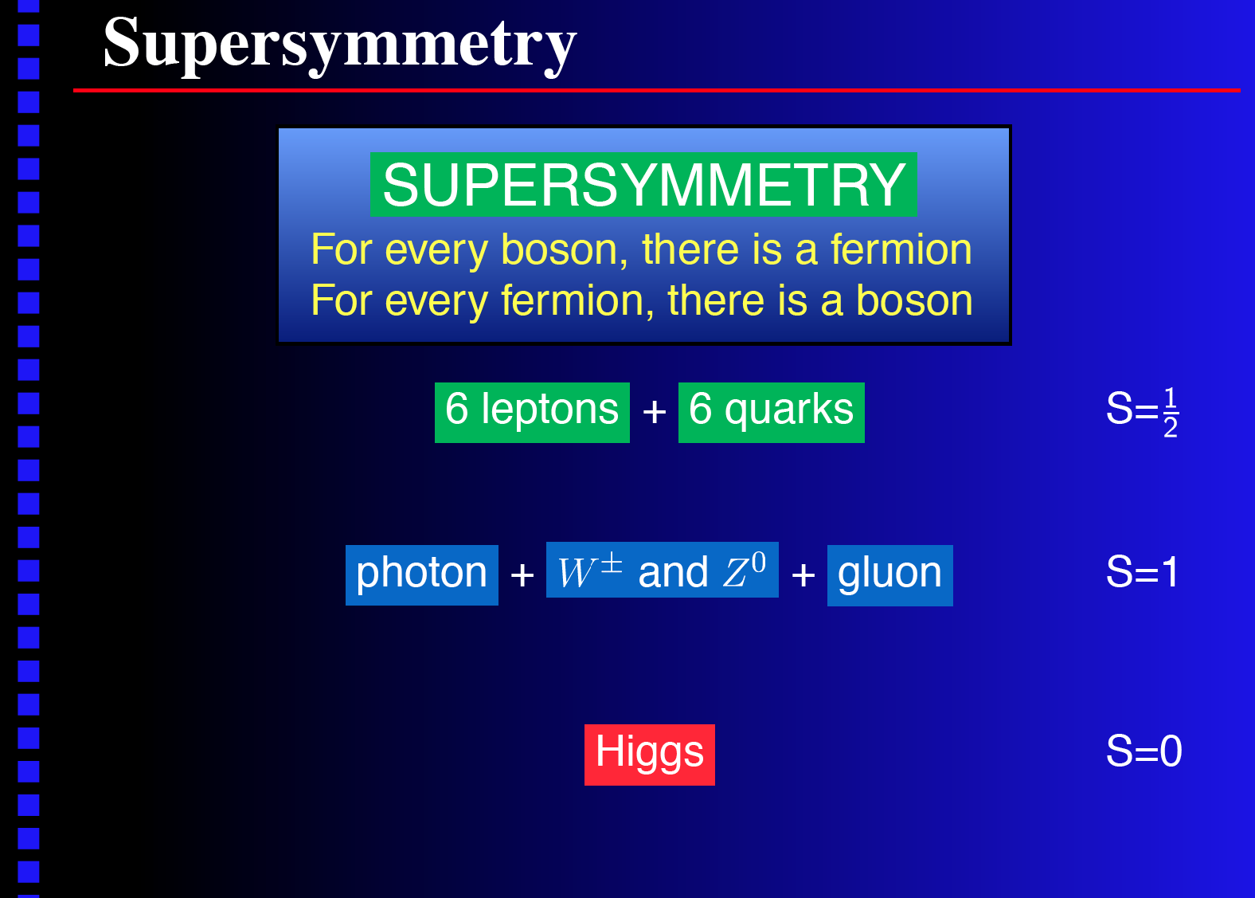
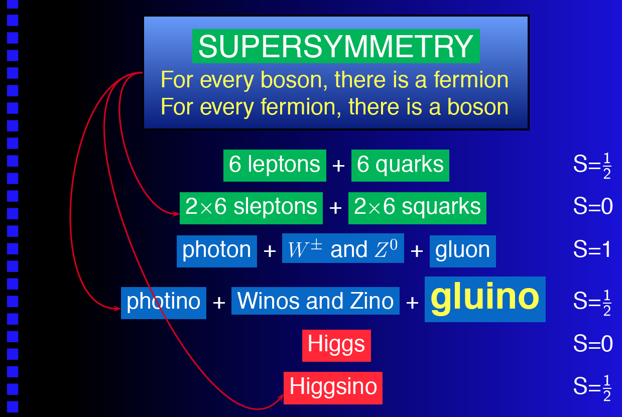
SMP's in SUSY
sleptons
squarks

Slide 5
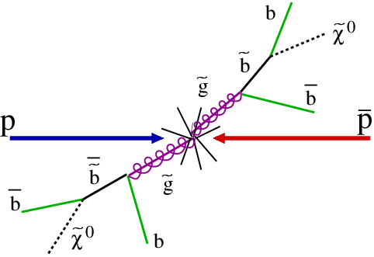
SMP's in SUSY
Conventional SUSY models predict:
  Heavy gluinos, squarks and sleptons
  Lightest Supersymmatric Particle is neutralino, sneutrino or gravitino: non-interacting!
  However, models exist, which predict stable gluino, squark and sleptons.
  Examples:
  Gauge-mediated SUSY breaking model
    Gravitino is usually LSP
    NLSP can only decay via gravitational coupling
    ➔if NLSP=slepton, can be long-lived!
  Split Supersymmetry
    Scalar particles (like squarks) are heavy
    ➔gluino decay is suppressed by heavy squark mass
    ➔gluino has large lifetime ~ stable
    String models: LSP and NLSP gluino

Slide 6
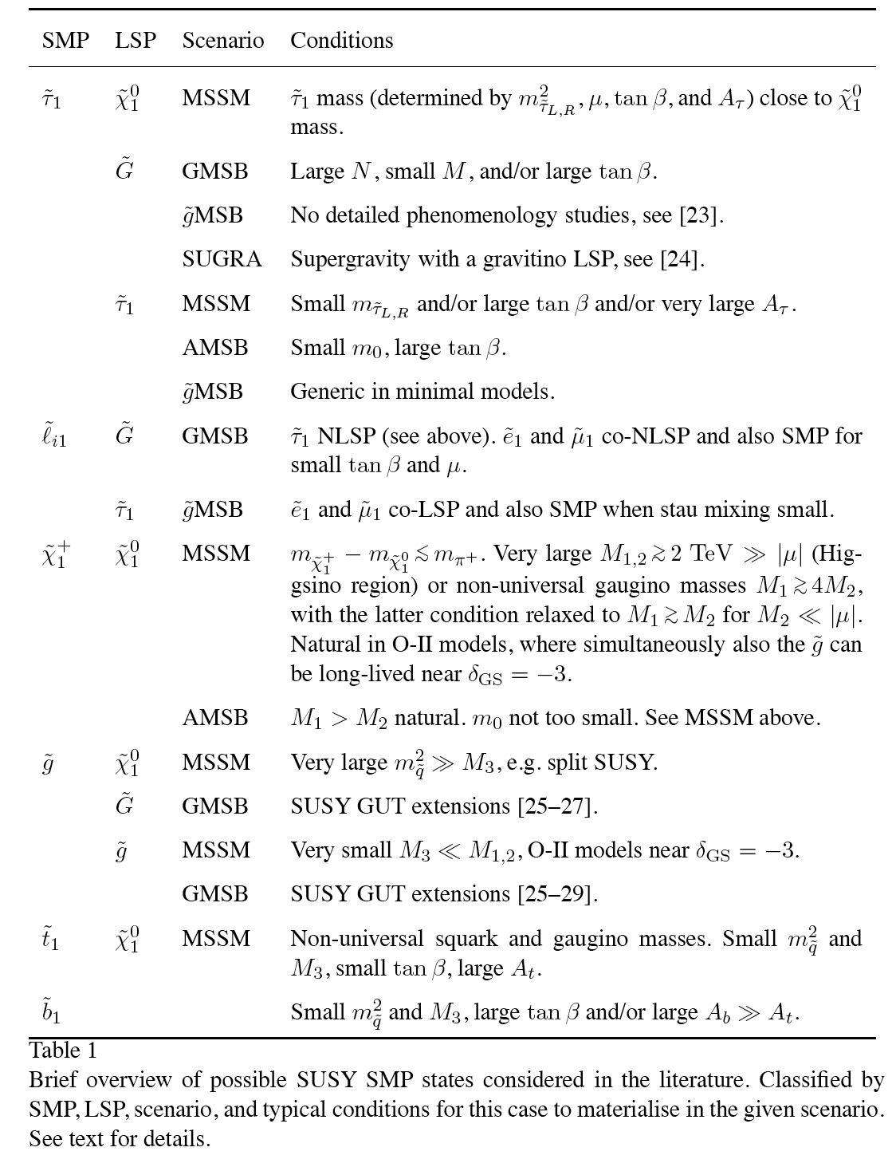

SMP's in SUSY
Overview of SMP's in SUSY
considered in literature, see
hep-ex/0611040 (phys. rep.)
(probably more models now!)
Just remember this: SMP's
  Gluino
  Squark: q (mostly t)
  Slepton: l (mostly τ )
  Masses O(100 GeV) and more
~
~
~
~

Slide 7
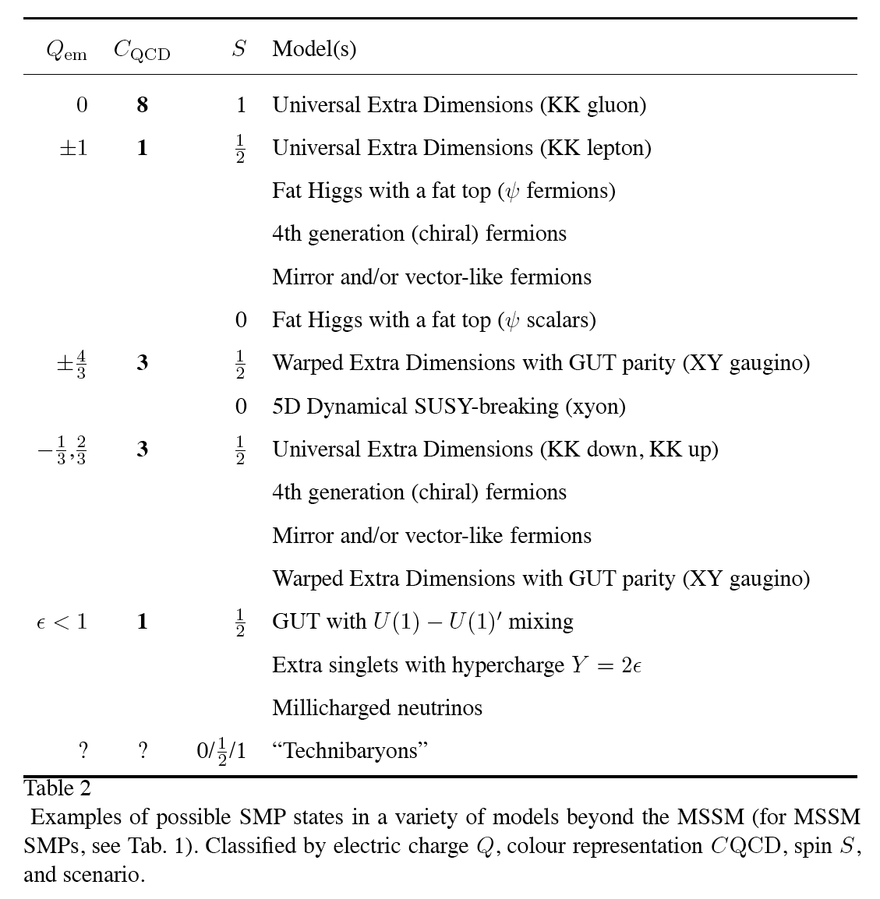


SMP's in other theories
Overview of SMP's in other
theories besides SUSY
see e.g. hep-ex/0611040
Most commonly studied
  Hyper-quarks
  4th generation quarks
  leptoquarks
  Masses O(100 GeV) and more

Slide 8
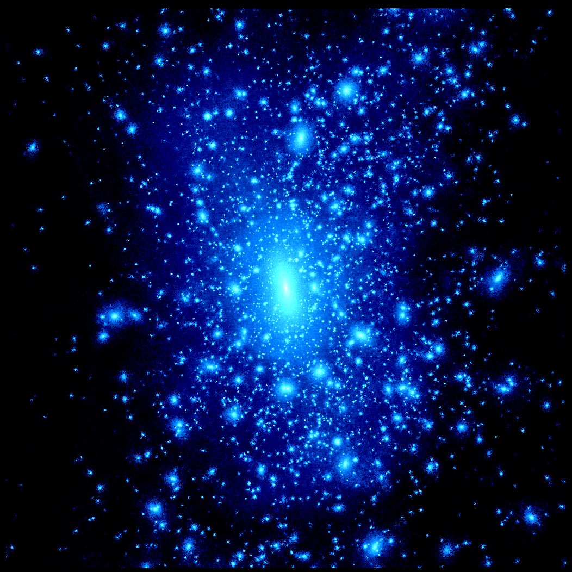
Lifetimes & cosmology
Cosmological limits are hard to reconcile with absolutely stable Strongly Interacting Massive Particles(SIMP'S)
  cosmic ray searches
  searches in ordinary matter
  dark matter searches
  ...
Particles can appear long-lived over a detector time scale (10⁻⁷s) and then decay to a WIMP
Many mechanisms to regulate lifetime
  R-parity conservation, decays via virtual lines etc.
  Mediated by heavy particles
SMP's encompass absolutely stable and
metastable objects.
Can still lead to dark matter canditates

Slide 9
Summary
Categorise SMP's in terms of experimentally relevant charge quantum numbers.
Electric charge | Colour charge | Magnetic charge | Signature | Example in theory
Q|>e | - | - | Very highly ionising, slow | Q-ball, black hole
Q=e | - | - | Highly ionising, slow | Slepton (SUSY)
Q=0,1/3e,2/3e Q=0.e,2e | Octet,triplet | - | Highly ionising, slow, charge exchange | R-hadrons, LQ hadrons
- |  | Dirac | Very highly ionising, slow | GUT Dirac argument
For particles with Q>|e|, fractionally charged particles and magnetically charged particles (monopoles) see talk on thursday by Albert de Roeck
At LHC have to search over fullest range of mass, charges, and lifetimes.
Reach is much further than LEP (exclusions typically up to 90 GeV)

Slide 10
Contents
Introduction: theory scenarios
Modelling production of heavy stable particles
Interactions of heavy stable particles in matter
Detection techniques
Searching for heavy stable particles in CMS
Searching for heavy stable particles in ATLAS
Summary

Slide 11

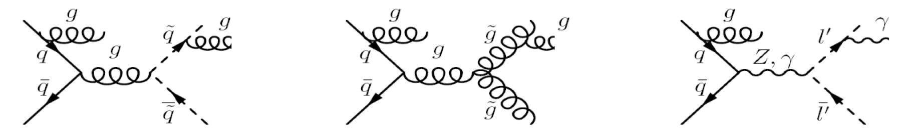

Modelling SMP production
Production cross section
Exotic stable or long-lived new particles are usually thought to be pair-produced at a collider:
Why not singly produced?
σ(ab → X) ∝ Γ(X → ab)~1/τ
If large enough lifetime to be seen in detector ➔very tiny production rate!
Production cross section of coloured particles at LO: O(α_{S}²)
Production cross section of colour-singlet particles at LO: O(α_{EW}²)
NLO calculations performed for some production processes

Slide 12
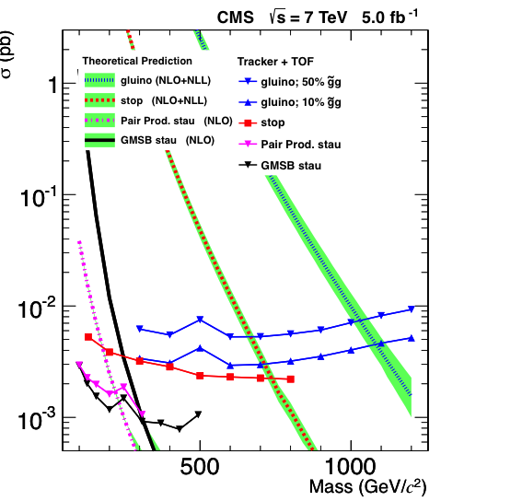
Production cross section
N=σL
In 5 fb⁻¹:
gluino:
M=500 GeV➔N=15000 produced
M=1 TeV➔N=50 produced
stau:
M=200 GeV➔N=50 produced

Slide 13

Modelling SMP production
Event topology
In principle 2 heavy particles are produced back to back in the transverse plane
However, other emissions can occur:
Extra particles can modify event topology!
Mostly ISR (little FSR) ➔additional jets can be produced together with 2 heavy particles
Heavy particles usually have large transverse momentum P_{T} and velocity β<1 (see next)
For colour-singlet particles: story ends here... they sail out through the detector
For coloured particles: they cannot escape confinement forces!

Slide 14
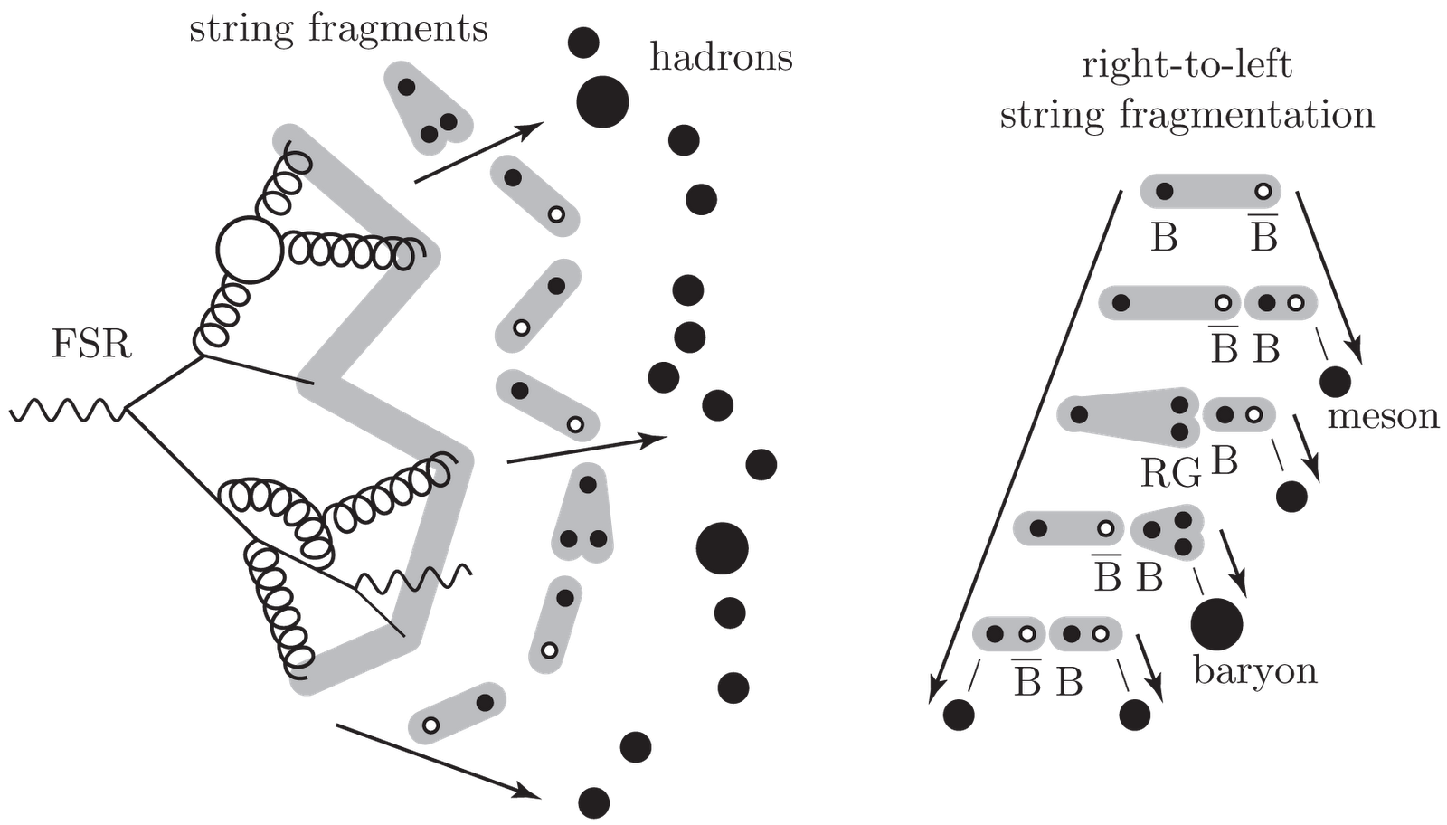
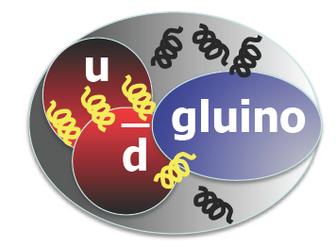
Modelling SMP production
Hadronization into R-hadrons
Coloured particle "hadronizes" (picks up gluons and quarks)
to form a colour singlet state: hadron.
Examples for colour triplet C₃ (e.g. squark):
C₃q (=meson) or C₃qq (=baryon).
Examples for colour octet C₈(e.g. gluino):
C₈qq (=meson) or C₈qqq (=baryon) or C₈g
These states are called R-hadrons
-
-
Types of R-hadron
About half of them is produced neutral, half charged
About 2-6% are R-baryons, rest are R-mesons (depending on event generator)
Issue for gluino-hadronization: may form gluino-gluon state (gluino-ball)!
  Need some parameter: f_{gg} : probability to form gluino-ball, default=0.1
~
Mass:
Hadronization process leads to increase of mass (small, but still)
I'll discuss later, together with nuclear interactions!

Slide 15
SMP properties
Event generators for SMP
Event generators for Stable Massive particles
general purpose event generators:
  PYTHIA, HERWIG: include hadronization of SMP
  Others.... e.g. Isajet, Sherpa, etc
  programs providing Matrix Elements e.g. Madgraph, CompHEP/CalcHEP, Prospino,
  SDECAY, ....
hep-ex/0511014
Non relativistic: β<1
Large P_{T}
14 TeV
14 TeV
Lifetime: Depends on the model. Usually cτ ~ O(m) or larger
14
14
14
Notes:
END: ANY QUESTIONS AT This point?? TIME 16.15-16.20

Slide 16
Contents
Introduction: theory scenarios
Modelling production of heavy stable particles
Interactions of heavy stable particles in matter
Detection techniques
Searching for heavy stable particles in CMS
Searching for heavy stable particles in ATLAS
Summary

Slide 17

Interactions of particles in matter
Dominant interactions of a massive particle (m>>m_{e})
Electromagnetic interactions (charged particles only)
  Ionization energy losses
  Multiple Coulomb scattering
  Transition radiation (?)
  Cherenkov radiation (?)
Nuclear interactions (charged and neutral hadrons)
How does a very heavy stable particle interact??

Slide 18
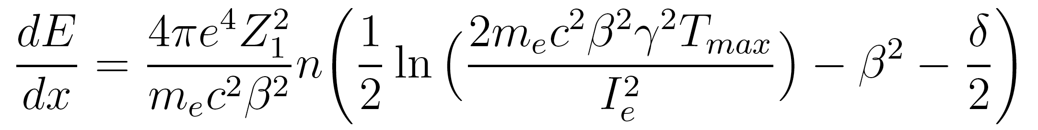
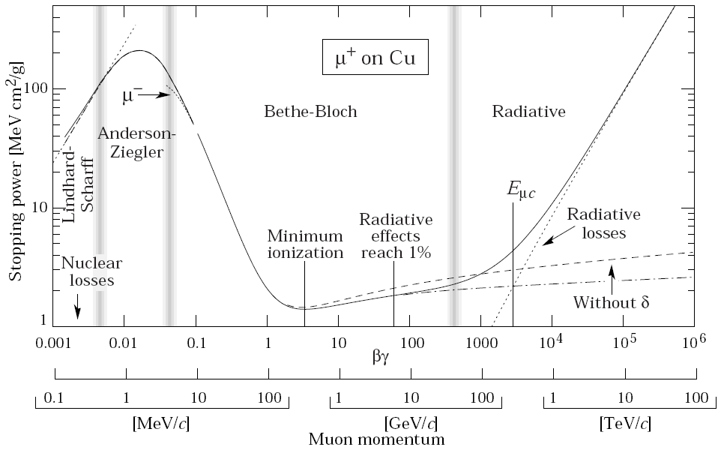
Ionization energy losses
Dominant energy loss for a heavy (m>>m_{e}) electrically charged particle when travelling through material is due to Coulomb scattering
Described by the Bethe-Bloch formula:
with
e and m_{e} the electron charge and mass
n the electron density of material
β the velocity of incident particle
Z₁ the charge of incident particle
I_{e} mean ionization potential of material
T_{max}=max kin energy transfer
δ density correction, because of polarisation in medium
dominant term
density effect, small
correction when βγ>3
Bethe-Bloch
When 0.003<βγ<3

Slide 19
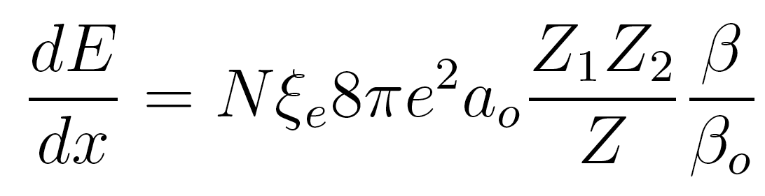
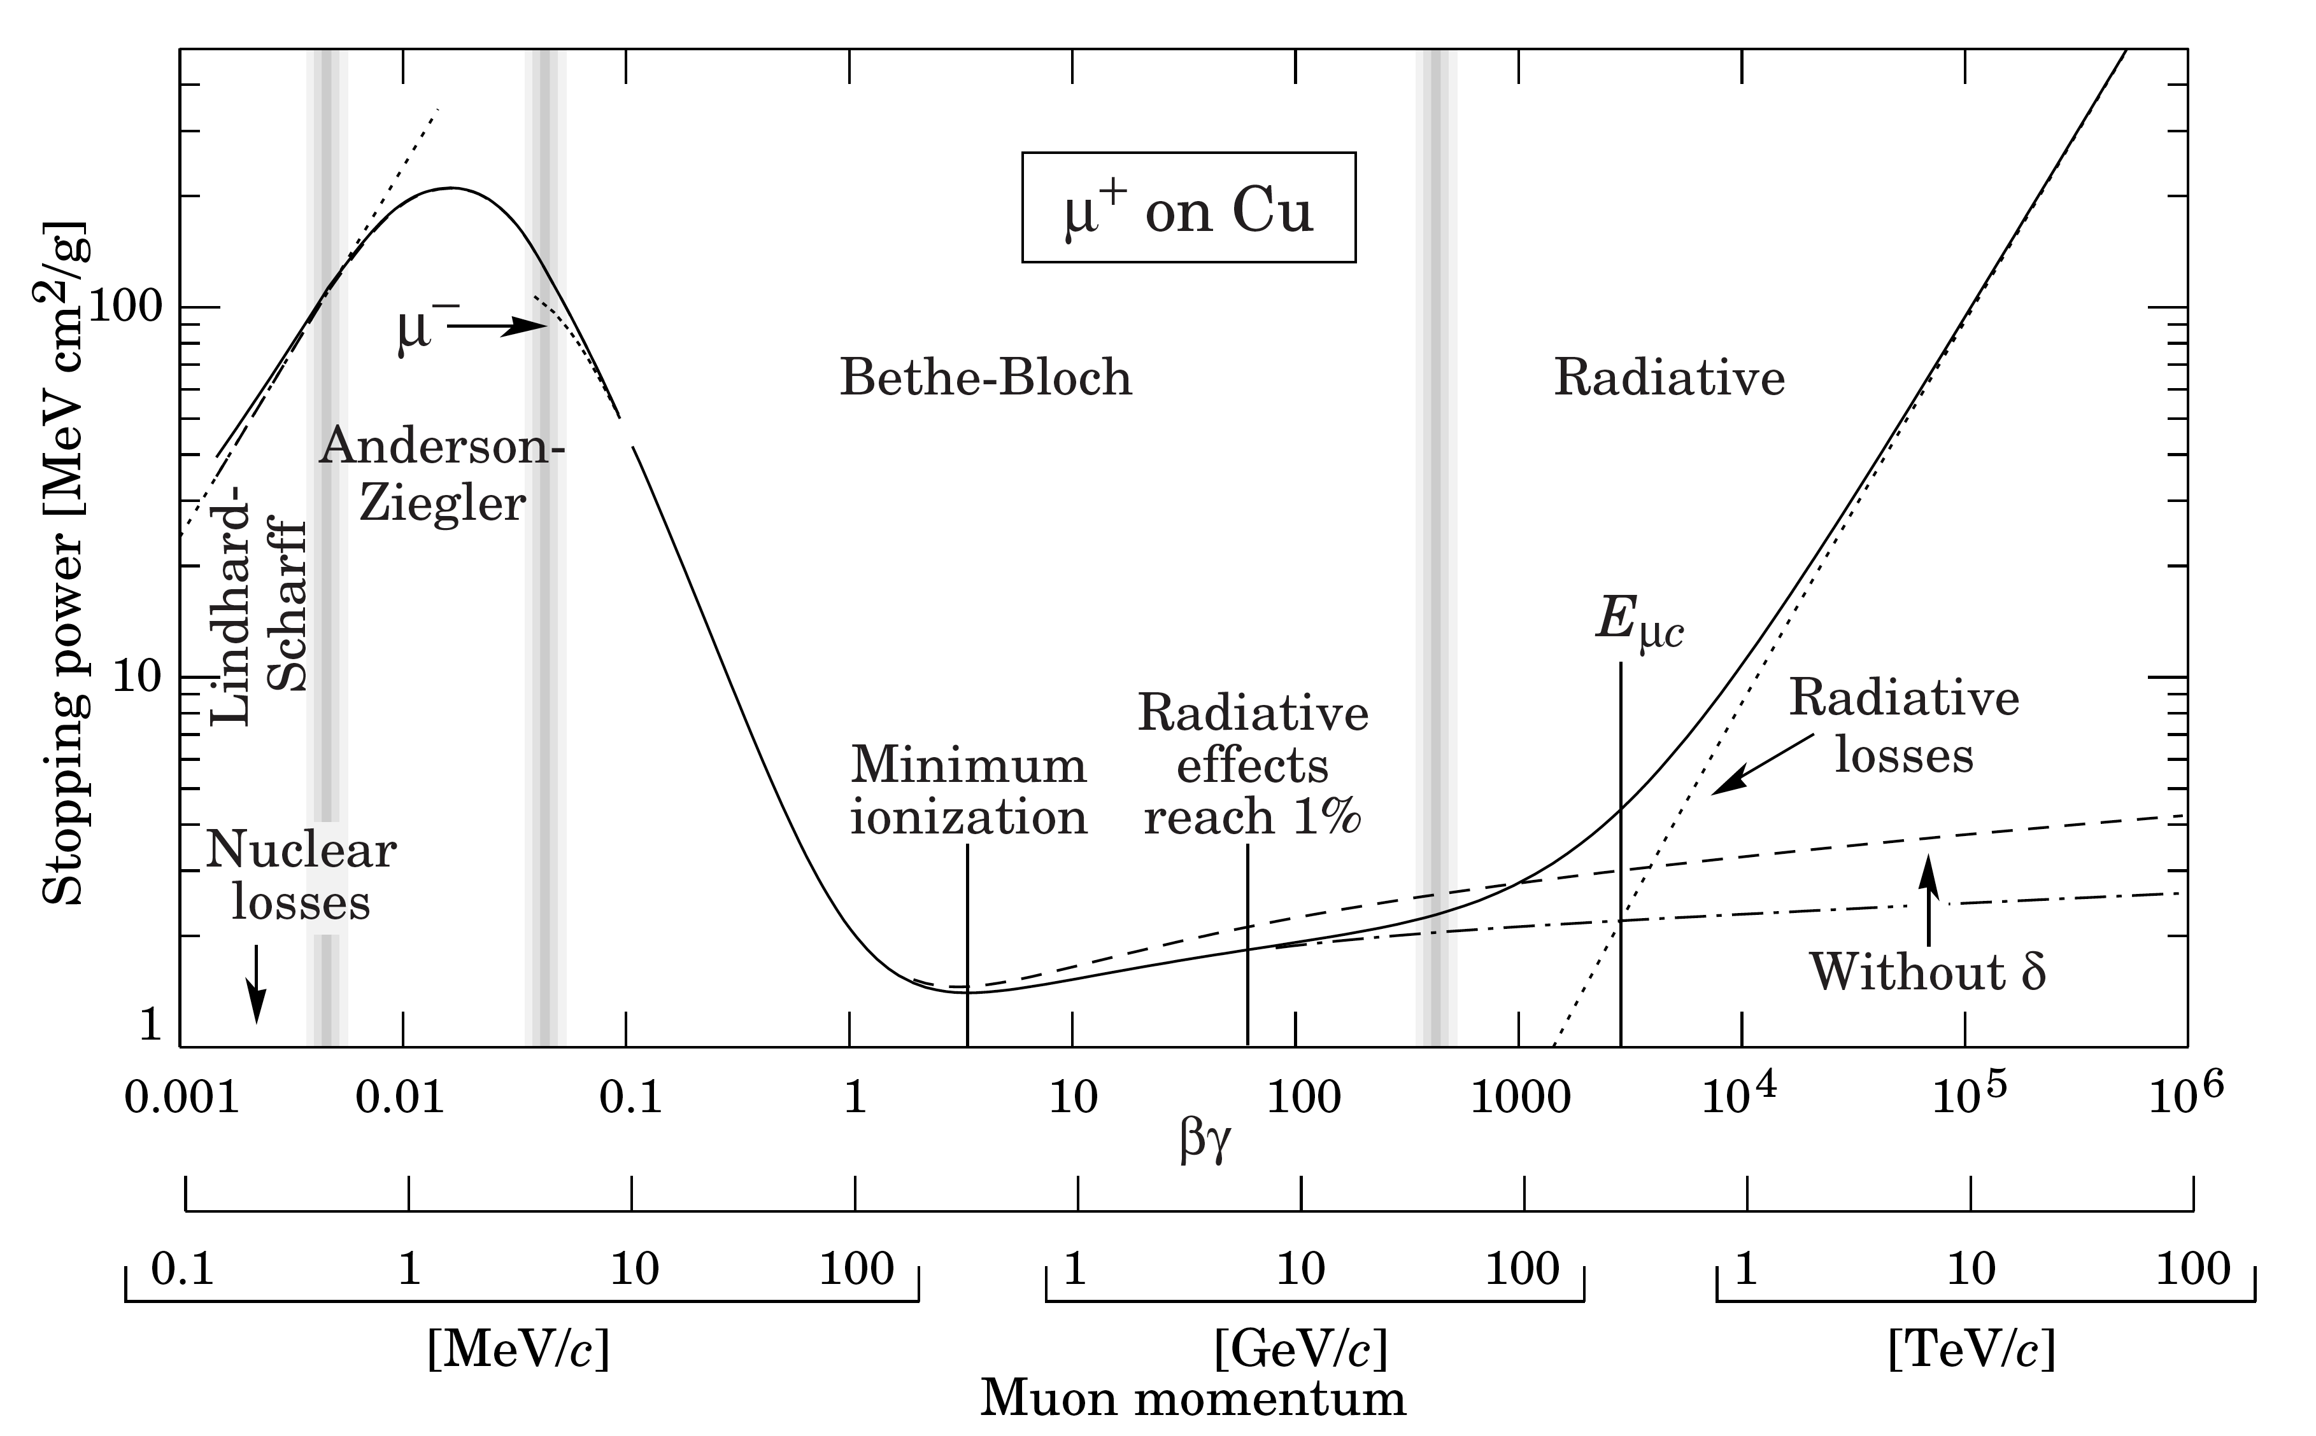
Ionization energy losses
For very slow particles, with velocities comparable or less than velocity of electrons in the atom, the Bethe-Bloch formula is no longer valid!
➔Linhard-Scharff region
Very slow particles β<Z₁^{2/3}β₀
with
N number of atoms per unit volume
ξ₁ = (Z₁)^{1/6}
a_{o} Bohr radius of hydrogen atom
Z^{2/3}=(Z₁^{2/3+}Z₂^{2/3})
β the velocity of incident particle
β₀ =0.0073, electron velocity in lowest Bohr orbit of hydrogen atom
low
intermediate
Intermediate region:
➔Anderson-Ziegler region.
can also use polynomials to join up the BB and LS region
18

Slide 20
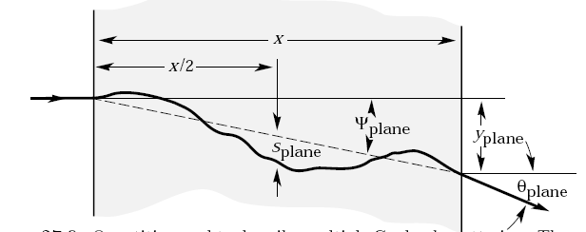
Multiple Coulomb Scattering
Electromagnetically charged particles suffer angular deflections mostly from nuclear Coulomb field (Rutherford scattering);
Multiple small scatters
→ rms scattering angle
Spatial angle described by 2D Gaussian
Empirical formula for projected rms
scattering angle:
where x=thickness, X₀=radiation length, z, β, p = charge, velocity, and momentum of particle
Heavy particle: small β, but also large p
→suffers moderate amount of angular deflections
Well understood!

Slide 21

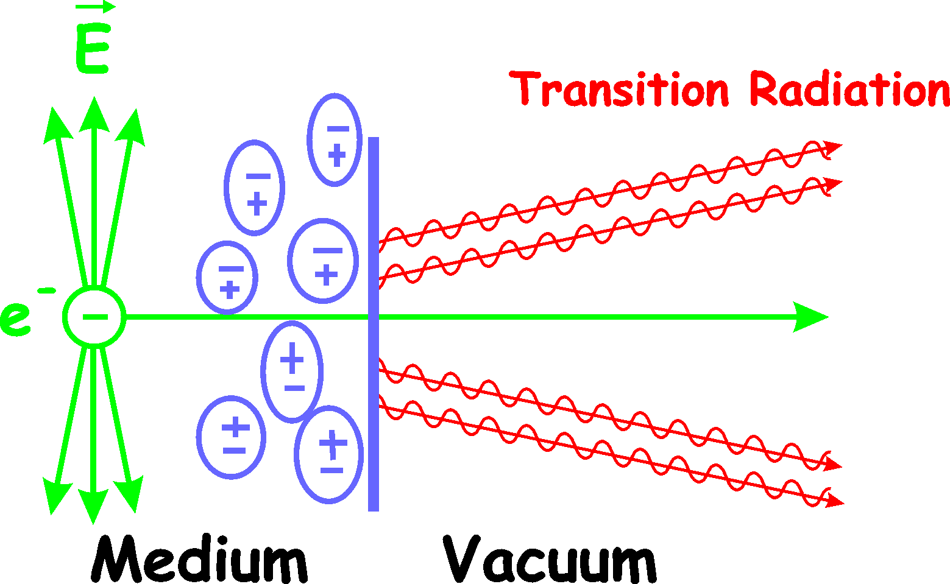
Transition radiation?
Transition radiation is produced when a relativistic particle traverses an inhomogeneous medium
  Boundary between different materials with different n.
Strange effect
  What is generating the radiation?
  Accelerated charges
Total energy radiated
Can be used to measure γ
Mostly used for electron & muon ID
Lack of TR can be used to distinguish
between a heavy and light charged
particle (combine with momentum
measurement)

Slide 22
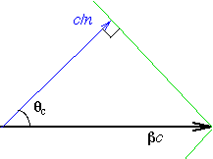
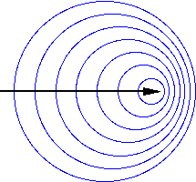
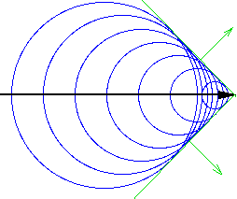
Cherenkov radiation?
Moving charge in matter
Wave front comes out at certain angle
Measureθ ➔ estimate particle velocity
Combine momentum measurement with velocity to get mass
Heavy particles withβ<1 are normally below the threshold
to emit Cherenkov radiation
Lack of Cherenkov radiation was used at LEP (DELPHI) to
detect heavy charged particles

Slide 23
Nuclear interactions
If the heavy particle is a hadron, it
undergoes nuclear interactions
What would happen during a nuclear collision?
We are not sure...
But in order not to miss it should have some reasonable description
Several people came up with creative models...
Let's look at these models! First some general observations
u
gluino
_
?
d
-
Examples of scattering models:
generic model
intermediate model
triple-Regge model

Slide 24
Nuclear interactions: general
Consider a parton C_{i} (e.g. gluino) of colour state i.
Interactions between C_{i} and quarks in target nucleons suppressed with 1/M²
➔probability that it will interact is small!!
So heavy state C_{i} is a spectator, i.e. non-interacting
It is accompanied by a coloured hadronic cloud of light constituents,
responsible for the interaction.
The interaction cross section will be typically that of a normal meson.
Next: concentrate on gluino-R-hadrons, but valid for any coloured heavy
object
"cloud-model"
u
gluino
_
R-hadron = passive object + interactingπ/ρ/K/n/p cloud.
 reservoir of kinetic energy!
d

Slide 25
Nuclear interactions: general
Example:
Let's consider a coloured state C₈qq
gluino with M=300, E=450 GeV➔γ factor=E/m=1.5
if quars are u and d quarks: m(ud) ≈ 2*300 MeV=0.6 GeV (constituent quarks mass=300 MeV)
Energy of interacting cloud: 0.6*γ ≈1 GeV ➔very low!!
_
To predict energy losses, need to know interaction length, identity of
scattered particles, phasespace (how many?), nuclear effects, ...
Before trying to predict what happens for heavy hadrons, let's first have a look at light hadrons!
24

Slide 26
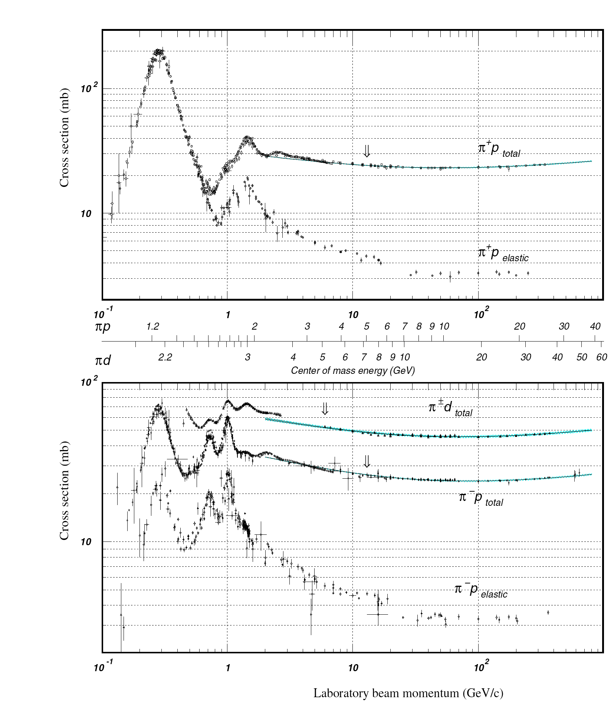
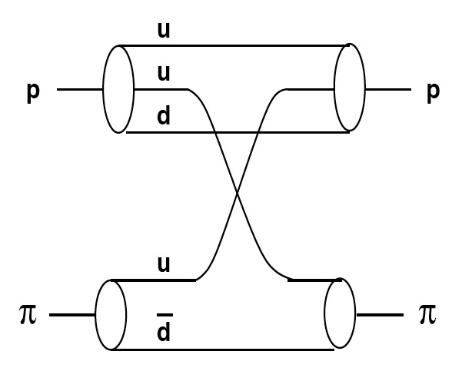
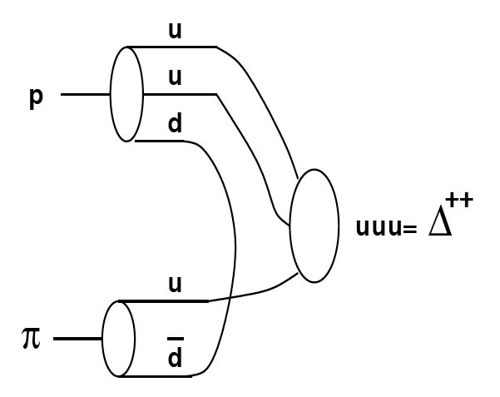
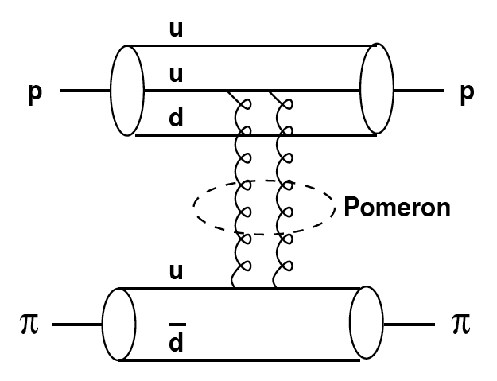
An example: π p scattering
Low energy
elastic scattering (2➔2)
charge exchange (2➔2)
resonances
Low energy region
High energy region
Δ⁺⁺
π+
n
d
Reggeon
+
+
+
-
-
+
Example of slide 23
High energy
as above plus
inelastic scattering (2➔N)
charge exchange (2➔N)
π-
Pomeron

Slide 27
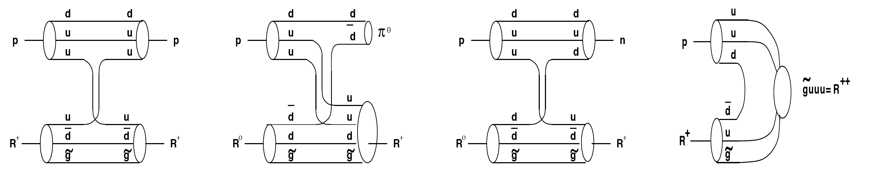
Nuclear scattering: generic model
What happens if we attach for example a gluino to the pion??
Heavy object does not participate in interaction!
Processes like in normal hadron scatteruing
hep-ex/0404001
Elastic scattering
Particles does
not change
identity
Baryon exchange:
Exothermic! Release of pion (light!)
Reverse reaction suppressed by phase space and rel. absence of pions in matter
Consequence: after a while just baryons!
Resonances:
unknown!
could be important...
but assume flat
Charge exchange: R⁰➔R^{+/-}
R^{+/-}➔R⁰
striking topologies!

Slide 28
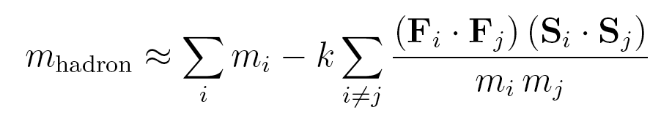
Nuclear scattering: generic model
What else happens if we attach for example a gluino to the pion??
Colour state of hadron is changed: e.g. not colour singlet pion,
but octet! Is M_{R-hadron} = M_{gluino}+m_{π}?? NO!
The masses are influenced! Do all R-hadrons weight the same?? NO!
Masses can be calculated in Heavy-Quark Effective Theory:
m_{i} are the constituent masses
F_{i} are the colour SU(3) matrices,
S_{i} the spin SU(2) matrices
k a parameter related to the wave function at the origin.
No big mass differences found (tedious calculations...)
Notes:
Is respondible for mass splitting for example between pion and rho mesons

Slide 29
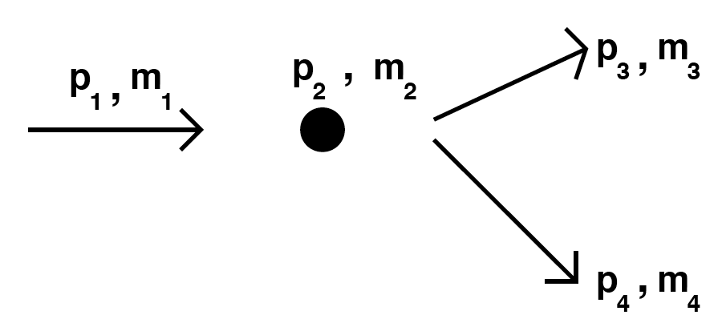
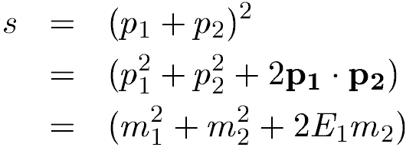
Nuclear scattering: generic model
What else will be produced?
hep-ex/0404001
How many additional particles (mostly π) will be produced (2➔N)?
Depends on phase space!
N is determined by the Q-factor:
with
pion with P_{T}=200 GeV ➔ Q=sqrt(m_{π}² + m_{p}²+2E_{π}m_{p})-m_{π}-m_{p}≈19 GeV
R-hadron with P_{T}=200 GeV and mass 200 GeV (E=282 GeV)➔
Q= sqrt(m_{R}² + m_{p}²+2E_{R}m_{p})-m_{R}-m_{p} ≈m_{R}(1+1/2m_{p}²/m_{R}²+E_{R}m_{p}/m_{R}²)-m_{R}-m_{p}
≈E_{R}m_{p}/m_{R}-m_{p}≈282*1/200-1≈0.4 GeV
For heavy particles, N turns out to be "usually" no larger than 3!

Slide 30
Nuclear scattering: generic model
hep-ex/0404001
Now we have an idea of the types of processes that can occur
But what about the cross sections (determining interaction length)??
Simpel approach: model based on geometrical cross sections (black disk)
Heavy object (like gluino) does not
contribute to "size" of the R-hadron
Total nucleon interaction cross section:
approximated by the asymptotic values
for the cross sections for normal hadrons
constant
States like C₈qq, C₃q, C₈qqq: just like pions: each quark contributes 12
mb to the total cross section.
A state like C₈g? Same as C₈qq
Average nuclear interaction length:
  R-baryons: 12 cm in iron.
  R-mesons: 3/2 larger.
u
gluino
u
_
_
d
d
-
-
-

Slide 31
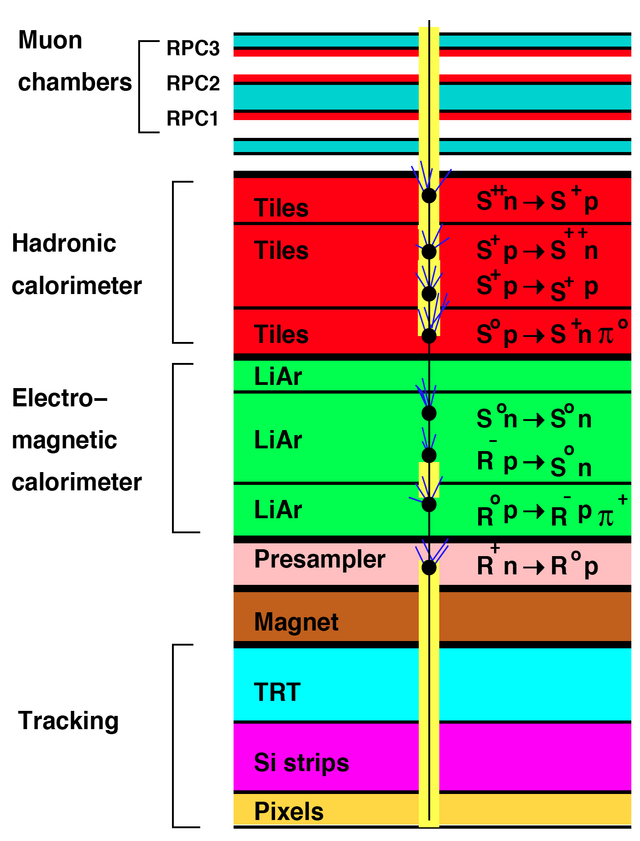
Generic model: phenomenology
Example of R-hadron interacting in ATLAS detector
Phenomenology:
Many different possibilities for how it would show up in a detector!
probably ends up as baryon
no strong preference for neutral or charged
hep-ex/0404001
hep-ex/0612161

Slide 32

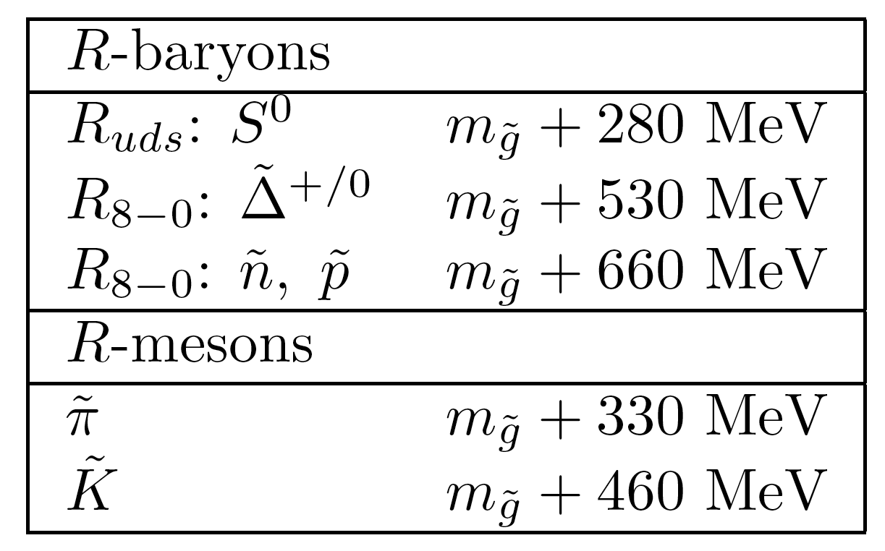
Nuclear scattering: intermediate model
Only applicable to stable gluino's (not squarks)
Scattering model: as before, same processes, black disk approximation
Gluino mass spectrum differs, based on "bag-model" calculations
(model for quark confinement, predicting mass, spin, ...)
Lightest state= udsg ̃ (S₀-R-baryon), light due to large hyper-fine splitting
Mostly R mesons produced. During repeated scattering R-baryons are formed.
Phenomenology: Possibly many R-hadrons end up in the lightest, neutral,
state...
arXiv 1011.2964
u
d
u

Slide 33
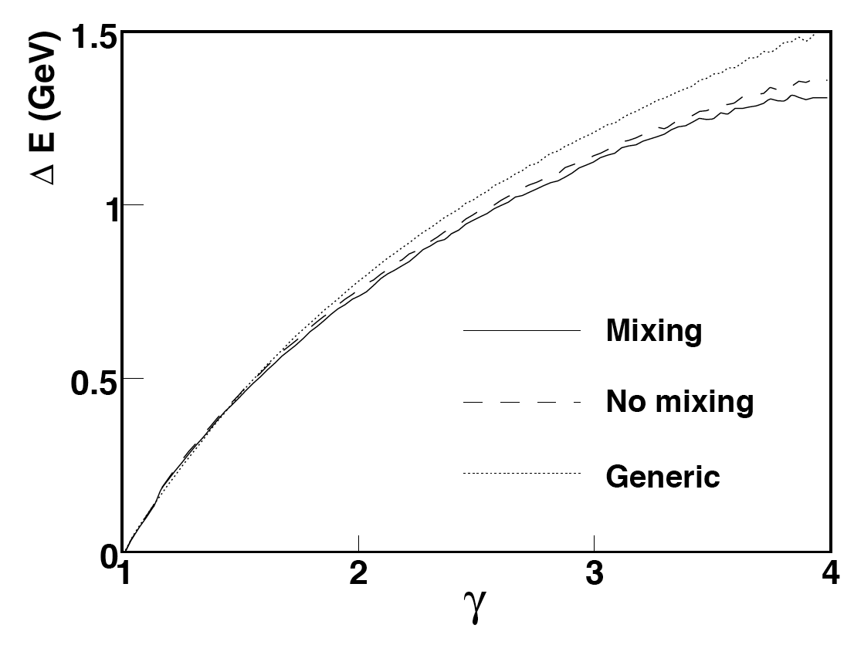
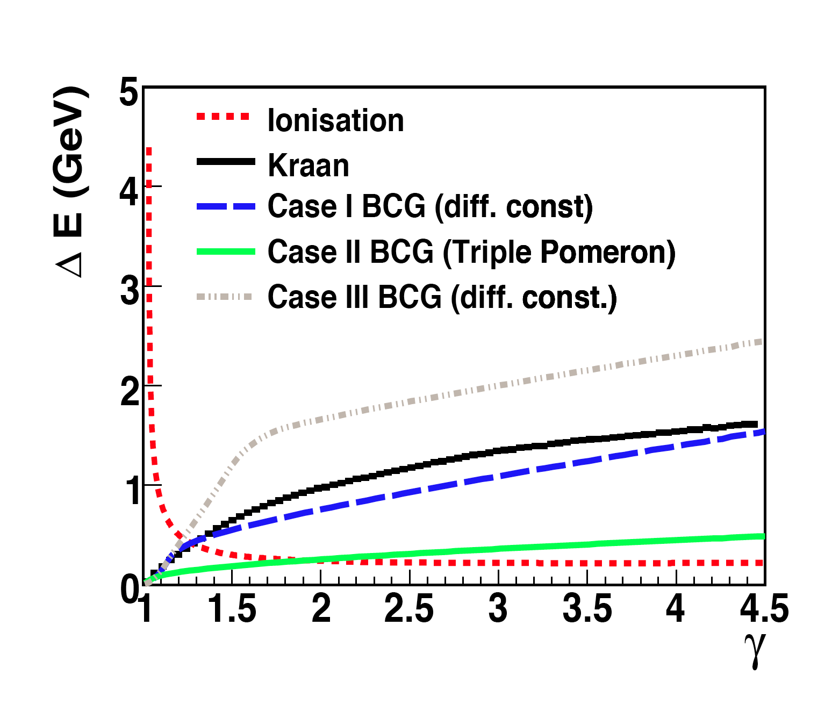
Nuclear scattering: other models
Triple-Regge model
  Derived from low energy hadron scattering
  Employing mass hierarchy as on previous slide: Rº is lightest baryon
  Most R-hadrons end up neutral after several interactions
  Models without considering baryons, so no conversion from mesons to baryons (BCG)
arXiv 0908.1868
hep-ph/980612
Energy loss
in iron vs γ

Slide 34
Summary of interactions
Electromagnetic interactions well understood
Variation in modelling of nuclear interactions
Can end up neutral/charged, don't know, can change➔weird signature!
Energy losses are small
Represents uncertainty for searches... (see next!)
Notes:
QUESTIONS? Time should be 16.50-16.55

Slide 35
Contents
Introduction: theory scenarios
Modelling production of heavy particles
Interactions in matter
Searching for heavy stable particles in CMS
Searching for heavy stable particles in ATLAS
Summary

Slide 36
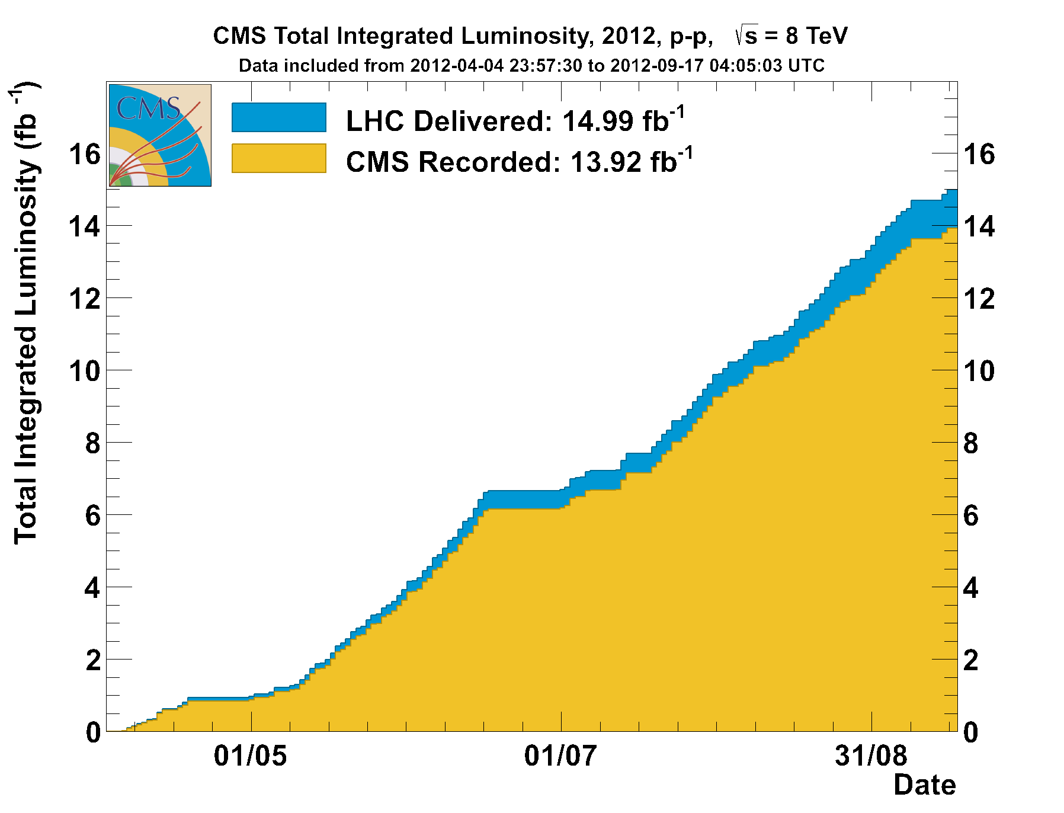
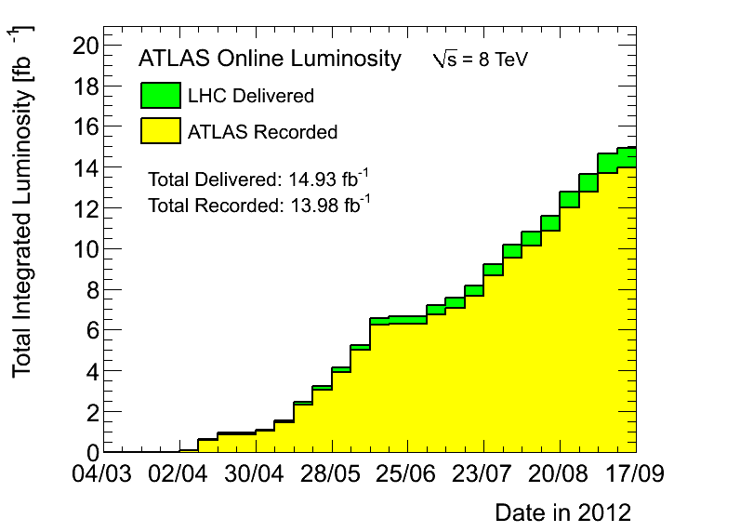
LHC is performing well …
2012: Proton – Proton collisions at 8 TeV
The experiments have collected ~14 fb⁻¹ recorded luminosity
…and in total expect more than 20 fb⁻¹ of data 2011-2012 combined
->Exciting times for searches
From Albert de Roeck-Moedal Workshop 2012

Slide 37
Searches for SMPs
Complementary search strategies to cover large range of particles in CMS and ATLAS...
Massive stable charged particles with unit charge traversing the detector
Massive stable particles stopped in the detector
Massive stable particles decaying in the detector
Massive stable charged particles with multiple charge traversing the detectors
Massive stable charge particles with fractional charge traversing the detector
Here!
See talk on thursday by Albert de Roeck!
Concentrate on techniques used in both experiments, show just a short summary
of subset of analyses (most recent).

Slide 38
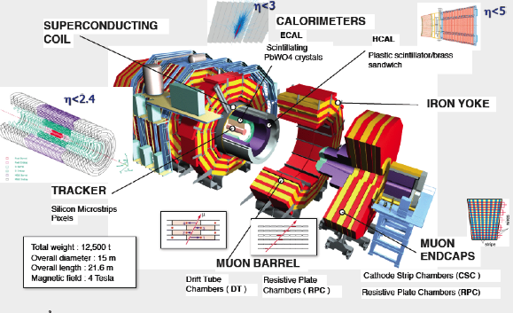
The CMS Experiment
Acceptance: Calorimetry |η| <5.0 Tracking |η|<2.4
Length = 22 m Width = 15 m Height = 15 m but spatial precision ~ 100 μm

Slide 39
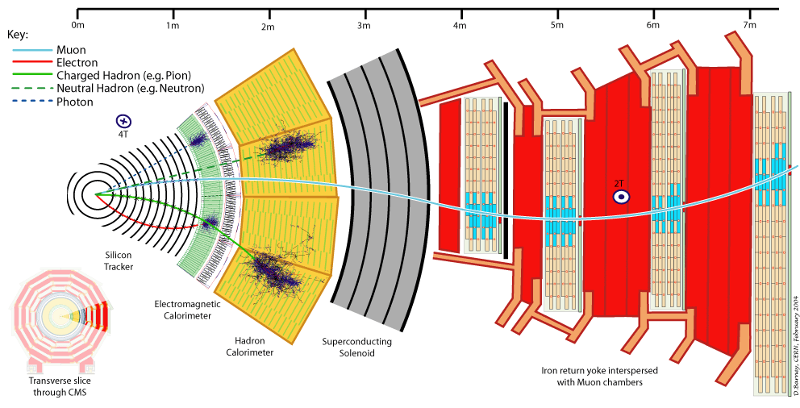
Particle Detection in CMS
Electromagnetic Calorimeter
Muon Spectrometer
Hadron Calorimeter
Inner Tracker
Magnet
Return flux
38
Notes:
38
Slowly explain how a particle attraverses the detector. First Moun (explain also bending), then Electron, then charged hadron, neutral hadron, photon

Slide 40
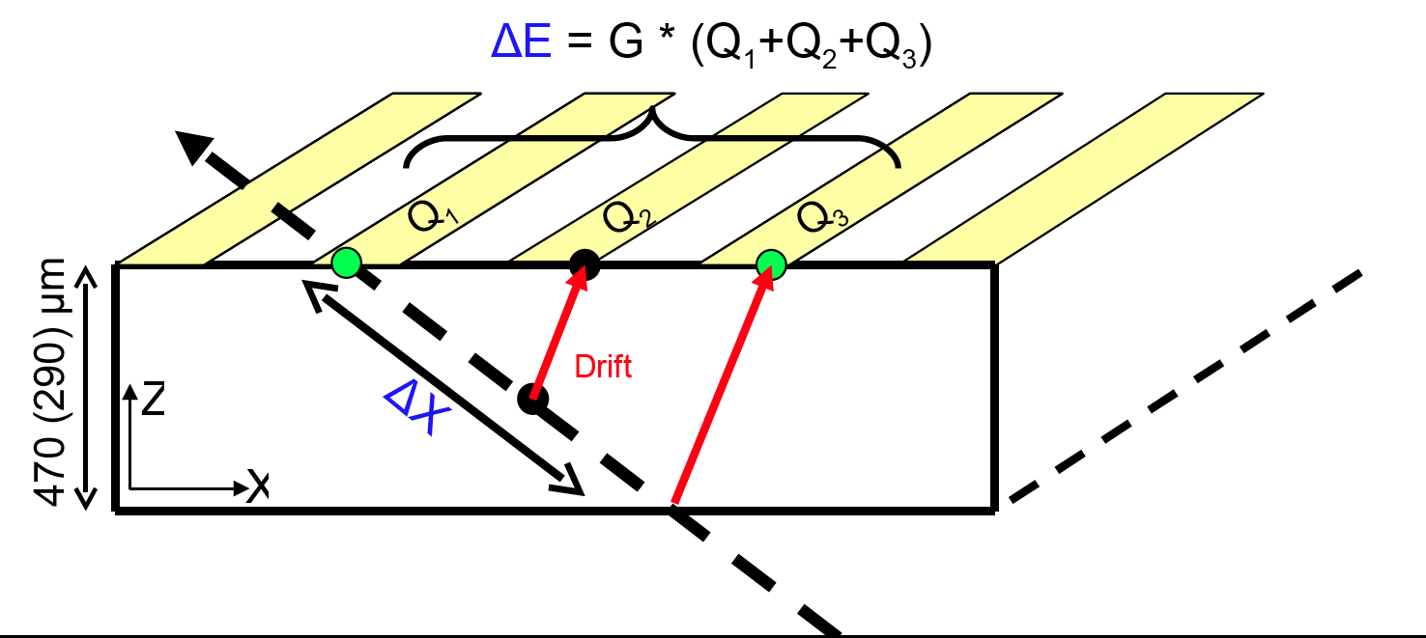

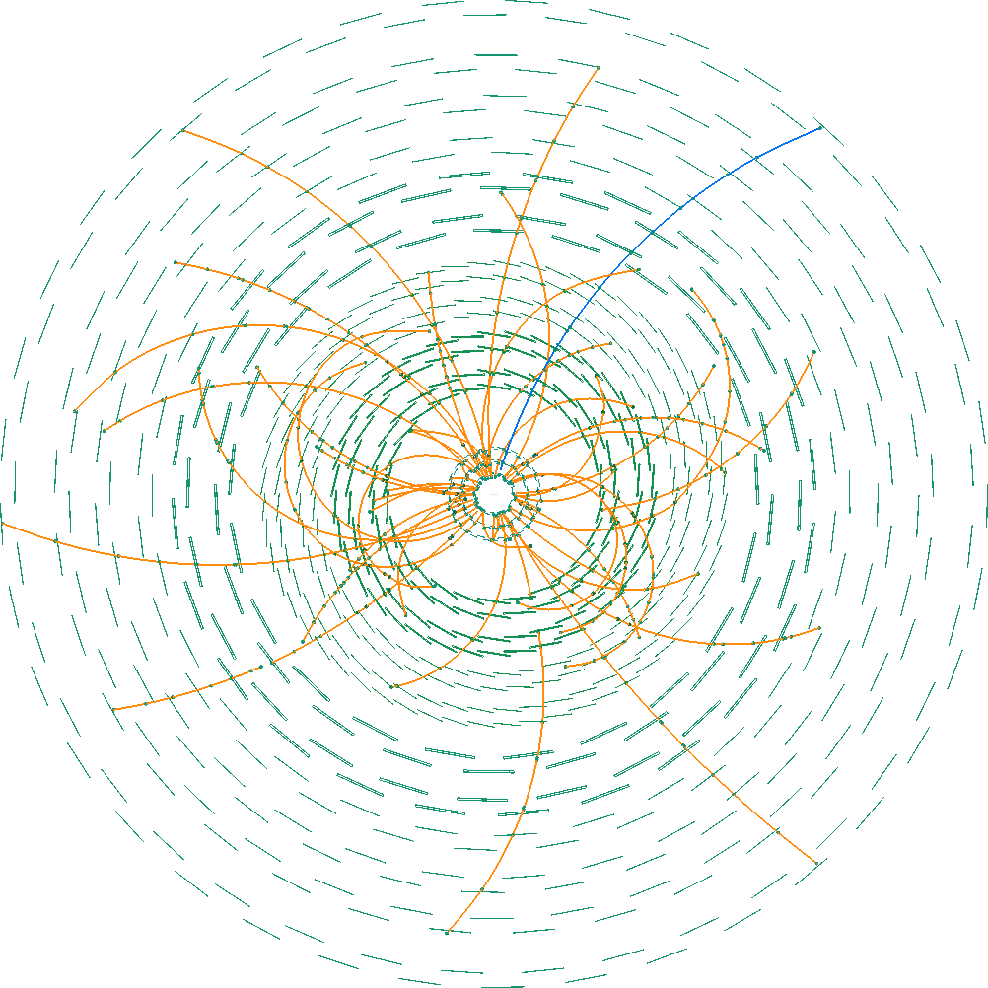

dE/dx measurement in tracker
Tracker provides:
Excellent Pt resolution
dE/dx measurement
ΔE/Δx needs:
ΔE: From Si pixels and strips:
Δx: Particle Trajectory
(local particle direction)
Computed for all on-track Strip Clusters.
Notes:
9/18/12
Dorian Kcira
39
semiconducting material,
particle creates electron-whole pairs

Slide 41
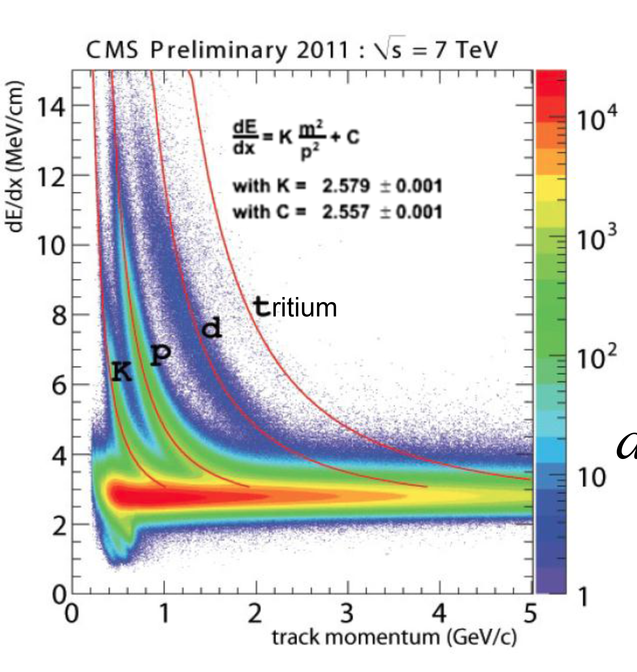
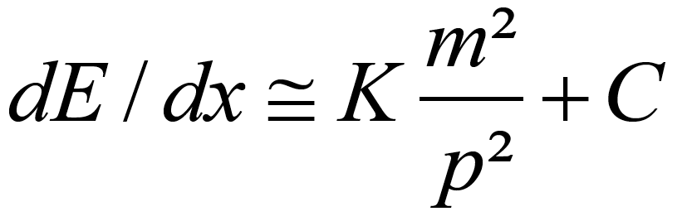
dE/dx measurement
Particle mass is reconstructed from particle momentum
and dE/dx
BetheBloch formula is aproximated in the region 0.2<β<0.9 by:
Constants K and C extracted
from a fit to proton in data.

Slide 42

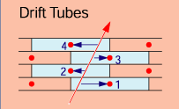
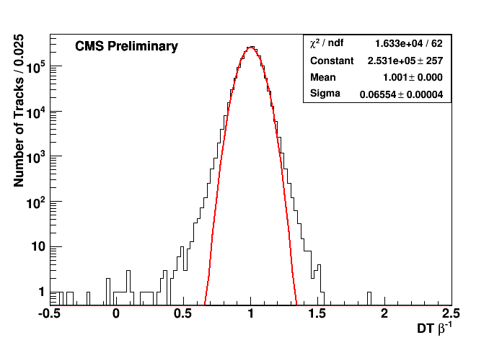
Muon system and TOF
Muon Spectrometer
Muon system provides:
Pt measurement
Time-Of-Flight information
  TOF=t_{detect}-t₀
  DT: up to 32 independent
  measurements
  CSC: up to 46 independent measurements
t_{detect}
σ_{DT}=0.065
σ_{CSC}=0.059
t₀
EXO-11-022
1/β

Slide 43
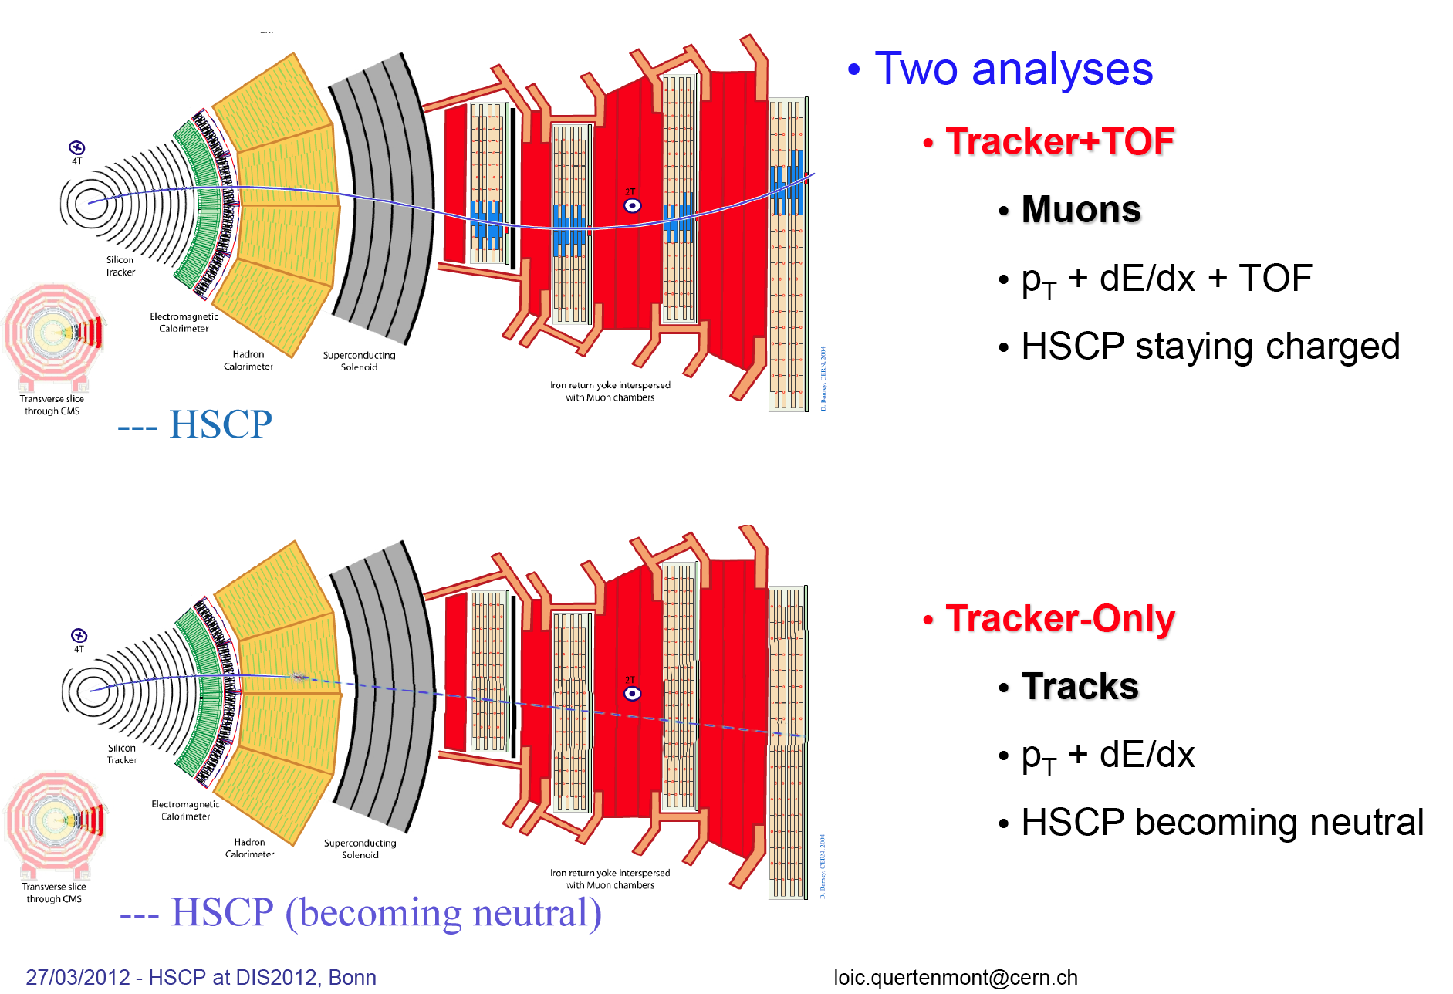
Heavy stable charged particle
Two analyses:
Tracker+TOF
  Physics model: stable g/t/τ, ...
  Muon-like signature
  Signature: high Pt+ large dE/dx + large TOF
Tracker-Only
  Physics model: stable g/t
  Muon system not used
  High Pt+ large dE/dx
~
~
~
~
~
arXiv:1205.0272

Slide 44


Heavy stable charged particle
Trigger issues: delay!
  Muon trigger: last muon stations in CMS at ~ 7 m
  Particle with β=1 reaches that in Δt=Δx/v=7/3*10^8=23 ns;
  Heavy particle with e.g. β=0.5 would arrive after 46 ns
  Muon L1 trigger (RPC) accepts tracks within 25ns after the bunch crossing time, or within the following 25 ns➔ it has 50 ns to reach the furthest muon station: so minimum velocity v=Δx/Δt=7m/50ns ≈ 0.47*c ➔β=0.47
  If it's slower, it's lost
  For β=0.6 CMS single muon trigger is 75% efficient! For β<0.45 decreases quickly
  2011 running period: bunch cross time was > 50ns
  When bunch crossing time get's shorter, the slow ones do not make it in time....
too late!

Slide 45
Heavy stable charged particle
Modelling production:
  stops/gluinos: pair produced
    different hadronization models
    staus: pair produced or via production of heavier particles that decay
• Triggers:
• Muon40 ➔ efficient for HSCP staying charged
• MET150 ➔ needed when both HSCP are neutral in the muon system
• Selection
• Track pT : Inner tracker transverse momentum
• Track I_{as} : Incompatibility of track energy loss w.r.t MIP expected dE/dx
• Muon 1/β : measured by muon system (see before)
Background
Data driven background prediction of the mass distribution (see next)
arXiv:1205.0272
Dominant systematic uncertainty: from E_{T}^{miss} trigger efficiency
(jet-energy scale), mainly important for charge suppression models

Slide 46
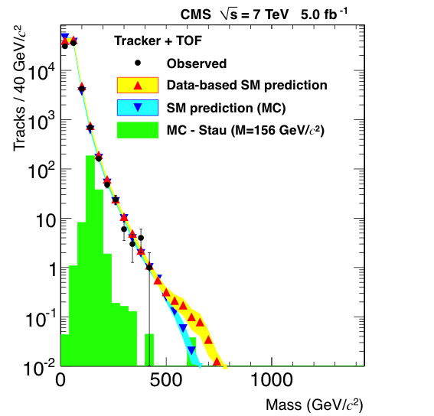
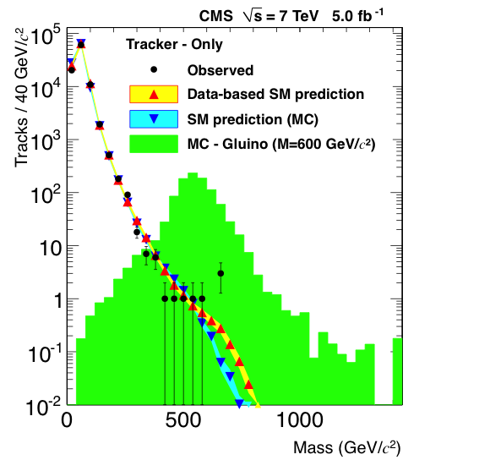
Heavy stable charged particle
Background:
Data driven background prediction of the mass distribution
Good agreement of reconstructed mass between data and expectation after loose selection cuts
tracker+TOF
tracker+TOF
Counting experiment : in mass window [M_{reco}– 2σ_{Mreco} , +inf]:
N=Lum*σ*ε ➔ extract limit on cross section σ
arXiv:1205.0272

Slide 47
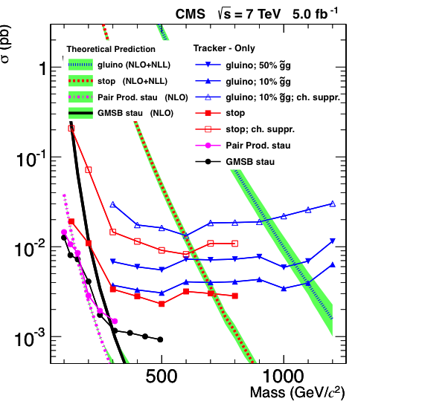
Heavy stable charged particles
arXiv:1205.0272
Stable particles that traverse the detector and move slowly
(stable gluino, stau, ...)
Search strategy | particle | mass (GeV)
Lepton-like | τ | 306 (GMSB SP7) 232 (Pair produced)
 | K | 482 (hyper-ρ mass 0.8 TeV) 599 (1.2 TeV) 747 (1.6 TeV)
Hadron-like | g | 1091 (Cloud-model) 923 (Charge suppression)
 | t | 735 (Cloud-model) 623 (Charge suppressed)
Search limits using
tracker de/dx and
Muon TOF information
Result for 4.7 fb⁻¹:
#Events consistent with
estimated background
~
~

Slide 48
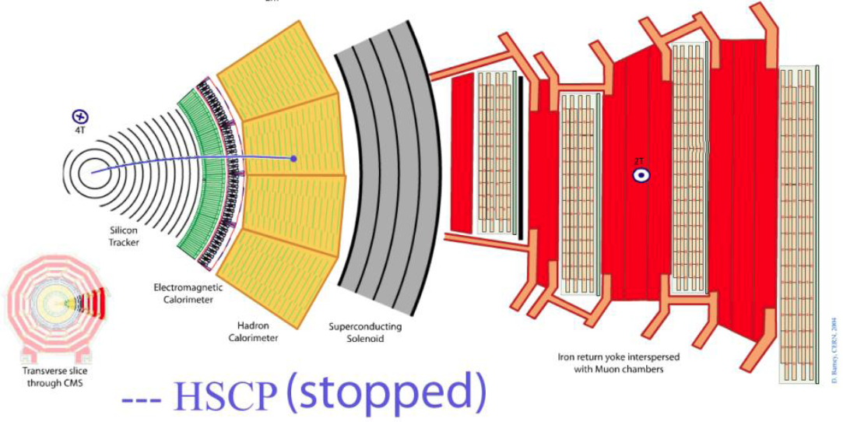
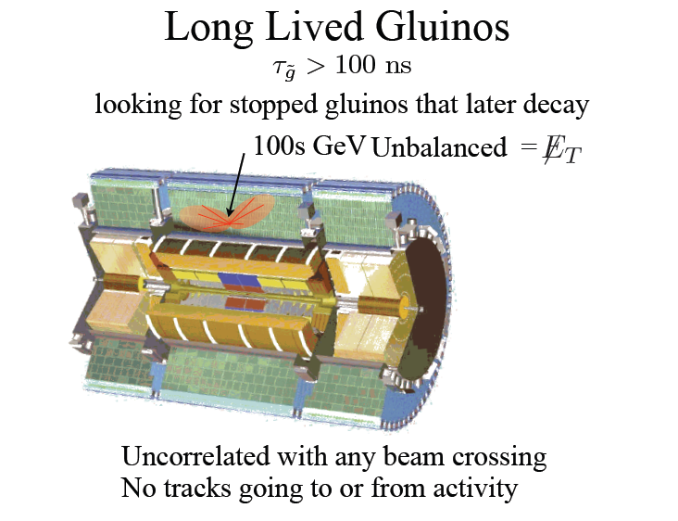
Search for stopped gluinos
Physics model:
R-hadrons that are slow, so that
they loose enough energy to get stopped ➔followed by decay
or
Signature of stopped HSCP
Energetic cluster in calorimeter coming from the decay of a stopped HSCP
Uncorrelated with any beam
crossing, no tracks going to
or from activity!
Energetic cluster!
arXiv:1207.0106
Notes:
TIME: 17.00

Slide 49
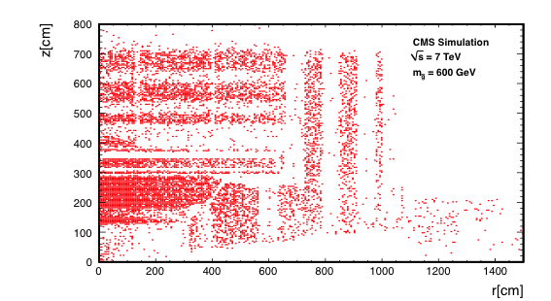
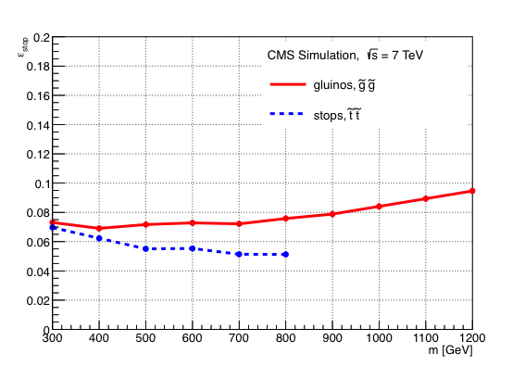
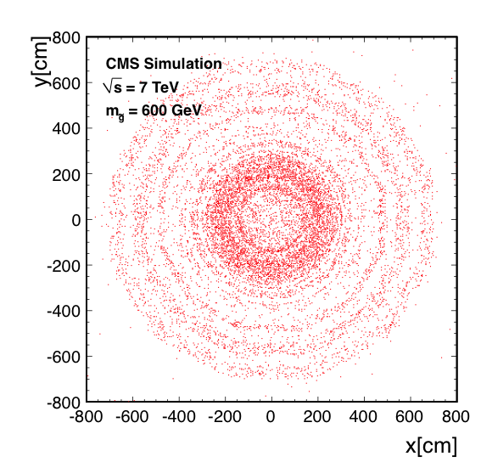
Search for stopped gluinos
Where do they stop in CMS??
Hadronic Calorimeter
EM Calorimeter
Stopping probability vs mass
When do they decay?
We don't know!
(ns, μs, ms, s, hrs, days, years??)
CMS covers wide range of lifetimes
https://twiki.cern.ch/twiki/bin/view/CMSPublic/PhysicsResultsEXO

Slide 50

Data and event selection
Albert de Roeck-Moedal Workshop 2012
Datasets
• Integrated luminosity 4.0fb-1, 246 hours of trigger live-time LHC fills
Trigger:
• 50 GeV jet && no signals from beam position and timing
Selection
• 70GeV Jet at |η|<3.0
Backgrounds: cosmic events, beam halo, instrumental backgrounds, noise
selection efficiency
Count events to get limit
Dominant systematic uncertainties (many systematic uncertainties for collision events are absent!)
• JES and background statistics

Slide 51


Limits
Gluino:
If M_{gluino} - M_{neutralino} > 100 GeV and Br( ) =100%:
Mgluino < 640 GeV are excluded @95% C.L. for lifetimes from 10 μs to 1000 s
Stop
If M_{stop} - M_{neutralino} > 200 GeV Br( ) =100%:
Mstop < 340 GeV are excluded @95% C.L. for lifetimes from 10 μs to 1000 s
Model independent limits also set on σ*BR*ε_{stopping}
arXiv:1207.0106

Slide 52





Displaced Photons
NB Strictly spoken
not an SMP following definition on slide 2...
Example of search for (meta) stable neutral particles (neutralino):
Physics model: GMSB models, Hidden Valleys
Signature: photon conversions in CMS tracker
➔Probe ~0.1-1.0 nsec lifetimes
(2-25 cm displaced vertices)
Selection: events with 2 jets, 2 photons and MET
CMS-EXO-11-067
Cross section upper limit
Transverse displacement
Albert de Roeck-Moedal Workshop 2012

Slide 53


Long Lived Particles
NB Strictly spoken
not an SMP following definition on slide 2...
Another example of search for (meta) stable neutral particles (neutralino):
Physics model: Hidden Valleys. e.g. with
Signature: displaced lepton pair (in CMS tracker, up to 50 cm displaced)
Selection: events with 2 jets, 2 photons and MET
CMS-EXO-11-101
m_{H}=200 GeV
m_{H}=1000 GeV
Upper limits on cross section ~ 0.7-10 fb (if decay in detector)

Slide 54
Contents
Introduction: theory scenarios
Modelling production of heavy particles
Interactions in matter
Searching for heavy stable particles in CMS
Searching for heavy stable particles in ATLAS
Summary
Notes:
TIME: 17.15

Slide 55

The ATLAS experiment

Slide 56



ATLAS tracking system
Tracking system used for:
Pt measurement
momentum and dE/dx
Pixels:
dE/dx measurement from
Time-Over-Threshold
(~ deposited charge)
Maximum ToT corresponds to
dE/dx = 8.5 * (dE/dx)_{MIP}
Transition Radiation Tracker:
Pt measurement only

Slide 57


ATLAS muon system and calorimeters
Muon system used for:
Pt measurement
TOF measurement
Significant delay could occur:
in last station:
β=0.5➔ Δt=t_{μ}-t_{HSCP} = 30 ns
TOF measurement with muon system
  using timing &position information
  using reconstruction: default track reconstruction assumes β=1
  ➔bad fit
  ➔re-reconstruct with different β values ➔esimate β
σ_{combined}=0.033
TOF measurement with Tile Calorimeter
  using timing &position information
ATLAS-CONF-2012-075

Slide 58
R-hadron search in ATLAS
Different types of searches considered:
(a) Without muon system
  timing from TileCal
  sensitive to R-hadrons produced charged,
  becoming neutal just before MS
(b) Inner Detector only
  sensitive to R-hadrons produced charged but
  becoming neutal after ID
  (fewer assumptions on scattering model etc)
(c) Full detector
  timing from TileCal and MS
  sensitive to sleptons etc
(d) Muon-based (not in CMS!)
  no ID
  sensitive to R-hadrons charged in MS, even when
  produced neutral!
MS
?
(a)
Cal
+
lD
+
MS
?
(b)
Cal
?
lD
+
MS
+
(c)
Cal
+
lD
+
MS
+
(d)
Cal
?
lD
?
MS
(e) Stopped gluinos (31 pb-1, not here)
(e)
Cal
lD
+
+

Slide 59


R-hadron search in ATLAS
Triggers:
• Muon18 ➔ efficient for HSCP staying charged
• MET60,70 ➔ needed when both HSCP are neutral in the muon system
• Selection: Track pT, dE/dx, β
Background
Data driven background prediction of the mass distribution
After all but the mass selection cuts applied.

Slide 60


R-hadron search in ATLAS
Exclusions:
long-lived sleptons: M>278 GeV
gluino: M>985 GeV
stop: M>683 GeV
bottom: M>612 GeV

Slide 61
How could we miss SMP's?
How could we miss seeing R-hadrons ?
• Hadronic scattering is eccentric eg cross section ridiculously higher than expected – short, split tracks etc.
• R-hadron is dominantly neutral and associated jet/MET too low for high lumi triggers (assuming pair production). Missed by monojet + MET
inclusive analyses.
• R-hadron has cτ>~detector size and decays in an unexpected way
• R-hadron has cτ<<detector size and decays in a way missed by other displaced vertex searches. – Trigger objects (associated production)

Slide 62
Summary and conclusion
CMS and ATLAS have a good possibilities for detecting SMP's
CMS and ATLAS are not especially designed for the detection of particles with unusual properties, but the detectors have sufficient flexibility. Time of flight and dE/dx are the key components, as well as displaced vertices, and more…
Studies are carried out on heavy stable charged particles, with fractional charge or multiple charge, stopping particles, displaced vertices…
Exciting times ahead!!

Slide 63
Sources used
Apart from papers already mentioned
https://twiki.cern.ch/twiki/bin/view/CMSPublic/PhysicsResultsEXO
https://twiki.cern.ch/twiki/bin/view/AtlasPublic/SupersymmetryPublicResults
https://twiki.cern.ch/twiki/bin/view/AtlasPublic/ExoticsPublicResults

Slide 64

Many thanks to
Tilman Plehn, Victor Gohmer, Thomas Schoerner-Sadenius
for having invited me here!

Slide 65


Slide 66


Slide 67

Magnetically charged particles
Dirac monopole has a magnetic charge equivalent to an electric charge of 137e/2,
Expected to suffer ionisation energy loss at a rate several thousand times greater than that of a particle with electric charge e!!
Not Coulomb force, but Lorentz force responsable for energy loss
Ratio between Dirac monopole and electrically charged particle with unit charge:
Would leave a striking ionisation signature!!!
Due to large energy loss could also lead to a
monopole becoming stopped in detector
material before reaching a tracking chamber.

