Slide 1
What can we infer from cosmology for fundamental laws of physics ?

Slide 2
Three lessons
Fundamental “constants” are not constant
No conflict between quantum physics and general relativity
Time and space are born at the big bang

Slide 3
1 Fundamental “constants” are not constant

Slide 4
Have coupling constants in the
early Universe
other values than today ?
Yes !

Slide 5
Fundamental couplings in quantum field theory
Masses and coupling constants
are determined by properties
of vacuum !
Similar to Maxwell – equations in matter

Slide 6
Condensed matter physics : laws depend on state of the system
Ground state , thermal equilibrium state …
Example : Laws of electromagnetism in superconductor are different from Maxwells’ laws

Slide 7
Standard model of particle physics :
Electroweak gauge symmetry is spontaneously broken by expectation value of Higgs scalar

Slide 8
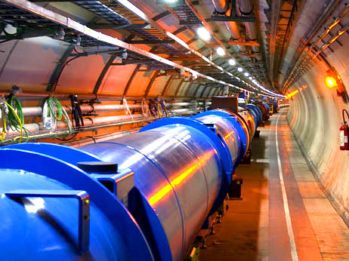
Spontaneous symmetry breaking to be confirmed at the LHC

Slide 9
Cosmology :
Universe is not in one fixed state
Dynamical evolution
Laws are expected to depend on time

Slide 10
Restoration of symmetry at high temperature in the early Universe
high T :
Less order
More symmetry
Example:
Magnets
Low T
SSB
<φ>=φ₀ ≠ 0
High T
SYM
<φ>=0

Slide 11
In hot plasma of early Universe : masses of electron und muon not different! similar strength of electromagnetic and weak interaction

Slide 12
Varying couplings
only question :
How strong is present variation of couplings ?

Slide 13
Can variation of fundamental “constants” be observed ?
Fine structure constant α (electric charge)
Ratio electron mass to proton mass
Ratio nucleon mass to Planck mass

Slide 14
Time evolution of couplings and scalar fields
Fine structure constant depends on value of
cosmon field : α(φ)
in standard model: couplings depend on value of Higgs scalar field
Time evolution of φ
Time evolution of α
Jordan,…

Slide 15
Static scalar fields
In Standard Model of particle physics :
Higgs scalar has settled to its present value around 10⁻¹² seconds after big bang.
Chiral condensate of QCD has settled at present value after quark-hadron phase transition around 10⁻⁶ seconds after big bang .
No scalar with mass below pion mass.
No substantial change of couplings after QCD phase transition.
Coupling constants are frozen.

Slide 16
Observation of time- or space- variation of couplings Physics beyond Standard Model

Slide 17
Particle masses in quintessence cosmology
can depend on value of cosmon field
similar to dependence on value of Higgs field

Slide 18
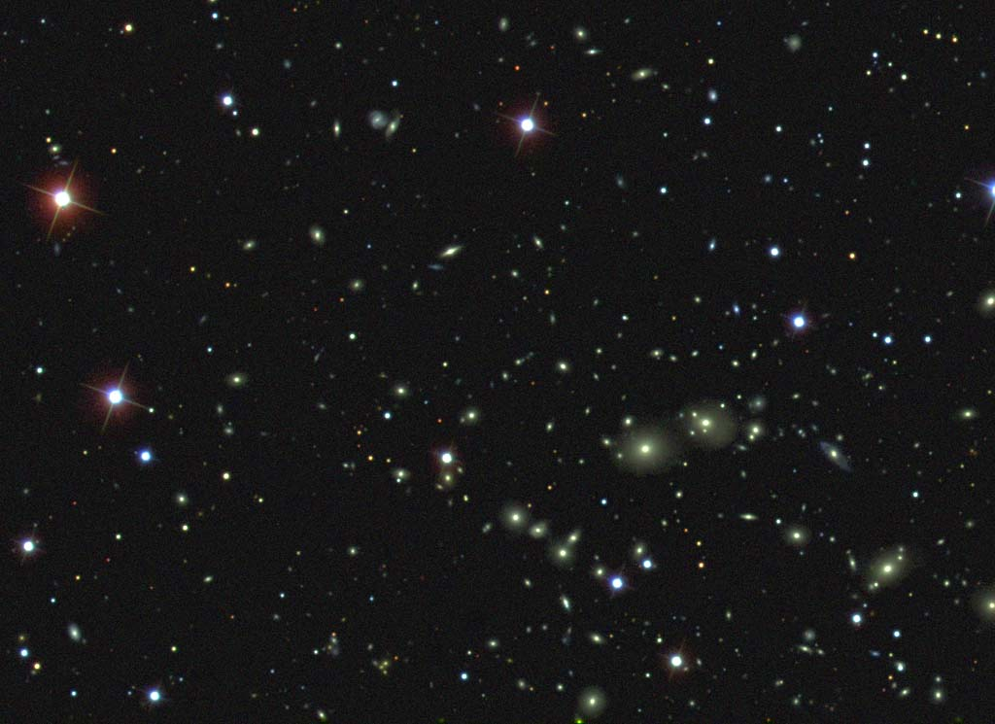
Dark Energy :
Energy density that does not clump
Photons , gravitons : insignificant

Slide 19
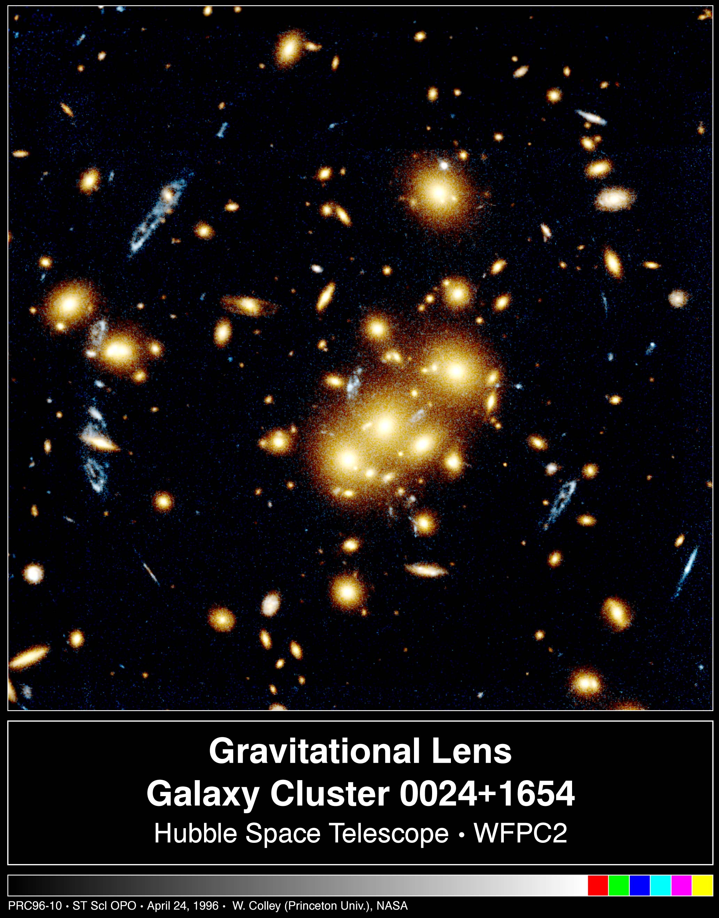
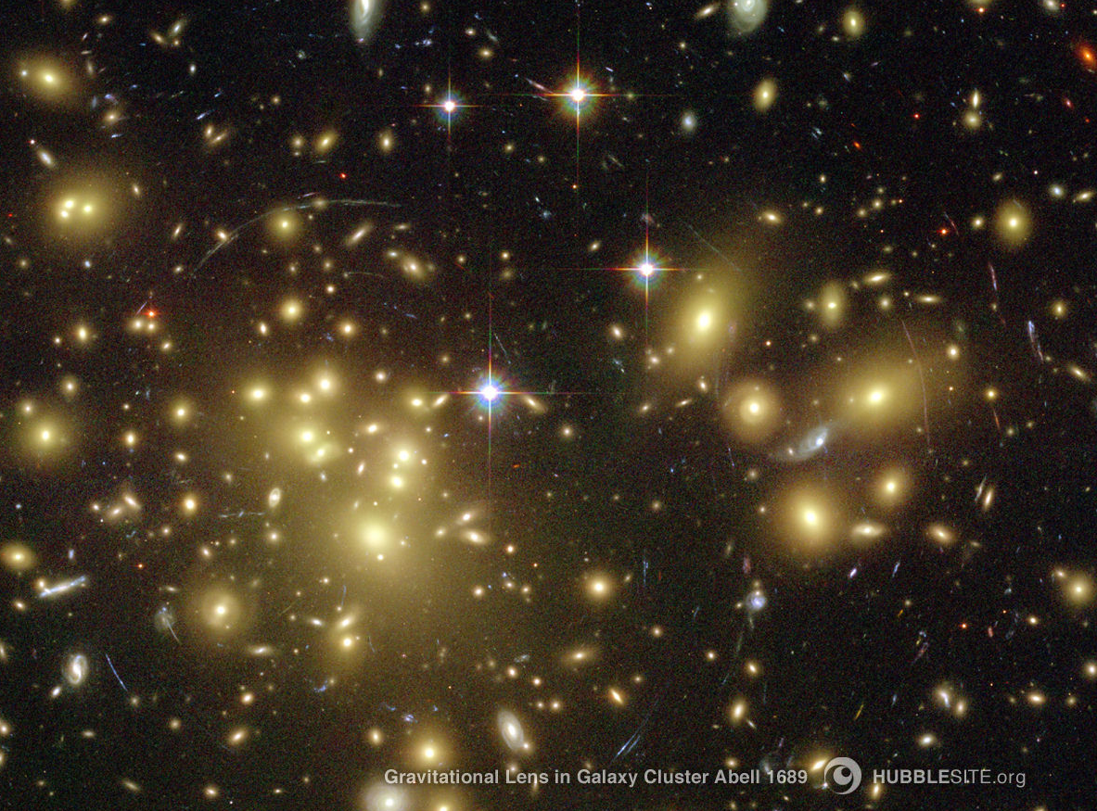
Gravitationslinse,HST

Slide 20
Space between clumps is not empty : Dark Energy !

Slide 21
Dark Energy :
Homogeneously distributed

Slide 22
Dark Energy density is the same at every point of space “ homogeneous “ No force in absence of matter – “ In what direction should it draw ? “

Slide 23
Einstein’s equations : almost static Dark Energy predicts accelerated expansion of Universe

Slide 24
Predictions for dark energy cosmologies
The expansion of the Universe
accelerates today !

Slide 25
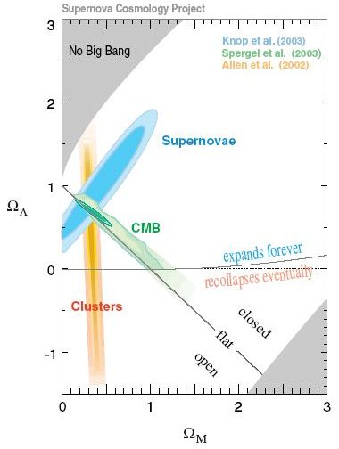
Dark Energy : observations fit together !

Slide 26
Composition of the Universe
Ω_{b} = 0.045 visible clumping
Ω_{dm}= 0.2 invisible clumping
Ω_{h} = 0.75 invisible homogeneous

Slide 27
What is Dark Energy ?
Cosmological Constant
or
Quintessence ?

Slide 28
Cosmological Constant - Einstein -
Constant λ compatible with all symmetries
No time variation in contribution to energy density
Why so small ? λ/M⁴ = 10⁻¹²⁰
Why important just today ?

Slide 29
Cosmological mass scales
Energy density
ρ ~ ( 2.4×10 ⁻³ eV )⁻ ⁴
Reduced Planck mass
M=2.44×10 ²⁷ eV
Newton’s constant
GN=(8πM²)
Only ratios of mass scales are observable !
homogeneous dark energy: ρ_{h}/M⁴ = 6.5 10ˉ¹²¹
matter: ρ_{m}/M⁴= 3.5 10ˉ¹²¹

Slide 30
Time evolution
tˉ² matter dominated universe
tˉ^{3/2} radiation dominated universe
ρ_{m}/M⁴ ~ aˉ³ ~
ρ_{r}/M⁴ ~ aˉ⁴ ~ t ⁻² radiation dominated universe
Huge age small ratio
Same explanation for small dark energy?

Slide 31
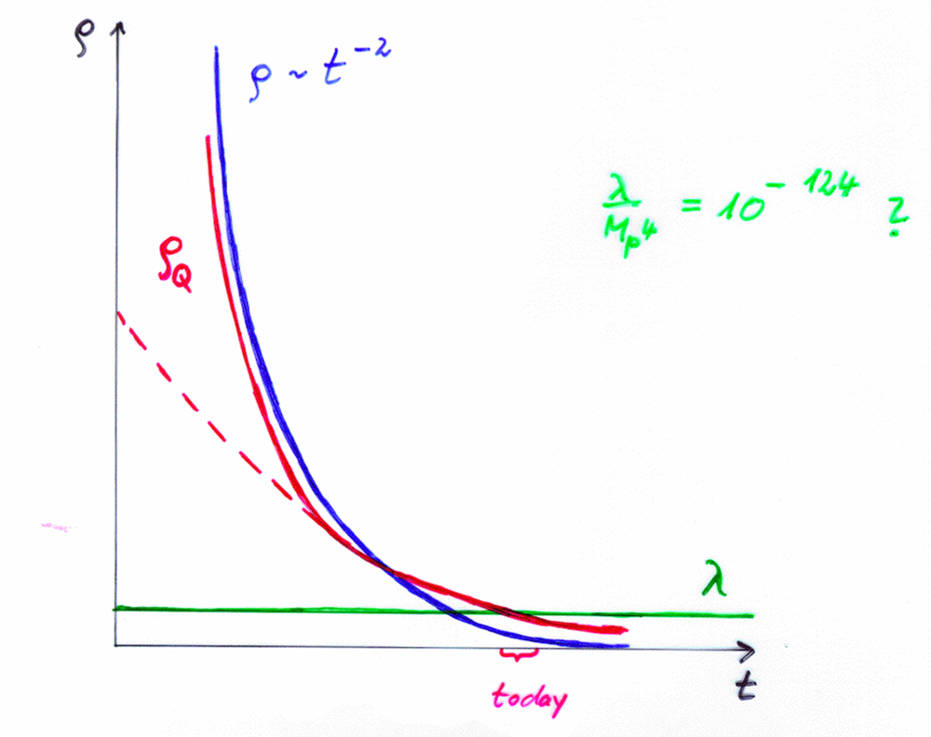
Cosm. Const. | Quintessence
static | dynamical

Slide 32
Quintessence
Dynamical dark energy ,
generated by scalar field
(cosmon)
C.Wetterich,Nucl.Phys.B302(1988)668, 24.9.87
P.J.E.Peebles,B.Ratra,ApJ.Lett.325(1988)L17, 20.10.87

Slide 33
Prediction : homogeneous dark energy influences recent cosmology - of same order as dark matter -
Original models do not fit the present observations
…. modifications

Slide 34
Quintessence
Cosmon – Field φ(x,y,z,t)
similar to electric field , but no direction ( scalar field )
Homogeneous und isotropic Universe : φ(x,y,z,t)=φ(t)
Potential und kinetic energy of the cosmon -field
contribute to a dynamical energy density of the Universe !

Slide 35
Cosmon
Scalar field changes its value even in the present cosmological epoch
Potential und kinetic energy of cosmon contribute to the energy density of the Universe
Time - variable dark energy :
ρ_{h}(t) decreases with time !

Slide 36
Evolution of cosmon field
Field equations
Potential V(φ) determines details of the model
V(φ) =M⁴ exp( - αφ/M )
for increasing φ the potential decreases towards zero !

Slide 37
Cosmon
Tiny mass
m_{c} ~ H (depends on time ! )
New long - range interaction

Slide 38
“Fundamental” Interactions
Strong, electromagnetic, weak
interactions
On astronomical
length scales:
graviton
+
cosmon
gravitation
cosmodynamics

Slide 39
Time varying constants
It is not difficult to obtain quintessence potentials from higher dimensional or string theories
Exponential form rather generic
( after Weyl scaling)
But most models show too strong time dependence of constants !

Slide 40
Bounds on time varying couplings from nucleosynthesis

Slide 41
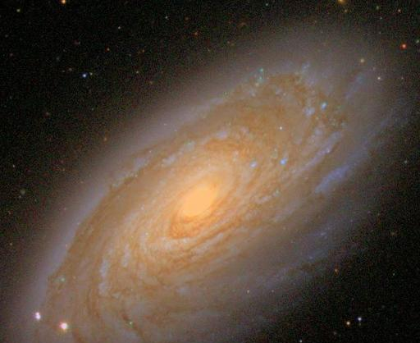
baryons :
the matter of stars and humans
Ω_{b} = 0.045

Slide 42
Abundancies of
primordial
light elements
from
nucleosynthesis
A.Coc

Slide 43
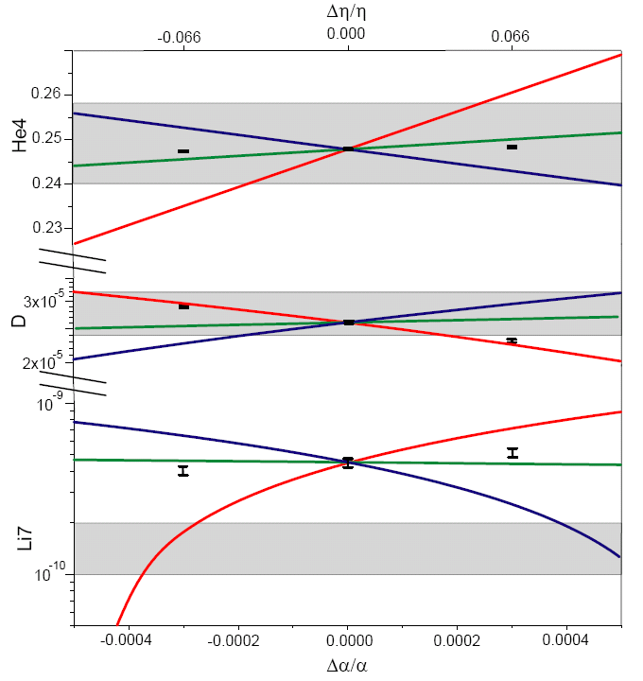
primordial abundances for three GUT models
present observations : 1σ
He
D
Li
T.Dent,
S.Stern,…

Slide 44
three GUT models
unification scale ~ Planck scale
1) All particle physics scales ~Λ_{QCD}
2) Fermi scale and fermion masses ~ unification scale
3) Fermi scale varies more rapidly than Λ_{QCD}
Δα/α ≈ 4 10⁻⁴ allowed for GUT 1 and 3 , larger for GUT 2
Δln(M_{n}/M_{P}) ≈40 Δα/α ≈ 0.015 allowed

Slide 45
Time variation of coupling constants
must be tiny –
would be of very high significance !
Possible signal for Quintessence

Slide 46
“Fundamental” Interactions
Strong, electromagnetic, weak
interactions
On astronomical
length scales:
graviton
+
cosmon
gravitation
cosmodynamics

Slide 47
“Fifth Force”
Mediated by scalar field
Coupling strength: weaker than gravity
( nonrenormalizable interactions ~ M⁻² )
Composition dependence
violation of equivalence principle
Quintessence: connected to time variation of
fundamental couplings
R.Peccei,J.Sola,C.Wetterich,Phys.Lett.B195,183(1987)
C.Wetterich , Nucl.Phys.B302,645(1988)

Slide 48
Violation of equivalence principle
Different couplings of cosmon to proton and neutron
Differential acceleration
“Violation of equivalence principle”
p,n
earth
cosmon
p,n
only apparent : new “fifth force” !

Slide 49
Differential acceleration
Two bodies with equal mass experience
a different acceleration !
η = ( a₁ – a₂ ) / ( a₁ + a₂ )
bound : η < 3 10⁻¹⁴

Slide 50
Cosmon coupling to atoms
Tiny !!!
Substantially weaker than gravity.
Non-universal couplings bounded by tests
of equivalence principle.
Universal coupling bounded by tests of Brans-Dicke parameter ω in solar system.
Only very small influence on cosmology.
( All this assumes validity of linear approximation )

Slide 51
Apparent violation of equivalence principle
and
time variation of fundamental couplings
measure both the
cosmon – coupling to ordinary matter

Slide 52
Differential acceleration η
For unified theories ( GUT ) :
η=Δa/2a
Q : time dependence of other parameters

Slide 53
Link between time variation of α
and violation of equivalence principle
typically : η = 10⁻¹⁴
^{if time variation of α}
^{near Oklo upper bound}
^{to be tested ( MICROSCOPE , …)}

Slide 54
2 No conflict between quantum physics and general relativity

Slide 55
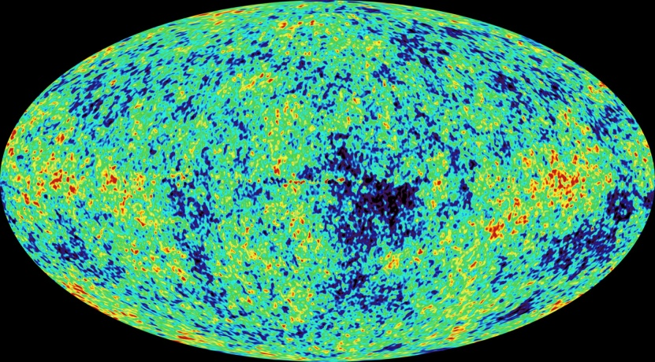
Cosmology and quantum physics
both :
Probabilistic theories
Correlations are crucial

Slide 56
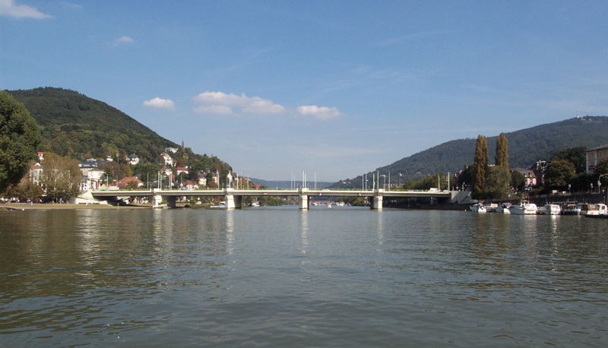
laws are based on probabilities
determinism as special case :
probability for event = 1 or 0
law of big numbers
unique ground state …

Slide 57
Correlations and reality
Correlations are physical reality , not only the expectation values of certain observables
Correlations can be non-local ( also in classical statistics ) ;
causal processes needed only for preparation of non-local correlations at some time in the past
Correlated subsystems cannot be separated –
the whole is more that the sum of parts

Slide 58
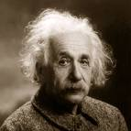
EPR - Paradoxon
Correlation between two spins is established at time of particle decay
No contradiction to causality or realism if correlations
are considered as genuine part of reality
(
for once : not right )

Slide 59
conditional probability
sequences of events( measurements )
are described by
conditional probabilities
both in classical statistics
and in quantum statistics

Slide 60
w(t₁)
:
not very suitable
for statement , if here and now
a pointer falls down

Slide 61
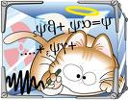
Schrödinger’s cat
conditional probability :
if nucleus decays
then cat dead with w_{c} = 1
(reduction of wave function)

Slide 62
Reduction of the wave function
Convenient way to describe conditional probabilities
Same in classical statistics for the Universe
Once realized (measured) :
new state for computation of probabilities

Slide 63
Metric and geometry
Quantum field theory :
Metric is expectation value of fluctuating field
It transforms as second rank symmetric tensor under diffeomorphisms ( general coordinate transformations )
General relativity : theory with particular symmetry – diffeomorphism symmetry
That’s all

Slide 64
General relativity and quantum theory
No basic contradiction
Metric is quantum field with same status as other fields ( e.g. photon or Higgs scalar )
Ultraviolet regularization : difficulty to implement diffeomorphism symmetry – several concepts : string theory, fixed point, lattice regularizations , lattice spinor gravity
Metric needs not to be fundamental

Slide 65
Metric as collective ( composite ) field
Metric field could be composed from fermions

Slide 66
Metric as collective ( composite ) field
or from scalars

Slide 67
Metric ambiguity
given metric
collective field with expectation value
new metric candidate
Which one is physical metric ?

Slide 68
3 Time and space are born at the big bang

Slide 69
Which metric to choose ?
Many candidates in general relativity
and quantum field theory

Slide 70
It does not matter !
for distances large compared to Planck length
Ambiguity close to Planck scale !
no unique metric anymore close to Planck scale
different metrics – different definitions of distances
no unique geometry
Space and time in the usual sense , with definite geometry , emerge only after the big bang

Slide 71
Theories with two or several metrics

Slide 72
Metric potential for one metric
Space-time independent metric
has to obey extremum condition

Slide 73
Metric potential for two metrics
New invariants are possible
Simple metric potential

Slide 74
Proportionality of metrics
ansatz:
Extremum of at with
solution with

Slide 75
Two metrics are equivalent if
only units for coordinates differ

Slide 76
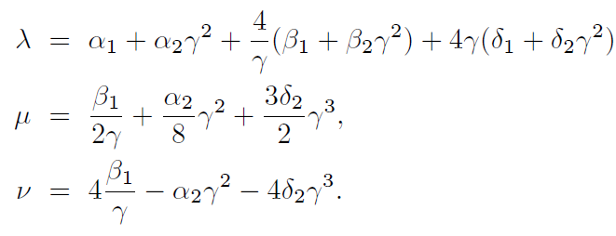
Massive tensors
expansion
tensor fields
mass terms

Slide 77
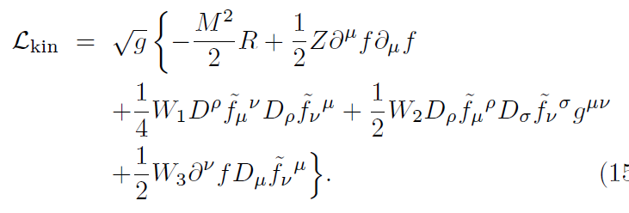
Kinetic term
Field equation ( for W₂=0,W₃=0)

Slide 78
Massive tensor field
Typical size of mass : Planck mass , ν/W₁ ~ M²
Yukawa type interaction , negligible for distances
larger than Planck length
Relevant for distances around Planck length

Slide 79
No unique metric at Planck scale
Proportionality between both metrics
is no longer valid once f plays a role!

Slide 80
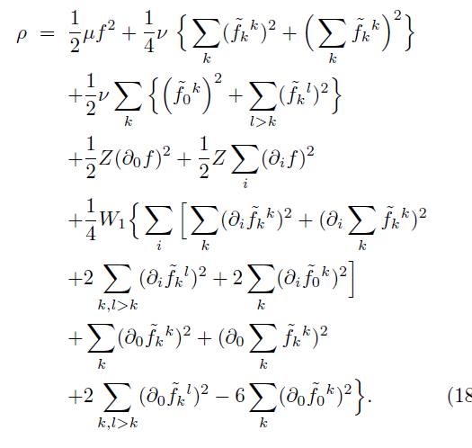
Energy density

Slide 81
Conclusions
Fundamental “constants” are not constant
No conflict between quantum physics and general relativity
Time and space are born at the big bang

Slide 82
End

Slide 83
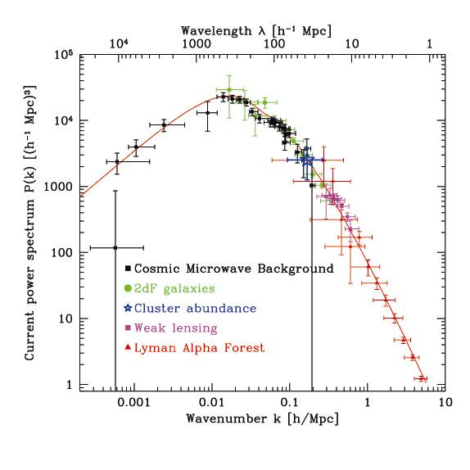
Structure formation : One primordial fluctuation spectrum
CMB agrees with
Galaxy distribution
Lyman – α
and
Gravitational
Lensing !
Waerbeke

Slide 84
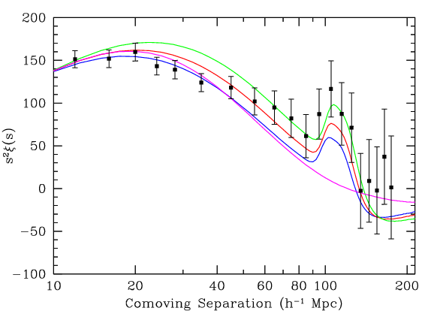
Power spectrum Baryon - Peak
galaxy –
correlation –
function
M.Tegmark + …
Structure formation : One primordial
fluctuation- spectrum
SDSS

