Slide 1
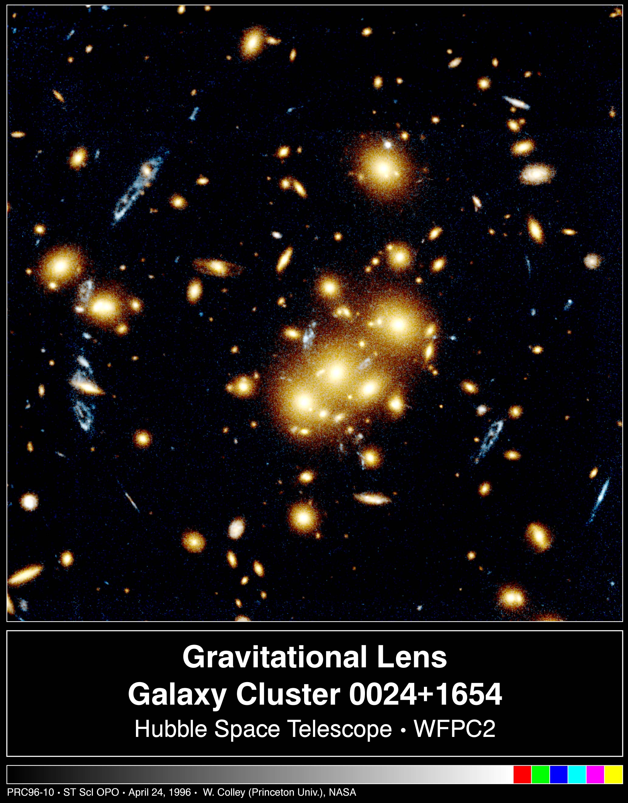
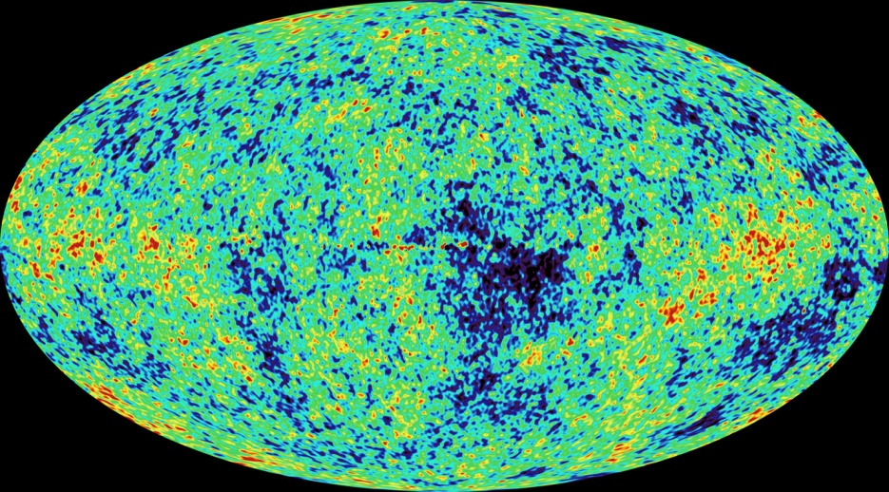
Dynamical Dark Energy

Slide 2
What is dynamical dark energy ?

Slide 3
What do we know about Dark Energy ?

Slide 4
Dark Energy dominates the Universe
Energy - density in the Universe
=
Matter + Dark Energy
25 % + 75 %

Slide 5
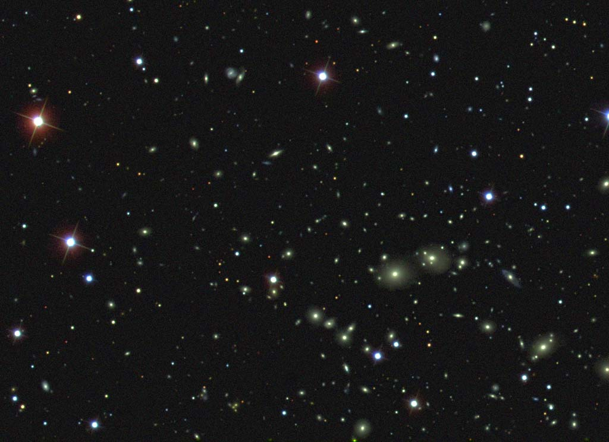
Dark Energy :
Energy density that does not clump
Photons , gravitons : insignificant

Slide 6
Dark Energy
Ω_{m} + X = 1
Ω_{m} : 25%
Ω_{h} : 75% Dark Energy
h : homogenous , often Ω_{Λ} instead of Ω_{h}

Slide 7
Space between clumps is not empty : Dark Energy !

Slide 8
Dark Energy :
Homogeneously distributed

Slide 9
Dark Energy density is the same at every point of space “ homogeneous “ No force in absence of matter – “ In what direction should it draw ? “

Slide 10
Einstein’s equations : static or slowly evolving Dark Energy predicts accelerated expansion of Universe

Slide 11
Predictions for dark energy cosmologies
The expansion of the Universe
accelerates today !

Slide 12
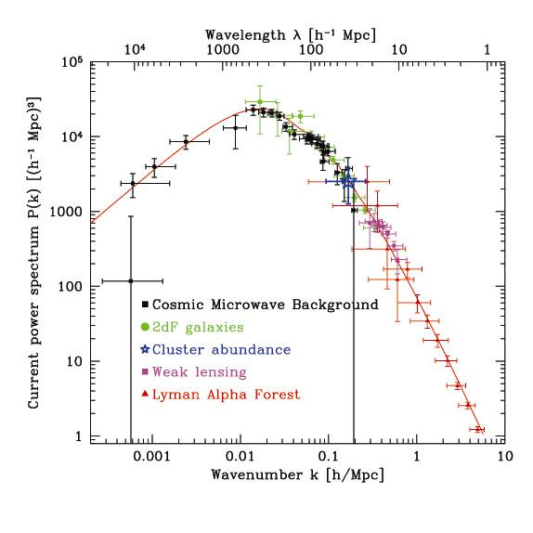
Structure formation : One primordial fluctuation spectrum
CMB agrees with
Galaxy distribution
Lyman – α
and
Gravitational
Lensing !
Waerbeke

Slide 13
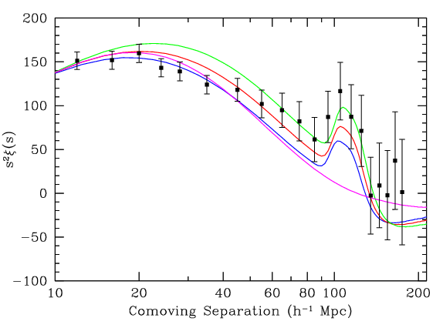
Power spectrum Baryon - Peak
galaxy –
correlation –
function
M.Tegmark + …
Structure formation : One primordial
fluctuation- spectrum
SDSS

Slide 14
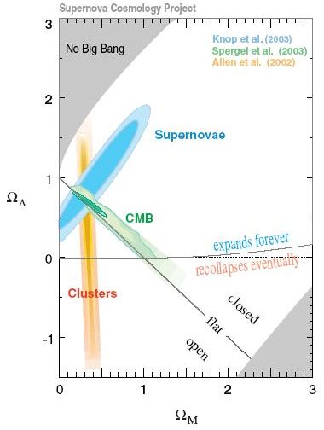
Dark Energy : observations fit together !

Slide 15
energy momentum tensor
One can always
write the gravitational
field equation in
this form !
T: matter ( dark matter and atoms ), photons,
neutrinos + dark component

Slide 16
universal description of dark energy
dark energy density : 0,0-component of dark component of energy momentum tensor
includes cosmological constant, quintessence, modified gravity, backreaction, …
Einstein frame with constant Planck mass has also essentially constant couplings and masses in standard model of particle physics

Slide 17
Cosmological Constant - Einstein -
Constant λ compatible with all symmetries
No time variation in contribution to energy density
Why so small ? λ/M⁴ = 10⁻¹²⁰
Why important just today ?

Slide 18
dynamical dark energy
dark component of energy momentum tensor changes with time
( homogeneous in space )

Slide 19
What is dynamical dark energy good for ?

Slide 20
What is dynamical dark energy good for ?
Dynamical dark energy can explain the size of the dark energy density

Slide 21
Cosmological mass scales
Energy density
ρ ~ ( 2.4×10 ⁻³ eV )⁻ ⁴
Reduced Planck mass
M=2.44×10 ²⁷ eV
Newton’s constant
GN=(8πM²)
Only ratios of mass scales are observable !
homogeneous dark energy: ρ_{h}/M⁴ = 6.5 10ˉ¹²¹
matter: ρ_{m}/M⁴= 3.5 10ˉ¹²¹

Slide 22
Time evolution
tˉ² matter dominated universe
tˉ^{3/2} radiation dominated universe
ρ_{m}/M⁴ ~ aˉ³ ~
ρ_{r}/M⁴ ~ aˉ⁴ ~ t ⁻² radiation dominated universe
Huge age small ratio
Same explanation for small dark energy?

Slide 23
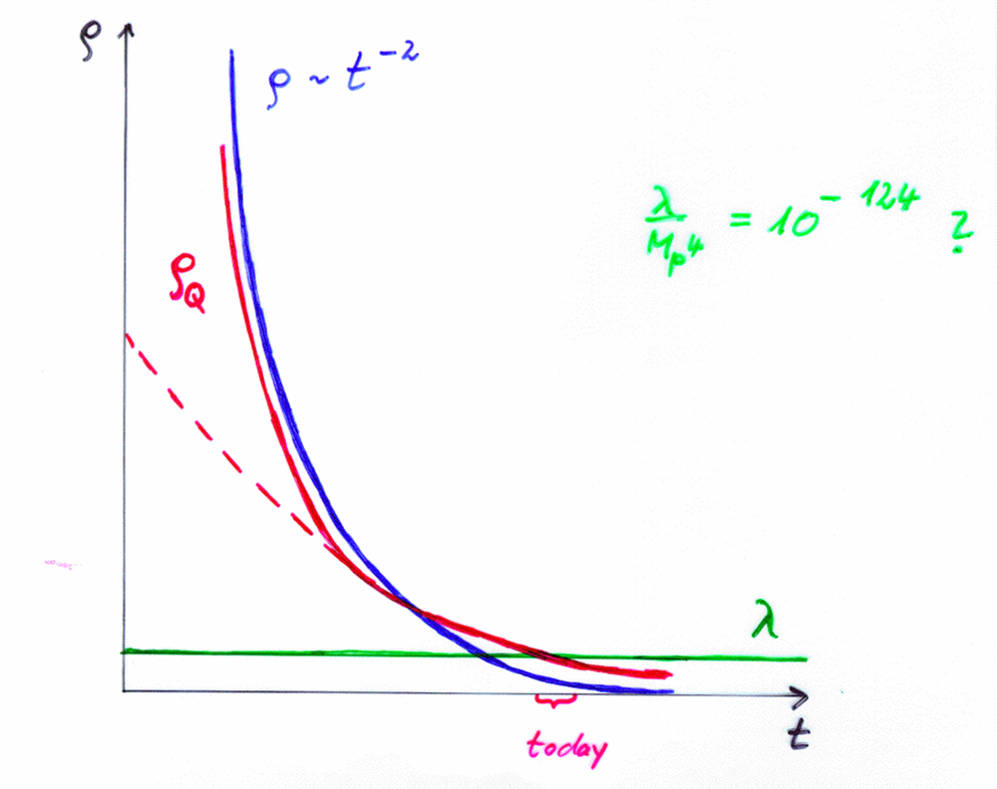
Cosm. Const. | Quintessence
static | dynamical

Slide 24
Fields

Slide 25
Quintessence
Dynamical dark energy ,
generated by scalar field
(cosmon)
C.Wetterich,Nucl.Phys.B302(1988)668, 24.9.87
P.J.E.Peebles,B.Ratra,ApJ.Lett.325(1988)L17, 20.10.87

Slide 26
Prediction : homogeneous dark energy influences recent cosmology - of same order as dark matter -
Original models do not fit the present observations
…. modifications

Slide 27
Quintessence
Cosmon – Field φ(x,y,z,t)
similar to electric field , but no direction ( scalar field )
Homogeneous und isotropic Universe : φ(x,y,z,t)=φ(t)
Potential und kinetic energy of the cosmon -field
contribute to a dynamical energy density of the Universe !

Slide 28
Cosmon
Scalar field changes its value even in the present cosmological epoch
Potential und kinetic energy of cosmon contribute to the energy density of the Universe
Time - variable dark energy :
ρ_{h}(t) decreases with time !

Slide 29
Evolution of cosmon field
Field equations
Potential V(φ) determines details of the model
V(φ) =M⁴ exp( - αφ/M )
for increasing φ the potential decreases towards zero !

Slide 30
Different possibilities (1)
Scalar field
0 – component of vector field
higher tensor fields
homogeneous cosmological value of field must be invariant under rotations
only transformation property matters , origin arbitrary

Slide 31
scalar field
scalar field may be “fundamental”,
or it may express higher order gravity ( many models of
modified gravity ), or non-local gravity,
or back-reaction, or higher dimensional properties ,
or other composite degrees of freedom
use simple degrees of freedom whenever you can !
(scalars, vectors etc.)
good coordinates for differential equations !

Slide 32
different possibilities (2)
more involved kinetic term
k- essence , ….
non-minimal coupling to gravity
( in Einstein frame )

Slide 33
Early dark energy

Slide 34
exponential potential constant fraction in dark energy
Ω_{h} = 3/α²
V(φ) =M⁴ exp( - αφ/M )
can explain order
of magnitude
of dark energy !

Slide 35
Cosmic Attractors
Solutions independent of initial conditions
typically V~t ⁻²
φ ~ ln ( t )
Ω_{h} ~ const.
details depend on V(φ)
or kinetic term
early cosmology

Slide 36
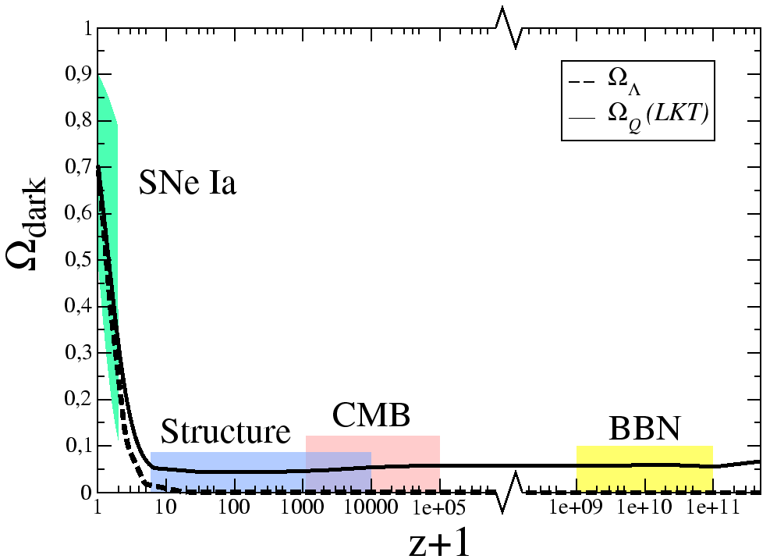
Early Dark Energy
cosmological constant : Ω_{h} ~ t² ~ (1+z)⁻³
M.Doran,…

Slide 37
Observational bounds on Ω_{h}
G.Robbers , M.Doran ,…

Slide 38
realistic quintessence
fraction in dark energy has to
increase in “recent time” !

Slide 39
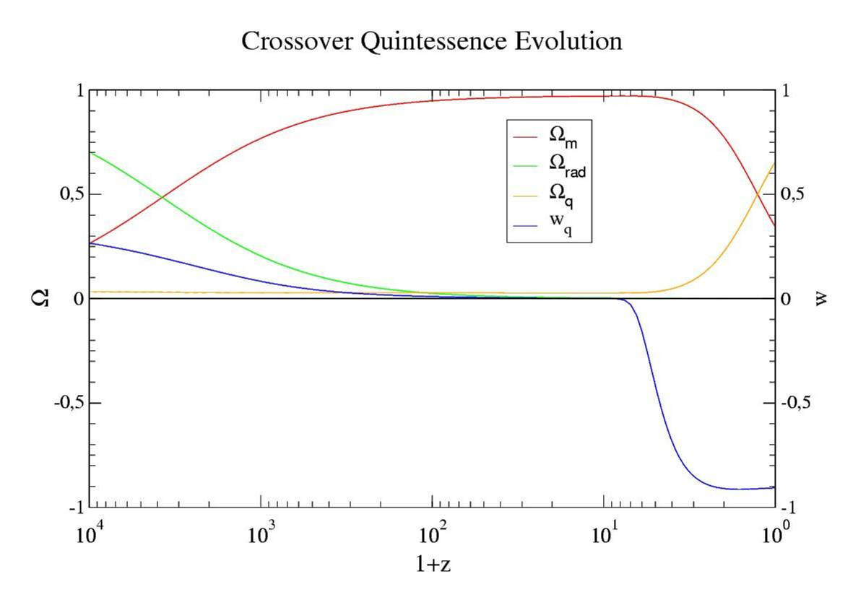
Quintessence becomes important “today”

Slide 40
coincidence problem
What is responsible for increase of Ω_{h} for z < 6 ?
Why now ?

Slide 41
Coupled dark energy

Slide 42
coupled dark energy
C.Wetterich , Astron.Astrophys.301(1995)321
L.Amendola,Phys.Rev.62(2000)043511
cosmon coupling to atoms much smaller
than gravity
cosmon coupling to dark matter restricted
by cosmological observation ( somewhat smaller
than gravity)
cosmon coupling to neutrinos can be substantially
stronger than gravity (Fardon,Nelson,Weiner)
larger couplings allowed if chameleon effect operates

Slide 43
Cosmon
Tiny mass
m_{c} ~ H (depends on time ! )
New long - range interaction

Slide 44
“Fundamental” Interactions
Strong, electromagnetic, weak
interactions
On astronomical
length scales:
graviton
+
cosmon
gravitation
cosmodynamics

Slide 45
Cosmon – atom coupling induces violation of equivalence principle
Different couplings of cosmon to proton and neutron
Differential acceleration
“Violation of equivalence principle”
p,n
earth
cosmon
p,n
only apparent : new “fifth force” !

Slide 46
Neutrino cosmon coupling
Strong bounds on atom-cosmon coupling from tests of equivalence principle or time variation of couplings.
No such bounds for neutrino-cosmon coupling.
In particle physics : Mass generation mechanism for neutrinos differs from charged fermions. Seesaw mechanism involves heavy particles whose mass may depend on the value of the cosmon field.

Slide 47
growing neutrino quintessence

Slide 48
Why neutrinos may play a role
Mass scales :
Dark Energy density : ρ ~ ( 2×10 ⁻³ eV )⁻ ⁴.
Neutrino mass : eV or below.
Cosmological trigger : Neutrinos became non-relativistic only in the late Universe .
Neutrinos can have coupling to cosmon stronger than gravity.

Slide 49
growing neutrino mass triggers transition to almost static dark energy
growing
neutrino
mass
L.Amendola, M.Baldi,…

Slide 50
effective cosmological trigger for stop of cosmon evolution : neutrinos get non-relativistic
this has happened recently !
sets scales for dark energy !

Slide 51
connection between dark energy and neutrino properties
= 1.27
present dark energy density given by neutrino mass
present equation
of state given by
neutrino mass !

Slide 52
growing neutrinos change cosmon evolution
modification of conservation equation for neutrinos

Slide 53
stopped scalar field mimicks a cosmological constant ( almost …)
rough approximation for dark energy :
before redshift 5-6 : scaling ( dynamical )
after redshift 5-6 : almost static
( cosmological constant )

Slide 54
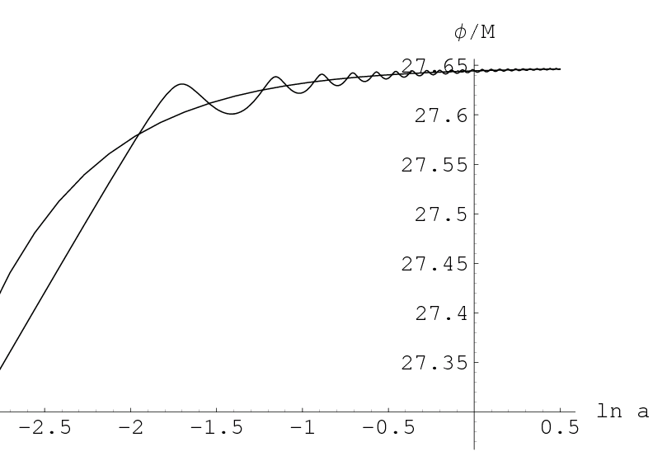
cosmon evolution
“stopped”
scaling

Slide 55
crossover to dark energy dominated universe
starts at time when “neutrino force” becomes
important for the evolution of the cosmon field
cosmological selection !

Slide 56
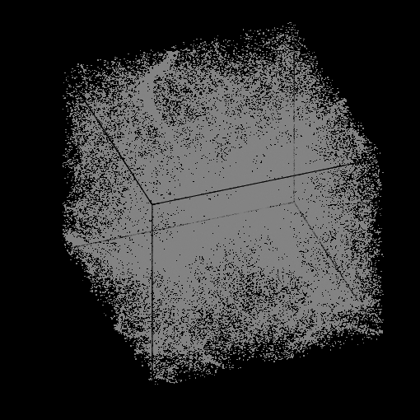
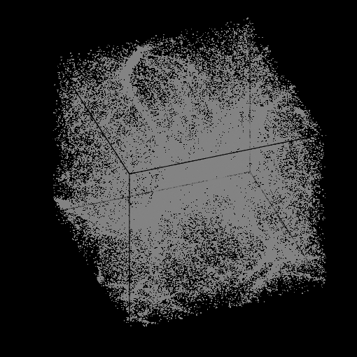
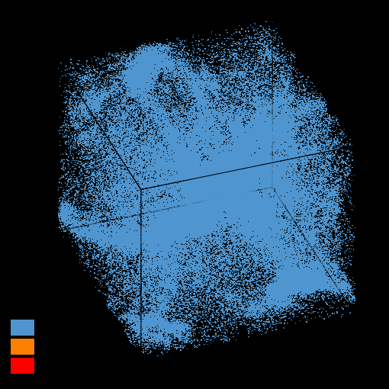
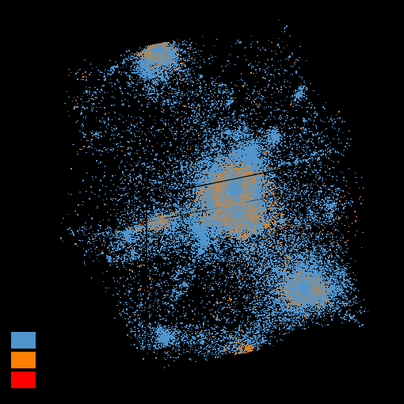
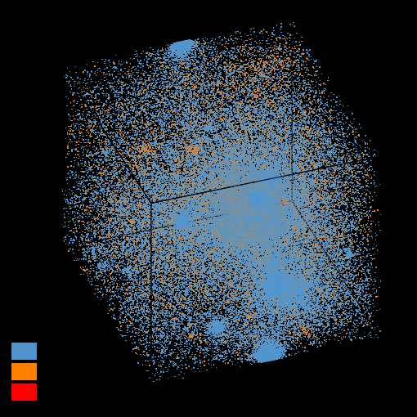
Formation of neutrino lumps
N- body simulation M.Baldi et al

Slide 57
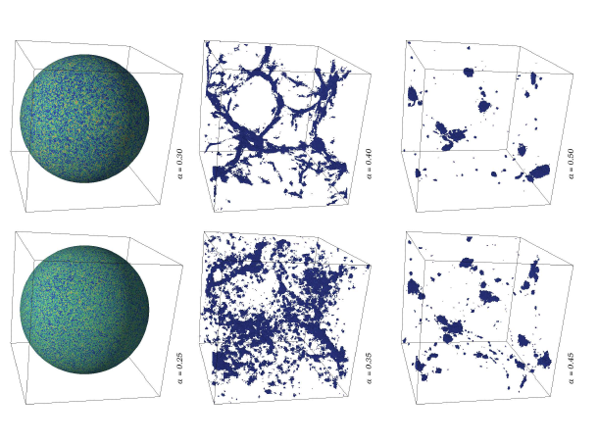
Formation of neutrino lumps Y.Ayaita,M.Weber,…

Slide 58
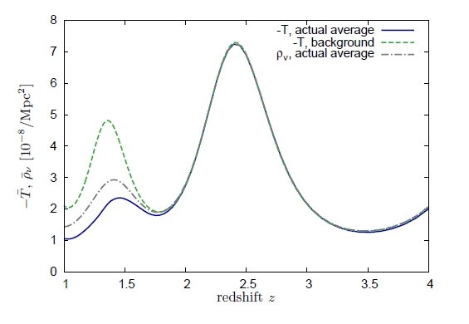
back-reaction : energy momentum tensor of neutrinos

Slide 59
Key questions for quintessence
Why does cosmon potential vanish for infinite time ? V(φ) =M⁴ exp( - αφ/M )
Dilatation symmetry in higher dimensions – not today
Why is time variation of fundamental couplings small ? ( e.g. fine structure constant , electron-proton mass ratio )
Fixed point behavior – not today
Why does Dark Energy dominate only in recent cosmology ( Why now ? – problem )
Growing neutrino mass - today

Slide 60
End

Slide 61
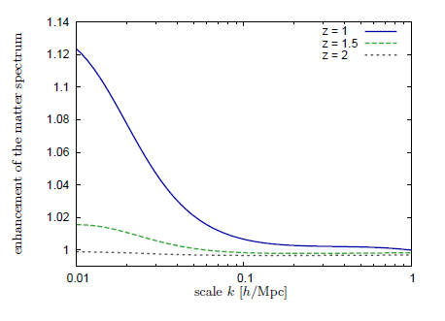
Small induced enhancement of dark matter power spectrum at large scales

Slide 62
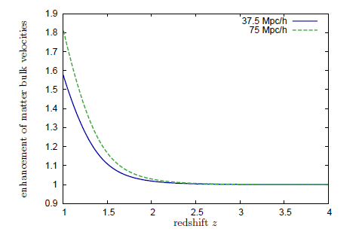
Enhanced bulk velocities

Slide 63
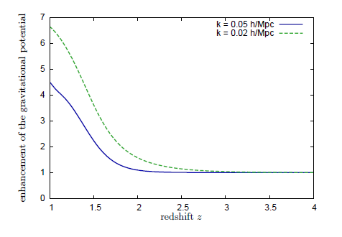
Enhancement of gravitational potential
Test of allowed parameter space by ISW effect

Slide 64
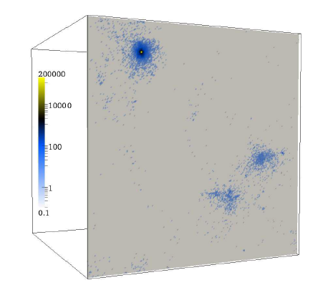
neutrino lumps

Slide 65
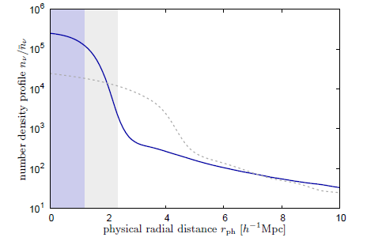
number density profile of neutrino lumps

Slide 66
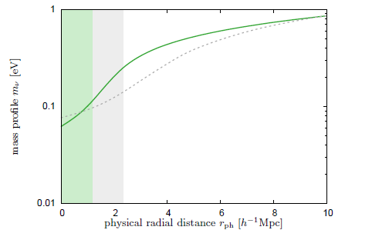
mass profile in neutrino lumps

Slide 67
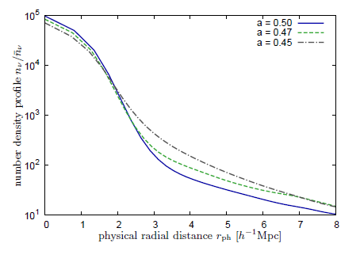
time dependence of neutrino distribution in lumps

Slide 68
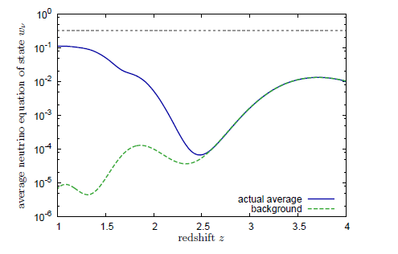
back-reaction : neutrino equation of state

Slide 69
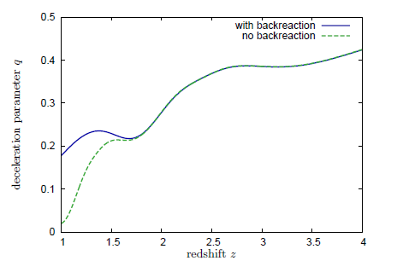
back-reaction : decelaration parameter

Slide 70
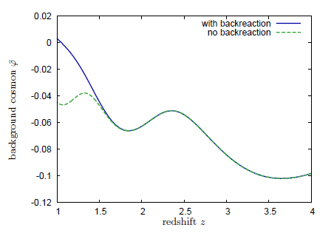
back-reaction: cosmon field

Slide 71
Conclusions
Cosmic event triggers qualitative change in evolution of cosmon
Cosmon stops changing after neutrinos become non-relativistic
Explains why now
Cosmological selection
Model can be distinguished from cosmological constant

Slide 72
Tests for growing neutrino quintessence

Slide 73
Hubble parameter
as compared to ΛCDM

Slide 74
Hubble parameter ( z < z_{c} )
only small
difference
from
ΛCDM !

Slide 75
bounds on average neutrino mass

Slide 76
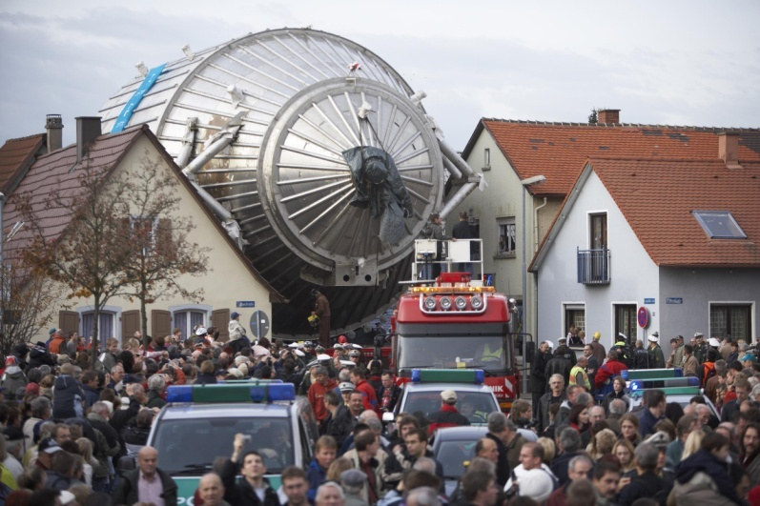
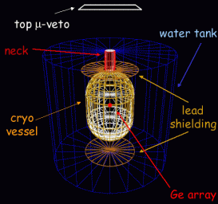
Can time evolution of neutrino mass be observed ?
Experimental determination of neutrino mass may turn out higher than cosmological upper bound in model with constant neutrino mass
( KATRIN, neutrino-less double beta decay )
GERDA

Slide 77
neutrino fluctuations
neutrino structures become nonlinear at z~1 for supercluster scales
stable neutrino-cosmon lumps exist
D.Mota , G.Robbers , V.Pettorino , …
N.Brouzakis , N.Tetradis ,…

Slide 78
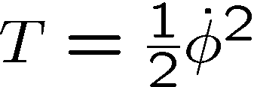
Equation of state
p=T-V pressure kinetic energy
ρ=T+V energy density
Equation of state
Depends on specific evolution of the scalar field

Slide 79
Negative pressure
w < 0 Ω_{h} increases (with decreasing z )
w < -1/3 expansion of the Universe is
accelerating
w = -1 cosmological constant
late universe with
small radiation component :

Slide 80
A few references
C.Wetterich , Nucl.Phys.B302,668(1988) , received 24.9.1987
P.J.E.Peebles,B.Ratra , Astrophys.J.Lett.325,L17(1988) , received 20.10.1987
B.Ratra,P.J.E.Peebles , Phys.Rev.D37,3406(1988) , received 16.2.1988
J.Frieman,C.T.Hill,A.Stebbins,I.Waga , Phys.Rev.Lett.75,2077(1995)
P.Ferreira, M.Joyce , Phys.Rev.Lett.79,4740(1997)
C.Wetterich , Astron.Astrophys.301,321(1995)
P.Viana, A.Liddle , Phys.Rev.D57,674(1998)
E.Copeland,A.Liddle,D.Wands , Phys.Rev.D57,4686(1998)
R.Caldwell,R.Dave,P.Steinhardt , Phys.Rev.Lett.80,1582(1998)
P.Steinhardt,L.Wang,I.Zlatev , Phys.Rev.Lett.82,896(1999)

