Slide 1
Varying fundamental constants - a key property and key problem of quintessence

Slide 2
Fundamental “constants” are not constant

Slide 3
Have coupling constants in the
early Universe
other values than today ?
Yes !

Slide 4
Fundamental couplings in quantum field theory
Masses and coupling constants
are determined by properties
of vacuum !
Similar to Maxwell – equations in matter

Slide 5
Condensed matter physics : laws depend on state of the system
Ground state , thermal equilibrium state …
Example : Laws of electromagnetism in superconductor are different from Maxwells’ laws

Slide 6
Standard model of particle physics :
Electroweak gauge symmetry is spontaneously broken by expectation value of Higgs scalar

Slide 7
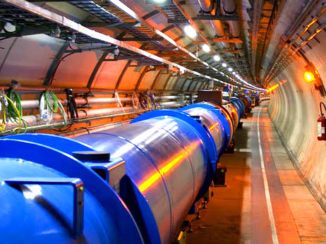
Spontaneous symmetry breaking confirmed at the LHC

Slide 8
Cosmology :
Universe is not in one fixed state
Dynamical evolution
Laws are expected to depend on time

Slide 9
Restoration of symmetry at high temperature in the early Universe
high T :
Less order
More symmetry
Example:
Magnets
Low T
SSB
<φ>=φ₀ ≠ 0
High T
SYM
<φ>=0

Slide 10
In hot plasma of early Universe : masses of electron und muon not different! similar strength of electromagnetic and weak interaction

Slide 11
Varying couplings
only question :
How strong is present variation of couplings ?

Slide 12
Can variation of fundamental “constants” be observed ?
Fine structure constant α (electric charge)
Ratio electron mass to proton mass
Ratio nucleon mass to Planck mass

Slide 13
Time evolution of couplings and scalar fields
Fine structure constant depends on value of
Higgs field : α(φ)
Time evolution of φ
Time evolution of α
Jordan,…

Slide 14
Static scalar fields
In Standard Model of particle physics :
Higgs scalar has settled to its present value around 10⁻¹² seconds after big bang.
Chiral condensate of QCD has settled at present value after quark-hadron phase transition around 10⁻⁶ seconds after big bang .
No scalar with mass below pion mass.
No substantial change of couplings after QCD phase transition.
Coupling constants are frozen.

Slide 15
Observation of time- or space- variation of couplings Physics beyond Standard Model

Slide 16
Particle masses in quintessence cosmology
can depend on value of cosmon field
similar to dependence on value of Higgs field

Slide 17
Time evolution of couplings and scalar fields
Fine structure constant depends on value of
cosmon field : α(φ)
Cosmon field changes in present cosmological epoch
Time evolution of φ
Time evolution of α
Jordan,…

Slide 18
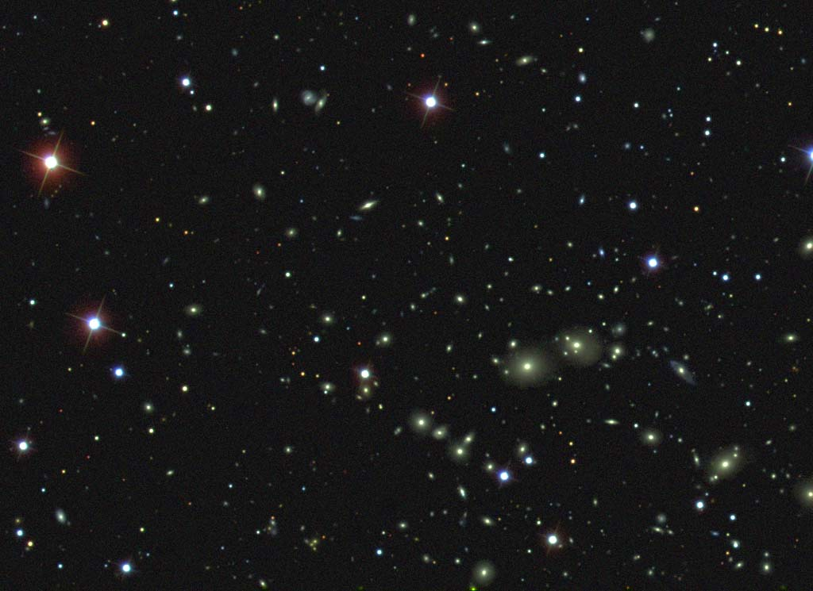
Dark Energy :
Energy density that does not clump
Photons , gravitons : insignificant

Slide 19
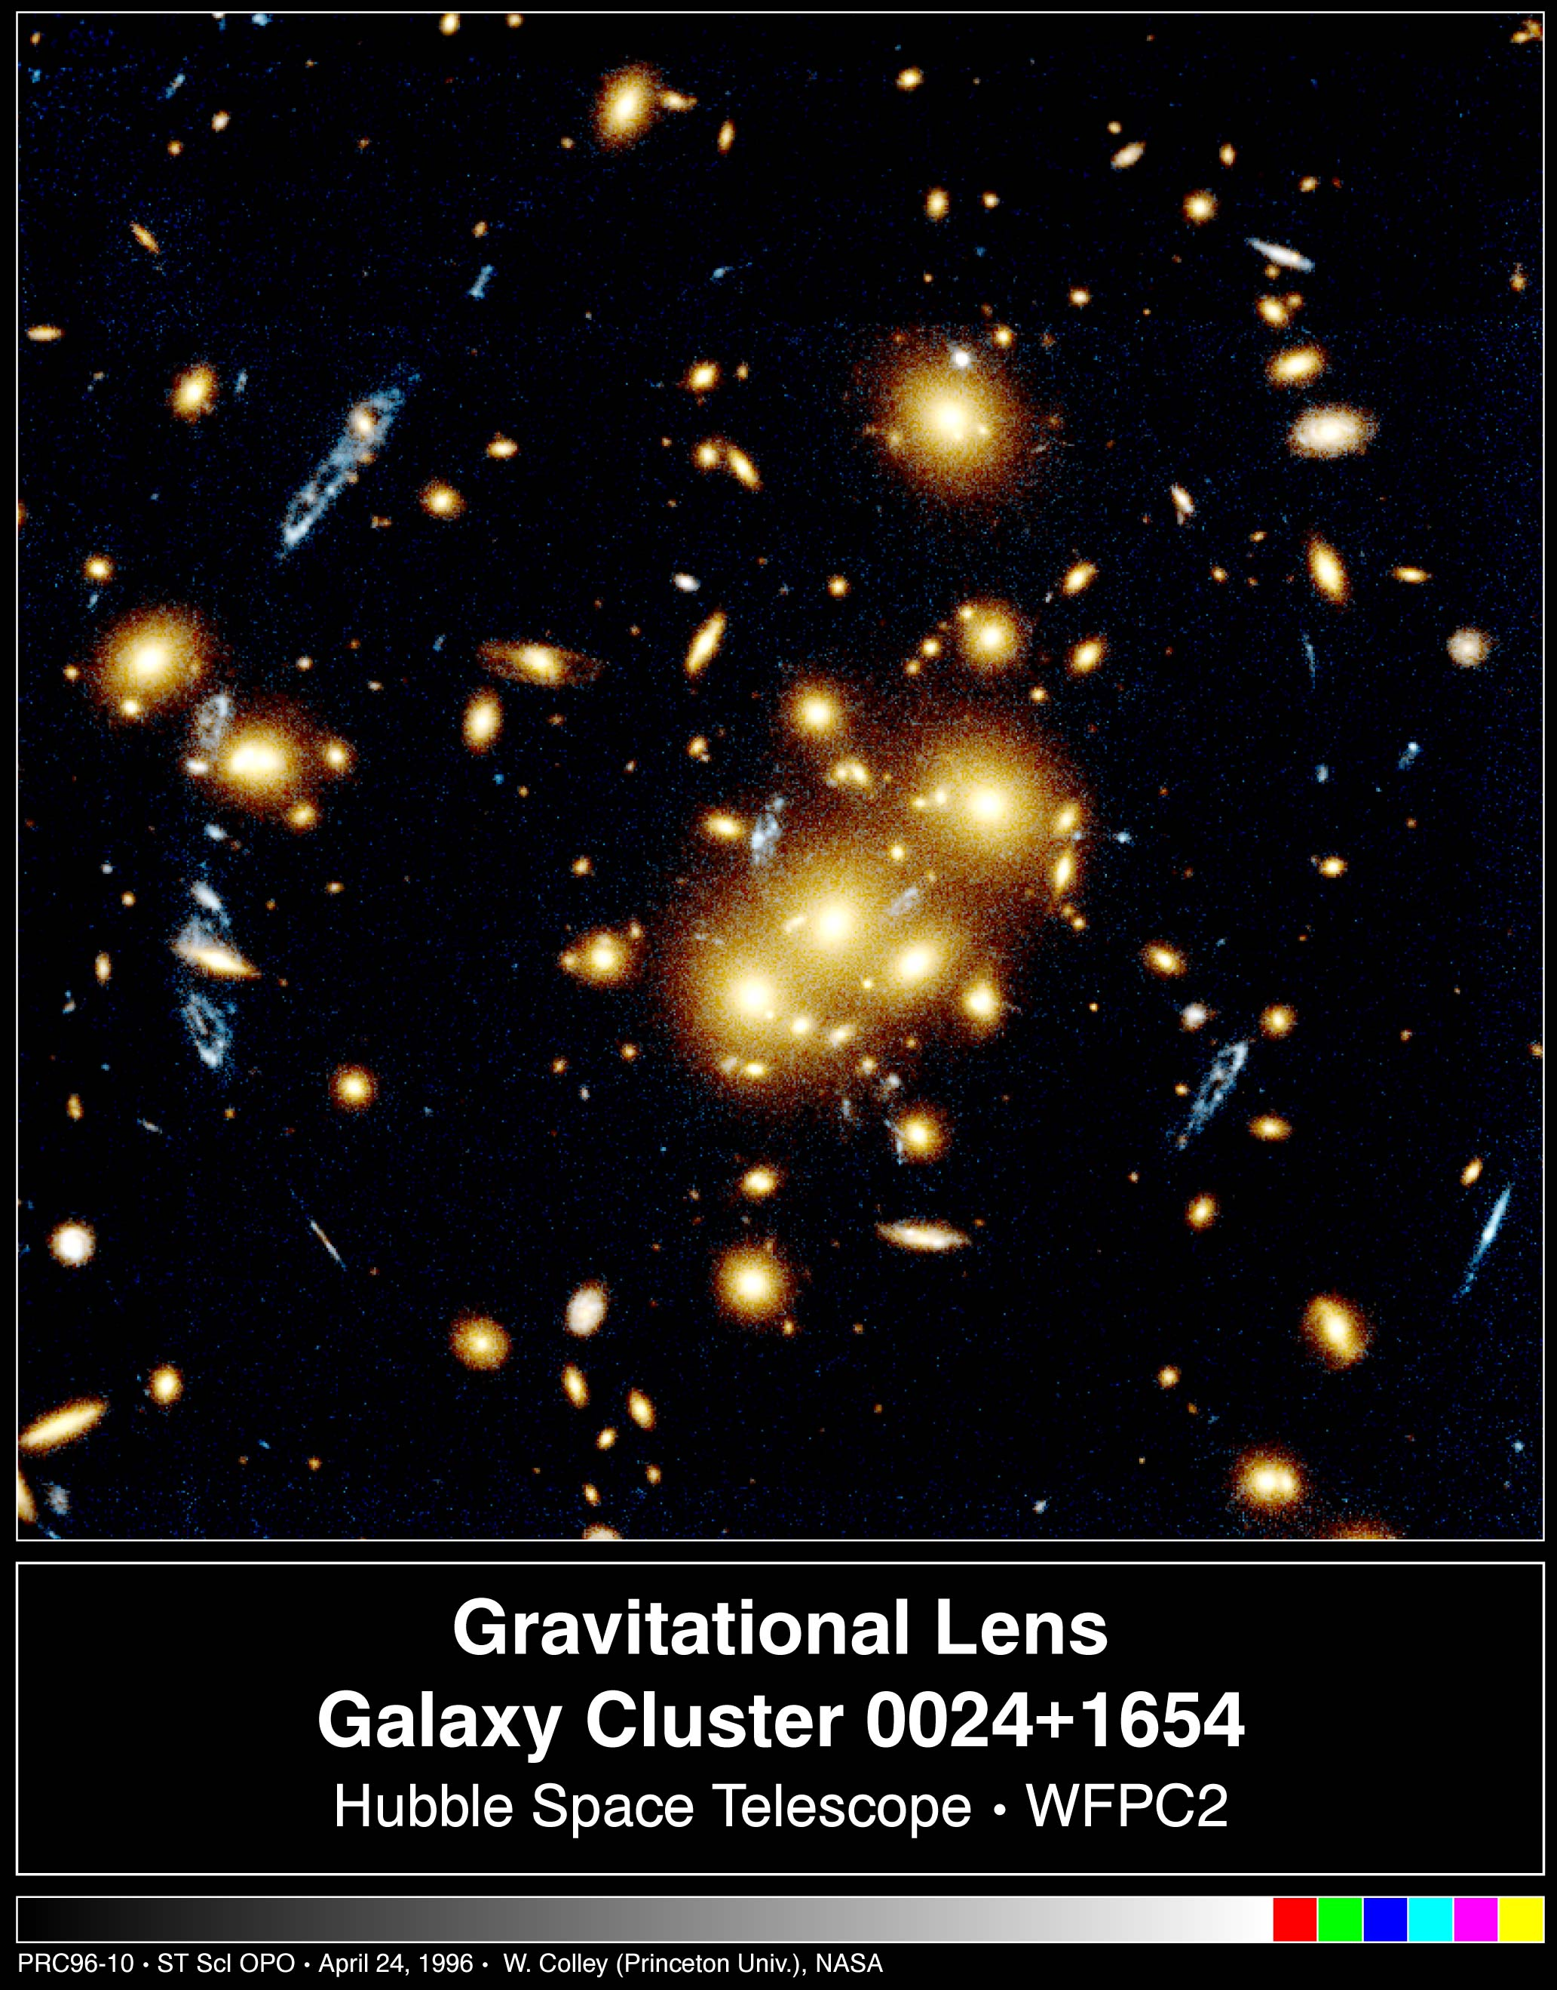
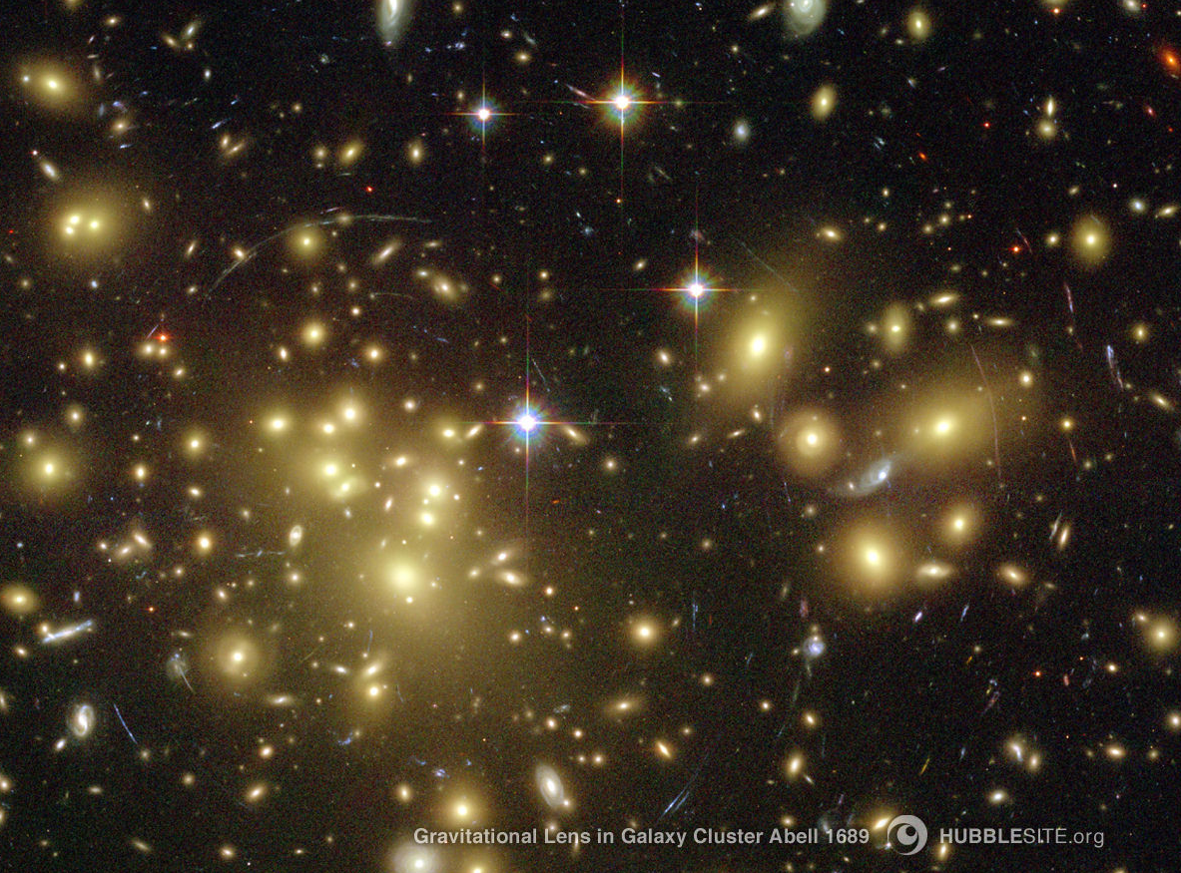
Matter
Gravitationslinse,HST

Slide 20
Space between clumps is not empty : Dark Energy !

Slide 21
Dark Energy :
Homogeneously distributed

Slide 22
Einstein’s equations : almost static Dark Energy predicts accelerated expansion of Universe

Slide 23
Predictions for dark energy cosmologies
The expansion of the Universe
accelerates today !

Slide 24
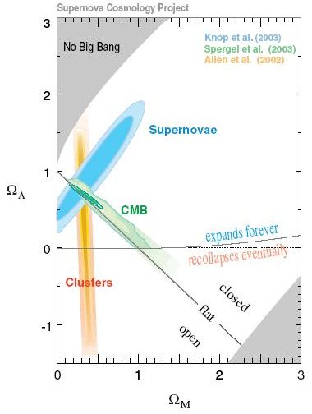
Dark Energy : observations fit together !

Slide 25
Composition of the Universe
Ω_{b} = 0.045 visible clumping
Ω_{dm}= 0.25 invisible clumping
Ω_{h} = 0.7 invisible homogeneous

Slide 26
What is Dark Energy ?
Cosmological Constant
or
Quintessence ?

Slide 27
Cosmological Constant - Einstein -
Constant λ compatible with all symmetries
No time variation in contribution to energy density
Why so small ? λ/M⁴ = 10⁻¹²⁰
Why important just today ?

Slide 28
Cosmological mass scales
Energy density
ρ ~ ( 2.4×10 ⁻³ eV )⁻ ⁴
Reduced Planck mass
M=2.44×10 ²⁷ eV
Newton’s constant
GN=(8πM²)
Only ratios of mass scales are observable !
homogeneous dark energy: ρ_{h}/M⁴ = 6.5 10ˉ¹²¹
matter: ρ_{m}/M⁴= 3.5 10ˉ¹²¹

Slide 29
Time evolution
tˉ² matter dominated universe
tˉ^{3/2} radiation dominated universe
ρ_{m}/M⁴ ~ aˉ³ ~
ρ_{r}/M⁴ ~ aˉ⁴ ~ t ⁻² radiation dominated universe
Huge age small ratio
Same explanation for small dark energy?

Slide 30
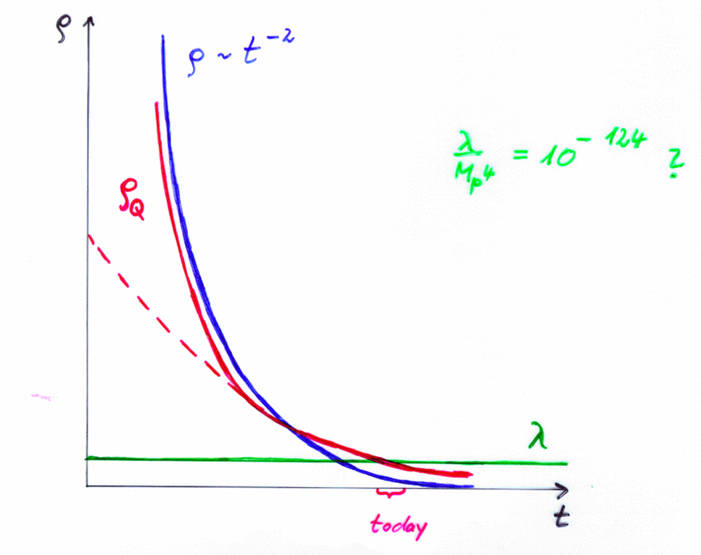
Cosm. Const. | Quintessence
static | dynamical

Slide 31
Quintessence
Dynamical dark energy ,
generated by scalar field
(cosmon)
C.Wetterich,Nucl.Phys.B302(1988)668, 24.9.87
P.J.E.Peebles,B.Ratra,ApJ.Lett.325(1988)L17, 20.10.87

Slide 32
Prediction : homogeneous dark energy influences recent cosmology - of same order as dark matter -
Original models do not fit the present observations
…. modifications

Slide 33
Quintessence
Cosmon – Field φ(x,y,z,t)
similar to electric field , but no direction ( scalar field )
Homogeneous und isotropic Universe : φ(x,y,z,t)=φ(t)
Potential und kinetic energy of the cosmon -field
contribute to a dynamical energy density of the Universe !

Slide 34
Cosmon
Scalar field changes its value even in the present cosmological epoch
Potential und kinetic energy of cosmon contribute to the energy density of the Universe
Time - variable dark energy :
ρ_{h}(t) decreases with time !

Slide 35
Evolution of cosmon field
Field equations
Potential V(φ) determines details of the model
V(φ) =M⁴ exp( - αφ/M )
for increasing φ the potential decreases towards zero !

Slide 36
Cosmon
Tiny mass
m_{c} ~ H (depends on time ! )
New long - range interaction

Slide 37
“Fundamental” Interactions
Strong, electromagnetic, weak
interactions
On astronomical
length scales:
graviton
+
cosmon
gravitation
cosmodynamics

Slide 38
Time varying constants
It is not difficult to obtain quintessence potentials from higher dimensional or string theories
Exponential form rather generic
( after Weyl scaling)
But most models show too strong time dependence of fundamental constants !

Slide 39
Bounds on time varying couplings from nucleosynthesis

Slide 40
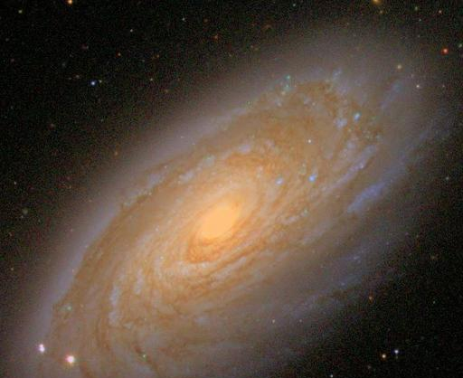
baryons :
the matter of stars and humans
Ω_{b} = 0.045

Slide 41
Abundancies of
primordial
light elements
from
nucleosynthesis
A.Coc

Slide 42
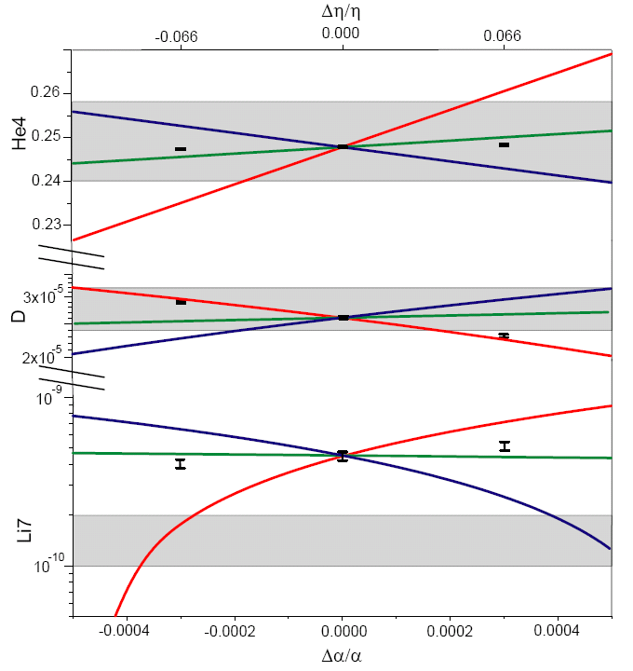
primordial abundances for three GUT models
present observations : 1σ
He
D
Li
T.Dent,
S.Stern,…

Slide 43
three GUT models
unification scale ~ Planck scale
1) All particle physics scales ~Λ_{QCD}
2) Fermi scale and fermion masses ~ unification scale
3) Fermi scale varies more rapidly than Λ_{QCD}
Δα/α ≈ 4 10⁻⁴ allowed for GUT 2 and 3 , larger for GUT 1
Δln(M_{n}/M_{P}) ≈40 Δα/α ≈ 0.015 allowed

Slide 44
Time variation of coupling constants
must be tiny –
would be of very high significance !
Possible signal for Quintessence

Slide 45
“Fundamental” Interactions
Strong, electromagnetic, weak
interactions
On astronomical
length scales:
graviton
+
cosmon
gravitation
cosmodynamics

Slide 46
“Fifth Force”
Mediated by scalar field
Coupling strength: weaker than gravity
( nonrenormalizable interactions ~ M⁻² )
Composition dependence
violation of equivalence principle
Quintessence: connected to time variation of
fundamental couplings
R.Peccei,J.Sola,C.Wetterich,Phys.Lett.B195,183(1987)
C.Wetterich , Nucl.Phys.B302,645(1988)

Slide 47
Violation of equivalence principle
Different couplings of cosmon to proton and neutron
Differential acceleration
“Violation of equivalence principle”
p,n
earth
cosmon
p,n
only apparent : new “fifth force” !

Slide 48
Differential acceleration
Two bodies with equal mass experience
a different acceleration !
η = ( a₁ – a₂ ) / ( a₁ + a₂ )
bound : η < 3 10⁻¹⁴

Slide 49
Apparent violation of equivalence principle
and
time variation of fundamental couplings
measure both the
cosmon – coupling to ordinary matter

Slide 50
Differential acceleration η
For unified theories ( GUT ) :
η=Δa/2a
Q : time dependence of other parameters

Slide 51
Link between time variation of α
and violation of equivalence principle
typically : η = 10⁻¹⁴
^{if time variation of α}
^{near Oklo upper bound}
^{to be tested ( MICROSCOPE , …)}

Slide 52
Cosmon coupling to atoms
Tiny !!!
Substantially weaker than gravity.
Non-universal couplings bounded by tests
of equivalence principle.
Universal coupling bounded by tests of Brans-Dicke parameter ω in solar system.
Only very small influence on cosmology.
( All this assumes validity of linear approximation )

Slide 53
key problem for realistic quintessence
tiny cosmon - atom coupling
Planck mass may increase, but particle
masses must be (almost ) proportional to it
C.Wetterich , Nucl.Phys.B302, 645 and 668 (1988)

Slide 54
Possible mechanism for tiny cosmon-atom couplings
asymptotic approach to fixed point for dimensionless couplings and mass ratios
at fixed point : no cosmon coupling to atoms – no time variation of fundamental constants
very near fixed point : tiny coupling
how small ?

Slide 55
Approach to fixed point for φ → ∞
requires for small time
variation of couplings :
or
similar for fine structure constant

Slide 56
Neutrino cosmon coupling
Strong bounds on atom-cosmon coupling from tests of equivalence principle or time variation of couplings.
No such bounds for neutrino-cosmon coupling.
In particle physics : Mass generation mechanism for neutrinos differs from charged fermions. Seesaw mechanism involves heavy particles whose mass may depend on the value of the cosmon field.

Slide 57
neutrino mass
seesaw and
cascade
mechanism
triplet expectation value ~ doublet squared
omit generation
structure

Slide 58
neutrino mass
( ? ) ….
C.Wetterich, Nucl.Phys.B187 (1981) 343
cascade ( seesaw II )
mechanism
M.Magg, C.W. 1980

Slide 59
Neutrino cosmon coupling
realized by dependence of neutrino mass on value of cosmon field
β ≈ 1 : cosmon mediated attractive force between neutrinos has similar strength as gravity

Slide 60
growing neutrino quintessence

Slide 61
growing neutrinos change cosmon evolution
modification of conservation equation for neutrinos

Slide 62
growing neutrino mass triggers transition to almost static dark energy
growing
neutrino
mass
L.Amendola, M.Baldi,…

Slide 63
effective cosmological trigger for stop of cosmon evolution : neutrinos get non-relativistic
this has happened recently !
sets scales for dark energy !

Slide 64
connection between dark energy and neutrino properties
= 1.27
present dark energy density given by neutrino mass
present equation
of state given by
neutrino mass !

Slide 65
Induced small cosmon-atom coupling
change of triplet expectation value induces tiny change of doublet expectation value
change of Fermi scale
change of ratio electron to proton mass
change of fine structure constant

Slide 66
Time variation of coupling constants
is tiny , but would be of very
high significance !
Size not predicted
Possible signal for Quintessence

Slide 67
End

