Slide 1
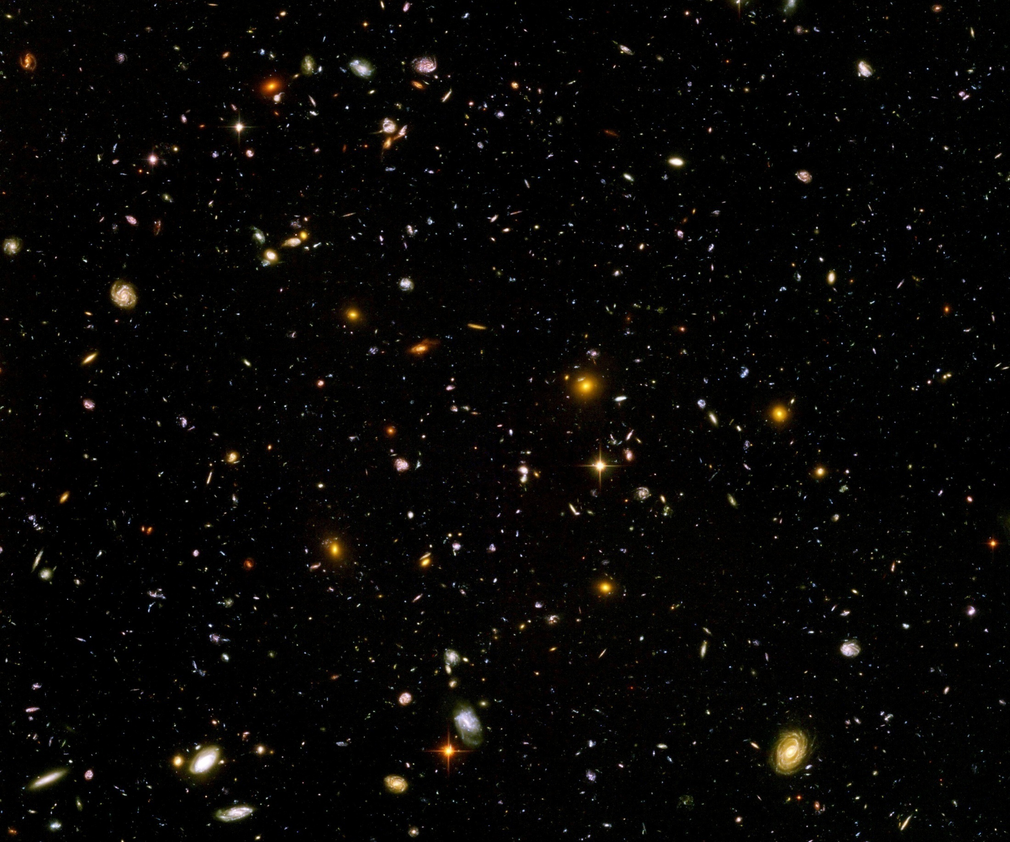
Expanding Universe or shrinking atoms ?

Slide 2
Big bang or freeze ?

Slide 3
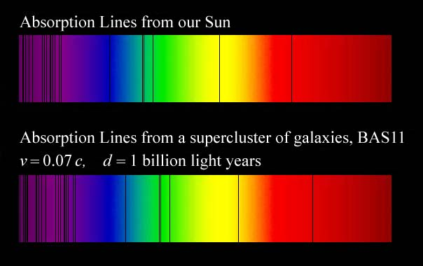
Do we know that the
Universe expands ?
instead of redshift due to expansion :
smaller frequencies have been emitted in the past, because electron mass was smaller !

Slide 4
Why do we see redshift of photons emitted in the distant past ?
photons are more red because they have been emitted with longer wavelength
frequency ~ mass
wavelength ~
atomsize

Slide 5
What is increasing ?
Ratio of distance between galaxies
over size of atoms !
atom size constant : expanding geometry
alternative : shrinking size of atoms

Slide 6
How can particle masses change with time ?
Particle masses are proportional to scalar field χ .
Scalar field varies with time.
Ratios of particle masses are independent of χ and therefore remain constant.
Compatibility with observational bounds on time dependence of particle mass ratios.
Dimensionless couplings are independent of χ .

Slide 7
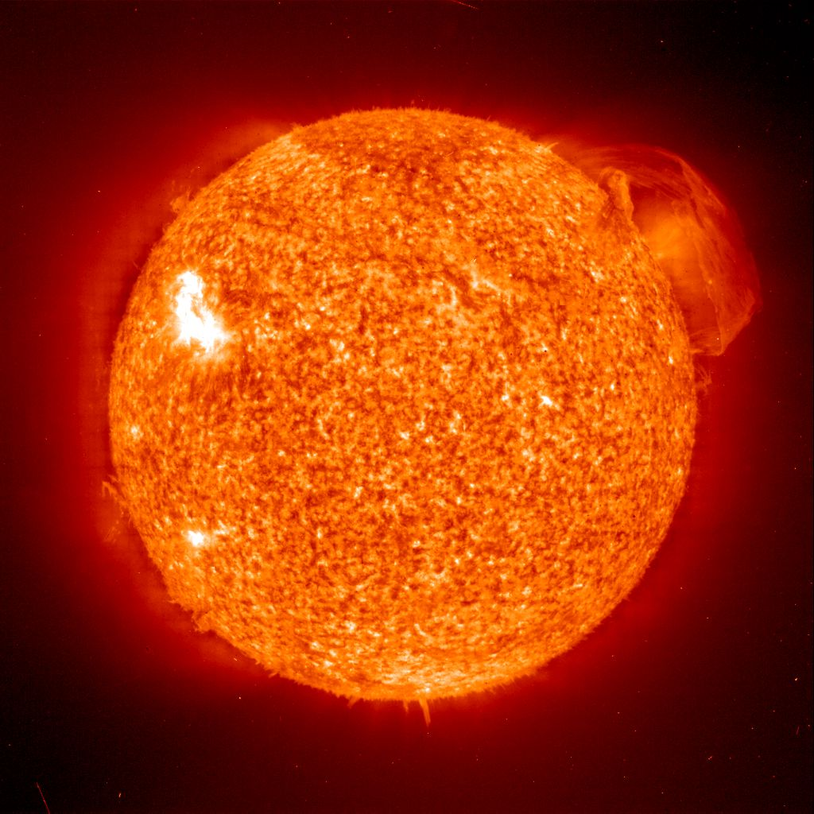
Do we know that the temperature was higher in the early Universe than now ?
Cosmic microwave radiation , nucleosynthesis
instead of
higher temperature :
smaller particle masses

Slide 8
Hot plasma ?
Temperature in radiation dominated Universe : T ~ χ ^{½} smaller than today
Ratio temperature / particle mass : T /m_{p} ~ χ ^{-½} larger than today
T/m_{p} counts ! This ratio decreases with time.
Nucleosynthesis , CMB emission as in standard cosmology !

Slide 9

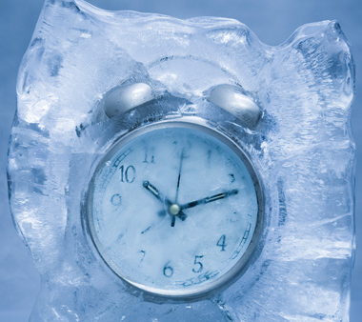
Big bang or freeze ?
freeze picture :
only rods for measurements
are set differently !

Slide 10
Big bang is not wrong, but alternative pictures exist !

Slide 11
Field relativity : different pictures of cosmology
same physical content can be described by different pictures
related by field – redefinitions , e.g. Weyl scaling , conformal scaling of metric
which picture is usefull ?

Slide 12


Relativity of geometry
Euclid … Newton : space and time
are absolute
Special relativity : space and time depend on observer
General relativity : spacetime is
influenced by matter ( including radiation )
geometry is independent of coordinates geometry is observable
Field relativity : geometry is relative

Slide 13
Spacetime is a description of correlations between “matter”.
Different pictures exist.

Slide 14
Why should you care about the freeze picture of the Universe ?
Some aspects are understood easier :
Beginning of Universe
Role of scale symmetry
Range of impact of quantum gravity

Slide 15
conclusions
Big bang singularity is artefact
of inappropriate choice of field variables –
no physical singularity
Quantum gravity may be observable in
dynamics of present Universe

Slide 16
variable gravity
“Newton’s constant is not constant”

Slide 17
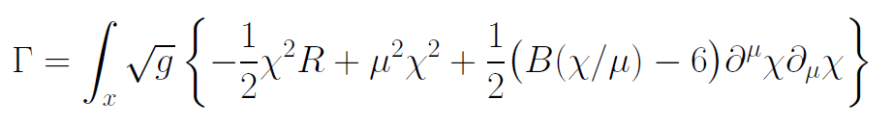
Variable Gravity
quantum effective action,
variation yields field equations
Einstein gravity :
M² R

Slide 18
Variable Gravity
Scalar field coupled to gravity
Effective Planck mass depends on scalar field
Simple quadratic scalar potential involves intrinsic mass μ
Nucleon and electron mass proportional to dynamical Planck mass
Neutrino mass has different dependence on scalar field

Slide 19
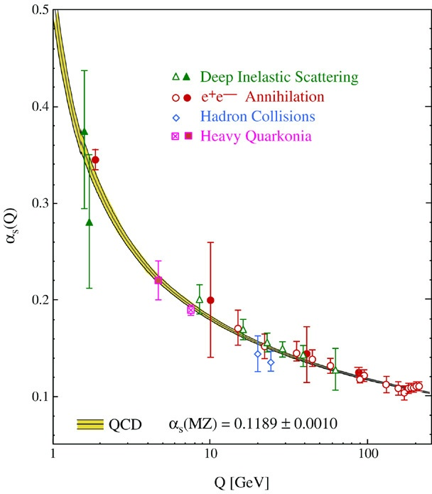
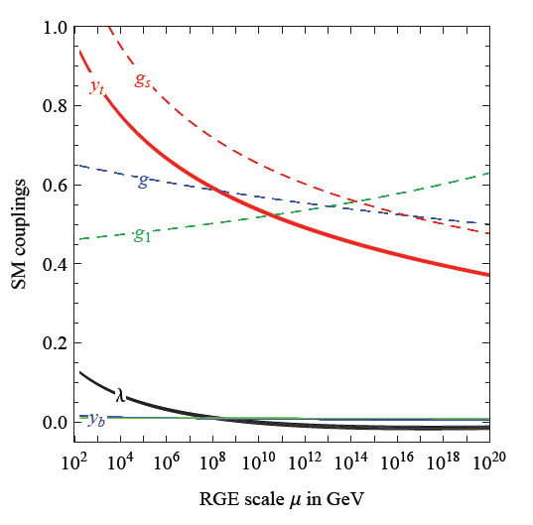
Running coupling
B varies if intrinsic scale µ changes
similar to QCD or standard model

Slide 20
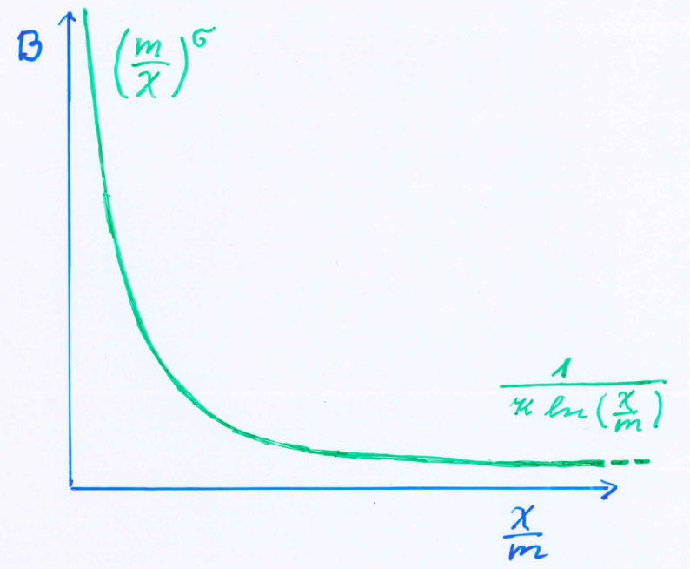
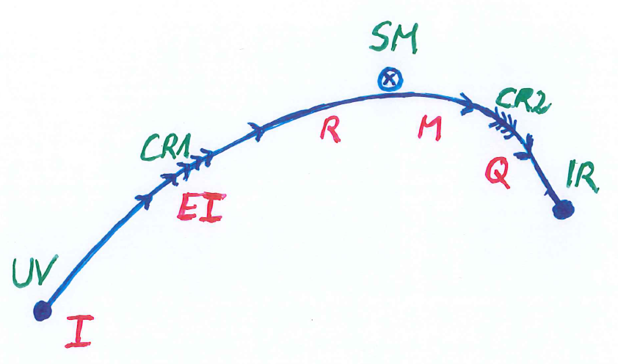
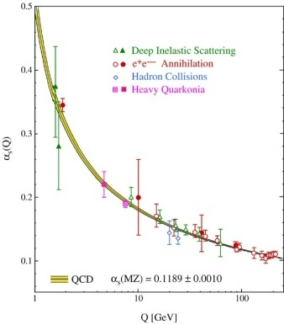
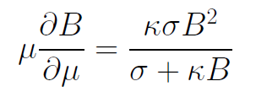
Kinetial B :
Crossover between two fixed points

Slide 21
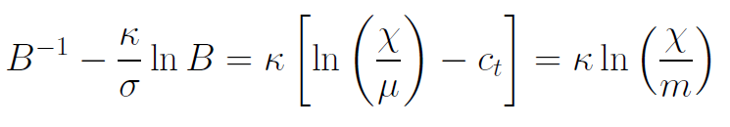
Kinetial B :
Crossover between two fixed points
running
coupling obeys
flow equation
m : scale of crossover
can be exponentially larger than intrinsic scale μ

Slide 22
Four-parameter model
model has four dimensionless parameters
three in kinetial :
σ ~ 2.5
κ ~ 0.5
c_{t} ~ 14 ( or m/μ )
one parameter for growth rate of neutrino mass over electron mass : γ ~ 8
+ standard model particles and dark matter : sufficient for realistic cosmology from inflation to dark energy
no more free parameters than ΛCDM

Slide 23
Cosmological solution
scalar field χ vanishes in the infinite past
scalar field χ diverges in the infinite future

Slide 24
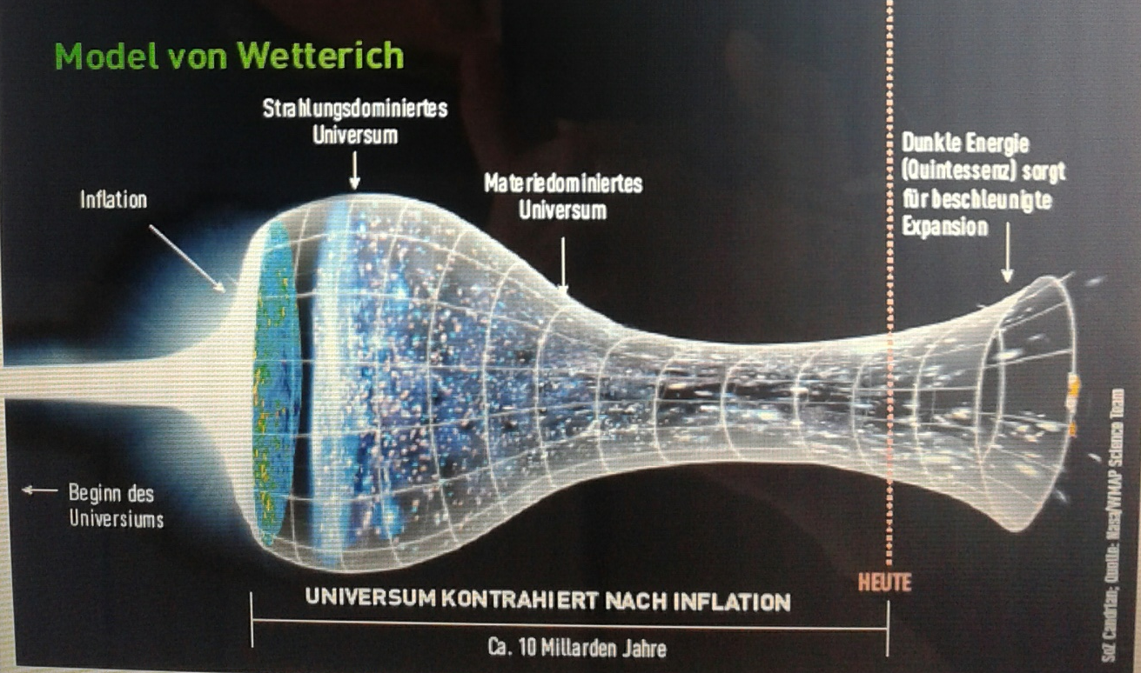
Strange evolution of Universe
Sonntagszeitung Zürich , Laukenmann

Slide 25
Model is compatible with present observations
Together with variation of neutrino mass over electron mass in present cosmological epoch :
model is compatible with all present observations, including inflation and dark energy

Slide 26
Einstein frame
“Weyl scaling” maps variable gravity model to Universe with fixed masses and standard expansion history.
Exact equivalence of different frames !
Standard gravity coupled to scalar field.
Only neutrino masses are growing.

Slide 27
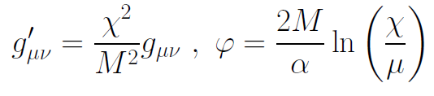
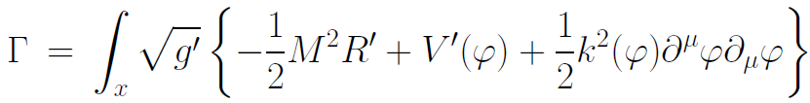
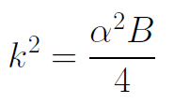

Einstein frame
Weyl scaling :
effective action in Einstein frame :

Slide 28
Field relativity
Weyl scaling :
changes geometry,
not a coordinate transformation

Slide 29
infinite past

Slide 30
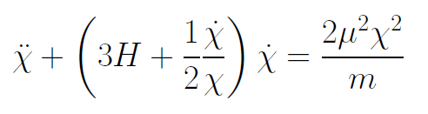
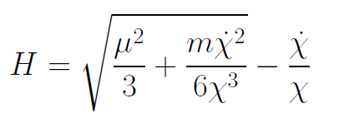
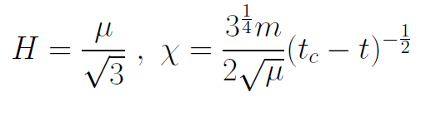
Infinite past : slow inflation
σ = 2 : field equations
approximative
solution
particles become massless in infinite past !

Slide 31
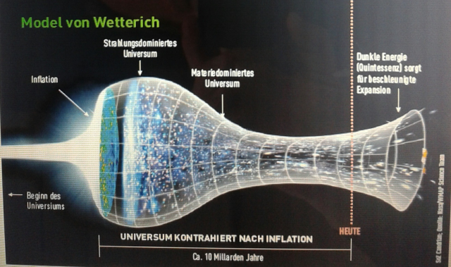
Eternal Universe
Asymptotic solution in
freeze frame :
solution valid back to the infinite past in physical time
no singularity
physical time to infinite past is infinite

Slide 32
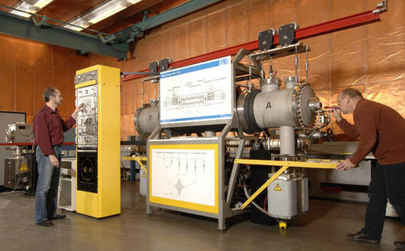
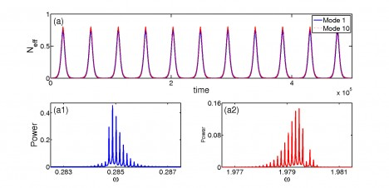
Physical time
count oscillations ….

Slide 33
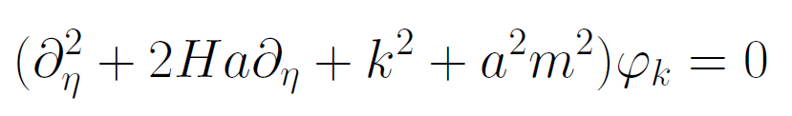
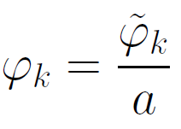
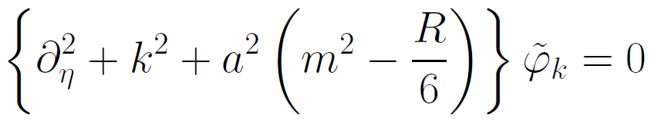
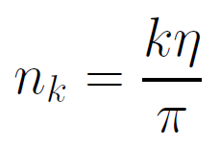

Physical time
field equation for scalar field mode
determine physical
time by counting
number of oscillations
( m=0 )

Slide 34
Physical time
counting : discrete
invariant under field transformations
same in all frames

Slide 35
Big bang singularity in Einstein frame is field singularity !
choice of frame with constant particle
masses is not well suited if
physical masses go to zero !

Slide 36
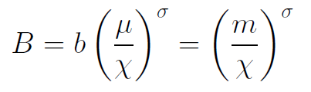
Inflation
solution for small χ : inflationary epoch
kinetial characterized by
anomalous dimension σ

Slide 37

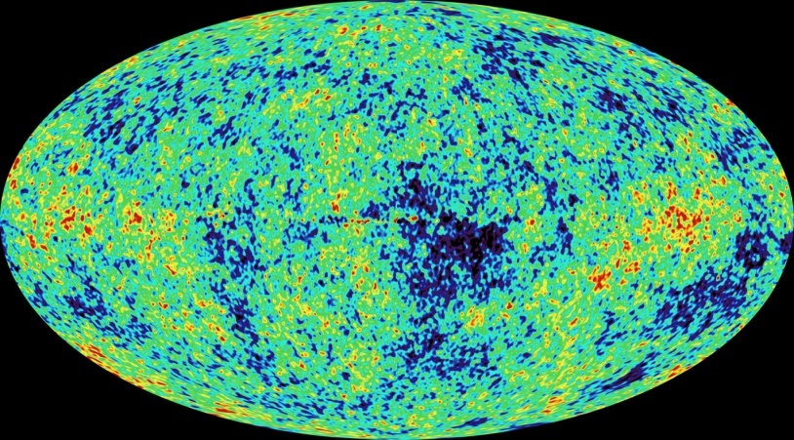
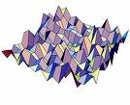
Primordial fluctuations
inflaton field : χ
primordial fluctuations of inflaton become observable in cosmic microwave background
Notes:
37

Slide 38


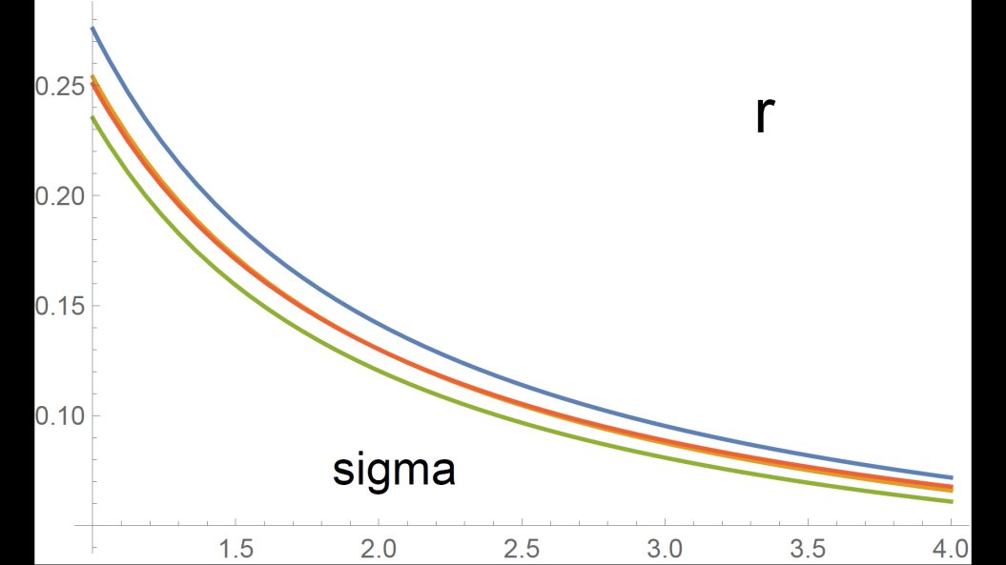
Anomalous dimension determines spectrum of primordial fluctuations
spectral index n
tensor amplitude r

Slide 39
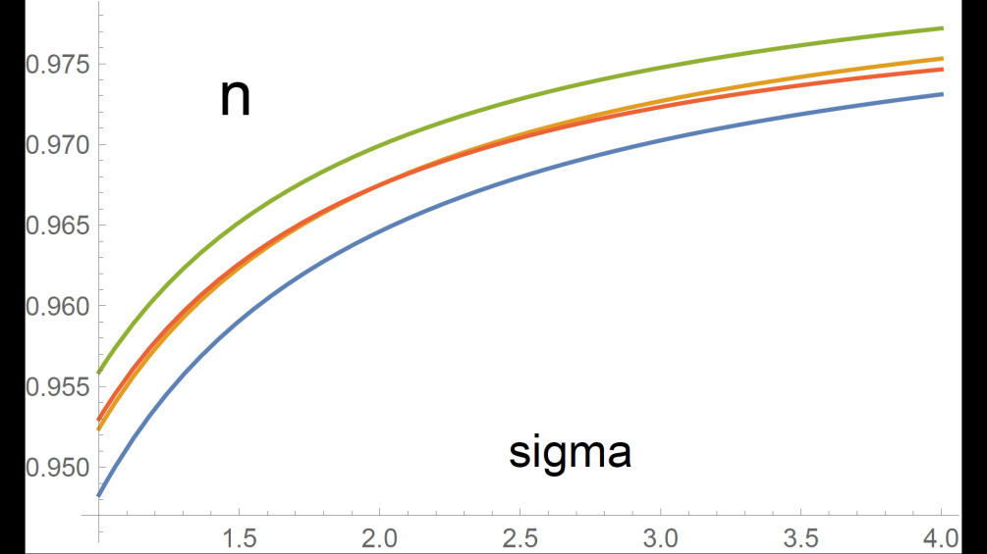
relation between n and r
r = 8.19 ( 1 – n ) - 0.1365

Slide 40
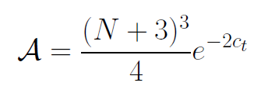

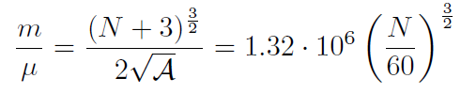
Amplitude of density fluctuations
small because of logarithmic running
near UV fixed point !
σ=1
N : number of e – foldings at horizon crossing

Slide 41
no small parameter for dark energy

Slide 42
Four-parameter model
model has four dimensionless parameters
three in kinetial :
σ ~ 2.5
κ ~ 0.5
c_{t} ~ 14 ( or m/μ )
one parameter for growth rate of neutrino mass over electron mass : γ ~ 8
+ standard model particles and dark matter : sufficient for realistic cosmology from inflation to dark energy
no more free parameters than ΛCDM

Slide 43
No tiny dimensionless parameters
( except gauge hierarchy )
μ = 2 • 10 ⁻³³ eV
one mass scale
one time scale μ⁻¹ = 10 ¹⁰ yr
Planck mass does not appear as parameter
Planck mass grows large dynamically

Slide 44
Slow Universe
Asymptotic solution in
freeze frame :
Expansion or shrinking always slow ,
characteristic time scale of the order of the age of the
Universe : t_{ch} ~ μ⁻¹ ~ 10 billion years !
Hubble parameter of the order of present Hubble
parameter for all times , including inflation and big bang !
Slow increase of particle masses !
μ= 2 • 10⁻³³ eV

Slide 45
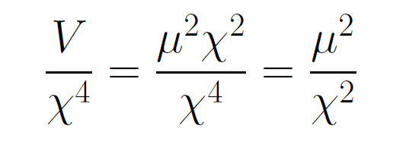
asymptotically vanishing cosmological „constant“
What matters : Ratio of potential divided by fourth power of Planck mass
vanishes for χ → ∞ !

Slide 46
Einstein frame
Weyl scaling :
effective action in Einstein frame :

Slide 47
small dimensionless number ?
needs two intrinsic mass scales
standard approach :V and M ( cosmological constant and Planck mass )
variable gravity : Planck mass moving to infinity , with fixed V ratio vanishes asymptotically !

Slide 48
Quintessence
Dynamical dark energy ,
generated by scalar field (cosmon )
C.Wetterich,Nucl.Phys.B302(1988)668, 24.9.87
P.J.E.Peebles,B.Ratra,ApJ.Lett.325(1988)L17, 20.10.87
Notes:
48

Slide 49
Prediction : homogeneous dark energy influences recent cosmology
- of same order as dark matter -
Original models do not fit the present observations
…. modifications
( different growth of neutrino mass )

Slide 50
Cosmon inflation
Unified picture of inflation and dynamical dark energy
Cosmon and inflaton are the same scalar field

Slide 51
quantum gravity with scalar field – the role of scale symmetry

Slide 52
fluctuations induce running couplings
violation of scale symmetry
well known in QCD or standard model

Slide 53
Quantum scale symmetry
quantum fluctuations violate scale symmetry
running dimensionless couplings
at fixed points , scale symmetry is exact !

Slide 54
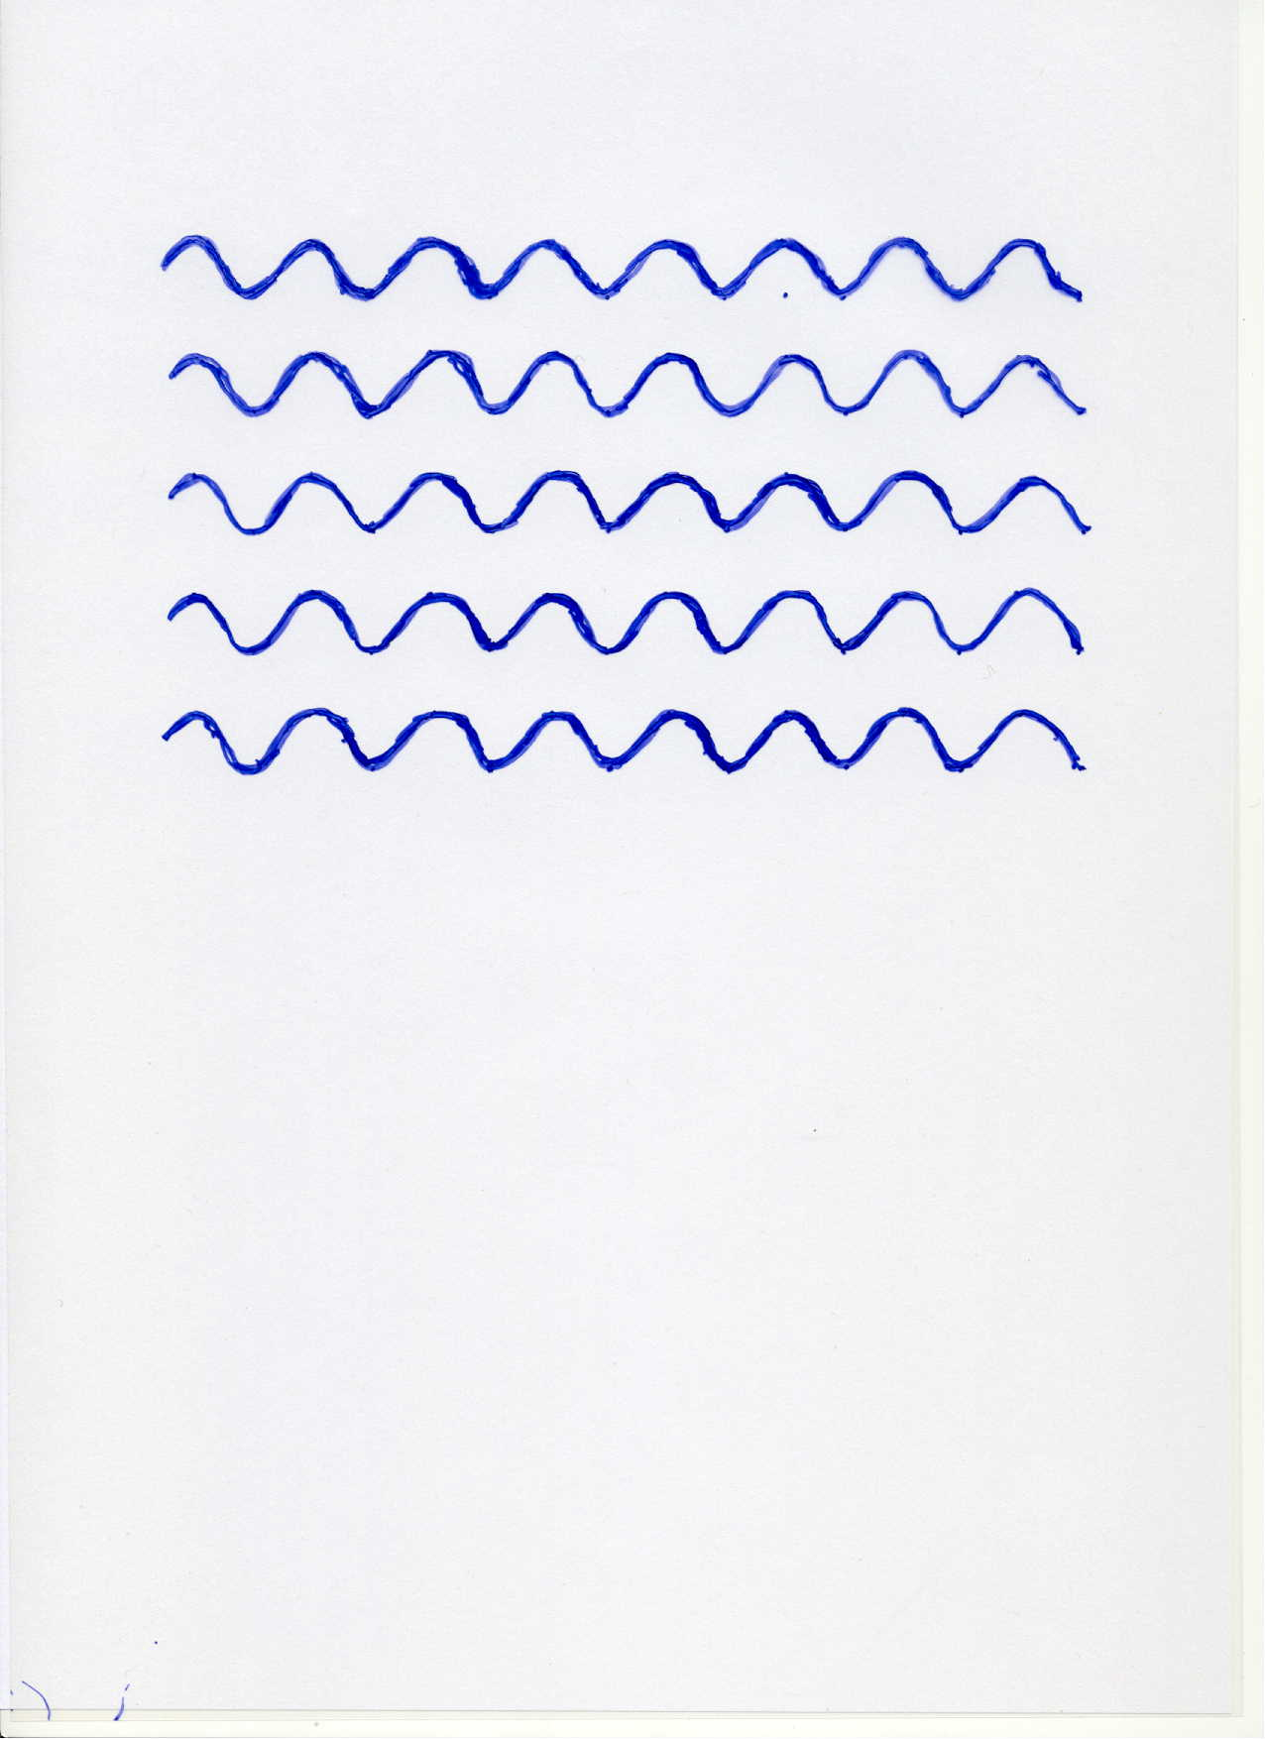


Scale symmetry
no scale symmetry
scale symmetry

Slide 55
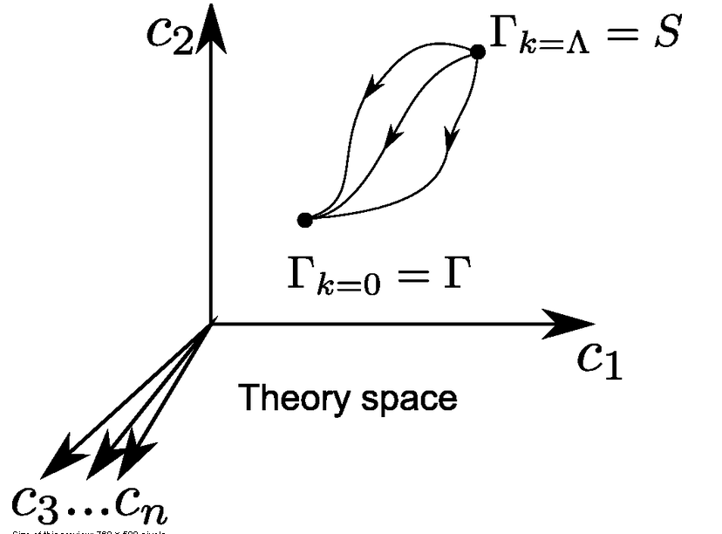
functional renormalization : flowing action
Wikipedia
Notes:
55

Slide 56

Crossover in quantum gravity

Slide 57

Origin of mass
UV fixed point : scale symmetry unbroken
all particles are massless
IR fixed point :
scale symmetry spontaneously broken,
massive particles , massless dilaton
crossover : explicit mass scale μ important
approximate SM fixed point : approximate scale symmetry spontaneously broken, massive particles , almost massless cosmon, tiny cosmon potential

Slide 58
Spontaneous breaking of scale symmetry
expectation value of scalar field breaks scale symmetry spontaneously
massive particles are compatible with scale symmetry
in presence of massive particles : sign of exact scale symmetry is exactly massless Goldstone boson – the dilaton

Slide 59
Approximate scale symmetry near fixed points
UV : approximate scale invariance of primordial fluctuation spectrum from inflation
IR : cosmon is pseudo Goldstone boson of
spontaneously broken scale symmetry,
tiny mass,
responsible for dynamical Dark Energy

Slide 60
Asymptotic safety
if UV fixed point exists :
quantum gravity is
non-perturbatively renormalizable !
S. Weinberg , M. Reuter

Slide 61
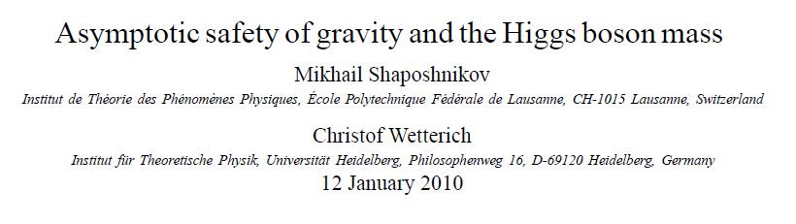
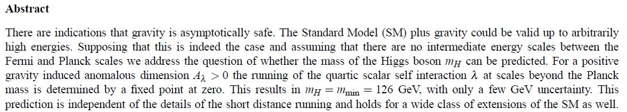
a prediction…

Slide 62

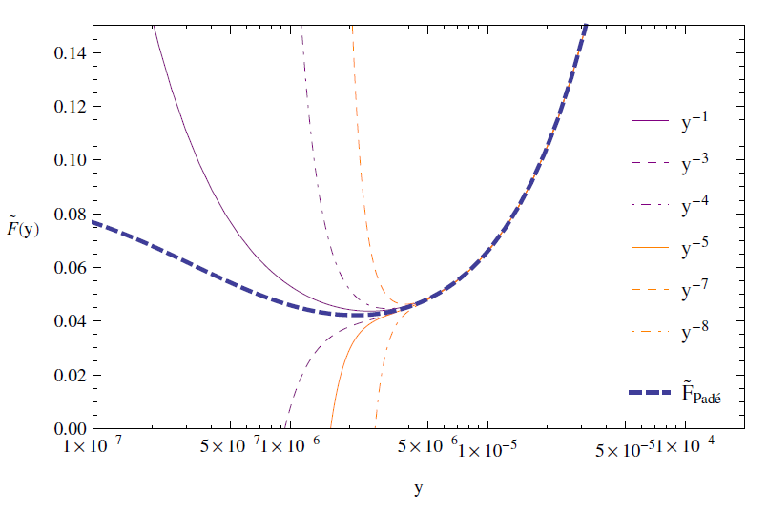



IR fixed point in quantum gravity
First positive indication from functional renormalization flow with truncation :
fixed point effective action :
large field
behavior of F

Slide 63
Possible consequences of crossover in quantum gravity
Realistic model for inflation and dark energy
with single scalar field

Slide 64
Cosmological solution : crossover from UV to IR fixed point
Dimensionless functions as B
depend only on ratio μ/χ .
IR: μ→0 , χ→∞
UV: μ→∞ , χ→0
Cosmology makes
crossover between
fixed points by
variation of χ .

Slide 65
renormalization flow and cosmological evolution
renormalization flow as function of µ
is mapped by dimensionless functions to
field dependence of effective action on scalar field χ
translates by solution of field equation to
dependence of cosmology an time t or η

Slide 66
Simplicity
simple description of all cosmological epochs
natural incorporation of Dark Energy :
inflation
Early Dark Energy
present Dark Energy dominated epoch

Slide 67
conclusions
Quantum gravity may be observable in
dynamics of present Universe
Fixed points and scale symmetry crucial
Big bang singularity is artefact
of inappropriate choice of field variables –
no physical singularity

Slide 68
conclusions (2)
crossover in quantum gravity is reflected in crossover in cosmology
quantum gravity becomes testable by cosmology
quantum gravity plays a role not only for primordial cosmology
crossover scenario explains different cosmological epochs
simple model is compatible with present observations
no more parameters than ΛCDM : tests possible

Slide 69
Growing neutrino masses and quintessence

Slide 70
Second stage of crossover
from SM to IR
in sector Beyond Standard Model
affects neutrino masses first ( seesaw or cascade mechanism )

Slide 71
Varying particle masses at onset of second crossover
All particle masses except for neutrinos are proportional to χ .
Ratios of particle masses remain constant.
Compatibility with observational bounds on time dependence of particle mass ratios.
Neutrino masses show stronger increase with χ , such that ratio neutrino mass over electron mass grows .

Slide 72
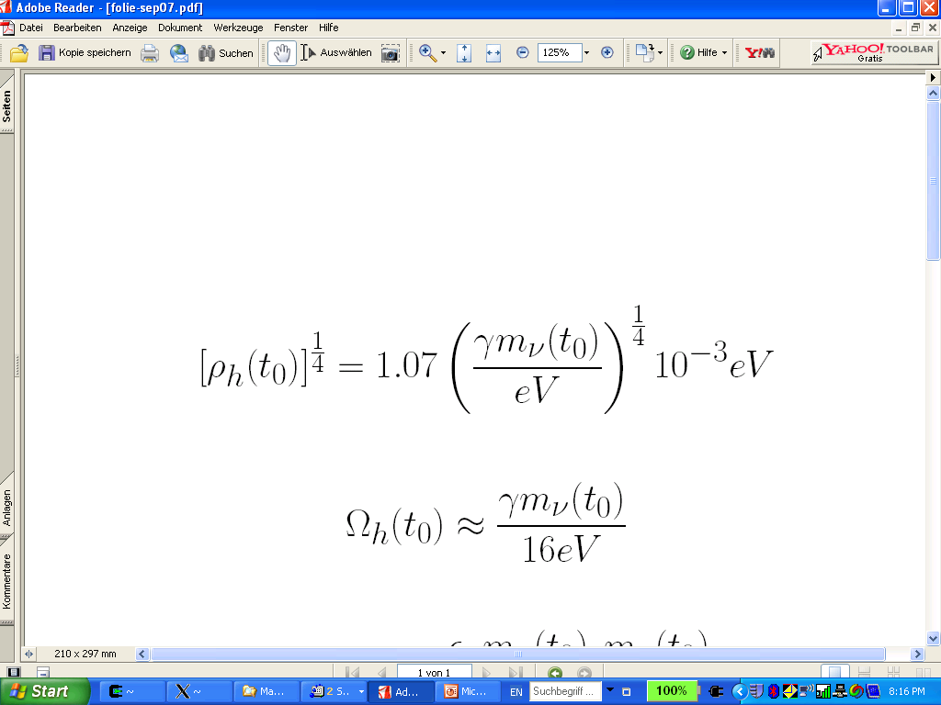
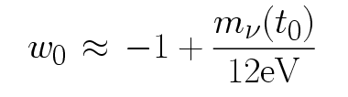
connection between dark energy and neutrino properties
L.Amendola,
M.Baldi, …
= 1.27
present dark energy density given by neutrino mass
present equation
of state given by
neutrino mass !
Notes:
72

Slide 73
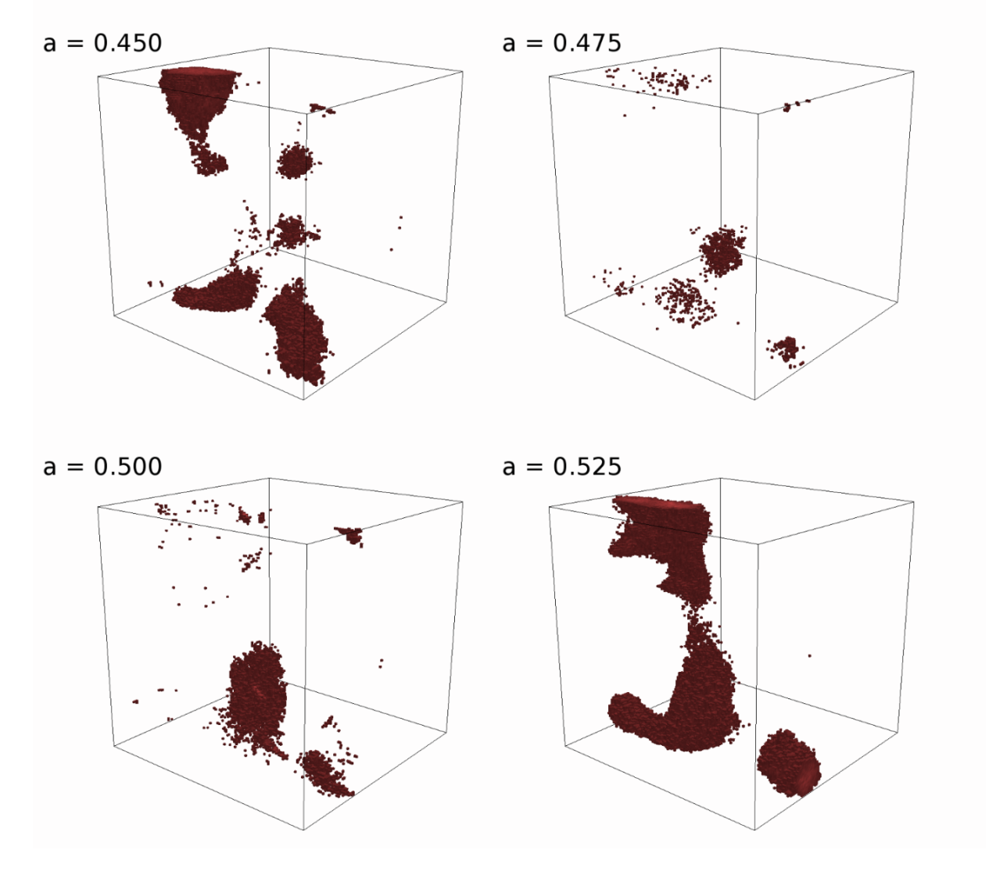
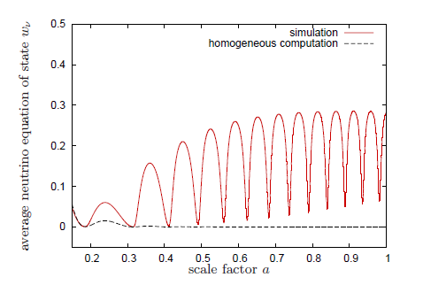
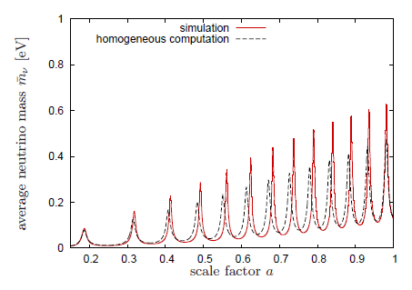
Oscillating neutrino lumps
Ayaita, Baldi, Fuehrer,
Puchwein,…
Y.Ayaita, M.Weber,…

Slide 74
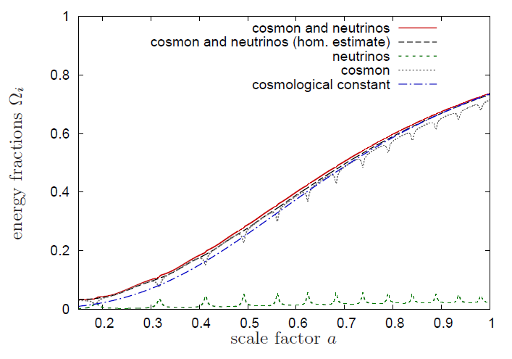
Evolution of dark energy similar to ΛCDM

Slide 75
Compatibility with observations and possible tests
Realistic inflation model
Almost same prediction for radiation, matter, and Dark Energy domination as ΛCDM
Presence of small fraction of Early Dark Energy
Large neutrino lumps

Slide 76
conclusions (3)
Variable gravity cosmologies can give a simple and realistic description of Universe
Compatible with tests of equivalence principle and bounds on variation of fundamental couplings if nucleon and electron masses are proportional to variable Planck mass
Cosmon dependence of ratio neutrino mass/ electron mass can explain why Universe makes a transition to Dark Energy domination now
characteristic signal : neutrino lumps

Slide 77
end

Slide 78
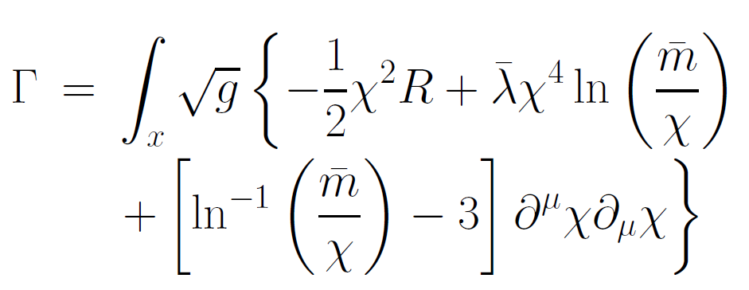
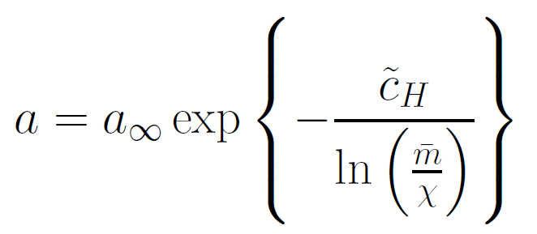
Primordial flat frame
Minkowski space in infinite past
absence of any singularity
geodesic completeness

Slide 79
First step of crossover ends inflation
induced by crossover in B
after crossover B changes only very slowly

Slide 80

Scaling solutions near SM fixed point
( approximation for constant B )
Different scaling solutions for
radiation domination and
matter domination

Slide 81
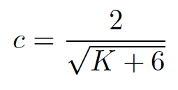


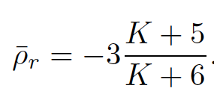
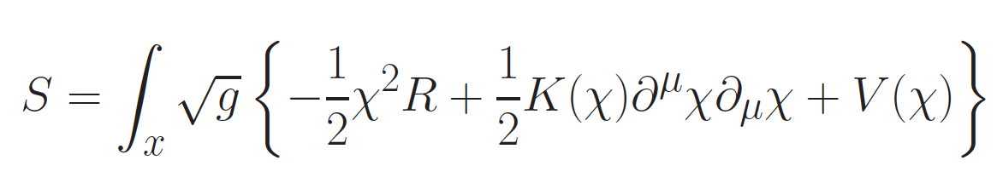
Radiation domination
Universe
shrinks !
K = B - 6
solution exists for B < 1 or K< -5

Slide 82
Varying particle masses near SM fixed point
All particle masses are proportional to χ .
( scale symmetry )
Ratios of particle masses remain constant.
Compatibility with observational bounds on time dependence of particle mass ratios.

Slide 83

Scaling of particle masses
mass of electron or nucleon is proportional
to variable Planck mass χ !
effective potential for Higgs doublet h

Slide 84

cosmon coupling to matter
q_{χ}=-(ρ-3p)/χ
F = χ²

Slide 85




Matter domination
Universe shrinks !
solution exists for
B < 4/3 ,
K = B - 6

Slide 86



Early Dark Energy
Energy density in radiation increases ,
proportional to cosmon potential
fraction in early dark energy
or m
observation requires B < 0.02 ( at CMB emission )

Slide 87





Dark Energy domination
neutrino masses scale
differently from electron mass
new scaling solution. not yet reached.
at present : transition period

Slide 88


Infrared fixed point
μ→ 0
B→ 0
no intrinsic mass scale
scale symmetry

Slide 89


Ultraviolet fixed point
μ→ ∞
kinetial diverges
scale symmetry with anomalous dimension σ

Slide 90




Renormalized field at UV fixed point
1 < σ
no mass
scale
deviation from
fixed point
vanishes for
μ→ ∞

