Slide 1
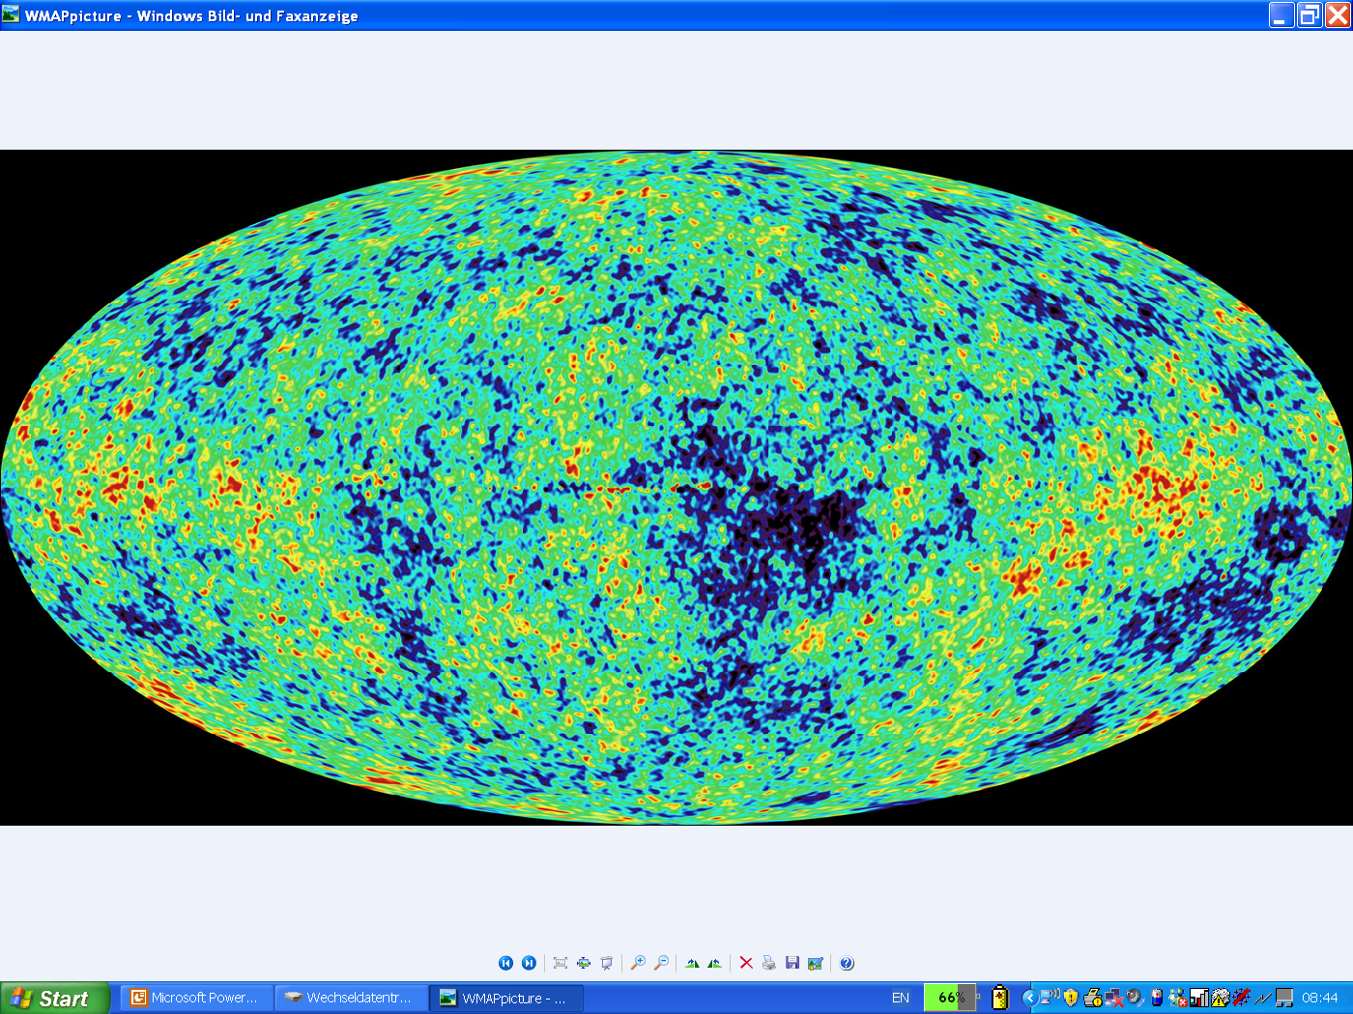
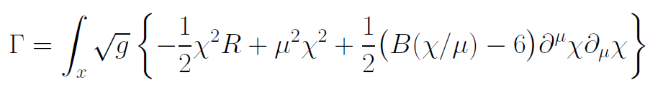
Graviton fluctuations erase the cosmological constant

Slide 2
In quantum gravity, the graviton fluctuations can play an important role on distances as large as the size of the Universe

Slide 3
Graviton propagator
effective action
Instability for V>0 : ”tachyonic mass term”

Slide 4
On shell graviton propagator
on shell :
( for solution of field equations )
homogenous isotropic metric,
conformal time
inverse graviton propagator in
de Sitter space
milder instability, not tachyonic, absent for
cosmologies close to de Sitter space

Slide 5
IR – instability for graviton fluctuations
problem solved ?
yes for primordial cosmic fluctuations ( on shell )
no for quantum gravity ( off shell )
Computation of effective action is an off-shell problem.
example : one needs the effective potential for the Higgs field in the vicinity of its minimum ( off shell ), not only at the minimum ( on shell )

Slide 6
Quantum gravity with scalar field
M² and V depend on scalar field
question : behavior of V for

Slide 7
Graviton barrier
Quantum gravity computation :
For
V cannot increase stronger than M² !
Instability of graviton propagator is avoided

Slide 8
Graviton barrier and solution of the cosmological constant problem
V cannot increase stronger than M² !
If M increases with 𝜒, and for cosmological solutions where 𝜒 asymptotically diverges for time going to infinity:
Effective cosmological constant vanishes in infinite future

Slide 9
Normalization of scalar field
If M increases monotonically with 𝜒 :
choose normalization of scalar
M= 𝜒

Slide 10
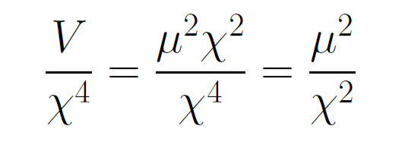
asymptotically vanishing cosmological „constant“
What matters : Ratio of potential divided by fourth power of Planck mass
vanishes for χ → ∞ !

Slide 11
Quintessence
Dynamical dark energy ,
generated by scalar field (cosmon )
C.Wetterich,Nucl.Phys.B302(1988)668, 24.9.87
P.J.E.Peebles,B.Ratra,ApJ.Lett.325(1988)L17, 20.10.87
Notes:
11

Slide 12
Prediction : homogeneous dark energy influences recent cosmology
- of same order as dark matter -
Original models do not fit the present observations
…. modifications
( different growth of neutrino mass )

Slide 13
Variable Gravity
Scalar field coupled to gravity
Effective Planck mass depends on scalar field
Simple quadratic scalar potential involves intrinsic mass μ
Nucleon and electron mass proportional to dynamical Planck mass

Slide 14
Einstein frame
“Weyl scaling” maps variable gravity model to Universe with fixed masses and standard expansion history.
Exact equivalence of different frames !
Standard gravity coupled to scalar field.

Slide 15
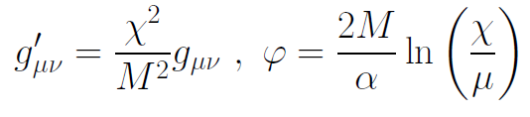
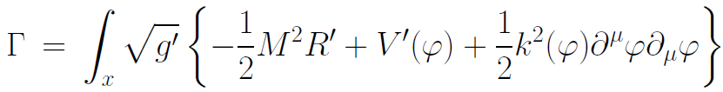
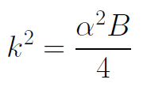

Einstein frame
Weyl scaling :
effective action in Einstein frame :

Slide 16
Quantum gravity computation by functional renormalization
Introduce infrared cutoff with scale k,
such that only fluctuations with
( covariant) momenta larger than k
are included.
Then lower k towards zero

Slide 17
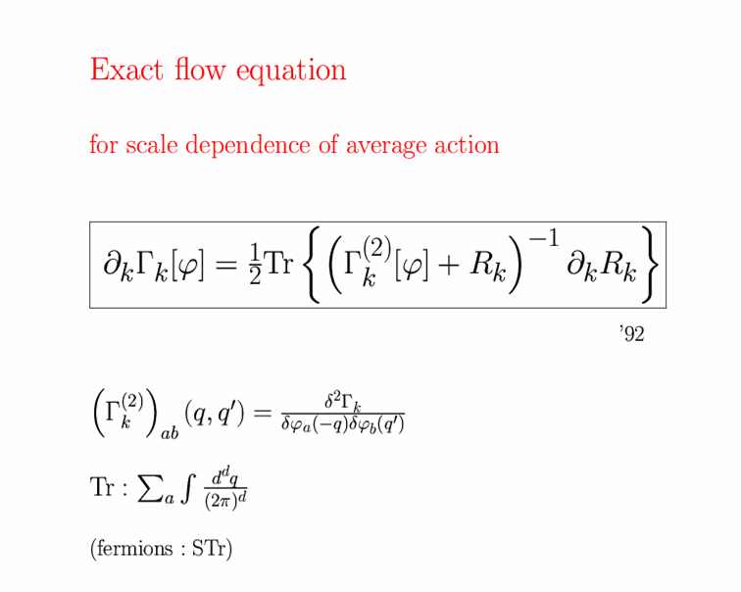
Exact renormalization group equation

Slide 18
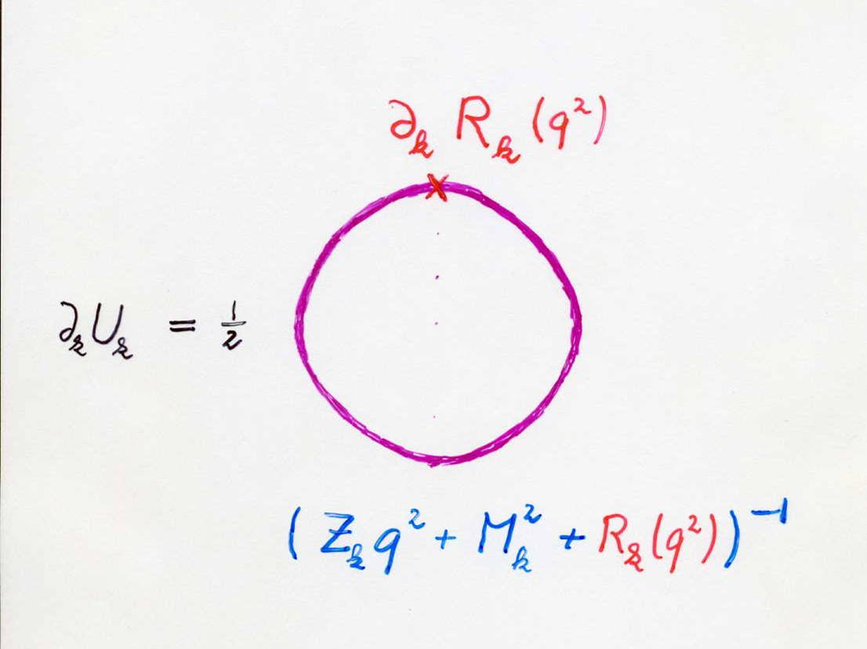
Functional flow equation for scale dependent effective action
IR cutoff
exact propagator

Slide 19
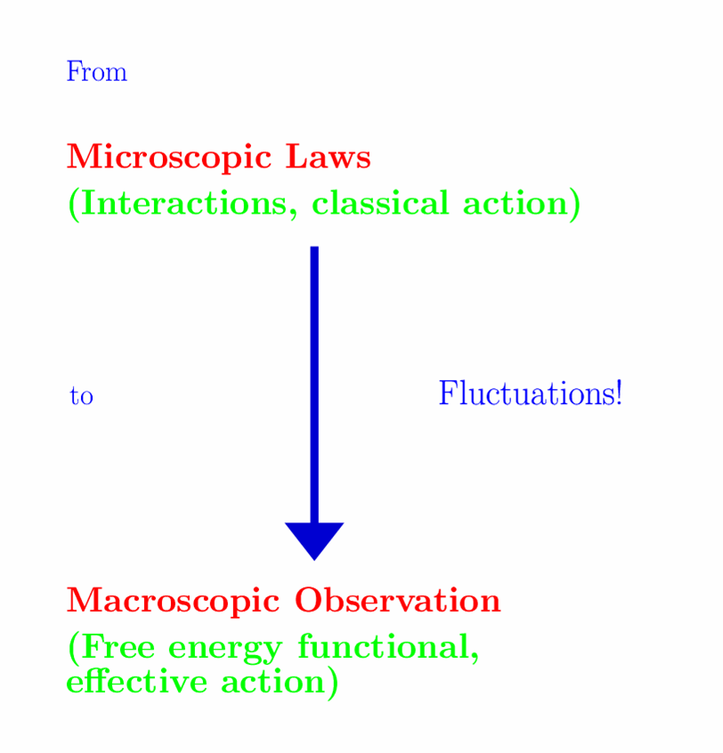


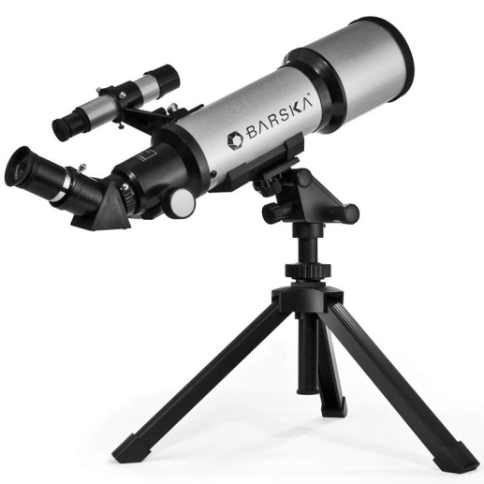

Slide 20
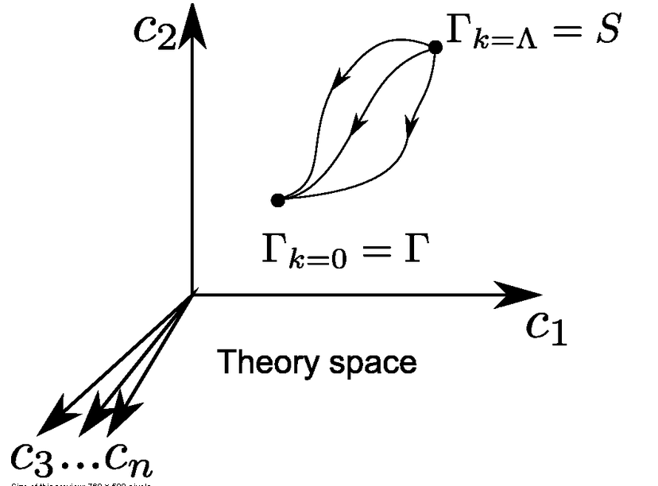
functional renormalization : flowing action
Wikipedia
Notes:
20

Slide 21
flowing action
microscopic law
macroscopic law
infinitely many couplings

Slide 22
flow of functions

Slide 23
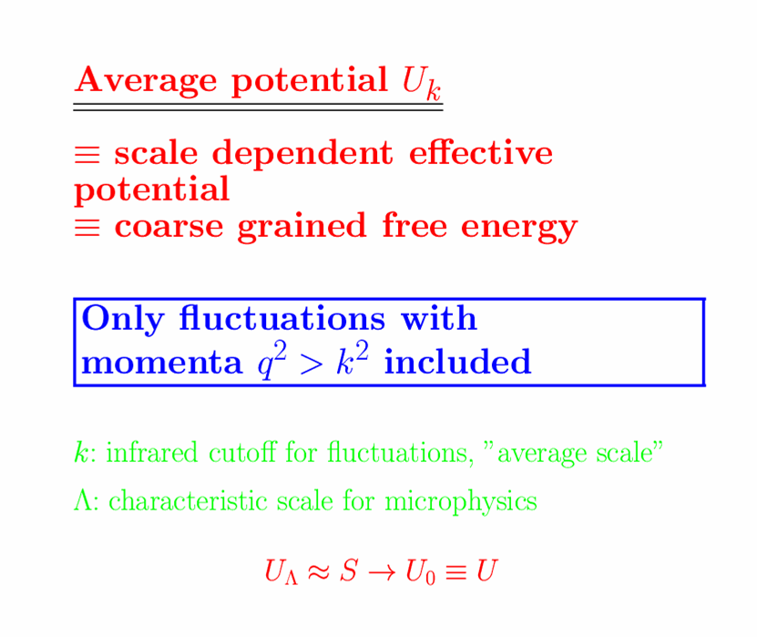
Effective potential includes all fluctuations

Slide 24
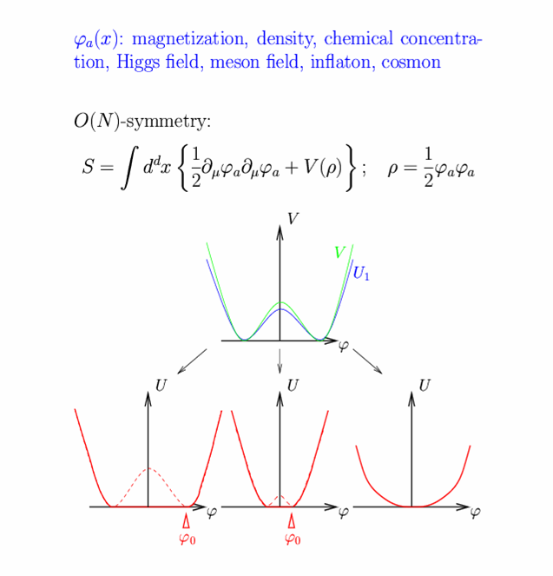
Scalar field theory

Slide 25
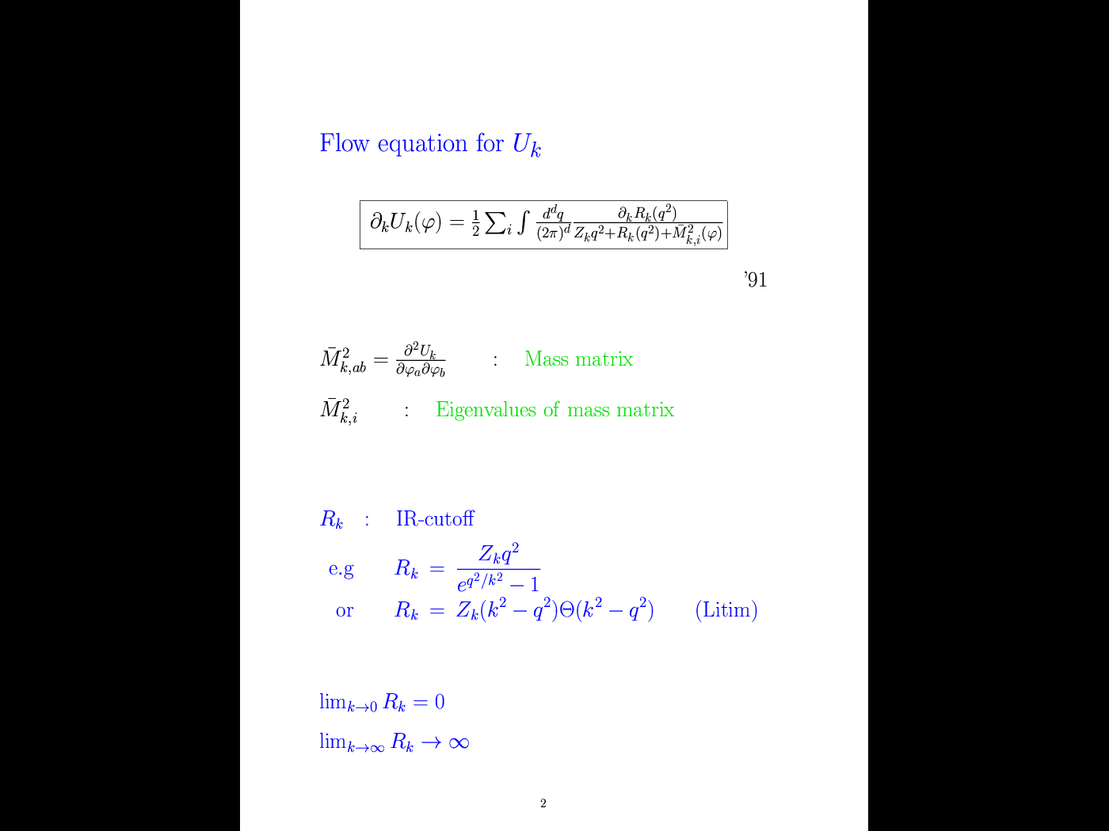
Flow equation for average potential
cutoff
propagator
with cutoff

Slide 26
Simple one loop structure –nevertheless (almost) exact
Well tested for non-perturbative phenomena:
critical exponents, Kosterlitz-Thouless phase transition, etc

Slide 27
Graviton contribution to flow of scalar potential
Litim cutoff:
crucial dimensionless quantity

Slide 28
Flow equation for v

Slide 29
Flow of v for different initial conditions

Slide 30
Infrared value of effective scalar potential for k/𝜒 → 0
v=1
graviton barrier !

Slide 31
Ultraviolet behavior for k/𝜒 → ∞
UV – and IR –
fixed points

Slide 32
Graviton contribution to flow of quartic scalar coupling : positive and substantial anomalous dimension

Slide 33
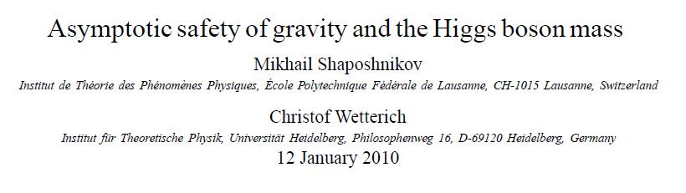
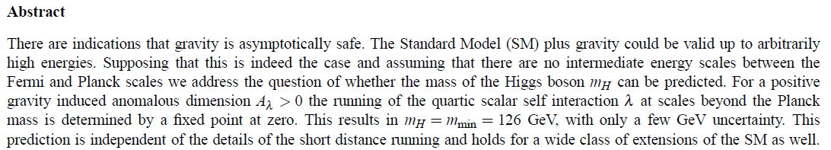
a prediction…

Slide 34
Asymptotic safety
if UV fixed point exists :
quantum gravity is
non-perturbatively renormalizable !
S. Weinberg , M. Reuter

Slide 35
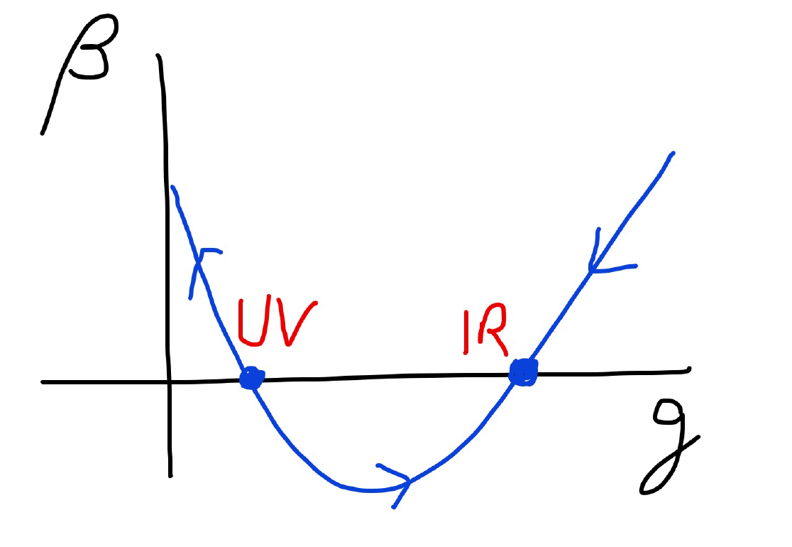
Asymptotic safety

Slide 36

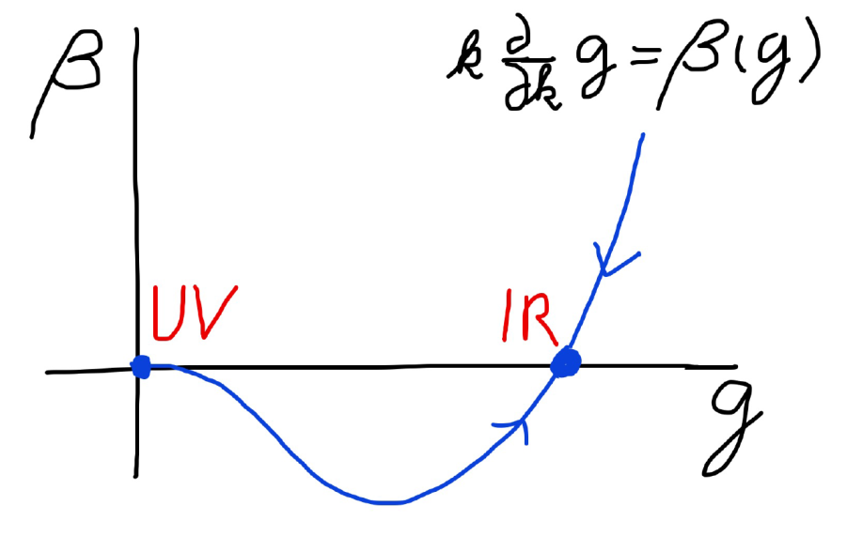
Asymptotic safety Asymptotic freedom
Relevant parameters yield undetermined couplings.
Quartic scalar coupling is not relevant and can therefore be predicted.

Slide 37
Quantum scale symmetry
quantum fluctuations violate scale symmetry
running dimensionless couplings
at fixed points , scale symmetry is exact !

Slide 38

Spontaneous breaking of scale symmetry
expectation value of scalar field breaks scale symmetry spontaneously
massive particles are compatible with scale symmetry
all mass scales proportional to scalar field$χ$ : electron mass, proton mass, Planck mass
in presence of massive particles : sign of exact scale symmetry is exactly massless Goldstone boson – the dilaton

Slide 39
Approximate scale symmetry near fixed points
UV : approximate scale invariance of primordial fluctuation spectrum from inflation
IR : cosmon is pseudo Goldstone boson of
spontaneously broken scale symmetry,
tiny mass,
responsible for dynamical Dark Energy

Slide 40
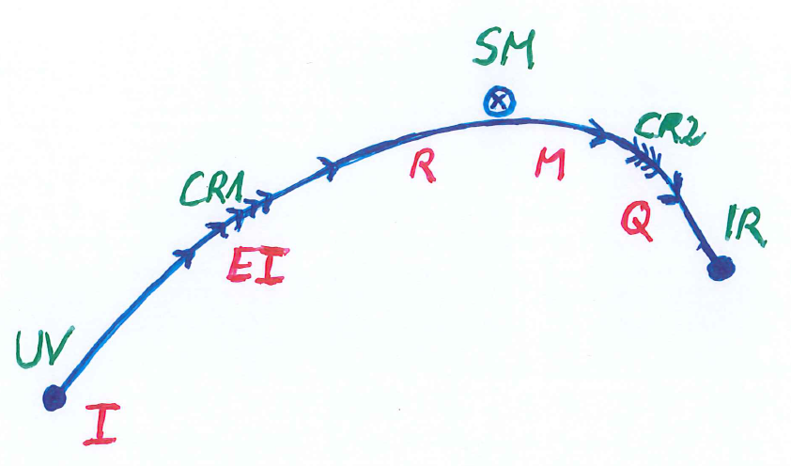

Crossover in quantum gravity

Slide 41
Possible consequences of crossover in quantum gravity
Realistic model for inflation and dark energy
with single scalar field

Slide 42
Variable Gravity
intrinsic scale 𝜇 replaces k
quantum effective action,
variation yields field equations,
solve for cosmology

Slide 43
Variable Gravity
Scalar field coupled to gravity
Effective Planck mass depends on scalar field
Simple quadratic scalar potential involves intrinsic mass μ
Nucleon and electron mass proportional to dynamical Planck mass

Slide 44
Cosmological solution : crossover from UV to IR fixed point
Dimensionless functions as B
depend only on ratio μ/χ .
IR: μ→0 , χ→∞
UV: μ→∞ , χ→0
Cosmology makes
crossover between
fixed points by
variation of χ .

Slide 45
renormalization flow and cosmological evolution
renormalization flow as function of µ
is mapped by dimensionless functions to
field dependence of effective action on scalar field χ
translates by solution of field equation to
dependence of cosmology on time t or η

Slide 46
Simplicity
simple description of all cosmological epochs
natural incorporation of Dark Energy :
inflation
Early Dark Energy
present Dark Energy dominated epoch

Slide 47
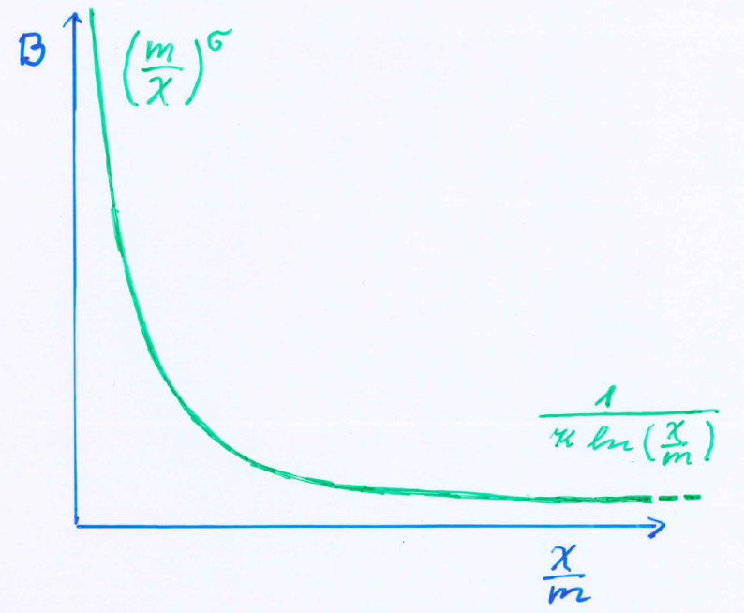
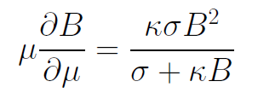
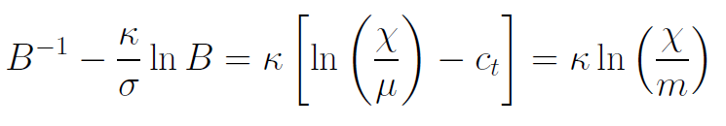
Kinetial B :
Crossover between two fixed points
Ansatz , not computed !
running
coupling obeys
flow equation
m : scale of crossover
can be exponentially larger than intrinsic scale μ

Slide 48
Cosmological solution
derive field equation from effective action of variable gravity
solve them for homogenous and isotropic metric and scalar field
scalar field χ vanishes in the infinite past
scalar field χ diverges in the infinite future

Slide 49
No tiny dimensionless parameters
( except matter sector, e.g. gauge hierarchy )
μ = 2 • 10 ⁻³³ eV
one mass scale
one time scale μ⁻¹ = 10 ¹⁰ yr
Planck mass does not appear as parameter
Planck mass grows large dynamically

Slide 50
Particle masses change with time
At SM fixed point :
All particle masses ( except for neutrinos ) are proportional to scalar field χ .
Scalar field varies with time – so do particle masses.
Ratios of particle masses are independent of χ and therefore remain constant.
Compatibility with observational bounds on time dependence of particle mass ratios.
Dimensionless couplings are independent of χ .

Slide 51
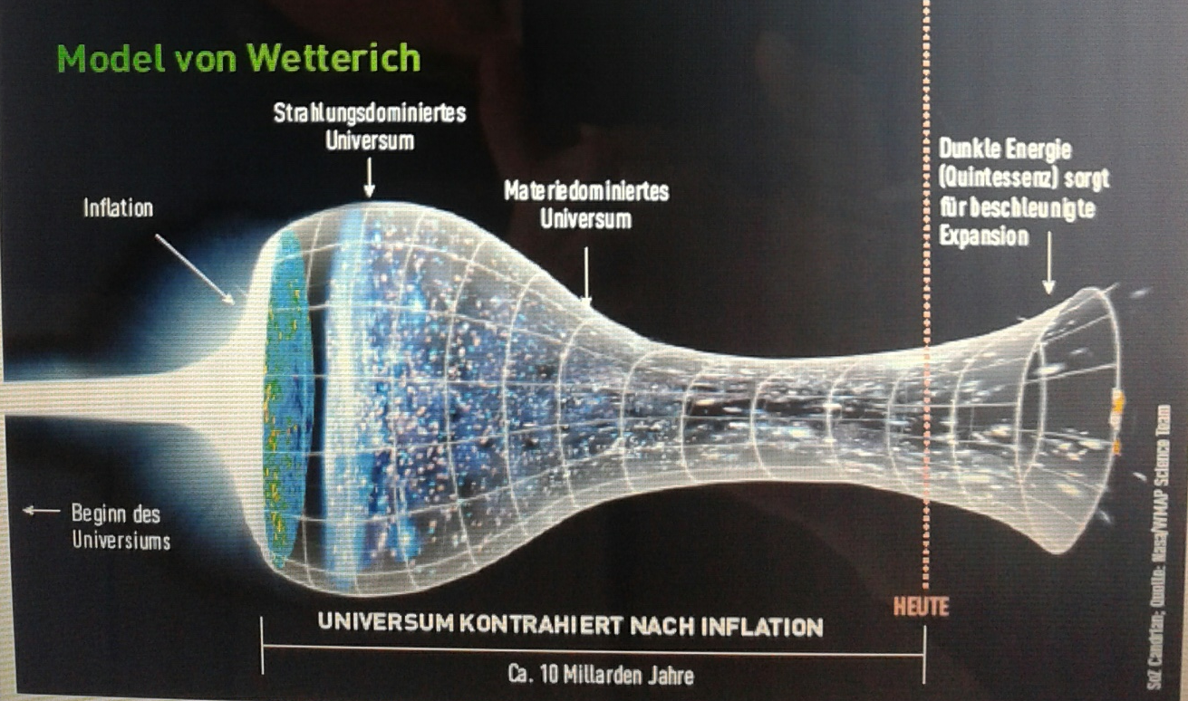
Strange evolution of Universe
Sonntagszeitung Zürich , Laukenmann

Slide 52
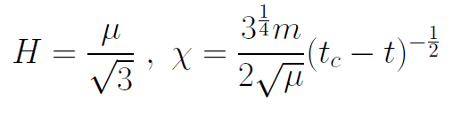
Slow Universe
Asymptotic solution :
Expansion or shrinking always slow ,
characteristic time scale of the order of the age of the
Universe : t_{ch} ~ μ⁻¹ ~ 10 billion years !
Hubble parameter of the order of present Hubble
parameter for all times , including inflation and big bang !
Slow increase of particle masses !
μ= 2 • 10⁻³³ eV

Slide 53
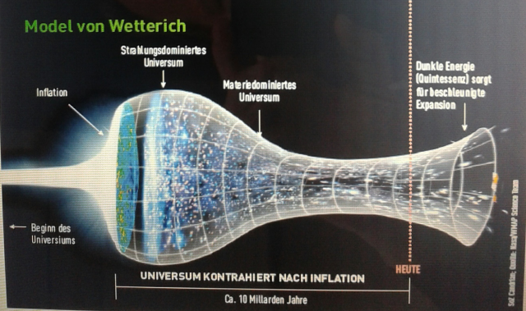
Eternal Universe
Asymptotic solution in
freeze frame :
solution valid back to the infinite past in physical time
no singularity
physical time to infinite past is infinite

Slide 54
small dimensionless number ?
needs two intrinsic mass scales
V and M ( cosmological constant and Planck mass )
variable Planck mass moving to infinity , with fixed V: ratio vanishes asymptotically !

Slide 55
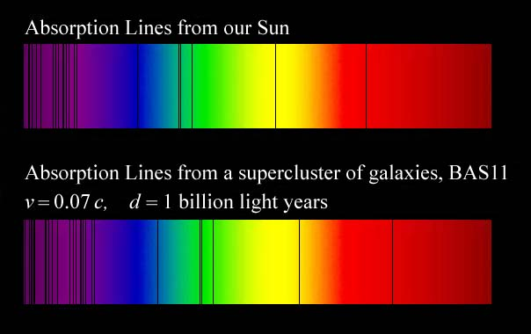
Do we know that the
Universe expands ?
instead of redshift due to expansion :
smaller frequencies have been emitted in the past, because electron mass was smaller !

Slide 56
What is increasing ?
Ratio of distance between galaxies
over size of atoms !
atom size constant : expanding geometry
alternative : shrinking size of atoms

Slide 57
Hot plasma ?
Temperature in radiation dominated Universe : T ~ χ ^{½} smaller than today
Ratio temperature / particle mass : T /m_{p} ~ χ ^{-½} larger than today
T/m_{p} counts ! This ratio decreases with time.
Nucleosynthesis , CMB emission as in standard cosmology !

Slide 58
Model is compatible with present observations
Together with variation of neutrino mass over electron mass in present cosmological epoch :
model is compatible with all present observations

Slide 59
Einstein frame
“Weyl scaling” maps variable gravity model to Universe with fixed masses and standard expansion history.
Exact equivalence of different frames !
Standard gravity coupled to scalar field.
Only neutrino masses are growing.

Slide 60
Einstein frame
Weyl scaling :
effective action in Einstein frame :

Slide 61
Field relativity : different pictures of cosmology
same physical content can be described by different pictures
related by field – redefinitions , e.g. Weyl scaling , conformal scaling of metric
which picture is usefull ?

Slide 62
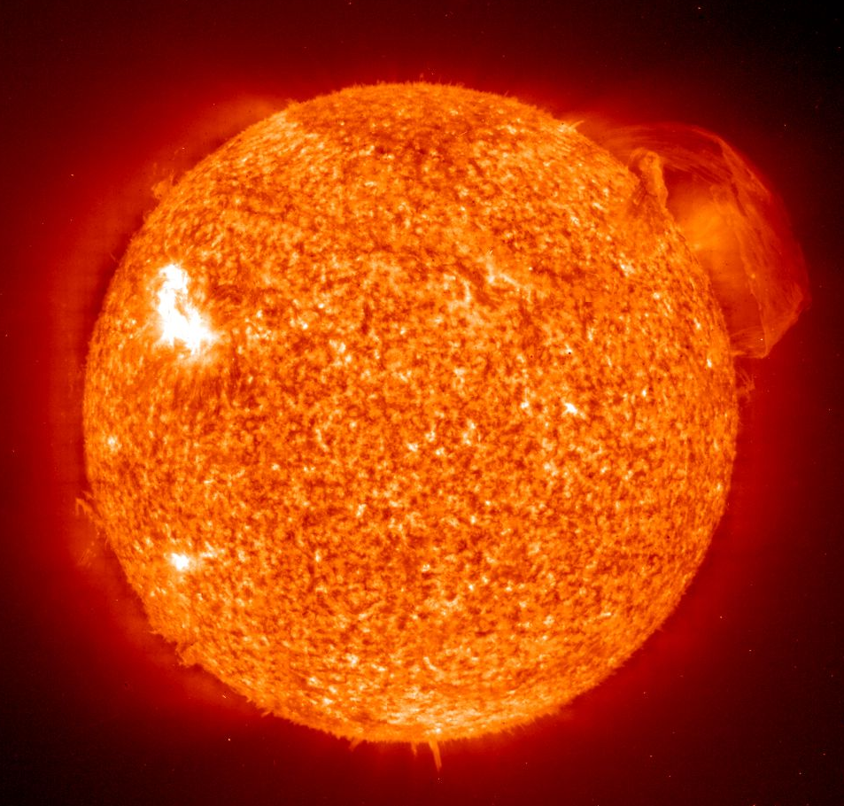
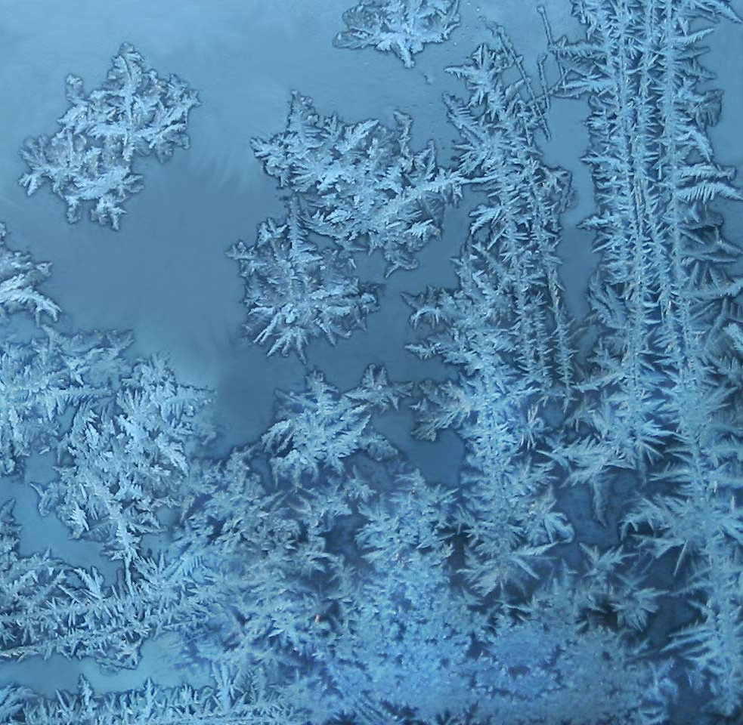
Big bang or freeze ?

Slide 63
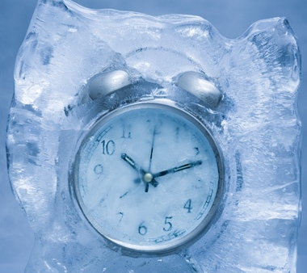
Big bang or freeze ?

Slide 64
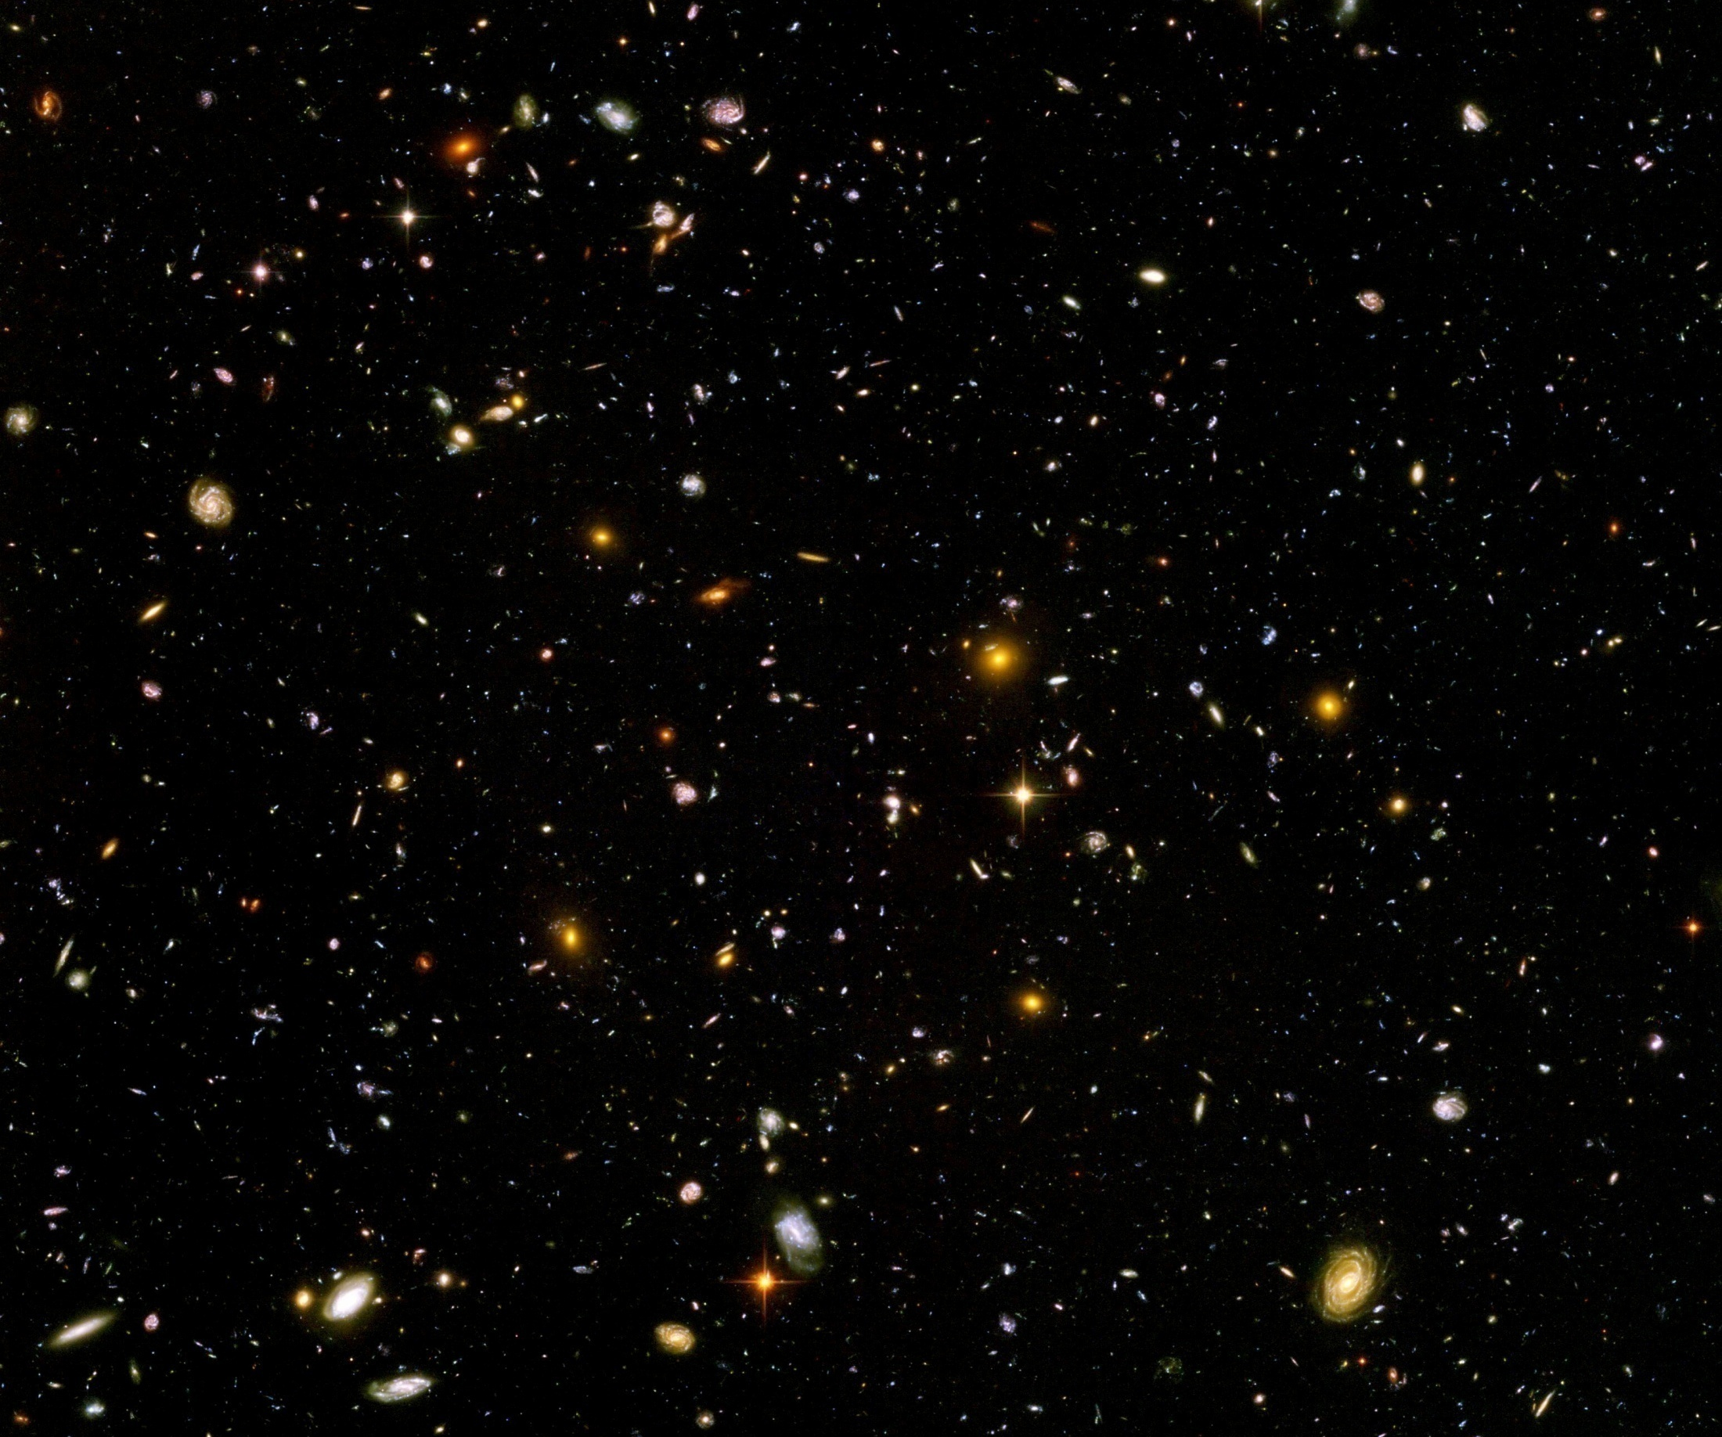
Big bang or freeze ?
just two ways of looking at same physics

Slide 65
Conclusions
Graviton fluctuations play a role at large distances
Graviton barrier for increase of scalar potential entails solution of cosmological constant problem
Cosmology is described by crossover from UV-fixed point (inflation) to IR-fixed point (dynamical dark energy)

Slide 66
end

Slide 67
Four-parameter model
model has four dimensionless parameters
three in kinetial B :
σ ~ 2.5
κ ~ 0.5
c_{t} ~ 14 ( or m/μ )
one parameter for present growth rate of neutrino mass over electron mass : γ ~ 8
+ standard model particles and dark matter : sufficient for realistic cosmology from inflation to dark energy
no more free parameters than ΛCDM

Slide 68

Origin of mass
UV fixed point : scale symmetry unbroken
all particles are massless
IR fixed point :
scale symmetry spontaneously broken,
massive particles , massless dilaton
crossover : explicit mass scale μ important
approximate SM fixed point : approximate scale symmetry spontaneously broken, massive particles , almost massless cosmon, tiny cosmon potential

Slide 69
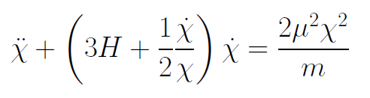
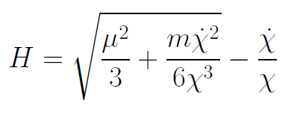
Infinite past : slow inflation
σ = 2 : field equations
approximate
solution

Slide 70
Eternal Universe
Asymptotic solution in
freeze frame :
solution valid back to the infinite past in physical time
no singularity
physical time to infinite past is infinite

Slide 71
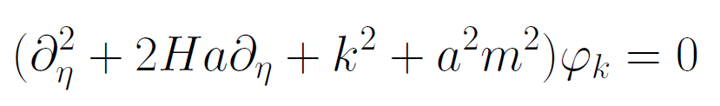
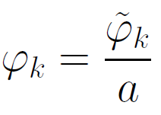
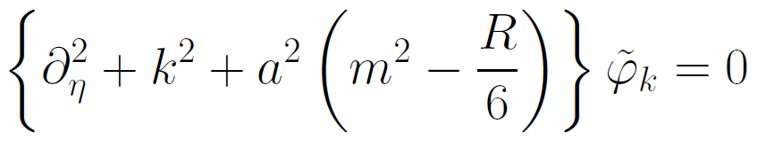
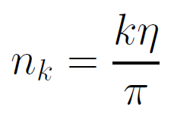

Physical time
field equation for scalar field mode
determine physical
time by counting
number of oscillations
( m=0 )

Slide 72
Big bang singularity in Einstein frame is field singularity !
choice of frame with constant particle
masses is not well suited if
physical masses go to zero !

Slide 73
conclusions (2)
Fixed points and scale symmetry crucial
Big bang singularity is artefact
of inappropriate choice of field variables –
no physical singularity

Slide 74
conclusions (3)
crossover in quantum gravity is reflected in crossover in cosmology
quantum gravity becomes testable by cosmology
quantum gravity plays a role not only for primordial cosmology
crossover scenario explains different cosmological epochs
simple model is compatible with present observations
no more parameters than ΛCDM : tests possible

Slide 75
Second stage of crossover
from SM to IR
in sector Beyond Standard Model
affects neutrino masses first ( seesaw or cascade mechanism )

Slide 76
Varying particle masses at onset of second crossover
All particle masses except for neutrinos are proportional to χ .
Ratios of particle masses remain constant.
Compatibility with observational bounds on time dependence of particle mass ratios.
Neutrino masses show stronger increase with χ , such that ratio neutrino mass over electron mass grows .

Slide 77
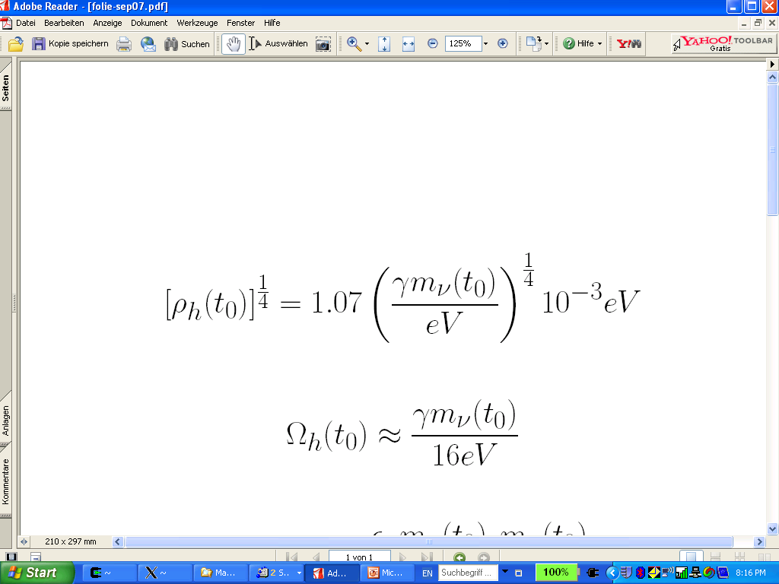
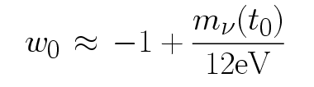
connection between dark energy and neutrino properties
L.Amendola,
M.Baldi, …
= 1.27
present dark energy density given by neutrino mass
present equation
of state given by
neutrino mass !
Notes:
77

Slide 78
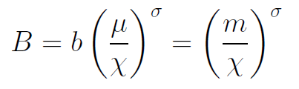
Inflation
solution for small χ : inflationary epoch
kinetial characterized by
anomalous dimension σ

Slide 79

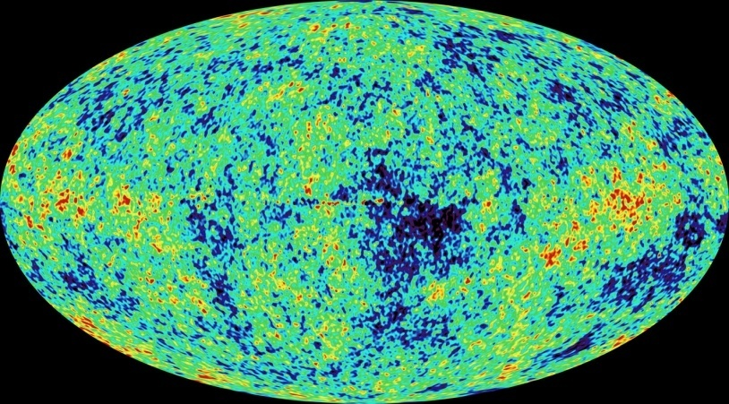
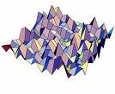
Primordial fluctuations
inflaton field : χ
primordial fluctuations of inflaton become observable in cosmic microwave background
Notes:
79

Slide 80


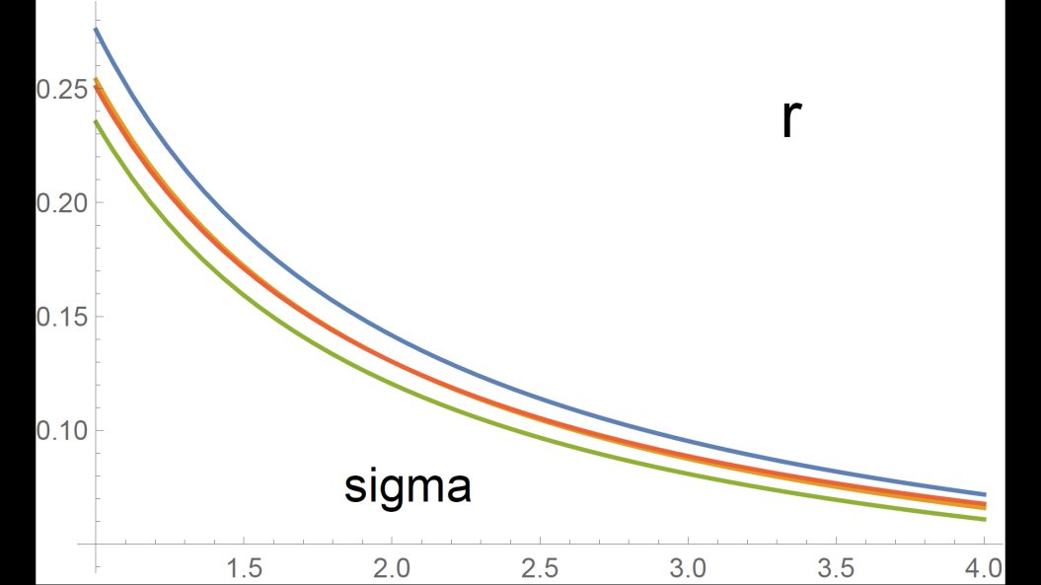
Anomalous dimension determines spectrum of primordial fluctuations
spectral index n
tensor amplitude r

Slide 81
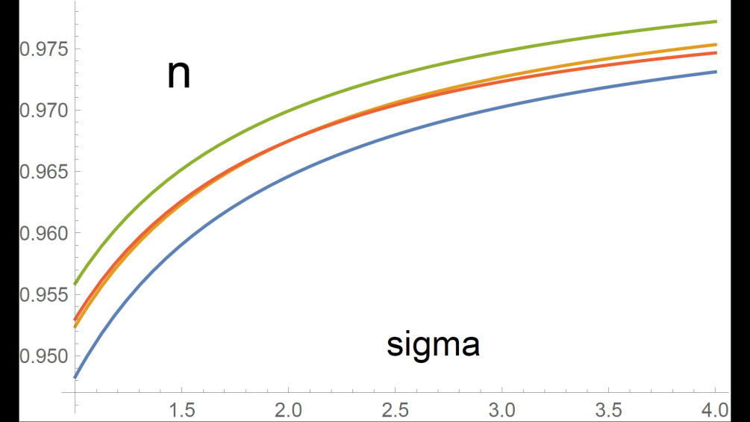
relation between n and r
r = 8.19 ( 1 – n ) - 0.1365

Slide 82
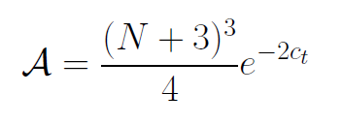

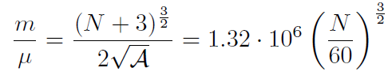
Amplitude of density fluctuations
small because of logarithmic running
near UV fixed point !
σ=1
N : number of e – foldings at horizon crossing

Slide 83
First step of crossover ends inflation
induced by crossover in B
after crossover B changes only very slowly

Slide 84
Scaling solution
Heating of the Universe after inflation
Scaling solution with almost fixed fraction of Early Dark Energy

Slide 85
Compatibility with observations and possible tests
Realistic inflation model
Almost same prediction for radiation, matter, and Dark Energy domination as ΛCDM
Presence of small fraction of Early Dark Energy
Large neutrino lumps

Slide 86
conclusions (4)
Variable gravity cosmologies can give a simple and realistic description of the Universe
Compatible with tests of equivalence principle and bounds on variation of fundamental couplings if nucleon and electron masses are proportional to variable Planck mass
Cosmon dependence of ratio neutrino mass/ electron mass can explain why Universe makes a transition to Dark Energy domination now
characteristic signal : neutrino lumps

Slide 87


Infrared fixed point
μ→ 0
B→ 0
no intrinsic mass scale
scale symmetry

Slide 88


Ultraviolet fixed point
μ→ ∞
kinetial diverges
scale symmetry with anomalous dimension σ

Slide 89
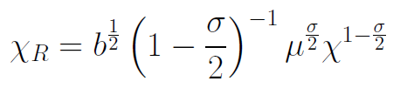
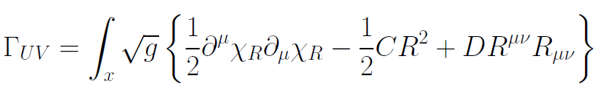
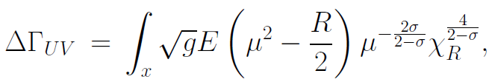
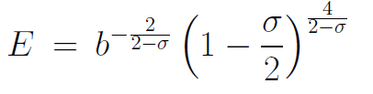
Renormalized field at UV fixed point
1 < σ
no mass
scale
deviation from
fixed point
vanishes for
μ→ ∞

