Slide 1
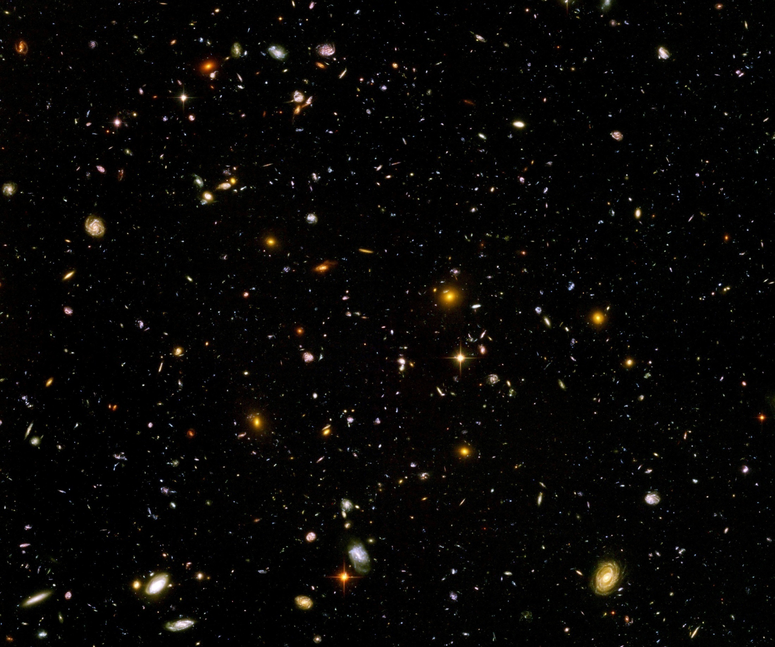
Scalar force in cosmology

Slide 2
“Fundamental” Interactions
Strong, electromagnetic, weak
interactions
On astronomical
length scales:
graviton
+
cosmon
gravitation
cosmodynamics

Slide 3
(A) Fifth force

Slide 4
Scalar tensor theories
Dirac’s hypothesis
Weyl scaling
Brans-Dicke theory
additional interaction :

Slide 5
Fifth force
coupling strength
range
m ∼ H : long range ( dynamical dark energy)
m ≫ H : short range ( dark matter )
concentrate on long range – effectively massless scalar for earth, solar system, galaxies, black holes, laboratory

Slide 6
Models with massless scalar fields
Higher dimensions : strings, Kaluza-Klein theories ( moduli )
Modified gravity ( Brans-Dicke theory, f(R)-theories, ….
if scalar plays a role for late cosmology : “ cosmon “

Slide 7
Standard model with non-renormalizable operators
𝜑 - dependent masses
𝜑 - dependent
gauge couplings
Tests of GR :
Tests of
equivalence principle:

Slide 8
Scalar force ( fifth force)
i
j
attractive:
repulsive:

Slide 9
“Fifth Force”
Mediated by scalar field
Coupling strength: weaker than gravity
( non-renormalizable interactions ~ M⁻² )
Composition dependence
violation of equivalence principle
Quintessence: connected to time variation of
fundamental couplings
R.Peccei,J.Sola,C.Wetterich,Phys.Lett.B195,183(1987)
C.Wetterich , Nucl.Phys.B302,645(1988)

Slide 10
Violation of equivalence principle
Different couplings of cosmon to proton and neutron
Differential acceleration
“Violation of equivalence principle”
p,n
earth
cosmon
p,n
only apparent : new “fifth force” !

Slide 11
Differential acceleration
Two bodies with equal mass experience
a different acceleration !
η = ( a₁ – a₂ ) / ( a₁ + a₂ )
bound : η < 3 10⁻¹⁴

Slide 12
Fundamental “constants” are not constant

Slide 13
Have coupling constants in the
early Universe
other values than today ?
Yes !

Slide 14
Fundamental couplings in quantum field theory
Masses and coupling constants
are determined by properties
of vacuum !
Similar to Maxwell – equations in matter

Slide 15
Standard model of particle physics :
Electroweak gauge symmetry is spontaneously broken by expectation value of Higgs scalar
Quark and lepton masses proportional to value of Higgs scalar

Slide 16
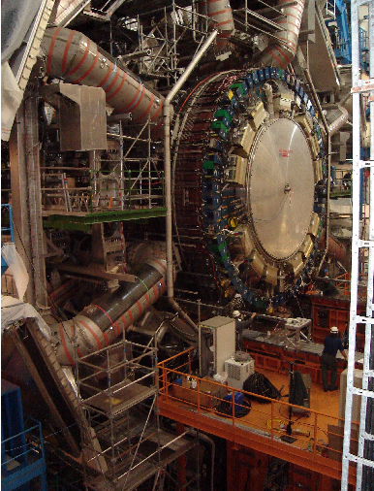
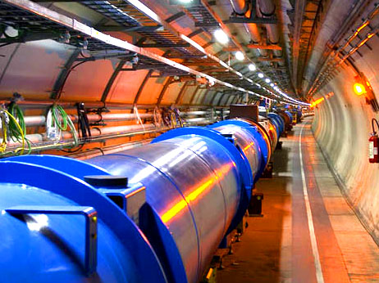
Spontaneous symmetry breaking confirmed at the LHC

Slide 17
Cosmology :
Universe is not in one fixed state
Dynamical evolution
Laws are expected to depend on time

Slide 18
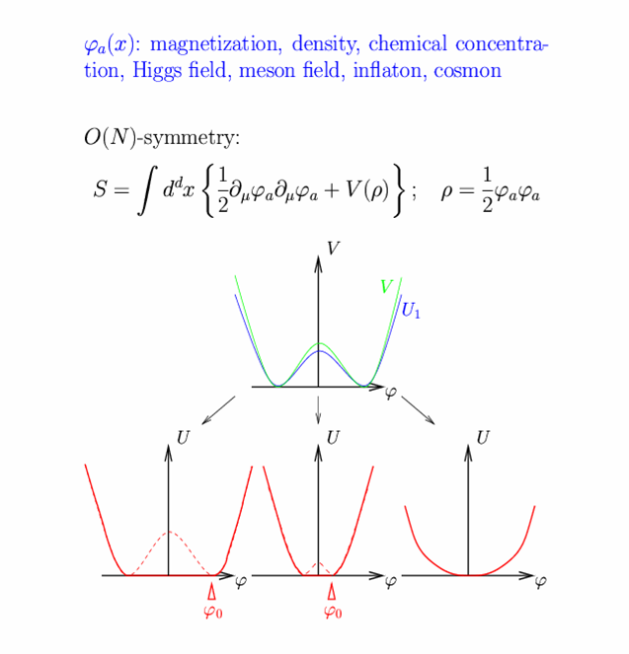
Restoration of symmetry at high temperature in the early Universe
high T :
Less order
More symmetry
Example:
Magnets
Low T
SSB
<φ>=φ₀ ≠ 0
High T
SYM
<φ>=0

Slide 19
In hot plasma of early Universe : masses of electron und muon not different! similar strength of electromagnetic and weak interaction

Slide 20
Varying couplings
only question :
How strong is present variation of couplings ?

Slide 21
Can variation of fundamental “constants” be observed ?
Fine structure constant α (electric charge)
Ratio electron mass to proton mass
Ratio nucleon mass to Planck mass

Slide 22
Time evolution of couplings and scalar fields
Fine structure constant depends on value of
scalar field : α(φ)
Time evolution of φ
Time evolution of α
Jordan,…

Slide 23
Static scalar fields
In Standard Model of particle physics :
Higgs scalar has settled to its present value around 10⁻¹² seconds after big bang.
Chiral condensate of QCD has settled at present value after quark-hadron phase transition around 10⁻⁶ seconds after big bang .
No scalar with mass below pion mass.
No substantial change of couplings after QCD phase transition.
Coupling constants are frozen.

Slide 24
Observation of time- or space- variation of couplings
Physics beyond Standard Model

Slide 25
Particle mass ratios and dimensionless couplings in quintessence cosmology
can depend on value of cosmon field
similar to dependence on value of Higgs field

Slide 26
Bounds on time varying couplings from nucleosynthesis

Slide 27
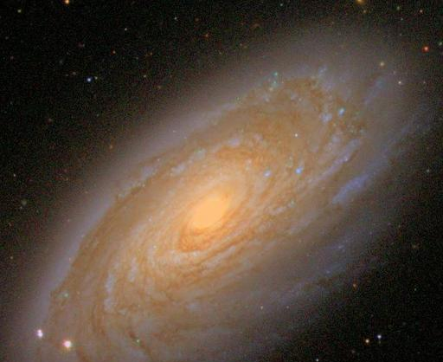
baryons :
the matter of stars and humans
Ω_{b} = 0.045

Slide 28
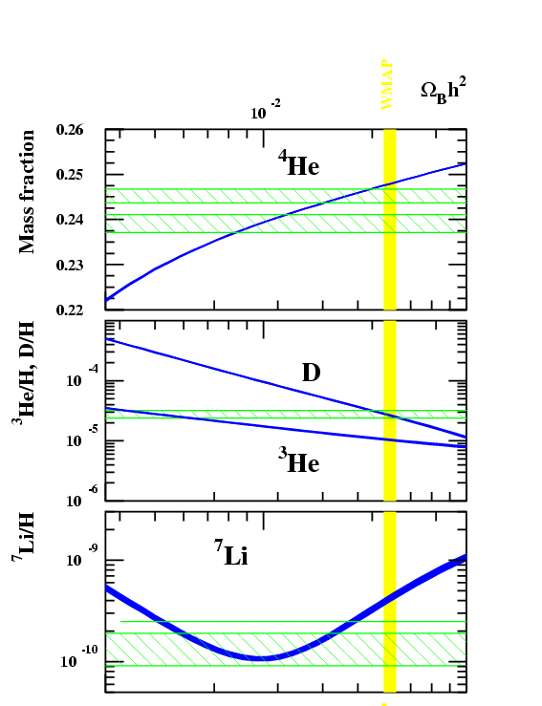
Abundancies of
primordial
light elements
from
nucleosynthesis
A.Coc

Slide 29
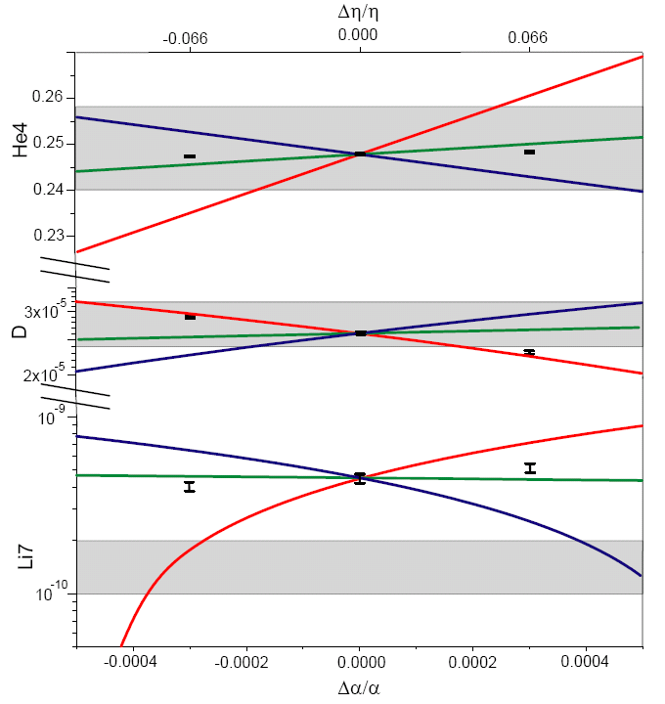
primordial abundances for three GUT models
present observations : 1σ
He
D
Li
T.Dent,
S.Stern,…

Slide 30
three GUT models
unification scale ~ Planck scale
1) All particle physics scales ~Λ_{QCD}
2) Fermi scale and fermion masses ~ unification scale
3) Fermi scale varies more rapidly than Λ_{QCD}
Δα/α ≈ 4 10⁻⁴ allowed for GUT 2 and 3 , larger for GUT 1
Δln(M_{n}/M_{P}) ≈40 Δα/α ≈ 0.015 allowed

Slide 31
Time variation of coupling constants
must be tiny –
would be of very high significance !
Possible signal for Quintessence

Slide 32
Apparent violation of equivalence principle
and
time variation of fundamental couplings
measure both the
cosmon – coupling to ordinary matter

Slide 33
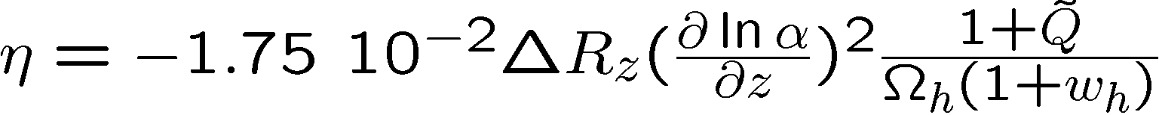
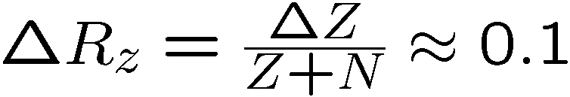
Differential acceleration η
For unified theories ( GUT ) :
η=Δa/2a
Q : time dependence of other parameters

Slide 34
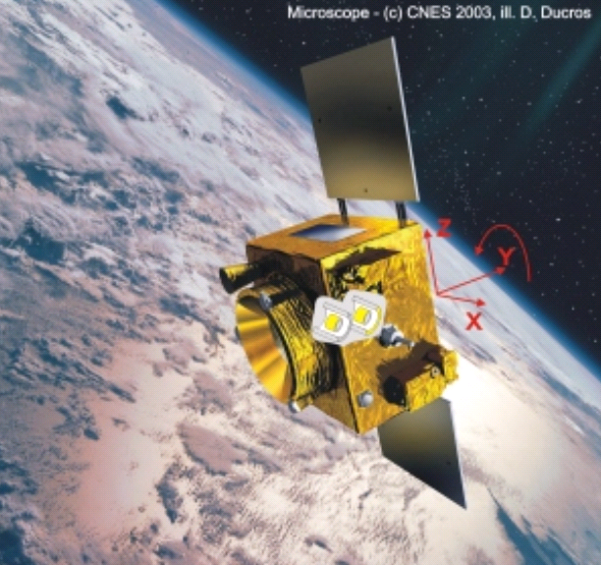
Link between time variation of α
and violation of equivalence principle
typically : η = 10⁻¹⁴
^{if time variation of α}
^{near Oklo upper bound}
^{to be tested ( MICROSCOPE , …)}

Slide 35
Cosmon coupling to atoms
Tiny !!!
Substantially weaker than gravity.
Non-universal couplings bounded by tests
of equivalence principle.
Universal coupling bounded by tests of Brans-Dicke parameter ω in solar system.
Only very small influence on cosmology.
( All this assumes validity of linear approximation )

Slide 36
Key questions (1)
Why is atom – scalar coupling much weaker than gravity?
Why is scalar (almost) massless despite the presence of quantum fluctuations ?

Slide 37
(B) Spontaneously broken scale symmetry

Slide 38
scale symmetry
No intrinsic length or mass scale present

Slide 39
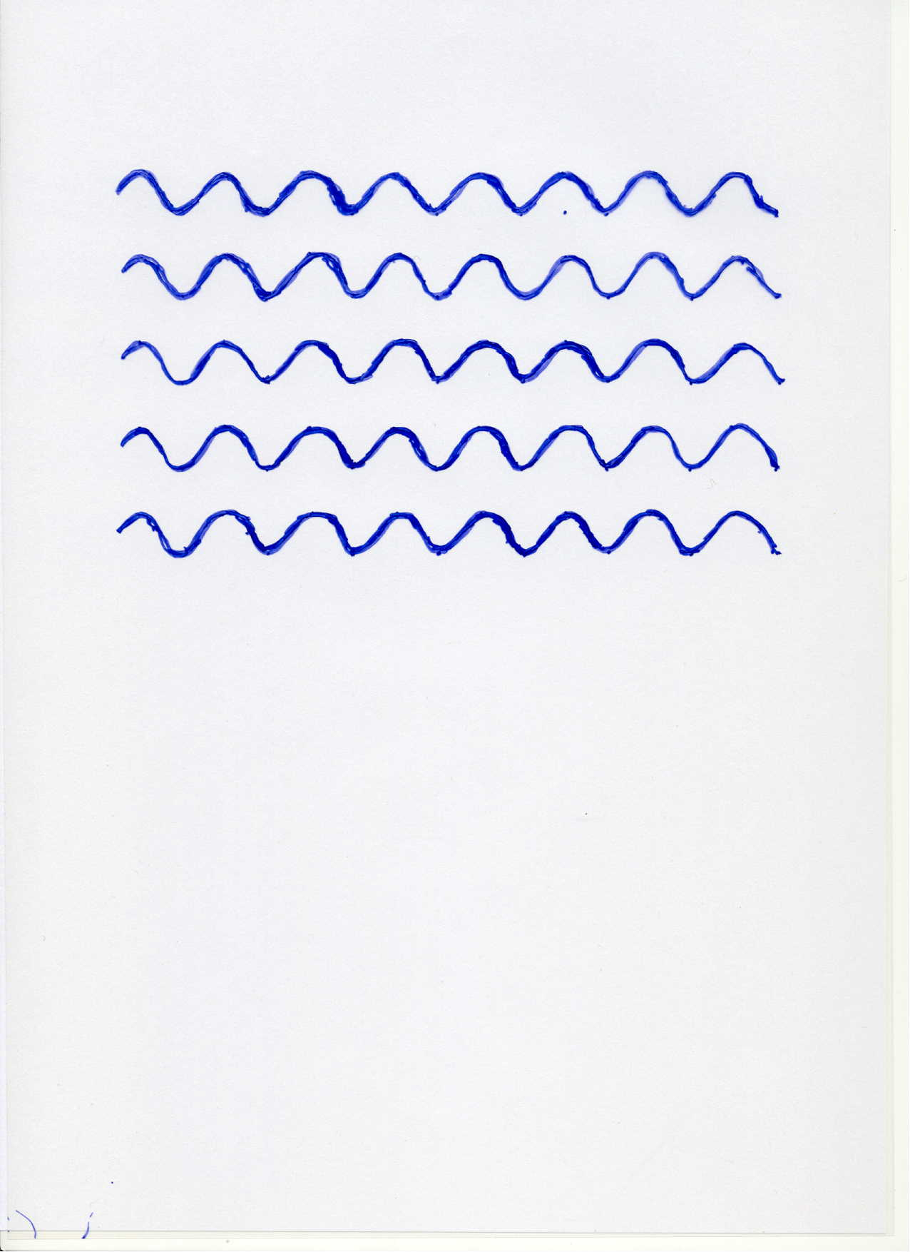


Scale symmetry
no scale symmetry
scale symmetry

Slide 40
Scale symmetry
All parameters with mass are
proportional to scalar field χ
Dimensionless couplings are independent of χ.
All particle masses are proportional to χ .
Ratios of particle masses remain constant.
Compatibility with observational bounds on time dependence of particle mass ratios.

Slide 41
Scale symmetry
All parameters with mass are
proportional to scalar field χ
gravity:
Higgs vev,
electron mass
QCD,
proton mass
Fujii, Zee

Slide 42
Spontaneous breaking of scale symmetry
expectation value of scalar field breaks scale symmetry spontaneously
massive particles are compatible with scale symmetry
in presence of massive particles : sign of exact scale symmetry is exactly massless Goldstone boson – the dilaton

Slide 43
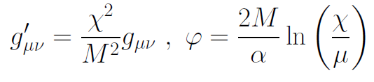
Einstein frame
Weyl scaling :
scale
transformation :

Slide 44
Key questions (1)
Why is atom – scalar coupling much weaker than gravity?
Why is scalar (almost) massless despite the presence of quantum fluctuations ?
answer
Scale symmetry explains both massless
scalar field and vanishing couplings

Slide 45
Key question (2)
Why does scale symmetry play a role even though it is violated by quantum fluctuations ?

Slide 46
quantum gravity with scalar field – the role of scale symmetry

Slide 47
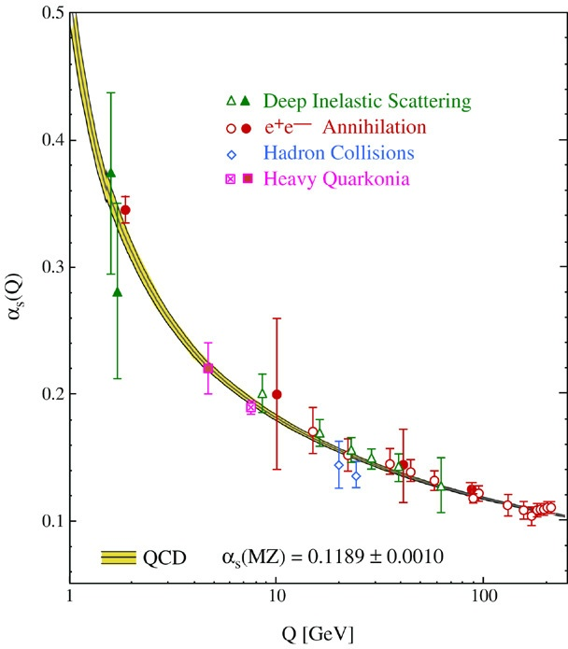
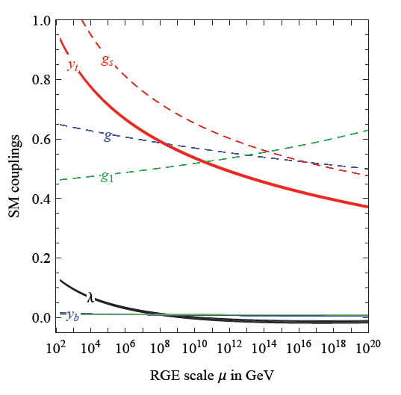
fluctuations induce running couplings
violation of scale symmetry
well known in QCD or standard model

Slide 48
Quantum scale symmetry
quantum fluctuations violate scale symmetry
running dimensionless couplings
at fixed points , scale symmetry is exact !

Slide 49
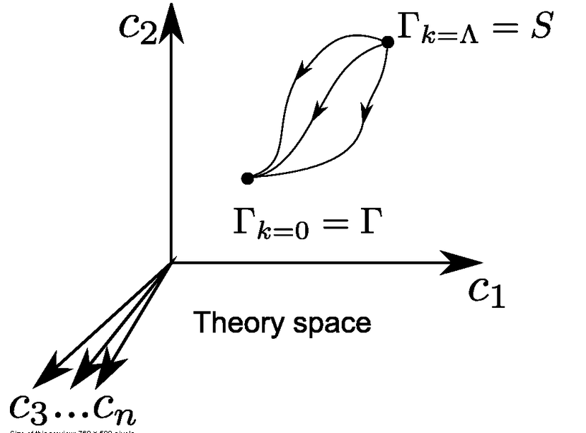
functional renormalization : flowing action
Wikipedia
Notes:
49

Slide 50
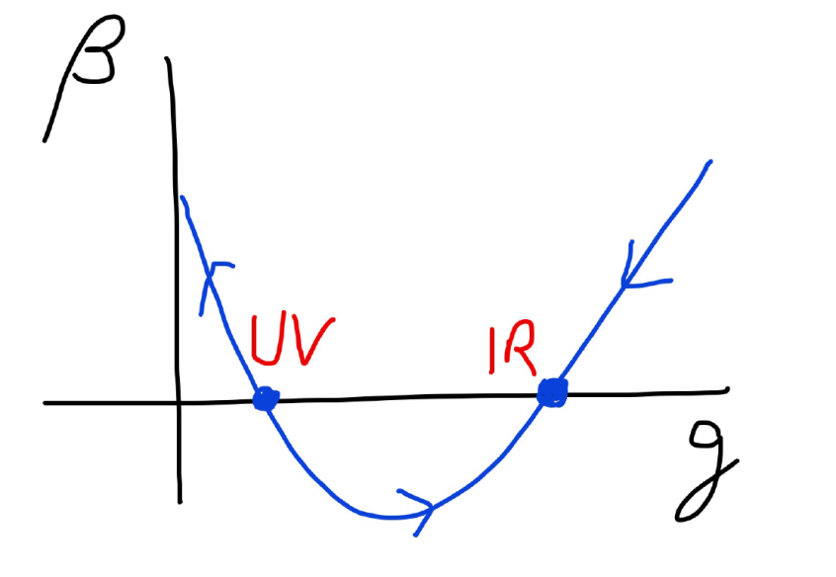
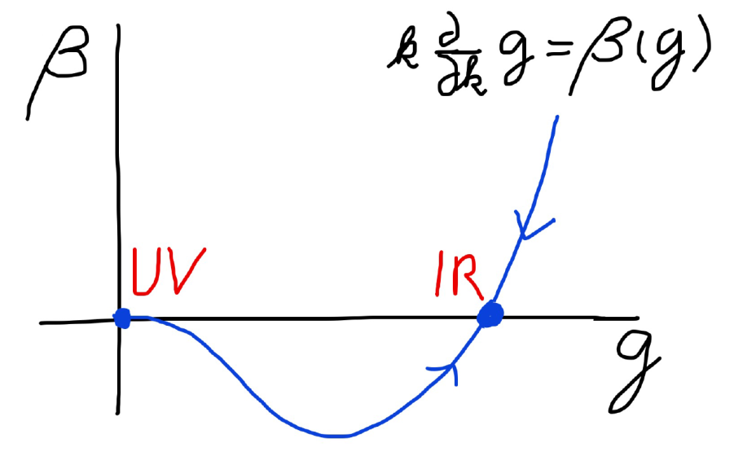
Asymptotic safety Asymptotic freedom
Relevant parameters yield undetermined couplings.
Quartic scalar coupling is not relevant and can therefore be predicted.

Slide 51
Key question (2)
Why does scale symmetry play a role even though it is violated by quantum fluctuations ?
answer
Fixed points
always realize scale symmetry

Slide 52
Key question (3)
Do fixed points play a role for cosmology ?

Slide 53
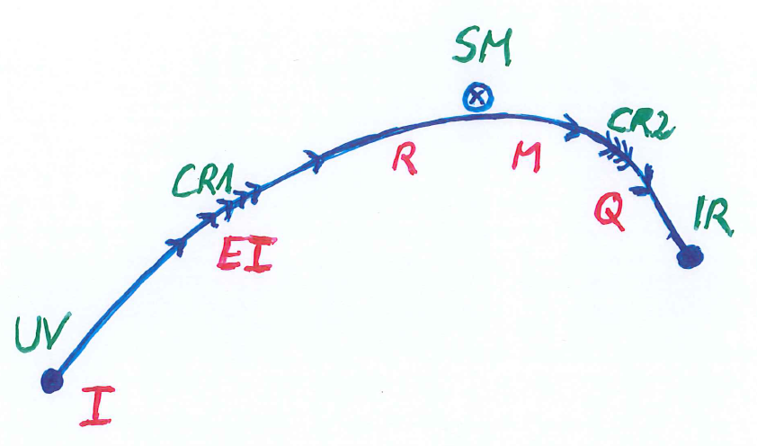

Crossover in quantum gravity

Slide 54
Approximate scale symmetry near fixed points
UV : approximate scale invariance of primordial fluctuation spectrum from inflation
IR : cosmon is pseudo Goldstone boson of
spontaneously broken scale symmetry,
tiny mass,
responsible for dynamical Dark Energy

Slide 55
Asymptotic safety
if UV fixed point exists :
quantum gravity is
non-perturbatively renormalizable !
S. Weinberg , M. Reuter

Slide 56
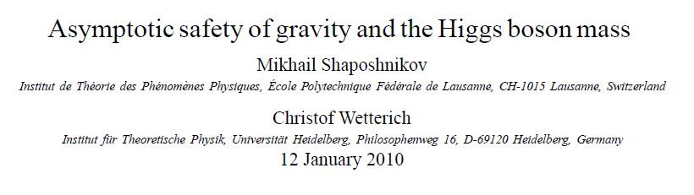
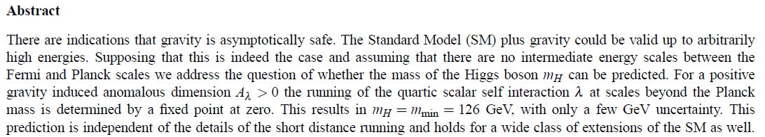
a prediction…

Slide 57
Possible consequences of crossover in quantum gravity
Realistic model for inflation and dark energy
with single scalar field

Slide 58
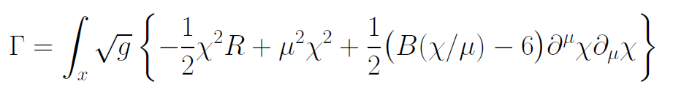
Variable Gravity
quantum effective action,
variation yields field equations
Einstein gravity :
M² R

Slide 59
Variable Gravity
Scalar field coupled to gravity
Effective Planck mass depends on scalar field
Simple quadratic scalar potential involves intrinsic mass μ
Nucleon and electron mass proportional to dynamical Planck mass
Neutrino mass has different dependence on scalar field

Slide 60
Cosmological solution : crossover from UV to IR fixed point
Dimensionless functions as B
depend only on ratio μ/χ .
IR: μ→0 , χ→∞
UV: μ→∞ , χ→0
Cosmology makes
crossover between
fixed points by
variation of χ .

Slide 61
renormalization flow and cosmological evolution
renormalization flow as function of µ
is mapped by dimensionless functions to
field dependence of effective action on scalar field χ
translates by solution of field equation to
dependence of cosmology an time t or η

Slide 62
Key question (3)
Do fixed points play a role for cosmology ?
answer
likely

Slide 63
(C) Approximate scale symmetry

Slide 64
Slowly running couplings close to fixed points

Slide 65
Simple mechanism for tiny cosmon-atom couplings
asymptotic approach to fixed point for dimensionless couplings and mass ratios
at fixed point : no cosmon coupling to atoms – no time variation of fundamental constants
very near fixed point : tiny coupling
how small ?

Slide 66
Neutrino cosmon coupling
Strong bounds on atom-cosmon coupling from tests of equivalence principle or time variation of couplings.
No such bounds for neutrino-cosmon coupling.
In particle physics : Mass generation mechanism for neutrinos differs from charged fermions. Seesaw mechanism involves heavy particles whose mass may depend on the value of the cosmon field.

Slide 67
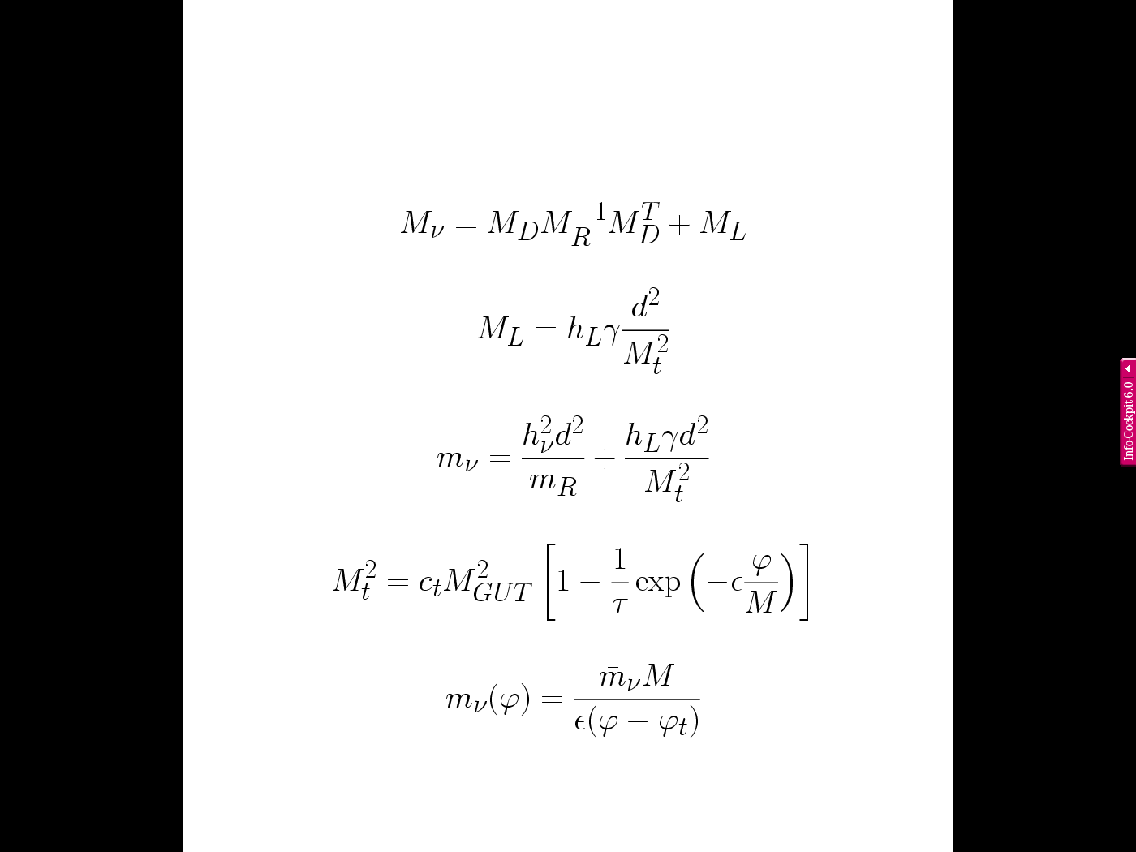
neutrino mass
seesaw and
cascade
mechanism
triplet expectation value ~ doublet squared
omit generation
structure

Slide 68
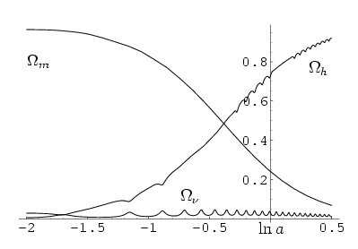
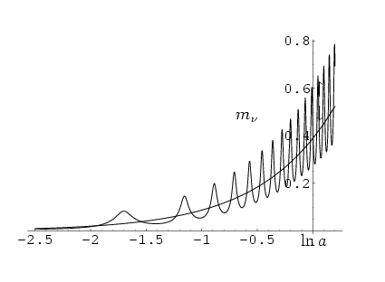
growing neutrino mass triggers transition to almost static dark energy
growing
neutrino
mass
L.Amendola, M.Baldi,…

Slide 69
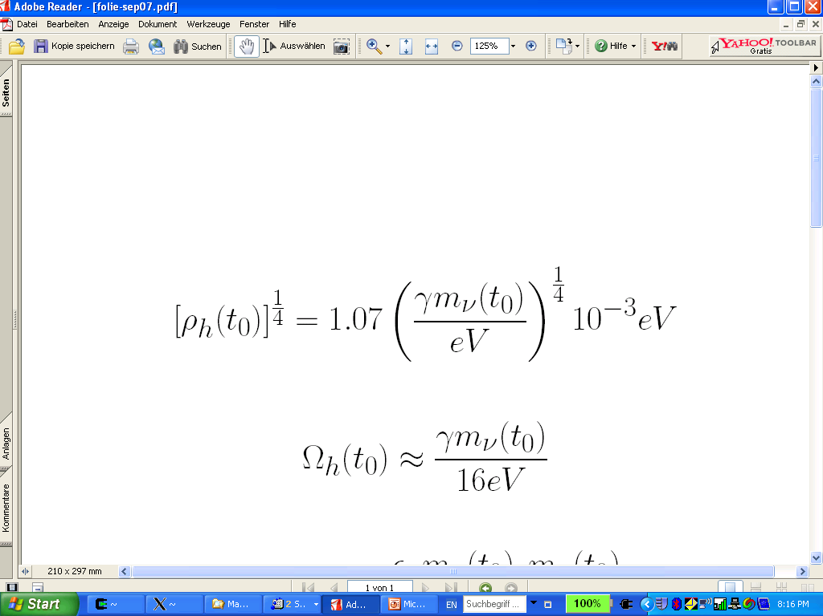
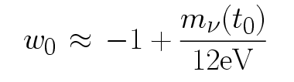
connection between dark energy and neutrino properties
= 1.27
present dark energy density given by neutrino mass
present equation
of state given by
neutrino mass !

Slide 70
Neutrino lumps
large m_{𝜈}
small m_{𝜈}
Casas, Pettorino,…

Slide 71
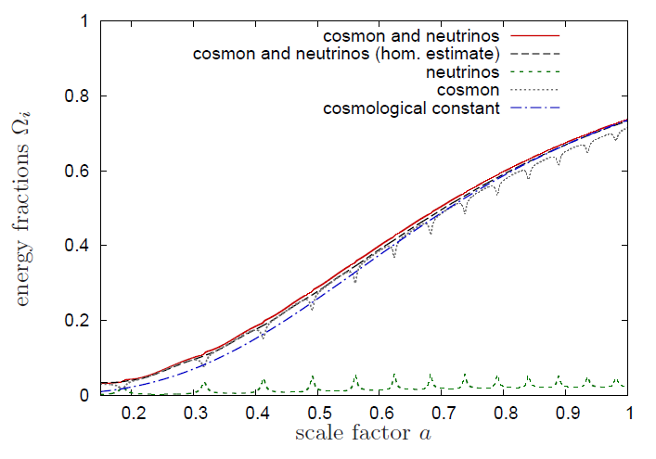
Evolution of dark energy similar to ΛCDM

Slide 72
Crossover cosmology

Slide 73
Running coupling B
B varies if intrinsic scale µ changes
similar to QCD or standard model

Slide 74
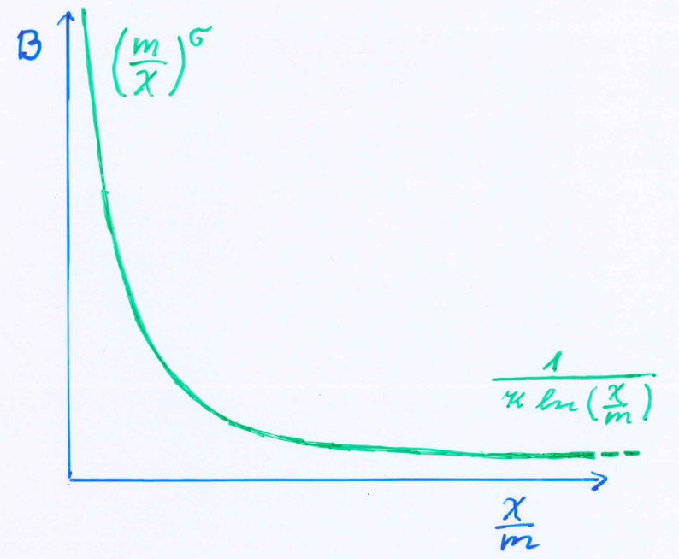
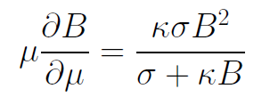
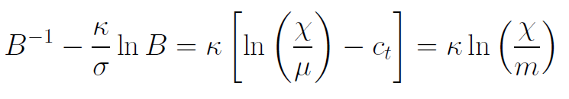
Kinetial B :
Crossover between two fixed points
assumption: running
coupling obeys
flow equation
m : scale of crossover
can be exponentially larger than intrinsic scale μ

Slide 75
Four-parameter model
model has four dimensionless parameters
three in kinetial :
σ ~ 2.5
κ ~ 0.5
c_{t} ~ 14 ( or m/μ )
one parameter for growth rate of neutrino mass over electron mass : γ ~ 8
+ standard model particles and dark matter : sufficient for realistic cosmology from inflation to dark energy
no more free parameters than ΛCDM

Slide 76
Cosmological solution
scalar field χ vanishes in the infinite past
scalar field χ diverges in the infinite future

Slide 77
No tiny dimensionless parameters
( except gauge hierarchy )
μ = 2 • 10 ⁻³³ eV
one mass scale
one time scale μ⁻¹ = 10 ¹⁰ yr
Planck mass does not appear as parameter
Planck mass grows large dynamically

Slide 78
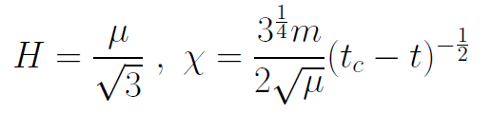
Slow Universe
Asymptotic solution in
freeze frame :
Expansion or shrinking always slow ,
characteristic time scale of the order of the age of the
Universe : t_{ch} ~ μ⁻¹ ~ 10 billion years !
Hubble parameter of the order of present Hubble
parameter for all times , including inflation and big bang !
Slow increase of particle masses !
μ= 2 • 10⁻³³ eV

Slide 79
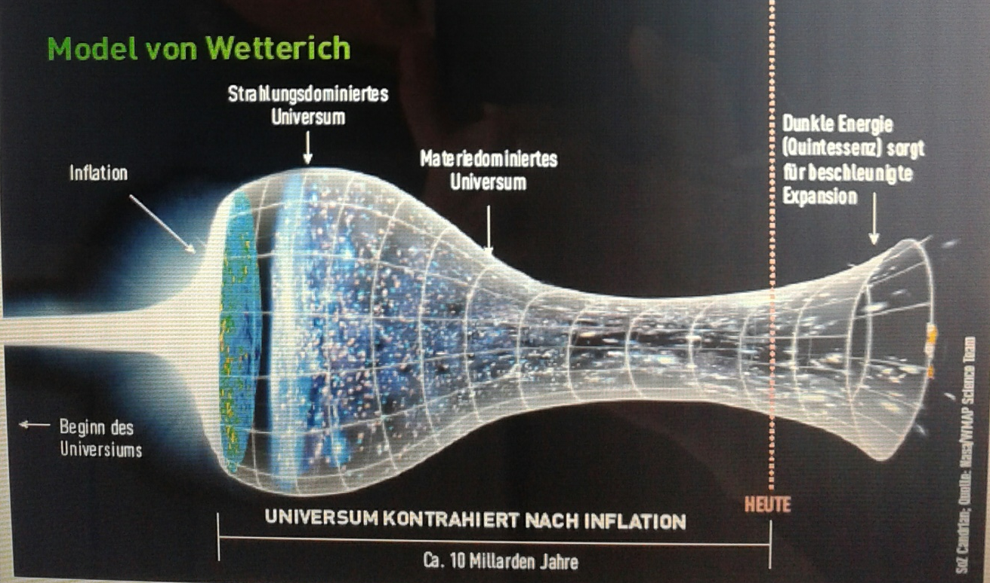
Strange evolution of Universe
Sonntagszeitung Zürich , Laukenmann

Slide 80
Model is compatible with present observations
Together with variation of neutrino mass over electron mass in present cosmological epoch :
model is compatible with all present observations, including inflation and dark energy

Slide 81
Big bang or freeze ?

Slide 82
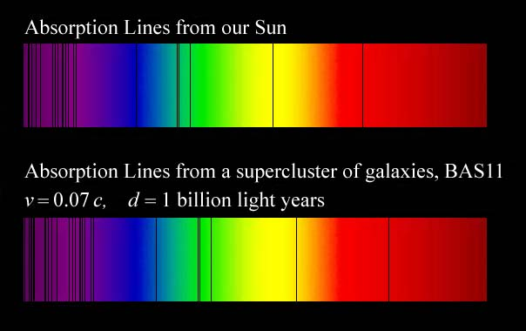
Do we know that the
Universe expands ?
instead of redshift due to expansion :
smaller frequencies have been emitted in the past, because electron mass was smaller !

Slide 83
Why do we see redshift of photons emitted in the distant past ?
photons are more red because they have been emitted with longer wavelength
frequency ~ mass
wavelength ~
atomsize

Slide 84
What is increasing ?
Ratio of distance between galaxies
over size of atoms !
atom size constant : expanding geometry
alternative : shrinking size of atoms

Slide 85
How can particle masses change with time ?
Particle masses are proportional to scalar field χ . Similar to Higgs field.
Scalar field varies with time.
Ratios of particle masses are independent of χ and therefore remain constant.
Compatibility with observational bounds on time dependence of particle mass ratios.
Dimensionless couplings are independent of χ .

Slide 86
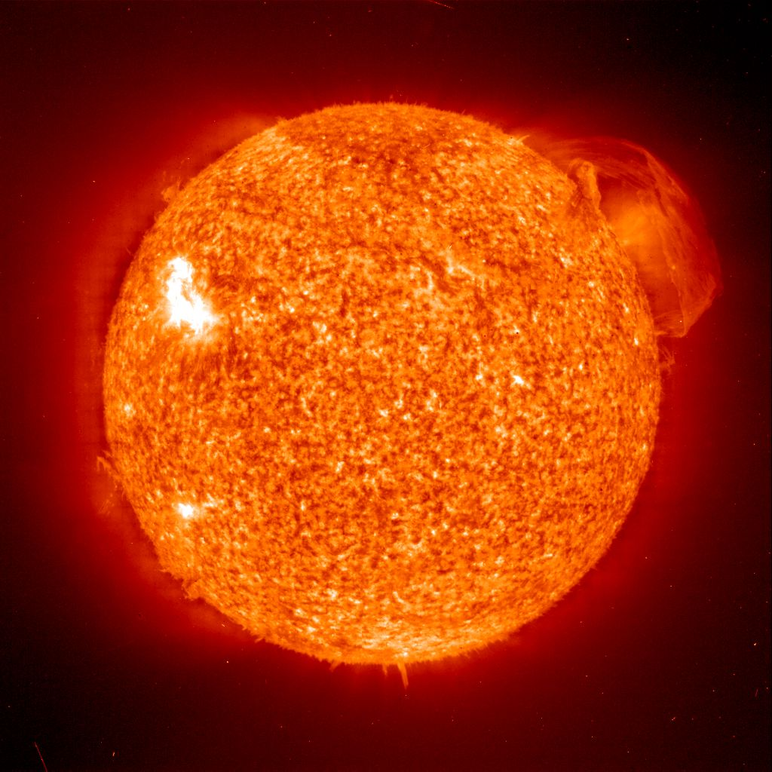
Do we know that the temperature was higher in the early Universe than now ?
Cosmic microwave radiation , nucleosynthesis
instead of
higher temperature :
smaller particle masses

Slide 87
Hot plasma ?
Temperature in radiation dominated Universe : T ~ χ ^{½} smaller than today
Ratio temperature / particle mass : T /m_{p} ~ χ ^{-½} larger than today
T/m_{p} counts ! This ratio decreases with time.
Nucleosynthesis , CMB emission as in standard cosmology !

Slide 88

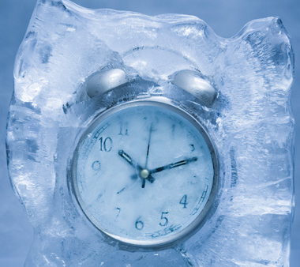
Big bang or freeze ?
freeze picture :
only rods for measurements
are set differently !

Slide 89

Big bang or freeze ?

Slide 90
Big bang is not wrong, but alternative pictures exist !

Slide 91
Conclusions
Scalar force in cosmology can arise from quantum scale symmetry
Realistic cosmology
Look for
time variation of fundamental constants, violation of equivalence principle,
huge lumps in cosmic neutrino background,
dynamical dark energy

Slide 92
end

Slide 93
Einstein frame
“Weyl scaling” maps variable gravity model to Universe with fixed masses and standard expansion history.
Exact equivalence of different frames !
Standard gravity coupled to scalar field.
Only neutrino masses are growing.

Slide 94
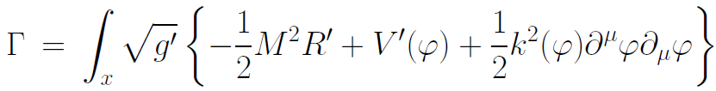
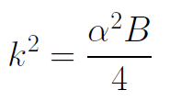

Einstein frame
Weyl scaling :
effective action in Einstein frame :

Slide 95
Field relativity
Weyl scaling :
changes geometry,
not a coordinate transformation

Slide 96
Field relativity : different pictures of cosmology
same physical content can be described by different pictures
related by field – redefinitions , e.g. Weyl scaling , conformal scaling of metric
which picture is usefull ?

Slide 97


Relativity of geometry
Euclid … Newton : space and time
are absolute
Special relativity : space and time depend on observer
General relativity : spacetime is
influenced by matter ( including radiation )
geometry is independent of coordinates
geometry is observable
Field relativity : geometry is relative

Slide 98
Spacetime is a description of correlations between “matter”.
Different pictures exist.

Slide 99
Solution of cosmological constant problem
not allowed
by quantum gravity
A ≥ 2

Slide 100
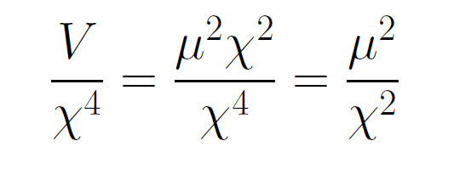
asymptotically vanishing cosmological „constant“
What matters : Ratio of potential divided by fourth power of Planck mass
vanishes for χ → ∞ !
V= 𝜇² χ²

Slide 101
small dimensionless number ?
needs two intrinsic mass scales
standard approach :V and M ( cosmological constant and Planck mass )
variable gravity : Planck mass moving to infinity , with fixed V ratio vanishes asymptotically !

Slide 102
no small parameter for dark energy

Slide 103
Einstein frame
Weyl scaling :
effective action in Einstein frame :

Slide 104
Quintessence
Dynamical dark energy ,
generated by scalar field (cosmon )
C.Wetterich,Nucl.Phys.B302(1988)668, 24.9.87
P.J.E.Peebles,B.Ratra,ApJ.Lett.325(1988)L17, 20.10.87
Notes:
104

Slide 105
Prediction : homogeneous dark energy influences recent cosmology
- of same order as dark matter -
Original models do not fit the present observations
…. modifications
( different growth of neutrino mass )

Slide 106
Second stage of crossover
from SM to IR
in sector Beyond Standard Model
affects neutrino masses first ( seesaw or cascade mechanism )

Slide 107
Varying particle masses at onset of second crossover
All particle masses except for neutrinos are proportional to χ .
Ratios of particle masses remain constant.
Compatibility with observational bounds on time dependence of particle mass ratios.
Neutrino masses show stronger increase with χ , such that ratio neutrino mass over electron mass grows .

Slide 108
Cosmic trigger
Stop of evolution of scalar field when neutrinos become non-relativistic
Transition from scaling solution to (almost) cosmological constant

Slide 109
neutrino mass
( ? ) ….
C.Wetterich, Nucl.Phys.B187 (1981) 343
cascade ( seesaw II )
mechanism
M.Magg, C.W. 1980

Slide 110
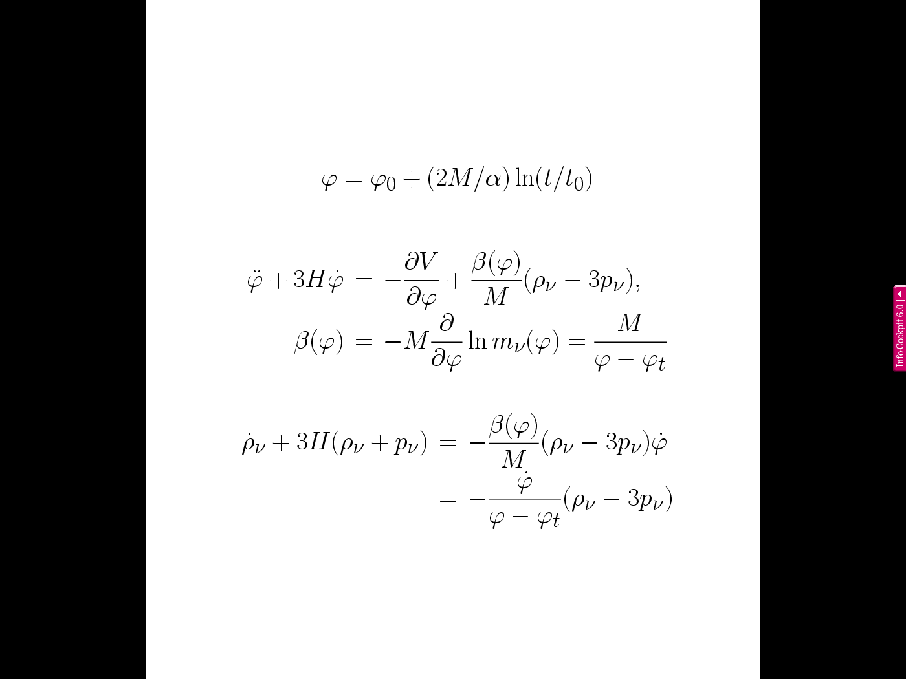
Neutrino cosmon coupling
realized by dependence of neutrino mass on value of cosmon field
β ≈ 1 : cosmon mediated attractive force between neutrinos has similar strength as gravity

Slide 111
growing neutrinos change cosmon evolution
modification of conservation equation for neutrinos

Slide 112
effective cosmological trigger for stop of cosmon evolution : neutrinos get non-relativistic
this has happened recently !
sets scales for dark energy !

Slide 113
In quantum gravity, the graviton fluctuations can play an important role on distances as large as the size of the Universe
- for long range scalar fields and dynamical dark energy
- not for all quantities

Slide 114
Instability of graviton propagator
effective action
Instability for V>0 : ”tachyonic mass term”

Slide 115
Graviton barrier
Quantum gravity computation :
For
V cannot increase stronger than M² !
Instability of graviton propagator is avoided

Slide 116
Graviton barrier and solution of the cosmological constant problem
V cannot increase stronger than M² !
If M increases with 𝜒, and for cosmological solutions where 𝜒 asymptotically diverges for time going to infinity:
Effective cosmological constant vanishes in infinite future
M = χ : V= 𝜇² χ²

Slide 117
Simplicity
simple description of all cosmological epochs
natural incorporation of Dark Energy :
inflation
Early Dark Energy
present Dark Energy
dominated epoch
J.Rubio…

Slide 118
Why should you care about the freeze picture of the Universe ?
Some aspects are understood easier :
Beginning of Universe
Role of scale symmetry
Range of impact of quantum gravity

Slide 119
infinite past

Slide 120
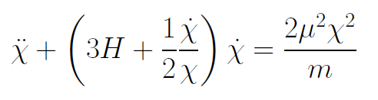
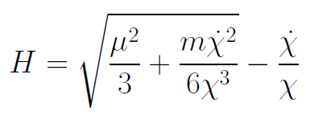
Infinite past : slow inflation
σ = 2 : field equations
approximative
solution
particles become massless in infinite past !

Slide 121
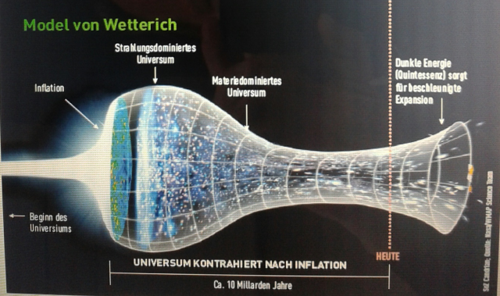
Eternal Universe
Asymptotic solution in
freeze frame :
solution valid back to the infinite past in physical time
no singularity
physical time to infinite past is infinite

Slide 122
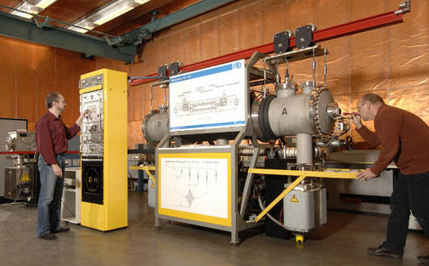
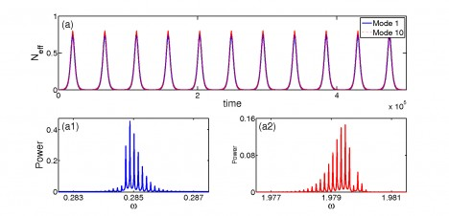
Physical time
count oscillations ….

Slide 123
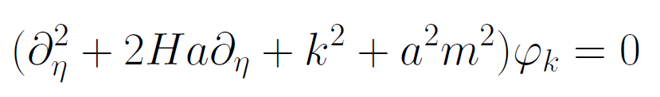
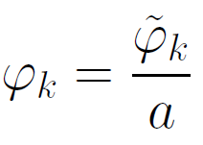
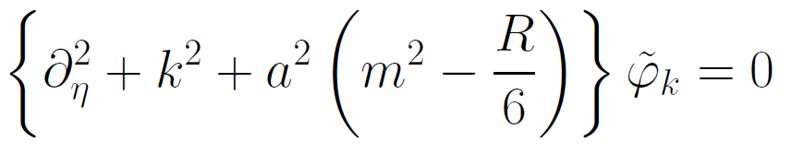
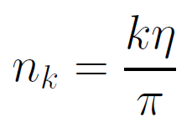

Physical time
field equation for scalar field mode
determine physical
time by counting
number of oscillations
( m=0 )

Slide 124
Physical time
counting : discrete
invariant under field transformations
same in all frames

Slide 125
Big bang singularity in Einstein frame is field singularity !
choice of frame with constant particle
masses is not well suited if
physical masses go to zero !

Slide 126



Cosmon coupling to atoms
has to be much weaker than gravity
requires for small time
variation of couplings :
or
similar for fine structure constant

