Slide 1
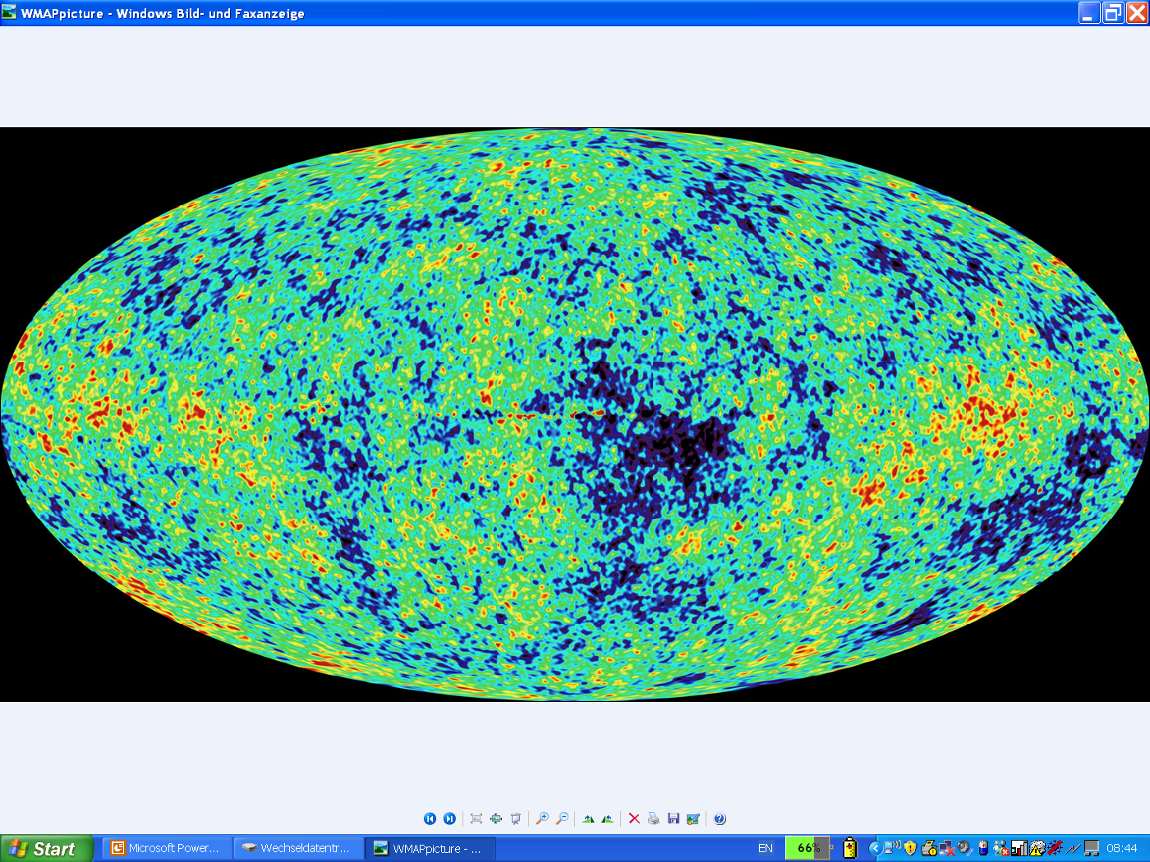
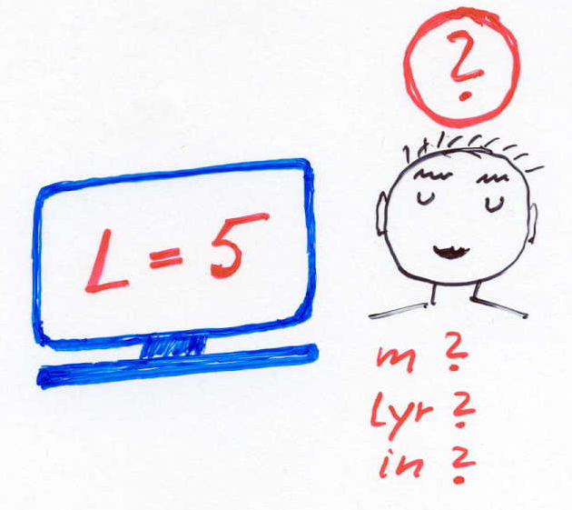
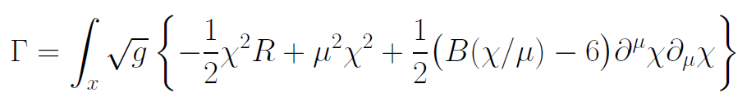
Scale symmetry – a link from quantum gravity to cosmology

Slide 2
scale symmetry
No intrinsic length or mass scale present

Slide 3
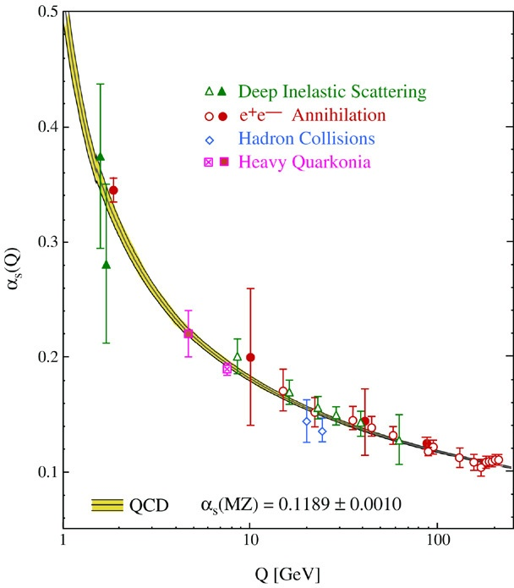
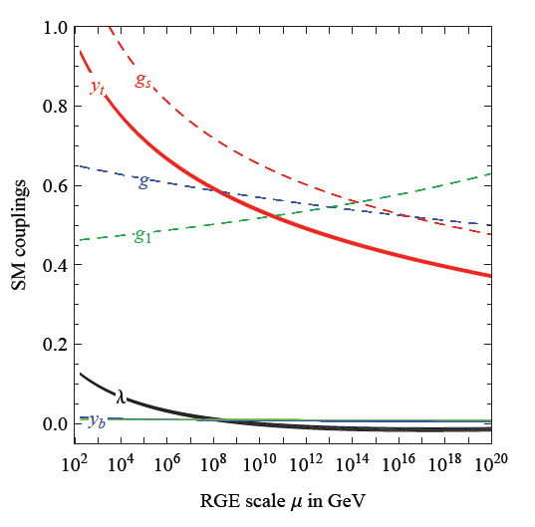
fluctuations induce running couplings
violation of scale symmetry
well known in QCD or standard model

Slide 4
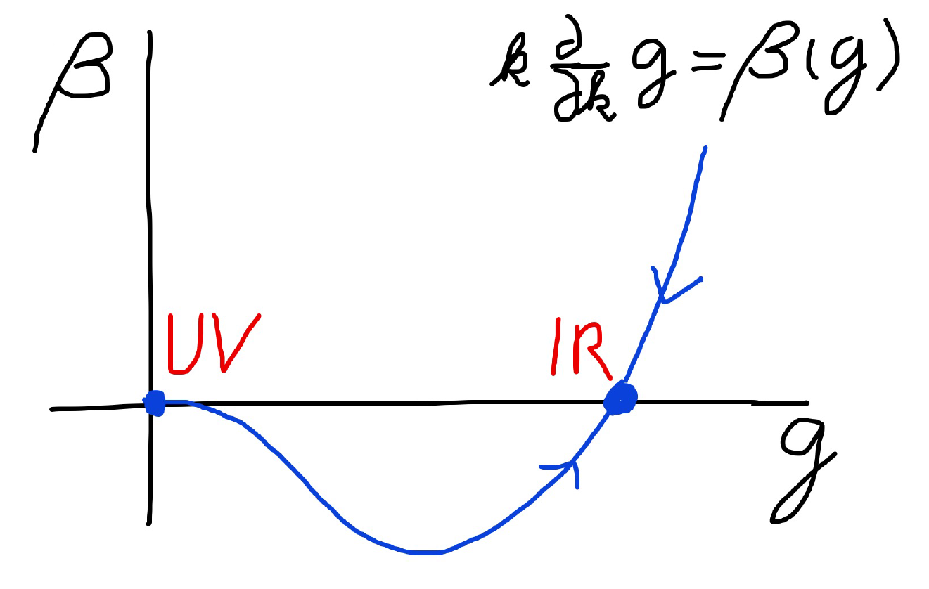
Fixed Points

Slide 5
Quantum scale symmetry
quantum fluctuations violate scale symmetry
running dimensionless couplings
at fixed points , scale symmetry is exact !

Slide 6
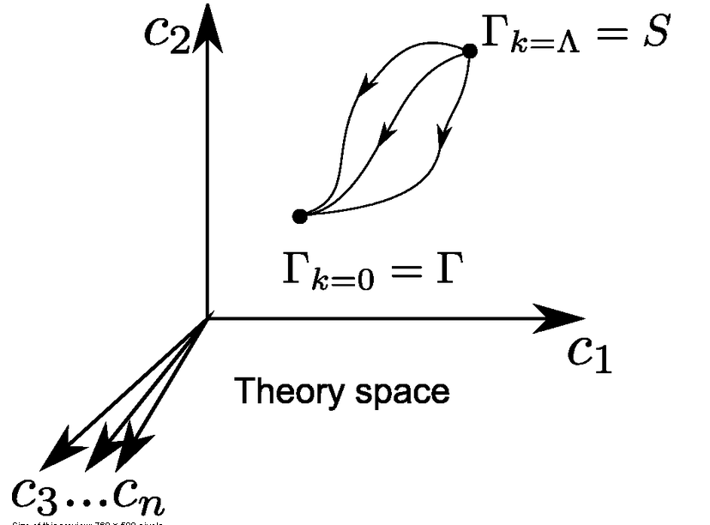
functional renormalization : flowing action
Wikipedia
Notes:
6

Slide 7
quantum gravity – the role of scale symmetry

Slide 8
Asymptotic safety
if UV fixed point exists :
quantum gravity is
non-perturbatively renormalizable !
S. Weinberg , M. Reuter

Slide 9

Flowing action
second order derivative expansion
variable gravity
metric and scalar field

Slide 10

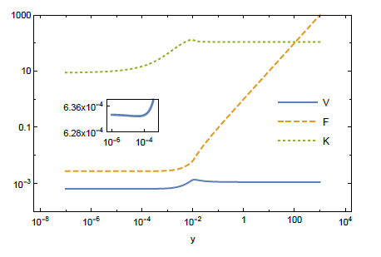
UV
IR

Slide 11
Anomalous dimension
solution with
vanishing
anomalous
dimension
candidates with anomalous dimension
more interesting
also matter and gauge fields need to be included

Slide 12
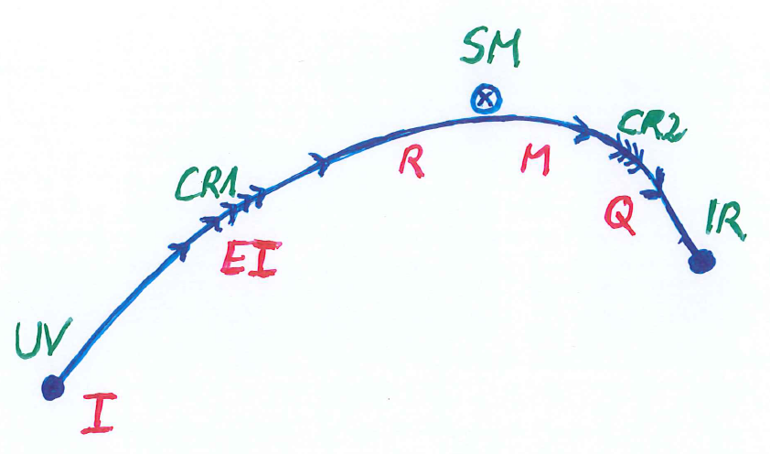

Crossover in quantum gravity
UV
IR

Slide 13

Origin of mass
UV fixed point : scale symmetry unbroken
all particles are massless
IR fixed point :
scale symmetry spontaneously broken,
massive particles , massless dilaton
crossover : explicit mass scale μ important
approximate SM fixed point : approximate scale symmetry spontaneously broken, massive particles , almost massless cosmon, tiny cosmon potential

Slide 14

Spontaneous breaking of scale symmetry
expectation value of scalar field breaks scale symmetry spontaneously
massive particles are compatible with scale symmetry
all mass scales proportional to scalar field$χ$ : electron mass, proton mass, Planck mass
in presence of massive particles : sign of exact scale symmetry is exactly massless Goldstone boson – the dilaton

Slide 15
Approximate scale symmetry near fixed points
UV : approximate scale invariance of primordial fluctuation spectrum from inflation
IR : cosmon is pseudo Goldstone boson of
spontaneously broken scale symmetry,
tiny mass,
responsible for dynamical Dark Energy

Slide 16
Asymptotic safety
if UV fixed point exists :
quantum gravity is
non-perturbatively renormalizable !
S. Weinberg , M. Reuter

Slide 17
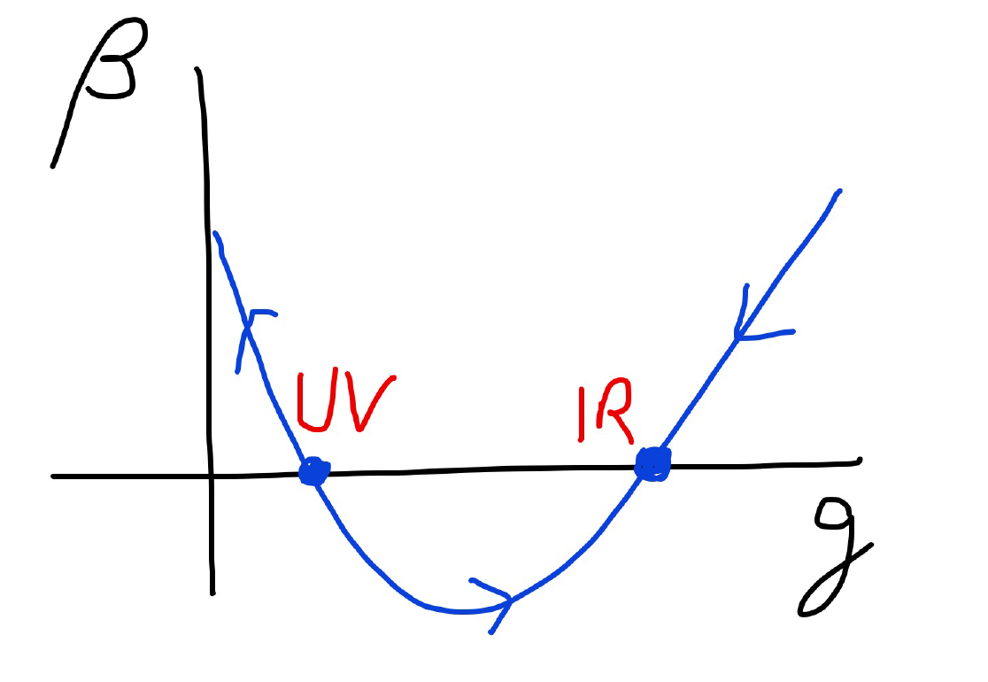
Asymptotic safety

Slide 18


Asymptotic safety Asymptotic freedom

Slide 19
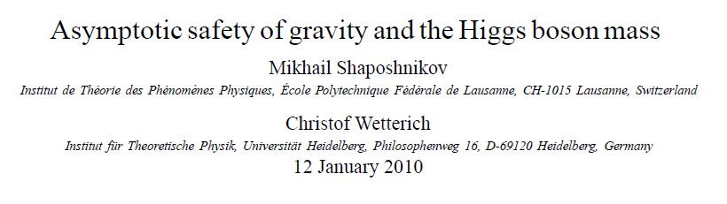
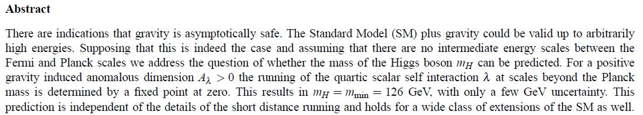
a prediction…

Slide 20
and a possibility

Slide 21
Possible consequences of crossover in quantum gravity
Realistic model for inflation and dark energy
with single scalar field

Slide 22
Variable Gravity
quantum effective action,
variation yields field equations
Einstein gravity :
M² R

Slide 23
Variable Gravity
Scalar field coupled to gravity
Effective Planck mass depends on scalar field
Simple quadratic scalar potential involves intrinsic mass μ
Nucleon and electron mass proportional to dynamical Planck mass

Slide 24
Cosmological solution : crossover from UV to IR fixed point
Dimensionless functions as B
depend only on ratio μ/χ .
IR: μ→0 , χ→∞
UV: μ→∞ , χ→0
Cosmology makes
crossover between
fixed points by
variation of χ .

Slide 25
renormalization flow and cosmological evolution
renormalization flow as function of µ
is mapped by dimensionless functions to
field dependence of effective action on scalar field χ
translates by solution of field equation to
dependence of cosmology on time t or η

Slide 26
Simplicity
simple description of all cosmological epochs
natural incorporation of Dark Energy :
inflation
Early Dark Energy
present Dark Energy dominated epoch

Slide 27
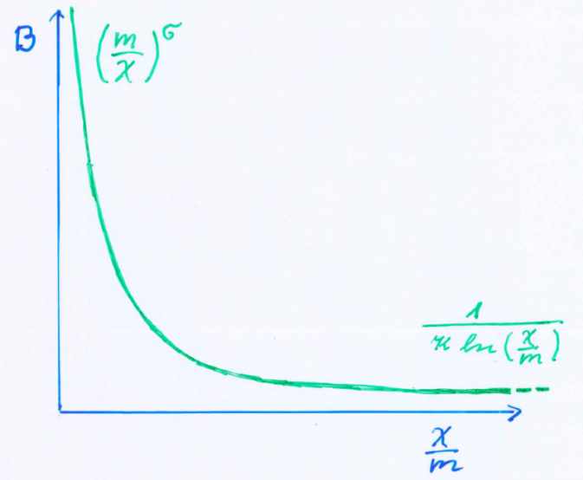
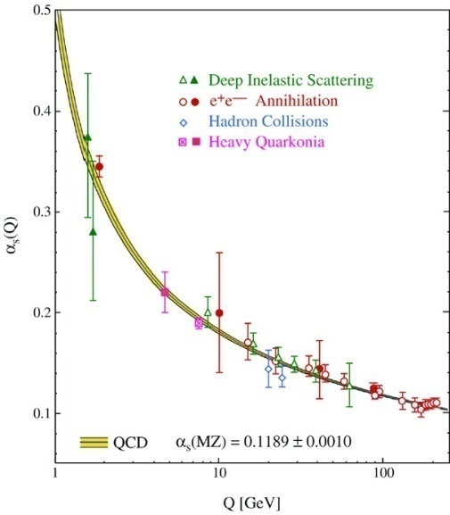
running coupling B
B varies if intrinsic scale µ changes
similar to QCD or standard model

Slide 28
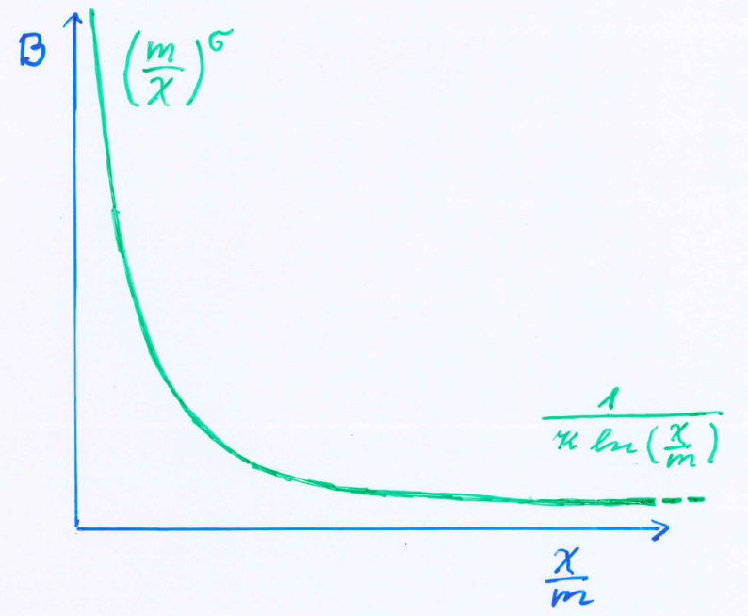
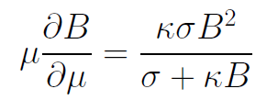

Kinetial B :
Crossover between two fixed points

Slide 29
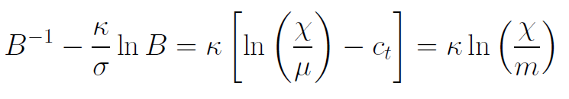
Kinetial B :
Crossover between two fixed points
running
coupling obeys
flow equation
m : scale of crossover
can be exponentially larger than intrinsic scale μ

Slide 30
Cosmological solution
derive field equation from effective action of variable gravity
solve them for homogenous and isotropic metric and scalar field
scalar field χ vanishes in the infinite past
scalar field χ diverges in the infinite future

Slide 31
No tiny dimensionless parameters
( except matter sector, e.g. gauge hierarchy )
μ = 2 • 10 ⁻³³ eV
one mass scale
one time scale μ⁻¹ = 10 ¹⁰ yr
Planck mass does not appear as parameter
Planck mass grows large dynamically

Slide 32
Particle masses change with time
At SM fixed point :
All particle masses ( except for neutrinos ) are proportional to scalar field χ .
Scalar field varies with time – so do particle masses.
Ratios of particle masses are independent of χ and therefore remain constant.
Compatibility with observational bounds on time dependence of particle mass ratios.
Dimensionless couplings are independent of χ .

Slide 33
Four-parameter model
model has four dimensionless parameters
three in kinetial B :
σ ~ 2.5
κ ~ 0.5
c_{t} ~ 14 ( or m/μ )
one parameter for present growth rate of neutrino mass over electron mass : γ ~ 8
+ standard model particles and dark matter : sufficient for realistic cosmology from inflation to dark energy
no more free parameters than ΛCDM

Slide 34
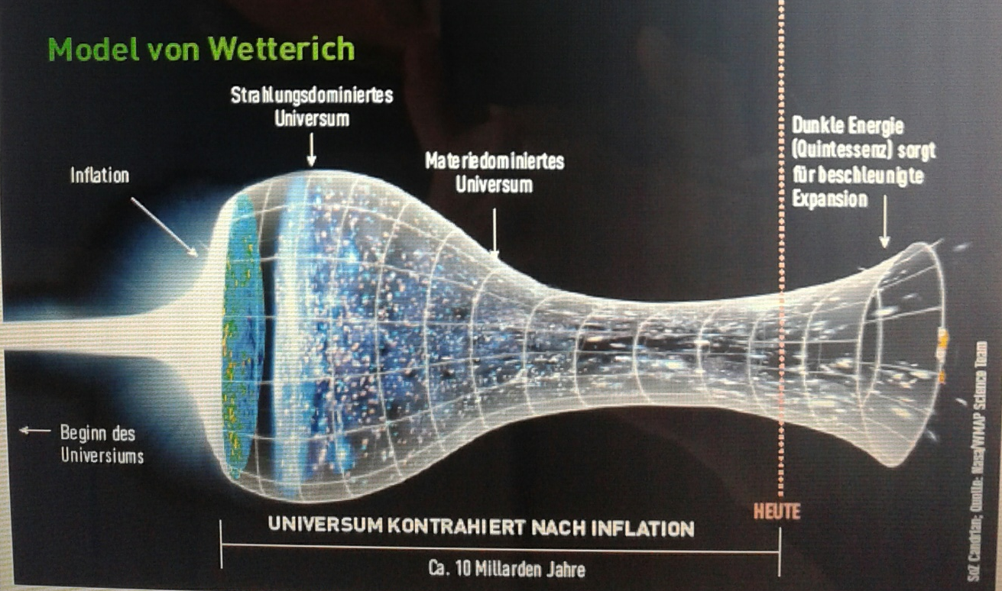
Strange evolution of Universe
Sonntagszeitung Zürich , Laukenmann

Slide 35
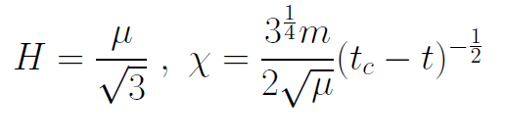
Slow Universe
Asymptotic solution :
Expansion or shrinking always slow ,
characteristic time scale of the order of the age of the
Universe : t_{ch} ~ μ⁻¹ ~ 10 billion years !
Hubble parameter of the order of present Hubble
parameter for all times , including inflation and big bang !
Slow increase of particle masses !
μ= 2 • 10⁻³³ eV

Slide 36
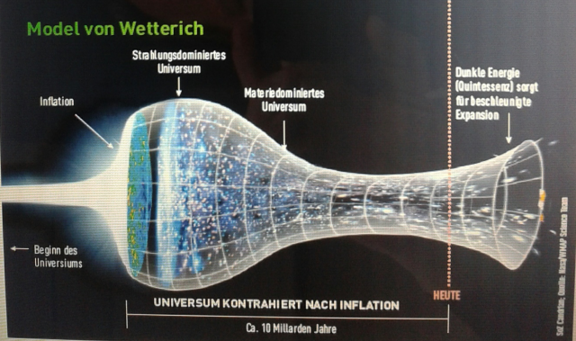
Eternal Universe
Asymptotic solution in
freeze frame :
solution valid back to the infinite past in physical time
no singularity
physical time to infinite past is infinite

Slide 37
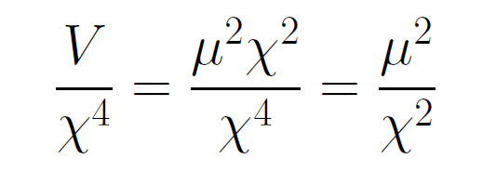
asymptotically vanishing cosmological „constant“
What matters : Ratio of potential divided by fourth power of Planck mass
vanishes for χ → ∞ !

Slide 38
small dimensionless number ?
needs two intrinsic mass scales
V and M ( cosmological constant and Planck mass )
variable Planck mass moving to infinity , with fixed V: ratio vanishes asymptotically !

Slide 39
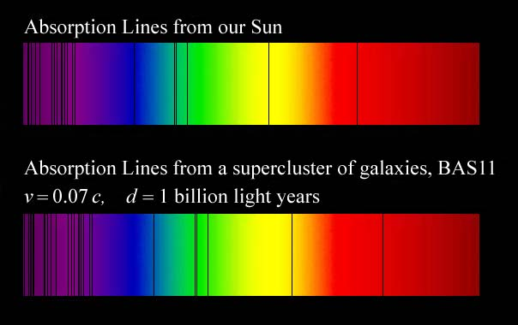
Do we know that the
Universe expands ?
instead of redshift due to expansion :
smaller frequencies have been emitted in the past, because electron mass was smaller !

Slide 40
What is increasing ?
Ratio of distance between galaxies
over size of atoms !
atom size constant : expanding geometry
alternative : shrinking size of atoms

Slide 41
Hot plasma ?
Temperature in radiation dominated Universe : T ~ χ ^{½} smaller than today
Ratio temperature / particle mass : T /m_{p} ~ χ ^{-½} larger than today
T/m_{p} counts ! This ratio decreases with time.
Nucleosynthesis , CMB emission as in standard cosmology !

Slide 42
Model is compatible with present observations
Together with variation of neutrino mass over electron mass in present cosmological epoch :
model is compatible with all present observations

Slide 43
Einstein frame
“Weyl scaling” maps variable gravity model to Universe with fixed masses and standard expansion history.
Exact equivalence of different frames !
Standard gravity coupled to scalar field.
Only neutrino masses are growing.

Slide 44
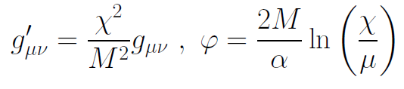
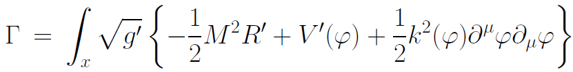
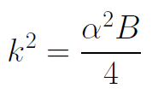

Einstein frame
Weyl scaling :
effective action in Einstein frame :

Slide 45
Field relativity : different pictures of cosmology
same physical content can be described by different pictures
related by field – redefinitions , e.g. Weyl scaling , conformal scaling of metric
which picture is usefull ?

Slide 46
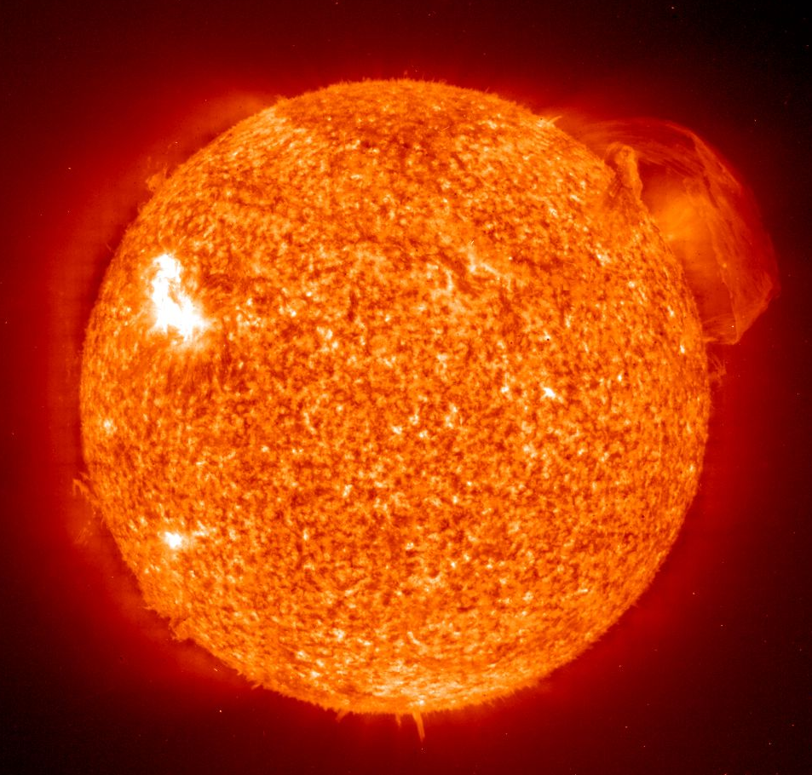
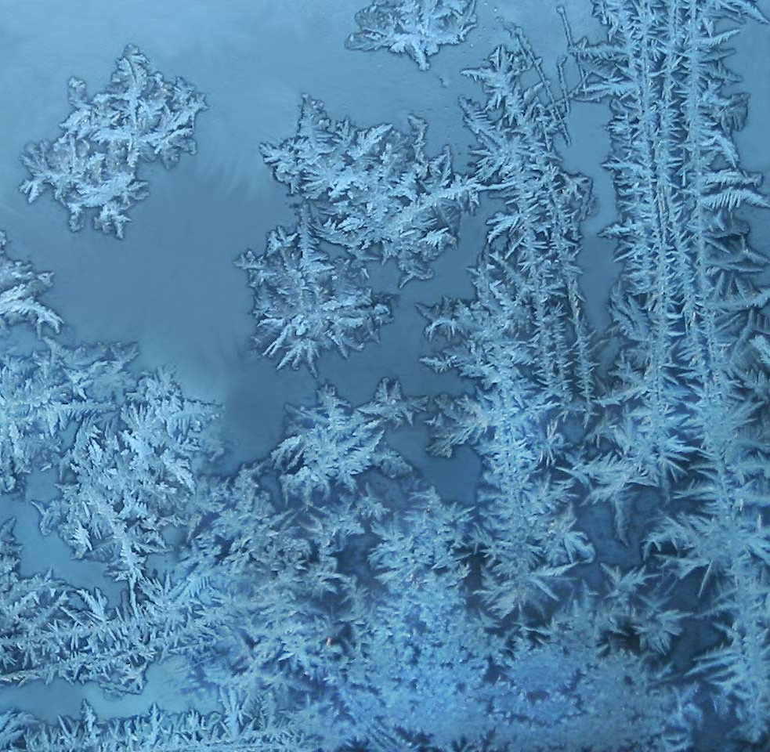
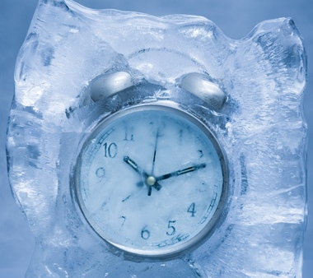
Big bang or freeze ?

Slide 47
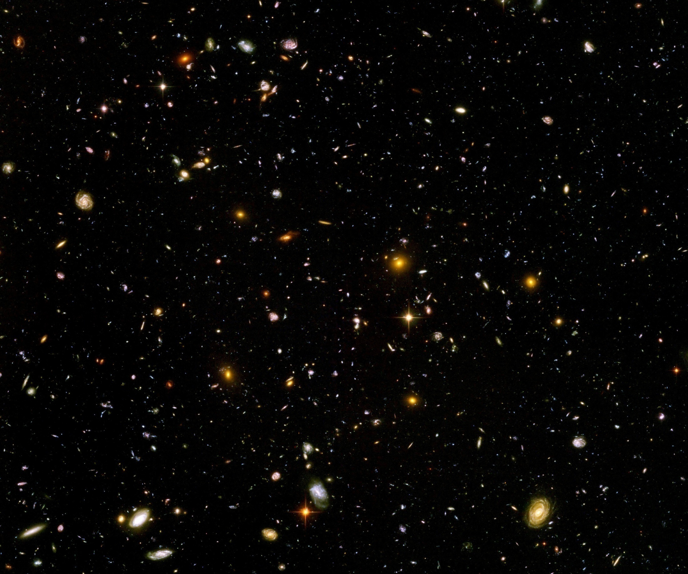
Big bang or freeze ?
just two ways of looking at same physics

Slide 48
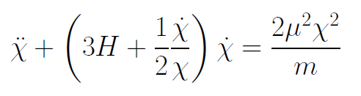
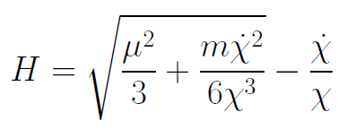
Infinite past : slow inflation
σ = 2 : field equations
approximate
solution

Slide 49
Eternal Universe
Asymptotic solution in
freeze frame :
solution valid back to the infinite past in physical time
no singularity
physical time to infinite past is infinite

Slide 50
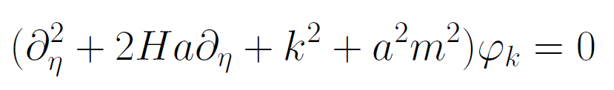
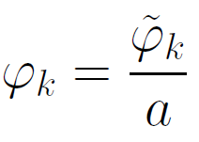
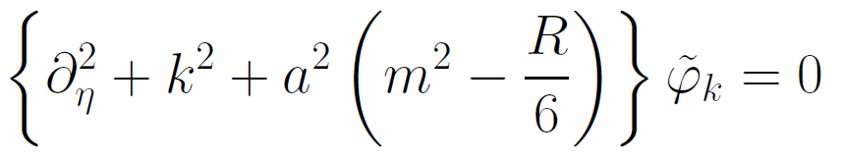
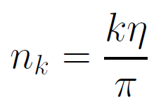

Physical time
field equation for scalar field mode
determine physical
time by counting
number of oscillations
( m=0 )

Slide 51
Big bang singularity in Einstein frame is field singularity !
choice of frame with constant particle
masses is not well suited if
physical masses go to zero !

Slide 52
conclusions
Fixed points and scale symmetry crucial
Big bang singularity is artefact
of inappropriate choice of field variables –
no physical singularity

Slide 53
conclusions (2)
crossover in quantum gravity is reflected in crossover in cosmology
quantum gravity becomes testable by cosmology
quantum gravity plays a role not only for primordial cosmology
crossover scenario explains different cosmological epochs
simple model is compatible with present observations
no more parameters than ΛCDM : tests possible

Slide 54
end

Slide 55
Quintessence
Dynamical dark energy ,
generated by scalar field (cosmon )
C.Wetterich,Nucl.Phys.B302(1988)668, 24.9.87
P.J.E.Peebles,B.Ratra,ApJ.Lett.325(1988)L17, 20.10.87
Notes:
55

Slide 56
Prediction : homogeneous dark energy influences recent cosmology
- of same order as dark matter -
Original models do not fit the present observations
…. modifications
( different growth of neutrino mass )

Slide 57
Second stage of crossover
from SM to IR
in sector Beyond Standard Model
affects neutrino masses first ( seesaw or cascade mechanism )

Slide 58
Varying particle masses at onset of second crossover
All particle masses except for neutrinos are proportional to χ .
Ratios of particle masses remain constant.
Compatibility with observational bounds on time dependence of particle mass ratios.
Neutrino masses show stronger increase with χ , such that ratio neutrino mass over electron mass grows .

Slide 59
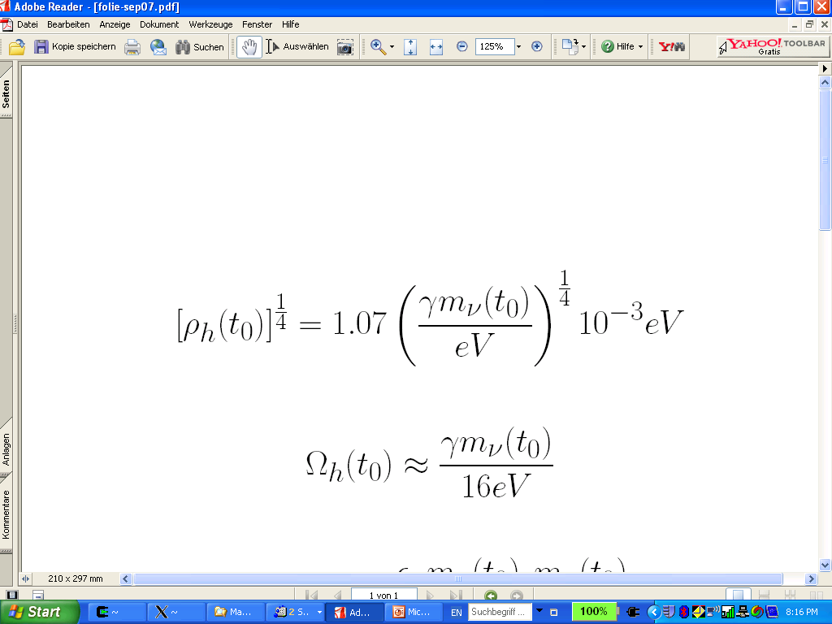
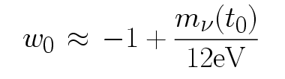
connection between dark energy and neutrino properties
L.Amendola,
M.Baldi, …
= 1.27
present dark energy density given by neutrino mass
present equation
of state given by
neutrino mass !
Notes:
59

Slide 60
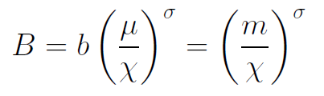
Inflation
solution for small χ : inflationary epoch
kinetial characterized by
anomalous dimension σ

Slide 61

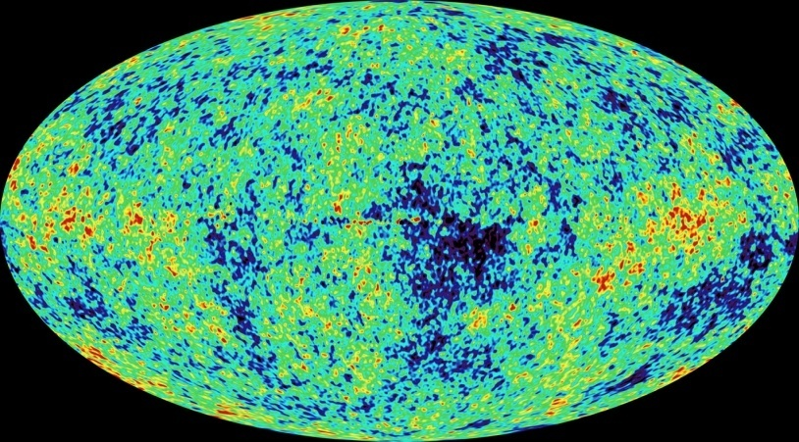
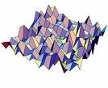
Primordial fluctuations
inflaton field : χ
primordial fluctuations of inflaton become observable in cosmic microwave background
Notes:
61

Slide 62


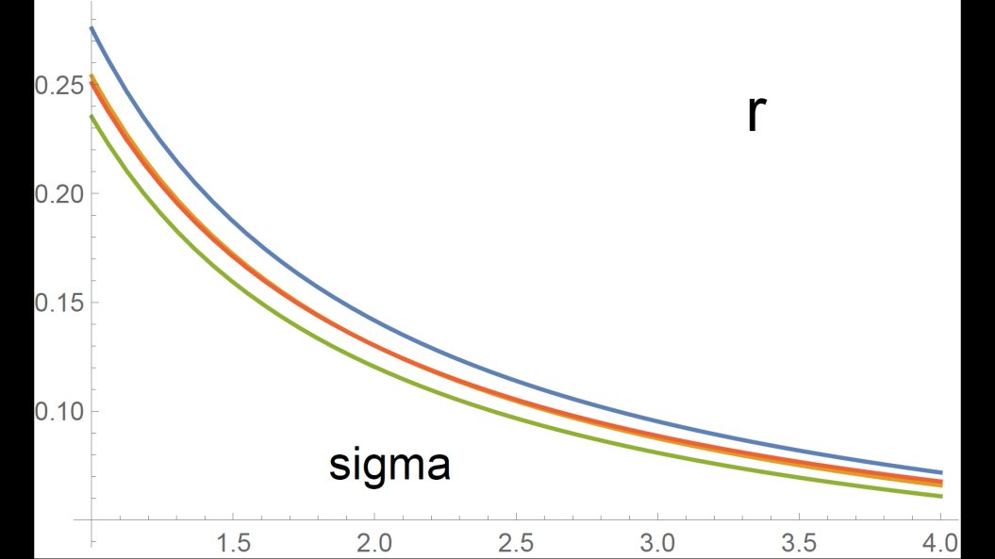
Anomalous dimension determines spectrum of primordial fluctuations
spectral index n
tensor amplitude r

Slide 63
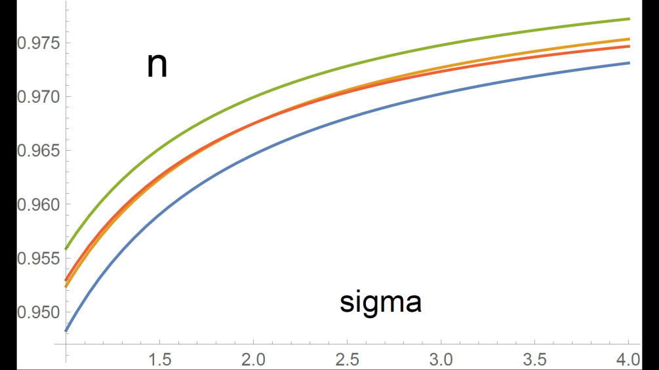
relation between n and r
r = 8.19 ( 1 – n ) - 0.1365

Slide 64
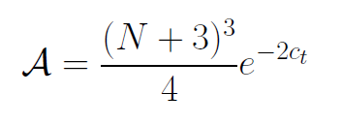

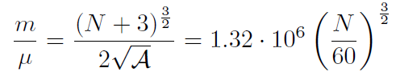
Amplitude of density fluctuations
small because of logarithmic running
near UV fixed point !
σ=1
N : number of e – foldings at horizon crossing

Slide 65
First step of crossover ends inflation
induced by crossover in B
after crossover B changes only very slowly

Slide 66
Scaling solution
Heating of the Universe after inflation
Scaling solution with almost fixed fraction of Early Dark Energy

Slide 67
Cosmon inflation
Unified picture of inflation and dynamical dark energy
Cosmon and inflaton are the same scalar field

Slide 68
Compatibility with observations and possible tests
Realistic inflation model
Almost same prediction for radiation, matter, and Dark Energy domination as ΛCDM
Presence of small fraction of Early Dark Energy
Large neutrino lumps

Slide 69
Simplicity
simple description of all cosmological epochs
natural incorporation of Dark Energy :
inflation
Early Dark Energy
present Dark Energy dominated epoch

Slide 70
conclusions (3)
Variable gravity cosmologies can give a simple and realistic description of the Universe
Compatible with tests of equivalence principle and bounds on variation of fundamental couplings if nucleon and electron masses are proportional to variable Planck mass
Cosmon dependence of ratio neutrino mass/ electron mass can explain why Universe makes a transition to Dark Energy domination now
characteristic signal : neutrino lumps

Slide 71


Infrared fixed point
μ→ 0
B→ 0
no intrinsic mass scale
scale symmetry

Slide 72


Ultraviolet fixed point
μ→ ∞
kinetial diverges
scale symmetry with anomalous dimension σ

Slide 73
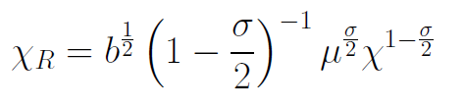
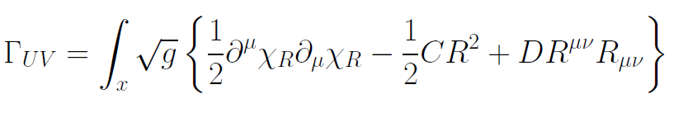
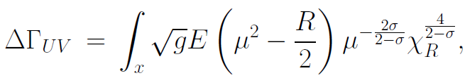
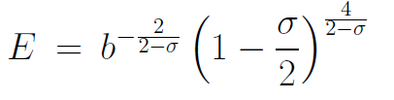
Renormalized field at UV fixed point
1 < σ
no mass
scale
deviation from
fixed point
vanishes for
μ→ ∞

