Slide 1
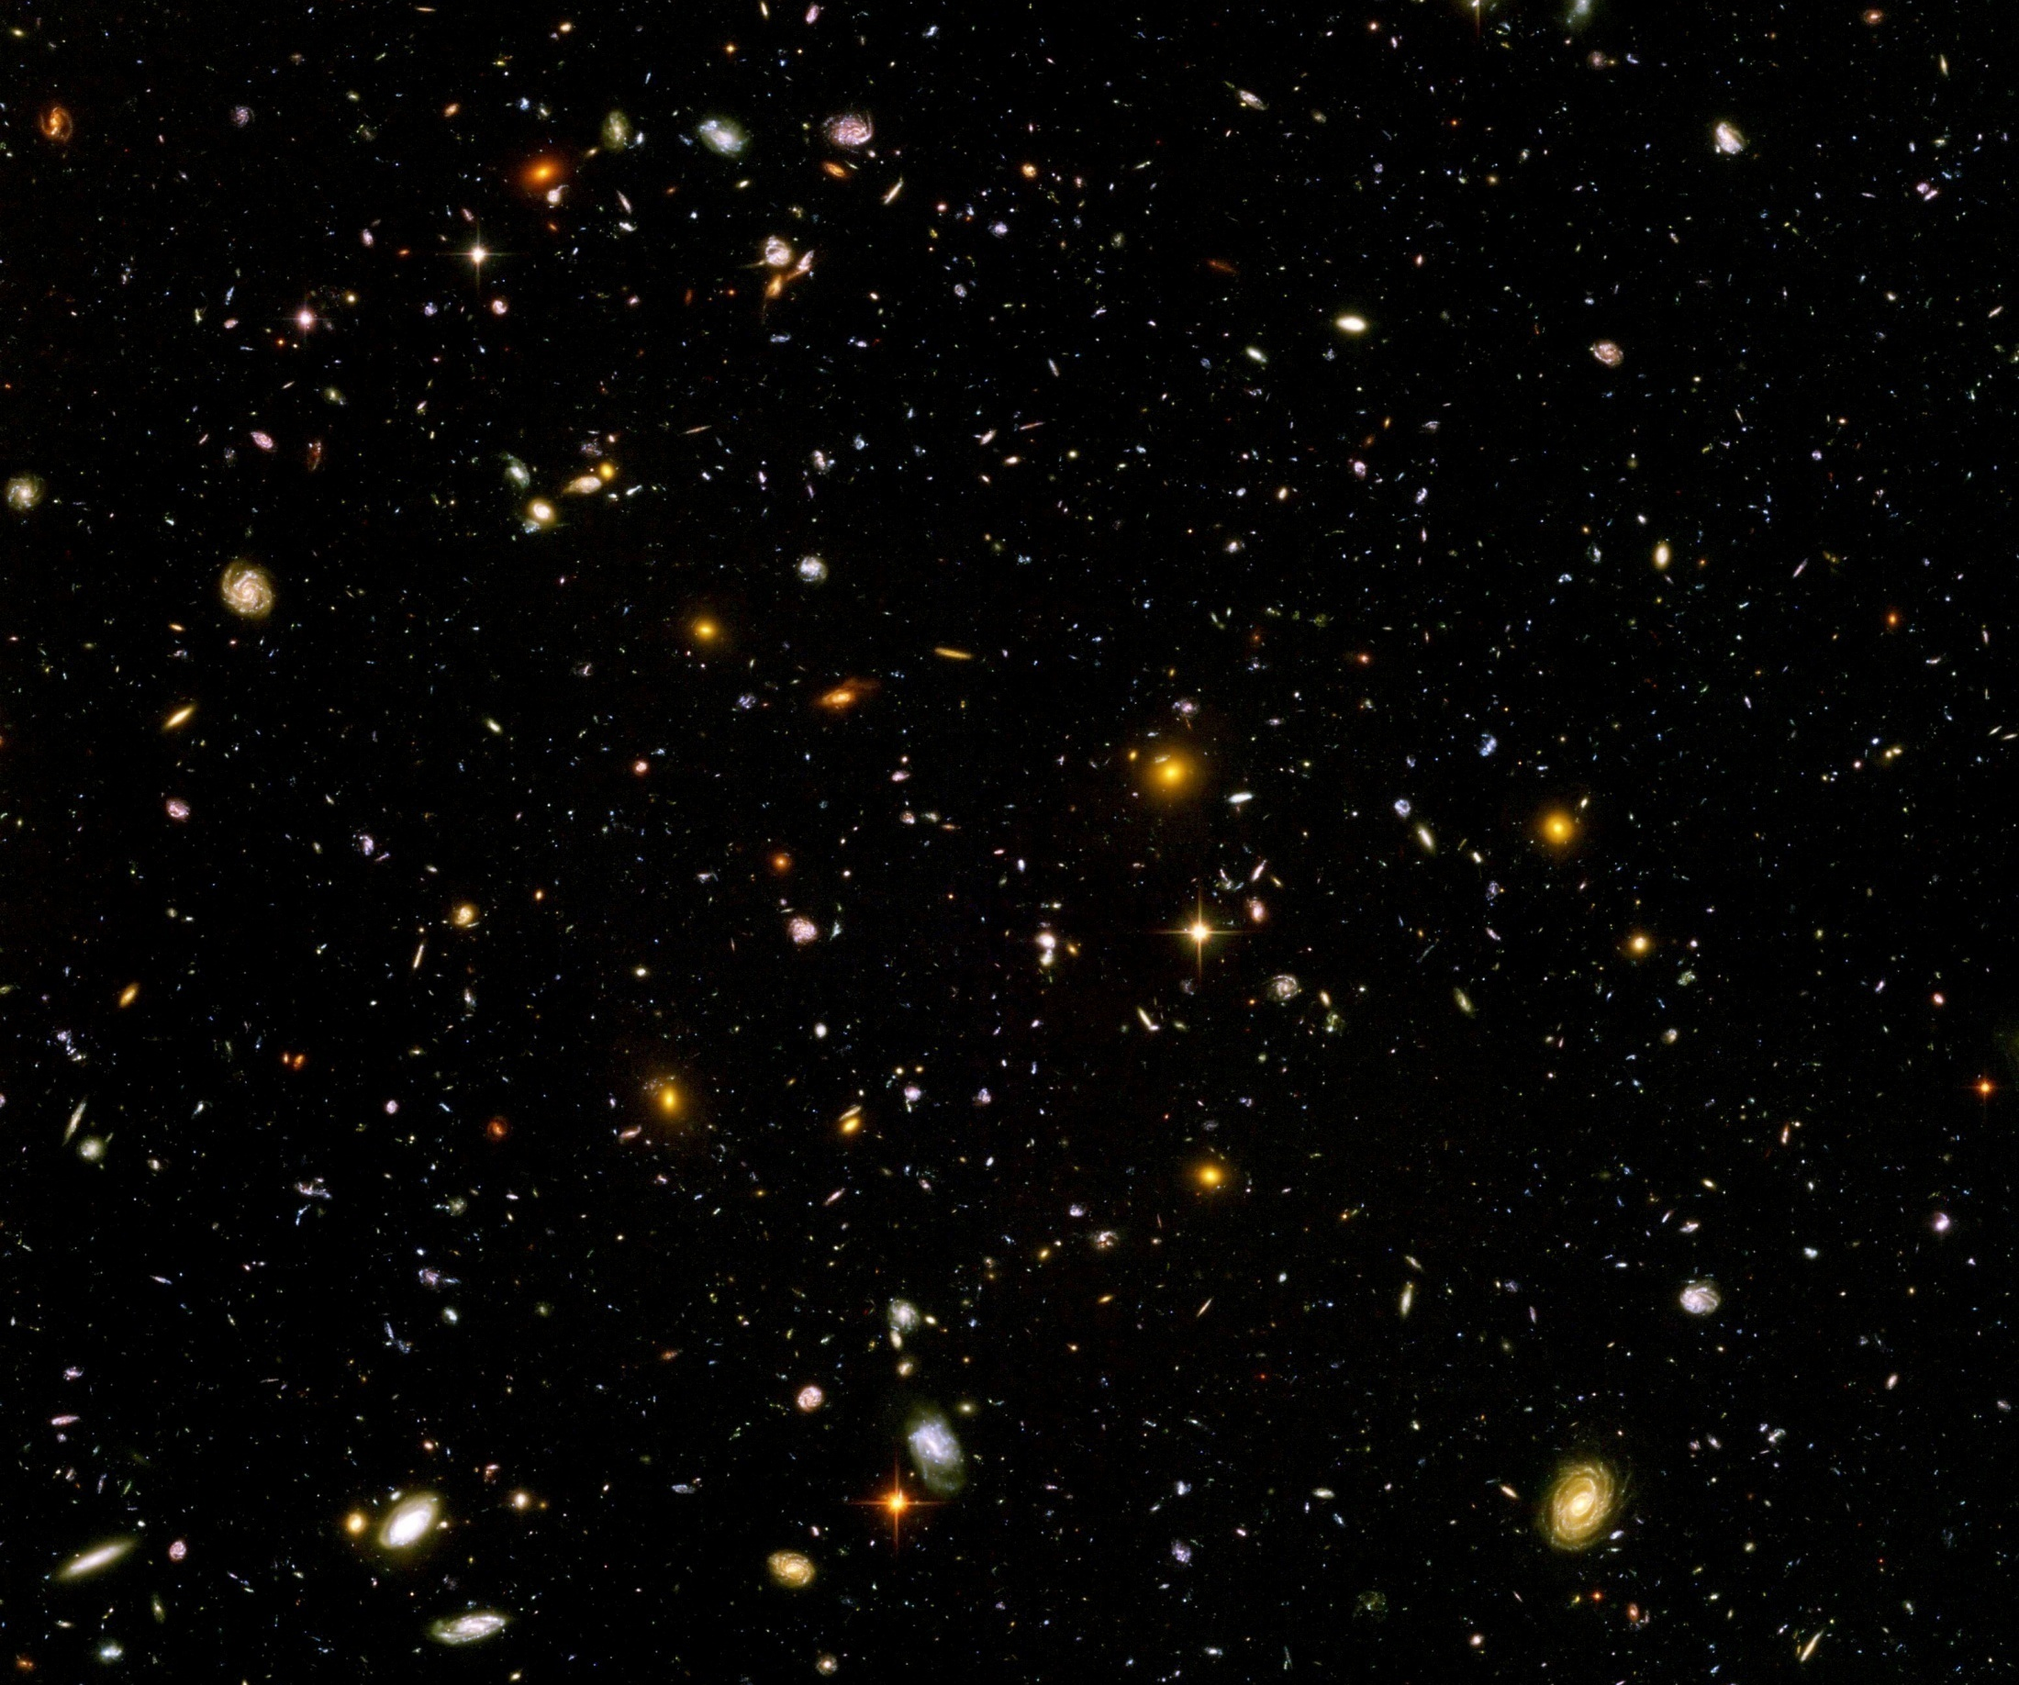
Expanding Universe or shrinking atoms ?
A new view on dynamical Dark Energy, and the Origin of the Universe

Slide 2
Expanding Universe or shrinking atoms ?

Slide 3
Hot big bang or freeze ?

Slide 4
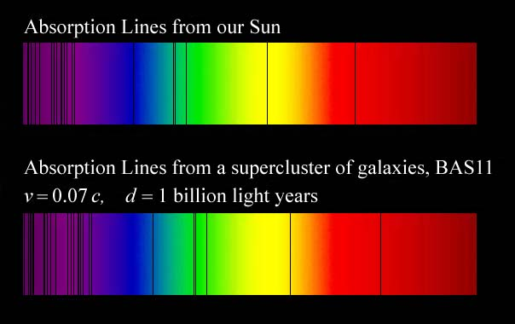
Do we know that the
Universe expands ?
instead of redshift due to expansion :
smaller frequencies have been emitted in the past, because electron mass was smaller !

Slide 5
Why do we see redshift of photons emitted in the distant past ?
photons are more red because they have been emitted with longer wavelength
frequency ~ mass
wavelength ~
atomsize

Slide 6
What is increasing ?
Ratio of distance between galaxies
over size of atoms !
atom size constant : expanding geometry
alternative : shrinking size of atoms

Slide 7
Only dimensionless ratios of length or mass scales are observable

Slide 8
How can particle masses change with time ?
Particle masses are proportional to scalar field χ . Similar to Higgs field.
Scalar field varies with time.
Ratios of particle masses are independent of χ and therefore remain constant.
Compatibility with observational bounds on time dependence of particle mass ratios.
Dimensionless couplings are independent of χ .

Slide 9

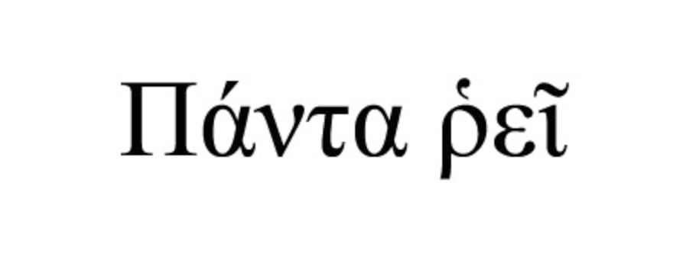

Slide 10
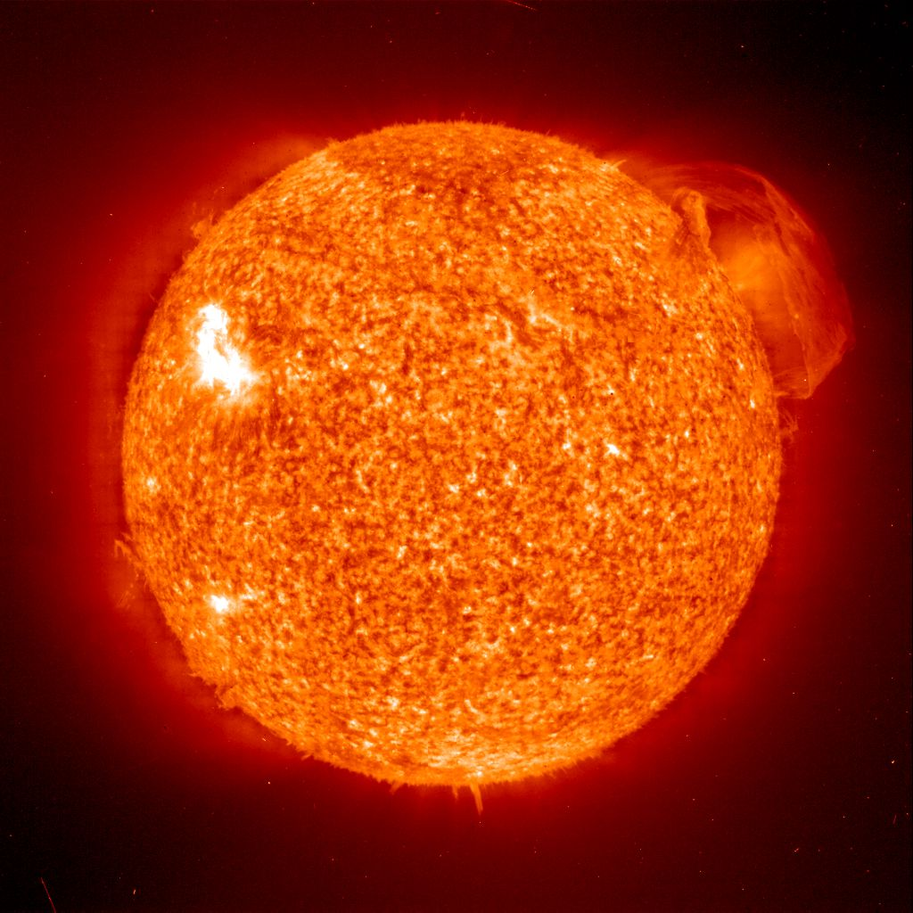
Do we know that the temperature was higher in the early Universe than now ?
Cosmic microwave radiation , nucleosynthesis
instead of
higher temperature :
smaller particle masses

Slide 11
Hot plasma ?
Temperature in radiation dominated Universe : T ~ χ ^{½} smaller than today
Particle masses : m_{p} ~ χ smaller than today
Ratio temperature / particle mass : T / m_{p} ~ χ ^{-½} larger than today
T/m_{p} counts ! This ratio decreases with time.
Nucleosynthesis , CMB emission as in standard cosmology !

Slide 12
Freeze Universe
The Universe may have started very cold,
and only later heat up.
Freeze picture of the Universe

Slide 13

Hot big bang or freeze ?

Slide 14
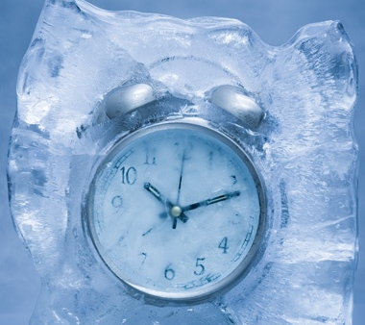
Big bang or freeze ?
freeze picture :
only rods for measurements
( masses ) are different !

Slide 15
Big bang is not wrong , but alternative pictures exist !

Slide 16
Field relativity : different pictures of cosmology
same physical content can be described by different pictures
related by field – redefinitions , e.g. Weyl scaling , conformal scaling of metric
observables cannot depend on choice of fields
metric is one of the fields
which picture is useful ?

Slide 17
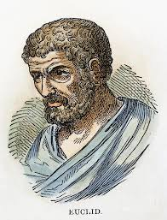


Relativity of geometry
Euclid … Newton : space and time
are absolute
Special relativity : space and time depend on observer
General relativity : space-time is
influenced by matter ( including radiation )
geometry is independent of coordinates
geometry is observable
Field relativity : geometry is relative

Slide 18
Space-time is a description of correlations between “matter”.
Observables cannot depend on choice of fields used to describe them.
Different pictures for geometry exist.

Slide 19
Why should you care about the freeze picture of the Universe ?
Some aspects are understood easier :
Beginning of Universe
Role of scale symmetry
Range of impact of quantum gravity

Slide 20
preview
Big bang singularity is artefact
of inappropriate choice of field variables –
no physical singularity
Quantum gravity may be observable in
dynamics of present Universe :
Dynamical Dark Energy

Slide 21
Quantum Gravity
Quantum Gravity is a
renormalisable quantum field theory
Asymptotic safety

Slide 22
Quantum scale symmetry
quantum fluctuations violate scale symmetry
running dimensionless couplings
at fixed points , scale symmetry is exact !
quantum fluctuations can generate scale symmetry !
at UV- fixed point for renormalizable quantum gravity : quantum scale symmetry is exact

Slide 23
Quantum scale symmetry
No parameter with dimension of
length or mass is present in the
quantum effective action.
Then invariance under
dilatations or global scale transformations
is realized.
Continuous global symmetry

Slide 24
quantum gravity with scalar field – the role of scale symmetry for cosmology

Slide 25
Spontaneous breaking of scale symmetry
expectation value of scalar field breaks scale symmetry spontaneously
massive particles are compatible with scale symmetry
in presence of massive particles : sign of exact scale symmetry is exactly massless Goldstone boson – the dilaton

Slide 26
Approximate scale symmetry near fixed points
UV : approximate scale invariance of primordial fluctuation spectrum from inflation
IR : cosmon is pseudo Goldstone boson of
spontaneously broken scale symmetry,
tiny mass,
responsible for dynamical Dark Energy

Slide 27
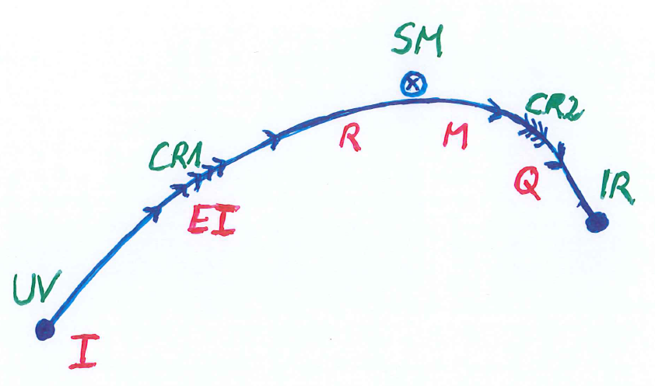
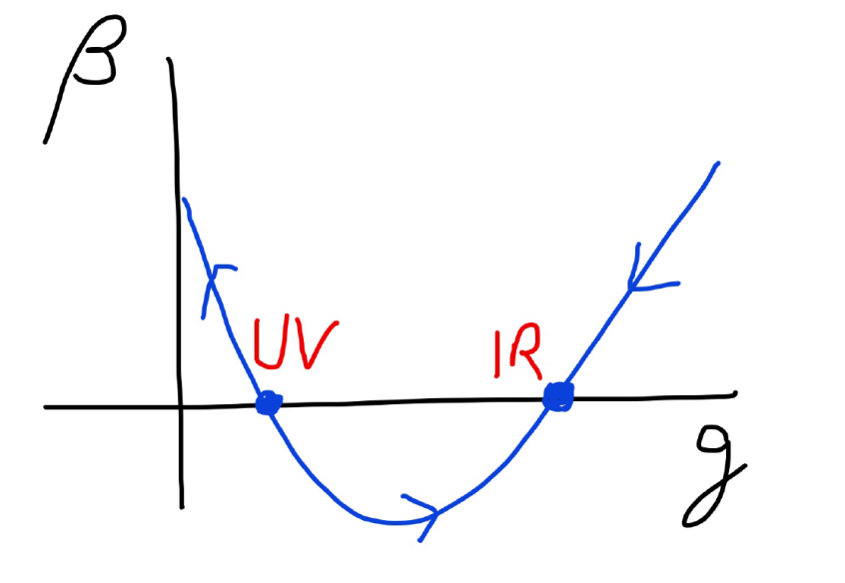
Possible consequences of crossover in quantum gravity
Realistic model for inflation and dark energy
with single scalar field

Slide 28
variable gravity
“Newton’s constant is not constant –
and particle masses are not constant”

Slide 29
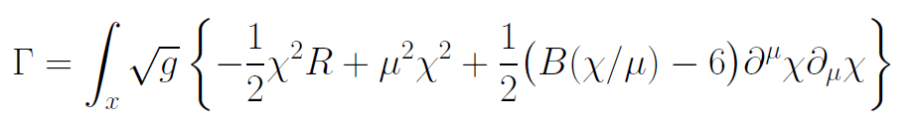
Variable Gravity
quantum effective action,
variation yields field equations
Einstein gravity :
M² R

Slide 30
Scale symmetry in variable gravity
( IR – fixed point )
quantum effective action,
variation yields field equations
Einstein gravity :
M² R

Slide 31
Variable Gravity
Scalar field coupled to gravity
Effective Planck mass depends on scalar field
Simple quadratic scalar potential involves intrinsic mass μ
Nucleon and electron mass proportional to dynamical Planck mass

Slide 32
Crossover
Possible description of crossover between two fixed points by scale dependence of “kinetial” B
Not the only possible description of crossover
Advantage : only one quantity, few parameters

Slide 33
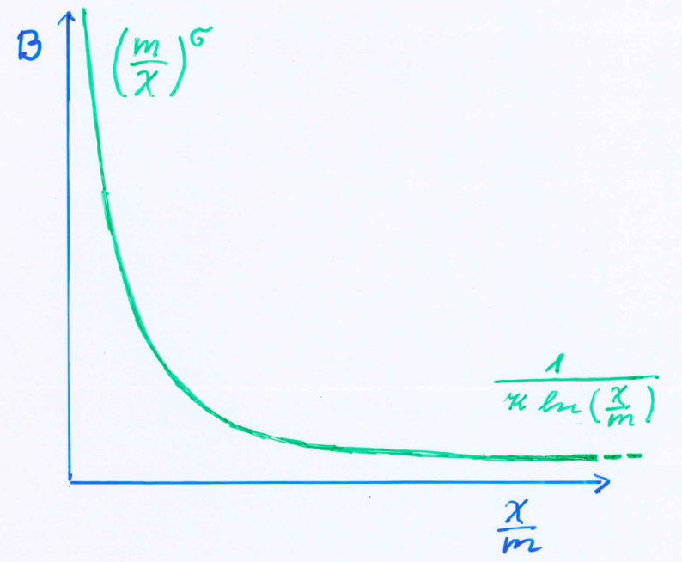
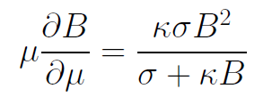
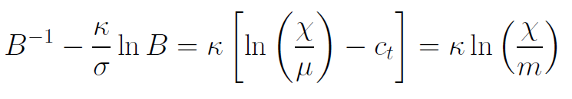
Kinetial B :
Crossover between two fixed points
assumption: running
coupling obeys
flow equation
m : scale of crossover
can be exponentially larger than intrinsic scale μ

Slide 34
Four-parameter model
model has four dimensionless parameters
three in kinetial :
σ ~ 2.5
κ ~ 0.5
c_{t} ~ 14 ( or m/μ )
one parameter for growth rate of neutrino mass over electron mass : γ ~ 8
+ standard model particles and dark matter : sufficient for realistic cosmology from inflation to dark energy
no more free parameters than ΛCDM

Slide 35
Cosmological solution
scalar field χ vanishes in the infinite past
scalar field χ diverges in the infinite future
J.Rubio,…

Slide 36
Model is compatible with present observations
Together with variation of neutrino mass over electron mass in present cosmological epoch :
model is compatible with all present observations, including inflation and dark energy

Slide 37
No tiny dimensionless parameters
( except gauge hierarchy )
μ = 2 • 10 ⁻³³ eV
one mass scale
one time scale μ⁻¹ = 10 ¹⁰ yr
Planck mass does not appear as parameter
Planck mass grows large dynamically

Slide 38
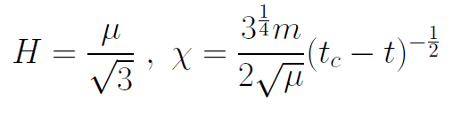
Slow Universe
Asymptotic solution in
freeze frame :
Expansion or shrinking always slow ,
characteristic time scale of the order of the age of the
Universe : t_{ch} ~ μ⁻¹ ~ 10 billion years !
Hubble parameter of the order of present Hubble
parameter for all times , including inflation and big bang !
Slow increase of particle masses !
μ= 2 • 10⁻³³ eV

Slide 39
Cosmic time is relative
Observable fluctuations,
that form later galaxies and other cosmic structures,
freeze 5000 billion years ago,
not 13.7 billion years ago

Slide 40
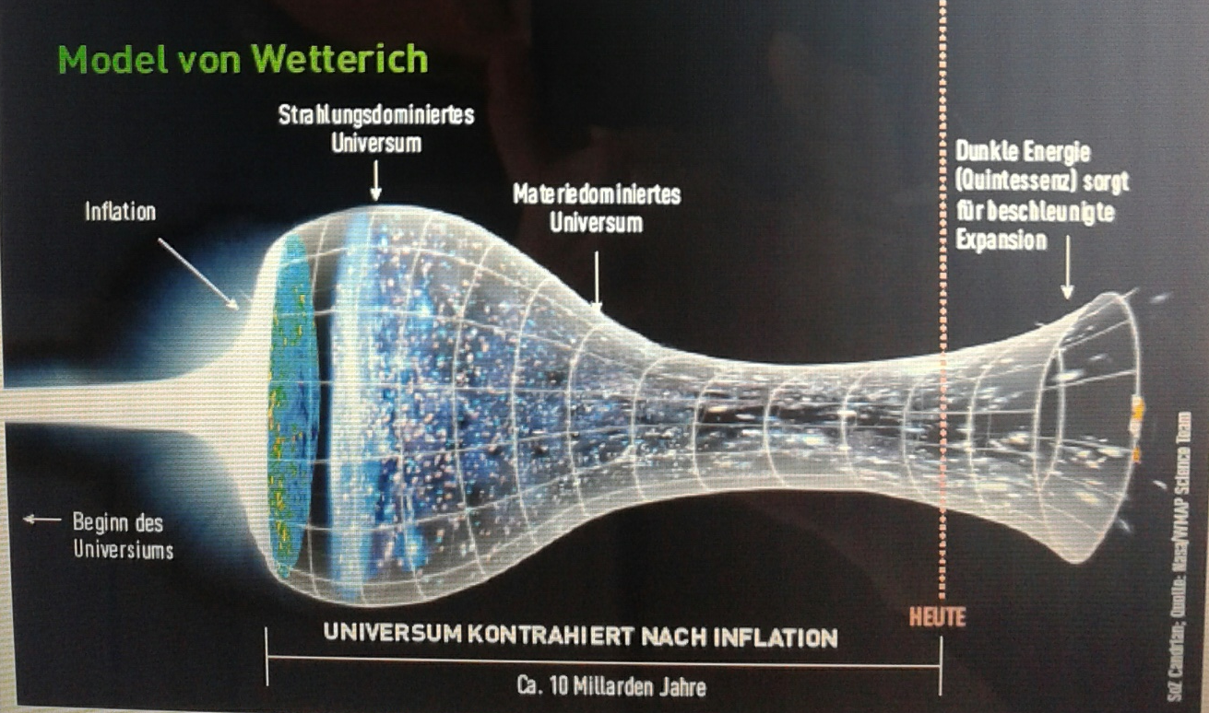
Strange evolution of Universe
Sonntagszeitung Zürich , Laukenmann

Slide 41
Einstein frame
“Weyl scaling” maps variable gravity model to Universe with fixed masses and standard expansion history.
Exact equivalence of different frames !
“ different pictures”
Standard gravity coupled to scalar field.

Slide 42
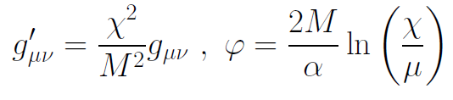
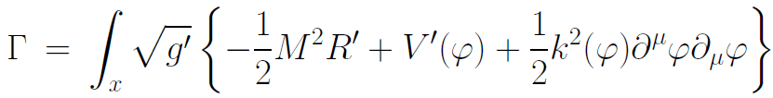
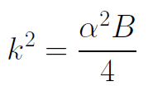

Einstein frame
Weyl scaling :
effective action in Einstein frame :

Slide 43
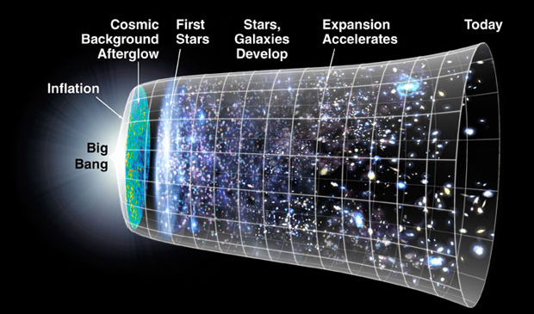
Field relativity
Weyl scaling :
changes geometry,
not a coordinate transformation

Slide 44
infinite past

Slide 45
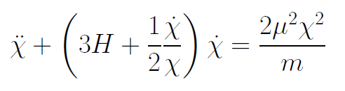
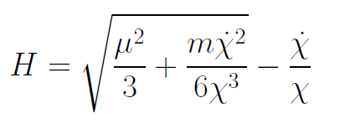
Infinite past : slow inflation
σ = 2 : field equations
approximative
solution
particles become massless in infinite past !

Slide 46
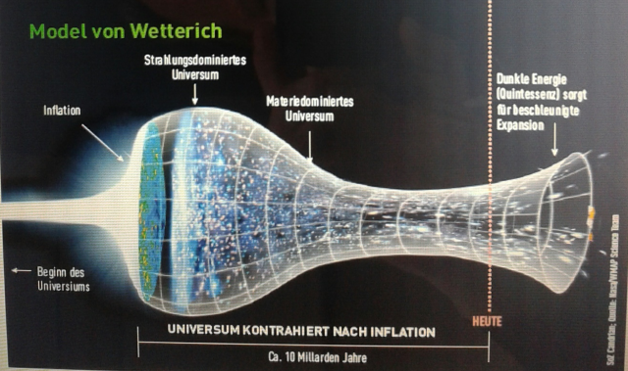
Eternal Universe
Asymptotic solution in
freeze frame :
solution valid back to the infinite past in physical time
no singularity
physical time to infinite past is infinite

Slide 47

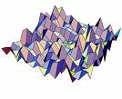
Eternal light-vacuum
Everywhere almost nothing
only fluctuations
All particles move
with light velocity,
similar to photons
strength of gravity
much stronger than today

Slide 48
In the beginning was light-like emptiness.

Slide 49
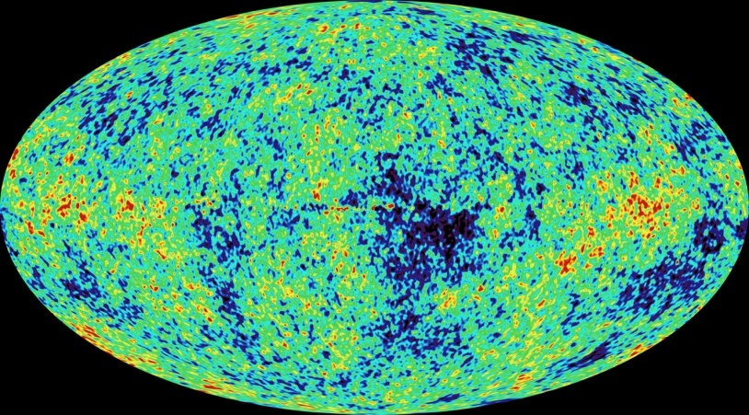
Eternal light-vacuum is unstable
Slow increase of particle masses and weakening of gravity
Only slow change of space-time geometry
Consequence for observation : primordial fluctuations become visible in cosmic background radiation
We see fluctuations in a stage 5000 billion years ago.

Slide 50
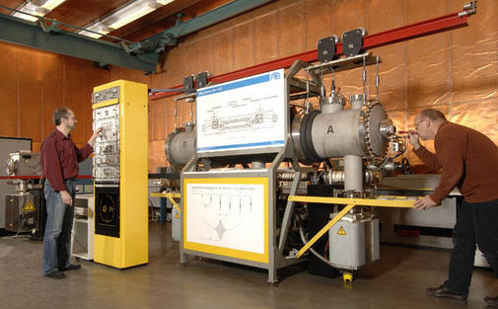
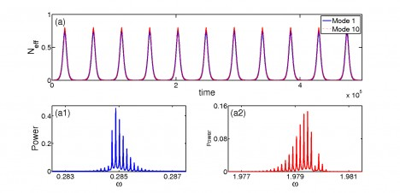
Physical time
count oscillations ….

Slide 51
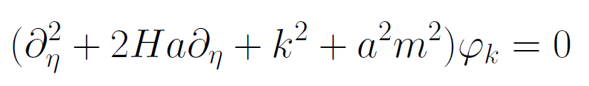
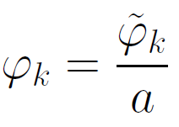
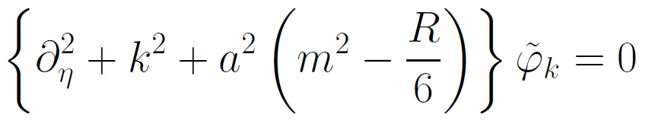
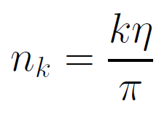

Physical time
field equation for scalar field mode
determine physical
time by counting
number of oscillations
( m=0 )

Slide 52
Physical time
counting : discrete
invariant under field transformations
same in all frames

Slide 53
Big bang singularity in Einstein frame is field singularity !
choice of frame with constant particle
masses is not well suited if
physical masses go to zero !

Slide 54


Field - singularity
Big Bang is field - singularity
similar ( but not identical with )
coordinate - singularity

Slide 55
Looking closer at the big bang picture
Same physical situation as in freeze picture
Infinite number of oscillations before big bang singularity is reached - infinite physical time !
At the beginning was light-like vacuum:
All particles effectively massless
Ratio mass over momentum counts, and all momenta
diverge in big bang picture as singularity is approached

Slide 56
Looking closer at the big bang picture
Singular field choice shrinks the infinite duration of beginning epoch to extremely short time interval for inflation
Proper time not a valid physical time for massless particles! ( frame – dependent )
Singularity theorems based on proper time being finite for approach to big bang : not valid !

Slide 57
Inflation

Slide 58
Beginning epoch : slow inflation
approximative
solution
Masses increase slowly with time
particles become massless in infinite past !

Slide 59
Particular model predicts properties of primordial fluctuation spectrum

Slide 60


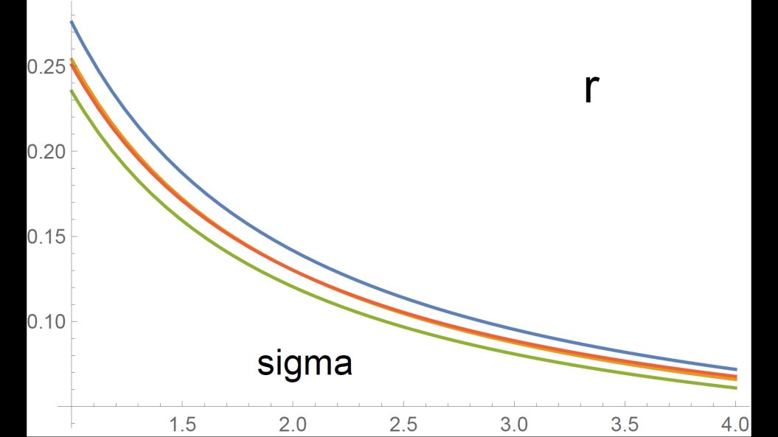
Anomalous dimension determines spectrum of primordial fluctuations
spectral index n
tensor amplitude r

Slide 61
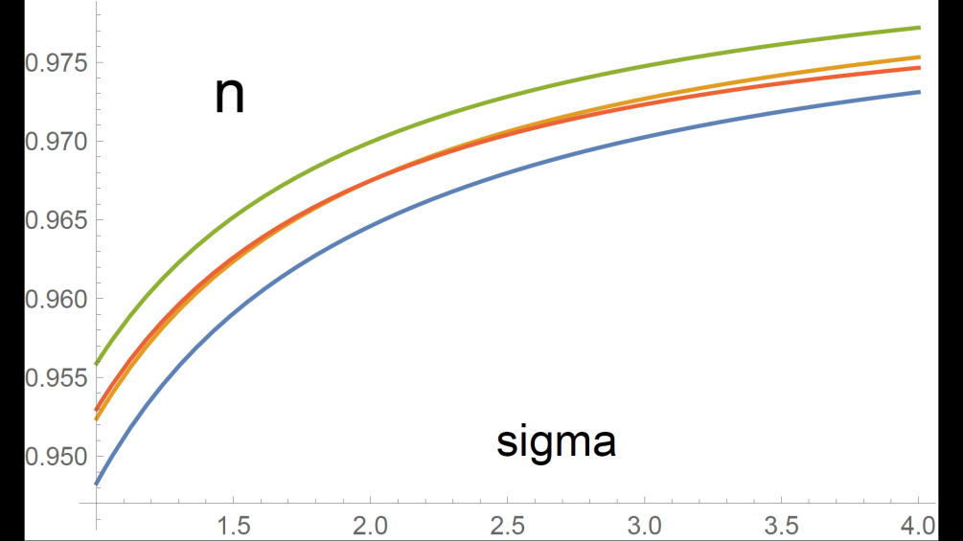
relation between n and r
r = 8.19 ( 1 – n ) - 0.1365

Slide 62
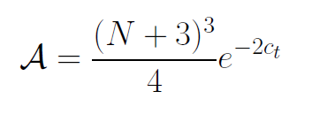

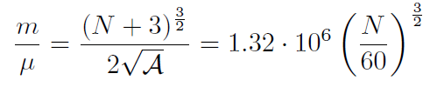
Amplitude of density fluctuations
small because of logarithmic running
near UV fixed point !
σ=1
N : number of e – foldings at horizon crossing

Slide 63
Primordial fluctuation spectrum
Precise properties change if model is modified
E.g. different function B
If UV- fixed point of quantum gravity can be computed reliably : Spectral parameters and amplitude can be predicted !

Slide 64
The Universe after inflation

Slide 65
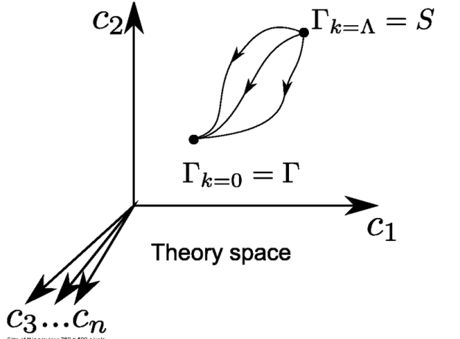
Crossover in quantum gravity and cosmology

Slide 66
Cosmological solution : crossover from UV to IR fixed point
Dimensionless functions as B
depend only on ratio μ/χ .
IR: μ→0 , χ→∞
UV: μ→∞ , χ→0
Cosmology makes
crossover between
fixed points by
variation of χ .
χ→0
χ→∞

Slide 67
Renormalization flow and cosmological evolution
renormalization flow as function of µ
is mapped by dimensionless functions to
field dependence of effective action on scalar field χ
translates by solution of field equation to
dependence of cosmology an time t or η

Slide 68
First step of crossover ends inflation
induced by crossover in B
after crossover B changes only very slowly

Slide 69
Transition to scaling solution
After end of inflation scalar field changes more rapidly
Kinetic energy dominated “kination” epoch
Entropy production, Heating of the Universe
Scaling solution with almost fixed fraction of Early Dark Energy

Slide 70
Evolution of dark energy fraction
J. Rubio,…

Slide 71
Scaling solution
after end of inflation
scaling solution with
few percent
of Early Dark Energy
Dark Energy decreases similar to radiation and matter

Slide 72
Freeze picture with shrinking Universe
Constant negative H ~ μ
μ = 2 • 10 ⁻³³ eV
t_{ch} ~ μ⁻¹ ~ 10 billion years
photons are more red because they have been emitted
with longer wavelength
frequency ~ mass
wavelength ~
atomsize

Slide 73
particle masses change with time
Particle masses are proportional to scalar field χ . Similar to Higgs field.
Scalar field varies with time.
Freeze picture possible only if there is a light scalar field that varies in time during radiation and matter domination – prediction !

Slide 74
“Fundamental” Interactions
Strong, electromagnetic, weak
interactions
On astronomical
length scales:
graviton
+
cosmon
gravitation
cosmodynamics

Slide 75
Dark energy

Slide 76
What is Dark Energy ?
Dark energy is energy density of scalar field χ
𝜌 = V + kinetic term
V= 𝜇² χ²
p = -V + kinetic term
Dark energy is dynamical if χ changes with time

Slide 77
No small parameter for dark energy

Slide 78
Four-parameter model
model has four dimensionless parameters
three in kinetial :
σ ~ 2.5
κ ~ 0.5
c_{t} ~ 14 ( or m/μ )
one parameter for growth rate of neutrino mass over electron mass : γ ~ 8
+ standard model particles and dark matter : sufficient for realistic cosmology from inflation to dark energy
no more free parameters than ΛCDM
no tiny parameter

Slide 79
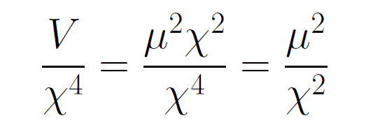
asymptotically vanishing cosmological „constant“
What matters : Ratio of potential divided by fourth power of Planck mass
vanishes for χ → ∞ !
V= 𝜇² χ²

Slide 80
small dimensionless number ?
needs two intrinsic mass scales
standard approach :V and M ( cosmological constant and Planck mass )
variable gravity : Planck mass moving to infinity , with fixed V ratio vanishes asymptotically !

Slide 81
Cosmological Constant
- Einstein -
Constant λ compatible with all symmetries
No time variation in contribution to energy density
Why so small ? λ/M⁴ = 10⁻¹²⁰
Why important just today ?

Slide 82
Cosmological mass scales
  Energy density
  ρ ~ ( 2.4×10 ⁻³ eV )⁻ ⁴
  Reduced Planck mass
  M=2.44×10 ²⁷ eV
  Newton’s constant
  GN=(8πM²)
Only ratios of mass scales are observable !
homogeneous dark energy: ρ_{h}/M⁴ = 7 10ˉ¹²¹
matter: ρ_{m}/M⁴= 3 10ˉ¹²¹

Slide 83
Time evolution
tˉ² matter dominated universe
tˉ^{3/2} radiation dominated universe
ρ_{m}/M⁴ ~ aˉ³ ~
ρ_{r}/M⁴ ~ aˉ⁴ ~ t ⁻² radiation dominated universe
Huge age small ratio
Same explanation for small dark energy?

Slide 84
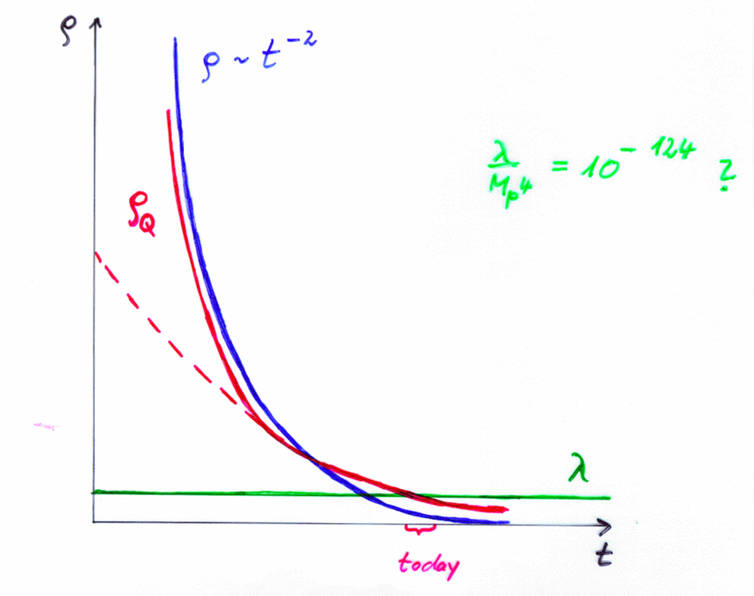
Cosm. Const. | Quintessence
static | dynamical

Slide 85
Quintessence
Dynamical dark energy ,
generated by scalar field (cosmon )
C.Wetterich,Nucl.Phys.B302(1988)668, 24.9.87
P.J.E.Peebles,B.Ratra,ApJ.Lett.325(1988)L17, 20.10.87
Notes:
85

Slide 86
Prediction : homogeneous dark energy influences recent cosmology
- of same order as dark matter -
Original models do not fit the present observations
…. modifications
( different growth of neutrino mass )

Slide 87
asymptotically vanishing cosmological „constant“
What matters : Ratio of potential divided by fourth power of Planck mass
vanishes for χ → ∞ !
V= 𝜇² χ²

Slide 88
Einstein frame
Weyl scaling :
effective action in Einstein frame :

Slide 89
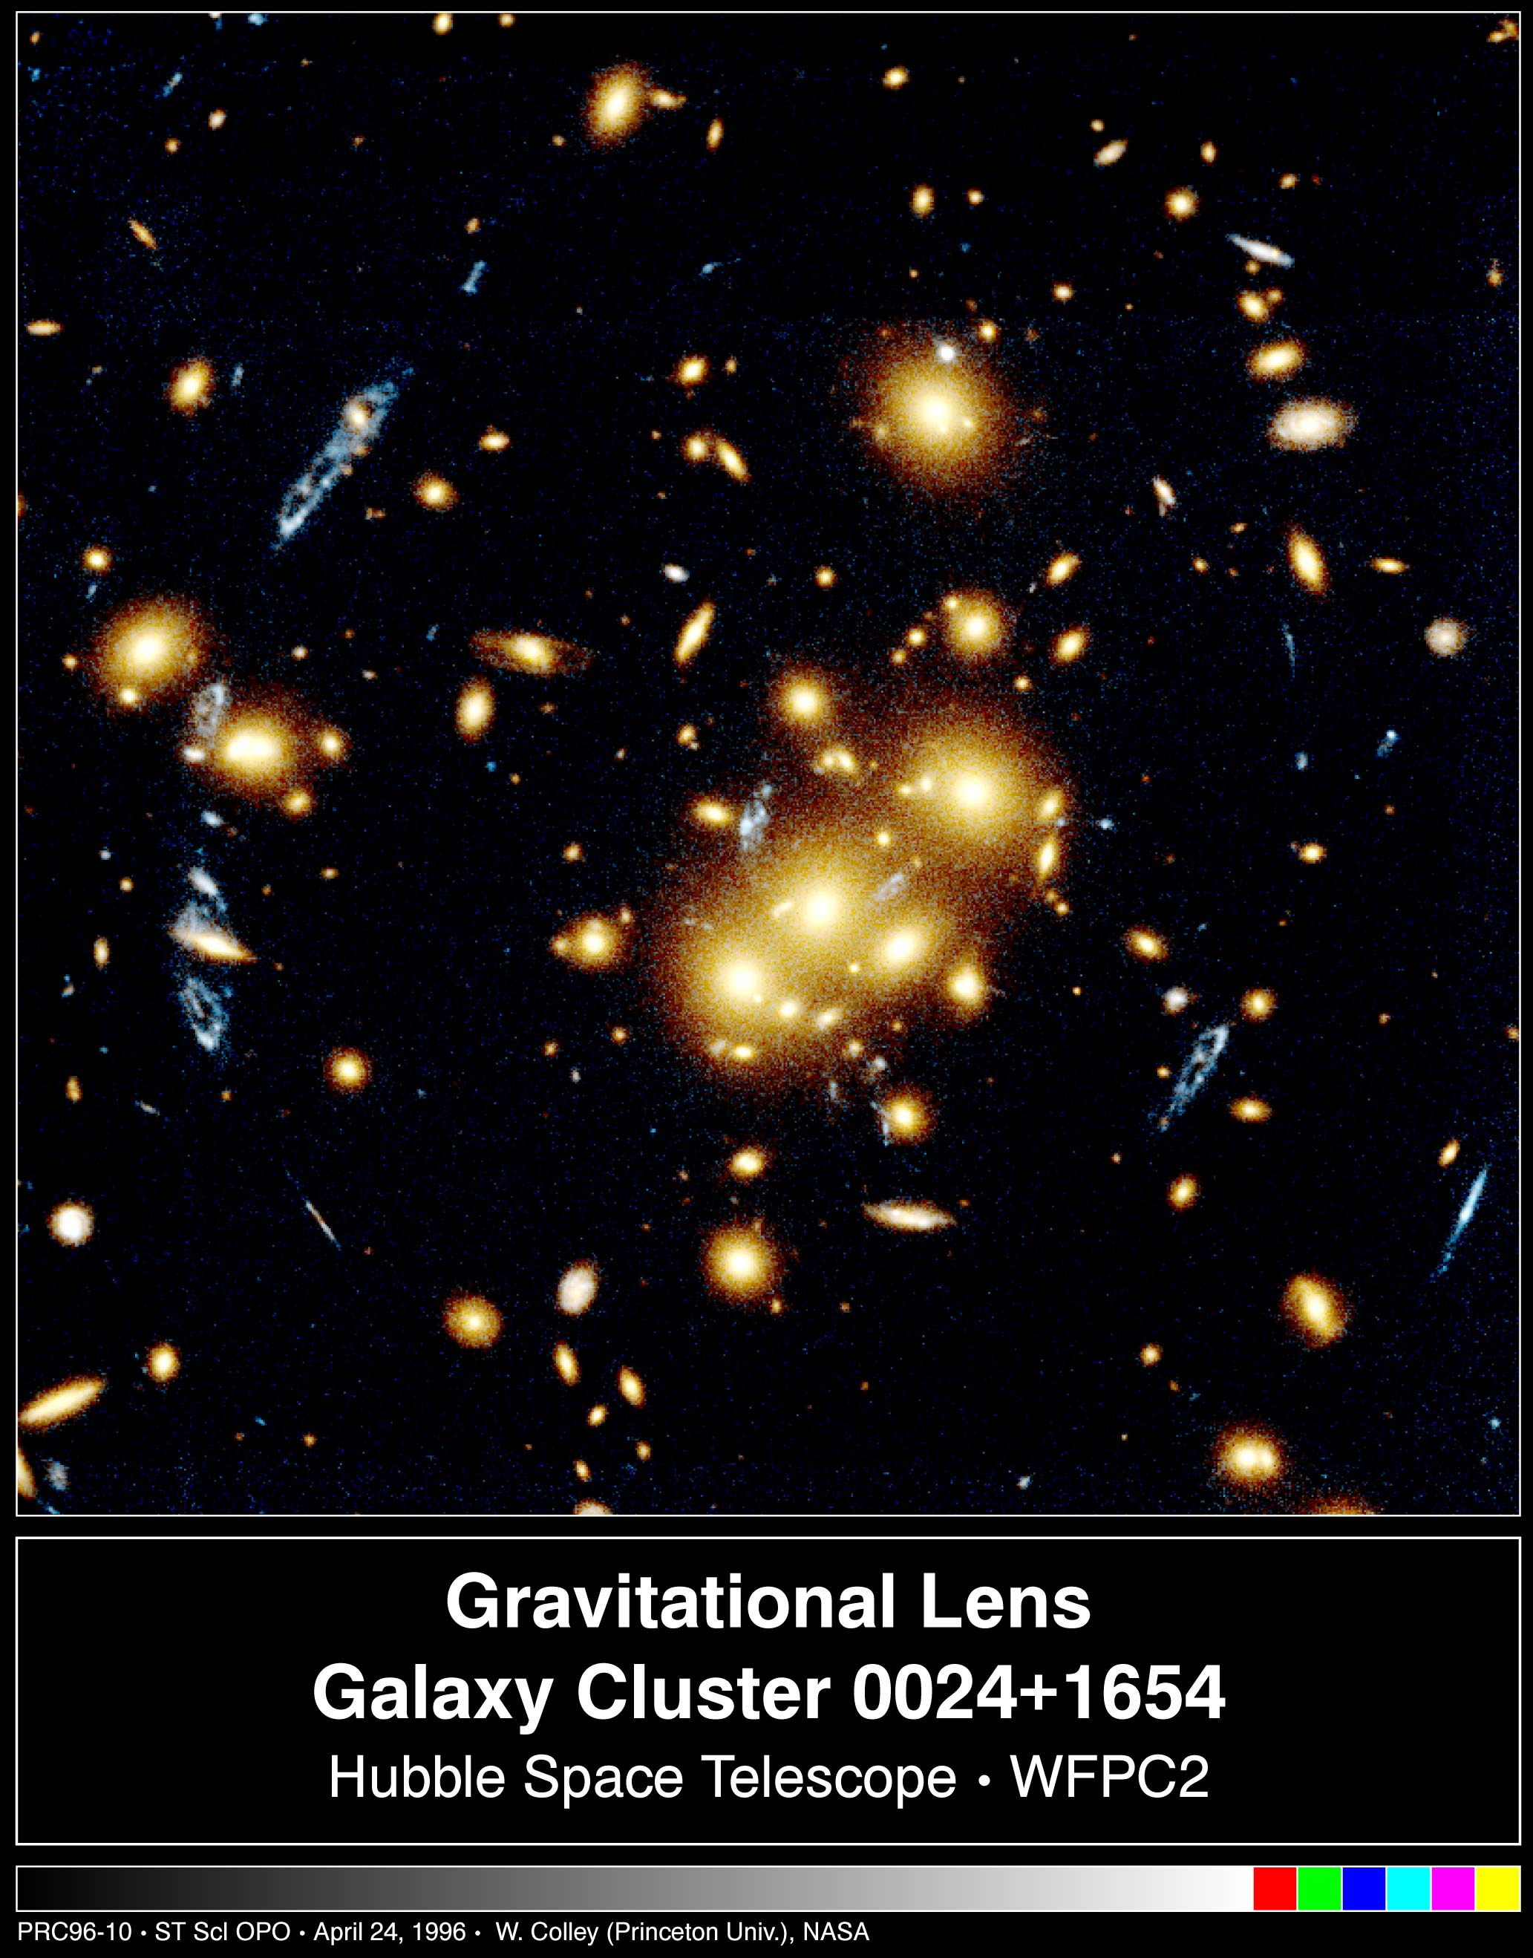
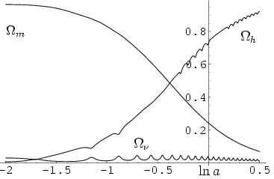
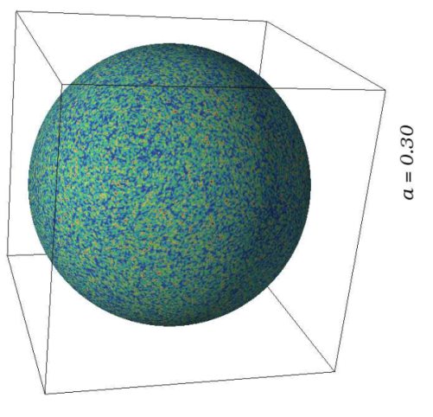
Growing neutrino quintessence

Slide 90
Growing neutrino masses and quintessence

Slide 91
Cosmic trigger can explain why now problem for dynamical dark energy
Stop of evolution of scalar field when neutrinos become non-relativistic
Transition from scaling solution to (almost) cosmological constant

Slide 92
Second stage of crossover
from SM to IR
in sector Beyond Standard Model
affects neutrino masses first ( seesaw or cascade mechanism )

Slide 93
Varying particle masses at onset of second crossover
Except for neutrinos all particle masses are proportional to χ .
Ratios of particle masses remain constant.
Compatibility with observational bounds on time dependence of particle mass ratios.
Neutrino masses show stronger increase with χ , such that ratio neutrino mass over electron mass grows .

Slide 94
Cosmic trigger
Stop of evolution of scalar field when neutrinos become non-relativistic
Transition from scaling solution to (almost) cosmological constant

Slide 95
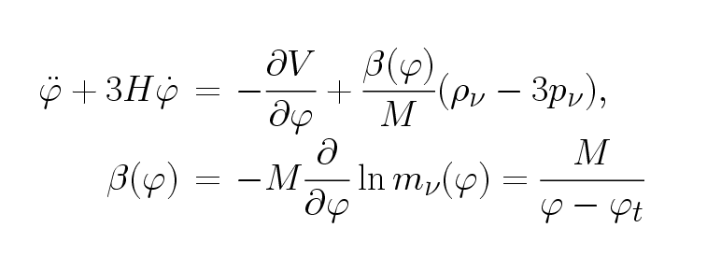
growing neutrinos change cosmon evolution
modification of conservation equation for neutrinos

Slide 96
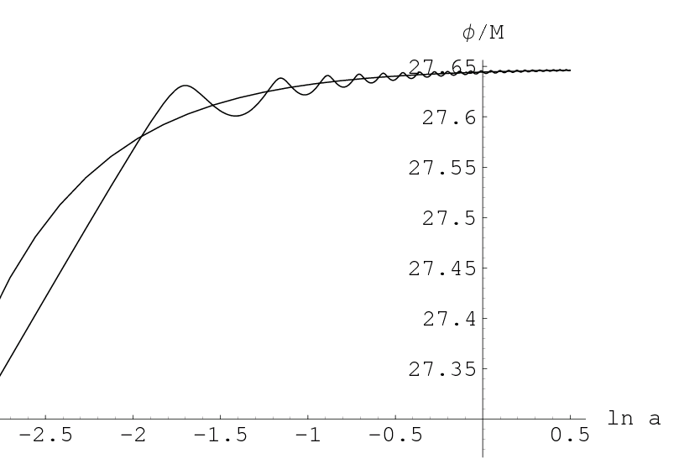
cosmon evolution
“stopped”
scaling

Slide 97
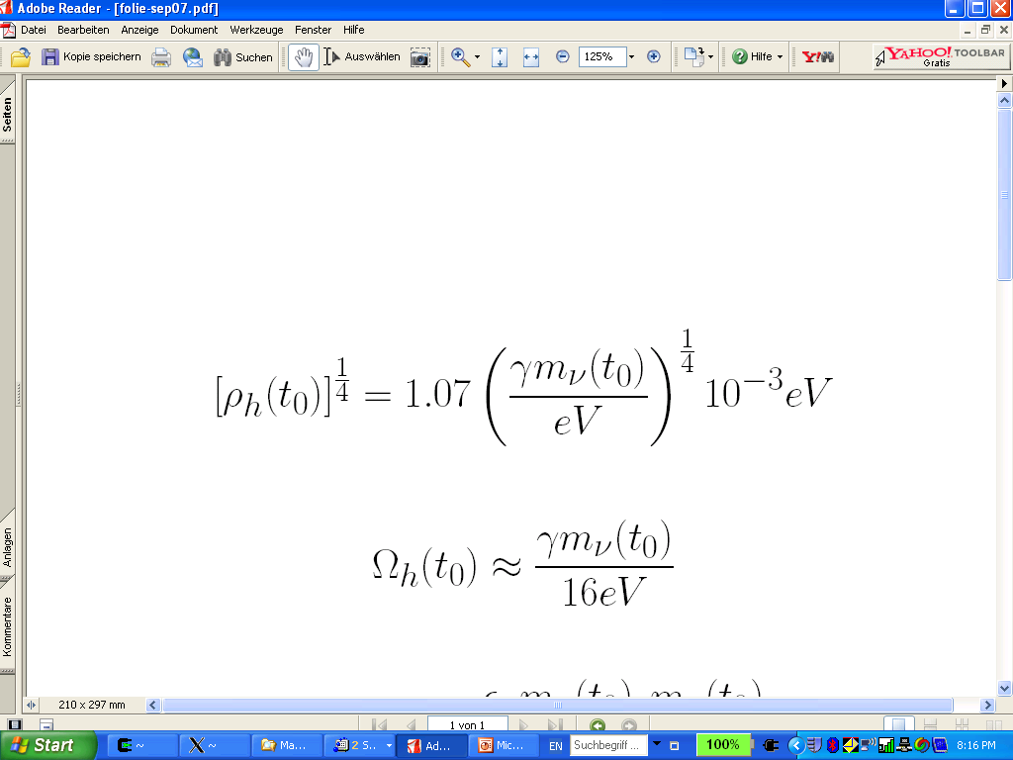
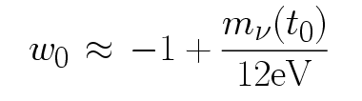
connection between dark energy and neutrino properties
L.Amendola,
M.Baldi, …
= 1.27
present dark energy density given by neutrino mass
present equation
of state given by
neutrino mass !
Notes:
97

Slide 98
Neutrino lumps
Scalar- mediated attractive force between neutrinos 1000 times stronger than gravitational attraction
Clumping of cosmic neutrino background
Formation of non-linear neutrino lumps

Slide 99
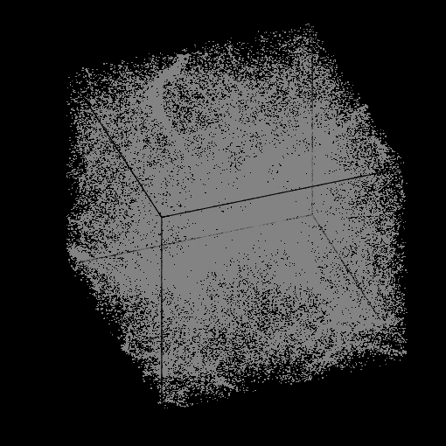

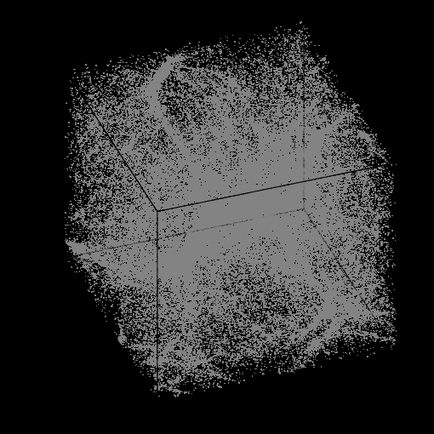
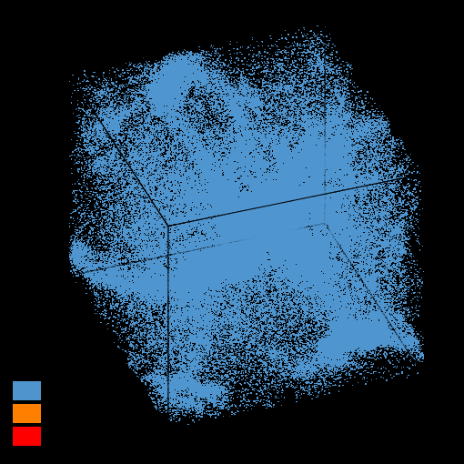
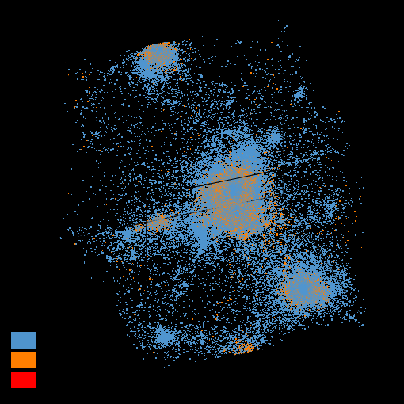
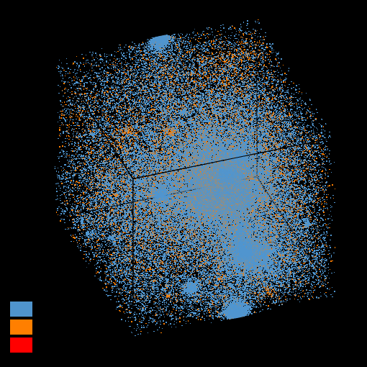
Formation of neutrino lumps
N- body simulation M.Baldi et al

Slide 100
Neutrino lumps
large m_{𝜈}
small m_{𝜈}
Casas, Pettorino,…

Slide 101
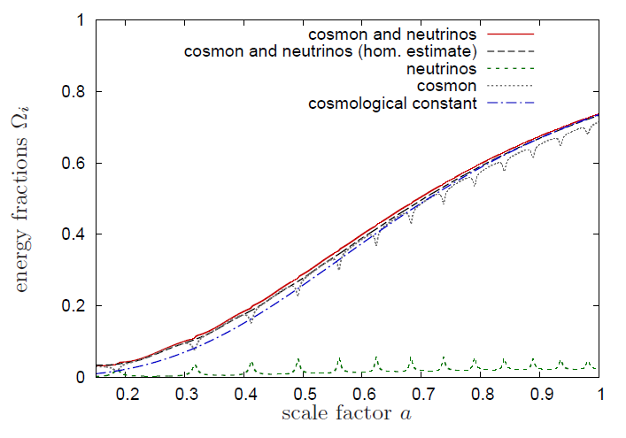
Evolution of dark energy similar to ΛCDM

Slide 102
Compatibility with observations and possible tests
Realistic inflation model
Almost same prediction for radiation, matter, and Dark Energy domination as ΛCDM
Presence of small fraction of Early Dark Energy
Reduces observed cosmic structures as
compared to ΛCDM extrapolation from CMB
Large neutrino lumps

Slide 103
Conclusions
Quantum gravity may be observable in
dynamics of present Universe
Fixed points and scale symmetry crucial
Big bang singularity is artefact
of inappropriate choice of field variables –
no physical singularity

Slide 104
Simplicity
simple description of all cosmological epochs
natural incorporation of Dark Energy :
inflation
Early Dark Energy
present Dark Energy
dominated epoch
J.Rubio…

Slide 105
conclusions (2)
Variable gravity cosmologies can give a simple and realistic description of the Universe
Compatible with tests of equivalence principle and bounds on variation of fundamental couplings if nucleon and electron masses are proportional to variable Planck mass
Cosmon dependence of ratio neutrino mass/ electron mass can explain why Universe makes a transition to Dark Energy domination now
characteristic signal : neutrino lumps

Slide 106
end

