Slide 1
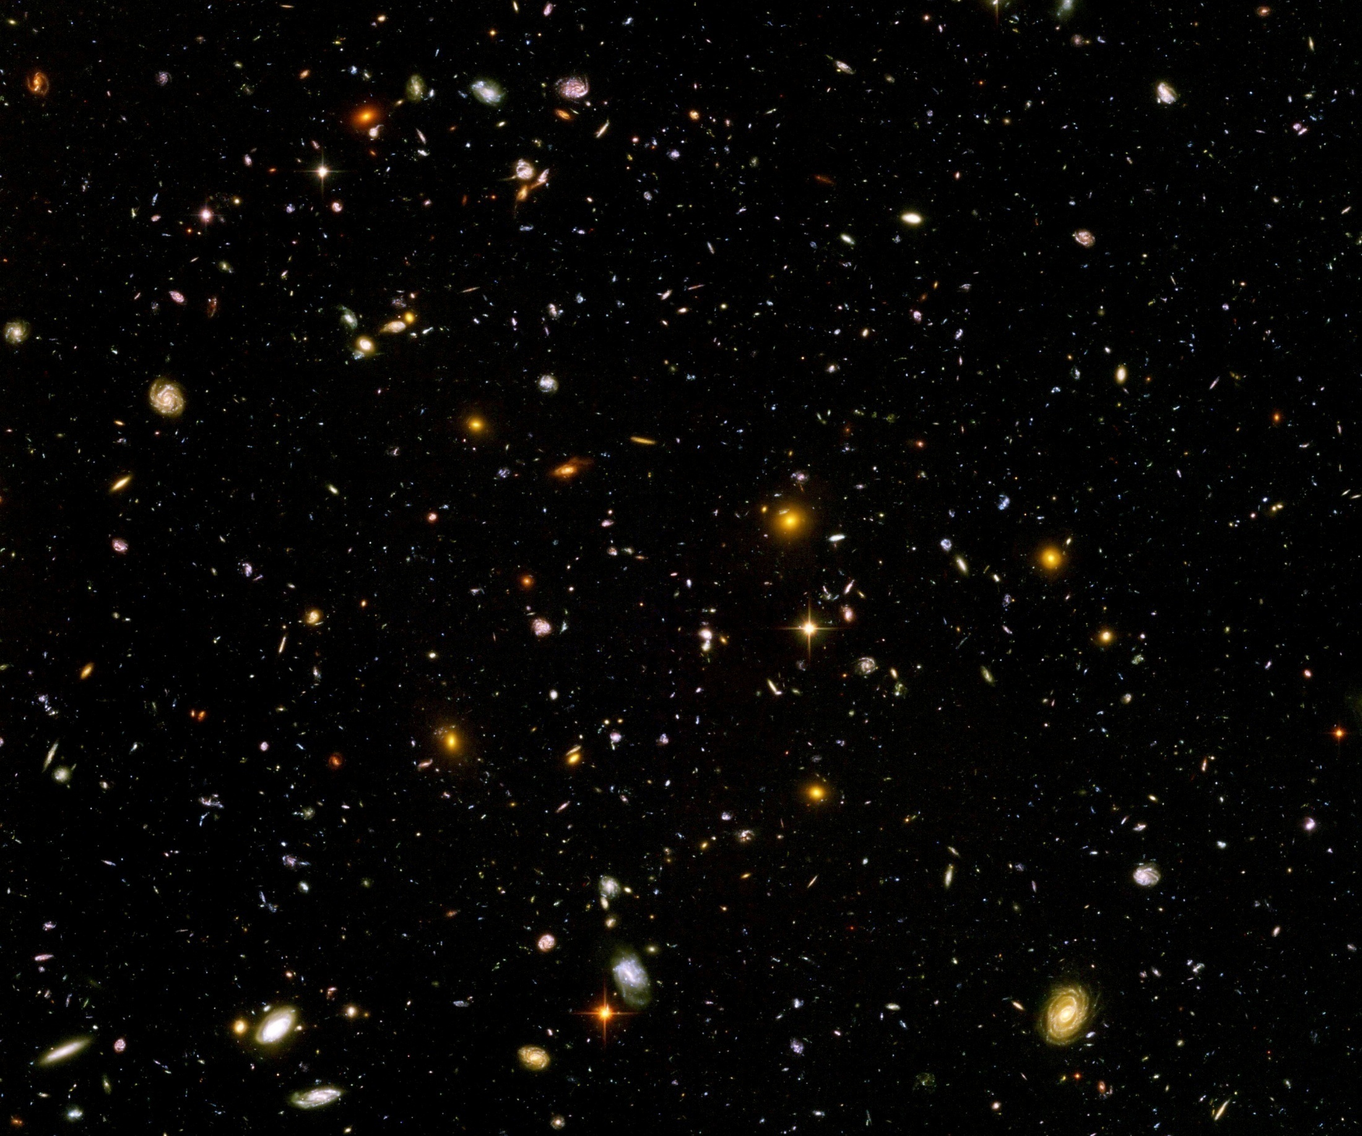
Quantum gravity and the beginning of the Universe

Slide 2
(1) How did the Universe begin ?

Slide 3
Beginning of Universe
Zu Anfang war die Welt öd und leer und währte ewig.
In the beginning the Universe was empty and lasted since ever.

Slide 4

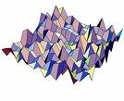
Eternal light-vacuum
Everywhere almost nothing
only fields and their fluctuations
All particles move
with light velocity,
similar to photons

Slide 5
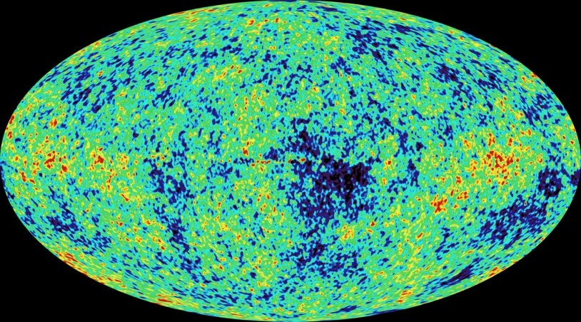
Eternal light-vacuum is unstable
Slow increase of particle masses
Only slow change of space-time geometry
Creation of particles and entropy
Consequence for observation : primordial fluctuations become visible in cosmic background radiation
We see fluctuations in a stage 5000 billion years ago.

Slide 6
The great emptiness story
In the beginning was light-like emptiness.

Slide 7
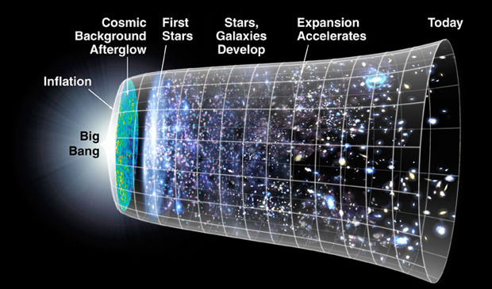
The big bang story
dramatic hot big bang
started 13.7 billion years ago
at the beginning extremely short period of cosmic inflation with almost exponential expansion of the Universe, duration around 10⁻⁴⁰ seconds
start with singularity : our whole observable Universe evolves from one point

Slide 8
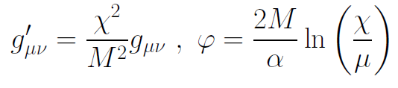
Field relativity
Both stories are equivalent
related by field transformation of the metric
different metrics related by Weyl transformation, which depends on scalar field ( inflaton )

Slide 9
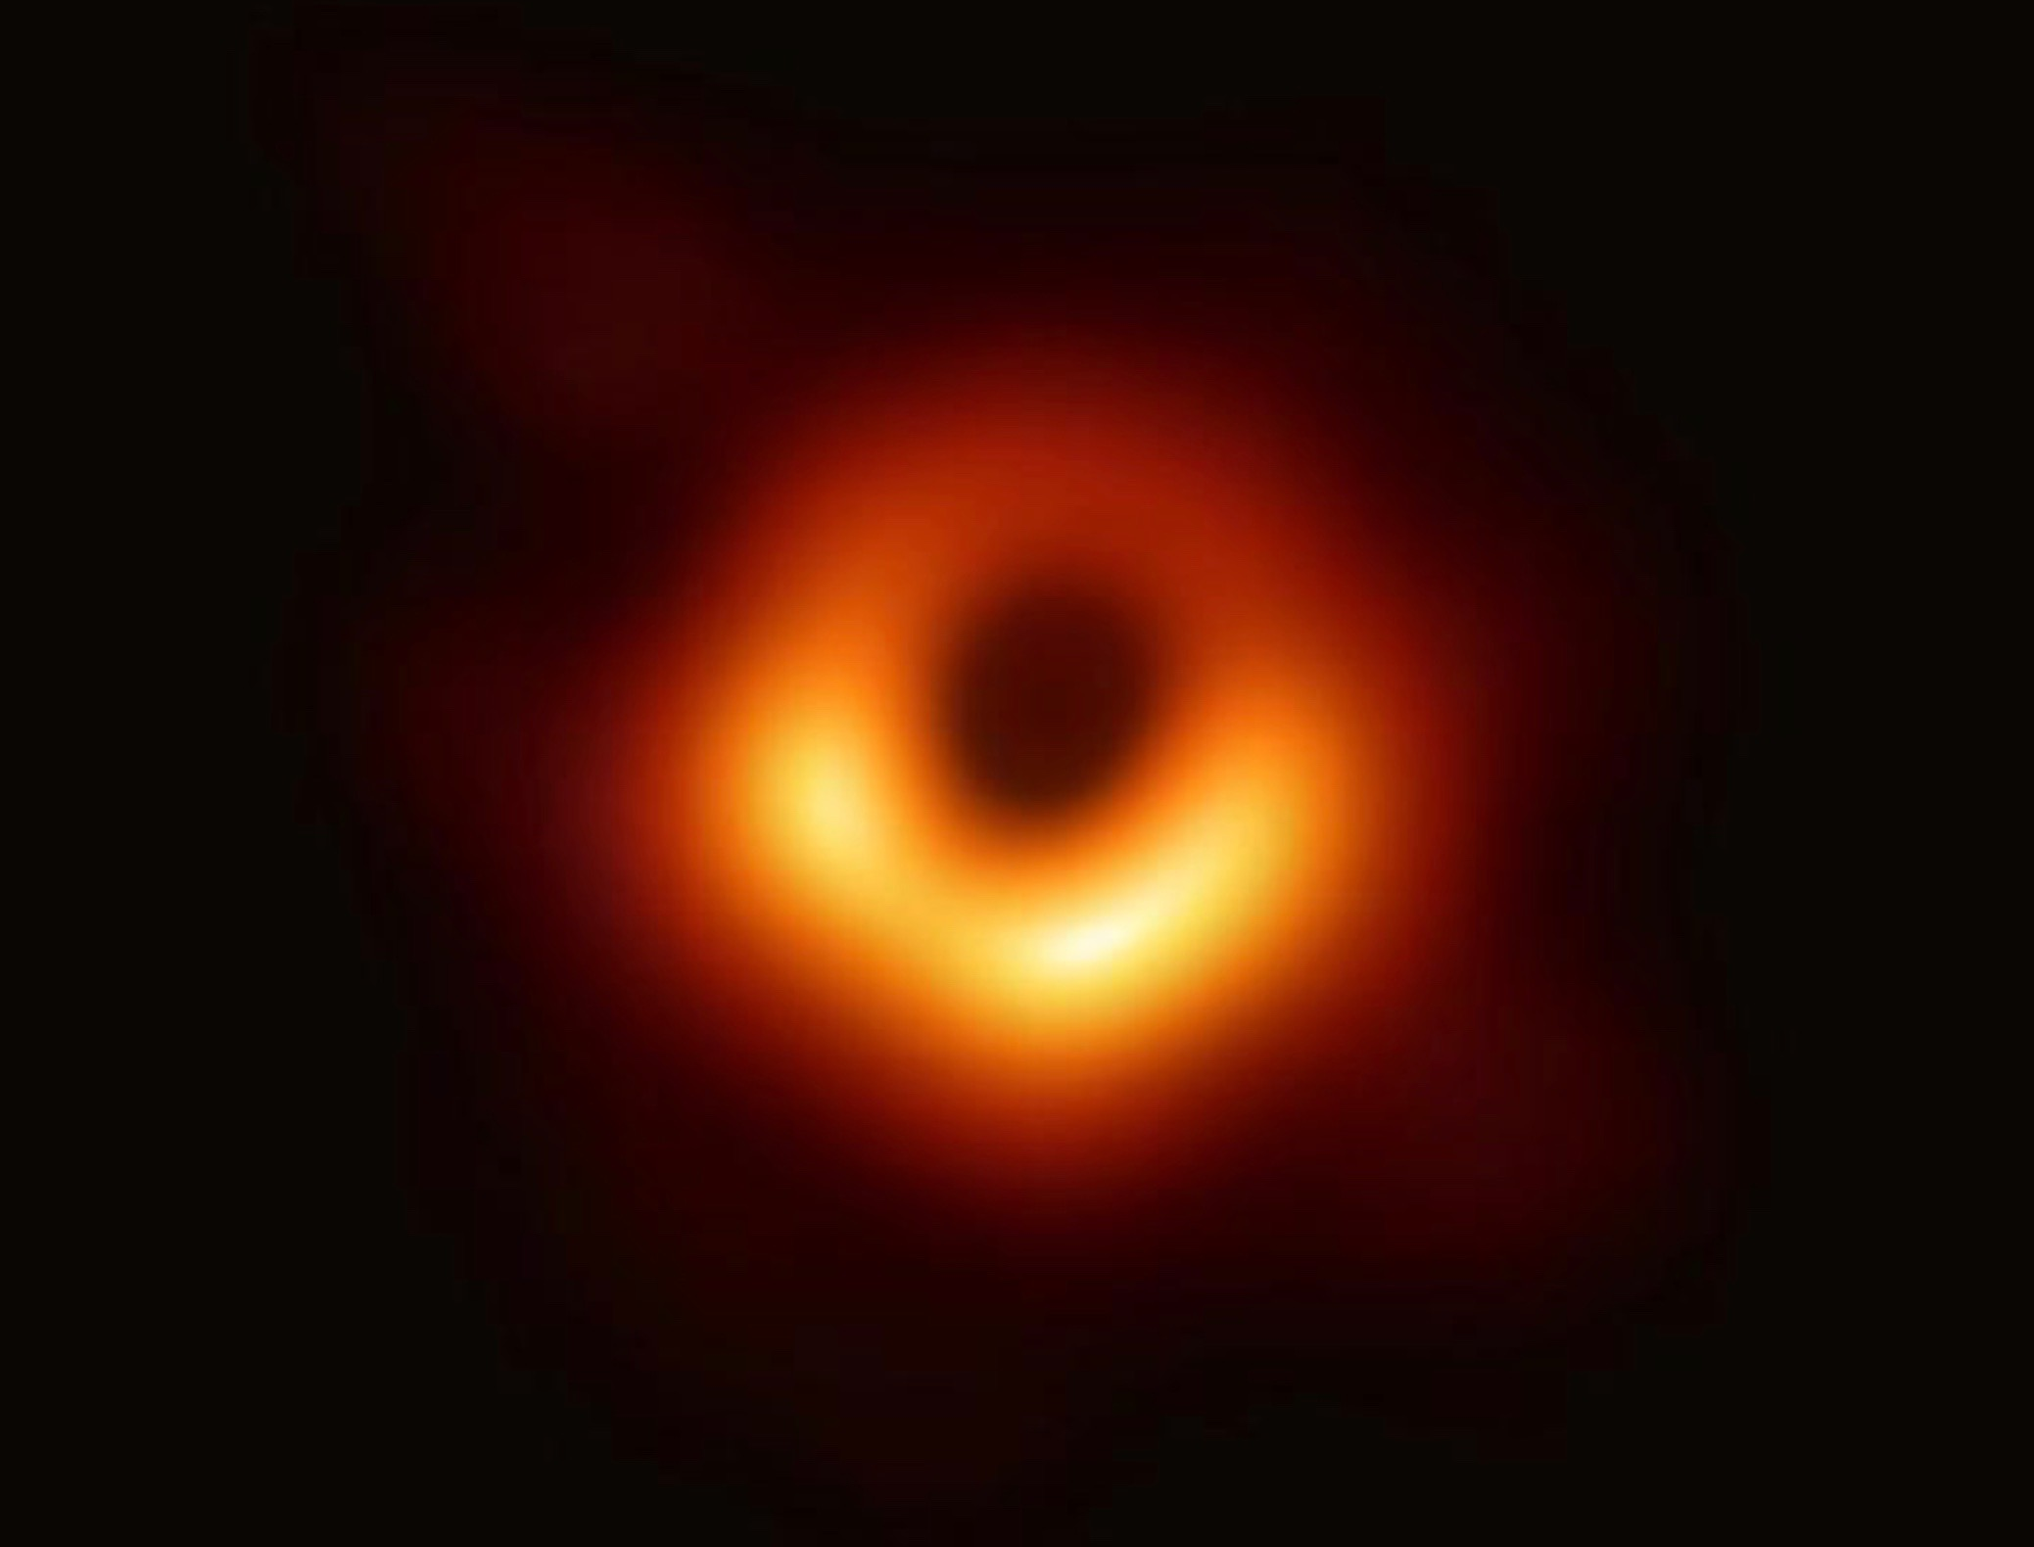
Metric
Metric field g_{μν} (t , x ) is central ingredient for gravity
similar to electric or magnetic fields
generalizes gravitational field in Newtonian gravity

Slide 10
different possible choices for the metric field

Slide 11
Field relativity : different pictures of cosmology
same physical content can be described by different pictures
related by field – redefinitions ,
observables cannot depend on choice of fields
different fields: different variables in differential equations
metric is one of the fields

Slide 12
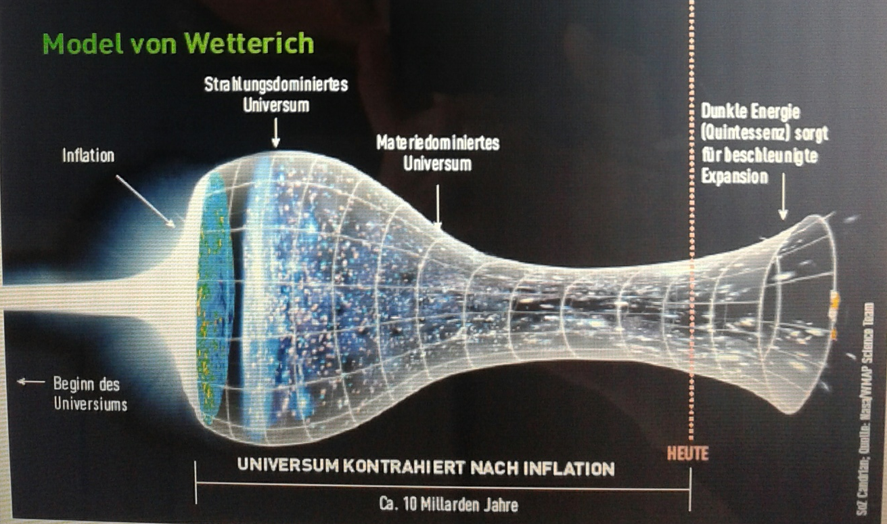
Field relativity
Weyl scaling :
changes geometry,
not a coordinate transformation

Slide 13
Expansion of the Universe
What does expansion of space mean ?
A field changes its value
that’s all
Propagation of particles and photons depend on the value of the metric field

Slide 14
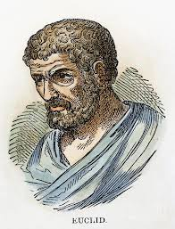


Relativity of geometry
Euclid … Newton : space and time
are absolute and observable
Special relativity : space and time depend on observer
General relativity : space-time is
influenced by matter ( including radiation )
geometry is independent of coordinates
geometry is observable
Field relativity : geometry is relative

Slide 15
Space-time is a description of correlations between “matter”.
Observables cannot depend on choice of fields used to describe them.
Different pictures for geometry exist.

Slide 16


Field - singularity
Big Bang is field - singularity
similar ( but not identical with )
coordinate - singularity

Slide 17
Do not always believe pictures
ask what is the physical content

Slide 18
Physical properties during inflationary epoch
All particles get effectively massless as singularity is approached
Relevant quantity : mass /momentum
Momentum diverges
Ratio goes to zero

Slide 19
Eternal light-vacuum
Everywhere almost nothing
only fields and their fluctuations
All particles move
with light velocity,
similar to photons

Slide 20
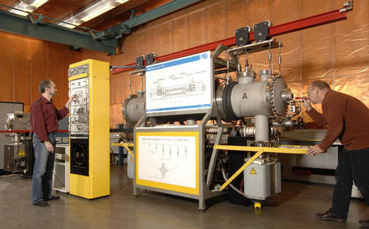
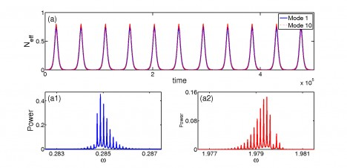
Physical time
count oscillations ….

Slide 21
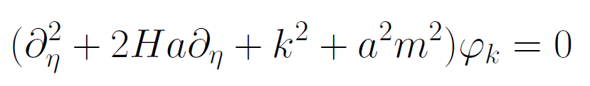
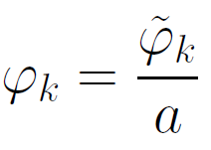
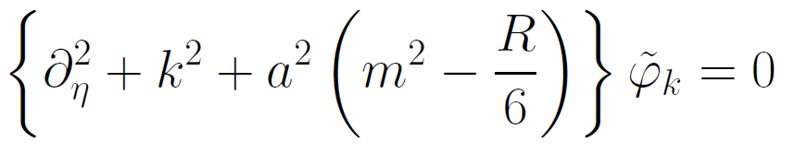
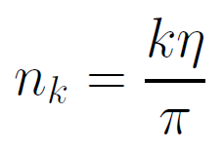

Physical time
field equation for scalar field mode
determine physical
time by counting
number of oscillations
( m=0 )

Slide 22
Physical time
counting : discrete
invariant under field transformations
same in all frames
physical time towards the past: infinite number of oscillations

Slide 23
Conclusion ( 1 )
There are equivalent pictures of the Universe with different geometry
Singularity free choice of fields is preferable for the description of the beginning

Slide 24
No scales in the infinite past
No time scale : time is infinite and no change of properties as time goes to minus infinity
No length scale : Universe is homogeneous and infinite
No mass scale : all particles are massless

Slide 25
(2) Quantum scale symmetry

Slide 26
Scale transformation
Scale all lengths and time with constant factor
Scale all masses with inverse factor

Slide 27
Quantum scale symmetry
No parameter with dimension of
length or mass is present in the
quantum effective action.
Then invariance under
dilatations or global scale transformations
is realized.
Continuous global symmetry

Slide 28
Un
Unbroken scale symmetry :
Physics looks the same on all scales
All “particles”
are
massless

Slide 29
Running couplings : the physics of fluctuations
The physical laws do not look the same on all length scales
Effective macroscopic laws emerge
Key concept in statistical physics /
condensed matter physics

Slide 30
Quantum fluctuations induce running
( momentum dependent ) couplings
Running fine structure constant
𝛼 = 1/137 for atoms
𝛼 = 1/128 at LEP
Induced by quantum fluctuations of electrons, muons, quarks etc.

Slide 31
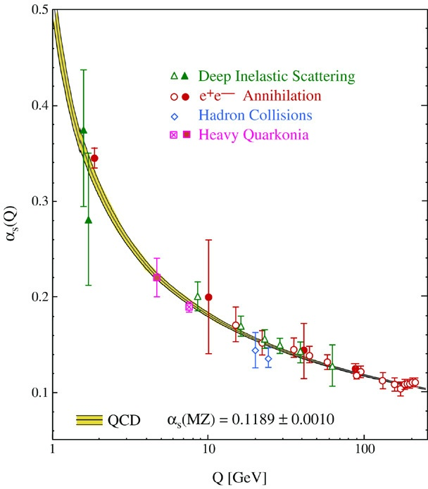
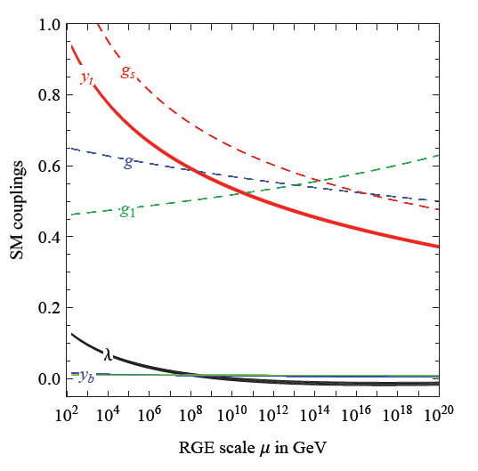
Quantum fluctuations induce running couplings
possible violation of scale symmetry
well known in QCD or standard model

Slide 32
Quantum scale symmetry
quantum fluctuations can violate scale symmetry
running dimensionless couplings
fixed point : no running of couplings
at fixed points , scale symmetry is exact !
quantum fluctuations can generate scale symmetry !

Slide 33
Scale symmetry and fixed points
Relative strength of gravity
Particle
scale
symmetry
Gravity
scale
symmetry
Distance from
electroweak
phase transition
Cosmic
scale
symmetry

Slide 34
Fixed points and scale symmetry
At a fixed point, scale symmetry is exact in the presence of fluctuations ( quantum scale symmetry )
Well known in condensed matter physics :
second order phase transition
fixed point or scaling solution
exact scale symmetry
critical phenomena
Classical or quantum Ising model

Slide 35
Quantum scale symmetry
Exactly on fixed point:
No parameter with dimension of
length or mass is present in the
quantum effective action.
Then invariance under
dilatations or global scale transformations
is realized as a quantum symmetry.
Continuous global symmetry

Slide 36
Have we observed scale symmetry in cosmology ?

Slide 37
Approximate scale symmetry near fixed points
UV : approximate scale invariance of primordial fluctuation spectrum from inflation
IR : cosmon is pseudo Goldstone boson of
spontaneously broken scale symmetry,
tiny mass,
responsible for dynamical Dark Energy

Slide 38
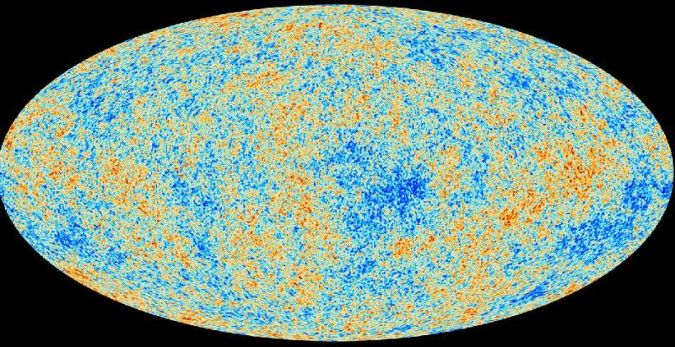
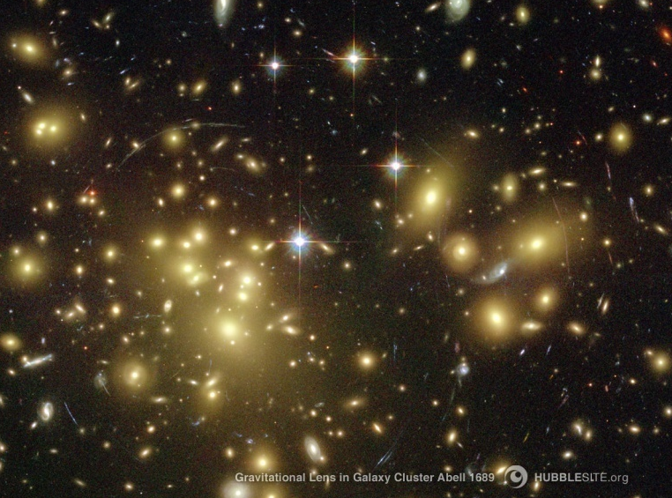
Almost scale invariant primordial fluctuation spectrum seeds all structure in the universe

Slide 39
Conclusion (2)
The beginning of the Universe is the reign of
quantum scale symmetry

Slide 40
(3) Quantum gravity

Slide 41
Quantum gravity

Slide 42
Quantum Gravity
Quantum Gravity can be a
renormalisable quantum field theory
Asymptotic safety

Slide 43
Asymptotic safety of quantum gravity
if UV fixed point exists :
quantum gravity is
non-perturbatively renormalizable !
S. Weinberg , M. Reuter

Slide 44
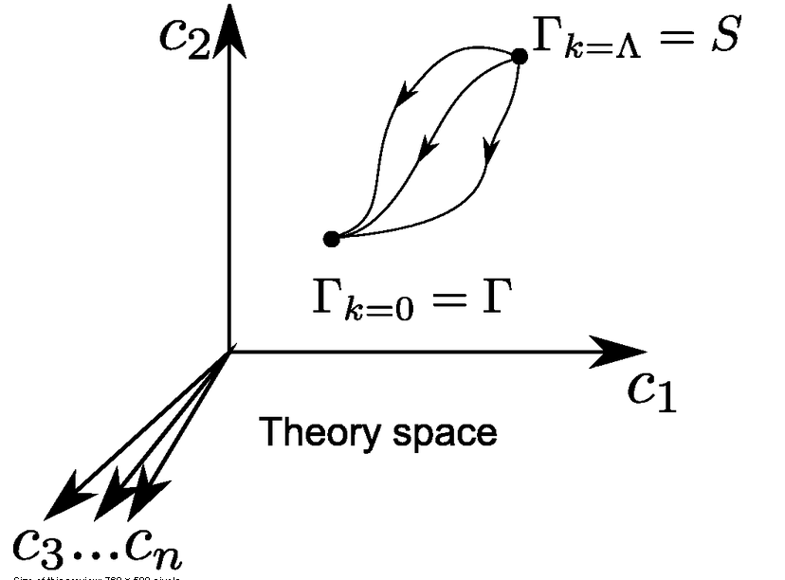
Functional renormalization : flowing action
Wikipedia
Notes:
44

Slide 45
Ultraviolet fixed point
UV fixed point
Wikipedia
Notes:
45

Slide 46
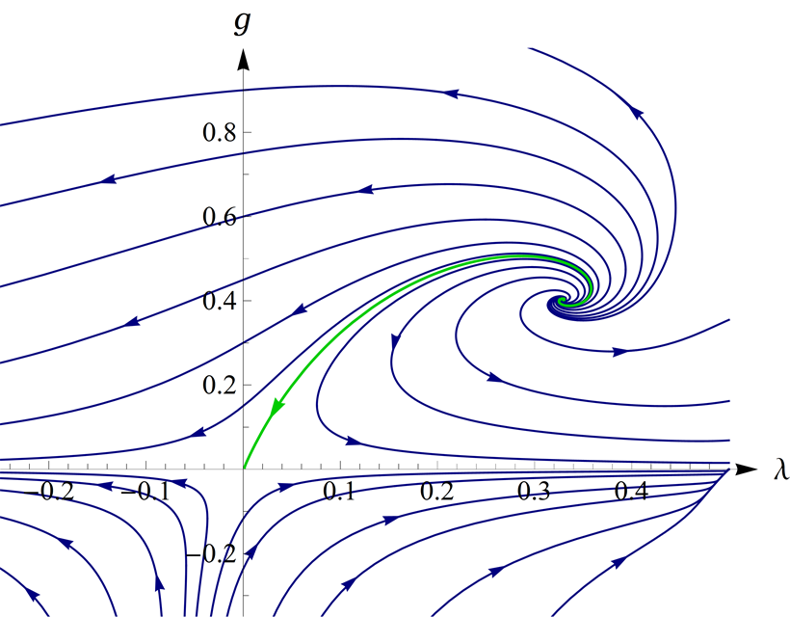
UV- fixed point for quantum gravity
Wikipedia

Slide 47
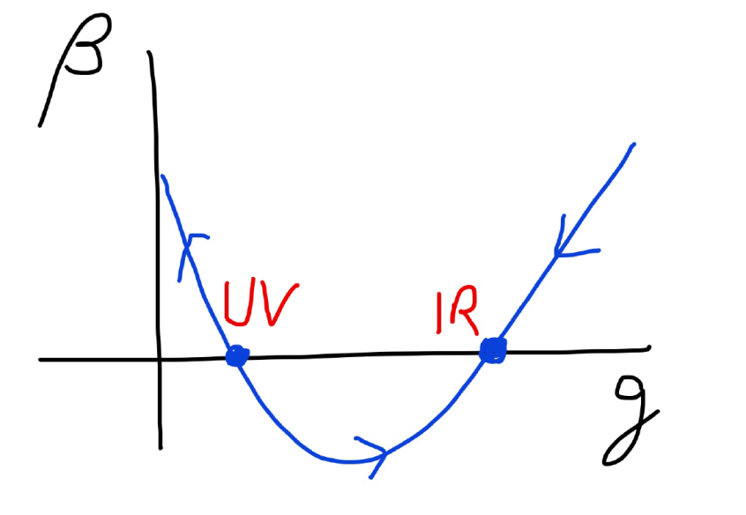
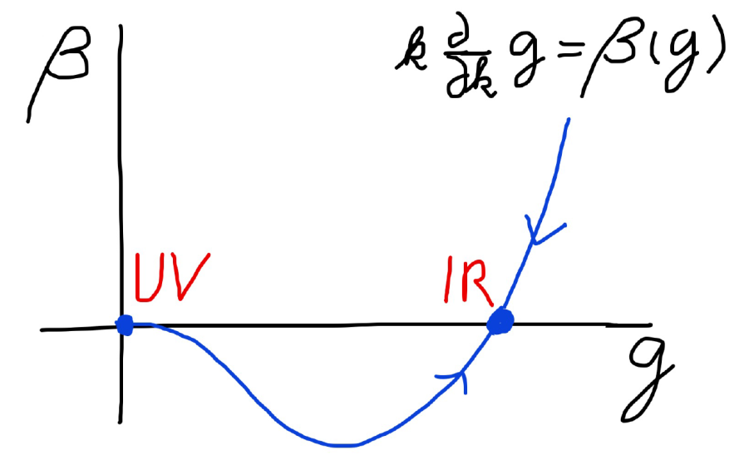
Asymptotic safety Asymptotic freedom
Relevant parameters yield undetermined couplings.
Quartic scalar coupling is not relevant and can therefore be predicted.

Slide 48
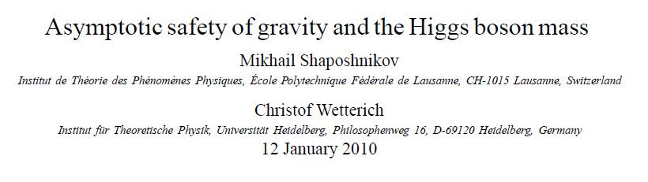
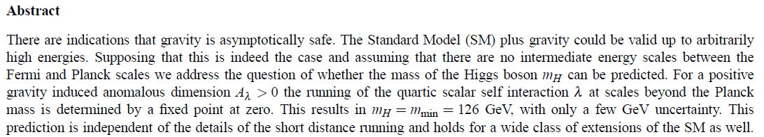
a prediction…

Slide 49

The mass of the Higgs boson, the great desert, and asymptotic safety of gravity

Slide 50
key points
great desert
solution of hierarchy problem at high scale
high scale fixed point
vanishing scalar coupling at fixed point
great desert
fixed point

Slide 51


Slide 52
Planck scale, gravity
no multi-Higgs model
no technicolor
no low scale
higher dimensions
no supersymmetry

Slide 53
Essential point for prediction of Higgs boson mass:
Initial value of quartic scalar coupling near Planck mass is predicted by quantum gravity
Results in prediction for ratio Higgs boson mass over W- boson mass, or
Higgs boson mass over top quark mass
Extrapolate perturbatively
to Fermi scale

Slide 54
Near Planck mass gravity is not weak !
Predictive power !

Slide 55
Flowing couplings
Couplings change with momentum scale due to quantum fluctuations.
Renormalization scale k : Only fluctuations with momenta larger k are included. The scale k can be momenta, geometric quantities, or just be introduced “by hand”.
Flow of k to zero : all fluctuations included, IR
Flow of k to infinity : UV

Slide 56
Renormalization group
How do couplings or physical laws change
with scale k ?

Slide 57
Strength of gravity
A.Eichhorn, CW, Spektrum der Wissenschaft

Slide 58
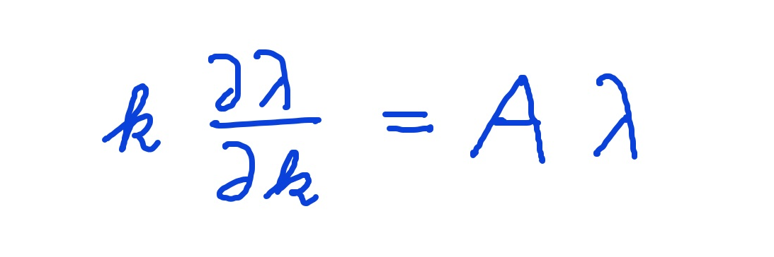
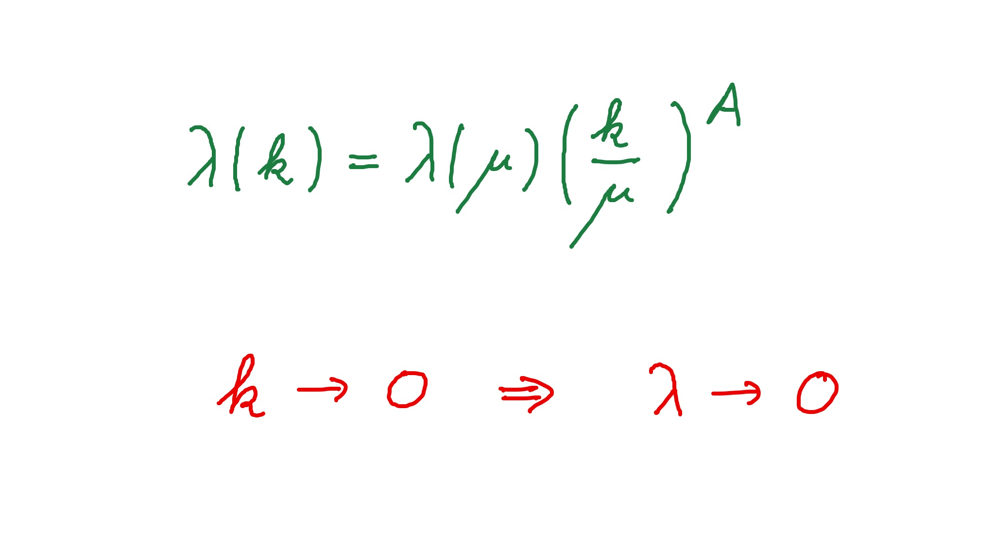
Graviton fluctuations erase quartic scalar coupling
Renormalization scale k : Only fluctuations with momenta larger k are included
gravity induced
anomalous dimension
A > 0

Slide 59
Fixed point
The quartic scalar coupling λ has a
fixed point at λ=0
It flows towards the fixed point as k is lowered :
irrelevant coupling
For a UV – complete theory it is predicted to assume the fixed point value

Slide 60
Quantum gravity prediction of mass of the Higgs boson
great desert
high scale fixed point
vanishing scalar coupling at fixed point
great desert
fixed point

Slide 61
Conclusions (3)
Predictions of quantum gravity
Simple approximation for graviton contribution to scalar potential:
Predicts mass of Higgs scalar
Solves Gauge Hierarchy problem ?
Solves cosmological constant problem

Slide 62
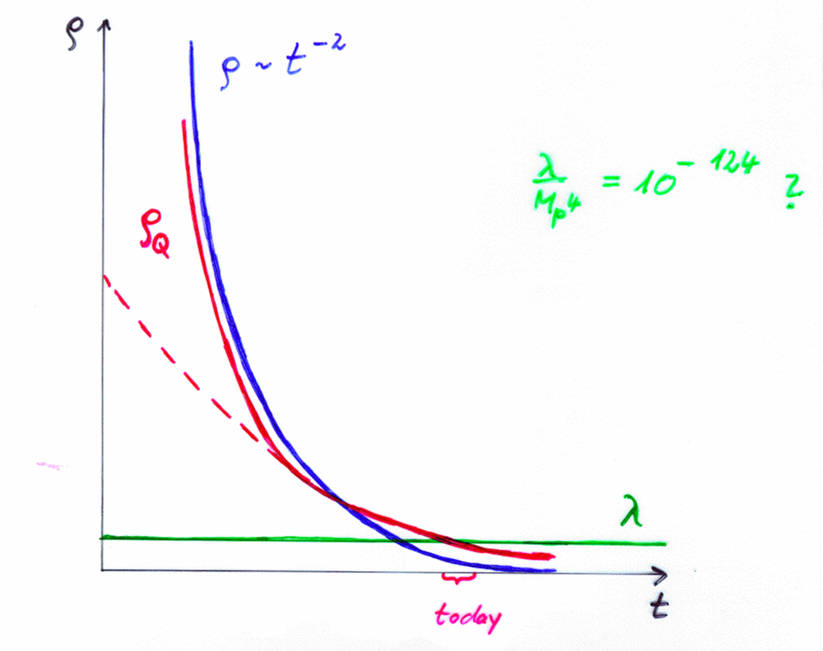
(4) Dark Energy

Slide 63
variable gravity
“Newton’s constant is not constant –
and particle masses are not constant”
“modified gravity"

Slide 64
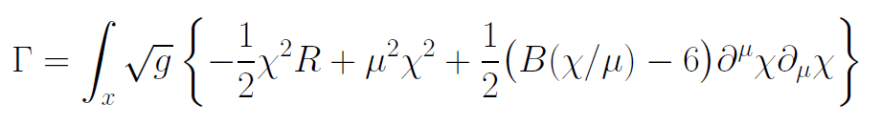
Variable Gravity
quantum effective action,
variation yields field equations
Einstein gravity :
M² R

Slide 65
Variable Gravity
Scalar field coupled to gravity
Effective Planck mass depends on scalar field
Simple quadratic scalar potential involves intrinsic mass μ
Nucleon and electron mass proportional to dynamical Planck mass

Slide 66

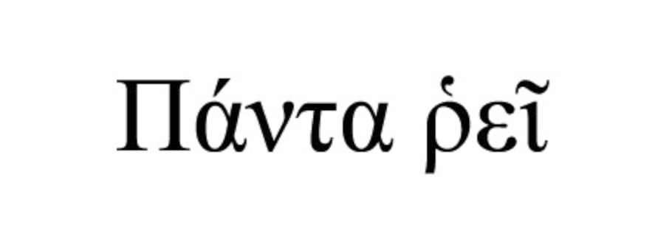

Slide 67
Cosmic scale symmetry and the cosmological constant problem
IR – fixed point reached for χ → ∞
Impact of intrinsic mass scale disappears

Slide 68
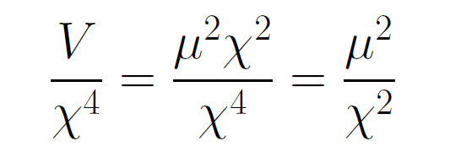
asymptotically vanishing cosmological „constant“
What matters : Ratio of potential divided by fourth power of Planck mass
vanishes for χ → ∞ !

Slide 69
Quintessence
Dynamical dark energy ,
generated by scalar field (cosmon )
C.Wetterich,Nucl.Phys.B302(1988)668, 24.9.87
P.J.E.Peebles,B.Ratra,ApJ.Lett.325(1988)L17, 20.10.87
Notes:
69

Slide 70
Prediction : homogeneous dark energy influences recent cosmology
- of same order as dark matter -
Original models do not fit the present observations
…. modifications
( different growth of neutrino mass )

Slide 71
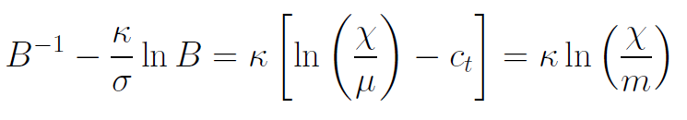
Model is compatible with present observations
Together with variation of neutrino mass over electron mass in present cosmological epoch :
model is compatible with all present observations, including inflation and dark energy

Slide 72
Cosmological solution
scalar field χ vanishes in the infinite past
scalar field χ diverges in the infinite future
J.Rubio,…

Slide 73
In scaling frame: strange evolution of Universe
Sonntagszeitung Zürich , Laukenmann

Slide 74
Expanding Universe or shrinking atoms ?

Slide 75
Hot big bang or freeze ?

Slide 76
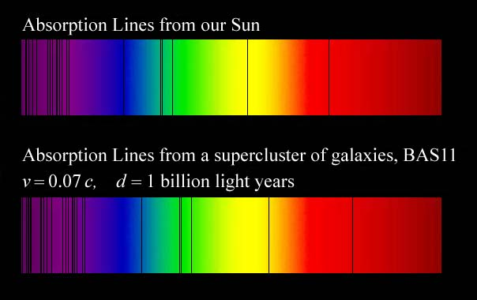
Do we know that the
Universe expands ?
instead of redshift due to expansion :
smaller frequencies have been emitted in the past, because electron mass was smaller !

Slide 77
Why do we see redshift of photons emitted in the distant past ?
photons are more red because they have been emitted with longer wavelength
frequency ~ mass
wavelength ~
atomsize

Slide 78
What is increasing ?
Ratio of distance between galaxies
over size of atoms !
atom size constant : expanding geometry
alternative : shrinking size of atoms

Slide 79
How can particle masses change with time ?
Particle masses are proportional to scalar field χ . Similar to Higgs field.
Scalar field varies with time.
Ratios of particle masses are independent of χ and therefore remain constant.
Compatibility with observational bounds on time dependence of particle mass ratios.
Dimensionless couplings are independent of χ .

Slide 80
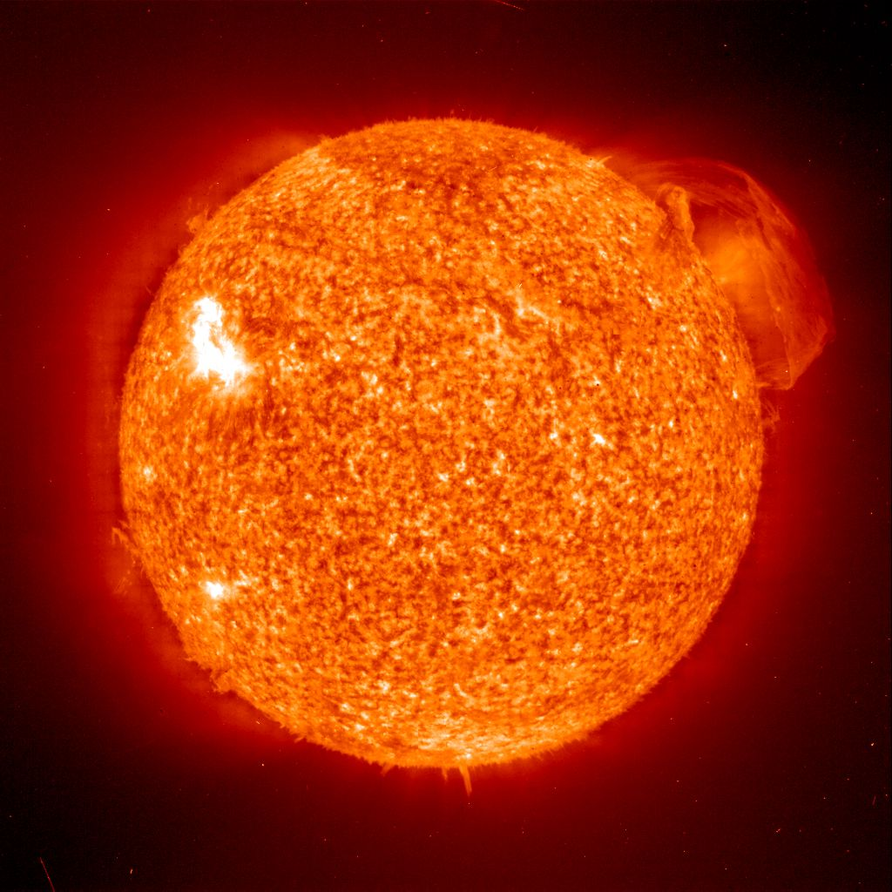
Do we know that the temperature was higher in the early Universe than now ?
Cosmic microwave radiation , nucleosynthesis
instead of
higher temperature :
smaller particle masses

Slide 81
Hot plasma ?
Temperature in radiation dominated Universe : T ~ χ ^{½} smaller than today
Ratio temperature / particle mass : T /m_{p} ~ χ ^{-½} larger than today
T/m_{p} counts ! This ratio decreases with time.
Nucleosynthesis , CMB emission as in standard cosmology !

Slide 82
Freeze Universe
The Universe may have started very cold,
and only later heat up.
Freeze picture of the Universe

Slide 83

Big bang or freeze ?

Slide 84
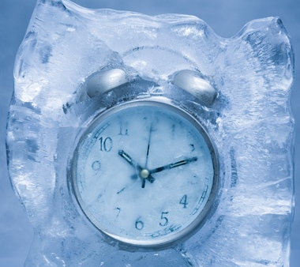
Big bang or freeze ?
freeze picture :
only rods for measurements
( masses ) are different !

Slide 85
Big bang is not wrong, but alternative pictures exist !

Slide 86
Conclusions
Quantum gravity is predictive renormalizable quantum field theory
Quantum scale symmetry crucial for understanding the beginning of the Universe
Simple ”scaling frame” for the choice of the metric field gives simple description without any singularities
Big bang singularity is a field singularity
Universe can be eternal in the past

Slide 87
end

