Slide 1
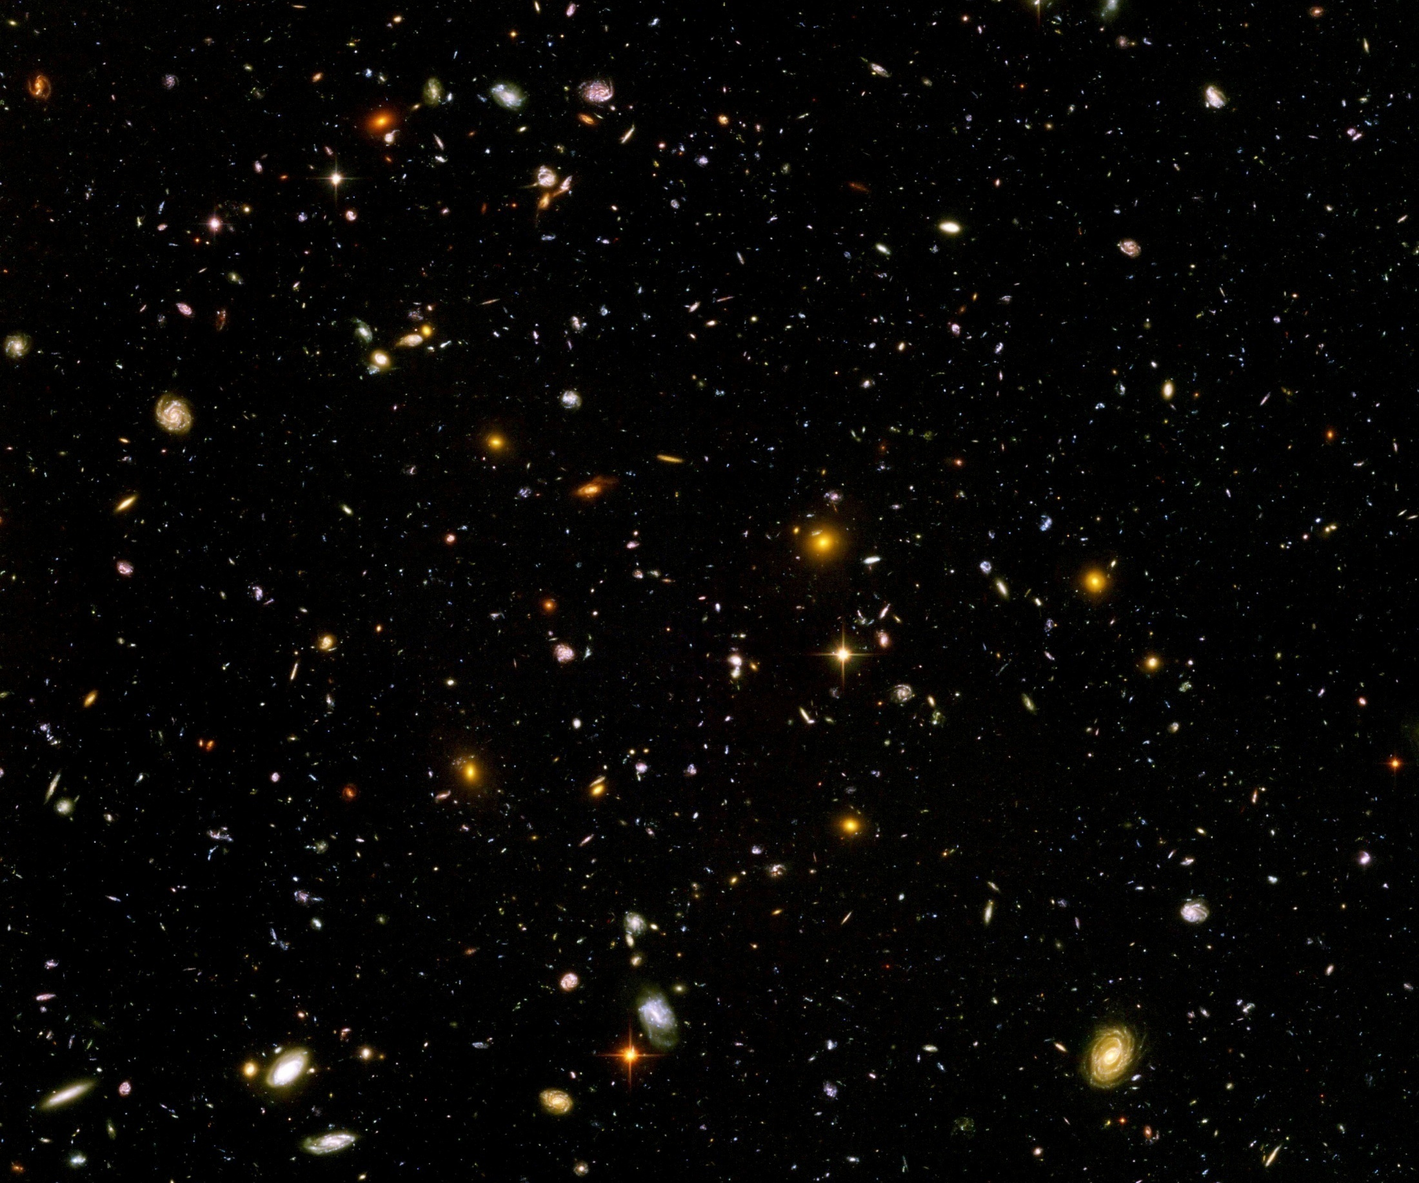
Scale symmetry in cosmology

Slide 2
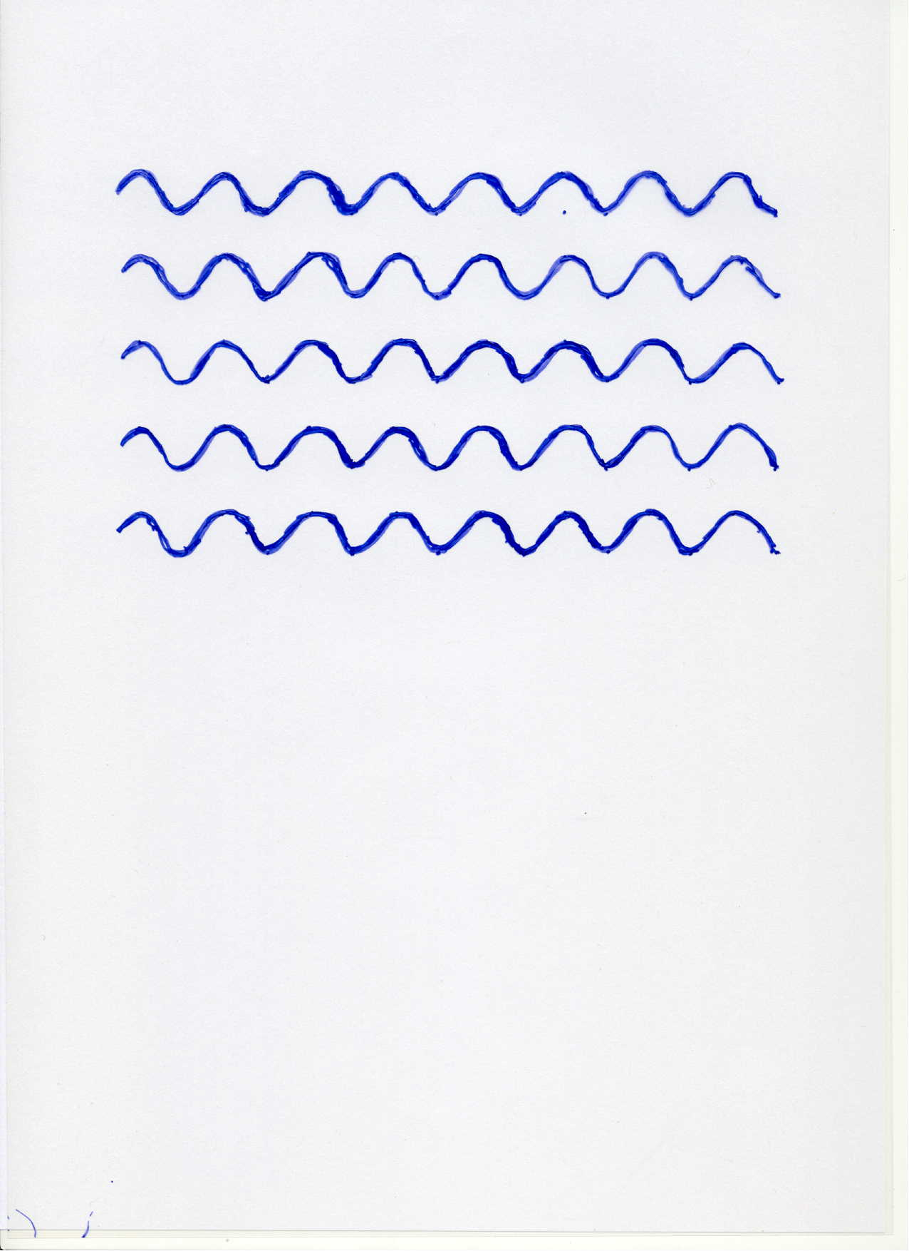
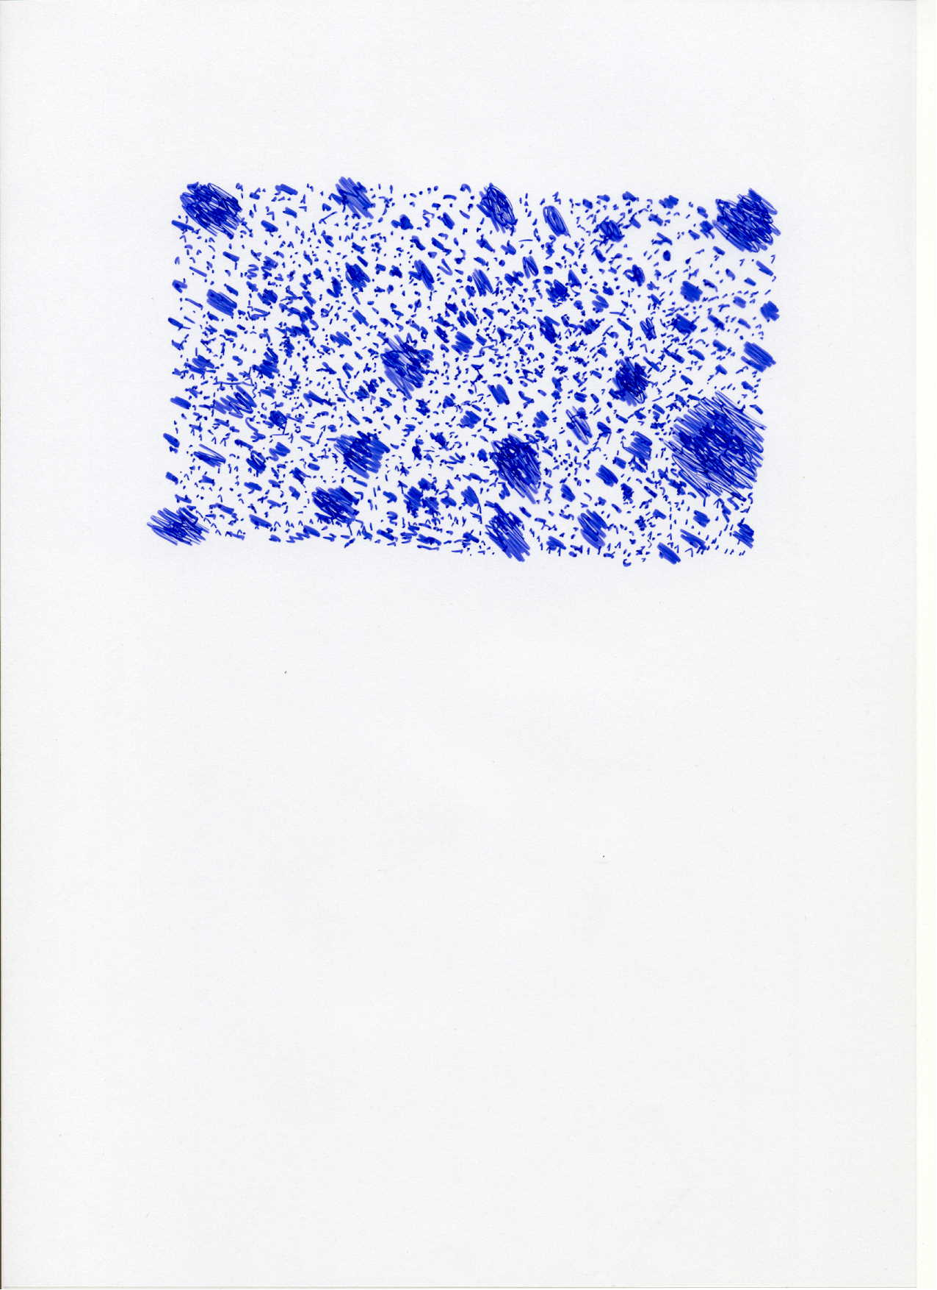

Scale symmetry
no
SSB
no scale symmetry
scale symmetry

Slide 3
Scale symmetry
No parameter with dimension of
length or mass is present in effective action.
Then invariance under
dilatations or global scale transformations
is realized.
Continuous global symmetry

Slide 4
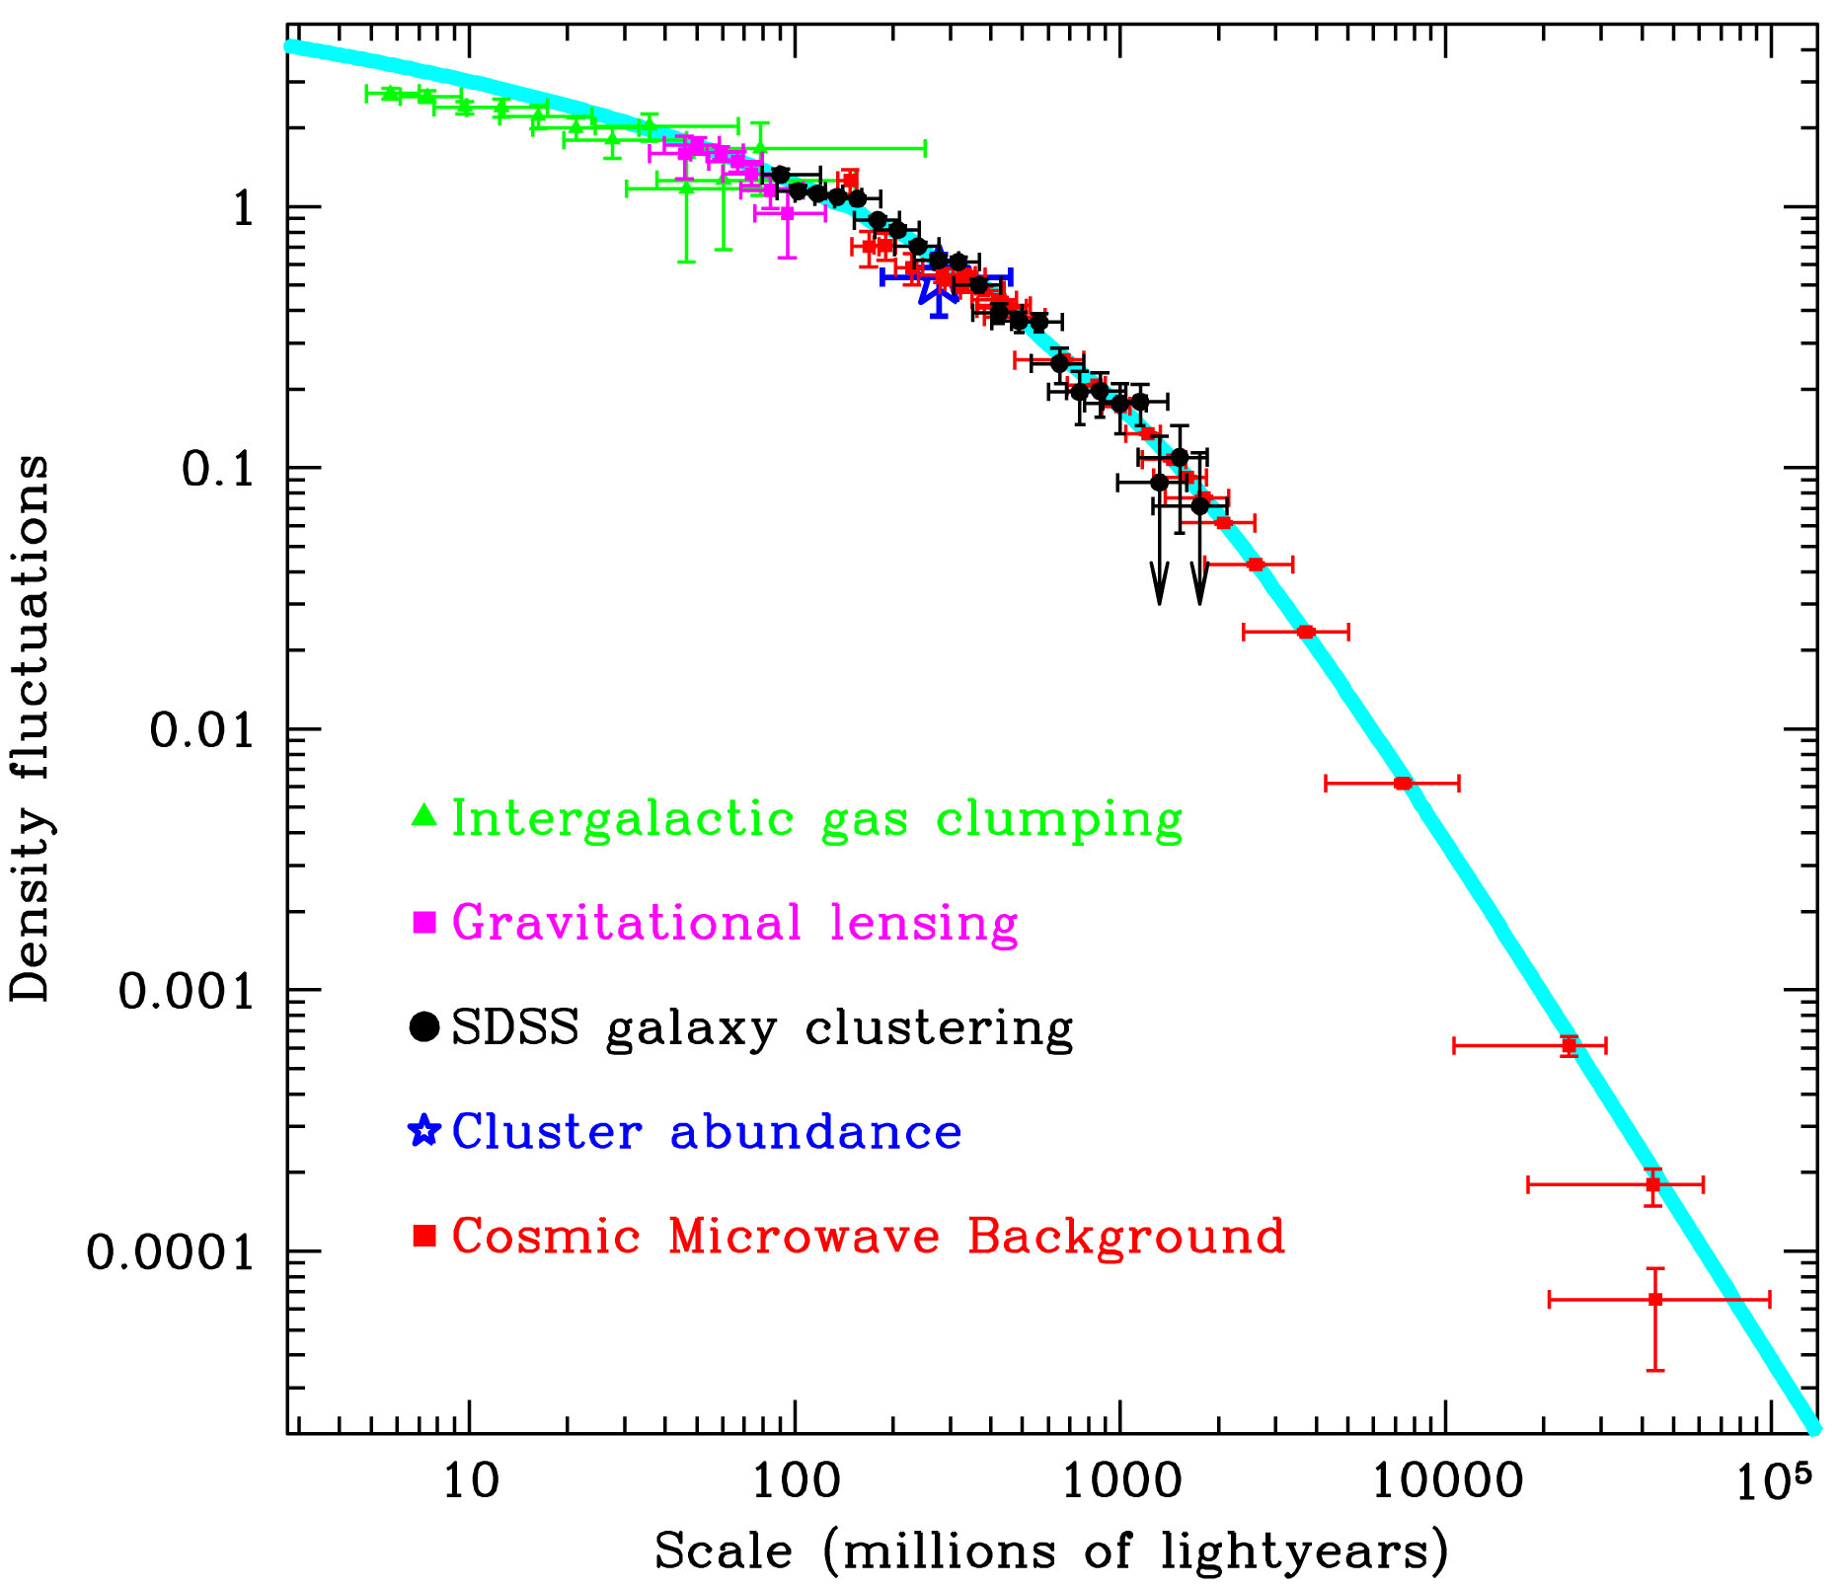
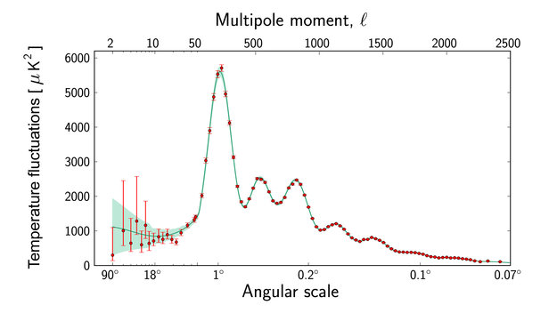
Scale symmetry in cosmology ?
scales are present in cosmology

Slide 5
Scale symmetry in elementary particle physics ?
proton mass , electron mass
scales are present in particle physics

Slide 6
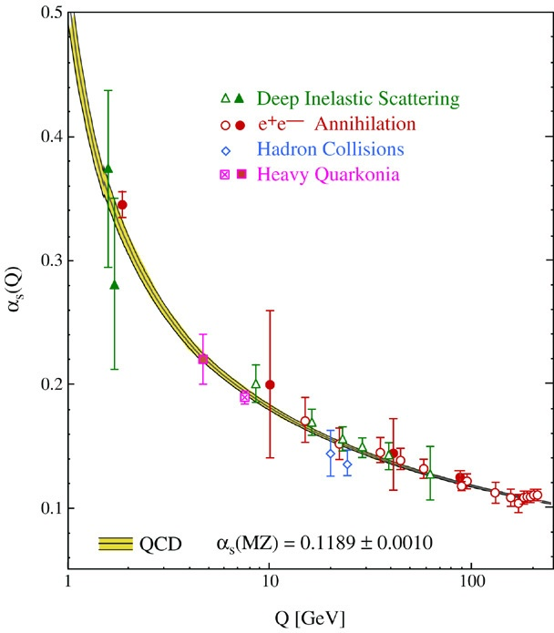
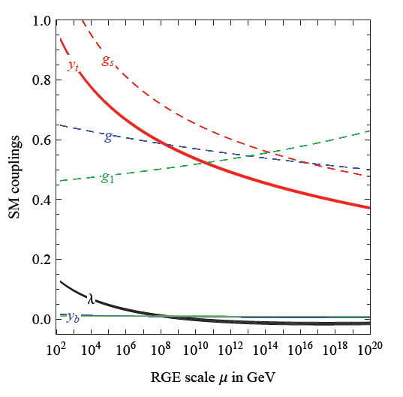
Quantum fluctuations induce running couplings
violation of scale symmetry
well known in QCD or standard model

Slide 7
Quantum scale symmetry
quantum fluctuations violate scale symmetry
running dimensionless couplings
at fixed points , scale symmetry is exact !
quantum fluctuations can generate scale symmetry !

Slide 8
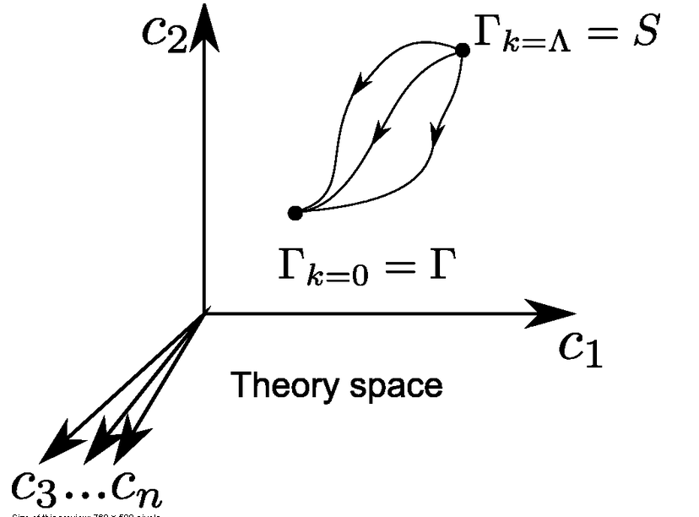
Functional renormalization : flowing action
Wikipedia
Notes:
8

Slide 9
Ultraviolet fixed point
UV fixed point
Wikipedia
Notes:
9

Slide 10
Asymptotic safety of quantum gravity
if UV fixed point exists :
quantum gravity is
non-perturbatively renormalizable !
S. Weinberg , M. Reuter

Slide 11
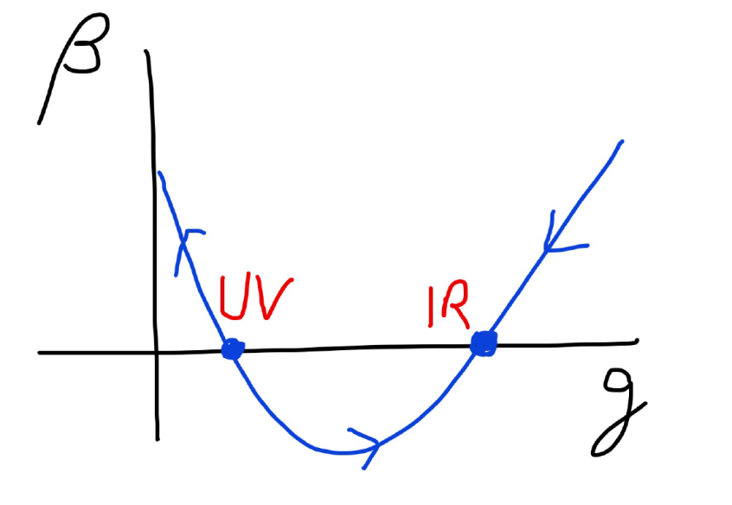
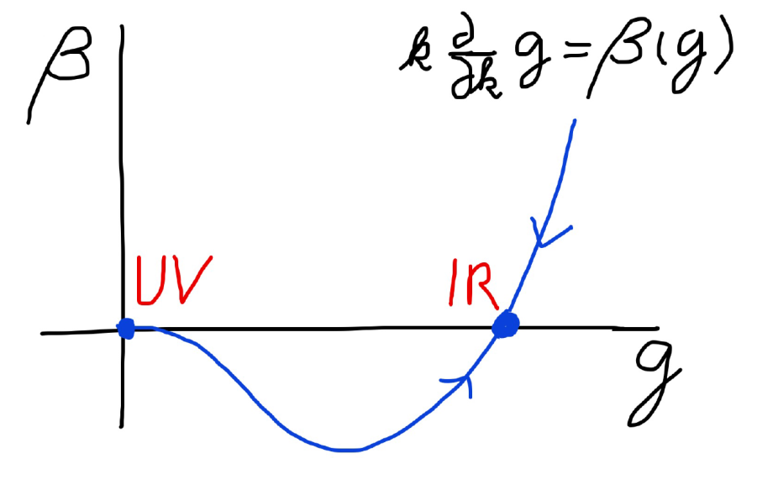
Asymptotic safety Asymptotic freedom
Relevant parameters yield undetermined couplings.
Quartic scalar coupling is not relevant and can therefore be predicted.

Slide 12
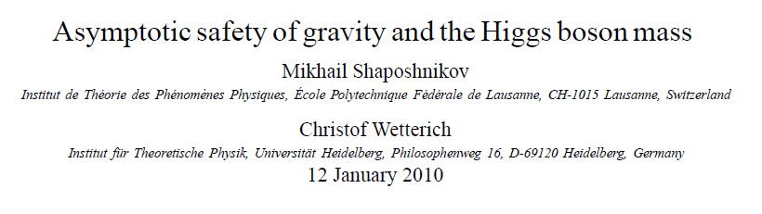
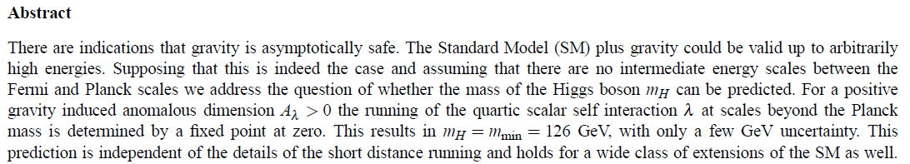
a prediction…

Slide 13
quantum gravity with scalar field – the role of scale symmetry for cosmology

Slide 14
Spontaneous breaking of scale symmetry
expectation value of scalar field breaks scale symmetry spontaneously
massive particles are compatible with scale symmetry
in presence of massive particles : sign of exact scale symmetry is exactly massless Goldstone boson – the dilaton

Slide 15
Approximate scale symmetry near fixed points
UV : approximate scale invariance of primordial fluctuation spectrum from inflation
IR : cosmon is pseudo Goldstone boson of
spontaneously broken scale symmetry,
tiny mass,
responsible for dynamical Dark Energy

Slide 16
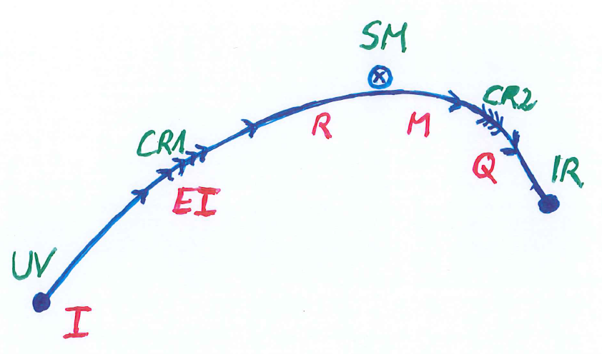
Possible consequences of crossover in quantum gravity
Realistic model for inflation and dark energy
with single scalar field

Slide 17
variable gravity
“Newton’s constant is not constant –
and particle masses are not constant”

Slide 18
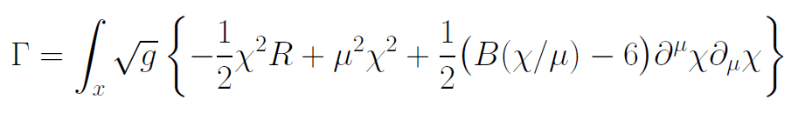
Variable Gravity
quantum effective action,
variation yields field equations
Einstein gravity :
M² R

Slide 19
Scale symmetry in variable gravity
( IR – fixed point )
quantum effective action,
variation yields field equations
Einstein gravity :
M² R

Slide 20
Variable Gravity
Scalar field coupled to gravity
Effective Planck mass depends on scalar field
Simple quadratic scalar potential involves intrinsic mass μ
Nucleon and electron mass proportional to dynamical Planck mass

Slide 21
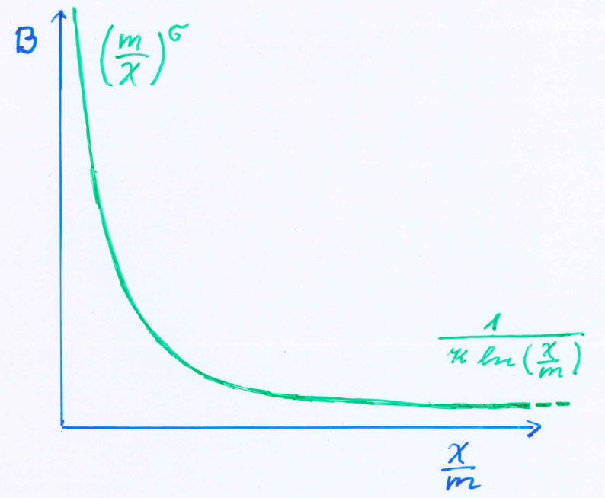
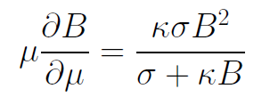
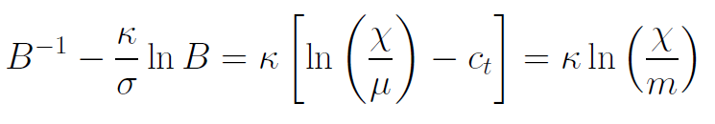
Kinetial B :
Crossover between two fixed points
assumption: running
coupling obeys
flow equation
m : scale of crossover
can be exponentially larger than intrinsic scale μ

Slide 22
Four-parameter model
model has four dimensionless parameters
three in kinetial :
σ ~ 2.5
κ ~ 0.5
c_{t} ~ 14 ( or m/μ )
one parameter for growth rate of neutrino mass over electron mass : γ ~ 8
+ standard model particles and dark matter : sufficient for realistic cosmology from inflation to dark energy
no more free parameters than ΛCDM

Slide 23
Model is compatible with present observations
Together with variation of neutrino mass over electron mass in present cosmological epoch :
model is compatible with all present observations, including inflation and dark energy

Slide 24
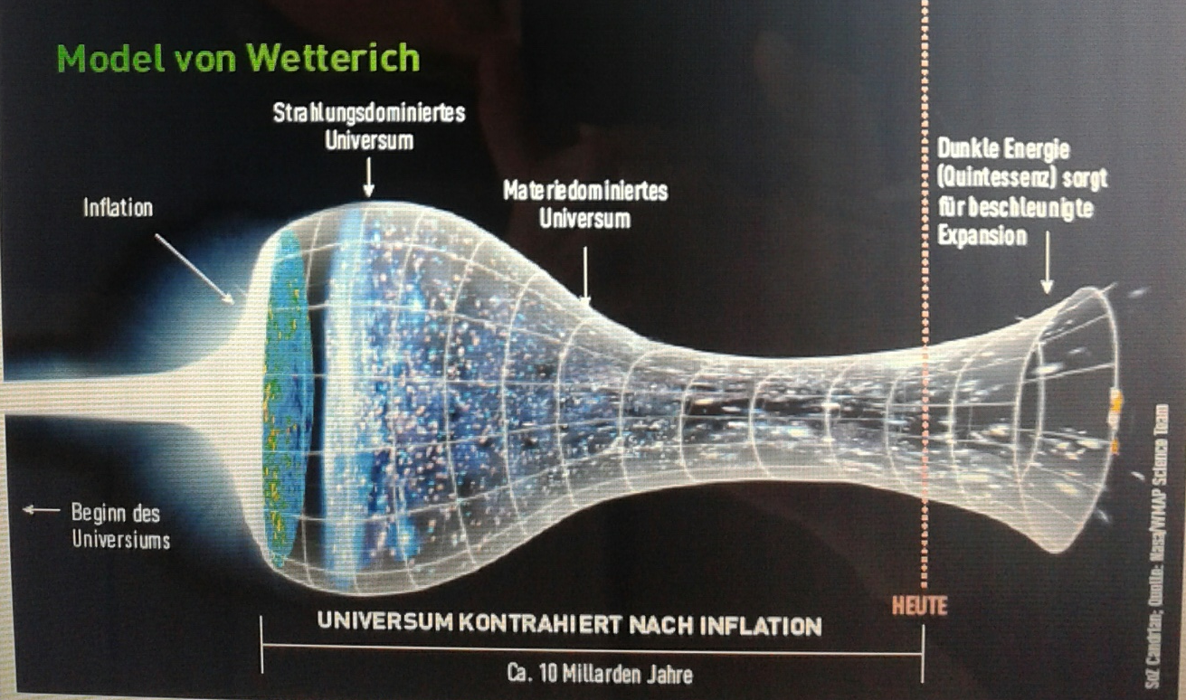
Strange evolution of Universe
Sonntagszeitung Zürich , Laukenmann

Slide 25
Expanding Universe or shrinking atoms ?

Slide 26
Hot big bang or freeze ?

Slide 27
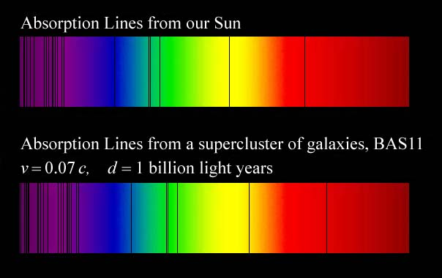
Do we know that the
Universe expands ?
instead of redshift due to expansion :
smaller frequencies have been emitted in the past, because electron mass was smaller !

Slide 28
Why do we see redshift of photons emitted in the distant past ?
photons are more red because they have been emitted with longer wavelength
frequency ~ mass
wavelength ~
atomsize

Slide 29
What is increasing ?
Ratio of distance between galaxies
over size of atoms !
atom size constant : expanding geometry
alternative : shrinking size of atoms

Slide 30
How can particle masses change with time ?
Particle masses are proportional to scalar field χ . Similar to Higgs field.
Scalar field varies with time.
Ratios of particle masses are independent of χ and therefore remain constant.
Compatibility with observational bounds on time dependence of particle mass ratios.
Dimensionless couplings are independent of χ .

Slide 31
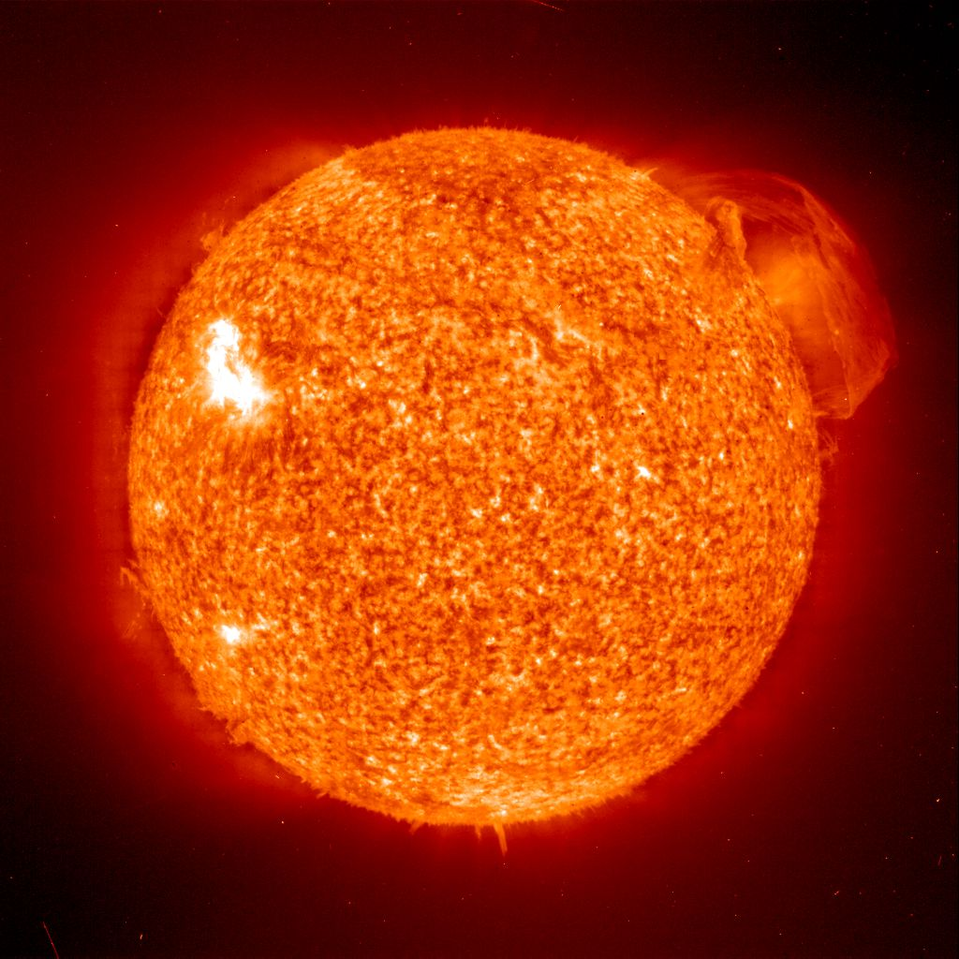
Do we know that the temperature was higher in the early Universe than now ?
Cosmic microwave radiation , nucleosynthesis
instead of
higher temperature :
smaller particle masses

Slide 32
Hot plasma ?
Temperature in radiation dominated Universe : T ~ χ ^{½} smaller than today
Ratio temperature / particle mass : T /m_{p} ~ χ ^{-½} larger than today
T/m_{p} counts ! This ratio decreases with time.
Nucleosynthesis , CMB emission as in standard cosmology !

Slide 33
Freeze Universe
The Universe may have started very cold,
and only later heat up.
Freeze picture of the Universe

Slide 34
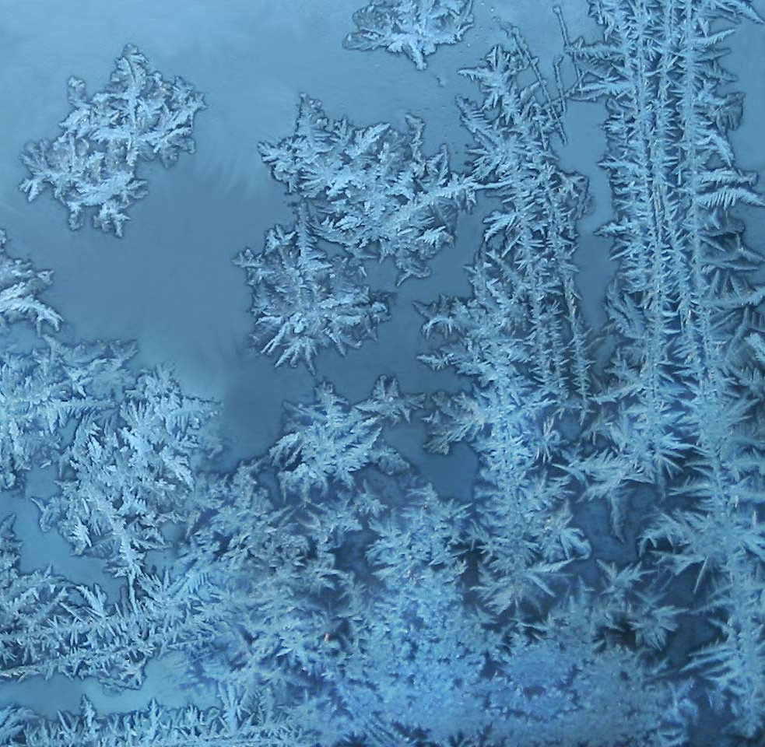
Big bang or freeze ?

Slide 35
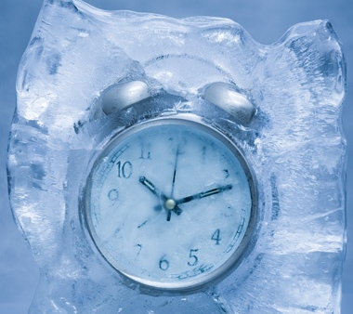
Big bang or freeze ?
freeze picture :
only rods for measurements
( masses ) are different !

Slide 36
Big bang is not wrong, but alternative pictures exist !

Slide 37
Einstein frame
“Weyl scaling” maps variable gravity model to Universe with fixed masses and standard expansion history.
Exact equivalence of different frames !
“ different pictures”
Standard gravity coupled to scalar field.

Slide 38
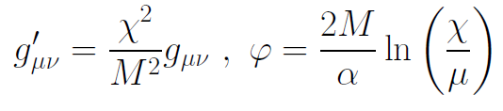
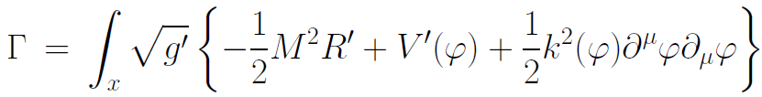
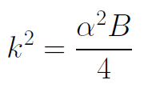

Einstein frame
Weyl scaling :
effective action in Einstein frame :

Slide 39
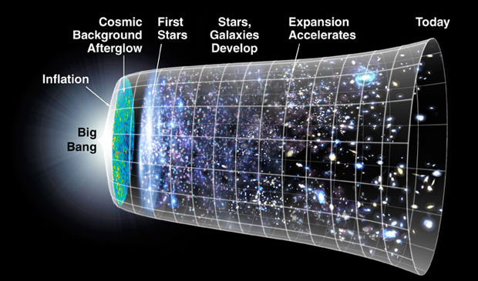
Field relativity
Weyl scaling :
changes geometry,
not a coordinate transformation

Slide 40
Cosmological solution
scalar field χ vanishes in the infinite past
scalar field χ diverges in the infinite future
J.Rubio,…

Slide 41
Field relativity : different pictures of cosmology
same physical content can be described by different pictures
related by field – redefinitions , e.g. Weyl scaling , conformal scaling of metric
observables cannot depend on choice of fields
metric is one of the fields
which picture is usefull ?

Slide 42
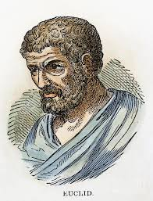


Relativity of geometry
Euclid … Newton : space and time
are absolute
Special relativity : space and time depend on observer
General relativity : space-time is
influenced by matter ( including radiation )
geometry is independent of coordinates
geometry is observable
Field relativity : geometry is relative

Slide 43
Space-time is a description of correlations between “matter”.
Observables cannot depend on choice of fields used to describe them.
Different pictures for geometry exist.

Slide 44
Why should you care about the freeze picture of the Universe ?
Some aspects are understood easier :
Natural tiny present dark energy
Beginning of Universe
Role of scale symmetry
Range of impact of quantum gravity

Slide 45
What is Dark Energy ?
Dark energy is energy density of scalar field χ
𝜌 = V + kinetic term
V= 𝜇² χ²
p = -V + kinetic term
Dark energy is dynamical if χ changes with time

Slide 46
No small parameter for dark energy

Slide 47
Four-parameter model
model has four dimensionless parameters
three in kinetial :
σ ~ 2.5
κ ~ 0.5
c_{t} ~ 14 ( or m/μ )
one parameter for growth rate of neutrino mass over electron mass : γ ~ 8
+ standard model particles and dark matter : sufficient for realistic cosmology from inflation to dark energy
no more free parameters than ΛCDM

Slide 48
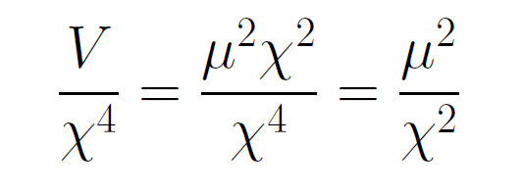
asymptotically vanishing cosmological „constant“
What matters : Ratio of potential divided by fourth power of Planck mass
vanishes for χ → ∞ !
V= 𝜇² χ²

Slide 49
small dimensionless number ?
needs two intrinsic mass scales
standard approach :V and M ( cosmological constant and Planck mass )
variable gravity : Planck mass moving to infinity , with fixed or moderately increasing V
ratio vanishes asymptotically !

Slide 50
Quintessence
Dynamical dark energy ,
generated by scalar field (cosmon )
C.Wetterich,Nucl.Phys.B302(1988)668, 24.9.87
P.J.E.Peebles,B.Ratra,ApJ.Lett.325(1988)L17, 20.10.87
Notes:
50

Slide 51
Prediction : homogeneous dark energy influences recent cosmology
- of same order as dark matter -
Original models do not fit the present observations
…. modifications
( different growth of neutrino mass )

Slide 52
No tiny dimensionless parameters
( except gauge hierarchy )
μ = 2 • 10 ⁻³³ eV
one mass scale
one time scale μ⁻¹ = 10 ¹⁰ yr
Planck mass does not appear as parameter
Planck mass grows large dynamically
Dark energy is tiny because Universe is old

Slide 53
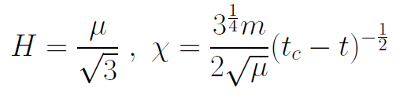
Slow Universe
Asymptotic solution in
freeze frame :
Expansion or shrinking always slow ,
characteristic time scale of the order of the age of the
Universe : t_{ch} ~ μ⁻¹ ~ 10 billion years !
Hubble parameter of the order of present Hubble
parameter for all times , including inflation and big bang !
Slow increase of particle masses !
μ= 2 • 10⁻³³ eV

Slide 54
infinite past

Slide 55
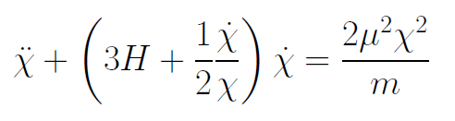
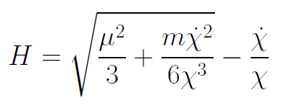
Infinite past : slow inflation
σ = 2 : field equations
approximative
solution
particles become massless in infinite past !

Slide 56
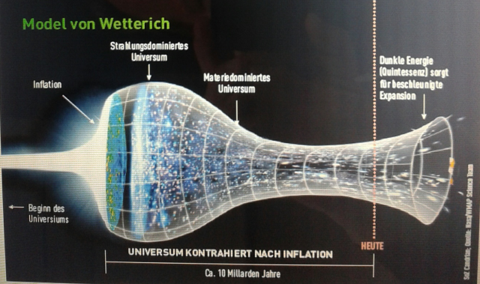
Eternal Universe
Asymptotic solution in
freeze frame :
solution valid back to the infinite past in physical time
no singularity
physical time to infinite past is infinite

Slide 57

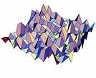
Eternal light-vacuum
Everywhere almost nothing
only fluctuations
All particles move
with light velocity,
similar to photons
strength of gravity
much stronger than today

Slide 58
In the beginning was light-like emptiness.

Slide 59
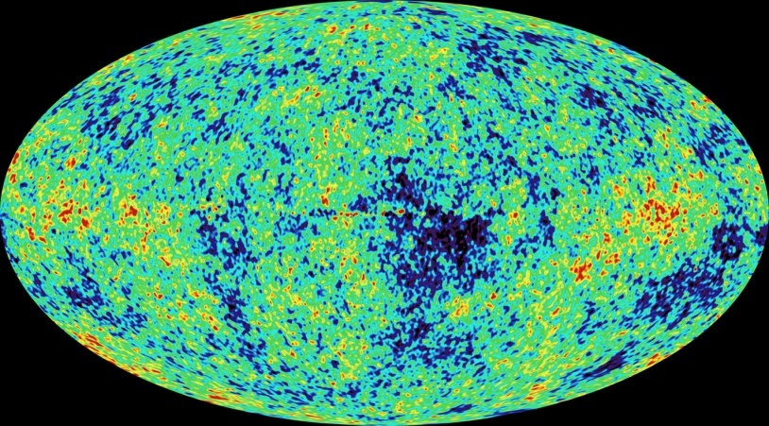
Eternal light-vacuum is unstable
Slow increase of particle masses and weakening of gravity
Only slow change of space-time geometry
Consequence for observation : primordial fluctuations become visible in cosmic background radiation
We see fluctuations in a stage 5000 billion years ago.

Slide 60
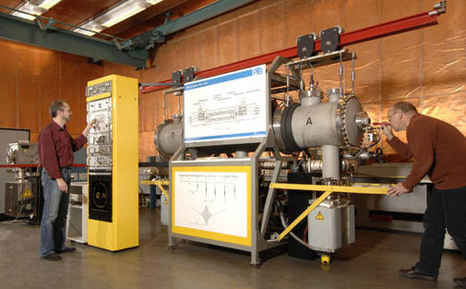
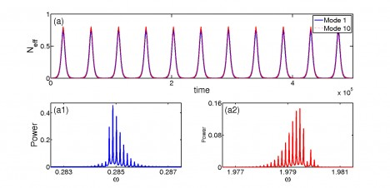
Physical time
count oscillations ….

Slide 61
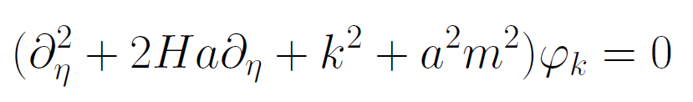
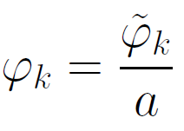
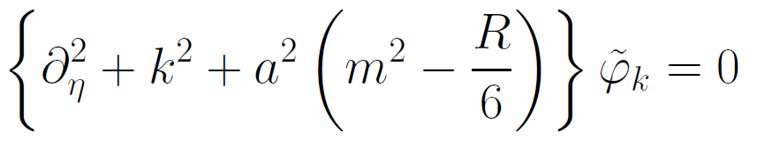
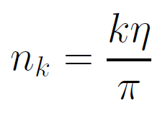

Physical time
field equation for scalar field mode
determine physical
time by counting
number of oscillations
( m=0 )

Slide 62
Physical time
counting : discrete
invariant under field transformations
same in all frames

Slide 63
Big bang singularity in Einstein frame is field singularity !
choice of frame with constant particle
masses is not well suited if
physical masses go to zero !

Slide 64

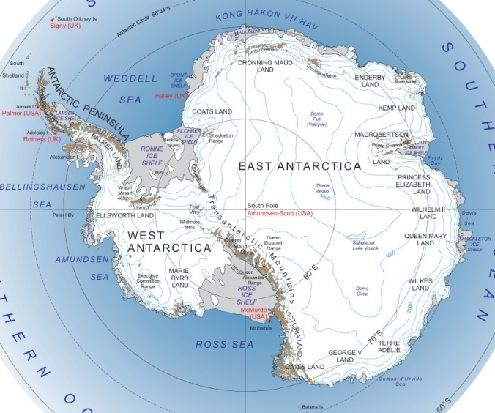
Field - singularity
Big Bang is field - singularity
similar ( but not identical with )
coordinate - singularity

Slide 65
Conclusions
Quantum gravity may be observable in
dynamics of present Universe
Fixed points and scale symmetry crucial
Big bang singularity is artefact
of inappropriate choice of field variables –
no physical singularity

Slide 66
end

Slide 67

Crossover in quantum gravity and cosmology

Slide 68
Cosmological solution : crossover from UV to IR fixed point
Dimensionless functions as B
depend only on ratio μ/χ .
IR: μ→0 , χ→∞
UV: μ→∞ , χ→0
Cosmology makes
crossover between
fixed points by
variation of χ .
χ→0
χ→∞

Slide 69
Renormalization flow and cosmological evolution
renormalization flow as function of µ
is mapped by dimensionless functions to
field dependence of effective action on scalar field χ
translates by solution of field equation to
dependence of cosmology an time t or η

Slide 70
Scaling solution
after end of inflation
scaling solution with
few percent
of Early Dark Energy
Dark Energy decreases
similar to radiation and
matter

Slide 71
Evolution of dark energy fraction
J. Rubio,…

Slide 72
Growing neutrino masses and quintessence

Slide 73
Second stage of crossover
from SM to IR
in sector Beyond Standard Model
affects neutrino masses first ( seesaw or cascade mechanism )

Slide 74
Varying particle masses at onset of second crossover
Except for neutrinos all particle masses are proportional to χ .
Ratios of particle masses remain constant.
Compatibility with observational bounds on time dependence of particle mass ratios.
Neutrino masses show stronger increase with χ , such that ratio neutrino mass over electron mass grows .

Slide 75
Cosmic trigger
Stop of evolution of scalar field when neutrinos become non-relativistic
Transition from scaling solution to (almost) cosmological constant

Slide 76
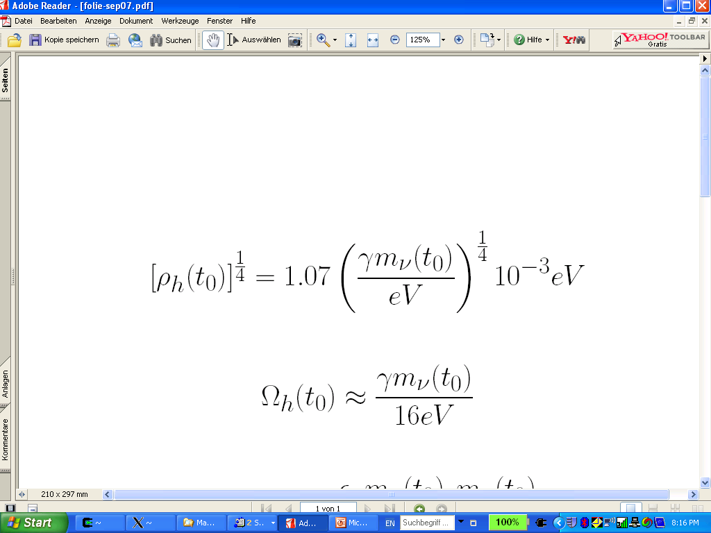
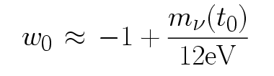
connection between dark energy and neutrino properties
L.Amendola,
M.Baldi, …
= 1.27
present dark energy density given by neutrino mass
present equation
of state given by
neutrino mass !
Notes:
76

Slide 77
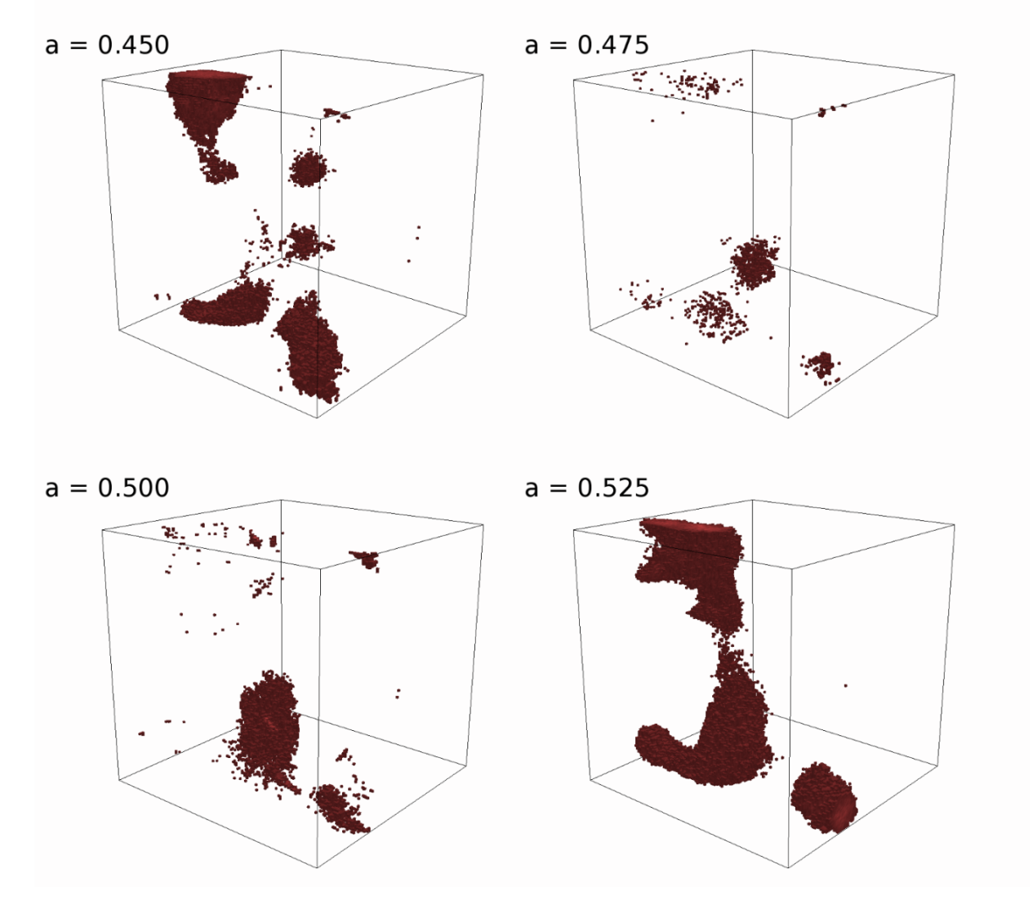
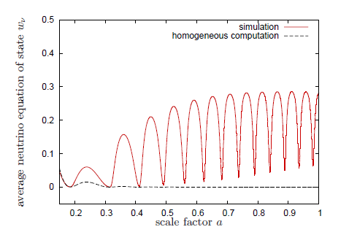
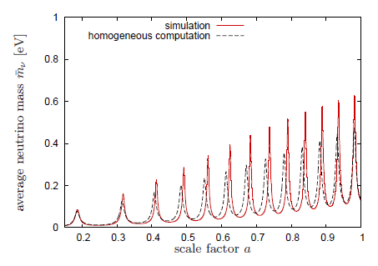
Oscillating neutrino lumps
Ayaita, Baldi, Fuehrer,
Puchwein,…
Y.Ayaita, M.Weber,…

Slide 78
Neutrino lumps
large m_{𝜈}
small m_{𝜈}
Casas, Pettorino,…

Slide 79
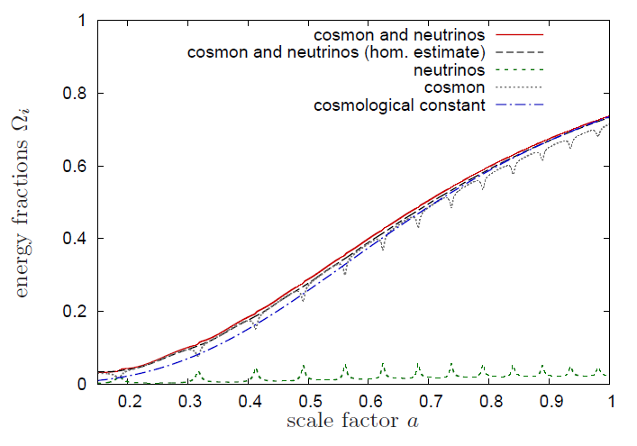
Evolution of dark energy similar to ΛCDM

Slide 80
Compatibility with observations and possible tests
Realistic inflation model
Almost same prediction for radiation, matter, and Dark Energy domination as ΛCDM
Presence of small fraction of Early Dark Energy
Large neutrino lumps

Slide 81
Simplicity
simple description of all cosmological epochs
natural incorporation of Dark Energy :
inflation
Early Dark Energy
present Dark Energy
dominated epoch
J.Rubio…

Slide 82
In quantum gravity, the graviton fluctuations can play an important role on distances as large as the size of the Universe
- for long range scalar fields and dynamical dark energy
- not for all quantities

Slide 83
Instability of graviton propagator
effective action
Instability for V>0 : ”tachyonic mass term”

Slide 84
Graviton barrier
Quantum gravity computation :
For
V cannot increase stronger than M² !
Instability of graviton propagator is avoided

Slide 85
Graviton barrier and solution of the cosmological constant problem
V cannot increase stronger than M² !
If M increases with 𝜒, and for cosmological solutions where 𝜒 asymptotically diverges for time going to infinity:
Effective cosmological constant vanishes in infinite future
M = χ : V= 𝜇² χ²

Slide 86
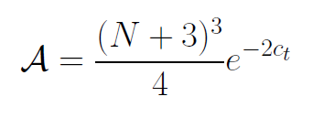

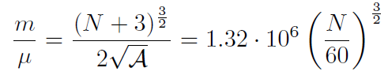
Amplitude of density fluctuations
small because of logarithmic running
near UV fixed point !
σ=1
N : number of e – foldings at horizon crossing

