Slide 1
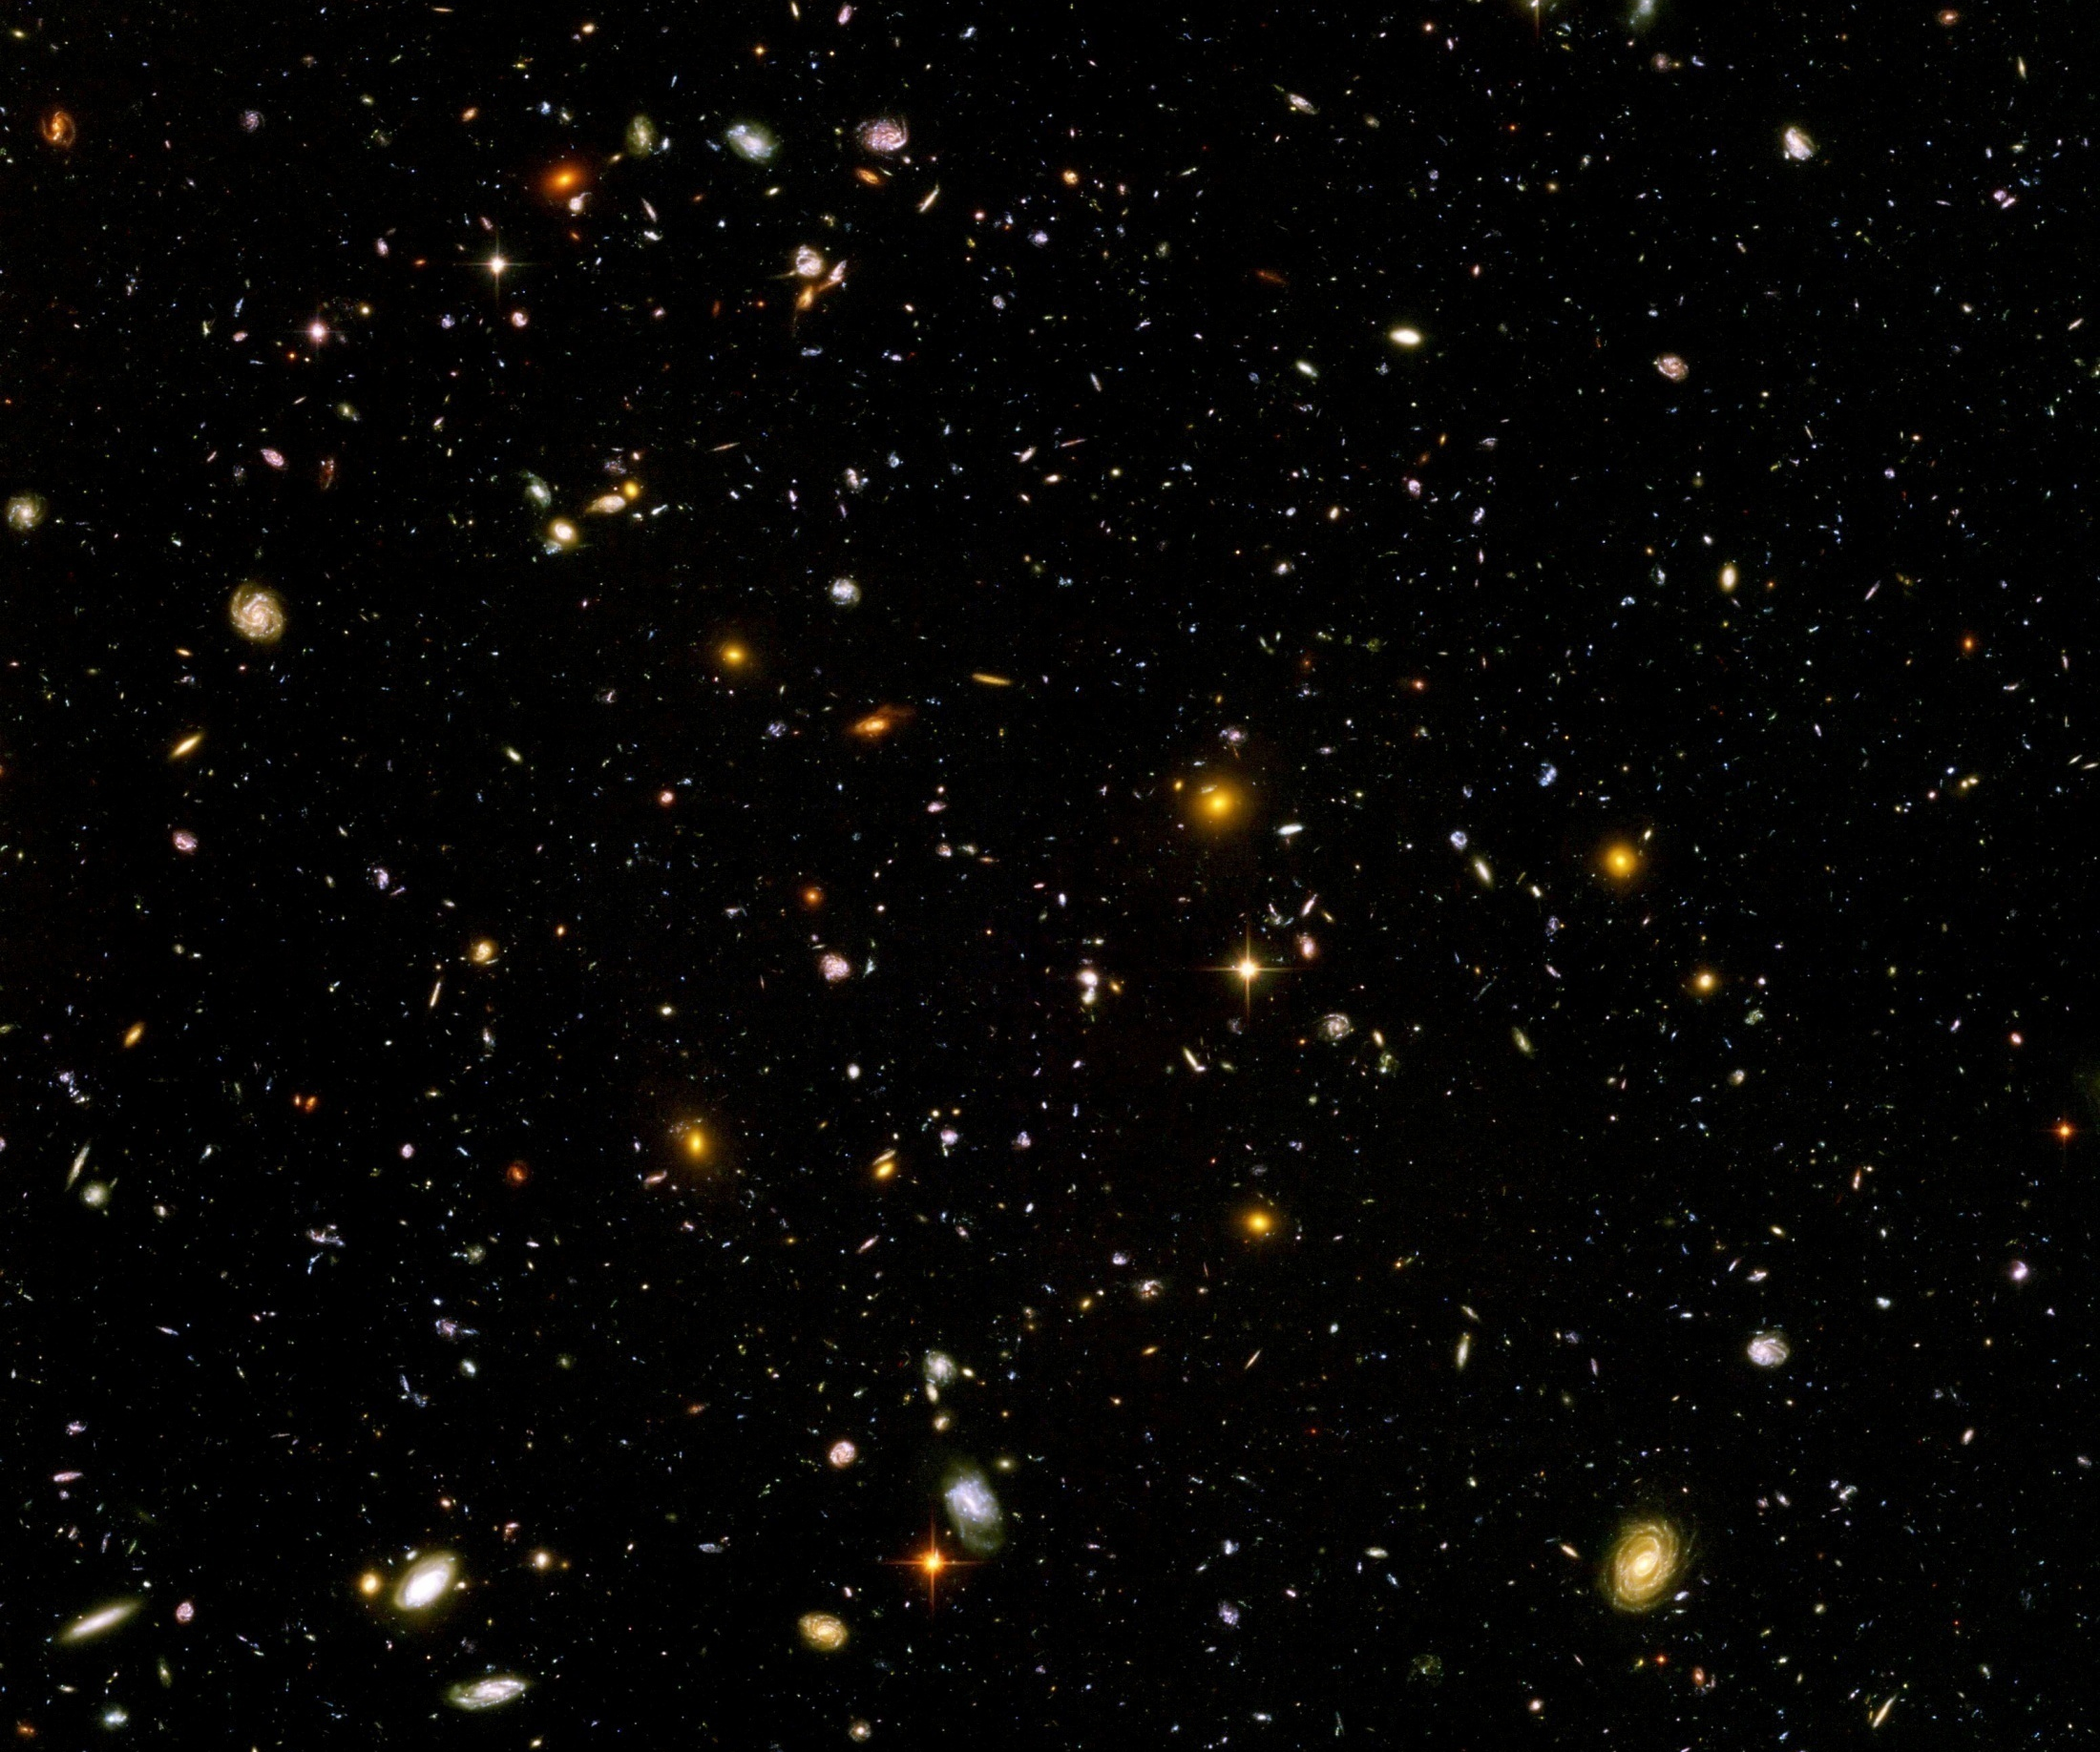
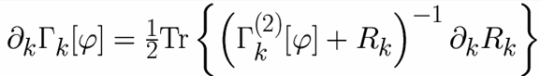
Quantum gravity prediction for dynamical dark energy

Slide 2
Quantum gravity
Gravity is field theory. Similar to electrodynamics. Metric field.
Gravity is gauge theory. Similar to QED or QCD. Gauge symmetry: general coordinate transformations ( diffeomorphisms )
Quantum gravity: include metric fluctuations in functional integral

Slide 3
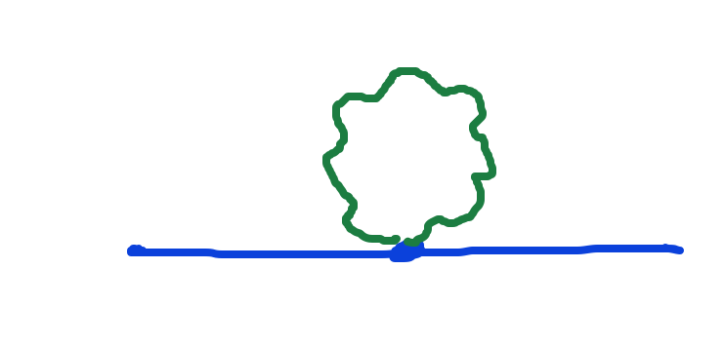
Metric fluctuations matter
Quantum gravity needs method to take them into account

Slide 4
Quantum gravity
Quantum gravity is similar to other quantum field theories
Difference: metric is tensor, gauge bosons are vectors
Difference: Einstein gravity is not perturbatively renormalizable
no small dimensionless coupling constant, effective coupling q²/M²

Slide 5
Quantum gravity
Quantum gravity is
non-perturbatively renormalizable
Asymptotic safety : non-perturbative renormalizabilty
Weinberg, Reuter, …
Use functional renormalization !

Slide 6
Flowing couplings
Couplings change with renormalization scale k due to
( quantum ) fluctuations.
Renormalization scale k : Only fluctuations with momenta larger k are included for (quantum) effective action.
Flow of k to zero : all fluctuations included, IR-limit
Flow of k to infinity : UV-limit
k-dependence can differ from momentum dependence

Slide 7
Ultraviolet fixed point
Flow of couplings stops for k →∞
Self-similarity: no explicit dependence on k
Theory can be extrapolated to arbitrary short distances
Completeness
Renormalizability

Slide 8
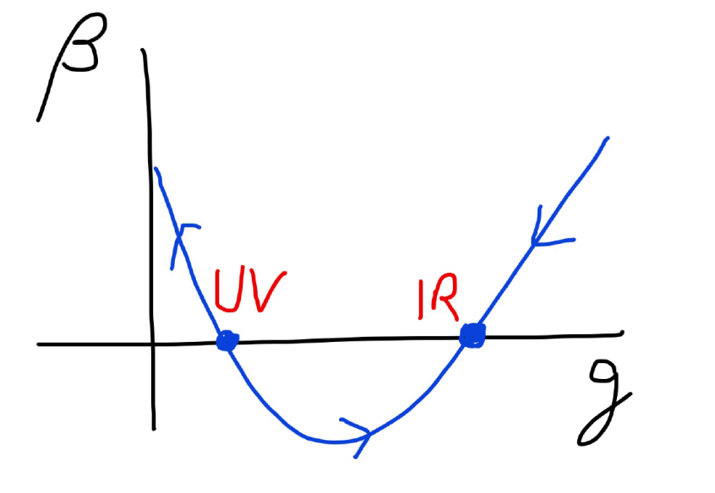
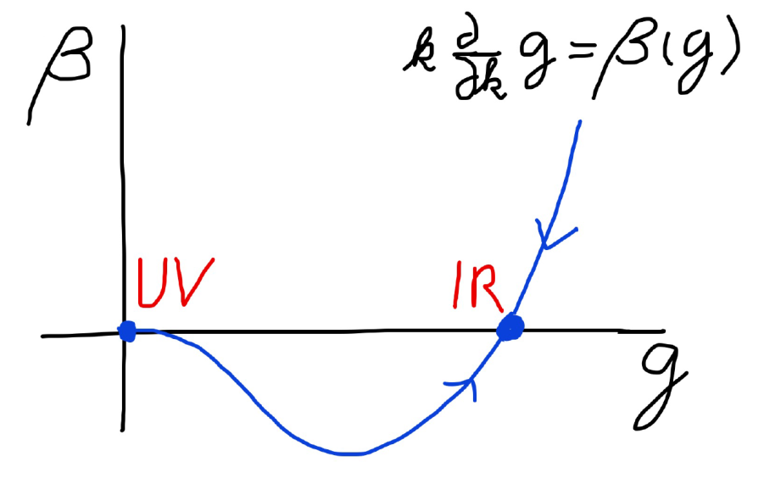
Asymptotic safety Asymptotic freedom

Slide 9
Asymptotically safe gravity
Ultraviolet fixed point exists for
quantum field theory for metric ( or vierbein ).

Slide 10
Predictivity
asymptotic safety is predictive
few relevant parameters govern flow away from UV-fixed point
translate to renormalizable couplings in standard model or extensions

Slide 11
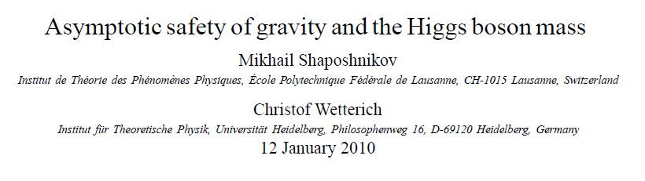
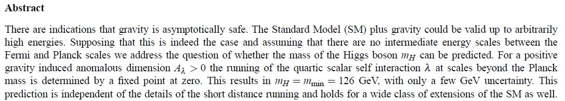
Prediction of mass of Higgs boson

Slide 12
Metric + scalar field
Inflation :
add scalar field ( inflaton )
Dynamical dark energy or quintessence:
add scalar field ( cosmon )

Slide 13
Can the scalar potential be predicted by functional renormalization for quantum gravity ?

Slide 14
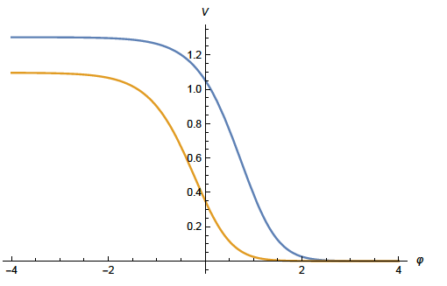
Quantum gravity prediction for generic form of potential for singlet scalar

Slide 15
prediction of (approximate ) quantum scale symmetry:
dynamical dark energy ,
generated by scalar field (cosmon )
C.Wetterich, Nucl.Phys.B302(1988)668, 24.9.87
P.J.E.Peebles, B.Ratra, ApJ.Lett.325(1988)L17, 20.10.87
Notes:
15

Slide 16
Quintessential inflation
Inflation
Dynamical
Dark Energy
Spokoiny, Peebles, Vilenkin, Peloso, Rosati, Dimopoulos, Valle, Giovannini,
Brax, Martin, Hossain, Myrzakulov, Sami, Saridakis, de Haro, Salo, Bettoni, Rubio…

Slide 17
Scaling solution

Slide 18
Scaling solutions
At fixed point: all ( infinitely many ) dimensionless couplings take fixed values
Full momentum dependence of graviton propagator ( no polynomial expansion )
Whole scalar potential is fixed, for arbitrary values of scalar field
Functional flow equations are needed

Slide 19
Scaling solutions are restrictive
scaling solutions are solutions of
non-linear differential equations
scaling potential needs to extend over
whole range of scalar field
predictivity !
in presence of gravitational fluctuations:
scalar effective potential no longer approximated by
polynomial

Slide 20
Relevant parameters and relevant functions
flow away from scaling solution is dominated by relevant functions
these should not be singular for finite values of scalar field, or diverge exponentially for increasing scalar field
typically only a few, associated to relevant parameters
Predictivity !

Slide 21
Dominant relevant mass scale
Flow away from fixed point induces intrinsic mass scales by dimensional transmutation
Intrinsic violation of quantum scale symmetry
Can be in different steps ( example Planck mass, QCD scale )
Dominant relevant mass scale is the largest intrinsic scale

Slide 22
Field dependent mass scales
Scenario: dominant relevant mass scale much below electron mass ( say 10⁻³ eV in appropriate units)
Planck mass and particle masses are given by cosmological ( expectation ) value of scalar field
Spontaneous breaking of scale symmetry
Scaling solution very good approximation for all momentum scales larger than dominant relevant mass scale

Slide 23
Scale symmetric standard model
Replace all mass scales by scalar field 𝜒
(1) Higgs potential
(2) Strong gauge coupling, normalized at , is independent of 𝜒
(3) Similar for all dimensionless couplings
Quantum effective action for standard model does
not involve intrinsic mass or length
Quantum scale symmetry
Fujii, Zee, CW
CW’87, Shaposhnikov et al

Slide 24
Cosmon
Spontaneously broken scale symmetry induces a Goldstone boson
Massless dilaton
Intrinsic mass scale from dominant relevant mass scale: Pseudo-Goldstone boson acquires a tiny mass
Cosmon
Naturally very light scalar particle !

Slide 25
quantum gravity prediction for scaling potential

Slide 26
Dilaton quantum gravity
functional renormalization for
quantum gravity coupled to a scalar field
Henz, Pawlowski, Rodigast, Yamada, Reichert,
Eichhorn, Pauly, Laporte, Pereira, Saueressig,
Wang, Knorr, …
for low order polynomial expansion of potential :
Percacci, Narain, …

Slide 27

Derivative expansion of effective action
variable gravity

Slide 28





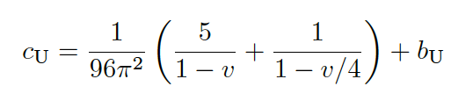



Flow equation for scalar potential
Differential equation for scaling solution

Slide 29

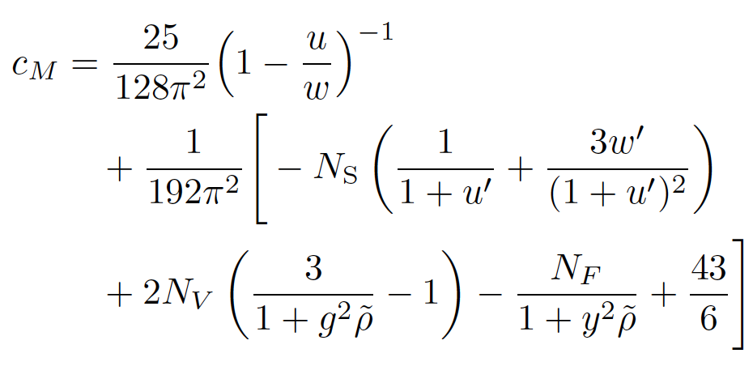
Differential equation for scaling solution for effective Planck mass
M.Yamada, …

Slide 30
Scaling potential for particles of
standard model
u : dimensionless
scalar potential
u= U/k⁴
x : logarithm of
scalar field value

Slide 31
Generic form of scaling potential
Interpolates between two plateaus
Scalar potential =
field dependent “cosmological constant”
Effectively massless particles contribute to flow
Different numbers of massless particles in different regions of field space

Slide 32
Coefficient of curvature scalar in standard model
w : dimensionless
field dependent
squared Planck mass
non-minimal
coupling of scalar field to gravity:
F=ξχ²R
x : logarithm of scalar field value

Slide 33
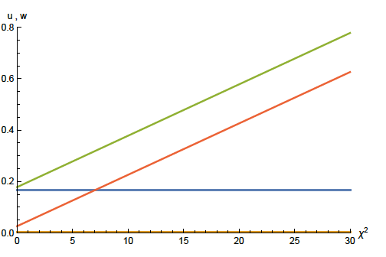
Approximate scaling solution
flat potential: u constant
non-minimal scalar- gravity coupling:
for large scalar field w increases proportional χ²
squared scalar field value χ²

Slide 34
looks natural no small parameter no tuning

Slide 35
Cosmology

Slide 36
Scaling solution in Einstein frame

Slide 37





Weyl transformation for variable gravity

Slide 38

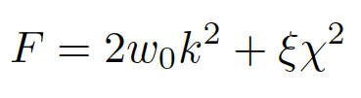

Scaling solution
For low energy
standard model :

Slide 39
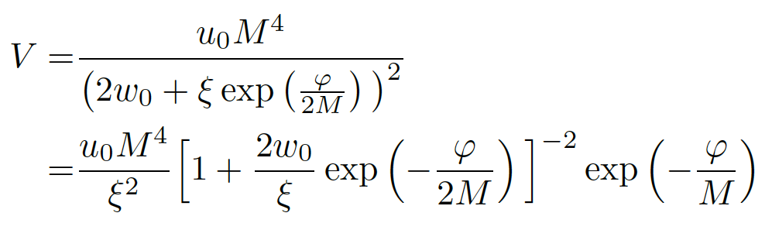
Scaling solution in Einstein frame

Slide 40
Mass scales in Einstein frame
Renormalization scale k is no longer present
Planck mass M not intrinsic: introduced only by change of variables

Slide 41
Asymptotic solution of cosmological constant problem
no tiny parameter !

Slide 42
Predictions for primordial cosmic fluctuations in inflationary cosmology
Depend on form of kinetial K
so far form of K assumed :
realistic cosmology possible for suitable K
K needs to be computed!

Slide 43
Cosmological solution
scalar field χ vanishes in the infinite past
scalar field χ diverges in the infinite future
J.Rubio,…

Slide 44
Conclusions
Fluctuations of the metric matter
They influence the behavior of scalar potentials for all field values
Quantum gravity relevant for early cosmology and late cosmology
Quantum scale symmetry is central ingredient for understanding cosmology
Fundamental scale invariance is highly predictive
Understanding of quantum gravity fluctuations still in beginning stage

Slide 45
Conclusion
Fixed points of quantum gravity
with associated quantum scale symmetry,
scaling solutions and relevant parameters
are crucial for understanding the
evolution of our Universe

Slide 46
end

