Slide 1
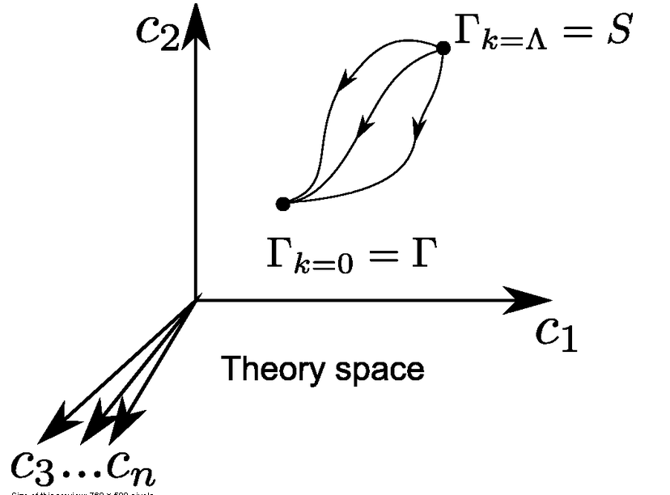
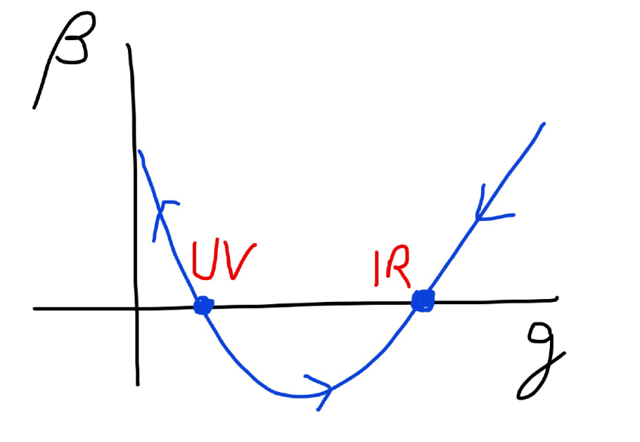
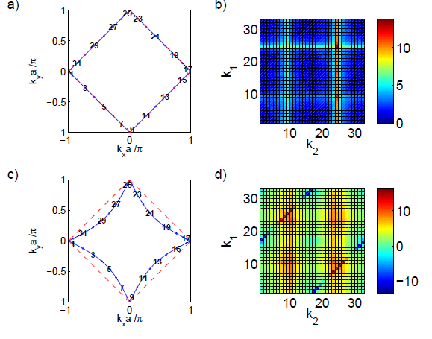
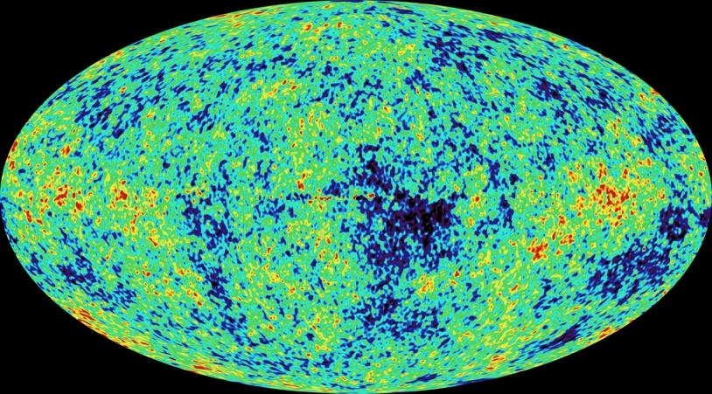
Functional renormalisation: understanding fluctuations
from superconductivity to quantum gravity

Slide 2
Functional renormalisation: from microphysical laws to macrophysical complexity

Slide 3
Functional integral
Wide applications:
partition function in statistical physics
whenever you deal with a probability distribution
also more general complex weight distributions

Slide 4
Microphysics
Formulated as partition function or functional integral
Microphysical laws are encoded in classical action S (microphysical action, related to Hamiltonian)
weight factor in probability distribution e ^{- S}
atomic interactions, quantum gravity,
standard model of particle physics, …

Slide 5
Macrophysics
Landau type theories for relevant degrees of freedom
extract properties from variation of effective action : field equations
superconductors, superfluidity …

Slide 6
Macroscopic understanding does not need all details of underlying microscopic physics
1) motion of planets : m_{i}
Newtonian mechanics of point particles
probabilistic atoms → deterministic planets
2) thermodynamics : T, µ, Gibbs free energy J(T,µ)
3) antiferromagnetic waves for correlated electrons
Γ[ s_{i}(x)]

Slide 7
How to get from microphysics to macrophysics ?
1) motion of planets : m_{i}
compute or measure mass of objects
( second order more complicated : tides etc. )
2) thermodynamics : J( T, µ )
integrate out degrees of freedom
3) antiferromagnetic waves for correlated electrons
Γ[ s_{i}(x) ] change degrees of freedom

Slide 8
central role of fluctuations

Slide 9
Classical and effective action
classical action : microscopic laws
quantum effective action : macroscopic laws
includes all fluctuation effects
(quantum, thermal, whatsoever…)
field equations are exact
Landau type theory
generates 1PI- correlation functions

Slide 10
Effective action

Slide 11
Field equations
The field equations we use for electromagnetism, gravity, or superfluidity are macroscopic equations.
They obtain by variation of the effective action, not the microscopic action.
“Classical field theory” is exact, but only with macroscopic field equations

Slide 12
Emergence of macroscopic laws with Functional Renormalisation

Slide 13
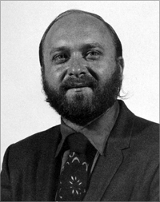
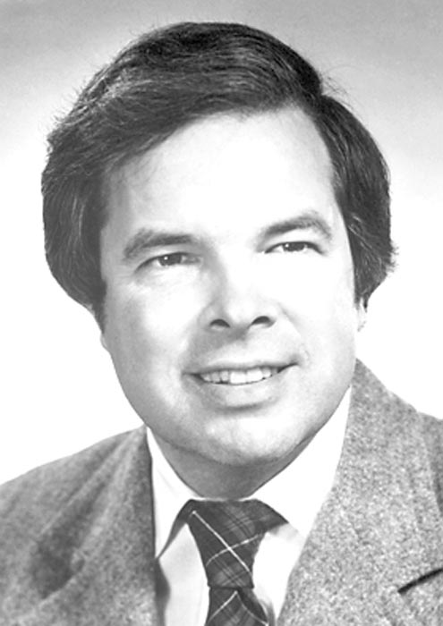
Do it stepwise : functional renormalisation
Leo Kadanoff Kenneth Wilson Franz Wegner

Slide 14
Scale dependent effective action
average effective action, flowing effective action
introduces momentum scale k by an
infrared cutoff
all fluctuations with momenta larger k are included
fluctuations with momenta smaller k are not yet included
effective laws at scale k

Slide 15
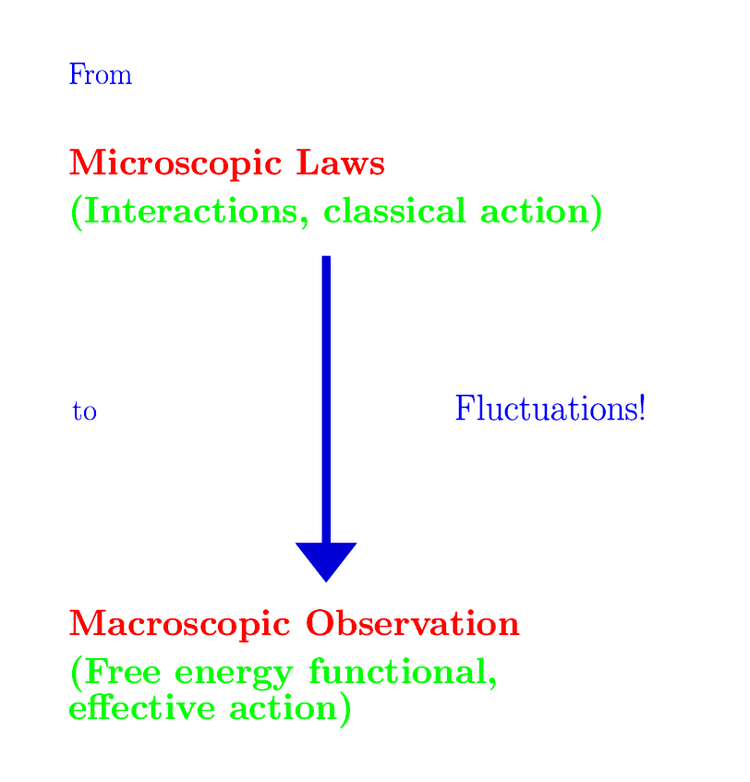
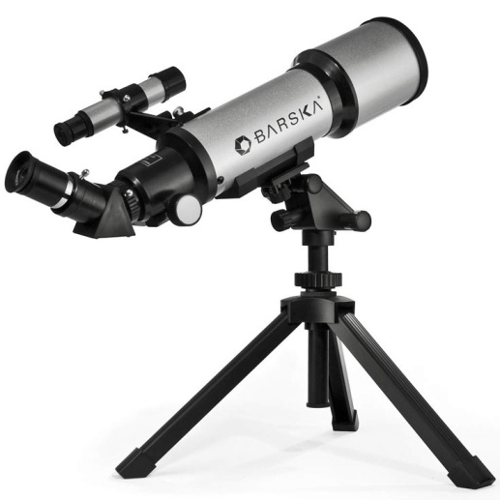

Slide 16
Exact renormalisation group equation
R_{k} : cutoff function
does not affect
high momentum fluctuations
cuts off
“infrared fluctuations”

Slide 17
Flowing action
Wikipedia

Slide 18
Flowing action
microscopic law
macroscopic law
infinitely many couplings

Slide 19
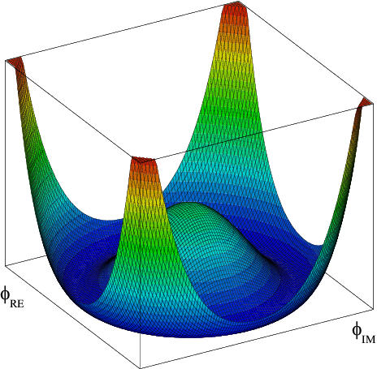
Effective potential
Effective potential
=
non – derivative
part of
effective action

Slide 20
Effective potential includes all fluctuations

Slide 21
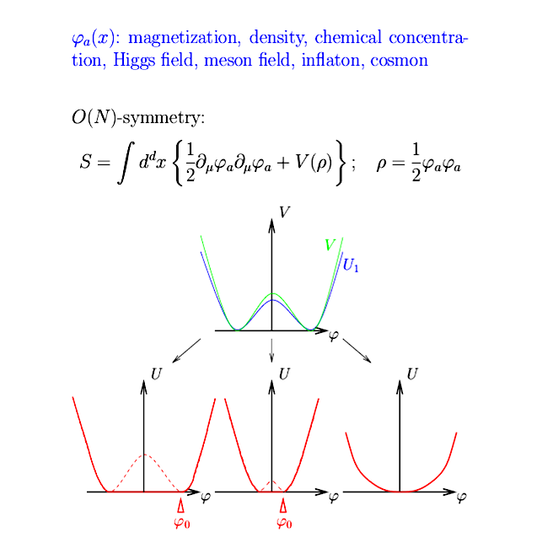
Scalar field theory

Slide 22
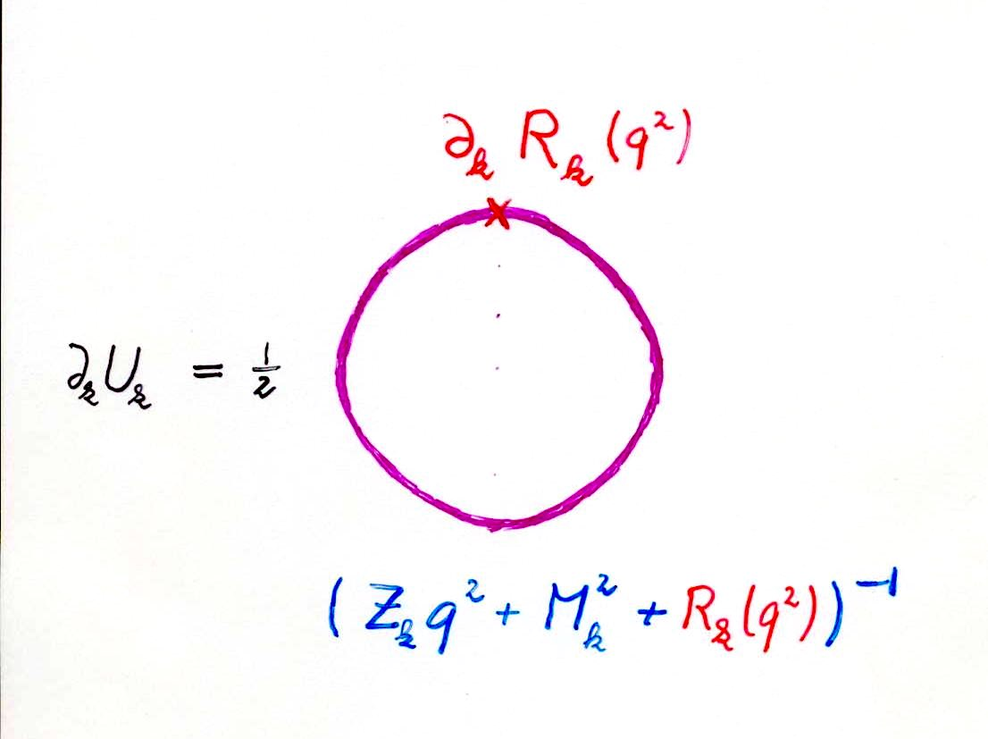
Simple one loop structure –nevertheless (almost) exact

Slide 23
Simple differential equation for O(N) – models , dimension d
t = ln( k )

Slide 24
unified approach
choose N
choose d
choose initial form of potential
run !

Slide 25
unified description of scalar models for all d and N

Slide 26
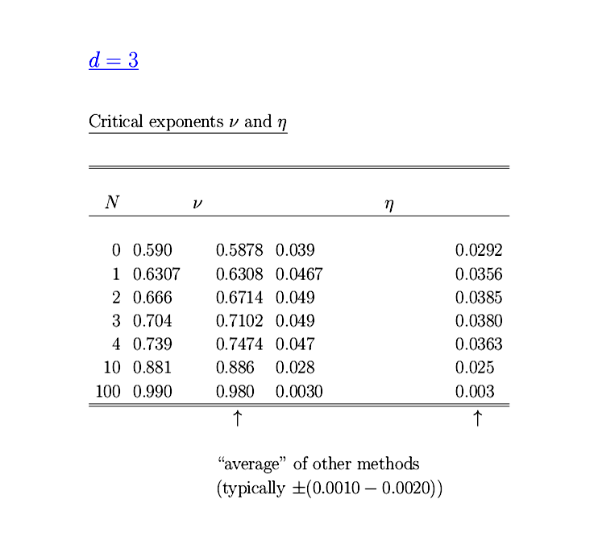
Flow of effective potential
Ising model
CO₂
Critical exponents
Experiment :
T* =304.15 K
p* =73.8.bar
ρ* = 0.442 g cm-2
S.Seide …

Slide 27
Critical exponents , d=3
ERGE world
ERGE world

Slide 28
More sophisticated approximations

Slide 29
Solution of partial differential equation :
yields highly nontrivial non-perturbative
results despite the one loop structure !
Example:
Kosterlitz-Thouless phase transition

Slide 30
Kosterlitz-Thouless phase transition (d=2,N=2)
Correct description of phase with
Goldstone boson
( infinite correlation length )
for T<T_{c}

Slide 31
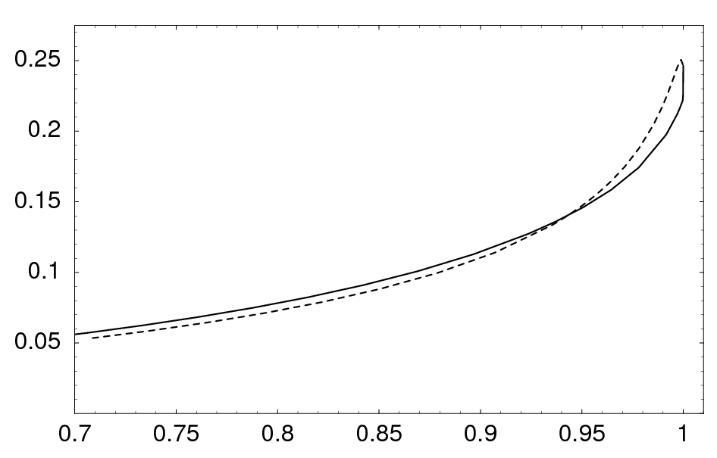
Temperature dependent anomalous dimension η
η
T/T_{c}

Slide 32
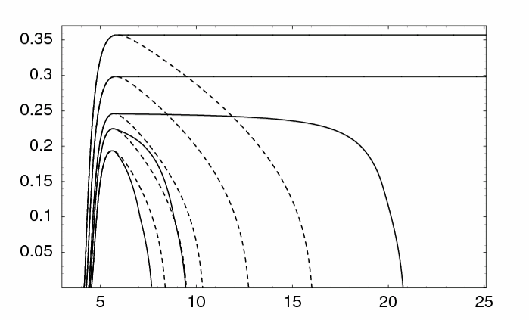
Running renormalized d-wave superconducting order parameter κ in doped Hubbard (-type ) model
T<T_{c}
κ
location
of
minimum
of u
T_{c}
local disorder
pseudo gap
T>T_{c}
C.Krahl,…
- ln (k/Λ)
macroscopic scale 1 cm

Slide 33
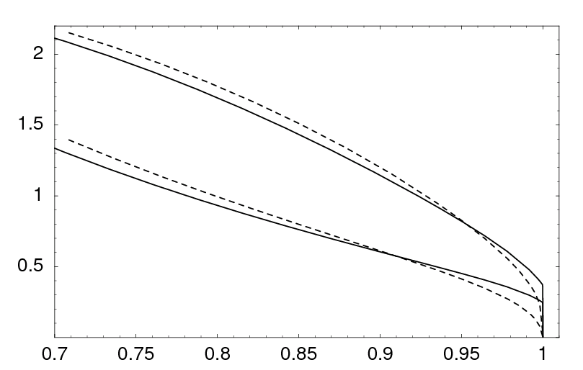
Renormalized order parameter κ and gap in electron propagator Δ in doped Hubbard model
100 Δ / t
κ
jump
T/T_{c}

Slide 34
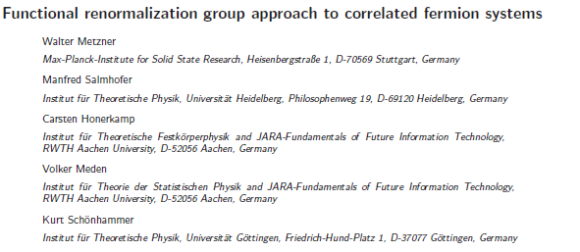
Flow of four point function Hubbard model

Slide 35
Many applications
Ultracold atoms ( quantum statistics )
Disorder
Turbulence ( non-equilibrium physics )
Density functional
Active matter ( biophysics )
Economics

Slide 36
Quantum gravity
Quantum Gravity can be a
renormalisable quantum field theory
Asymptotic safety

Slide 37
Asymptotic safety of quantum gravity
if UV fixed point exists :
quantum gravity is
non-perturbatively renormalizable !
S. Weinberg , M. Reuter

Slide 38
Ultraviolet fixed point
UV fixed point
Wikipedia

Slide 39
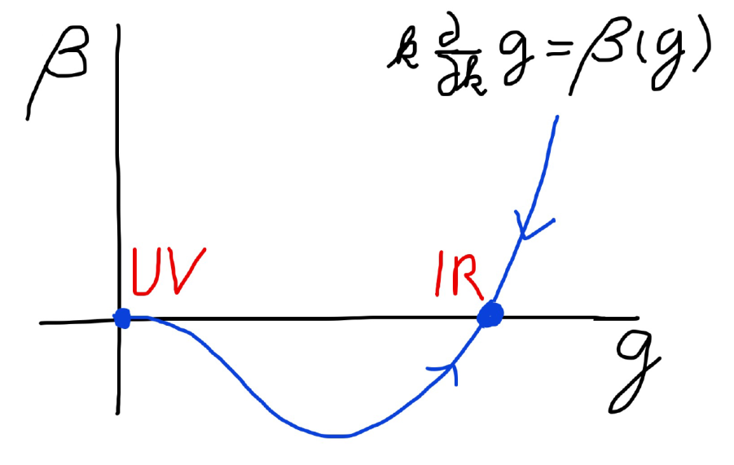
Asymptotic safety Asymptotic freedom
Relevant parameters yield undetermined couplings.
Quartic scalar coupling is not relevant and can therefore be predicted.

Slide 40
Irrelevant parameters
Can be predicted !
Standard model of particles has many renormalisable couplings as free parameters.
Those corresponding to irrelevant parameters at UV-fixed point can be predicted !
Quartic coupling for Higgs scalar is irrelevant parameter.

Slide 41
a prediction…

Slide 42
Cosmology with
quantum scale symmetry

Slide 43
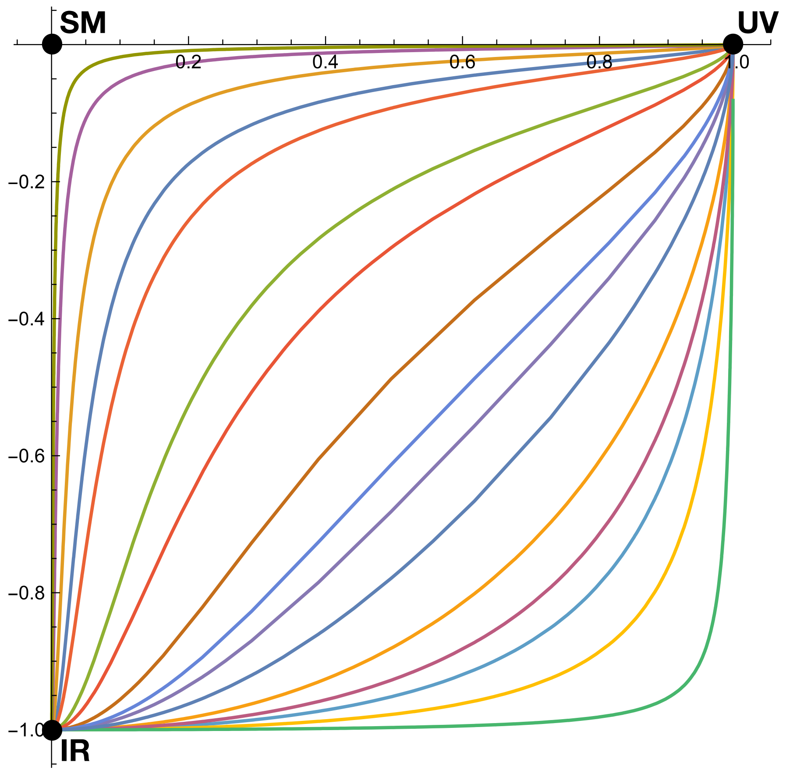
Quantum scale symmetry
Exactly on fixed point:
No parameter with dimension of
length or mass is present in the
quantum effective action.
Then invariance under
dilatations or global scale transformations
is realized as a quantum symmetry.
Continuous global symmetry

Slide 44
Approximate scale symmetry
near fixed points
UV : approximate scale invariance of primordial fluctuation spectrum from inflation

Slide 45
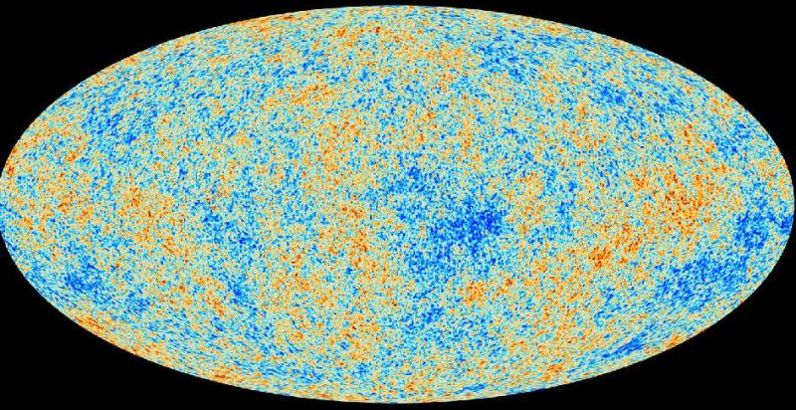
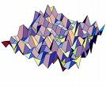
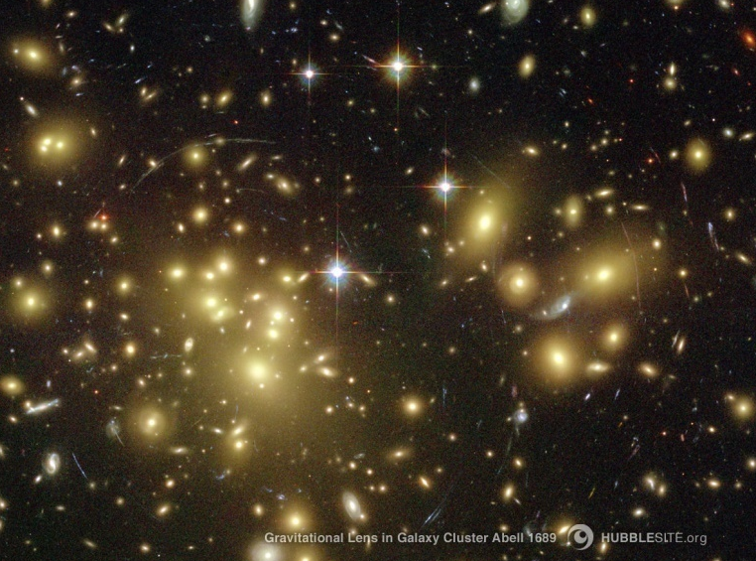
Almost scale invariant primordial fluctuation spectrum seeds all structure in the universe

Slide 46
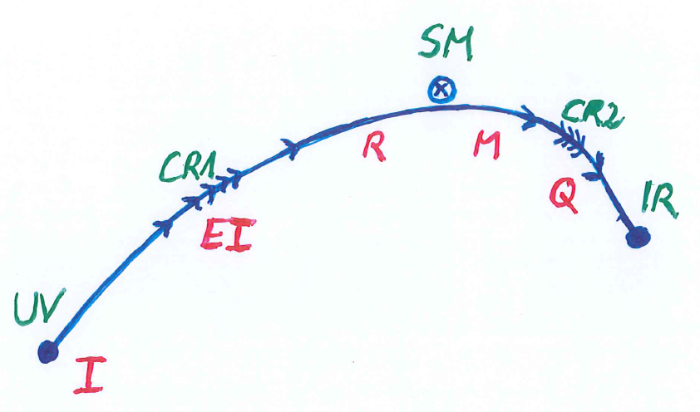
Crossover in quantum gravity

Slide 47
Cosmological solution
scalar field χ vanishes in the infinite past
scalar field χ diverges in the infinite future
J.Rubio,…

Slide 48
Fundamental scale invariance
Scaling solution is exact
All relevant parameters vanish

Slide 49
Predictivity
Theories with fundamental scale invariance are very predictive
Absence of relevant parameters
New criterion for fundamental theories
Stronger than renormalisability

Slide 50
Scaling solutions are restrictive
Scaling solutions are particular solutions of non-linear differential equations
In presence of gravitational fluctuations: scalar effective potential no longer approximated by polynomial

Slide 51
Scaling potential in
standard model

Slide 52
Coefficient of curvature scalar in standard model

Slide 53
Higgs inflation not compatible with asymptotic safety

Slide 54
Scaling potential for GUT with non-zero gauge coupling
Spontaneous
symmetry breaking by scaling solution near Planck scale

Slide 55
Asymptotically vanishing
cosmological „constant“
What matters : Ratio of potential divided by fourth power of Planck mass
vanishes for χ → ∞ !
k= 2 • 10⁻³ eV

Slide 56
Quintessence
Dynamical dark energy ,
generated by scalar field (cosmon )
C.Wetterich,Nucl.Phys.B302(1988)668, 24.9.87
P.J.E.Peebles,B.Ratra,ApJ.Lett.325(1988)L17, 20.10.87

Slide 57
Prediction : homogeneous dark energy influences recent cosmology - of same order as dark matter -
Original models do not fit the present observations
…. modifications
( different growth of neutrino mass )

Slide 58
Einstein frame
“Weyl scaling” maps variable gravity model to Universe with fixed masses and standard expansion history.
For scaling solutions: scale k disappears !
Standard gravity coupled to scalar field.
Exact equivalence of different frames !
“ different pictures”

Slide 59
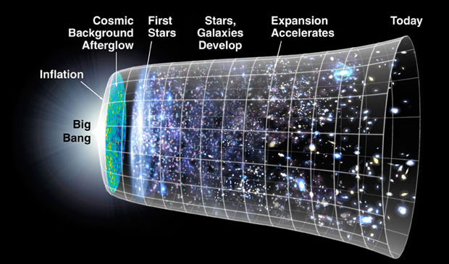
Field relativity
Weyl scaling :
changes geometry,
not a coordinate transformation

Slide 60
Models of this type are compatible with present observations
Together with variation of neutrino mass over electron mass in present cosmological epoch :
model is compatible with all present observations, including inflation and dark energy

Slide 61
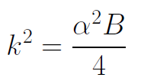
Einstein frame
Weyl scaling :
effective action in Einstein frame :

Slide 62
Spontaneous breaking of scale symmetry
expectation value of scalar field breaks scale symmetry spontaneously
massive particles are compatible with scale symmetry
in presence of massive particles : sign of exact scale symmetry is exactly massless Goldstone boson – the dilaton

Slide 63
Approximate scale symmetry near fixed points
UV : approximate scale invariance of primordial fluctuation spectrum from inflation
IR : cosmon is pseudo Goldstone boson of
spontaneously broken scale symmetry,
tiny mass,
responsible for dynamical Dark Energy

Slide 64
Simplicity
simple description of all cosmological epochs
natural incorporation of Dark Energy :
inflation
Early Dark Energy
present Dark Energy dominated epoch

Slide 65
Conclusions
Functional renormalisation has worked out in many areas of physics,
even biology and economics…
try it out !

Slide 66
end

