Slide 1
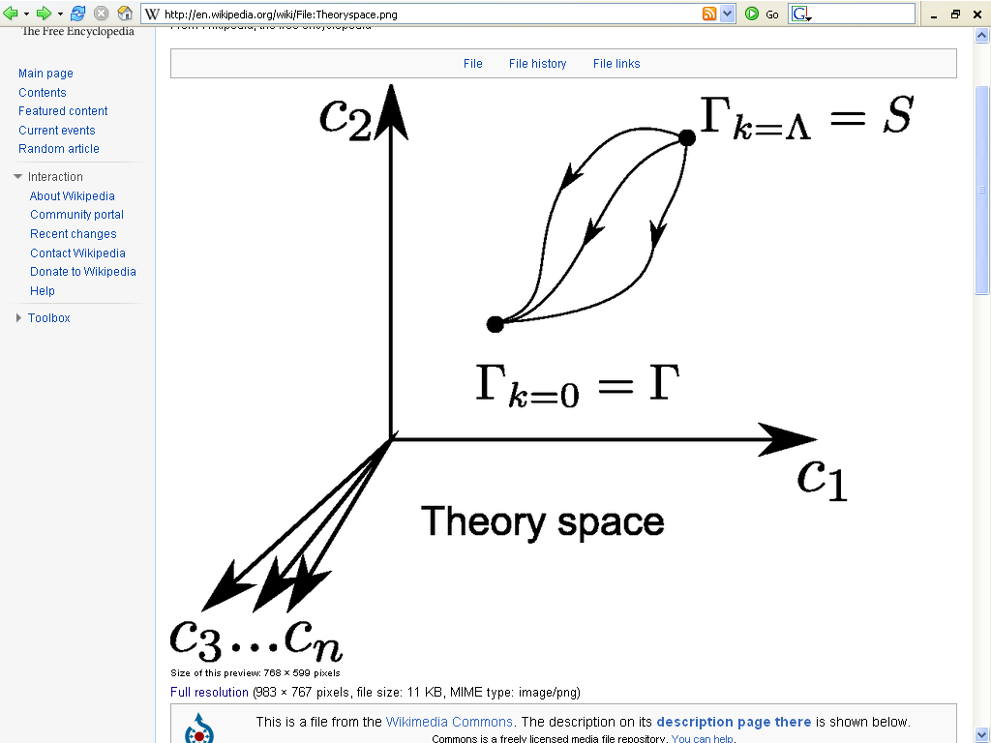
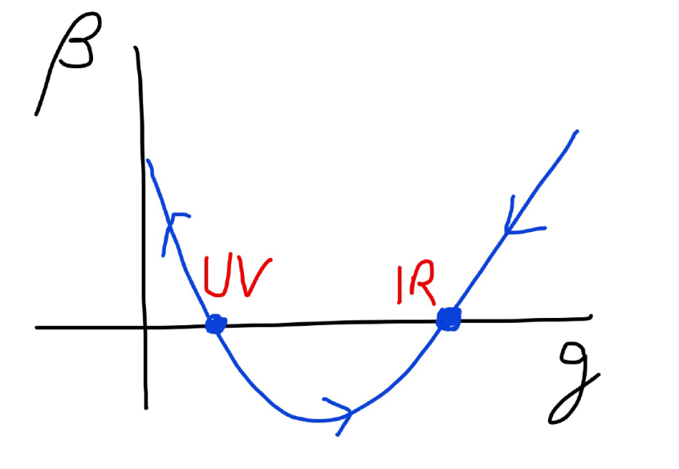
Fundamental scale invariance
UV fixed point

Slide 2
Renormalizable theories
1) Ultraviolet fixed point :
scaling solution
2) Flow away from fixed point :
relevant parameters

Slide 3
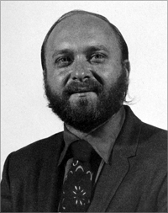
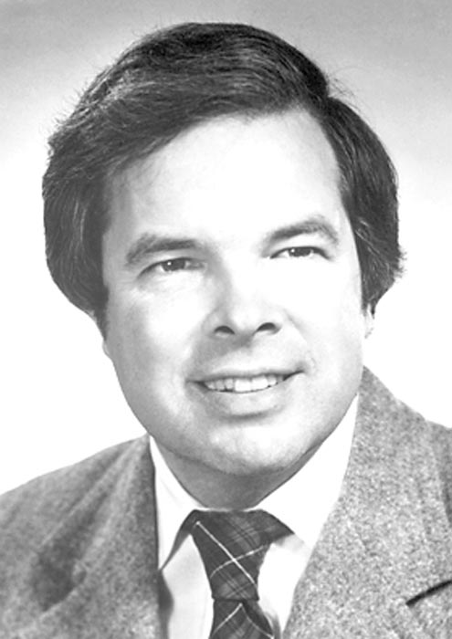
Functional renormalization
Leo Kadanoff Kenneth Wilson Franz Wegner

Slide 4
Exact renormalization group equation
R_{k} : cutoff function
does not affect
high momentum fluctuations
cuts off
“infrared fluctuations”

Slide 5
flowing action
microscopic law
macroscopic law
infinitely many couplings

Slide 6
Ultraviolet fixed point
UV fixed point
Wikipedia

Slide 7
Fundamental scale invariance
Scaling solution
that’s it

Slide 8
Ultraviolet fixed point
UV fixed point
Wikipedia

Slide 9
Condensed matter physics
Exactly on critical temperature of second order phase transition

Slide 10
Flow equation and
scaling solution
Flow equation for canonical fields
Scaling solution for scale invariant fields

Slide 11
Is the world described by a
scaling solution ?

Slide 12
Effective action for scalar field and gravity
Scaling fields
Scale invariant effective action

Slide 13
Absence of relevant parameters
for fundamental scale invariance

Slide 14
Predictivity
Theories with fundamental scale symmetry are very predictive
Absence of relevant parameters
New criterion for fundamental theories
Stronger than renormalizability

Slide 15
Scaling solutions are restrictive
Scaling solutions are particular solutions of non-linear differential equations
In presence of gravitational fluctuations: scalar effective potential no longer approximated by polynomial

Slide 16
Scaling potential in
standard model

Slide 17
Coefficient of curvature scalar in standard model

Slide 18
Higgs inflation not compatible with asymptotic safety

Slide 19
Scaling potential for GUT with non-zero gauge coupling
Spontaneous
symmetry breaking by scaling solution near Planck scale

Slide 20
Asymptotically vanishing
cosmological „constant“
What matters : Ratio of potential divided by fourth power of Planck mass
vanishes for χ → ∞ !
k= 2 • 10⁻³ eV

Slide 21
Quintessence
Dynamical dark energy ,
generated by scalar field (cosmon )
C.Wetterich,Nucl.Phys.B302(1988)668, 24.9.87
P.J.E.Peebles,B.Ratra,ApJ.Lett.325(1988)L17, 20.10.87

Slide 22
Prediction : homogeneous dark energy influences recent cosmology - of same order as dark matter -
Original models do not fit the present observations
…. modifications
( different growth of neutrino mass )

Slide 23
Einstein frame
“Weyl scaling” maps variable gravity model to Universe with fixed masses and standard expansion history.
For scaling solutions: scale k disappears !
Standard gravity coupled to scalar field.
Exact equivalence of different frames !
“ different pictures”

Slide 24
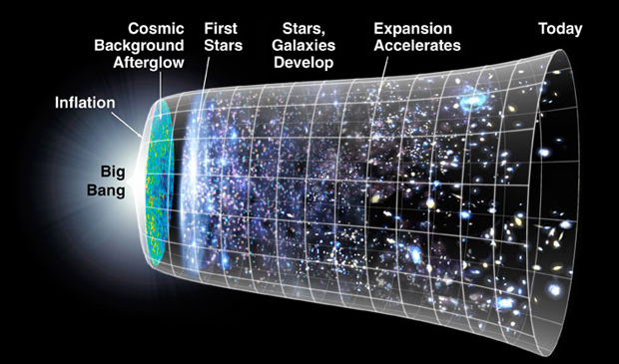
Field relativity
Weyl scaling :
changes geometry,
not a coordinate transformation

Slide 25
Models of this type are compatible with present observations
Together with variation of neutrino mass over electron mass in present cosmological epoch :
model is compatible with all present observations, including inflation and dark energy

Slide 26
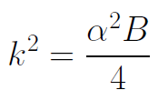
Einstein frame
Weyl scaling :
effective action in Einstein frame :

Slide 27
Cosmological solution
scalar field χ vanishes in the infinite past
scalar field χ diverges in the infinite future
J.Rubio,…

Slide 28
Why is the world described by a scaling solution ?

Slide 29
Fundamental theory
without scale
Fundamental fields are dimensionless
Length scale can be introduced for distances, mass=inverse length for derivatives
Metric appears as composite object
dimension: mass squared

Slide 30
Effective action for
scale invariant fields
Assume that continuum limit exists for this effective action
No intrinsic scale

Slide 31
Canonical fields
Canonical metric is dimensionless
Introduce renormalisation scale k
Canonical scalar fields have dimension mass
General renormalized fields

Slide 32
Fundamental scale invariance
Scale k introduced only for convenience - no need to do so
Scale invariant flow equation

Slide 33
Continuum limit
Non- trivial part:
Existence of continuum limit in terms of scaling fields : fixed couplings at microscopic scale (e.g. lattice cutoff )
Not realised in standard QCD

Slide 34
Where do the observed scales in Nature come from ?

Slide 35
Quantum scale symmetry
No parameter with dimension of
length or mass is present in the
quantum effective action. Even not k!
Then invariance under
dilatations or global scale transformations
is realized.
Continuous global symmetry

Slide 36
Spontaneous breaking of scale symmetry
expectation value of scalar field breaks scale symmetry spontaneously
massive particles are compatible with scale symmetry
in presence of massive particles : sign of exact scale symmetry is exactly massless Goldstone boson – the dilaton

Slide 37
Scale symmetry
no scale symmetry
scale symmetry
only if no spontaneous symmetry breaking!

Slide 38
Approximate scale symmetry near fixed points
UV : approximate scale invariance of primordial fluctuation spectrum from inflation
IR : cosmon is pseudo Goldstone boson of
spontaneously broken scale symmetry,
tiny mass,
responsible for dynamical Dark Energy

Slide 39
Realistic particle physics
Compatible with
quantum scale symmetry
Compatible with
fundamental scale invariance

Slide 40
Scale symmetric standard model
Replace all mass scales by scalar field 𝜒
(1) Higgs potential
(2) Strong gauge coupling, normalized at , is independent of 𝜒
(3) Similar for all dimensionless couplings
Quantum effective action for standard model does
not involve intrinsic mass or length
Quantum scale symmetry
For : : massless Goldstone boson
Fujii,
Zee, CW
CW’87

Slide 41
Running couplings
Couplings run as function of
Scale invariant flow equation

Slide 42
Conclusions
Fundamental scale invariance is a new selection criterion for fundamental theories
Particular renormalizable theories for which no scale is present at all
Exact scaling solution of flow equation

Slide 43
end

