Slide 1
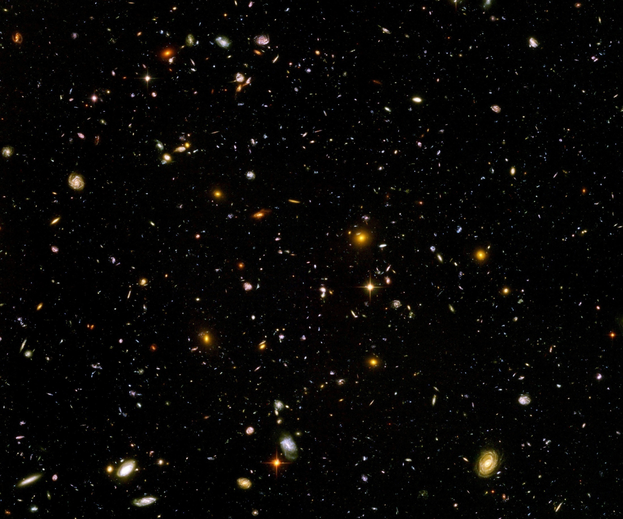
Scale symmetry in particle physics, gravity and cosmology – predictions from fixed points

Slide 2
Quantum scale symmetry
No parameter with dimension of
length or mass is present in the
quantum effective action.
Then invariance under
dilatations or global scale transformations
is realized.
Continuous global symmetry

Slide 3
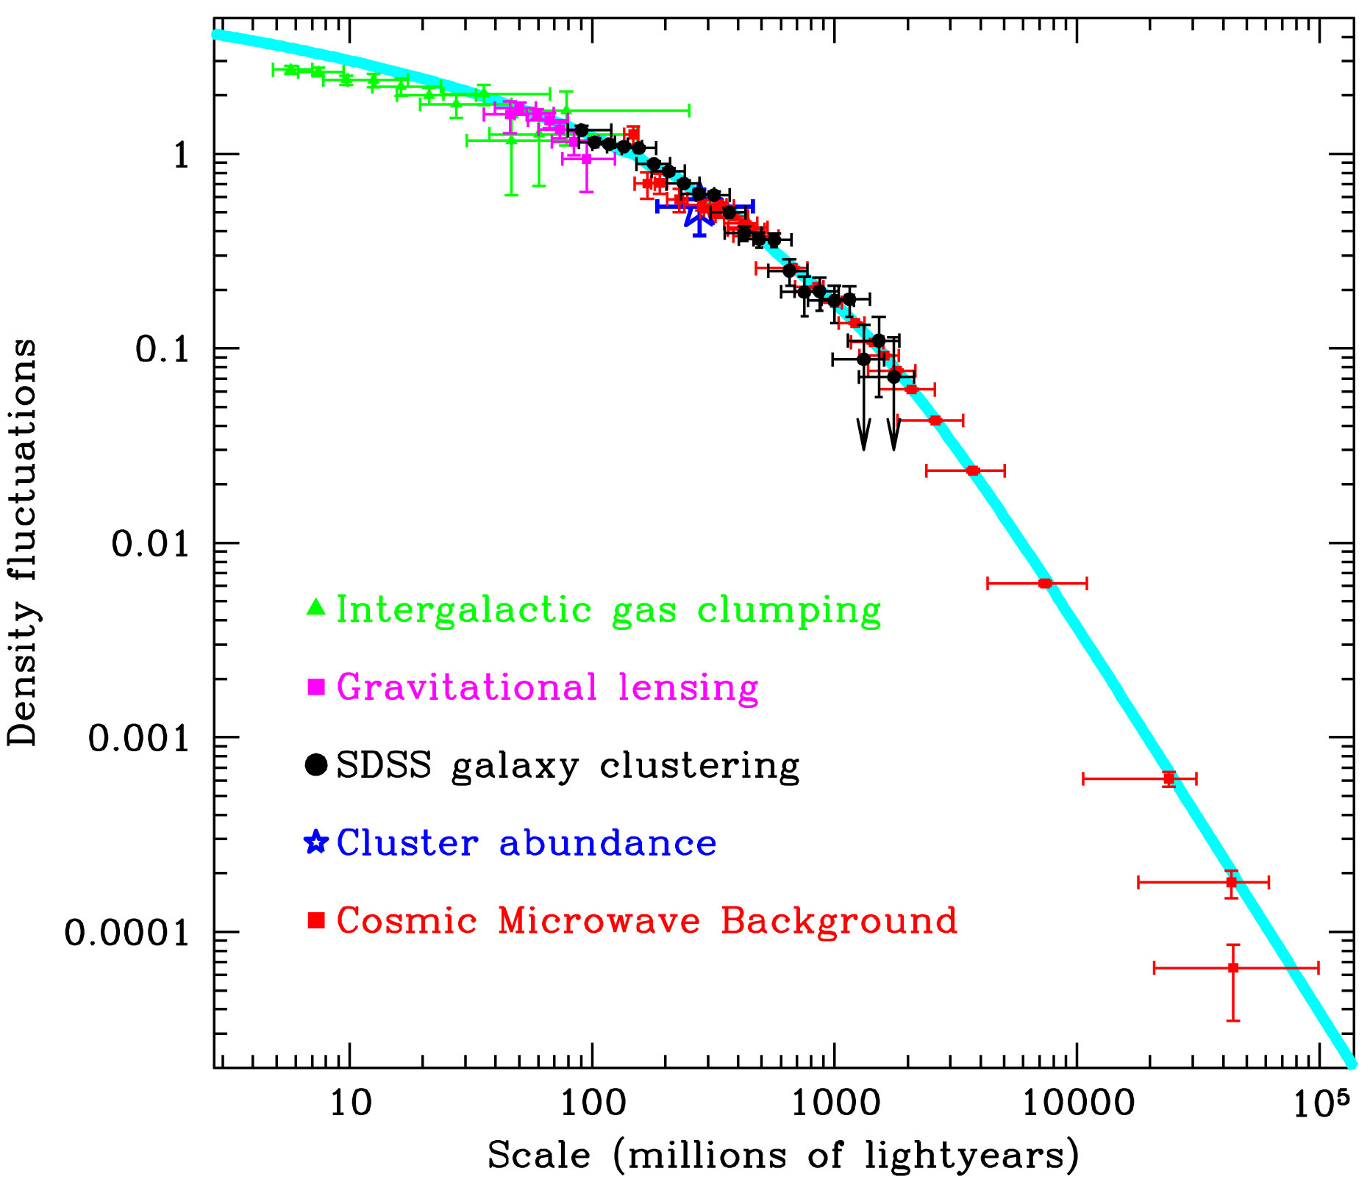
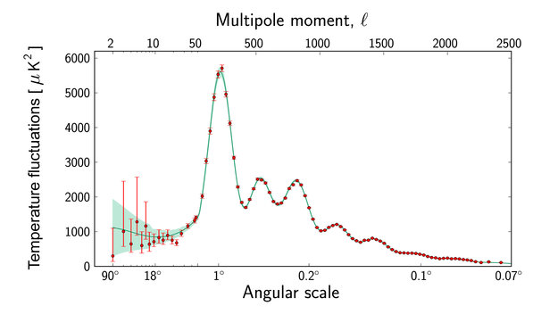
Scale symmetry in cosmology ?
Almost scale invariant primordial fluctuation spectrum
scales are present in cosmology

Slide 4
Scale symmetry in elementary particle physics ?
proton mass , electron mass
Scales are present in particle physics,
but very small as compared to Planck mass
High momentum scattering almost scale invariant

Slide 5
Quantum scale symmetry

Slide 6
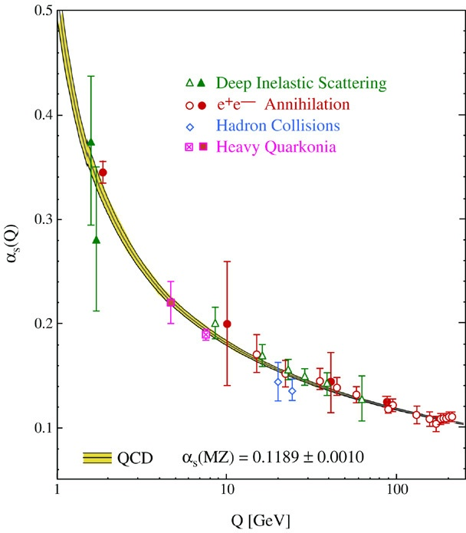
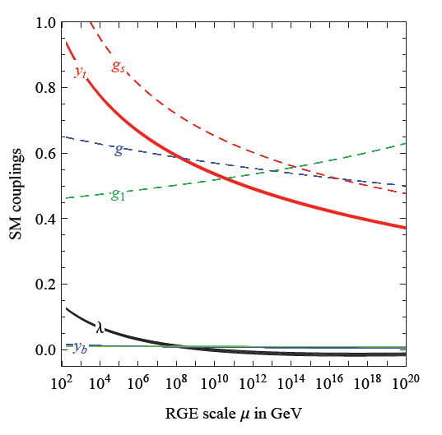
Quantum fluctuations induce running couplings
violation of scale symmetry
well known in QCD or standard model

Slide 7
Quantum scale symmetry
quantum fluctuations violate scale symmetry
running dimensionless couplings
at fixed points , scale symmetry is exact !
quantum fluctuations can generate scale symmetry !

Slide 8
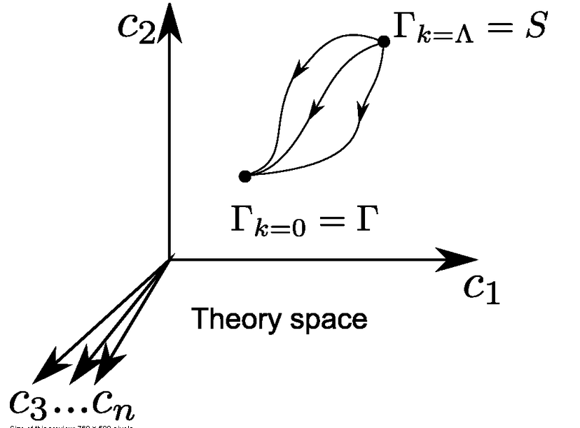
Functional renormalization : flowing action
Wikipedia
Notes:
8

Slide 9
Ultraviolet fixed point
UV fixed point
Wikipedia
Notes:
9

Slide 10
Quantum scale symmetry
Exactly on fixed point:
No parameter with dimension of
length or mass is present in the
quantum effective action for renormalized fields.
Then invariance under
dilatations or global scale transformations
is realized as a quantum symmetry.
Continuous global symmetry

Slide 11
Example :
Wilson-Fisher fixed point

Slide 12
Renormalized field and microscopic field
propagator ~
potential

Slide 13
Two scale symmetries
Gravity scale symmetry:
includes transformation of metric and scalar
singlet for variable Planck mass
Particle scale symmetry:
Symmetry of effective theory below Planck mass
relative scaling of momenta with respect to Planck mass
Violated by running couplings

Slide 14
Gravity scale symmetry

Slide 15
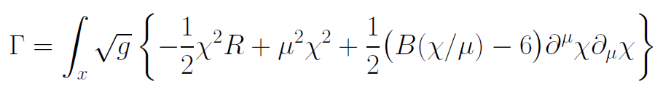
Gravity scale symmetry
Replace Planck mass by scalar field
…

Slide 16
Spontaneous breaking of scale symmetry
expectation value of scalar field breaks scale symmetry spontaneously
massive particles are compatible with scale symmetry
in presence of massive particles : sign of exact scale symmetry is exactly massless Goldstone boson – the dilaton

Slide 17
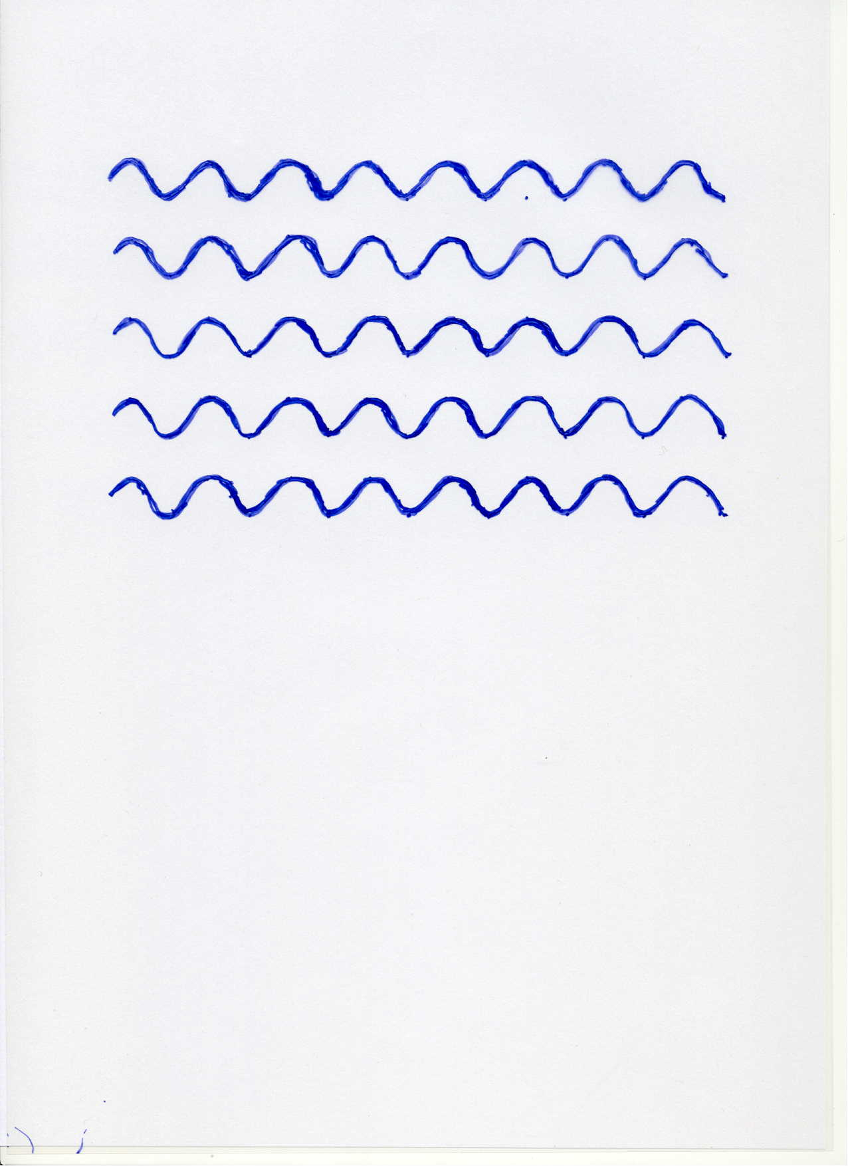
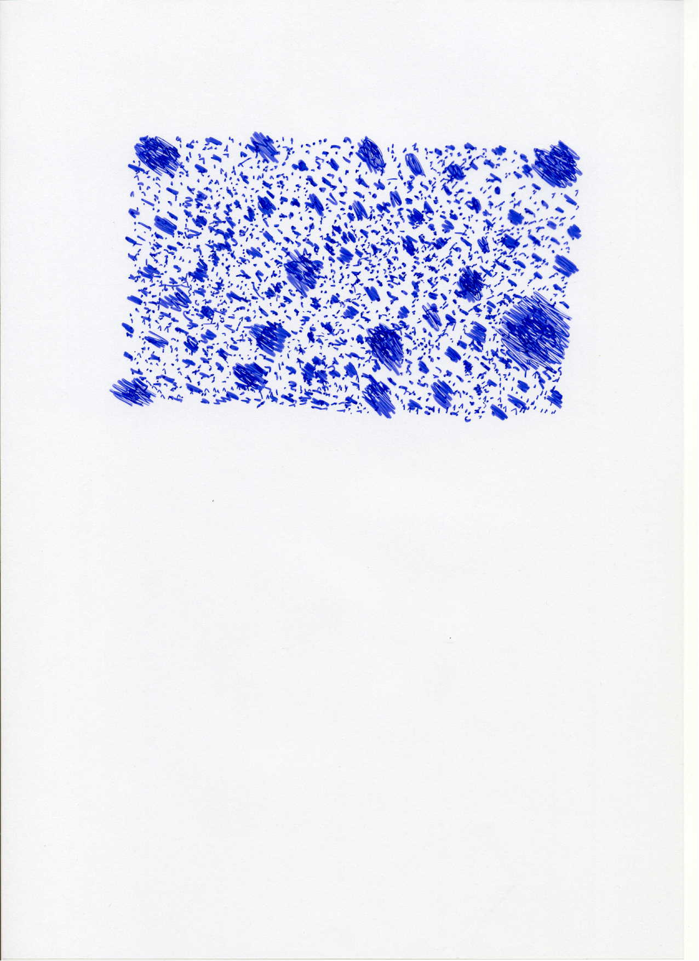

Scale symmetry
no scale symmetry
scale symmetry
only if no spontaneous symmetry breaking!

Slide 18
Scale symmetric standard model
Replace all mass scales by scalar field 𝜒
(1) Higgs potential
(2) Strong gauge coupling, normalized at , is independent of 𝜒
(3) Similar for all dimensionless couplings
Quantum effective action for standard model does
not involve intrinsic mass or length
Quantum scale symmetry
For : massless Goldstone boson
Fujii,
Zee, CW
CW’87

Slide 19
Particle scale symmetry

Slide 20
Second order vacuum electroweak phase transition fixed point quantum scale symmetry

Slide 21
Scale symmetry and Fermi scale
Vacuum electroweak phase transition is (almost) second order, including all effects from quantum fluctuations
Critical surface of second order phase transition: exact fixed point, quantum scale symmetry
Scale symmetry guarantees “naturalness” of gauge hierarchy
C. Wetterich, Phys. Lett.B140(1984)215,
W. A. Bardeen, FERMILAB-CONF-95-391-T(1995)

Slide 22
Scale symmetry and Fermi scale
Vacuum electroweak phase transition is (almost) second order
Critical surface of second order phase transition: exact fixed point, quantum scale symmetry
Scale symmetry guarantees “naturalness” of small (gauge hierarchy)
No fine tuning for renormalisation group improved perturbation theory for deviation from critical surface
C. Wetterich, Phys. Lett.B140(1984)215,
W. A. Bardeen, FERMILAB-CONF-95-391-T(1995)

Slide 23
Fine tuning ?
Fine tuning of parameters , quadratic divergences concern bare perturbation theory for location of critical surface in coupling constant space.
not relevant for observation,
not particularly interesting,
regularization dependent, not universal,
always depends on unknown microscopic details
bare perturbation theory is bad expansion

Slide 24
Quantum Gravity
Quantum Gravity can be a
renormalisable quantum field theory
Asymptotic safety

Slide 25
Asymptotic safety of quantum gravity
if UV fixed point exists :
quantum gravity is
non-perturbatively renormalizable !
S. Weinberg , M. Reuter

Slide 26
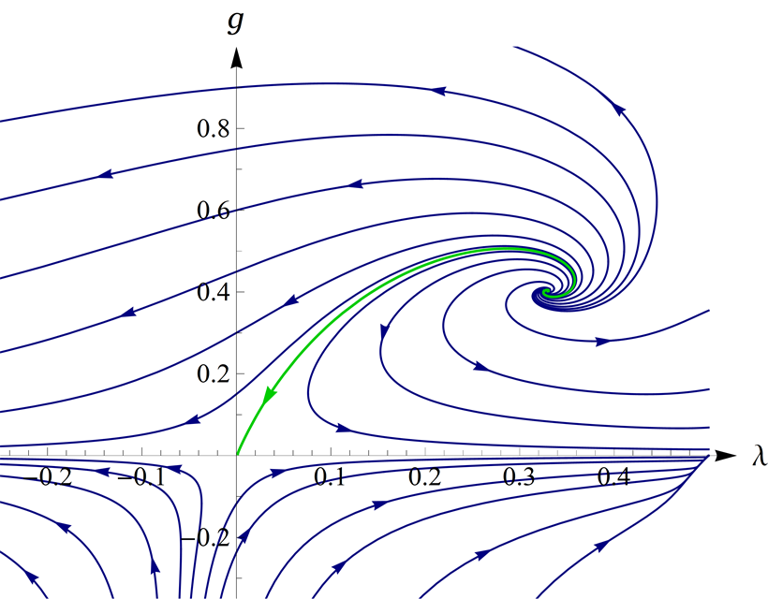
UV- fixed point for quantum gravity
Wikipedia

Slide 27
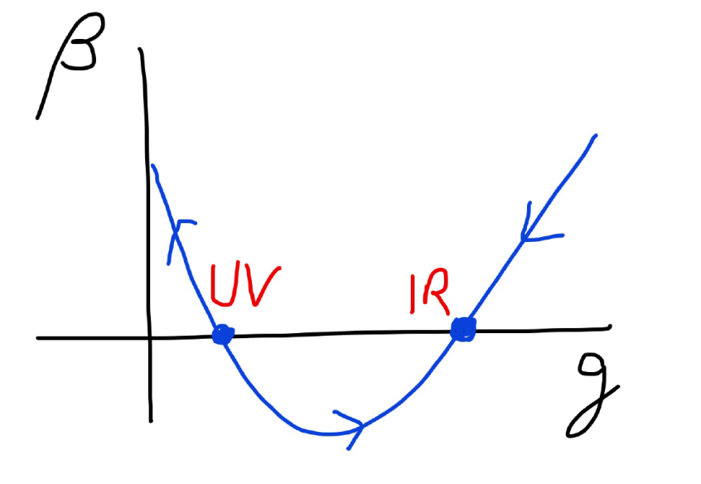
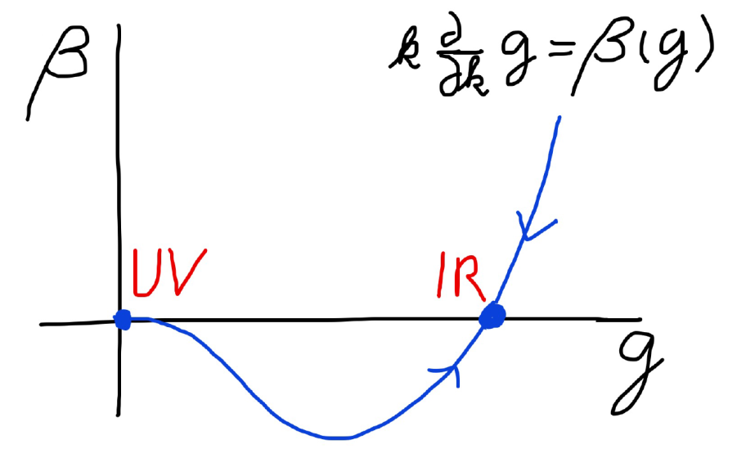
Asymptotic safety Asymptotic freedom
Relevant parameters yield undetermined couplings.
Quartic scalar coupling is not relevant and can therefore be predicted.

Slide 28
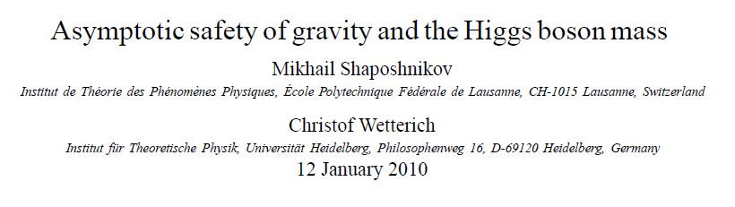
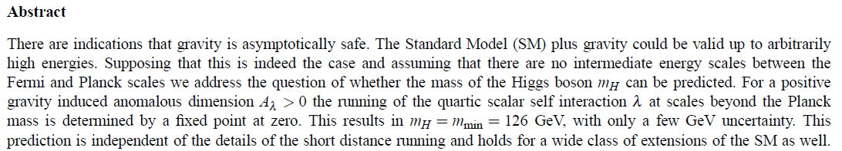
a prediction…

Slide 29
Gravity contributions to running couplings in standard model
Running Planck mass :
For quartic scalar coupling
(R.Percacci et al)
Large k :
Add fermions
+…

Slide 30
Computation of graviton contribution
traceless transverse metric fluctuations
Graviton approximation

Slide 31
Graviton propagator
effective action
Instability for V>0 : ”tachyonic mass term”

Slide 32
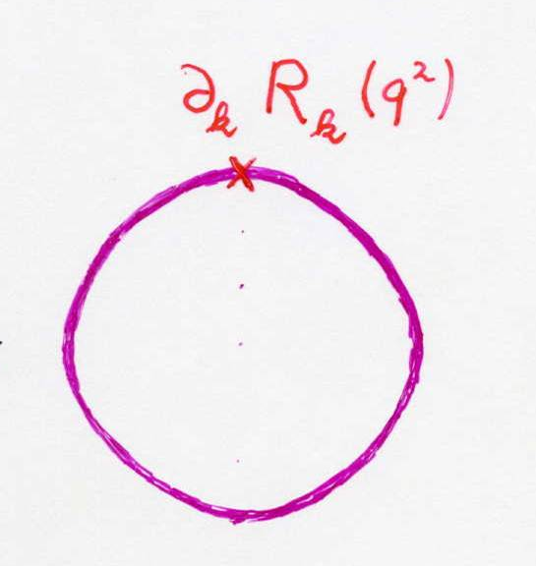
Graviton contribution to flow of scalar potential
Litim cutoff:

Slide 33
Graviton contributions to
Higgs potential
Graviton
contribution:
For large k :

Slide 34
Graviton contribution to flow of quartic scalar coupling : positive and substantial anomalous dimension

Slide 35
Possible explanation of gauge hierarchy
Phys.Lett. B770 (2017) 268-271

Slide 36
Infrared flow in gravity
for k much smaller than M

Slide 37
Graviton contribution to flow of scalar potential
crucial dimensionless quantity

Slide 38
Flow equation for v

Slide 39
Flow of v for different initial conditions

Slide 40
Infrared value of effective scalar potential for k/𝜒 → 0
v=1
graviton barrier !

Slide 41
Graviton fluctuations erase the cosmological constant

Slide 42
Graviton barrier and solution of the cosmological constant problem
V cannot increase stronger than M² !
If M increases with 𝜒, and for cosmological solutions where 𝜒 asymptotically diverges for time going to infinity:
Effective cosmological constant vanishes
in infinite future

Slide 43
Normalization of scalar field
If M increases monotonically with 𝜒 :
choose normalization of scalar
M= 𝜒

Slide 44
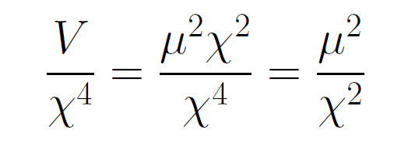
asymptotically vanishing cosmological „constant“
What matters : Ratio of potential divided by fourth power of Planck mass
vanishes for χ → ∞ !

Slide 45
Quintessence
Dynamical dark energy ,
generated by scalar field (cosmon )
C.Wetterich,Nucl.Phys.B302(1988)668, 24.9.87
P.J.E.Peebles,B.Ratra,ApJ.Lett.325(1988)L17, 20.10.87
Notes:
45

Slide 46
Prediction : homogeneous dark energy influences recent cosmology
- of same order as dark matter -
Original models do not fit the present observations
…. modifications
( different growth of neutrino mass )

Slide 47
Ultraviolet flow of v for k/𝜒 → ∞
UV – and IR –
fixed points

Slide 48
Quantum gravity has
UV- and IR- fixed point
Near UV fixed point:
Relevant parameters yield undetermined couplings.
Quartic scalar coupling is irrelevant and can therefore be predicted.

Slide 49
Quantum gravity with scalar field – the role of scale symmetry for cosmology

Slide 50
Approximate scale symmetry near fixed points
UV : approximate scale invariance of primordial fluctuation spectrum from inflation
IR : cosmon is pseudo Goldstone boson of
spontaneously broken scale symmetry,
tiny mass,
responsible for dynamical Dark Energy

Slide 51
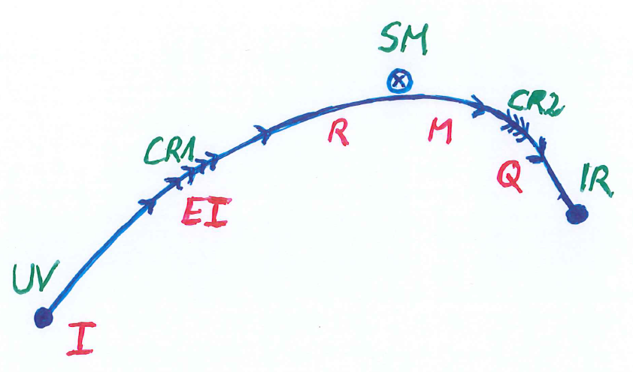
Possible consequences of crossover in quantum gravity
Realistic model for inflation and dark energy
with single scalar field

Slide 52
variable gravity
“Newton’s constant is not constant –
and particle masses are not constant”

Slide 53

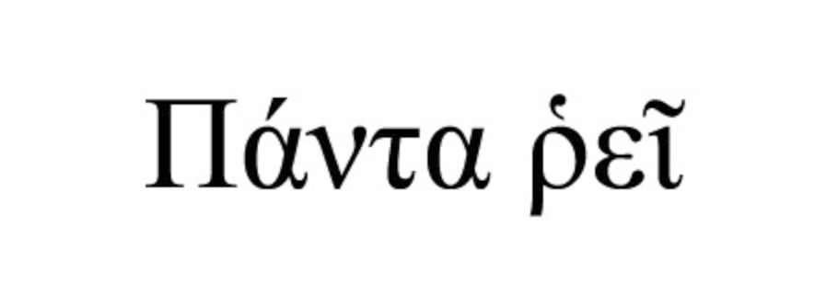

Slide 54
Variable Gravity
quantum effective action,
variation yields field equations
Einstein gravity :
M² R

Slide 55
+ scale symmetric standard model
Replace all mass scales by scalar field 𝜒
(1) Higgs potential
(2) Strong gauge coupling, normalized at , is independent of 𝜒
+ scale invariant action for dark matter

Slide 56
Scale symmetry in variable gravity
( IR – fixed point )
quantum effective action,
variation yields field equations
Einstein gravity :
M² R

Slide 57
Variable Gravity
Scalar field coupled to gravity
Effective Planck mass depends on scalar field
Simple quadratic scalar potential involves intrinsic mass μ
Nucleon and electron mass proportional to dynamical Planck mass

Slide 58
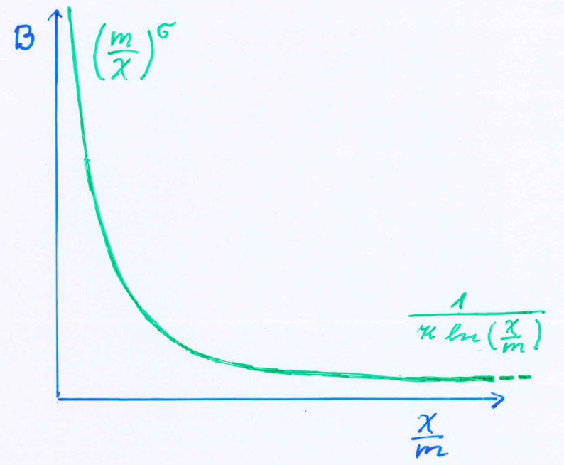
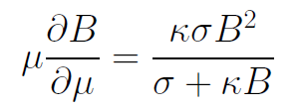
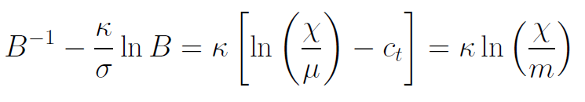
Kinetial B :
Crossover between two fixed points
assumption: running
coupling obeys
flow equation
m : scale of crossover
can be exponentially larger than intrinsic scale μ

Slide 59
Four-parameter model
model has four dimensionless parameters
three in kinetial :
σ ~ 2.5
κ ~ 0.5
c_{t} ~ 14 ( or m/μ )
one parameter for growth rate of neutrino mass over electron mass : γ ~ 8
+ standard model particles and dark matter : sufficient for realistic cosmology from inflation to dark energy
no more free parameters than ΛCDM

Slide 60
Cosmology
Add matter and radiation (standard model + dark matter)
Solve field equations…

Slide 61
Cosmological solution
scalar field χ vanishes in the infinite past
scalar field χ diverges in the infinite future
J.Rubio,…

Slide 62
Model is compatible with present observations
Together with variation of neutrino mass over electron mass in present cosmological epoch :
model is compatible with all present observations, including inflation and dark energy

Slide 63
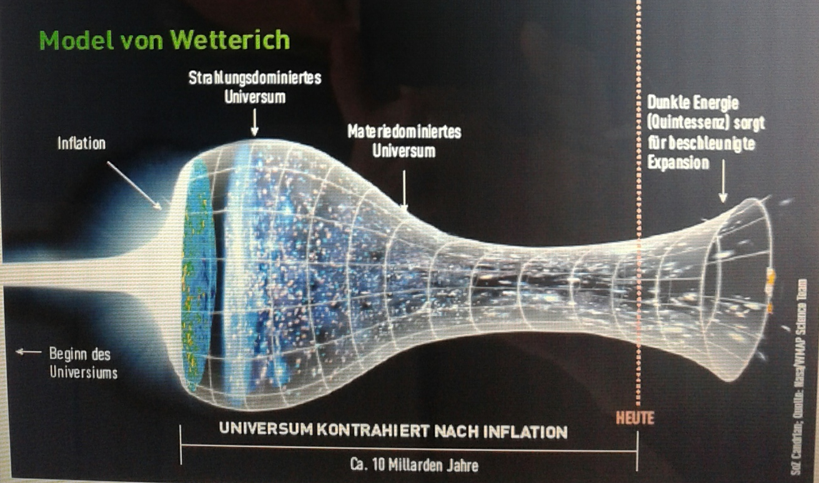
Strange evolution of Universe
Sonntagszeitung Zürich , Laukenmann

Slide 64
Expanding Universe or shrinking atoms ?

Slide 65
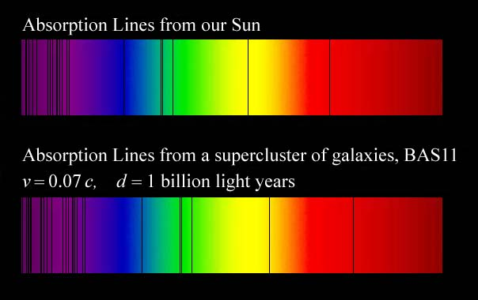
Do we know that the
Universe expands ?
instead of redshift due to expansion :
smaller frequencies have been emitted in the past, because electron mass was smaller !

Slide 66
Why do we see redshift of photons emitted in the distant past ?
photons are more red because they have been emitted with longer wavelength
frequency ~ mass
wavelength ~
atomsize

Slide 67
What is increasing ?
Ratio of distance between galaxies
over size of atoms !
atom size constant : expanding geometry
alternative : shrinking size of atoms

Slide 68
Big bang is not wrong, but alternative pictures exist !

Slide 69
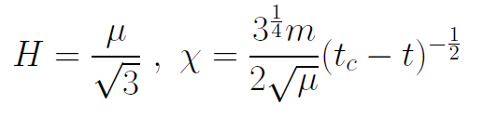
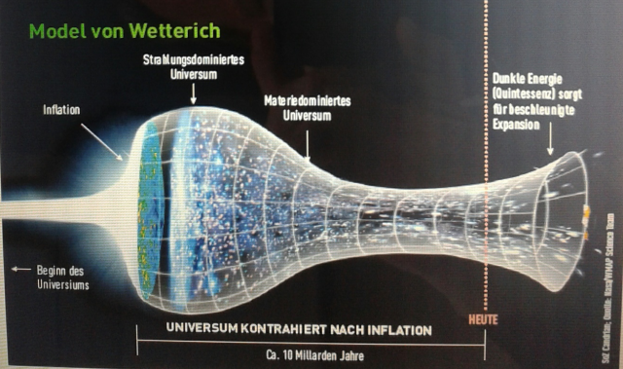
Eternal Universe
Asymptotic solution in
freeze frame :
solution valid back to the infinite past in physical time
no singularity
physical time to infinite past is infinite

Slide 70
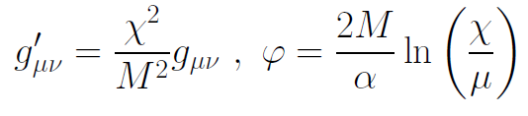

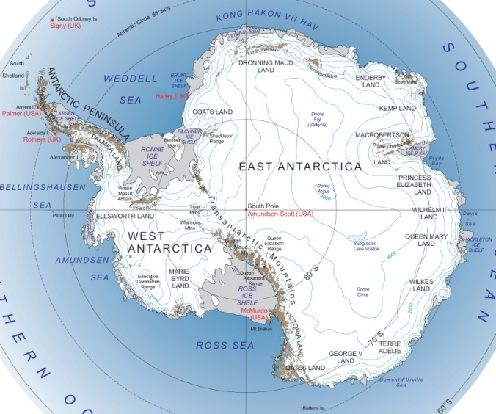
Field - singularity
Big Bang is field - singularity
similar ( but not identical with )
coordinate - singularity

Slide 71
Conclusions
Quantum gravity may be observable in
dynamics of early and present Universe
Predictions for parameters of standard model of particle physics
Fixed points and scale symmetry crucial
Big bang singularity is artefact
of inappropriate choice of field variables –
no physical singularity

Slide 72
end

Slide 73
Einstein frame
“Weyl scaling” maps variable gravity model to Universe with fixed masses and standard expansion history.
Exact equivalence of different frames !
“ different pictures”
Standard gravity coupled to scalar field.

Slide 74
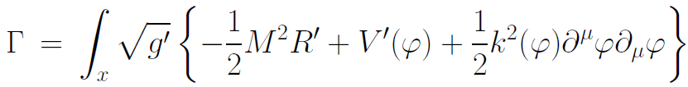
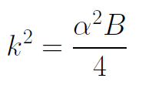

Einstein frame
Weyl scaling :
effective action in Einstein frame :

Slide 75
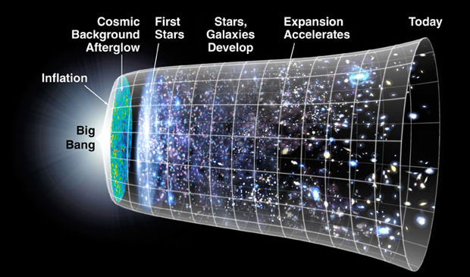
Field relativity
Weyl scaling :
changes geometry,
not a coordinate transformation

Slide 76
Field relativity : different pictures of cosmology
same physical content can be described by different pictures
related by field – redefinitions , e.g. Weyl scaling , conformal scaling of metric
observables cannot depend on choice of fields
metric is one of the fields
which picture is usefull ?

Slide 77
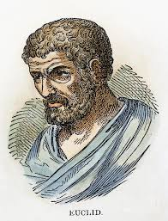


Relativity of geometry
Euclid … Newton : space and time
are absolute
Special relativity : space and time depend on observer
General relativity : space-time is
influenced by matter ( including radiation )
geometry is independent of coordinates
geometry is observable
Field relativity : geometry is relative

Slide 78
Space-time is a description of correlations between “matter”.
Observables cannot depend on choice of fields used to describe them.
Different pictures for geometry exist.

Slide 79
How can particle masses change with time ?
Particle masses are proportional to scalar field χ . Similar to Higgs field.
Scalar field varies with time.
Ratios of particle masses are independent of χ and therefore remain constant.
Compatibility with observational bounds on time dependence of particle mass ratios.
Dimensionless couplings are independent of χ .

Slide 80
Hot big bang or freeze ?

Slide 81
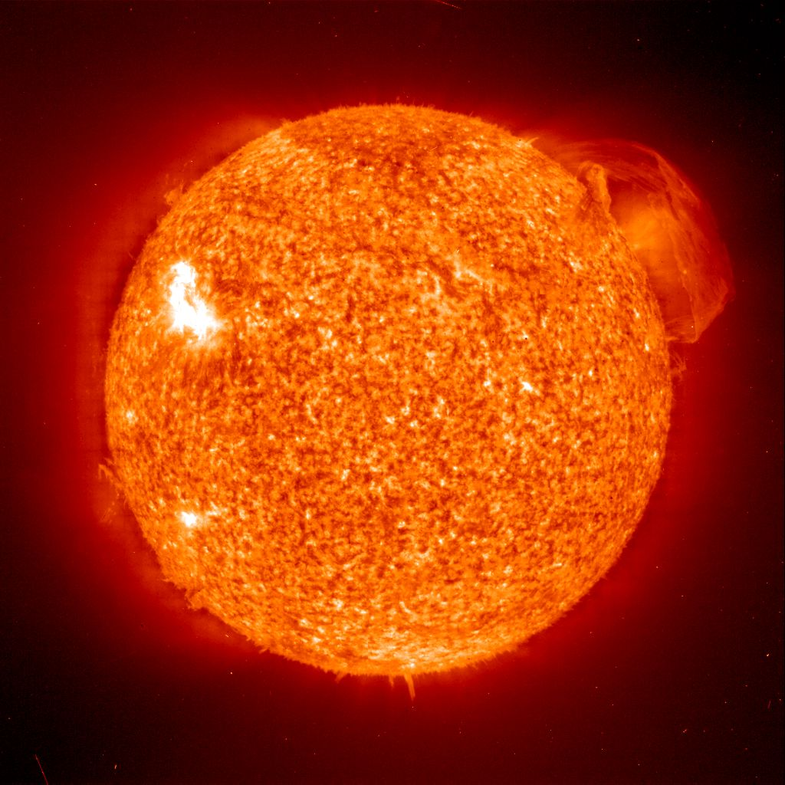
Do we know that the temperature was higher in the early Universe than now ?
Cosmic microwave radiation , nucleosynthesis
instead of
higher temperature :
smaller particle masses

Slide 82
Hot plasma ?
Temperature in radiation dominated Universe : T ~ χ ^{½} smaller than today
Ratio temperature / particle mass : T /m_{p} ~ χ ^{-½} larger than today
T/m_{p} counts ! This ratio decreases with time.
Nucleosynthesis , CMB emission as in standard cosmology !

Slide 83
Freeze Universe
The Universe may have started very cold,
and only later heat up.
Freeze picture of the Universe

Slide 84
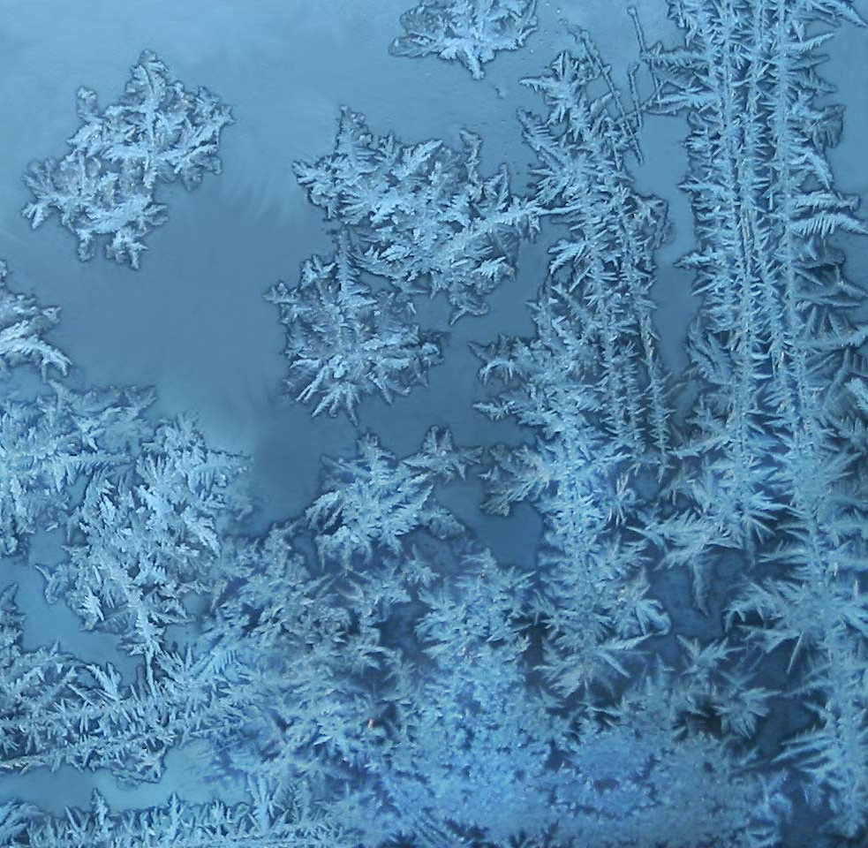
Big bang or freeze ?

Slide 85
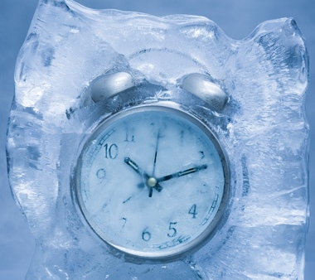
Big bang or freeze ?
freeze picture :
only rods for measurements
( masses ) are different !

Slide 86
Why should you care about the freeze picture of the Universe ?
Some aspects are understood easier :
Natural tiny present dark energy
Beginning of Universe
Role of scale symmetry
Range of impact of quantum gravity

Slide 87
No tiny dimensionless parameters
( except gauge hierarchy )
μ = 2 • 10 ⁻³³ eV
one mass scale
one time scale μ⁻¹ = 10 ¹⁰ yr
Planck mass does not appear as parameter
Planck mass grows large dynamically
Dark energy is tiny because Universe is old

Slide 88
Slow Universe
Asymptotic solution in
freeze frame :
Expansion or shrinking always slow ,
characteristic time scale of the order of the age of the
Universe : t_{ch} ~ μ⁻¹ ~ 10 billion years !
Hubble parameter of the order of present Hubble
parameter for all times , including inflation and big bang !
Slow increase of particle masses !
μ= 2 • 10⁻³³ eV

Slide 89
infinite past

Slide 90
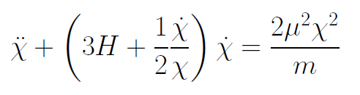
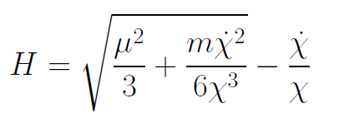
Infinite past : slow inflation
σ = 2 : field equations
approximative
solution
particles become massless in infinite past !

Slide 91
Eternal Universe
Asymptotic solution in
freeze frame :
solution valid back to the infinite past in physical time
no singularity
physical time to infinite past is infinite

Slide 92

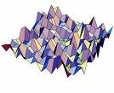
Eternal light-vacuum
Everywhere almost nothing
only fluctuations
All particles move
with light velocity,
similar to photons
strength of gravity
much stronger than today

Slide 93
In the beginning was light-like emptiness.

Slide 94
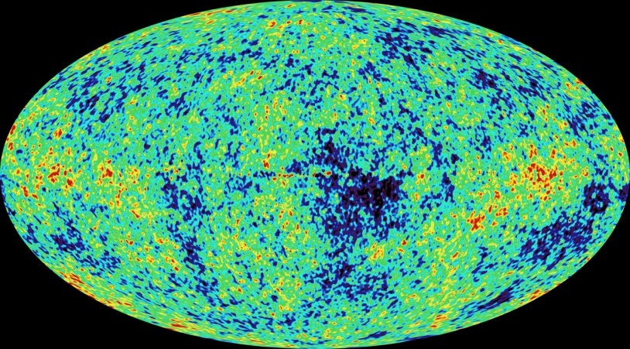
Eternal light-vacuum is unstable
Slow increase of particle masses and weakening of gravity
Only slow change of space-time geometry
Consequence for observation : primordial fluctuations become visible in cosmic background radiation
We see fluctuations in a stage 5000 billion years ago.

Slide 95
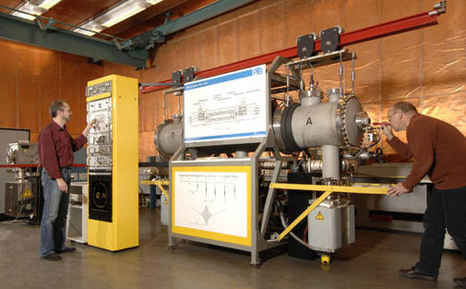
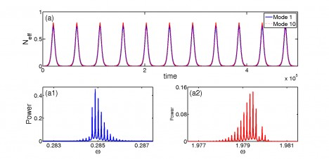
Physical time
count oscillations ….

Slide 96
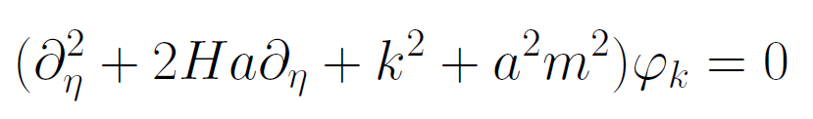
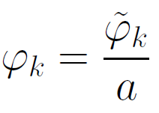
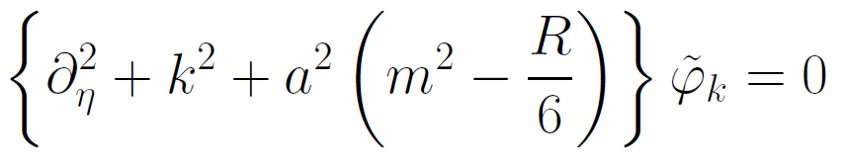
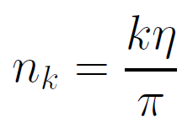

Physical time
field equation for scalar field mode
determine physical
time by counting
number of oscillations
( m=0 )

Slide 97
Physical time
counting : discrete
invariant under field transformations
same in all frames

Slide 98
Big bang singularity in Einstein frame is field singularity !
choice of frame with constant particle
masses is not well suited if
physical masses go to zero !

Slide 99

Crossover in quantum gravity and cosmology

Slide 100
Cosmological solution : crossover from UV to IR fixed point
Dimensionless functions as B
depend only on ratio μ/χ .
IR: μ→0 , χ→∞
UV: μ→∞ , χ→0
Cosmology makes
crossover between
fixed points by
variation of χ .
χ→0
χ→∞

Slide 101
Renormalization flow and cosmological evolution
renormalization flow as function of µ
is mapped by dimensionless functions to
field dependence of effective action on scalar field χ
translates by solution of field equation to
dependence of cosmology an time t or η

Slide 102
Scaling solution
after end of inflation
scaling solution with
few percent
of Early Dark Energy
Dark Energy decreases
similar to radiation and
matter

Slide 103
Evolution of dark energy fraction
J. Rubio,…

Slide 104
Growing neutrino masses and quintessence

Slide 105
Second stage of crossover
from SM to IR
in sector Beyond Standard Model
affects neutrino masses first ( seesaw or cascade mechanism )

Slide 106
Varying particle masses at onset of second crossover
Except for neutrinos all particle masses are proportional to χ .
Ratios of particle masses remain constant.
Compatibility with observational bounds on time dependence of particle mass ratios.
Neutrino masses show stronger increase with χ , such that ratio neutrino mass over electron mass grows .

Slide 107
Cosmic trigger
Stop of evolution of scalar field when neutrinos become non-relativistic
Transition from scaling solution to (almost) cosmological constant

Slide 108
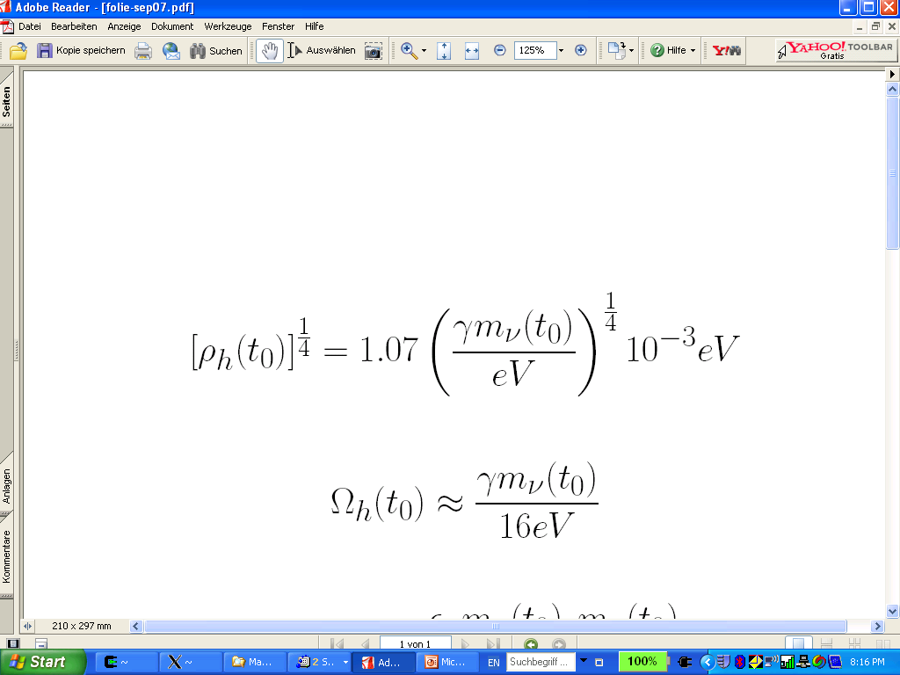
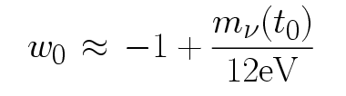
connection between dark energy and neutrino properties
L.Amendola,
M.Baldi, …
= 1.27
present dark energy density given by neutrino mass
present equation
of state given by
neutrino mass !
Notes:
108

Slide 109
Neutrino lumps
large m_{𝜈}
small m_{𝜈}
Casas, Pettorino,…

