Slide 1
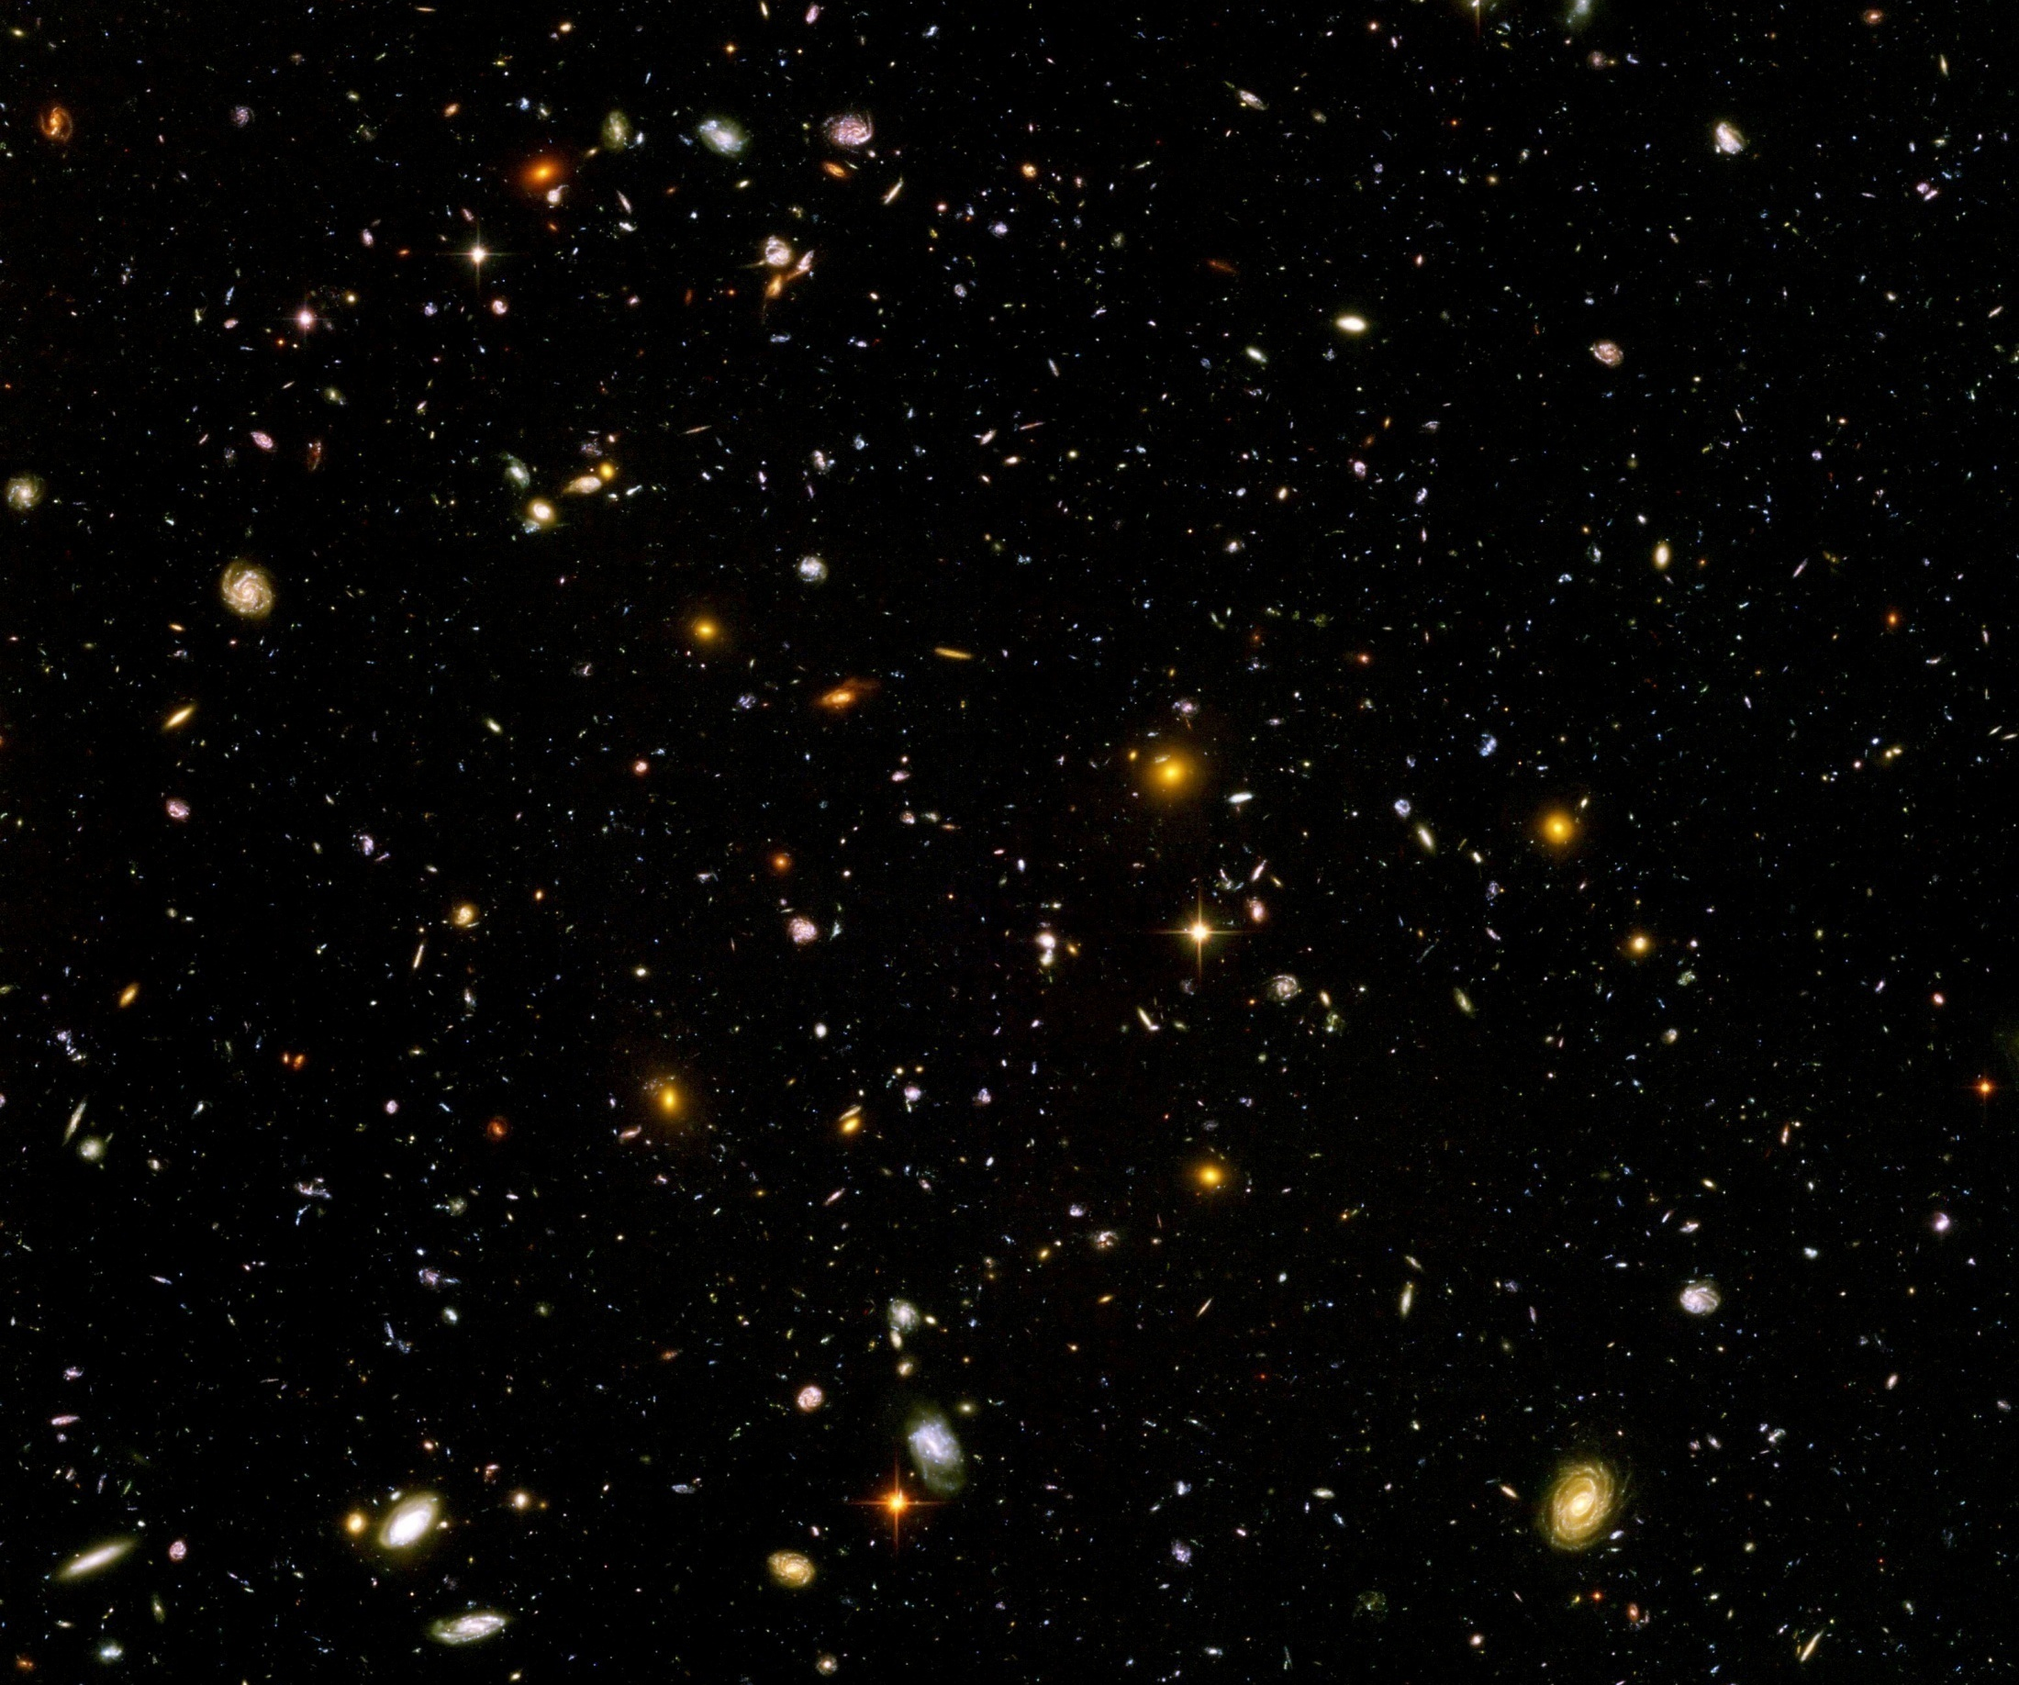
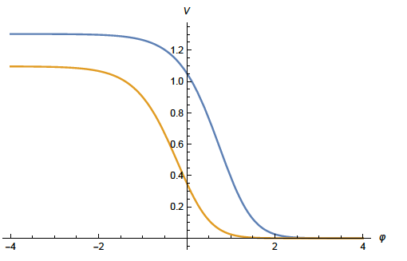
Functional renormalization for the beginning and the present Universe

Slide 2
Extension of general relativity
Einstein’s general relativity is insufficient
Early Universe: cannot explain isotropy of primordial density fluctuations
Inflationary Universe
Late cosmology: Cannot explain accelerated expansion ?
( Dynamical ? ) dark energy

Slide 3
Metric + scalar field
Inflation :
add scalar field ( inflaton )
Dynamical dark energy or quintessence:
add scalar field ( cosmon )
inflaton = cosmon ?

Slide 4

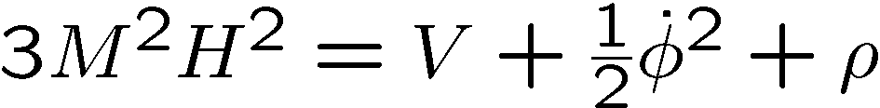
Cosmological equations
same equations for inflation and dynamical dark energy

Slide 5
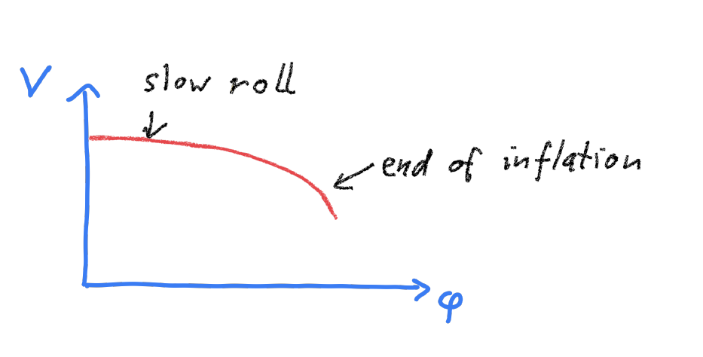
Potential for inflation

Slide 6
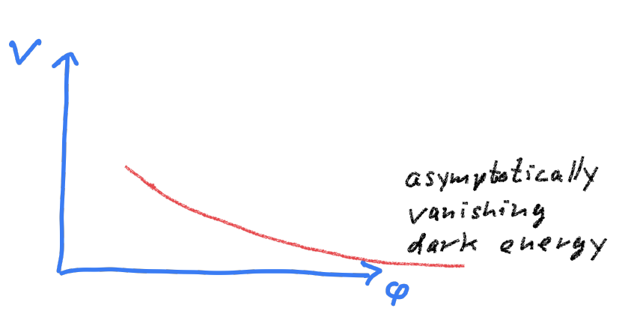
Potential for dynamical dark energy

Slide 7
Potential for quintessential inflation

Slide 8
Quintessential inflation
Inflation
Dynamical
Dark Energy
Spokoiny, Peebles, Vilenkin, Peloso, Rosati, Dimopoulos, Valle, Giovannini,
Brax, Martin, Hossain, Myrzakulov, Sami, Saridakis, de Haro, Salo, Bettoni, Rubio…

Slide 9
FRG prediction of scaling solution for quantum gravity

Slide 10
Quantum gravity
Gravity is field theory. Similar to electrodynamics. Metric field.
Gravity is gauge theory. Similar to QED or QCD. Gauge symmetry: general coordinate transformations ( diffeomorphisms )
Quantum gravity: include metric fluctuations in functional integral

Slide 11
Quantum gravity
Quantum gravity is similar to other quantum field theories
Difference: metric is tensor, gauge bosons are vectors
Difference: Quantum gravity is not perturbatively renormalizable
no small coupling, effective coupling q²/M²

Slide 12
Quantum gravity
Quantum gravity is
non-perturbatively renormalizable
Asymptotic safety
Weinberg, Reuter, …
Uses functional renormalization

Slide 13
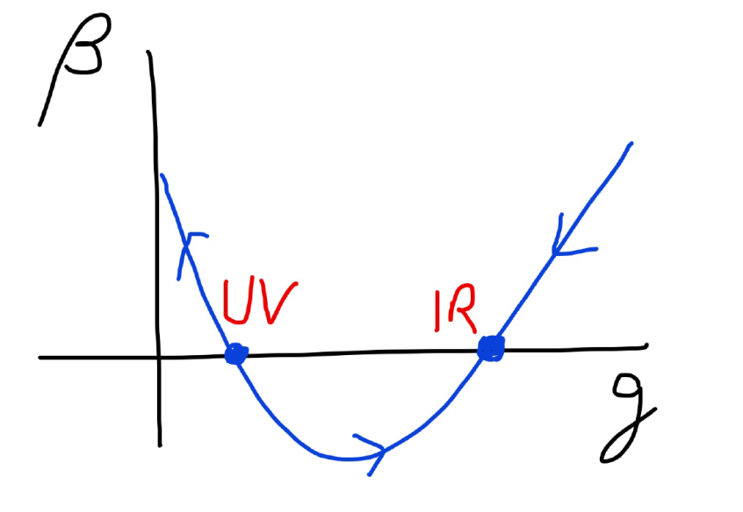
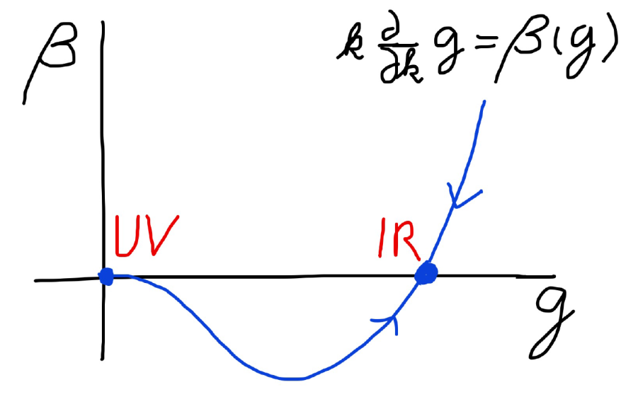
Asymptotic safety Asymptotic freedom

Slide 14
Functional renormalization for the scalar effective potential

Slide 15
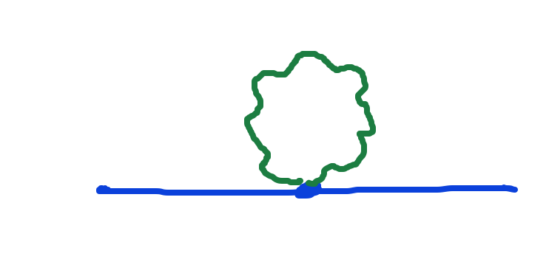
Graviton fluctuations matter
Quantum gravity needs method to take them into account

Slide 16
Flowing couplings
Couplings change with momentum scale due to quantum fluctuations.
Renormalization scale k : Only fluctuations with momenta larger k are included. Can be different from flow with momenta or geometrical properties.
Flow of k to zero : all fluctuations included, IR
Flow of k to infinity : UV

Slide 17
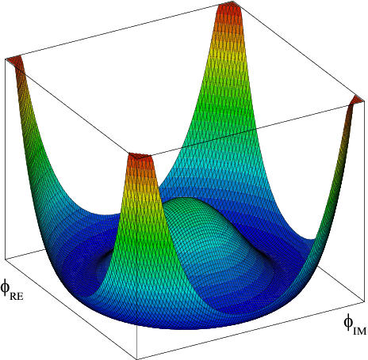
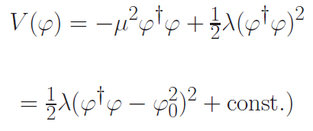

Flow of quartic Higgs coupling
Fermi scale

Slide 18
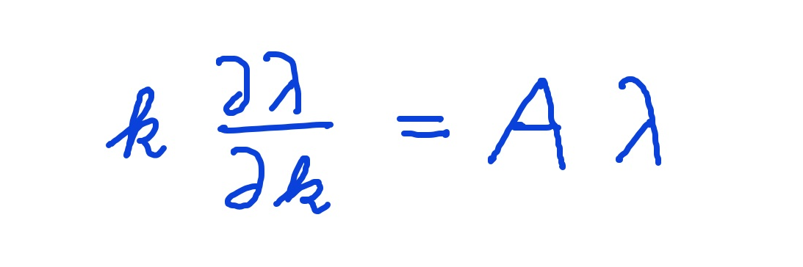
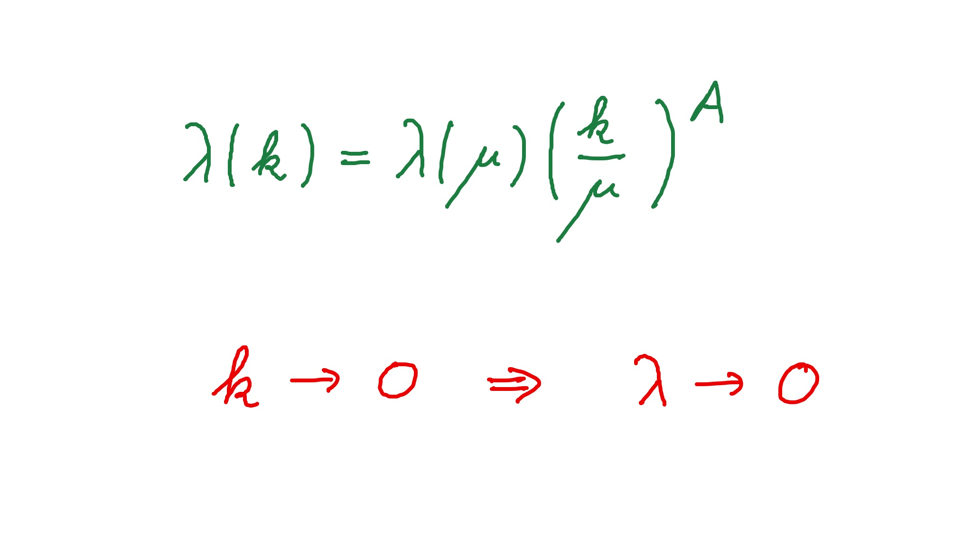
Graviton fluctuations erase quartic scalar coupling
Renormalization scale k : Only fluctuations with momenta larger k are included.
Consider first only fluctuations of metric or graviton :
gravity induced
anomalous dimension
A > 0
for
constant A :

Slide 19
Metric induced scalar anomalous dimension A
Universality
same for scalar fields with arbitrary quantum numbers
independent of non-gravitational couplings

Slide 20
Quantum gravity flattens scalar potentials

Slide 21
Fixed point
The quartic scalar coupling λ has a
fixed point at λ=0
For A>0 it flows towards the fixed point as k is lowered: irrelevant coupling
For a UV – complete theory it is predicted to assume the fixed point value

Slide 22
Gravitational contribution to running quartic coupling
running Planck mass :
dimensionless
squared Planck mass
for length scales smaller than the Planck length:
metric fluctuations dominate, constant A

Slide 23
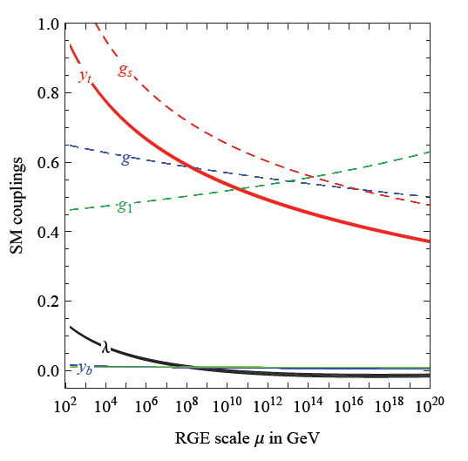
Prediction for quartic Higgs coupling
great desert
high scale fixed point
quartic scalar coupling predicted to be very small at transition scale where gravity decouples
great desert
fixed point

Slide 24
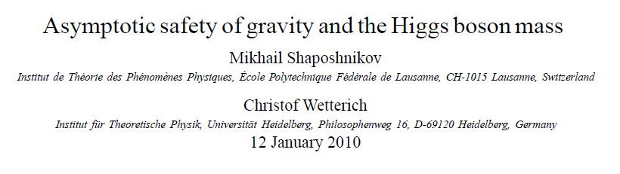
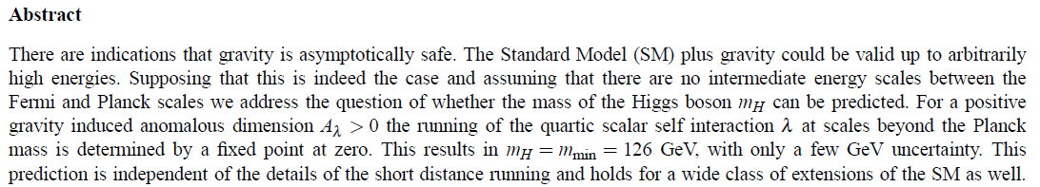
Prediction of mass of Higgs boson

Slide 25
Scaling solutions

Slide 26
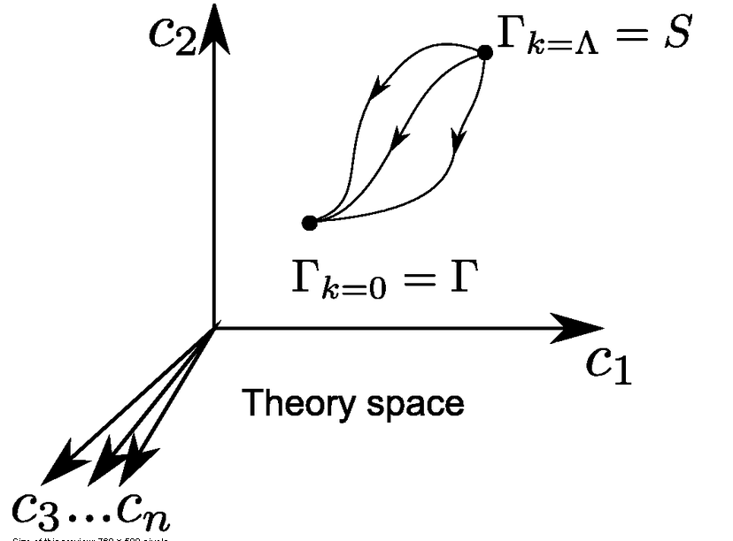
Ultraviolet fixed point
UV fixed point
Wikipedia

Slide 27
Renormalizable theories
1) Ultraviolet fixed point :
scaling solution
2) Flow away from fixed point :
relevant parameters

Slide 28
Scaling solutions
At fixed point: all ( infinitely many ) dimensionless couplings take fixed values
Whole scalar potential is fixed, for arbitrary values of scalar field
Functional flow equations are needed

Slide 29
Scaling solutions are restrictive
Scaling solutions are particular solutions of non-linear differential equations
In presence of gravitational fluctuations: scalar effective potential no longer approximated by polynomial

Slide 30
Scaling solutions and cosmology
Cosmology involves scalar potentials over large range of field values
Inflaton potential
Higgs potential for Higgs inflation
Cosmon potential for dynamical dark energy or quintessence

Slide 31
Quantum gravity : these potentials are not arbitrary

Slide 32
Dilaton quantum gravity
quantum gravity coupled to a scalar field
Henz, Pawlowski, Rodigast, Yamada, Reichert,
Eichhorn, Pauly, Laporte, Pereira, Saueressig, Wang…

Slide 33






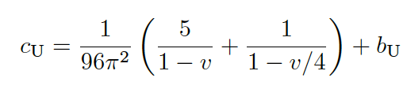



Flow equation for scalar potential
Differential equation for scaling solution

Slide 34
Scaling potential in
standard model
u : dimensionless
scalar potential
u= U/k⁴
x : logarithm of
scalar field value

Slide 35
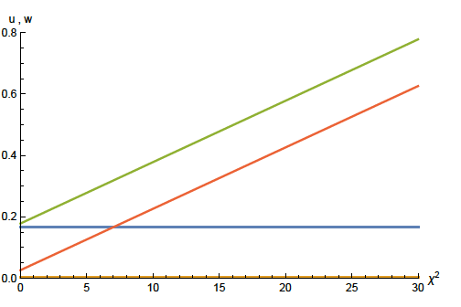
Scaling solution : flat potential

Slide 36

Derivative expansion of effective action
variable gravity

Slide 37

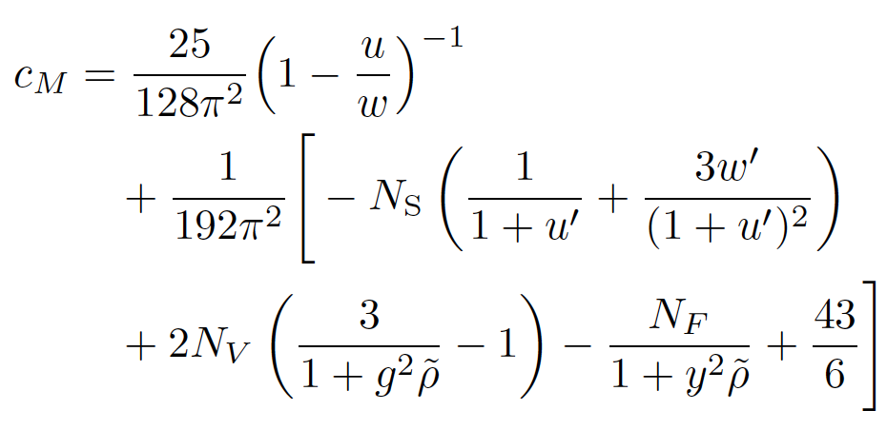
Differential equation for scaling solution for effective Planck mass
w =2 F/ k²
M. Yamada, …

Slide 38
Coefficient of curvature scalar in standard model
w : dimensionless
field dependent
squared Planck
mass
w =2 F/ k²
non-minimal
coupling of
scalar field
to gravity : ξχ²R

Slide 39
Scaling solution : flat potential, non-minimal scalar- gravity coupling

Slide 40
Scaling solution in Einstein frame

Slide 41
Quintessential inflation
Inflation
Dynamical
Dark Energy
Spokoiny, Peebles, Vilenkin, Peloso, Rosati, Dimopoulos, Valle, Giovannini,
Brax, Martin, Hossain, Myrzakulov, Sami, Saridakis, de Haro, Salo, Bettoni, Rubio…

Slide 42





Weyl transformation for variable gravity

Slide 43

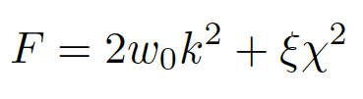

Scaling solution
For low energy
standard model :

Slide 44
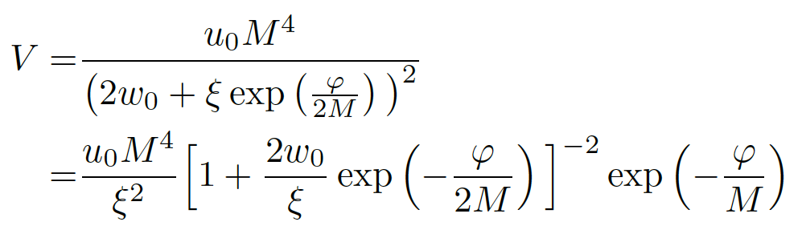
Scaling solution in Einstein frame

Slide 45
Mass scales in Einstein frame
Renormalization scale k is no longer present
Planck mass M not intrinsic: introduced only by change of variables

Slide 46
Asymptotic solution of cosmological constant problem
no tiny parameter !

Slide 47
Cosmological solution
scalar field χ vanishes in the infinite past
scalar field χ diverges in the infinite future
J.Rubio,…

Slide 48
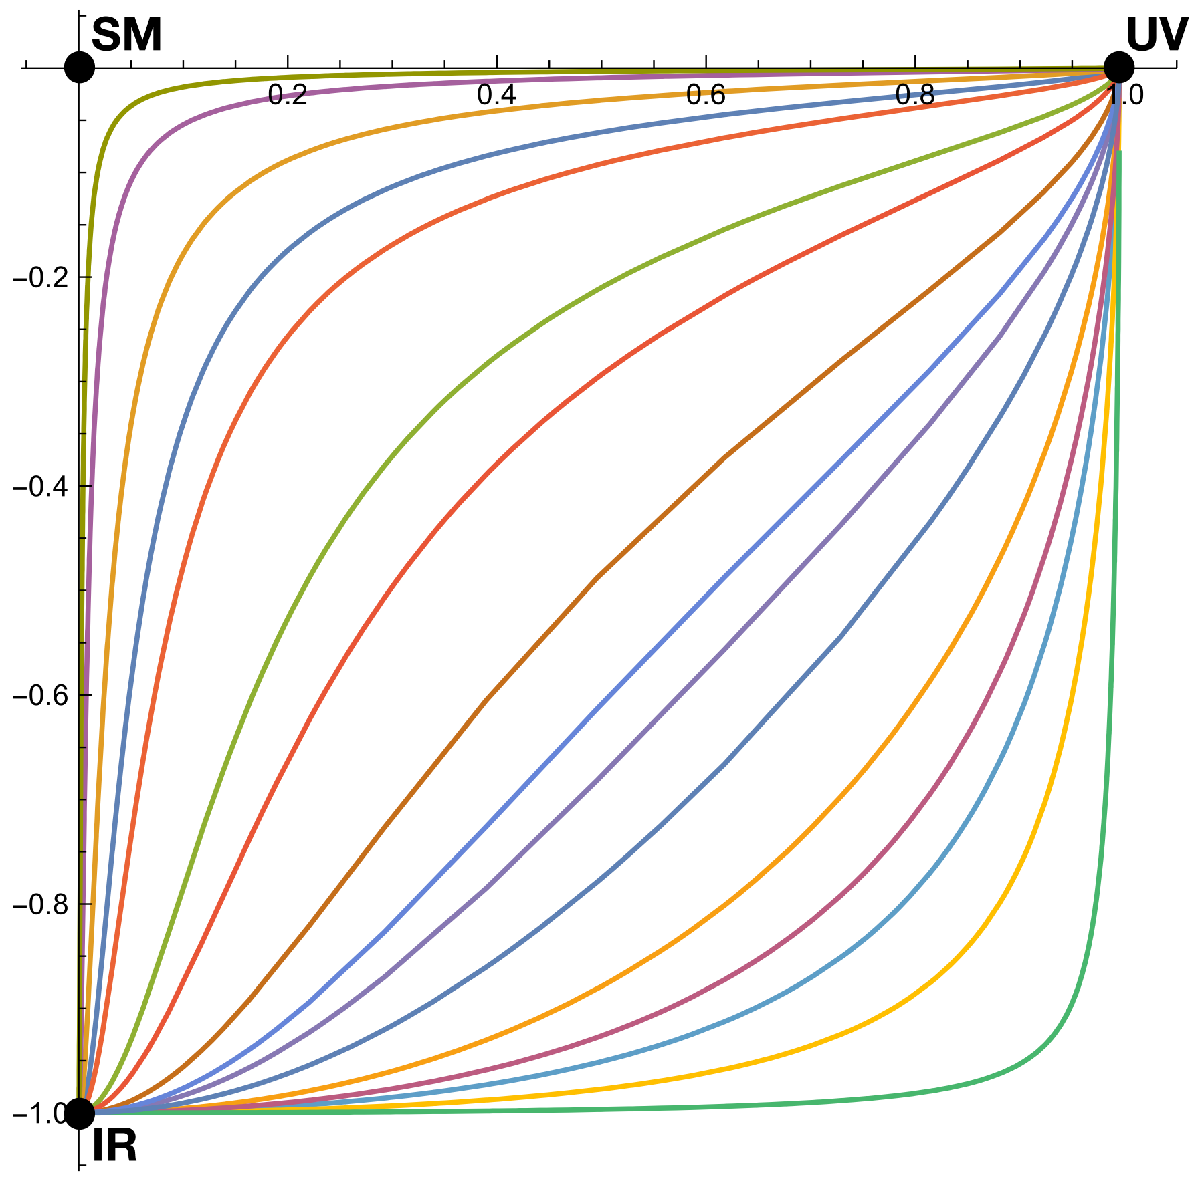
Quantum scale symmetry
Exactly on fixed point:
No parameter with dimension of
length or mass is present in the
quantum effective action.
EVEN NOT k !
Then invariance under
dilatations or global scale transformations
is realized as a quantum symmetry.
Continuous global symmetry

Slide 49
Approximate scale symmetry near fixed points
UV : approximate scale invariance of primordial fluctuation spectrum from inflation
IR : cosmon is pseudo Goldstone boson of
spontaneously broken scale symmetry,
tiny mass,
responsible for dynamical Dark Energy

Slide 50
Spontaneous breaking of scale symmetry
expectation value of scalar field breaks scale symmetry spontaneously
massive particles are compatible with scale symmetry
in presence of massive particles : sign of exact scale symmetry is exactly massless Goldstone boson – the dilaton

Slide 51
Dynamical dark energy

Slide 52
Asymptotically vanishing
cosmological „constant“
What matters : Ratio of potential divided by fourth power of Planck mass
vanishes for χ → ∞ !
k= 2 • 10⁻³ eV

Slide 53
Quintessence
Dynamical dark energy ,
generated by scalar field (cosmon )
C.Wetterich,Nucl.Phys.B302(1988)668, 24.9.87
P.J.E.Peebles,B.Ratra,ApJ.Lett.325(1988)L17, 20.10.87

Slide 54
Prediction : homogeneous dark energy influences recent cosmology
- of same order as dark matter -
Original models do not fit the present observations
…. modifications
( different growth of neutrino mass )

Slide 55
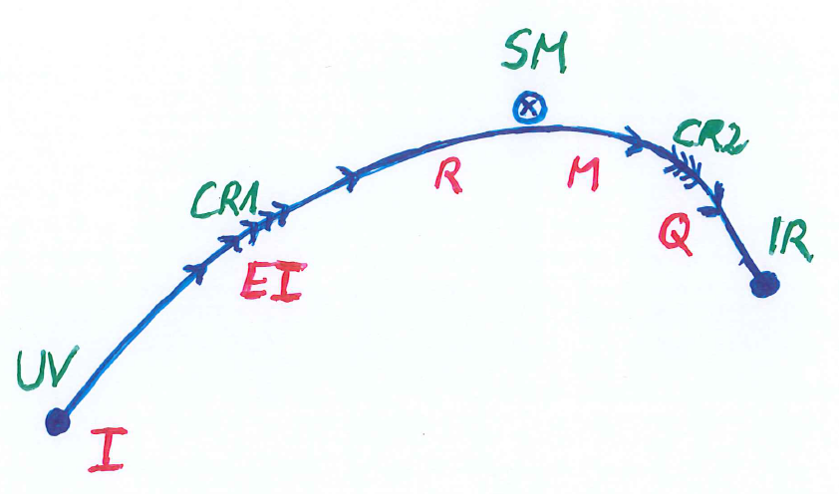
Crossover in quantum gravity

Slide 56
Simplicity
simple description of all cosmological epochs
natural incorporation of Dark Energy :
inflation
Early Dark Energy
present Dark Energy dominated epoch

Slide 57
Fundamental scale invariance

Slide 58
Fundamental scale invariance
Scaling solution
that’s it

Slide 59
Ultraviolet fixed point
UV fixed point
Wikipedia

Slide 60
Fundamental scale invariance
Scaling solution is exact
All relevant parameters vanish

Slide 61
Predictivity
Theories with fundamental scale symmetry are very predictive
Absence of relevant parameters
New criterion for fundamental theories
Stronger than renormalizability

Slide 62
Fundamental scale invariance and cosmology
Scaling solution maps dependence on renormalization scale k to dependence on cosmon field
Solution of field equations maps this to time dependence in cosmology
Direct predictivity for cosmology

Slide 63
Conclusions
Fluctuations of the metric matter
They influence the behavior of scalar potentials for all field values
Quantum gravity relevant for early cosmology and late cosmology
Quantum scale symmetry is central ingredient for understanding cosmology
Fundamental scale invariance is highly predictive
Understanding of quantum gravity fluctuations still in beginning stage

Slide 64
end

Slide 65
Quantum gravity and the beginning of the Universe

Slide 66
Beginning of the Universe
Infinite past: Vanishing scalar field
Exact quantum scale symmetry
No spontaneous symmetry breaking of scale symmetry
All particles are massless
Metric or vierbein vanishes
Universe is dominated by fluctuations ( nonzero two-point function) : inhomogeneous Universe

Slide 67
Beginning of Universe
Zu Anfang war die Welt öd und leer und währte ewig.
In the beginning the Universe was empty and lasted since ever.

Slide 68

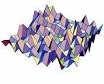
Eternal light-vacuum
Everywhere almost nothing
only fields and their fluctuations
All particles move
with light velocity,
similar to photons

Slide 69
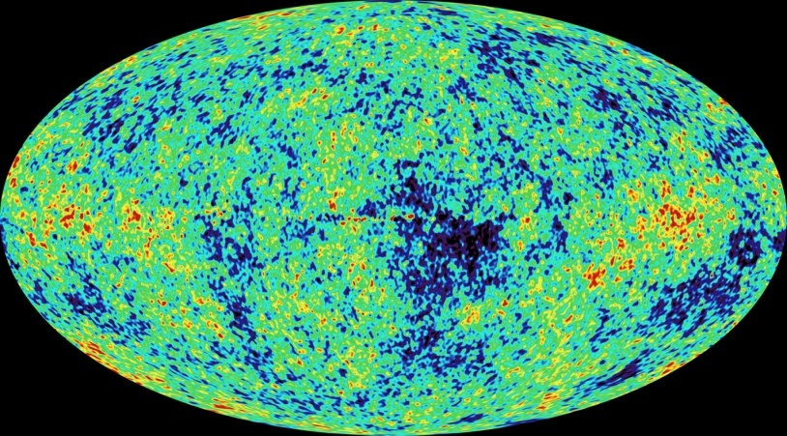
Eternal light-vacuum is unstable
Slow increase of particle masses
Only slow change of space-time geometry
Creation of particles and entropy
Consequence for observation : primordial fluctuations become visible in cosmic background radiation
We see fluctuations in a stage 5000 billion years ago.

Slide 70
The great emptiness story
In the beginning was light-like emptiness.

Slide 71
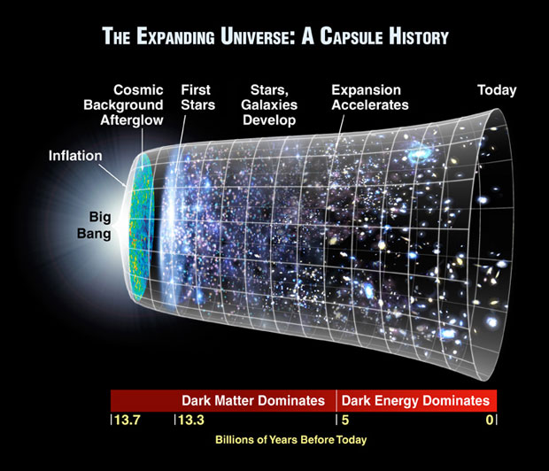
The big bang story
dramatic hot big bang
started 13.7 billion years ago
at the beginning extremely short period of cosmic inflation with almost exponential expansion of the Universe, duration around 10⁻⁴⁰ seconds
start with singularity : our whole observable Universe evolves from one point

Slide 72
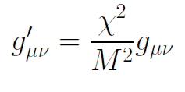
Field relativity
Both stories are equivalent
related by field transformation of the metric
different metrics related by Weyl transformation, which depends on scalar field ( inflaton )

Slide 73
Metric frames
“Weyl scaling” maps variable gravity model to Universe with fixed masses and standard expansion history.
For scaling solutions: scale k disappears !
Standard gravity coupled to scalar field.
Exact equivalence of different frames !
“ different pictures”

Slide 74
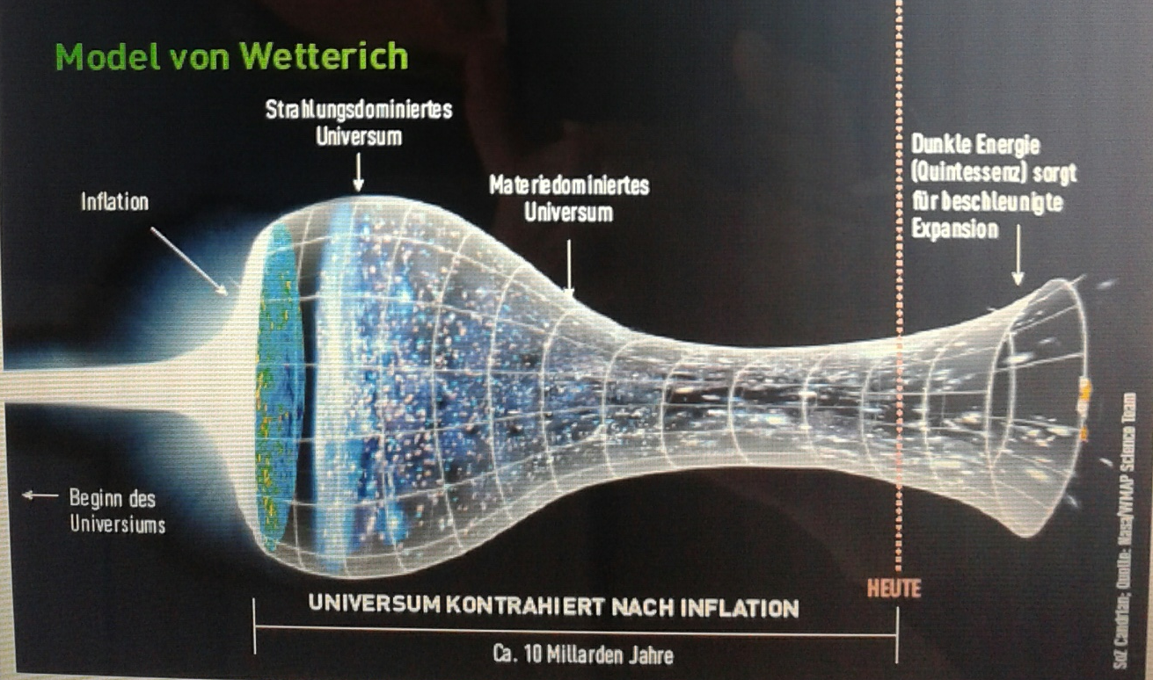
Field relativity
Weyl scaling :
changes geometry,
not a coordinate transformation

Slide 75

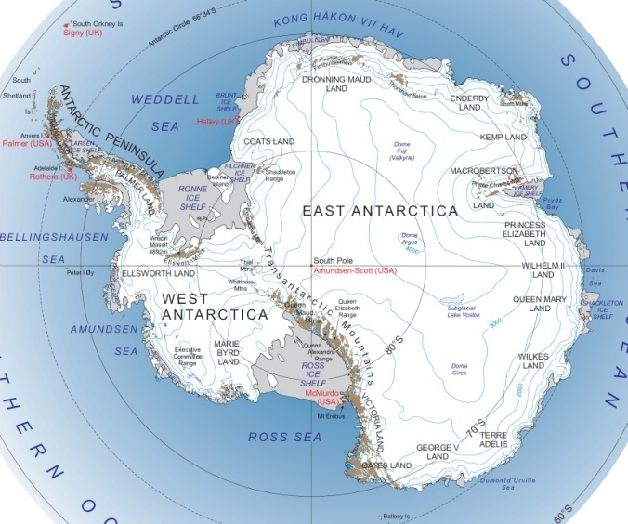
Field - singularity
Big Bang is field - singularity
similar ( but not identical with )
coordinate - singularity

Slide 77



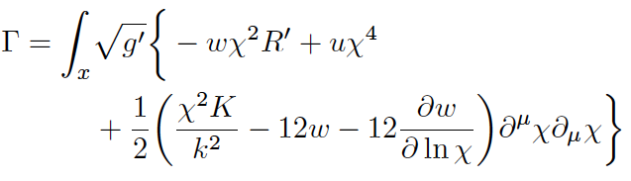

Scale symmetry near
UV- fixed point
kinetial :
scalar anomalous dimension σ , take σ =2
Weyl
scaling

Slide 78
Higgs inflation not compatible with asymptotic safety

Slide 79
Scaling potential for GUT with non-zero gauge coupling
Spontaneous
symmetry breaking by scaling solution near Planck scale

Slide 80
Scale symmetric standard model
Replace all mass scales by scalar field 𝜒
(1) Higgs potential
(2) Strong gauge coupling, normalized at , is independent of 𝜒
(3) Similar for all dimensionless couplings
Quantum effective action for standard model does
not involve intrinsic mass or length
Quantum scale symmetry
For : : massless Goldstone boson
Fujii,
Zee, CW
CW’87

