Slide 1
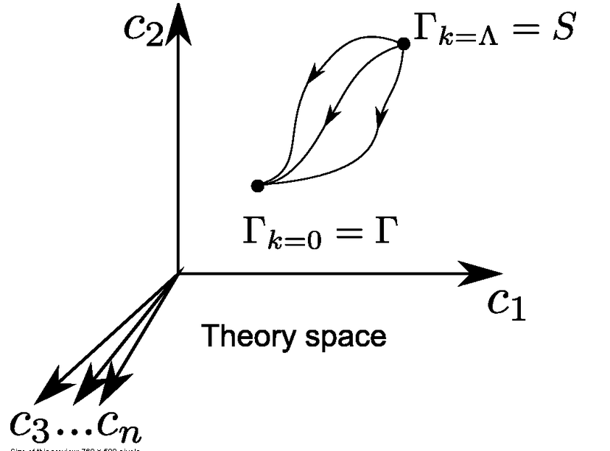
Functional renormalisation: a bridge from microphysics to macrophysics

Slide 2
Functional renormalisation: from microphysical laws to macrophysical complexity

Slide 3
Functional integral
Wide applications:
partition function in statistical physics
whenever you deal with a probability distribution
also more general complex weight distributions

Slide 4
Microphysics
Formulated as partition function or functional integral
Microphysical laws are encoded in classical action S (microphysical action, related to Hamiltonian)
weight factor in probability distribution e ^{- S}
atomic interactions, quantum gravity,
standard model of particle physics, …

Slide 5
Macrophysics
Landau type theories for relevant degrees of freedom
extract properties from variation of effective action :
field equations, correlation function, 1PI-vertices
superconductors, superfluidity …

Slide 6
Macroscopic understanding does not need all details of underlying microscopic physics
1) motion of planets : m_{i}
Newtonian mechanics of point particles
probabilistic atoms → deterministic planets
2) thermodynamics : T, µ, Gibbs free energy J(T,µ)
3) antiferromagnetic waves for correlated electrons
Γ[ s_{i}(x)]

Slide 7
How to get from microphysics to macrophysics ?
1) motion of planets : m_{i}
compute or measure mass of objects
( second order more complicated : tides etc. )
2) thermodynamics : J( T, µ )
integrate out degrees of freedom
3) antiferromagnetic waves for correlated electrons
Γ[ s_{i}(x) ] change degrees of freedom

Slide 8
central role of fluctuations

Slide 9
Classical and effective action
classical action : microscopic laws
quantum effective action : macroscopic laws
includes all fluctuation effects
(quantum, thermal, whatsoever…)
field equations are exact
Landau type theory
generates 1PI- correlation functions

Slide 10
Effective action

Slide 11
Field equations
The field equations we use for electromagnetism, gravity, or superfluidity are macroscopic equations.
They obtain by variation of the effective action, not the microscopic action.
“Classical field theory” is exact, but only with macroscopic field equations

Slide 12
Emergence of macroscopic laws with Functional Renormalisation

Slide 13
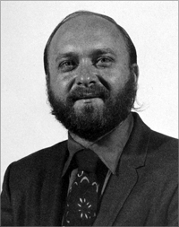
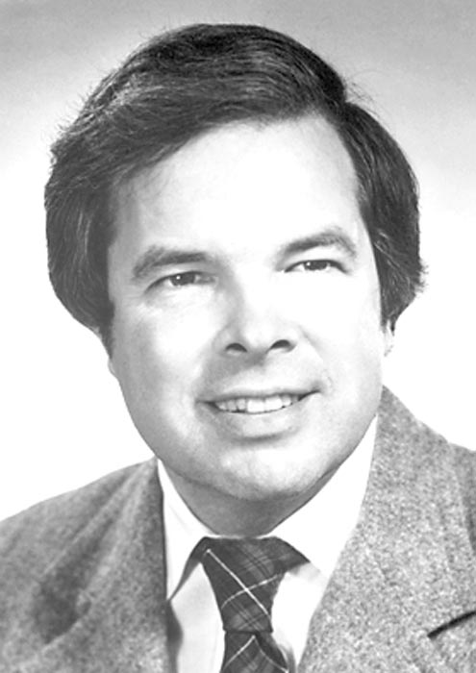
Do it stepwise : functional renormalisation
Leo Kadanoff Kenneth Wilson Franz Wegner

Slide 14
Scale dependent effective action
average effective action, flowing effective action
introduces momentum scale k by an
infrared cutoff
all fluctuations with momenta larger k are included
fluctuations with momenta smaller k are not yet included
effective laws at scale k

Slide 15
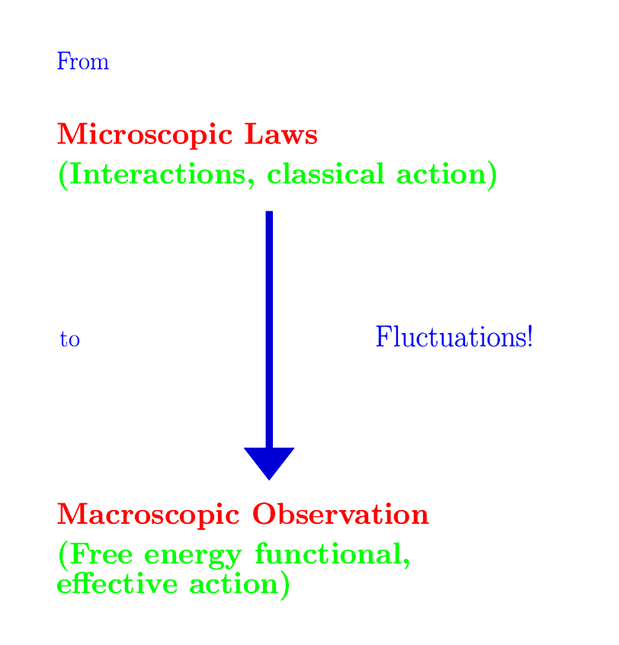
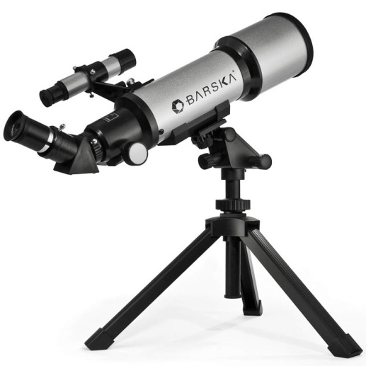

Slide 16
Exact renormalisation group equation
R_{k} : cutoff function
does not affect
high momentum fluctuations
cuts off
“infrared fluctuations”

Slide 17
Flowing action
Wikipedia

Slide 18
Flowing action
microscopic law
macroscopic law
infinitely many couplings

Slide 19
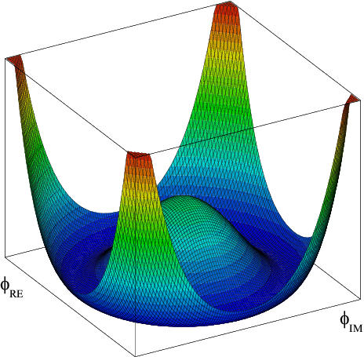
Effective potential
Effective potential
=
non – derivative
part of
effective action

Slide 20
Effective potential includes all fluctuations

Slide 21
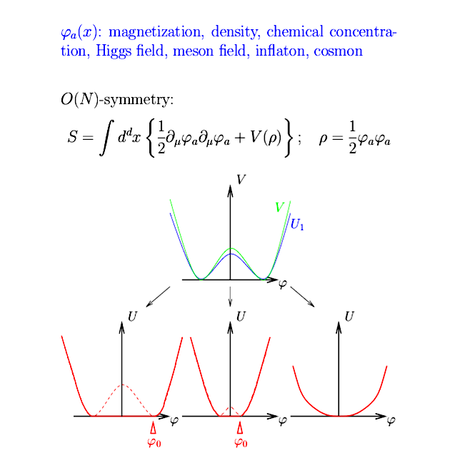
Scalar field theory

Slide 22
Flow equation for average potential
cutoff
propagator
with cutoff

Slide 23
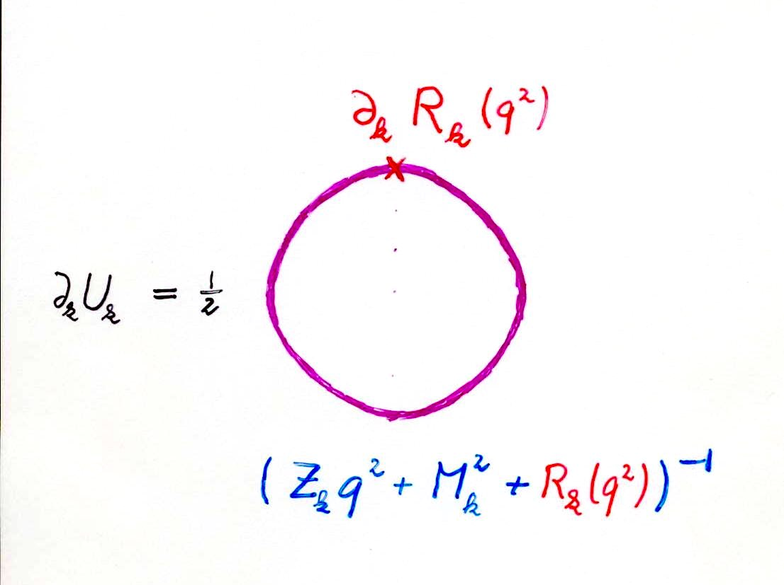
Simple one loop structure –nevertheless (almost) exact

Slide 24
Simple differential equation for O(N) – models , dimension d
t = ln( k )

Slide 25
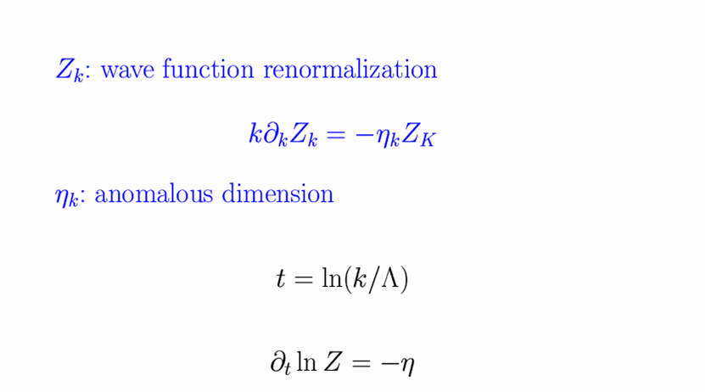
Wave function renormalization and anomalous dimension
for Z_{k} (φ,q²) : flow equation is exact !

Slide 26
unified approach
choose N
choose d
choose initial form of potential
run !

Slide 27
unified description of scalar models for all d and N

Slide 28
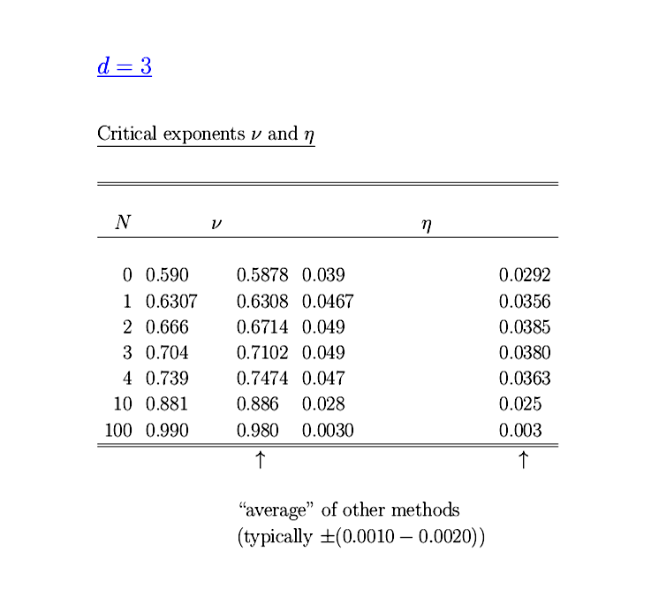
Flow of effective potential
Ising model
CO₂
Critical exponents
Experiment :
T* =304.15 K
p* =73.8.bar
ρ* = 0.442 g cm-2
S.Seide …

Slide 29
Critical exponents , d=3
ERGE world
ERGE world

Slide 30
More sophisticated approximations

Slide 31
Solution of partial differential equation :
yields highly nontrivial non-perturbative
results despite the one loop structure !
Example:
Kosterlitz-Thouless phase transition

Slide 32
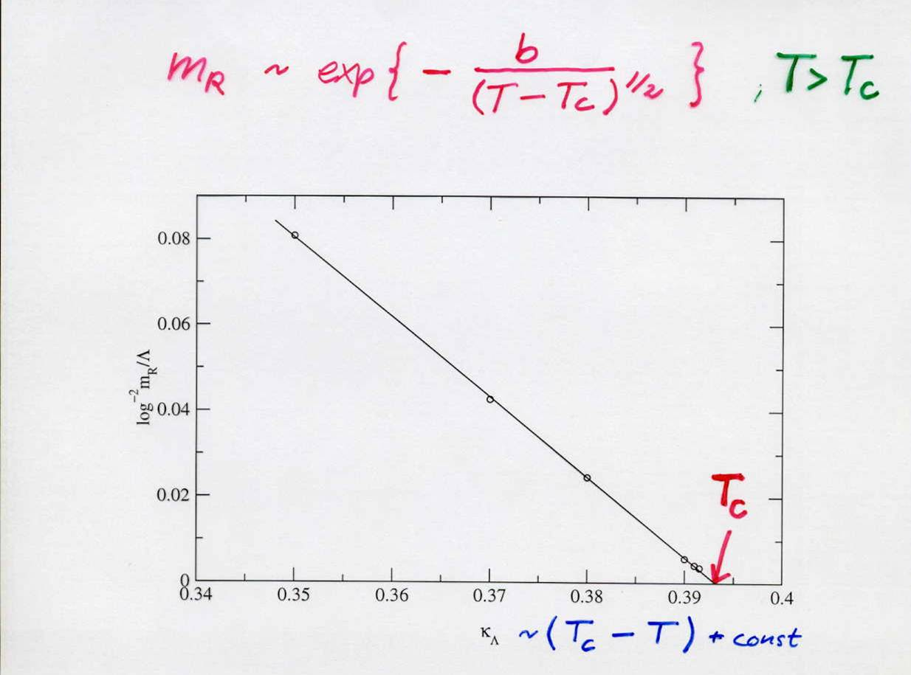
Essential scaling : d=2, N=2
Flow equation contains correctly the non-perturbative information !
(essential scaling usually described by vortices)
Von Gersdorff …

Slide 33
Kosterlitz-Thouless phase transition (d=2, N=2)
Correct description of phase with
Goldstone boson
( infinite correlation length )
for T<T_{c}

Slide 34
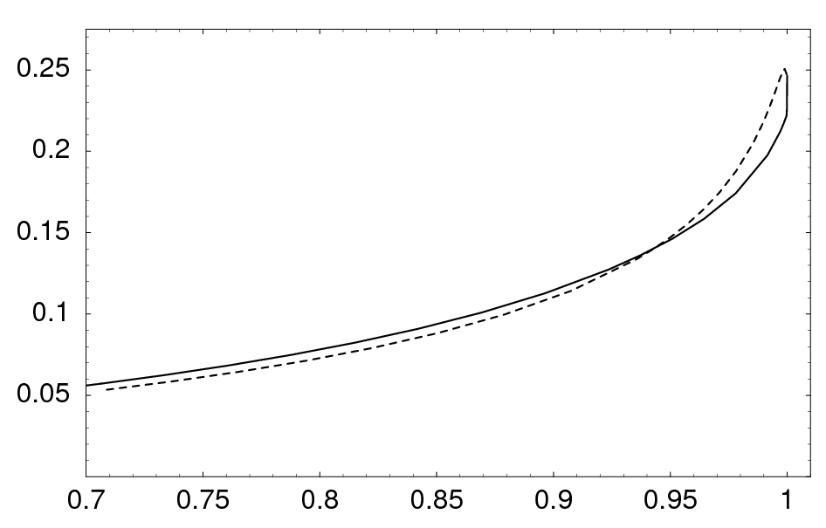
Temperature dependent anomalous dimension η
η
T/T_{c}

Slide 35
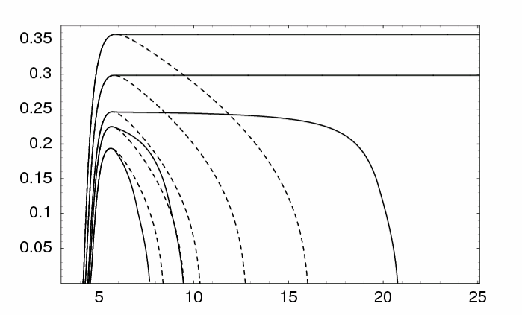
Running renormalized d-wave superconducting order parameter κ in doped Hubbard (-type ) model
T<T_{c}
κ
location
of
minimum
of u
T_{c}
local disorder
pseudo gap
T>T_{c}
C.Krahl,…
- ln (k/Λ)
macroscopic scale 1 cm

Slide 36
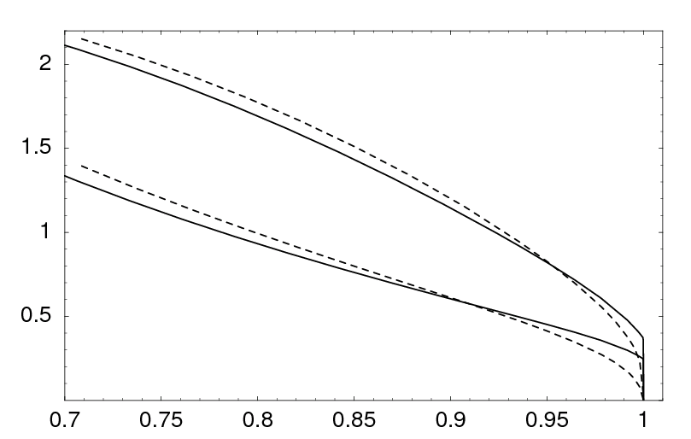
Renormalized order parameter κ and gap in electron propagator Δ in doped Hubbard model
100 Δ / t
κ
jump
T/T_{c}

Slide 37
Anti-ferromagnetic and superconducting order in the Hubbard model
A functional renormalization group study
T. Baier, E. Bick,
C. Krahl, J. Mueller, S. Friederich, …

Slide 38
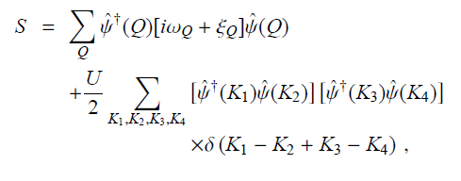
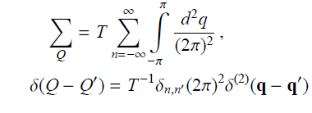
Action for Hubbard model

Slide 39
Truncation for flowing action

Slide 40
Additional bosonic fields
anti-ferromagnetic
charge density wave
s-wave superconducting
d-wave superconducting
initial values for flow : bosons are decoupled auxiliary fields ( microscopic action )

Slide 41
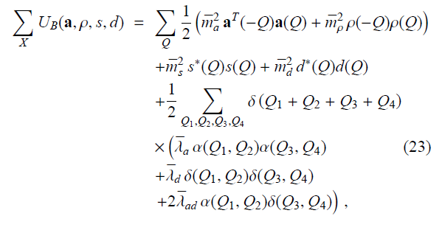
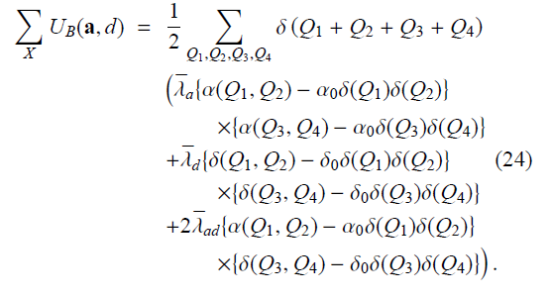
Effective potential for bosons
SYM
microscopic :
only “mass terms”
SSB

Slide 42
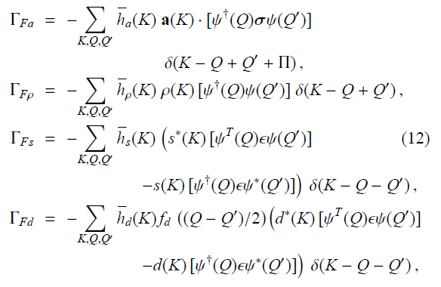
Yukawa coupling between fermions and bosons
Microscopic Yukawa couplings vanish !

Slide 43
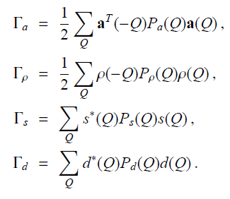
Kinetic terms for bosonic fields
anti-ferromagnetic
boson
d-wave superconducting
boson

Slide 44
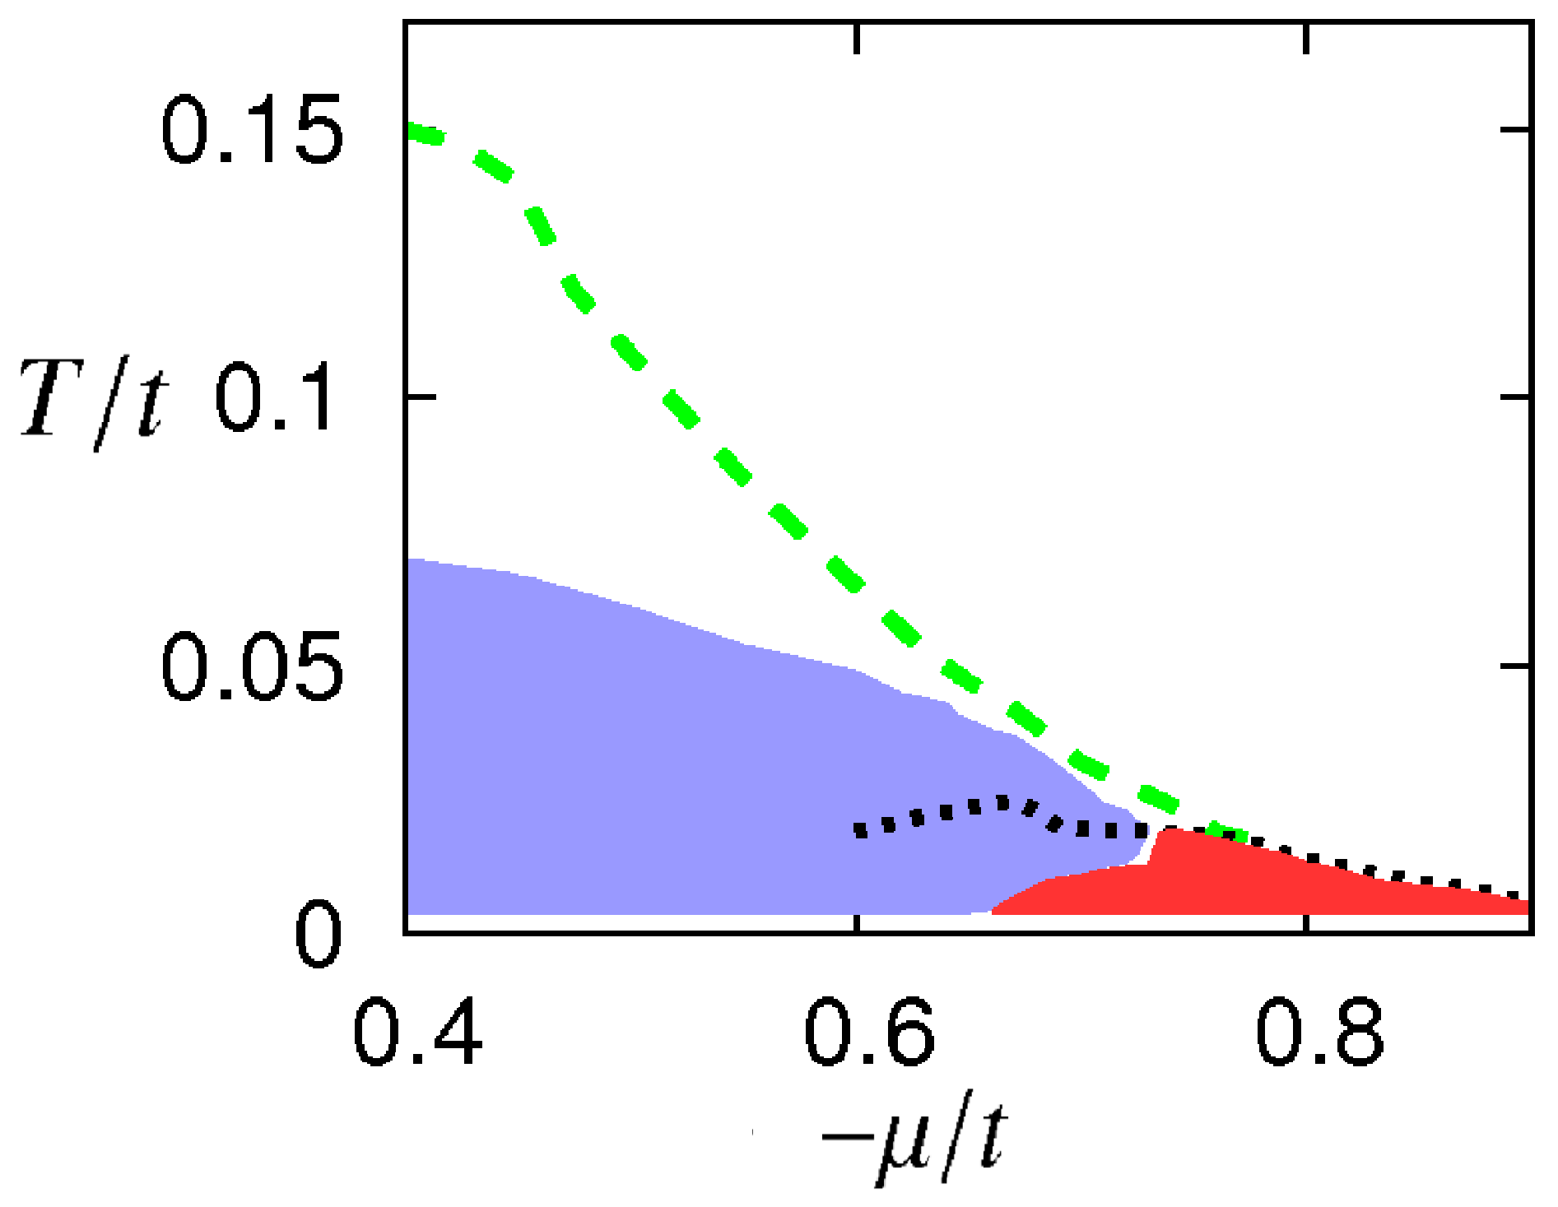
Phase diagram
AF
SC

Slide 45
Anti-ferromagnetism in Hubbard model
SO(3) – symmetric scalar model coupled to fermions
For low enough k : fermion degrees of freedom decouple effectively
crucial question : running of κ ( location of minimum of effective potential , renormalized , dimensionless )

Slide 46
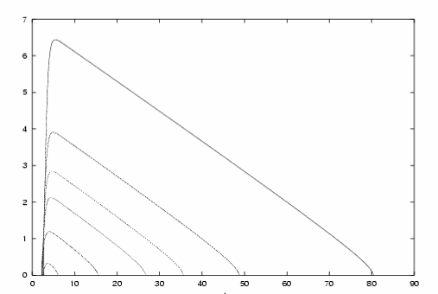
Critical temperature
For T<T_{c} : κ remains positive for k/t > 10⁻⁹
size of probe > 1 cm
κ
T/t=0.05
T/t=0.1
T_{c}=0.115
local disorder
pseudo gap
-ln(k/t)
SSB

Slide 47
Below the pseudocritical temperature
the reign of the
goldstone bosons
effective nonlinear O(3) – σ - model

Slide 48
critical behavior
for interval T_{c} < T < T_{pc}
evolution as for classical Heisenberg model
cf. Chakravarty,Halperin,Nelson

Slide 49
Mermin-Wagner theorem ?
No spontaneous symmetry breaking
of continuous symmetry in d=2 !
not valid in practice !

Slide 50
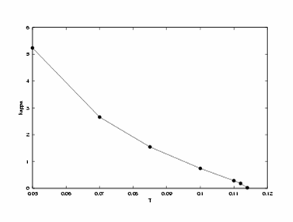
Below the critical temperature :
Infinite-volume-correlation-length becomes larger than sample size
finite sample ≈ finite k : order remains effectively
U = 3
antiferro-
magnetic
order
parameter
T_{c}/t = 0.115
temperature in units of t

Slide 51
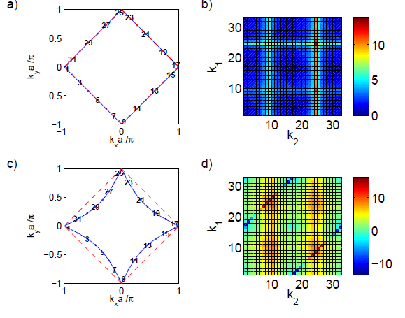
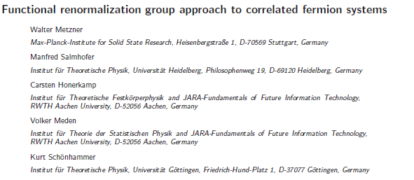
Flow of four point function Hubbard model

Slide 52
Many applications
Ultracold atoms ( quantum statistics )
Disorder
Turbulence ( non-equilibrium physics )
Density functional
Active matter ( biophysics )
Economics

Slide 53
Conclusions
Functional renormalisation has worked out in many areas of physics,
even biology and economics…
try it out !

Slide 54
end

