Slide 1
Simplified flow equation

Slide 2
Simplified flow equation
Flow equation for effective average action is sometimes difficult to handle in practice…
Simplified flow equation

Slide 3
Simplified flow equation
Particular field-dependent cutoff function is used
Field-dependent root of wave function renormalization N
Field-dependent anomalous dimension E
n needs to be large enough for UV- finiteness and decoupling of massive modes, d=4 : n=3

Slide 4
Properties of simplified flow equation

Slide 5
Local gauge symmetry
second functional derivative of gauge invariant effective action involves covariant derivatives and transforms as tensor
sufficient that N is chosen to transform as a tensor
add universal measure term from regularized Faddeev-Popov determinant

Slide 6
Arbitrary metric and signature
g= det g_{𝜇𝜈}
all factors of i for Minkowski signature from g<0

Slide 7
Analytic continuation
for analytic E: all poles are given by zeros of

Slide 8
Automatic cutoff of dangerous modes with large effects in perturbation theory
IR –cutoff for massless modes
cutoff of momenta near Fermi surface

Slide 9
Status of simplified flow equation

Slide 10
Field dependent cutoff function
field dependence of cutoff is essential ingredient
needed for gauge invariance
see previous work on gauge invariant flow equation
needed for derivation of simple form
often used in practice as truncation by background field method

Slide 11
Simplified flow equation is lowest order of systematic expansion
Exact flow equation for field dependent cutoff
Q can be expanded in loops
SFE : Q=0

Slide 12
Particular form of simplified flow equation
Start with
Field dependent cutoff
Block diagonal constant anomalous dimension

Slide 13
Particular choice of cutoff function
Choose r(x) obeying
For n=3, 𝛾=1:
Solution
yields wanted form

Slide 14
Computation of correction term Q
Exact flow equation for field dependent cutoff
Q can be expanded in loops
SFE : Q=0

Slide 15
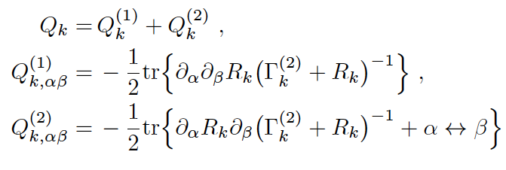
Expansion of correction term
Lowest order is a one-loop expression
Higher orders involve higher loops
Loop expansion of correction term, not flow equation
Dominant error from truncations

Slide 16
Conclusions
Simplified flow equation yields qualitatively correct physics in many situations, in particular for gauge theories or for Minkowski space
SFE is easy to handle (heat kernel methods)
SFE is often quantitatively reliable. Corrections can be computed in loop expansion and turn often out to be small. Suppressed by small couplings, loop factors…

Slide 17
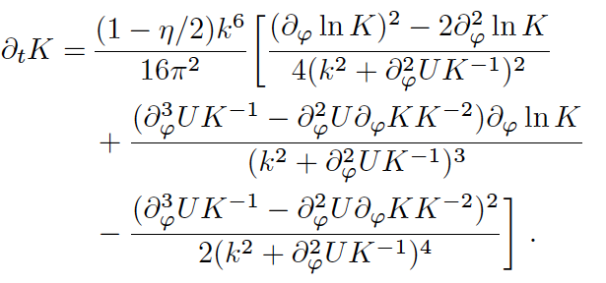
New fixed point for scalar QFT in d=4
Truncation
Flow of potential
Flow of kinetial
Fixed point

Slide 18
Quantum scale symmetry
Fixed point is invariant under multiplicative rescaling of 𝜑
SFE preserves this symmetry
corrections preserve this symmetry
If crossover trajectory to trivial fixed point for large 𝜑 exists:
UV completion of non-trivial scalar QFT in d=4

Slide 19
end

Slide 20
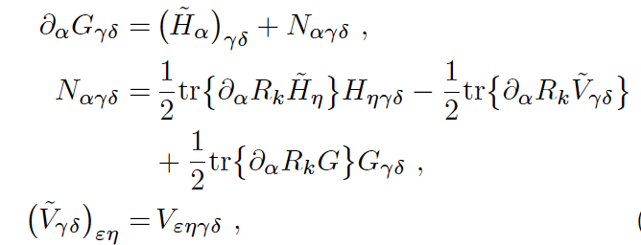
Expansion of correction term
Use
yields
Set D=0

