Slide 1
Field transformations in functional flow equations powerful tool for effective action and flowing action

Slide 2
Wide applications
Composite fields
mesons in QCD
antiferromagnetic spin waves in Hubbard model
relation between composite and fundamental fields can depend on renormalization scale k
Dressed fields
incorporating some type of wave function renormalization
Computational simplifications by transforming away unpleasant terms in flow equations (“essential RG”)
Better insights for symmetries

Slide 3
Linear field transformations
Standard example : renormalized fields
Momentum- dependent field transformations transform different Fourier modes separately
Useful to simplify propagator if momentum dependence is sufficiently smooth
Transforming away the Fermi surface for electrons in solids seems not to be a good idea …
Transformation of fields in position space can get complicated

Slide 4


“Transforming away” the
Fermi surface
inverse propagator
regular linear FT
physics moves to vertices

Slide 5
“Irrelevant couplings”
Couplings that can be transformed away are not unphysical
If one calls couplings that can be transformed away “irrelevant”: irrelevant is not unphysical
Field transformations move physical information between different sectors of flowing action
In general: physical observables involve combination of choice of fields and functionals of these fields ( correlation functions )

Slide 6
Non-linear field transformations

Slide 7
Non- linear field transformations
(Too?) powerful tool for effective action and flowing action
Many possibilities : for example, one can transform away the potential in a scalar field theory
Information is shuffled to other sectors
While field transformations are exact, truncations can become very misleading
Keep track of physics !

Slide 8
Microscopic and macroscopic field transformations
Microscopic field transformations transform fluctuating field variables in functional integral
Possibly combined with new sources and new cutoff for „composite fields“ in flowing action
( Jan Pawlowski, essential RG )
Macroscopic field transformations transform field variables in effective action or flowing action

Slide 9
Jacobian
Microscopic field transformations involve a Jacobian
Comes back indirectly through initial conditions even if integration variables in functional integral are kept fixed, and only sources and cutoff are changed ( Jan Pawlowski, essential RG )
Macroscopic field transformations have no Jacobian

Slide 10





Example: non-linear kinetial
classical action
functional measure
model with interactions: non-linear field classical equations

Slide 11



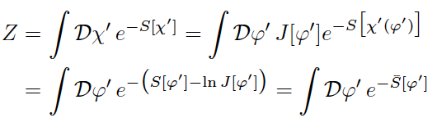

Microscopic field transformation
non-linear field transformation
Jacobian

Slide 12






FT induced potential
Jacobian results in scalar potential for classical action
equivalent formulations
suitable kinetial can lead to spontaneous symmetry breaking

Slide 13
k- dependent field transformations
Correction terms in flow equations
Macroscopic FT : corrections due to simple change of the variables which are kept fixed in flow equations
Microscopic FT : corrections due to k – dependent Jacobian
Linear field transformations : Macroscopic and microscopic FT are equivalent
In practice: often only small difference between microscopic and macroscopic non-linear field transformations H. Gies, …

Slide 14
Two- field formalism
Keep fundamental and composite fields
( quarks and mesons )
often most powerful
not covered in this talk
Gies, Pawlowski, Floerchinger, …

Slide 15
Macroscopic and microscopic field transformations

Slide 16
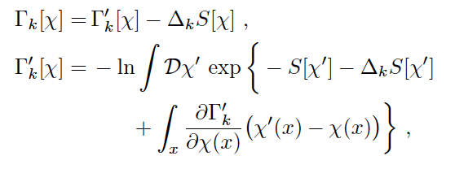


Functional integral for flowing action
Implicit functional integral with cutoff
Exact flow equation

Slide 17



Macroscopic field transformation
Variable change in differential equation
Can be used to derive scaling form of flow equation or “eliminate” certain couplings
CW hep-ph/9604227
Gies,…hep-th/0107221

Slide 18
Field relativity
Effective actions related by macroscopic field transformations are strictly equivalent
Different geometries for same physics

Slide 19
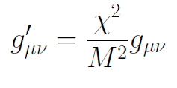
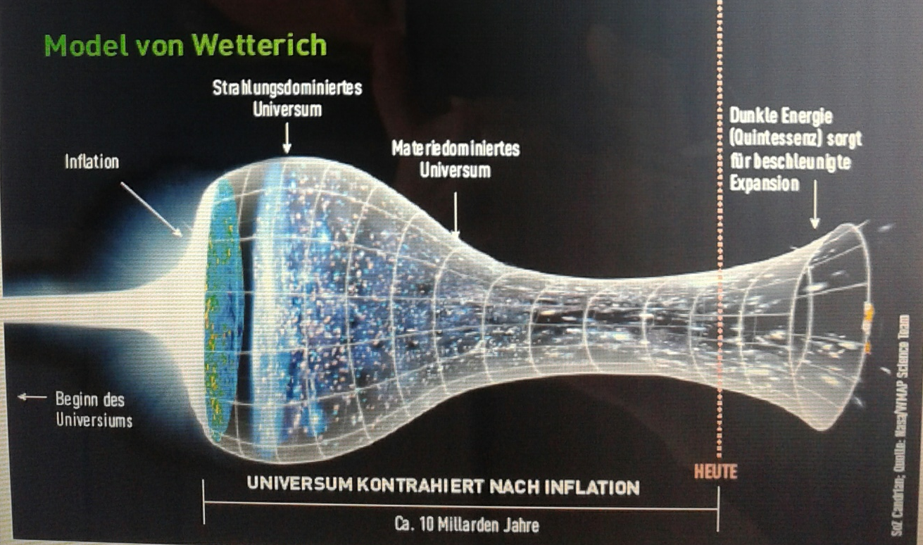
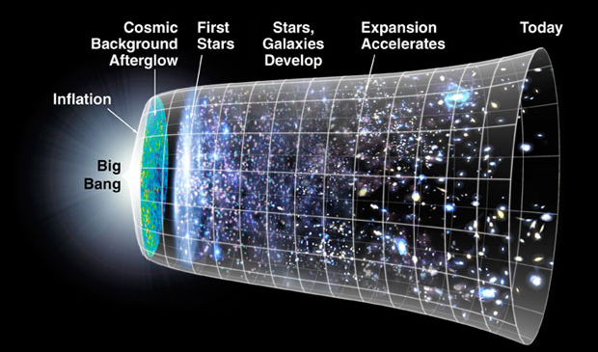
Field relativity
Weyl scaling :
changes geometry,
not a coordinate transformation

Slide 20
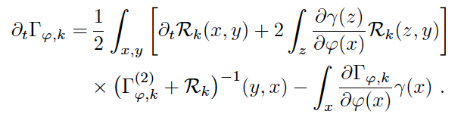
Microscopic field transformation
correction term in flow equation is not identical to macroscopic field transformation
Pawlowski,
Baldazzi, Ben Ali Zinati, Falls, …

Slide 21
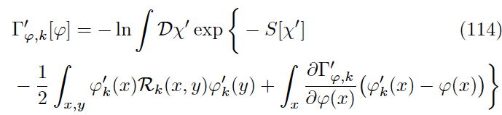

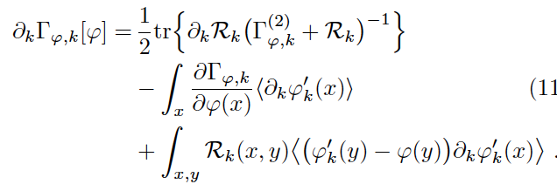
Flowing action for composite fields
functional integral for flowing action for composite fields

Slide 22




RG - kernel
expectation values for k > 0
RG - kernel
flow equation

Slide 23
Macroscopic and microscopic field transformations do not yield identical flow equations
different correction terms
macroscopic FT
microscopic FT

Slide 24
Different flowing actions
macroscopic FT
microscopic FT
different sources, different cutoff

Slide 25
Variable transformation in functional integral
One could transform variables in functional integral
k- dependent classical action for composite fields yield corrections to flow equation

Slide 26
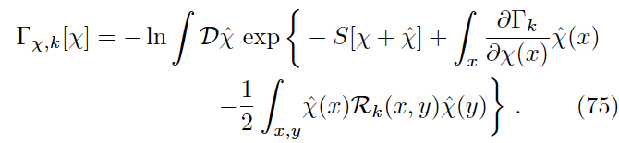
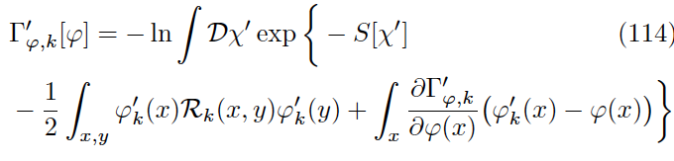
Initial conditions
For microscopic FT the Jacobian strikes back !
Relation between classical action and flowing action at large k involves Jacobian
For linear measure:
General measure:
Proof: Change of integration variable

Slide 27
Advantages and disadvantages
microscopic FT:
advantages: cutoff can be adapted to composite fields,
richer possibilities of “eliminating couplings”
disadvantages: no direct access to fundamental correlation functions,
Jacobian in initial conditions
macroscopic FT:
advantage: contact to fundamental correlation functions remains straightforward if field transformation is reconstructed

Slide 28
Flowing action and correlation functions

Slide 29



Relation RG- kernel to correlations of fundamental fields
for non-linear microscopic FT the relation between the RG- kernel and correlation functions of fundamental fields gets complex
example:
RG – kernel involves correlation functions of composite fields of arbitrary order

Slide 30




“Transforming away” the potential…
For a suitably chosen RG kernel contributions to the scalar potential can be “transformed away”
Assume fermion fluctuations induce
For truncation the fermion contribution is cancelled
if one chooses RG – kernel , with
Physical information moved from potential to Yukawa couplings
Spontaneous symmetry breaking now through complicated Yukawa couplings

Slide 31
“Irrelevant couplings”
Couplings that can be transformed away are not unphysical
If one calls couplings that can be transformed away “irrelevant”: irrelevant is not unphysical
Field transformations move physical information between different sectors of flowing action
In general: physical observables involve combination of choice of fields and functionals of these fields ( correlation functions )

Slide 32
Flowing action and correlations
Meaningful truncations need understanding of relation between flowing action and correlation functions at least qualitatively
Defining flowing action by arbitrary flow equation and boundary conditions is not sufficient
Danger of truncating away relevant physical information

Slide 33


microscopic FT with k – dependent macroscopic field
integrate
with initial value
initial value may not need Jacobian
yields relation for expectation value, not microscopic field transformation
direct contact to correlations of fundamental or composite fields is not available

Slide 34
Conclusions
Field transformations are powerful tool for functional flow equations
Control of physical properties and relation to correlation functions is necessary
“Irrelevant couplings” are not unphysical
Universality can help, but is not guaranteed
Macroscopic and microscopic non-linear field transformations lead to different flowing actions

Slide 35
end

