Slide 1
The mass of the Higgs boson, the great desert, and asymptotic safety of gravity

Slide 2
a prediction…

Slide 3
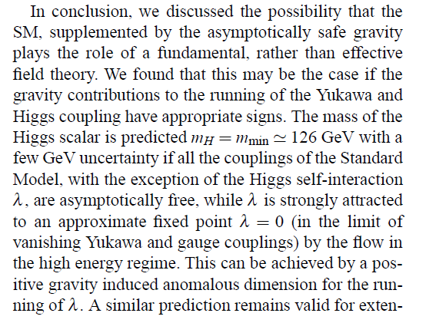
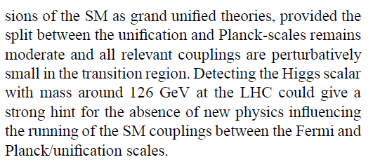
a prediction …

Slide 4
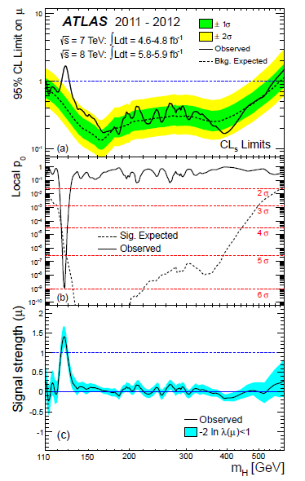
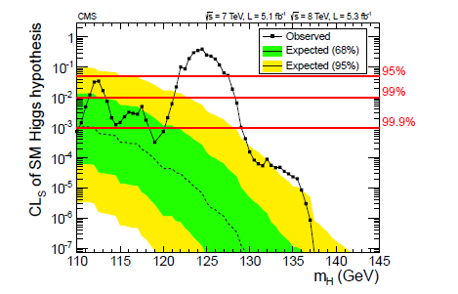
LHC : Higgs particle observation
CMS 2011/12
ATLAS 2011/12

Slide 5
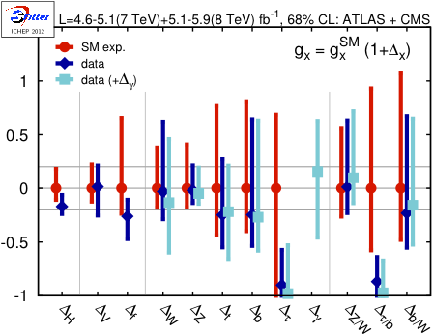
standard model Higgs boson
T.Plehn, M.Rauch

Slide 6
too good to be true ?
500 theoretical physicists = 500 models
equidistant predictions
range 100-600 GeV …
3 GeV bins : one expects several correct predictions ,
but for contradicting models
motivation behind prediction ?

Slide 7
key points
great desert
solution of hierarchy problem at high scale
high scale fixed point
vanishing scalar coupling at fixed point

Slide 9
Quartic scalar coupling
prediction of mass of Higgs boson
=
prediction of value of quartic scalar coupling λ
at Fermi scale

Slide 10
Running couplings, Infrared interval, UV-IR mapping

Slide 11
Running quartic scalar coupling λ and Yukawa coupling of top quark h
neglect gauge couplings g

Slide 12
Partial infrared fixed point
Gauge Hierarchy Due To Strong Interactions?. C. Wetterich (Freiburg U.). Apr 1981. 20 pp. Published in Phys.Lett. B104 (1981) 269

Slide 13
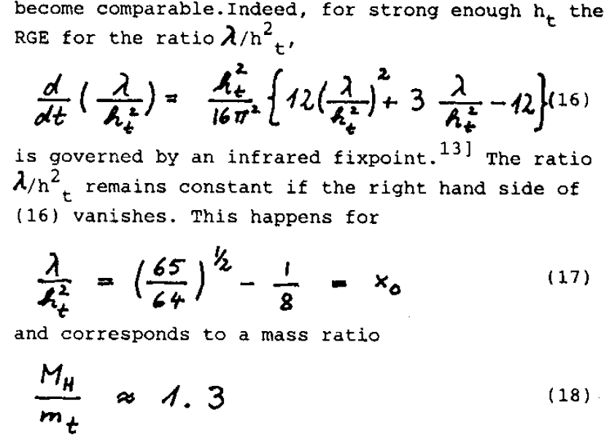

Slide 14
infrared interval
allowed values of λ or λ/h² at UV-scale Λ :
between zero and infinity
are mapped to
finite infrared interval of values of
λ/h² at Fermi scale

Slide 15
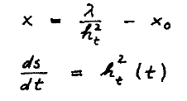
infrared interval
deviation from partial
fixed point
flow parameter s

Slide 16
infrared interval
small x :
solution
infrared interval shrinks as μ/Λ decreases

Slide 17
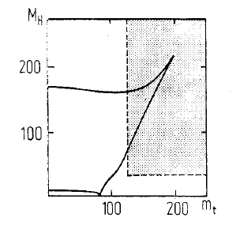
infrared interval

Slide 18
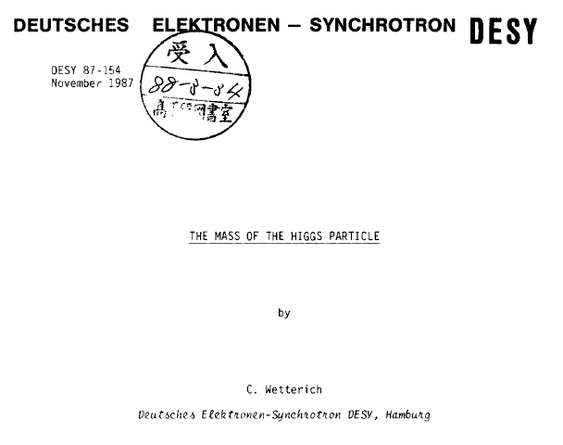
The Mass Of The Higgs Particle. C. Wetterich (DESY). Nov 1987. 52 pp. DESY-87-154, C87/07/23 Talk presented at Conference: C87-07-23 (Trieste HEP Workshop 1987:0403)

Slide 19
realistic mass of top quark (2010), ultraviolet cutoff: reduced Planck mass

Slide 20
ultraviolet- infrared map
Whole range of small λ
at ultraviolet scale is mapped by
renormalization flow
to lower bound of infrared interval !
Prediction of Higgs boson mass
close to 126 GeV

Slide 21
remark on metastable vacuum
no model known where this is realized in reliable way

Slide 22
key points
great desert
solution of hierarchy problem at high scale
high scale fixed point
vanishing scalar coupling at fixed point

Slide 23
gauge hierarchy problem and fine tuning problem

Slide 24
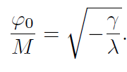
quantum effective potential
scalar field χ with high expectation value M,
say Planck mass

Slide 25
anomalous mass dimension
one loop,
neglect gauge couplings g

Slide 26
fixed point for γ = 0
zero temperature electroweak phase transition (as function of γ ) is essentially second order
fixed point with effective dilatation symmetry
no flow of γ at fixed point
naturalness due to enhanced symmetry
small deviations from fixed point due to running couplings: leading effect is lower bound on Fermi scale by quark-antiquark condensates

Slide 27
renormalization group improved perturbation theory
no change of form of flow equation
loop corrections to anomalous mass dimension
small γ at high scale remains small at low scale
no need of tuning order by order in perturbation theory
fine tuning problem artefact of bad expansion ( perturbation theory does not see fixed point and associated effective dilatation symmetry )
+ …

Slide 28
critical physics
second order phase transition corresponds to critical surface in general space of couplings
flow of couplings remains within critical surface
once couplings are near critical surface at one scale, they remain in the vicinity of critical surface
gauge hierarchy problem : explain why world is near critical surface for electroweak phase transition
explanation can be at arbitrary scale !

Slide 29
critical physics in statistical physics
use of naïve perturbation theory
( without RG – improvement )
would make the existence of critical temperature look “unnatural”
artefact of badly converging expansion

Slide 30
conclusions fine tuning problem
Fine Tuning Problem And The Renormalization Group. C. Wetterich (CERN). Feb 1983. 13 pp. Published in Phys.Lett. B140 (1984) 215

Slide 31
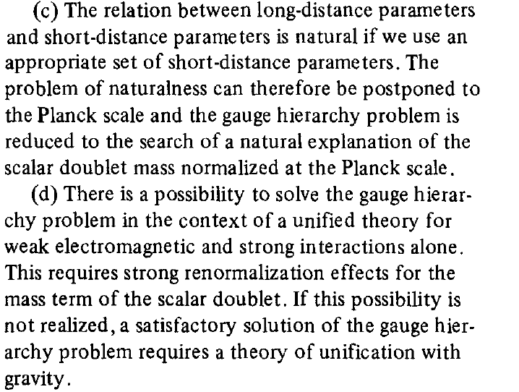

Slide 32
SUSY vs Standard Model
natural predictions
baryon and lepton number conservation SM
flavor and CP violation described by CKM matrix SM
absence of strangeness violating neutral currents SM
g-2 etc. SM
dark matter particle (WIMP) SUSY

Slide 33
key points
great desert
solution of hierarchy problem at high scale
high scale fixed point
vanishing scalar coupling at fixed point

Slide 34
high scale fixed point

Slide 35
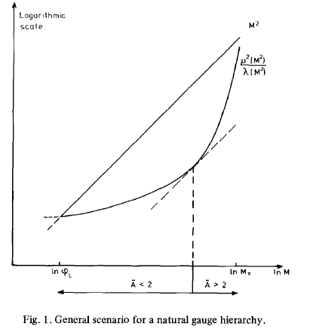
large anomalous mass dimension ?
Gauge Hierarchy Due To Strong Interactions?. C. Wetterich (Freiburg U.). Apr 1981. 20 pp. Published in Phys.Lett. B104 (1981) 269

Slide 36
relevant and irrelevant couplings
A < 2 deviation from critical surface is relevant coupling
A > 2 deviation from critical surface is irrelevant coupling
parameters in effective action are attracted towards the critical surface as scale k flows towards the infrared
self-tuned criticality

Slide 37
comparison with critical density in cosmology

Slide 38
fixed point in short-distance theory
short-distance theory extends SM
minimal: SM + gravity
higher dimensional theory ?
grand unification ?
( almost) second order electroweak phase transition guarantees ( approximate ) fixed point of flow
needed : deviation from fixed point is an irrelevant parameter (A>2)

Slide 39
self-tuned criticality
deviation from fixed point is an irrelevant parameter (A>2)
critical behavior realized for wide range of parameters
in statistical physics : models of this type are known for d=2
d=4: second order phase transitions found ,
self-tuned criticality not yet found

Slide 40
asymptotic safety for gravity
Weinberg , Reuter

Slide 41
running Planck mass
infrared cutoff scale k ,
for k=0 :

Slide 42
fixed point for dimensionless ratio M/k

Slide 43
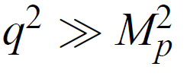
scaling at short distances

Slide 44
infrared unstable fixed point: transition from scaling to constant Planck mass

Slide 45
a prediction…

Slide 46
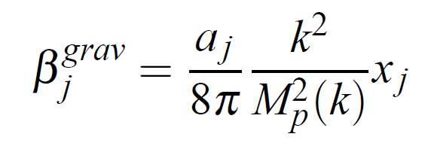
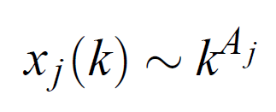
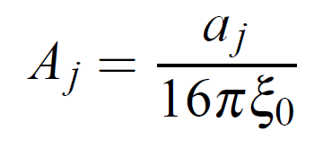
gravitational running
a < 0 for gauge and Yukawa couplings
asymptotic freedom

Slide 47
modified running of quartic scalar coupling in presence of metric fluctuations
+…
for a > 0 and small h :
λ is driven fast too very small values !
e.g. a=3 found in gravity computations

Slide 48
short distance flow of λ
integral dominated by small interval in k’

Slide 49
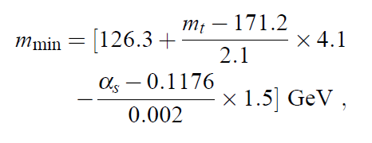
prediction for mass of Higgs scalar
2010

Slide 50
uncertainties
typical uncertainty is a few GeV
central value has moved somewhat upwards , close to 129 GeV
change in top-mass and strong gauge coupling
inclusion of three loop running and two loop matching

Slide 51
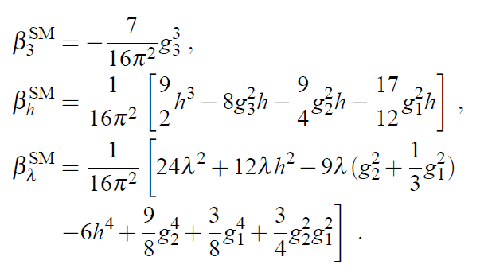
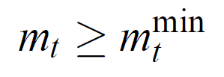
bound on top quark mass
quartic scalar coupling has to remain positive during flow
( otherwise Coleman-Weinberg symmetry breaking at high scale)
~170 GeV

Slide 52
short distance fixed point at λ=0
interesting speculation
top quark mass “predicted” to be close to minimal value , as found in experiment

Slide 53
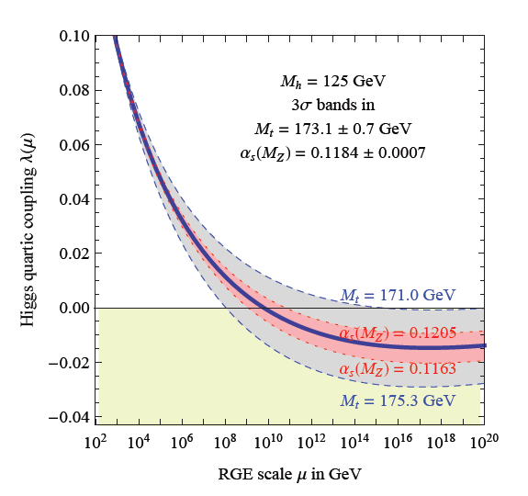
running quartic scalar coupling
Degrassi
et al

Slide 54
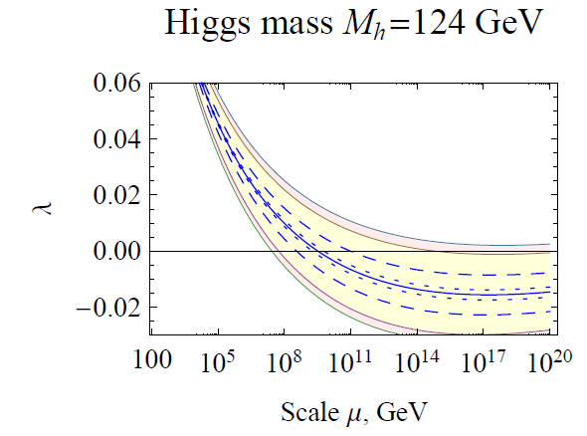
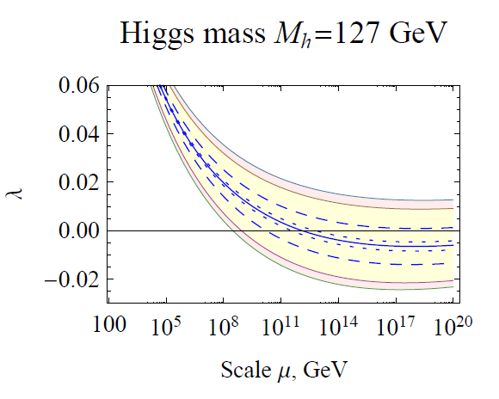
top “prediction” for known Higgs boson mass ?

Slide 55
conclusions
observed value of Higgs boson mass is compatible with great desert
short distance fixed point with small λ predicts Higgs boson mass close to 126 GeV
prediction in SM+gravity, but also wider class of models
desert: no new physics at LHC and future colliders
relevant scale for neutrino physics may be low or intermediate ( say 10¹¹ GeV ) - oasis in desert ?

Slide 57
end

Slide 58
one loop flow equations

Slide 59
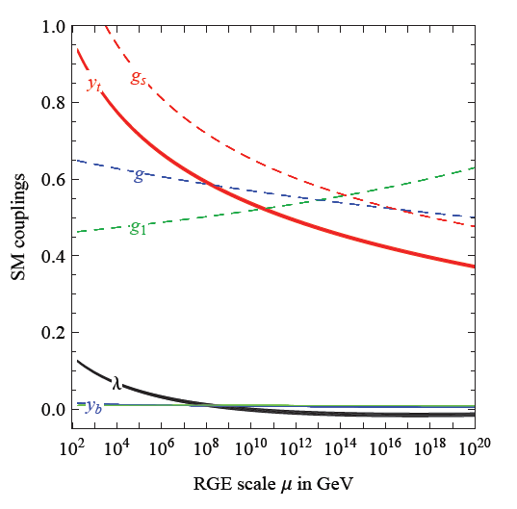
running SM couplings
Degrassi
et al

Slide 60
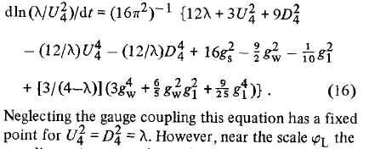
partial infrared fixed point for ratio quartic scalar coupling / squared Yukawa coupling ( four generations )
Gauge Hierarchy Due To Strong Interactions?. C. Wetterich (Freiburg U.). Apr 1981. 20 pp. Published in Phys.Lett. B104 (1981) 269

Slide 61
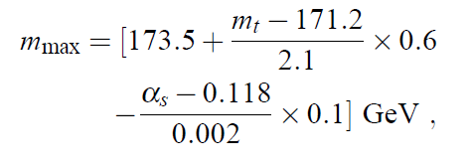
infrared interval

