Slide 1
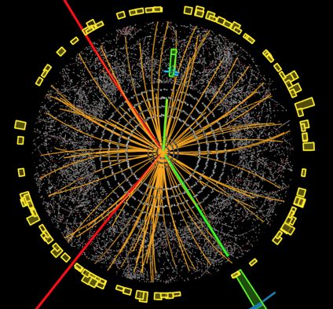
The mass of the Higgs boson and the great desert to the Planck scale

Slide 2
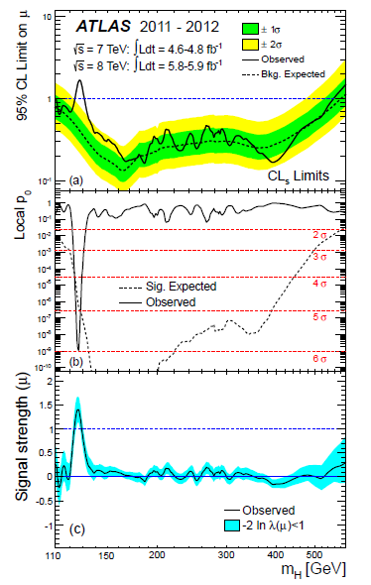
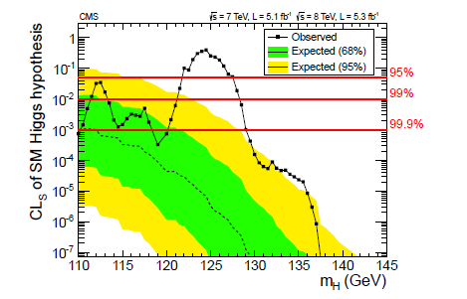
LHC : Higgs particle observation
CMS 2011/12
ATLAS 2011/12

Slide 3
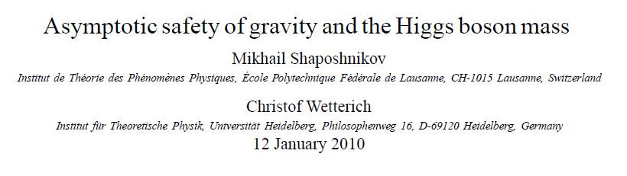
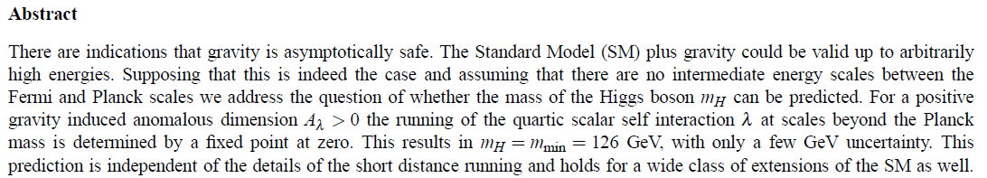
a prediction…

Slide 4
too good to be true ?
500 theoretical physicists = 500 models
equidistant predictions
range 100-600 GeV …
3 GeV bins : one expects several correct predictions ,
but for contradicting models
motivation behind prediction ?

Slide 5
key points
great desert
solution of hierarchy problem at high scale
high scale fixed point
vanishing scalar coupling at fixed point

Slide 6
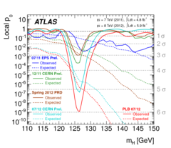
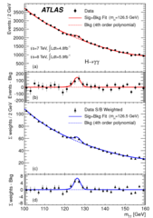
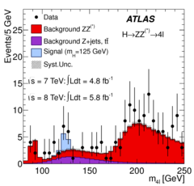
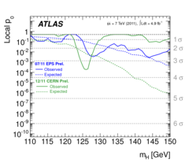
Higgs boson found

Slide 7
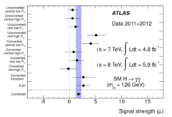
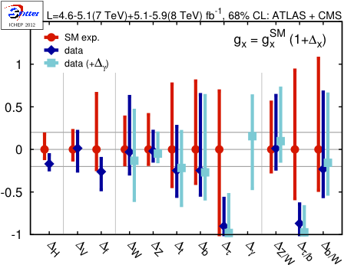
standard model Higgs boson
T.Plehn, M.Rauch

Slide 8
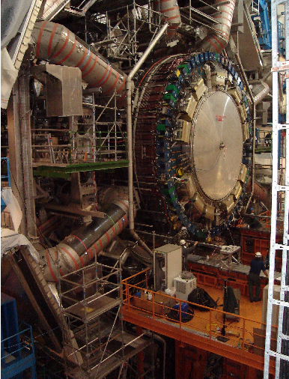
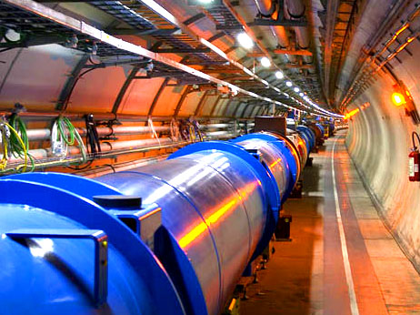
Spontaneous symmetry breaking confirmed at the LHC

Slide 9
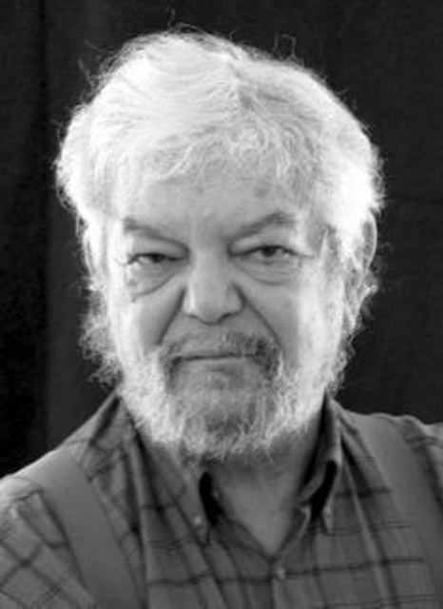
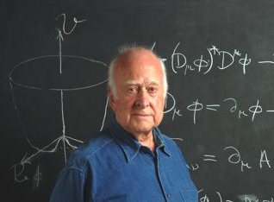
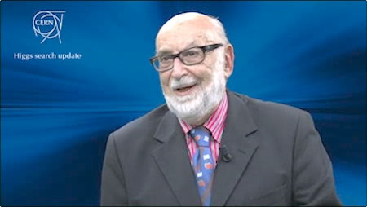
Higgs mechanism verified
Higgs Brout
Englert

Slide 10
Spontaneous symmetry breaking

Slide 11
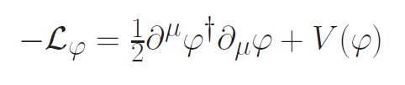
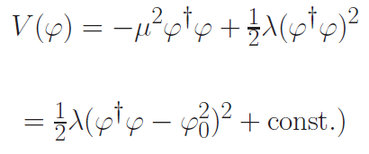



Spontaneous symmetry breaking
Fermi scale

Slide 12
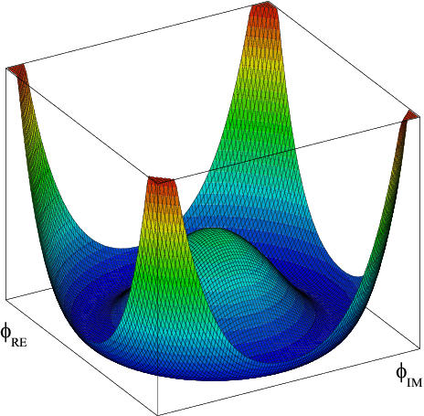
Scalar potential

Slide 13


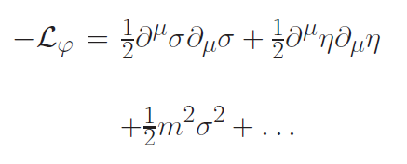

Radial mode and
Goldstone mode
expand around minimum of potential
mass term for
radial mode

Slide 14
massless Goldstone mode

Slide 15
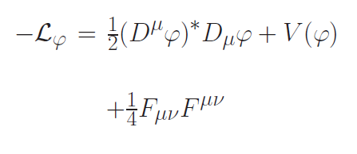


Abelian Higgs mechanism supraconductivity
coupling of complex scalar field to photon

Slide 16
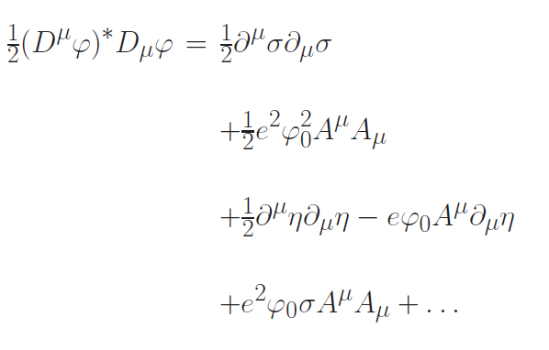
Abelian Higgs mechanism supraconductivity
massive photon !

Slide 17


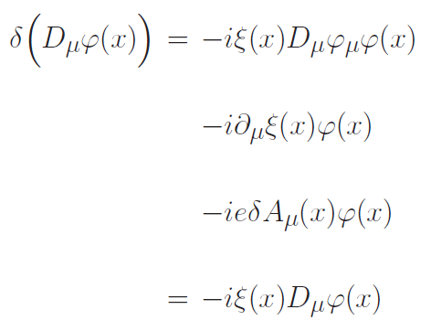
Gauge symmetry
Goldstone boson is gauge degree of freedom
no physical particle
can be eliminated by gauge transformation
in favor of longitudinal component of massive photon

Slide 18

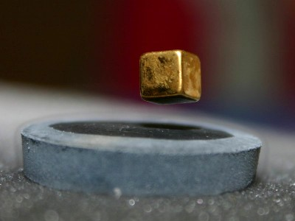
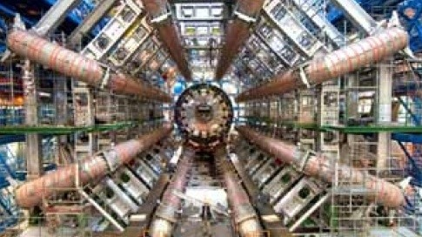
Photon mass m=e φ

Slide 19
Standard – Model of electroweak interactions :
Higgs - mechanism
The masses of all fermions and gauge bosons are proportional to the ( vacuum expectation ) value of a scalar field φ_{H} ( Higgs scalar )
For electron, quarks , W- and Z- bosons :
m_{electron} = h_{electron *} φ_{H} etc.

Slide 20
lessons

Slide 21
1
Vacuum is complicated

Slide 22
mass generated by vacuum properties
particles: excitations of vacuum
Their properties depend on
properties of vacuum

Slide 23
vacuum is not empty !

Slide 24
2
Fundamental “constants” are not constant

Slide 25
Have coupling constants in the
early Universe
other values than today ?
Yes !

Slide 26
Fundamental couplings in quantum field theory
Masses and coupling constants
are determined by properties
of vacuum !
Similar to Maxwell – equations in matter

Slide 27
Condensed matter physics : laws depend on state of the system
Ground state , thermal equilibrium state …
Example : Laws of electromagnetism in superconductor are different from Maxwells’ laws

Slide 28
Standard model of particle physics :
Electroweak gauge symmetry is spontaneously broken by expectation value of Higgs scalar

Slide 29
Cosmology :
Universe is not in one fixed state
Dynamical evolution
Laws are expected to depend on time

Slide 30
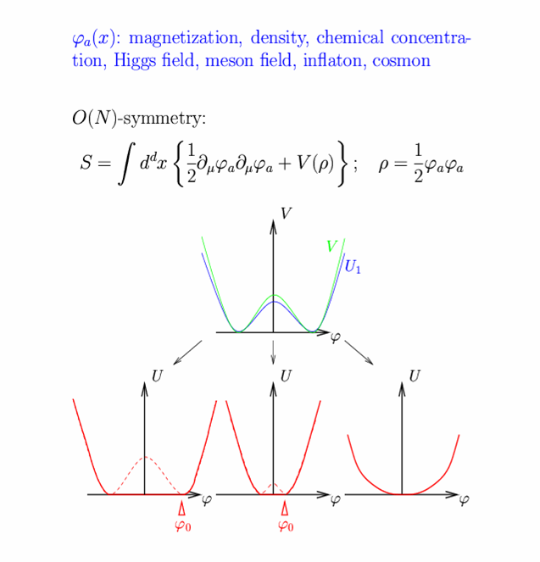
Restoration of symmetry at high temperature in the early Universe
high T :
Less order
More symmetry
Example:
Magnets
Low T
SSB
<φ>=φ₀ ≠ 0
High T
SYM
<φ>=0

Slide 31
Standard – Model of electroweak interactions :
Higgs - mechanism
The masses of all fermions and gauge bosons are proportional to the ( vacuum expectation ) value of a scalar field φ_{H} ( Higgs scalar )
For electron, quarks , W- and Z- bosons :
m_{electron} = h_{electron *} φ_{H} etc.

Slide 32
In hot plasma of early Universe : masses of electron und muon not different! similar strength of electromagnetic and weak interaction

Slide 33

electromagnetic phase transition in early universe
10⁻¹² s after big bang
most likely smooth
crossover
could also be more
violent first order
transition

Slide 34
Varying couplings
How strong is present variation of couplings ?

Slide 35
Can variation of fundamental “constants” be observed ?
Fine structure constant α (electric charge)
Ratio electron mass to proton mass
Ratio nucleon mass to Planck mass

Slide 36
Time evolution of couplings and scalar fields
Fine structure constant depends on value of
Higgs field : α(φ)
Time evolution of φ
Time evolution of α
Jordan,…

Slide 37
Static scalar fields
In Standard Model of particle physics :
Higgs scalar has settled to its present value around 10⁻¹² seconds after big bang.
Chiral condensate of QCD has settled at present value after quark-hadron phase transition around 10⁻⁶ seconds after big bang .
No scalar with mass below pion mass.
No substantial change of couplings after QCD phase transition.
Coupling constants are frozen.

Slide 38
Observation of time- or space- variation of couplings
Physics beyond Standard Model

Slide 39
Particle masses in quintessence cosmology
can depend on value of cosmon field
similar to dependence on value of Higgs field

Slide 40
3
Standard model of particle physics could be valid down to the Planck length

Slide 41

The mass of the Higgs boson, the great desert, and asymptotic safety of gravity

Slide 42
a prediction…

Slide 43
key points
great desert
solution of hierarchy problem at high scale
high scale fixed point
vanishing scalar coupling at fixed point

Slide 44


Slide 45
Planck scale, gravity
no multi-Higgs model
no technicolor
no low scale
higher dimensions
no supersymmetry

Slide 46

Quartic scalar coupling
prediction of mass of Higgs boson
=
prediction of value of quartic scalar coupling λ
at Fermi scale

Slide 47
Radial mode = Higgs scalar
expansion around minimum of potential
Fermi scale
mass term for
radial mode

Slide 48
Running couplings,
Infrared interval,
UV-IR mapping

Slide 49
renormalization
couplings depend on length scale,
or mass scale k

Slide 50


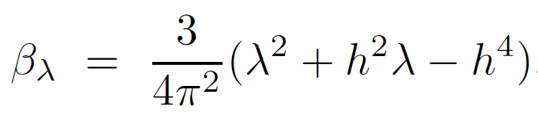
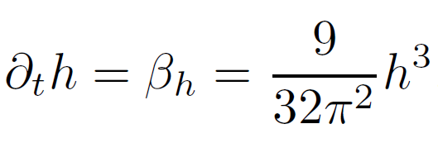

Running quartic scalar coupling λ and Yukawa coupling of top quark h
neglect gauge couplings g

Slide 51
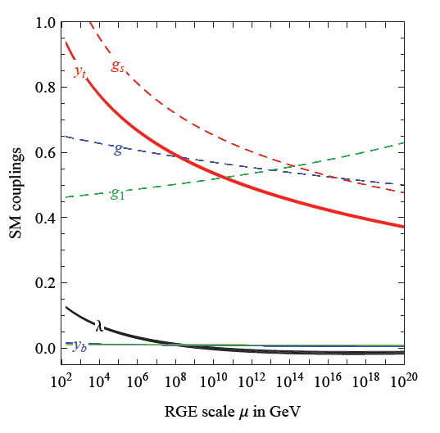
running SM couplings
Degrassi
et al

Slide 52
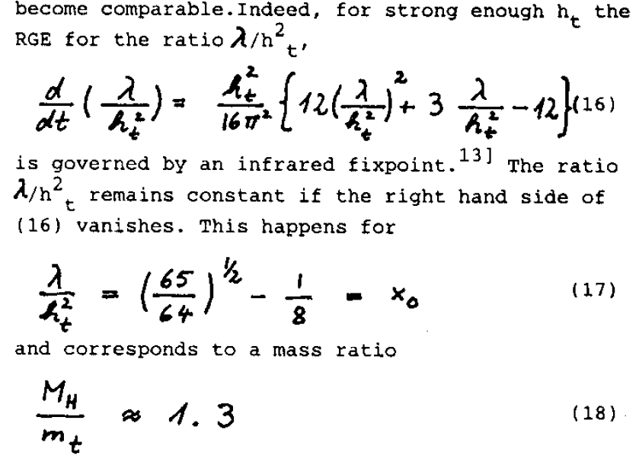
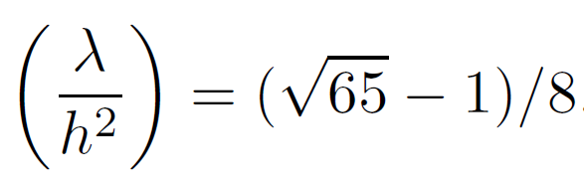
Partial infrared fixed point

Slide 53
infrared interval
allowed values of λ or λ/h² at UV-scale Λ :
between zero and infinity
are mapped to
finite infrared interval of values of
λ/h² at Fermi scale

Slide 54
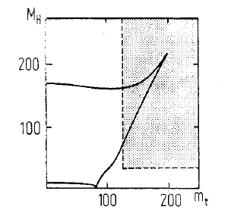
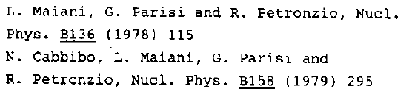
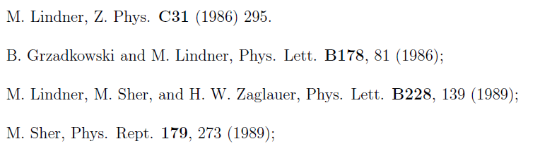
infrared interval

Slide 55

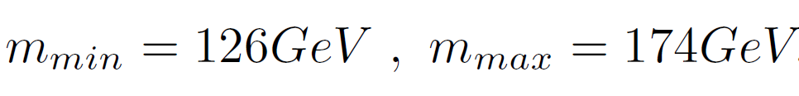
realistic mass of top quark (2010), ultraviolet cutoff: reduced Planck mass

Slide 56
ultraviolet- infrared map
Whole range of small λ
at ultraviolet scale is mapped by
renormalization flow
to lower bound of infrared interval !
Prediction of Higgs boson mass
close to 126 GeV

Slide 57
high scale fixed point

Slide 58
high scale fixed point
with small λ
predicts Higgs boson mass
close to 126 GeV

Slide 59
key points
great desert
solution of hierarchy problem at high scale
high scale fixed point
vanishing scalar coupling at fixed point

Slide 60
fixed point in short-distance theory
short-distance theory extends SM
minimal: SM + gravity
higher dimensional theory ?
grand unification ?
( almost) second order electroweak phase transition guarantees ( approximate ) fixed point of flow
needed for gauge hierarchy: deviation from fixed point is an irrelevant parameter

Slide 61
asymptotic safety for gravity
Weinberg , Reuter

Slide 62
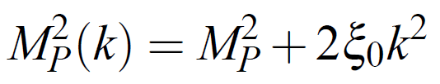
running Planck mass
infrared cutoff scale k ,
for k=0 :

Slide 63

fixed point for dimensionless ratio M/k

Slide 64
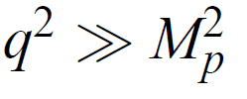
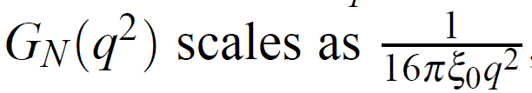
scaling at short distances

Slide 65
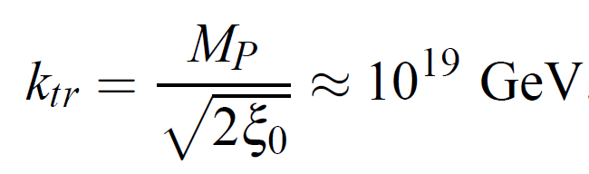

infrared unstable fixed point: transition from scaling to constant Planck mass

Slide 66
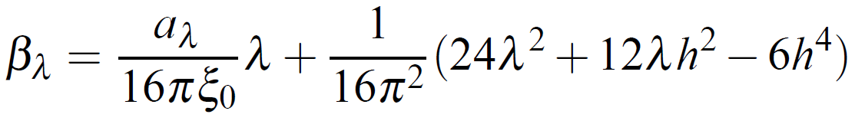
modified running of quartic scalar coupling in presence of metric fluctuations
+…
for a > 0 and small h :
λ is driven fast too very small values !
e.g. a=3 found in gravity computations

Slide 67
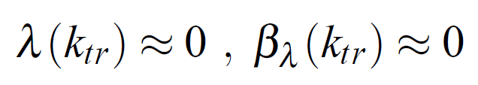
short distance fixed point at λ=0
interesting speculation
top quark mass “predicted” to be close to minimal value , as found in experiment

Slide 68
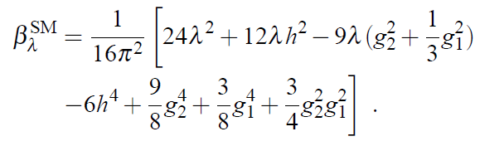
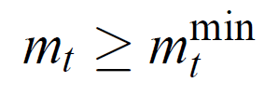
bound on top quark mass
quartic scalar coupling has to remain positive during flow
( otherwise Coleman-Weinberg symmetry breaking at high scale)
~170 GeV

Slide 69

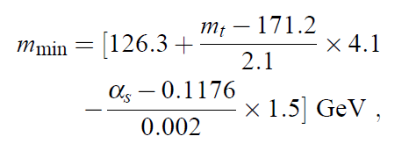
prediction for mass of Higgs scalar
2010

Slide 70
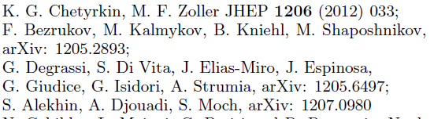
uncertainties
typical uncertainty is a few GeV
central value has moved somewhat upwards , close to 129 GeV
change in top-mass and strong gauge coupling
inclusion of three loop running and two loop matching

Slide 71
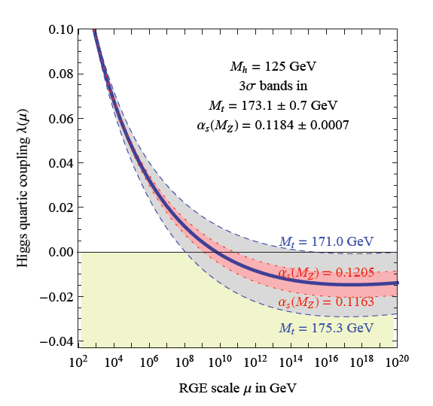
running quartic scalar coupling
Degrassi
et al

Slide 72
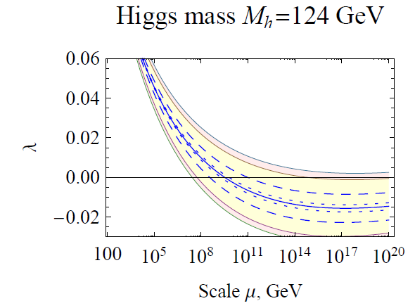
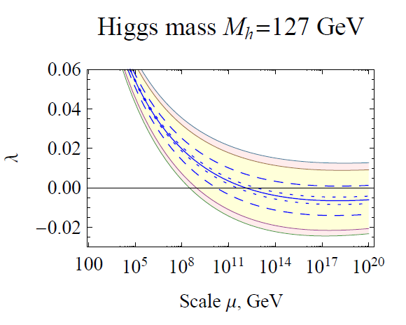
Sensitivity to Higgs boson mass for given top quark mass

Slide 73
top “prediction” for known
Higgs boson mass
for m_{H} =126 Gev :
m_{t} = 171.5 GeV

Slide 74
What if top pole mass is 173 GeV ?
standard model needs extension around 10¹¹ GeV
scale of seesaw for neutrinos
heavy triplet ?

Slide 76
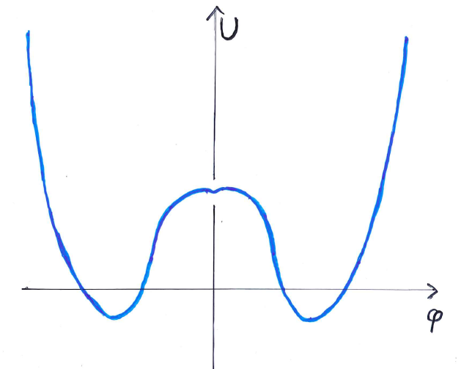
remark on metastable vacuum
no model known where this is realized in reliable way

Slide 77
conclusions
observed value of Higgs boson mass is compatible with great desert
short distance fixed point with small λ predicts Higgs boson mass close to 126 GeV
prediction in SM+gravity, but also wider class of models
desert: no new physics at LHC and future colliders
relevant scale for neutrino physics may be low or intermediate ( say 10¹¹ GeV ) - oasis in desert ?

Slide 79
end

Slide 80
gauge hierarchy problem and fine tuning problem

Slide 81

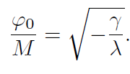
quantum effective potential
scalar field χ with high expectation value M,
say Planck mass

Slide 82


anomalous mass dimension
one loop,
neglect gauge couplings g

Slide 83
fixed point for γ = 0
zero temperature electroweak phase transition (as function of γ ) is essentially second order
fixed point with effective dilatation symmetry
no flow of γ at fixed point
naturalness due to enhanced symmetry
small deviations from fixed point due to running couplings: leading effect is lower bound on Fermi scale by quark-antiquark condensates

Slide 84
critical physics
second order phase transition corresponds to critical surface in general space of couplings
flow of couplings remains within critical surface
once couplings are near critical surface at one scale, they remain in the vicinity of critical surface
gauge hierarchy problem : explain why world is near critical surface for electroweak phase transition
explanation can be at arbitrary scale !

Slide 85
critical physics in statistical physics
use of naïve perturbation theory
( without RG – improvement )
would make the existence of critical temperature look “unnatural”
artefact of badly converging expansion

Slide 86
self-tuned criticality
deviation from fixed point is an irrelevant parameter (A>2)
critical behavior realized for wide range of parameters
in statistical physics : models of this type are known for d=2
d=4: second order phase transitions found ,
self-tuned criticality found in models of scalars coupled to gauge fields (QCD), Gies…
realistic electroweak model not yet found

Slide 87
SUSY vs Standard Model
natural predictions
baryon and lepton number conservation SM
flavor and CP violation described by CKM matrix SM
absence of strangeness violating neutral currents SM
g-2 etc. SM
dark matter particle (WIMP) SUSY

Slide 88




gravitational running
a < 0 for gauge and Yukawa couplings
asymptotic freedom

