Slide 1
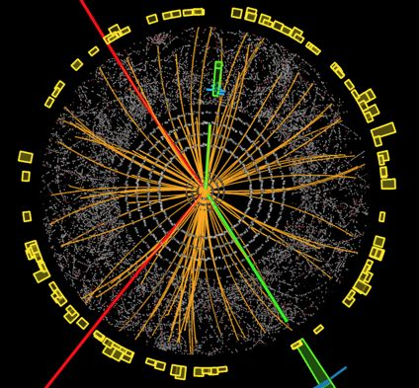
The Higgs boson and its mass

Slide 2
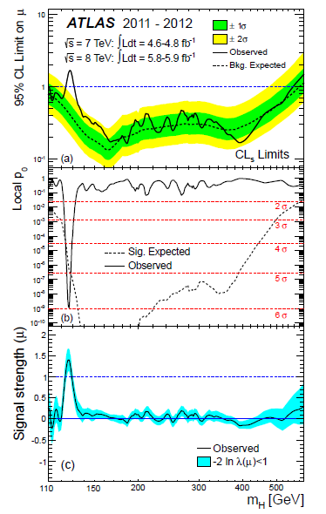
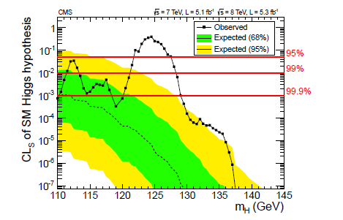
LHC : Higgs particle observation
CMS 2011/12
ATLAS 2011/12

Slide 3
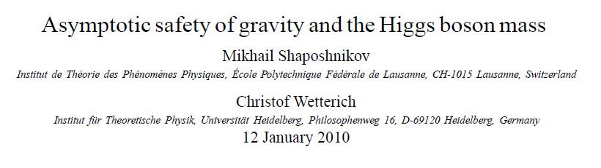
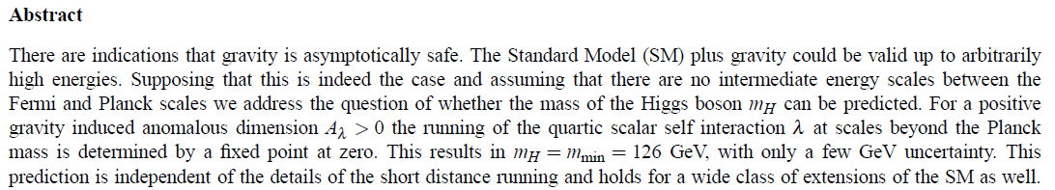
a prediction…

Slide 4
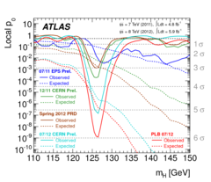
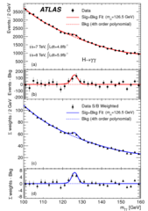
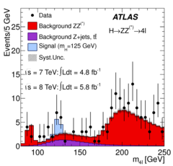
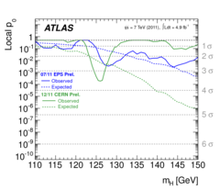
Higgs boson found

Slide 5
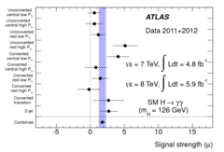
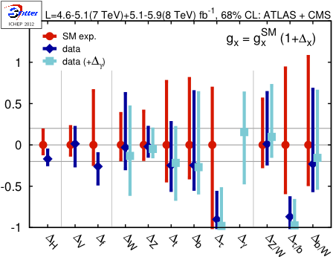
standard model Higgs boson
T.Plehn, M.Rauch

Slide 6
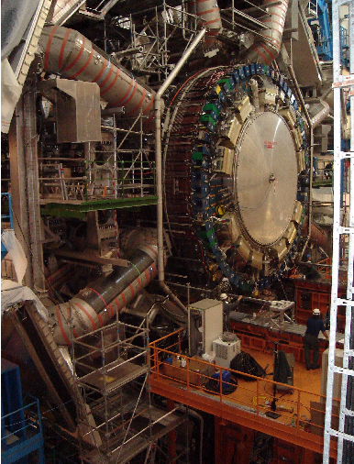
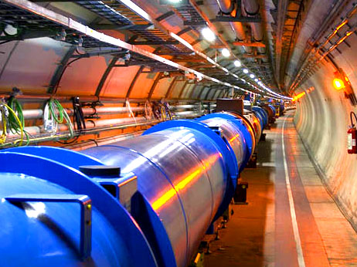
Spontaneous symmetry breaking confirmed at the LHC

Slide 7
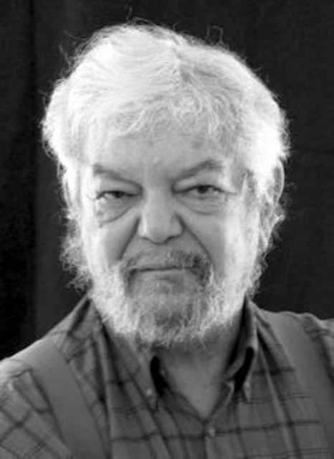
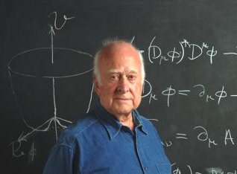
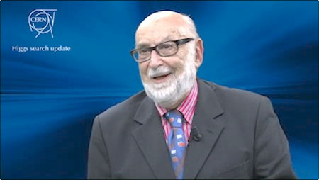
Higgs mechanism verified
Higgs Brout
Englert

Slide 8
Spontaneous symmetry breaking

Slide 9

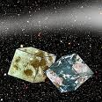
Physics only describes probabilities
Gott würfelt

Slide 10
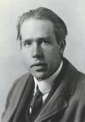
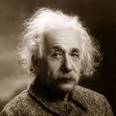
Physics only describes probabilities
Gott würfelt
Gott würfelt nicht

Slide 11


Physics only describes probabilities
Gott würfelt
Gott würfelt nicht
humans can only deal with probabilities

Slide 12
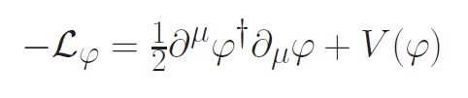
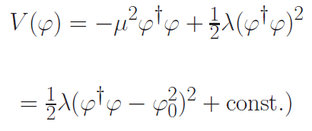



Spontaneous symmetry breaking
Fermi scale

Slide 13
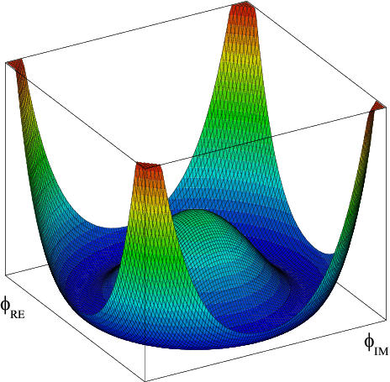
Scalar potential

Slide 14


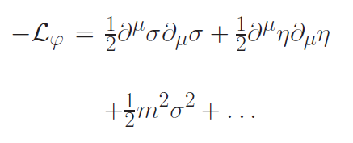

Radial mode and
Goldstone mode
expand around minimum of potential
mass term for
radial mode

Slide 15
massless Goldstone mode

Slide 16
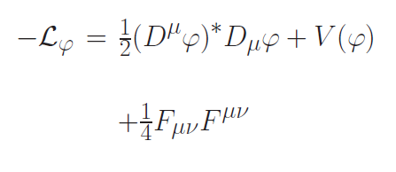


Abelian Higgs mechanism supraconductivity
coupling of complex scalar field to photon

Slide 17
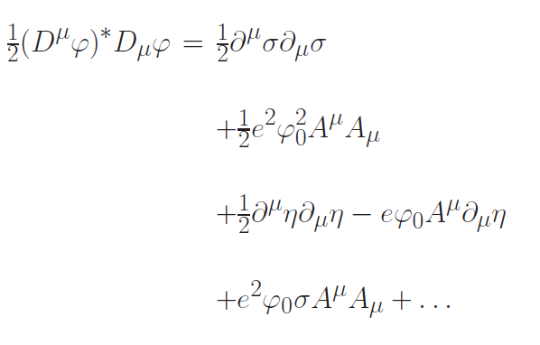
Abelian Higgs mechanism supraconductivity
massive photon !

Slide 18


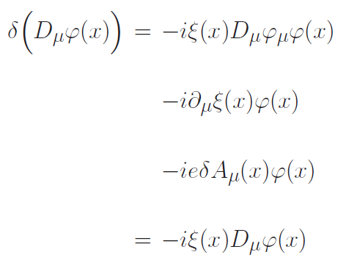
Gauge symmetry
Goldstone boson is gauge degree of freedom
no physical particle
can be eliminated by gauge transformation
in favor of longitudinal component of massive photon

Slide 19
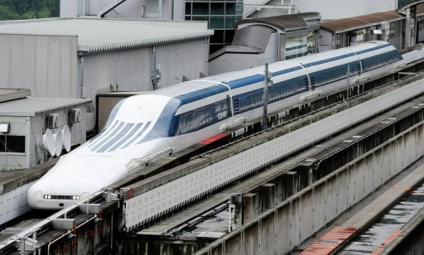
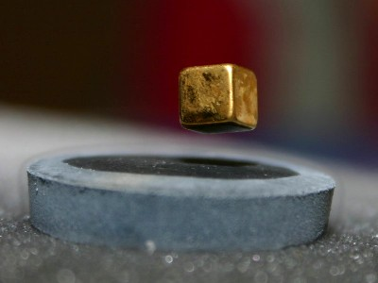
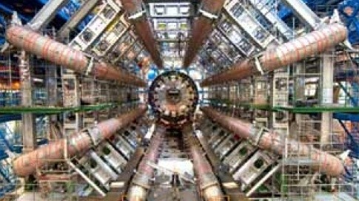
Photon mass m=e φ

Slide 20
Standard – Model of electroweak interactions :
Higgs - mechanism
The masses of all fermions and gauge bosons are proportional to the ( vacuum expectation ) value of a scalar field φ_{H} ( Higgs scalar )
For electron, quarks , W- and Z- bosons :
m_{electron} = h_{electron *} φ_{H} etc.

Slide 21
lessons

Slide 22
1
Vacuum is complicated

Slide 23
mass generated by vacuum properties
particles: excitations of vacuum
Their properties depend on
properties of vacuum

Slide 24
vacuum is not empty !

Slide 25
2
Fundamental “constants” are not constant

Slide 26
Have coupling constants in the
early Universe
other values than today ?
Yes !

Slide 27
Fundamental couplings in quantum field theory
Masses and coupling constants
are determined by properties
of vacuum !
Similar to Maxwell – equations in matter

Slide 28
Condensed matter physics : laws depend on state of the system
Ground state , thermal equilibrium state …
Example : Laws of electromagnetism in superconductor are different from Maxwells’ laws

Slide 29
Standard model of particle physics :
Electroweak gauge symmetry is spontaneously broken by expectation value of Higgs scalar

Slide 30
Cosmology :
Universe is not in one fixed state
Dynamical evolution
Laws are expected to depend on time

Slide 31
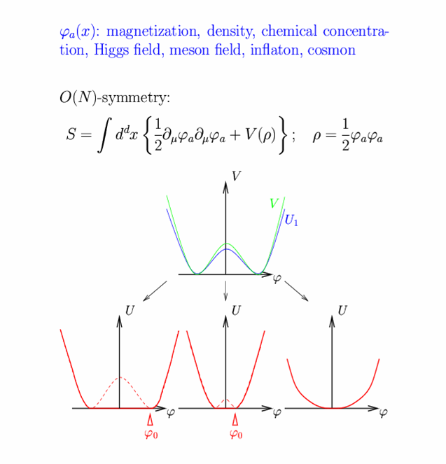
Restoration of symmetry at high temperature in the early Universe
high T :
Less order
More symmetry
Example:
Magnets
Low T
SSB
<φ>=φ₀ ≠ 0
High T
SYM
<φ>=0

Slide 32
Standard – Model of electroweak interactions :
Higgs - mechanism
The masses of all fermions and gauge bosons are proportional to the ( vacuum expectation ) value of a scalar field φ_{H} ( Higgs scalar )
For electron, quarks , W- and Z- bosons :
m_{electron} = h_{electron *} φ_{H} etc.

Slide 33
In hot plasma of early Universe : masses of electron und muon not different! similar strength of electromagnetic and weak interaction

Slide 34
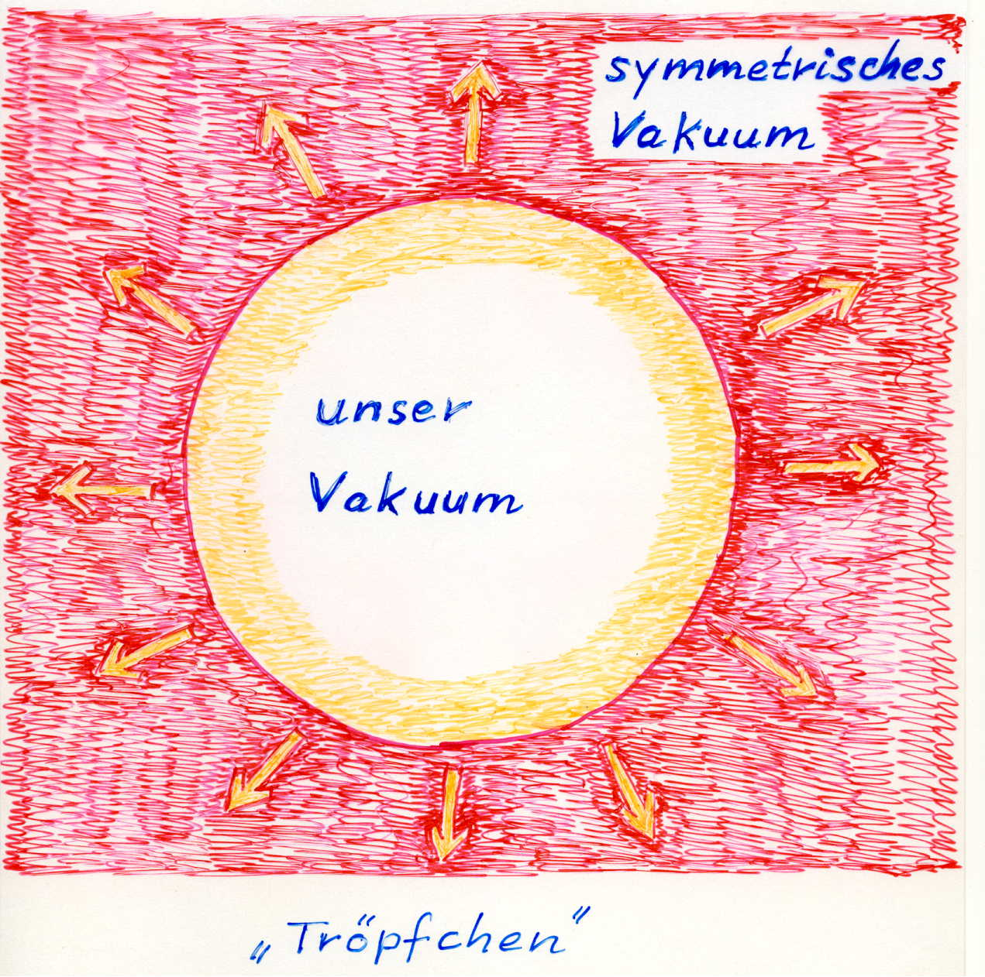
electromagnetic phase transition in early universe
10⁻¹² s after big bang
most likely smooth
crossover
could also be more
violent first order
transition

Slide 35
Varying couplings
How strong is present variation of couplings ?

Slide 36
Can variation of fundamental “constants” be observed ?
Fine structure constant α (electric charge)
Ratio electron mass to proton mass
Ratio nucleon mass to Planck mass

Slide 37
Time evolution of couplings and scalar fields
Fine structure constant depends on value of
cosmon field : α(φ)
in standard model: couplings depend on value of Higgs scalar field
Time evolution of φ
Time evolution of α
Jordan,…

Slide 38
Static scalar fields
In Standard Model of particle physics :
Higgs scalar has settled to its present value around 10⁻¹² seconds after big bang.
Chiral condensate of QCD has settled at present value after quark-hadron phase transition around 10⁻⁶ seconds after big bang .
No scalar with mass below pion mass.
No substantial change of couplings after QCD phase transition.
Coupling constants are frozen.

Slide 39
Observation of time- or space- variation of couplings
Physics beyond Standard Model

Slide 40
Particle masses in quintessence cosmology
can depend on value of cosmon field
similar to dependence on value of Higgs field

Slide 41
3
Standard model of particle physics could be valid down to the Planck length

Slide 42

The mass of the Higgs boson, the great desert, and asymptotic safety of gravity

Slide 43
a prediction…

Slide 44
key points
great desert
solution of hierarchy problem at high scale
high scale fixed point
vanishing scalar coupling at fixed point

Slide 45


Slide 46
Planck scale, gravity
no multi-Higgs model
no technicolor
no low scale
higher dimensions
no supersymmetry

Slide 47

Quartic scalar coupling
prediction of mass of Higgs boson
=
prediction of value of quartic scalar coupling λ
at Fermi scale

Slide 48
Radial mode = Higgs scalar
expansion around minimum of potential
Fermi scale
mass term for
radial mode

Slide 49
Running couplings,
Infrared interval,
UV-IR mapping

Slide 50
renormalization
couplings depend on length scale,
or mass scale k

Slide 51


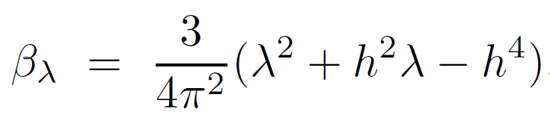
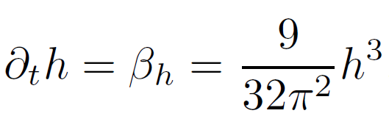

Running quartic scalar coupling λ and Yukawa coupling of top quark h
neglect gauge couplings g

Slide 52
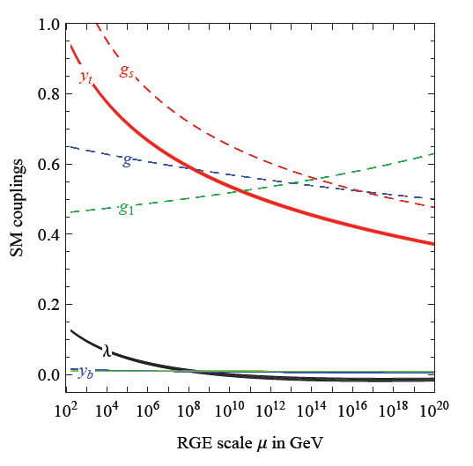
running SM couplings
Degrassi
et al

Slide 53
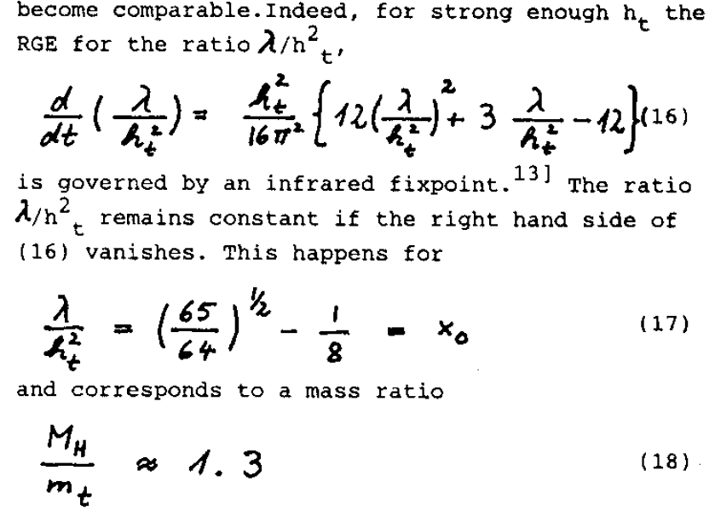
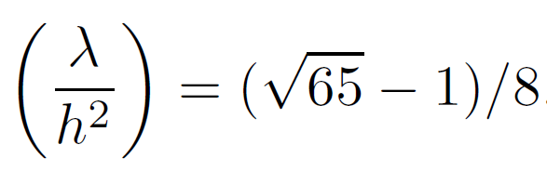
Partial infrared fixed point

Slide 54
infrared interval
allowed values of λ or λ/h² at UV-scale Λ :
between zero and infinity
are mapped to
finite infrared interval of values of
λ/h² at Fermi scale

Slide 55
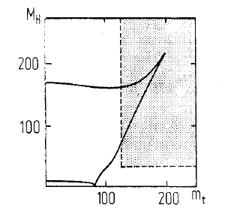
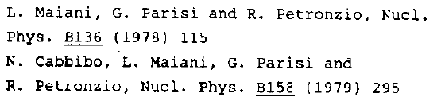
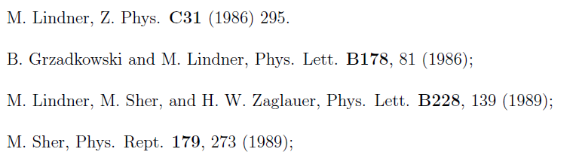
infrared interval

Slide 56

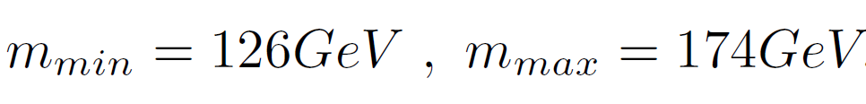
realistic mass of top quark (2010), ultraviolet cutoff: reduced Planck mass

Slide 57
ultraviolet- infrared map
Whole range of small λ
at ultraviolet scale is mapped by
renormalization flow
to lower bound of infrared interval !
Prediction of Higgs boson mass
close to 126 GeV

Slide 58
high scale fixed point

Slide 59
high scale fixed point
with small λ
predicts Higgs boson mass
close to 126 GeV

Slide 60
key points
great desert
solution of hierarchy problem at high scale
high scale fixed point
vanishing scalar coupling at fixed point

Slide 61
fixed point in short-distance theory
short-distance theory extends SM
minimal: SM + gravity
higher dimensional theory ?
grand unification ?
( almost) second order electroweak phase transition guarantees ( approximate ) fixed point of flow
needed : deviation from fixed point is an irrelevant parameter (A>2)

Slide 62
asymptotic safety for gravity
Weinberg , Reuter

Slide 63
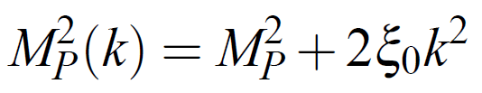
running Planck mass
infrared cutoff scale k ,
for k=0 :

Slide 64

fixed point for dimensionless ratio M/k

Slide 65
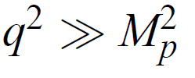
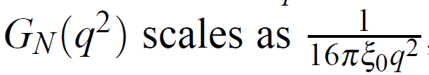
scaling at short distances

Slide 66
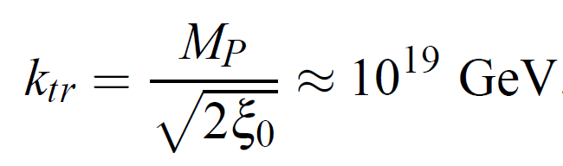

infrared unstable fixed point: transition from scaling to constant Planck mass

Slide 67
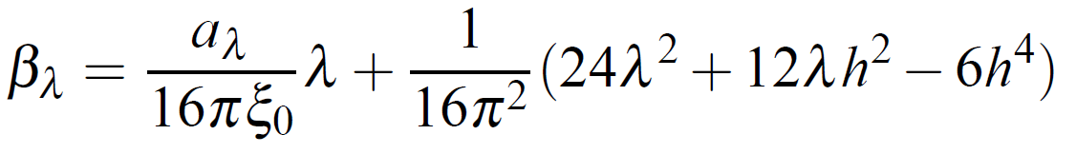
modified running of quartic scalar coupling in presence of metric fluctuations
+…
for a > 0 and small h :
λ is driven fast too very small values !
e.g. a=3 found in gravity computations

Slide 68
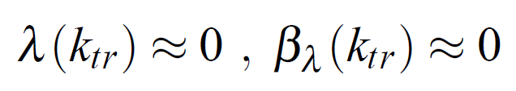
short distance fixed point at λ=0
interesting speculation
top quark mass “predicted” to be close to minimal value , as found in experiment

Slide 69
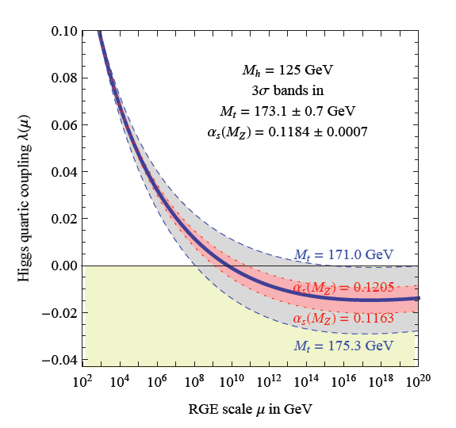
running quartic scalar coupling
Degrassi
et al

Slide 70
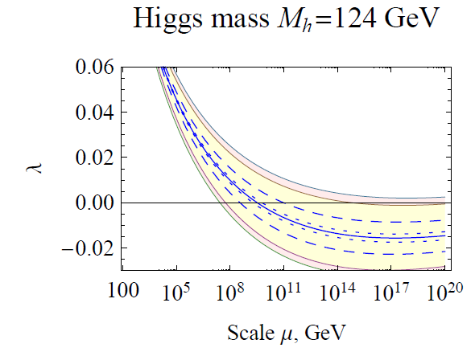
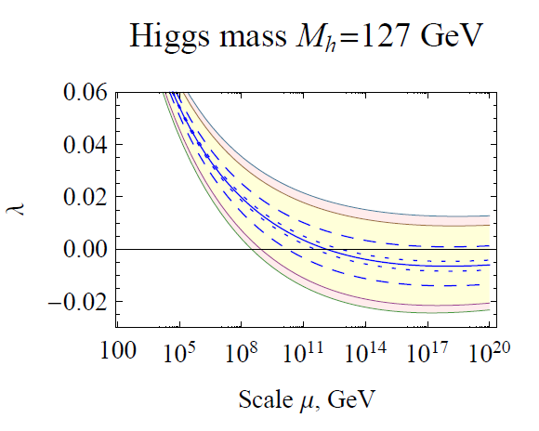
Sensitivity to Higgs boson mass for given top quark mass

Slide 71
top “prediction” for known
Higgs boson mass
for m_{H} =126 Gev :
m_{t} = 171.5 GeV

Slide 72
conclusions
observed value of Higgs boson mass is compatible with great desert
short distance fixed point with small λ predicts Higgs boson mass close to 126 GeV
prediction in SM+gravity, but also wider class of models
desert: no new physics at LHC and future colliders
relevant scale for neutrino physics may be low or intermediate ( say 10¹¹ GeV ) - oasis in desert ?

Slide 74
end

Slide 75
gauge hierarchy problem and fine tuning problem

Slide 76

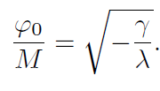
quantum effective potential
scalar field χ with high expectation value M,
say Planck mass

Slide 77


anomalous mass dimension
one loop,
neglect gauge couplings g

Slide 78
fixed point for γ = 0
zero temperature electroweak phase transition (as function of γ ) is essentially second order
fixed point with effective dilatation symmetry
no flow of γ at fixed point
naturalness due to enhanced symmetry
small deviations from fixed point due to running couplings: leading effect is lower bound on Fermi scale by quark-antiquark condensates

Slide 79
critical physics
second order phase transition corresponds to critical surface in general space of couplings
flow of couplings remains within critical surface
once couplings are near critical surface at one scale, they remain in the vicinity of critical surface
gauge hierarchy problem : explain why world is near critical surface for electroweak phase transition
explanation can be at arbitrary scale !

Slide 80
critical physics in statistical physics
use of naïve perturbation theory
( without RG – improvement )
would make the existence of critical temperature look “unnatural”
artefact of badly converging expansion

Slide 81
self-tuned criticality
deviation from fixed point is an irrelevant parameter (A>2)
critical behavior realized for wide range of parameters
in statistical physics : models of this type are known for d=2
d=4: second order phase transitions found ,
self-tuned criticality found in models of scalars coupled to gauge fields (QCD), Gies…
realistic electroweak model not yet found

Slide 82
SUSY vs Standard Model
natural predictions
baryon and lepton number conservation SM
flavor and CP violation described by CKM matrix SM
absence of strangeness violating neutral currents SM
g-2 etc. SM
dark matter particle (WIMP) SUSY

Slide 83




gravitational running
a < 0 for gauge and Yukawa couplings
asymptotic freedom

Slide 84


bound on top quark mass
quartic scalar coupling has to remain positive during flow
( otherwise Coleman-Weinberg symmetry breaking at high scale)
~170 GeV

