Slide 1
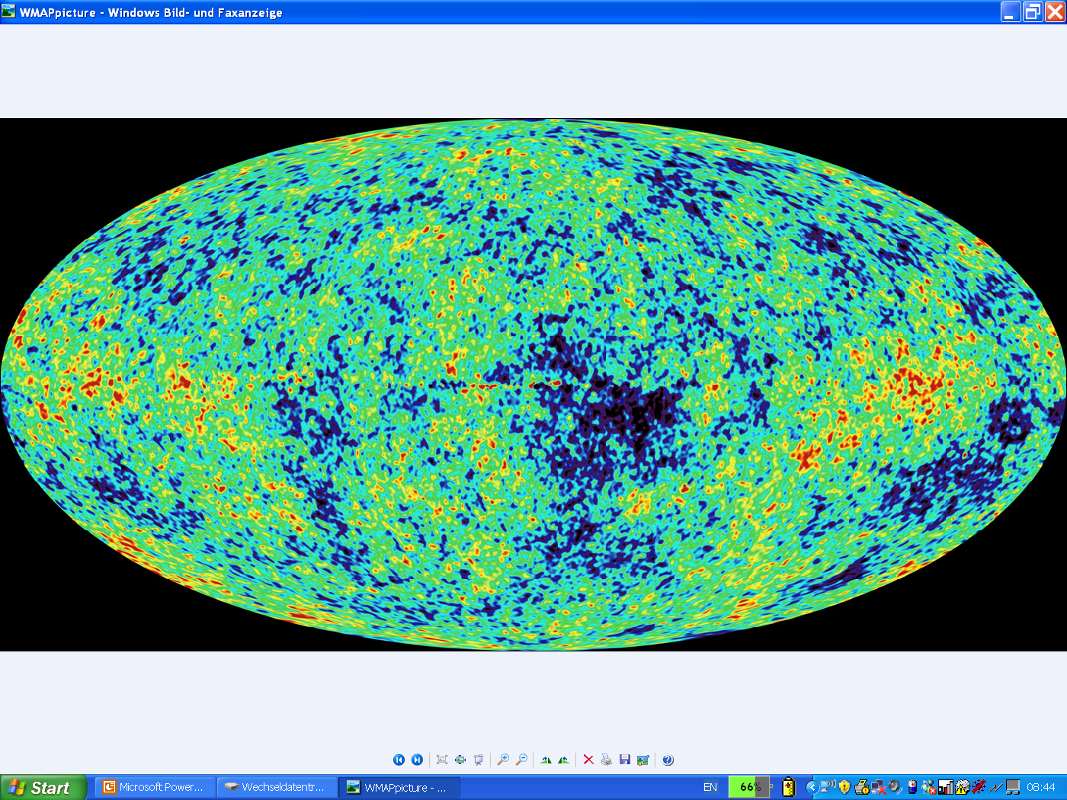
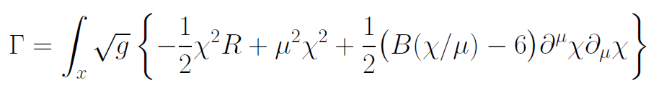
Graviton fluctuations erase the cosmological constant

Slide 2
In quantum gravity, the graviton fluctuations can play an important role on distances as large as the size of the Universe

Slide 3
Graviton propagator
effective action
Instability for V>0 : ”tachyonic mass term”

Slide 4
On shell graviton propagator
on shell :
( for solution of field equations )
homogenous isotropic metric,
conformal time
inverse graviton propagator in
de Sitter space
milder instability, not tachyonic, absent for
cosmologies close to de Sitter space

Slide 5
IR – instability for graviton fluctuations
problem solved ?
yes for primordial cosmic fluctuations ( on shell )
no for quantum gravity ( off shell )
Computation of effective action is an off-shell problem.
example : one needs the effective potential for the Higgs field in the vicinity of its minimum ( off shell ), not only at the minimum ( on shell )

Slide 6
Quantum gravity with scalar field
M² and V depend on scalar field
question : behavior of V for

Slide 7
Graviton barrier
Quantum gravity computation :
For
V cannot increase stronger than M² !
Instability of graviton propagator is avoided

Slide 8
Graviton barrier and solution of the cosmological constant problem
V cannot increase stronger than M² !
If M increases with 𝜒, and for cosmological solutions where 𝜒 asymptotically diverges for time going to infinity:
Effective cosmological constant vanishes in infinite future

Slide 9
Normalization of scalar field
If M increases monotonically with 𝜒 :
choose normalization of scalar
M= 𝜒

Slide 10
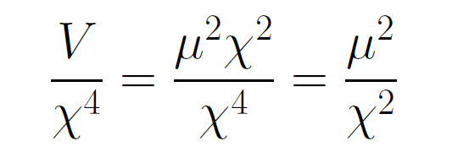
asymptotically vanishing cosmological „constant“
What matters : Ratio of potential divided by fourth power of Planck mass
vanishes for χ → ∞ !

Slide 11
Quintessence
Dynamical dark energy ,
generated by scalar field (cosmon )
C.Wetterich,Nucl.Phys.B302(1988)668, 24.9.87
P.J.E.Peebles,B.Ratra,ApJ.Lett.325(1988)L17, 20.10.87
Notes:
11

Slide 12
Prediction : homogeneous dark energy influences recent cosmology
- of same order as dark matter -
Original models do not fit the present observations
…. modifications
( different growth of neutrino mass )

Slide 13
Variable Gravity
Scalar field coupled to gravity
Effective Planck mass depends on scalar field
Simple quadratic scalar potential involves intrinsic mass μ
Nucleon and electron mass proportional to dynamical Planck mass

Slide 14
Einstein frame
“Weyl scaling” maps variable gravity model to Universe with fixed masses and standard expansion history.
Exact equivalence of different frames !
Standard gravity coupled to scalar field.

Slide 15
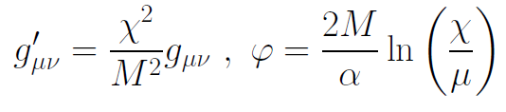
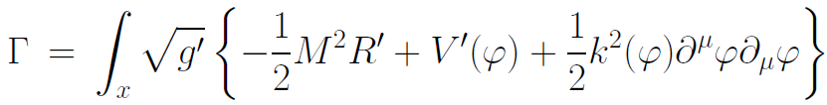
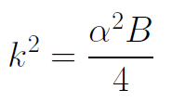

Einstein frame
Weyl scaling :
effective action in Einstein frame :

Slide 16
Quantum gravity computation by functional renormalization
Introduce infrared cutoff with scale k,
such that only fluctuations with
( covariant) momenta larger than k
are included.
Then lower k towards zero

Slide 17
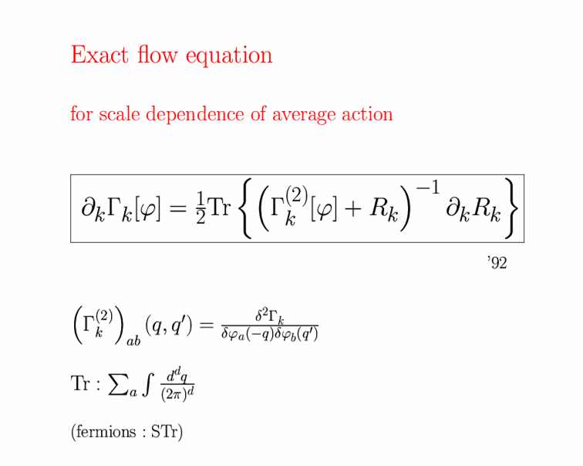
Exact renormalization group equation

Slide 18
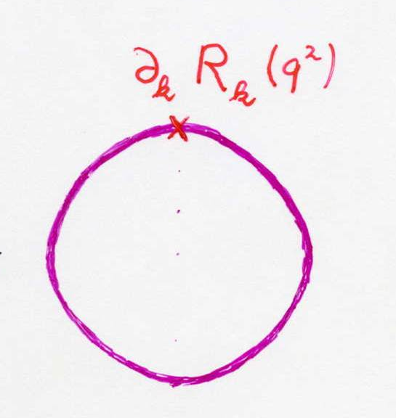
Functional flow equation for scale dependent effective action
IR cutoff
exact propagator

Slide 19
Graviton contribution to flow of scalar potential
Litim cutoff:
crucial dimensionless quantity

Slide 20
Flow equation for v

Slide 21
Flow of v for different initial conditions

Slide 22
Infrared value of effective scalar potential for k/𝜒 → 0
v=1
graviton barrier !

Slide 23
Graviton fluctuations erase the cosmological constant

Slide 24
Ultraviolet behavior for k/𝜒 → ∞
UV – and IR –
fixed points

Slide 25
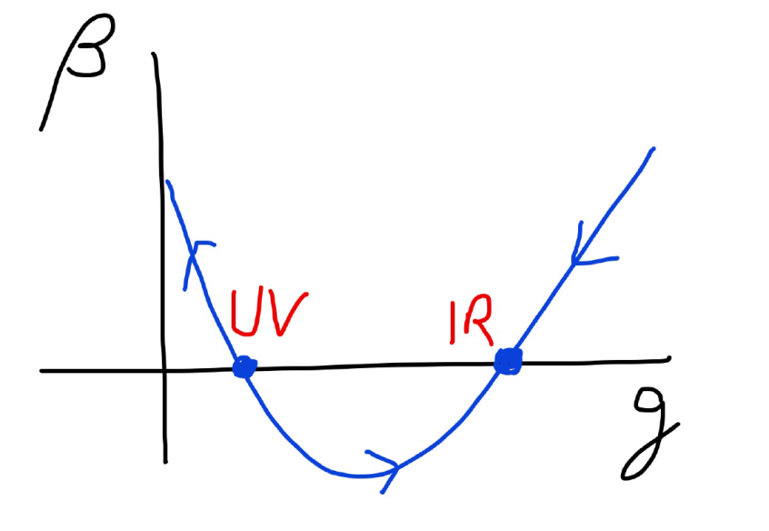
Quantum gravity has
UV- and IR- fixed point
Near UV fixed point:
Relevant parameters yield undetermined couplings.
Quartic scalar coupling is irrelevant and can therefore be predicted.

Slide 26
Graviton contribution to flow of quartic scalar coupling : positive and substantial anomalous dimension

Slide 27
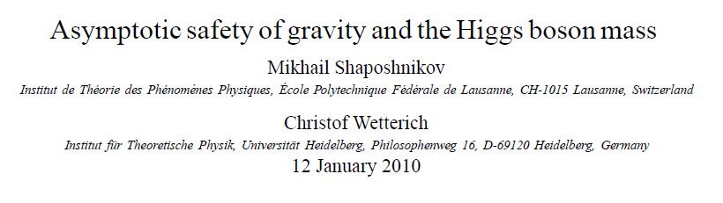
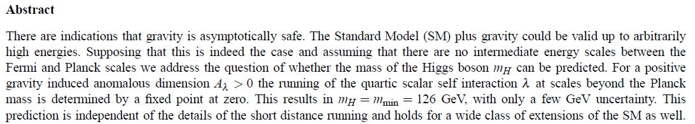
a prediction…

Slide 28
Possible explanation of gauge hierarchy
Phys.Lett. B770 (2017) 268-271

Slide 29
Quantum scale symmetry
quantum fluctuations violate scale symmetry
running dimensionless couplings
at fixed points , scale symmetry is exact !

Slide 30

Spontaneous breaking of scale symmetry
expectation value of scalar field breaks scale symmetry spontaneously
massive particles are compatible with scale symmetry
all mass scales proportional to scalar field$χ$ : electron mass, proton mass, Planck mass
in presence of massive particles : sign of exact scale symmetry is exactly massless Goldstone boson – the dilaton

Slide 31
Approximate scale symmetry near fixed points
UV : approximate scale invariance of primordial fluctuation spectrum from inflation
IR : cosmon is pseudo Goldstone boson of
spontaneously broken scale symmetry,
tiny mass,
responsible for dynamical Dark Energy

Slide 32
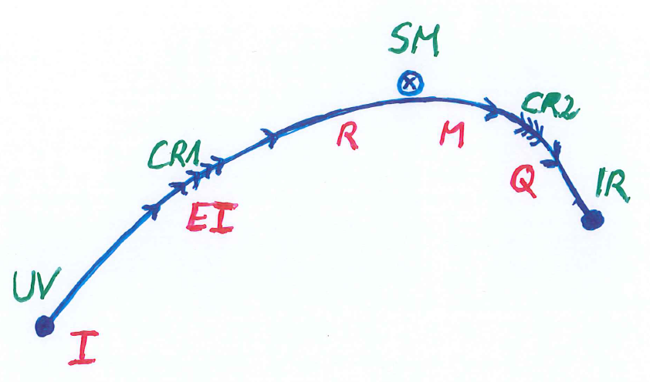
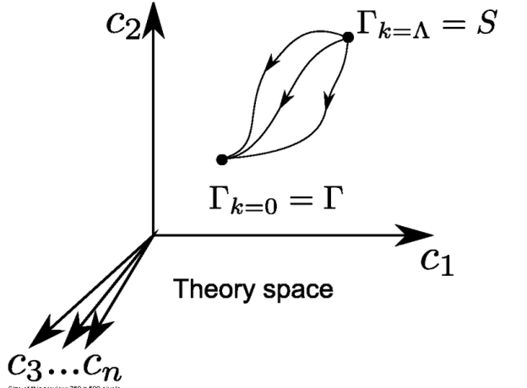
Crossover in quantum gravity

Slide 33
Possible consequences of crossover in quantum gravity
Realistic model for inflation and dark energy
with single scalar field

Slide 34
Variable Gravity
intrinsic scale 𝜇 replaces k
quantum effective action,
variation yields field equations,
solve for cosmology

Slide 35
Variable Gravity
Scalar field coupled to gravity
Effective Planck mass depends on scalar field
Simple quadratic scalar potential involves intrinsic mass μ
Nucleon and electron mass proportional to dynamical Planck mass

Slide 36
Cosmological solution : crossover from UV to IR fixed point
Dimensionless functions as B
depend only on ratio μ/χ .
IR: μ→0 , χ→∞
UV: μ→∞ , χ→0
Cosmology makes
crossover between
fixed points by
variation of χ .

Slide 37
renormalization flow and cosmological evolution
renormalization flow as function of µ
is mapped by dimensionless functions to
field dependence of effective action on scalar field χ
translates by solution of field equation to
dependence of cosmology on time t or η

Slide 38
Simplicity
simple description of all cosmological epochs
natural incorporation of Dark Energy :
inflation
Early Dark Energy
present Dark Energy dominated epoch

Slide 39
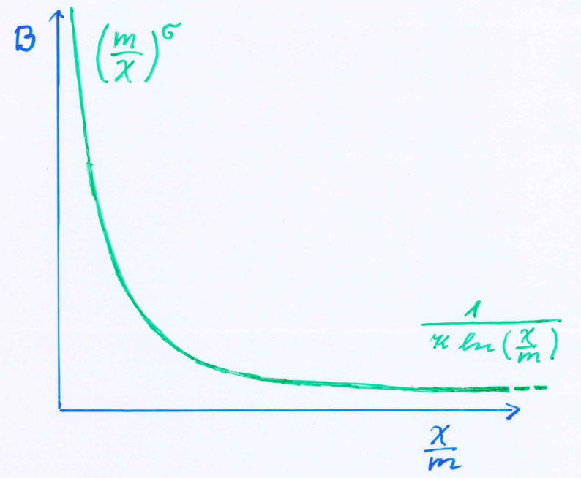
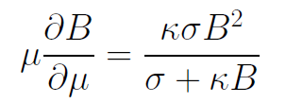
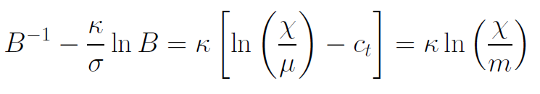
Kinetial B :
Crossover between two fixed points
Ansatz , not computed !
running
coupling obeys
flow equation
m : scale of crossover
can be exponentially larger than intrinsic scale μ

Slide 40
Cosmological solution
derive field equation from effective action of variable gravity
solve them for homogenous and isotropic metric and scalar field
scalar field χ vanishes in the infinite past
scalar field χ diverges in the infinite future

Slide 41
No tiny dimensionless parameters
( except matter sector, e.g. gauge hierarchy )
μ = 2 • 10 ⁻³³ eV
one mass scale
one time scale μ⁻¹ = 10 ¹⁰ yr
Planck mass does not appear as parameter
Planck mass grows large dynamically

Slide 42
Particle masses change with time
At SM fixed point :
All particle masses ( except for neutrinos ) are proportional to scalar field χ .
Scalar field varies with time – so do particle masses.
Ratios of particle masses are independent of χ and therefore remain constant.
Compatibility with observational bounds on time dependence of particle mass ratios.
Dimensionless couplings are independent of χ .

Slide 43
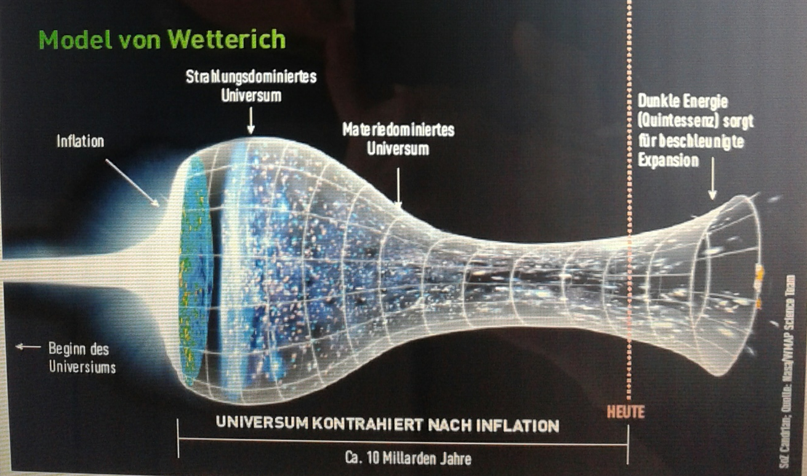
Strange evolution of Universe
Sonntagszeitung Zürich , Laukenmann

Slide 44
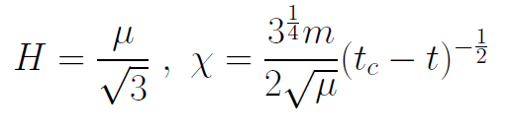
Slow Universe
Asymptotic solution :
Expansion or shrinking always slow ,
characteristic time scale of the order of the age of the
Universe : t_{ch} ~ μ⁻¹ ~ 10 billion years !
Hubble parameter of the order of present Hubble
parameter for all times , including inflation and big bang !
Slow increase of particle masses !
μ= 2 • 10⁻³³ eV

Slide 45
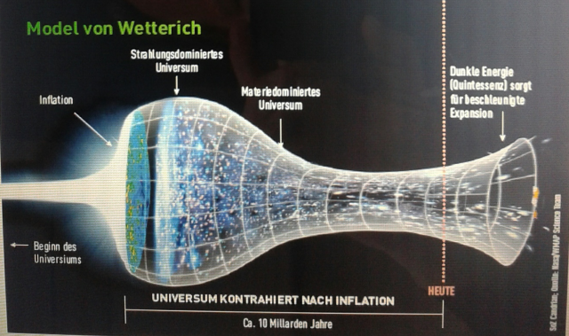
Eternal Universe
Asymptotic solution in
freeze frame :
solution valid back to the infinite past in physical time
no singularity
physical time to infinite past is infinite

Slide 46
small dimensionless number ?
needs two intrinsic mass scales
V and M ( cosmological constant and Planck mass )
variable Planck mass moving to infinity , with fixed V: ratio vanishes asymptotically !

Slide 47
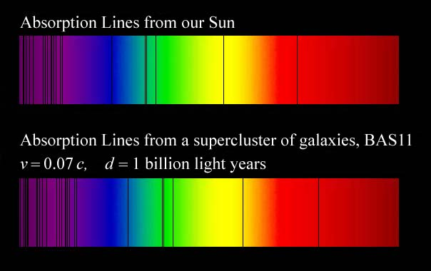
Do we know that the
Universe expands ?
instead of redshift due to expansion :
smaller frequencies have been emitted in the past, because electron mass was smaller !

Slide 48
What is increasing ?
Ratio of distance between galaxies
over size of atoms !
atom size constant : expanding geometry
alternative : shrinking size of atoms

Slide 49
Hot plasma ?
Temperature in radiation dominated Universe : T ~ χ ^{½} smaller than today
Ratio temperature / particle mass : T /m_{p} ~ χ ^{-½} larger than today
T/m_{p} counts ! This ratio decreases with time.
Nucleosynthesis , CMB emission as in standard cosmology !

Slide 50
Model is compatible with present observations
Together with variation of neutrino mass over electron mass in present cosmological epoch :
model is compatible with all present observations

Slide 51
Einstein frame
“Weyl scaling” maps variable gravity model to Universe with fixed masses and standard expansion history.
Exact equivalence of different frames !
Standard gravity coupled to scalar field.
Only neutrino masses are growing.

Slide 52
Einstein frame
Weyl scaling :
effective action in Einstein frame :

Slide 53
Field relativity : different pictures of cosmology
same physical content can be described by different pictures
related by field – redefinitions , e.g. Weyl scaling , conformal scaling of metric
which picture is usefull ?

Slide 54
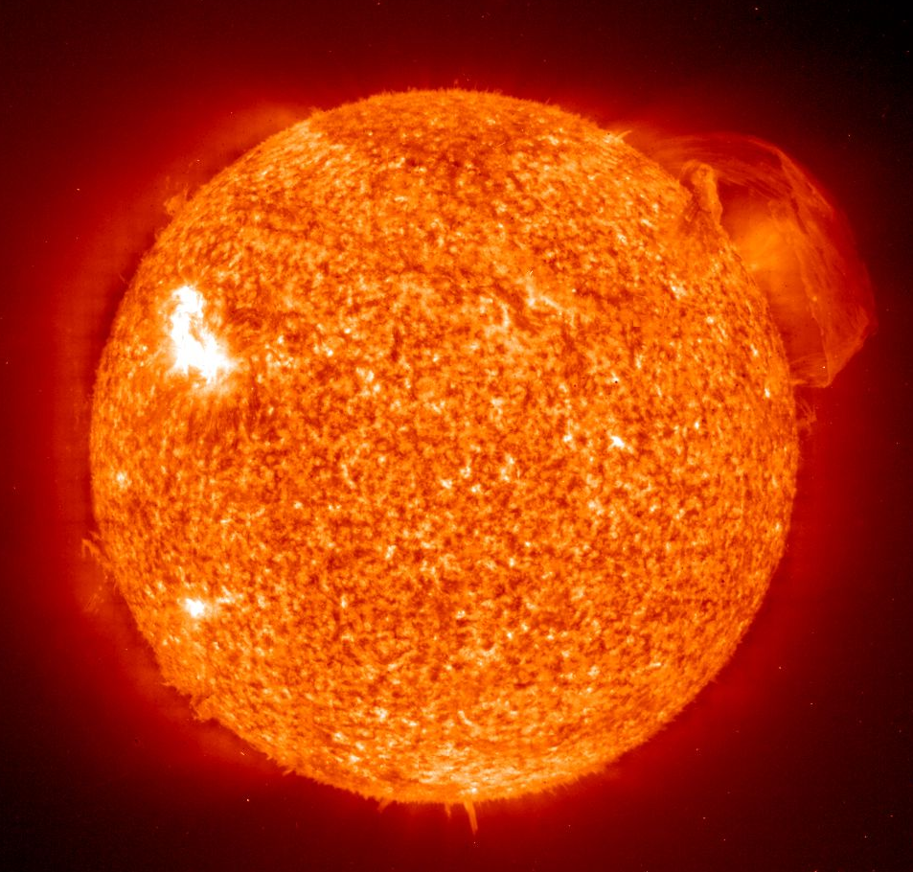

Big bang or freeze ?

Slide 55
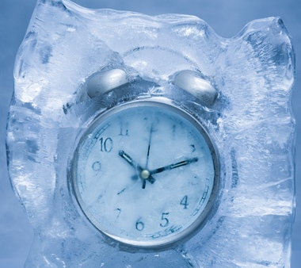
Big bang or freeze ?

Slide 56
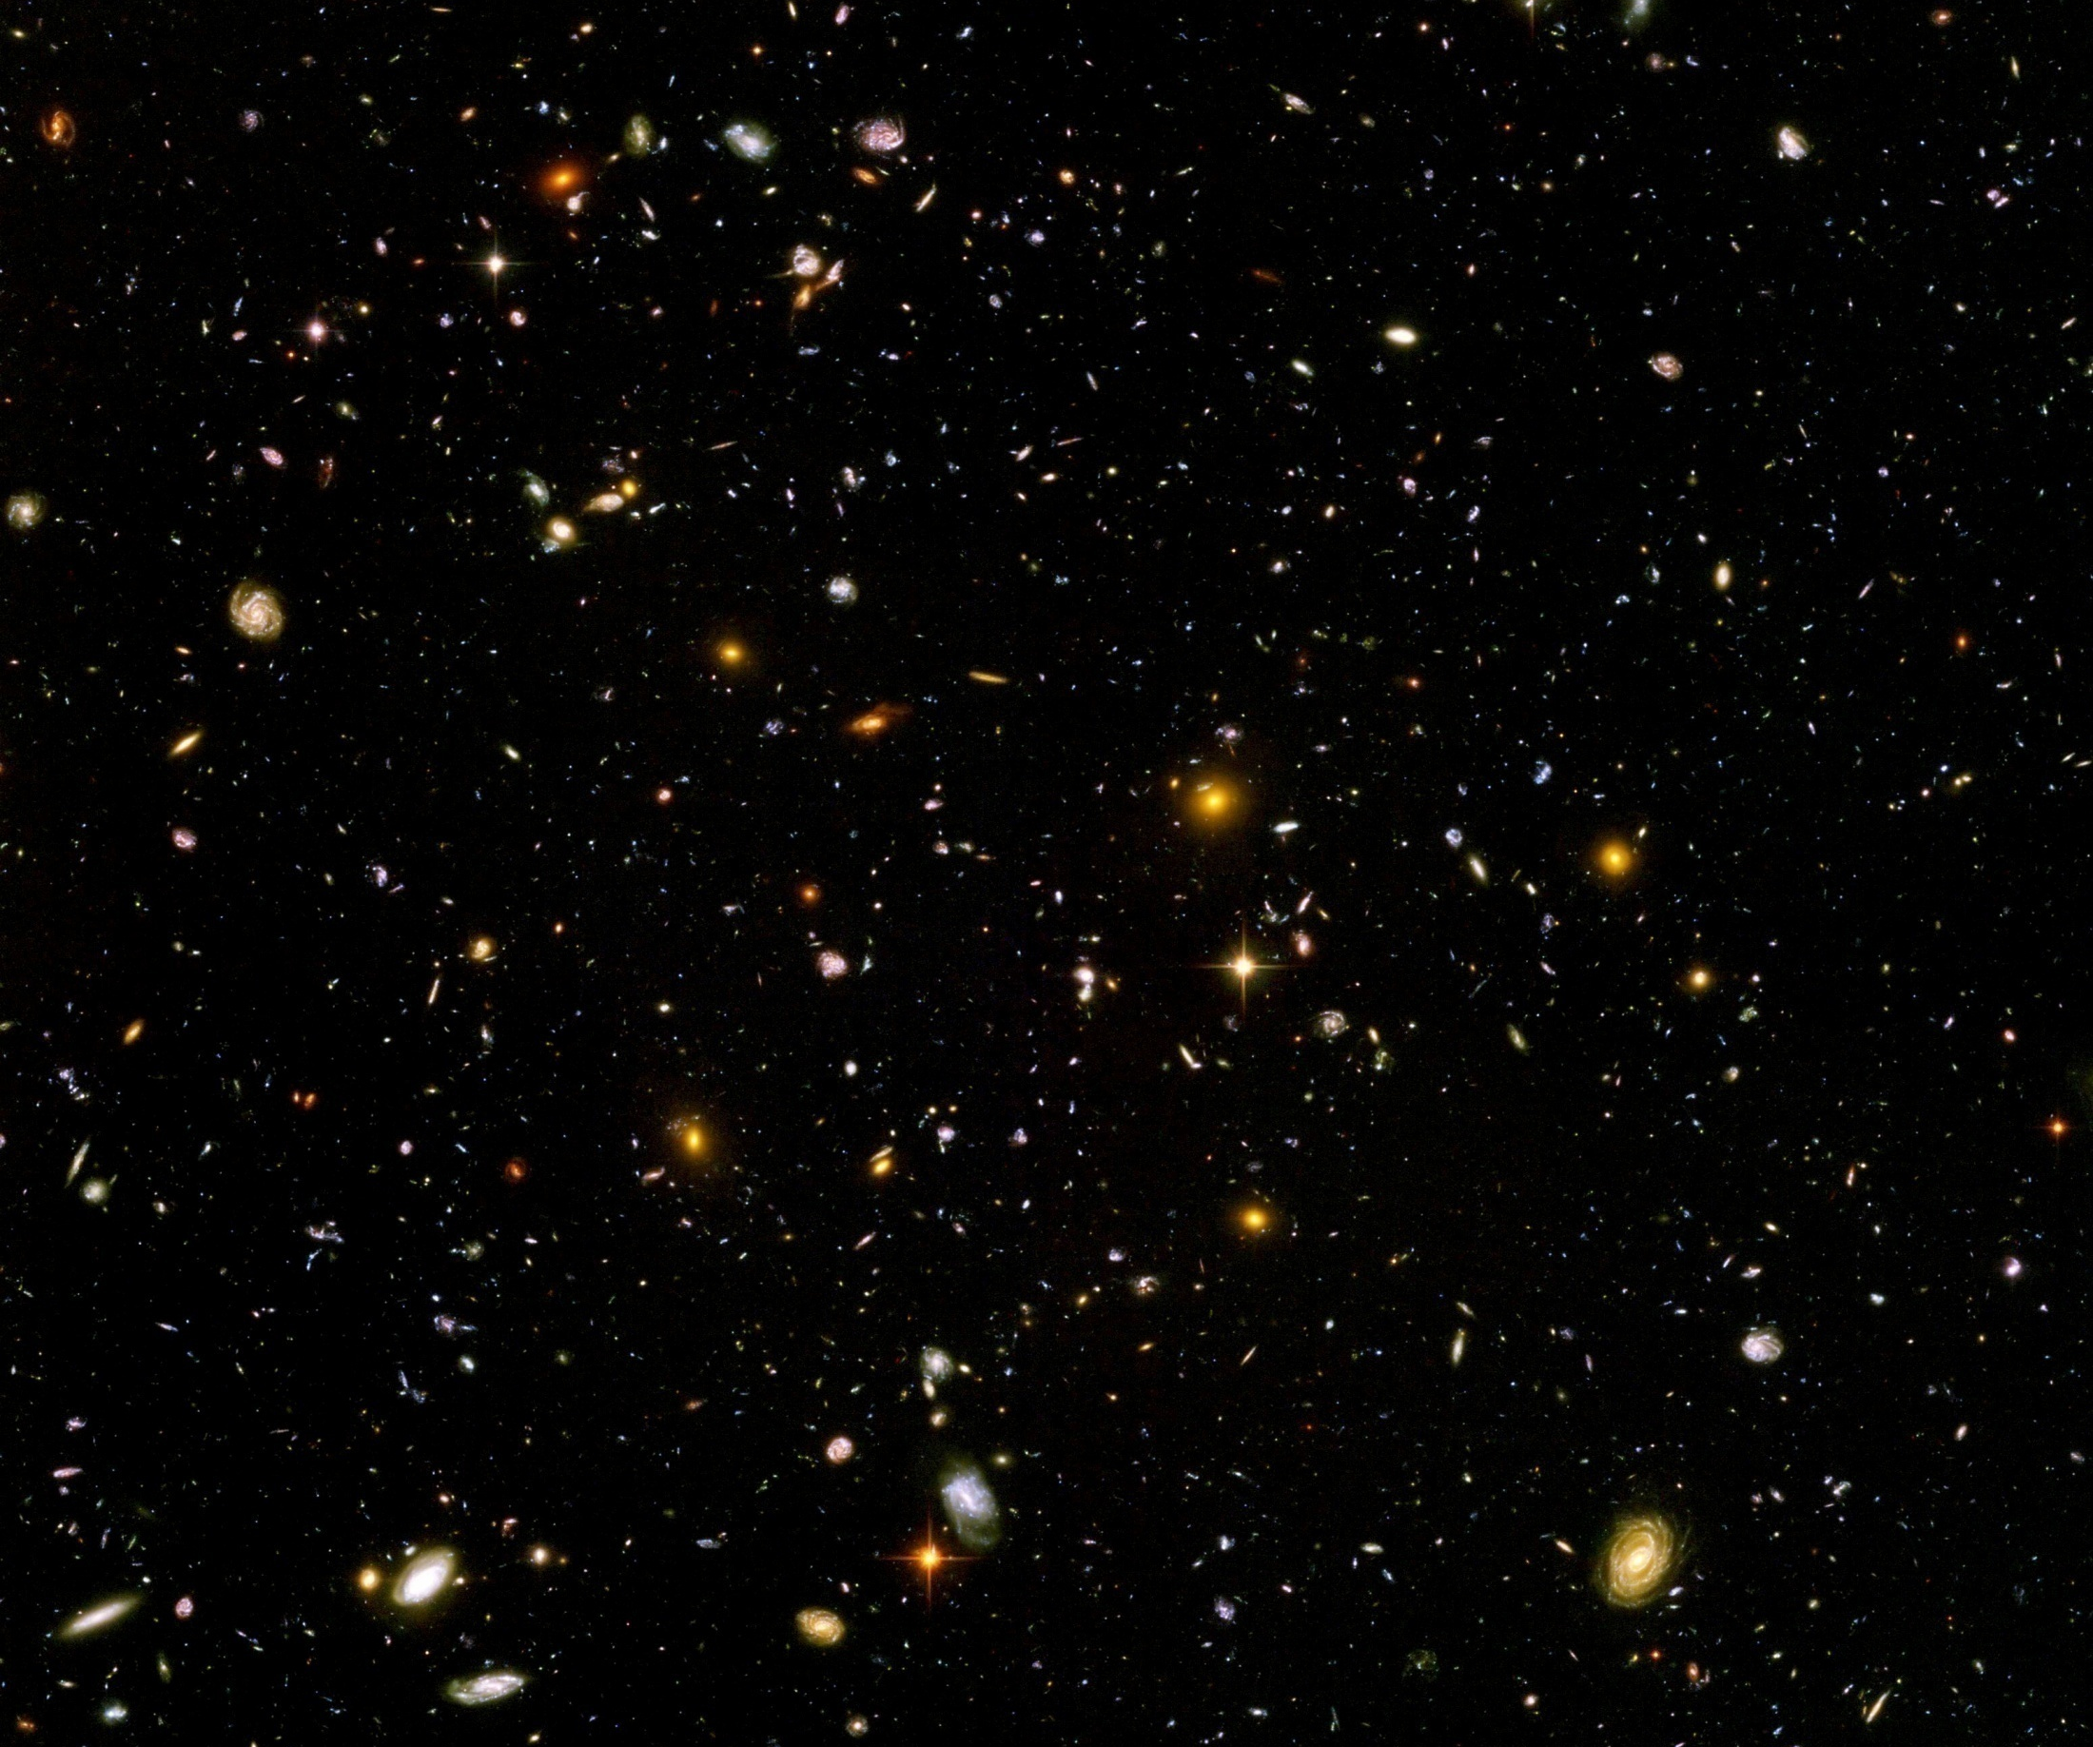
Big bang or freeze ?
just two ways of looking at same physics

Slide 57
Big bang singularity in Einstein frame is field singularity !
choice of frame with constant particle
masses is not well suited if
physical masses go to zero !

Slide 58

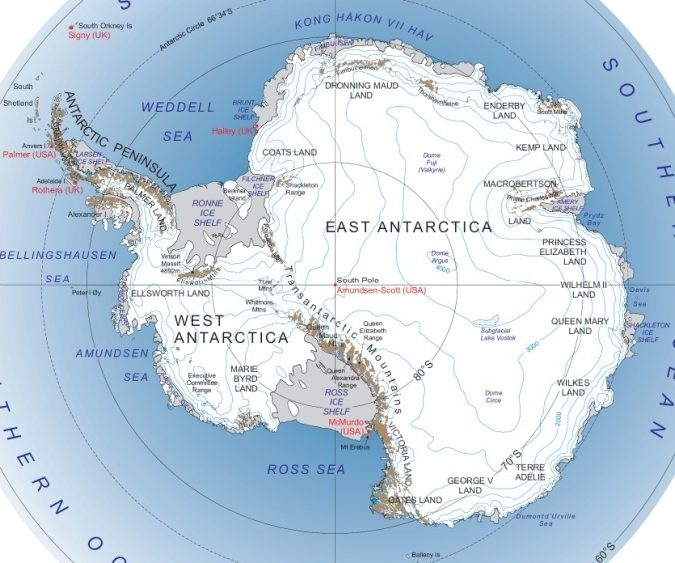
Field - singularity
Big Bang is field - singularity
similar ( but not identical with )
coordinate - singularity

Slide 59
Conclusions
Graviton fluctuations play a role at large distances
Graviton barrier for increase of scalar potential entails solution of cosmological constant problem
Cosmology is described by crossover from UV-fixed point (inflation) to IR-fixed point (dynamical dark energy)

Slide 60
conclusions (2)
crossover in quantum gravity is reflected in crossover in cosmology
quantum gravity becomes testable by cosmology
quantum gravity plays a role not only for primordial cosmology
crossover scenario explains different cosmological epochs
simple model is compatible with present observations
no more parameters than ΛCDM : tests possible

Slide 61
end

Slide 62

Gauge invariant flow equation involves projection on physical fluctuations
G_{P} : propagator for
physical fluctuations
measure contributions do not depend
on effective action

Slide 63

Closed flow equation
projection on physical fluctuations
makes second functional derivative invertible

Slide 64
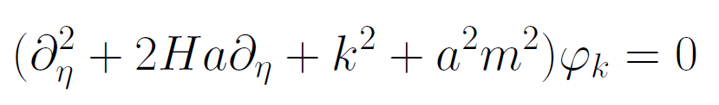
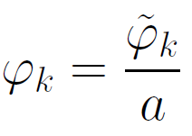
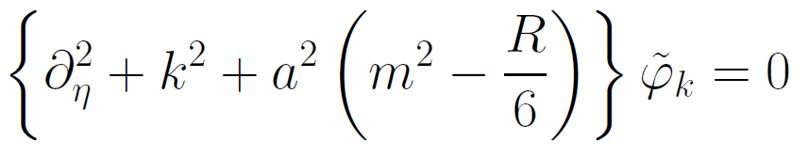
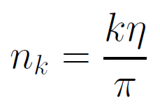

Physical time
field equation for scalar field mode
determine physical
time by counting
number of oscillations
( m=0 )

