Slide 1
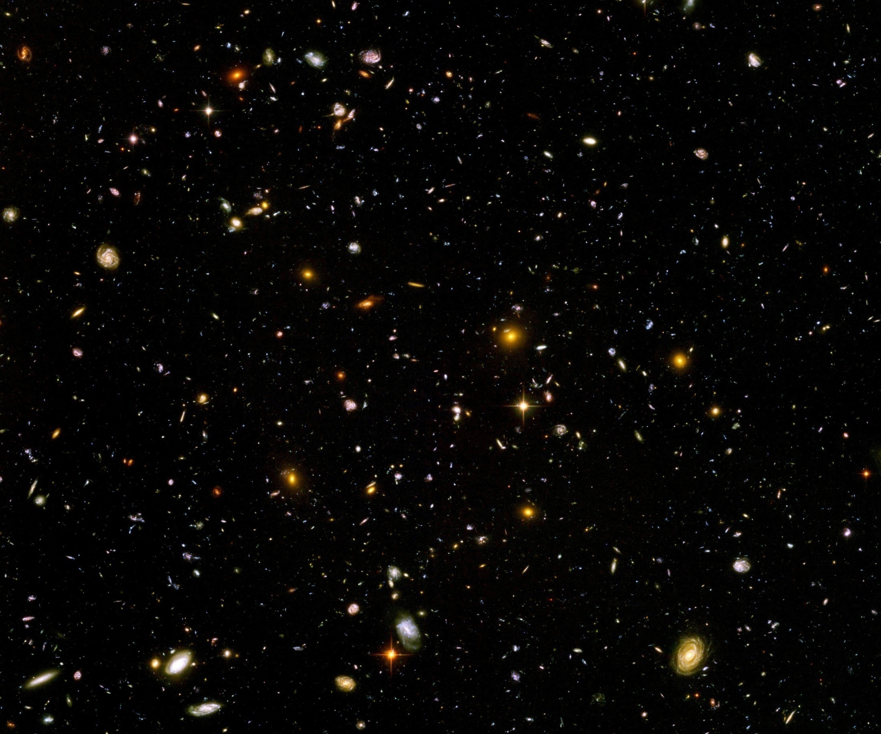
Pregeometry and emergent general relativity

Slide 2
What is pregeometry ?
Theory with diffeomorphism invariance without fundamental metric
Metric emerges as composite object
Geometry is emerging, not fundamental
Diffeomorphism symmetry is fundamental

Slide 3
Degrees of freedom
Metric is collective or composite degree of freedom
similar to pions in QCD
Basic theory formulated in terms of different degrees of freedom
similar to quarks and gluons in QCD

Slide 4
Why pregeometry ?
Problems with metric quantum gravity:
Euclidean functional integral for metric gravity problematic
Lattice approaches ?
Asymptotic safety presumably correct, but no simple picture of microscopic formulation has emerged so far

Slide 5
Fermionic pregeometry
Pregeometry based only on fundamental fermions Akama, Amati,Veneziano, Denardo,Spallucci
Spinor gravity implements local Lorentz symmetry
Spinor gravity with global Lorentz symmetry Hebecker,…

Slide 6
Pregeometry as
Yang- Mills theory
Euclidean formulation
Gauge symmetry : SO(4)
Additional vector field in vector representation of SO(4) allows for diffeomorphism invariant action
”Generalized vierbein”

Slide 7
Fields and covariant derivatives
Gauge fields
Vierbein
Field strength
Covariant derivative of vierbein

Slide 8
Composite metric
Restrict generalized vierbein to
Inverse vierbein
Metric as vierbein bilinear (shorthand)

Slide 9
Classical action
Kinetic terms
Gauge fields :
Vierbein:

Slide 10
Classical action
Gauge and diffeomorphism invariant kinetic term for gauge fields and vierbein
4x4 + 4x6 degrees of freedom
4 + 6 gauge degrees of freedom
30 physical fields
all dynamical : difference to Cartan’s geometry

Slide 11
Levi - Civita connection
Formed from vierbein via composite metric

Slide 12
Limit of general relativiy
Cartan’s geometry
Express action in terms of metric and U
results in higher derivative gravity
Stelle

Slide 13
Stability and generalized Higgs mechanism

Slide 14
Positivity of euclidean action
Kinetic terms
Gauge fields :
Vierbein:

Slide 15
Flat space
Flat space solves field equations
Stability of fluctuations: expand around flat space
Stable high momentum behavior

Slide 16
Expansion
Decompose fluctuations in representations of SO(4)

Slide 17
Expansion
Decompose fluctuations in representations of SO(4)

Slide 18
Stable high momentum behavior

Slide 19
Generalized Higgs mechanism
Flat space breaks local gauge symmetry “spontaneously”
Gauge bosons become massive

Slide 20
Mode mixing
Vierbein fluctuations and gauge fields mix
Example: graviton modes

Slide 21
Stable graviton sector
Inverse propagator matrix
Only zero eigenvalue for q²=0
Inverse propagator

Slide 22
Effective action
Quantum fluctuations induce additional terms in effective action
Invariant linear in field strength

Slide 23
General relativity as effective low energy theory
Express field strength in terms of metric and U
Einstein Hilbert term from
Source for U:

Slide 24
Effective theory for low curvature and low momentum
Approximate solution
Insertion:
+ higher derivative terms

Slide 25
Graviton propagator
inverse propagator matrix
massless + massive graviton:
propagator has poles at
stable particle for

Slide 26
Graviton propagator
inverse propagator
no tachyon or ghost for

Slide 27
Analytic continuation
Analytic continuation of euclidean theory well defined
Continuation in field: phase factor for fields with Lorentz-index 0
Analytic continuation of gauge symmetry SO(4) to SO(1,3)

Slide 28
Cosmology from pregeometry

Slide 29
Effective action
Add scalar singlet field χ
purpose: simple implementation of
quantum scale symmetry
effective
action
Z, B, C, M², m², n², K, V, Y: coupling functions of field χ

Slide 30
Crossover solution of homogenous field equations
s= ln(χ/M)
H

Slide 31
Crossover solution of homogenous field equations
s= ln(χ/M)
Late cosmology
with dynamical
dark energy
Inflationary
epoch
H

Slide 32
Crossover from
UV – fixed point in infinite past to
IR – fixed point in infinite future
s= ln(χ/M)
Inflationary
epoch
Late cosmology
with dynamical
dark energy
H

Slide 33
Coupling functions
stability for:
ansatz motivated by scaling solutions of quantum gravity, similar to asymptotic safety,
quantum scale symmetry

Slide 34
Scaling solutions of functional flow equations
At fixed point: all ( infinitely many ) couplings take fixed values
Whole scalar potential is fixed, for arbitrary values of scalar field
Functional flow equations are needed

Slide 35
Scaling solutions are restrictive
Scaling solutions are particular solutions of non-linear differential equations
In presence of gravitational fluctuations: scalar effective potential no longer approximated by polynomial

Slide 36
Scaling solutions and cosmology
Cosmology involves scalar potentials over large range of field values
Inflaton potential
Higgs potential for Higgs inflation
Cosmon potential for dynamical dark energy or quintessence

Slide 37
Quantum gravity : these potentials are not arbitrary

Slide 38
Scaling potential in
standard model
u : dimensionless
scalar potential
u= U/k⁴
x : logarithm of
scalar field value

Slide 39
Coefficient of curvature scalar in standard model
w : dimensionless
field dependent
squared Planck
mass
w = 2 M²/ k²
non-minimal
coupling of
scalar field
to gravity

Slide 40
Scaling solutions motivate choice of coupling functions
for given coupling functions:
derive field equations, solve them

Slide 41
Early approach to stable cosmic attractor
Basin of attraction

Slide 42
Crossover in scaling solution induces end of early attractor, end of inflation

Slide 43
Variable gravity as effective theory
inflation, end of inflation, late cosmology :
well approximated by variable gravity
( modified) general relativity
+ scalar field

Slide 44
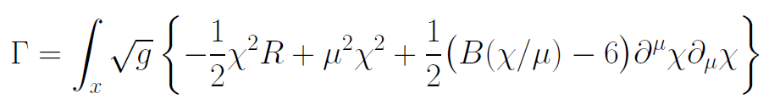
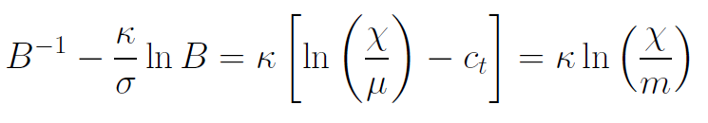
Models of this type are compatible with present observations
Together with variation of neutrino mass over electron mass in present cosmological epoch :
A model compatible with all present observations, including inflation and dark energy

Slide 45
Cosmological solution
scalar field χ vanishes in the infinite past
scalar field χ diverges in the infinite future
J.Rubio,…

Slide 46
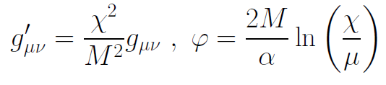
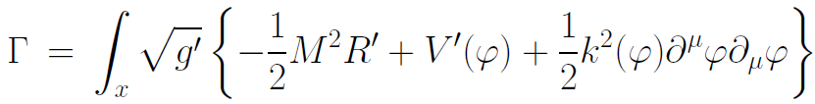
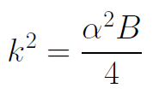

Einstein frame
Weyl scaling :
effective action in Einstein frame :

Slide 47
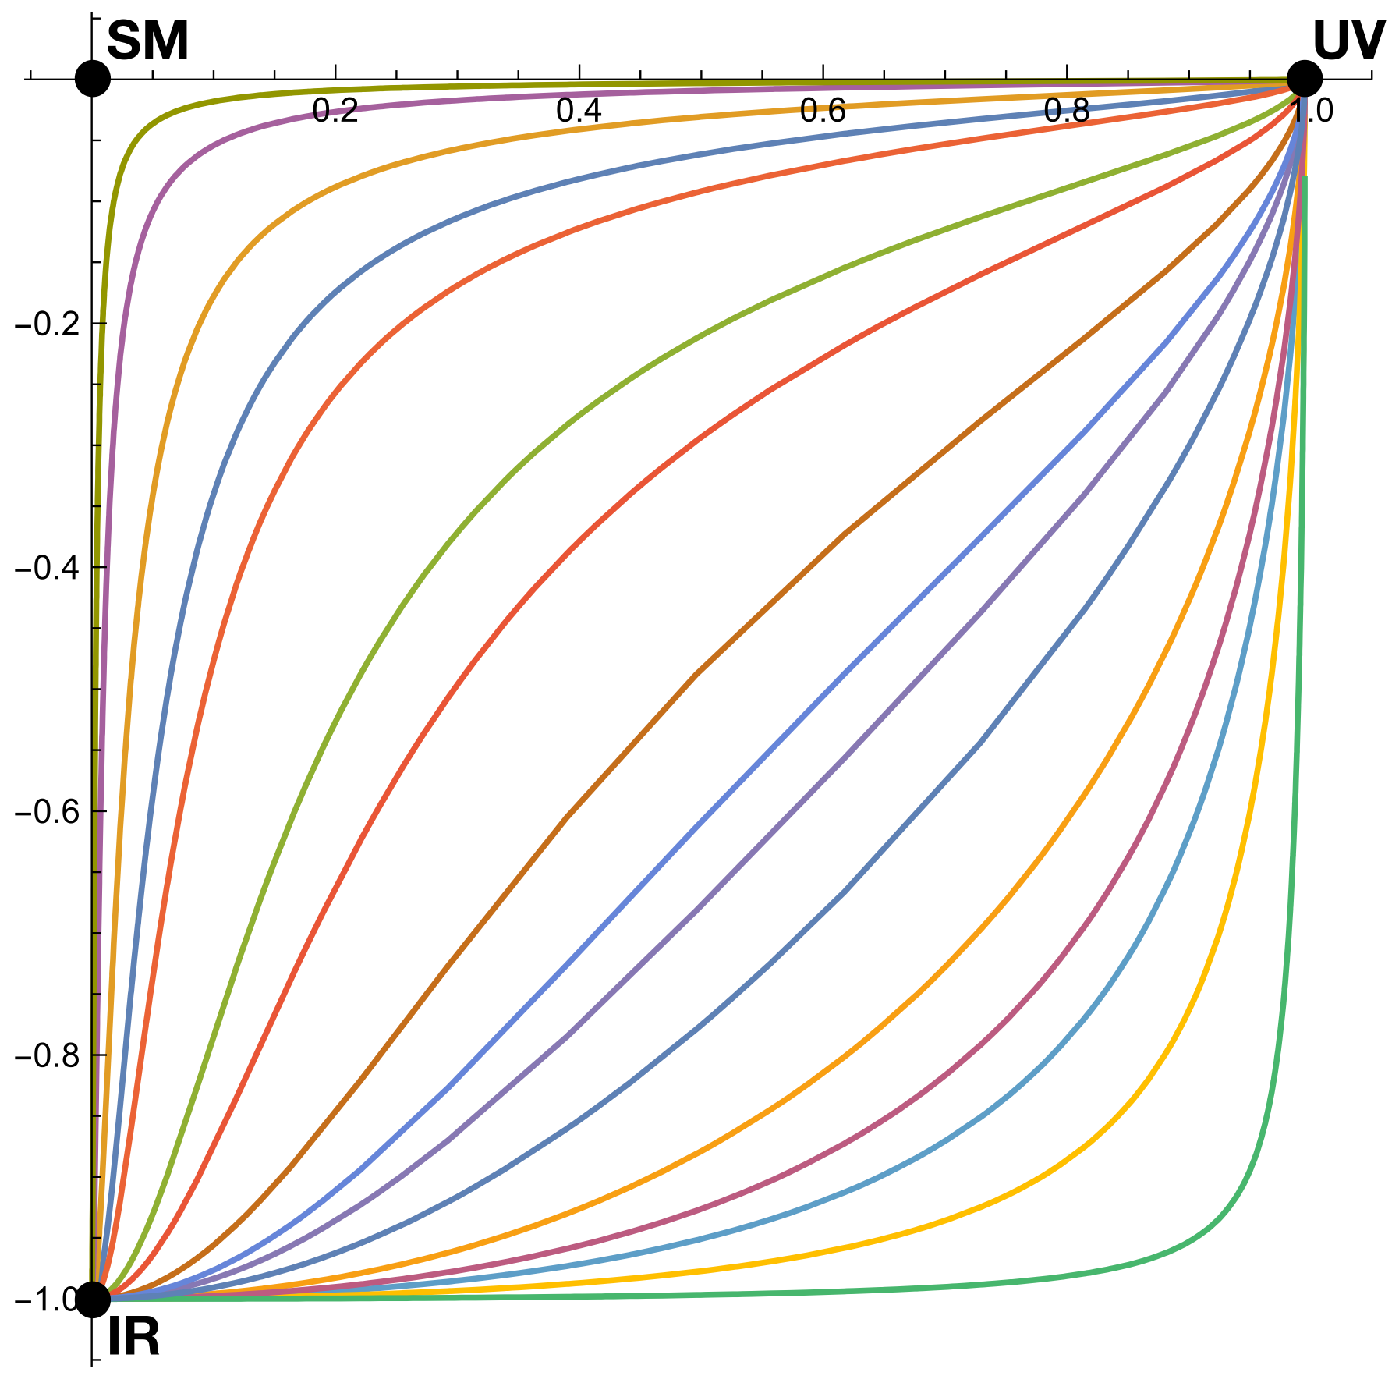
Quantum scale symmetry
Exactly on fixed point:
No parameter with dimension of
length or mass is present in the
quantum effective action.
Then invariance under
dilatations or global scale transformations
is realized as a quantum symmetry.
Continuous global symmetry

Slide 48
Approximate scale symmetry
near fixed points
UV : approximate scale invariance of primordial fluctuation spectrum from inflation

Slide 49

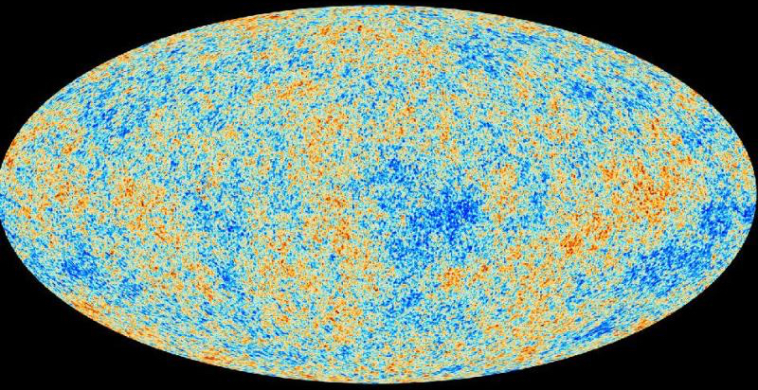
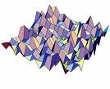
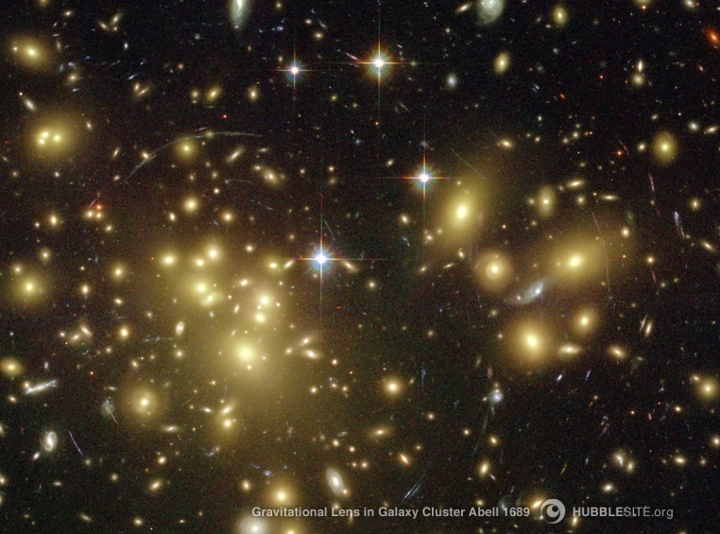
Almost scale invariant primordial fluctuation spectrum seeds all structure in the universe

Slide 50
Dynamical dark energy

Slide 51
Asymptotically vanishing
cosmological „constant“
What matters : Ratio of potential divided by fourth power of Planck mass
vanishes for χ → ∞ !
k= 2 • 10⁻³ eV

Slide 52
Quintessence
Dynamical dark energy ,
generated by scalar field (cosmon )
C.Wetterich,Nucl.Phys.B302(1988)668, 24.9.87
P.J.E.Peebles,B.Ratra,ApJ.Lett.325(1988)L17, 20.10.87

Slide 53
Prediction : homogeneous dark energy influences recent cosmology
- of same order as dark matter -
Original models do not fit the present observations
…. modifications
( different growth of neutrino mass )

Slide 54
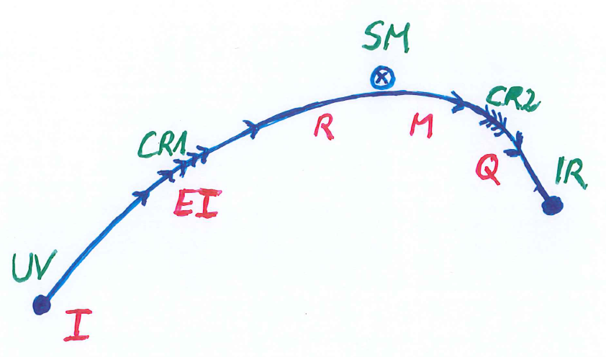
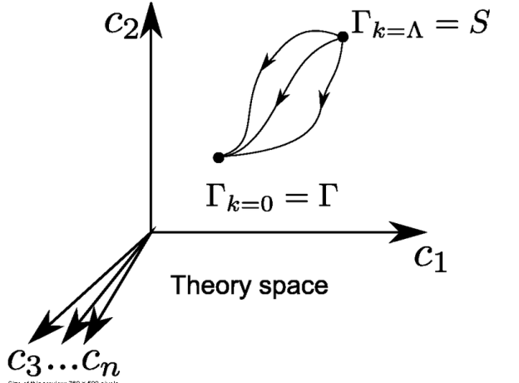
Crossover in quantum gravity
UV- fixed
point

Slide 55
Spontaneous breaking of scale symmetry
expectation value of scalar field breaks scale symmetry spontaneously
massive particles are compatible with scale symmetry
in presence of massive particles : sign of exact scale symmetry is exactly massless Goldstone boson – the dilaton

Slide 56
Approximate scale symmetry near fixed points
UV : approximate scale invariance of primordial fluctuation spectrum from inflation
IR : cosmon is pseudo Goldstone boson of
spontaneously broken scale symmetry,
tiny mass,
responsible for dynamical Dark Energy

Slide 57
Simplicity
simple description of all cosmological epochs
natural incorporation of Dark Energy :
inflation
Early Dark Energy
present Dark Energy dominated epoch

Slide 58
Quantum gravity and the beginning of the Universe

Slide 59
Beginning of Universe
Zu Anfang war die Welt öd und leer und währte ewig.
In the beginning the Universe was empty and lasted since ever.

Slide 60

Eternal light-vacuum
Everywhere almost nothing
only fields and their fluctuations
All particles move
with light velocity,
similar to photons

Slide 61
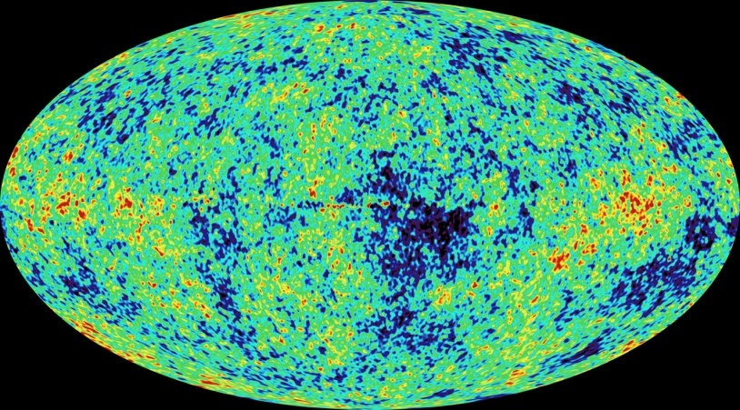
Eternal light-vacuum is unstable
Slow increase of particle masses
Only slow change of space-time geometry
Creation of particles and entropy
Consequence for observation : primordial fluctuations become visible in cosmic background radiation
We see fluctuations in a stage 5000 billion years ago.

Slide 62
Einstein frame
“Weyl scaling” maps variable gravity model to Universe with fixed masses and standard expansion history.
For scaling solutions: scale k disappears !
Standard gravity coupled to scalar field.
Exact equivalence of different frames !
“ different pictures”

Slide 63
Einstein frame
Weyl scaling :
effective action in Einstein frame :

Slide 64
Cosmological solution
scalar field χ vanishes in the infinite past
scalar field χ diverges in the infinite future
J.Rubio,…

Slide 65
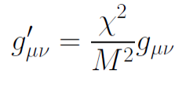
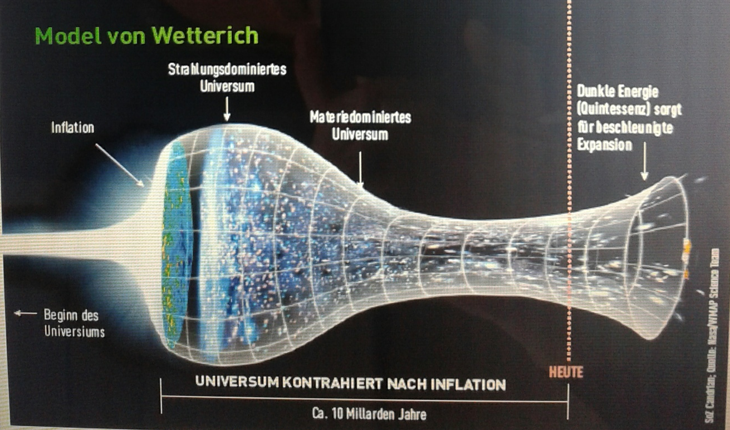
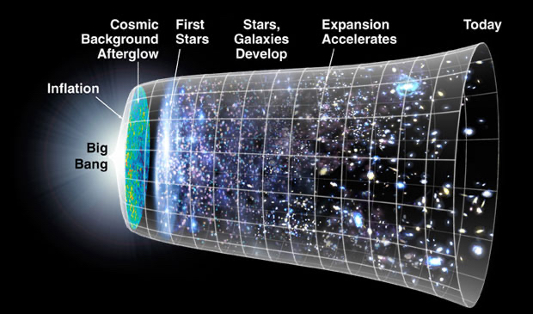
Field relativity
Weyl scaling :
changes geometry,
not a coordinate transformation

Slide 66
The great emptiness story
In the beginning was light-like emptiness.

Slide 67
The big bang story
dramatic hot big bang
started 13.7 billion years ago
at the beginning extremely short period of cosmic inflation with almost exponential expansion of the Universe, duration around 10⁻⁴⁰ seconds
start with singularity : our whole observable Universe evolves from one point

Slide 68
Field relativity
Both stories are equivalent
related by field transformation of the metric
different metrics related by Weyl transformation, which depends on scalar field ( inflaton )

Slide 69
Conclusions
geometry is not fundamental
emergent general relativity
interesting and realistic cosmology
pregeometry: well defined Euclidean action
flowing coupling functions in QFT : in principle calculable !
candidate for quantum gravity

Slide 70
end

Slide 71
Fundamental scale invariance
Scaling solution is exact
All relevant parameters vanish

Slide 72
Predictivity
Theories with fundamental scale symmetry are very predictive
Absence of relevant parameters
New criterion for fundamental theories
Stronger than renormalizability

Slide 73
Fundamental theory
without scale
Fundamental fields are dimensionless
Length scale can be introduced for distances, mass=inverse length for derivatives
Metric appears as composite object
dimension: mass squared

Slide 74
Canonical fields
Canonical metric is dimensionless
Introduce renormalisation scale k
Canonical scalar fields have dimension mass
General renormalized fields

