Slide 1
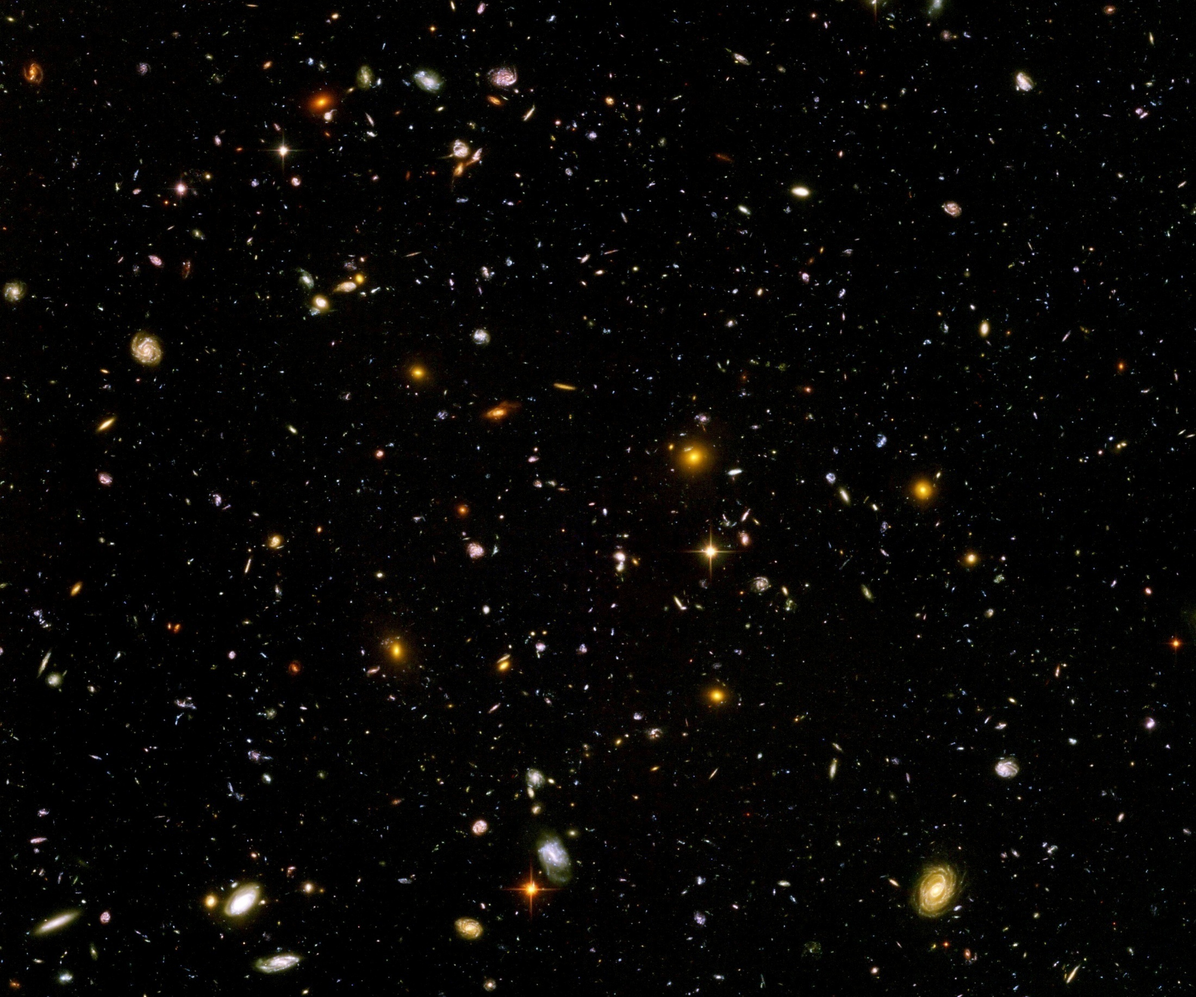
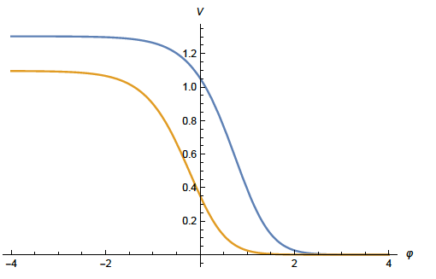
Quantum gravity from the beginning to the present Universe

Slide 2
Extension of general relativity
Einstein’s general relativity is insufficient
Early Universe: cannot explain isotropy of primordial density fluctuations
Inflationary Universe
Late cosmology: Cannot explain accelerated expansion ?
( Dynamical ? ) dark energy

Slide 3
Metric + scalar field
Inflation :
add scalar field ( inflaton )
Dynamical dark energy or quintessence :
add scalar field ( cosmon )
inflaton = cosmon ?

Slide 4
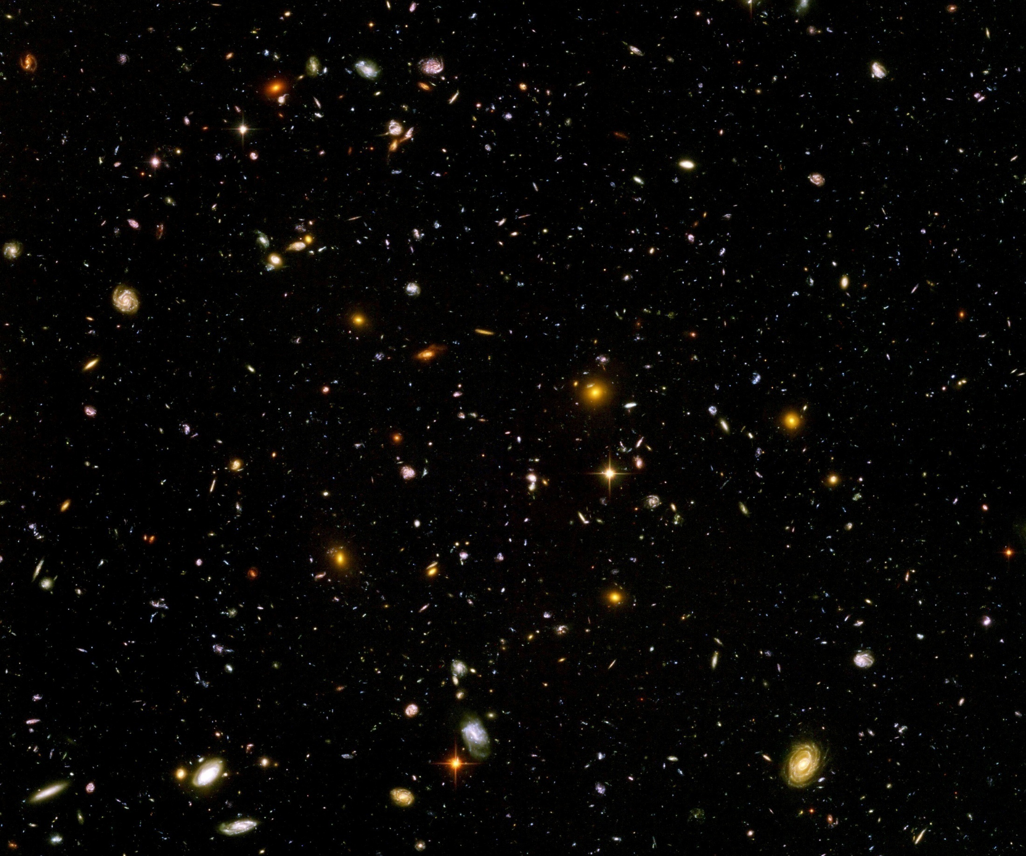
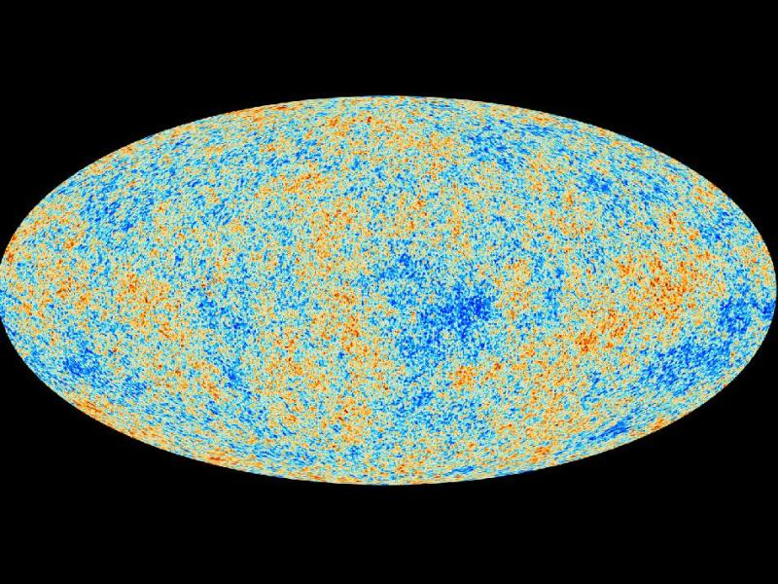
Can observations look back to inflation ?

Slide 5

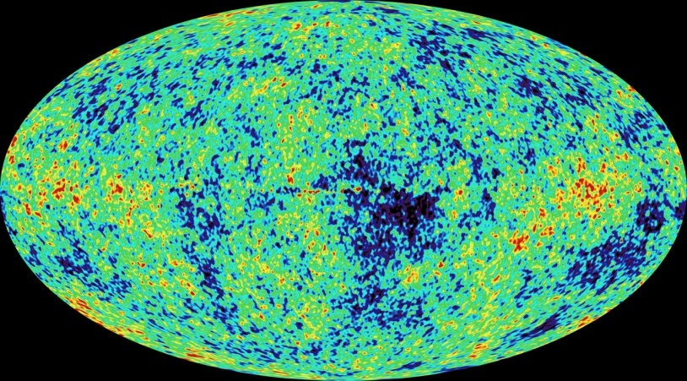
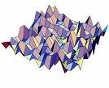
Primordial fluctuations
inflaton field : 𝜑
primordial fluctuations of inflaton field become observable in cosmic microwave background
Notes:
5

Slide 6
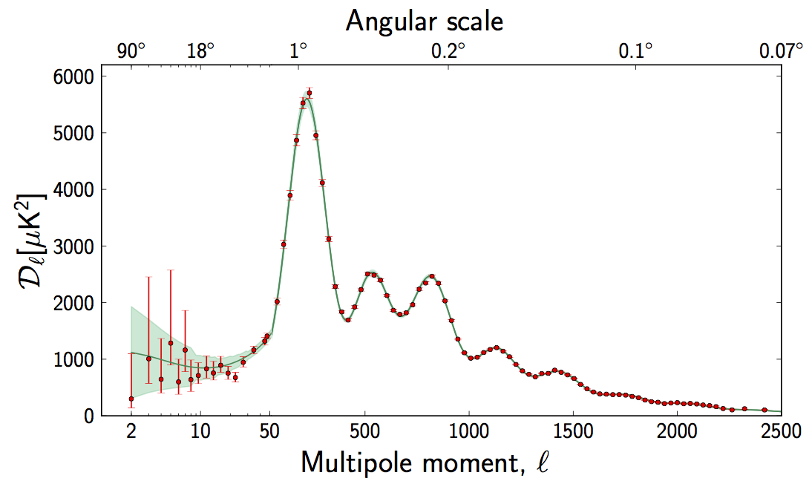
Amplitude of temperature fluctuations in dependence of size of spots ( angle )
contrast
angle
ca 10 degrees
ca 1 degree

Slide 7
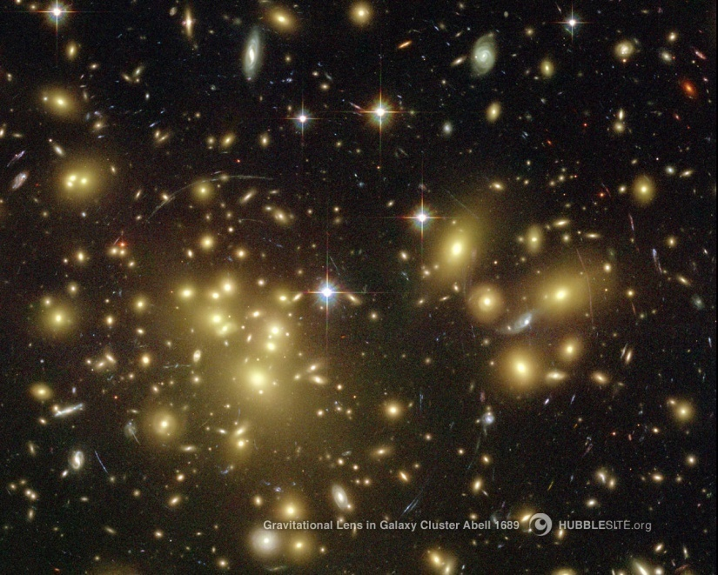
The structures in the Universe grow from quantum fluctuations during inflation

Slide 8

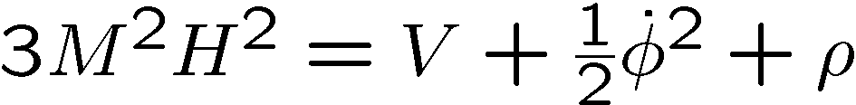
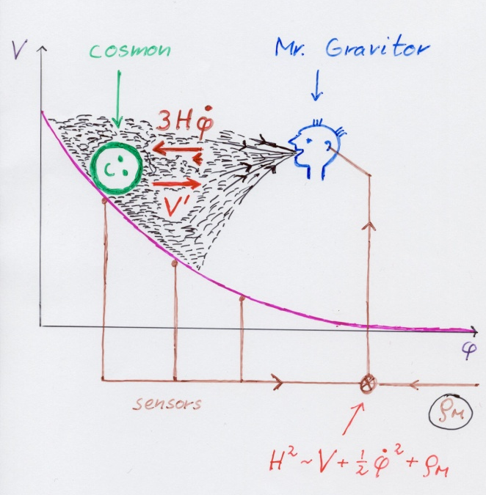
Cosmological equations

Slide 9
same equations for inflation and dynamical dark energy

Slide 10
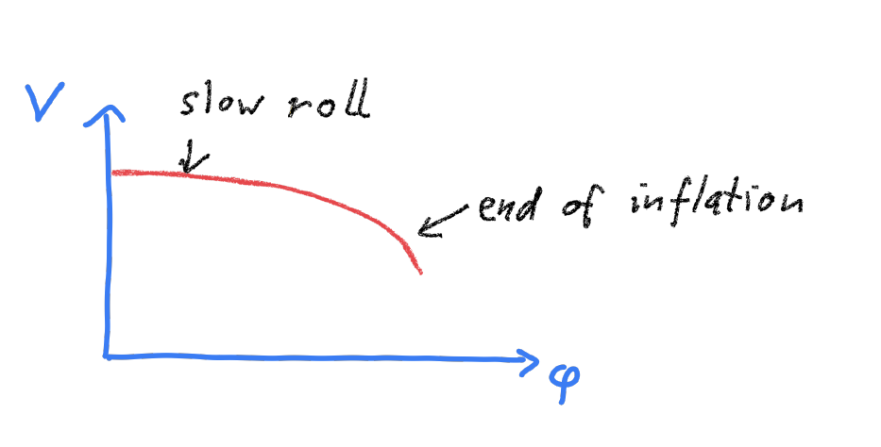
Potential for inflation

Slide 11
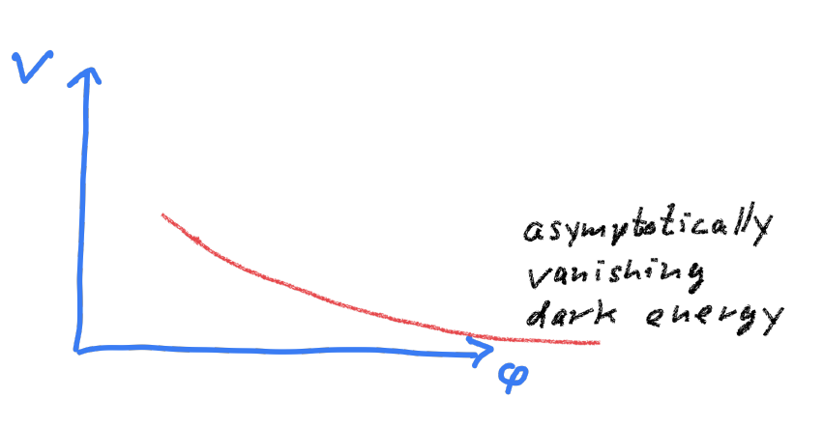
Potential for dynamical dark energy

Slide 12
Potential for quintessential inflation

Slide 13
Quintessential inflation
Inflation
Dynamical
Dark Energy
Spokoiny, Peebles, Vilenkin, Peloso, Rosati, Dimopoulos, Valle, Giovannini,
Brax, Martin, Hossain, Myrzakulov, Sami, Saridakis, de Haro, Salo, Bettoni, Rubio…

Slide 14
Prediction of scaling solution for quantum gravity

Slide 15
Quantum gravity
Gravity is field theory. Similar to electrodynamics. Metric field.
Gravity is gauge theory. Similar to QED or QCD. Gauge symmetry: general coordinate transformations ( diffeomorphisms )
Quantum gravity: include metric fluctuations in functional integral

Slide 16
Quantum gravity
Quantum gravity is similar to other quantum field theories
Difference: metric is tensor, gauge bosons are vectors
Difference: Quantum gravity is not perturbatively renormalizable
no small coupling, effective coupling q²/M²

Slide 17
Quantum gravity
Quantum gravity is
non-perturbatively renormalizable
Asymptotic safety
Weinberg, Reuter, …
Uses functional renormalization

Slide 18
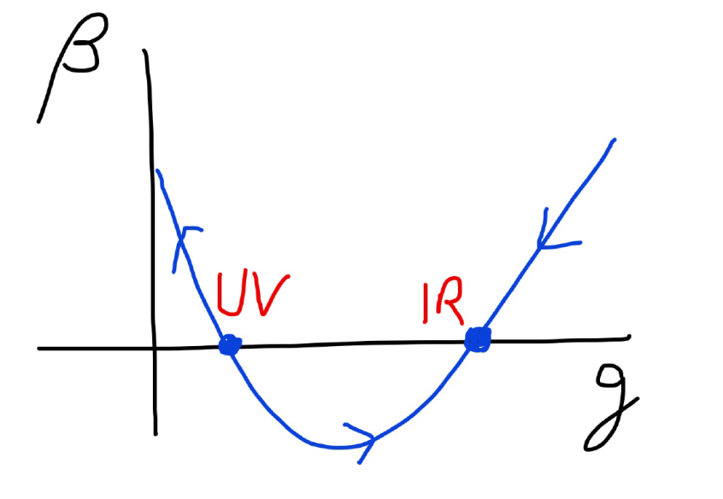
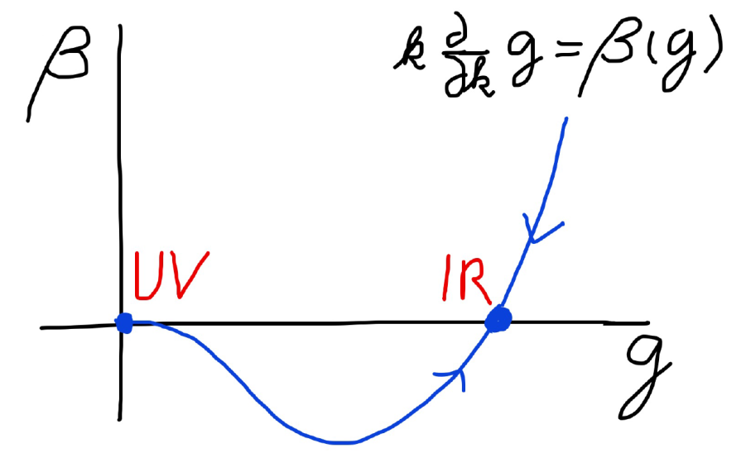
Asymptotic safety Asymptotic freedom

Slide 19
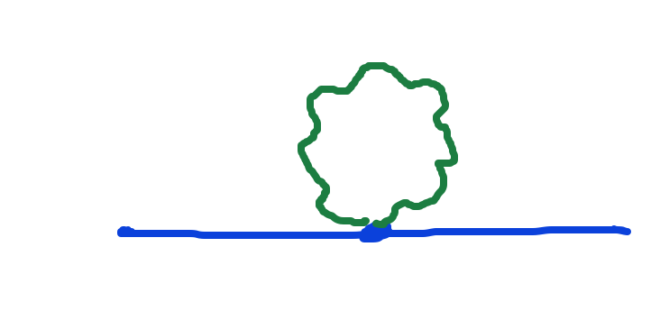
Graviton fluctuations matter
Quantum gravity needs method to take them into account

Slide 20
Flowing couplings
Couplings change with momentum scale due to quantum fluctuations.
Renormalization scale k : Only fluctuations with momenta larger k are included. The scale k can be momenta, geometric quantities, or just be introduced “by hand”.
Flow of k to zero : all fluctuations included, IR
Flow of k to infinity : UV

Slide 21
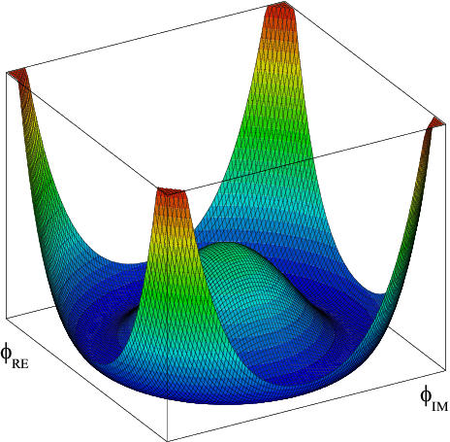
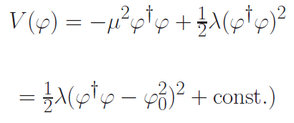

Flow of quartic Higgs coupling
Fermi scale

Slide 22
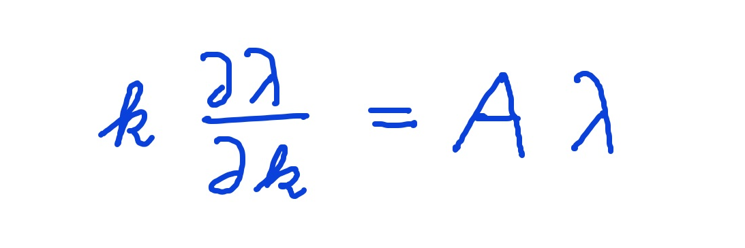
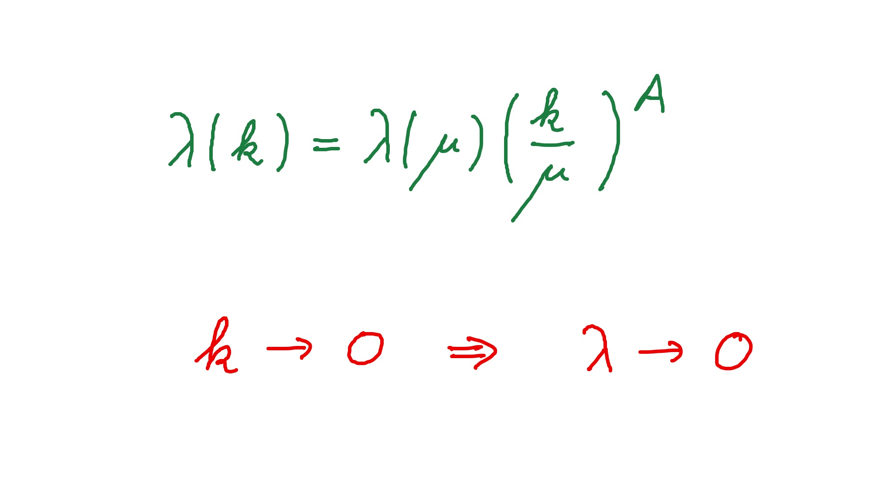
Graviton fluctuations erase quartic scalar coupling
Renormalization scale k : Only fluctuations with momenta larger k are included.
Consider first only fluctuations of metric or graviton :
gravity induced
anomalous dimension
A > 0
for
constant A :

Slide 23
Quantum gravity flattens scalar potentials

Slide 24
Fixed point
The quartic scalar coupling λ has a
fixed point at λ=0
For A>0 it flows towards the fixed point as k is lowered: irrelevant coupling
For a UV – complete theory it is predicted to assume the fixed point value

Slide 25
Gravitational contribution to running quartic coupling
running Planck mass :
dimensionless
squared Planck mass
for length scales smaller than the Planck length:
metric fluctuations dominate, constant A

Slide 26
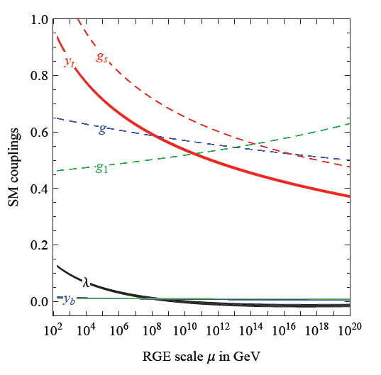
Prediction for quartic Higgs coupling
great desert
high scale fixed point
quartic scalar coupling predicted to be very small at transition scale where gravity decouples
great desert
fixed point

Slide 27
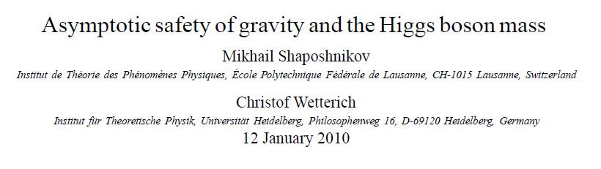
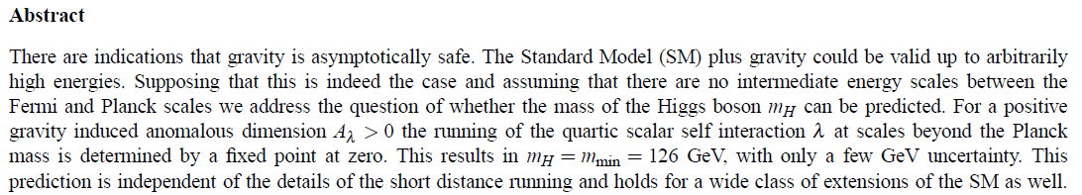
Prediction of mass of Higgs boson

Slide 28
Scaling solutions

Slide 29
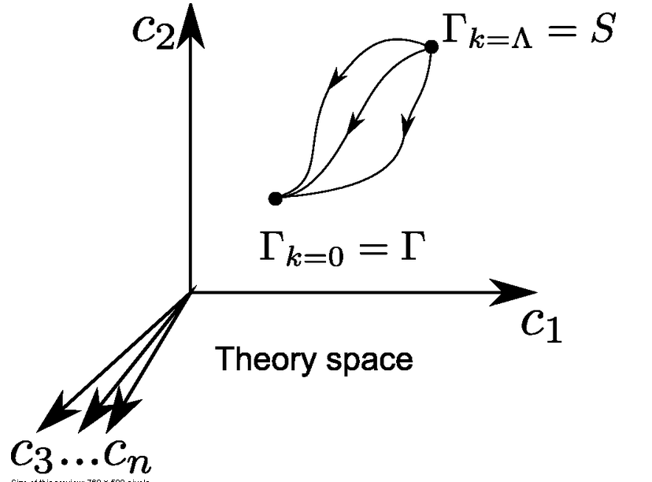
Ultraviolet fixed point
UV fixed point
Wikipedia

Slide 30
Renormalizable theories
1) Ultraviolet fixed point :
scaling solution
2) Flow away from fixed point :
relevant parameters

Slide 31
Scaling solutions
At fixed point: all ( infinitely many ) dimensionless couplings take fixed values
Whole scalar potential is fixed, for arbitrary values of scalar field
Functional flow equations are needed

Slide 32
Scaling solutions are restrictive
Scaling solutions are particular solutions of non-linear differential equations
In presence of gravitational fluctuations: scalar effective potential no longer approximated by polynomial

Slide 33
Scaling solutions and cosmology
Cosmology involves scalar potentials over large range of field values
Inflaton potential
Higgs potential for Higgs inflation
Cosmon potential for dynamical dark energy or quintessence

Slide 34
Quantum gravity : these potentials are not arbitrary

Slide 35
Dilaton quantum gravity
quantum gravity coupled to a scalar field
Henz, Pawlowski, Rodigast, Yamada, Reichert,
Eichhorn, Pauly, Laporte, Pereira, Saueressig, Wang…

Slide 36
Scaling potential in
standard model
u : dimensionless
scalar potential
u= U/k⁴
x : logarithm of
scalar field value

Slide 37
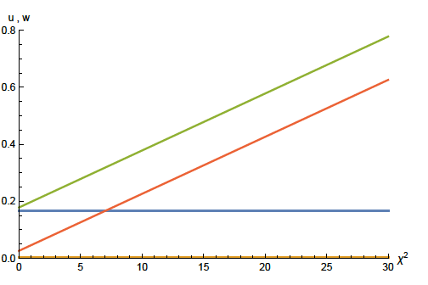
Scaling solution : flat potential

Slide 38

Derivative expansion of effective action

Slide 39
Coefficient of curvature scalar in standard model
w : dimensionless
field dependent
squared Planck
mass
w =2 F/ k²
non-minimal
coupling of
scalar field
to gravity

Slide 40
Scaling solution in Einstein frame

Slide 41





Weyl transformation for variable gravity

Slide 42
Dimensionless potential
( cosmological “constant” )
Dimensionless ratio
V / M⁴ = U / F²
invariant under Weyl scaling
Only this ratio is observable !

Slide 43

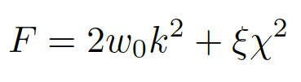

Scaling solution
For low energy
standard model :

Slide 44
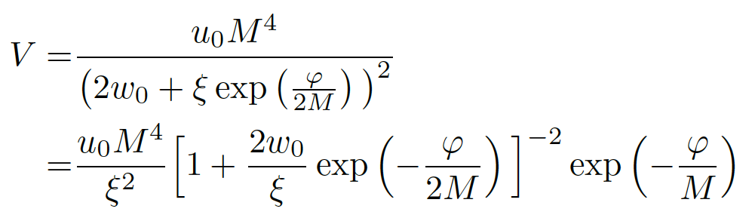
Scaling solution in Einstein frame

Slide 45
Mass scales in Einstein frame
Renormalization scale k is no longer present
Planck mass M not intrinsic: introduced only by change of variables

Slide 46
Asymptotic solution of cosmological constant problem

Slide 47
Cosmological solution
scalar field χ vanishes in the infinite past
scalar field χ diverges in the infinite future
J.Rubio,…

Slide 48
Dynamical dark energy

Slide 49
Asymptotically vanishing
cosmological „constant“
What matters : Ratio of potential divided by fourth power of Planck mass
vanishes for χ → ∞ !
k= 2 • 10⁻³ eV

Slide 50
Quintessence
Dynamical dark energy ,
generated by scalar field (cosmon )
C.Wetterich,Nucl.Phys.B302(1988)668, 24.9.87
P.J.E.Peebles,B.Ratra,ApJ.Lett.325(1988)L17, 20.10.87

Slide 51
Prediction : homogeneous dark energy influences recent cosmology
- of same order as dark matter -
Original models do not fit the present observations
…. modifications
( different growth of neutrino mass )

Slide 52
Metric frames
“Weyl scaling” maps variable gravity model to Universe with fixed masses and standard expansion history.
For scaling solutions: scale k disappears !
Standard gravity coupled to scalar field.
Exact equivalence of different frames !
“ different pictures”

Slide 53
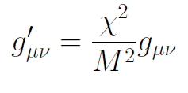
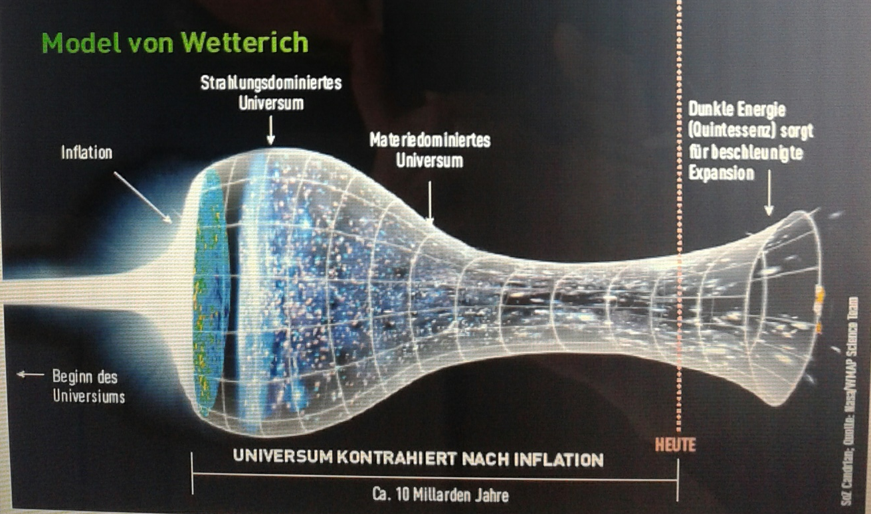
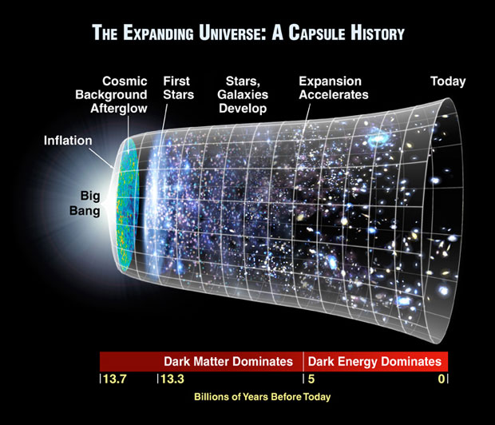
Field relativity
Weyl scaling :
changes geometry,
not a coordinate transformation

Slide 54
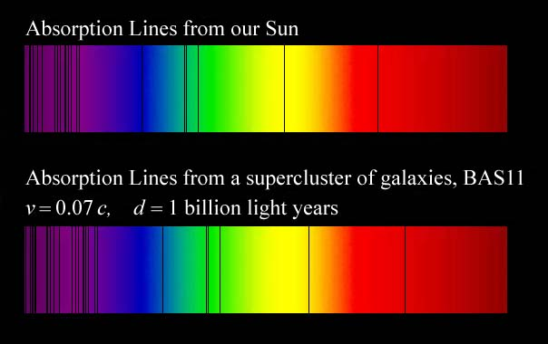
Why do we see redshift of photons emitted in the distant past ?
photons are more red because they have been emitted with longer wavelength
frequency ~ mass
wavelength ~
atomsize

Slide 55
Quantum gravity and the beginning of the Universe

Slide 56
Beginning of Universe
Zu Anfang war die Welt öd und leer und währte ewig.
In the beginning the Universe was empty and lasted since ever.

Slide 57
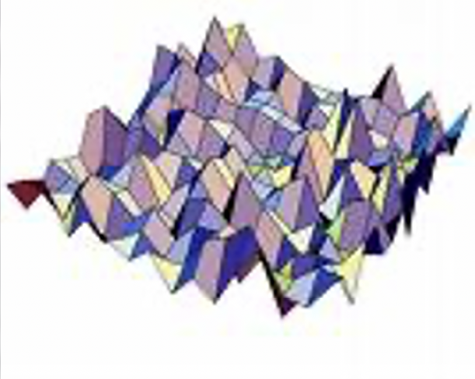
Eternal light-vacuum
Everywhere almost nothing
only fields and their fluctuations
All particles move
with light velocity,
similar to photons

Slide 58
Eternal light-vacuum is unstable
Slow increase of particle masses
Only slow change of space-time geometry
Creation of particles and entropy
Consequence for observation : primordial fluctuations become visible in cosmic background radiation
We see fluctuations in a stage 5000 billion years ago.

Slide 59
The great emptiness story
In the beginning was light-like emptiness.

Slide 60
The big bang story
dramatic hot big bang
started 13.7 billion years ago
at the beginning extremely short period of cosmic inflation with almost exponential expansion of the Universe, duration around 10⁻⁴⁰ seconds
start with singularity : our whole observable Universe evolves from one point

Slide 61
Field relativity
Both stories are equivalent
related by field transformation of the metric
different metrics related by Weyl transformation, which depends on scalar field ( inflaton )

Slide 62

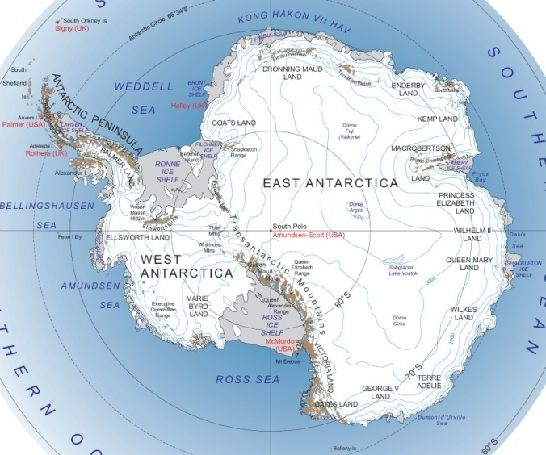
Field - singularity
Big Bang is field - singularity
similar ( but not identical with )
coordinate - singularity

Slide 63
Conclusions
Fluctuations of the metric matter
They influence the behavior of scalar potentials for all field values
Quantum gravity relevant for early cosmology and late cosmology
Quantum scale symmetry is central ingredient for understanding cosmology
Understanding of quantum gravity fluctuations still in beginning stage

Slide 64
end

Slide 65
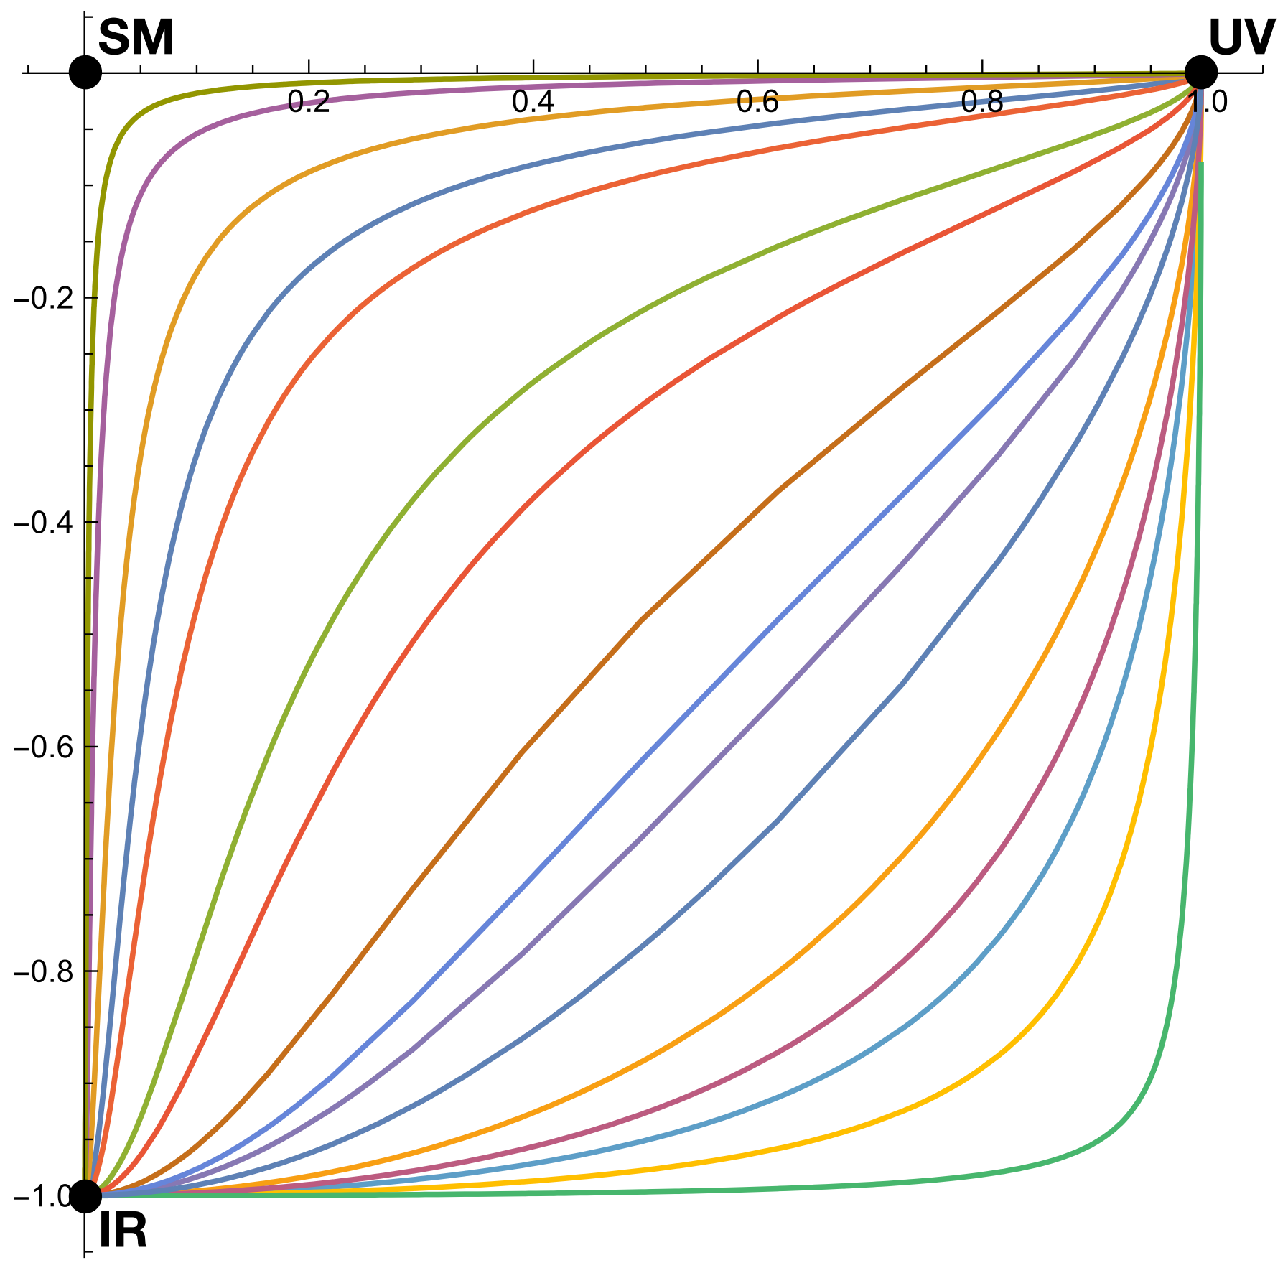
Quantum scale symmetry
Exactly on fixed point:
No parameter with dimension of
length or mass is present in the
quantum effective action.
EVEN NOT k !
Then invariance under
dilatations or global scale transformations
is realized as a quantum symmetry.
Continuous global symmetry

Slide 66
Approximate scale symmetry
near fixed points
UV : approximate scale invariance of primordial fluctuation spectrum from inflation

Slide 67
Almost scale invariant primordial fluctuation spectrum seeds all structure in the universe

Slide 68



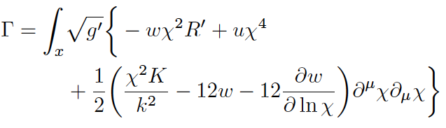

Scale symmetry near
UV- fixed point
kinetial :
scalar anomalous dimension σ , take σ =2
Weyl
scaling

Slide 69
Approximate scale symmetry near fixed points
UV : approximate scale invariance of primordial fluctuation spectrum from inflation
IR : cosmon is pseudo Goldstone boson of
spontaneously broken scale symmetry,
tiny mass,
responsible for dynamical Dark Energy

Slide 70
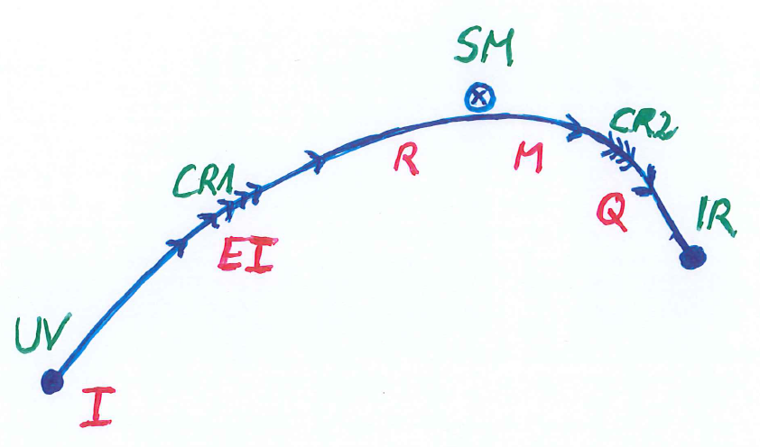
Crossover in quantum gravity

Slide 71
Spontaneous breaking of scale symmetry
expectation value of scalar field breaks scale symmetry spontaneously
massive particles are compatible with scale symmetry
in presence of massive particles : sign of exact scale symmetry is exactly massless Goldstone boson – the dilaton

Slide 72
Approximate scale symmetry near fixed points
UV : approximate scale invariance of primordial fluctuation spectrum from inflation
IR : cosmon is pseudo Goldstone boson of
spontaneously broken scale symmetry,
tiny mass,
responsible for dynamical Dark Energy

Slide 73
Simplicity
simple description of all cosmological epochs
natural incorporation of Dark Energy :
inflation
Early Dark Energy
present Dark Energy dominated epoch

Slide 74
Scale symmetric standard model
Replace all mass scales by scalar field 𝜒
(1) Higgs potential
(2) Strong gauge coupling, normalized at , is independent of 𝜒
(3) Similar for all dimensionless couplings
Quantum effective action for standard model does
not involve intrinsic mass or length
Quantum scale symmetry
For : : massless Goldstone boson
Fujii,
Zee, CW
CW’87

Slide 75
Fundamental scale invariance

Slide 76
Fundamental scale invariance
Scaling solution
that’s it

Slide 77
Ultraviolet fixed point
UV fixed point
Wikipedia

Slide 78
Fundamental scale invariance
Scaling solution is exact
All relevant parameters vanish

Slide 79
Predictivity
Theories with fundamental scale symmetry are very predictive
Absence of relevant parameters
New criterion for fundamental theories
Stronger than renormalizability

Slide 80
Scaling solutions and inflation
Scaling solutions are interesting for inflation:
flat potential
non minimal scalar – gravity coupling
general properties do not depend on particular representation of scalar field
scalar singlet = inflaton

Slide 81
Higgs inflation not compatible with asymptotic safety

Slide 82
Scaling potential for GUT with non-zero gauge coupling
Spontaneous
symmetry breaking by scaling solution near Planck scale

