Slide 1
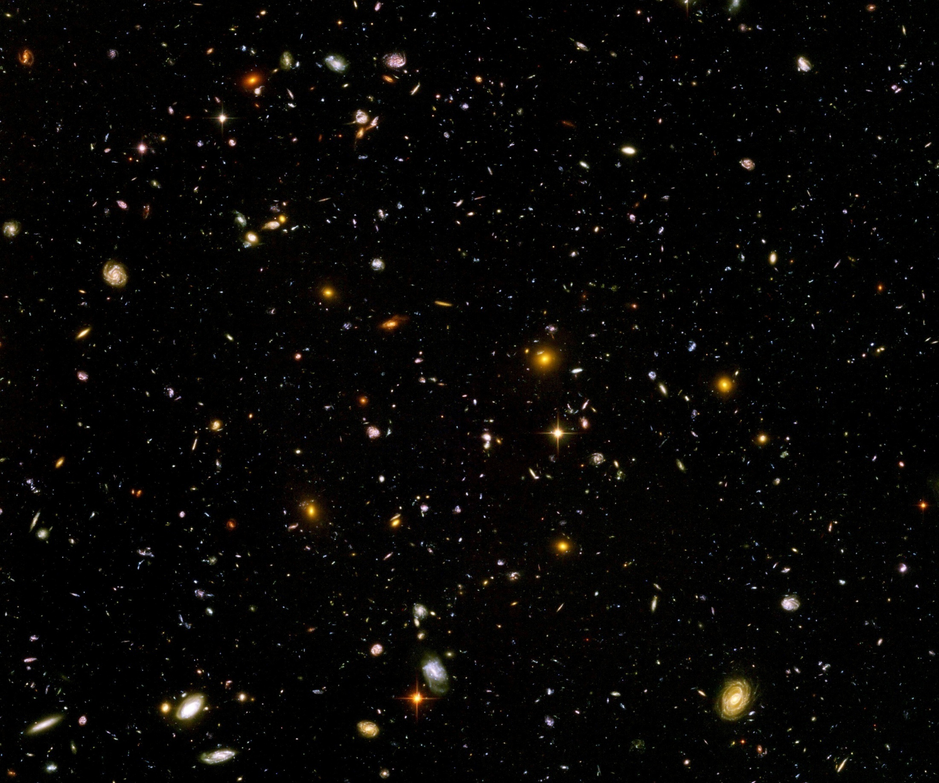
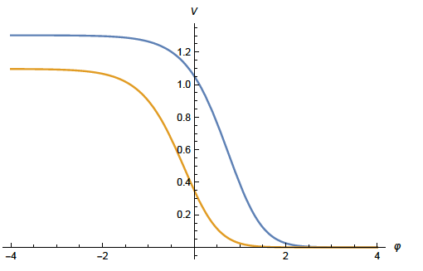
Quantum gravity from the beginning to the present Universe

Slide 2
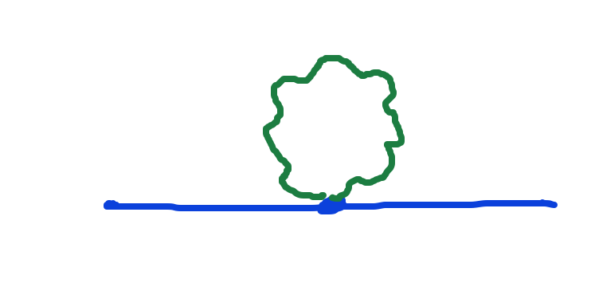
Graviton fluctuations matter
Quantum gravity needs method to take them into account

Slide 3
Quantum gravity
Gravity is field theory. Similar to electrodynamics. Metric field.
Gravity is gauge theory. Similar to QED or QCD. Gauge symmetry: general coordinate transformations ( diffeomorphisms )
Quantum gravity: include metric fluctuations in functional integral

Slide 4
Quantum gravity
Quantum gravity is similar to other quantum field theories
Difference: metric is tensor, gauge bosons are vectors
Difference: Quantum gravity is not perturbatively renormalizable
no small coupling, effective coupling q²/M²

Slide 5
Quantum gravity
Quantum gravity is
non-perturbatively renormalizable
Asymptotic safety
Weinberg, Reuter, …
Uses functional renormalization

Slide 6
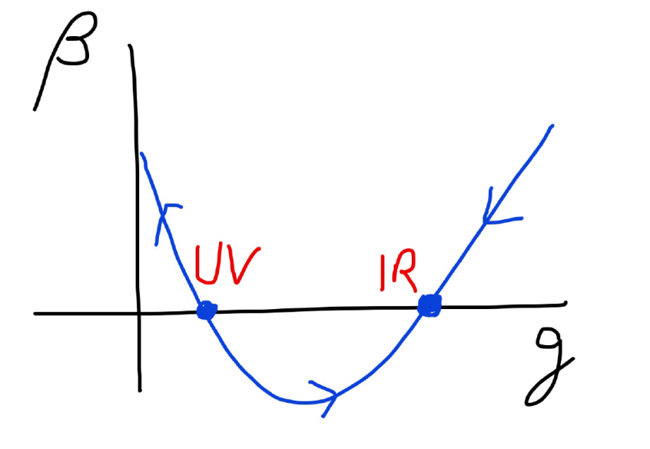
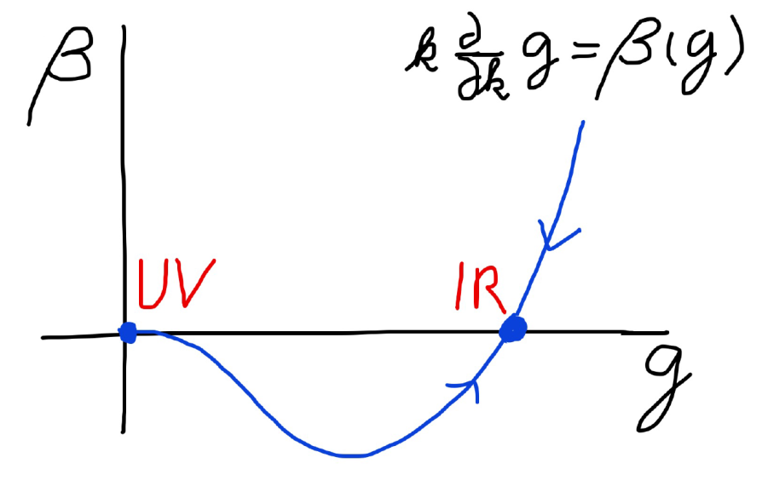
Asymptotic safety Asymptotic freedom

Slide 7
Flowing couplings
Couplings change with momentum scale due to quantum fluctuations.
Renormalization scale k : Only fluctuations with momenta larger k are included. The scale k can be momenta, geometric quantities, or just be introduced “by hand”.
Flow of k to zero : all fluctuations included, IR
Flow of k to infinity : UV

Slide 8
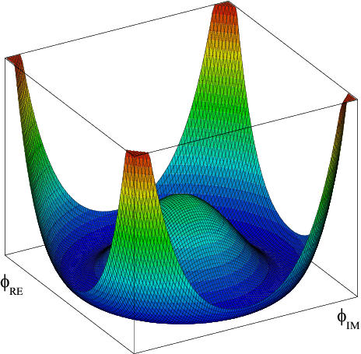
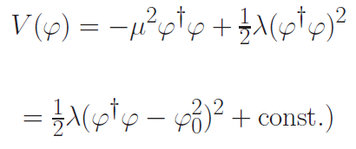

Flow of quartic Higgs coupling
Fermi scale

Slide 9
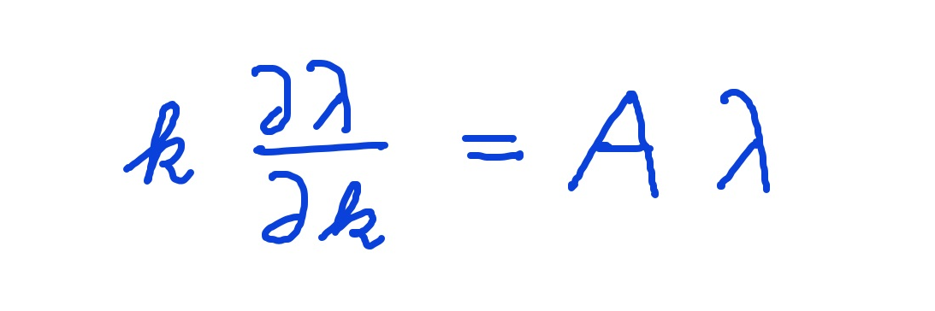
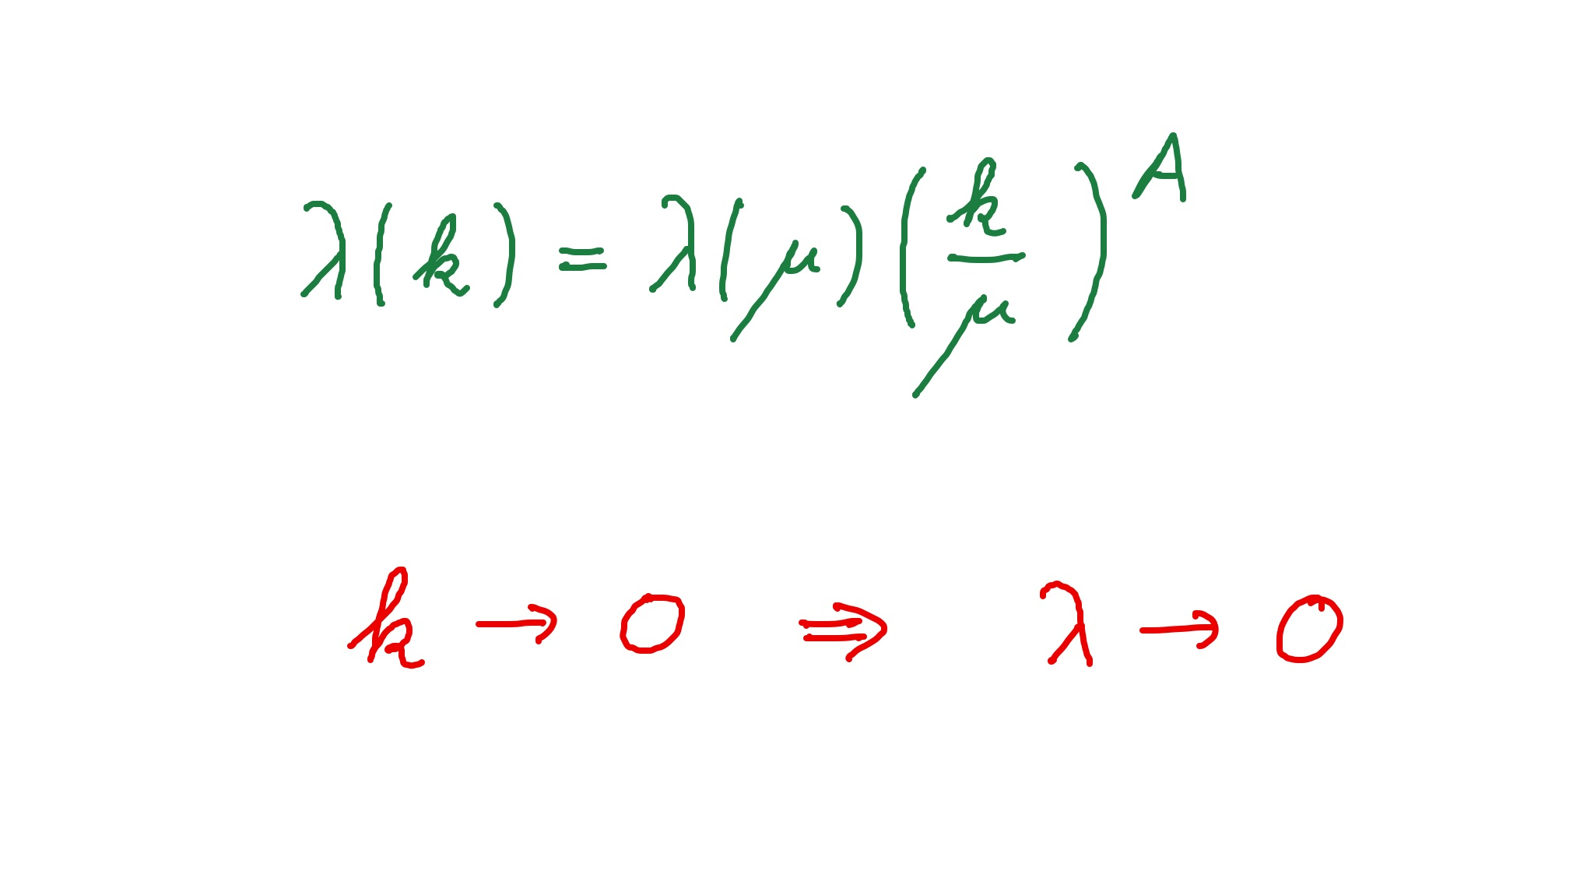
Graviton fluctuations erase quartic scalar coupling
Renormalization scale k : Only fluctuations with momenta larger k are included.
Consider first only fluctuations of metric or graviton :
gravity induced
anomalous dimension
A > 0
for
constant A :

Slide 10
Quantum gravity flattens scalar potentials

Slide 11
Fixed point
The quartic scalar coupling λ has a
fixed point at λ=0
For A>0 it flows towards the fixed point as k is lowered: irrelevant coupling
For a UV – complete theory it is predicted to assume the fixed point value

Slide 12
Gravitational contribution to running quartic coupling
running Planck mass :
dimensionless
squared Planck mass
for length scales smaller than the Planck length:
metric fluctuations dominate, constant A

Slide 13
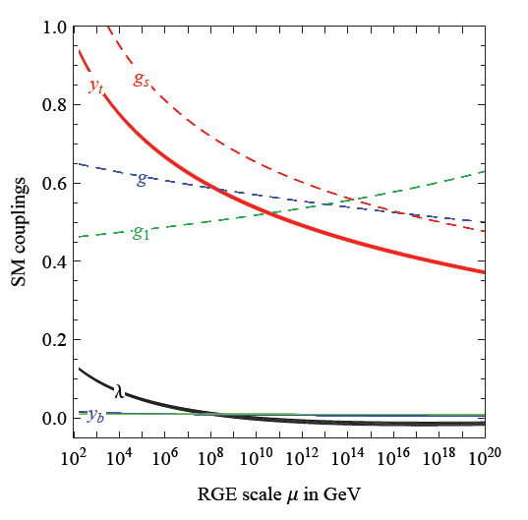
Prediction for quartic Higgs coupling
great desert
high scale fixed point
quartic scalar coupling predicted to be very small at transition scale where gravity decouples
great desert
fixed point

Slide 14
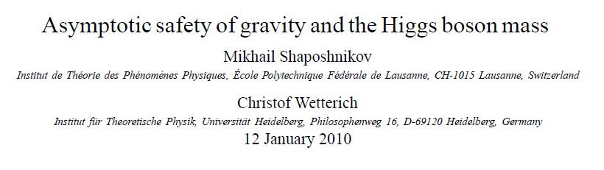
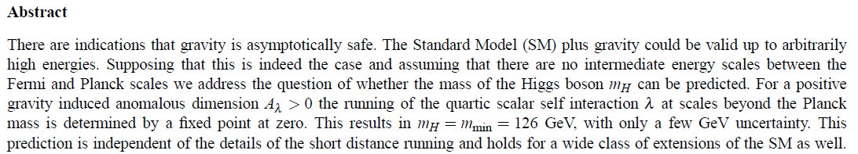
Prediction of mass of Higgs boson

Slide 15
Scaling solutions

Slide 16
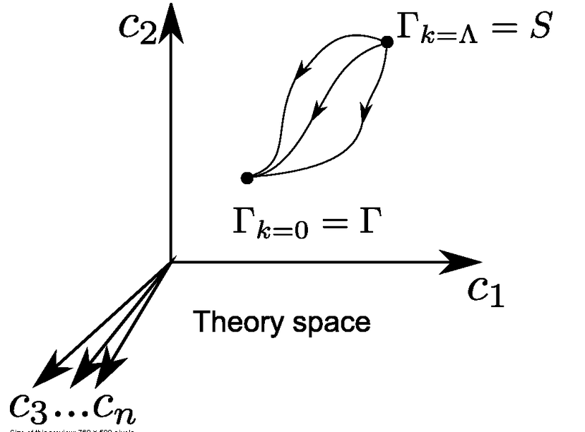
Ultraviolet fixed point
UV fixed point
Wikipedia

Slide 17
Renormalizable theories
1) Ultraviolet fixed point :
scaling solution
2) Flow away from fixed point :
relevant parameters

Slide 18
Scaling solutions
At fixed point: all ( infinitely many ) dimensionless couplings take fixed values
Whole scalar potential is fixed, for arbitrary values of scalar field
Functional flow equations are needed

Slide 19
Scaling solutions are restrictive
Scaling solutions are particular solutions of non-linear differential equations
In presence of gravitational fluctuations: scalar effective potential no longer approximated by polynomial

Slide 20
Scaling solutions and cosmology
Cosmology involves scalar potentials over large range of field values
Inflaton potential
Higgs potential for Higgs inflation
Cosmon potential for dynamical dark energy or quintessence

Slide 21
Quantum gravity : these potentials are not arbitrary

Slide 22
Dilaton quantum gravity
quantum gravity coupled to a scalar field
Henz, Pawlowski, Rodigast, Yamada, Reichert,
Eichhorn, Pauly, Laporte, Pereira, Saueressig, Wang…

Slide 23
Scaling potential in
standard model
u : dimensionless
scalar potential
u= U/k⁴
x : logarithm of
scalar field value

Slide 24
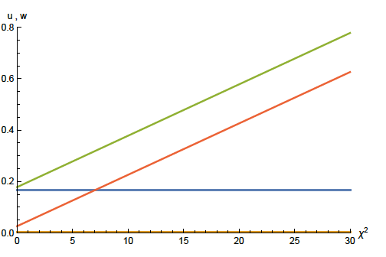
Scaling solution : flat potential

Slide 25

Derivative expansion of effective action
variable gravity

Slide 26
Coefficient of curvature scalar in standard model
w : dimensionless
field dependent
squared Planck
mass
w =2 F/ k²
non-minimal
coupling of
scalar field
to gravity

Slide 27
Scaling solution : flat potential, non-minimal scalar- gravity coupling

Slide 28
Scaling solution in Einstein frame

Slide 29
Quintessential inflation
Inflation
Dynamical
Dark Energy
Spokoiny, Peebles, Vilenkin, Peloso, Rosati, Dimopoulos, Valle, Giovannini,
Brax, Martin, Hossain, Myrzakulov, Sami, Saridakis, de Haro, Salo, Bettoni, Rubio…

Slide 30





Weyl transformation for variable gravity

Slide 31

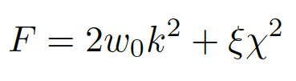

Scaling solution
For low energy
standard model :

Slide 32
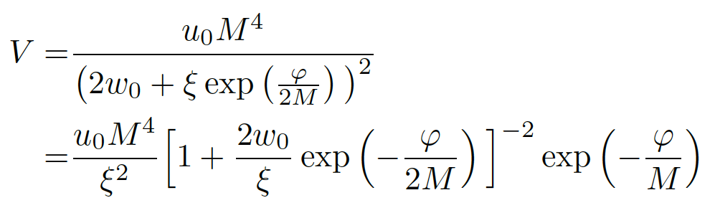
Scaling solution in Einstein frame

Slide 33
Mass scales in Einstein frame
Renormalization scale k is no longer present
Planck mass M not intrinsic: introduced only by change of variables

Slide 34
Asymptotic solution of cosmological constant problem
no tiny parameter !

Slide 35
Cosmological solution
scalar field χ vanishes in the infinite past
scalar field χ diverges in the infinite future
J.Rubio,…

Slide 36
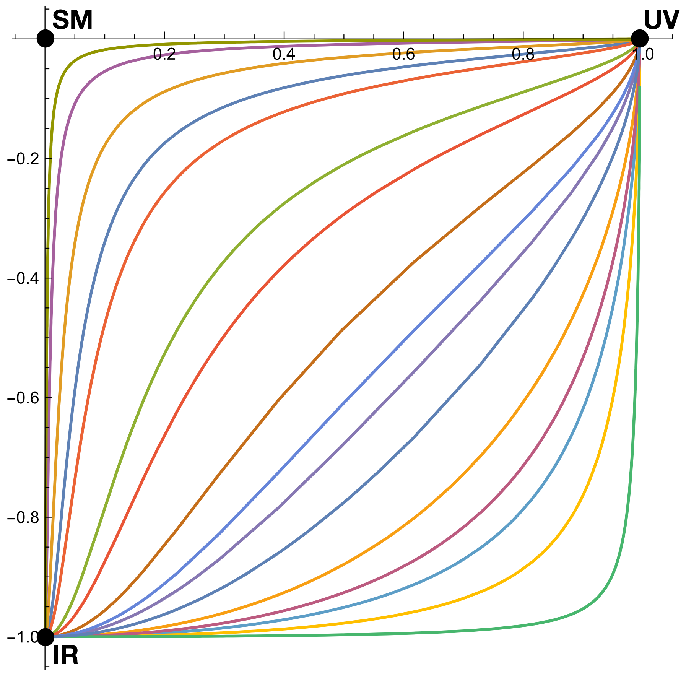
Quantum scale symmetry
Exactly on fixed point:
No parameter with dimension of
length or mass is present in the
quantum effective action.
EVEN NOT k !
Then invariance under
dilatations or global scale transformations
is realized as a quantum symmetry.
Continuous global symmetry

Slide 37
Approximate scale symmetry near fixed points
UV : approximate scale invariance of primordial fluctuation spectrum from inflation
IR : cosmon is pseudo Goldstone boson of
spontaneously broken scale symmetry,
tiny mass,
responsible for dynamical Dark Energy

Slide 38
Spontaneous breaking of scale symmetry
expectation value of scalar field breaks scale symmetry spontaneously
massive particles are compatible with scale symmetry
in presence of massive particles : sign of exact scale symmetry is exactly massless Goldstone boson – the dilaton

Slide 39
Dynamical dark energy

Slide 40
Asymptotically vanishing
cosmological „constant“
What matters : Ratio of potential divided by fourth power of Planck mass
vanishes for χ → ∞ !
k= 2 • 10⁻³ eV

Slide 41
Quintessence
Dynamical dark energy ,
generated by scalar field (cosmon )
C.Wetterich,Nucl.Phys.B302(1988)668, 24.9.87
P.J.E.Peebles,B.Ratra,ApJ.Lett.325(1988)L17, 20.10.87

Slide 42
Prediction : homogeneous dark energy influences recent cosmology
- of same order as dark matter -
Original models do not fit the present observations
…. modifications
( different growth of neutrino mass )

Slide 43
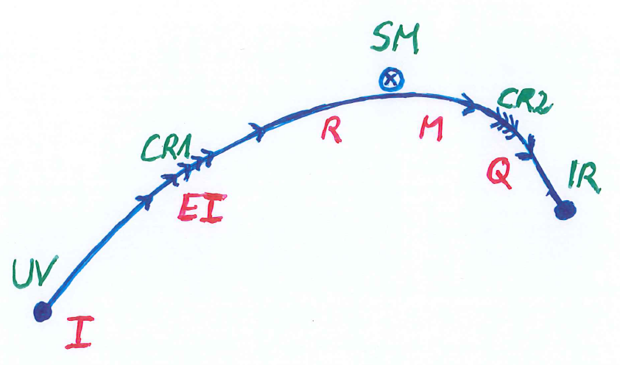
Crossover in quantum gravity

Slide 44
Simplicity
simple description of all cosmological epochs
natural incorporation of Dark Energy :
inflation
Early Dark Energy
present Dark Energy dominated epoch

Slide 45
Metric frames
“Weyl scaling” maps variable gravity model to Universe with fixed masses and standard expansion history.
For scaling solutions: scale k disappears !
Standard gravity coupled to scalar field.
Exact equivalence of different frames !
“ different pictures”

Slide 46
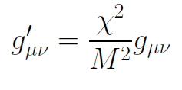
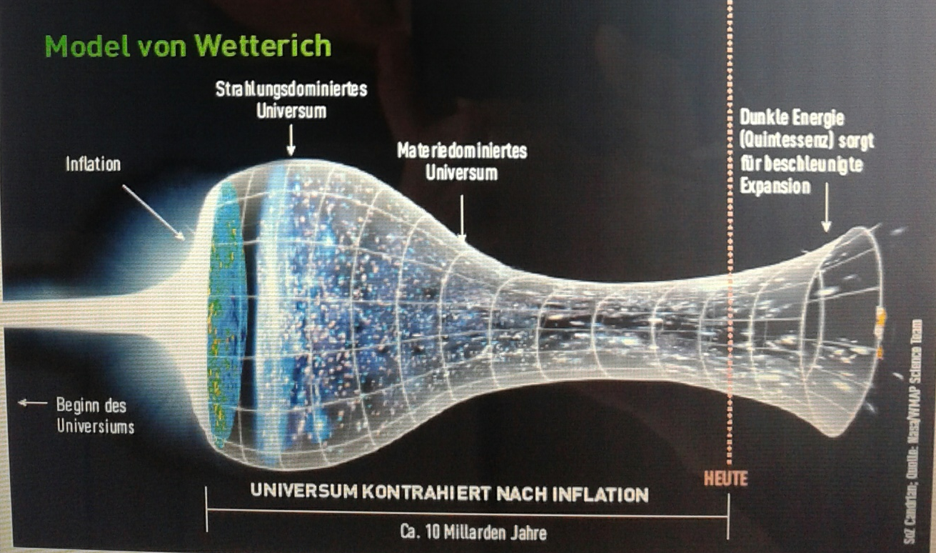
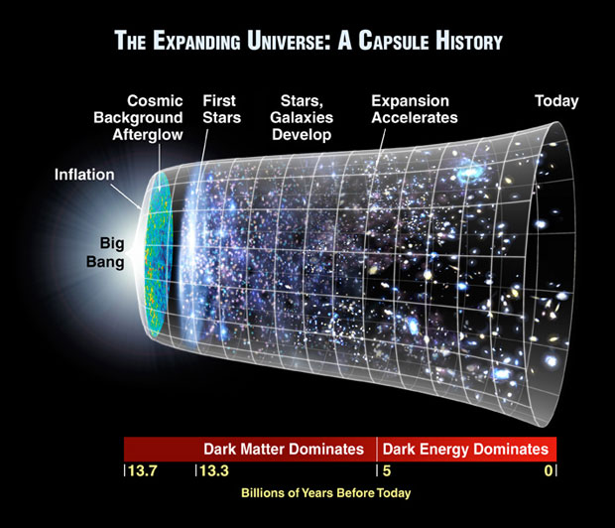
Field relativity
Weyl scaling :
changes geometry,
not a coordinate transformation

Slide 47
Quantum gravity and the beginning of the Universe

Slide 48
Beginning of Universe
Zu Anfang war die Welt öd und leer und währte ewig.
In the beginning the Universe was empty and lasted since ever.

Slide 49

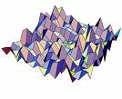
Eternal light-vacuum
Everywhere almost nothing
only fields and their fluctuations
All particles move
with light velocity,
similar to photons

Slide 50
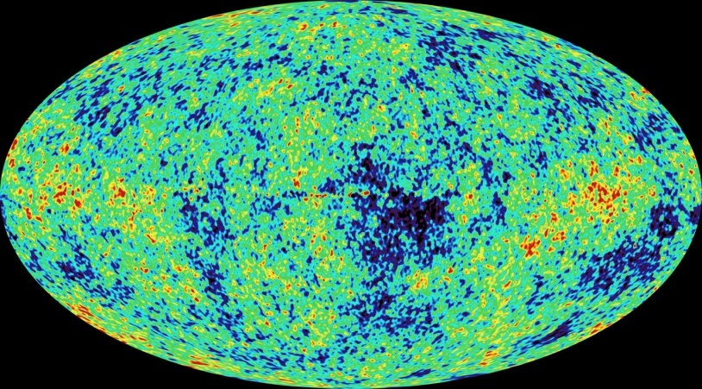
Eternal light-vacuum is unstable
Slow increase of particle masses
Only slow change of space-time geometry
Creation of particles and entropy
Consequence for observation : primordial fluctuations become visible in cosmic background radiation
We see fluctuations in a stage 5000 billion years ago.

Slide 51
The great emptiness story
In the beginning was light-like emptiness.

Slide 52
The big bang story
dramatic hot big bang
started 13.7 billion years ago
at the beginning extremely short period of cosmic inflation with almost exponential expansion of the Universe, duration around 10⁻⁴⁰ seconds
start with singularity : our whole observable Universe evolves from one point

Slide 53
Field relativity
Both stories are equivalent
related by field transformation of the metric
different metrics related by Weyl transformation, which depends on scalar field ( inflaton )

Slide 54

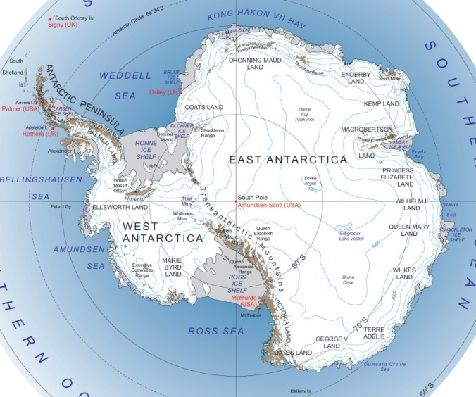
Field - singularity
Big Bang is field - singularity
similar ( but not identical with )
coordinate - singularity

Slide 55
Conclusions
Fluctuations of the metric matter
They influence the behavior of scalar potentials for all field values
Quantum gravity relevant for early cosmology and late cosmology
Quantum scale symmetry is central ingredient for understanding cosmology
Understanding of quantum gravity fluctuations still in beginning stage

Slide 56
end

Slide 57
Fundamental scale invariance

Slide 58
Fundamental scale invariance
Scaling solution
that’s it

Slide 59
Ultraviolet fixed point
UV fixed point
Wikipedia

Slide 60
Fundamental scale invariance
Scaling solution is exact
All relevant parameters vanish

Slide 61
Predictivity
Theories with fundamental scale symmetry are very predictive
Absence of relevant parameters
New criterion for fundamental theories
Stronger than renormalizability

Slide 62
Fundamental scale invariance and cosmology
Scaling solution maps dependence on renormalization scale k to dependence on cosmon field
Solution of field equations maps this to time dependence in cosmology
Direct predictivity for cosmology

Slide 63
Fundamental theory
without scale
Fundamental fields are dimensionless
Length scale can be introduced for distances, mass=inverse length for derivatives
Metric can appear as composite object
dimension: mass squared

Slide 64
Effective action for
scale invariant fields
Assume that continuum limit exists for this effective action
No intrinsic scale

Slide 65
Canonical fields
Canonical metric is dimensionless
Introduce renormalisation scale k
Canonical scalar fields; dimension mass
General renormalized fields

Slide 66
Approximate scale symmetry
near fixed points
UV : approximate scale invariance of primordial fluctuation spectrum from inflation

Slide 67
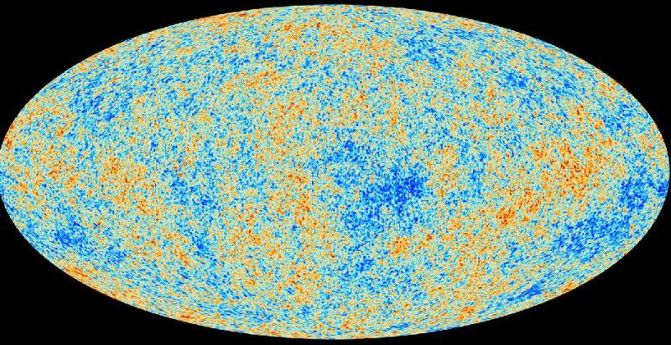
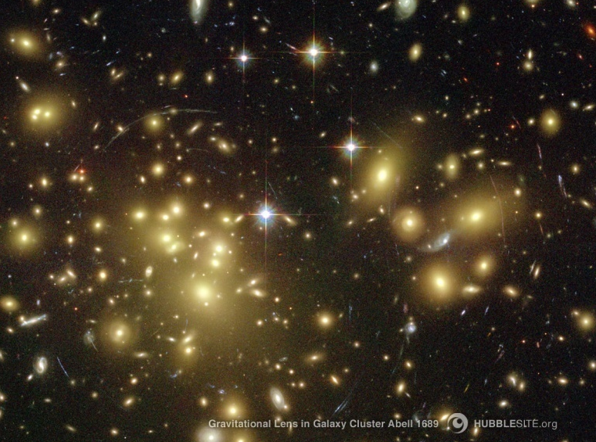
Almost scale invariant primordial fluctuation spectrum seeds all structure in the universe

Slide 68



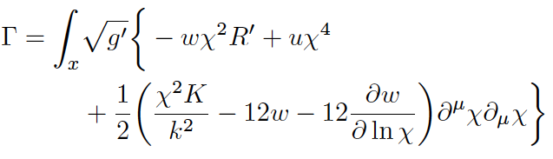

Scale symmetry near
UV- fixed point
kinetial :
scalar anomalous dimension σ , take σ =2
Weyl
scaling

Slide 69
Higgs inflation not compatible with asymptotic safety

Slide 70
Scaling potential for GUT with non-zero gauge coupling
Spontaneous
symmetry breaking by scaling solution near Planck scale

Slide 71
Scale symmetric standard model
Replace all mass scales by scalar field 𝜒
(1) Higgs potential
(2) Strong gauge coupling, normalized at , is independent of 𝜒
(3) Similar for all dimensionless couplings
Quantum effective action for standard model does
not involve intrinsic mass or length
Quantum scale symmetry
For : : massless Goldstone boson
Fujii,
Zee, CW
CW’87

