Slide 1
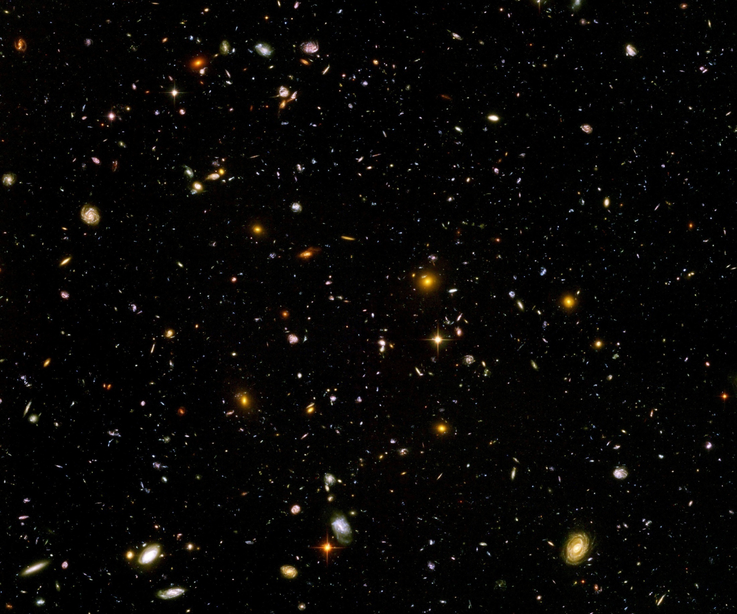
Quantum gravity predictions for dark energy

Slide 2
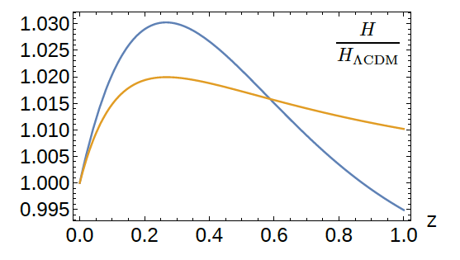
Predictions
Dynamical solution of cosmological constant problem
Prediction of dynamical dark energy
Realistic cosmology?

Slide 3
(1) Largest intrinsic mass scale
LIMS is the largest mass scale generated by flow of relevant couplings
Explicit violation of quantum scale symmetry
Example QCD with light quarks: confinement scale

Slide 4
Ultraviolet fixed point
Flow of couplings stops for k →∞
Self-similarity: no explicit dependence on k
Theory can be extrapolated to arbitrary short distances
Completeness
Renormalizability

Slide 5
Predictivity
few relevant parameters govern flow away from UV-fixed point
translate to renormalizable couplings in standard model or extensions
generate intrinsic mass scales
largest one : LIMS
LIMS only sets overall mass scale
involves no parameter tuning

Slide 6
(2) LIMS in quantum gravity
Often LIMS is associated to Planck mass
No need for that!
Proposal:
LIMS of the order of neutrino masses
or smaller
Electron mass, Planck mass much larger?
Particle masses given by field

Slide 7
Metric + scalar field
Inflation :
add scalar field ( inflaton )
Dynamical dark energy or quintessence:
add scalar field ( cosmon )
…

Slide 8
(3) Spontaneous breaking of quantum scale symmetry and the scale invariant standard model
Non-zero cosmological value of scalar field 𝜒(t) breaks quantum scale symmetry spontaneously
No intrinsic mass parameter larger than LIMS:
All masses larger than neutrino masses are proportional to 𝜒

Slide 9
Scale symmetric standard model
Replace all mass scales by scalar field 𝜒
(1) Higgs potential
(2) Strong gauge coupling, normalized at , is independent of 𝜒
(3) Similar for all dimensionless couplings
Quantum effective action for standard model does
not involve intrinsic mass or length
Quantum scale symmetry
Fujii, Zee, CW
CW’87, Shaposhnikov et al

Slide 10
(4) Scaling solution
UV – fixed point : scaling solution of functional renormalization
FRG scale k larger than LIMS:
Scaling solution very good approximation
Scaling solution is predictive!

Slide 11
Can the scalar potential be predicted by functional renormalization for quantum gravity ?

Slide 12
Dilaton quantum gravity
functional renormalization for
quantum gravity coupled to a scalar field
Henz, Pawlowski, Rodigast, Yamada, Reichert,
Eichhorn, Pauly, Laporte, Pereira, Saueressig,
Wang, Knorr, …
for low order polynomial expansion of potential : Percacci, Narain, …

Slide 13
Functional flow equation for scalar potential
Scaling solution: no explicit dependence of u on k

Slide 14
Generic form of scaling potential
Interpolates between plateaus
Scalar potential =
field dependent “cosmological constant”
Effectively massless particles contribute to flow
Different numbers of massless particles in different regions of field space
No quartic coupling λ 𝜒 ⁴

Slide 15
Scaling solutions are restrictive
scaling solutions are solutions of
non-linear differential equations
scaling potential needs to extend over
whole range of scalar field
predictivity !
in presence of gravitational fluctuations:
scalar effective potential no longer approximated by
polynomial

Slide 16
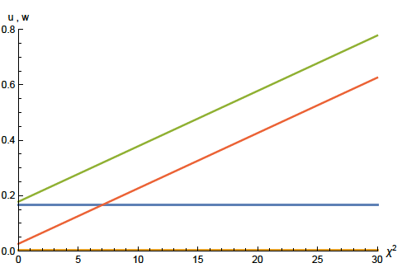
Coefficient of curvature scalar in standard model
non-minimal coupling of scalar field to gravity:
F=ξχ²R
w : dimensionless
field dependent
squared Planck mass

Slide 17
Approximate scaling solution
flat potential: u constant
non-minimal scalar- gravity coupling:
for large scalar field w increases proportional χ²
squared scalar field value χ²

Slide 18
looks natural no small parameter no tuning

Slide 19
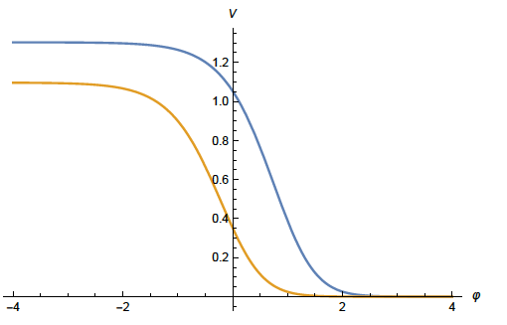
Scaling solution in Einstein frame

Slide 20
Weyl transformation for variable gravity

Slide 21
Quintessential inflation
Inflation
Dynamical
Dark Energy
Spokoiny, Peebles, Vilenkin, Peloso, Rosati, Dimopoulos, Valle, Giovannini,
Brax, Martin, Hossain, Myrzakulov, Sami, Saridakis, de Haro, Salo, Bettoni, Rubio…

Slide 22
(5) Dynamical solution of cosmological constant problem
no tiny parameter !

Slide 23
Mass scales in Einstein frame
Renormalization scale k is no longer present
Planck mass M not intrinsic: introduced only by change of variables

Slide 24
(6) Dynamical dark energy prediction of (approximate ) quantum scale symmetry:
dynamical dark energy ,
generated by scalar field (cosmon )
C.Wetterich, Nucl.Phys.B302(1988)668, 24.9.87
P.J.E.Peebles, B.Ratra, ApJ.Lett.325(1988)L17, 20.10.87
Notes:
24

Slide 25
Cosmon
Spontaneously broken scale symmetry induces a Goldstone boson
Massless dilaton
Intrinsic mass scale from LIMS : Pseudo-Goldstone boson acquires a tiny mass
Cosmon
Naturally very light scalar particle !

Slide 26
(7) Scaling potential for standard model
Mass thresholds matter

Slide 27
Quantum scale symmetry violation in neutrino sector
Neutrino masses involve beyond standard model physics
Effective neutrino Yukawa coupling in Einstein frame
Cosmon – neutrino coupling

Slide 28
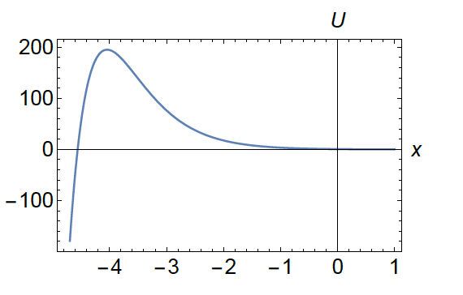
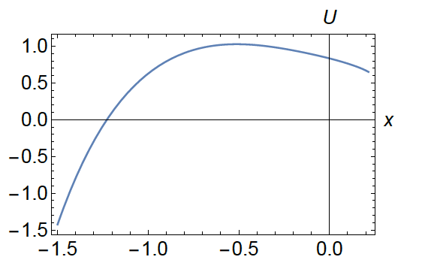
Scaling potential
Quantum scale symmetry
in neutrino sector, c_{B-L}=0
Field dependent
neutrino masses
U in units of

Slide 29
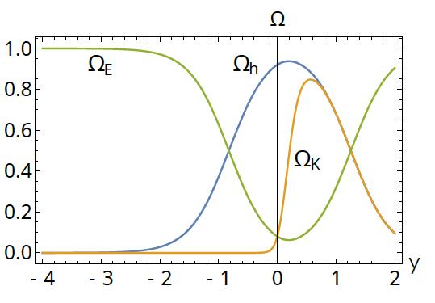
(8) Cosmology
For quantum scale symmetry in neutrino sector :
dynamical solution of cosmological constant problem, but time evolution of dynamical dark energy is not realistic
y=ln(a)

Slide 30
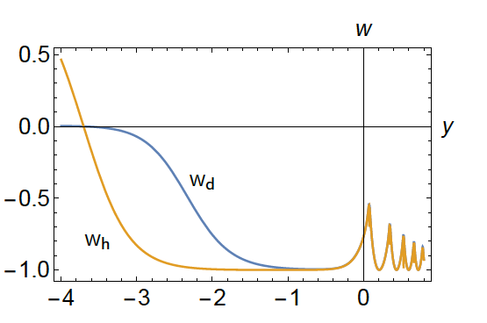
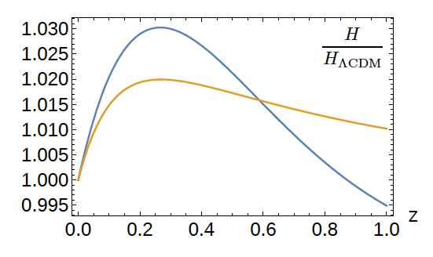
Field dependent neutrino mass
realistic cosmology?
equation of state w
Hubble parameter
y=ln(a)

Slide 31
Conclusion
Fixed point of quantum gravity
with associated quantum scale symmetry,
scaling solutions and relevant parameters
is crucial for understanding the
evolution of our Universe

