Slide 1
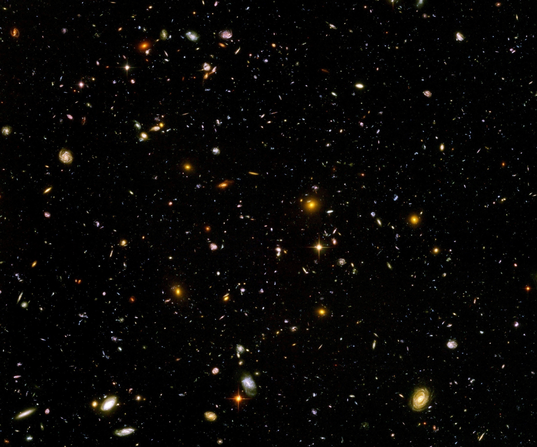
Quantum gravity predictions for particle physics and cosmology

Slide 2
Quantum gravity predictions for particle physics

Slide 3
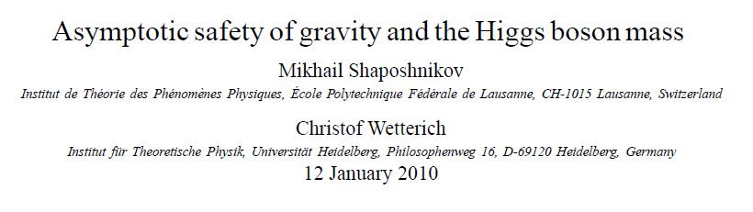
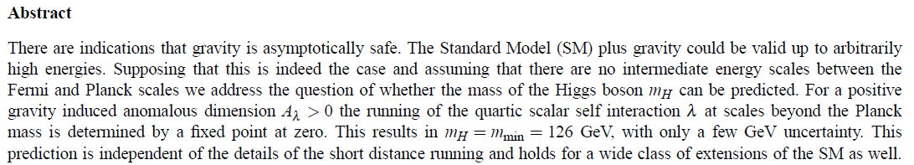
Prediction of mass of Higgs boson

Slide 4
Why can quantum gravity make predictions for particle physics ?

Slide 5
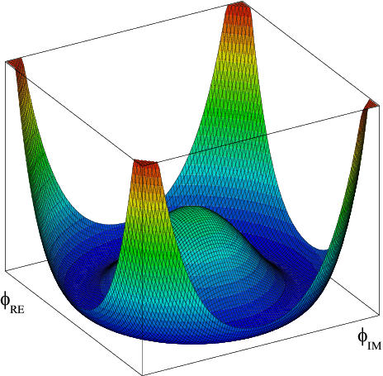
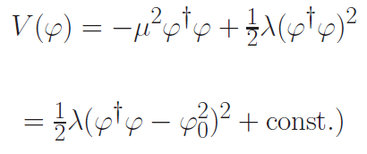

Effective potential for Higgs scalar
Fermi scale

Slide 6


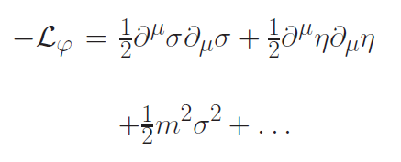

Radial mode and
Goldstone mode
expand around minimum of potential
mass term for
radial mode

Slide 7
Quartic scalar coupling
prediction of mass of Higgs boson
=
prediction of value of quartic scalar coupling λ
at Fermi scale

Slide 8
Why can quantum gravity make predictions for quartic scalar coupling ?

Slide 9
Mass scales
Fermi scale 𝜑₀ ~ 100 GeV
Planck mass M ~ 10¹⁸ GeV
Gravity at Fermi scale is very weak : How can it influence the effective potential for the Higgs scalar and the mass of the Higgs boson ?

Slide 10
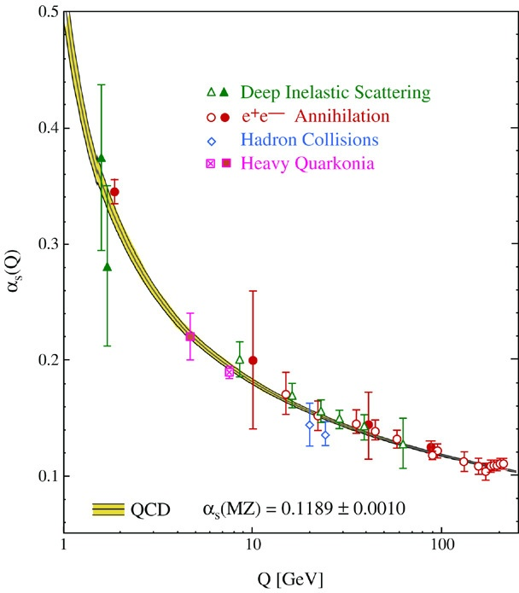
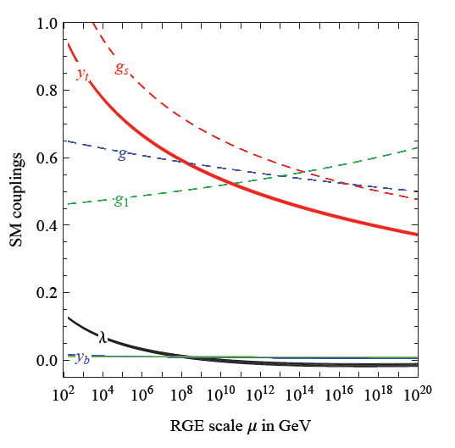
Quantum fluctuations induce running couplings
possible violation of scale symmetry
well known in QCD or standard model
Bethke
Degrassi et al

Slide 11
Quantum fluctuations induce running couplings
possible violation of scale symmetry
well known in QCD or standard model

Slide 12

The mass of the Higgs boson, the great desert, and asymptotic safety of gravity

Slide 13
key points
great desert
solution of hierarchy problem at high scale
high scale fixed point
vanishing scalar coupling at fixed point
great desert
fixed point

Slide 14


Slide 15
Planck scale, gravity
no multi-Higgs model
no technicolor
no low scale
higher dimensions
no supersymmetry

Slide 16
Essential point for quantum gravity prediction of Higgs boson mass:
Initial value of quartic scalar coupling near Planck mass is predicted by quantum gravity
Results in prediction for ratio Higgs boson mass over W- boson mass, or
Higgs boson mass over top quark mass
Extrapolate perturbatively
to Fermi scale

Slide 17
Near Planck mass gravity is not weak !
Predictive power !

Slide 18
Flowing couplings
Couplings change with momentum scale due to quantum fluctuations.
Renormalization scale k : Only fluctuations with momenta larger k are included. The scale k can be momenta, geometric quantities, or just be introduced “by hand”.
Flow of k to zero : all fluctuations included, IR
Flow of k to infinity : UV

Slide 19
Renormalization group
How do couplings or physical laws change
with scale k ?

Slide 20
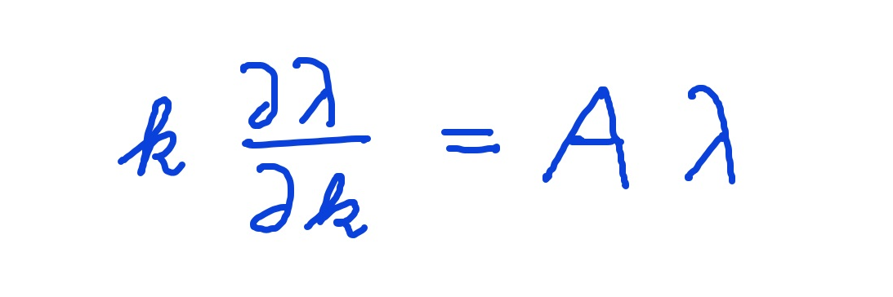
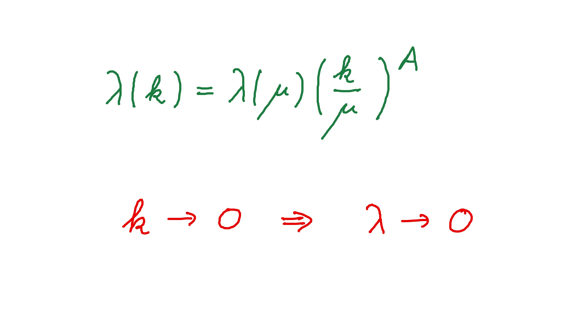
Graviton fluctuations erase quartic scalar coupling
Renormalization scale k : Only fluctuations with momenta larger k are included.
Consider first only fluctuations of metric or graviton :
gravity induced
anomalous dimension
A > 0
for
constant A :

Slide 21
Fixed point
The quartic scalar coupling λ has a
fixed point at λ=0
For A>0 it flows towards the fixed point as k is lowered:
irrelevant coupling
For a UV – complete theory it is predicted to assume the fixed point value

Slide 22
Gravitational contribution to running quartic coupling
running Planck mass :
dimensionless
squared Planck mass
for length scales smaller than the Planck length:
metric fluctuations dominate, constant A

Slide 23
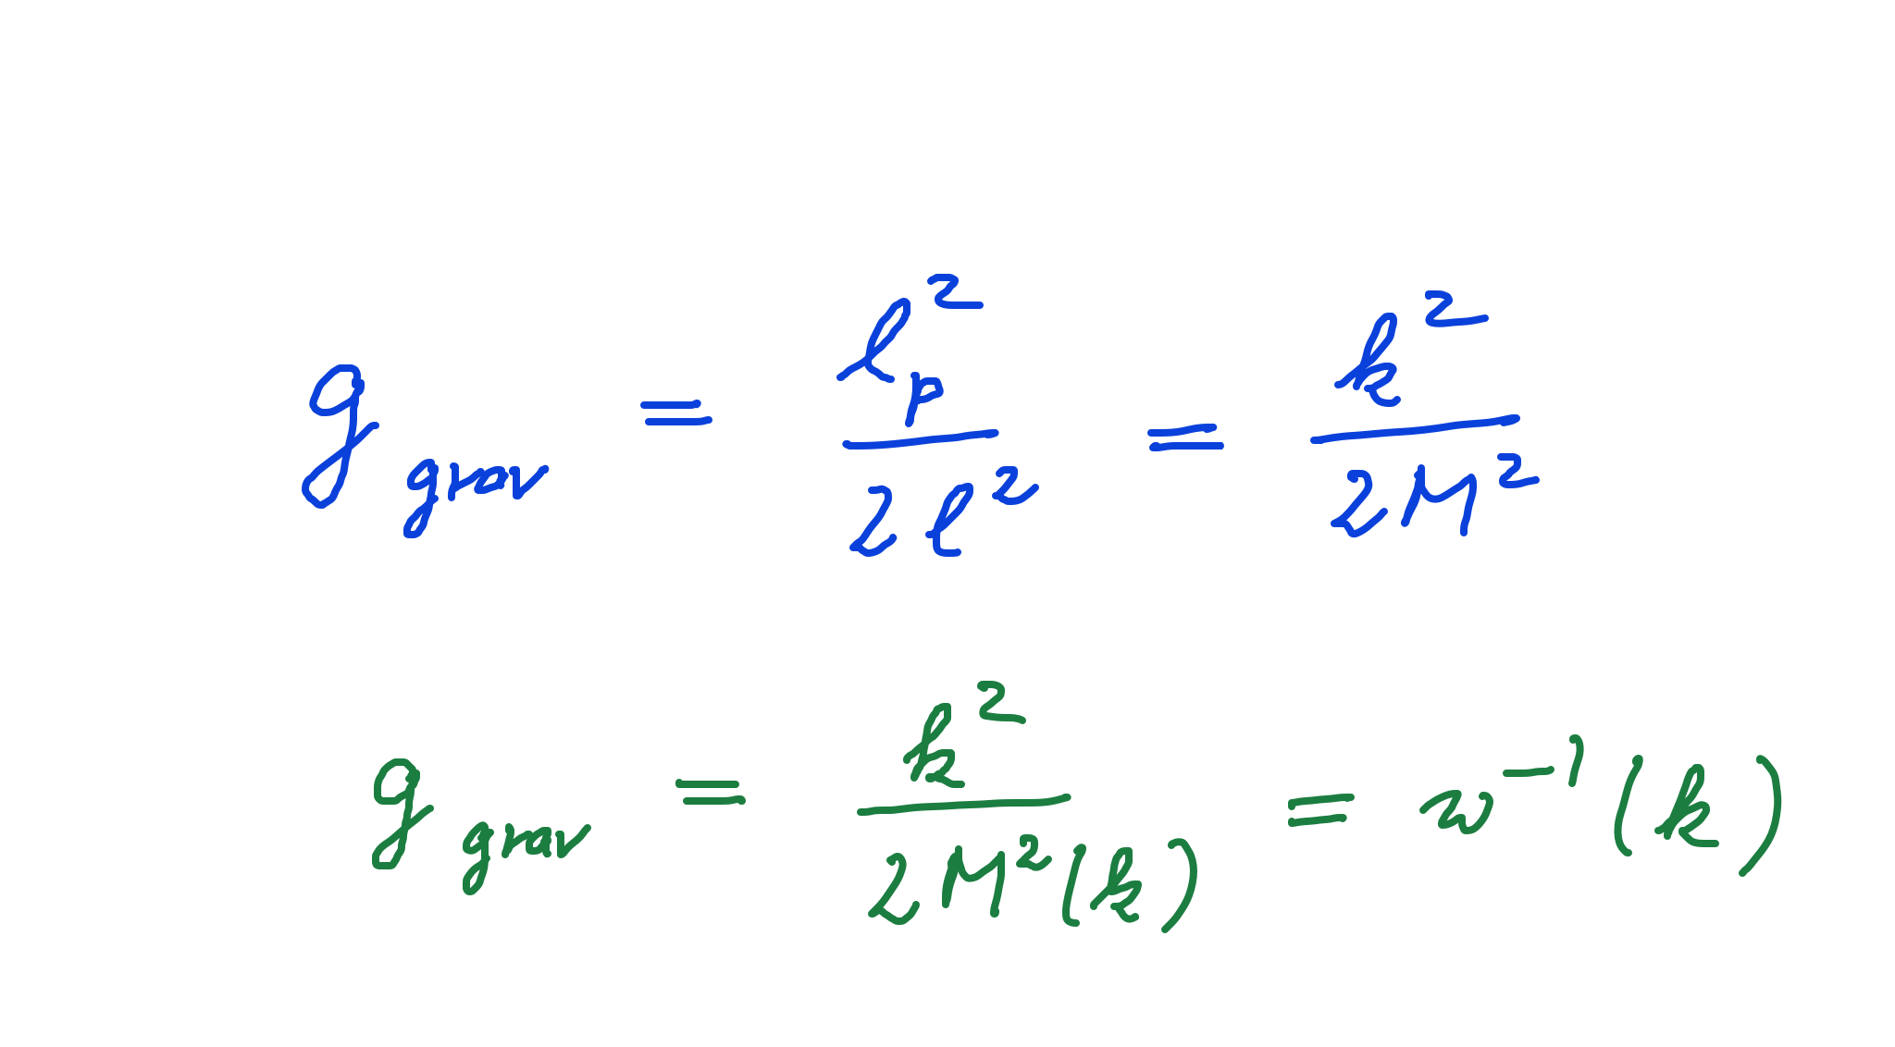
Strength of gravity
l_{p} : Planck length
M : Planck mass
running gravitational coupling

Slide 24
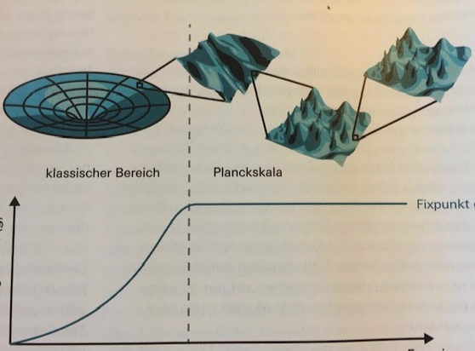
Strength of gravity
classical gravity
quantum gravity
fixed point
strength
of
gravity
g_{grav}
energy
inverse distance
A. Eichhorn, CW, Spektrum der Wissenschaft

Slide 25
Flowing dimensionless Planck mass
Renormalization scale k : Only fluctuations with momenta larger k are included
Flowing
Planck mass M²(k)

Slide 26
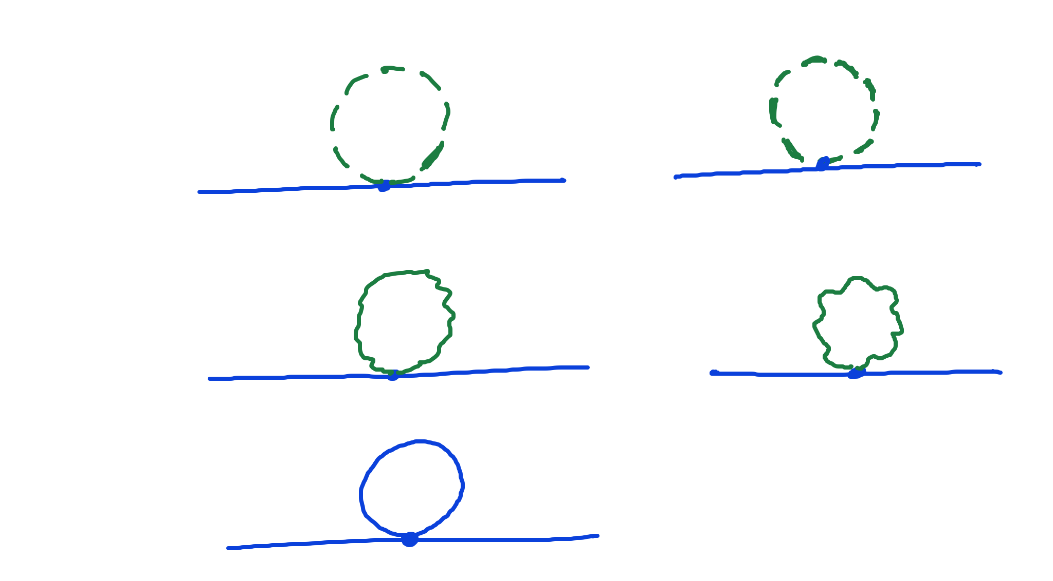
Universality of gravity
scalar loop,
fermion loop
gauge boson
loop
graviton
loop

Slide 27
Universality of gravity
scalar loop,
fermion loop
gauge boson
loop
graviton
loop
c is independent of coupling constants

Slide 28
Flowing dimensionless Planck mass
Renormalization scale k : Only fluctuations with momenta larger k are included
Flowing
Planck mass M²(k)
matter
contribution
4 N_{V} – N_{S} - N_{F}
with graviton
contribution

Slide 29
Flowing Planck mass
Flowing
Planck mass M²(k)
solution :

Slide 30
Flowing dimensionless Planck mass
Flowing
Planck mass M²(k)
Dimensionless
squared Planck mass
solution :

Slide 31
Fixed point and flow away from fixed point
UV - fixed point
approached
for k → ∞
Near UV – fixed point : M ~ k
=
Transition to constant M for small k,
gravity gets weak, w ⁻¹ decreases to zero
M is relevant parameter, cannot be predicted

Slide 32
Weak and constant gravity
Two regimes for the
( inverse ) strength
of gravity

Slide 33
Gravitational contribution to running quartic coupling
Running Planck mass :
large k : constant A
small k: A ~ k² / M²
transition at
k_{t} ~ 10¹⁹ GeV

Slide 34
UV – fixed point for quartic coupling
Flow equation for λ :
Fixed point : λ = C / A

Slide 35
Prediction for quartic Higgs coupling
great desert
high scale fixed point
quartic scalar coupling predicted to be very small at transition scale where gravity decouples
great desert
fixed point

Slide 36
Quantum Gravity
Quantum Gravity is a
renormalisable quantum field theory
Asymptotic safety

Slide 37
Asymptotic safety of quantum gravity
if UV fixed point exists :
quantum gravity is
non-perturbatively renormalizable !
S. Weinberg , M. Reuter

Slide 38
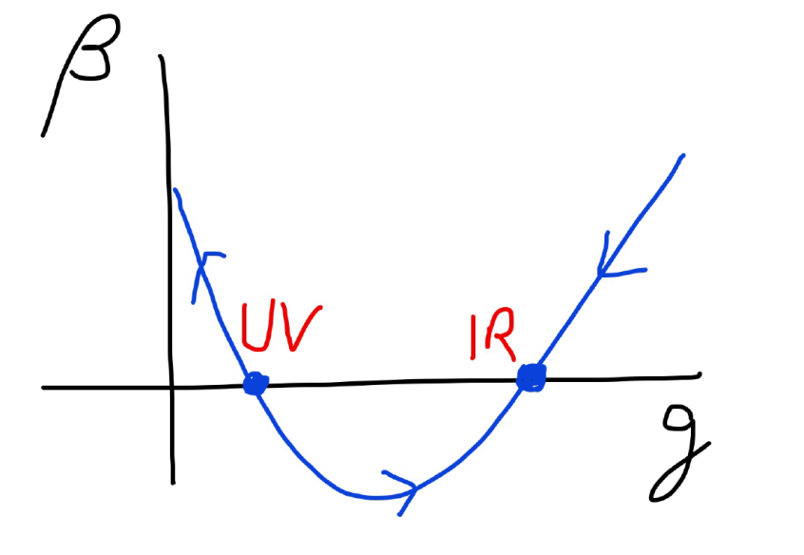
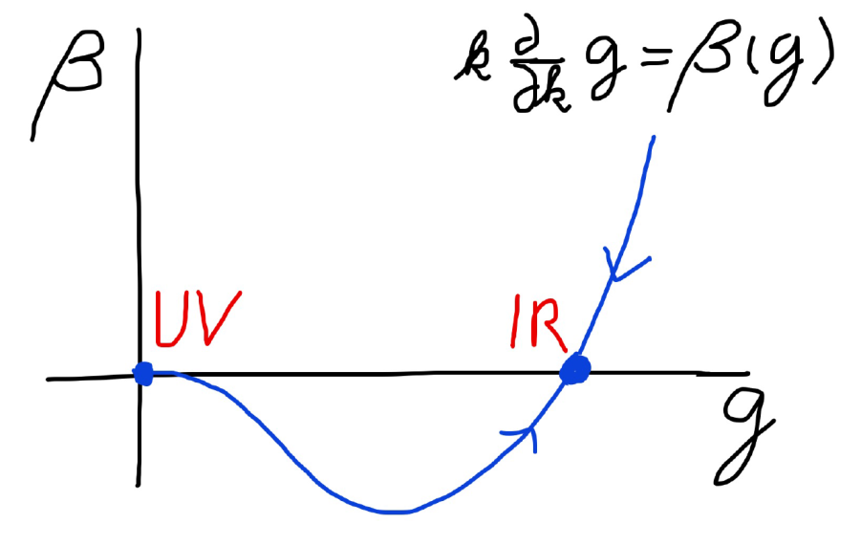
Asymptotic safety Asymptotic freedom
Relevant parameters yield undetermined couplings.
Quartic scalar coupling is not relevant and can therefore be predicted.

Slide 39
Enhanced predictivity for
UV – fixed point
Free parameters of a theory correspond to relevant parameters for small deviations from fixed point.
If the number of relevant parameters at the UV-fixed point is smaller than the number of free parameters ( renormalizable couplings ) in the standard model:
Relations between standard model parameters become predictable !

Slide 40
How to compute non-perturbative quantum gravity effects ?

Slide 41
Quantum gravity computation by functional renormalization
Introduce infrared cutoff with scale k,
such that only fluctuations with
( covariant) momenta larger than k
are included.
Then lower k towards zero

Slide 42
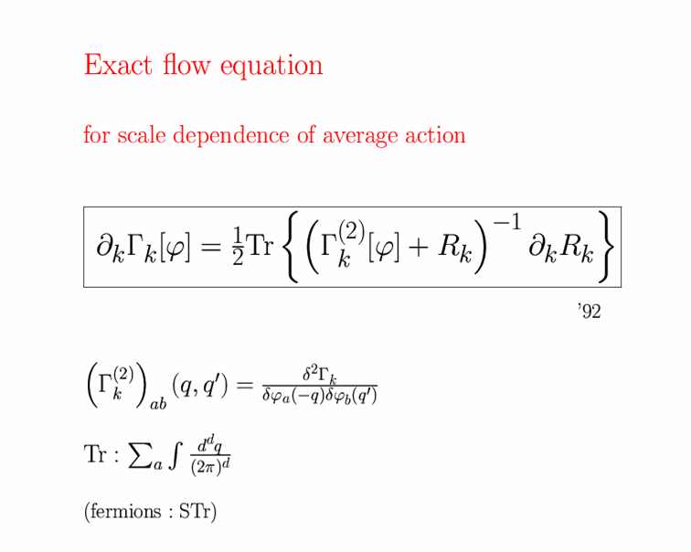
Exact renormalization group equation

Slide 43
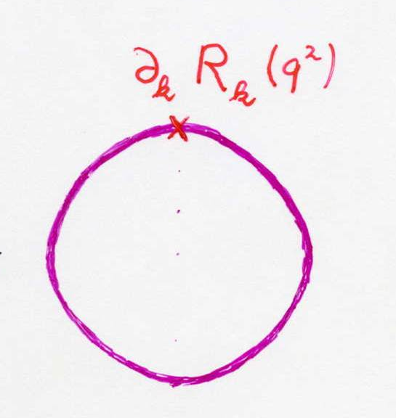
Functional flow equation for scale dependent effective action
IR cutoff
exact propagator

Slide 44
Exact renormalization group equation

Slide 45
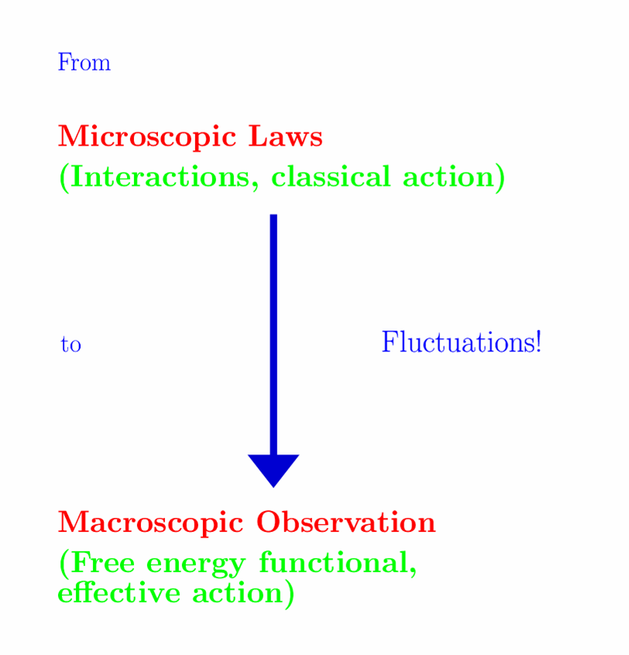


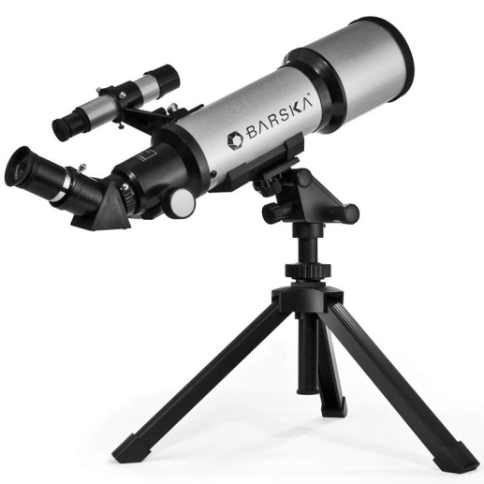

Slide 46
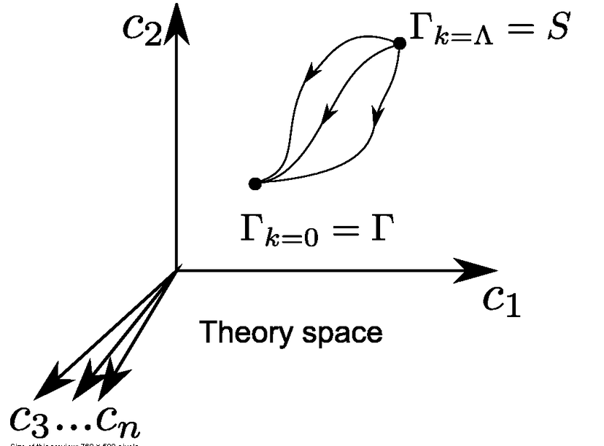
functional renormalization : flowing action
Wikipedia
Notes:
46

Slide 47
flowing action
microscopic law
macroscopic law
infinitely many couplings

Slide 48
Ultraviolet fixed point
UV fixed point
Extrapolation of microscopic law to
infinitely short distances is possible.
Complete theory
Notes:
48

Slide 49
Prediction of mass of Higgs boson ?
Quartic scalar coupling irrelevant ?
needs or A>0

Slide 50
Quartic scalar coupling is irrelevant parameter
Can be predicted !
Pawlowski, Reichert, Yamada,…

Slide 51
Conclusion (1)
Quantum gravity is a renormalizable quantum field theory, realized by UV - fixed point of running couplings or flowing effective action
Quantum gravity is predictive :
Mass of the Higgs boson ( and more …? )
Properties of inflation
Properties of dark energy

Slide 52
Quantum scale symmetry
Exactly on fixed point:
No parameter with dimension of
length or mass is present in the
quantum effective action.
Then invariance under
dilatations or global scale transformations
is realized as a quantum symmetry.
Continuous global symmetry

Slide 53
Scale symmetry in cosmology

Slide 54
Approximate scale symmetry near fixed points
UV : approximate scale invariance of primordial fluctuation spectrum from inflation
IR : cosmon is pseudo Goldstone boson of
spontaneously broken scale symmetry,
tiny mass,
responsible for dynamical Dark Energy

Slide 55
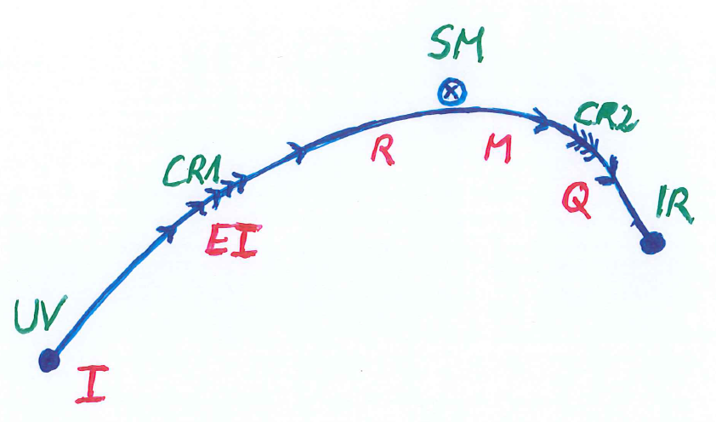
Possible consequences of crossover in quantum gravity
Realistic model for inflation and dark energy
with single scalar field

Slide 56
Inflation : the vicinity of the UV- fixed point

Slide 57
Starobinski inflation
Scale symmetry if M²/R ( and V/R² ) go to zero.
Cosmological solution : R decreases
Early stages : very large R, close to scale symmetry

Slide 58
Starobinski inflation
Scale symmetry for large R/M²
End of inflation : C R near M²
Substantial violation of scale symmetry
Primordial fluctuation spectrum:
frozen long before end of inflation
approximate scale symmetry of fluctuation spectrum

Slide 59
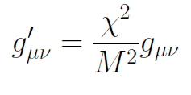

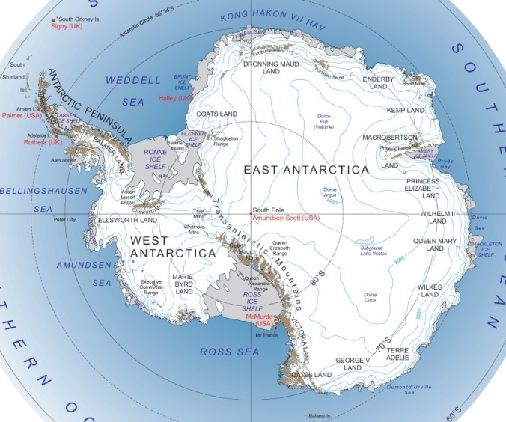
Eternal Universe
Universe exists since infinite past ( in physical time),
close to fixed point.
Big Bang is field – singularity, due to inappropriate choice of field variables for the metric.
This is similar, but not identical,
to coordinate - singularity

Slide 60
Conclusion (2)
Fixed points of quantum gravity
and associated quantum scale symmetry
are crucial for understanding the
evolution of our Universe

Slide 61
variable gravity
“Newton’s constant is not constant –
and particle masses are not constant”

Slide 62
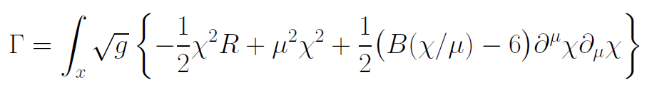
Variable Gravity
quantum effective action,
variation yields field equations
Einstein gravity :
M² R

Slide 63
+ scale symmetric standard model
Replace all mass scales by scalar field 𝜒
(1) Higgs potential
(2) Strong gauge coupling, normalized at , is independent of 𝜒
+ scale invariant action for dark matter

Slide 64
Variable Gravity
Scalar field coupled to gravity
Effective Planck mass depends on scalar field
Simple quadratic scalar potential involves intrinsic mass μ
Nucleon and electron mass proportional to dynamical Planck mass

Slide 65

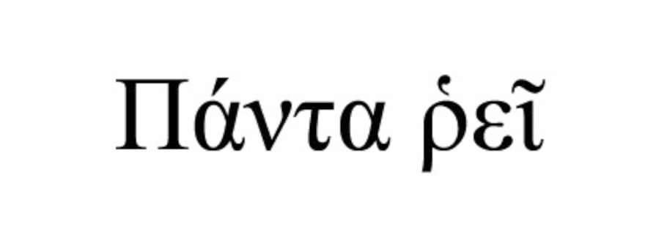

Slide 66
Scale symmetry in variable gravity
( IR – fixed point )
IR fixed point for μ/χ =0 :
quantum scale symmetry
Tiny violation of scale symmetry
for tiny μ/χ .

Slide 67
Cosmic scale symmetry and the cosmological constant problem
IR – fixed point reached for χ → ∞
Impact of intrinsic mass scale disappears

Slide 68
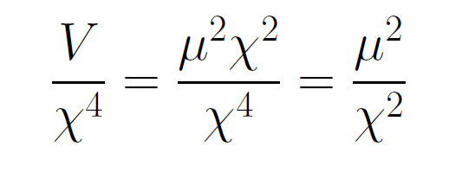
asymptotically vanishing cosmological „constant“
What matters : Ratio of potential divided by fourth power of Planck mass
vanishes for χ → ∞ !

Slide 69
Quintessence
Dynamical dark energy ,
generated by scalar field (cosmon )
C.Wetterich,Nucl.Phys.B302(1988)668, 24.9.87
P.J.E.Peebles,B.Ratra,ApJ.Lett.325(1988)L17, 20.10.87
Notes:
69

Slide 70
Prediction : homogeneous dark energy influences recent cosmology
- of same order as dark matter -
Original models do not fit the present observations
…. modifications
( different growth of neutrino mass )

Slide 71
A new view from quantum gravity
Simple approximation for graviton contribution to scalar potential:
Predicts mass of Higgs scalar
Solves Gauge Hierarchy problem ?
Solves cosmological constant problem

Slide 72
Quantum scale symmetry at fixed points
Quantum scale symmetry plays important role in
particle physics and cosmology
Particle scale symmetry is crucial for understanding of gauge hierarchy
SM- fixed point
Cosmic scale symmetry is crucial for dynamical dark energy
IR- fixed point
Gravity scale symmetry rules beginning of cosmology
UV- fixed point

Slide 73
Scale symmetry and fixed points
Relative strength of gravity
Particle
scale
symmetry
Gravity
scale
symmetry
Distance from
electroweak
phase transition
Cosmic
scale
symmetry

Slide 74
Conclusions (3)
Many incorrect statements on naturalness
neglect the important consequences of quantum
scale symmetry and associated fixed points.
Symmetries crucial for naturalness
Near fixed points : Individual contributions do not represent a natural value for the total effect

Slide 75
end

