Slide 1
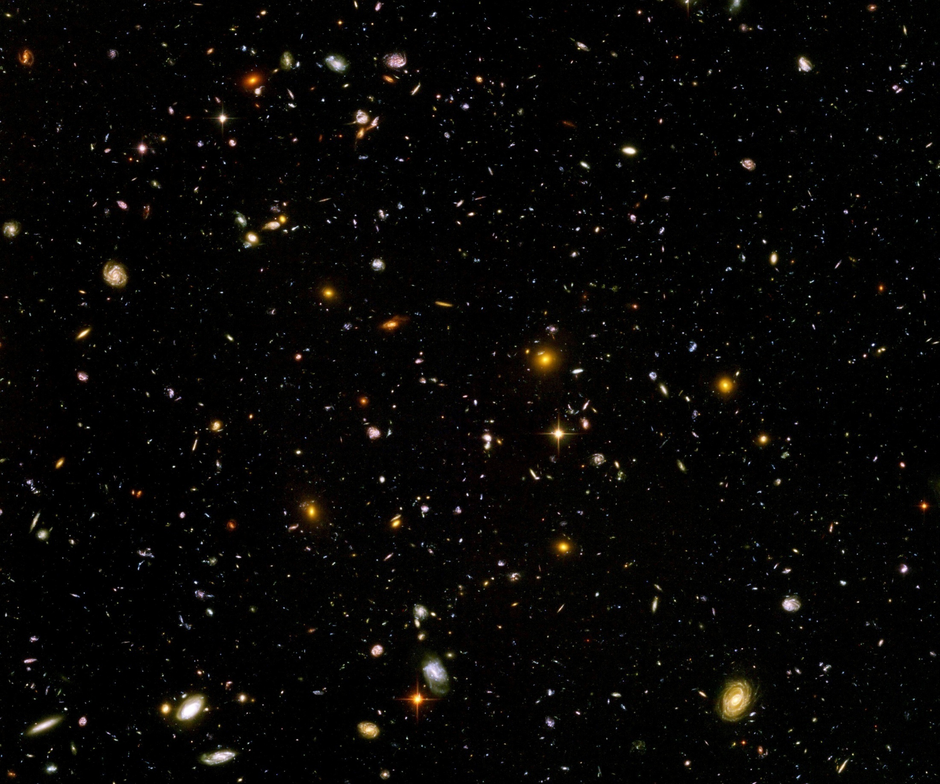
Quantum gravity predictions for particle physics and cosmology

Slide 2
quantum gravity

Slide 3
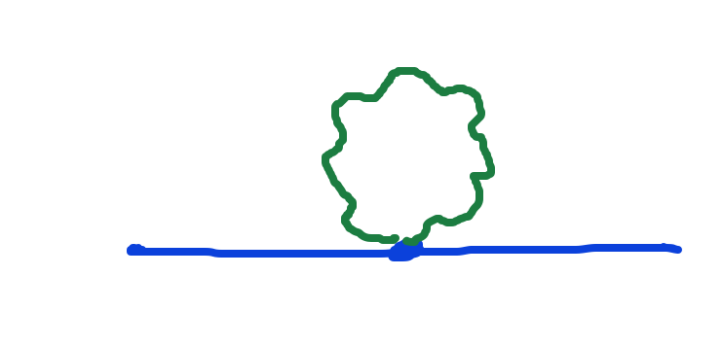
Graviton fluctuations matter
Quantum gravity needs method to take them into account

Slide 4
Quantum gravity
Gravity is field theory. Similar to electrodynamics. Metric field.
Gravity is gauge theory. Similar to QED or QCD. Gauge symmetry: general coordinate transformations ( diffeomorphisms )
Quantum gravity: include metric fluctuations in functional integral

Slide 5
Quantum gravity
Quantum gravity is similar to other quantum field theories
Difference: metric is tensor, gauge bosons are vectors ( vierbein, spin connection )
Difference: Quantum ( Einstein- ) gravity is not perturbatively renormalizable
no small dimensionless coupling constant, effective coupling q²/M²

Slide 6
Quantum gravity
Quantum gravity is
non-perturbatively renormalizable
Asymptotic safety : non-perturbative renormalizabilty
Weinberg, Reuter, …
Use functional renormalization !

Slide 7
Renormalizability
Theory can be extrapolated to
infinitely small distances or
infinitely large energies.

Slide 8
Flowing couplings
Couplings change with renormalization scale k due to ( quantum ) fluctuations.
Renormalization scale k : Only fluctuations with momenta larger k are included.
Flow of k to zero : all fluctuations included, IR-limit
Flow of k to infinity : UV-limit

Slide 9
Ultraviolet fixed point
Flow of couplings stops
Renormalizable theories have ultraviolet fixed point in the scale dependence of couplings
( renormalization flow )
Theory can be extrapolated to arbitrary short distances
Completeness

Slide 10
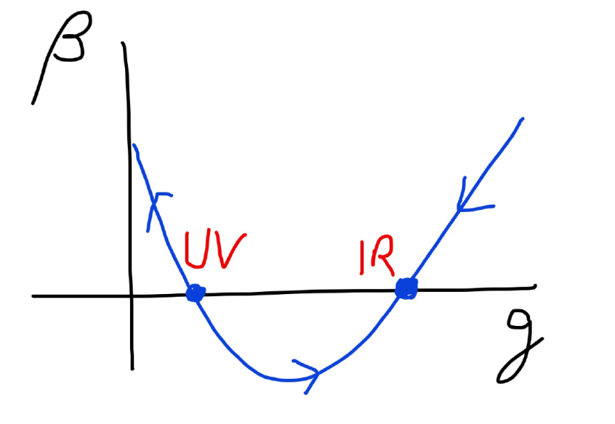
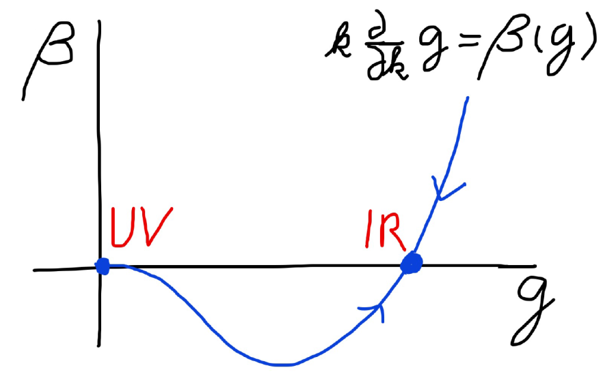
Asymptotic safety Asymptotic freedom

Slide 11
Asymptotically safe gravity
Ultraviolet fixed point exists for
quantum field theory for metric ( or vierbein ).

Slide 12
Quantum gravity predictions for particle physics

Slide 13
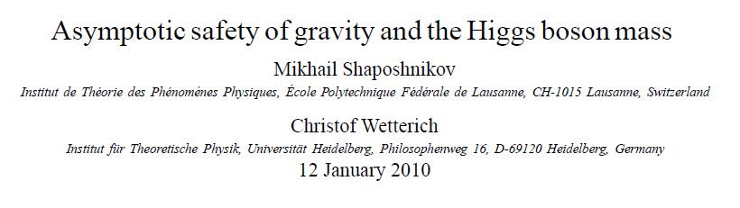
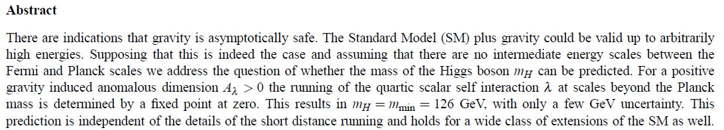
Prediction of mass of Higgs boson

Slide 14
Why can quantum gravity make predictions for particle physics ?

Slide 15

Quartic scalar coupling
prediction of mass of Higgs boson
=
prediction of value of quartic scalar coupling λ
at Fermi scale

Slide 16
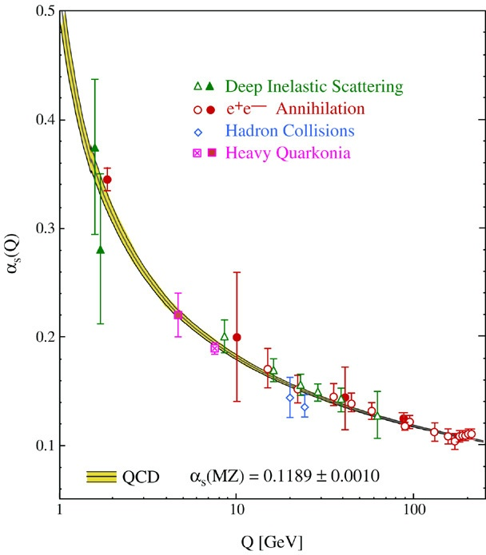
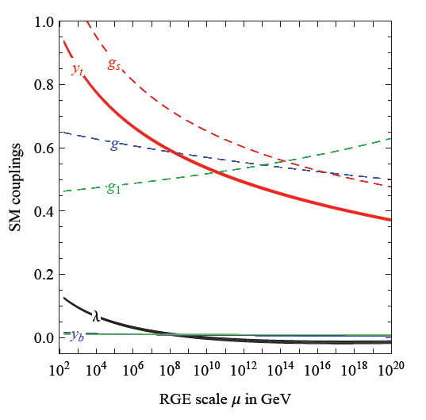
Quantum fluctuations induce running couplings
running quartic scalar coupling, gauge couplings and Yukawa couplings
Bethke
Degrassi et al

Slide 17
Quantum fluctuations induce running couplings
connect Planck scale and Fermi scale

Slide 18
key points
great desert
( solution of hierarchy problem at high scale )
high scale fixed point
vanishing scalar coupling at fixed point
great desert
fixed point

Slide 19

Planck scale, gravity
no multi-Higgs model
no technicolor
no low scale
higher dimensions
no supersymmetry

Slide 20
Near Planck mass gravity is not weak !
Predictive power !

Slide 21
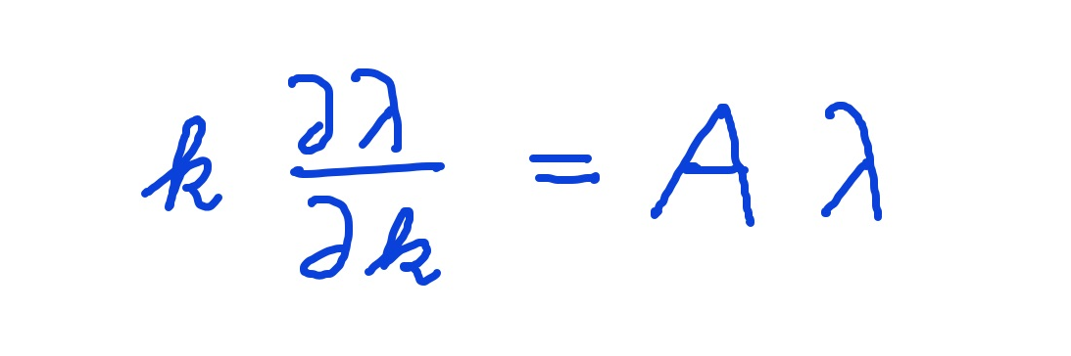
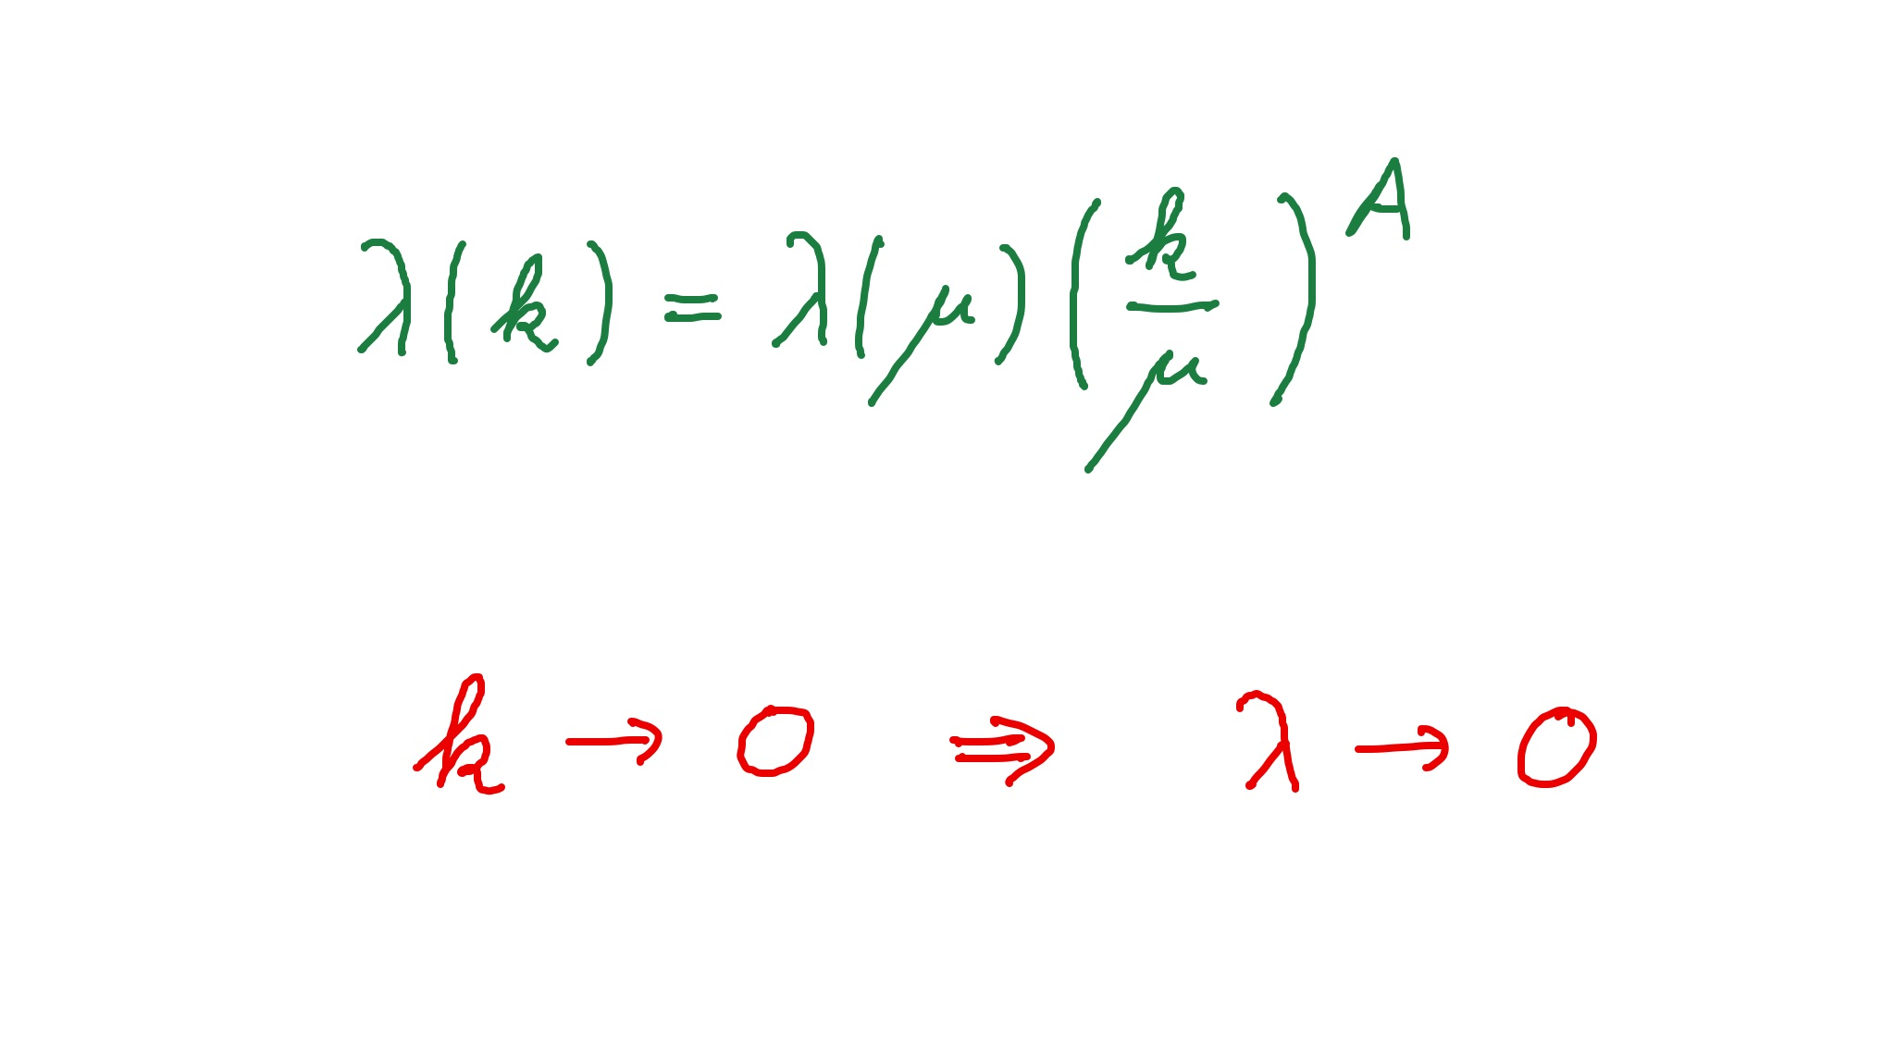
Graviton fluctuations erase quartic scalar coupling
Renormalization scale k : Only fluctuations with momenta larger k are included.
Consider first only fluctuations of metric or graviton :
gravity induced
anomalous dimension
A > 0
for
constant A :

Slide 22
Fixed point
The quartic scalar coupling λ has a
fixed point at λ=0
For A>0 it flows towards the fixed point as k is lowered:
irrelevant coupling
For a UV – complete theory irrelevant couplings are predicted to assume the fixed point value

Slide 23
Gravitational contribution to running quartic coupling
running Planck mass :
dimensionless
squared Planck mass

Slide 24
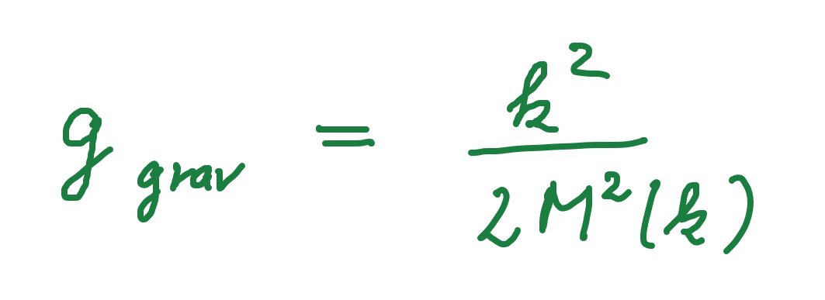
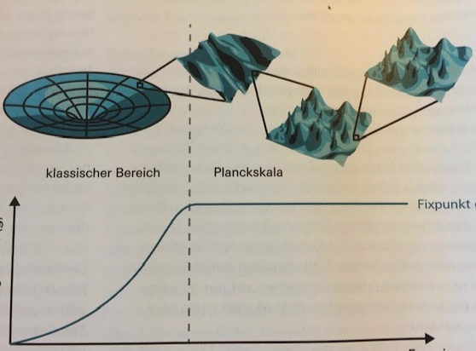
Strength of gravity
classical gravity
quantum gravity
fixed point
strength
of
gravity
g_{grav}
k, energy scale
inverse distance
A. Eichhorn, CW, Spektrum der Wissenschaft

Slide 25
Flowing Planck mass
Renormalization scale k : Only fluctuations with momenta larger k are included
Flowing
Planck mass M²(k)
matter
contribution
4 N_{V} – N_{S} - N_{F}
with graviton
contribution

Slide 26
Flowing Planck mass
Flowing
Planck mass M²(k)
solution :

Slide 27
Enhanced predictivity for
UV – fixed point
Free parameters of a theory correspond to relevant parameters for small deviations from fixed point.
If the number of relevant parameters at the UV-fixed point is smaller than the number of free parameters ( renormalizable couplings ) in the standard model:
Relations between standard model parameters become predictable !

Slide 28
Conclusion (1)
Quantum gravity is a renormalizable quantum field theory, realized by UV - fixed point of running couplings or flowing effective action
Quantum gravity is predictive :
Mass of the Higgs boson ( and more …? )
Properties of inflation
Properties of dark energy

Slide 29
Quantum gravity predictions for cosmology

Slide 30
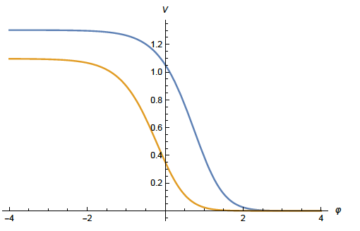
Quintessential inflation
Inflation
Dynamical
Dark Energy
Spokoiny, Peebles, Vilenkin, Peloso, Rosati, Dimopoulos, Valle, Giovannini,
Brax, Martin, Hossain, Myrzakulov, Sami, Saridakis, de Haro, Salo, Bettoni, Rubio…

Slide 31
Scaling solutions
At fixed point: all ( infinitely many ) dimensionless couplings take fixed values
Whole scalar potential is fixed, for arbitrary values of scalar field
Functional flow equations are needed

Slide 32
Scaling solutions are restrictive
Scaling solutions are particular solutions of non-linear differential equations
In presence of gravitational fluctuations: scalar effective potential no longer approximated by polynomial

Slide 33
Scaling solutions and cosmology
Cosmology involves scalar potentials over large range of field values
Inflaton potential
Higgs potential for Higgs inflation
Cosmon potential for dynamical dark energy or quintessence

Slide 34
Quantum gravity : these potentials are not arbitrary

Slide 35
Dilaton quantum gravity
quantum gravity coupled to a scalar field
Henz, Pawlowski, Rodigast, Yamada, Reichert,
Eichhorn, Pauly, Laporte, Pereira, Saueressig, Wang…

Slide 36
Scaling potential in
standard model
u : dimensionless
scalar potential
u= U/k⁴
x : logarithm of
scalar field value

Slide 37
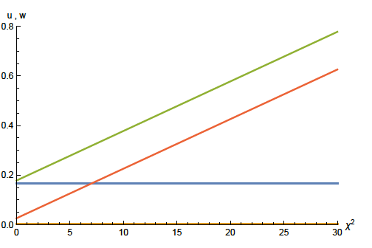
Scaling solution : flat potential
squared scalar field value χ²

Slide 38

Derivative expansion of effective action
variable gravity

Slide 39
Coefficient of curvature scalar in standard model
w : dimensionless
field dependent
squared Planck
mass
w =2 F/ k²
non-minimal
coupling of
scalar field
to gravity: ξχ²R

Slide 40
Scaling solution : flat potential, non-minimal scalar- gravity coupling

Slide 41
Scaling solution in Einstein frame

Slide 42





Weyl transformation for variable gravity

Slide 43

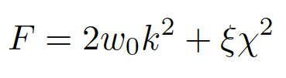

Scaling solution
For low energy
standard model :

Slide 44
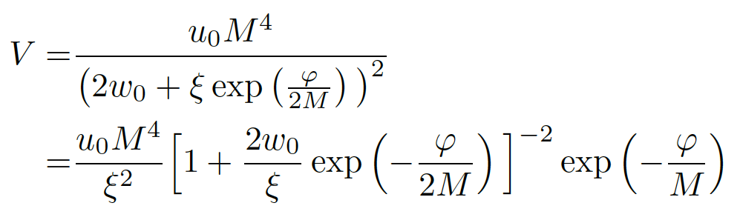
Asymptotic solution of cosmological constant problem
no tiny parameter !

Slide 45
Cosmological solution
scalar field χ vanishes in the infinite past
scalar field χ diverges in the infinite future
J.Rubio,…

Slide 46
Conclusion (2)
Fixed points of quantum gravity
and associated quantum scale symmetry
are crucial for understanding the
evolution of our Universe

Slide 47
Quantum gravity and the beginning of the Universe

Slide 48
Beginning of Universe
Zu Anfang war die Welt öd und leer und währte ewig.
In the beginning the Universe was empty and lasted since ever.

Slide 49

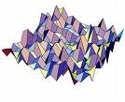
Eternal light-vacuum
Everywhere almost nothing
only fields and their fluctuations
All particles move
with light velocity,
similar to photons

Slide 50
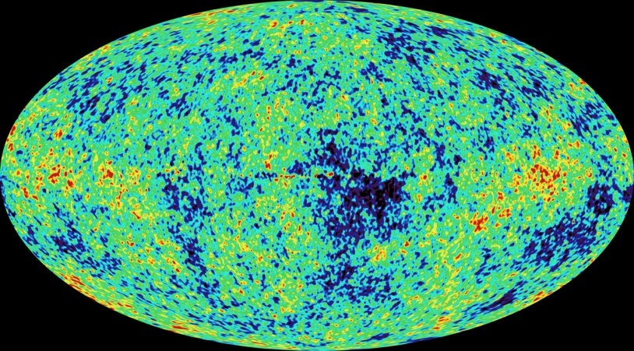
Eternal light-vacuum is unstable
Slow increase of particle masses
Only slow change of space-time geometry
Creation of particles and entropy
Consequence for observation : primordial fluctuations become visible in cosmic background radiation
We see fluctuations in a stage 5000 billion years ago.

Slide 51
The great emptiness story
In the beginning was light-like emptiness.

Slide 52
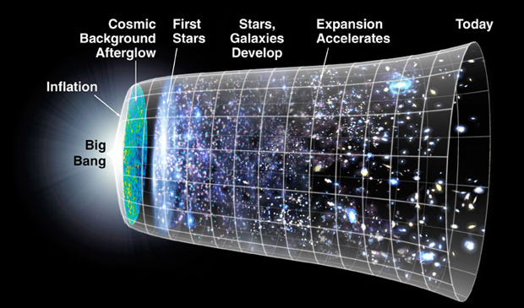
The big bang story
dramatic hot big bang
started 13.7 billion years ago
at the beginning extremely short period of cosmic inflation with almost exponential expansion of the Universe, duration around 10⁻⁴⁰ seconds
start with singularity : our whole observable Universe evolves from one point

Slide 53
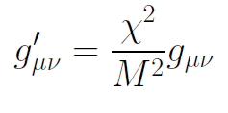
Field relativity
Both stories are equivalent
related by field transformation of the metric
different metrics related by Weyl transformation, which depends on scalar field ( inflaton )

Slide 54

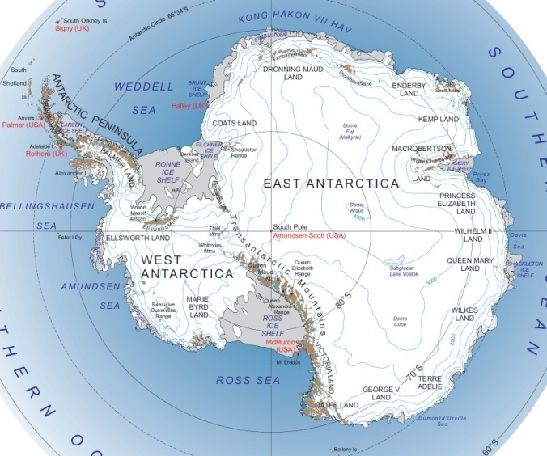
Field - singularity
Big Bang is field - singularity
similar ( but not identical with )
coordinate - singularity

Slide 55
end

