Slide 1
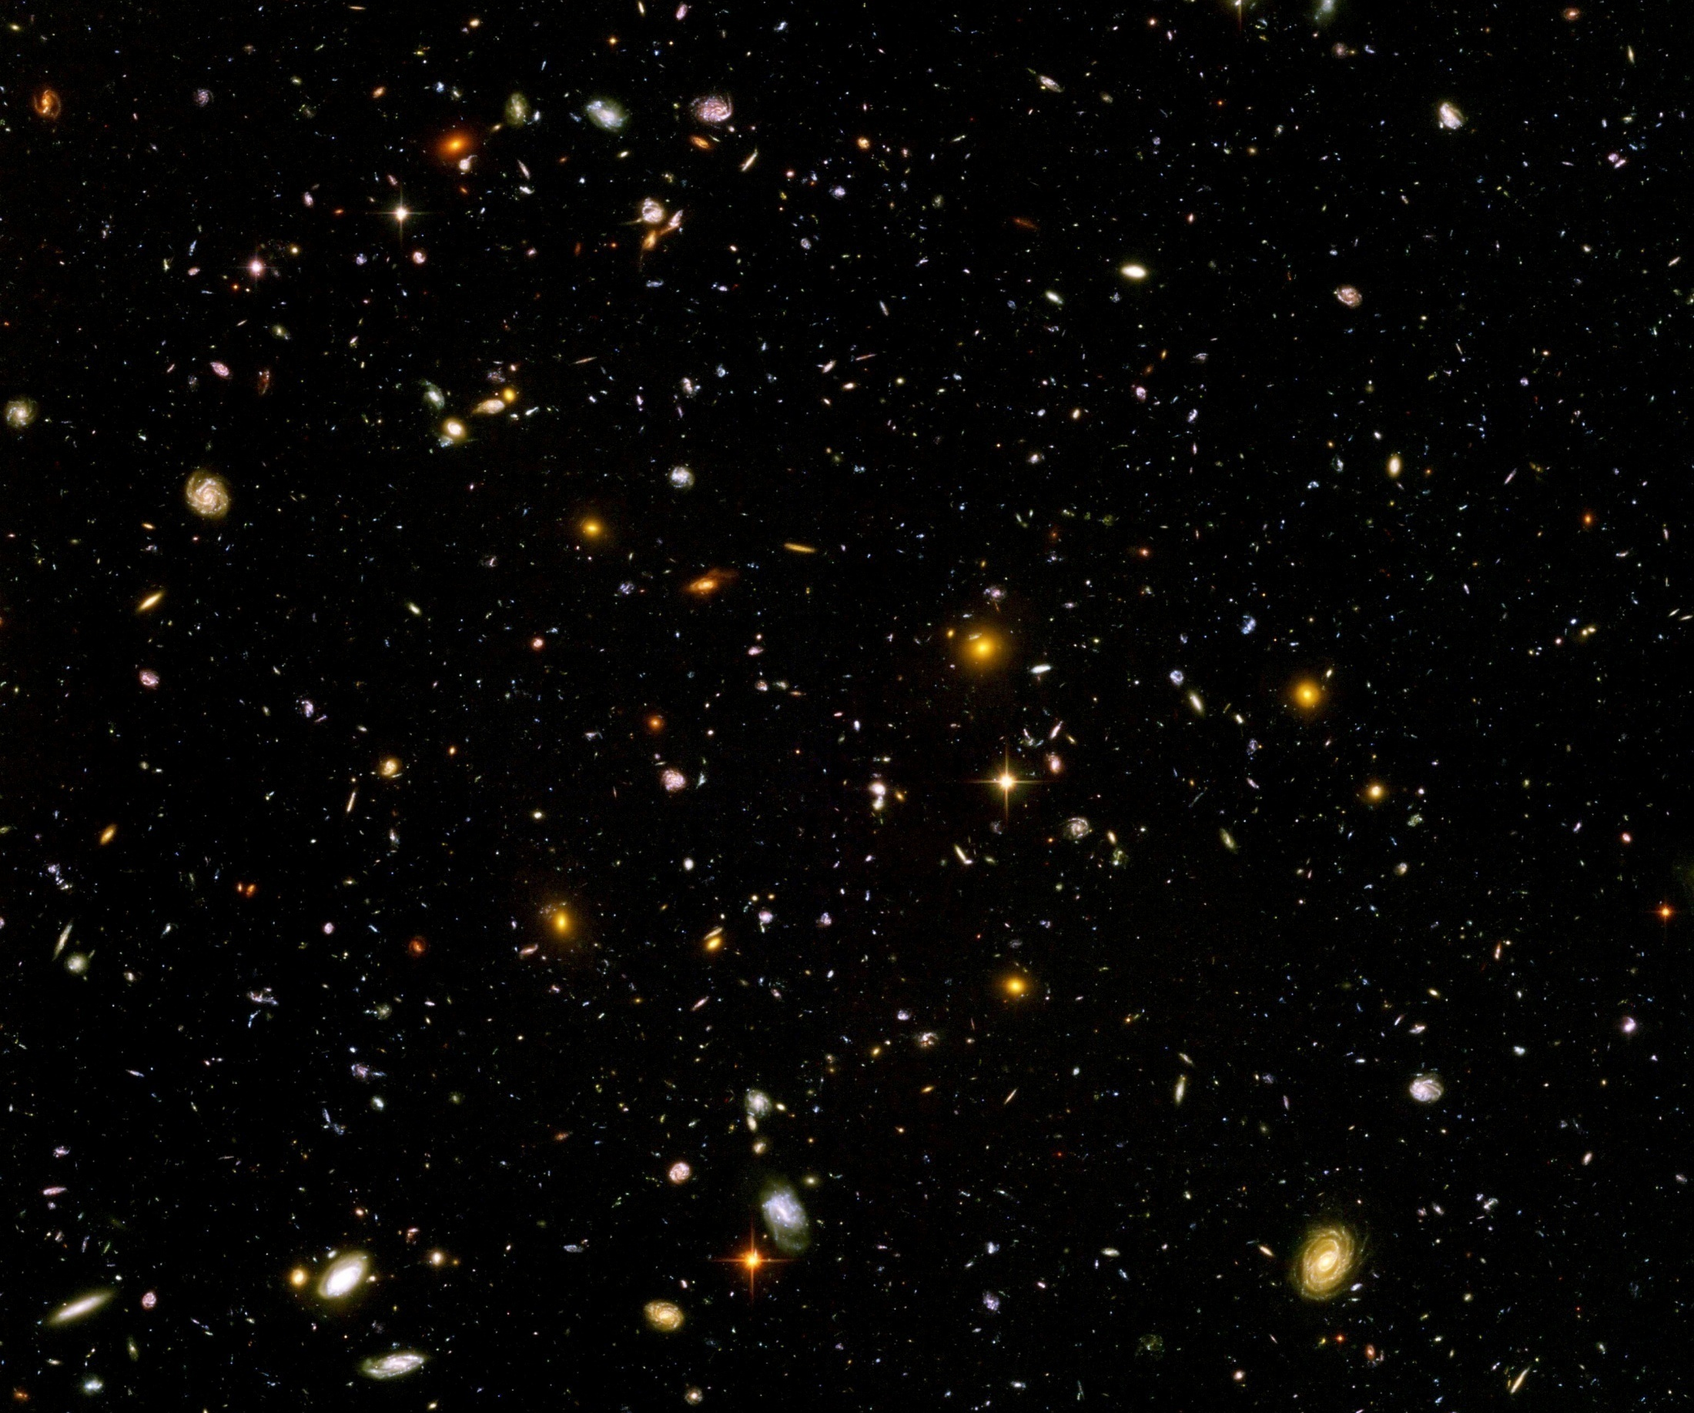
Quantum gravity predictions for particle physics and cosmology

Slide 2
quantum gravity

Slide 3
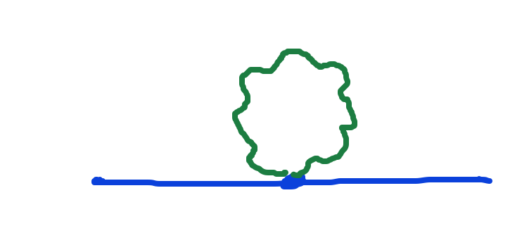
Graviton fluctuations matter
Quantum gravity needs method to take them into account

Slide 4
Fluctuations of metric, vierbein
Near and beyond Planck scale
Typically includes other (geometrical) fields
Completely new structure ?
around the Planck scale ?
Should not leave substantial trace in primordial cosmic fluctuations ( isotropy,… )

Slide 5
Quantum gravity
Gravity is field theory. Similar to electrodynamics. Metric field.
Gravity is gauge theory. Similar to QED or QCD. Gauge symmetry: general coordinate transformations ( diffeomorphisms )
Quantum gravity: include metric fluctuations in functional integral

Slide 6
Quantum gravity
Quantum gravity is similar to other quantum field theories
Difference: metric is tensor, gauge bosons are vectors ( vierbein, spin connection : vectors )
Difference: Quantum ( Einstein- ) gravity is not perturbatively renormalizable
no small dimensionless coupling constant, effective coupling q²/M²

Slide 7
Quantum gravity
Quantum gravity is
non-perturbatively renormalizable
Asymptotic safety : non-perturbative renormalizabilty
Weinberg, Reuter, …
Use functional renormalization !

Slide 8
Renormalizability
Theory can be extrapolated to
infinitely small distances or
infinitely large energies.

Slide 9
Flowing couplings
Couplings change with renormalization scale k due to
( quantum ) fluctuations.
Renormalization scale k : Only fluctuations with momenta larger k are included.
Flow of k to zero : all fluctuations included, IR-limit
Flow of k to infinity : UV-limit
k-dependence can differ from momentum dependence

Slide 10
Ultraviolet fixed point
Flow of dimensionless couplings stops as k increases towards infinity
Renormalizable theories have ultraviolet fixed point in the scale dependence of couplings
( renormalization flow )
Theory can be extrapolated to arbitrarily short distances
Completeness

Slide 11
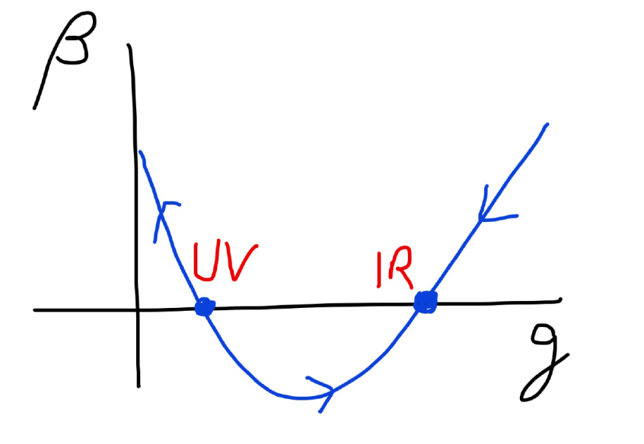
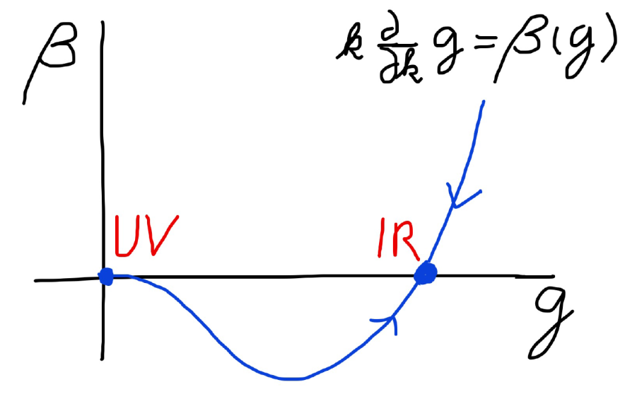
Asymptotic safety Asymptotic freedom

Slide 12
Asymptotically safe gravity
Ultraviolet fixed point exists for
quantum field theory for metric ( or vierbein ).

Slide 13
Quantum gravity predictions for particle physics

Slide 14
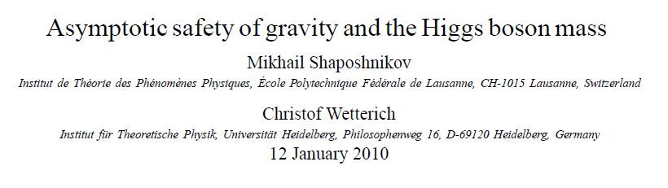
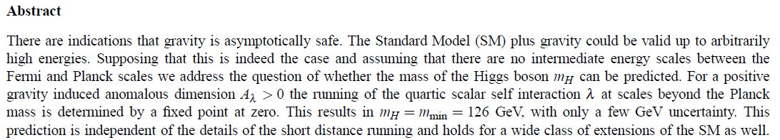
Prediction of mass of Higgs boson

Slide 15
Why can quantum gravity make predictions for particle physics ?

Slide 16

Quartic scalar coupling
prediction of mass of Higgs boson
=
prediction of value of quartic scalar coupling λ
at Fermi scale

Slide 17
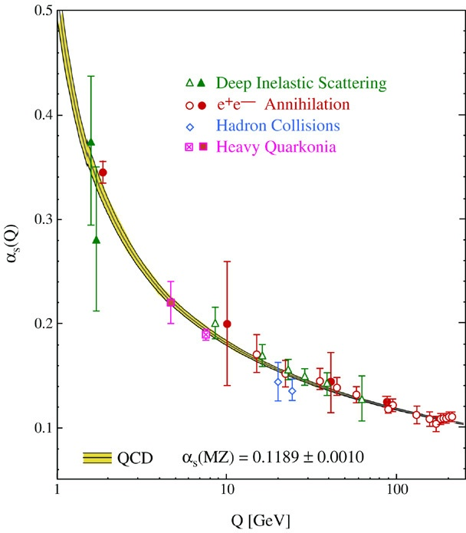
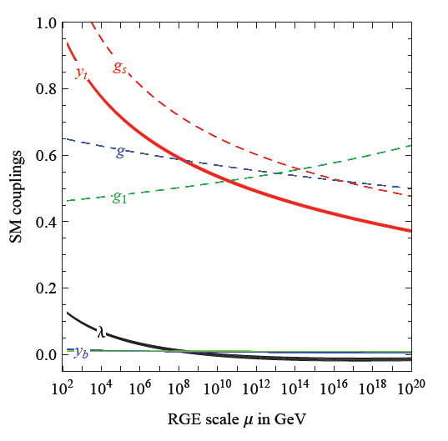
Quantum fluctuations induce running couplings
running quartic scalar coupling, gauge couplings and Yukawa couplings
Bethke
Degrassi et al

Slide 18
Quantum fluctuations induce running couplings
connect Planck scale and Fermi scale

Slide 19
key points
great desert
( solution of hierarchy problem at high scale )
high scale fixed point
vanishing scalar coupling at fixed point
great desert
fixed point

Slide 20

Planck scale, gravity
no multi-Higgs model
no technicolor
no low scale
higher dimensions
no supersymmetry

Slide 21
Oasis in the desert ?
Possible
Mass generation for neutrinos
Dark matter particles
Axions
Beyond standard model physics
Should not strongly affect the running of the ratio between quartic scalar coupling and top Yukawa coupling

Slide 22
Near Planck mass gravity is not weak !
Predictive power !

Slide 23
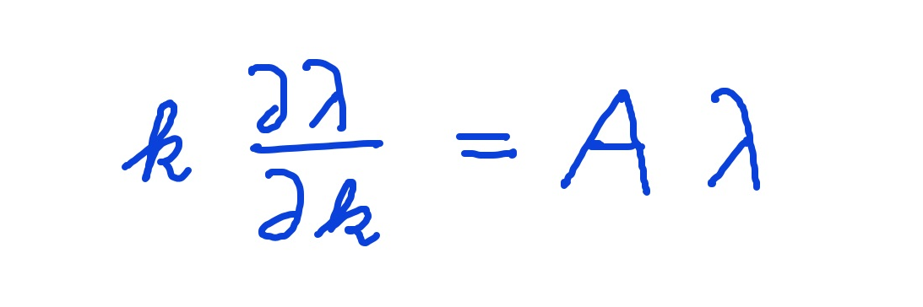
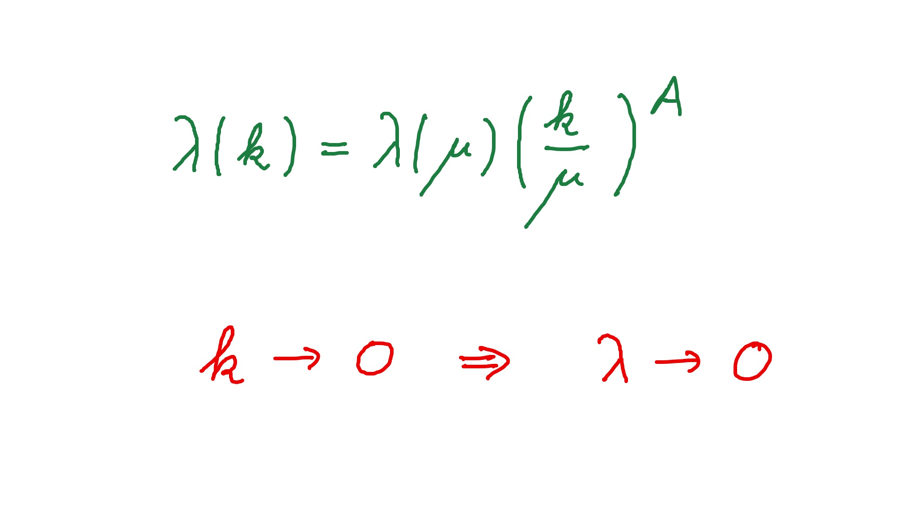
Graviton fluctuations erase quartic scalar coupling
Renormalization scale k : Only fluctuations with momenta larger k are included.
Consider first only fluctuations of metric or graviton :
gravity induced
anomalous dimension
A > 0
for
constant A :

Slide 24
Fixed point
The quartic scalar coupling λ has a
fixed point at λ=0
For A>0 it flows towards the fixed point as k is lowered:
irrelevant coupling Narain, Percacci
For a UV – complete theory irrelevant couplings are predicted to assume the fixed point value

Slide 25
Gravitational contribution to running quartic coupling
running Planck mass :
dimensionless
squared Planck mass

Slide 26
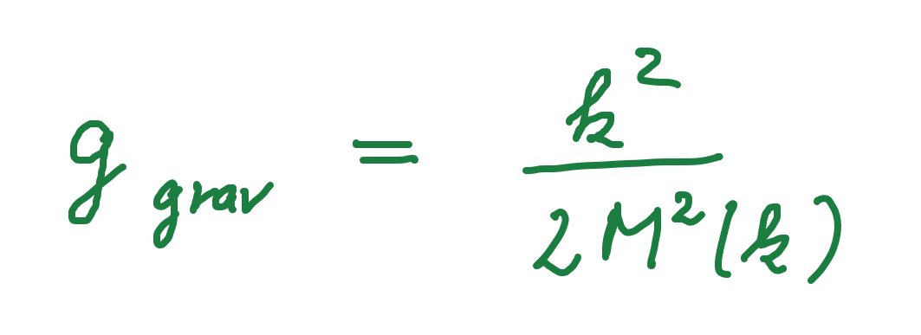
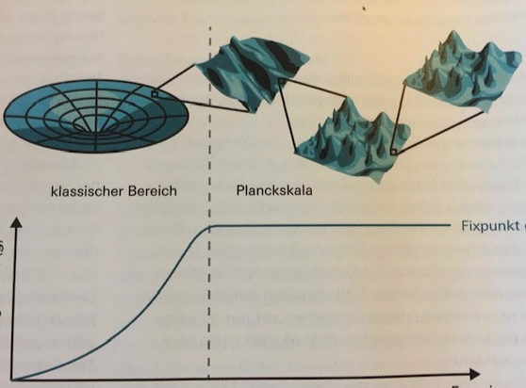
Strength of gravity
classical gravity
quantum gravity
fixed point
strength
of
gravity
g_{grav}
k, energy scale
inverse distance
A. Eichhorn, CW, Spektrum der Wissenschaft

Slide 27
Flowing Planck mass
Renormalization scale k : Only fluctuations with momenta larger k are included
Flowing
Planck mass M²(k)
M. Reuter
matter
contribution
4 N_{V} – N_{S} - N_{F}
with graviton
contribution

Slide 28
Flowing Planck mass
Flowing
Planck mass M²(k)
solution :

Slide 29
Enhanced predictivity for
UV – fixed point
Free parameters of a theory correspond to relevant parameters for small deviations from fixed point.
If the number of relevant parameters at the UV-fixed point is smaller than the number of free parameters ( renormalizable couplings ) in the standard model:
Relations between standard model parameters become predictable !

Slide 30
Asymptotically safe standard model
Standard model seems compatible with asymptotic safety of gravity
There exists a suitable UV-fixed point for which all observed couplings can be realized
Non – trivial statement
Dou, Percacci, Daum, Reuter, Eichhorn, Dona, Perrini, Held, Pawlowski, Reichert, Yamada, Oda, Saueressig, Hamada, Lumma, Pauly, Pastor-Gutierrez and many more

Slide 31
FRG landscape
Beyond Standard Model physics
similar predictions or restrictions for particles beyond standard model
not everything goes !
Eichhorn, Yamada, Oda, Reichert, Pauly, De Brito, Lino dos Santos, Kowalska, Sessolo, Hamada, Pereira, Miqueleto…

Slide 32
Conclusion (1)
Quantum gravity is a renormalizable quantum field theory, realized by UV - fixed point of running couplings or flowing effective action
Quantum gravity is predictive :
Mass of the Higgs boson
Constraints on mass of t - quark (Eichhorn, Held)
Scalar potential in GUT model
Restrictions for Beyond-SM Particles

Slide 33
Quantum gravity predictions for cosmology

Slide 34
Inflation
minimal setting for standard model + gravity :
coefficient of R² term 𝛼 is relevant parameter
can be chosen freely
large 𝛼 : Starobinski inflation
Gubitosi, Ooijer, Ripken, Saueressig,
Platania, Vacca, Laporte, Perreira, Wang, Knorr, Bonanno, Falls,…

Slide 35
Inflation and dynamical dark energy
Quantum gravity with singlet scalar field

Slide 36
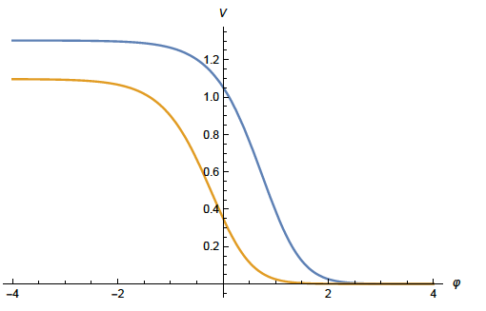
Quintessential inflation
Inflation
Dynamical
Dark Energy
Spokoiny, Peebles, Vilenkin, Peloso, Rosati, Dimopoulos, Valle, Giovannini,
Brax, Martin, Hossain, Myrzakulov, Sami, Saridakis, de Haro, Salo, Bettoni, Rubio…

Slide 37
Scaling solutions
At fixed point: all ( infinitely many ) dimensionless couplings take fixed values
Whole scalar potential is fixed, for arbitrary values of scalar field
Functional flow equations are needed

Slide 38
Scaling solutions are restrictive
Scaling solutions are particular solutions of non-linear differential equations
In presence of gravitational fluctuations: scalar effective potential no longer approximated by polynomial

Slide 39
Scaling solutions and cosmology
Cosmology involves scalar potentials over large range of field values
Inflaton potential
Higgs potential for Higgs inflation
Cosmon potential for dynamical dark energy or quintessence

Slide 40
Quantum gravity : these potentials are not arbitrary

Slide 41
Dilaton quantum gravity
quantum gravity coupled to a scalar field
Henz, Pawlowski, Rodigast, Yamada, Reichert,
Eichhorn, Pauly, Laporte, Pereira, Saueressig,
Wang, Knorr, …
for low order polynomial expansion of potential : Percacci, Narain, …

Slide 42
Scaling potential in
standard model
u : dimensionless
scalar potential
u= U/k⁴
x : logarithm of
scalar field value

Slide 43
Generic form of scaling potential
Interpolates between two plateaus
Scalar potential =
field dependent “cosmological constant”
Effectively massless particles contribute to flow
Different numbers of massless particles in different regions of field space
Gravity induced anomalous dimension A describes approach to scaling solution

Slide 44
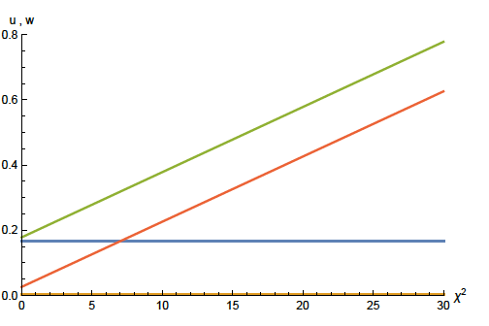
Scaling solution : flat potential
w
u
squared scalar field value χ²

Slide 45

Derivative expansion of effective action
variable gravity
F : field dependent squared Planck mass

Slide 46
Coefficient of curvature scalar in standard model
w : dimensionless
field dependent
squared Planck mass
w =2 F/ k²
non-minimal
coupling of
scalar field
to gravity: ξχ²R
x : logarithm of scalar field value

Slide 47
Approximate scaling solution
flat potential: u constant
non-minimal scalar- gravity coupling:
for large scalar field w increases proportional χ²

Slide 48
looks natural no small parameter no tuning

Slide 49
Scaling solution in Einstein frame

Slide 50





Weyl transformation for variable gravity

Slide 51

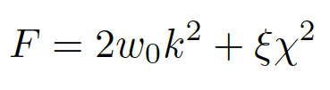

Scaling solution
For low energy
standard model :

Slide 52
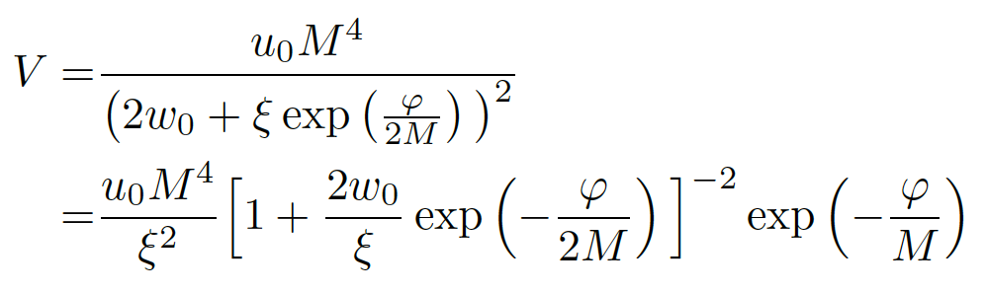
Asymptotic solution of cosmological constant problem
no tiny parameter !

Slide 53
Cosmological solution
scalar field χ vanishes in the infinite past
scalar field χ diverges in the infinite future
J.Rubio,…

Slide 54
Predictions for primordial cosmic fluctuations
Depend on form of kinetial K
so far form of K assumed assumed :
realistic cosmology possible for suitable K
K needs to be computed!

Slide 55
Alternatives for inflation in asymptotically safe quantum gravity
use flow away from the scaling solution
relevant parameters
coefficient of R² term 𝛼
large 𝛼 : Starobinski inflation
Saueressig, Platania, Vacca, Laporte, Perreira, Wang
Higgs inflation?

Slide 56
Conclusion (2)
Fixed points of quantum gravity
and associated quantum scale symmetry
are crucial for understanding the
evolution of our Universe

Slide 57
Quantum gravity and the beginning of the Universe

Slide 58
Beginning of Universe
Zu Anfang war die Welt öd und leer und währte ewig.
In the beginning the Universe was empty and lasted since ever.

Slide 59
Beginning close to ultraviolet fixed point for vanishing scalar field
all particles massless for χ = 0
fluctuations dominate
metric field vanishes
quantum scale symmetry
(equivalent primordial flat frame: initial flat Minkowski space )

Slide 60
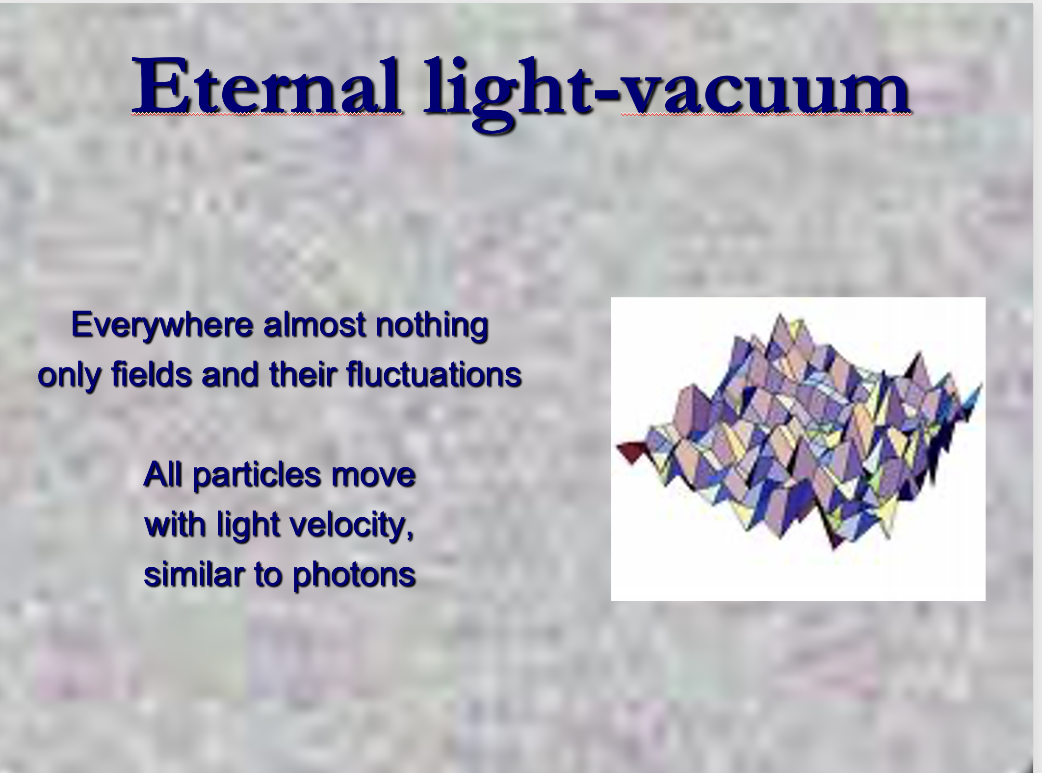

Slide 61

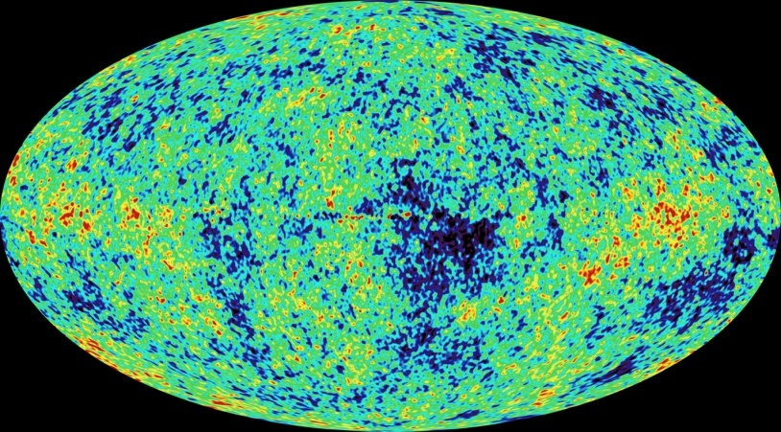
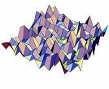
Eternal light-vacuum is unstable
Slow increase of particle masses
Only slow change of space-time geometry
Creation of particles and entropy at crossover away from UV-fixed point
Consequence for observation : primordial fluctuations become visible in cosmic background radiation
We see fluctuations in a stage more than 1000 billion years ago.

Slide 62
The great emptiness story
In the beginning was light-like emptiness.

Slide 63
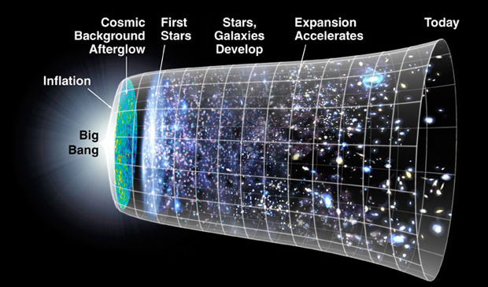
The big bang story
dramatic hot big bang
started 13.7 billion years ago
at the beginning extremely short period of cosmic inflation with almost exponential expansion of the Universe, duration around 10⁻⁴⁰ seconds
start with singularity : our whole observable Universe evolves from one point

Slide 64
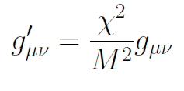
Field relativity
Both stories are equivalent
related by field transformation of the metric
different metrics related by Weyl transformation, which depends on scalar field ( inflaton )

Slide 65

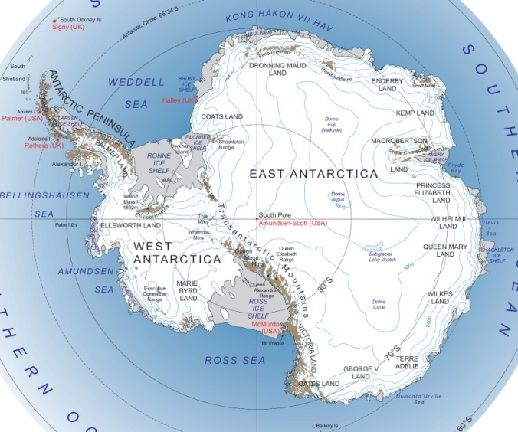
Field - singularity
Big Bang is field - singularity
similar ( but not identical with )
coordinate - singularity

Slide 66
end

