Slide 1
Quantum gravity predictions for particle physics

Slide 2
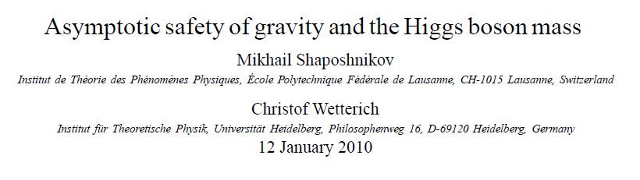
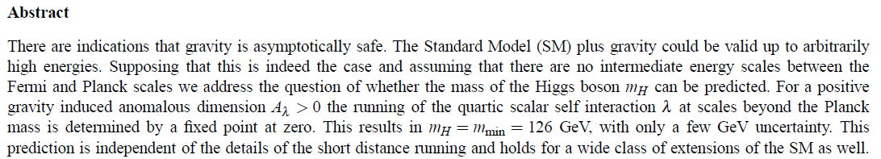
Prediction of mass of Higgs boson

Slide 3
Why can quantum gravity make predictions for particle physics ?

Slide 4
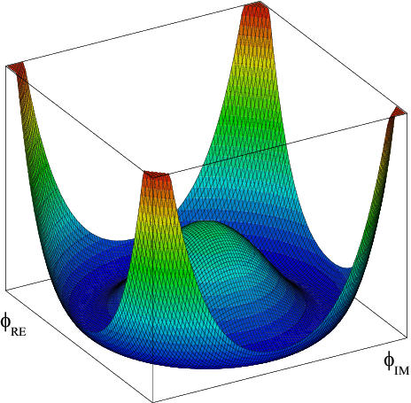
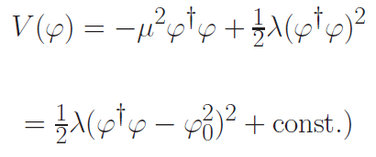

Effective potential for Higgs scalar
Fermi scale

Slide 5


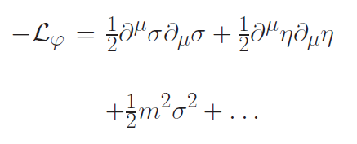

Radial mode and
Goldstone mode
expand around minimum of potential
mass term for
radial mode

Slide 6
Quartic scalar coupling
prediction of mass of Higgs boson
=
prediction of value of quartic scalar coupling λ
at Fermi scale

Slide 7
Why can quantum gravity make predictions for quartic scalar coupling ?

Slide 8
Mass scales
Fermi scale 𝜑₀ ~ 100 GeV
Planck mass M ~ 10¹⁸ GeV
Gravity at Fermi scale is very weak : How can it influence the effective potential for the Higgs scalar and the mass of the Higgs boson ?

Slide 9
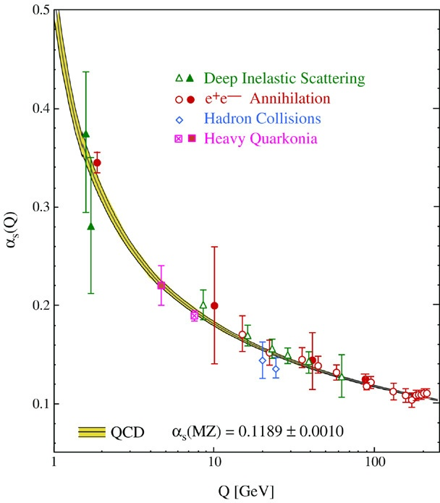
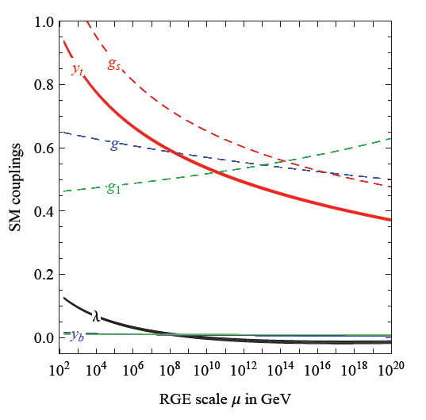
Quantum fluctuations induce running couplings
possible violation of scale symmetry
well known in QCD or standard model
Bethke
Degrassi et al

Slide 10
Quantum fluctuations induce running couplings
possible violation of scale symmetry
well known in QCD or standard model

Slide 11

The mass of the Higgs boson, the great desert, and asymptotic safety of gravity

Slide 12
key points
great desert
solution of hierarchy problem at high scale
high scale fixed point
vanishing scalar coupling at fixed point
great desert
fixed point

Slide 13


Slide 14
Planck scale, gravity
no multi-Higgs model
no technicolor
no low scale
higher dimensions
no supersymmetry

Slide 15
Essential point for prediction of Higgs boson mass:
Initial value of quartic scalar coupling near Planck mass is predicted by quantum gravity
Results in prediction for ratio Higgs boson mass over W- boson mass, or
Higgs boson mass over top quark mass
Extrapolate perturbatively
to Fermi scale

Slide 16
Near Planck mass gravity is not weak !
Predictive power !

Slide 17
Flowing couplings
Couplings change with momentum scale due to quantum fluctuations.
Renormalization scale k : Only fluctuations with momenta larger k are included. The scale k can be momenta, geometric quantities, or just be introduced “by hand”.
Flow of k to zero : all fluctuations included, IR
Flow of k to infinity : UV

Slide 18
Renormalization group
How do couplings or physical laws change
with scale k ?

Slide 19
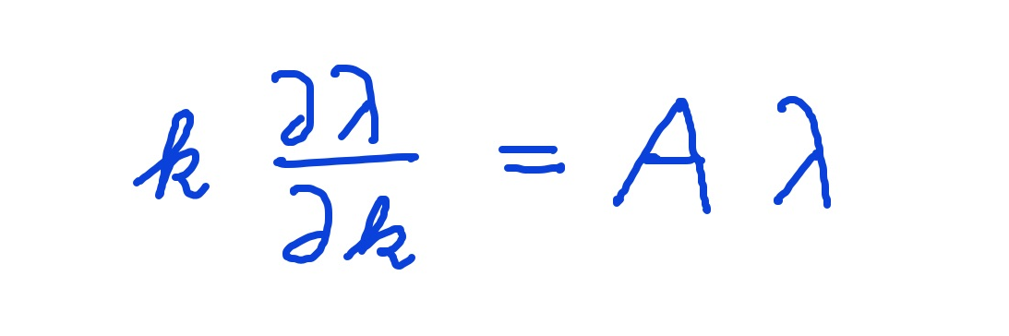
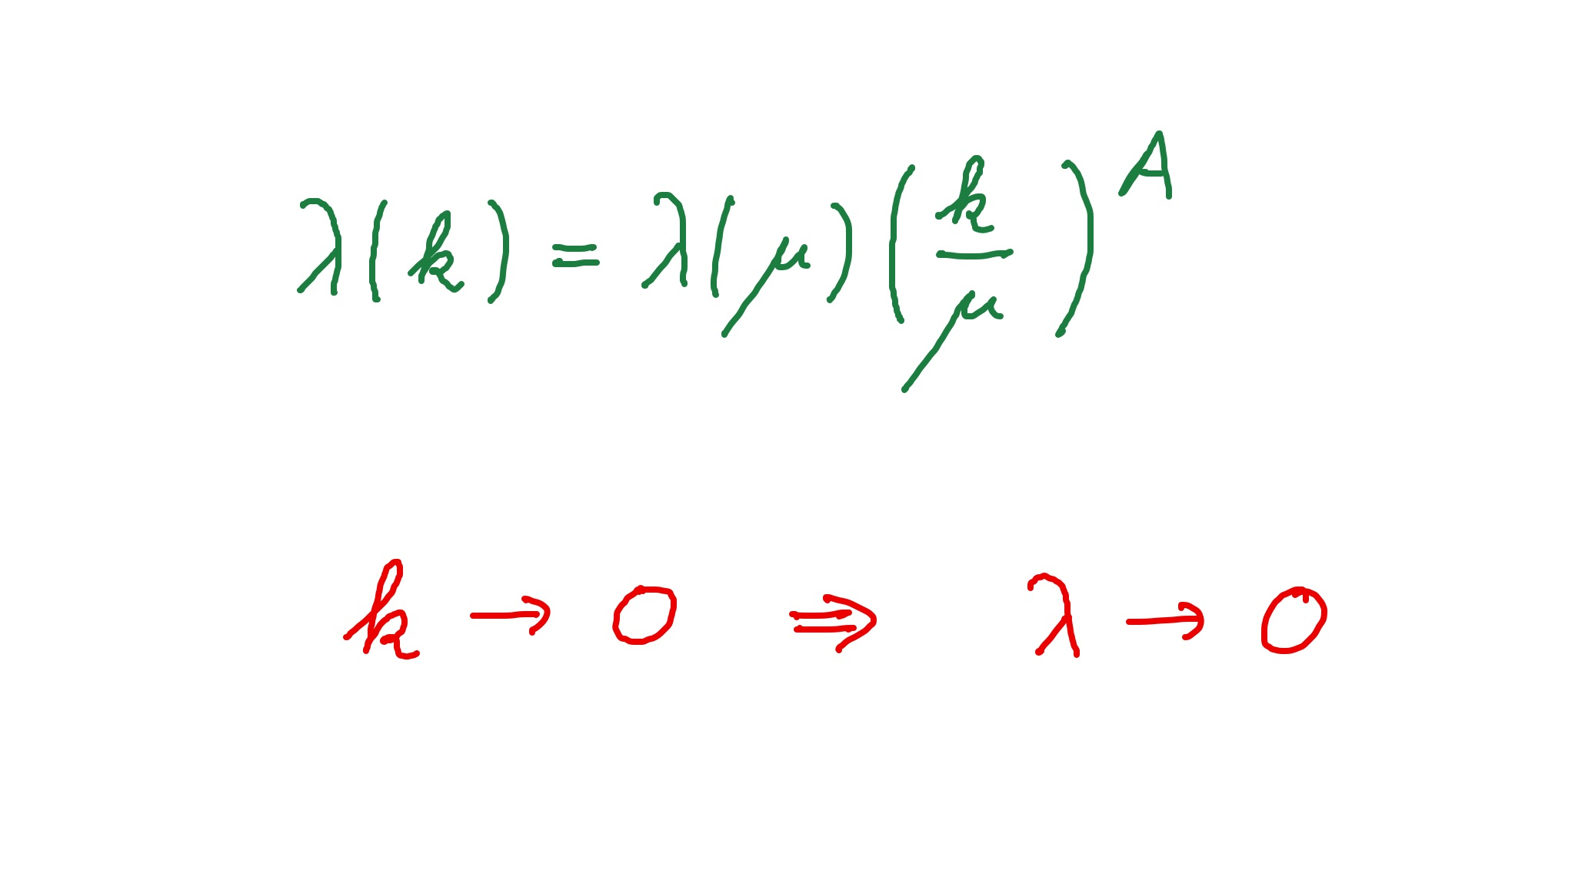
Graviton fluctuations erase quartic scalar coupling
Renormalization scale k : Only fluctuations with momenta larger k are included
gravity induced
anomalous dimension
A > 0

Slide 20
Fixed point
The quartic scalar coupling λ has a
fixed point at λ=0
It flows towards the fixed point as k is lowered :
irrelevant coupling
For a UV – complete theory it is predicted to assume the fixed point value

Slide 21
Gravitational contribution to running quartic coupling
running Planck mass :
dimensionless
squared Planck mass

Slide 22
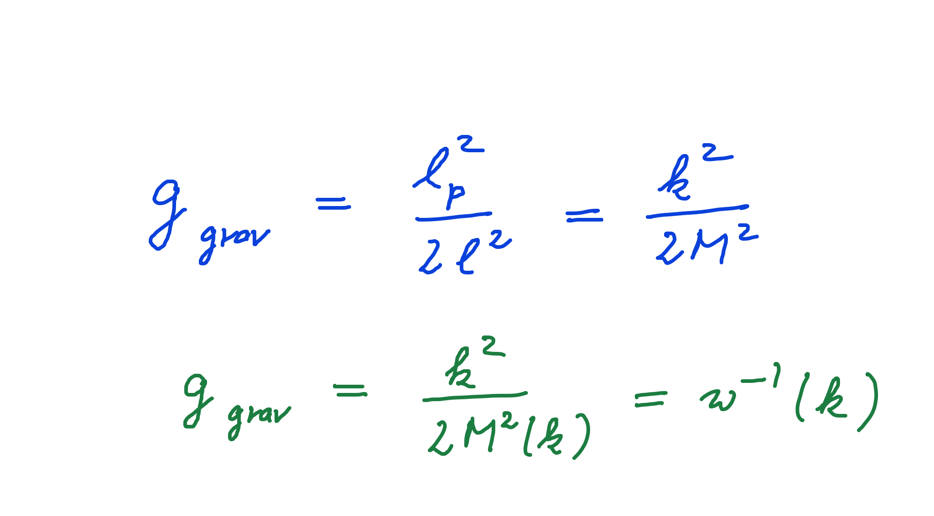
Strength of gravity
l_{p} : Planck length
M : Planck mass
running gravitational coupling

Slide 23
Strength of gravity
A.Eichhorn, CW, Spektrum der Wissenschaft

Slide 24
Gravitational contribution to running quartic coupling
running Planck mass :
dimensionless
squared Planck mass
large k : constant A
small k: A ~ k² / M²
transition at
k_{t} ~ 10¹⁹ GeV

Slide 25
Flowing dimensionless Planck mass
Renormalization scale k : Only fluctuations with momenta larger k are included
Flowing
Planck mass M²(k)

Slide 26
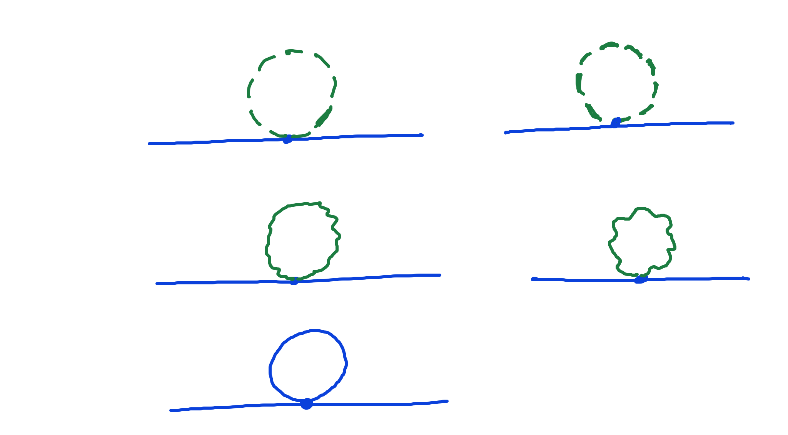
Universality of gravity
scalar loop,
fermion loop
gauge boson
loop
graviton
loop

Slide 27
Universality of gravity
scalar loop,
fermion loop
gauge boson
loop
graviton
loop
c is independent of coupling constants

Slide 28
Flowing dimensionless Planck mass
Renormalization scale k : Only fluctuations with momenta larger k are included
Flowing
Planck mass M²(k)
matter
contribution
4 N_{V} – N_{S} - N_{F}
with graviton
contribution

Slide 29
Flowing dimensionless Planck mass
Flowing
Planck mass M²(k)
solution :

Slide 30
Flowing dimensionless Planck mass
Flowing
Planck mass M²(k)
Dimensionless
squared Planck mass
solution :

Slide 31
Fixed point and flow away from fixed point
UV - fixed point
approached
for k → ∞
Near UV – fixed point : M ~ k
=
Transition to constant M for small k,
gravity gets weak, w⁻¹ decreases to zero
M is relevant parameter, cannot be predicted

Slide 32
Weak and constant gravity
Two regimes for the
( inverse ) strength
of gravity

Slide 33
Gravitational contribution to running quartic coupling
Running Planck mass :
large k : constant A
small k: A ~ k² / M²
transition at
k_{t} ~ 10¹⁹ GeV

Slide 34
UV – fixed point for quartic coupling
Flow equation for λ :
Fixed point : λ = C / A

Slide 35
Quantum Gravity
Quantum Gravity is a
renormalisable quantum field theory
Asymptotic safety

Slide 36
Asymptotic safety of quantum gravity
if UV fixed point exists :
quantum gravity is
non-perturbatively renormalizable !
S. Weinberg , M. Reuter

Slide 37
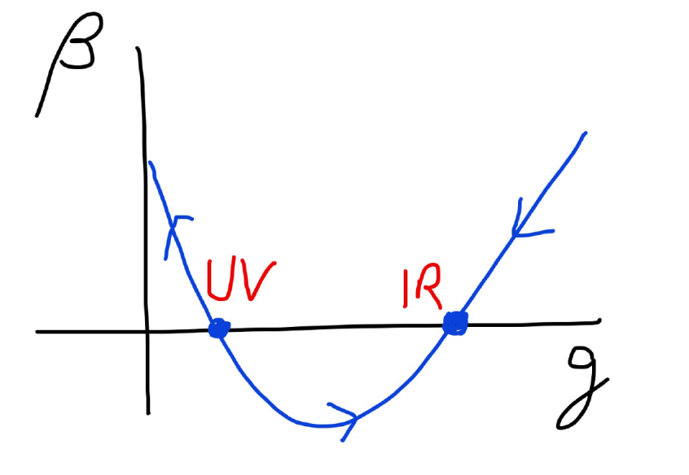
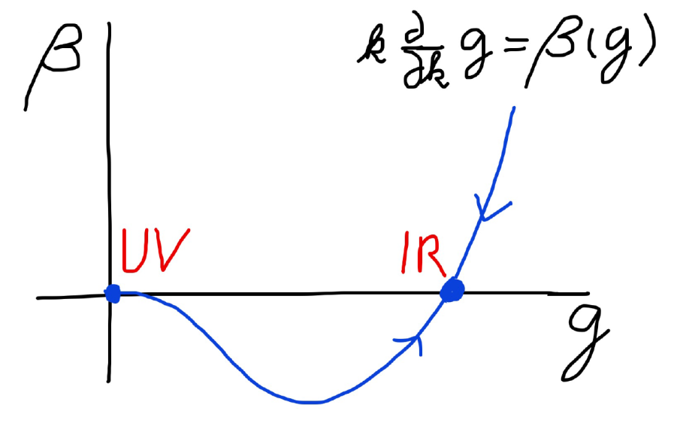
Asymptotic safety Asymptotic freedom
Relevant parameters yield undetermined couplings.
Quartic scalar coupling is not relevant and can therefore be predicted.

Slide 38
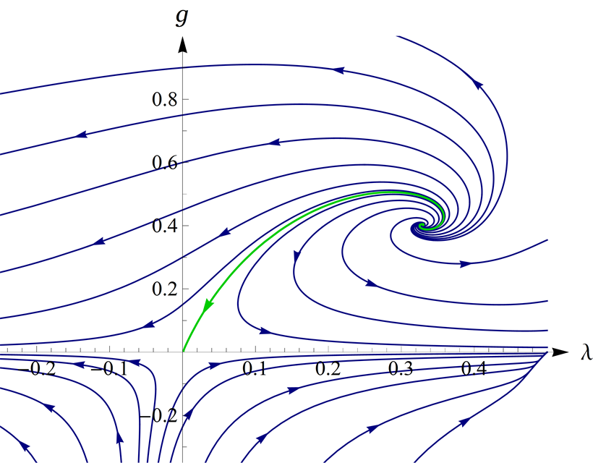
UV- fixed point for quantum gravity
Wikipedia

Slide 39
Enhanced predictivity for
UV – fixed point
Free parameters of a theory correspond to relevant parameters for small deviations from fixed point.
If the number of relevant parameters at the UV-fixed point is smaller than the number of free parameters ( renormalizable couplings ) in the standard model:
Relations between standard model parameters become predictable !

Slide 40
Fixed points
couplings dimensionless
Flow equation
Fixed points: zeros of beta-function
No running No scale
Quantum scale symmetry

Slide 41
Stability matrix
couplings dimensionless
Flow equation
Expand in
vicinity of
fixed point
T : stability matrix

Slide 42
Critical exponents
: Eigenvalues of stability matrix T
= Critical exponents
Linearized
solution
Irrelevant parameters: eigenvectors in coupling constant space with
flow towards fixed point values as k is lowered

Slide 43
Irrelevant parameters
“Forget” information about initial values
Central ingredient for
predictivity of quantum field theories
For UV – complete theories : irrelevant parameters have to take precisely the fixed point values
Relevant parameters flow away from fixed point as k is lowered – they are the only free parameters

Slide 44
Predictivity at fixed point
Irrelevant parameters are predicted to take fixed point values
Only relevant parameters are free
Number of free parameters of a renormalizable quantum field theory = number of relevant parameters at the fixed point

Slide 45
a prediction…
Quartic scalar coupling is irrelevant coupling

Slide 46
Prediction of Higgs boson mass:
Value of quartic scalar coupling near Planck mass is predicted by UV- fixed point
Gravity decouples below Planck mass , resulting in perturbative flow
Extrapolate perturbatively
to Fermi scale :

Slide 47
How to compute non-perturbative quantum gravity effects ?

Slide 48
Quantum gravity computation by functional renormalization
Introduce infrared cutoff with scale k,
such that only fluctuations with
( covariant) momenta larger than k
are included.
Then lower k towards zero

Slide 49
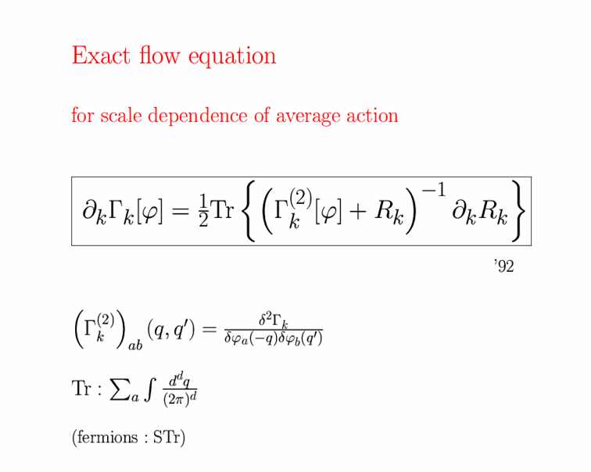
Exact renormalization group equation

Slide 50
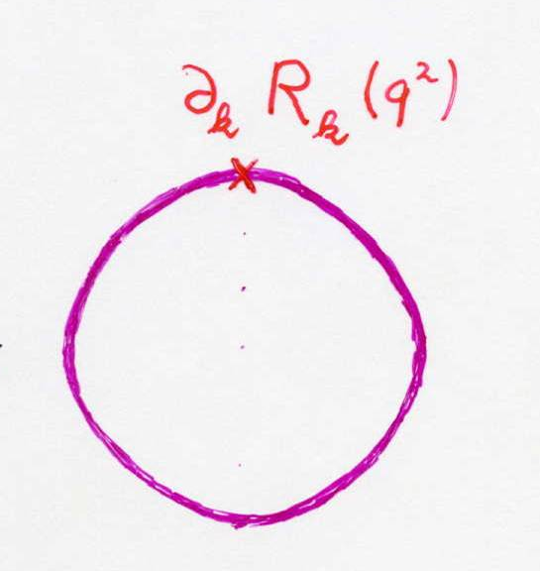
Functional flow equation for scale dependent effective action
IR cutoff
exact propagator

Slide 51
Exact renormalization group equation

Slide 52
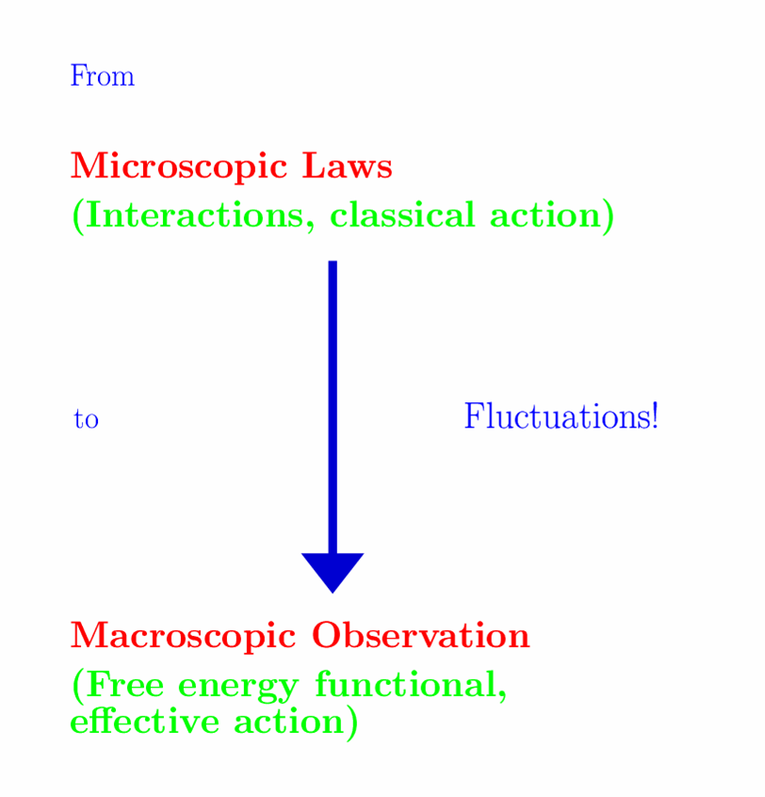

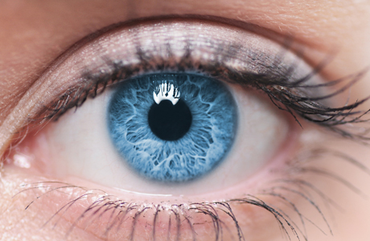
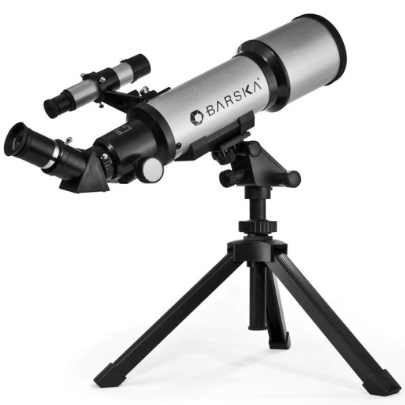

Slide 53
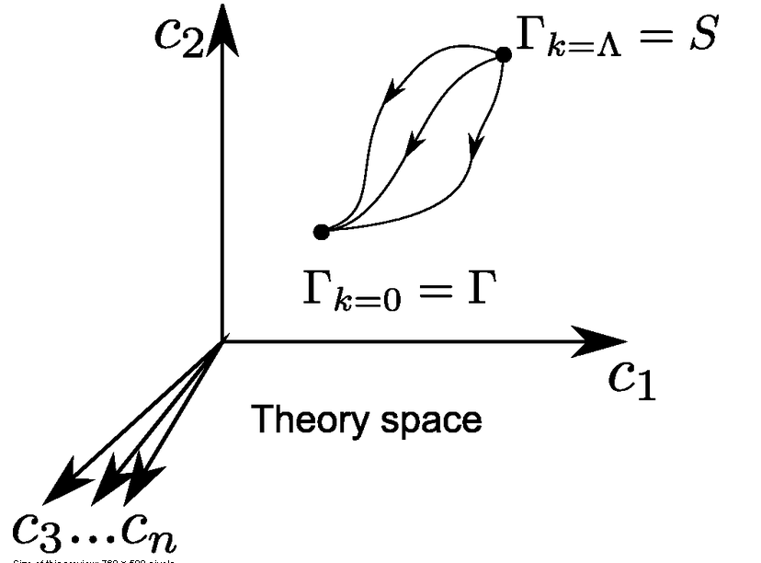
functional renormalization : flowing action
Wikipedia
Notes:
53

Slide 54
flowing action
microscopic law
macroscopic law
infinitely many couplings

Slide 55
Ultraviolet fixed point
UV fixed point
Extrapolation of microscopic law to
infinitely short distances is possible.
Complete theory
Notes:
55

Slide 56
Prediction of mass of Higgs boson ?
Quartic scalar coupling irrelevant ?
needs or A>0

Slide 57
Quartic scalar coupling is irrelevant parameter
Can be predicted !
Pawlowski, Reichert, Yamada,…

Slide 58
Predictivity for Fermi scale ?
Scalar mass term irrelevant ?

Slide 59
Higgs mass term is irrelevant for strong enough gravity

Slide 60
Critical exponent for Higgs mass term
For suitable particle content of model:
Higgs mass term is an irrelevant parameter

Slide 61
Gauge hierarchy
Possible explanation of small parameter : distance from second order vacuum electroweak phase transition is
irrelevant parameter
at UV – fixed point

Slide 62
Possible explanation of gauge hierarchy
Phys.Lett. B770 (2017) 268-271

Slide 63
Prediction of Fermi scale
If scalar mass term is irrelevant and vacuum electroweak phase transition would be precisely second order:
The Fermi scale would be predicted to be zero !
Running gauge and Yukawa couplings in standard model imply that vacuum electroweak phase transition is not precisely second order. Small effect.
Small Fermi scale and huge gauge hierarchy expected.
May be a couple of orders too small as compared to observation ? Not known definitely.

Slide 64
Predictions of quantum gravity ?
Simple approximation for graviton contribution to scalar potential:
Predicts mass of Higgs scalar
Solves Gauge Hierarchy problem ?
Solves cosmological constant problem

Slide 65
Conclusions
Quantum gravity is a renormalizable quantum field theory, realized by UV - fixed point of running couplings or flowing effective action
Quantum gravity is predictive :
Mass of the Higgs boson ( and more …? )
Properties of inflation
Properties of dark energy

Slide 66
end

Slide 67
Quantum gravity prediction for the cosmological “constant” ?

Slide 68
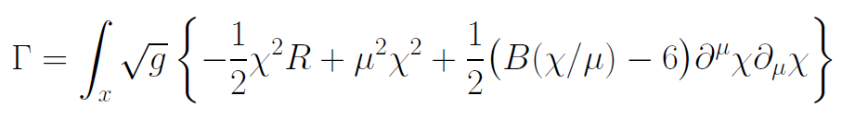
Variable Gravity
quantum effective action,
variation yields field equations

Slide 69
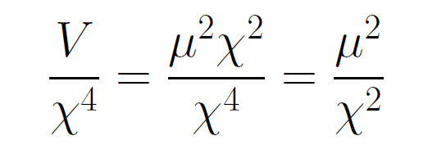
Asymptotically vanishing cosmological „constant“
What matters : Ratio of potential divided by fourth power of Planck mass
vanishes for χ → ∞ !

Slide 70
small dimensionless number ?
needs two intrinsic mass scales
standard approach :V and M ( cosmological constant and Planck mass )
variable gravity : Planck mass moving to infinity , with fixed V ratio vanishes asymptotically !

Slide 71
Variable Gravity in scaling frame

Slide 72
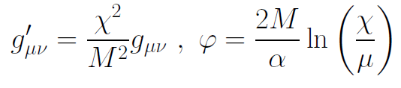
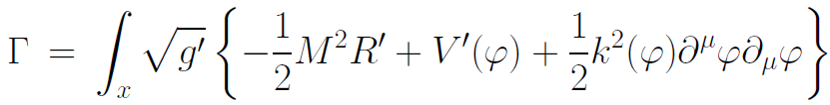
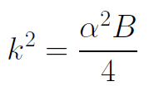

Variable gravity in Einstein frame
Weyl scaling :
effective action in Einstein frame :

Slide 73
Quintessence
Dynamical dark energy ,
generated by scalar field (cosmon )
C.Wetterich,Nucl.Phys.B302(1988)668, 24.9.87
P.J.E.Peebles,B.Ratra,ApJ.Lett.325(1988)L17, 20.10.87
Notes:
73

Slide 74
Prediction : homogeneous dark energy influences recent cosmology
- of same order as dark matter -
Original models do not fit the present observations
…. modifications
( different growth of neutrino mass )

Slide 75
Quantum gravity restricts the increase of scalar potential for large fields

Slide 76
In quantum gravity, the graviton fluctuations can play an important role on distances as large as the size of the Universe
- for long range scalar fields and dynamical dark energy
- not for all quantities

Slide 77
Graviton barrier
Quantum gravity computation :
For
V cannot increase stronger than M² !
Instability of graviton propagator is avoided

Slide 78
Graviton barrier and solution of the cosmological constant problem
V cannot increase stronger than M² !
If M increases with 𝜒, and for cosmological solutions where 𝜒 asymptotically diverges for time going to infinity:
Effective cosmological constant vanishes in infinite future
M = χ : V= 𝜇² χ²

Slide 79
Asymptotically vanishing cosmological „constant“
What matters : Ratio of potential divided by fourth power of Planck mass
vanishes for χ → ∞ !

