Slide 1
Quantum gravity predictions for particle physics

Slide 2
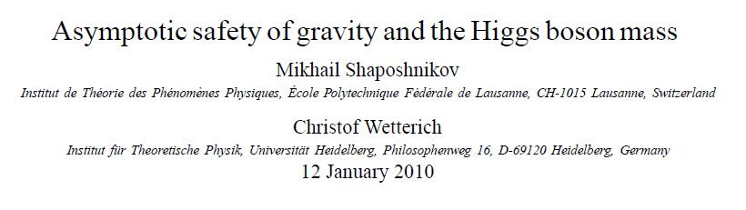
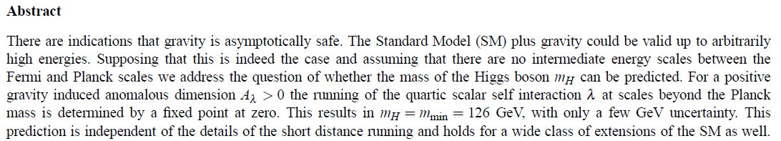
Prediction of mass of Higgs boson

Slide 3
Why can quantum gravity make predictions for particle physics ?

Slide 4
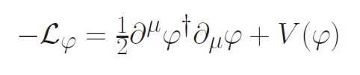
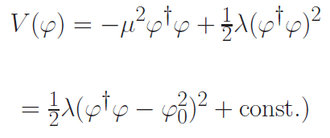



Spontaneous symmetry breaking
Fermi scale

Slide 5
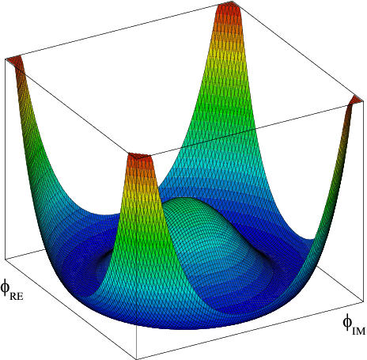
Scalar potential

Slide 6


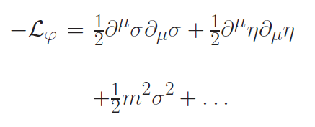

Radial mode and
Goldstone mode
expand around minimum of potential
mass term for
radial mode

Slide 7
Quartic scalar coupling
prediction of mass of Higgs boson
=
prediction of value of quartic scalar coupling λ
at Fermi scale

Slide 8
Why can quantum gravity make predictions for quartic scalar coupling ?

Slide 9
Mass scales
Fermi scale 𝜑₀ ~ 100 GeV
Planck mass M ~ 10¹⁸ GeV
Gravity at Fermi scale is very weak : How can it influence the effective potential for the Higgs scalar and the mass of the Higgs boson ?

Slide 10
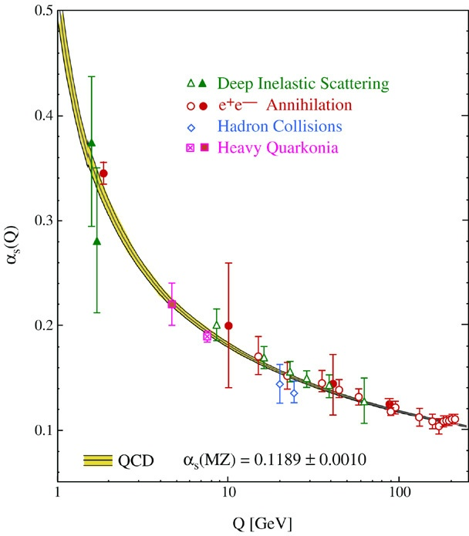
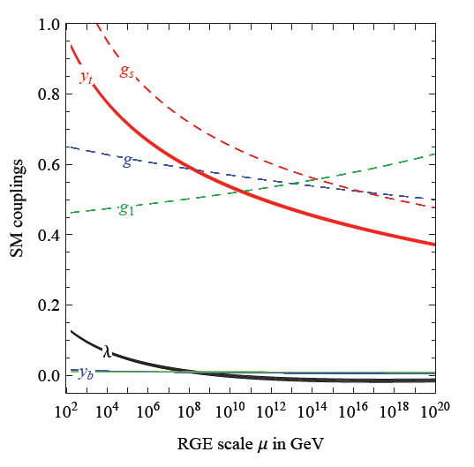
Quantum fluctuations induce running couplings
possible violation of scale symmetry
well known in QCD or standard model

Slide 11
Quantum fluctuations induce running couplings
possible violation of scale symmetry
well known in QCD or standard model

Slide 12

The mass of the Higgs boson, the great desert, and asymptotic safety of gravity

Slide 13
key points
great desert
solution of hierarchy problem at high scale
high scale fixed point
vanishing scalar coupling at fixed point
great desert
fixed point

Slide 14


Slide 15
Planck scale, gravity
no multi-Higgs model
no technicolor
no low scale
higher dimensions
no supersymmetry

Slide 16
Essential point for prediction of Higgs boson mass:
Initial value of quartic scalar coupling near Planck mass is predicted by quantum gravity
Results in prediction for ratio Higgs boson mass over W- boson mass, or
Higgs boson mass over top quark mass
Extrapolate perturbatively
to Fermi scale

Slide 17
Near Planck mass gravity is not weak !
Predictive power !

Slide 18
Flowing couplings
Couplings change with momentum scale due to quantum fluctuations.
Renormalization scale k : Only fluctuations with momenta larger k are included. The scale k can be momenta, geometric quantities, or just be introduced “by hand”.
Flow of k to zero : all fluctuations included, IR
Flow of k to infinity : UV

Slide 19
Renormalization group
How do couplings or physical laws change
with scale k ?

Slide 20
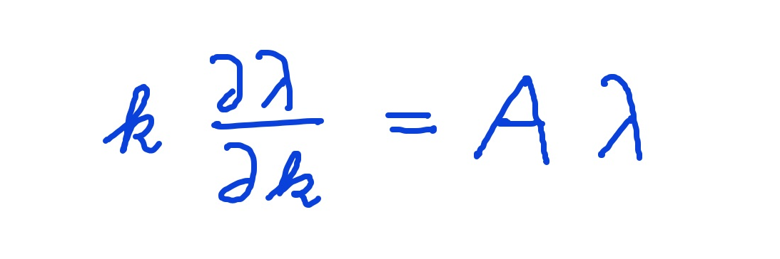
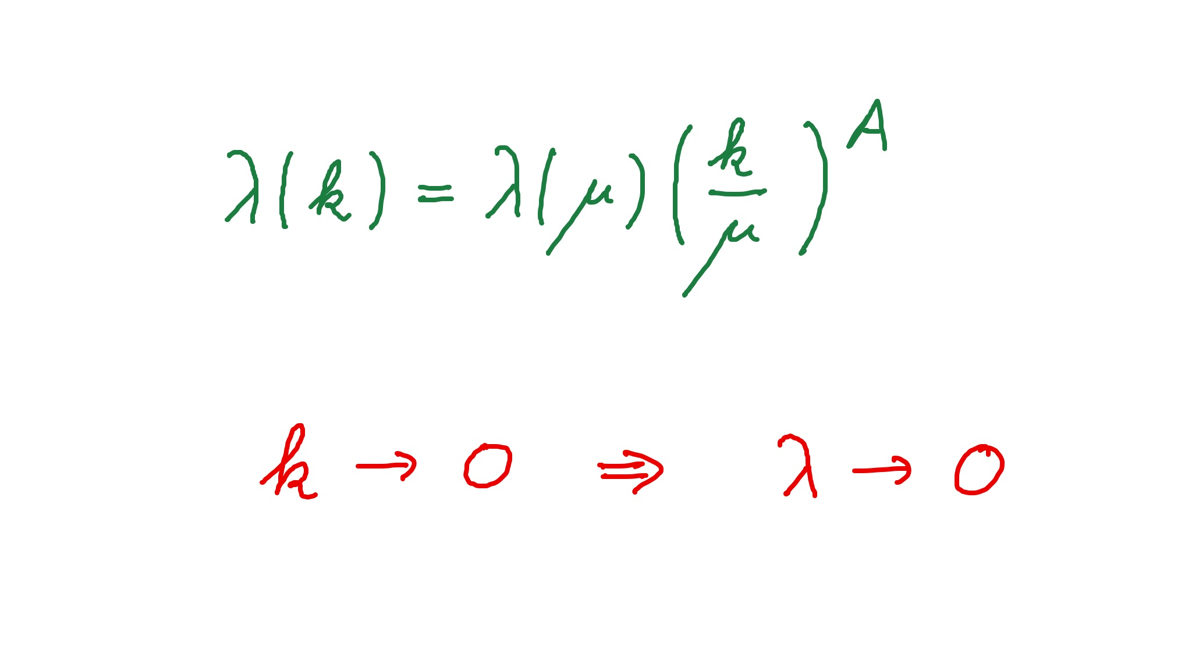
Graviton fluctuations erase quartic scalar coupling
Renormalization scale k : Only fluctuations with momenta larger k are included
gravity induced
anomalous dimension
A > 0

Slide 21
Fixed point
The quartic scalar coupling λ has a
fixed point at λ=0
It flows towards the fixed point as k is lowered :
irrelevant coupling
For a UV – complete theory it is predicted to assume the fixed point value

Slide 22
Gravitational contribution to running quartic coupling
running Planck mass :
dimensionless
squared Planck mass

Slide 23
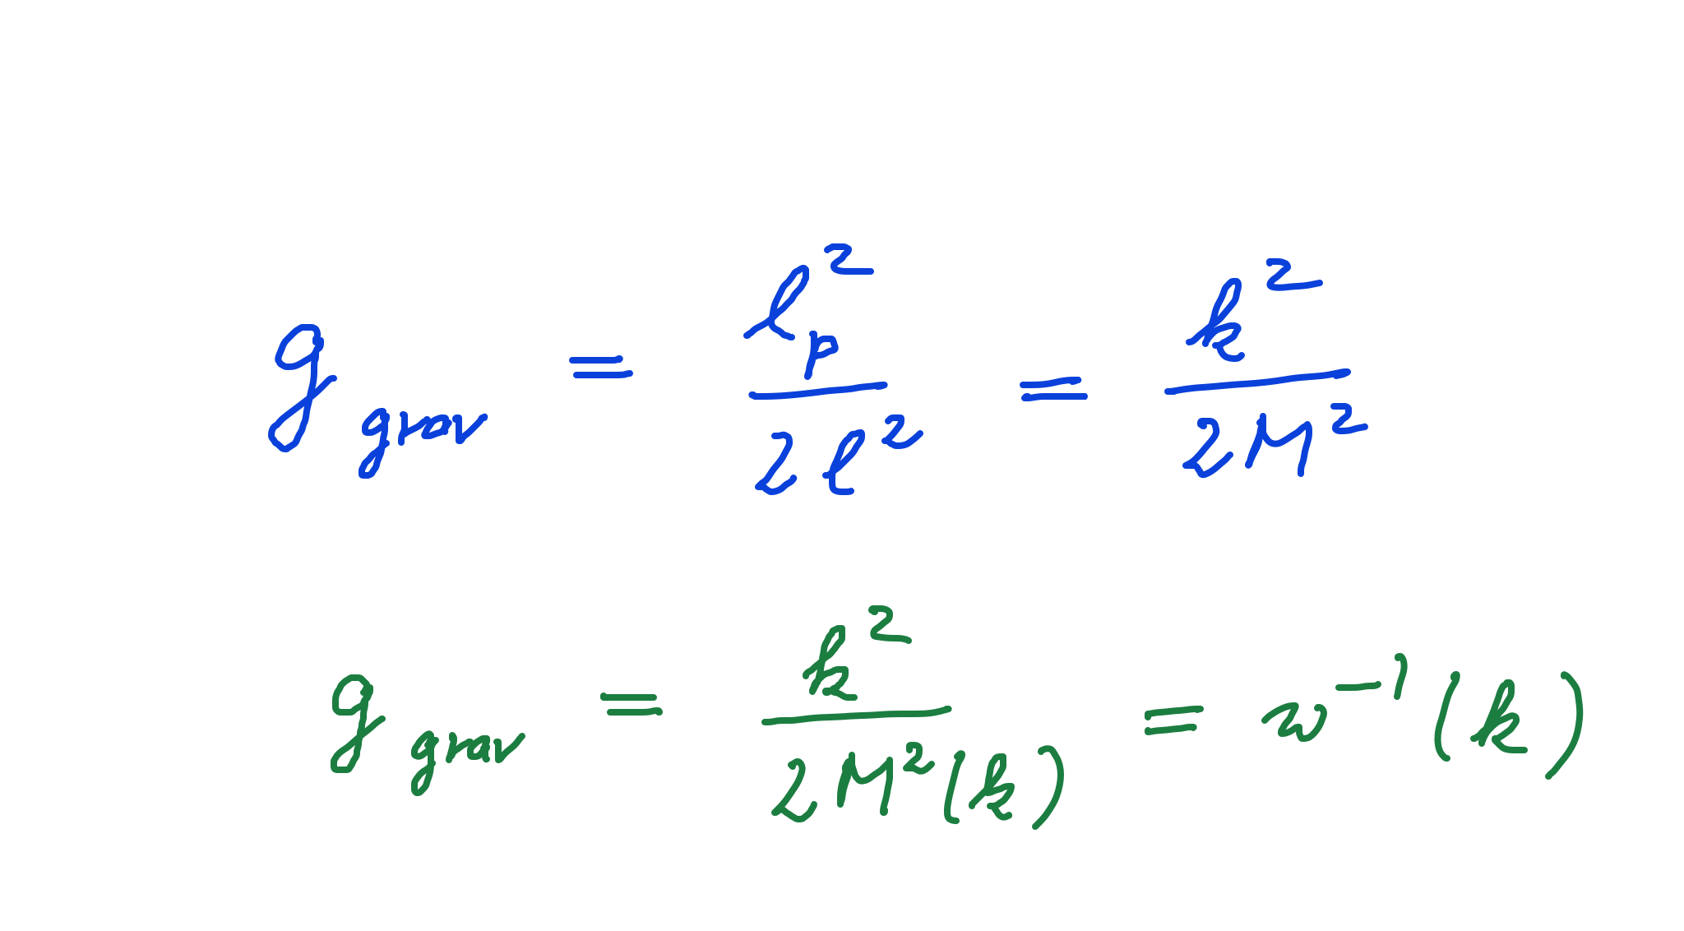
Strength of gravity
l_{p} : Planck length
M : Planck mass
running gravitational coupling

Slide 24
Strength of gravity
A.Eichhorn, CW, Spektrum der Wissenschaft

Slide 25
Gravitational contribution to running quartic coupling
running Planck mass :
dimensionless
squared Planck mass
large k : constant A
small k: A ~ k² / M²
transition at
k_{t} ~ 10¹⁹ GeV

Slide 26
Flowing dimensionless Planck mass
Renormalization scale k : Only fluctuations with momenta larger k are included
Flowing
Planck mass M²(k)

Slide 27
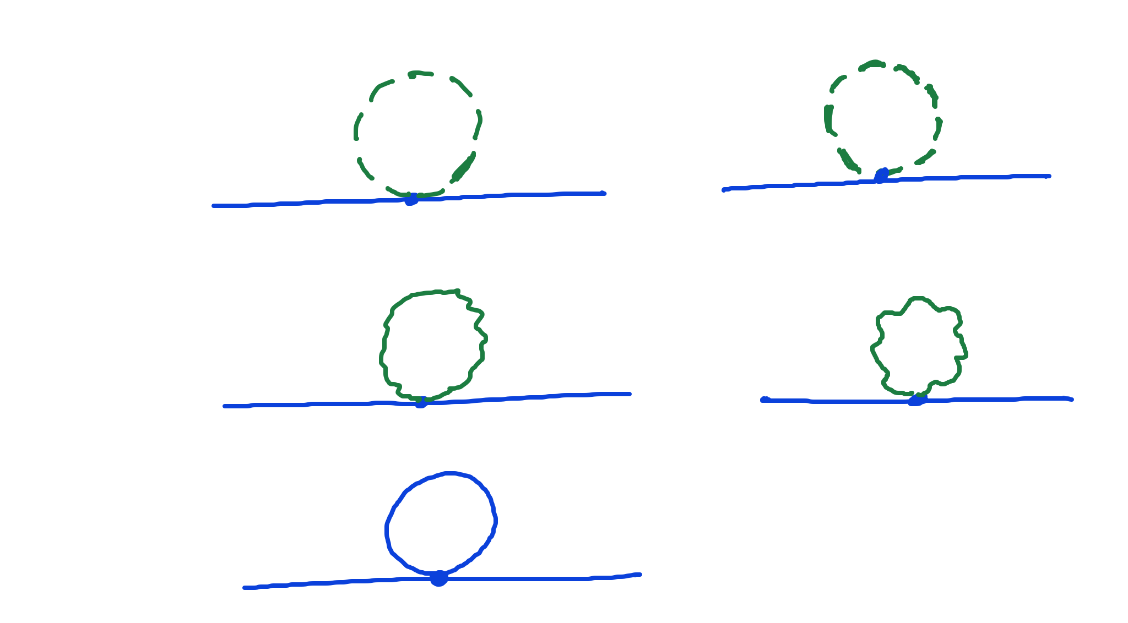
Universality of gravity
scalar loop,
fermion loop
gauge boson
loop
graviton
loop

Slide 28
Universality of gravity
scalar loop,
fermion loop
gauge boson
loop
graviton
loop
c is independent of coupling constants

Slide 29
Flowing dimensionless Planck mass
Renormalization scale k : Only fluctuations with momenta larger k are included
Flowing
Planck mass M²(k)
matter
contribution
4 N_{V} – N_{S} - N_{F}
with graviton
contribution

Slide 30
Flowing dimensionless Planck mass
Flowing
Planck mass M²(k)
solution :

Slide 31
Flowing dimensionless Planck mass
Flowing
Planck mass M²(k)
Dimensionless
squared Planck mass
solution :

Slide 32
Fixed point and flow away from fixed point
UV - fixed point
approached
for k → ∞
Near UV – fixed point : M ~ k
=
Transition to constant M for small k,
gravity gets weak, w⁻¹ decreases to zero

Slide 33
Weak and constant gravity
Two regimes for the
( inverse ) strength
of gravity

Slide 34
Gravitational contribution to running quartic coupling
Running Planck mass :
large k : constant A
small k: A ~ k² / M²
transition at
k_{t} ~ 10¹⁹ GeV

Slide 35
UV – fixed point for quartic coupling
Flow equation for λ :
Fixed point : λ = C / A

Slide 36
Quantum Gravity
Quantum Gravity is a
renormalisable quantum field theory
Asymptotic safety

Slide 37
Asymptotic safety of quantum gravity
if UV fixed point exists :
quantum gravity is
non-perturbatively renormalizable !
S. Weinberg , M. Reuter

Slide 38
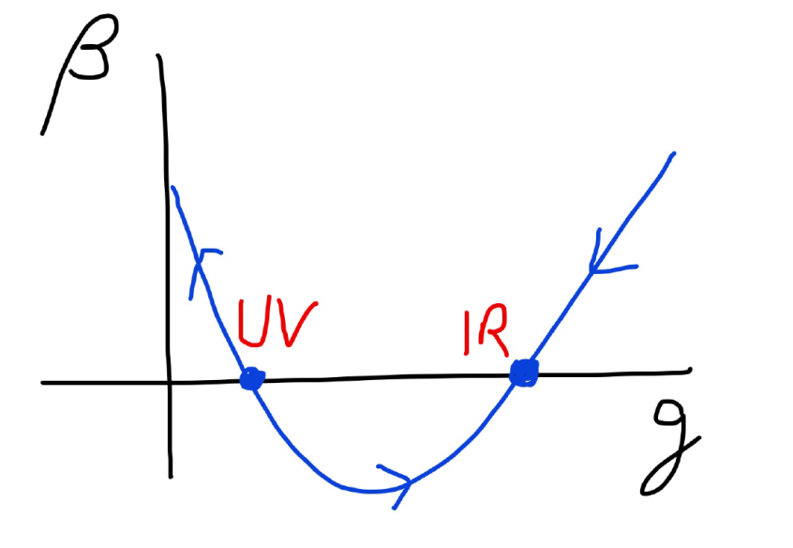
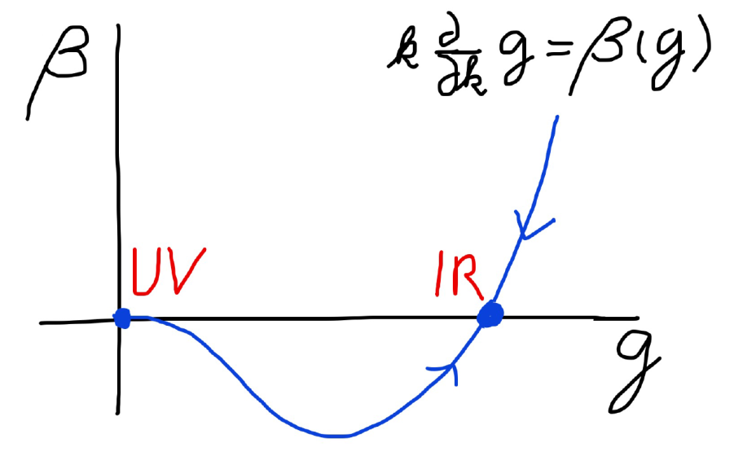
Asymptotic safety Asymptotic freedom
Relevant parameters yield undetermined couplings.
Quartic scalar coupling is not relevant and can therefore be predicted.

Slide 39
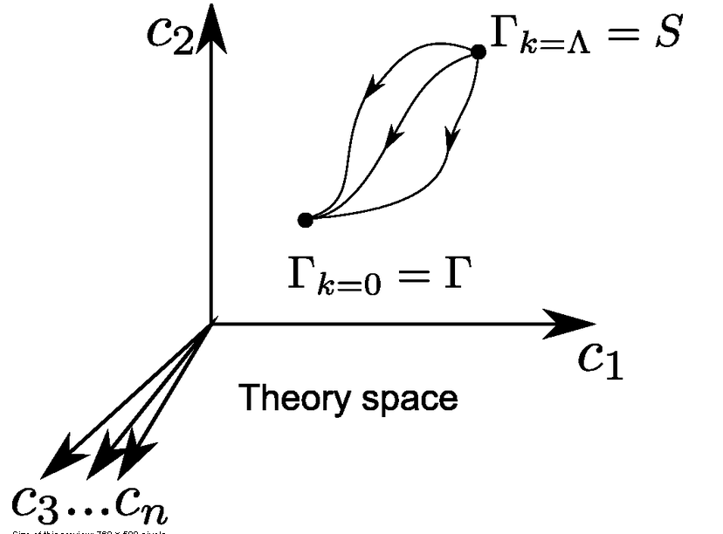
Ultraviolet fixed point
UV fixed point
Wikipedia
Notes:
39

Slide 40
Scale symmetry and fixed points
Relative strength of gravity
Particle
scale
symmetry
Gravity
scale
symmetry
Distance from
electroweak
phase transition
Cosmic
scale
symmetry

Slide 41
Gravity scale symmetry

Slide 42
At UV – fixed point: gravity scale symmetry is exact quantum scale symmetry
No parameter with dimension of
length or mass is present in the
quantum effective action.
Then invariance under
dilatations or global scale transformations
is realized.
Continuous global symmetry

Slide 43
Quantum scale symmetry
quantum fluctuations can violate scale symmetry
running dimensionless couplings
at fixed points , scale symmetry is exact !
quantum fluctuations can generate scale symmetry !

Slide 44
Ultraviolet fixed point for quantum gravity
quantum gravity is
non-perturbatively renormalizable !
S. Weinberg , M. Reuter

Slide 45
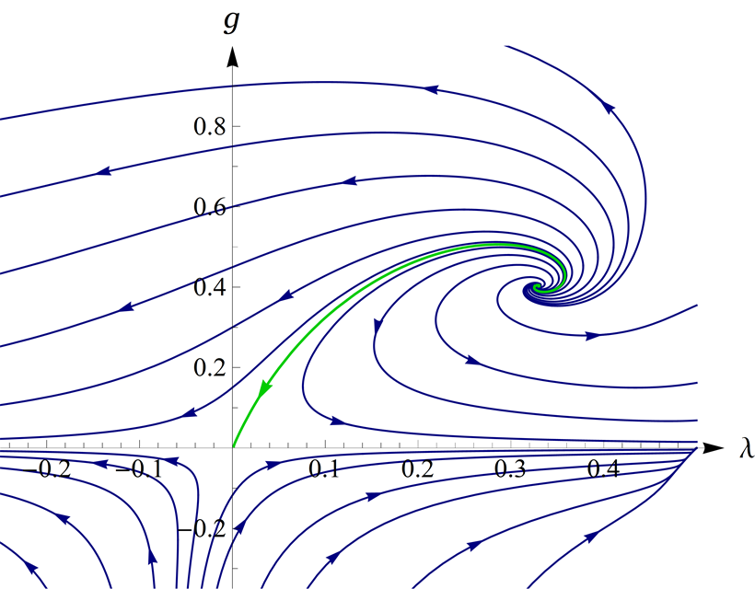
UV- fixed point for quantum gravity
Wikipedia

Slide 46
Necessity of UV – fixed point
If gravity and particle physics can be described by a common quantum field theory which is valid for length scales smaller than the Planck length:
UV – fixed point is necessary !
This holds even if the most fundamental formulation of gravity involves different degrees of freedom. Metric may be composite or collective degree of freedom.

Slide 47
Enhanced predictivity for
UV – fixed point
Free parameters of a theory correspond to relevant parameters for small deviations from fixed point.
If the number of relevant parameters at the UV-fixed point is smaller than the number of free parameters ( renormalizable couplings ) in the standard model:
Relations between standard model parameters become predictable !

Slide 48
Fixed points
couplings dimensionless
Flow equation
Fixed points: zeros of beta-function
No running No scale
Quantum scale symmetry

Slide 49
Stability matrix
couplings dimensionless
Flow equation
Expand in
vicinity of
fixed point
T : stability matrix

Slide 50
Critical exponents
: Eigenvalues of stability matrix T
= Critical exponents
Linearized
solution
Irrelevant parameters: eigenvectors in coupling constant space with
flow towards fixed point values as k is lowered

Slide 51
Irrelevant parameters
“Forget” information about initial values
Central ingredient for
predictivity of quantum field theories
For UV – complete theories : irrelevant parameters have to take precisely the fixed point values
Relevant parameters flow away from fixed point as k is lowered – they are the only free parameters

Slide 52
Relevant and irrelevant parameters
: Eigenvalues of stability matrix T
= Critical exponents
Linearized
solution
Irrelevant parameters
Relevant parameters for positive
Critical exponents have free

Slide 53
Predictivity at fixed point
Irrelevant parameters are predicted to take fixed point values
Only relevant parameters are free
Number of free parameters of a renormalizable quantum field theory = number of relevant parameters at the fixed point

Slide 54
a prediction…
Quartic scalar coupling is irrelevant coupling

Slide 55
Prediction of Higgs boson mass:
Value of quartic scalar coupling near Planck mass is predicted by UV- fixed point
Gravity decouples below Planck mass , resulting in perturbative flow
Extrapolate perturbatively
to Fermi scale :

Slide 56
How to compute non-perturbative quantum gravity effects ?

Slide 57
Quantum gravity computation by functional renormalization
Introduce infrared cutoff with scale k,
such that only fluctuations with
( covariant) momenta larger than k
are included.
Then lower k towards zero

Slide 58
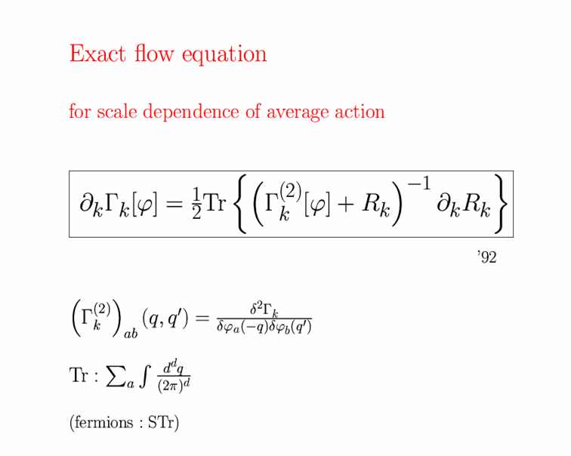
Exact renormalization group equation

Slide 59
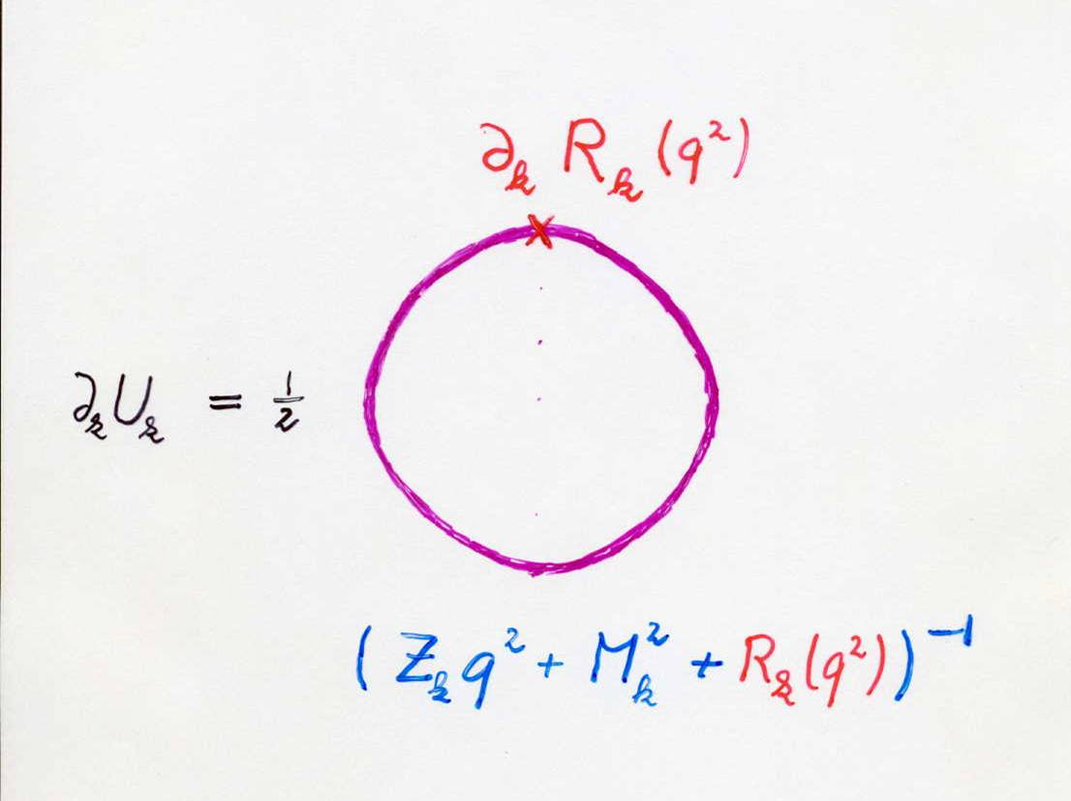
Functional flow equation for scale dependent effective action
IR cutoff
exact propagator

Slide 60
Exact renormalization group equation

Slide 61
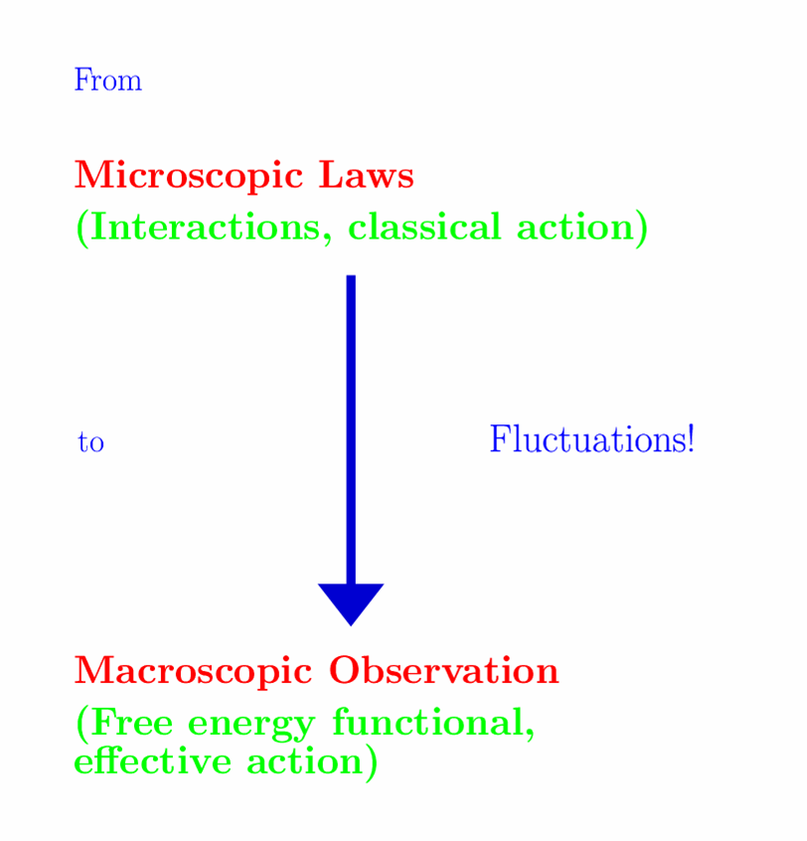

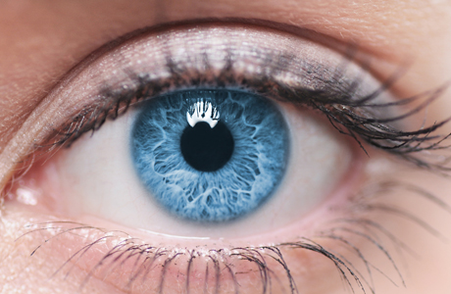
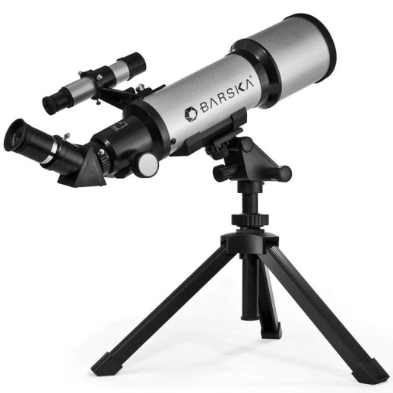

Slide 62

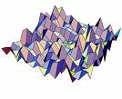

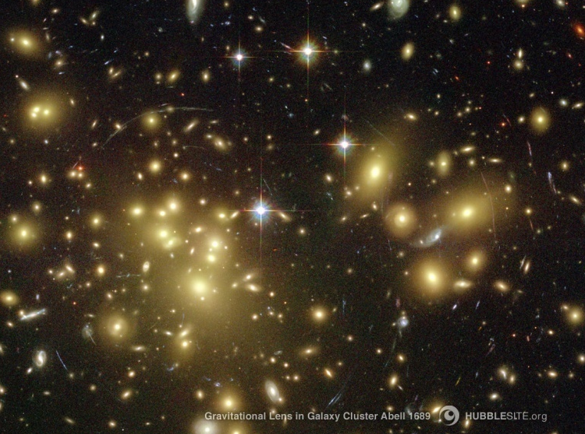

Slide 63
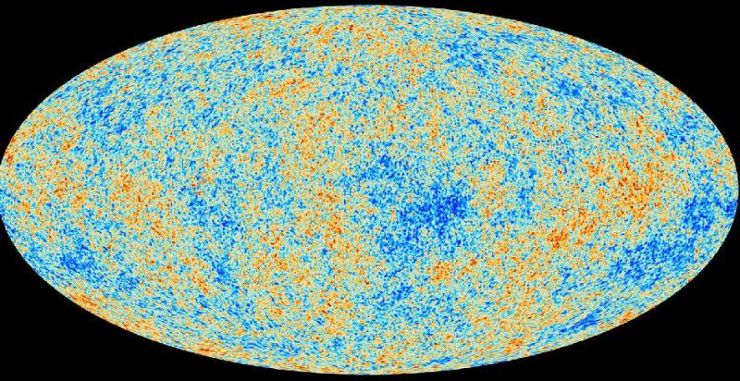
Almost scale invariant primordial fluctuation spectrum seeds all structure in the universe

Slide 64
functional renormalization : flowing action
Wikipedia
Notes:
64

Slide 65
flowing action
microscopic law
macroscopic law
infinitely many couplings

Slide 66
Ultraviolet fixed point
UV fixed point
Extrapolation of microscopic law to
infinitely short distances is possible.
Complete theory
Notes:
66

Slide 67
flow of functions

Slide 68
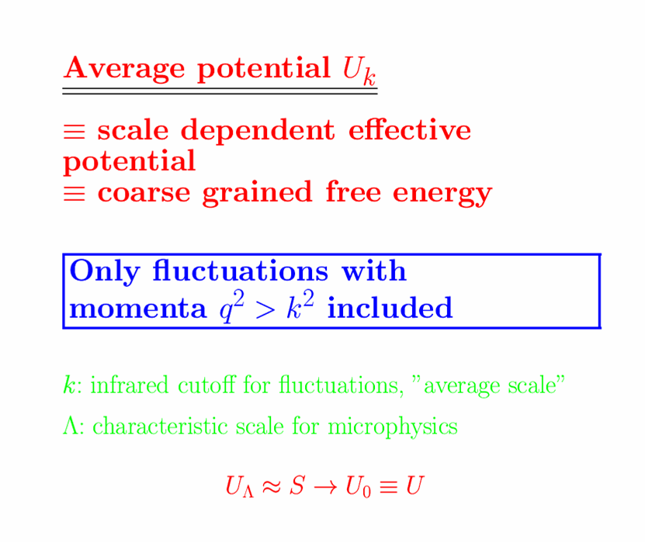
Effective potential includes all fluctuations

Slide 69
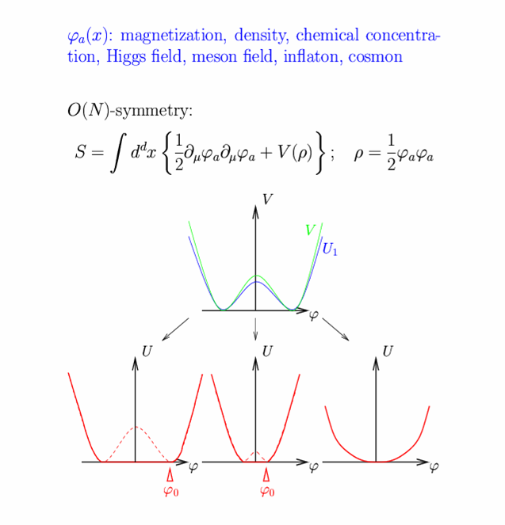
Scalar field theory

Slide 70
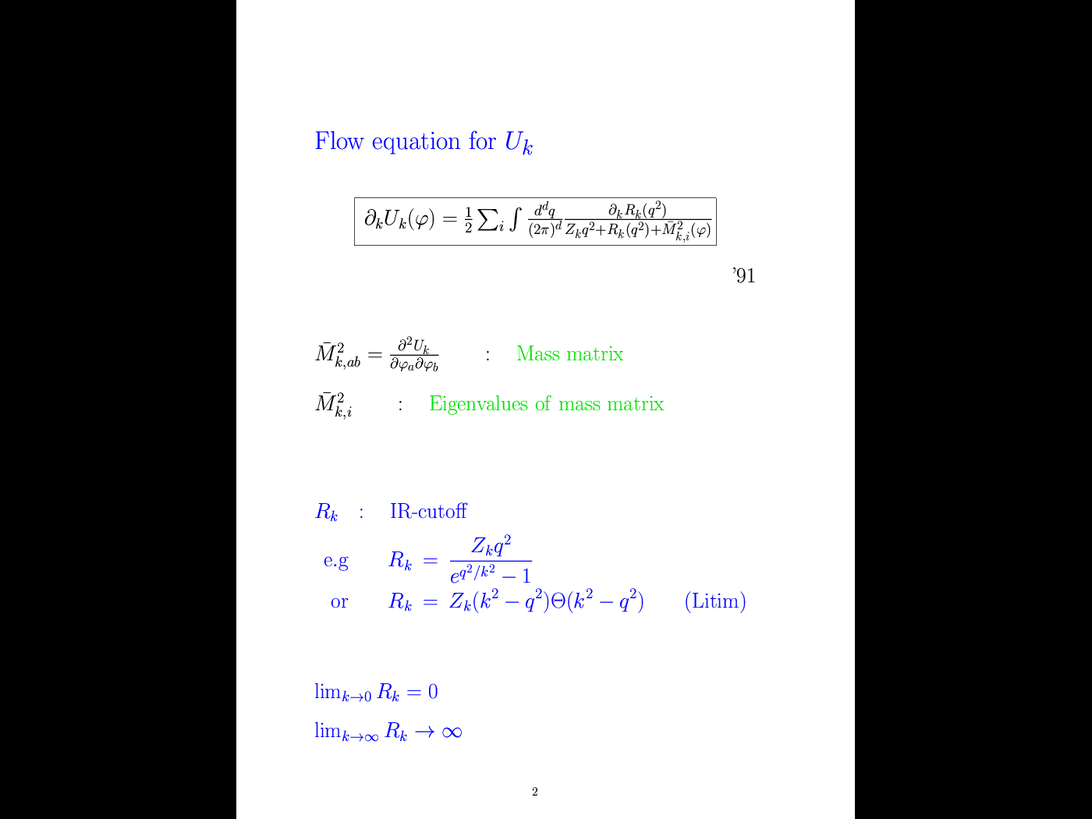
Flow equation for average potential
cutoff
propagator
with cutoff

Slide 71
Simple one loop structure –nevertheless (almost) exact
Well tested for non-perturbative phenomena:
critical exponents, Kosterlitz-Thouless phase transition, etc

Slide 72
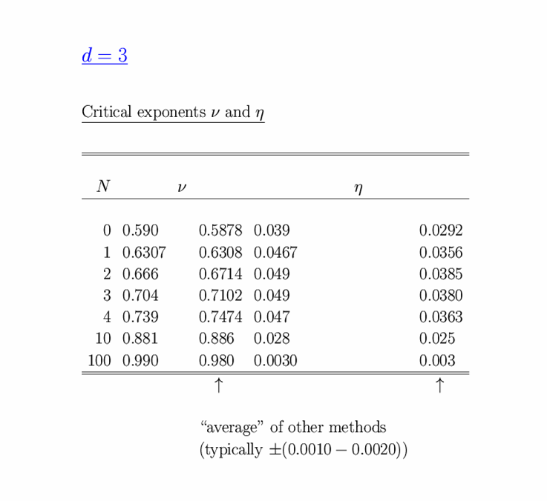
Critical exponents , d=3
FRG world
FRG world
FRG : first order
derivative expansion

Slide 73
Computation of graviton contribution
traceless transverse metric fluctuations
Graviton approximation

Slide 74
Graviton propagator G
effective action
for V>0 : ”tachyonic mass term”

Slide 75
Graviton contribution to flow of cosmological constant V
Litim cutoff:
Valid either for constant M or M = 𝜒

Slide 76
Graviton contribution to flow of effective scalar potential :
Replace V by effective potential U
add scalar fluctuation :

Slide 77
Graviton contribution to flow of quartic scalar coupling :
positive and substantial anomalous dimension A
Gravity decouples
below Planck mass

Slide 78
Graviton contributions to effective potential for Higgs field h
Graviton contribution
for M² = f k² + 𝜒 ² :
Take derivatives with respect to 𝜌 = h² (primes)
mass term
quartic coupling
Gravity induced
anomalous dimension

Slide 79
Graviton contributions to quartic Higgs coupling
Gravity induced anomalous dimension is
universal for all scalar fields
For large k :
f = 2c dimensionless squared Planck mass , u = U/k⁴

Slide 80
Gravity contributions to running couplings in standard model
Running Planck mass :
For quartic scalar coupling
(R.Percacci et al)
Large k :
Add fermions
+…

Slide 81
Essential point for prediction of Higgs boson mass:
More precisely : ratio Higgs boson mass over W-boson mass, or Higgs boson mass over top quark mass
Initial value of quartic scalar coupling near Planck mass is predicted by UV- fixed point
Extrapolate perturbatively
to Fermi scale :

Slide 82
Relevant and irrelevant dimensionless couplings for Higgs potential
J.Pawlowski, M.Reichert, M.Yamada,…
Effective scalar potential depends on 𝜌 = h²
Dimensionless quantities :

Slide 83
Effective potential near origin
dimensionless
mass term
quartic coupling

Slide 84
Flow equations

Slide 85
Fixed point for v₀

Slide 86
Stability matrix
For fixed point at

Slide 87
Prediction of mass of Higgs boson ?
needs or A>0

Slide 88
Quartic scalar coupling is irrelevant parameter
Can be predicted !

Slide 89
Predictivity for Fermi scale ?

Slide 90
Higgs mass term is irrelevant for strong enough gravity

Slide 91
Critical exponent for Higgs mass term
For suitable particle content of model:
Higgs mass term is an irrelevant parameter

Slide 92
Gauge hierarchy
Possible explanation of small parameter : distance from second order vacuum electroweak phase transition is irrelevant parameter at UV – fixed point

Slide 93
Possible explanation of gauge hierarchy
Phys.Lett. B770 (2017) 268-271

Slide 94
Prediction of Fermi scale
If scalar mass term is irrelevant and vacuum electroweak phase transition would be precisely second order:
The Fermi scale would be predicted to be zero !
Running gauge and Yukawa couplings in standard model imply that vacuum electroweak phase transition is not precisely second order. Small effect.
Small Fermi scale and huge gauge hierarchy expected.
May be a couple of orders too small as compared to observation ? Not known definitely.

Slide 95
Quantum gravity prediction for the cosmological “constant” ?

Slide 96
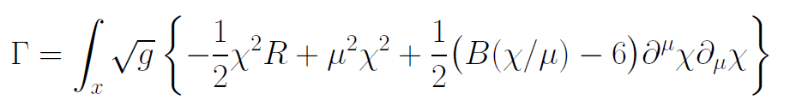
Variable Gravity
quantum effective action,
variation yields field equations

Slide 97
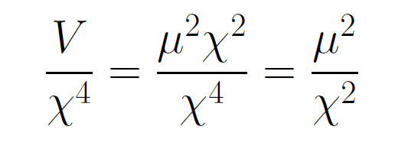
Asymptotically vanishing cosmological „constant“
What matters : Ratio of potential divided by fourth power of Planck mass
vanishes for χ → ∞ !

Slide 98
small dimensionless number ?
needs two intrinsic mass scales
standard approach :V and M ( cosmological constant and Planck mass )
variable gravity : Planck mass moving to infinity , with fixed V ratio vanishes asymptotically !

Slide 99
Variable Gravity in scaling frame

Slide 100
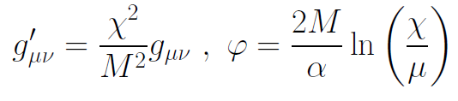
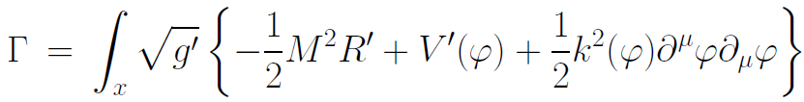
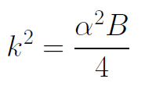

Variable gravity in Einstein frame
Weyl scaling :
effective action in Einstein frame :

Slide 101
Quintessence
Dynamical dark energy ,
generated by scalar field (cosmon )
C.Wetterich,Nucl.Phys.B302(1988)668, 24.9.87
P.J.E.Peebles,B.Ratra,ApJ.Lett.325(1988)L17, 20.10.87
Notes:
101

Slide 102
Prediction : homogeneous dark energy influences recent cosmology
- of same order as dark matter -
Original models do not fit the present observations
…. modifications
( different growth of neutrino mass )

Slide 103
Quantum gravity restricts the increase of scalar potential for large fields

Slide 104
Quantum gravity with scalar field
M² and V depend on scalar field
question : behavior of V for

Slide 105
Infrared flow in gravity
for k much smaller than M

Slide 106
Graviton contribution to flow of scalar potential
crucial dimensionless quantity

Slide 107
Flow equation for v

Slide 108
Flow of v for different initial conditions

Slide 109
Infrared value of effective scalar potential for k/𝜒 → 0
v=1
graviton barrier !

Slide 110
Graviton fluctuations erase the cosmological constant

Slide 111
Graviton barrier and solution of the cosmological constant problem
V cannot increase stronger than M² !
If M increases with 𝜒, and for cosmological solutions where 𝜒 asymptotically diverges for time going to infinity:
Effective cosmological constant vanishes
in infinite future

Slide 112
Normalization of scalar field
If M increases monotonically with 𝜒 :
choose normalization of scalar M= 𝜒
V cannot increase stronger than 𝜒 ² !

Slide 113
In quantum gravity, the graviton fluctuations can play an important role on distances as large as the size of the Universe
- for long range scalar fields and dynamical dark energy
- not for all quantities

Slide 114
Reason : instability of graviton propagator in flat space for V>0
effective action
Instability for V>0 : ”tachyonic mass term”
Strong enhancement of quantum fluctuations
Quantum fluctuations avoid instability

Slide 115
Graviton barrier
Quantum gravity computation :
For
V cannot increase stronger than M² !
Instability of graviton propagator is avoided

Slide 116
Graviton barrier and solution of the cosmological constant problem
V cannot increase stronger than M² !
If M increases with 𝜒, and for cosmological solutions where 𝜒 asymptotically diverges for time going to infinity:
Effective cosmological constant vanishes in infinite future
M = χ : V= 𝜇² χ²

Slide 117
Asymptotically vanishing cosmological „constant“
What matters : Ratio of potential divided by fourth power of Planck mass
vanishes for χ → ∞ !

Slide 118
Predictions of quantum gravity ?
Simple approximation for graviton contribution to scalar potential:
Predicts mass of Higgs scalar
Solves Gauge Hierarchy problem ?
Solves cosmological constant problem

Slide 119
Conclusions
Quantum gravity is a renormalizable quantum field theory, realized by UV - fixed point of running couplings or flowing effective action
Quantum gravity is predictive :
Mass of the Higgs boson ( and more …? )
Properties of inflation
Properties of dark energy

Slide 120
end

Slide 121

Gauge invariant flow equation involves projection on physical fluctuations
G_{P} : propagator for
physical fluctuations
measure contributions do not depend
on effective action

Slide 122

Closed flow equation
projection on physical fluctuations
makes second functional derivative invertible

Slide 123
On shell graviton propagator
on shell :
( for solution of field equations )
homogenous isotropic metric,
conformal time
inverse graviton propagator in
de Sitter space
milder instability, not tachyonic, absent for
cosmologies close to de Sitter space

Slide 124
IR – instability for graviton fluctuations
problem solved ?
yes for primordial cosmic fluctuations ( on shell )
no for quantum gravity ( off shell )
Computation of effective action is an off-shell problem.
example : one needs the effective potential for the Higgs field in the vicinity of its minimum ( off shell ), not only at the minimum ( on shell )

