Slide 1
Probabilistic cellular automata for fermionic quantum field theories

Slide 2
Some interacting fermionic quantum field theories or many body systems are equivalent to probabilistic cellular automata

Slide 3
Quantum field theory and quantum mechanics
Is the Thirring model a model for quantum mechanics ?
Yes, for a given vacuum consider the one-particle state.

Slide 4
Quantum mechanics from classical statistics
Probabilistic Cellular automata are classical statistical systems
Quantum mechanics emerges from a classical statistical system.
All no go theorems ( Bell etc. ) are circumvented

Slide 5
Fermions
quantum objects
wave function totally antisymmetric
( Pauli principle )
anticommutator for annihilation and creation operators
anticommuting Grassmann variables
functional integral or partition function for many body systems or quantum field theories is Grassmann functional integral

Slide 6
Cellular automaton
Deterministic manipulation of bits
Updating rule of bit configurations in sequential steps
usually: repetition
( Classical computer is a type of cellular automaton
without repetition )

Slide 7
Cellular automaton
At each step :
each bit configuration changes to a unique new bit configuration according to an updating rule
for a fixed initial configuration : classical deterministic computing

Slide 8
Updating rule for Thirring automaton
one – dimensional chain, x : discrete lattice sites
at each x : red and green right movers and left movers ( 4 different species at each site )
at each time step: configuration for right(left) movers moves one position to the right(left)
if two single particles meet:
colors are exchanged

Slide 9
Updating rule
at each time step configuration for right(left) movers moves one position to the right(left), periodicity in x
if precisely two single particles meet at a site : colors are exchanged

Slide 10
Half filled ground states

Slide 11
Soliton
black line : no right movers,
or two right movers with different colors

Slide 12
Soliton separates different vacua

Slide 13
Probabilistic cellular automaton
Probability distribution for initial configurations
( or other probabilistic boundary condition )

Slide 14
Probabilistic cellular automaton
Probabilistic initial condition: Specify
at initial time t_{in} for each bit configuration
a probability
Evolution: every given configuration at t_{in}
propagates at t to a configuration
Updating rule: specifies

Slide 15
Wave function for probabilistic cellular automaton
Probability distribution: at every time t a bit configuration τ occurs with probability , which equals the probability for the initial bit configuration from which it originates.
Real wave function q(t): probability amplitude
N – component unit vector

Slide 16
Deterministic and probabilistic cellular automaton
Deterministic CA : sharp wave function
Probabilistic CA : arbitrary wave function

Slide 17
Particle wave duality
Particle aspect:
Bits: yes/no decisions
Possible measurement values 1 or 0
Discrete spectrum of observables
Wave aspect : continuous wave function
more generally: continuity of probabilistic information

Slide 18
Step evolution operator
Evolution for basic time step is encoded in the step evolution operator
Contains the updating rule for CA

Slide 19
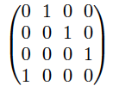
Unique jump matrix
Step evolution operator for cellular automata is unique jump matrix
In every row and coloumn: precisely one element +1 or -1, all other elements zero

Slide 20
Equivalence with fermionic QFT
The probabilistic Thirring automaton is equivalent with a fermionic quantum field theory in 1+1 dimensions, namely a discretization of a type of Thirring model
two colors: a,b = 1,2 = red, green

Slide 21
Fermions are Ising spins or bits
Fermionic occupation numbers n = 0 , 1
Classical bits
Ising spins s = 2n -1
Bit configurations = many body states of fermions

Slide 22
Fermionic wave function
Occupation number basis for multi- fermion systems:
To each bit configuration one associates an element of the wave function
Occupation numbers for different space points and species

Slide 23
Complex structure
Real formulation of complex wave function always possible
Complex formulation of real wave function requires complex structure based on appropriate involution
particle - hole conjugation

Slide 24
QFT- CA equivalence
A ( discrete ) fermionic quantum field theory is equivalent to a probabilistic cellular automaton if the evolution operator for discrete time steps is a
unique jump matrix
( in a real formulation of the evolution equation)

Slide 25
Continuum limit
Discretized fermionic QFT ( e.g. on lattice ) makes model well defined
Regularized functional integral
Step evolution operator
Needs continuum limit

Slide 26
FRG ?

Slide 27
Overall probability distribution for cellular automata
Generalized Ising model:
limit : β to infinity , σ to zero :
only one possibility for change , unique jump
probabilistic
aspects only in
boundary term :

Slide 28
Functional integral for cellular automata
Generalized Ising model:
limit : β to infinity , σ to zero :
only one possibility for change , unique jump
Functional renormalization for cellular automata

Slide 29
Probabilistic computing with static memory materials ?
Let general equilibrium classical statistics transport information from one layer to the next
Simulation, with D. Sexty

Slide 30
Static memory materials
Generalized Ising model:
Boundary term :

Slide 31
Classical interference
Depending on boundary conditions :
Positive
interference
Negative
interference

Slide 32
Static memory material for two dimensional Ising spins on Euclidean square lattice can describe propagation of Weyl fermion in two- dimensional Minkowski space

Slide 33
Continuum limit
Similar generalized Ising model for
Thirring automaton
Continuum limit involves
coarse graining
Functional renormalization such that
pure quantum state remains pure
quantum state on coarse grained level

Slide 34
Step evolution operator
Sequence of kinetic ( free ) and interaction part
Local interaction
(1) at each time step configuration for right(left) movers
moves one position to the right(left),
(2) if precisely two single particles meet at a site : colors are exchanged

Slide 35
Annihilation and creation operators
Step evolution operator for Thirring automaton can be written in terms of fermionic annihilation and creation operators

Slide 36
Hamiltonian
Define H by
Interpolating continuous time evolution
Agrees with discrete evolution for
Schrödinger equation

Slide 37
Naïve continuum limit
Hamiltonian simplifies in the continuum limit
Standard form of Hamiltonian for fermions

Slide 38
General bit fermion map
Isomorphism between generalized Ising model and Grassmann functional integral
Based on identical step evolution operator for both models, with associated map of observables
In our case: proof that discrete Thirring model with two colors has the same step evolution operator as the cellular automaton

Slide 39
Discrete fermionic quantum QFT evolution is unitary
Grassmann functional integral

Slide 40
Functional renormalization of probabilistic cellular automata
Functional integral for discretized fermionic QFT: Grassmann variables
Functional integral for generalized Ising model
Extract effective evolution equation for one-particle excitations from two point function
Two point function from effective action
No need for investigation with explicit boundary terms
Boundary terms as source terms

Slide 41
Quantum formalism for classical statistics
Formalism for information transport from one hypersurface to the next:
Classical wave functions and density matrix
Transfer matrix formalism : Heisenberg picture
Wave functions : Schrödinger picture
Non commuting operators for observables
Quantum rules from classical statistical rules

Slide 42
Momentum observable
Measures periodicity of wave function
Statistical observable, similar to temperature
No fixed value in microstate
Classical correlation function with occupation numbers does not exist
Needs probabilistic information

Slide 43
Quantum mechanics from classical statistics

Slide 44
Quantum mechanics from classical statistics
For particular quantum model:
Isomorphism between classical statistics
( probabilistic cellular automaton,
generalized Ising model )
and quantum mechanics
( many body quantum system for fermions )

Slide 45
Equivalence
Expectation values of all observables are the same in both models
Two equivalent descriptions of the same physical reality

Slide 46
Important conceptual consequences
Probabilistic cellular automata are
classical statistical systems
Fermionic quantum field theories are
quantum systems
Quantum mechanics emerges from classical statistics
Quantum formalism can be used for classical statistics

Slide 47
Can quantum physics be described by classical probabilities ?
“ No go “ theorems
Bell , Clauser , Horne , Shimony , Holt
implicit assumption : use of classical correlation function for all correlations between measurements
Kochen , Specker
assumption : unique map from quantum operators to classical observables

Slide 48
Conclusion
Particular quantum field theory for interacting fermions is equivalent to the classical statistical model of a particular probabilistic cellular automaton.
Large family of models – not all models!
Examples for quantum mechanics from classical statistics
Useful for simulating fermionic models and understanding of statistical properties of cellular automata?

Slide 49
Question
What is the true continuum limit ?
Can one formulate FRG such that unitary evolution is preserved?

Slide 50
end

Slide 51
Reduction of wave function
Reduction of wave function is a convenient technical method to describe conditional probabilities for sequences of measurements
This must not be a physical process during the measurement

Slide 52
conditional probability
sequences of events( measurements )
are described by
conditional probabilities
both in classical statistics
and in quantum statistics

Slide 53
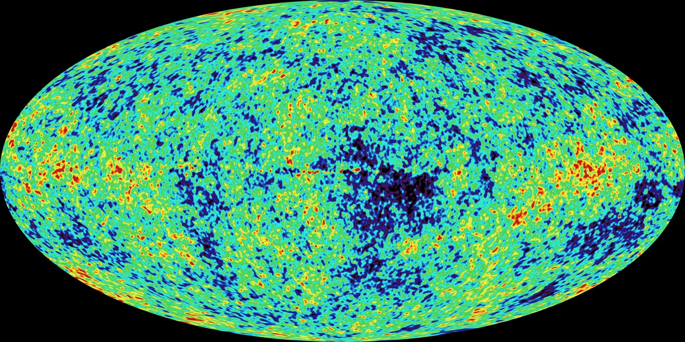
w(t₁)
:
not very suitable
for statement , if here and now
a pointer falls down

Slide 54
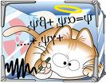
Schrödinger’s cat
conditional probability :
if nucleus decays
then cat dead with w_{c} = 1
(reduction of wave function)

Slide 55
Continuum limit

Slide 56
Lorentz symmetry
Dirac spinor
Action
Infinitesimal Lorentz transformation

