Slide 1
Quantum fermions from classical bits

Slide 2
Fermions
quantum objects
wave function totally antisymmetric
( Pauli principle )
anticommutator for annihilation and creation operators
anticommuting Grassmann variables
functional integral or partition function for many body systems or quantum field theories is Grassmann functional integral

Slide 3
Some interacting fermionic quantum field theories or many body systems are equivalent to probabilistic cellular automata

Slide 4
Cellular automaton
Deterministic manipulation of bits
Updating rule of bit configurations in sequential steps
usually: repetition
( Classical computer is a type of cellular automaton )

Slide 5
Cellular automaton
At each step :
each bit configuration changes to a unique new bit configuration according to an updating rule
for a fixed initial configuration : classical deterministic computing

Slide 6
Updating rule for
Thirring automaton
one – dimensional chain, x : discrete lattice sites
at each x : red and green right movers and left movers
( 4 different species at each site )
at each time step: configuration for right(left) movers moves one position to the right(left)
if two single particles meet:
colors are exchanged

Slide 7
Updating rule
at each time step configuration for right(left) movers moves one position to the right(left), periodicity in x
if precisely two single particles meet at a site : colors are exchanged

Slide 8
Half filled ground states

Slide 9
Soliton
black line : two right movers with different colors

Slide 10







Soliton separates different vacua

Slide 11
Probabilistic cellular automaton
Probability distribution for initial configurations
( or other probabilistic boundary condition )

Slide 12
Equivalence with fermionic QFT
The probabilistic Thirring automaton is equivalent with a discretized fermionic quantum field theory in 1+1 dimensions, namely a type of Thirring model
two colors: a,b = 1,2 = red, green

Slide 13
Important conceptual consequences
Probabilistic cellular automata are
classical statistical systems
Fermionic quantum field theories are
quantum systems
Quantum mechanics emerges from classical statistics
Quantum formalism can be used for classical statistics

Slide 14
Fermions are Ising spins or bits
Fermionic occupation numbers n = 0 , 1
Classical bits
Ising spins s = 2n -1
Bit configurations = many body states of fermions

Slide 15
Free fermion in d=1+1
t
x

Slide 16
Single particle wave function for free fermion in d=1+1
q² (t_{in} , x) determines probability to find fermion
at initial time t_{in} at position x
t
x

Slide 17
Probabilistic cellular automaton
Probability distribution for initial configurations
( or other probabilistic boundary condition )

Slide 18
Probabilistic cellular automaton
Probabilistic initial condition: Specify
at initial time t_{in} for each bit configuration
a probability
Evolution: every given configuration at t_{in}
propagates at t to a configuration
Updating rule: specifies

Slide 19
Wave function for probabilistic cellular automaton
Probability distribution: at every time t a
bit configuration τ occurs with probability
Real wave function q(t): probability amplitude
N – component unit vector

Slide 20
Deterministic and probabilistic cellular automaton
Deterministic CA : sharp wave function
Probabilistic CA : arbitrary wave function

Slide 21
Particle wave duality
Particle aspect:
Bits: yes/no decisions
Possible measurement values 1 or 0
Discrete spectrum of observables
Wave aspect : continuous wave function
more generally: continuity of probabilistic information

Slide 22
Step evolution operator
Evolution for basic time step is encoded in the step evolution operator
Contains the updating rule for CA

Slide 23
step evolution operator
step evolution operator is orthogonal matrix
rotates the wave function
in presence of complex structure : unitary evolution
unique jump operator : in each row and column exactly one element one , all other elements zero

Slide 24
example : switch between two bits

Slide 25
Step evolution operator for
Thirring automaton
Sequence of kinetic ( free ) and interaction part
Local interaction
(1) at each time step configuration for right(left) movers
moves one position to the right(left),
(2) if precisely two single particles meet at a site : colors are exchanged

Slide 26
Annihilation and creation operators
Step evolution operator can be written in terms of fermionic annihilation and creation operators

Slide 27
Hamiltonian
Define H by
Interpolating continuous time evolution
Agrees with discrete evolution for
Schrödinger equation

Slide 28
Continuum limit
Hamiltonian simplifies in the continuum limit
Standard form of Hamiltonian for fermions

Slide 29
Quantum rules
The wave function of the cellular automaton is
identical to the wave function of a quantum
multi-fermion system for all discrete times
The quantum rule for expectation values follows from the classical statistical rule for expectation values

Slide 30
Probabilistic cellular automaton is equivalent to quantum field theory for fermions with interactions

Slide 31
General bit- fermion map
Fermion model in terms of Grassmann functional integral is equivalent to generalized Ising model
Isomorphism for evolution and observables
Map is general. But not always positive weight distribution for Ising type model, and unitary evolution.

Slide 32
Discrete fermion model in 1+1 dimensions
Grassmann functional integral

Slide 33
Continuum limit

Slide 34
Lorentz symmetry
Dirac spinor
Action
Infinitesimal Lorentz transformation

Slide 35
Quantum field theory for fermions with interactions
Thirring model with two colors
Particular value of coupling

Slide 36
Complex structure
So far real wave function
In the presence of a complex structure this can be mapped to a complex wave function
complex conjugation : exchange of 0 and 1, or exchange of particles and holes
half filled ground state : antiparticles = holes

Slide 37

Quantum mechanics from classical statistics

Slide 38
Quantum mechanics from classical statistics
For particular quantum model:
Isomorphism between classical statistics
( probabilistic cellular automaton,
generalized Ising model )
and quantum mechanics
( many body quantum system for fermions )

Slide 39
Equivalence
Expectation values of all observables are the same in both models
Two equivalent descriptions of the same physical reality

Slide 40
Can quantum physics be described by classical probabilities ?
“ No go “ theorems
Bell , Clauser , Horne , Shimony , Holt
implicit assumption : use of classical correlation function for all correlations between measurements
Kochen , Specker
assumption : unique map from quantum operators to classical observables

Slide 41
Quantum formalism for classical statistics
Formalism for information transport from one hypersurface to the next:
Classical wave functions and density matrix
Transfer matrix formalism : Heisenberg picture
Wave functions : Schrödinger picture
Non commuting operators for observables
Quantum rules from classical statistical rules

Slide 42
structural elements of quantum mechanics

Slide 43
wave function as probability amplitude

Slide 44
quantum rule for expectation values of observables follows from classical statistical rule for expectation values

Slide 45
unitary time evolution
ν

Slide 46
h

Slide 47
Simple conversion factor for units

Slide 48
i

Slide 49
presence of complex structure

Slide 50
[A,B]=C

Slide 51
non – commuting operators examples : particle numbers,
Hamilton operator, momentum necessary to represent observables in incomplete statistics

Slide 52
Conclusion
Particular quantum field theory for interacting fermions is equivalent to the classical statistical model of a particular probabilistic cellular automaton.
Example for quantum mechanics from classical statistics
Useful for simulating fermionic models and understanding of statistical properties of cellular automata?

Slide 53
end

Slide 54


Determinism vs. Probabilism
“ Does god throw dices ? ”

Slide 55
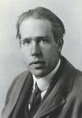
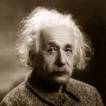
… an old dispute
Gott würfelt
Gott würfelt nicht

Slide 56


not todays topic
Gott würfelt
Gott würfelt nicht
humans can only deal with probabilities

Slide 57
determinism vs. probabilism
my personal view :
determinism not needed
one can start with probabilistic theory and probabilistic evolution
nevertheless : deterministic evolution remains a possible logical option
- in practice fictitious

Slide 58
Probabilistic subsystems
quantum mechanics of single atoms arises from
quantum subsystems
subsystems are genuinely probabilistic
part of information is lost by focus on subsystem
partially ”integrating out” degrees of freedom

Slide 60
Reduction of wave function
Reduction of wave function is a convenient technical method to describe conditional probabilities
This must not be a physical process during the measurement

Slide 61
conditional probability
sequences of events( measurements )
are described by
conditional probabilities
both in classical statistics
and in quantum statistics

Slide 62
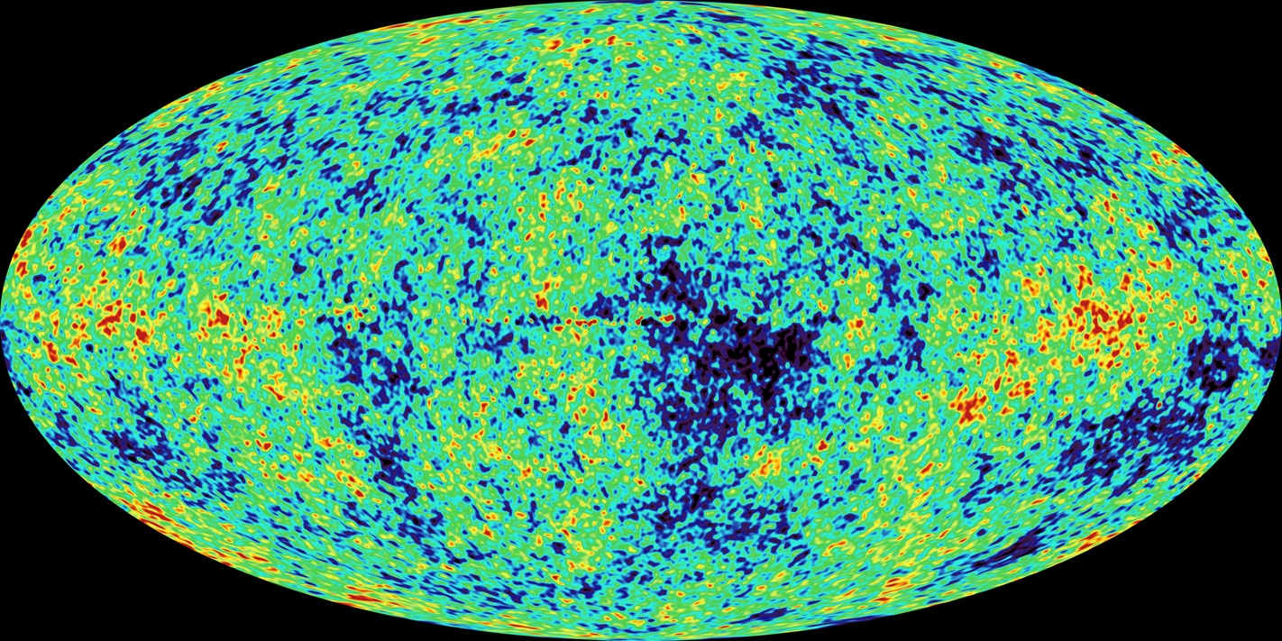
w(t₁)
:
not very suitable
for statement , if here and now
a pointer falls down

Slide 63


Schrödinger’s cat
conditional probability :
if nucleus decays
then cat dead with w_{c} = 1
(reduction of wave function)

Slide 64
Reduction of wave function
Reduction of wave function is a convenient technical method to describe conditional probabilities
This must not be a physical process during the measurement

Slide 65
correlation and operator product
Classical statistical systems admit many product structures of observables
Many different definitions of correlation functions possible , not only classical correlation !
Type of measurement determines correct selection of correlation function !
Ideal quantum measurement should be compatible with information in quantum subsystem

Slide 66
General bit fermion map
Isomorphism between generalized Ising model and Grassmann functional integral
Based on identical step evolution operator for both models, with associated map of observables
In our case: proof that discrete Thirring model with two colors has the same step evolution operator as the cellular automaton

Slide 67
Probabilistic formalism for cellular automata
Generalized Ising model:
limit : beta to infinity , sigma to zero :
only one possibility for change , unique jump
probabilistic
aspects only in
boundary term :

Slide 68
Functional integral for cellular automata ( free fermions )
Generalized Ising model:
limit : beta to infinity , sigma to zero :
only one possibility for change , unique jump
Functional renormalization for cellular automata

