Slide 1
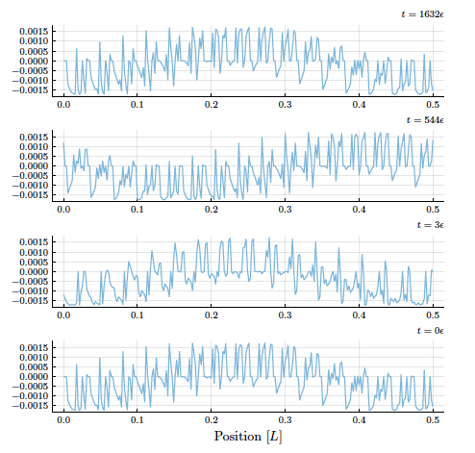
Quantum systems from probabilistic cellular automata

Slide 2
The probabilistic world
Physicists describe the Universe by a probability distribution for events at all times and positions
Classical statistics
Quantum mechanics follows by focus on time-local subsystems

Slide 3
Overall view on quantum mechanics
Quantum mechanics from quantum field theory
Functional integral : variables for all times ( fields, bit configurations, paths )
Local time physics :
Focus on hypersurfaces
labeled by t

Slide 4
Quantum mechanics
Projection on local time subsystem
( Feynman )
Wave function, operators,
linear evolution law, 𝜓(t+𝜀)=U(t) 𝜓(t)
superposition of solutions,
formalism of quantum mechanics

Slide 5
Overall probability distribution for events at all times and positions
Euclidean functional integral

Slide 6
Euclidean functional integral
Projection on local time subsystem
( Feynman )
Wave function, operators,
linear evolution law,
superposition of solutions,
formalism of quantum mechanics

Slide 7
Euclidean functional integral
Wave function q(t) is real
Loss of information during evolution, e.g. approach to equilibrium state with some correlation time or length
Not always !

Slide 8
Probabilistic cellular automata with deterministic invertible updating are classical probabilistic systems No loss of information during evolution They are discrete quantum systems

Slide 9
Cellular automaton
Deterministic manipulation of bit configurations
Updating rule of bit configurations in sequential steps
Updating of a cell depends only on some neighboring cells
Repetition ( at least after certain number of time steps)
( Classical computer is an automaton without repetition )

Slide 10
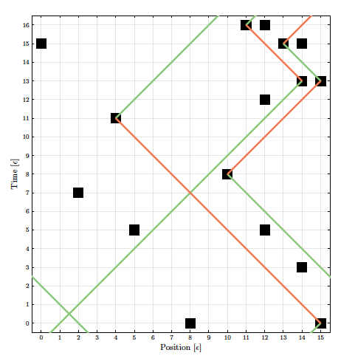
Updating rule for random automaton
Four types of bits
right- and left- movers
red and green
At randomly distributed scattering points:
occupied bits change direction and color.
Repetition of distribution after certain number of time steps

Slide 11
Cellular automaton
Updating of bits
in cell (t, x)
is influenced only
by the cells
(t-𝜀, x-𝜀) and
(t-𝜀, x+𝜀).
Causal structure of QFT with light cones

Slide 12
Probabilistic cellular automaton
Probability distribution for initial configurations
deterministic updating

Slide 13
Probabilistic cellular automaton
Probabilistic initial condition: Specify at initial time t_{in}
for each bit configuration a probability
Evolution: every given configuration at t_{in}
propagates at t to a configuration
Updating rule: specifies

Slide 14
Overall probability distribution
Follow trajectory of some initial configuration
Probabilities are equal for each point on trajectory
Probabilities for arbitrary bit configurations in time and space. They differ from zero only for configurations that can be reached allowed trajectories
Classical probabilistic system

Slide 15
Wave function for probabilistic cellular automaton
Local time probability distribution: at every time t a bit configuration τ occurs with probability , which equals the probability for the initial bit configuration from which it originates.
Real wave function q(t): probability amplitude
q(t) is a unit vector

Slide 16
Deterministic and probabilistic cellular automaton
Deterministic CA : sharp wave function
Probabilistic CA : arbitrary wave function

Slide 17
Step evolution operator
Evolution for basic time step is encoded in the step evolution operator
Contains the updating rule for CA

Slide 18
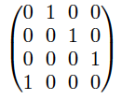
Unique jump matrix
Step evolution operator for cellular automata is unique jump matrix
In every row and column: precisely one element +1 or -1, all other elements zero
is orthogonal
and therefore unitary

Slide 19
Hamiltonian
Define H by
H is Hermitian and piecewise constant
Interpolating continuous time evolution
Schrödinger equation
Solution agrees with discrete evolution for t=

Slide 20
Complex structure
Suitable set of two discrete transformations for complex conjugation and multiplication by i
Configurations at given t with single occupied bit: (x, 𝛾)
Wave function for a single occupied bit: q_{𝛾}(t, x)
red and green correspond to
real and imaginary parts of complex wave function

Slide 21
Random probabilistic automaton
Four types of bits
right- and left- movers
red and green
At randomly distributed scattering points:
change of direction and color
Repetition after certain number of time steps

Slide 22
Free massless Dirac fermions
Without scattering: automaton describes quantum field theory for free massless Dirac fermions in one space and one time dimension
Arbitrary number of fermions
Half filled vacuum with all negative energy states filled
Single fermion state: 𝜓_{𝛼}(t, x)

Slide 23
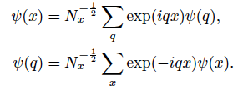
Momentum observable for single fermion state
Fourier transform
Momentum operator
Continuum limit
Momentum distribution
Expectation value

Slide 24
Conserved momentum
Momentum is a conserved quantity
The expectation values
do not depend on time
Momentum eigenstates : plane waves
They require probabilistic automaton with smooth wave functions

Slide 25
Statistical observables
Momentum is a statistical observable
No fixed value for given bit configuration
Characterizes properties of probabilistic information ( similar to temperature )
Does not commute with position operator
Bell’s inequalities do not apply to pair position and momentum since no classical correlation function can be defined

Slide 26
Numerical solution
Simulate simple system by following trajectories numerically

Slide 27
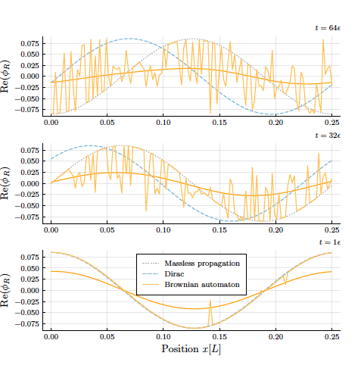
Brownian automaton
Single bit occupied
Start with smooth probability distribution
( harmonics corresponding to solution of Dirac equation with mass )
evolution at different
time steps

Slide 28
Conserved energy
Mesoscopic Hamiltonian defines conserved energy observable
H is not known explicitly
Single time step
Generalized potential
Repeat M_{t} times: mesoscopic Hamiltonian H

Slide 29
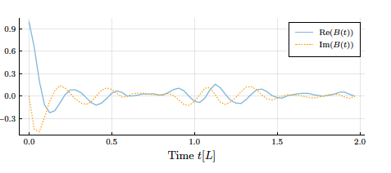
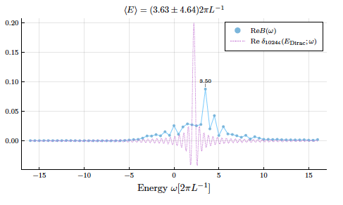
Conserved energy
Energy is conserved, but spectrum and eigenfunctions of
Hamiltonian not known.
Analyze energy spectrum from transition element
Superposition of
energy eigenstates

Slide 30
Periodic evolution of probability distribution for energy eigenstates
Automaton with periodicity in space:
Energy eigenstate found explicitly
Evolution

Slide 31
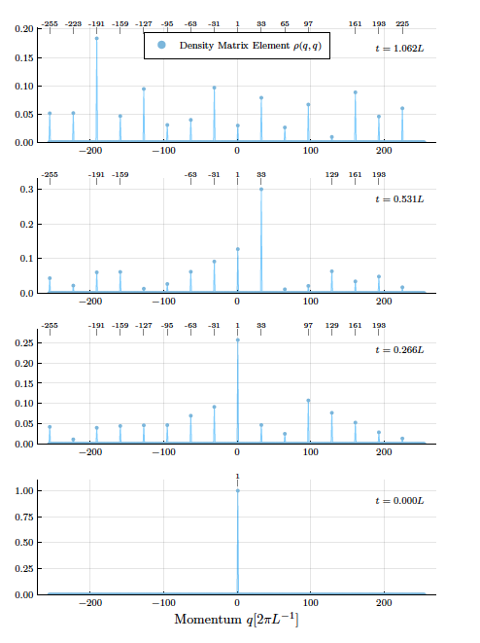
Conserved coarse grained momentum
Space translation invariance by M_{x} introduces conserved coarse grained momentum
Evolution of
momentum distribution
Diagonalize H on subspace with given coarse grained momentum

Slide 32
Naïve continuum limit
If commutator terms in expansion of U can be neglected for smooth enough wave functions
Hamiltonian for free massive Dirac particle
with mass proportional to mean number of scattering points

Slide 33
Dispersion relation for early evolution of Brownian automaton

Slide 34
Conclusion
Quantum formalism very useful for investigation of random probabilistic automaton
Continuum limit for random automaton not established
Extended model for quantum particle
in a potential ?

Slide 35
Quantum mechanics from classical statistics
Probabilistic cellular automata are classical statistical systems.
Probabilistic cellular automata are discrete quantum systems.
Quantum mechanics emerges from a classical statistical system.
No go theorems ( Bell etc. ) do not apply to all pairs of observables.

Slide 36
Outlook: How to find overall classical probability distribution for quantum particle in an arbitrary potential ?
Top down approach: Find automaton for interesting QFT. Construct vacuum and one-particle excitation. Find continuum limit. Realistic setting, but hard to implement.
Bottom up approach: Explicit construction of probabilistic automaton is already done for
quantum particle in harmonic potential
single qubit with arbitrary time-dependent Hamiltonian
Classical probability distribution not realistic,
but useful conceptually. No contradictions.

Slide 37
Beyond probabilistic automata
“Unitary” change of probability distribution more general than probabilistic automata
Step evolution operator can be orthogonal, but not a unique jump matrix
Small neuromorphic computer has learned how to find the classical probability distribution for arbitrary (entangled) two-qubit states and to perform arbitrary unitary transformations
( with C. Pehle )

Slide 38
Classical probability distribution for maximally entangled two-qubit quantum state
6 classical bits,
64 configurations
bit quantum map
from probability
distribution to
quantum density
matrix

Slide 39
Automaton has been constructed for discrete fermion model with interactions in 1+1 dimensions
Grassmann functional integral

Slide 40
Naïve continuum limit is Lorentz invariant
Dirac spinor
a=1,2
Action
Infinitesimal Lorentz transformation

Slide 41
Is this all useful?
Quantum formalism offers new insights for the dynamics of probabilistic cellular automata
New forms of correlated computing
Clarification of origin of quantum concepts – demystification
Probabilistic realism is a philosophical concept
Restrictions on fundamental theory?

Slide 42
end

Slide 43
Probabilistic automata for fermionic quantum field theories

Slide 44
Fermions
quantum objects
wave function totally antisymmetric
( Pauli principle )
anticommutator for annihilation and creation operators
anticommuting Grassmann variables
functional integral or partition function for many body systems or quantum field theories is Grassmann functional integral

Slide 45
Fermions are Ising spins or bits
Fermionic occupation numbers n = 0 , 1
Classical bits
Ising spins s = 2n -1
Bit configurations = many body states of fermions

Slide 46
Fermionic wave function
Occupation number basis for multi- fermion systems:
To each bit configuration one associates a component of the wave function
Occupation numbers for different space points and species

Slide 47
Probabilistic cellular automata for fermionic quantum field theories
Wave function in same Hilbert space
If step evolution operator for automaton is the same as for the fermionic quantum field theory: Both are equivalent

Slide 48
Updating rule for Thirring automaton
one – dimensional chain, x : discrete lattice sites
at each x : red and green right movers and left movers ( 4 different species at each site )
at each time step: configuration for right(left) movers moves one position to the right(left)
if two single particles meet:
colors are exchanged

Slide 49
Particle wave duality
Particle aspect:
Bits: yes/no decisions
Possible measurement values 1 or 0
Discrete spectrum of observables
Wave aspect : continuous wave function
more generally: continuity of probabilistic information

Slide 50
QFT- CA equivalence
A fermionic quantum field theory is equivalent to a probabilistic cellular automaton if the evolution operator for discrete time steps is a
unique jump matrix
( in a real formulation of the evolution equation)

Slide 51
General bit fermion map
Isomorphism between generalized Ising model and Grassmann functional integral
Based on identical step evolution operator for both models, with associated map of observables
In our case: proof that discrete Thirring model with two colors has the same step evolution operator as the cellular automaton

Slide 52
Discrete fermion model in 1+1 dimensions
Grassmann functional integral

Slide 53
Naïve continuum limit

Slide 54
Lorentz symmetry
Dirac spinor
Action
Infinitesimal Lorentz transformation

Slide 55
Can quantum physics be described by classical probabilities ?
“ No go “ theorems
Bell , Clauser , Horne , Shimony , Holt
implicit assumption : use of classical correlation function for all correlations between measurements
Kochen , Specker
assumption : unique map from quantum operators to classical observables

Slide 56
Conclusion
Particular quantum field theory for interacting fermions is equivalent to the classical statistical model of a particular probabilistic cellular automaton.
Large family of models – not all models!
Examples for quantum mechanics from classical statistics
Useful for simulating fermionic models and understanding of statistical properties of cellular automata?

