Slide 1
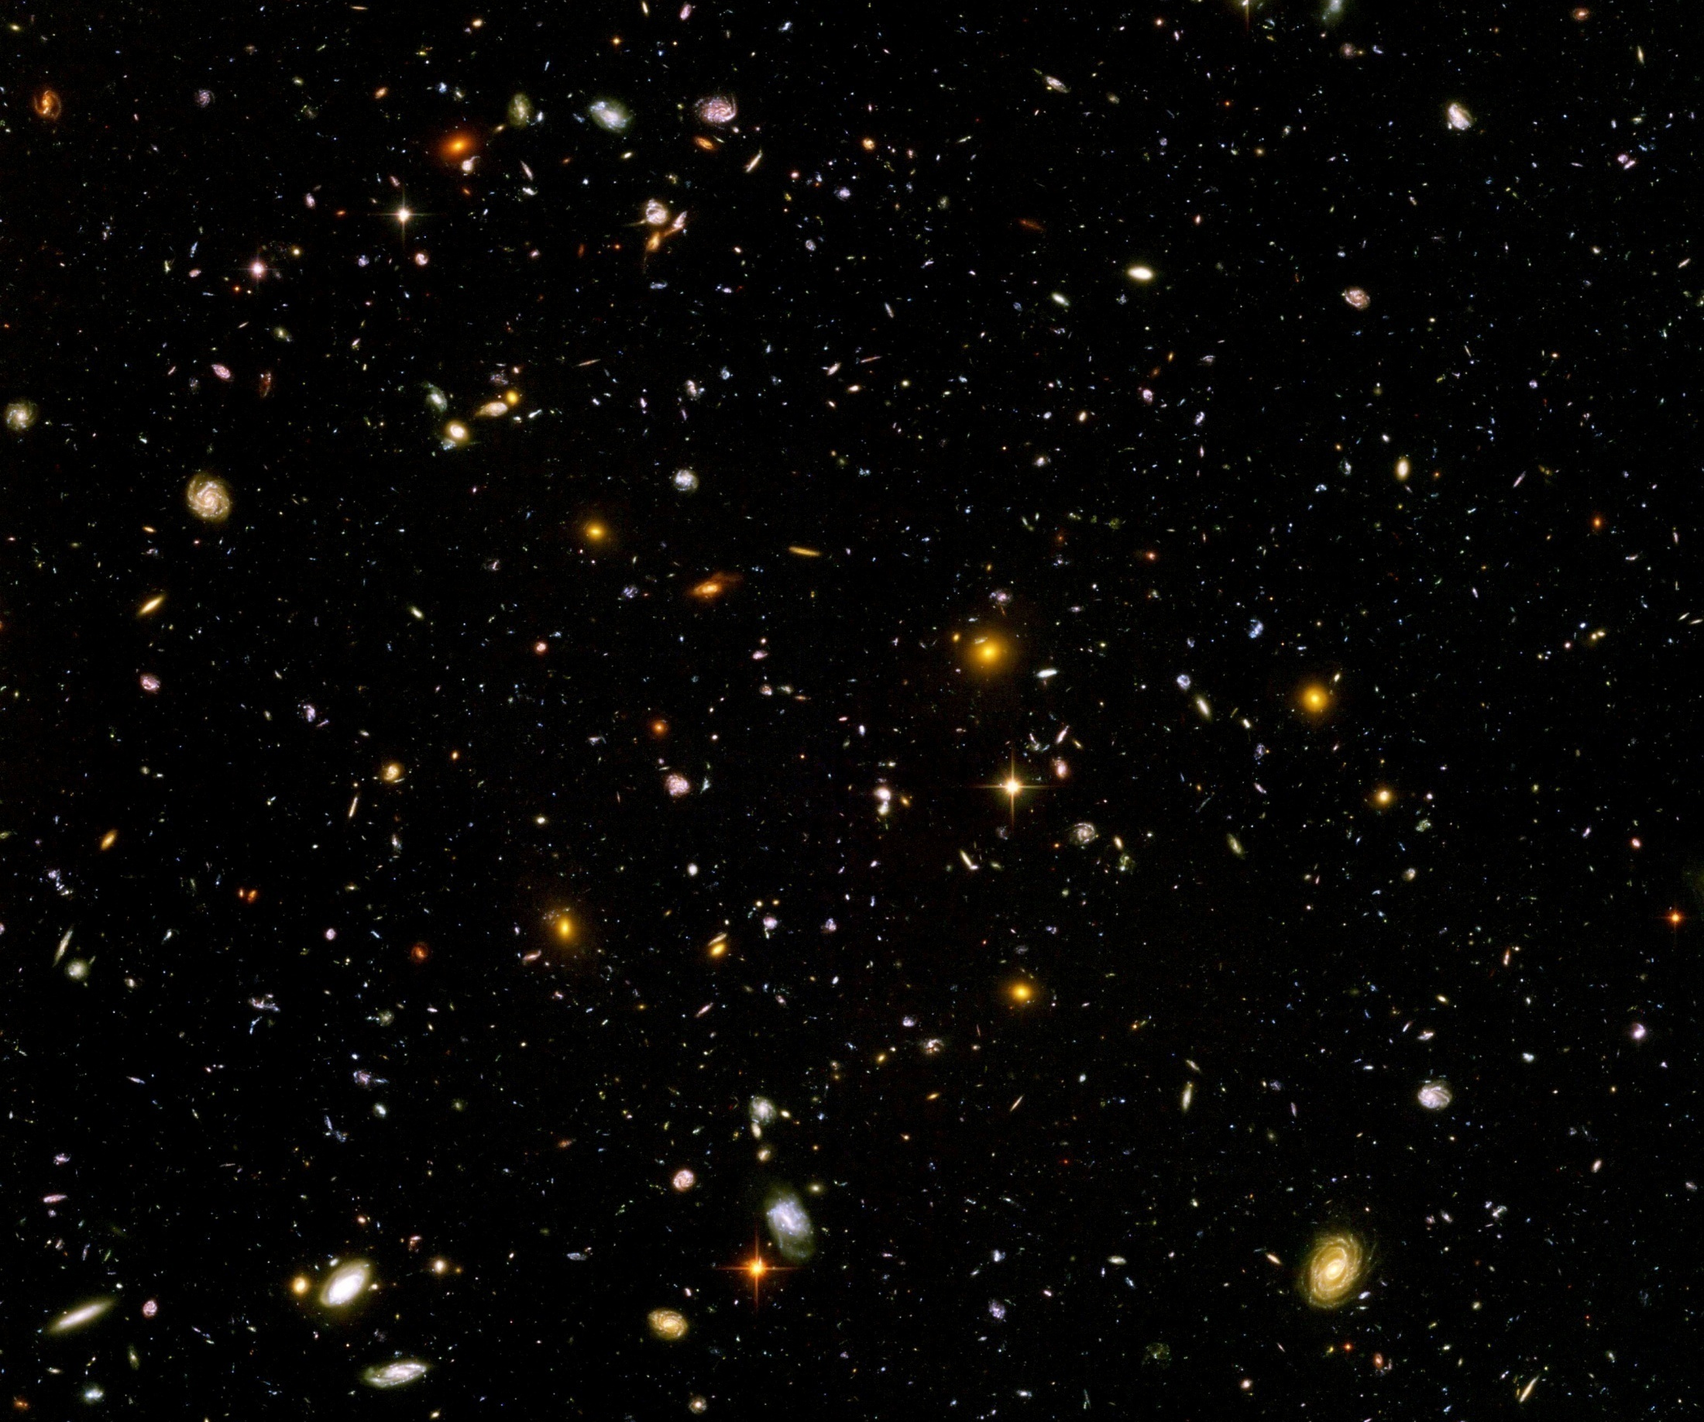
Scale symmetry in particle physics and cosmology

Slide 2
Scale transformation
Scale all lengths with constant factor
Scale all masses with inverse factor

Slide 3
Quantum scale symmetry
No parameter with dimension of
length or mass is present in the
quantum effective action.
Then invariance under
dilatations or global scale transformations
is realized.
Continuous global symmetry

Slide 4
Scale transformation of renormalized fields

Slide 5
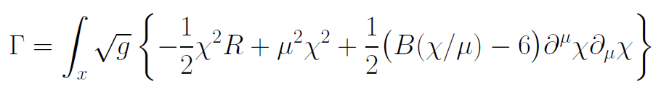
Scale symmetric classical gravity
Replace Planck mass by scalar field
…

Slide 6
Scale invariance of scalar kinetic term

Slide 7
Classical scale symmetry
No parameter with dimension of
length or mass is present in the
classical action.

Slide 8
Classical scale symmetry
No parameter with dimension of
length or mass is present in the
classical action.
Examples : pure QCD,
QED with zero electron mass

Slide 9
Have we observed scale symmetry ?

Slide 10

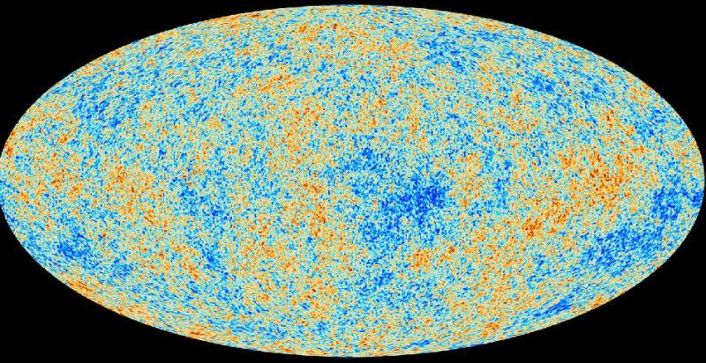
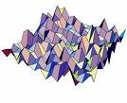
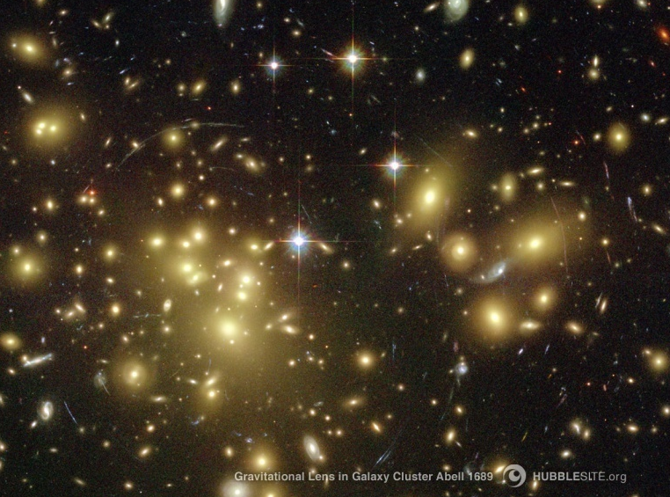
Almost scale invariant primordial fluctuation spectrum seeds all structure in the universe

Slide 11
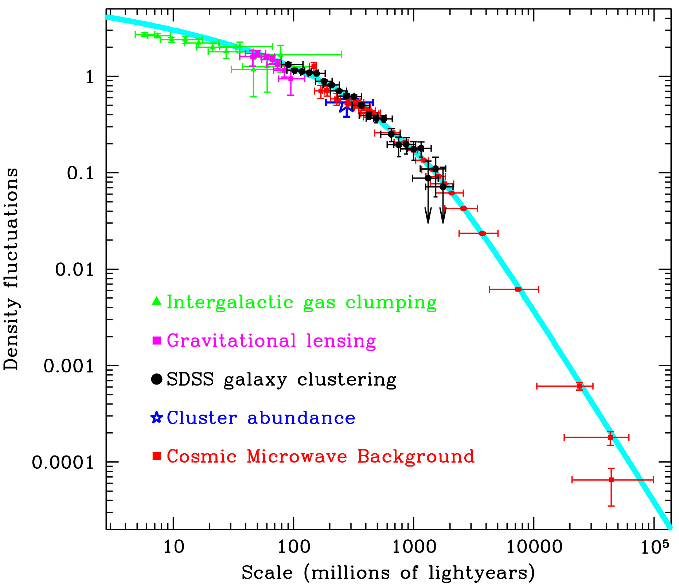
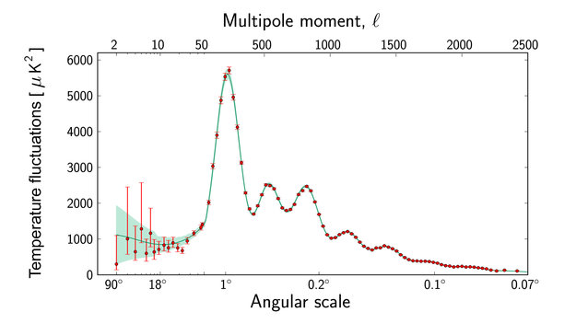
Scale symmetry in cosmology ?
Almost scale invariant primordial fluctuation spectrum
scales are present in cosmology

Slide 12
Scale symmetry in elementary particle physics ?
proton mass , electron mass
Scales are present in particle physics,
but very small as compared to Planck mass
High momentum scattering almost scale invariant

Slide 13
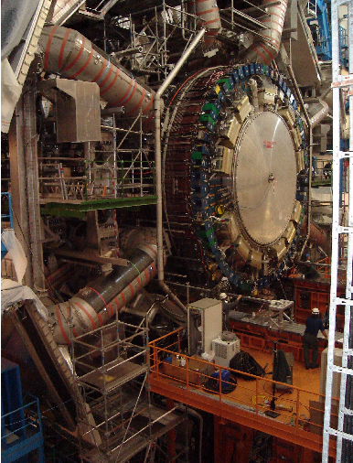
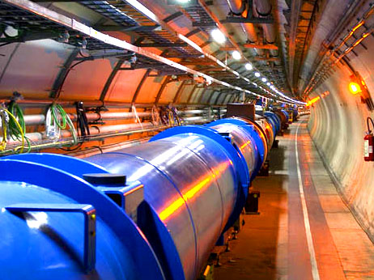
Approximate scale symmetry at highest energies at the LHC
and at the next collider ?

Slide 14
Quantum scale symmetry

Slide 15
Quantum fluctuations induce running
( momentum dependent ) couplings
Running fine structure constant
𝛼 = 1/137 for atoms
𝛼 = 1/128 at LEP
Induced by quantum fluctuations of electrons, muons, quarks etc.

Slide 16
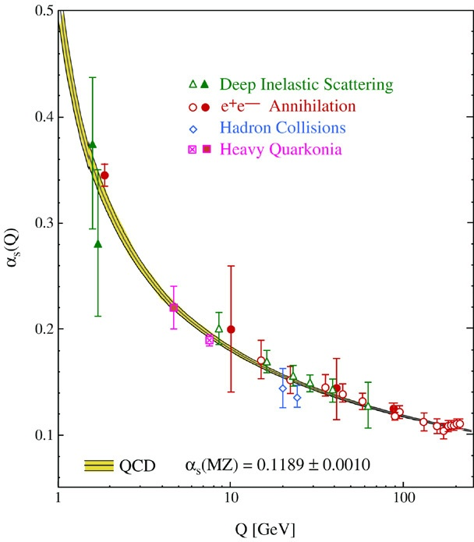
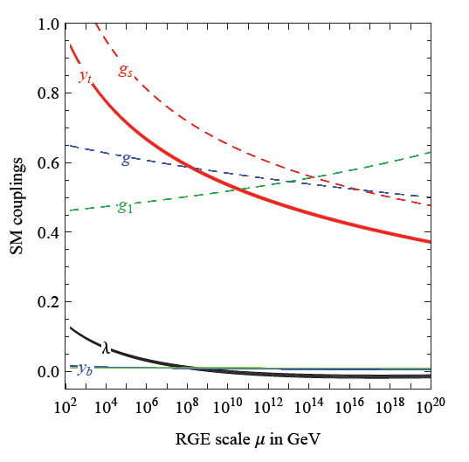
Quantum fluctuations induce running couplings
possible violation of scale symmetry
well known in QCD or standard model

Slide 17
Quantum scale symmetry
quantum fluctuations can violate scale symmetry
running dimensionless couplings
at fixed points , scale symmetry is exact !
quantum fluctuations can generate scale symmetry !

Slide 18
Fixed points and scale symmetry
At a fixed point, scale symmetry is exact in the presence of fluctuations ( quantum scale symmetry )
Well known in condensed matter physics :
second order phase transition
fixed point or scaling solution
exact scale symmetry
critical phenomena
Classical or quantum Ising model

Slide 19
Un
Unbroken scale symmetry :
Physics looks the same on all scales

Slide 20
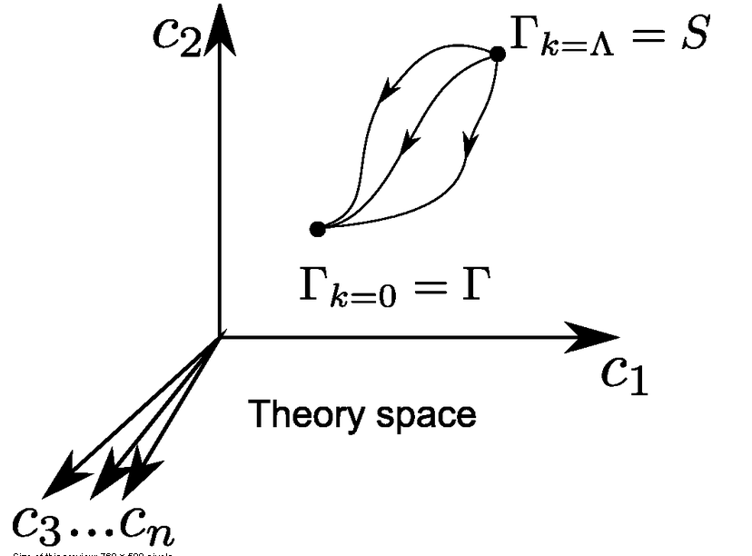
Functional renormalization : flowing action
Wikipedia
Notes:
20

Slide 21
Ultraviolet fixed point
UV fixed point
Wikipedia
Notes:
21

Slide 22
Quantum scale symmetry
Exactly on fixed point:
No parameter with dimension of
length or mass is present in the
quantum effective action.
Then invariance under
dilatations or global scale transformations
is realized as a quantum symmetry.
Continuous global symmetry

Slide 23
Three scale symmetries
Gravity scale symmetry:
includes transformation of fields for particles, metric
and scalar singlet UV - fixed point
Particle scale symmetry:
scalar singlet kept fixed ( or fixed Planck mass )
relative scaling of momenta with respect to
Planck mass SM - fixed point
Cosmic scale symmetry :
involves metric and cosmon ( pseudo Goldstone boson of
spontaneously broken scale symmetry ) IR - fixed point

Slide 24
Scale symmetry and fixed points
Relative strength of gravity
Particle
scale
symmetry
Gravity
scale
symmetry
Distance from
electroweak
phase transition
Cosmic
scale
symmetry

Slide 25
Gravity scale symmetry

Slide 26
Gravity scale symmetry
Replace Planck mass by scalar field
…

Slide 27
Gravity scale symmetry
Replace Planck mass by scalar field
Cosmological solution : 𝜒(t) differs from zero
Spontaneous breaking of scale symmetry

Slide 28
Particle masses from spontaneous scale symmetry breaking
Electron mass proportional to 𝜒
m_{e} ∼ 𝜑₀ ( expectation value of Higgs scalar )
𝜑₀ ∼ 𝜒
m_{e} = y_{e} 𝜑₀ ( Yukawa coupling )

Slide 29
Spontaneous symmetry breaking confirmed at the LHC

Slide 30
Spontaneous breaking of scale symmetry
expectation value of scalar field breaks scale symmetry spontaneously
particle masses can be proportional to scalar field 𝜒
massive particles are compatible with scale symmetry
in presence of massive particles : sign of exact scale symmetry is exactly massless Goldstone boson – the dilaton

Slide 31
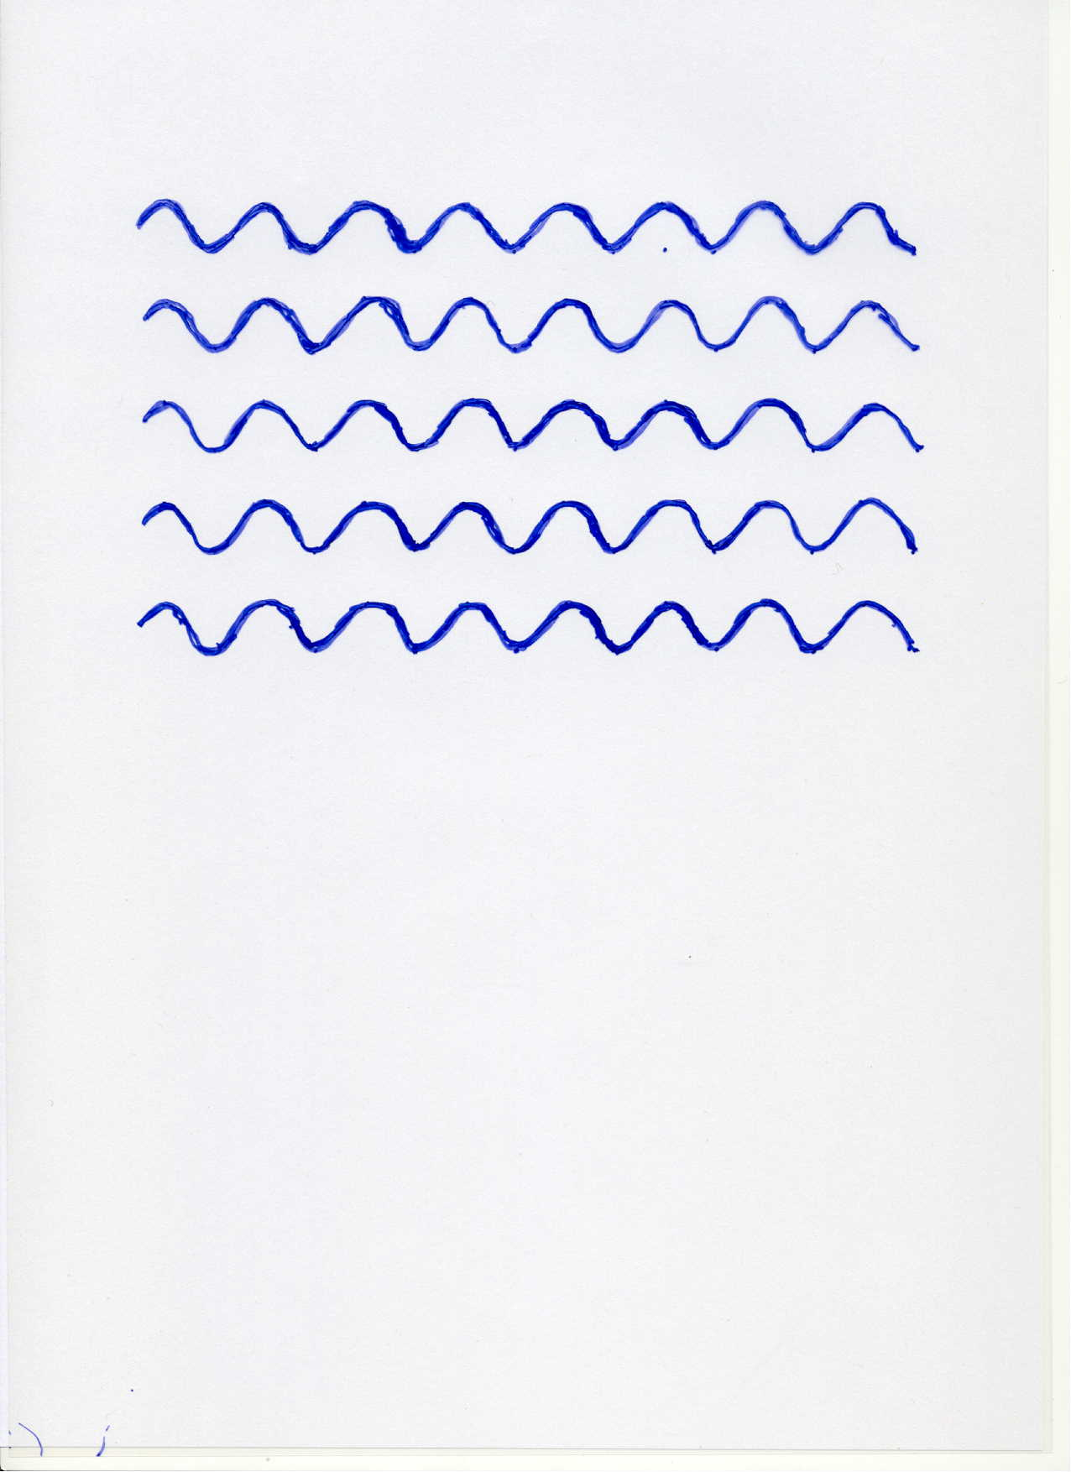
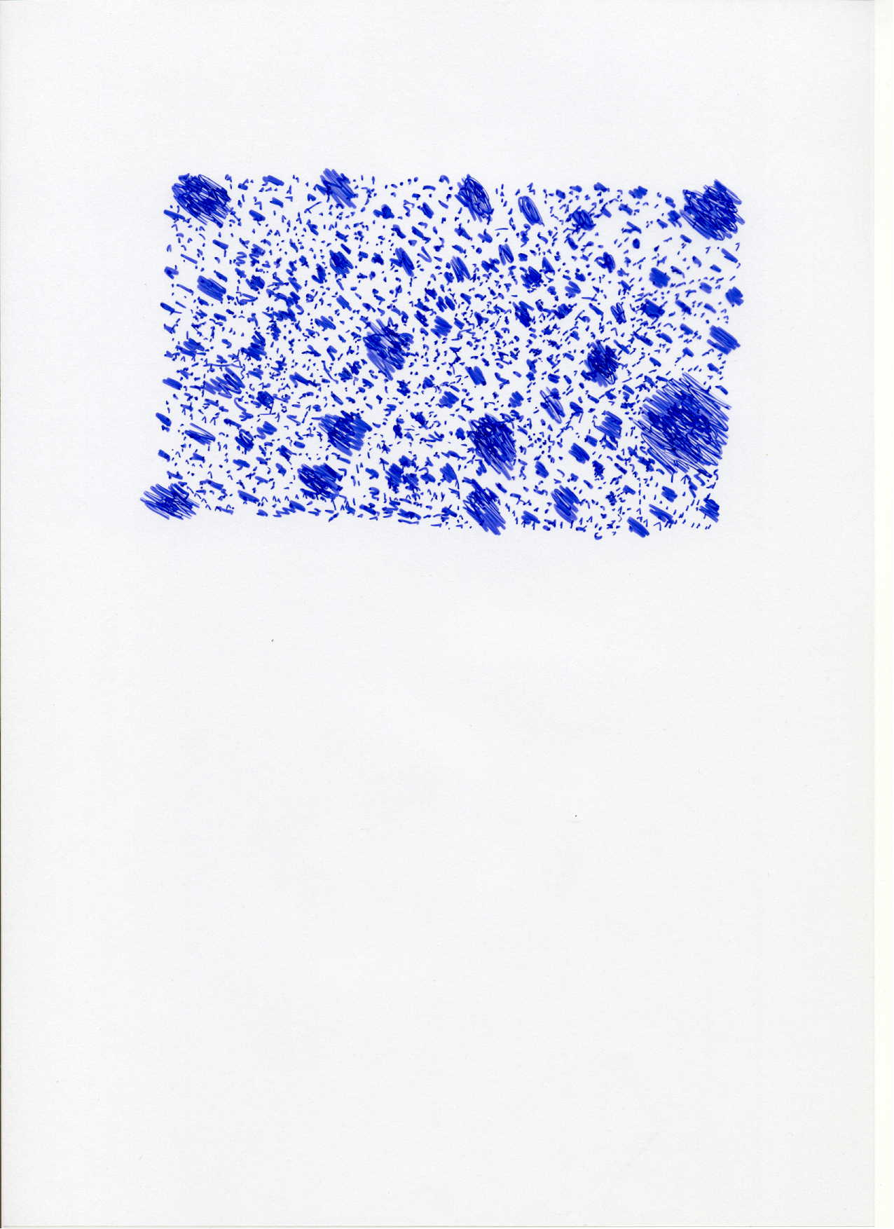

Scale symmetry
no scale symmetry
scale symmetry
only if no spontaneous symmetry breaking!

Slide 32
Scale symmetric standard model
Replace all mass scales by scalar field 𝜒
(1) Higgs potential
(2) Strong gauge coupling, normalized at , is independent of 𝜒
(3) Similar for all dimensionless couplings
Quantum effective action for standard model does
not involve intrinsic mass or length
Fujii
Englert
Zee
CW
CW’87

Slide 33
Scale symmetric standard model
Replace all mass scales by scalar field 𝜒
Quantum effective action for standard model does
not involve intrinsic mass or length scale
Quantum scale invariant standard model
For : massless Goldstone boson
CW’87
Shaposhnikov, Zenhausern’08

Slide 34
Gravity scale symmetry does not protect small Fermi scale
Effective potential
is scale invariant for arbitrary 𝜀

Slide 35
Particle scale symmetry

Slide 36
Particle scale symmetry
is the scale symmetry for the
effective low energy theory below the Planck mass

Slide 37
Second order vacuum electroweak phase transition fixed point quantum scale symmetry

Slide 38
Scale symmetry and Fermi scale
Vacuum electroweak phase transition is (almost) second order, including all effects from quantum fluctuations
Critical surface of second order phase transition: exact fixed point, quantum scale symmetry
Scale symmetry guarantees “naturalness” of gauge hierarchy
C. Wetterich, Phys. Lett.B140(1984)215,
W. A. Bardeen, FERMILAB-CONF-95-391-T(1995)

Slide 39
Scale symmetry and Fermi scale
Vacuum electroweak phase transition is (almost) second order
Critical surface of second order phase transition: exact fixed point, quantum scale symmetry
Scale symmetry guarantees “naturalness” of small gauge hierarchy
No fine tuning for renormalisation group improved perturbation theory for deviation from critical surface

Slide 40
Fine tuning
Need to understand small parameter
Suitable renormalized parameter needs not to be tuned: take distance from second order vacuum electroweak phase transition as one of the relevant parameters
If distance from phase transition is small:
expression in terms of other large renormalized
parameters necessarily involves cancellations

Slide 41
Technical fine tuning ?
Quadratic divergences concern bare perturbation theory for location of critical surface in coupling constant space.
not relevant for observation,
not particularly interesting,
regularization dependent, not universal,
always depends on unknown microscopic details
bare perturbation theory is bad expansion

Slide 42
Vacuum electroweak phase transition in quantum gravity

Slide 43
Quantum Gravity
Quantum Gravity can be a
renormalisable quantum field theory
Asymptotic safety

Slide 44
Asymptotic safety of quantum gravity
if UV fixed point exists :
quantum gravity is
non-perturbatively renormalizable !
S. Weinberg , M. Reuter

Slide 45
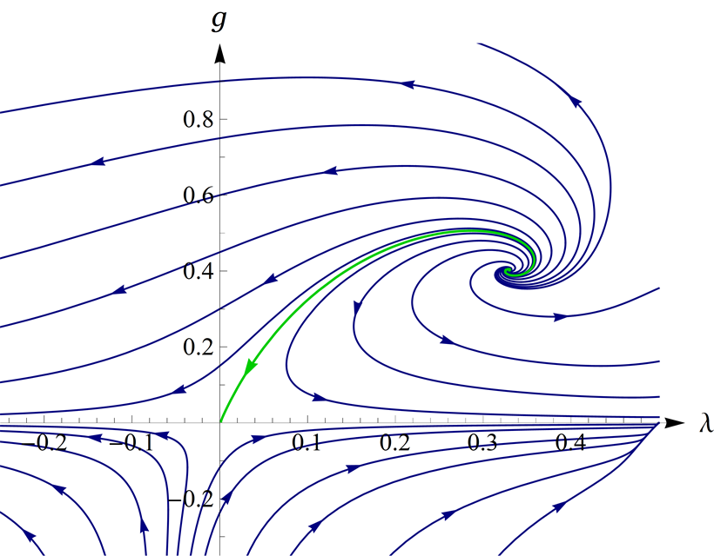
UV- fixed point for quantum gravity
Wikipedia

Slide 46
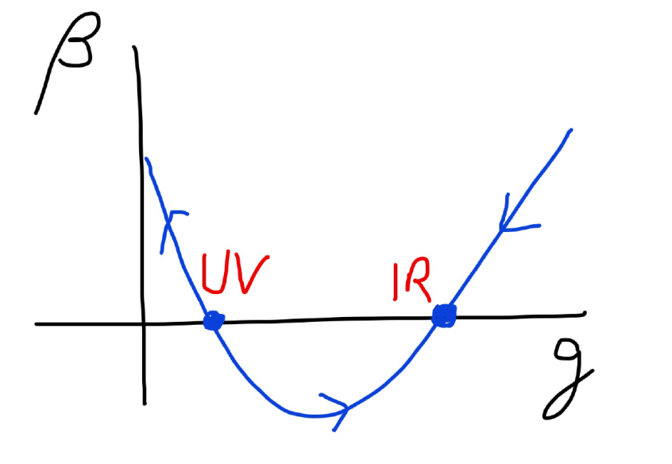
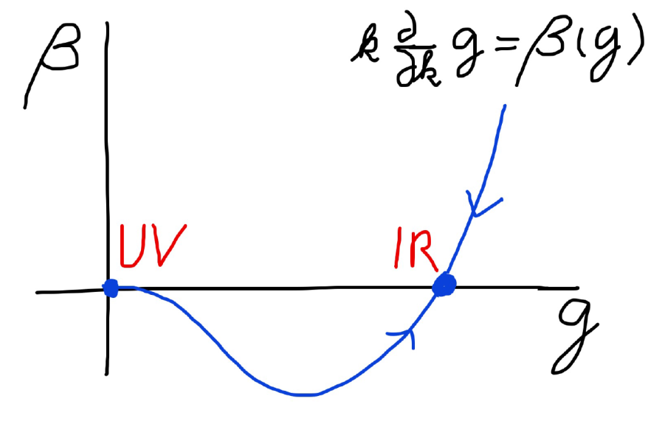
Asymptotic safety Asymptotic freedom
Relevant parameters yield undetermined couplings.
Quartic scalar coupling is not relevant and can therefore be predicted.

Slide 47
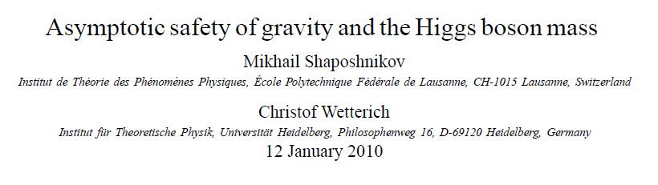
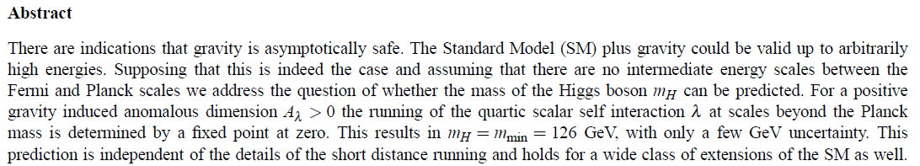
a prediction…

Slide 48
Essential points for prediction of Higgs boson mass:
More precisely : ratio Higgs boson mass over W-boson mass, or Higgs boson mass over top quark mass
Initial value of quartic scalar coupling near Planck mass is predicted by UV- fixed point
Extrapolate perturbatively
to Fermi scale :

Slide 49
Flow diagram
Relative strength of gravity
Particle
scale
symmetry
Gravity
scale
symmetry
Distance from
electroweak
phase transition
Cosmic
scale
symmetry

Slide 50
Flowing dimensionless Planck mass
Renormalization scale k : Only fluctuations with momenta larger k are included
Flowing
Planck mass M²(k)
Dimensionless
squared Planck mass
solution :

Slide 51
Fixed point and crossover
UV - fixed point
approached
for k → ∞
Near UV – fixed point : M ~ k
Transition to constant M for small k,
Gravity gets weak, w⁻¹ decreases to zero

Slide 52
Flowing dimensionless ratio for distance from electroweak phase transition
Dimensionless
distance from
EW-phase transition
Particle contribution
Gravity contribution : A=b/w , dominates for large k, small w
Flow equation :

Slide 53
Ultraviolet ( UV ) fixed point
Planck mass scales proportional to k
Exactly on electroweak phase transition

Slide 54
General solution of flow equations
Two relevant parameters
( free integration constants )
:
and
M(k=0) can either be intrinsic scale or field 𝜒

Slide 55
Flow diagram
Different trajectories: different

Slide 56
Critical trajectory
0
=0
not crossed
by flow !
Particle scale symmetry

Slide 57
Fixed points

Slide 58
Particle scale symmetry
Gravity is neglected
Relative scaling of
momentum scales
as compared to
Planck mass

Slide 59
Quantum effective action including all fluctuations
M(k=0) can either be intrinsic scale or field 𝜒
For M(k=0) = 𝜒 :
quantum scale invariant standard model

Slide 60
Where to solve the gauge hierarchy problem ?
Important consequence of particle scale symmetry:
The scale of physics which could explain the gauge hierarchy may be as high as the Planck scale
Close vicinity of second order phase transition holds for all scales
No need for solution at TeV-scales !

Slide 61
Decoupling of degrees of freedom

Slide 62
Gauge hierarchy
Possible explanation of small parameter : distance from second order vacuum electroweak phase transition is irrelevant parameter at UV – fixed point

Slide 63
Possible explanation of gauge hierarchy
Phys.Lett. B770 (2017) 268-271

Slide 64
Scale symmetry in cosmology

Slide 65
Approximate scale symmetry near fixed points
UV : approximate scale invariance of primordial fluctuation spectrum from inflation
IR : cosmon is pseudo Goldstone boson of
spontaneously broken scale symmetry,
tiny mass,
responsible for dynamical Dark Energy

Slide 66
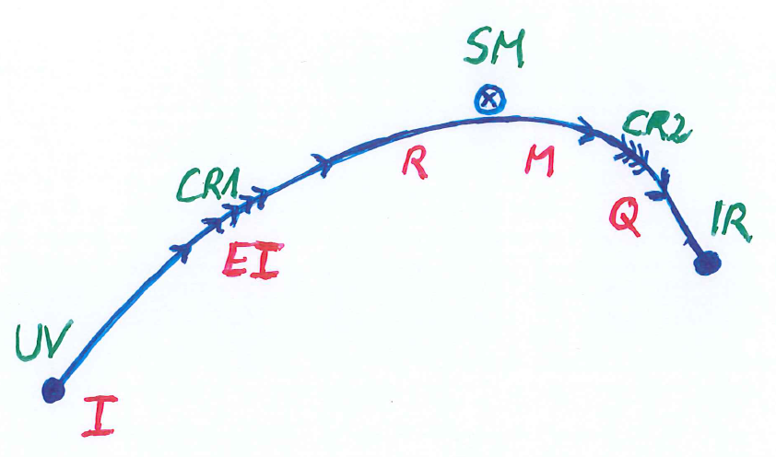
Possible consequences of crossover in quantum gravity
Realistic model for inflation and dark energy
with single scalar field

Slide 67
Inflation : the vicinity of the UV- fixed point

Slide 68
Starobinski inflation
Scale symmetry if M²/R ( and V/R² ) go to zero.
Cosmological solution : R decreases
Early stages : very large R, close to scale symmetry

Slide 69
Starobinski inflation
Scale symmetry for large R/M²
End of inflation : C R near M²
Substantial violation of scale symmetry
Primordial fluctuation spectrum:
frozen long before end of inflation
approximate scale symmetry of fluctuation spectrum

Slide 70
Higgs inflation
Scale symmetry if: large,
and running of dimensionless couplings slow

Slide 71
Higgs inflation
Inflationary epoch : large
End of inflation : around one
Standard cosmology after end of inflation :
small

Slide 72
Cosmon inflation
scale invariance : small μ²/R
or small μ/χ
UV and IR fixed point

Slide 73
Cosmic scale symmetry

Slide 74
variable gravity
“Newton’s constant is not constant –
and particle masses are not constant”

Slide 75
Variable Gravity
quantum effective action,
variation yields field equations
Einstein gravity :
M² R

Slide 76
+ scale symmetric standard model
Replace all mass scales by scalar field 𝜒
(1) Higgs potential
(2) Strong gauge coupling, normalized at , is independent of 𝜒
+ scale invariant action for dark matter

Slide 77
Variable Gravity
Scalar field coupled to gravity
Effective Planck mass depends on scalar field
Simple quadratic scalar potential involves intrinsic mass μ
Nucleon and electron mass proportional to dynamical Planck mass

Slide 78

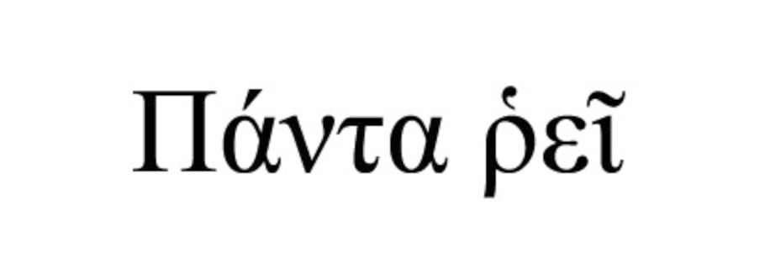

Slide 79
Scale symmetry in variable gravity
( IR – fixed point )
IR fixed point for μ/χ =0 :
quantum scale symmetry
Tiny violation of scale symmetry
for tiny μ/χ .

Slide 80
Cosmic scale symmetry and the cosmological constant problem
IR – fixed point reached for χ → ∞
Impact of intrinsic mass scale disappears

Slide 81
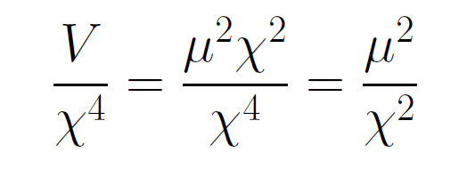
asymptotically vanishing cosmological „constant“
What matters : Ratio of potential divided by fourth power of Planck mass
vanishes for χ → ∞ !

Slide 82
Quintessence
Dynamical dark energy ,
generated by scalar field (cosmon )
C.Wetterich,Nucl.Phys.B302(1988)668, 24.9.87
P.J.E.Peebles,B.Ratra,ApJ.Lett.325(1988)L17, 20.10.87
Notes:
82

Slide 83
Prediction : homogeneous dark energy influences recent cosmology
- of same order as dark matter -
Original models do not fit the present observations
…. modifications
( different growth of neutrino mass )

Slide 84
Predictions of quantum gravity ?
Simple approximation for graviton contribution to scalar potential:
Predicts mass of Higgs scalar
Solves Gauge Hierarchy problem
Solves cosmological constant problem

Slide 85
Conclusions
Quantum scale symmetry plays important role in
particle physics and cosmology
Particle scale symmetry is crucial for understanding of gauge hierarchy
SM- fixed point
Cosmic scale symmetry is crucial for dynamical dark energy
IR- fixed point
Gravity scale symmetry rules beginning of cosmology
UV- fixed point

Slide 86
Scale symmetry and fixed points
Relative strength of gravity
Particle
scale
symmetry
Gravity
scale
symmetry
Distance from
electroweak
phase transition
Cosmic
scale
symmetry

Slide 87
Conclusions (2)
Many incorrect statements on naturalness
neglect the important consequences of quantum
scale symmetry and associated fixed points.
Symmetries crucial for naturalness
Near fixed points : Individual contributions do not represent a natural value for the total effect

Slide 88
end

