Slide 1
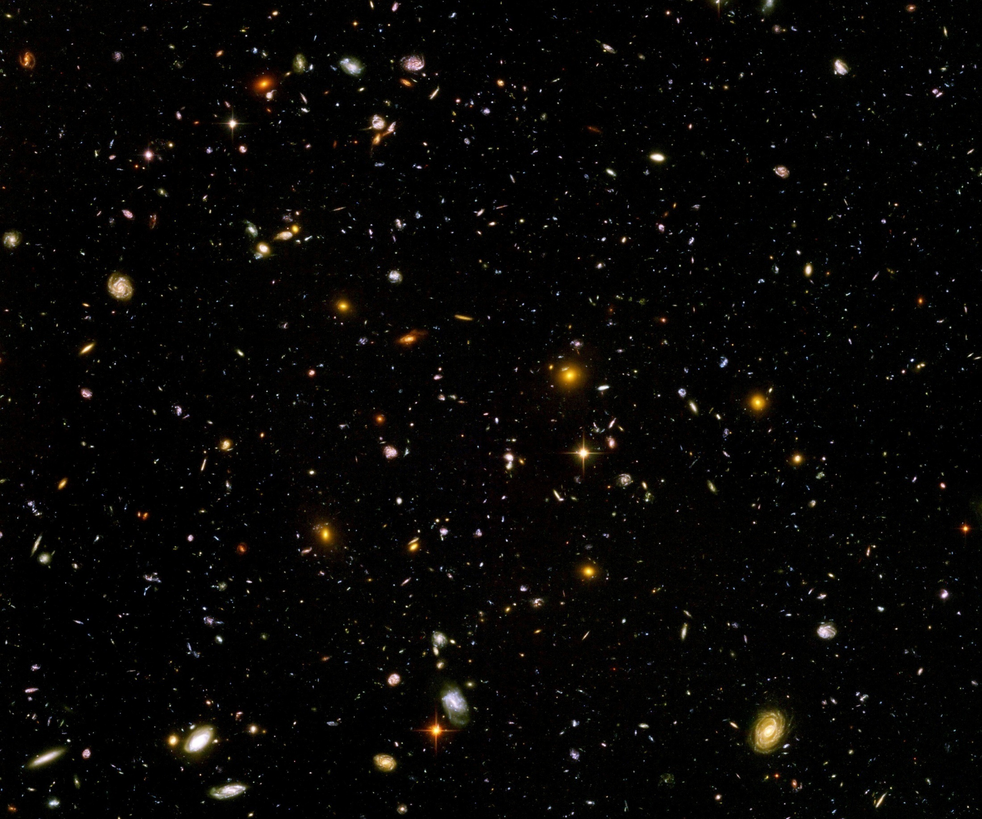
Scale symmetry in particle physics and cosmology

Slide 2
Scale symmetry
No parameter with dimension of
length or mass is present in the
quantum effective action.
Then invariance under
dilatations or global scale transformations
is realized.
Continuous global symmetry

Slide 3
Scale symmetry in elementary particle physics ?
proton mass , electron mass
scales are present in particle physics,
but very small as compared to Planck mass

Slide 4
Scale symmetry and Fermi scale
Vacuum electroweak phase transition is (almost) second order
Critical surface of second order phase transition: exact fixed point, quantum scale symmetry
Scale symmetry guarantees “naturalness” of small (gauge hierarchy)
No fine tuning for renormalisation group improved perturbation theory
C. Wetterich, Phys. Lett.B140(1984)215,
W. A. Bardeen, FERMILAB-CONF-95-391-T(1995)

Slide 5
Quantum scale symmetry

Slide 6
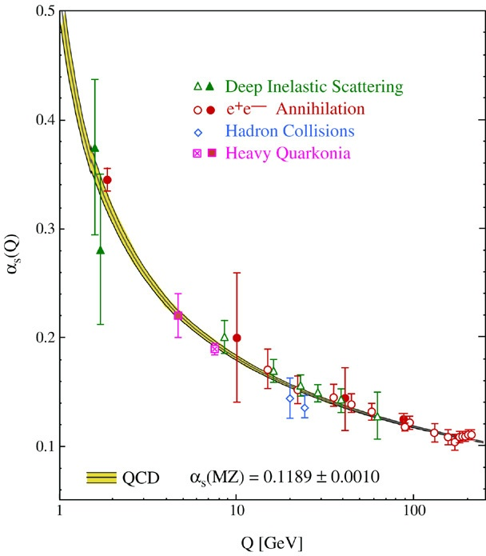
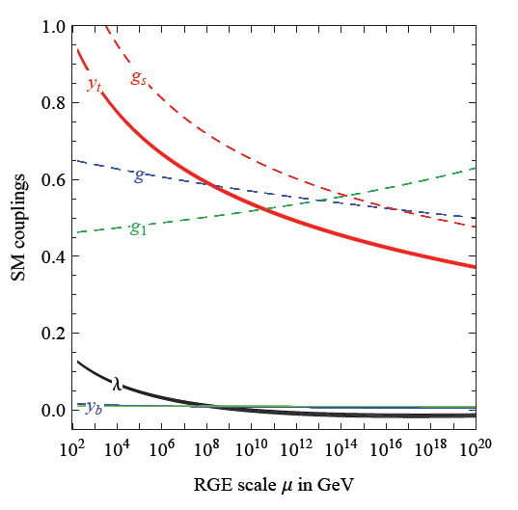
Quantum fluctuations induce running couplings
violation of scale symmetry
well known in QCD or standard model

Slide 7
Quantum scale symmetry
quantum fluctuations violate scale symmetry
running dimensionless couplings
at fixed points , scale symmetry is exact !
quantum fluctuations can generate scale symmetry !

Slide 8
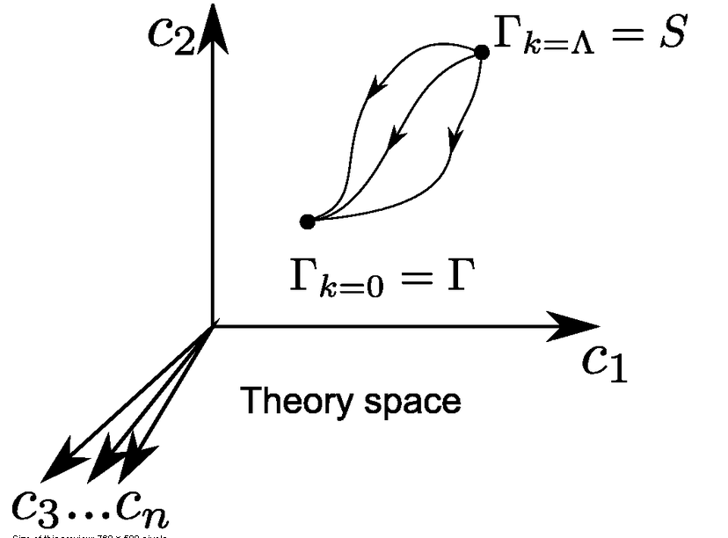
Functional renormalization : flowing action
Wikipedia
Notes:
8

Slide 9
Ultraviolet fixed point
UV fixed point
Wikipedia
Notes:
9

Slide 10
Quantum scale symmetry
Exactly on fixed point:
No parameter with dimension of
length or mass is present in the
quantum effective action.
Then invariance under
dilatations or global scale transformations
is realized as a quantum symmetry.
Continuous global symmetry

Slide 11
Scale symmetry and Fermi scale
Vacuum electroweak phase transition is (almost) second order, including all effects from quantum fluctuations
Critical surface of second order phase transition: exact fixed point, quantum scale symmetry
Scale symmetry guarantees “naturalness” of gauge hierarchy
C. Wetterich, Phys. Lett.B140(1984)215,
W. A. Bardeen, FERMILAB-CONF-95-391-T(1995)

Slide 12
Quantum Gravity
Quantum Gravity is a
renormalisable quantum field theory
Asymptotic safety

Slide 13
Asymptotic safety of quantum gravity
if UV fixed point exists :
quantum gravity is
non-perturbatively renormalizable !
S. Weinberg , M. Reuter

Slide 14
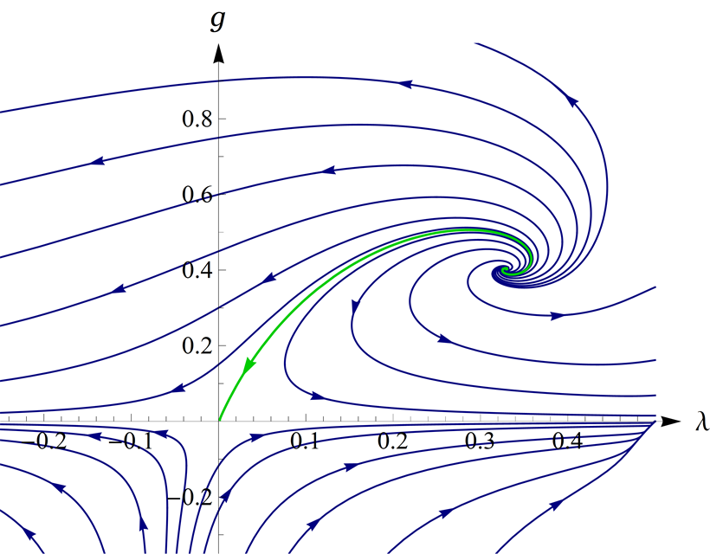
UV- fixed point for quantum gravity
Wikipedia

Slide 15
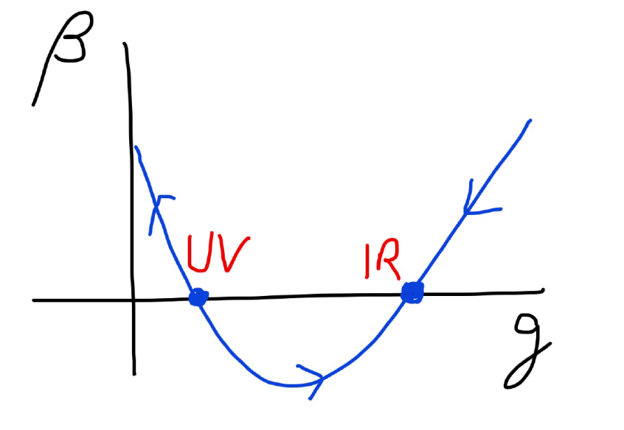
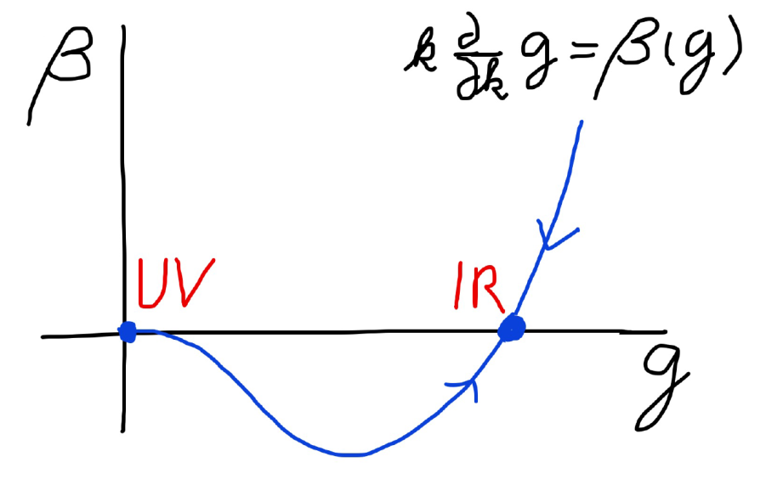
Asymptotic safety Asymptotic freedom
Relevant parameters yield undetermined couplings.
Quartic scalar coupling is not relevant and can therefore be predicted.

Slide 16
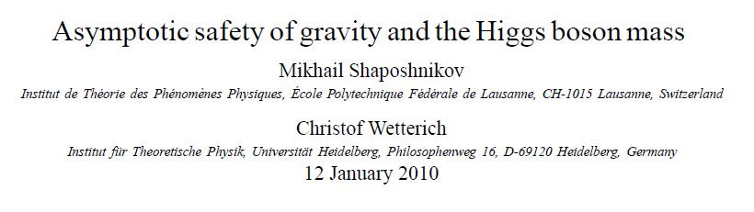
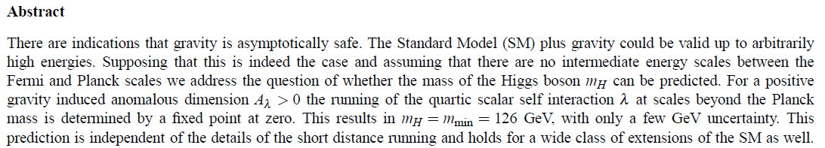
a prediction…

Slide 17
Quantum gravity with scalar field – the role of scale symmetry for cosmology

Slide 18
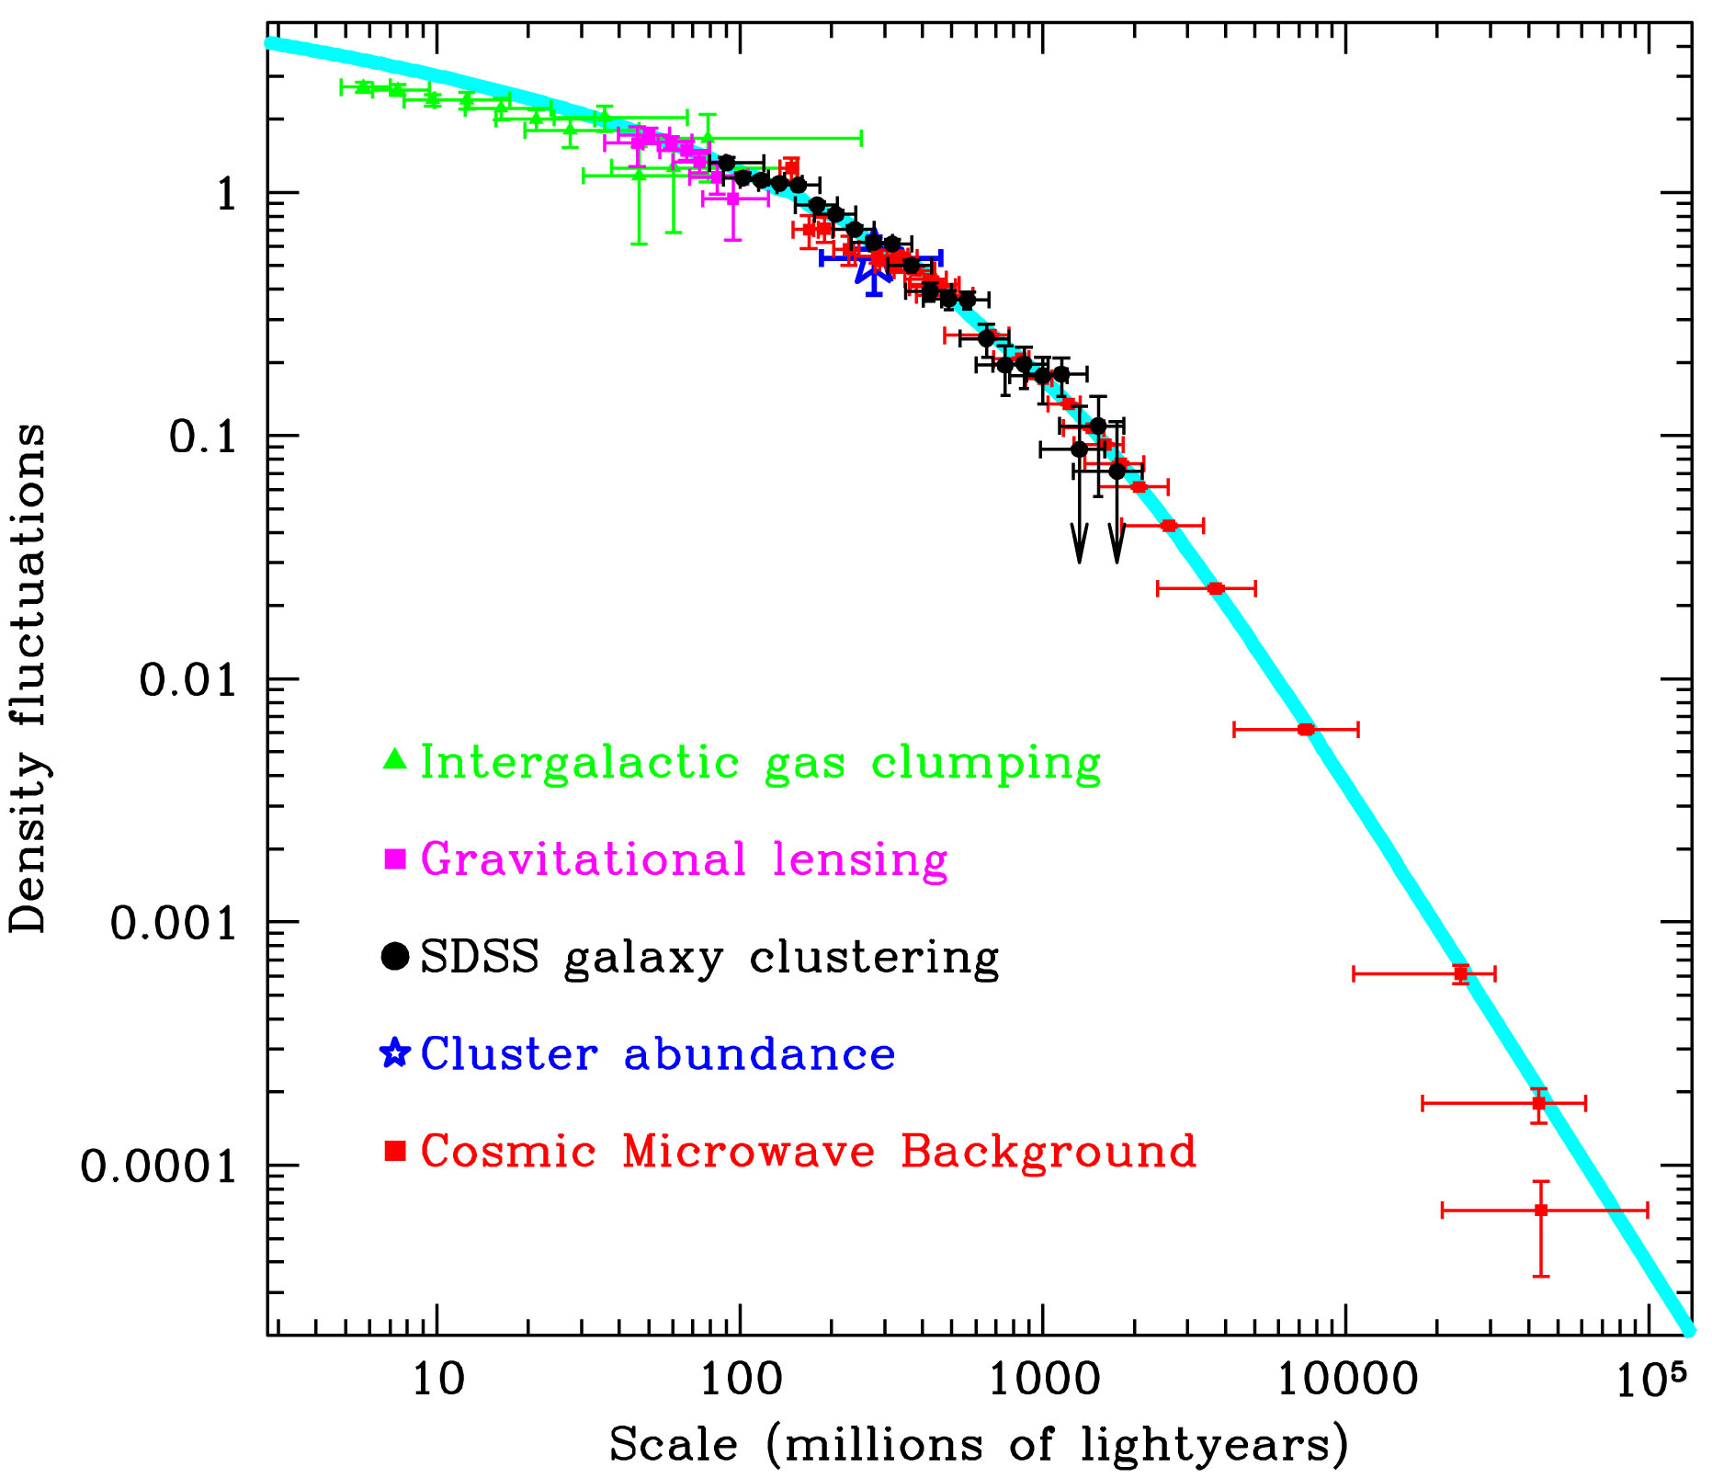
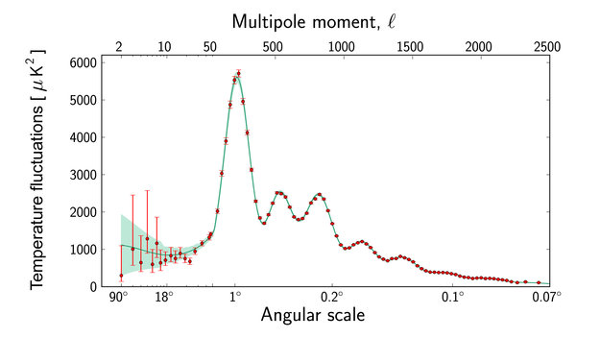
Scale symmetry in cosmology ?
scales are present in cosmology

Slide 19
Spontaneous breaking of scale symmetry
expectation value of scalar field breaks scale symmetry spontaneously
massive particles are compatible with scale symmetry
in presence of massive particles : sign of exact scale symmetry is exactly massless Goldstone boson – the dilaton

Slide 20
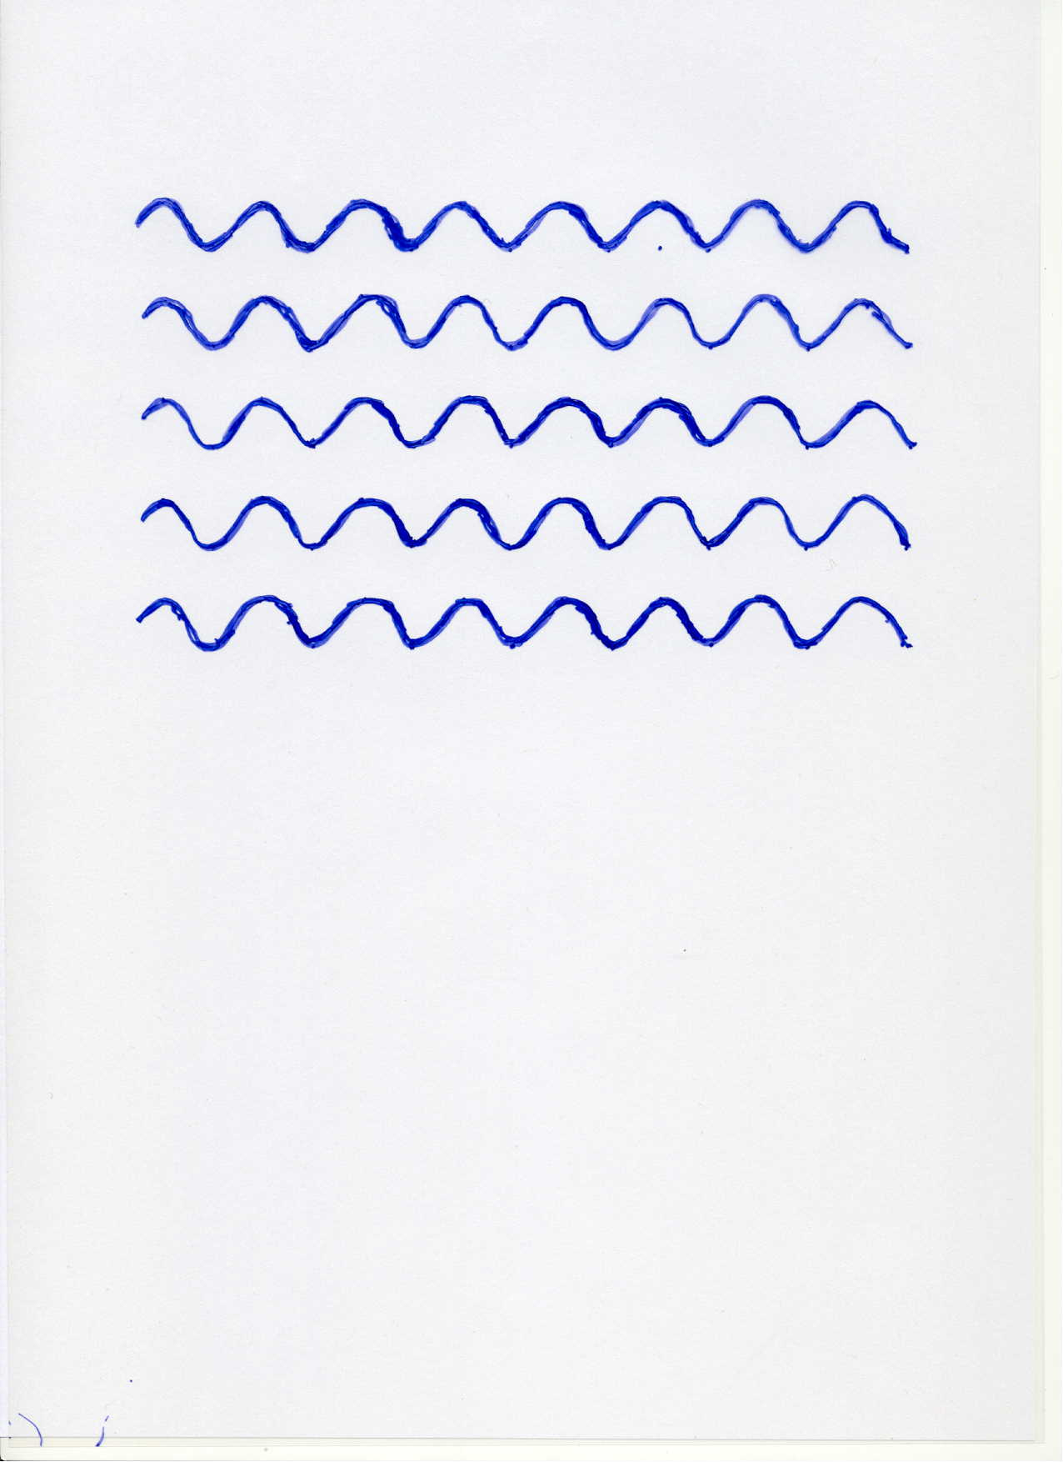
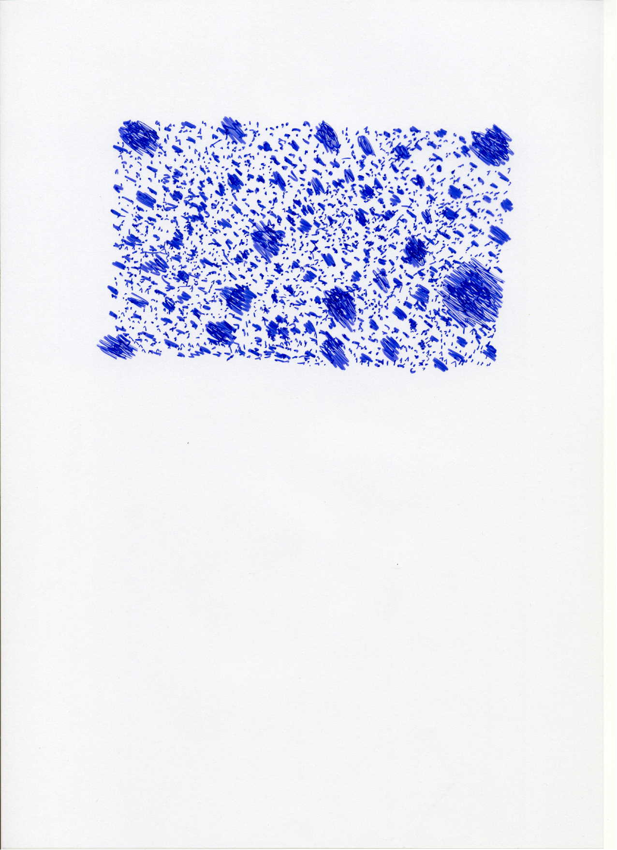

Scale symmetry
no scale symmetry
scale symmetry
only if no spontaneous symmetry breaking!

Slide 21
Approximate scale symmetry near fixed points
UV : approximate scale invariance of primordial fluctuation spectrum from inflation
IR : cosmon is pseudo Goldstone boson of
spontaneously broken scale symmetry,
tiny mass,
responsible for dynamical Dark Energy

Slide 22
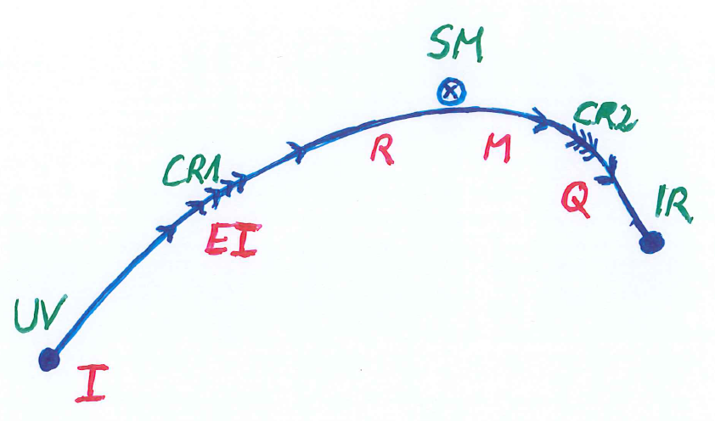
Possible consequences of crossover in quantum gravity
Realistic model for inflation and dark energy
with single scalar field

Slide 23
Scale symmetric standard model
Replace all mass scales by scalar field 𝜒
(1) Higgs potential
(2) Strong gauge coupling, normalized at , is independent of 𝜒
(3) Similar for all dimensionless couplings
Quantum effective action for standard model does
not involve intrinsic mass or length
Quantum scale symmetry
For : massless Goldstone boson

Slide 24
Two scale symmetries
Gravity scale symmetry:
includes transformation of metric and scalar
singlet
Particle scale symmetry:
metric and scalar singlet kept fixed
relative scaling of momenta with respect to
Planck mass

Slide 25
variable gravity
“Newton’s constant is not constant –
and particle masses are not constant”

Slide 26

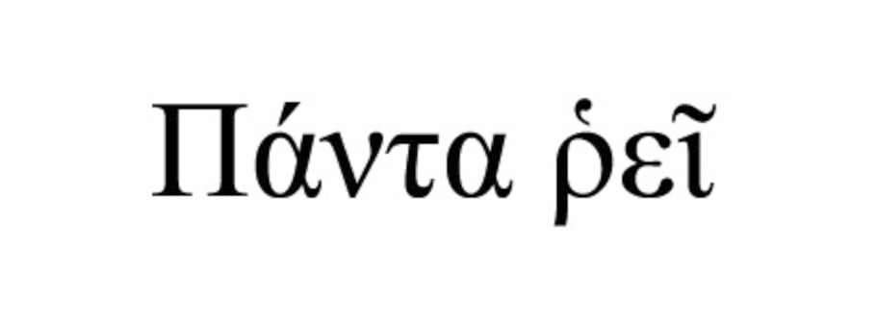

Slide 27
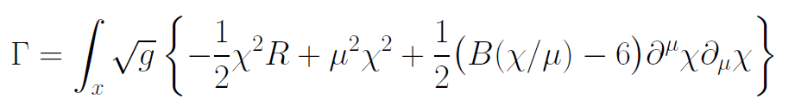
Variable Gravity
quantum effective action,
variation yields field equations
Einstein gravity :
M² R

Slide 28
Scale symmetry in variable gravity
( IR – fixed point )
quantum effective action,
variation yields field equations
Einstein gravity :
M² R

Slide 29
Variable Gravity
Scalar field coupled to gravity
Effective Planck mass depends on scalar field
Simple quadratic scalar potential involves intrinsic mass μ
Nucleon and electron mass proportional to dynamical Planck mass

Slide 30
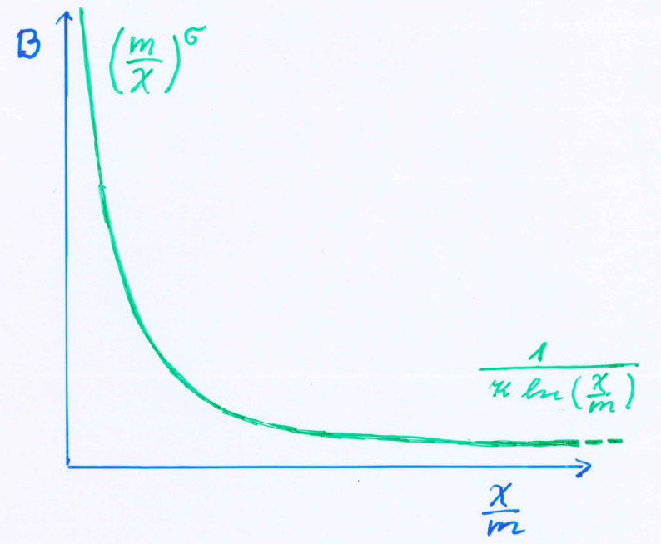
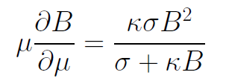
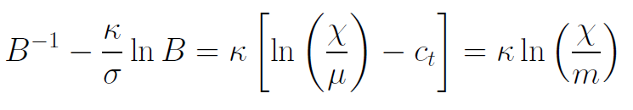
Kinetial B :
Crossover between two fixed points
assumption: running
coupling obeys
flow equation
m : scale of crossover
can be exponentially larger than intrinsic scale μ

Slide 31
Four-parameter model
model has four dimensionless parameters
three in kinetial :
σ ~ 2.5
κ ~ 0.5
c_{t} ~ 14 ( or m/μ )
one parameter for growth rate of neutrino mass over electron mass : γ ~ 8
+ standard model particles and dark matter : sufficient for realistic cosmology from inflation to dark energy
no more free parameters than ΛCDM

Slide 32
Cosmology
Add matter and radiation (standard model + dark matter)
Solve field equations…

Slide 33
Model is compatible with present observations
Together with variation of neutrino mass over electron mass in present cosmological epoch :
model is compatible with all present observations, including inflation and dark energy

Slide 34
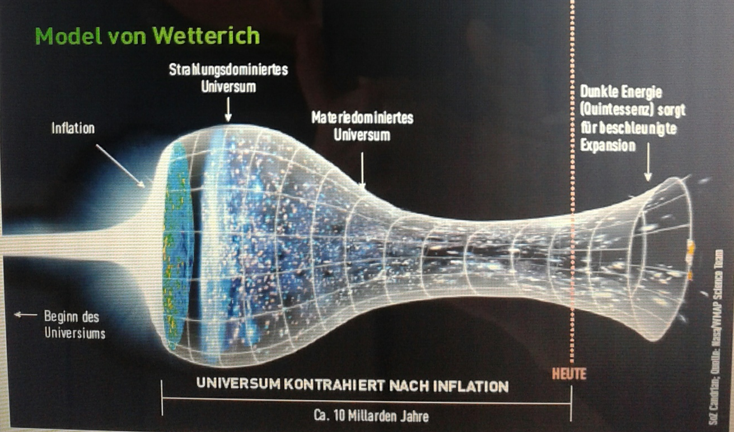
Strange evolution of Universe
Sonntagszeitung Zürich , Laukenmann

Slide 35
Expanding Universe or shrinking atoms ?

Slide 36
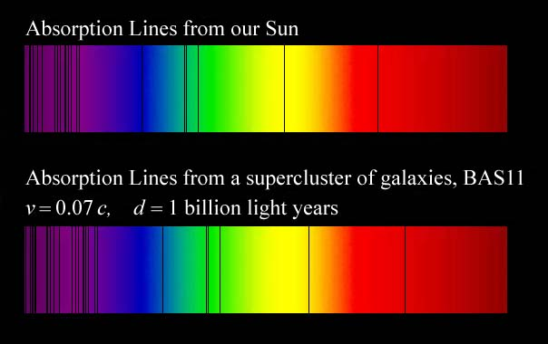
Do we know that the
Universe expands ?
instead of redshift due to expansion :
smaller frequencies have been emitted in the past, because electron mass was smaller !

Slide 37
Why do we see redshift of photons emitted in the distant past ?
photons are more red because they have been emitted with longer wavelength
frequency ~ mass
wavelength ~
atomsize

Slide 38
What is increasing ?
Ratio of distance between galaxies
over size of atoms !
atom size constant : expanding geometry
alternative : shrinking size of atoms

Slide 39
How can particle masses change with time ?
Particle masses are proportional to scalar field χ . Similar to Higgs field.
Scalar field varies with time.
Ratios of particle masses are independent of χ and therefore remain constant.
Compatibility with observational bounds on time dependence of particle mass ratios.
Dimensionless couplings are independent of χ .

Slide 40
Hot big bang or freeze ?

Slide 41
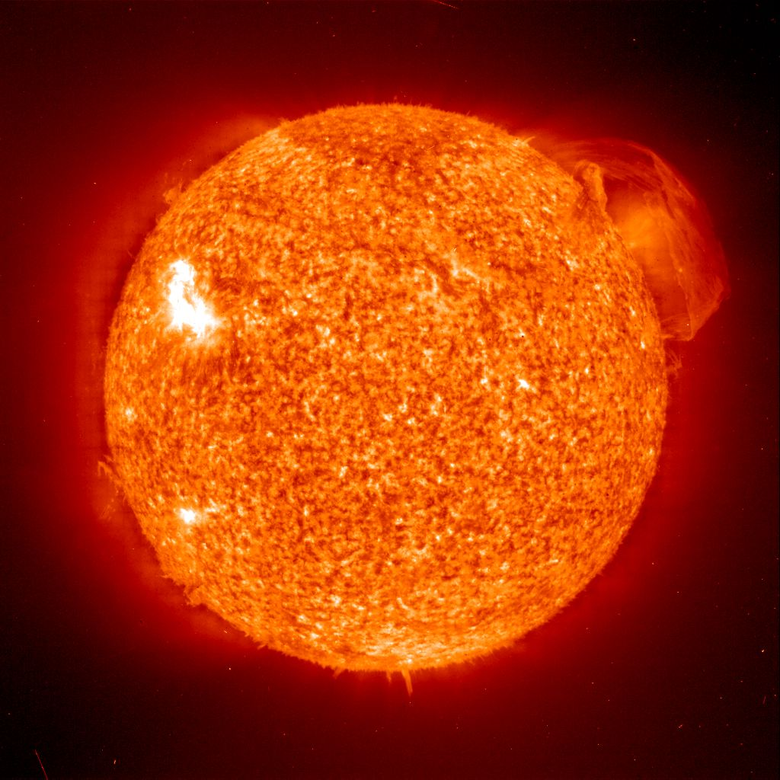
Do we know that the temperature was higher in the early Universe than now ?
Cosmic microwave radiation , nucleosynthesis
instead of
higher temperature :
smaller particle masses

Slide 42
Hot plasma ?
Temperature in radiation dominated Universe : T ~ χ ^{½} smaller than today
Ratio temperature / particle mass : T /m_{p} ~ χ ^{-½} larger than today
T/m_{p} counts ! This ratio decreases with time.
Nucleosynthesis , CMB emission as in standard cosmology !

Slide 43
Freeze Universe
The Universe may have started very cold,
and only later heat up.
Freeze picture of the Universe

Slide 44
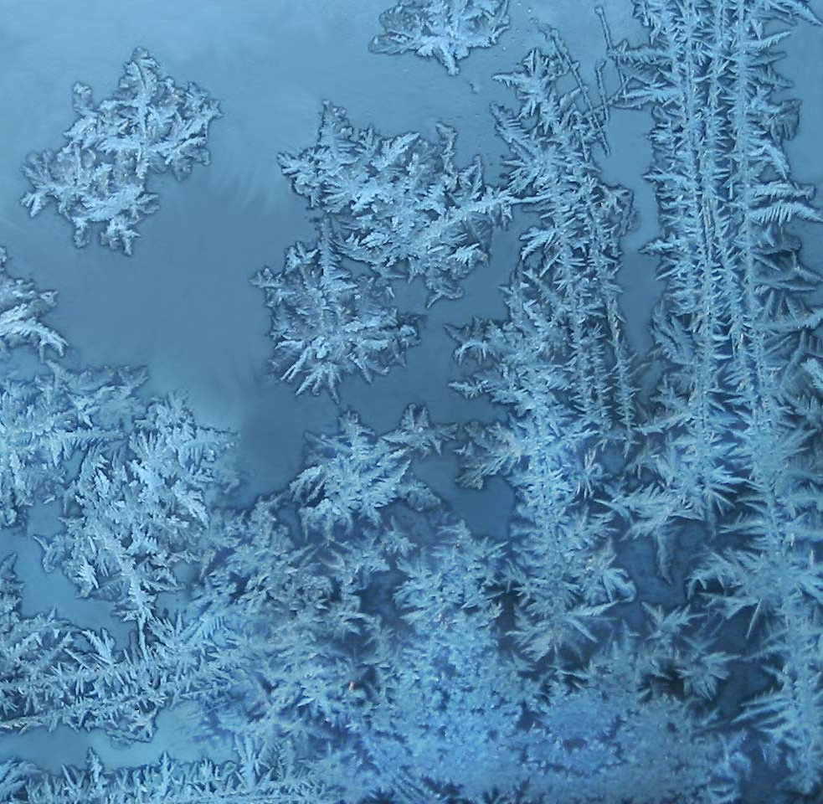
Big bang or freeze ?

Slide 45
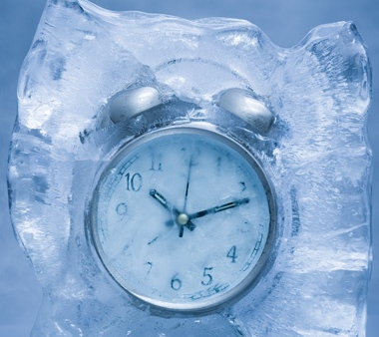
Big bang or freeze ?
freeze picture :
only rods for measurements
( masses ) are different !

Slide 46
Big bang is not wrong, but alternative pictures exist !

Slide 47
Einstein frame
“Weyl scaling” maps variable gravity model to Universe with fixed masses and standard expansion history.
Exact equivalence of different frames !
“ different pictures”
Standard gravity coupled to scalar field.

Slide 48
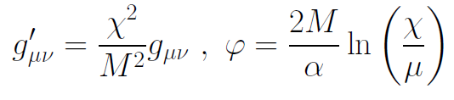
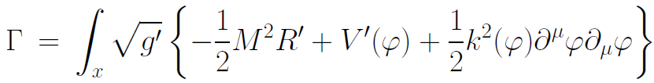
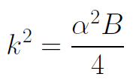

Einstein frame
Weyl scaling :
effective action in Einstein frame :

Slide 49
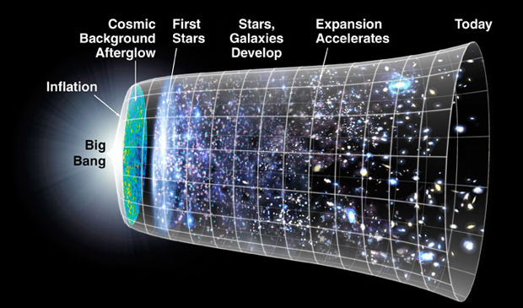
Field relativity
Weyl scaling :
changes geometry,
not a coordinate transformation

Slide 50
Cosmological solution
scalar field χ vanishes in the infinite past
scalar field χ diverges in the infinite future
J.Rubio,…

Slide 51
Field relativity : different pictures of cosmology
same physical content can be described by different pictures
related by field – redefinitions , e.g. Weyl scaling , conformal scaling of metric
observables cannot depend on choice of fields
metric is one of the fields
which picture is usefull ?

Slide 52
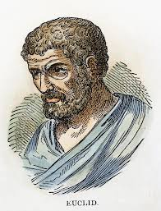


Relativity of geometry
Euclid … Newton : space and time
are absolute
Special relativity : space and time depend on observer
General relativity : space-time is
influenced by matter ( including radiation )
geometry is independent of coordinates
geometry is observable
Field relativity : geometry is relative

Slide 53
Space-time is a description of correlations between “matter”.
Observables cannot depend on choice of fields used to describe them.
Different pictures for geometry exist.

Slide 54
Why should you care about the freeze picture of the Universe ?
Some aspects are understood easier :
Natural tiny present dark energy
Beginning of Universe
Role of scale symmetry
Range of impact of quantum gravity

Slide 55
What is Dark Energy ?
Dark energy is energy density of scalar field χ
𝜌 = V + kinetic term
V= 𝜇² χ²
p = -V + kinetic term
Dark energy is dynamical if χ changes with time

Slide 56
No small parameter for dark energy

Slide 57
Four-parameter model
model has four dimensionless parameters
three in kinetial :
σ ~ 2.5
κ ~ 0.5
c_{t} ~ 14 ( or m/μ )
one parameter for growth rate of neutrino mass over electron mass : γ ~ 8
+ standard model particles and dark matter : sufficient for realistic cosmology from inflation to dark energy
no more free parameters than ΛCDM

Slide 58
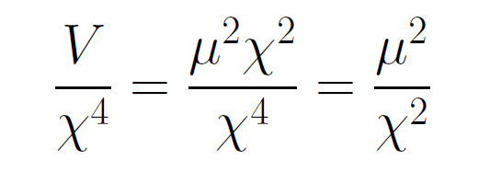
asymptotically vanishing cosmological „constant“
What matters : Ratio of potential divided by fourth power of Planck mass
vanishes for χ → ∞ !
V= 𝜇² χ²

Slide 59
small dimensionless number ?
needs two intrinsic mass scales
standard approach :V and M ( cosmological constant and Planck mass )
variable gravity : Planck mass moving to infinity , with fixed or moderately increasing V
ratio vanishes asymptotically !

Slide 60
Quintessence
Dynamical dark energy ,
generated by scalar field (cosmon )
C.Wetterich,Nucl.Phys.B302(1988)668, 24.9.87
P.J.E.Peebles,B.Ratra,ApJ.Lett.325(1988)L17, 20.10.87
Notes:
60

Slide 61
Prediction : homogeneous dark energy influences recent cosmology
- of same order as dark matter -
Original models do not fit the present observations
…. modifications
( different growth of neutrino mass )

Slide 62
No tiny dimensionless parameters
( except gauge hierarchy )
μ = 2 • 10 ⁻³³ eV
one mass scale
one time scale μ⁻¹ = 10 ¹⁰ yr
Planck mass does not appear as parameter
Planck mass grows large dynamically
Dark energy is tiny because Universe is old

Slide 63
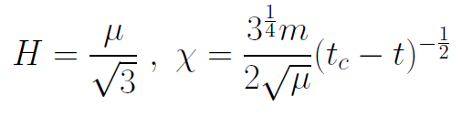
Slow Universe
Asymptotic solution in
freeze frame :
Expansion or shrinking always slow ,
characteristic time scale of the order of the age of the
Universe : t_{ch} ~ μ⁻¹ ~ 10 billion years !
Hubble parameter of the order of present Hubble
parameter for all times , including inflation and big bang !
Slow increase of particle masses !
μ= 2 • 10⁻³³ eV

Slide 64
infinite past

Slide 65
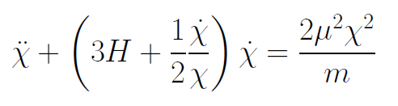
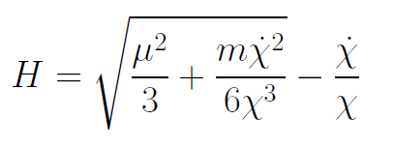
Infinite past : slow inflation
σ = 2 : field equations
approximative
solution
particles become massless in infinite past !

Slide 66
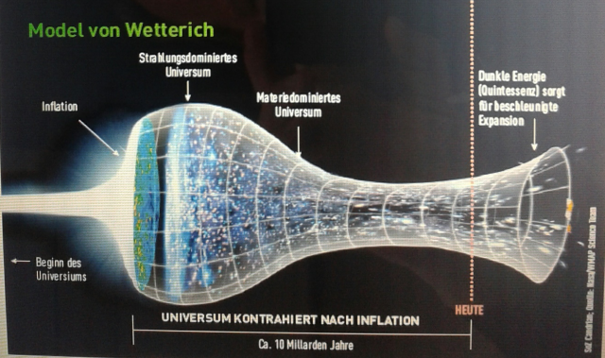
Eternal Universe
Asymptotic solution in
freeze frame :
solution valid back to the infinite past in physical time
no singularity
physical time to infinite past is infinite

Slide 67

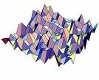
Eternal light-vacuum
Everywhere almost nothing
only fluctuations
All particles move
with light velocity,
similar to photons
strength of gravity
much stronger than today

Slide 68
In the beginning was light-like emptiness.

Slide 69
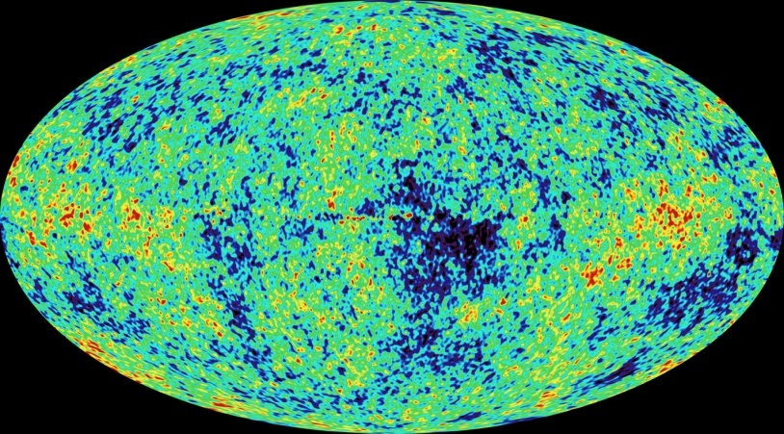
Eternal light-vacuum is unstable
Slow increase of particle masses and weakening of gravity
Only slow change of space-time geometry
Consequence for observation : primordial fluctuations become visible in cosmic background radiation
We see fluctuations in a stage 5000 billion years ago.

Slide 70
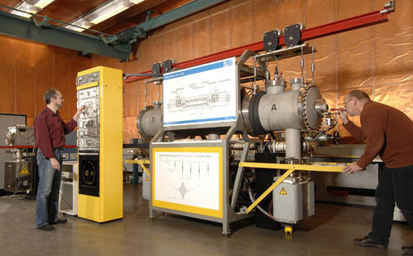
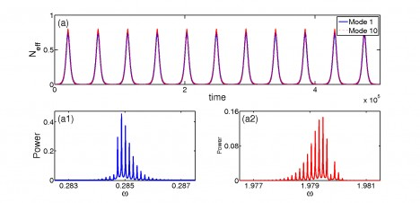
Physical time
count oscillations ….

Slide 71
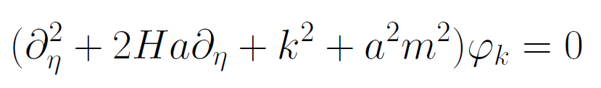
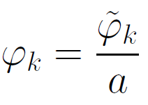
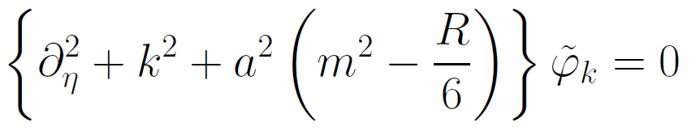
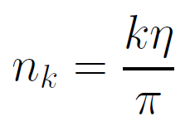

Physical time
field equation for scalar field mode
determine physical
time by counting
number of oscillations
( m=0 )

Slide 72
Physical time
counting : discrete
invariant under field transformations
same in all frames

Slide 73
Big bang singularity in Einstein frame is field singularity !
choice of frame with constant particle
masses is not well suited if
physical masses go to zero !

Slide 74

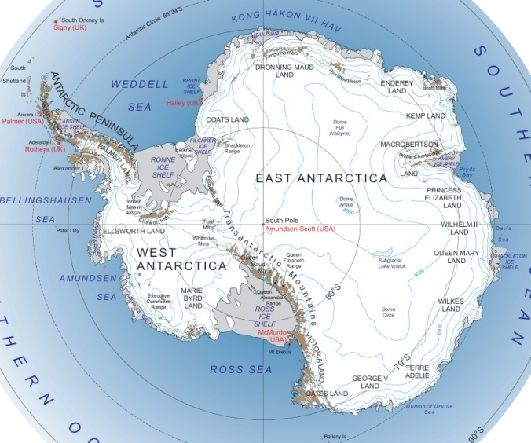
Field - singularity
Big Bang is field - singularity
similar ( but not identical with )
coordinate - singularity

Slide 75
Conclusions
Quantum gravity may be observable in
dynamics of present Universe
Fixed points and scale symmetry crucial
Big bang singularity is artefact
of inappropriate choice of field variables –
no physical singularity

Slide 76
end

Slide 77

Crossover in quantum gravity and cosmology

Slide 78
Cosmological solution : crossover from UV to IR fixed point
Dimensionless functions as B
depend only on ratio μ/χ .
IR: μ→0 , χ→∞
UV: μ→∞ , χ→0
Cosmology makes
crossover between
fixed points by
variation of χ .
χ→0
χ→∞

Slide 79
Renormalization flow and cosmological evolution
renormalization flow as function of µ
is mapped by dimensionless functions to
field dependence of effective action on scalar field χ
translates by solution of field equation to
dependence of cosmology an time t or η

Slide 80
Scaling solution
after end of inflation
scaling solution with
few percent
of Early Dark Energy
Dark Energy decreases
similar to radiation and
matter

Slide 81
Evolution of dark energy fraction
J. Rubio,…

Slide 82
Growing neutrino masses and quintessence

Slide 83
Second stage of crossover
from SM to IR
in sector Beyond Standard Model
affects neutrino masses first ( seesaw or cascade mechanism )

Slide 84
Varying particle masses at onset of second crossover
Except for neutrinos all particle masses are proportional to χ .
Ratios of particle masses remain constant.
Compatibility with observational bounds on time dependence of particle mass ratios.
Neutrino masses show stronger increase with χ , such that ratio neutrino mass over electron mass grows .

Slide 85
Cosmic trigger
Stop of evolution of scalar field when neutrinos become non-relativistic
Transition from scaling solution to (almost) cosmological constant

Slide 86
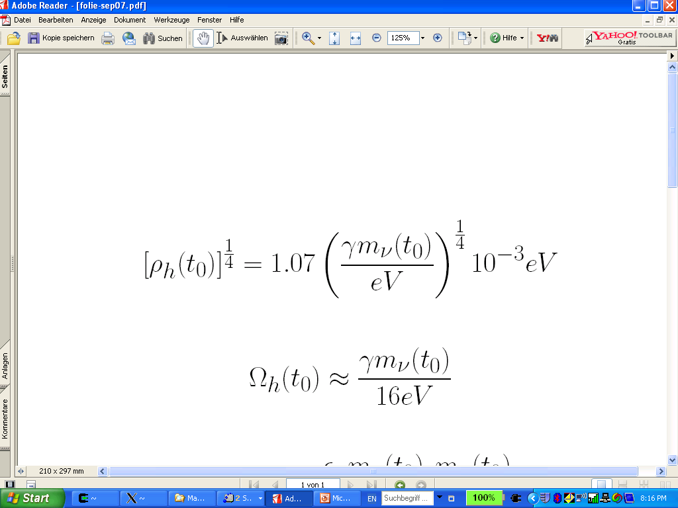
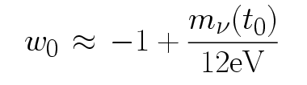
connection between dark energy and neutrino properties
L.Amendola,
M.Baldi, …
= 1.27
present dark energy density given by neutrino mass
present equation
of state given by
neutrino mass !
Notes:
86

Slide 87
Neutrino lumps
large m_{𝜈}
small m_{𝜈}
Casas, Pettorino,…

Slide 88
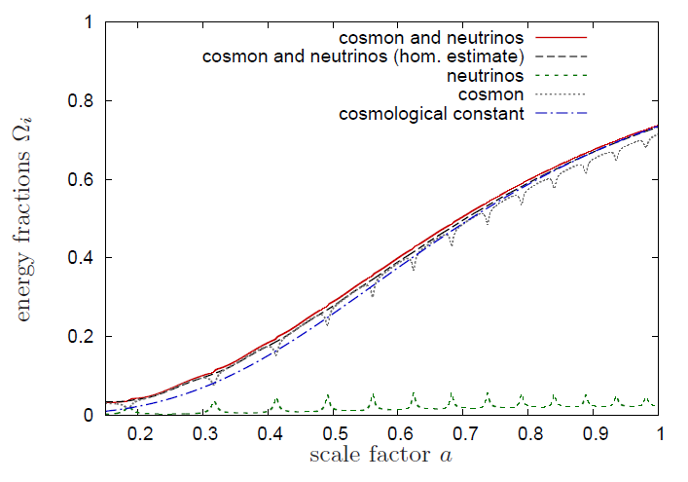
Evolution of dark energy similar to ΛCDM

Slide 89
Compatibility with observations and possible tests
Realistic inflation model
Almost same prediction for radiation, matter, and Dark Energy domination as ΛCDM
Presence of small fraction of Early Dark Energy
Large neutrino lumps

Slide 90
Simplicity
simple description of all cosmological epochs
natural incorporation of Dark Energy :
inflation
Early Dark Energy
present Dark Energy
dominated epoch
J.Rubio…

Slide 91
In quantum gravity, the graviton fluctuations can play an important role on distances as large as the size of the Universe
- for long range scalar fields and dynamical dark energy
- not for all quantities

Slide 92
Instability of graviton propagator
effective action
Instability for V>0 : ”tachyonic mass term”

Slide 93
Graviton barrier
Quantum gravity computation :
For
V cannot increase stronger than M² !
Instability of graviton propagator is avoided

Slide 94
Graviton barrier and solution of the cosmological constant problem
V cannot increase stronger than M² !
If M increases with 𝜒, and for cosmological solutions where 𝜒 asymptotically diverges for time going to infinity:
Effective cosmological constant vanishes in infinite future
M = χ : V= 𝜇² χ²

Slide 95
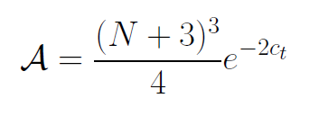

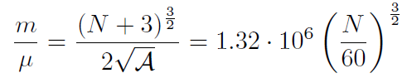
Amplitude of density fluctuations
small because of logarithmic running
near UV fixed point !
σ=1
N : number of e – foldings at horizon crossing

