Slide 1
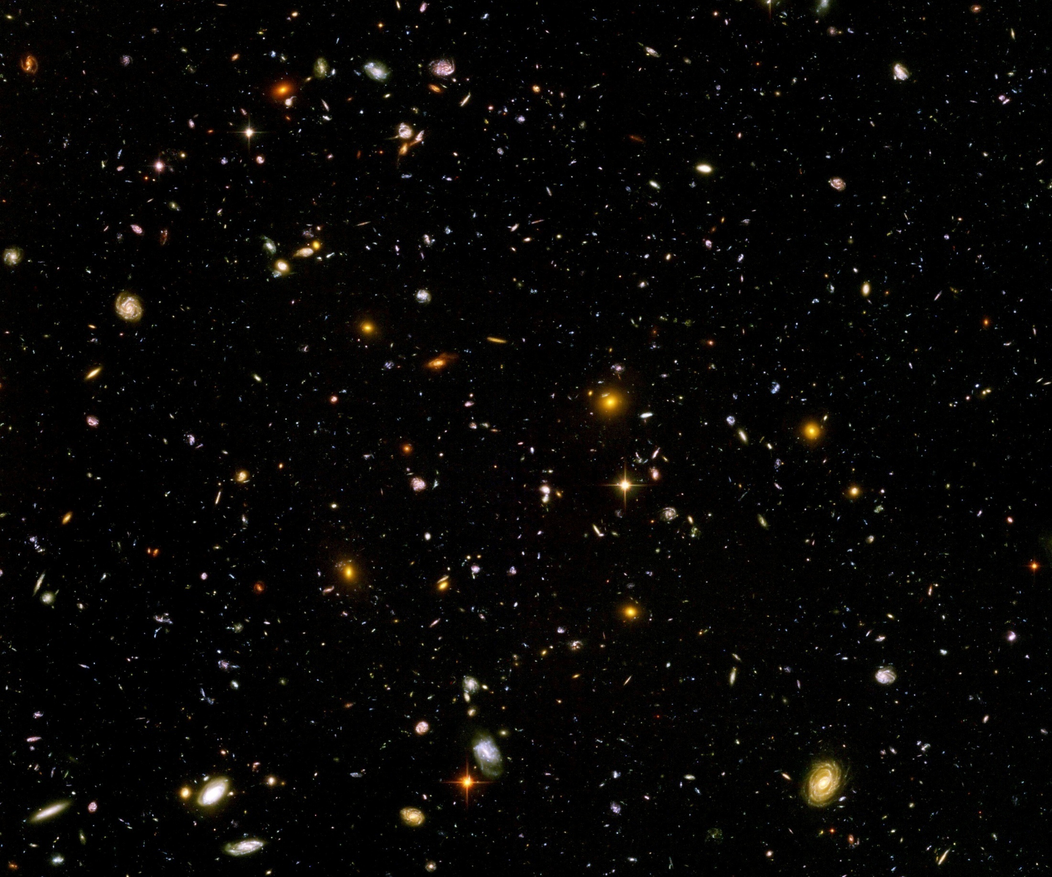
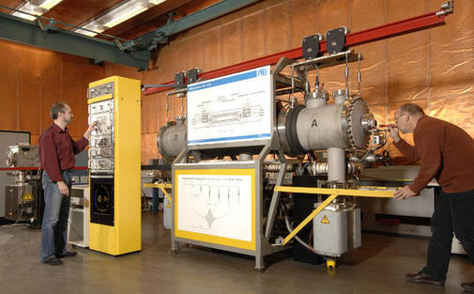
High precision data for fundamental constants – what do we learn about the Universe ?

Slide 2
Time variation of fundamental constants
For cosmology : time variation of fundamental constants can give information on dynamics of the Universe
Tiny effect, with important consequences
High precision required !

Slide 3
Fundamental “constants” are not constant

Slide 4
Have coupling constants in the
very early Universe
other values than today ?
Yes !

Slide 5
Fundamental couplings in quantum field theory
Masses and coupling constants
are determined by properties
of vacuum !
Similar to Maxwell – equations in matter

Slide 6
Standard model of particle physics :
Electroweak gauge symmetry is spontaneously broken by expectation value of Higgs scalar
Quark and lepton masses proportional to value of Higgs scalar

Slide 7
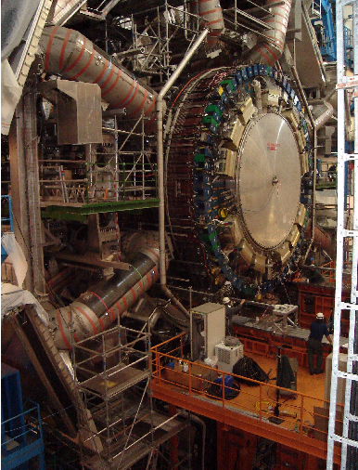
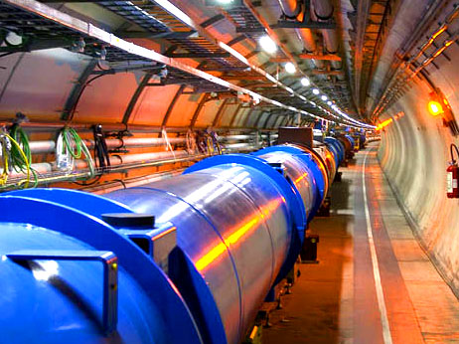
Spontaneous symmetry breaking confirmed at the LHC

Slide 8
Cosmology :
Universe is not in one fixed state
Dynamical evolution
Laws are expected to depend on time

Slide 9
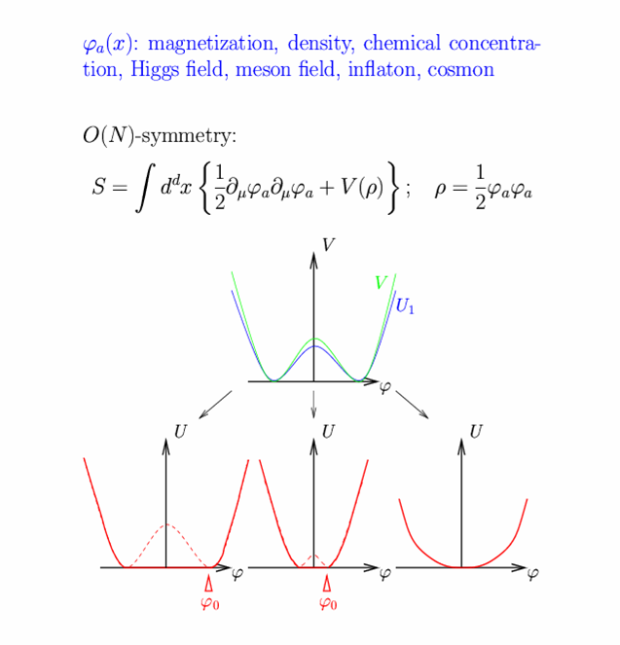
Restoration of symmetry at high temperature in the early Universe
high T :
Less order
More symmetry
Example:
Magnets
Low T
SSB
<φ>=φ₀ ≠ 0
High T
SYM
<φ>=0

Slide 10
In hot plasma of early Universe : masses of electron und muon not different! similar strength of electromagnetic and weak interaction

Slide 11
Varying couplings
only question :
How strong is present variation of couplings ?

Slide 12
Can variation of fundamental “constants” be observed ?
Fine structure constant α (electric charge)
Ratio electron mass to proton mass
Ratio nucleon mass to Planck mass

Slide 13
Time evolution of couplings and scalar fields
Fine structure constant depends on value of
scalar field : α(φ)
Time evolution of φ
Time evolution of α
Jordan,…

Slide 14
Static scalar fields
In Standard Model of particle physics :
Higgs scalar has settled to its present value
around 10⁻¹² seconds after big bang.
Chiral condensate of QCD has settled at present value after quark-hadron phase transition around 10⁻⁶ seconds after big bang .
No scalar with mass below pion mass.
No substantial change of couplings after QCD phase transition.
Coupling constants are frozen.

Slide 15
Observation of time- or space- variation of couplings
Physics beyond Standard Model

Slide 16
Particle mass ratios and dimensionless couplings in quintessence cosmology
can depend on value of cosmon field
similar to dependence on value of Higgs field

Slide 17
Bounds on time varying couplings from nucleosynthesis

Slide 18
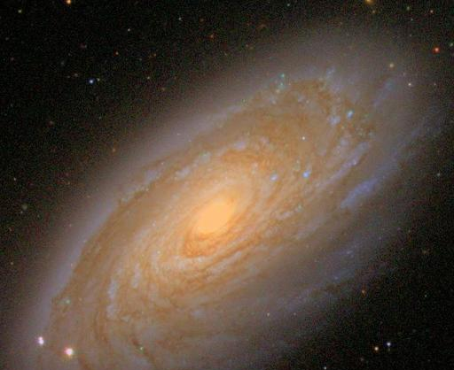
baryons :
the matter of stars and humans
Ω_{b} = 0.045

Slide 19
Abundancies of
primordial
light elements
from
nucleosynthesis
Cyburt, Fields, Olive, Yeh, 2015

Slide 20
Nucleosynthesis + CMB
Cyburt, Fields, Olive, Yeh, 2015
purple:
BBN+CMB
yellow:
observation

Slide 21
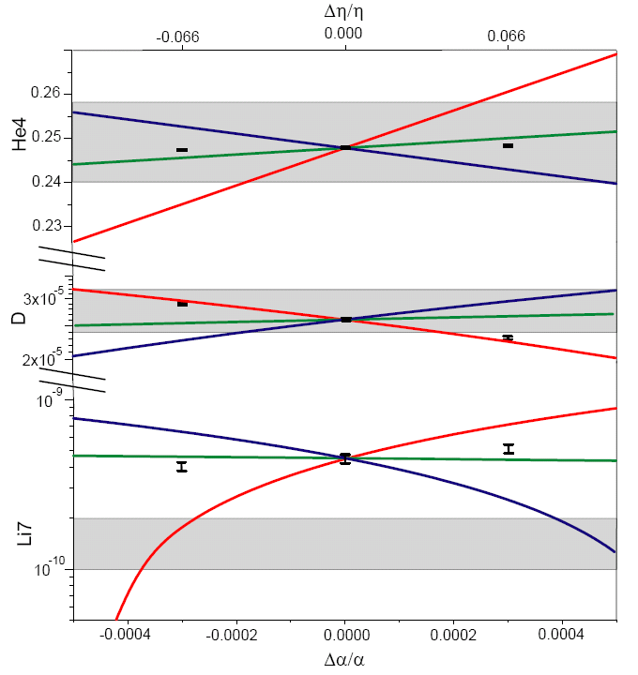
primordial abundances for three GUT models
present observations : 1σ
He
D
Li
T.Dent,
S.Stern,…

Slide 22
three GUT models
unification scale ~ Planck scale
1) All particle physics scales ~Λ_{QCD}
2) Fermi scale and fermion masses ~ unification scale
3) Fermi scale varies more rapidly than Λ_{QCD}
Δα/α ≈ 4 10⁻⁴ allowed for GUT 2 and 3 , larger for GUT 1
Δln(M_{n}/M_{P}) ≈40 Δα/α ≈ 0.015 allowed

Slide 23
Time variation of coupling constants
must be tiny –
would be of very high significance !
Possible signal for Quintessence

Slide 24
“Fundamental” Interactions
Strong, electromagnetic, weak
interactions
On astronomical
length scales:
graviton
+
cosmon
gravitation
cosmodynamics

Slide 25
Variation of fundamental couplings and apparent violation of equivalence principle

Slide 26
Coupling of cosmon to atoms needed :
Standard model with non-renormalizable operators
𝜑 - dependent masses
𝜑 - dependent
gauge couplings

Slide 27
Fifth force

Slide 28
Scalar tensor theories
Dirac’s hypothesis
Weyl scaling
Brans-Dicke theory
additional interaction :

Slide 29
Fifth force
coupling strength
range
m ∼ H : long range ( dynamical dark energy)
m ≫ H : short range ( dark matter )
concentrate on long range – effectively massless scalar for earth, solar system, galaxies, black holes, laboratory

Slide 30
Models with massless scalar fields
Higher dimensions : strings, Kaluza-Klein theories ( moduli )
Modified gravity ( Brans-Dicke theory, f(R)-theories, ….)
if scalar plays a role for late cosmology : “ cosmon “

Slide 31
Standard model with non-renormalizable operators
𝜑 - dependent masses
𝜑 - dependent
gauge couplings
Tests of GR :
Tests of
equivalence principle:

Slide 32
Scalar force ( fifth force)
i
j
attractive:
repulsive:

Slide 33
“Fifth Force”
Mediated by scalar field
Coupling strength: weaker than gravity
( non-renormalizable interactions ~ M⁻² )
Composition dependence
violation of equivalence principle
Quintessence: connected to time variation of
fundamental couplings
R.Peccei,J.Sola,C.Wetterich,Phys.Lett.B195,183(1987)
C.Wetterich , Nucl.Phys.B302,645(1988)

Slide 34
Violation of equivalence principle
Couplings of cosmon to proton and neutron not proportional to mass
Differential acceleration
“Violation of equivalence principle”
p,n
earth
cosmon
p,n
only apparent : new “fifth force” !

Slide 35
Differential acceleration
Two bodies with equal mass experience
a different acceleration !
η = ( a₁ – a₂ ) / ( a₁ + a₂ )
bound : η < 10⁻¹⁴

Slide 36
Apparent violation of equivalence principle
and
time variation of fundamental couplings
measure both the
cosmon – coupling to ordinary matter

Slide 37
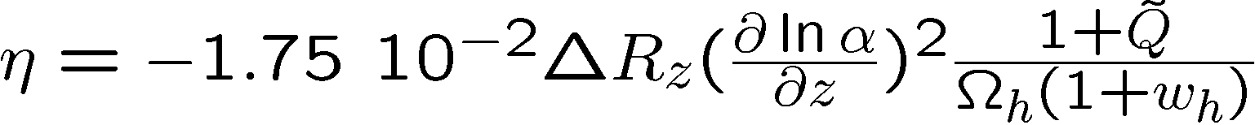
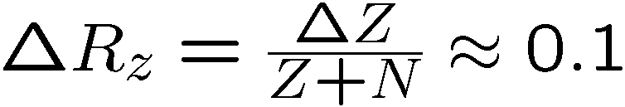
Differential acceleration η
For unified theories ( GUT ) :
η=Δa/2a
Q : time dependence of other parameters

Slide 38
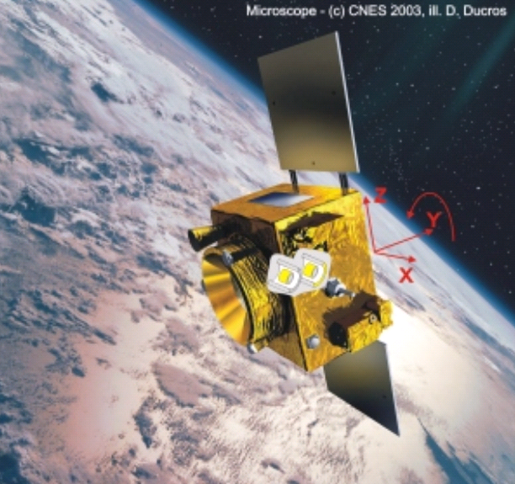
Link between time variation of α
and violation of equivalence principle
typically : η = 10⁻¹⁴
^{if time variation of α}
^{near Oklo upper bound}
^{tested by MICROSCOPE , …}

Slide 39
Cosmon coupling to atoms
Tiny !!!
Substantially weaker than gravity.
Non-universal couplings bounded by tests
of equivalence principle.
Universal coupling bounded by tests of Brans-Dicke parameter ω in solar system.
Only very small influence on cosmology.
( All this assumes validity of linear approximation )

Slide 40
Conclusion (1)
Time variation of couplings
Find it , and you discover a new fundamental interaction.
This interaction remains relevant at the largest length scales.
Measure as precise as you can!

Slide 41
Should one expect a fifth force ?

Slide 42
Key questions (1)
Why is atom – scalar coupling much weaker than gravity?
Why is scalar (almost) massless despite the presence of quantum fluctuations ?

Slide 43
Answer (1)
Quantum scale symmetry predicts massless scalar field with vanishing couplings
Approximate quantum scale symmetry predicts very light scalar field with tiny couplings

Slide 44
Spontaneously broken quantum scale symmetry

Slide 45
scale symmetry
No intrinsic length or mass scale present

Slide 46
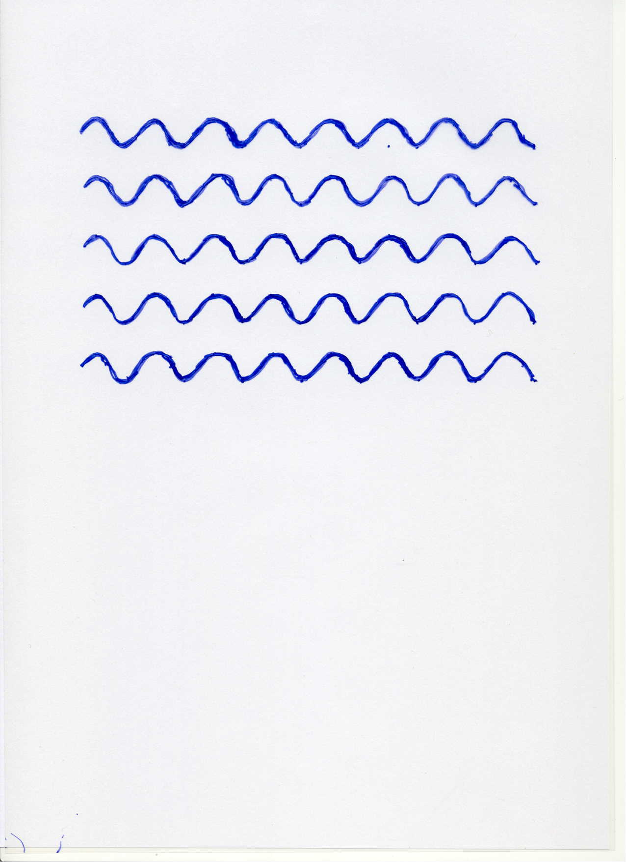


Scale symmetry
no scale symmetry
scale symmetry
only if no spontaneous symmetry breaking!

Slide 47
Quantum scale symmetry
All parameters with mass are
proportional to scalar field χ
Dimensionless couplings are independent of χ.
All particle masses are proportional to χ .
Ratios of particle masses remain constant.
Compatibility with observational bounds on time dependence of particle mass ratios.

Slide 48
Quantum scale symmetry
All parameters with mass are proportional to scalar field χ.
Generalized Higgs mechanism
gravity:
Higgs vev,
electron mass
QCD,
proton mass

Slide 49
Quantum scale symmetric standard model
Replace all mass scales by scalar field 𝜒
(1) Higgs potential
(2) Strong gauge coupling, normalized at , is independent of 𝜒
(3) Similar for all dimensionless couplings
Quantum effective action for standard model does
not involve intrinsic mass or length
Quantum scale symmetric standard model
For : massless Goldstone boson
Fujii
Englert
Zee
CW’87
CW’87

Slide 50
Spontaneous breaking of scale symmetry
expectation value of scalar field breaks scale symmetry spontaneously
massive particles are compatible with scale symmetry
in presence of massive particles : sign of exact scale symmetry is exactly massless Goldstone boson – the dilaton

Slide 51
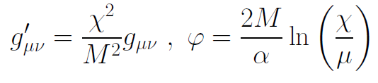
Einstein frame
Weyl scaling :
scale
transformation :

Slide 52
Key questions (1)
Why is atom – scalar coupling much weaker than gravity?
Why is scalar (almost) massless despite the presence of quantum fluctuations ?
answer
Scale symmetry explains both massless
scalar field and vanishing couplings

Slide 53
Approximate scale symmetry

Slide 54
Slowly running couplings close to fixed points

Slide 55
Simple mechanism for tiny cosmon - atom couplings
asymptotic approach to fixed point for dimensionless couplings and mass ratios
at fixed point : no cosmon coupling to atoms – no time variation of fundamental constants
very near fixed point : tiny coupling
how small ?

Slide 56
Simple mechanism for very light scalar field
Exact scale symmetry : massless Goldstone boson
Approximate scale symmetry : very light pseudo-Goldstone boson

Slide 57
Key question (2)
Do fixed points play a role for cosmology ?

Slide 58
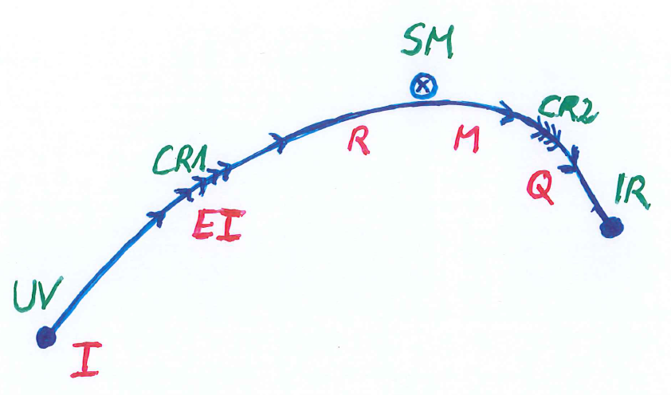
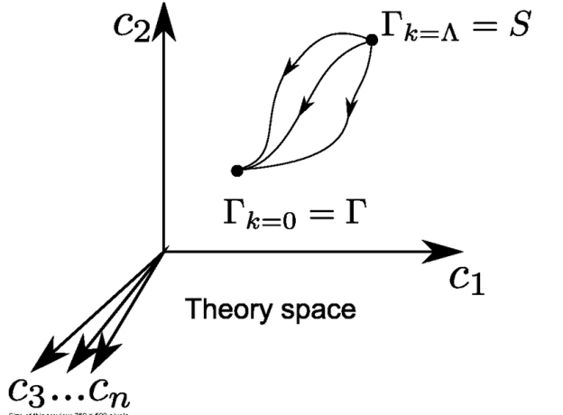
Crossover in quantum gravity

Slide 59
Approximate scale symmetry near fixed points
UV : approximate scale invariance of primordial fluctuation spectrum from inflation
IR : cosmon is pseudo Goldstone boson of
spontaneously broken scale symmetry,
tiny mass,
responsible for dynamical Dark Energy

Slide 60
Asymptotic safety
if UV fixed point exists :
quantum gravity is
non-perturbatively renormalizable !
S. Weinberg , M. Reuter

Slide 61
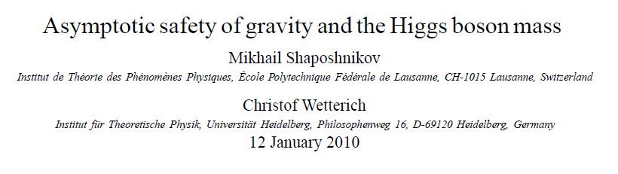
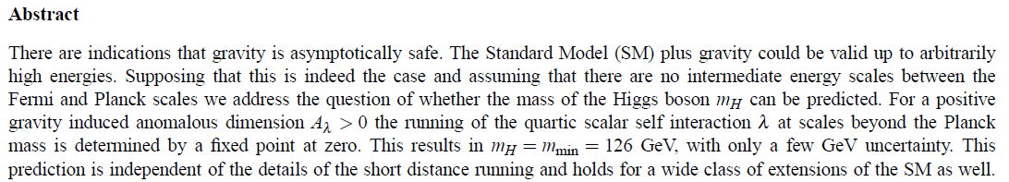
a prediction…

Slide 62
Possible consequences of crossover in quantum gravity
Realistic model for inflation and dark energy
with single scalar field

Slide 63
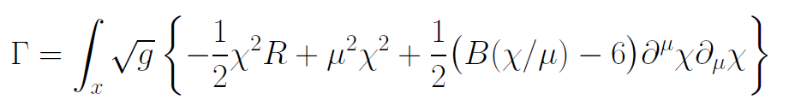
Variable Gravity
quantum effective action,
variation yields field equations
Einstein gravity :
M² R

Slide 64
Variable Gravity
Scalar field coupled to gravity
Effective Planck mass depends on scalar field
Simple quadratic scalar potential involves intrinsic mass μ
Nucleon and electron mass proportional to dynamical Planck mass
Neutrino mass has different dependence on scalar field

Slide 65
Cosmological solution : crossover from UV to IR fixed point
Dimensionless functions as B
depend only on ratio μ/χ .
IR: μ→0 , χ→∞
UV: μ→∞ , χ→0
Cosmology makes
crossover between
fixed points by
variation of χ .

Slide 66
Key question (2)
Do fixed points play a role for cosmology ?
answer
likely

Slide 67
Crossover cosmology
Realistic cosmology can arise from crossover between two fixed points
Universe exists since infinite past
No big bang singularity

Slide 68
Conclusions
Scalar force in cosmology can arise from quantum scale symmetry
Realistic cosmology
Look for
time variation of fundamental constants, violation of equivalence principle,
huge lumps in cosmic neutrino background,
dynamical dark energy

Slide 69
end

Slide 70
Crossover cosmology

Slide 71
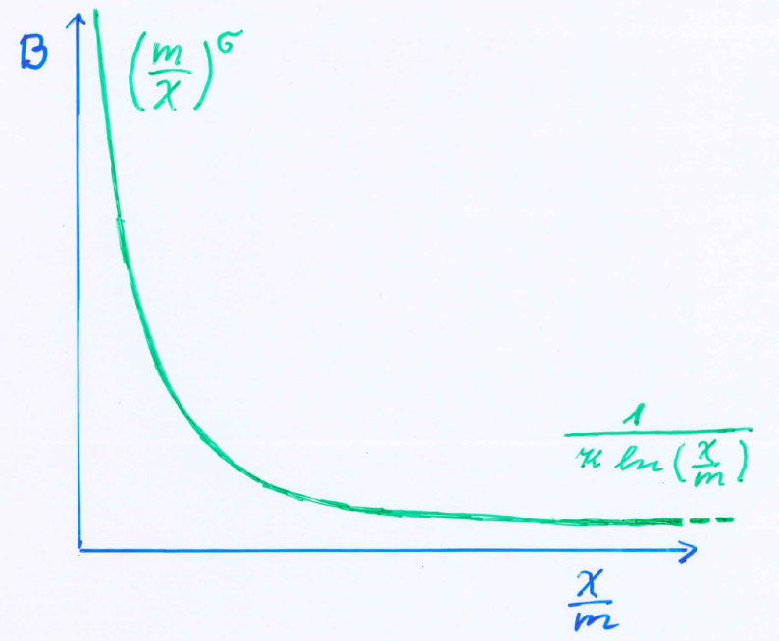
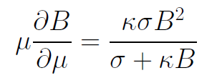
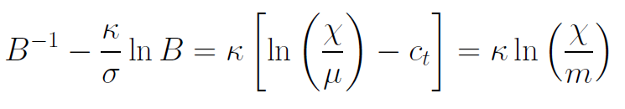
Kinetial B :
Crossover between two fixed points
assumption: running
coupling obeys
flow equation
m : scale of crossover
can be exponentially larger than intrinsic scale μ

Slide 72
Four-parameter model
model has four dimensionless parameters
three in kinetial :
σ ~ 2.5
κ ~ 0.5
c_{t} ~ 14 ( or m/μ )
one parameter for growth rate of neutrino mass over electron mass : γ ~ 8
+ standard model particles and dark matter : sufficient for realistic cosmology from inflation to dark energy
no more free parameters than ΛCDM

Slide 73
Model is compatible with present observations
Together with variation of neutrino mass over electron mass in present cosmological epoch :
model is compatible with all present observations, including inflation and dark energy

Slide 74
Simplicity
simple description of all cosmological epochs
natural incorporation of Dark Energy :
inflation
Early Dark Energy
present Dark Energy
dominated epoch
J.Rubio…

Slide 75
Cosmological solution
scalar field χ vanishes in the infinite past
scalar field χ diverges in the infinite future

Slide 76
No tiny dimensionless parameters
( except gauge hierarchy )
μ = 2 • 10 ⁻³³ eV
one mass scale
one time scale μ⁻¹ = 10 ¹⁰ yr
Planck mass does not appear as parameter
Planck mass grows large dynamically

Slide 77
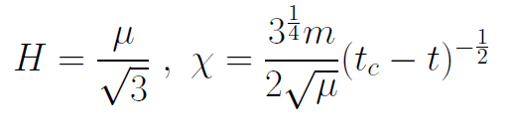
Slow Universe
Asymptotic solution in
freeze frame :
Expansion or shrinking always slow ,
characteristic time scale of the order of the age of the
Universe : t_{ch} ~ μ⁻¹ ~ 10 billion years !
Hubble parameter of the order of present Hubble
parameter for all times , including inflation and big bang !
Slow increase of particle masses !
μ= 2 • 10⁻³³ eV

Slide 78
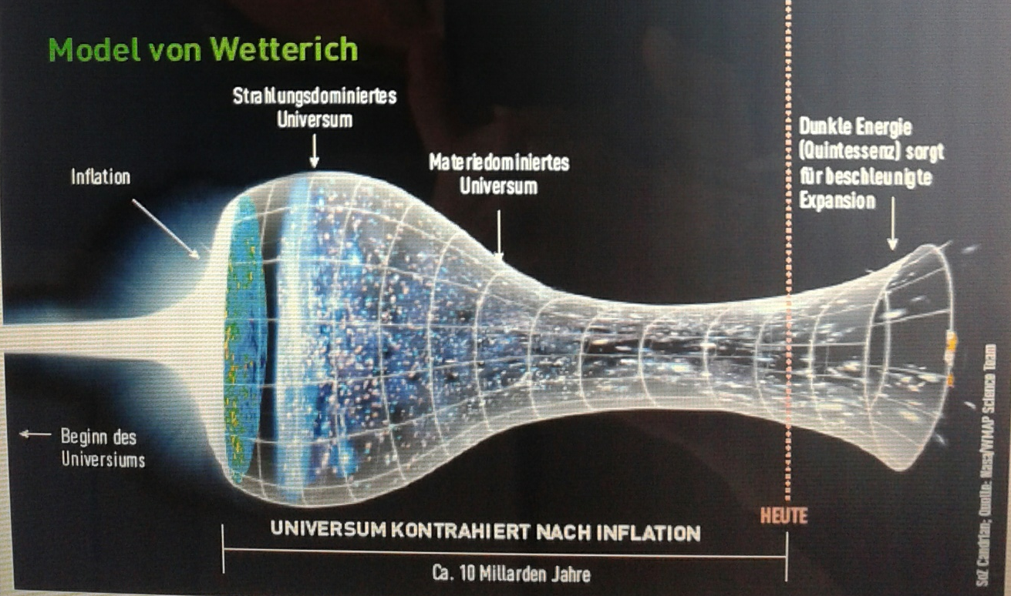
Strange evolution of Universe
Sonntagszeitung Zürich , Laukenmann

Slide 79
Einstein frame
Different choice of metric field :
Big bang cosmology with inflation and dynamical dark energy
Different frames are equivalent

Slide 80
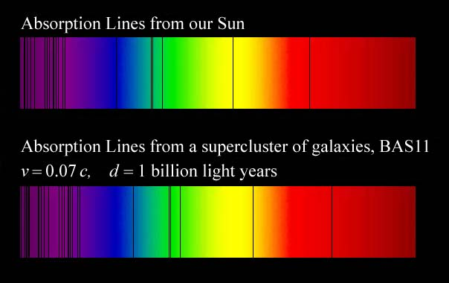
Why do we see redshift of photons emitted in the distant past ?
photons are more red because they have been emitted with longer wavelength
frequency ~ mass
wavelength ~
atomsize

Slide 81
What is increasing ?
Ratio of distance between galaxies
over size of atoms !
atom size constant : expanding geometry
alternative : shrinking size of atoms

Slide 82
Big bang is not wrong, but alternative pictures exist !

Slide 83
Einstein frame
“Weyl scaling” maps variable gravity model to Universe with fixed masses and standard expansion history.
Exact equivalence of different frames !
Standard gravity coupled to scalar field.
Only neutrino masses are growing.

Slide 84
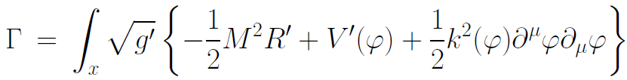
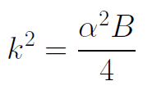

Einstein frame
Weyl scaling :
effective action in Einstein frame :

Slide 85
infinite past

Slide 86
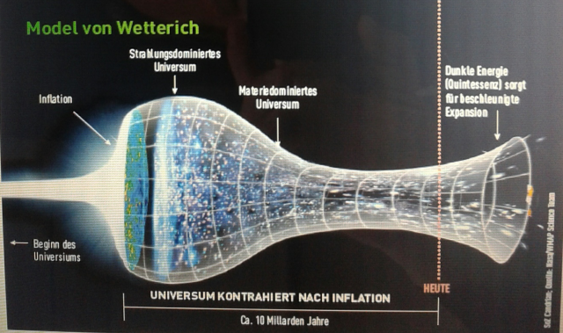
Eternal Universe
Asymptotic solution in
freeze frame :
solution valid back to the infinite past in physical time
no singularity
physical time to infinite past is infinite

Slide 87
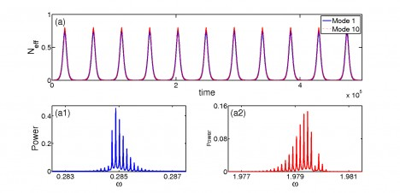
Physical time
count oscillations ….

Slide 88
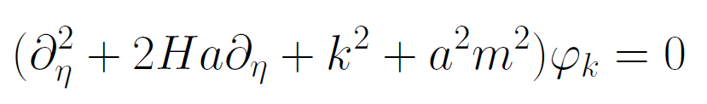
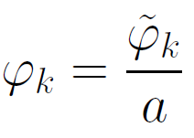
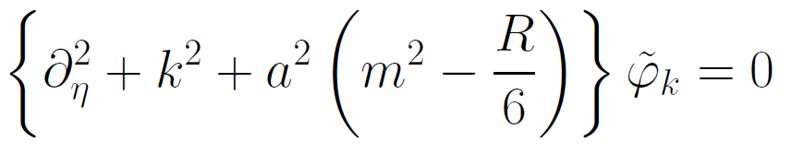
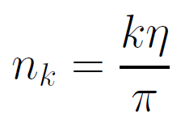

Physical time
field equation for scalar field mode
determine physical
time by counting
number of oscillations
( m=0 )

Slide 89
Physical time
counting : discrete
invariant under field transformations
same in all frames

