Slide 1
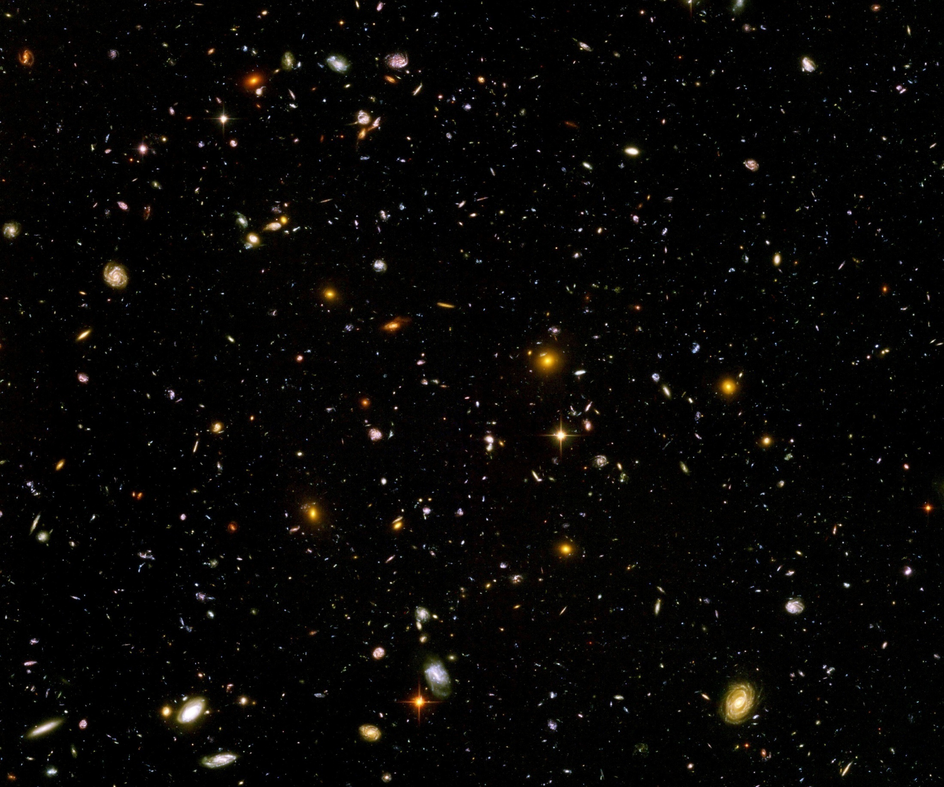
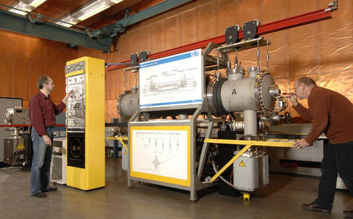
Time variation of „fundamental constants“ in quintessence cosmologies

Slide 2
Fundamental “constants” are not constant

Slide 3
Have coupling constants in the
very early Universe
other values than today ?
Yes !

Slide 4
Fundamental couplings in quantum field theory
Masses and coupling constants
are determined by properties
of vacuum !
Similar to Maxwell – equations in matter

Slide 5
Standard model of particle physics :
Electroweak gauge symmetry is spontaneously broken by expectation value of Higgs scalar
Quark and lepton masses proportional to value of Higgs scalar

Slide 6
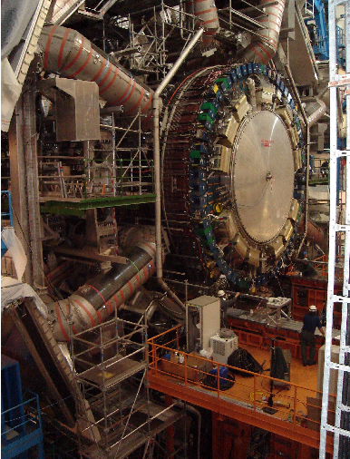
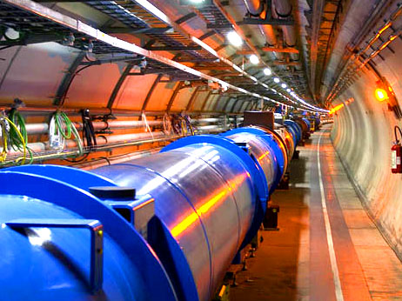
Spontaneous symmetry breaking confirmed at the LHC

Slide 7
Cosmology :
Universe is not in one fixed state
Dynamical evolution
Laws are expected to depend on time

Slide 8
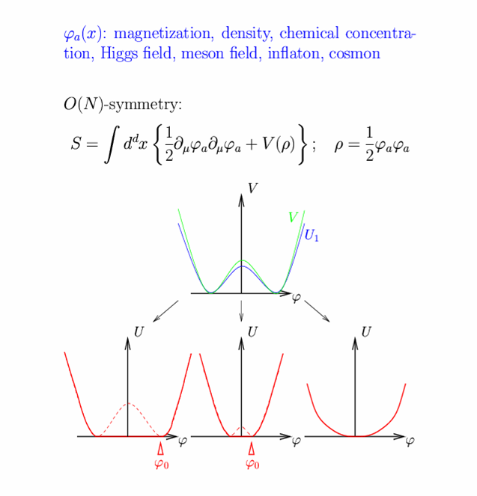
Restoration of symmetry at high temperature in the early Universe
high T :
Less order
More symmetry
Example:
Magnets
Low T
SSB
<φ>=φ₀ ≠ 0
High T
SYM
<φ>=0

Slide 9
In hot plasma of early Universe : masses of electron und muon not different! similar strength of electromagnetic and weak interaction

Slide 10
Varying couplings
only question :
How strong is present variation of couplings ?

Slide 11
Can variation of fundamental “constants” be observed ?
Fine structure constant α (electric charge)
Ratio electron mass to proton mass
Ratio nucleon mass to Planck mass

Slide 12
Time evolution of couplings and scalar fields
Fine structure constant depends on value of
scalar field : α(φ)
Time evolution of φ
Time evolution of α
Jordan,…

Slide 13
Static scalar fields
In Standard Model of particle physics :
Higgs scalar has settled to its present value around 10⁻¹² seconds after big bang.
Chiral condensate of QCD has settled at present value after quark-hadron phase transition around 10⁻⁶ seconds after big bang .
No scalar with mass below pion mass.
No substantial change of couplings after QCD phase transition.
Coupling constants are frozen.

Slide 14
Observation of time- or space- variation of couplings
Physics beyond Standard Model

Slide 15
Quintessence
Dynamical dark energy ,
generated by scalar field
(cosmon)
C.Wetterich,Nucl.Phys.B302(1988)668, 24.9.87
P.J.E.Peebles,B.Ratra,ApJ.Lett.325(1988)L17, 20.10.87

Slide 16
Prediction : homogeneous dark energy influences recent cosmology
- of same order as dark matter -
Original models do not fit the present observations
…. modifications

Slide 17
Cosmon
Scalar field changes its value even in the present cosmological epoch
Potential und kinetic energy of cosmon contribute to the energy density of the Universe
Time - variable dark energy :
ρ_{h}(t) decreases with time !

Slide 18

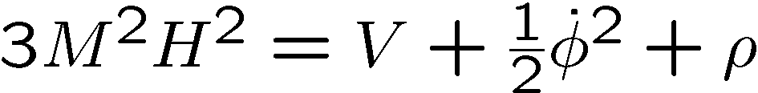
Evolution of cosmon field
Field equations
Potential V(φ) determines details of the model
V(φ) =M⁴ exp( - αφ/M )
for increasing φ the potential decreases towards zero !

Slide 19
Cosmon
Tiny mass
m_{c} ~ H (depends on time ! )
New long - range interaction

Slide 20
“Fundamental” Interactions
Strong, electromagnetic, weak
interactions
On astronomical
length scales:
graviton
+
cosmon
gravitation
cosmodynamics

Slide 21
Time varying constants
It is not difficult to obtain quintessence potentials from higher dimensional or string theories
Exponential form rather generic
( after Weyl scaling)
But most models show too strong time dependence of fundamental constants !

Slide 22
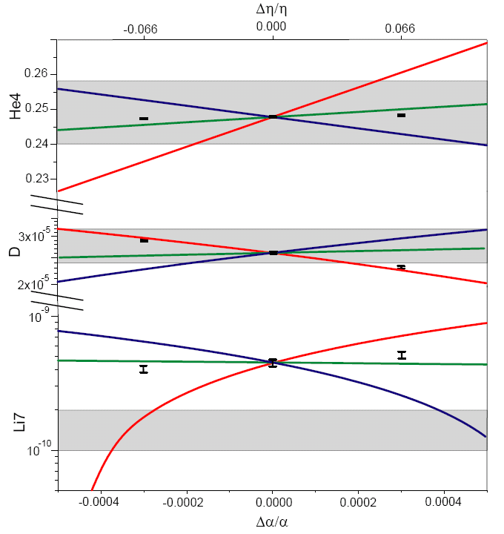
primordial abundances for three GUT models
present observations : 1σ
He
D
Li
T.Dent,
S.Stern,…

Slide 23
Time variation of coupling constants
must be tiny –
would be of very high significance !
Possible signal for Quintessence

Slide 24
Fifth force

Slide 25
Fifth force
coupling strength
range
m ∼ H : long range ( dynamical dark energy)
m ≫ H : short range ( dark matter )
concentrate on long range – effectively massless scalar for earth, solar system, galaxies, black holes, laboratory

Slide 26
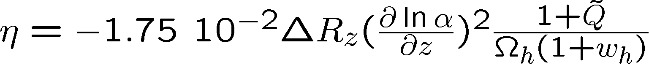
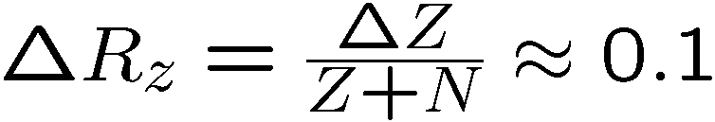
Differential acceleration η
For unified theories ( GUT ) :
η=Δa/2a
Q : time dependence of other parameters

Slide 27
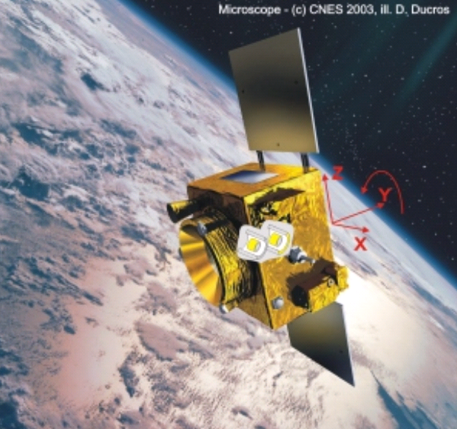
Link between time variation of α
and violation of equivalence principle
typically : η = 10⁻¹⁴
^{if time variation of α}
^{near Oklo upper bound}
^{( MICROSCOPE , …)}

Slide 28
Cosmon coupling to atoms
Tiny !!!
Substantially weaker than gravity.
Non-universal couplings bounded by tests
of equivalence principle.
Universal coupling bounded by tests of Brans-Dicke parameter ω in solar system.
Only very small influence on cosmology.
( All this assumes validity of linear approximation )

Slide 29
Key questions (1)
Why is atom – scalar coupling much weaker than gravity?
Why is scalar (almost) massless despite the presence of quantum fluctuations ?

Slide 30
Spontaneously broken scale symmetry

Slide 31
scale symmetry
No intrinsic length or mass scale present

Slide 32
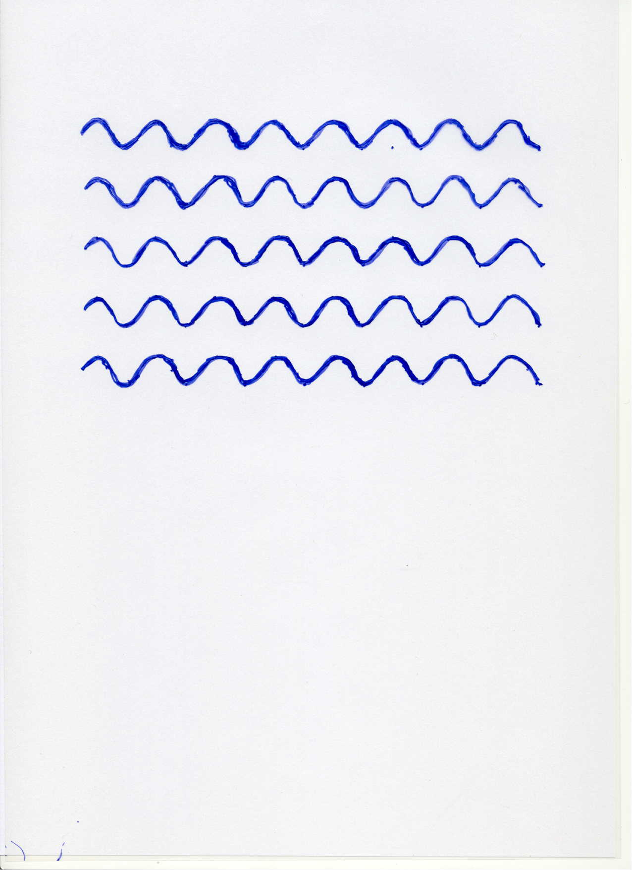


Scale symmetry
no scale symmetry
scale symmetry
only if no spontaneous symmetry breaking!

Slide 33
Scale symmetry
All parameters with mass are
proportional to scalar field χ
Dimensionless couplings are independent of χ.
All particle masses are proportional to χ .
Ratios of particle masses remain constant.
Compatibility with observational bounds on time dependence of particle mass ratios even if χ changes with time.

Slide 34
Scale symmetry
All parameters with mass are
proportional to scalar field χ
Classical scale symmetry with gravity:
Fujii, Zee

Slide 35
Quantum scale symmetry
quantum fluctuations violate scale symmetry
running dimensionless couplings
at fixed points , scale symmetry is exact !
quantum scale symmetry

Slide 36
Quantum scale symmetry
In the quantum effective action
all parameters with mass are
proportional to scalar field χ
gravity:
Higgs vev,
electron mass
QCD,
proton mass

Slide 37
Spontaneous breaking of scale symmetry
expectation value of scalar field breaks scale symmetry spontaneously
massive particles are compatible with scale symmetry
in presence of massive particles : sign of exact scale symmetry is exactly massless Goldstone boson – the dilaton

Slide 38
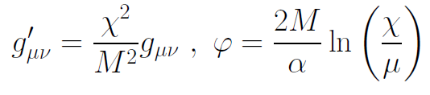
Einstein frame
Weyl scaling :
scale
transformation :

Slide 39
Key questions (1)
Why is atom – scalar coupling much weaker than gravity?
Why is scalar (almost) massless despite the presence of quantum fluctuations ?
answer
Scale symmetry explains both massless
scalar field and vanishing couplings

Slide 40
Approximate scale symmetry

Slide 41
Slowly running couplings close to fixed points

Slide 42
Simple mechanism for tiny cosmon - atom couplings
asymptotic approach to fixed point for dimensionless couplings and mass ratios
at fixed point : no cosmon coupling to atoms – no time variation of fundamental constants
very near fixed point : tiny coupling
how small ?

Slide 43
Simple mechanism for very light scalar field
Exact scale symmetry : massless Goldstone boson
Approximate scale symmetry : very light pseudo-Goldstone boson

Slide 44
Key question (2)
Do fixed points play a role for cosmology ?

Slide 45
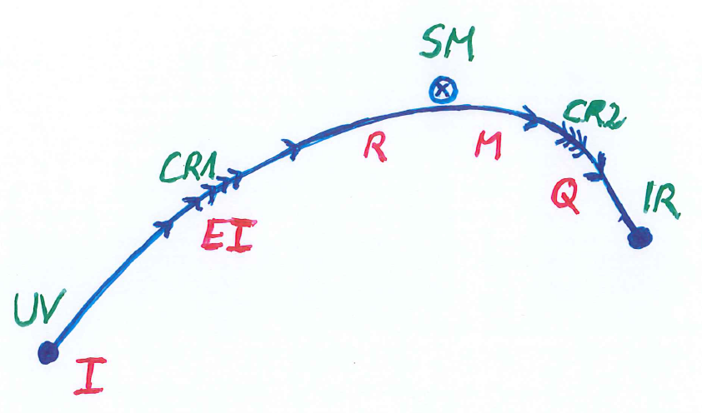
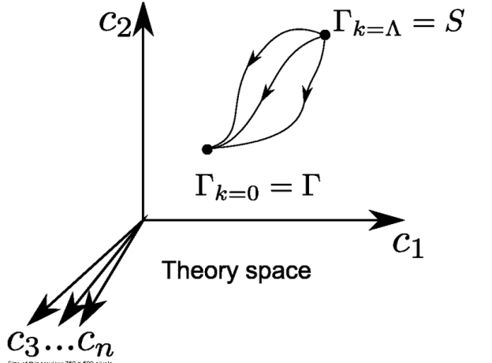
Crossover in quantum gravity

Slide 46
Approximate scale symmetry near fixed points
UV : approximate scale invariance of primordial fluctuation spectrum from inflation
IR : cosmon is pseudo Goldstone boson of
spontaneously broken scale symmetry,
tiny mass,
responsible for dynamical Dark Energy

Slide 47
Asymptotic safety
if UV fixed point exists :
quantum gravity is
non-perturbatively renormalizable !
S. Weinberg , M. Reuter

Slide 48
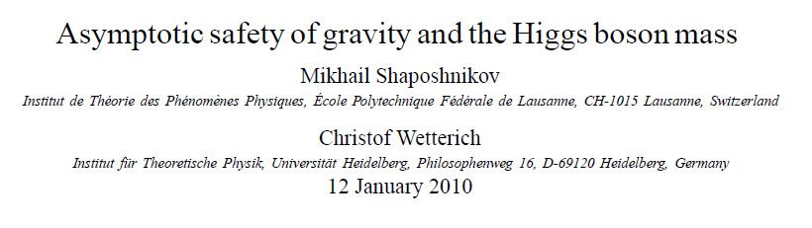
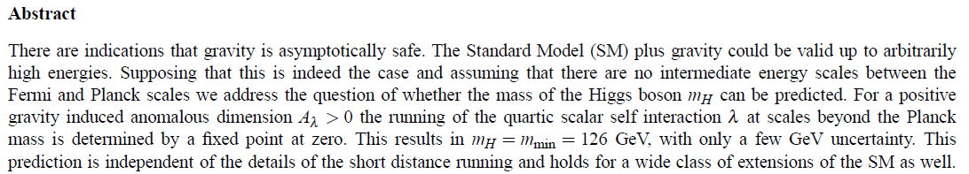
a prediction…

Slide 49
Possible consequences of crossover in quantum gravity
Realistic model for inflation and dark energy
with single scalar field

Slide 50
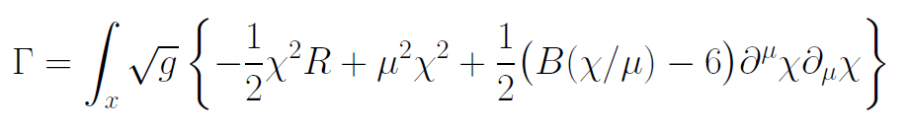
Variable Gravity
quantum effective action,
variation yields field equations
Einstein gravity :
M² R

Slide 51
Variable Gravity
Scalar field coupled to gravity
Effective Planck mass depends on scalar field
Simple quadratic scalar potential involves intrinsic mass μ
Nucleon and electron mass proportional to dynamical Planck mass
Neutrino mass has different dependence on scalar field

Slide 52
Cosmological solution : crossover from UV to IR fixed point
Dimensionless functions as B
depend only on ratio μ/χ .
IR: μ→0 , χ→∞
UV: μ→∞ , χ→0
Cosmology makes
crossover between
fixed points by
variation of χ .

Slide 53
Key question (2)
Do fixed points play a role for cosmology ?
answer
likely

Slide 54
Conclusions
Scalar force in cosmology can arise from quantum scale symmetry
Realistic cosmology
Look for
time variation of fundamental constants, violation of equivalence principle,
huge lumps in cosmic neutrino background,
dynamical dark energy

Slide 55
end

Slide 56
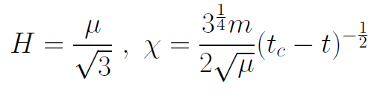
Slow Universe
Asymptotic solution in
freeze frame :
Expansion or shrinking always slow ,
characteristic time scale of the order of the age of the
Universe : t_{ch} ~ μ⁻¹ ~ 10 billion years !
Hubble parameter of the order of present Hubble
parameter for all times , including inflation and big bang !
Slow increase of particle masses !
μ= 2 • 10⁻³³ eV

Slide 57
infinite past

Slide 58
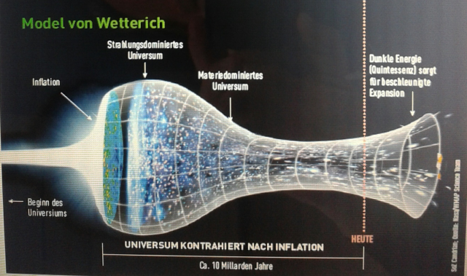
Eternal Universe
Asymptotic solution in
freeze frame :
solution valid back to the infinite past in physical time
no singularity
physical time to infinite past is infinite

Slide 59
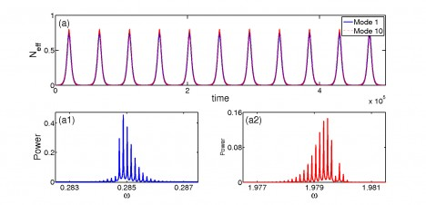
Physical time
count oscillations ….

Slide 60
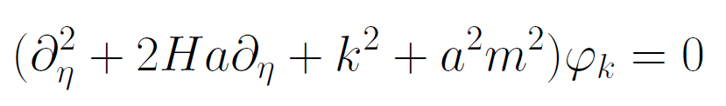
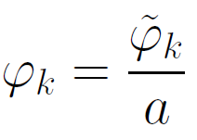
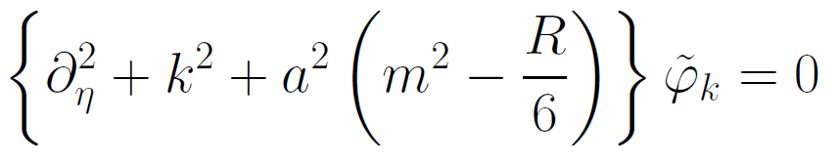
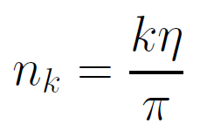

Physical time
field equation for scalar field mode
determine physical
time by counting
number of oscillations
( m=0 )

Slide 61
Physical time
counting : discrete
invariant under field transformations
same in all frames

Slide 62
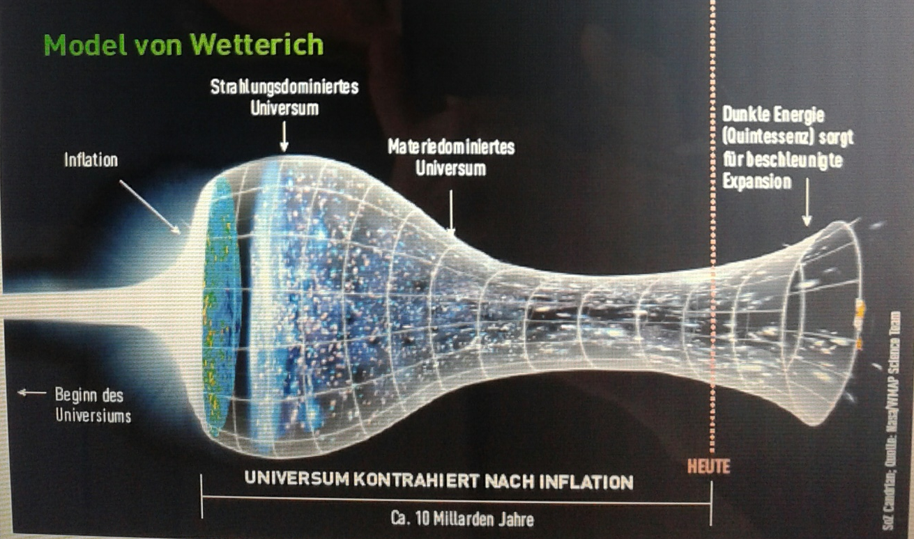
Strange evolution of Universe
Sonntagszeitung Zürich , Laukenmann

Slide 63
Big bang or freeze ?

Slide 64
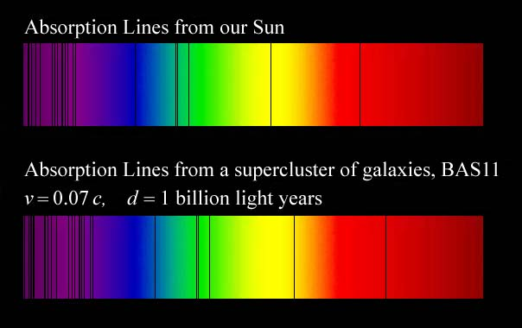
Do we know that the
Universe expands ?
instead of redshift due to expansion :
smaller frequencies have been emitted in the past, because electron mass was smaller !

Slide 65
Why do we see redshift of photons emitted in the distant past ?
photons are more red because they have been emitted with longer wavelength
frequency ~ mass
wavelength ~
atomsize

Slide 66
What is increasing ?
Ratio of distance between galaxies
over size of atoms !
atom size constant : expanding geometry
alternative : shrinking size of atoms

Slide 67
Key question (3)
Why does scale symmetry play a role even though it is violated by quantum fluctuations ?

Slide 68
quantum gravity with scalar field – the role of scale symmetry

Slide 69
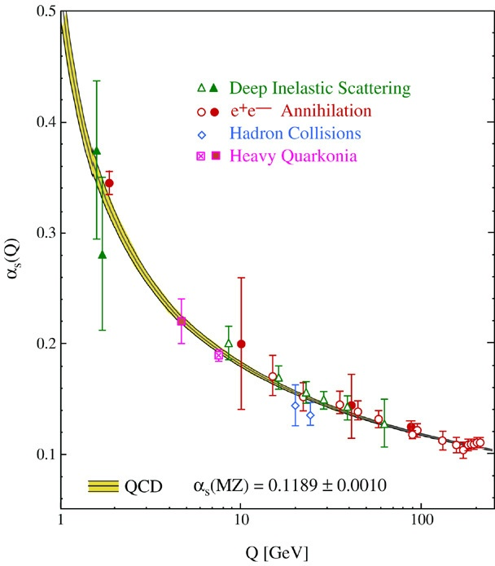
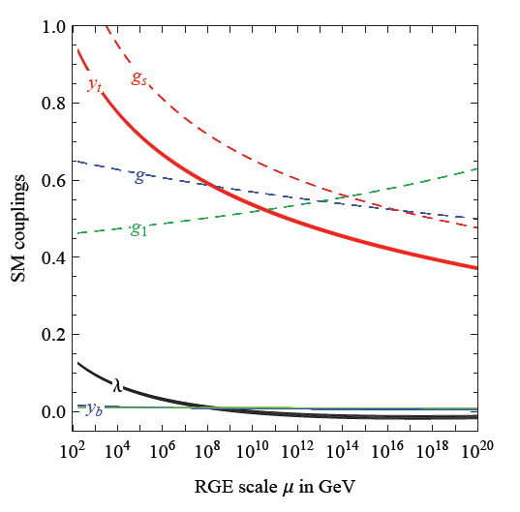
fluctuations induce running couplings
violation of scale symmetry
well known in QCD or standard model

Slide 70
Quantum scale symmetry
quantum fluctuations violate scale symmetry
running dimensionless couplings
at fixed points , scale symmetry is exact !

Slide 71

functional renormalization : flowing action
Wikipedia
Notes:
71

Slide 72
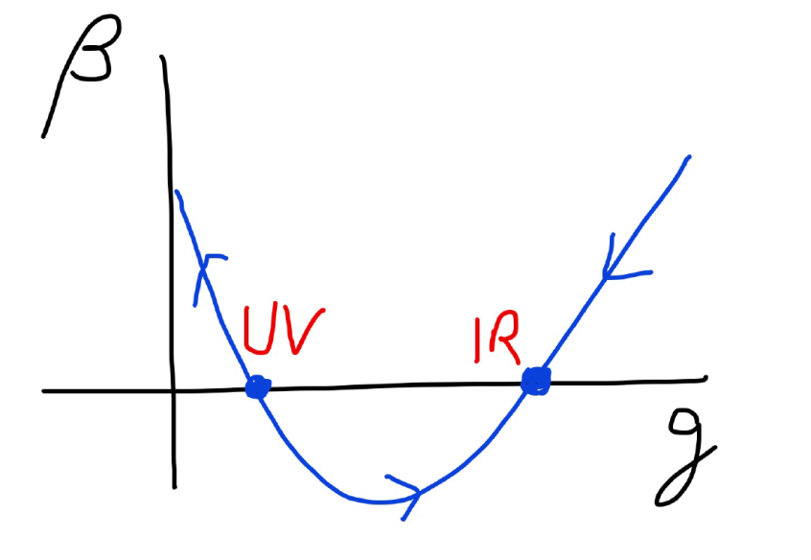
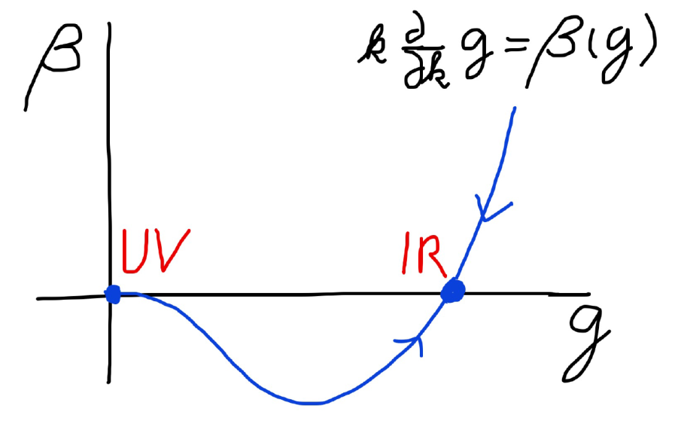
Asymptotic safety Asymptotic freedom
Relevant parameters yield undetermined couplings.
Quartic scalar coupling is not relevant and can therefore be predicted.

Slide 73
Key question (3)
Why does scale symmetry play a role even though it is violated by quantum fluctuations ?
answer
Fixed points
always realize scale symmetry

Slide 74
Big bang singularity in Einstein frame is field singularity !
choice of frame with constant particle
masses is not well suited if
physical masses go to zero !

