Slide 1
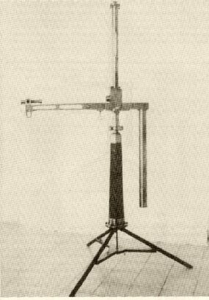
Quantum scale symmetry and the Equivalence principle

Slide 2
Equivalence principle
Coupling of graviton to proton and neutron proportional to mass
Same acceleration
Equivalence principle
p,n
earth
graviton
p,n

Slide 3
Violation of equivalence principle
Different couplings of cosmon to proton and neutron
Differential acceleration
“Violation of equivalence principle”
p,n
earth
cosmon
p,n
only apparent : new “fifth force” !

Slide 4
New scalar force
Spontaneously broken quantum scale symmetry predicts massless scalar ( cosmon )
Only tiny violation of equivalence principle if scale symmetry is approximate

Slide 5
“Fundamental” Interactions
Strong, electromagnetic, weak
interactions
On astronomical
length scales:
graviton
+
cosmon
gravitation
cosmodynamics

Slide 6
Scale symmetry

Slide 7
Scale transformation
Scale all lengths with constant factor
Scale all masses with inverse factor

Slide 8
Un
Unbroken scale symmetry :
Physics looks the same on all scales

Slide 9
Scale transformation of renormalized fields

Slide 10
Have we observed scale symmetry ?

Slide 11

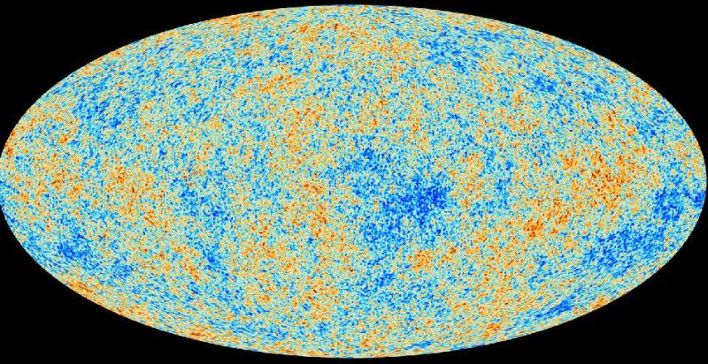
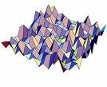
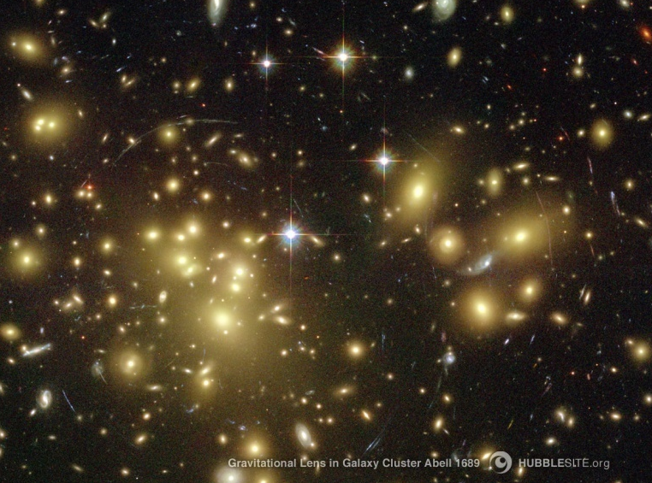
Almost scale invariant primordial fluctuation spectrum seeds all structure in the universe

Slide 12
Scale symmetry in elementary particle physics ?
proton mass , electron mass
Scales are present in particle physics,
but very small as compared to Planck mass
High momentum scattering almost scale invariant

Slide 13
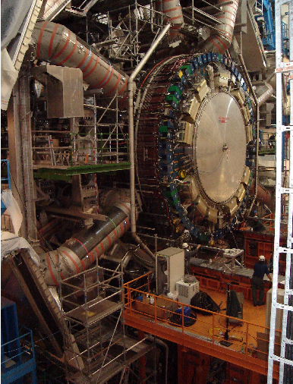
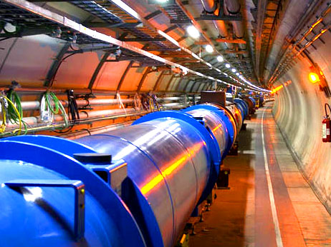
Approximate scale symmetry at highest energies at the LHC
and at the next collider ?

Slide 14
Quantum scale symmetry

Slide 15
Quantum scale symmetry
No parameter with dimension of
length or mass is present in the
quantum effective action.
Then invariance under
dilatations or global scale transformations
is realized.
Continuous global symmetry

Slide 16
Quantum fluctuations induce running
( momentum dependent ) couplings
Running fine structure constant
𝛼 = 1/137 for atoms
𝛼 = 1/128 at LEP
Induced by quantum fluctuations of electrons, muons, quarks etc.

Slide 17
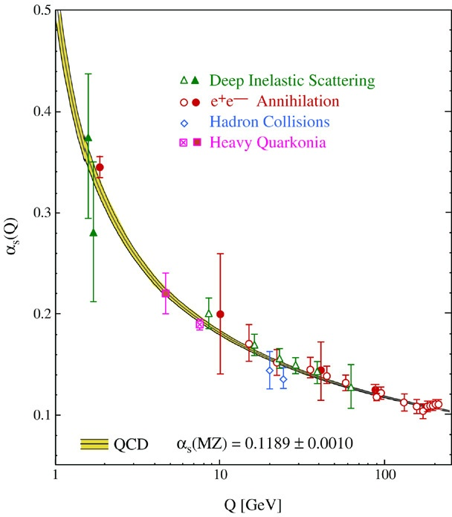
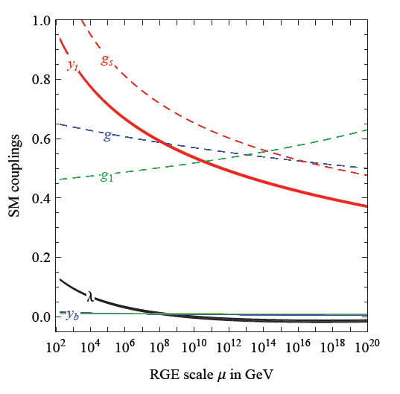
Quantum fluctuations induce running couplings
possible violation of scale symmetry
well known in QCD or standard model
Bethke
Degrassi et al

Slide 18
Quantum scale symmetry
quantum fluctuations can violate scale symmetry
running dimensionless couplings
at fixed points , scale symmetry is exact !
quantum fluctuations can generate scale symmetry !

Slide 19
Fixed points and scale symmetry
At a fixed point, scale symmetry is exact in the presence of fluctuations ( quantum scale symmetry )
Well known in condensed matter physics :
second order phase transition
fixed point or scaling solution
exact scale symmetry
critical phenomena
Classical or quantum Ising model

Slide 20
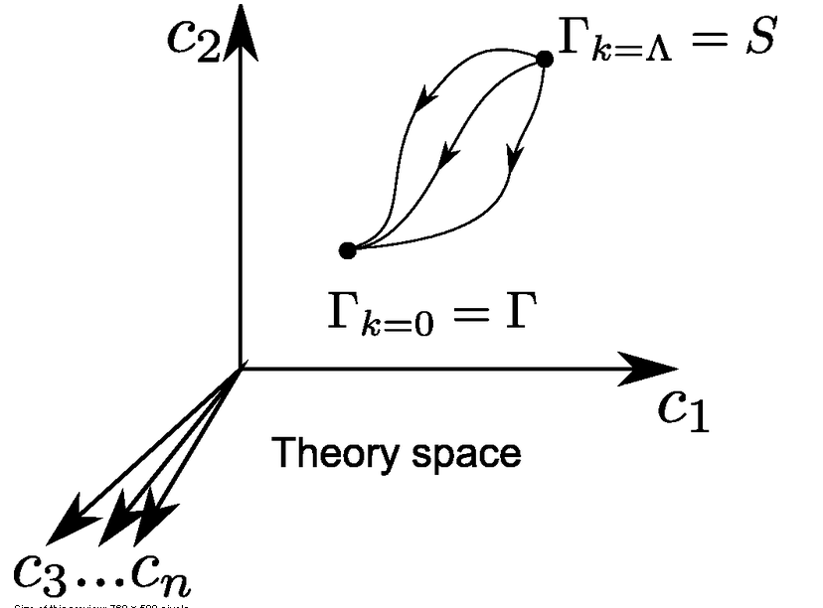
Functional renormalization : flowing action
Wikipedia
Notes:
20

Slide 21
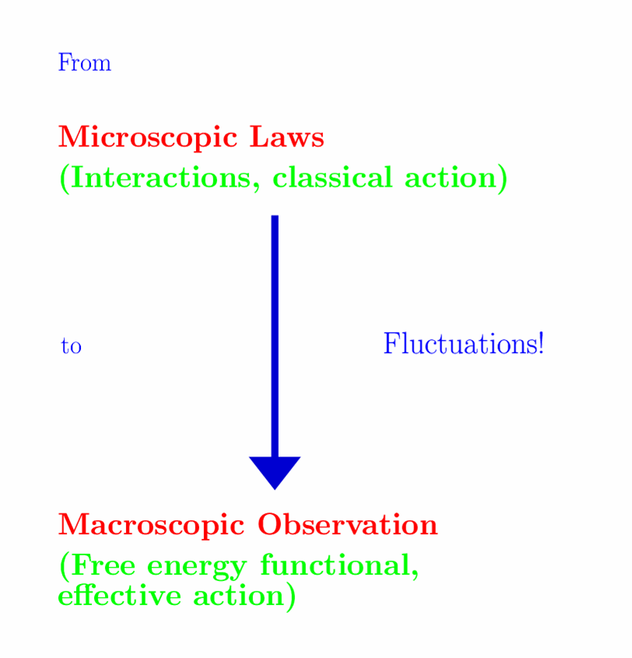


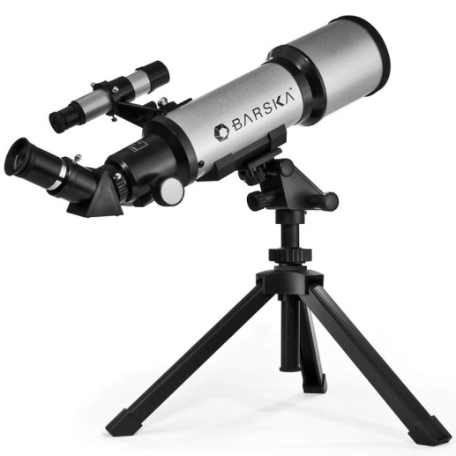

Slide 22
Ultraviolet fixed point
UV fixed point
Wikipedia
Notes:
22

Slide 23
Quantum scale symmetry
Exactly on fixed point:
No parameter with dimension of
length or mass is present in the
quantum effective action.
Then invariance under
dilatations or global scale transformations
is realized as a quantum symmetry.
Continuous global symmetry

Slide 24
Scale symmetry and fixed points
Relative strength of gravity
Particle
scale
symmetry
Gravity
scale
symmetry
Distance from
electroweak
phase transition
Cosmic
scale
symmetry

Slide 25
Gravity scale symmetry

Slide 26
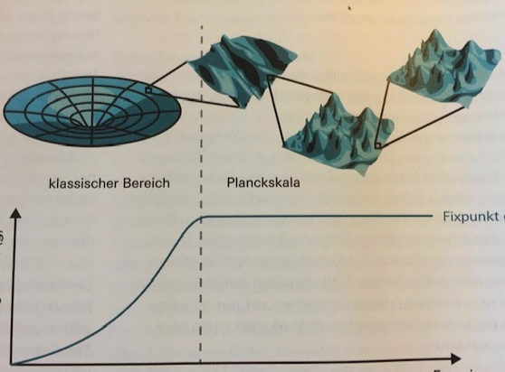
Strength of gravity
classical gravity
quantum gravity
fixed point
strength
of
gravity
energy
inverse distance
A. Eichhorn, CW, Spektrum der Wissenschaft

Slide 27
Asymptotic safety of quantum gravity
if UV fixed point exists :
quantum gravity is
non-perturbatively renormalizable
quantum field theory !
S. Weinberg , M. Reuter

Slide 28
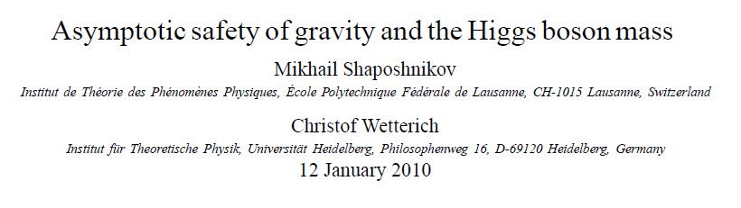
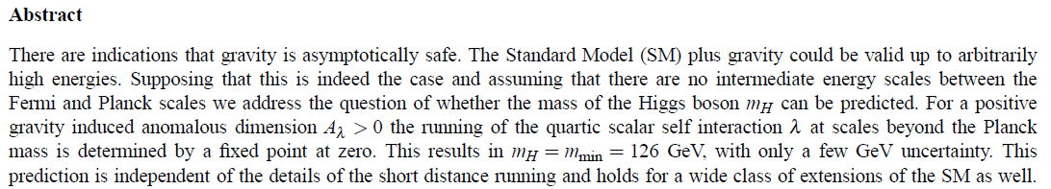
a prediction…

Slide 29
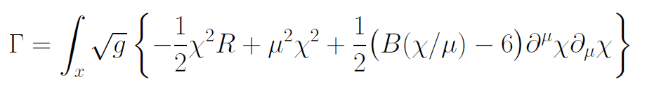
Gravity scale symmetry
Replace Planck mass by scalar field 𝜒
…
“Modified gravity” :
solve modified cosmological field equations

Slide 30
Almost scale invariant primordial fluctuation spectrum seeds all structure in the Universe
In the infinite past
Universe “begins”
at the fixed point

Slide 31
Gravity scale symmetry
Replace Planck mass by scalar field
Cosmological solution : 𝜒(t) differs from zero,
equals zero only in the infinite past
Spontaneous breaking of scale symmetry

Slide 32
Scale symmetry
All parameters with mass are
proportional to scalar field χ
Dimensionless couplings are independent of χ.
All particle masses are proportional to χ .
Ratios of particle masses remain constant.
Compatibility with observational bounds on time dependence of particle mass ratios even if χ changes with time.

Slide 33
Particle masses from spontaneous scale symmetry breaking
Electron mass proportional to 𝜒
m_{e} ∼ 𝜑₀ ( expectation value of Higgs scalar )
𝜑₀ ∼ 𝜒
m_{e} = y_{e} 𝜑₀ ( Yukawa coupling )

Slide 34
Spontaneous breaking of scale symmetry
expectation value of scalar field breaks scale symmetry spontaneously
particle masses can be proportional to scalar field 𝜒
massive particles are compatible with scale symmetry
in presence of massive particles : sign of exact scale symmetry is exactly massless Goldstone boson – the dilaton or cosmon

Slide 35
Spontaneous symmetry breaking confirmed at the LHC

Slide 36
Variable Gravity
Scalar field coupled to gravity
Effective Planck mass depends on scalar field
Simple quadratic scalar potential involves intrinsic mass μ
Nucleon and electron mass proportional to dynamical Planck mass

Slide 37

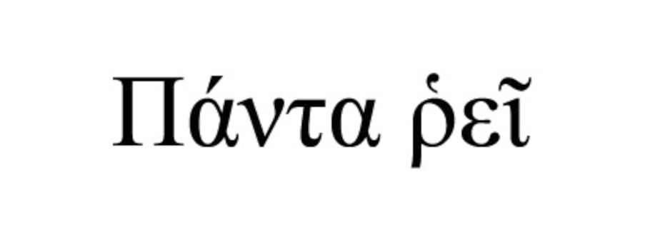

Slide 38
Fifth force

Slide 39
Scalar force ( fifth force)
i
j
attractive:
repulsive:

Slide 40
Simple mechanism for very light scalar field
Exact scale symmetry : massless Goldstone boson
Approximate scale symmetry : very light pseudo-Goldstone boson
Candidate for scalar fifth force

Slide 41
Simple mechanism for tiny cosmon - atom couplings
asymptotic approach to fixed point for dimensionless couplings and mass ratios
at fixed point : no cosmon coupling to atoms – no time variation of fundamental constants
very near fixed point : tiny coupling
how small ?

Slide 42
Conclusions
Quantum gravity makes predictions that can be tested by present observations and experiments
Eötvös - type experiments remain very relevant today: test of tiny violations of quantum scale symmetry

Slide 43
end

Slide 44
Slowly running couplings close to fixed points

Slide 45
Quintessence
Dynamical dark energy ,
generated by scalar field (cosmon )
C.Wetterich,Nucl.Phys.B302(1988)668, 24.9.87
P.J.E.Peebles,B.Ratra,ApJ.Lett.325(1988)L17, 20.10.87
Notes:
45

Slide 46
Prediction : homogeneous dark energy influences recent cosmology
- of same order as dark matter -
Original models do not fit the present observations
…. modifications
( different growth of neutrino mass )

Slide 47
Differential acceleration
Two bodies with equal mass experience
a different acceleration !
η = ( a₁ – a₂ ) / ( a₁ + a₂ )
bound : η < 3 10⁻¹⁴

Slide 48
Apparent violation of equivalence principle
and
time variation of fundamental couplings
measure both the
cosmon – coupling to ordinary matter

Slide 49
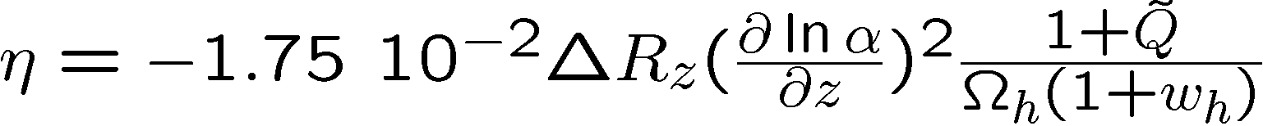
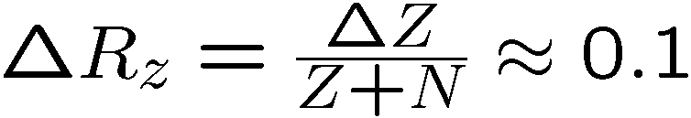
Differential acceleration η
For unified theories ( GUT ) :
η=Δa/2a
Q : time dependence of other parameters

Slide 50
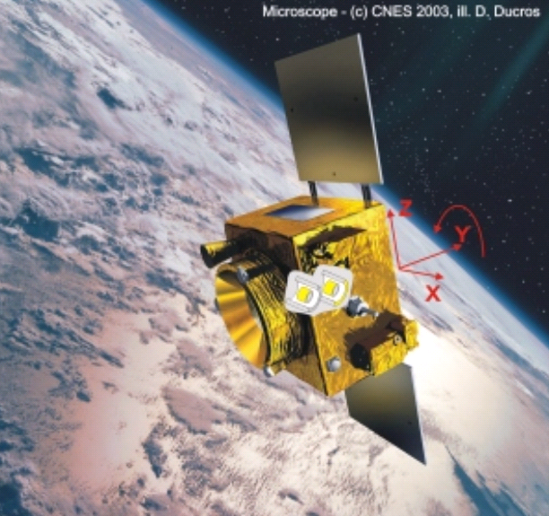
Link between time variation of α
and violation of equivalence principle
typically : η = 10⁻¹⁴
^{if time variation of α}
^{near Oklo upper bound}
^{to be tested ( MICROSCOPE , …)}

Slide 51
Cosmon coupling to atoms
Tiny !!!
Substantially weaker than gravity.
Non-universal couplings bounded by tests
of equivalence principle.
Universal coupling bounded by tests of Brans-Dicke parameter ω in solar system.
Only very small influence on cosmology.
( All this assumes validity of linear approximation )

