Slide 1
Tutorial on Quanty at ESRF
DFT – Tight-binding - LigandField
Maurits W. Haverkort
Institute for theoretical physics – Heidelberg University
M.W.Haverkort@thphys.uni-heidelberg.de

Slide 2
Three examples
MgO
NiO
Alkali metals

Slide 4
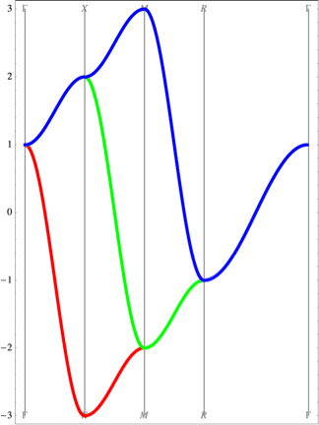
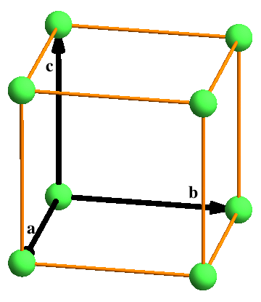
p-orbitals on a cubic lattice nearest neighbor interaction only
Unit cell

Slide 5
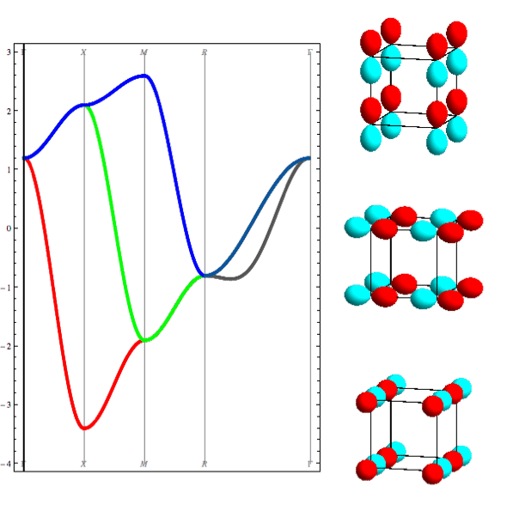
p-orbitals on a cubic lattice
Unit cell

Slide 6
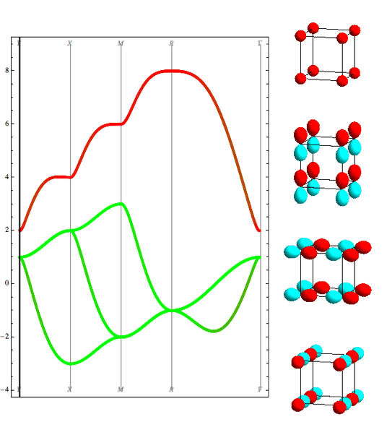
s- and p-orbitals on a cubic lattice
Unit cell

Slide 7
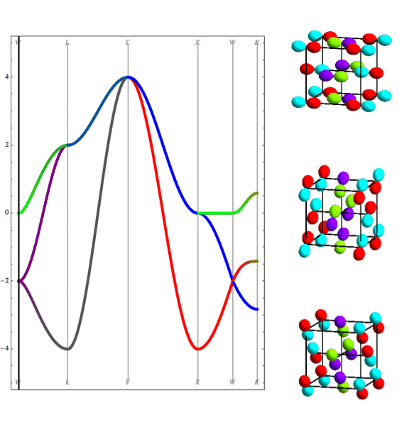
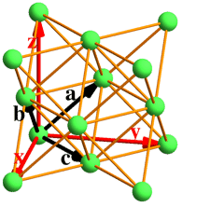
p-orbitals on a face centered cubic lattice
Unit cell

Slide 8
MgO – rocksalt structure
O
Mg

Slide 9
MgO – band-structure
Mg-3s character
O-2p character

Slide 10

MgO – band-structure
Nearest neighbor tight binding
Full DFT calculation
L
Γ
X
W

Slide 11
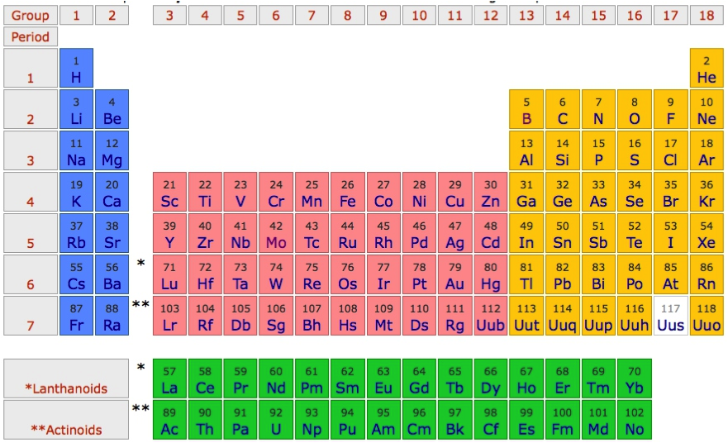
MgO – band-structure

Slide 12
MgO – band-structure
1s²2s²2p⁴
1s²2s²2p⁶3s²

Slide 13
MgO – band-structure
1s²2s²2p⁶
1s²2s²2p⁶3s⁰

Slide 14
MgO – atomic orbitals
Mg-3s

Slide 15
MgO – atomic orbitals
O-2p

Slide 16
MgO – atomic orbitals
Mg-3s
O-2p

Slide 17
MgO – wannier orbitals
Mg-3s
atomic
Mg-3s
Wannier

Slide 18
MgO – wannier orbitals
O-2p
atomic
O-2p
Wannier

Slide 19
MgO – wannier orbitals

Slide 20
MgO – wannier orbitals
Mg-3s
Wannier
O-2p
Wannier
Mg-3s
atomic
O-2p
atomic

Slide 21
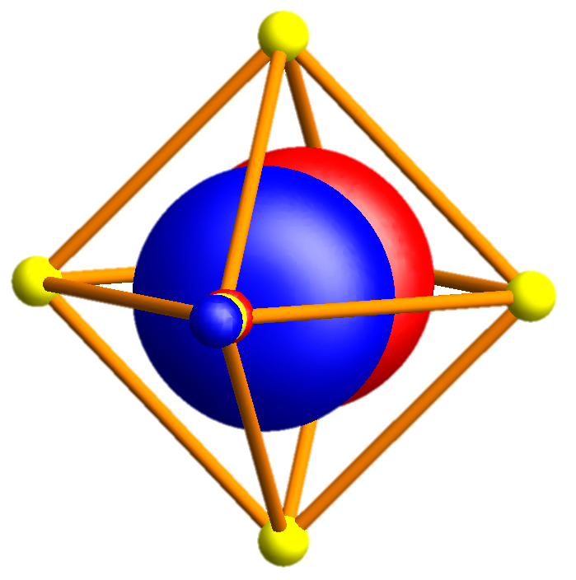
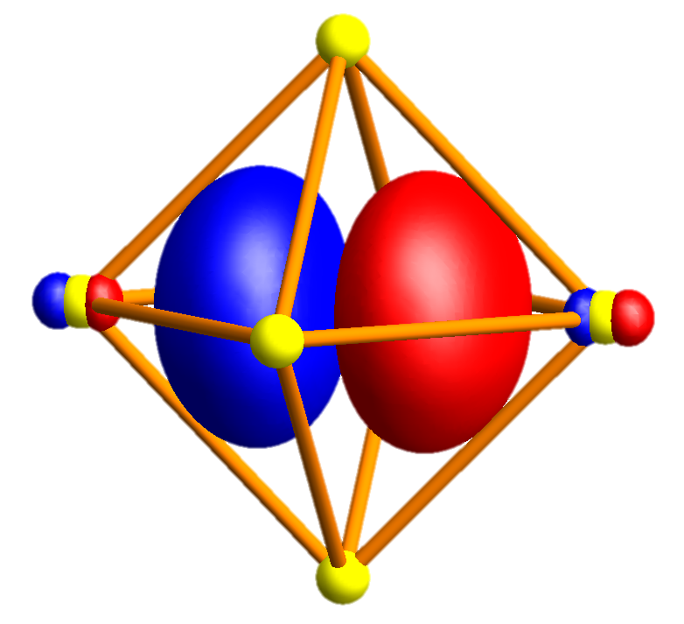
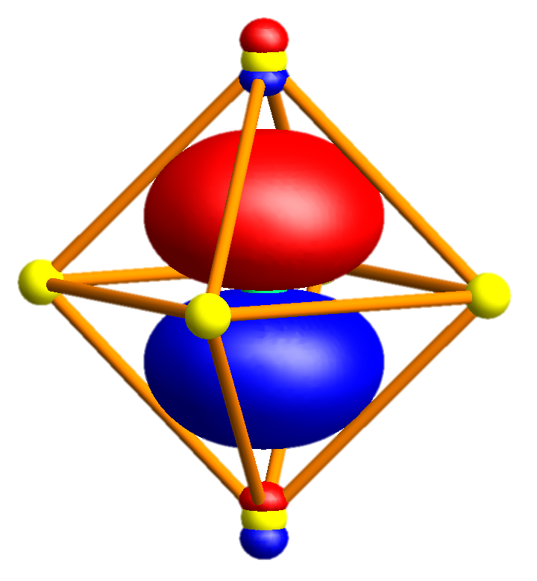
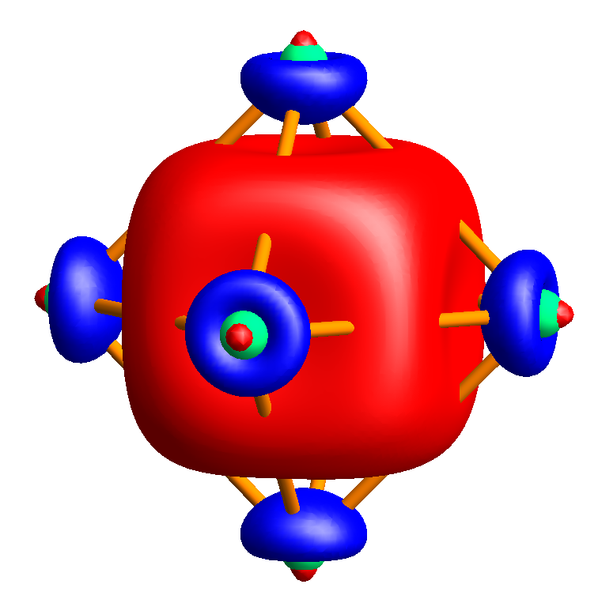
MgO – wannier orbitals

Slide 22
MgO – band-structure

Slide 23
MgO – band-structure – minimal basis O-p and Mg-s

Slide 24
MgO – band-structure – minimal basis O-p and Mg-s
Mg 3s
O 2p
O 2s
Mg 2p

Slide 25
MgO – band-structure – minimal basis O-p and Mg-s
Mg 3s
O 2p
O 2s
Mg 2p

Slide 26
MgO – band-structure – minimal basis O-p and Mg-s
Mg 3s
Mg 3s
O 2p
O 2p
O 2s
Mg 2p

Slide 27
MgO – band-structure – minimal basis O-p and Mg-s
Mg 3s
Mg 3s
O 2p
O 2p
O 2s
Mg 2p

Slide 28
NiO – rocksalt structure
O
Ni

Slide 29
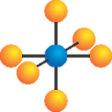
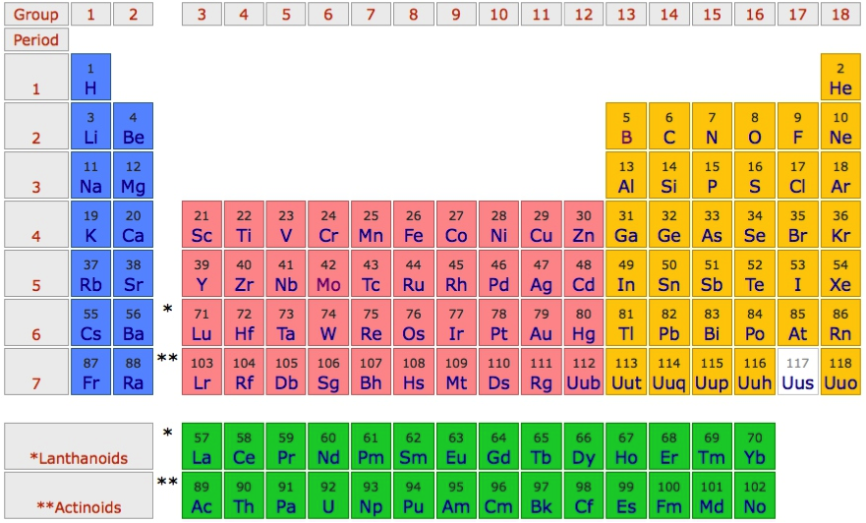
Use NiO as an example material
O²⁻ - 2p⁶
Ni²⁺ - 4s⁰ 3d⁸

Slide 30
“Downfold” the DFT results to obtain basis of choice

Slide 31
Pick a basis of “TM-d” and “O-p” Wannier orbitals
e_{g} σ bond
t_{2g} π bond

Slide 32
The TM-d Wannier orbitals are very close to atomic orbitals

Slide 33
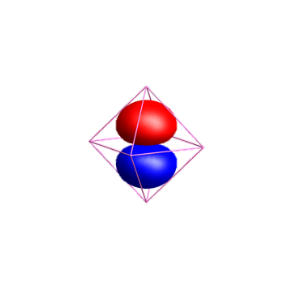
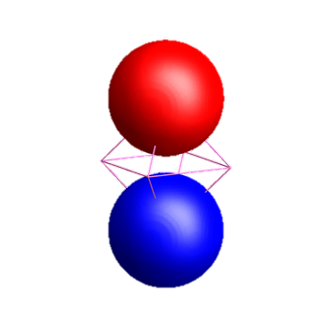
The O-p Wannier orbitals have tails!!!
O-2p
Ni-4s

Slide 34
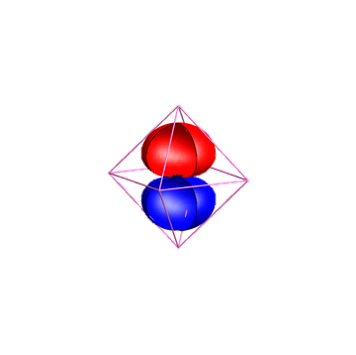
The O-p Wannier orbitals have tails!!!
O-2p
Ni-4s

Slide 35
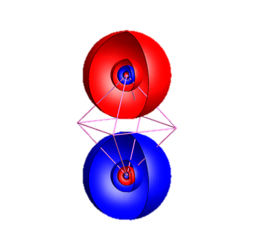
The O-p Wannier orbitals have tails!!!
O-2p
Ni-4s

Slide 36
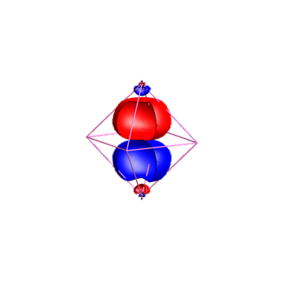
The O-p Wannier orbitals have tails!!!
Ni-4s
O-2p

Slide 37
Pick a basis of “TM-d” and “O-p” Wannier orbitals

Slide 38
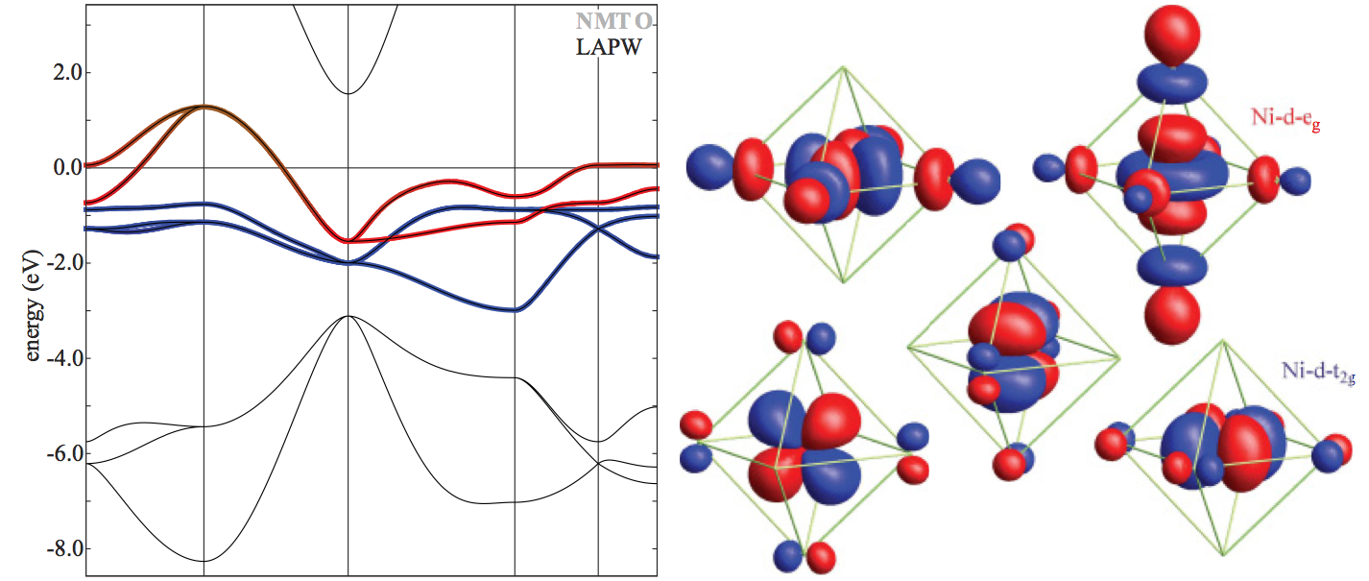
Pick a basis of “TM-d” Wannier orbitals

Slide 39
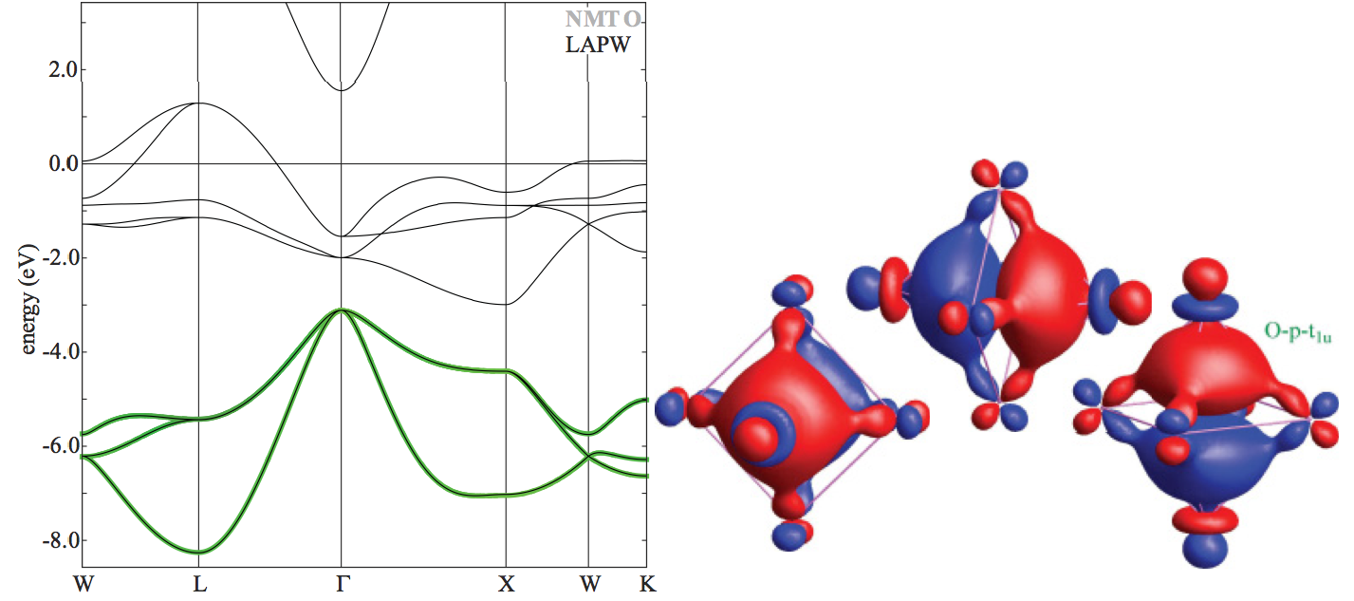
Pick a basis of “O-p” Wannier orbitals

Slide 40
NiO in a LDA band-structure picture

Slide 41
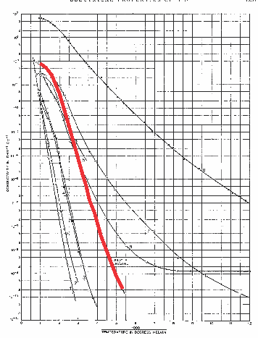
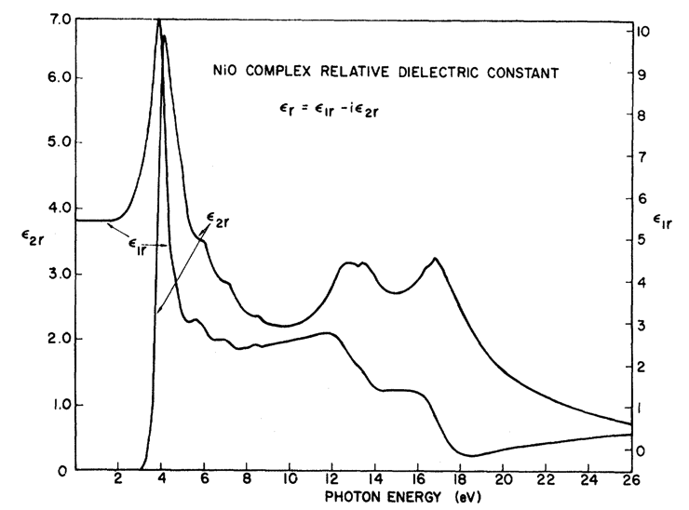
In LDA NiO is a metal: Experimentally it is a good insulator
F. J. Morin, Phys. Rev. 93, 1199 (1954)
R. Newman and R. M. Chrenko,
Phys. Rev 114 1507 (1959)
Room temperature
ρ~10⁵ Ο cm
Optical-gap
3.5 – 4.0 eV

Slide 42
“Downfold” the DFT results to obtain basis of choice

Slide 43
Orbital energy level diagram obtained from LDA

Slide 44
Orbital energy level diagram obtained from LDA

Slide 45
Orbital energy level diagram obtained from LDA

Slide 46
Orbital energy level diagram obtained from LDA

Slide 47
Orbital energy level diagram obtained from LDA

Slide 48
Create ligand orbitals from O-2p Wannier orbitals

Slide 49
Create ligand orbitals from O-2p Wannier orbitals

Slide 50
Create ligand orbitals from O-2p Wannier orbitals

Slide 51
Create ligand orbitals from O-2p Wannier orbitals

Slide 52
Create ligand orbitals from O-2p Wannier orbitals

Slide 53
Create ligand orbitals from O-2p Wannier orbitals

Slide 54
Create ligand orbitals from O-2p Wannier orbitals

Slide 55
Create ligand orbitals from O-2p Wannier orbitals

Slide 56
Create ligand orbitals from O-2p Wannier orbitals

Slide 57
Create ligand orbitals from O-2p Wannier orbitals

Slide 58
Create ligand orbitals from O-2p Wannier orbitals

Slide 59
Create ligand orbitals from O-2p Wannier orbitals

Slide 60
Create ligand orbitals from O-2p Wannier orbitals

Slide 61
Create ligand orbitals from O-2p Wannier orbitals

Slide 62
Orbital energy level diagram obtained from LDA

Slide 63
Tight binding description of Alkali metals
Alkali metals are close to free electron like

Slide 64
Free electron like description
Energy momentum relation of a free electron
Maximal velocity is given by the Fermi momentum

Slide 65
Free electron like description – Brillouin zone folding

Slide 66
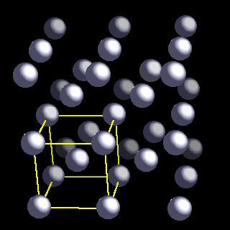
Brillion zone of Li (bcc)

Slide 67
Brillion zone of Li

Slide 68
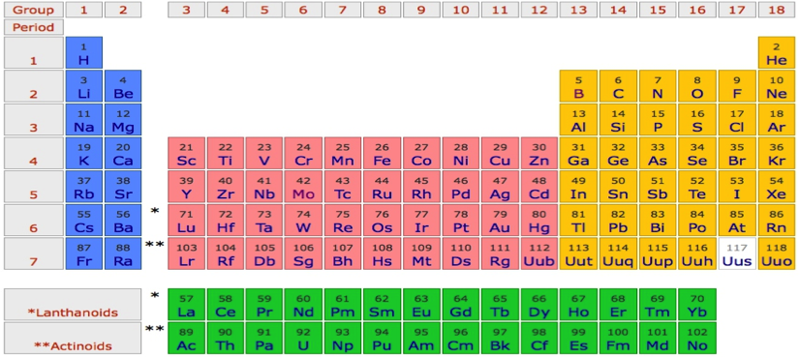
Li
P
Γ
P
H
P
Γ
P
H
P
Γ
P

Slide 69
Na
P
Γ
P
H
P
Γ
P
H
P
Γ
P

Slide 70
K
P
Γ
P
H
P
Γ
P
H
P
Γ
P

Slide 71
Rb
P
Γ
P
H
P
Γ
P
H
P
Γ
P

Slide 72
Cs
P
Γ
P
H
P
Γ
P
H
P
Γ
P

Slide 73
Fr
P
Γ
P
H
P
Γ
P
H
P
Γ
P

Slide 74
Li - Tigth binding description – “atomic” orbitals
φ_{2s}(r)
Li-atom
neighbor
Li-atom
neighbor
Li-atom

Slide 75
Li - Tigth binding description – “atomic” orbitals

Slide 76
Li - Tigth binding description – “atomic” orbitals
Non-orthogonal
Basis, but that is ok.

Slide 77
Li - Tigth binding description – “atomic” orbitals
Tight binding description of free electron like state

Slide 78
Li - Tigth binding description – “atomic” orbitals

Slide 79
Li - Tigth binding description – “atomic” orbitals

Slide 80
Li - Tigth binding description – “atomic” orbitals

Slide 81
Li - Tigth binding description – “atomic” orbitals

Slide 82
Li - Tigth binding description – “atomic” orbitals

Slide 83
Li - Tigth binding description – “atomic” orbitals

Slide 84
Li - Tigth binding description – “atomic” orbitals

Slide 85
Li - Tigth binding description – “atomic” orbitals

Slide 86
Li - Tigth binding description – “atomic” orbitals
p_{x}
s

Slide 87
Li - Tigth binding description – “atomic” orbitals
p_{z}
s
p_{x}
p_{y}

Slide 88
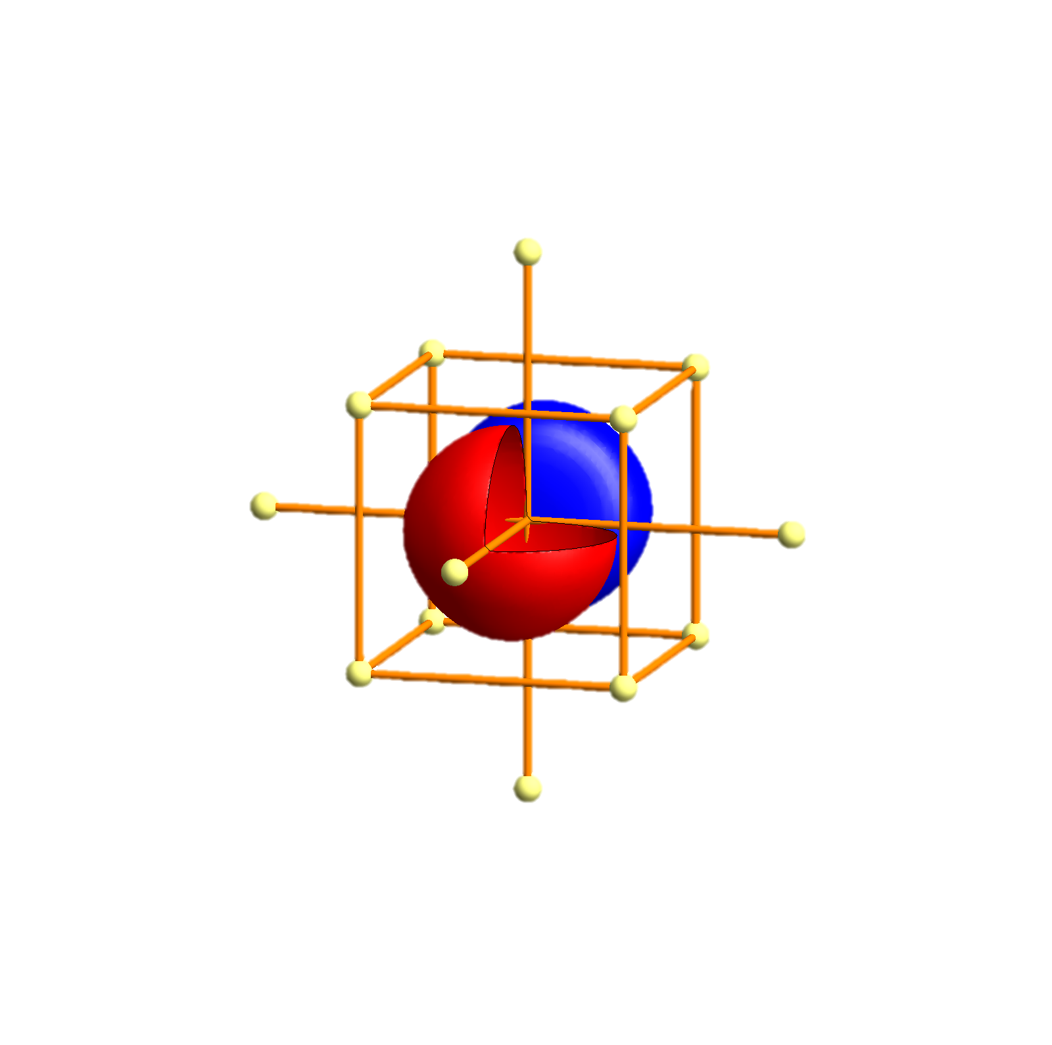
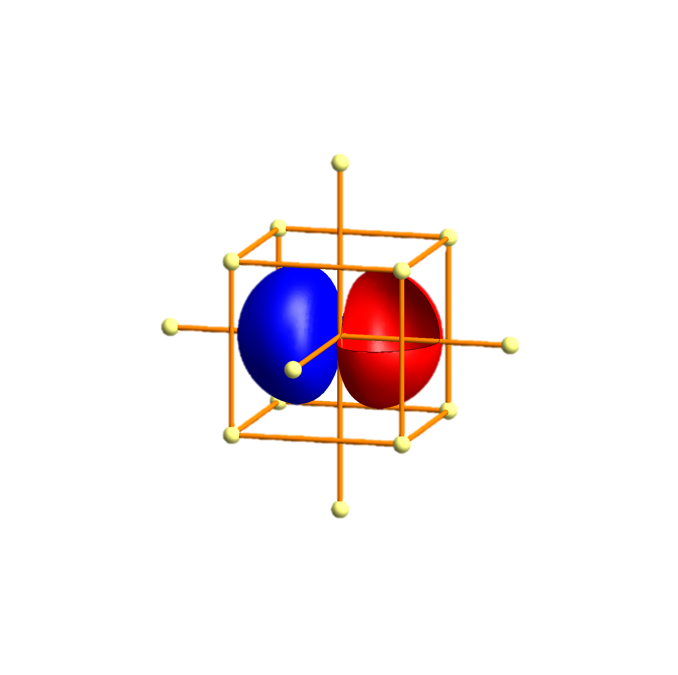
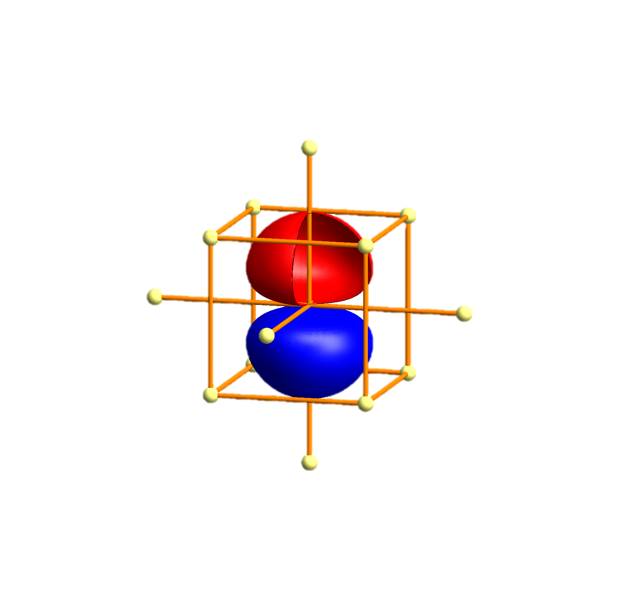
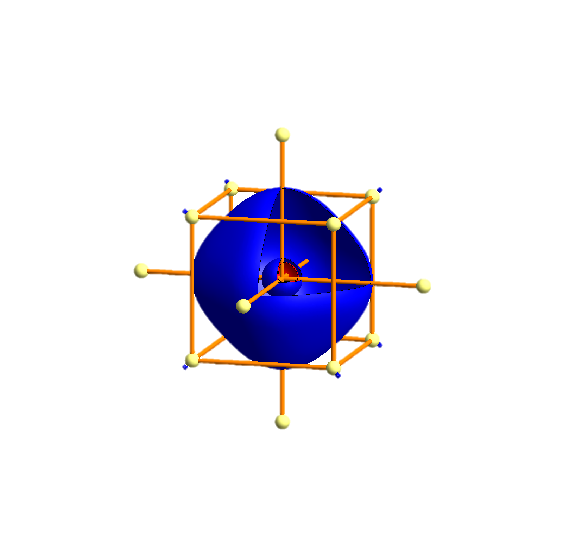
Li - Tigth binding description – atomic orbitals
p_{x}
p_{x}
p_{y}
p_{z}
s
s
P
Γ
P
H
P
Γ
P
H
P
Γ
P

Slide 89
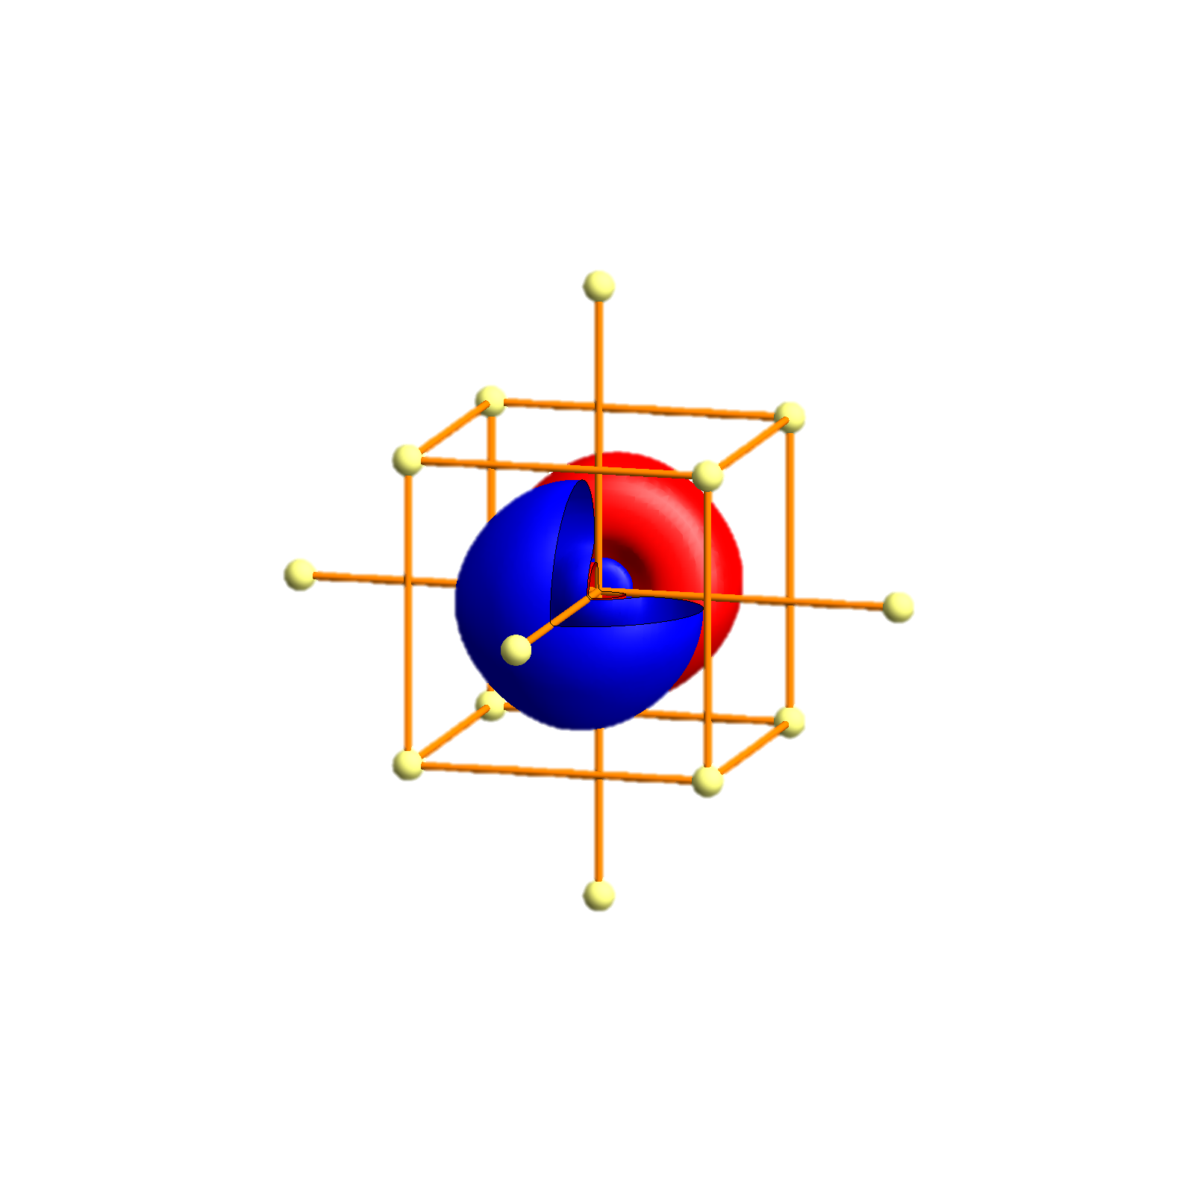
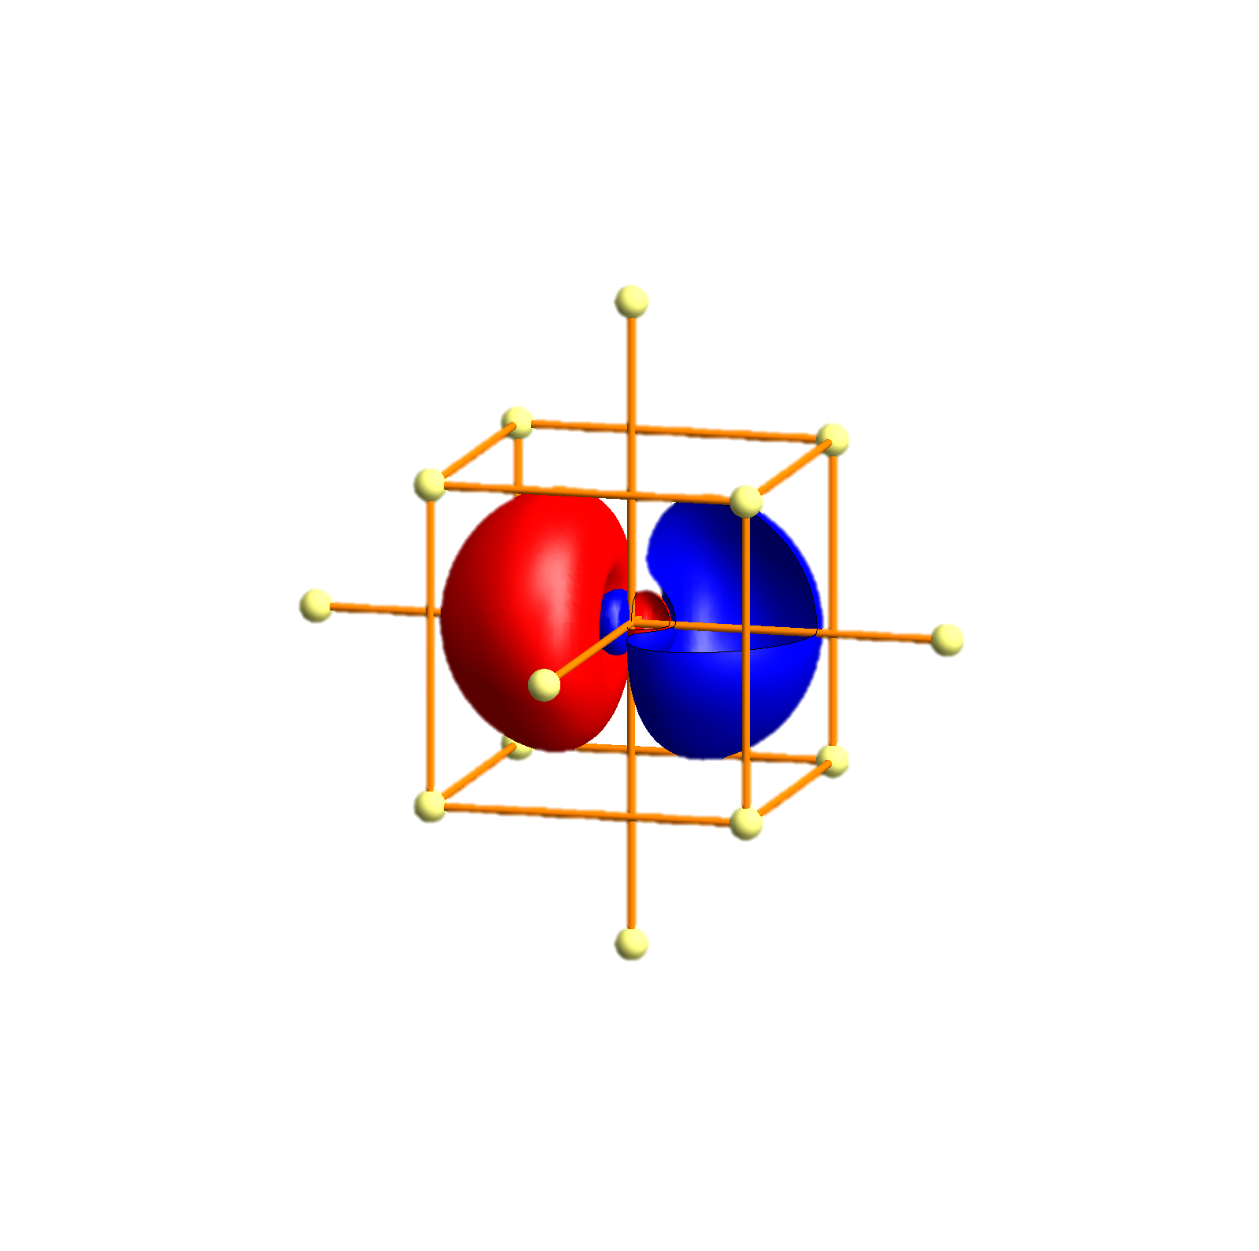
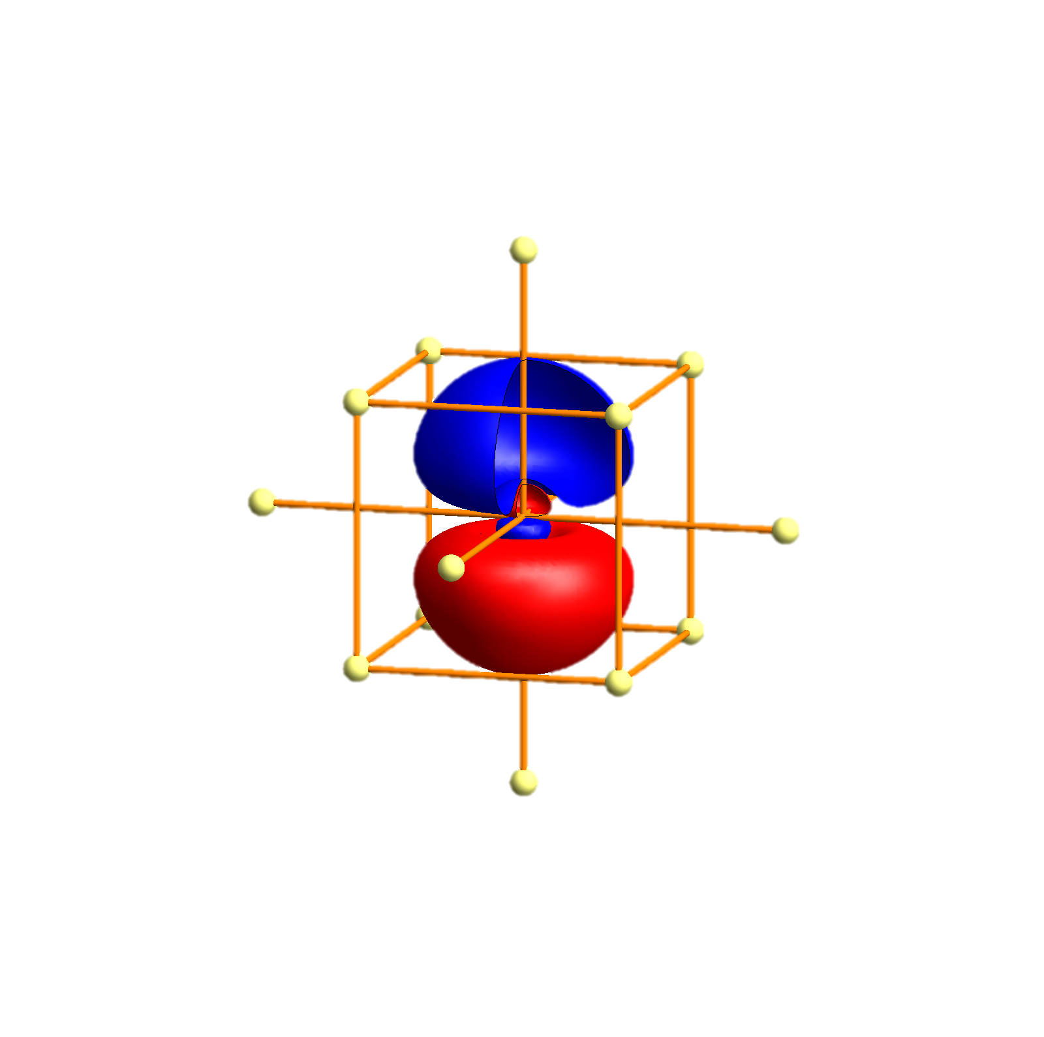
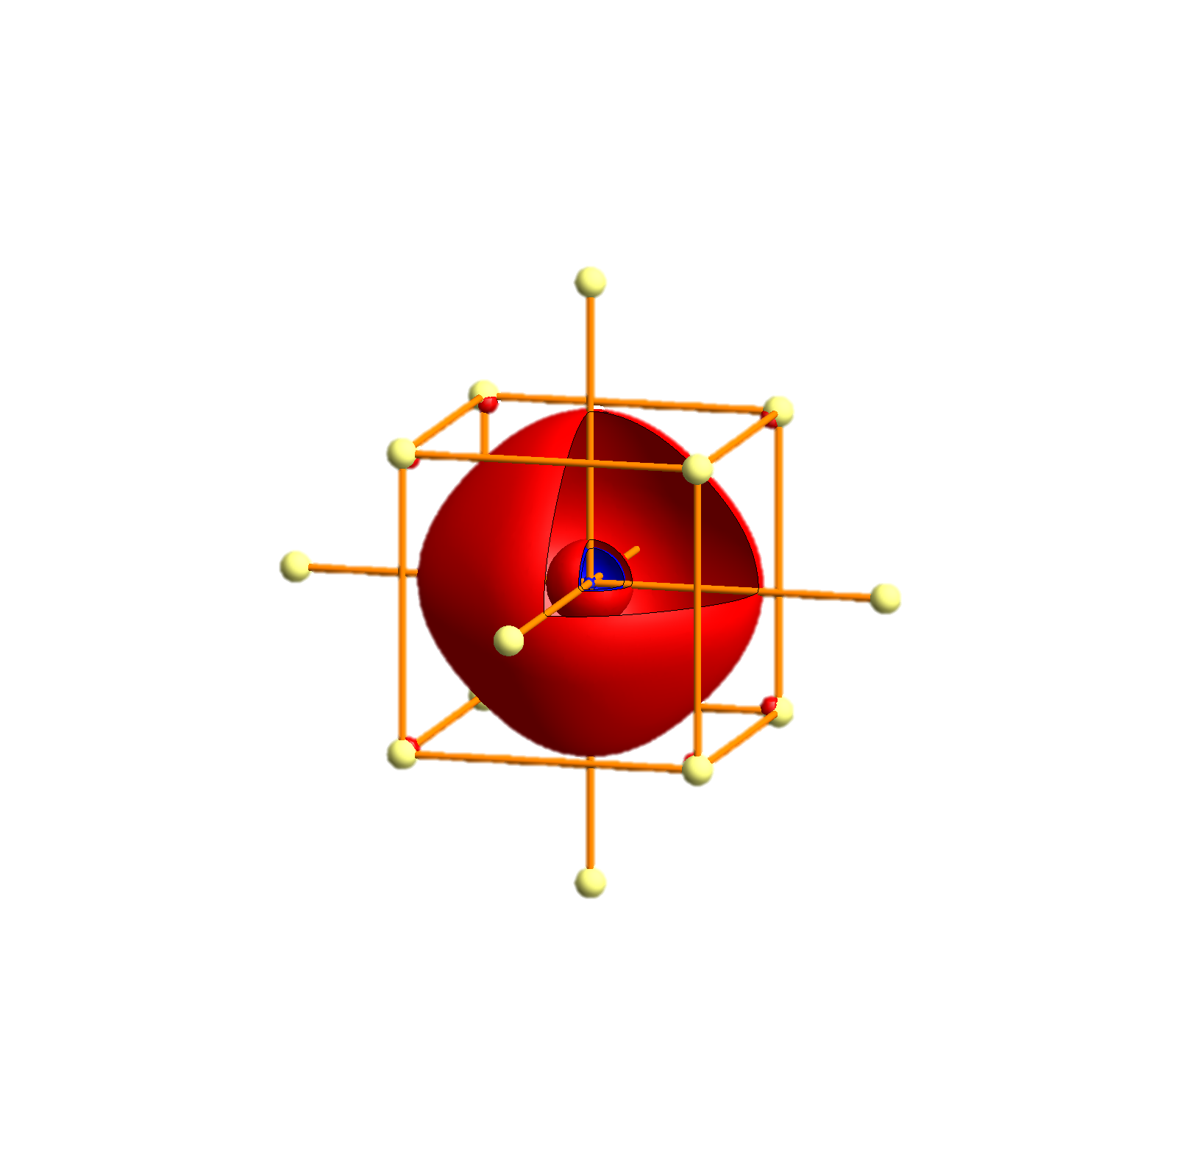
Na - Tigth binding description – atomic orbitals
p_{x}
p_{y}
p_{z}
s

Slide 90
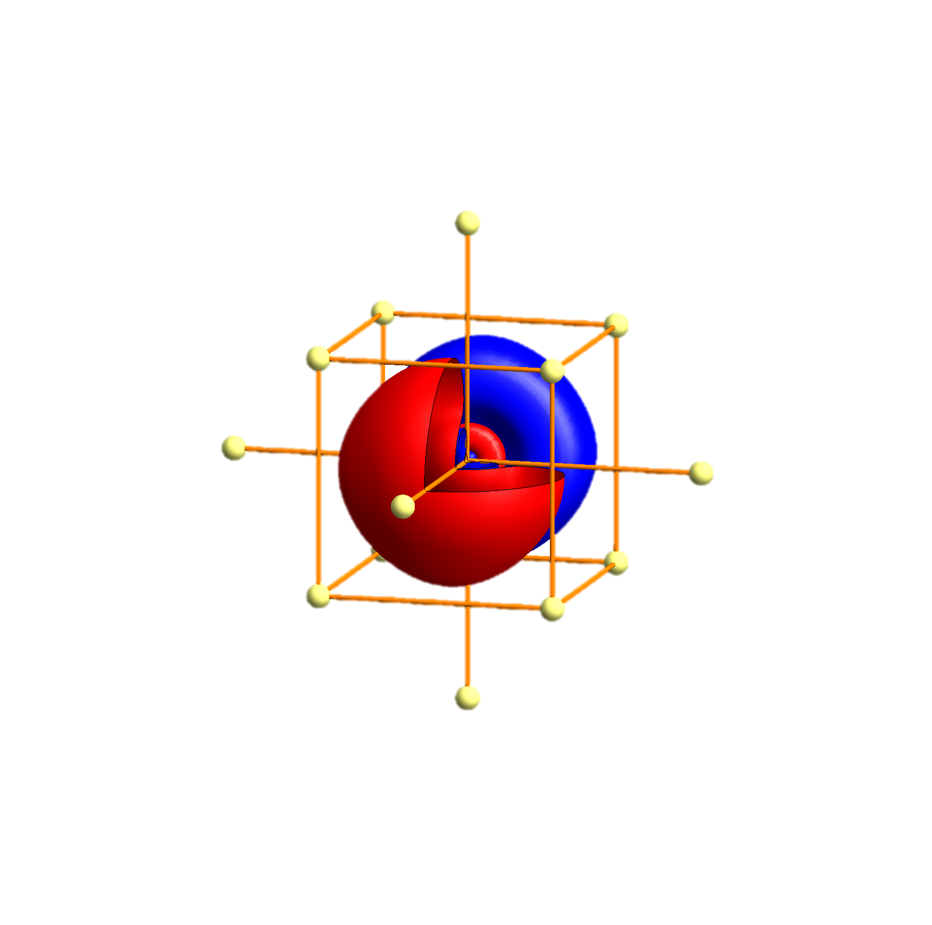
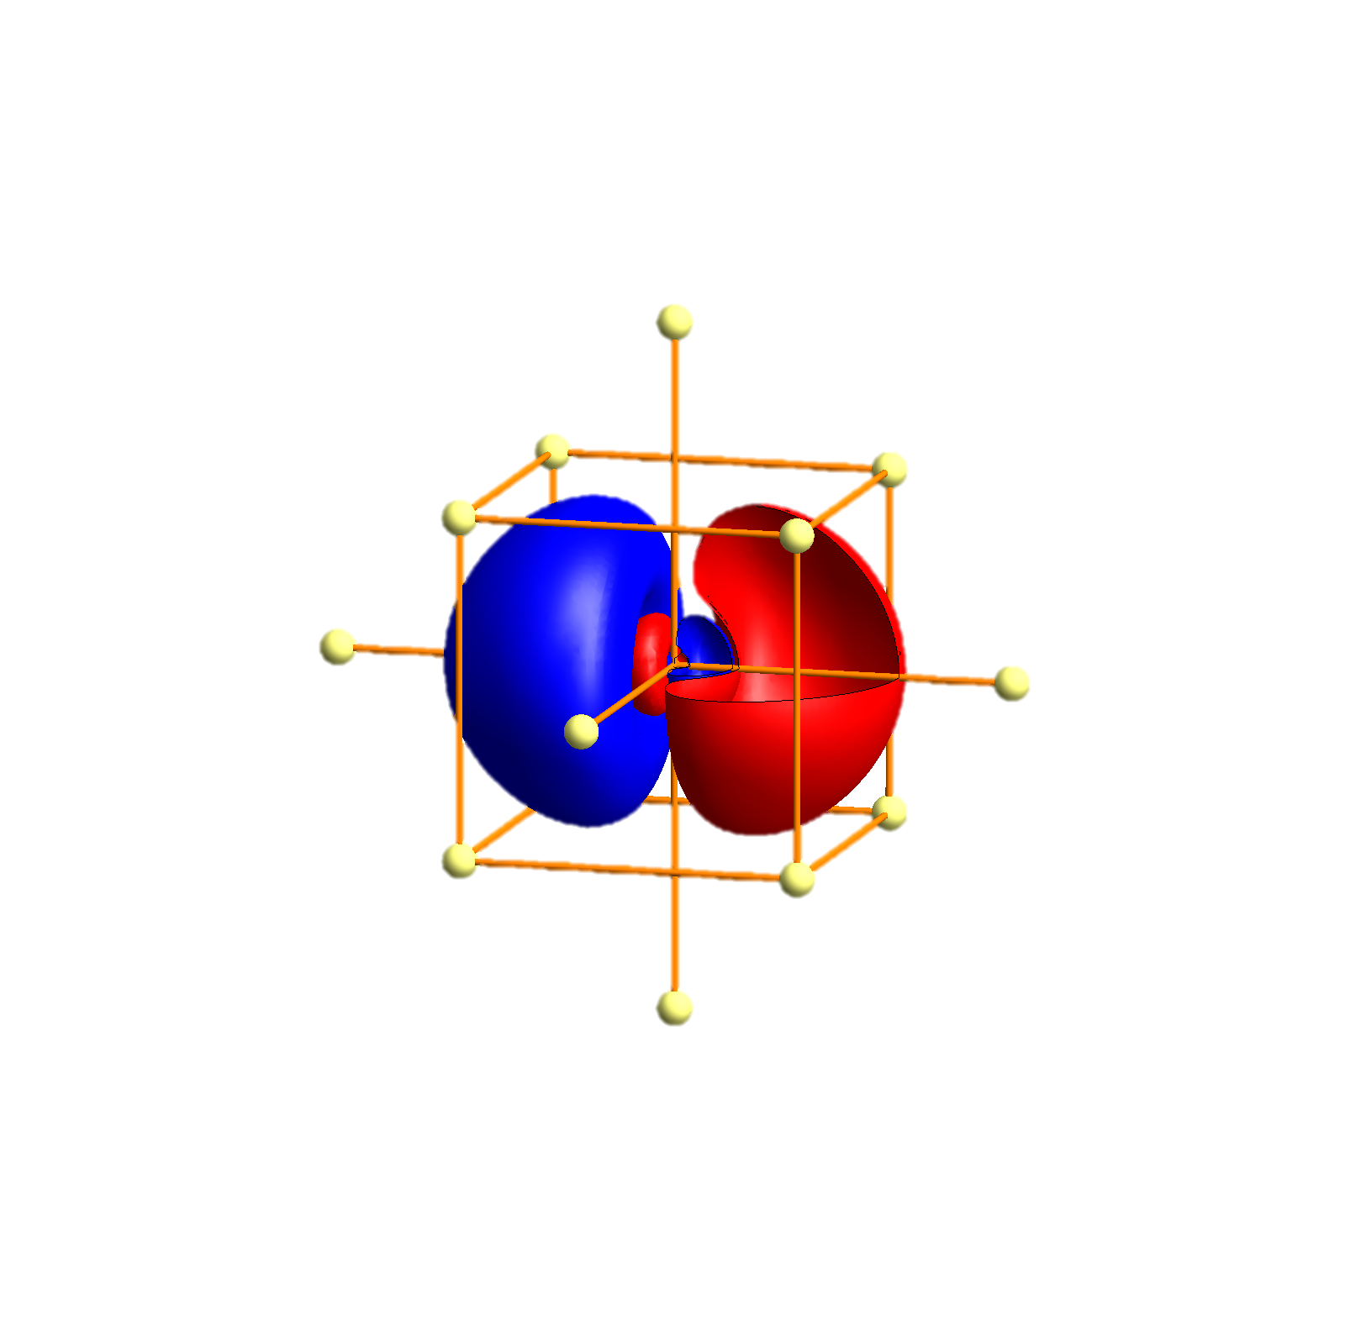
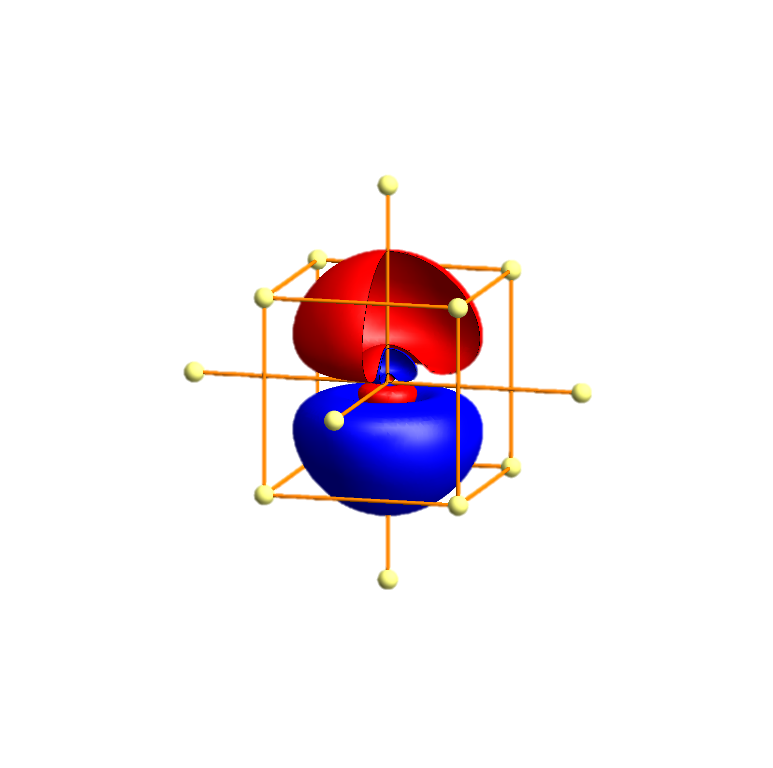
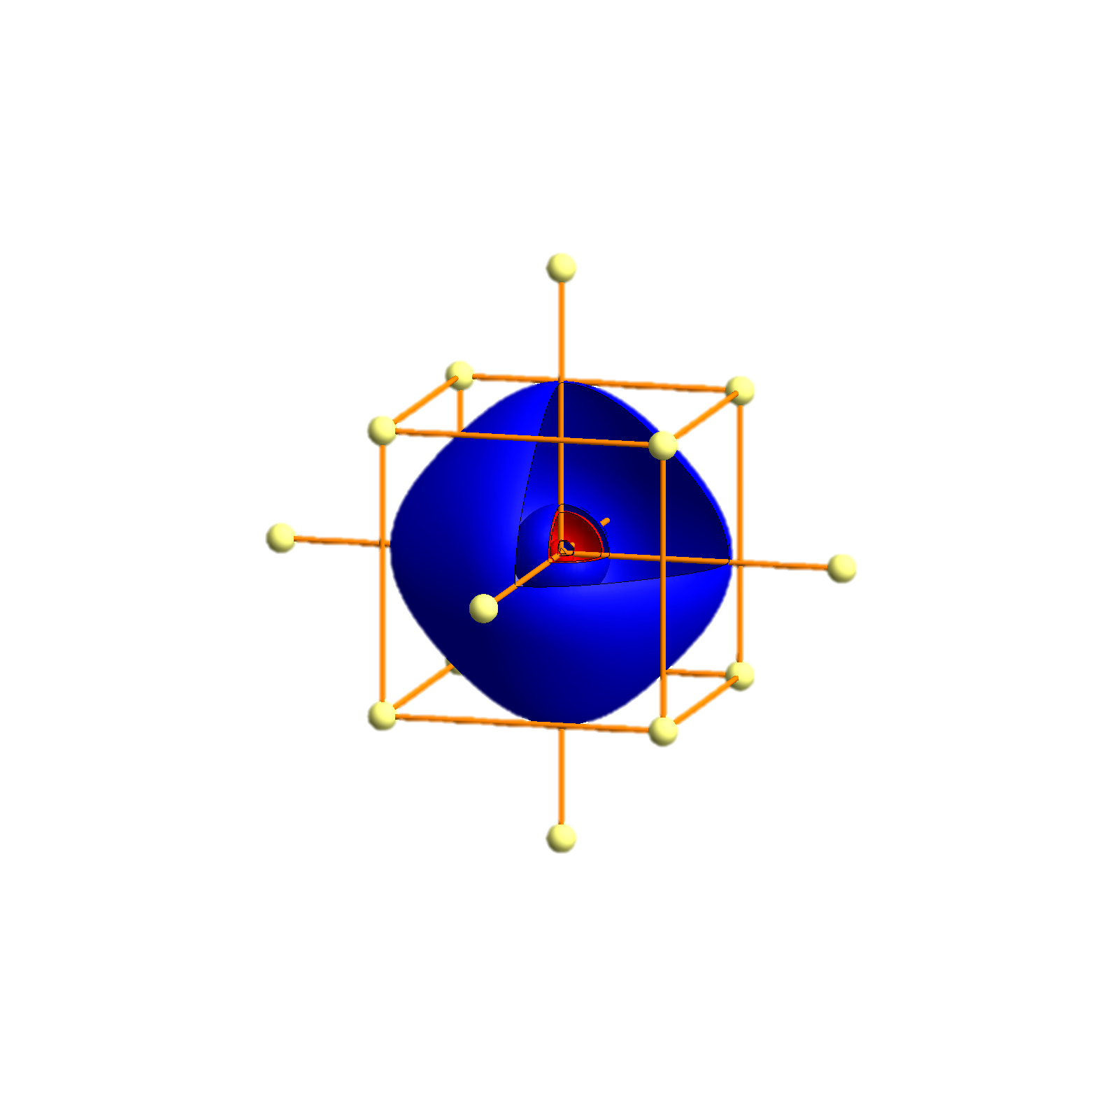
K- Tigth binding description – atomic orbitals
p_{x}
p_{y}
p_{z}
s
P
Γ
P
H
P
Γ
P
H
P
Γ
P

Slide 91
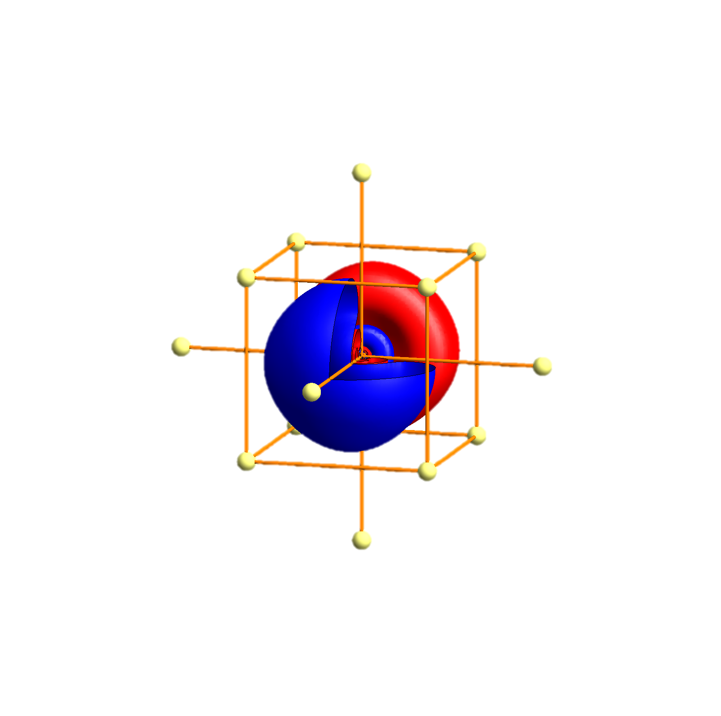
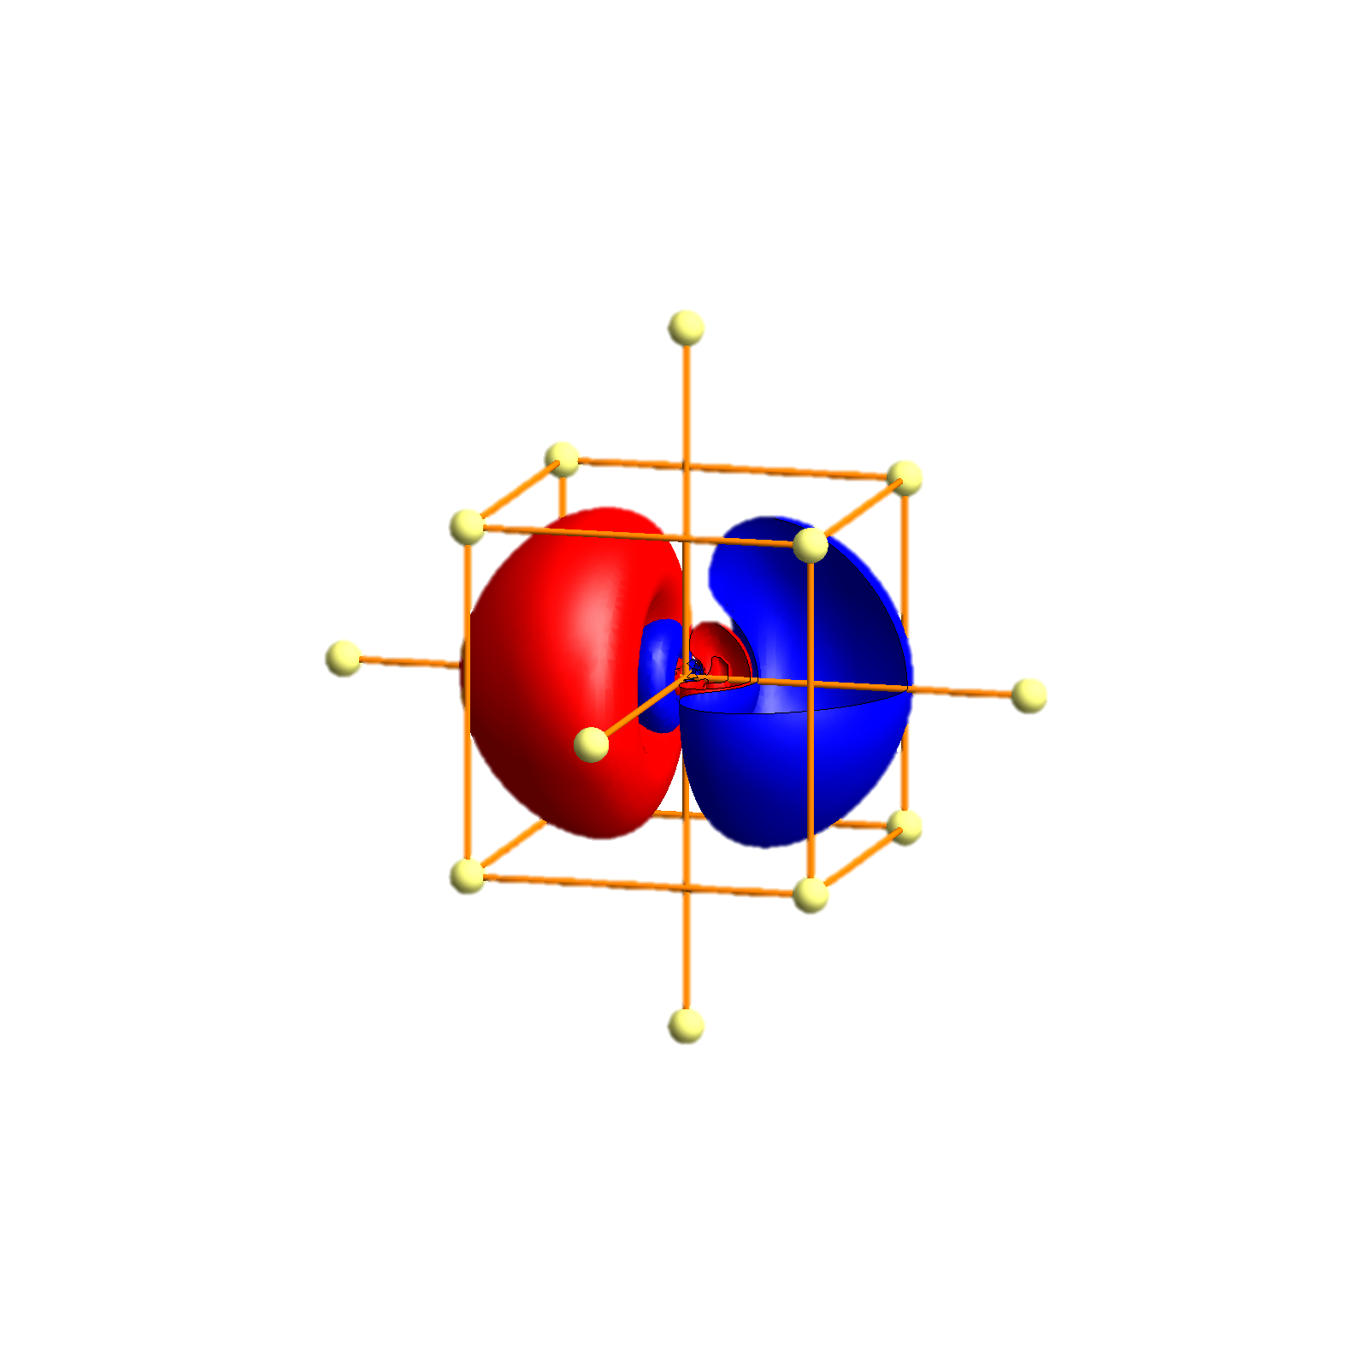
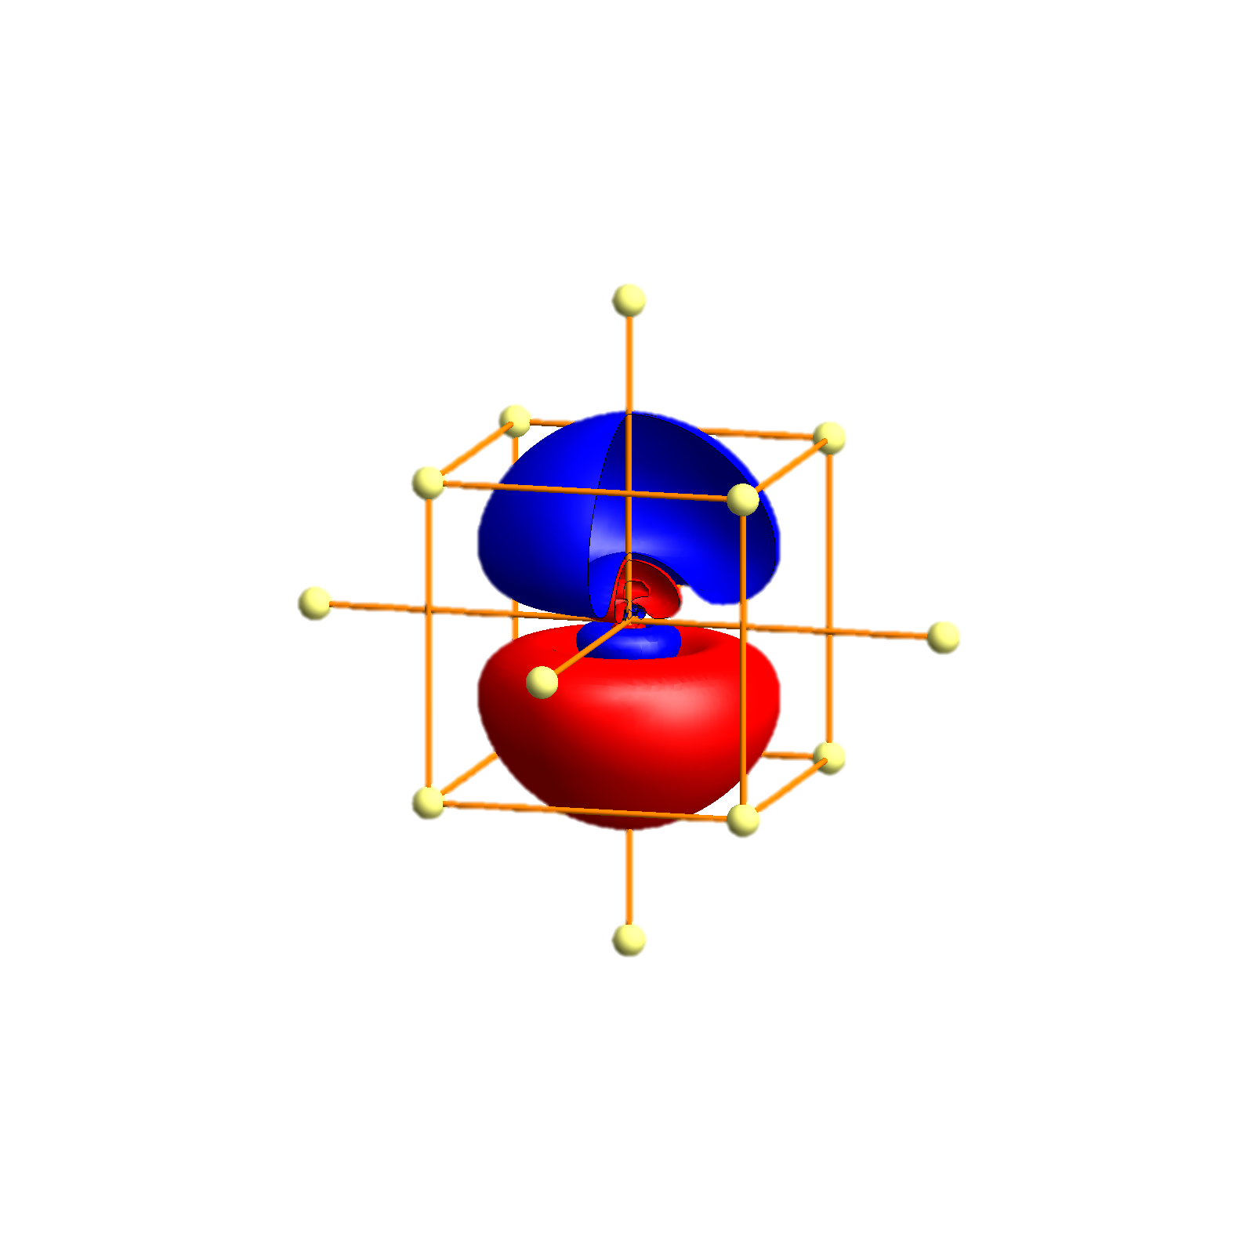
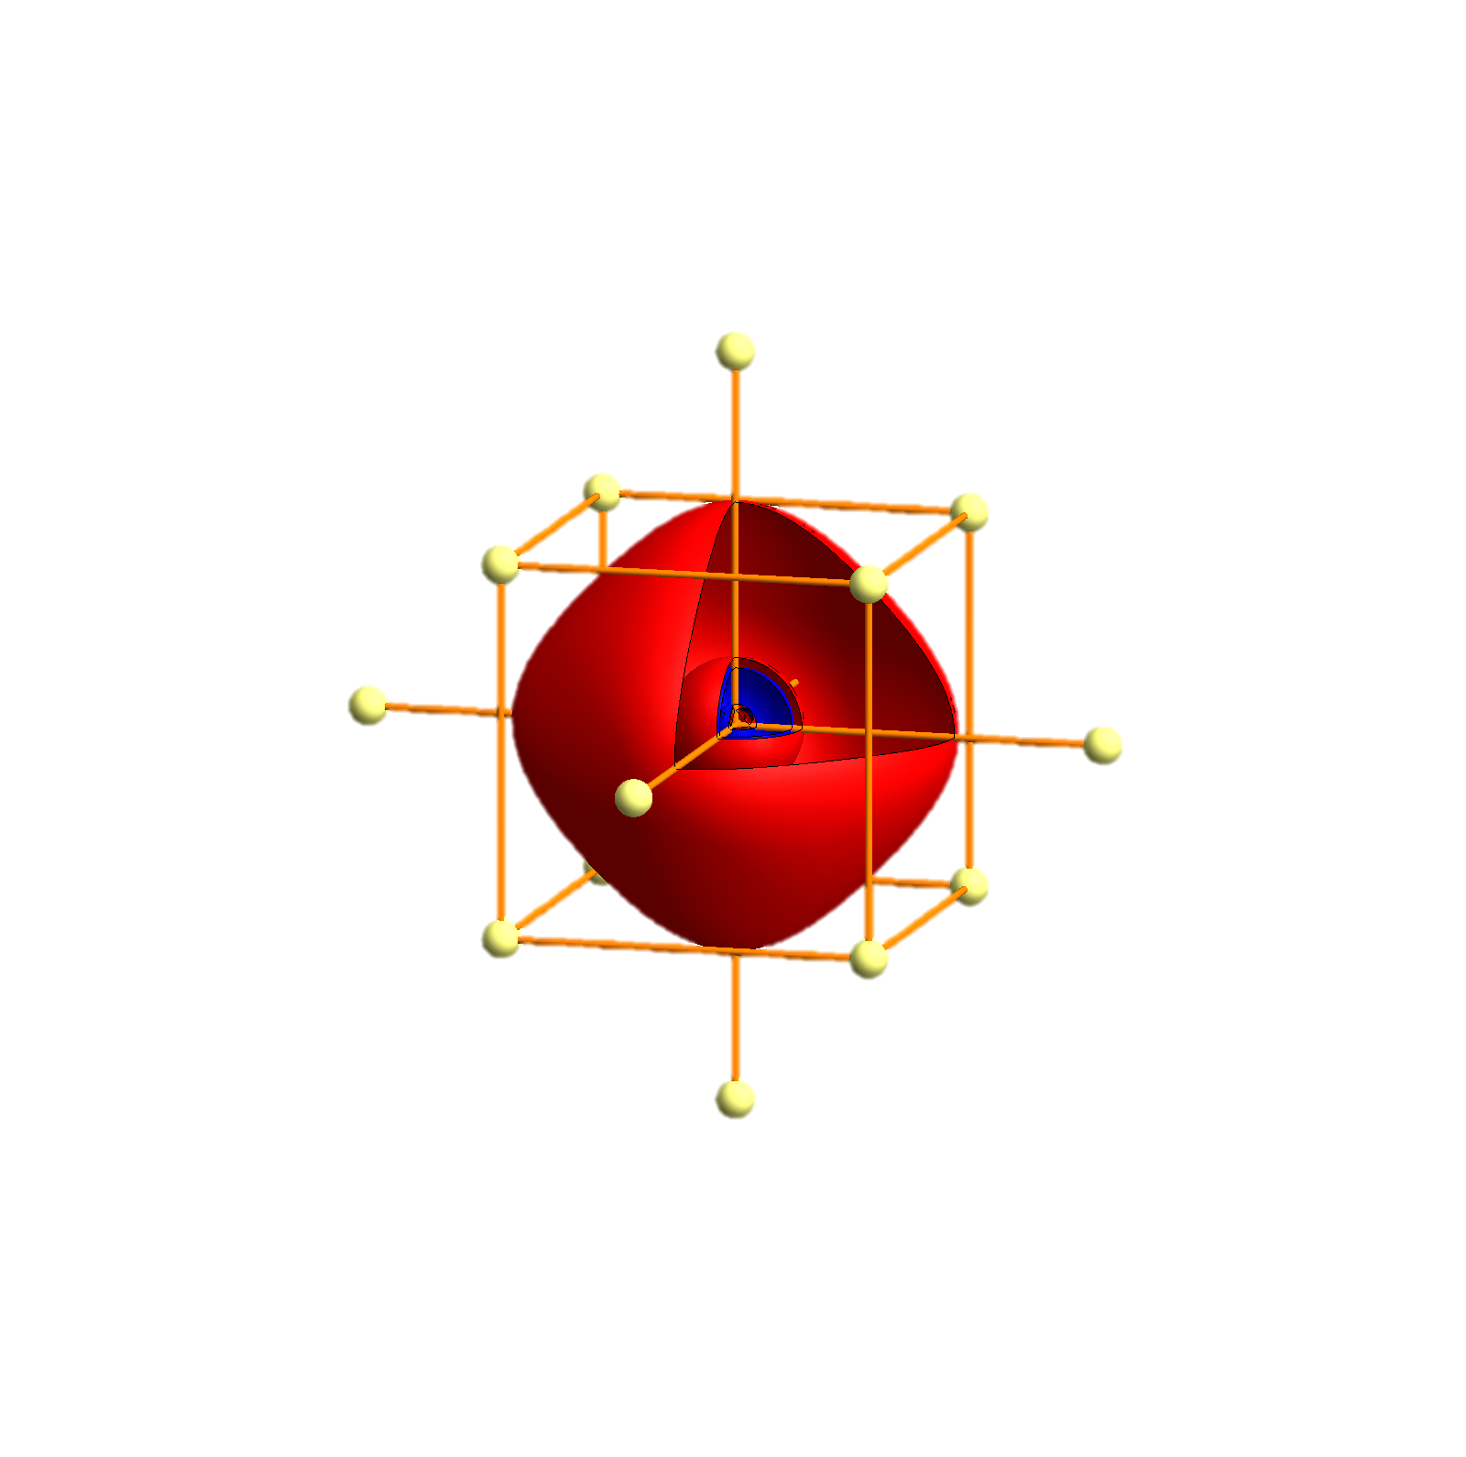
Rb - Tigth binding description – atomic orbitals
p_{x}
p_{y}
p_{z}
s
P
Γ
P
H
P
Γ
P
H
P
Γ
P

Slide 92


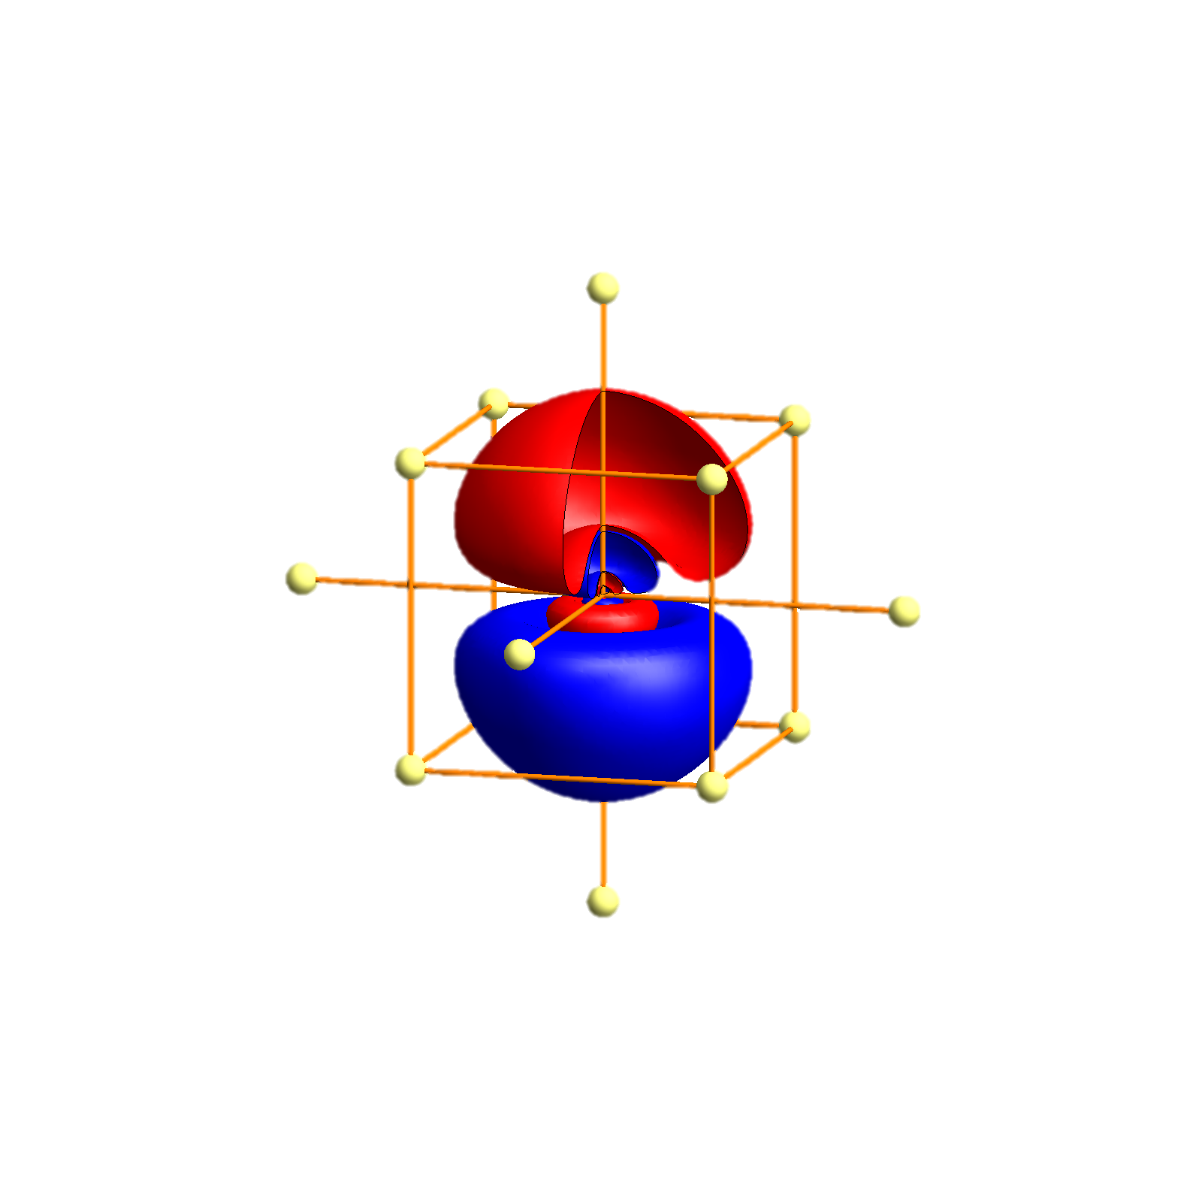
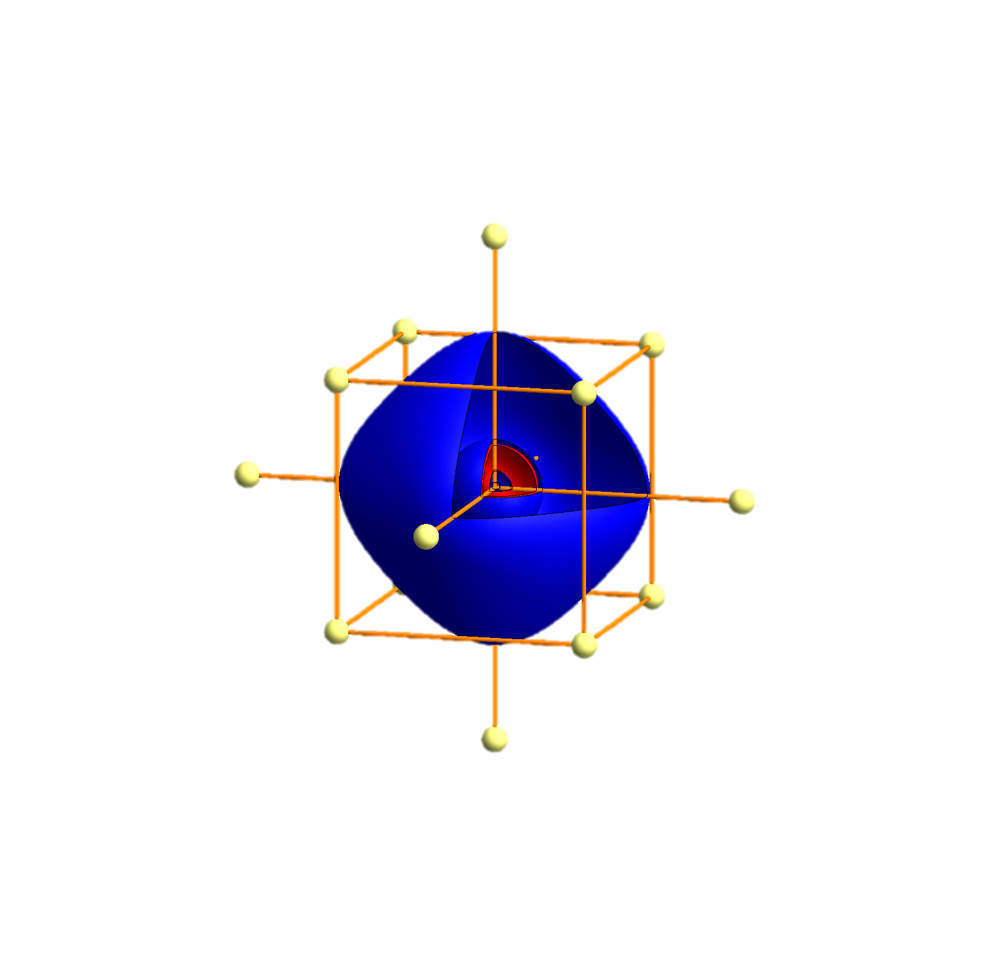
Cs - Tigth binding description – atomic orbitals
p_{x}
p_{y}
p_{z}
s
P
Γ
P
H
P
Γ
P
H
P
Γ
P

Slide 93


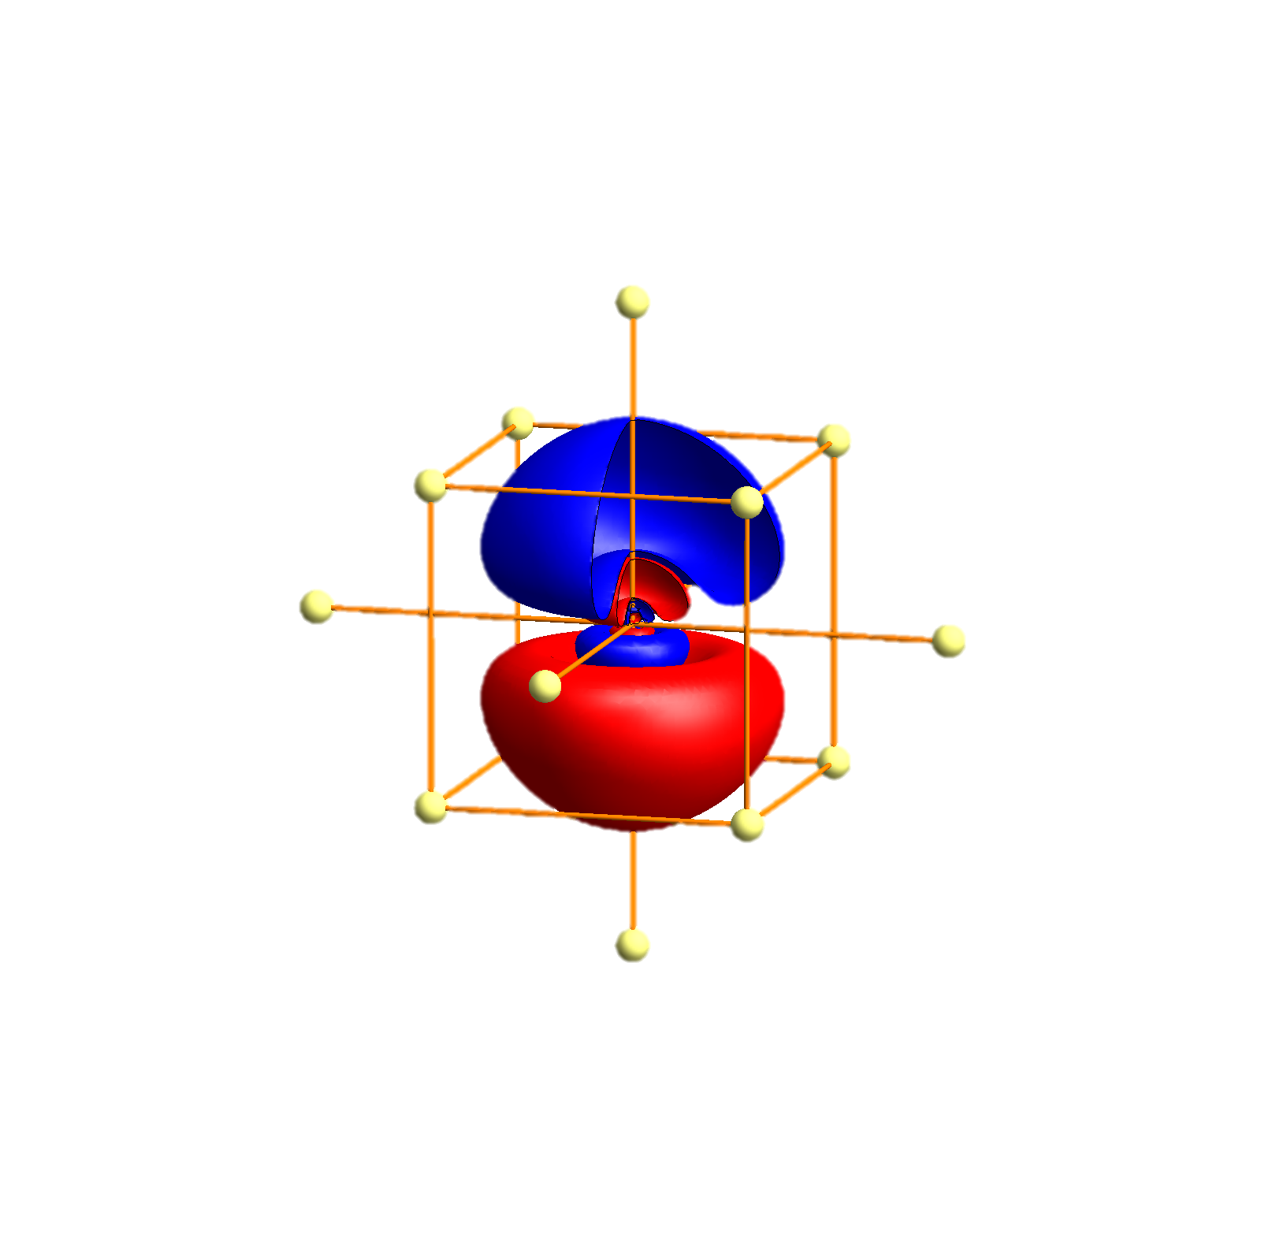
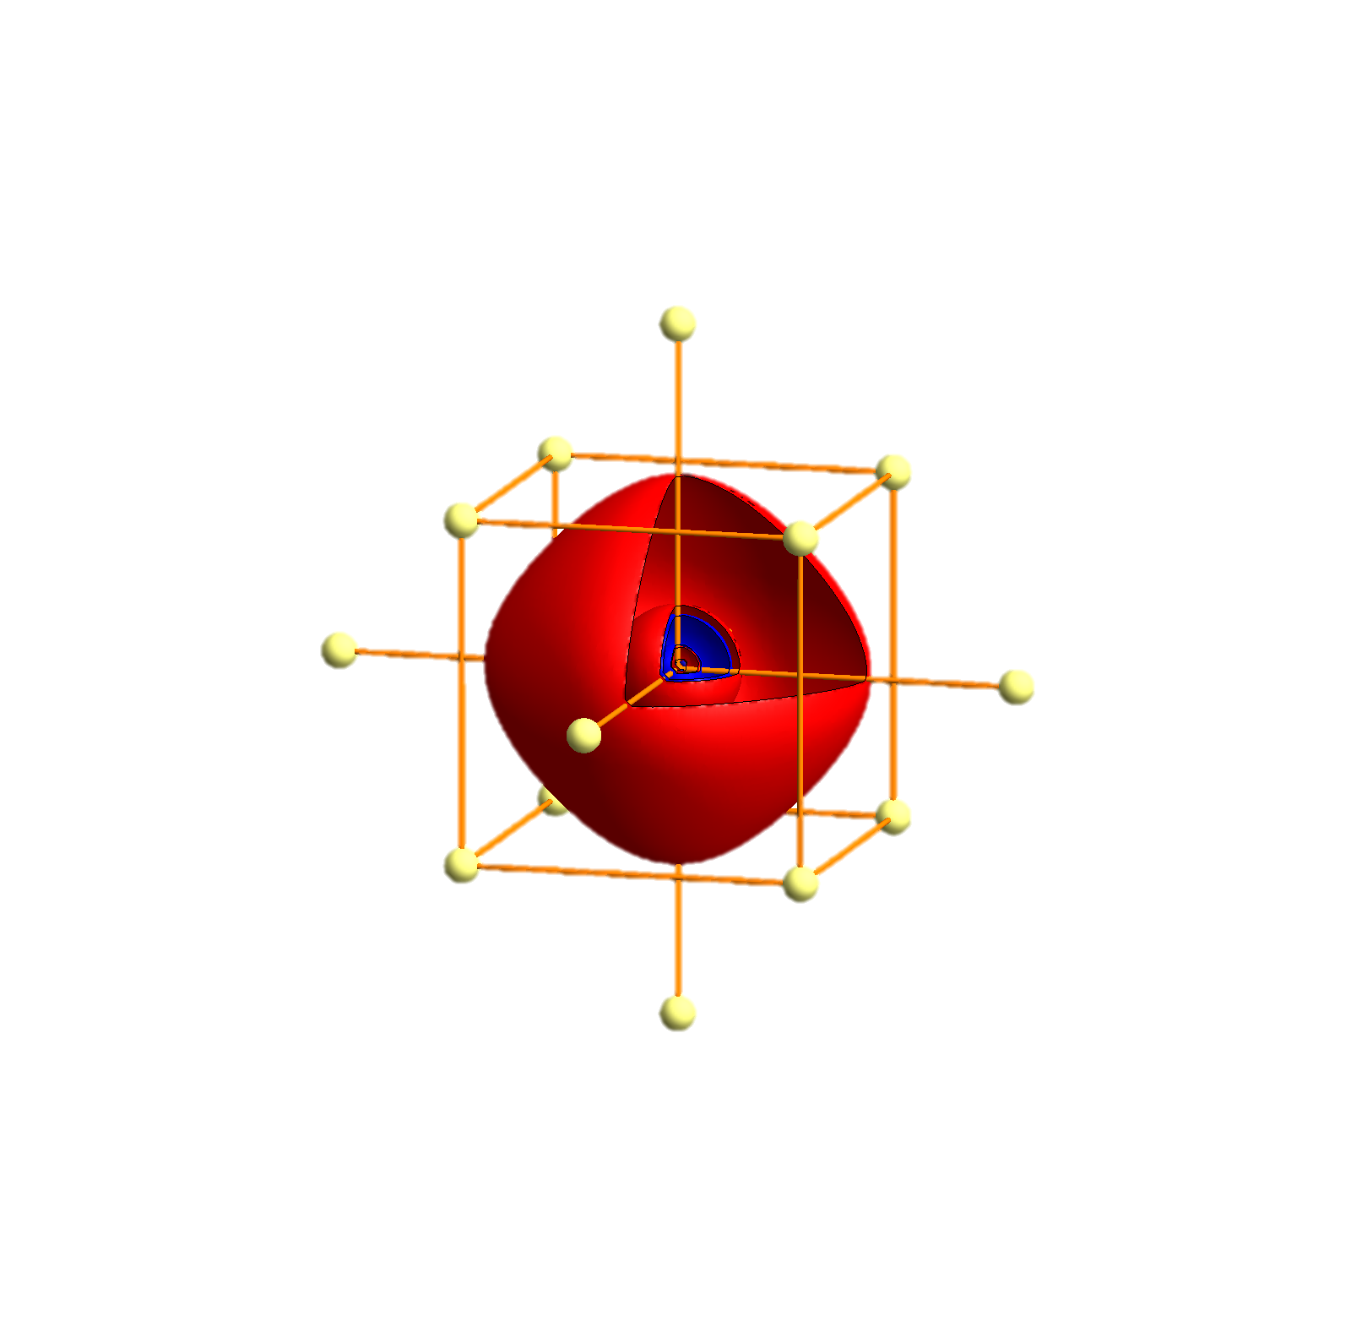
Fr - Tigth binding description – atomic orbitals
p_{x}
p_{y}
p_{z}
s
P
Γ
P
H
P
Γ
P
H
P
Γ
P

