Slide 1
Theory of resonant x-ray spectroscopy; excitons and multiplets
Transition metal and rare earth compounds show a wealth of different properties. May it be as materials for energy storage (battery compounds), dyes in solar cells, elements in the read head of hard-disks, high temperature superconductors, or the active centers in many of the known enzymes. The wealth of properties of these materials is related to the large number of low energy degrees of freedom of the transition metal ion. The local interactions between these often open shell systems lead to these low energy degrees of freedom, but also make these materials involved to understand.
Core level spectroscopy in many cases turns out to be a very efficient method to study the local properties of these systems. With x-ray absorption spectroscopy one can probe the average electronic structure, with resonant x-ray diffraction the ordered electronic structure and with resonant inelastic x-ray scattering the dynamics of low energy excitations. For the understanding of these spectra, in this class of materials, it is important to realize that one needs to treat the interactions between the electrons beyond mean field approximations. It is not sufficient to assume independent electrons interacting with an average potential, but one has to consider the interaction between each pair of electrons explicitly. In the spectra this leads to excitons and multiplets that dominate the spectral line-shape. Within the lecture I will introduce these concepts, in the tutorial I will provide a hands on session calculating core level spectroscopy using a code in Mathematica.

Slide 2
Theory of resonant x-ray spectroscopy;
excitons and multiplets
http://www.thphys.uni-heidelberg.de/~haverkort/talks/start
Maurits W. Haverkort
Institute for theoretical physics – Heidelberg University
M.W.Haverkort@thphys.uni-heidelberg.de
Positions available

Slide 3
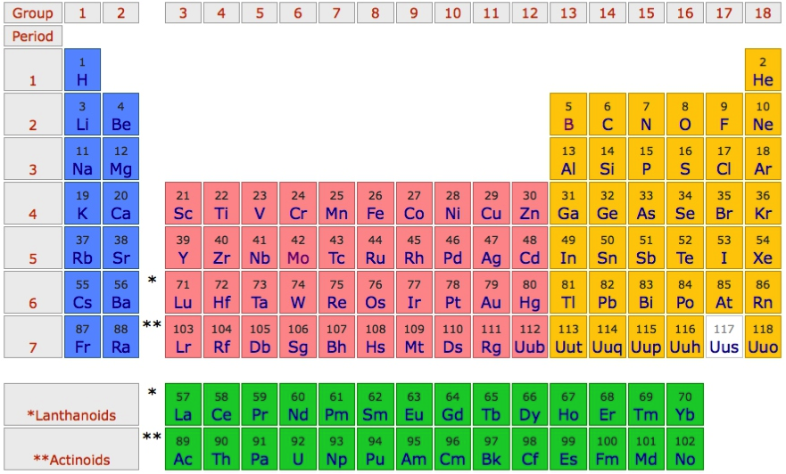
Challenges in solid state physics / chemistry
Important for technology
Important in biochemistry (active centers of enzymes)
Often open shell systems, involved to understand

Slide 4
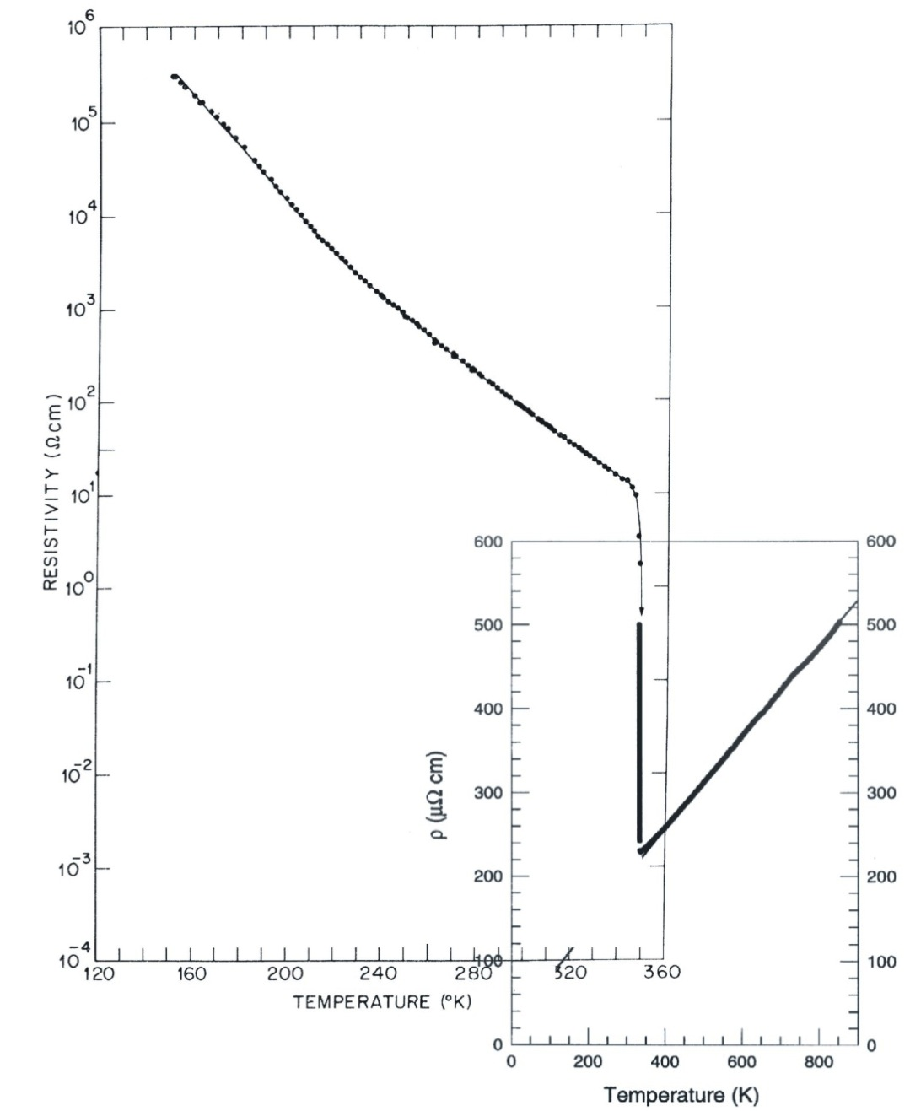
Transition metal compounds; a large variety of properties
Metal insulator transitions
VO₂
Resistivity (Ωcm)
P. B. Allen et al.,
PRB 48, 4359 (1993)
M. Marezio et al.,
PRB 5, 2541 (1972)

Slide 5
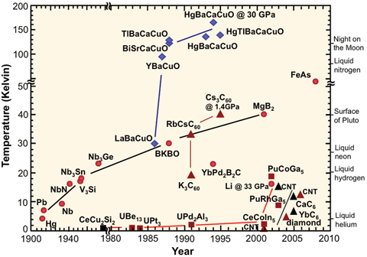
Transition metal compounds; a large variety of properties
High-Tc superconductivity

Slide 6
Transition metal compounds; a large variety of properties
Active centers in enzymes
Fe in Heme
Mn role in photosynthesis

Slide 7
Interaction between the charge, lattice, orbital and spin
Charge
Lattice
Spin
Orbital

Slide 8
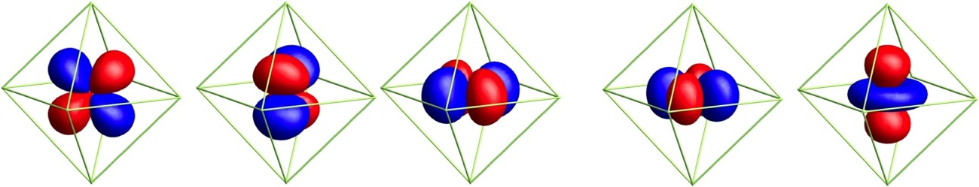
Need tools to measure
Spin arrangements (element resolved of TM multilayers)
Valence and local symmetry of TM compounds
Orbital occupation (the d-shell is 5 fold degenerate)
Spectroscopy
_{(x-ray spectroscopy)}
d_{yz}
d_{xz}
d_{xy}
d_{x}2_{-y}2
d_{3z}2_{-r}2
And excitations (spin-waves – magnons – orbital excitations)
Notes:
----- Meeting Notes (12/7/12 18:14) -----
Outline
link between them
Spin orbital physics
- Dispersion
- Local occupation, ground state wavefunction
- spatial extend

Slide 9
Quiz: what happens when a photon hits an atom?
For example an H atom with one electron in the s-shell
A) At some point in time the photon gets absorbed, the photon disappears and the electron in the s-shell is excited to the p-shell
B) Photons are electromagnetic waves. The electron starts to oscillate around the nucleus with the photon frequency
C) Photons are particles. The photon bounces like a ball of the electron, thereby transferring part of its energy to the electron
Notes:
I know that the 1s to 2p excitation of H is not in the x-ray range ( ¾ Rydberg, 10.2 eV) but all our theories are conveniently rather independent from the actual energy scale. (Linear response does not depend on the value of omega) For the purist replace H by Fe25+ (also a single electron around a nucleus, but as Z=26 in this case the excitation energy is 26^2 * ¾ = 507 Rydberg or 6898 eV)

Slide 10
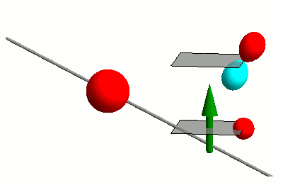
Interaction of photons with matter

Slide 11
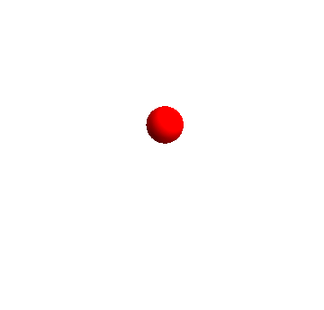
Interaction of photons with matter

Slide 12
Need tools to measure: Orbital, Spin, Charge
X-ray Absorption Spectroscopy (XAS) at the TM 2p to 3d edge
Technique developed in late 1980’s
Fink, Sawatzky, Fuggle
Thole, van der Laan
Chen, Sette
2p

Slide 13
Need tools to measure: Orbital, Spin, Charge
X-ray Absorption Spectroscopy (XAS) at the TM 2p to 3d edge
Resonant X-ray Diffraction (RXD)
Hannon, Trammel, Bloom, Gibbs
Phys. Rev. Lett. 61, 1245 (1988)
Phys. Rev. B 43, 5663 (1991)
Cara, Thole
Rev. Mod. Phys. 66, 1509 (1994)
2p

Slide 14
Need tools to measure: Orbital, Spin, Charge
X-ray Absorption Spectroscopy (XAS) at the TM 2p to 3d edge
Resonant X-ray Diffraction (RXD)
Resonant Inelastic X-ray Scattering (RIXS)
Theory prediction of magnetic excitations
J. Luo, G. T. Trammell, and J. P. Hannon,
Phys. Rev. Lett. 71, 287 (1993).
F.M.F. de Groot, P. Kuiper, and G. A. Sawatzky,
Phys. Rev. B 57, 14584 (1998).
Experimental realization
L. Braicovich, G. Ghiringhelli, N. B. Brookes, et al.
Phys. Rev. Lett. 102, 167401 (2009).
2p
Notes:
----- Meeting Notes (12/7/12 17:29) -----
Quantitative (real might be offending ...)
----- Meeting Notes (12/7/12 18:14) -----
What did I do
Development of model based on DFT wannier

Slide 15
Need tools to measure: Orbital, Spin, Charge
X-ray Absorption Spectroscopy (XAS) at the TM 2p to 3d edge
Resonant X-ray Diffraction (RXD)
Resonant Inelastic X-ray Scattering (RIXS)
non-resonant Inelastic X-ray Scattering (IXS)
Nobelprize Compton
Light elements – band excitations:
Keijo Hämäläinen, W. Schulke
Excitonic excitations TM and RE compounds:
B. C. Larson et al. PRL 99, 026401 (2007)
M. W. Haverkort et al. PRL 99, 257401 (2007)
R. A. Gordon, et al. EPL 81, 26004 (2008)
T. Willers, et al. PRL 109, 046401 (2012)
3p
Notes:
wannier

Slide 16
X-ray Absorption Spectroscopy
2p

Slide 17
X-ray Absorption Spectroscopy – some observations
Data L. H. Tjeng et al.

Slide 18
X-ray Absorption Spectroscopy – some observations
2p
Data L. H. Tjeng et al.

Slide 19
X-ray Absorption Spectroscopy – some observations
Valence dependence – ground state symmetry determines the line shape
Data L. H. Tjeng et al.

Slide 20
X-ray Absorption Spectroscopy – some observations
Polarized XAS
Sensitive to
Orbital occupation
Natural linear dichroism
2p
C. T. Chen et al PRL 68, 2543 (1992)

Slide 21
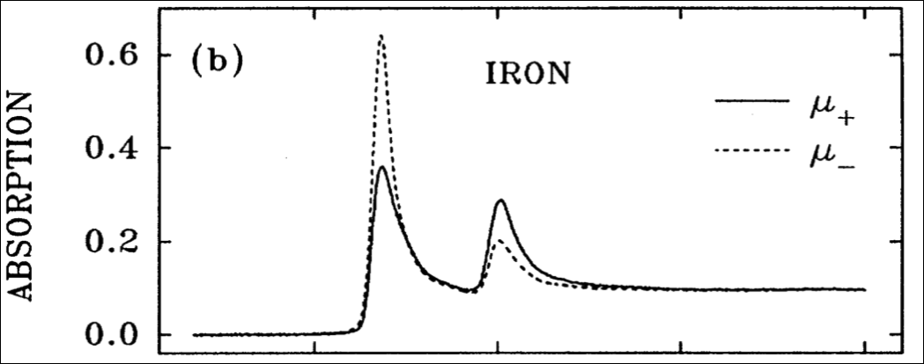
X-ray absorption spectroscopy – Spin sensitive
Polarized XAS
Sensitive to
Magnetic moments
Magnetic circular dichroism
2p
700
720
740
760
Photon energy (eV)
J. Stöhr, J. Elec. Spec. Rel. Phonom. 75, 253 (1995).

Slide 22
X-ray Absorption Spectroscopy – some observations
Polarized XAS
Sensitive to
Magnetic moments
Magnetic linear dichroism
2p
P. Kuiper et al., PRL 70, 1549 (1993)

Slide 23
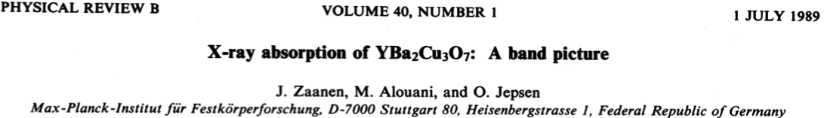
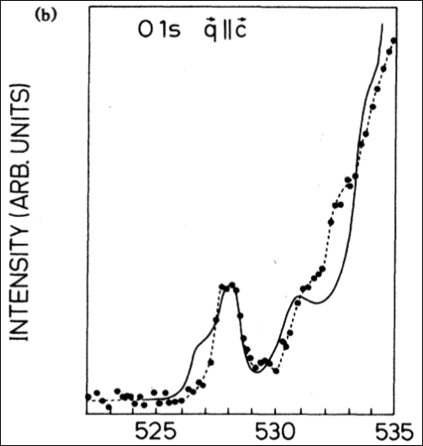
X-ray absorption spectroscopy – a band picture
1s

Slide 24
X-ray absorption spectroscopy – one electron selection rules
Fermi’s golden rule
The math simplifies with the use of Green’s functions

Slide 25
X-ray absorption spectroscopy – one electron selection rules
Fermi’s golden rule
The math simplifies with the use of Green’s functions

Slide 26
X-ray absorption spectroscopy – one electron selection rules
Fermi’s golden rule
The math simplifies with the use of Green’s functions

Slide 27
X-ray absorption spectroscopy – one electron selection rules

Slide 28
X-ray absorption spectroscopy – one electron selection rules

Slide 29
X-ray absorption spectroscopy – one electron selection rules

Slide 30
X-ray absorption spectroscopy – one electron selection rules
C. T. Chen et al. Phys. Rev. Lett. 68, 2543 (1992)

Slide 31
X-ray absorption spectroscopy – correlations in the d-shell
Intensity
2p
Energy (eV)

Slide 32
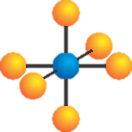
Use NiO as an example material
O²⁻ - 2p⁶
Ni²⁺ - 4s⁰ 3d⁸

Slide 33
Partly filled degenerate d-shell – in LDA NiO is a metal

Slide 34
X-ray absorption spectroscopy – correlations in the d-shell
Experiment is sharper than LDA empty density of states
Branching ratio (L₂, L₃ intensity ratio is not 3:2)
Experiment shows more structure (multiplets) than DOS
2p

Slide 35
X-ray absorption spectroscopy – correlations in the d-shell
Experiment is sharper than LDA empty density of states
Branching ratio (L₂, L₃ intensity ratio is not 3:2)
Experiment shows more structure (multiplets) than DOS
2p

Slide 36
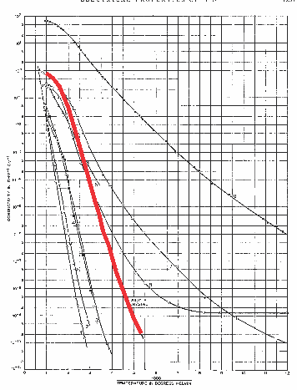
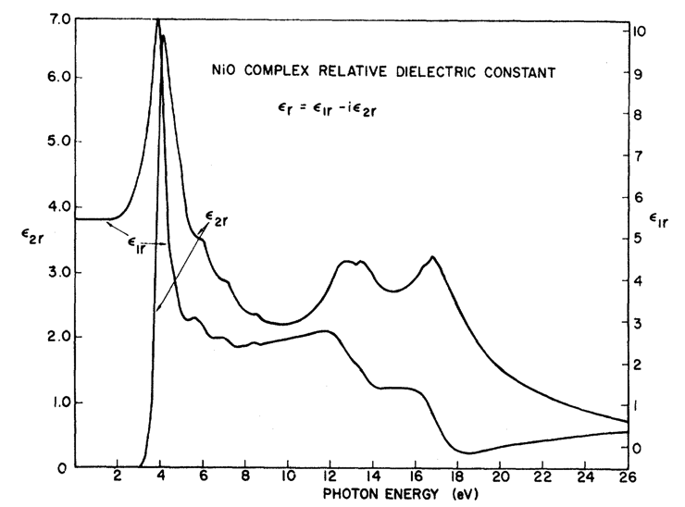
In LDA NiO is a metal: Experimentally it is a good insulator
F. J. Morin, Phys. Rev. 93, 1199 (1954)
R. Newman and R. M. Chrenko,
Phys. Rev 114 1507 (1959)
Room temperature
ρ~10⁵ Ο cm
Conductivity (Ω⁻¹ cm⁻¹)
Optical-gap
3.5 – 4.0 eV
Temperature⁻¹

Slide 37
Mott-Hubbard insulator
Difference between anti-ferromagnetic Neel order and spin-singlet configurations
Energy gain W
Energy cost U
vs.

Slide 38
Mott-Hubbard insulator
Keep all correlations on a single central site – use a (dynamical) mean-field approximation for the rest of the solid.

Slide 39
X-ray absorption spectroscopy – correlations in the d-shell
W=1
U=0
Intensity
2p
Energy (eV)
Y. Lu, M. Höppner, O. Gunnarsson, M.W. Haverkort, PRB 90, 085102 (2014)

Slide 40
X-ray absorption spectroscopy – correlations in the d-shell
W=1
U=0.25
Intensity
2p
Energy (eV)
Y. Lu, M. Höppner, O. Gunnarsson, M.W. Haverkort, PRB 90, 085102 (2014)

Slide 41
X-ray absorption spectroscopy – correlations in the d-shell
W=1
U=0.5
Intensity
2p
Energy (eV)
Y. Lu, M. Höppner, O. Gunnarsson, M.W. Haverkort, PRB 90, 085102 (2014)

Slide 42
X-ray absorption spectroscopy – correlations in the d-shell
W=1
U=1.0
Intensity
2p
Energy (eV)
Y. Lu, M. Höppner, O. Gunnarsson, M.W. Haverkort, PRB 90, 085102 (2014)

Slide 43
X-ray absorption spectroscopy – correlations in the d-shell
W=1
U=1.5
Intensity
2p
Energy (eV)
Y. Lu, M. Höppner, O. Gunnarsson, M.W. Haverkort, PRB 90, 085102 (2014)

Slide 44
X-ray absorption spectroscopy – correlations in the d-shell
W=1
U=2.0
Intensity
2p
Energy (eV)
Y. Lu, M. Höppner, O. Gunnarsson, M.W. Haverkort, PRB 90, 085102 (2014)

Slide 45
X-ray absorption spectroscopy – correlations in the d-shell
W=1
U=2.0
Intensity
2p
Energy (eV)
Y. Lu, M. Höppner, O. Gunnarsson, M.W. Haverkort, PRB 90, 085102 (2014)

Slide 46
X-ray absorption spectroscopy – excitons
W=1
U=20
Q=0
Core – valence interaction
Intensity
2p
Energy (eV)
M.W. Haverkort, G. Sangiovanni, P. Hansmann, A. Toschi, Y. Lu, S. Macke EPL, 108 57004 (2014)

Slide 47
X-ray absorption spectroscopy – excitons
W=1
U=20
Q=0.25
Intensity
2p
Energy (eV)
M.W. Haverkort, G. Sangiovanni, P. Hansmann, A. Toschi, Y. Lu, S. Macke EPL, 108 57004 (2014)

Slide 48
X-ray absorption spectroscopy – excitons
W=1
U=20
Q=0.5
Intensity
2p
Energy (eV)
M.W. Haverkort, G. Sangiovanni, P. Hansmann, A. Toschi, Y. Lu, S. Macke EPL, 108 57004 (2014)

Slide 49
X-ray absorption spectroscopy – excitons
W=1
U=20
Q=1.0
Intensity
2p
Energy (eV)
M.W. Haverkort, G. Sangiovanni, P. Hansmann, A. Toschi, Y. Lu, S. Macke EPL, 108 57004 (2014)

Slide 50
X-ray absorption spectroscopy – excitons
W=1
U=20
Q=1.25
Intensity
2p
Energy (eV)
M.W. Haverkort, G. Sangiovanni, P. Hansmann, A. Toschi, Y. Lu, S. Macke EPL, 108 57004 (2014)
Notes:
----- Meeting Notes (12/7/12 17:29) -----
Quantitative (real might be offending ...)
----- Meeting Notes (12/7/12 18:14) -----
What did I do
Development of model based on DFT wannier

Slide 51
X-ray absorption spectroscopy – excitons
W=1
U=20
Q=1.5
Intensity
2p
Energy (eV)
M.W. Haverkort, G. Sangiovanni, P. Hansmann, A. Toschi, Y. Lu, S. Macke EPL, 108 57004 (2014)
Notes:
----- Meeting Notes (12/7/12 17:29) -----
Quantitative (real might be offending ...)
----- Meeting Notes (12/7/12 18:14) -----
What did I do
Development of model based on DFT wannier

Slide 52
X-ray absorption spectroscopy – excitons
W=1
U=20
Q=1.75
Intensity
2p
Energy (eV)
M.W. Haverkort, G. Sangiovanni, P. Hansmann, A. Toschi, Y. Lu, S. Macke EPL, 108 57004 (2014)

Slide 53
X-ray absorption spectroscopy – excitons
W=1
U=20
Q=2.0
Exciton
Intensity
Continuum edge jump
2p
Energy (eV)
M.W. Haverkort, G. Sangiovanni, P. Hansmann, A. Toschi, Y. Lu, S. Macke EPL, 108 57004 (2014)

Slide 54
X-ray absorption spectroscopy – excitons
2p

Slide 55
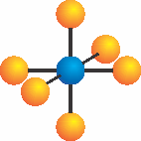


X-ray absorption spectroscopy – excitons
2p

Slide 56
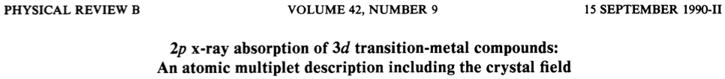
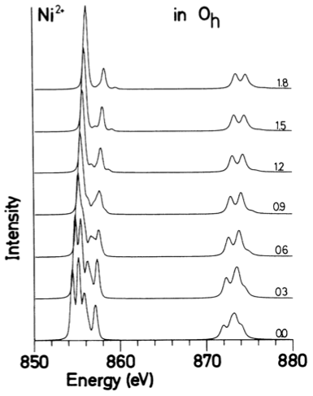
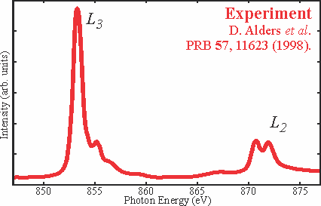
Local many body calculations based on parameters

Slide 57
Ligand field theory for NiO
O²⁻ - 2p⁶
Ni²⁺ - 4s⁰ 3d⁸

Slide 58
Orbital energy level diagram
e_{g}
t_{2g}

Slide 59
Coulomb repulsion
d_{x2-y2}
d_{xy}
Notes:
----- Meeting Notes (12/7/12 17:29) -----
Quantitative (real might be offending ...)
----- Meeting Notes (12/7/12 18:14) -----
What did I do
Development of model based on DFT wannier

Slide 60
Coulomb repulsion
Coulomb repulsion is smaller when electrons are farther apart
d_{z2}
d_{x2-y2}
d_{xy}

Slide 61
Coulomb repulsion
Coulomb repulsion is smaller when electrons are farther apart
d_{z2}
d_{x2-y2}
d_{xy}
d_{xy}
Notes:
----- Meeting Notes (12/7/12 17:29) -----
Quantitative (real might be offending ...)
----- Meeting Notes (12/7/12 18:14) -----
What did I do
Development of model based on DFT wannier

Slide 62
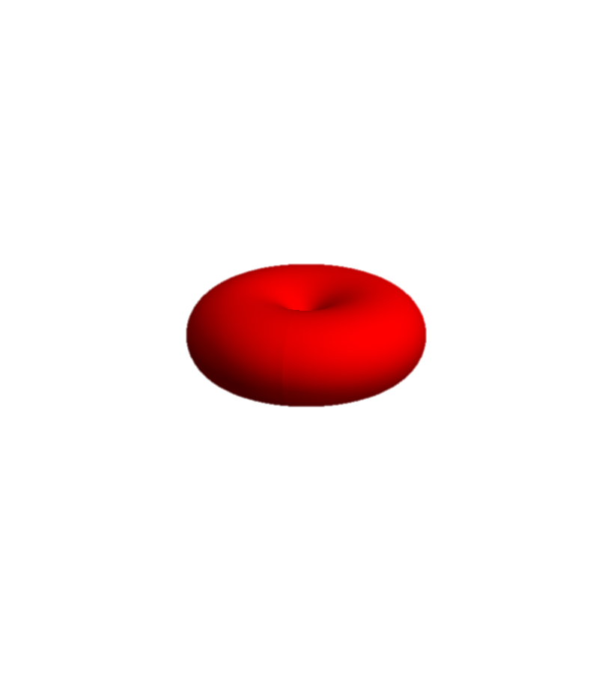
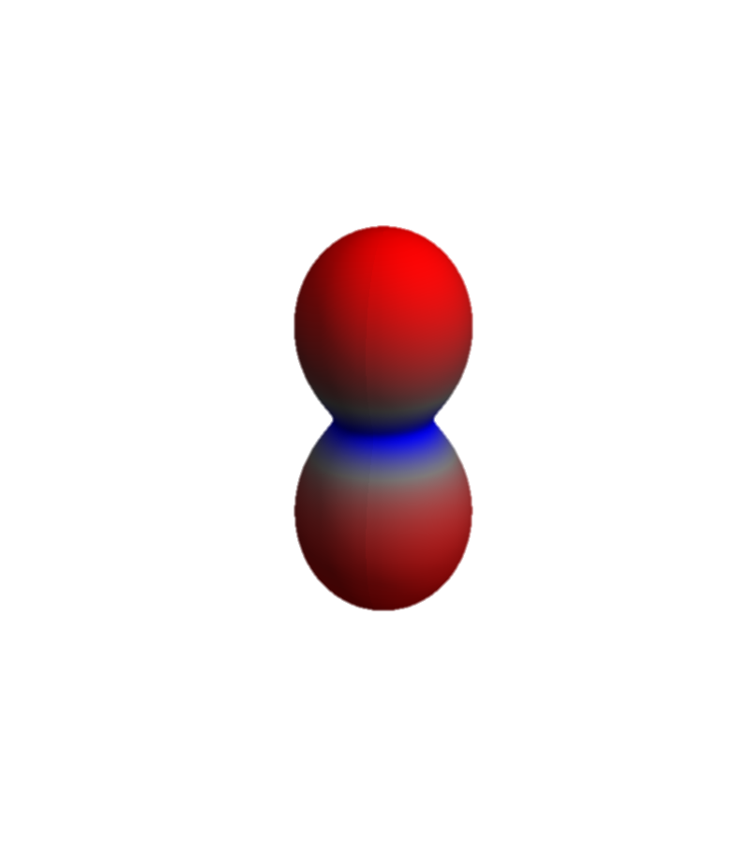
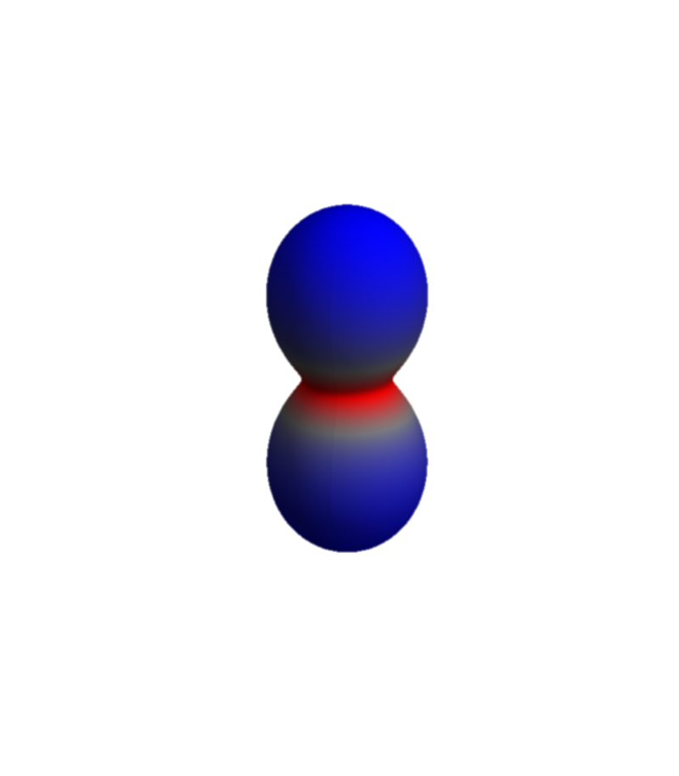
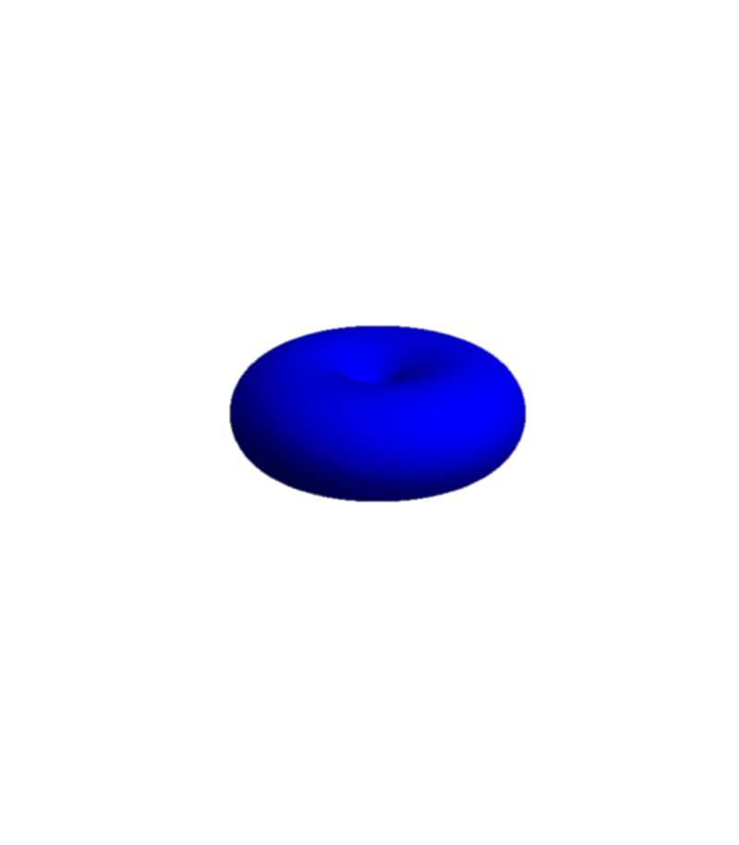
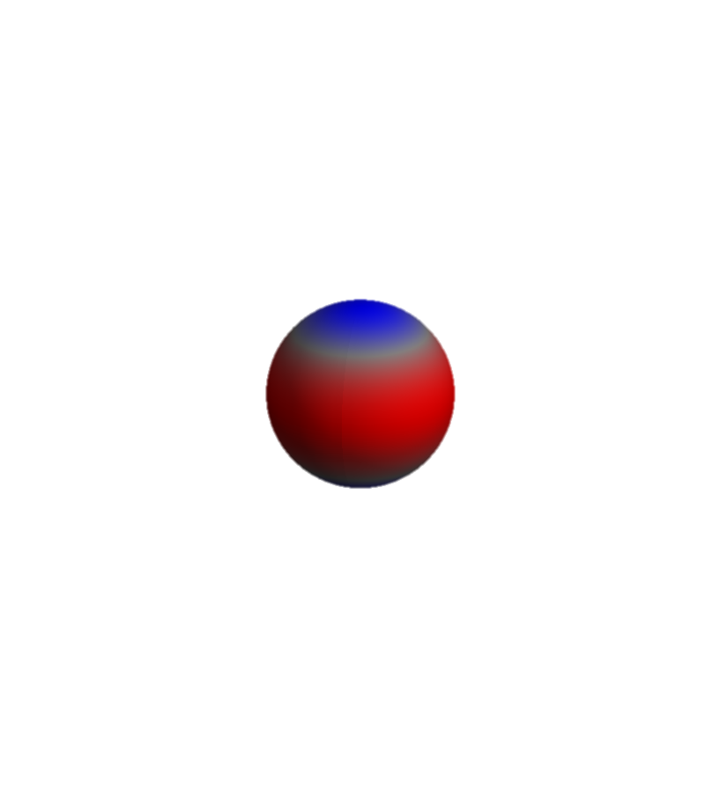
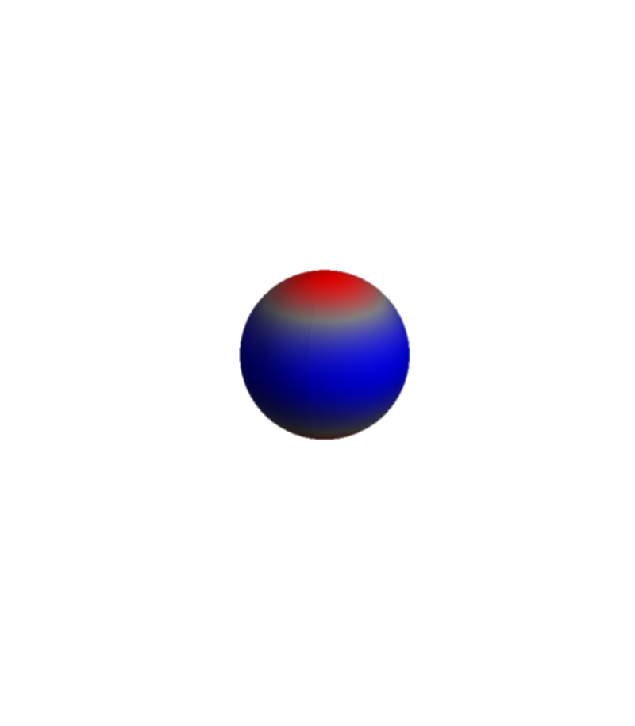
XAS final state for NiO 2p⁵3d⁹
Ni – 2p
Ni – 3d
L₃ edge
L₂ edge

Slide 63
Local many body calculations based on parameters
Parameters
Size of the Coulomb interaction
Size of the crystal-field

Slide 64
Can we calculate these parameters?
Parameters
Size of the Coulomb interaction
Size of the crystal-field
Notes:
-

Slide 65
Obtain parameters from LDA
M.W. Haverkort, M. Zwierzycki, O.K. Andersen, PRB 85, 165113 (2012).

Slide 66
In LDA NiO is a metal: Experimentally it is a good insulator
F. J. Morin, Phys. Rev. 93, 1199 (1954)
R. Newman and R. M. Chrenko,
Phys. Rev 114 1507 (1959)
Room temperature
ρ~10⁵ Ο cm
Conductivity (Ω⁻¹ cm⁻¹)
Optical-gap
3.5 – 4.0 eV
Temperature⁻¹

Slide 67
Although NiO is a metal in LDA, there are many things correct
M.W. Haverkort, M. Zwierzycki, O.K. Andersen, PRB 85, 165113 (2012).

Slide 68
“Downfold” the DFT results to obtain basis of choice
M.W. Haverkort, M. Zwierzycki, O.K. Andersen, PRB 85, 165113 (2012).

Slide 69
Pick a basis of “TM-d” and “O-p” Wannier orbitals
M.W. Haverkort, M. Zwierzycki, O.K. Andersen, PRB 85, 165113 (2012).

Slide 70
Full multiplet ligand field model based on DFT
M.W. Haverkort, M. Zwierzycki, O.K. Andersen, PRB 85, 165113 (2012).

Slide 71
How to calculate 2p X-ray Absorption Spectroscopy
Theory
Experiment
Start from LDA potential
Create Wannier functions
On this basis and potential build local Hamiltonian including all local many body interactions
Solve by exact diagonalization
Phys. Rev. B 85, 165113 (2012)
2p
M.W. Haverkort, M. Zwierzycki, O.K. Andersen, PRB 85, 165113 (2012).

Slide 72
Interpretation without theory – sum rules
Theory
Experiment
2p

Slide 73
Sum rules for circular dichroism: orbital and spin momentum

Slide 74
Sum rules for circular dichroism: orbital and spin momentum

Slide 75
Sum rules for circular dichroism: orbital and spin momentum

Slide 76
Sum rules for circular dichroism: orbital and spin momentum

Slide 77
Sum rules for circular dichroism: orbital and spin momentum

Slide 78
Sum rules for circular dichroism: orbital and spin momentum

Slide 79
Sum rules for linear dichroism: orbital occupation

Slide 80
XAS and the conductivity tensor (σ) – an example for s to p
Real
Imaginary
Absorption –Im[σ]
(in Landau Lifschitz absorption is Re[σ])
ω₀

Slide 81
But the conductivity tensor (σ) is a TENSOR

Slide 82
But the conductivity tensor (σ) is a TENSOR
Absorption
–Im[ε.σ.ε]

Slide 83
The conductivity tensor (σ) in cubic symmetry

Slide 84
The conductivity tensor (σ) in tetragonal symmetry

Slide 85
The conductivity tensor (σ) in orthorhombic symmetry

Slide 86
The conductivity tensor (σ) in monoclinic symmetry

Slide 87
The conductivity tensor (σ) in triclinic symmetry

Slide 88
The conductivity tensor (σ) in magnetic materials

Slide 89
The conductivity tensor (σ) in magnetic materials

Slide 90
Sum rules for circular dichroism: orbital and spin momentum

Slide 91
Thole et al.’s sum-rules in tensor form. s to p excitations

Slide 92
And now momentum, i.e. spatial resolved, from XAS to RXD
X-ray Absorption Spectroscopy (XAS) at the TM 2p to 3d edge
Resonant X-ray Diffraction (RXD)
Hannon, Trammel, Bloom, Gibbs
Phys. Rev. Lett. 61, 1245 (1988)
Phys. Rev. B 43, 5663 (1991)
Cara, Thole
Rev. Mod. Phys. 66, 1509 (1994)
2p

Slide 93
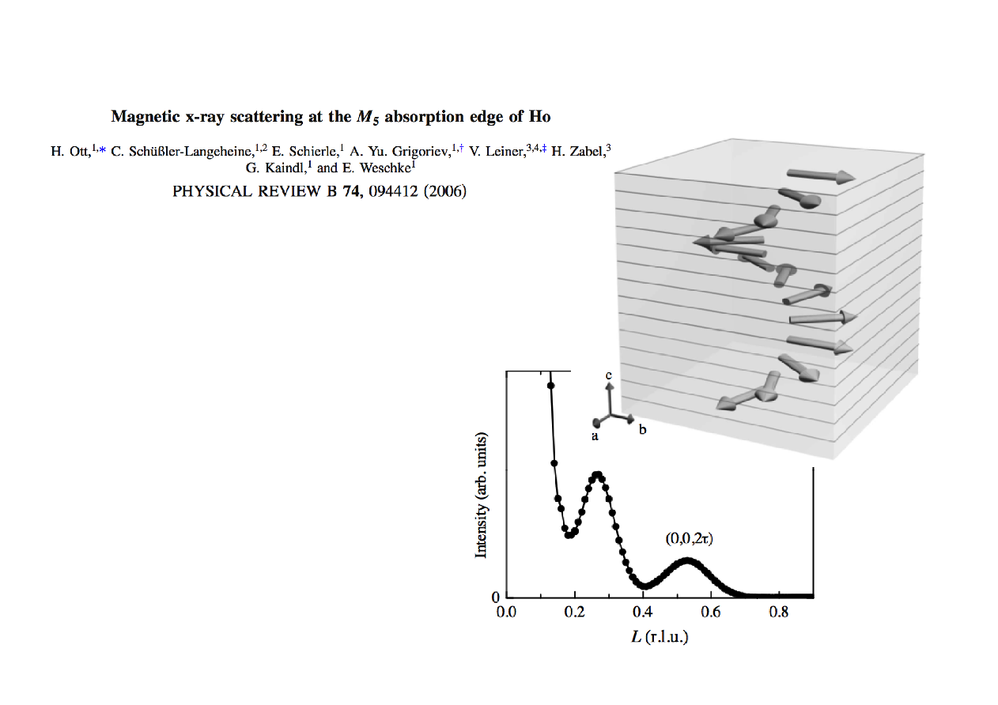
An example magnetic Bragg reflection of Ho metal film
2p

Slide 94
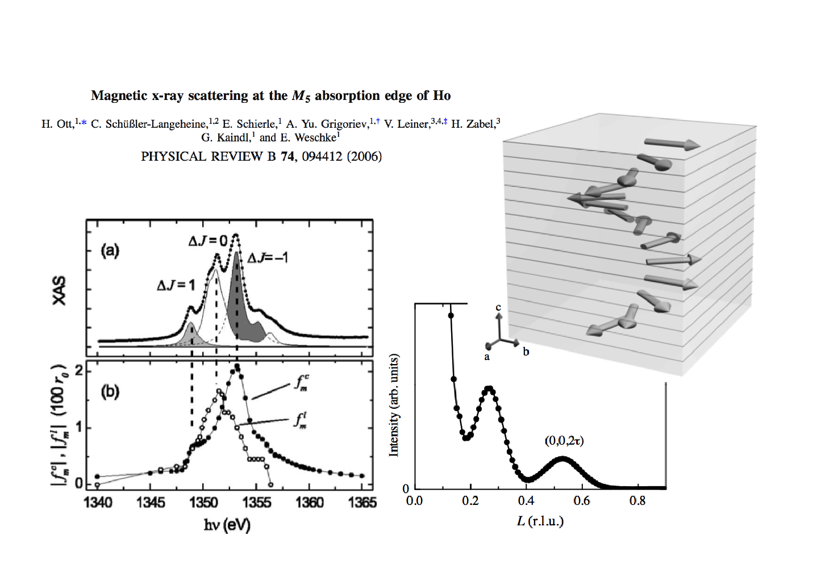
An example magnetic Bragg reflection of Ho metal film

Slide 95
Relation between resonant x-ray diffraction and absorption
2p
2p

Slide 96
An example magnetic Bragg reflection of Ho metal film

Slide 97
Fundamental spectra from the literature

Slide 98
Fundamental spectra from the literature

Slide 99
Fundamental spectra from the literature

Slide 100
Fundamental spectra from the literature

Slide 101
An example magnetic Bragg reflection of Ho metal film

Slide 102
Can we use sum-rules to get quantitative information
E. Benckiser et al., Nature Materials 10, 189 (2011). S. Macke et al., Advanced Materials 26, 6554 (2014).

Slide 103
Can we use sum-rules to get quantitative information
E. Benckiser et al., Nature Materials 10, 189 (2011). S. Macke et al., Advanced Materials 26, 6554 (2014).

Slide 104
Can we use sum-rules to get quantitative information
E. Benckiser et al., Nature Materials 10, 189 (2011). S. Macke et al., Advanced Materials 26, 6554 (2014).

Slide 105
Can we use sum-rules to get quantitative information
E. Benckiser et al., Nature Materials 10, 189 (2011). S. Macke et al., Advanced Materials 26, 6554 (2014).

Slide 106
Can we use sum-rules to get quantitative information
E. Benckiser et al., Nature Materials 10, 189 (2011). S. Macke et al., Advanced Materials 26, 6554 (2014).

Slide 107
Can we use sum-rules to get quantitative information
E. Benckiser et al., Nature Materials 10, 189 (2011). S. Macke et al., Advanced Materials 26, 6554 (2014).

Slide 108
Solve Maxwell's equations (with side conditions)
E. Benckiser et al., Nature Materials 10, 189 (2011). S. Macke et al., Advanced Materials 26, 6554 (2014).

Slide 109
And now excitations , from RXD to RIXS
X-ray Absorption
Spectroscopy
Resonant X-ray
Diffraction
Resonant Inelastic
X-ray scattering
2p
2p
2p

Slide 110
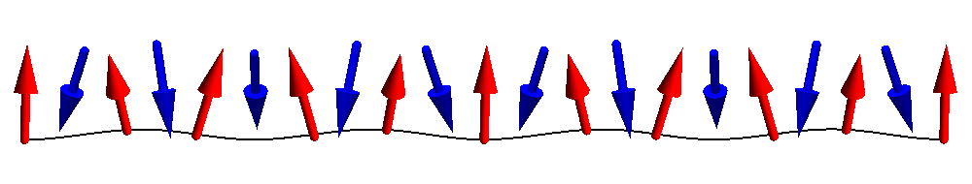
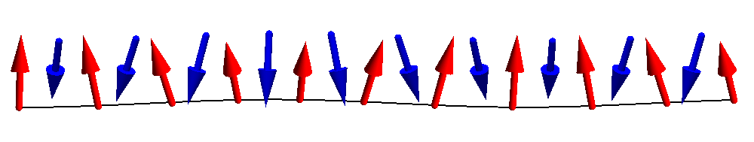
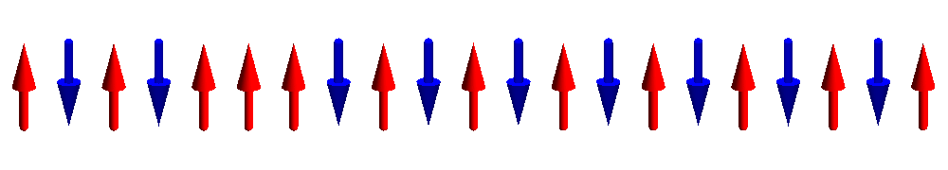
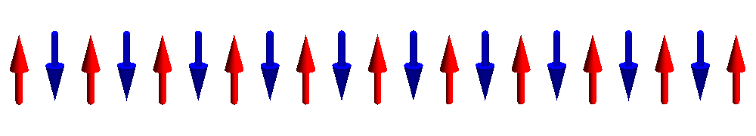
Dispersing magnons

Slide 111
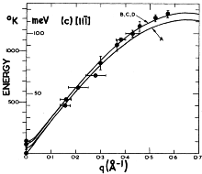
Dispersing magnons – Neutron scattering
Interaction of Neutrons with matter is well understood (magnetic dipole),
single magnon intensity
q-dispersion
M. T. Hutchings and E. J. Samuelsen,
Phys. Rev. B 6, 3447 (1972)

Slide 112
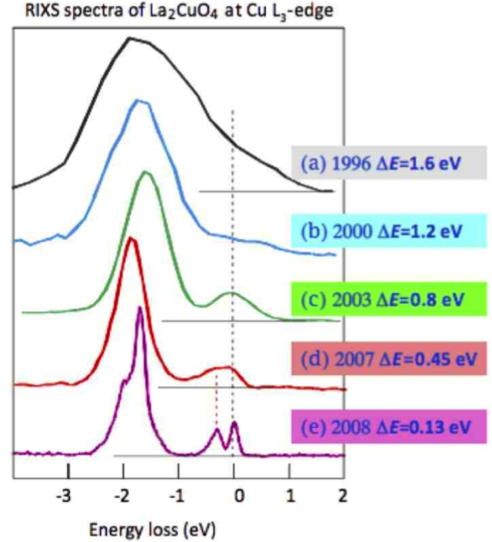
Recent development – measure spin dynamics with x-rays
Resonant Inelastic
X-ray Scattering
RIXS
It now becomes feasible to measure the dynamics of low energy excitations in:
thin films
surfaces
Interfaces
nano-crystals
molecules
Picture by G. Ghiringhelli and L. Braicovich

Slide 113
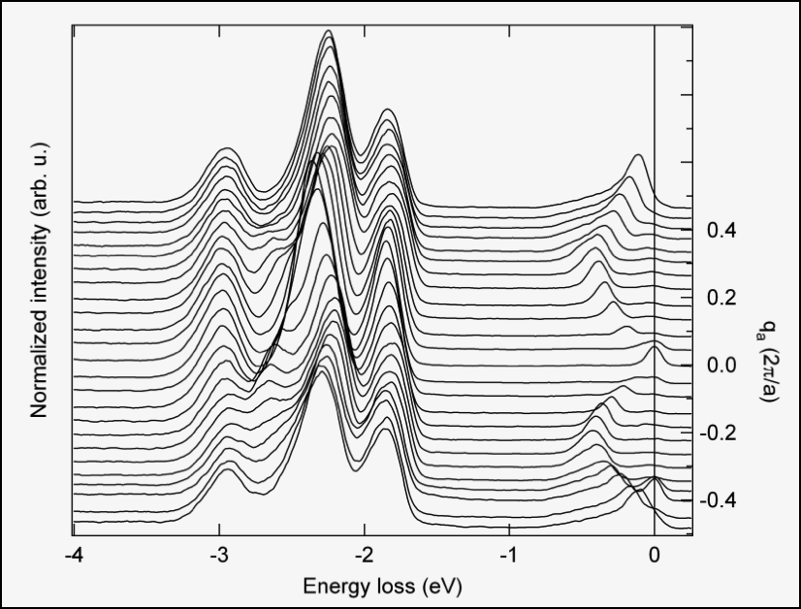
RIXS – very high quality data on small samples
orbitons
spinons
J. Schlappa et al., Nature 485, 82

Slide 114
What is Resonant Inelastic X-ray Scattering (RIXS)
Intermediate state with core hole and one extra valence electron
Outgoing light of
~ 0.5 to 10 keV
minus
10 meV to 10 eV
Incoming light of
~ 0.5 to 10 keV
M.W. Haverkort PRL 105, 167404 (2010)

Slide 115
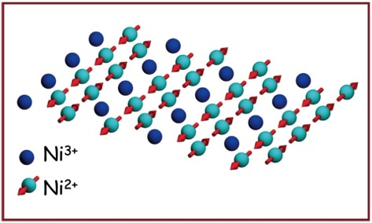
RIXS – what does one measure
Intermediate state
Initial state
Final state
M.W. Haverkort PRL 105, 167404 (2010)

Slide 116
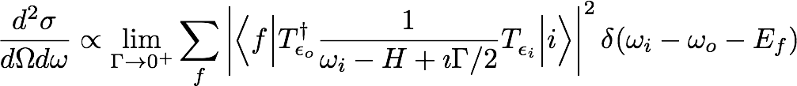
RIXS – what does one measure
Interaction of Neutrons with matter is easy (magnetic dipole),
but for resonant inelastic x-ray scattering nothing is obvious.
A lot is known though…
M.W. Haverkort PRL 105, 167404 (2010)

Slide 117
RIXS – what does one measure
Interaction of Neutrons with matter is easy (magnetic dipole),
but for resonant inelastic x-ray scattering nothing is obvious.
A lot is known though…
M.W. Haverkort PRL 105, 167404 (2010)

Slide 118
RIXS – what is the cross section
Interaction of Neutrons with matter is easy (magnetic dipole),
but for resonant inelastic x-ray scattering nothing is obvious.
A lot is known though…
M.W. Haverkort PRL 105, 167404 (2010)

Slide 119
RIXS – what does one measure
Interaction of Neutrons with matter is easy (magnetic dipole),
but for resonant inelastic x-ray scattering nothing is obvious.
A lot is known though…
M.W. Haverkort PRL 105, 167404 (2010)

Slide 120
RIXS – what does one measure
Interaction of Neutrons with matter is easy (magnetic dipole),
but for resonant inelastic x-ray scattering nothing is obvious.
A lot is known though…
M.W. Haverkort PRL 105, 167404 (2010)

Slide 121
RIXS – what does one measure
Interaction of Neutrons with matter is easy (magnetic dipole),
but for resonant inelastic x-ray scattering nothing is obvious.
A lot is known though…
M.W. Haverkort PRL 105, 167404 (2010)

Slide 122
RIXS – what does one measure
Interaction of Neutrons with matter is easy (magnetic dipole),
but for resonant inelastic x-ray scattering nothing is obvious.
A lot is known though…
M.W. Haverkort PRL 105, 167404 (2010)

Slide 123
RIXS – what does one measure
Interaction of Neutrons with matter is easy (magnetic dipole),
but for resonant inelastic x-ray scattering nothing is obvious.
A lot is known though…
M.W. Haverkort PRL 105, 167404 (2010)

Slide 124
RIXS – what does one measure
Interaction of Neutrons with matter is easy (magnetic dipole),
but for resonant inelastic x-ray scattering nothing is obvious.
A lot is known though…
M.W. Haverkort PRL 105, 167404 (2010)

Slide 125
RIXS – what does one measure
Interaction of Neutrons with matter is easy (magnetic dipole),
but for resonant inelastic x-ray scattering nothing is obvious.
A lot is known though…
BOOM
M.W. Haverkort PRL 105, 167404 (2010)

Slide 126


RIXS – what does one measure
Interaction of Neutrons with matter is easy (magnetic dipole),
but for resonant inelastic x-ray scattering nothing is obvious.
A lot is known though…
M.W. Haverkort PRL 105, 167404 (2010)

Slide 127
RIXS – what does one measure
Intermediate state
Initial state
Final state

Slide 128

Relations between absorption, elastic- and inelastic scattering
The elastic scattering tensor is related to the absorption by the optical theorem (Conservation of energy)
Elastic scattering is a limiting case of inelastic scattering:
If one restricts the inelastic scattering operator R to the ground-state one describes the elastic scattering
For the description of magnetic excitations:
Expand the scattering operator on spin operators
M.W. Haverkort PRL 105, 167404 (2010)

Slide 129


RIXS – effective operator – spin excitations
Effective operator for spin excitations only
M.W. Haverkort PRL 105, 167404 (2010)

Slide 130
RIXS – effective operator – spin excitations
Need to calculate x-ray absorption spectra
… and spin susceptibilities
M.W. Haverkort PRL 105, 167404 (2010)

Slide 131
RIXS – effective operator – spin excitations
Theory
Experiment
Need to calculate x-ray absorption spectra
σ⁽⁰⁾=
M.W. Haverkort PRL 105, 167404 (2010)

Slide 132
Predicted RIXS spectra with cross polarized light
spin susceptibility, same as neutron scattering
M.W. Haverkort PRL 105, 167404 (2010)

Slide 133
General polarization: RIXS is a mixture of 1 and 2 spin flips
M.W. Haverkort PRL 105, 167404 (2010)

Slide 134
Spin excitations in 1-dimension
S. Glawion et al. PRL 107, 107402 (2011).

Slide 135
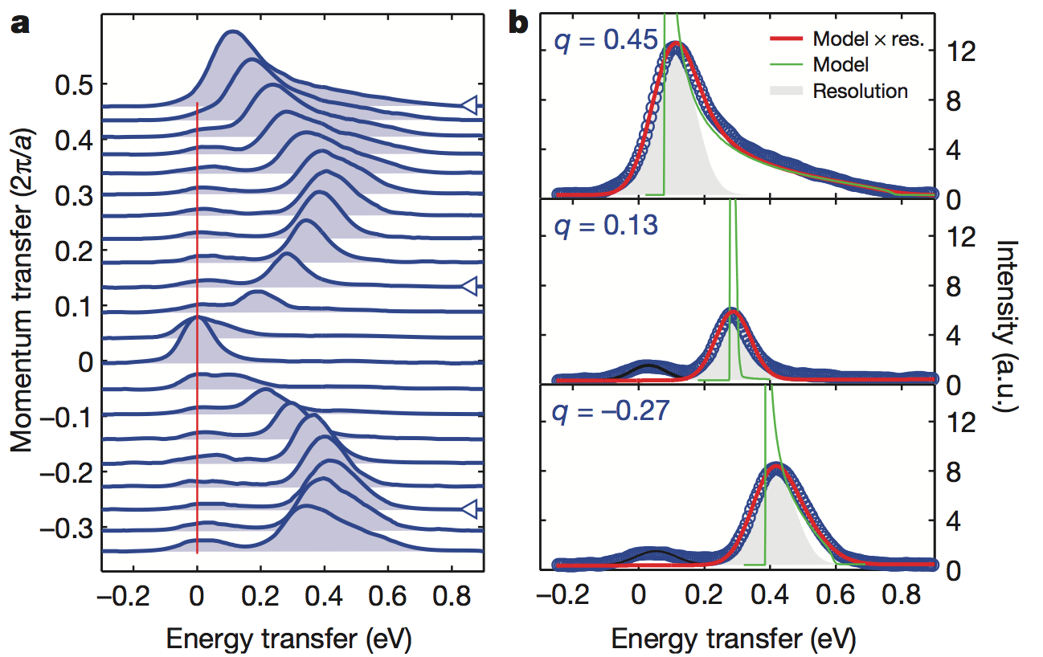
Spin excitations in 1 dimension – Sr₂CuO₃
J. Schlappa et al., Nature 485, 82

Slide 136
Dispersing orbitals
orbitons
spinons
J. Schlappa et al., Nature 485, 82

Slide 137
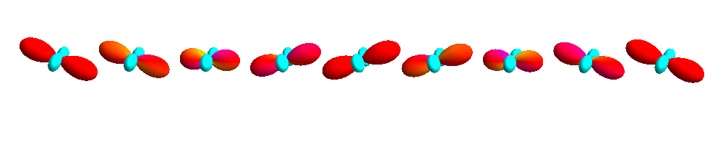
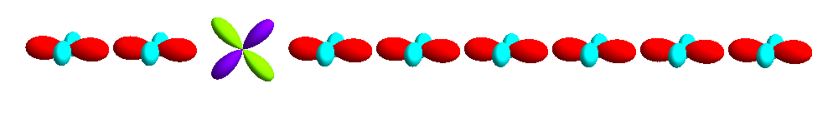
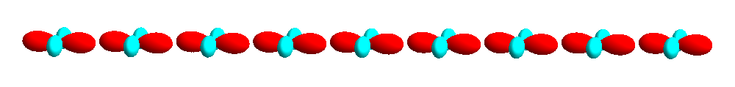
Dispersing orbitals
J. Schlappa et al., Nature 485, 82

Slide 138
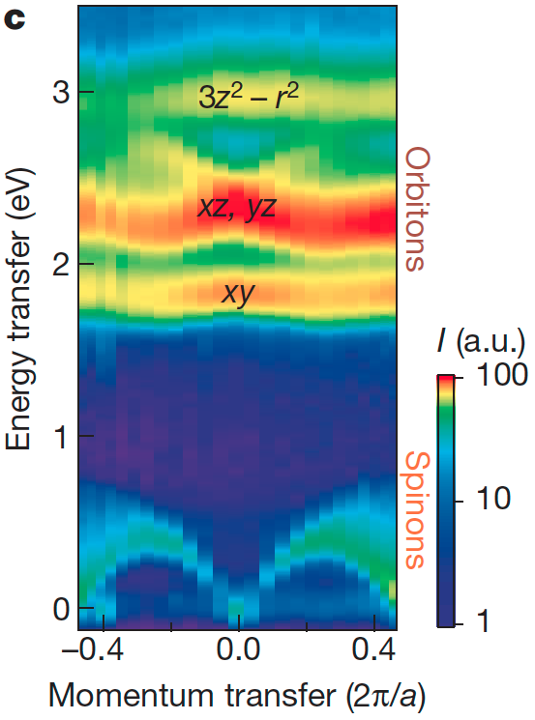
Dispersing orbitals
J. Schlappa et al., Nature 485, 82

Slide 139
Additional literature
Core level spectroscopy of Solids
Frank M. F. de Groot and Akio Kotani
NEXAFS Spectroscopy
Joachim Stöhr
Introduction to ligand field theory (chapter 1 – 6)
Carl Johan Ballhausen (1962)
Physical Chemistry (chapter 13 – 18, (10 – 15) edition 5 (8))
Peter Atkins (2006)

Slide 140

Software to do multiplet calculations
Quanty
www.quanty.org
Quanty is a script language which allows the user to program quantum mechanical problems in second quantization and when possible solve these. It can be used in quantum chemistry as post Hartree-Fock or in one of the LDA++ schemes. (self consistent field, configuration interaction, coupled cluster, restricted active space, ...) The idea of Quanty is that the user can focus on the model and its physical or chemical meaning. Quanty will take care of the mathematics.

Slide 141

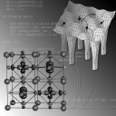



Notes:
CONCLUSIONS

Slide 142
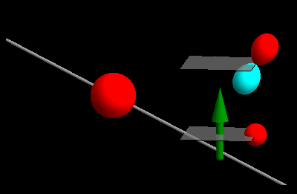
Notes:
CONCLUSIONS

Slide 143
Ligand field theory for NiO
O²⁻ - 2p⁶
Ni²⁺ - 4s⁰ 3d⁸

Slide 144
Orbital energy level diagram
e_{g}
t_{2g}

Slide 145
Coulomb repulsion
d_{x2-y2}
d_{xy}
Notes:
----- Meeting Notes (12/7/12 17:29) -----
Quantitative (real might be offending ...)
----- Meeting Notes (12/7/12 18:14) -----
What did I do
Development of model based on DFT wannier

Slide 146
Coulomb repulsion
Coulomb repulsion is smaller when electrons are farther apart
d_{z2}
d_{x2-y2}
d_{xy}

Slide 147
Coulomb repulsion
Coulomb repulsion is smaller when electrons are farther apart
d_{z2}
d_{x2-y2}
d_{xy}
d_{xy}
Notes:
----- Meeting Notes (12/7/12 17:29) -----
Quantitative (real might be offending ...)
----- Meeting Notes (12/7/12 18:14) -----
What did I do
Development of model based on DFT wannier

Slide 148
Coulomb repulsion

Slide 149
Coulomb repulsion

Slide 150
Coulomb repulsion
Notes:
----- Meeting Notes (12/7/12 17:29) -----
Quantitative (real might be offending ...)
----- Meeting Notes (12/7/12 18:14) -----
What did I do
Development of model based on DFT wannier

Slide 151
Coulomb repulsion

Slide 152
Slater integrals – a multipole expansion

Slide 153
Slater integrals – a multipole expansion

Slide 154
Screening of mulitpole Coulomb interaction is small

Slide 155
Coulomb repulsion in spherical symmetry – Atomic multiplets
Orbital occupation
Angular momentum
Term symbol
d¹ (d⁹)
m_{l}
^{(2S+1)}L
-2 | -1 | 0 | 1 | 2
L_{z}=-2 S_{z}=1/2
L=2 S=1/2
²D
d² (d⁸)
m_{l}
-2 | -1 | 0 | 1 | 2
L_{z}=-3 S_{z}=1
L=3 S=1
³F
-2 | -1 | 0 | 1 | 2
L_{z}=-2 S_{z}=1
L=? S=1
³?

Slide 156
Coulomb repulsion in spherical symmetry – Atomic multiplets
Orbital occupation
Angular momentum
d² (d⁸)
m_{l}
-2 | -1 | 0 | 1 | 2
L_{z}=-3 S_{z}=1
There are 5*4/2=10 ways to place two spin up electrons in 5 orbitals
10 Triplets
-2 | -1 | 0 | 1 | 2
L_{z}=-2 S_{z}=1
-2 | -1 | 0 | 1 | 2
L_{z}=-1 S_{z}=0
There are 5*5=25 ways to place a spin up and a spin down electron in 5 orbitals
25 – 10 = 15 singlets

Slide 157
Coulomb repulsion in spherical symmetry – Atomic multiplets
Orbital occupation
Angular momentum
Term symbol
^{(2S+1)}L
L_{z}=-3 to 3
S_{z}=-1 to 1
³F
There are
(2L+1)(2S+1) = 7*3 = 21
states in the ³F term

Slide 158
Coulomb repulsion in spherical symmetry – Atomic multiplets
Orbital occupation
Angular momentum
Term symbol
d² (d⁸)
m_{l}
^{(2S+1)}L
-2 | -1 | 0 | 1 | 2
L_{z}=-3 S_{z}=1
L=3 S=1
³F
-2 | -1 | 0 | 1 | 2
L_{z}=-2 S_{z}=1
L=3 S=1
³F
-2 | -1 | 0 | 1 | 2
}
L_{z}=-1 S_{z}=1
-2 | -1 | 0 | 1 | 2
³F
³P
L_{z}=-1 S_{z}=1

Slide 159
Coulomb repulsion in spherical symmetry – Atomic multiplets
Angular momentum
Term symbol
^{(2S+1)}L
There are
(2L+1)(2S+1) = 7*3 = 21
states in the ³F term
L_{z}=-3 to 3
S_{z}=-1 to 1
³F
There are
(2L+1)(2S+1) = 3*3 = 9
states in the ³P term
L_{z}=-1 to 1
S_{z}=-1 to 1
³P
³F ³P ¹G ¹D ¹S

Slide 160
Energy level diagram
¹S – F⁰ + 14/49 F² + 2/7 F⁴
¹G – F⁰ + 4/49 F² + 1/441 F⁴
³P – F⁰ + 7/49 F² – 4/21 F⁴
¹D – F⁰ – 3/49 F² + 4/49 F⁴
³F – F⁰ – 8/49 F² – 1/49 F⁴

Slide 161
Energy level diagram
e_{g}
t_{2g}

Slide 162
Lowest state ³A₂

Slide 163
First excited state at ~ 1.1 eV ³T₂

Slide 164
Second excited state at ~1.8 eV ³T₂

Slide 165
Third excited state at ~2.0 eV ¹E

Slide 166
…

Slide 167
Last d – d excited state ¹A₁

Slide 168
Compare to experiment

Slide 169
Bare Coulomb interactions
Use either F⁰ from experiment or constraint RPA

Slide 170
Resulting multiplet splitting in spherical symmetry

Slide 171
Multiplet splitting v.s. band width

Slide 172
Multiplet splitting v.s. one particle energy level diagram

