Slide 1
Tutorial on Quanty at ESRF
Second quantization and Green’s functions
Maurits W. Haverkort
Institute for theoretical physics – Heidelberg University
M.W.Haverkort@thphys.uni-heidelberg.de

Slide 2
Quantum mechanics for solids / molecules
Why do we use mean-field approximations like Hartree-Fock and Density Functional Theory (in the local density approximation) and why do we not just solve Schrödinger's equation
with

Slide 3
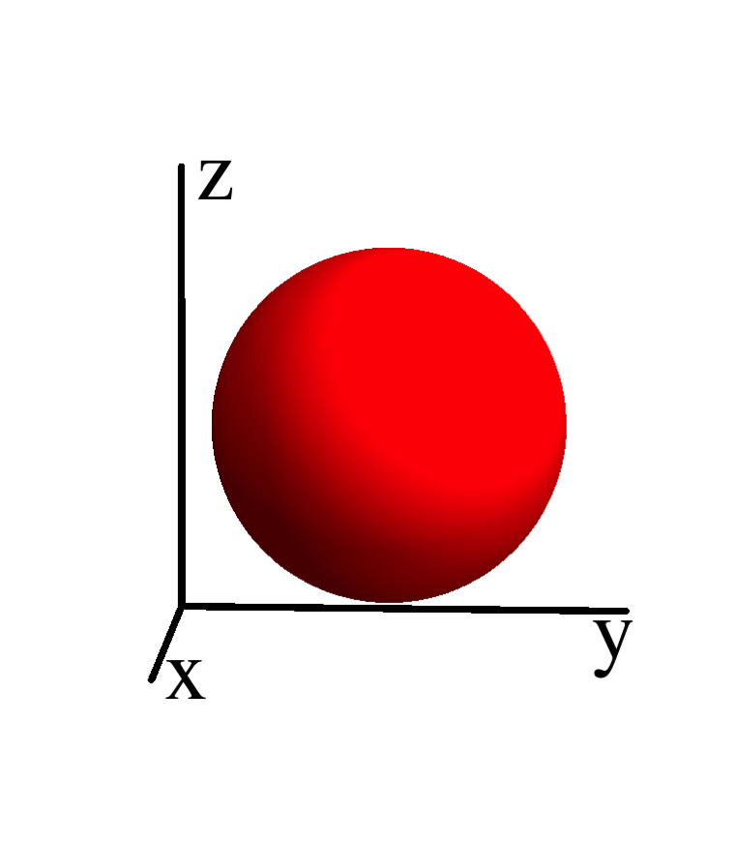
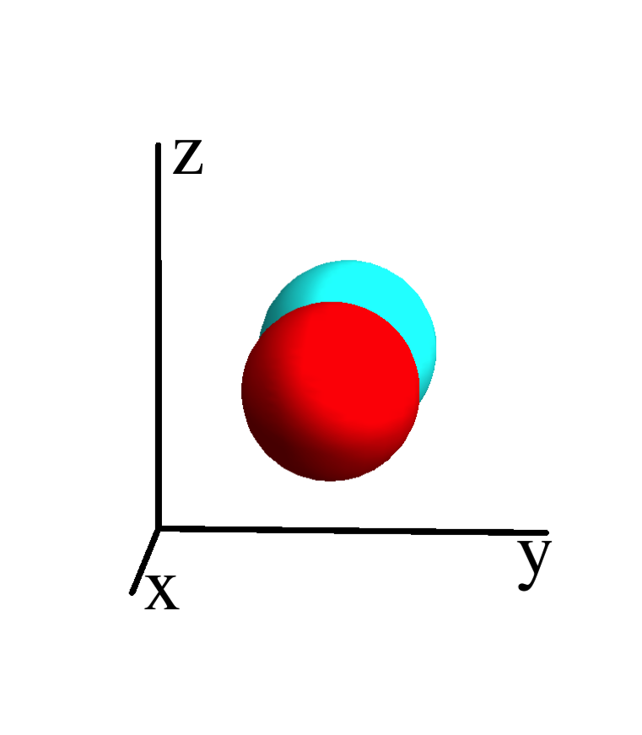
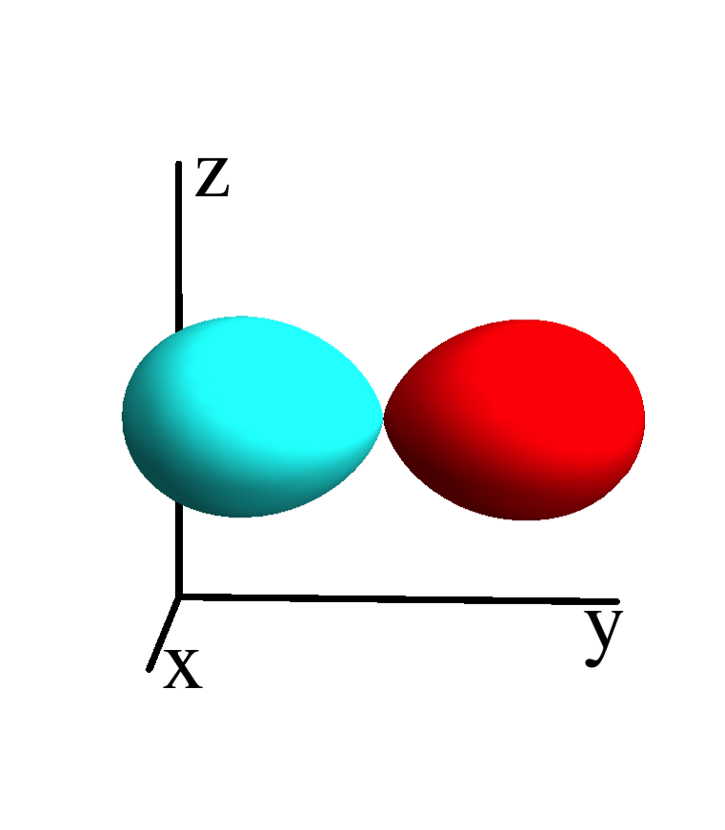
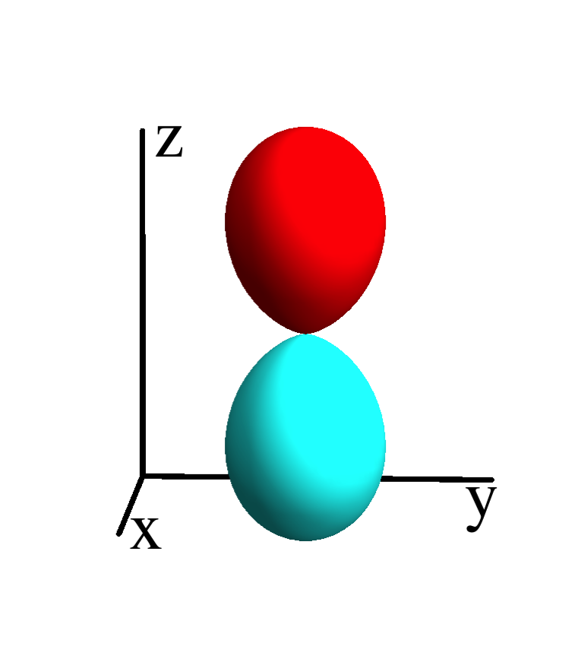
Quantum mechanics in matrix formalism – 1 electron
Define a basis of spin-orbitals
ε_{s}
Hamiltonian is a matrix on this basis
ε_{p}
ε_{p}
ε_{p}

Slide 4
Quantum mechanics in matrix formalism – multi electron
_
Define a basis of many electron wave-functions (states)
0
ε_{s}
ε_{p}
ε_{p}
ε_{p}
Hamiltonian is a matrix on this basis
ε_{s}+ε_{p}+U_{sp}
ε_{s}+ε_{p}+U_{sp}
ε_{s}+ε_{p}+U_{sp}
2ε_{p}+U_{pp}
2ε_{p}+U_{pp}
2ε_{p}+U_{pp}
ε_{s}+2ε_{p}
+2U_{sp}+U_{pp}
ε_{s}+2ε_{p}
+2U_{sp}+U_{pp}
ε_{s}+2ε_{p}
+2U_{sp}+U_{pp}
…
3ε_{p}
+3U_{pp}

Slide 5

Exponential scaling of quantum mechanics
Example cluster of H atoms
# spin-
orbitals
# electrons
# atoms
# states
1 | 2 | 1 |  | ( ) | 2
2
1
Cluster of H atom
only include the 1s orbital

Slide 6
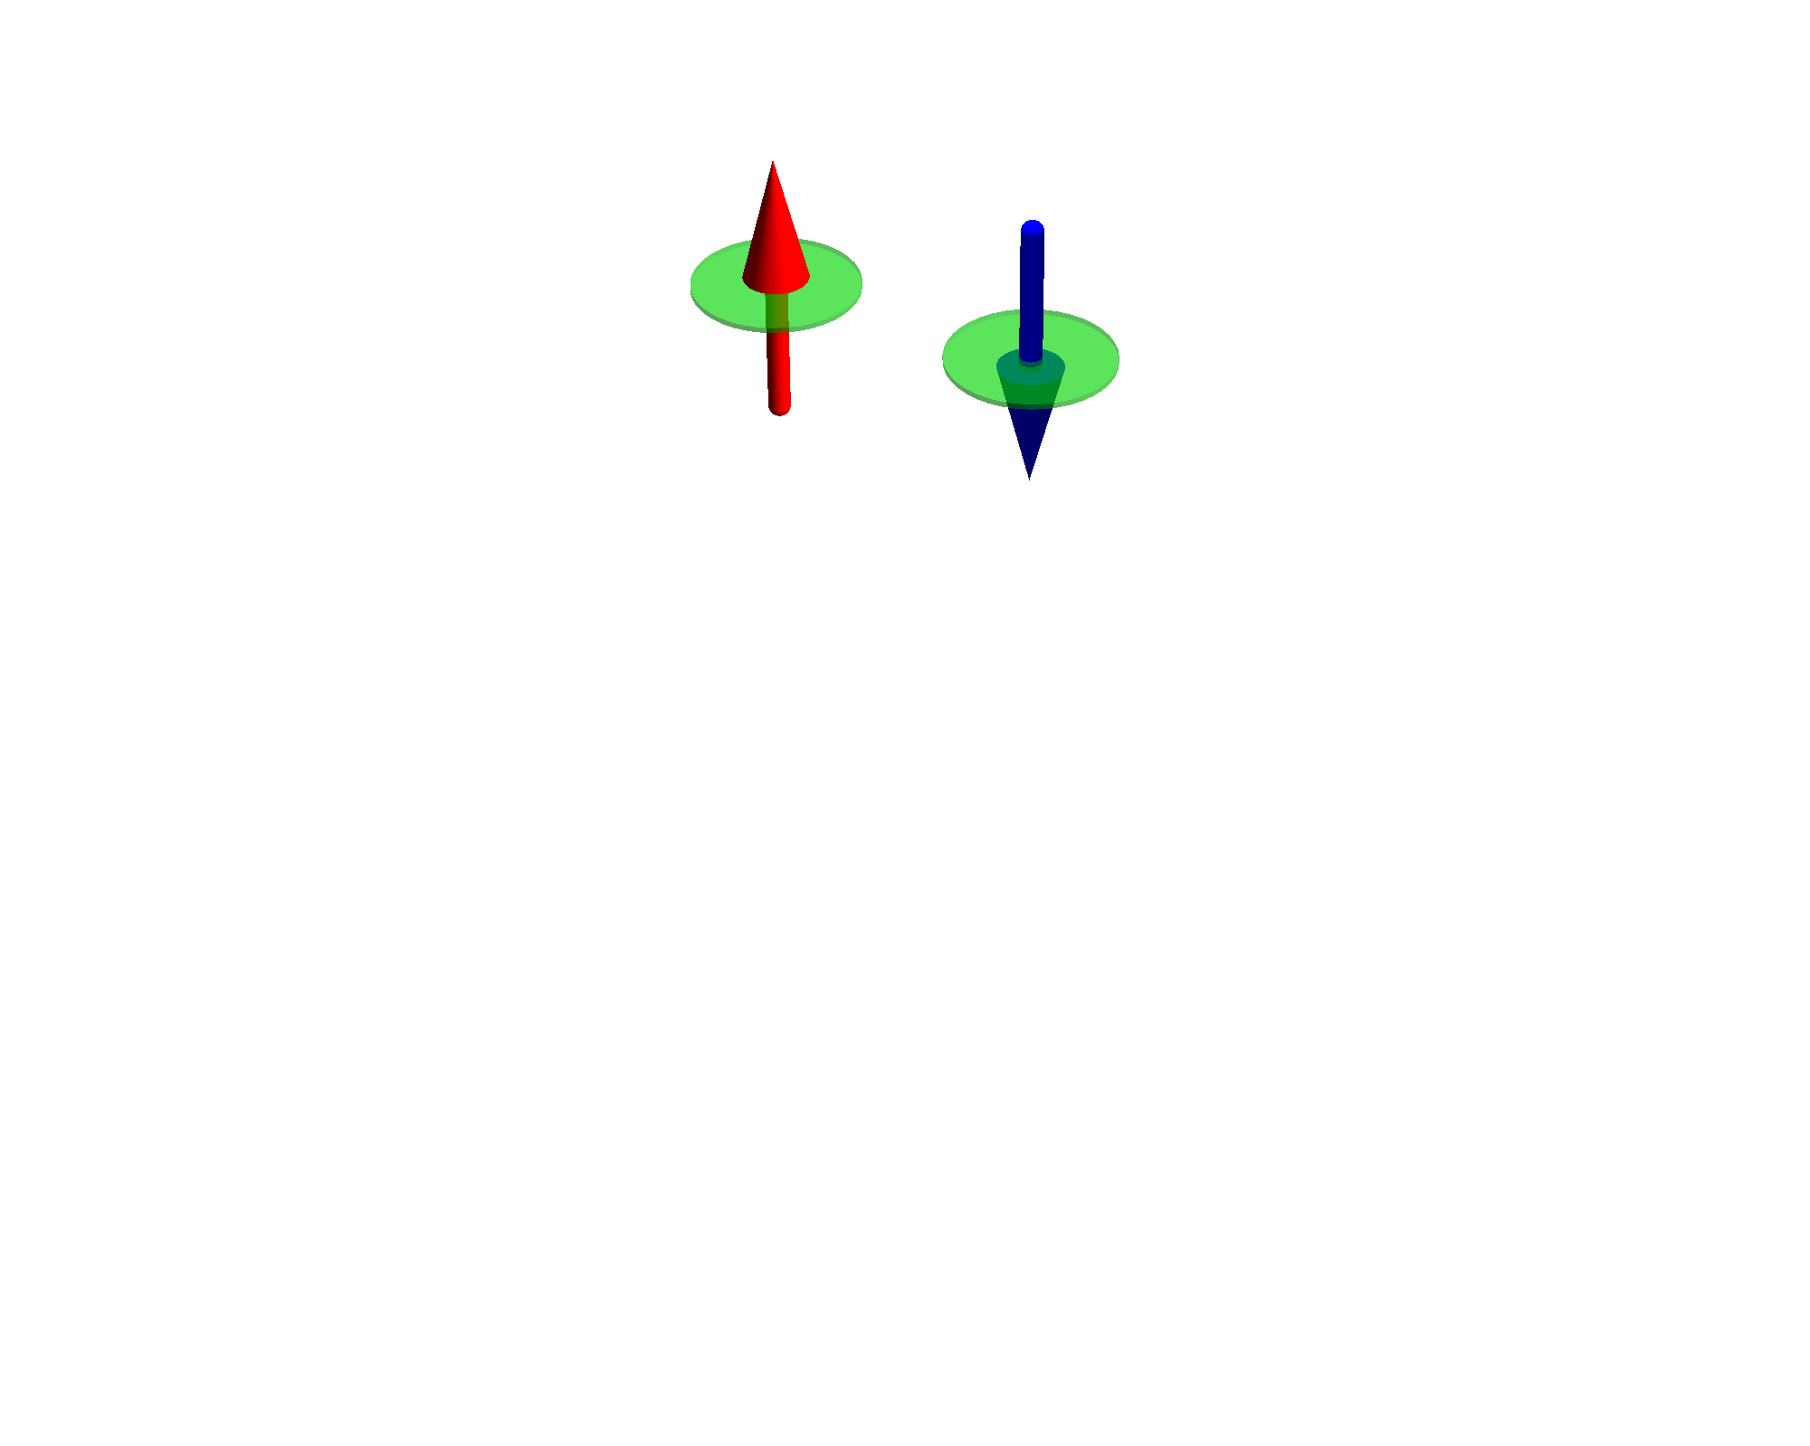
Exponential scaling of quantum mechanics
Example cluster of H atoms
# spin-
orbitals
# electrons
# atoms
# states
1 | 2 | 1 |  | ( ) | 2
2 | 4 | 2 |  | ( ) | 6
2
1
4
2
Cluster of H atom
only include the 1s orbital

Slide 7
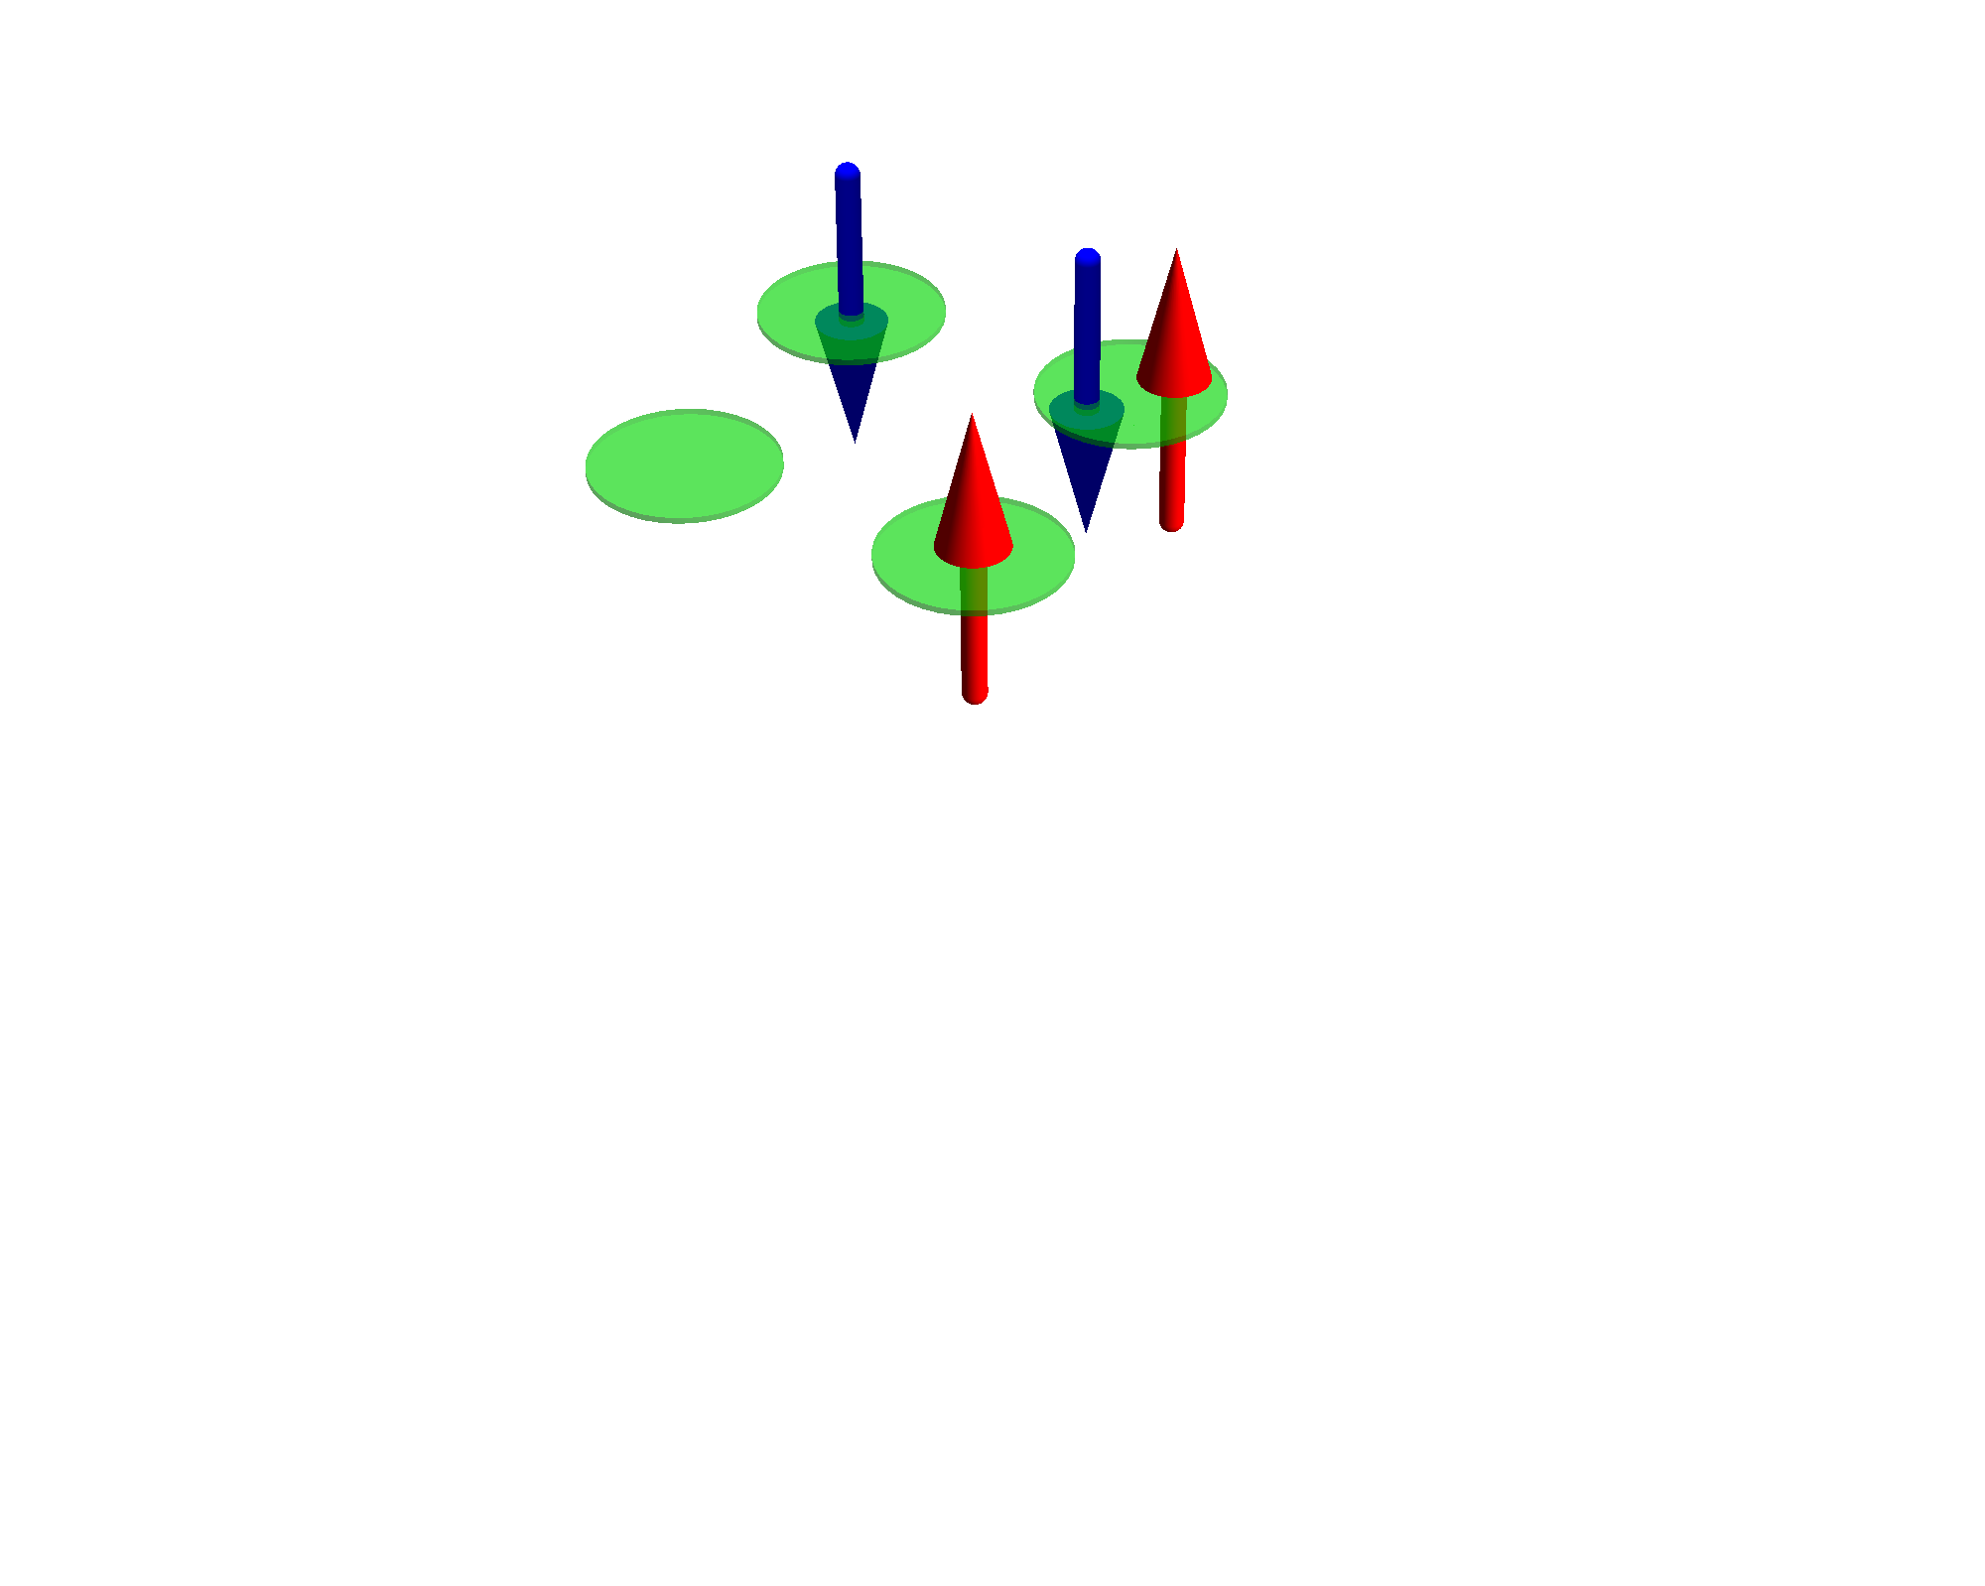
Exponential scaling of quantum mechanics
Example cluster of H atoms
# spin-
orbitals
# electrons
# atoms
# states
1 | 2 | 1 |  | ( ) | 2
2 | 4 | 2 |  | ( ) | 6
4 | 8 | 4 |  | ( ) | 70
2
1
4
2
8
4
Cluster of H atom
only include the 1s orbital

Slide 8
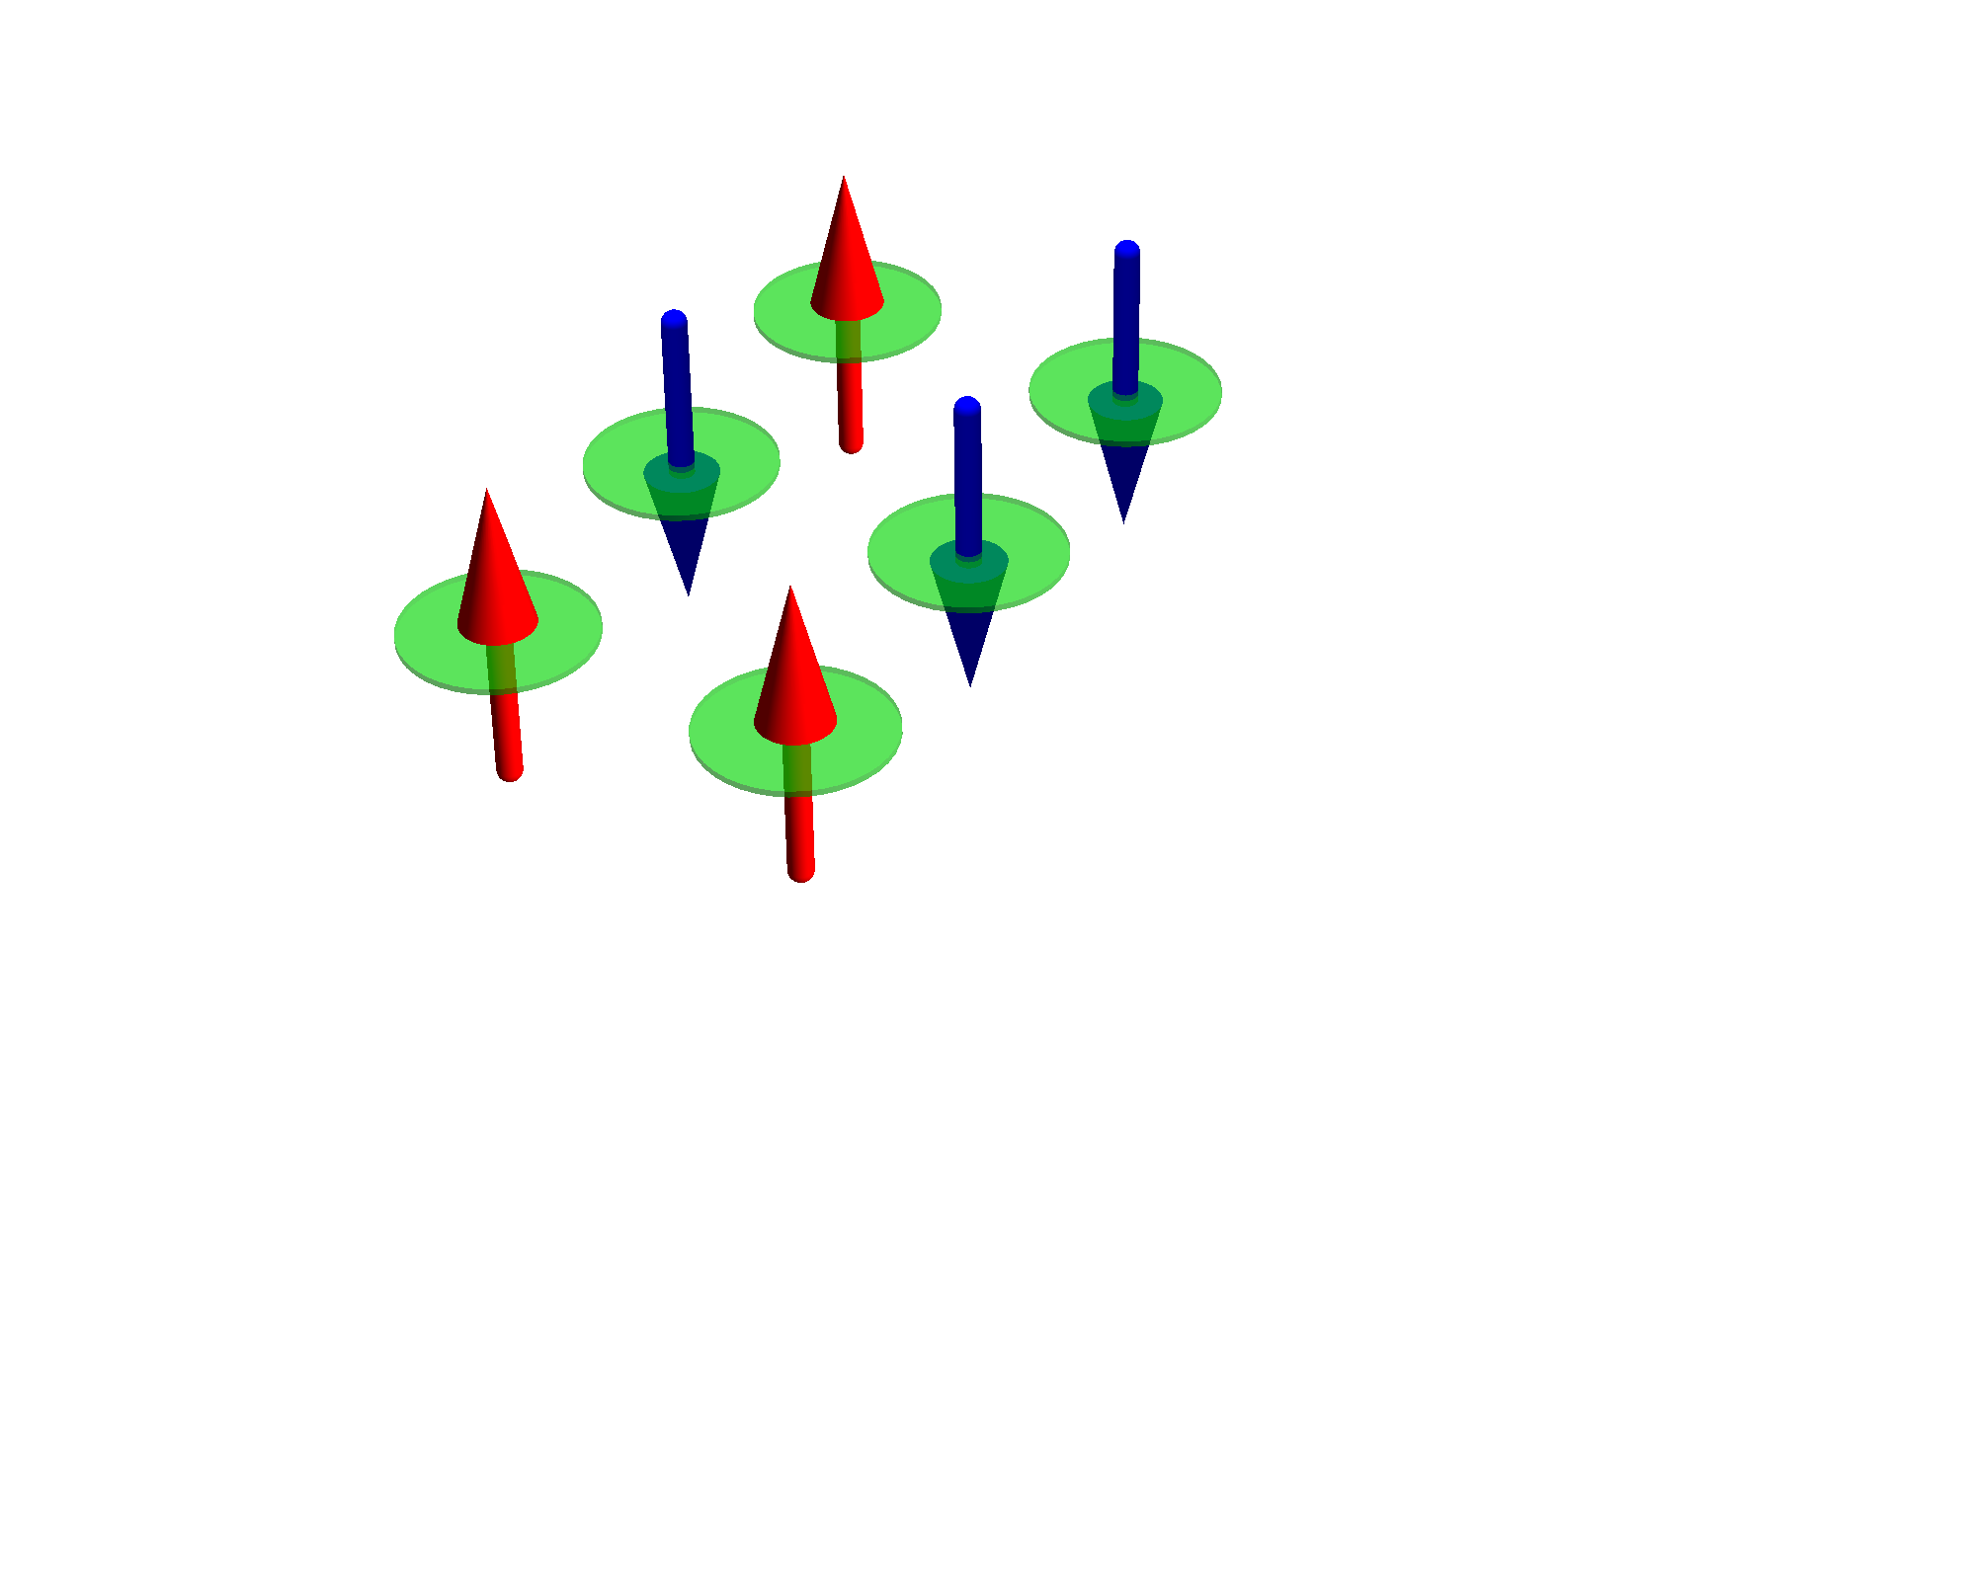
Exponential scaling of quantum mechanics
Example cluster of H atoms
# spin-
orbitals
# electrons
# atoms
# states
1 | 2 | 1 |  | ( ) | 2
2 | 4 | 2 |  | ( ) | 6
4 | 8 | 4 |  | ( ) | 70
6 | 12 | 6 |  | ( ) | 924
2
1
4
2
8
4
12
6
Cluster of H atom
only include the 1s orbital

Slide 9
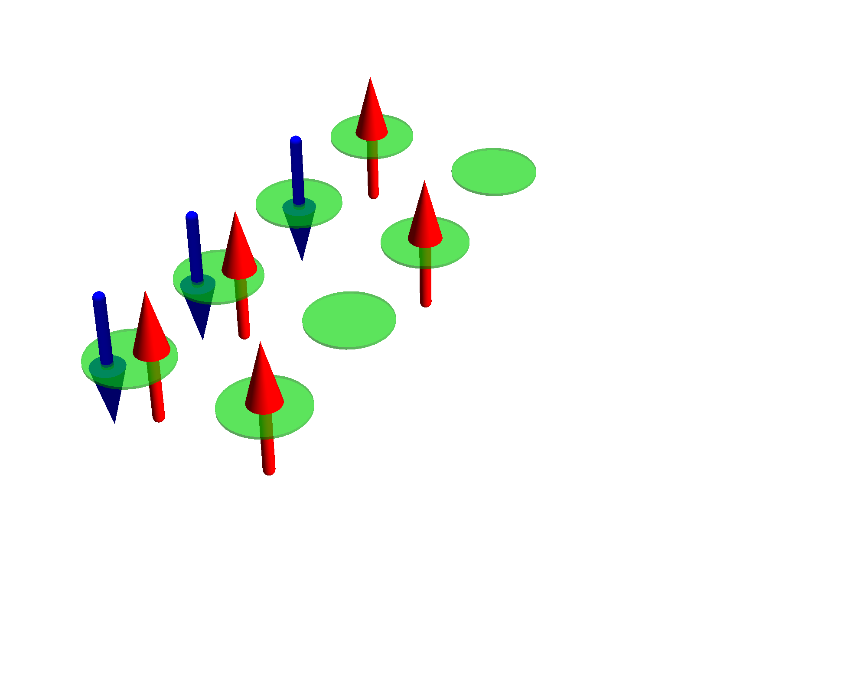
Exponential scaling of quantum mechanics
Example cluster of H atoms
# spin-
orbitals
# electrons
# atoms
# states
1 | 2 | 1 |  | ( ) | 2
2 | 4 | 2 |  | ( ) | 6
4 | 8 | 4 |  | ( ) | 70
6 | 12 | 6 |  | ( ) | 924
8 | 16 | 8 |  | ( ) | 12 870
2
1
4
2
8
4
12
6
16
8
Cluster of H atom
only include the 1s orbital

Slide 10
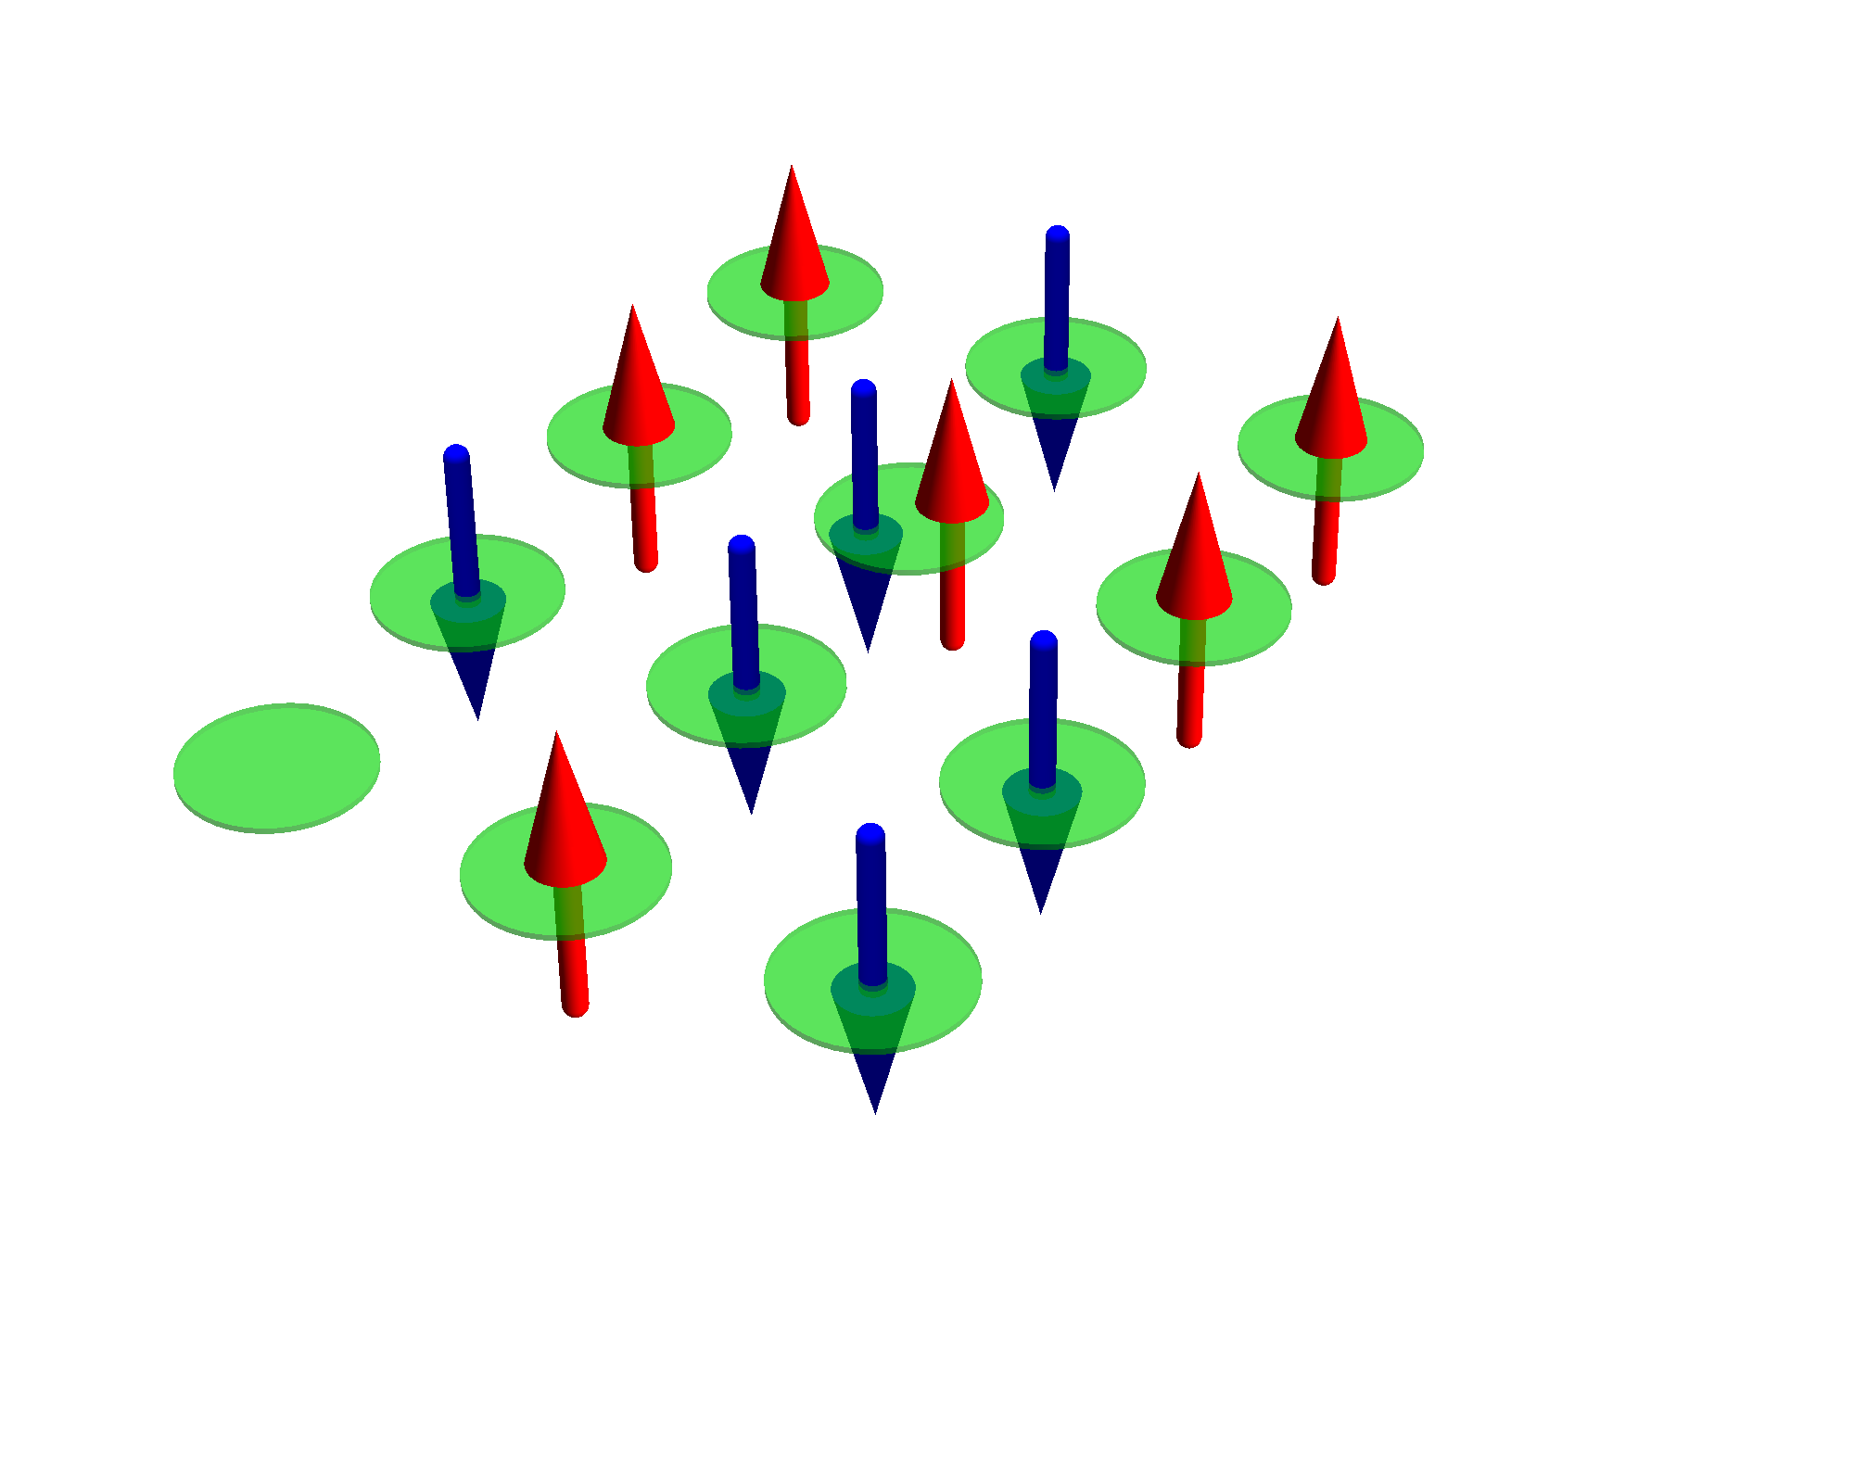
Exponential scaling of quantum mechanics
Example cluster of H atoms
# spin-
orbitals
# electrons
# atoms
# states
1 | 2 | 1 |  | ( ) | 2
2 | 4 | 2 |  | ( ) | 6
4 | 8 | 4 |  | ( ) | 70
6 | 12 | 6 |  | ( ) | 924
8 | 16 | 8 |  | ( ) | 12 870
10 | 20 | 10 |  | ( ) | 184 756
2
1
4
2
8
4
12
6
16
8
20
10
Cluster of H atom
only include the 1s orbital

Slide 11
Exponential scaling of quantum mechanics
Example cluster of H atoms
# spin-
orbitals
# electrons
# atoms
# states
1 | 2 | 1 |  | ( ) | 2
2 | 4 | 2 |  | ( ) | 6
4 | 8 | 4 |  | ( ) | 70
6 | 12 | 6 |  | ( ) | 924
8 | 16 | 8 |  | ( ) | 12 870
10 | 20 | 10 |  | ( ) | 184 756
12 | 24 | 12 |  | ( ) | 2 704 156
2
1
4
2
8
4
12
6
16
8
20
10
Cluster of H atom
only include the 1s orbital
24
12

Slide 12
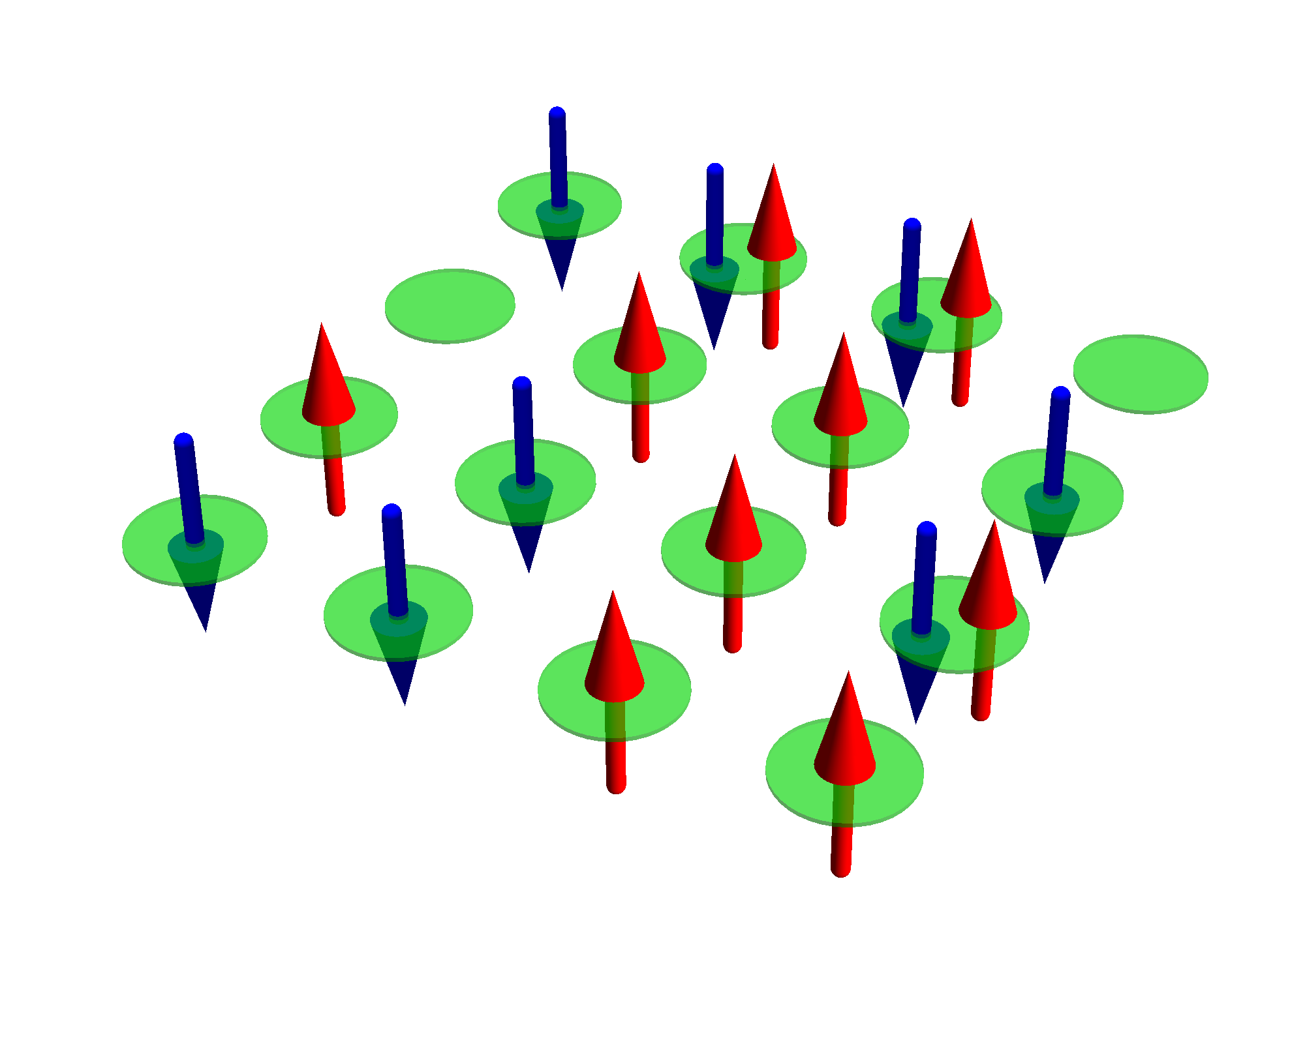
Exponential scaling of quantum mechanics
Example cluster of H atoms
# spin-
orbitals
# electrons
# atoms
# states
1 | 2 | 1 |  | ( ) | 2
2 | 4 | 2 |  | ( ) | 6
4 | 8 | 4 |  | ( ) | 70
6 | 12 | 6 |  | ( ) | 924
8 | 16 | 8 |  | ( ) | 12 870
10 | 20 | 10 |  | ( ) | 184 756
12 | 24 | 12 |  | ( ) | 2 704 156
14 | 28 | 14 |  | ( ) | 40 116 600
2
1
4
2
8
4
12
6
16
8
20
10
Cluster of H atom
only include the 1s orbital
24
12
28
14

Slide 13
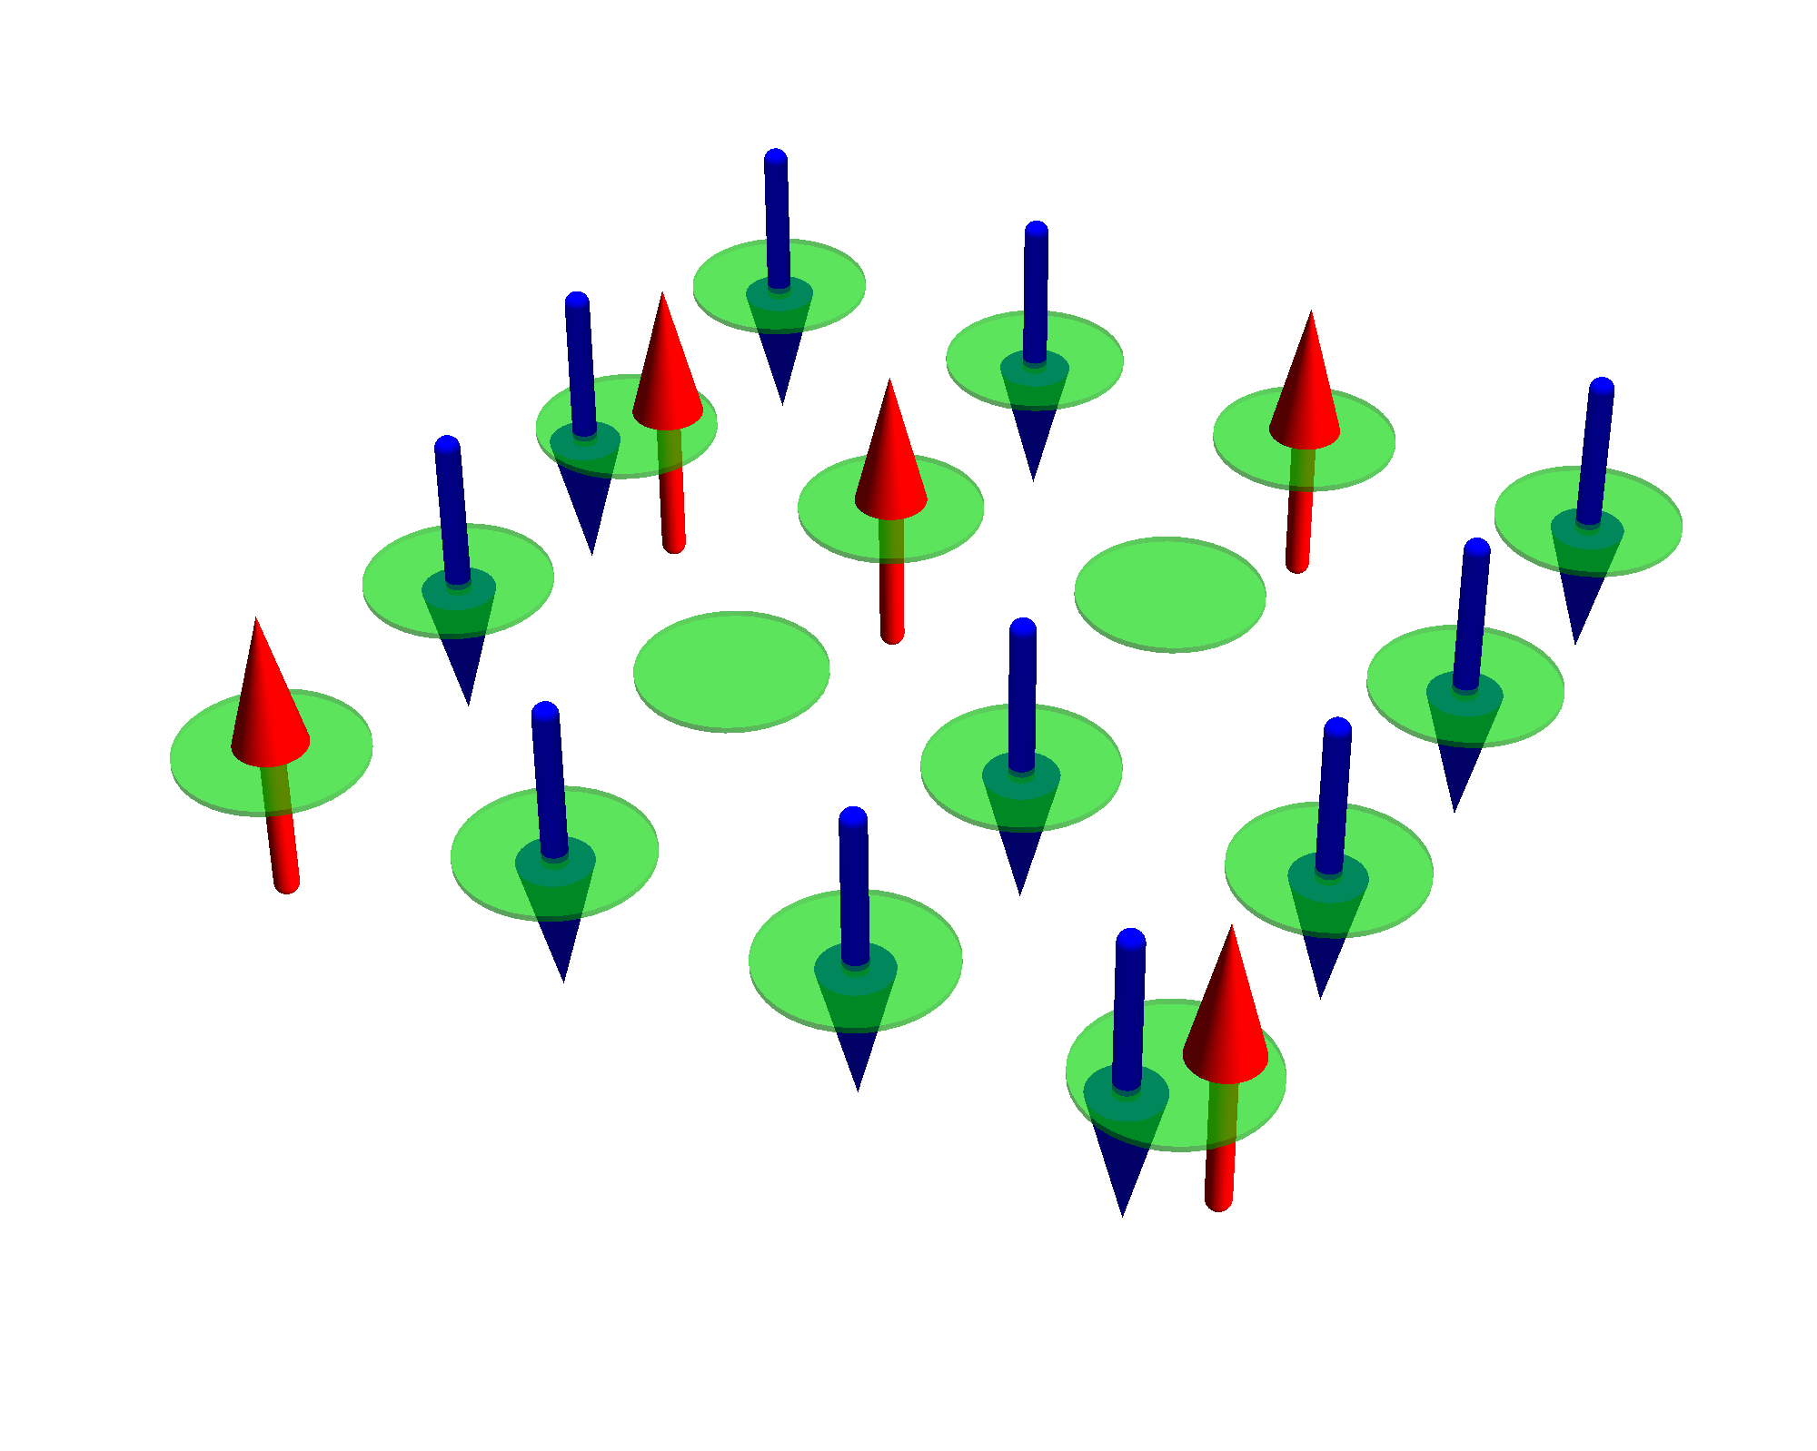
Exponential scaling of quantum mechanics
Example cluster of H atoms
# spin-
orbitals
# electrons
# atoms
# states
1 | 2 | 1 |  | ( ) | 2
2 | 4 | 2 |  | ( ) | 6
4 | 8 | 4 |  | ( ) | 70
6 | 12 | 6 |  | ( ) | 924
8 | 16 | 8 |  | ( ) | 12 870
10 | 20 | 10 |  | ( ) | 184 756
12 | 24 | 12 |  | ( ) | 2 704 156
14 | 28 | 14 |  | ( ) | 40 116 600
16 | 32 | 16 |  | ( ) | 601 080 390
2
1
4
2
8
4
12
6
16
8
20
10
Cluster of H atom
only include the 1s orbital
24
12
28
14
32
16

Slide 14
Exponential scaling of quantum mechanics
Example cluster of H atoms
# spin-
orbitals
# electrons
# atoms
# states
1 | 2 | 1 |  | ( ) | 2
2 | 4 | 2 |  | ( ) | 6
4 | 8 | 4 |  | ( ) | 70
6 | 12 | 6 |  | ( ) | 924
8 | 16 | 8 |  | ( ) | 12 870
10 | 20 | 10 |  | ( ) | 184 756
12 | 24 | 12 |  | ( ) | 2 704 156
14 | 28 | 14 |  | ( ) | 40 116 600
16 | 32 | 16 |  | ( ) | 601 080 390
18 | 36 | 18 |  | ( ) | 9 075 135 300
2
1
4
2
8
4
12
6
16
8
20
10
Cluster of H atom
only include the 1s orbital
24
12
28
14
32
16
36
18

Slide 15
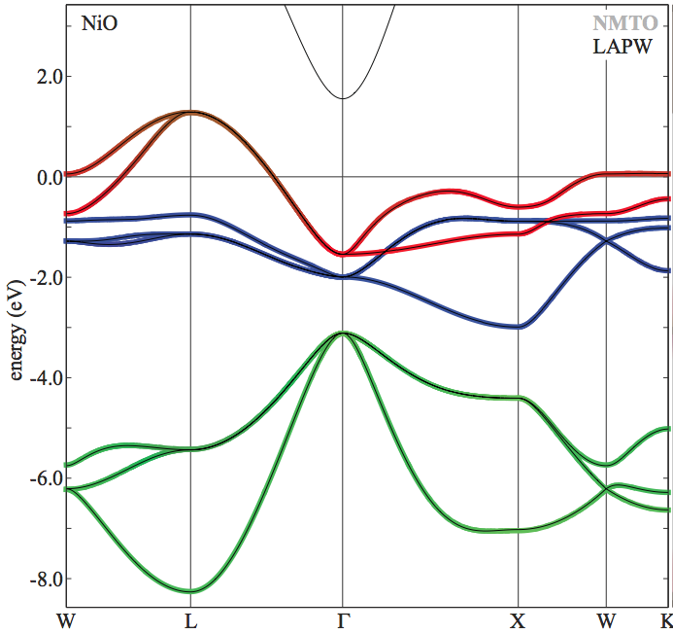
Exponential scaling of quantum mechanics
Example NiO
# spin-
orbitals
# electrons
# unit cells
# states
1 | 16 | 14 |  | ( ) | 120
16
14
NiO
Ni 3d and O 2p per unit cell
On LDA level NiO is metallic (in reality a good insulator)

Slide 16
Exponential scaling of quantum mechanics
Example NiO
# spin-
orbitals
# electrons
# unit cells
# states
1 | 16 | 14 |  | ( ) | 120
2 | 32 | 28 |  | ( ) | 35 960
16
14
32
28
NiO
Ni 3d and O 2p per unit cell
On LDA level NiO is metallic (in reality a good insulator)

Slide 17
Exponential scaling of quantum mechanics
Example NiO
# spin-
orbitals
# electrons
# unit cells
# states
1 | 16 | 14 |  | ( ) | 120
2 | 32 | 28 |  | ( ) | 35 960
3 | 48 | 42 |  | ( ) | 12 271 512
16
14
32
28
48
42
NiO
Ni 3d and O 2p per unit cell
On LDA level NiO is metallic (in reality a good insulator)

Slide 18
Exponential scaling of quantum mechanics
Example NiO
# spin-
orbitals
# electrons
# unit cells
# states
1 | 16 | 14 |  | ( ) | 120
2 | 32 | 28 |  | ( ) | 35 960
3 | 48 | 42 |  | ( ) | 12 271 512
4 | 64 | 56 |  | ( ) | 4 426 165 368
16
14
32
28
48
42
64
56
NiO
Ni 3d and O 2p per unit cell
On LDA level NiO is metallic (in reality a good insulator)

Slide 19
Exponential scaling of quantum mechanics
Example NiO
# spin-
orbitals
# electrons
# unit cells
# states
1 | 16 | 14 |  | ( ) | 120
2 | 32 | 28 |  | ( ) | 35 960
3 | 48 | 42 |  | ( ) | 12 271 512
4 | 64 | 56 |  | ( ) | 4 426 165 368
5 | 80 | 70 |  | ( ) | 1 646 492 110 120
16
14
32
28
48
42
64
56
80
70
NiO
Ni 3d and O 2p per unit cell
On LDA level NiO is metallic (in reality a good insulator)

Slide 20
Exponential scaling of quantum mechanics
Example NiO
# spin-
orbitals
# electrons
# unit cells
# states
1 | 16 | 14 |  | ( ) | 120
2 | 32 | 28 |  | ( ) | 35 960
3 | 48 | 42 |  | ( ) | 12 271 512
4 | 64 | 56 |  | ( ) | 4 426 165 368
5 | 80 | 70 |  | ( ) | 1 646 492 110 120
6 | 96 | 84 |  | ( ) | 624 668 654 531 480
16
14
32
28
48
42
64
56
80
70
96
84
NiO
Ni 3d and O 2p per unit cell
On LDA level NiO is metallic (in reality a good insulator)

Slide 21
Exponential scaling of quantum mechanics
Example NiO
# spin-
orbitals
# electrons
# unit cells
# states
1 | 16 | 14 |  | ( ) | 120
2 | 32 | 28 |  | ( ) | 35 960
3 | 48 | 42 |  | ( ) | 12 271 512
4 | 64 | 56 |  | ( ) | 4 426 165 368
5 | 80 | 70 |  | ( ) | 1 646 492 110 120
6 | 96 | 84 |  | ( ) | 624 668 654 531 480
7 | 112 | 98 |  | ( ) | 240 260 199 935 164 200
16
14
32
28
48
42
64
56
80
70
96
84
NiO
Ni 3d and O 2p per unit cell
On LDA level NiO is metallic (in reality a good insulator)
112
98

Slide 22
Exponential scaling of quantum mechanics
Example NiO
# spin-
orbitals
# electrons
# unit cells
# states
1 | 16 | 14 |  | ( ) | 120
2 | 32 | 28 |  | ( ) | 35 960
3 | 48 | 42 |  | ( ) | 12 271 512
4 | 64 | 56 |  | ( ) | 4 426 165 368
5 | 80 | 70 |  | ( ) | 1 646 492 110 120
6 | 96 | 84 |  | ( ) | 624 668 654 531 480
7 | 112 | 98 |  | ( ) | 240 260 199 935 164 200
…
16
14
32
28
48
42
64
56
80
70
96
84
NiO
Ni 3d and O 2p per unit cell
On LDA level NiO is metallic (in reality a good insulator)
112
98

Slide 23
What to do….
If you want / need to keep all correlations and have a solid, …. You’re basically still screwed. ☺
Here, start the approximations from the other side.
Include all correlations, but approximate the periodicity of the crystal.
Good for local properties in insulators.
Magnetic susceptibility, Orbital occupation, Valence, Excitonic spectra.
Start simple and introduce a language needed for discussing correlated materials: orbital – Slater determinant, valence fluctuations, multiplet
Beyond, … large research field with many achievements I do not talk about today.
Green’s functions, self energy + approximations

Slide 24
Quanty
Many possible models,
Many possible types of spectroscopy, response functions, properties to calculate, some work in a specific model, some don’t
Implement a script language that solves quantum many body problems using the best of quantum physics and quantum chemistry that allows you to define different models and calculate spectra

Slide 26
Introducing language – Second quantization
Many particle wave function
with

Slide 27
Introducing language – Second quantization
For H atom
Many particle wave function
  One particle orbital
  With quantum number

Slide 28
Introducing language – Second quantization
For He atom
Many particle wave function
Assume orbitals have similar structure as H orbitals and take as an ansatz the state:
  One particle orbital
  With quantum number
with
And optimize to find lowest energy

Slide 29
Introducing language – Second quantization
One problem: 4 solutions
Many particle wave function
  One particle orbital
  With quantum number
  Pauli: postulate: no math reason, but new physics:
Two electrons can not be in the same spin-orbital
They are all orthogonal to each other

Slide 30
Introducing language – Second quantization
One problem: 4 solutions
Many particle wave function
  One particle orbital
  With quantum number
  Pauli: postulate: no math reason, but new physics:
Two electrons can not be in the same spin-orbital
  Oh Oh still two states left …. Eh ….
  Must hold for any basis, see what happens when rotating the spin quantization axis
They are all orthogonal to each other

Slide 31
Introducing language – Second quantization

Slide 32
Introducing language – Second quantization

Slide 33
Introducing language – Second quantization
He ansatz wavefunction
Many particle wave function
  One particle orbital
  With quantum number
  Pauli: postulate: no math reason, but new physics:
Two electrons can not be in the same spin-orbital for any basis (anti-symmetrize)

Slide 34
Introducing language – Second quantization
He ansatz wavefunction
Many particle wave function
  One particle orbital
  With quantum number
  Pauli: postulate: no math reason, but new physics:
Two electrons can not be in the same spin-orbital for any basis (anti-symmetrize)

Slide 35
Introducing language – Second quantization
He ansatz wavefunction
Many particle wave function
  One particle orbital
  With quantum number
  Single Slater determinant

Slide 36
Introducing language – Second quantization
Li ansatz wavefunction

Slide 37
Introducing language – Second quantization
Ne ansatz wave function
  Not practical, need a different notation

Slide 38
Introducing language – Second quantization

Slide 39
Introducing language – Second quantization

Slide 40
Introducing language – Second quantization

Slide 41
Introducing language – Second quantization
Paul: postulate: no math reason, but new physics:
Two electrons can not be in the same spin-orbital for any basis (anti-symmetrize)

Slide 42
Introducing language – Second quantization
  One particle orbital
  With quantum number
  Single Slater determinant
Many particle wave function

Slide 44
Operators in second quantization
How to calculate:
or:
Distinguish two cases

Slide 45
Operators in second quantization
One particle operators
Two particle operators

Slide 46
Operators in second quantization
One particle operators
Proof: homework
with,
Two particle operators
with,

Slide 48
Transitions, spectroscopy and Green’s functions

Slide 49
Quiz: what happens when a photon hits an atom?
For example an H atom with one electron in the s-shell
A) At some point in time the photon gets absorbed, the photon disappears and the electron in the s-shell is excited to the p-shell
B) Photons are electromagnetic waves. The electron starts to oscillate around the nucleus with the photon frequency
C) Electrons are particles. The photon bounces like a ball of the electron, thereby transferring part of its energy to the electron
Notes:
I know that the 1s to 2p excitation of H is not in the x-ray range ( ¾ Rydberg, 10.2 eV) but all our theories are conveniently rather independent from the actual energy scale. (Linear response does not depend on the value of omega) For the purist replace H by Fe25+ (also a single electron around a nucleus, but as Z=26 in this case the excitation energy is 26^2 * ¾ = 507 Rydberg or 6898 eV)

Slide 50
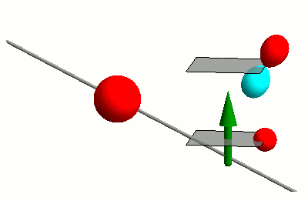
Interaction of photons with matter
RIXS
nIXS

Slide 51
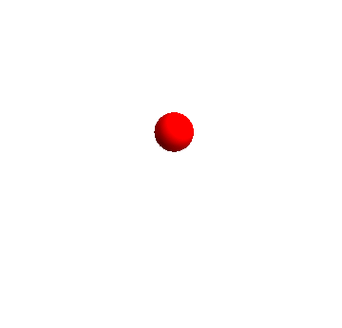
Interaction of photons with matter
RIXS
nIXS

Slide 52
Time dependent perturbation theory
Fermi’s golden rule

Slide 53
Time dependent perturbation theory
Fermi’s golden rule
Green’s function – spectral representation (energy domain)

Slide 54
Time dependent perturbation theory
Fermi’s golden rule
Green’s function – spectral representation (energy domain)
Green’s function – (time domain)

Slide 55


Slide 56
Time dependent perturbation theory
Fermi’s golden rule
Green’s function – spectral representation (energy domain)
Green’s function – (time domain)

Slide 57
Time dependent perturbation theory
Green’s function – (time domain)
At time t=0 an excitation is created
In spectroscopy one probes if at time t the excitation is still at the same place, or if it moved away.
Spectroscopy probes the dynamics of the system

Slide 58
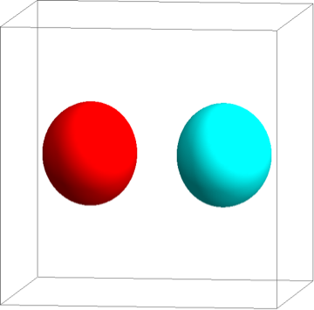
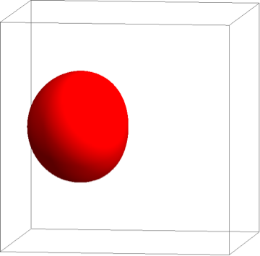
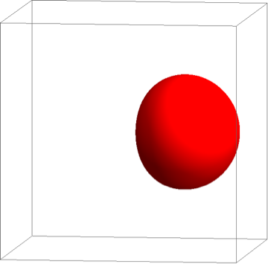
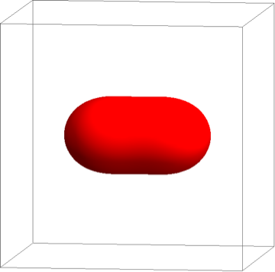
Example on an H₂ molecule
1s
1s

Slide 59
Example on an H₂ molecule
1s
1s

Slide 60
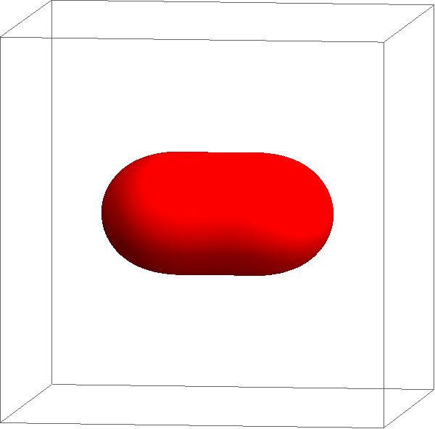
Example on an H₂ molecule
1s
1s

Slide 61

Example on an H₂ molecule
Intensity
Excitation energy

Slide 62

Example on an H₂ molecule – with correlations

Slide 63
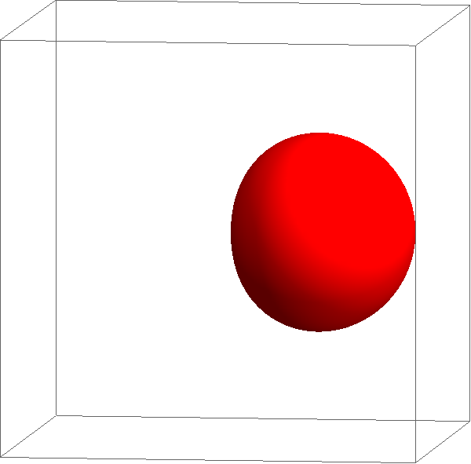
Example on an H₂ molecule – with correlations

Slide 64
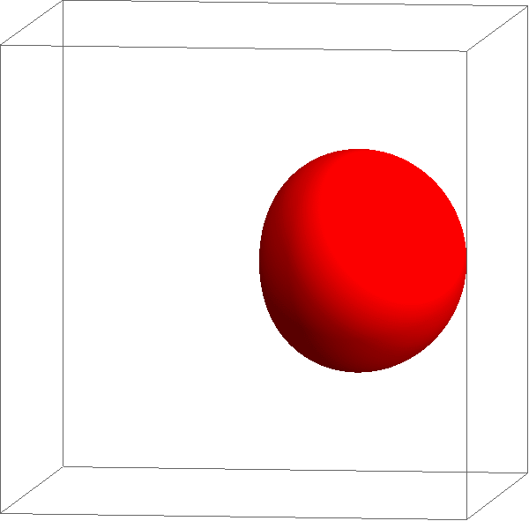
Example on an H₂ molecule – with correlations

Slide 65
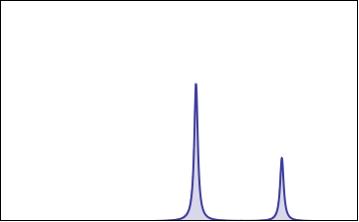
Example on an H₂ molecule – with correlations
Intensity
Excitation energy

Slide 66
Example on an H₂ molecule – with correlations
1s
1s
Intensity
Excitation energy

Slide 67
The problem is (almost) never in the transition operator
Fermi’s golden rule

Slide 68
The problem is (almost) never in the transition operator
Fermi’s golden rule
Green’s function – spectral representation (energy domain)

Slide 69
The problem is (almost) never in the transition operator
Fermi’s golden rule
Green’s function – spectral representation (energy domain)
Green’s function – (time domain)

Slide 70
The description of all the eigenstates can be hard
Fermi’s golden rule
Green’s function – spectral representation (energy domain)
Green’s function – (time domain)

Slide 71
The calculation of the resolvent of the Hamiltonian
Fermi’s golden rule
Green’s function – spectral representation (energy domain)
Green’s function – (time domain)

Slide 72
The time evolution of the excited state can be hard
Fermi’s golden rule
Green’s function – spectral representation (energy domain)
Green’s function – (time domain)

Slide 73
Spectroscopy – different T, same equations
PES
Optics

Slide 74
X-ray spectroscopy – different T, same equations
PES
XAS
RXD
RIXS
nIXS
cPES
NEXAFS
XES
X-Raman
XPS
XAFS
FY

Slide 75
Non-linear Spectroscopy – different T, same equations
Pump Probe
XAS
PES
XAS
RXD
RIXS
cPES
NEXAFS
XES
XPS
XAFS
FY

Slide 76
Three classes of excitations – different approximations on H
Band excitations
Resonances
Excitons

Slide 77
Tutorial 1

