Slide 1
Core level spectroscopy of transition metal and rare earth compounds
Transition metal and rare earth compounds show a wealth of different properties. They are used as materials for energy storage (battery compounds), dyes in solar cells, elements in the read head of hard disks, high temperature superconductors, or the active centers in many of the known enzymes. The large variety of tunable properties of these materials is related to the large number of low energy degrees of freedom of the transition metal or rare earth ion. Correlations between the electrons in a solid lead to a detailed interplay between the local spin, charge, orbital and lattice degrees of freedom. The result is extremely rich physics of these open shell systems. At the same time the interplay between several low energy degrees of freedom make these materials involved to understand. Although enormous theoretical progress has been made during the last years in the understanding of correlated materials one often needs experimental input to understand particular phenomenon.
Core level spectroscopy in many cases turns out to be a very efficient method to study the many body properties of these systems. Core level photoelectron spectroscopy allows one to determine how the low energy Hamiltonian arises from the high-energy scale interactions. It thus provides information on the low energy model parameters of the system. X-ray absorption spectroscopy contains information on the local electronic structure. It provides information on the symmetry of the wave function, such as the local spin-state or orbital occupation. Resonant x-ray diffraction is related to x-ray absorption, in addition to x-ray absorption it allows one to study the special dependence of local electronic order in the system. Resonant inelastic x-ray scattering allows one to study the dynamics of low energy excitations. Non-resonant inelastic x-ray scattering of core level excitations is a technique rather comparable to x-ray absorption spectroscopy with the difference that it allows for non-dipole transitions, useful in the study of involved orbital or multipole ordering.
For the understanding of these spectra, in this class of materials, it is important to realize that one needs to treat the interactions between the electrons beyond mean field approximations. It is not sufficient to assume independent electrons interacting with an average potential, but one has to consider the interaction between each pair of electrons explicitly. In the spectra, this leads to excitons and multiplets that dominate the spectral line-shape.
In this talk I will discuss these various forms of core level spectroscopy, which material properties one can obtain with these techniques and how to theoretically understand these spectra. During the tutorial, I will introduce Quanty, (www.quanty.org) a versatile many body quantum script language that allows one to relatively easily write small programs that can calculate core level spectra of a variety of materials using different levels of approximation or models.

Slide 2
Core level spectroscopy
of transition metal and rare earth compounds
http://www.thphys.uni-heidelberg.de/~haverkort/teaching/
Maurits W. Haverkort
Institute for theoretical physics, Heidelberg University, Heidelberg, Germany
M.W.Haverkort@thphys.uni-heidelberg.de

Slide 3
Quiz: what happens when a photon hits an atom?
For example an H atom with one electron in the s-shell
A) At some point in time the photon gets absorbed, the photon disappears and the electron in the s-shell is excited to the p-shell
B) Photons are electromagnetic waves. The electron starts to oscillate around the nucleus with the photon frequency
C) Electrons are particles. The photon bounces like a ball of the electron, thereby transferring part of its energy to the electron
Notes:
I know that the 1s to 2p excitation of H is not in the x-ray range ( ¾ Rydberg, 10.2 eV) but all our theories are conveniently rather independent from the actual energy scale. (Linear response does not depend on the value of omega) For the purist replace H by Fe25+ (also a single electron around a nucleus, but as Z=26 in this case the excitation energy is 26^2 * ¾ = 507 Rydberg or 6898 eV)

Slide 4
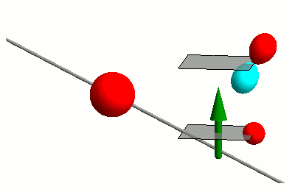
Interaction of photons with matter
RIXS
nIXS

Slide 5

Interaction of photons with matter
RIXS
nIXS

Slide 6
Response theory (linear)
Fermi’s golden rule
Energy conservation
Initial state
Final state

Slide 7
Response theory (linear)
Fermi’s golden rule
The math simplifies with the use of Green’s functions

Slide 8
Response theory (linear)
Fermi’s golden rule
The math simplifies with the use of Green’s functions

Slide 9
Response theory (linear)
Fermi’s golden rule
The math simplifies with the use of Green’s functions

Slide 10
Response theory
First order response functions
Higher order response functions (two photon, second order)

Slide 11
Second talk
XAS
RXD
RIXS
nIXS

Slide 12
Need tools to measure: Orbital, Spin, Charge
X-ray Absorption Spectroscopy (XAS) at the TM 2p to 3d edge
Technique developed in late 1980’s
Fink, Sawatzky, Fuggle
Thole, van der Laan
Chen, Sette
2p

Slide 13
Need tools to measure: Orbital, Spin, Charge
X-ray Absorption Spectroscopy (XAS) at the TM 2p to 3d edge
Resonant X-ray Diffraction (RXD)
Hannon, Trammel, Bloom, Gibbs
Phys. Rev. Lett. 61, 1245 (1988)
Phys. Rev. B 43, 5663 (1991)
Cara, Thole
Rev. Mod. Phys. 66, 1509 (1994)
2p

Slide 14
Need tools to measure: Orbital, Spin, Charge
X-ray Absorption Spectroscopy (XAS) at the TM 2p to 3d edge
Resonant X-ray Diffraction (RXD)
Resonant Inelastic X-ray Scattering (RIXS)
Theory prediction of magnetic excitations
J. Luo, G. T. Trammell, and J. P. Hannon,
Phys. Rev. Lett. 71, 287 (1993).
F.M.F. de Groot, P. Kuiper, and G. A. Sawatzky,
Phys. Rev. B 57, 14584 (1998).
Experimental realization
L. Braicovich, G. Ghiringhelli, N. B. Brookes, et al.
Phys. Rev. Lett. 102, 167401 (2009).
2p

Slide 15
Need tools to measure: Orbital, Spin, Charge
X-ray Absorption Spectroscopy (XAS) at the TM 2p to 3d edge
Resonant X-ray Diffraction (RXD)
Resonant Inelastic X-ray Scattering (RIXS)
non-resonant Inelastic X-ray Scattering (IXS)
Nobelprize Compton
Light elements – band excitations:
Keijo Hämäläinen, W. Schulke
Excitonic excitations TM and RE compounds:
B. C. Larson et al. PRL 99, 026401 (2007)
M. W. Haverkort et al. PRL 99, 257401 (2007)
R. A. Gordon, et al. EPL 81, 26004 (2008)
T. Willers, et al. PRL 109, 046401 (2012)
3p

Slide 16
non-resonant Inelastic X-ray Scattering (IXS)
X-ray Absorption Spectroscopy (XAS) at the TM 2p to 3d edge
3p

Slide 17
Back to XAS
X-ray Absorption Spectroscopy (XAS) at the TM 2p to 3d edge
Technique developed in late 1980’s
Fink, Sawatzky, Fuggle
Thole, van der Laan
Chen, Sette
2p

Slide 18
Two ways to calculate XAS

Slide 19
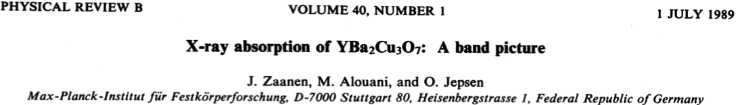
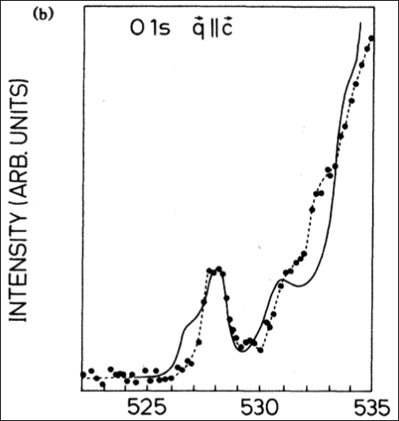
Two ways to calculate XAS – bands
1s

Slide 20
Two ways to calculate XAS – excitons
Theory
Experiment
Start from LDA potential
Create Wannier functions
On this basis and potential build local Hamiltonian including all local many body interactions
Solve by exact diagonalization
Phys. Rev. B 85, 165113 (2012)
2p

Slide 21
Interpretation without theory – sum rules
Theory
Experiment
2p

Slide 22
Sum rules for circular dichroism: orbital and spin momentum

Slide 23
Sum rules for circular dichroism: orbital and spin momentum

Slide 24
Sum rules for circular dichroism: orbital and spin momentum

Slide 25
Sum rules for circular dichroism: orbital and spin momentum

Slide 26
Sum rules for circular dichroism: orbital and spin momentum

Slide 27
Sum rules for circular dichroism: orbital and spin momentum

Slide 28
Sum rules for linear dichroism: orbital occupation

Slide 29
XAS and the conductivity tensor (σ) – an example for s to p
Real
Imaginary
Absorption –Im[σ]
(in Landau Lifschitz absorption is Re[σ])
ω₀

Slide 30
But the conductivity tensor (σ) is a TENSOR

Slide 31
But the conductivity tensor (σ) is a TENSOR
Absorption
–Im[ε.σ.ε]

Slide 32
But the conductivity tensor (σ) is a TENSOR
Spectrum measured with
x-polarized light

Slide 33
But the conductivity tensor (σ) is a TENSOR
Spectrum measured with
y-polarized light

Slide 34
But the conductivity tensor (σ) is a TENSOR
Spectrum measured with
z-polarized light

Slide 35
But the conductivity tensor (σ) is a TENSOR
Spectrum measured with
(y+z)-polarized light

Slide 36
But the conductivity tensor (σ) is a TENSOR
Spectrum measured with
(y+z)-polarized light
½

Slide 37
But the conductivity tensor (σ) is a TENSOR
Spectrum measured with
(y+z)-polarized light
½

Slide 38
But the conductivity tensor (σ) is a TENSOR
Spectrum measured with
(y+z)-polarized light
½

Slide 39
But the conductivity tensor (σ) is a TENSOR
Spectrum measured with
(y+z)-polarized light
½

Slide 40
The conductivity tensor (σ) in cubic symmetry

Slide 41
The conductivity tensor (σ) in tetragonal symmetry

Slide 42
The conductivity tensor (σ) in orthorhombic symmetry

Slide 43
The conductivity tensor (σ) in monoclinic symmetry

Slide 44
The conductivity tensor (σ) in triclinic symmetry

Slide 45
The conductivity tensor (σ) in magnetic materials

Slide 46
The conductivity tensor (σ) in magnetic materials

Slide 47
Sum rules for circular dichroism: orbital and spin momentum

Slide 48
Thole et al.’s sum-rules in tensor form. s to p excitations

Slide 49
And now momentum, i.e. spatial resolved, from XAS to RXD
X-ray Absorption Spectroscopy (XAS) at the TM 2p to 3d edge
Resonant X-ray Diffraction (RXD)
Hannon, Trammel, Bloom, Gibbs
Phys. Rev. Lett. 61, 1245 (1988)
Phys. Rev. B 43, 5663 (1991)
Cara, Thole
Rev. Mod. Phys. 66, 1509 (1994)
2p

Slide 50
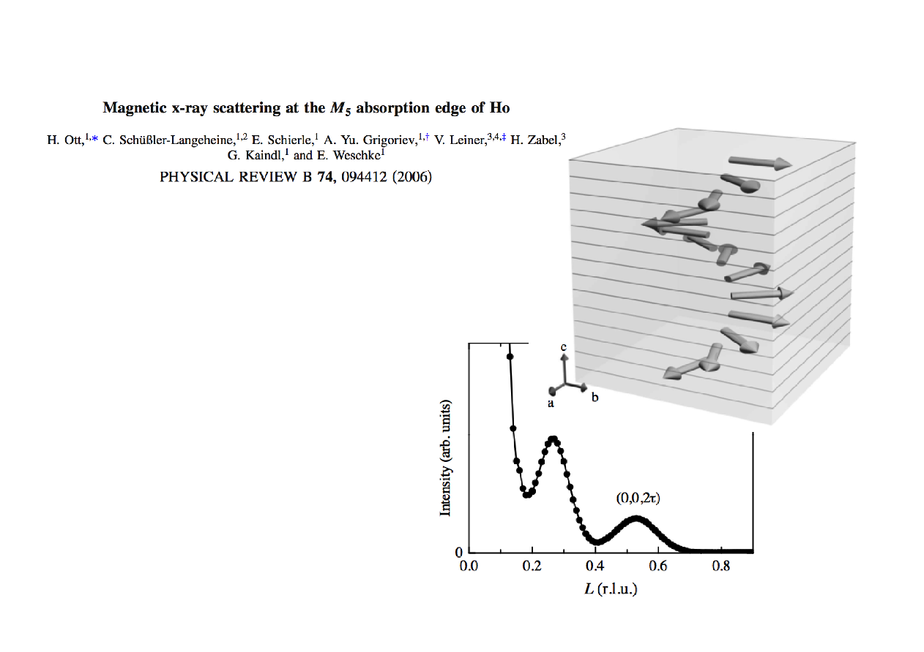
An example magnetic Bragg reflection of Ho metal film
2p

Slide 51
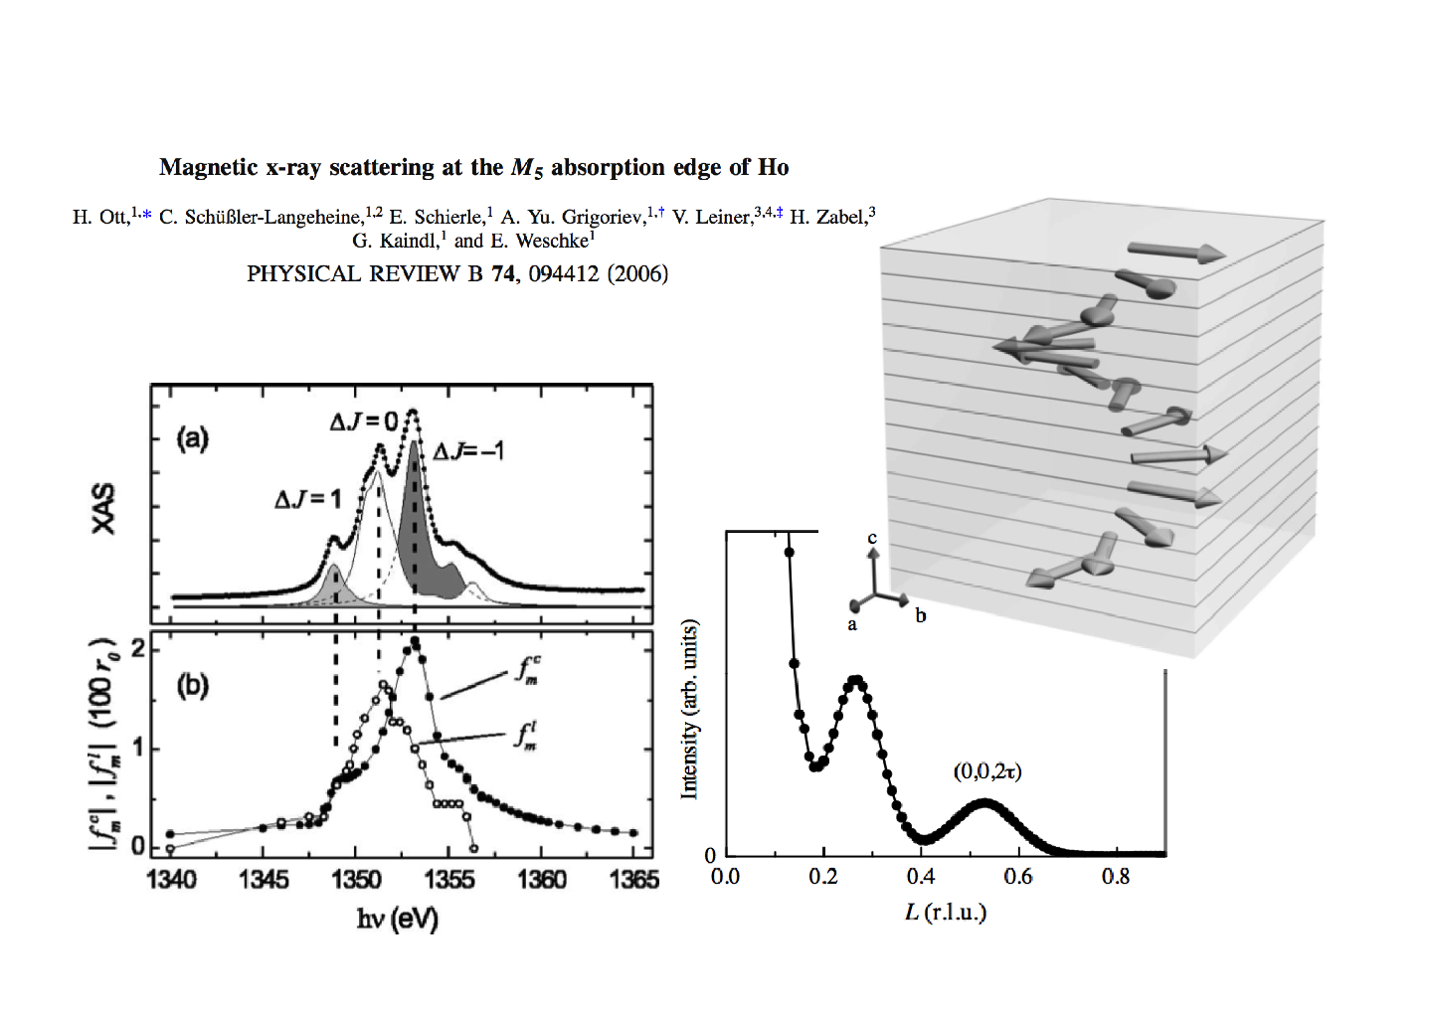
An example magnetic Bragg reflection of Ho metal film

Slide 52
Absorption and diffraction – two sides of the same coin

Slide 53
Absorption and diffraction – two sides of the same coin
Crystalline sollid
Each site gets polarized by the photon field and the local charge density starts to oscillate.
Absorption
Scattering
σ_{i}
σ_{i}
σ_{i}
σ_{i}

Slide 54
Relation between resonant x-ray diffraction and absorption
2p
2p

Slide 55
Absorption and diffraction – two sides of the same coin
Crystalline sollid
Each site gets polarized by the photon field and the local charge density starts to oscillate.
Absorption
Scattering
σ_{i}
σ_{i}
σ_{i}
σ_{i}
Diffraction at given momentum determined by the sum of local scattering with correct phase:

Slide 56
An example magnetic Bragg reflection of Ho metal film

Slide 57
Fundamental spectra from the literature

Slide 58
Fundamental spectra from the literature

Slide 59
Fundamental spectra from the literature

Slide 60
Fundamental spectra from the literature

Slide 61
An example magnetic Bragg reflection of Ho metal film

Slide 62
Can we use sum-rules to get quantitative information

Slide 63
Can we use sum-rules to get quantitative information

Slide 64
Can we use sum-rules to get quantitative information

Slide 65
Can we use sum-rules to get quantitative information

Slide 66
Can we use sum-rules to get quantitative information

Slide 67
Can we use sum-rules to get quantitative information

Slide 68
Solve Maxwell's equations (with side conditions)

Slide 69
And now excitations , from RXD to RIXS
X-ray Absorption
Spectroscopy
Resonant X-ray
Diffraction
Resonant Inelastic
X-ray scattering
2p
2p
2p

Slide 70
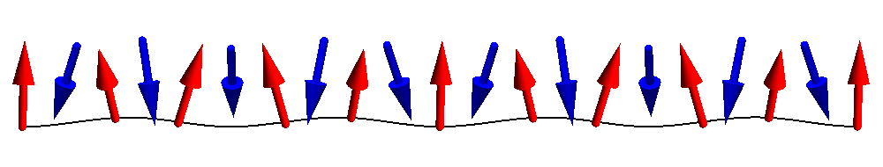
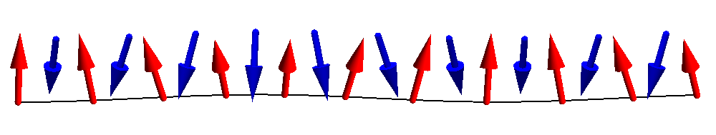
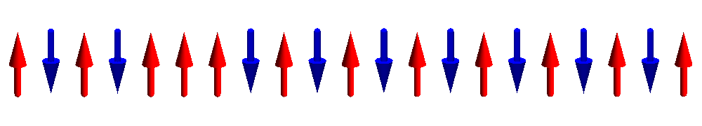
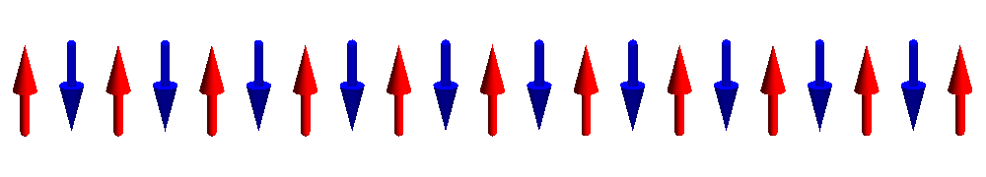
Dispersing magnons

Slide 71
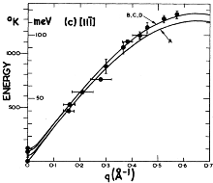
Dispersing magnons – Neutron scattering
Interaction of Neutrons with matter is well understood (magnetic dipole),
single magnon intensity
q-dispersion
M. T. Hutchings and E. J. Samuelsen,
Phys. Rev. B 6, 3447 (1972)

Slide 72
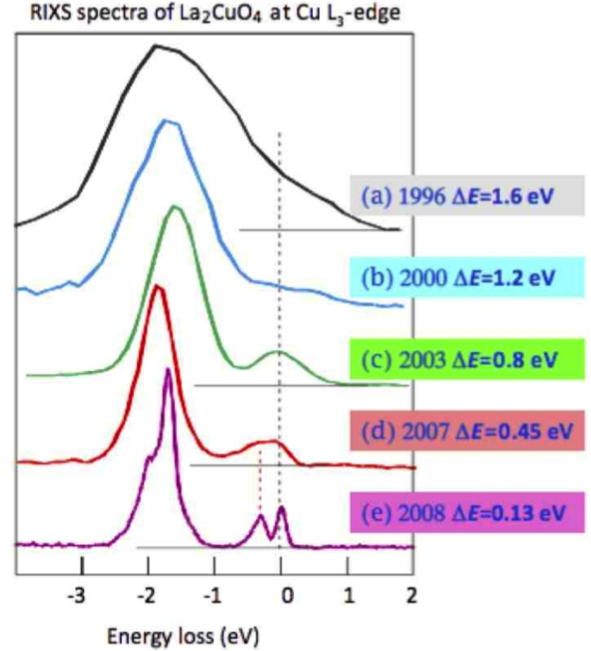
Recent development – measure spin dynamics with x-rays
Resonant Inelastic
X-ray Scattering
RIXS
It now becomes feasible to measure the dynamics of low energy excitations in:
thin films
surfaces
Interfaces
nano-crystals
molecules
Picture by G. Ghiringhelli and L. Braicovich

Slide 73
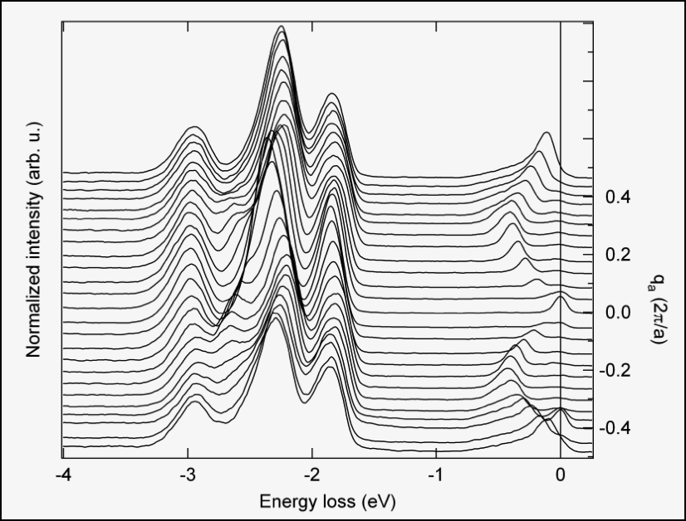
RIXS – very high quality data on small samples
orbitons
spinons

Slide 74
What is Resonant Inelastic X-ray Scattering (RIXS)
Intermediate state with core hole and one extra valence electron
Outgoing light of
~ 0.5 to 10 keV
minus
10 meV to 10 eV
Incoming light of
~ 0.5 to 10 keV

Slide 75
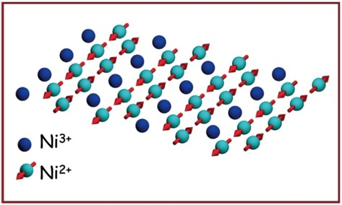
RIXS – what does one measure
Intermediate state
Initial state
Final state

Slide 76
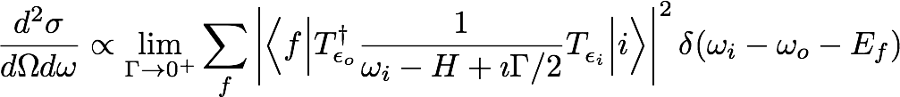
RIXS – what does one measure
Interaction of Neutrons with matter is easy (magnetic dipole),
but for resonant inelastic x-ray scattering nothing is obvious.
A lot is known though…

Slide 77
RIXS – what does one measure
Interaction of Neutrons with matter is easy (magnetic dipole),
but for resonant inelastic x-ray scattering nothing is obvious.
A lot is known though…

Slide 78
RIXS – what is the cross section
Interaction of Neutrons with matter is easy (magnetic dipole),
but for resonant inelastic x-ray scattering nothing is obvious.
A lot is known though…

Slide 79
RIXS – what does one measure
Interaction of Neutrons with matter is easy (magnetic dipole),
but for resonant inelastic x-ray scattering nothing is obvious.
A lot is known though…

Slide 80
RIXS – what does one measure
Interaction of Neutrons with matter is easy (magnetic dipole),
but for resonant inelastic x-ray scattering nothing is obvious.
A lot is known though…

Slide 81
RIXS – what does one measure
Interaction of Neutrons with matter is easy (magnetic dipole),
but for resonant inelastic x-ray scattering nothing is obvious.
A lot is known though…

Slide 82
RIXS – what does one measure
Interaction of Neutrons with matter is easy (magnetic dipole),
but for resonant inelastic x-ray scattering nothing is obvious.
A lot is known though…

Slide 83
RIXS – what does one measure
Interaction of Neutrons with matter is easy (magnetic dipole),
but for resonant inelastic x-ray scattering nothing is obvious.
A lot is known though…

Slide 84
RIXS – what does one measure
Interaction of Neutrons with matter is easy (magnetic dipole),
but for resonant inelastic x-ray scattering nothing is obvious.
A lot is known though…

Slide 85
XAS – XRD – RIXS – a time dependent picture

Slide 86

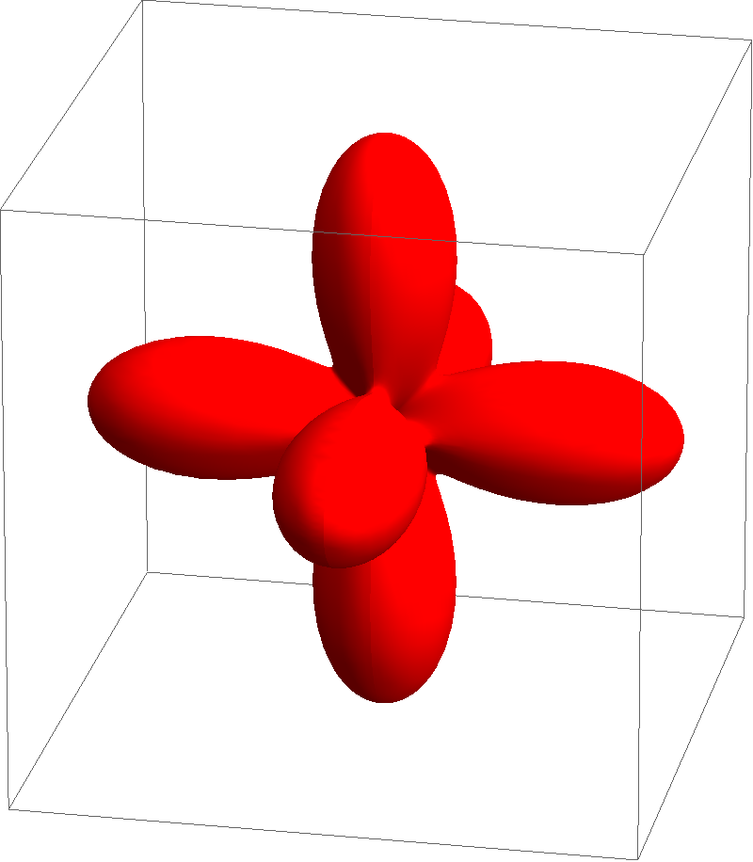
XAS – XRD – RIXS – a time dependent picture in NiO
e_{g}
t_{2g}

Slide 87
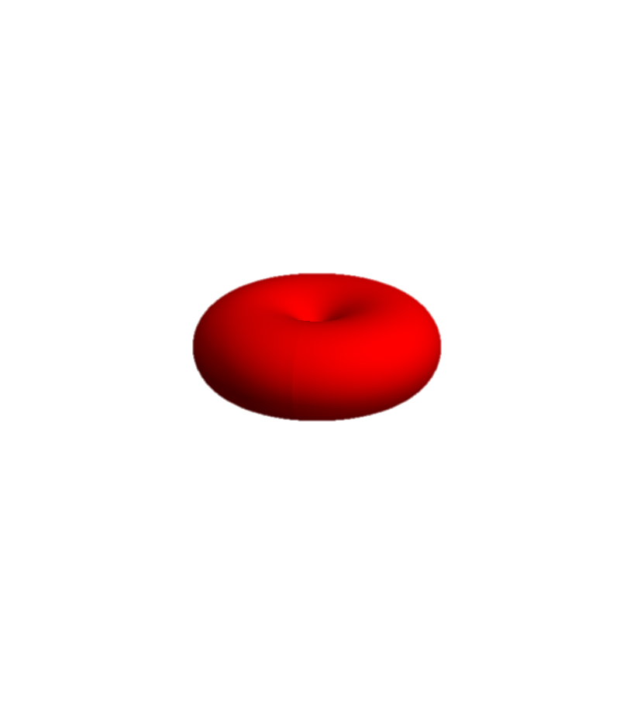
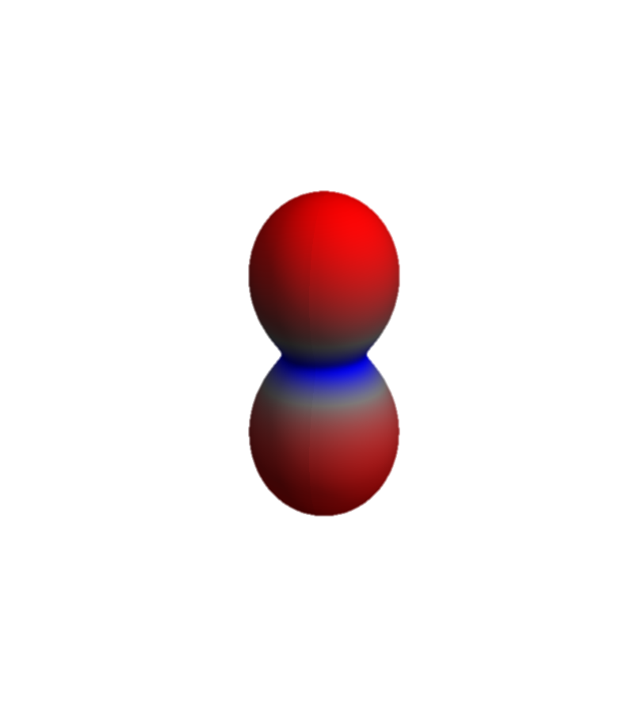
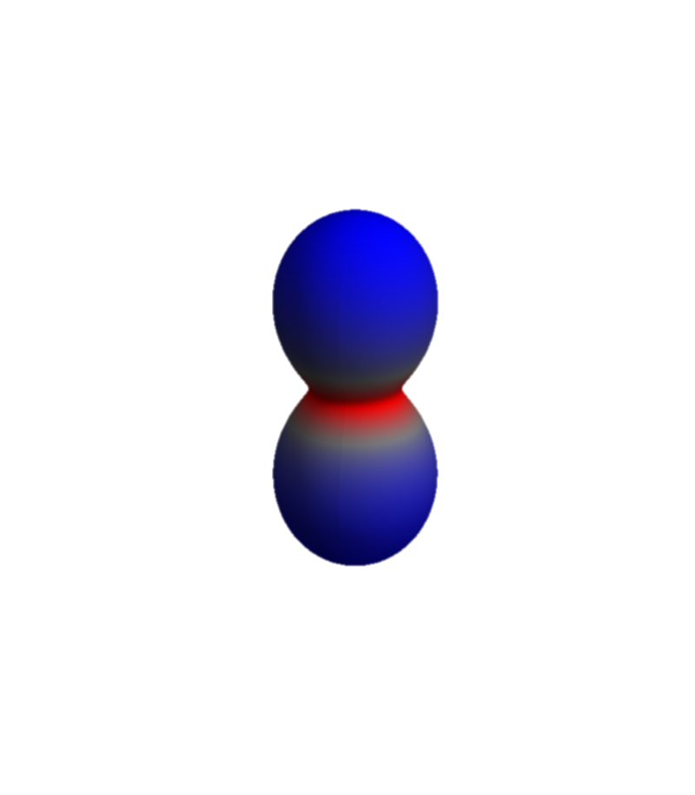
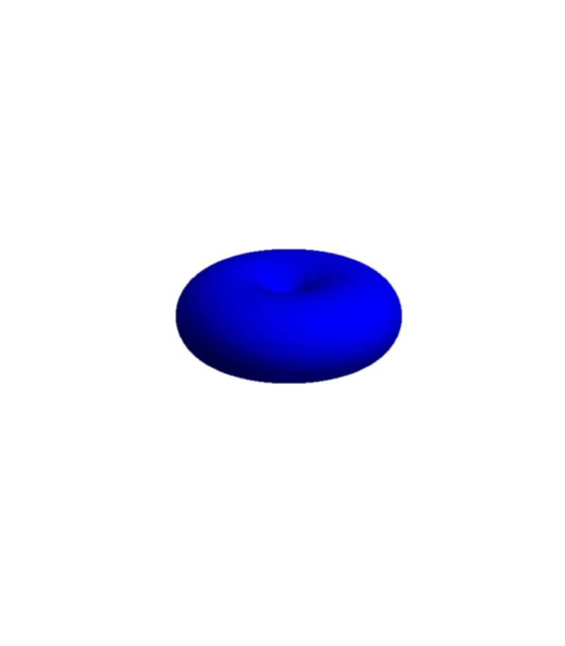
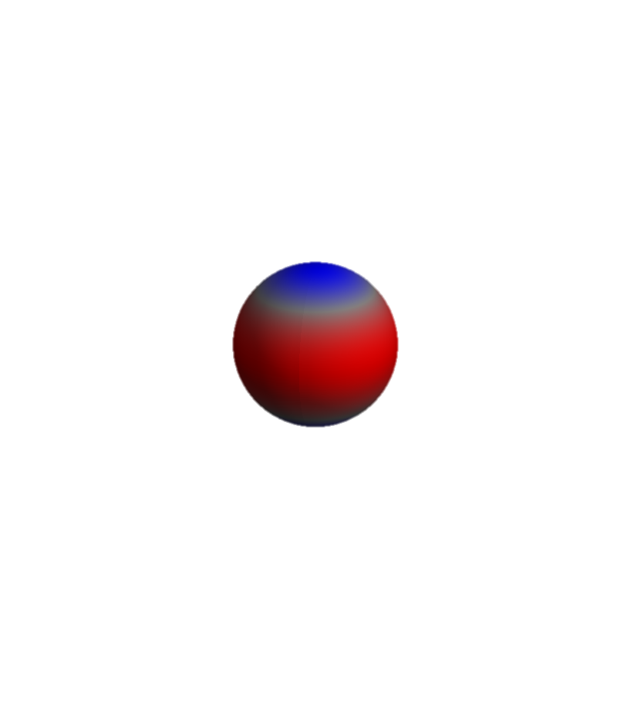
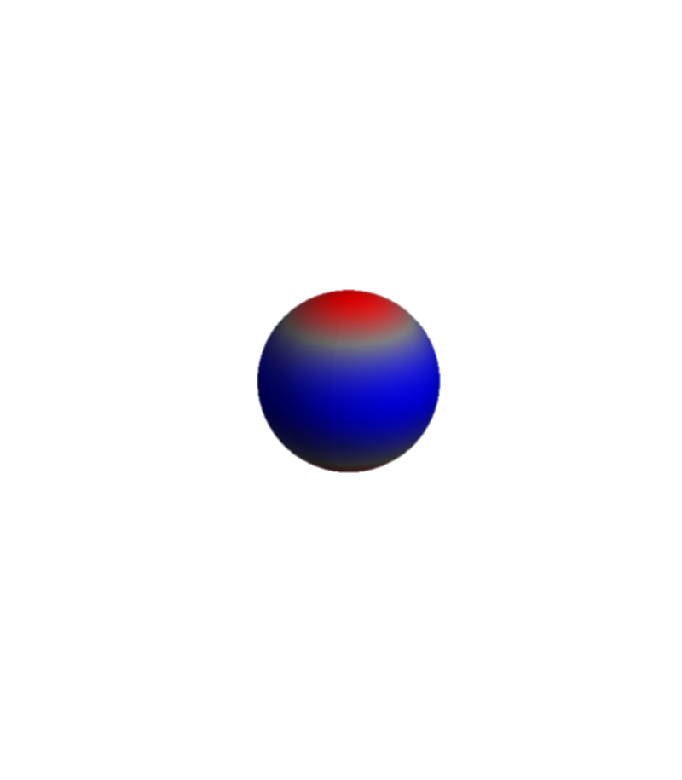
NiO – Ni 2p to Ni 3d excitation
Ni-3d and O-2p on level of DMFT. (locally all interactions included)
e_{g}
After excitation Auger decay is possible, and included:
Ni-3d, Ni-3p, or Ni-3s scatters into the Ni-2p core hole and a Ni-3d, Ni-3p or Ni-3s orbital is emitted into εs,p,d,f,g or h orbital
t_{2g}
Ni-3d and Ni-2p Coulomb interactions are local and included

Slide 88
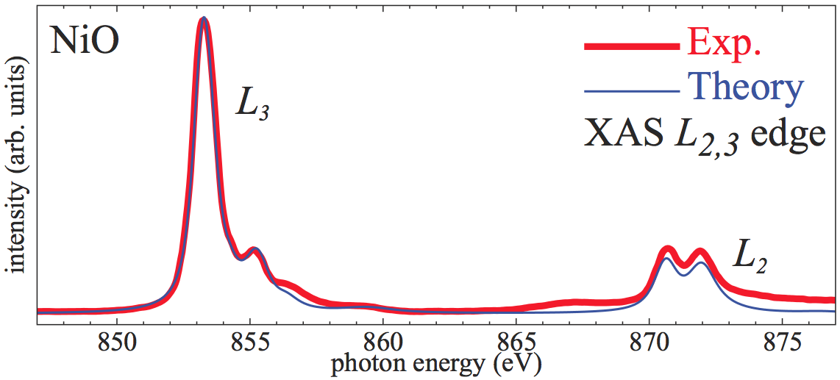
NiO – Ni 2p to Ni 3d excitation
X-ray absorption of NiO (L₂₃ edge) is well described.
How does the wave-function (charge density) evolve as a function of time when the sample is hit by an x-ray pulse?

Slide 89
NiO – Ni 2p to Ni 3d excitation
We include a light field of 1 kV per Angstrom (possible at SLAC) at an energy of 852 eV.
e_{g}
t_{2g}
Pulse duration is 100 atto seconds
Upto χ₇ (4-th-order) response functions are included

Slide 90
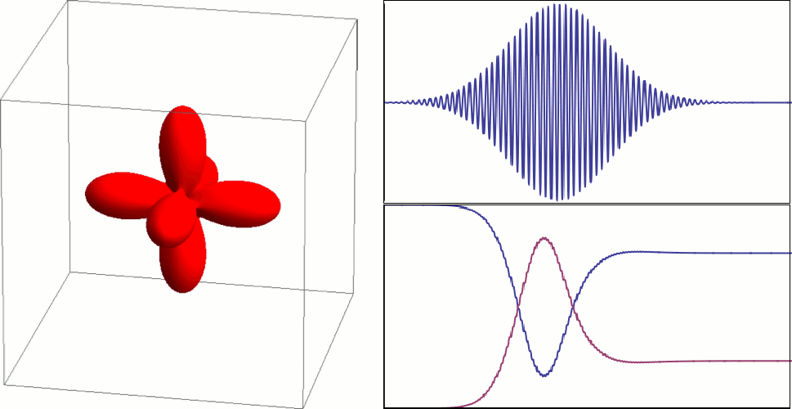
NiO 2p to 3d excitation in the time domain
Energy of pulse 852 eV
FWHM 100 as
41 eV
1 kV Å⁻¹
holes in Ni 3d-shell
holes in Ni 2p-shell
350 attosecond

Slide 91
RIXS – what does one measure
Interaction of Neutrons with matter is easy (magnetic dipole),
but for resonant inelastic x-ray scattering nothing is obvious.
A lot is known though…

Slide 92
RIXS – what does one measure
Interaction of Neutrons with matter is easy (magnetic dipole),
but for resonant inelastic x-ray scattering nothing is obvious.
A lot is known though…
BOOM

Slide 93


RIXS – what does one measure
Interaction of Neutrons with matter is easy (magnetic dipole),
but for resonant inelastic x-ray scattering nothing is obvious.
A lot is known though…

Slide 94
RIXS – what does one measure
Intermediate state
Initial state
Final state

Slide 95

Relations between absorption, elastic- and inelastic scattering
The elastic scattering tensor is related to the absorption by the optical theorem (Conservation of energy)
Elastic scattering is a limiting case of inelastic scattering:
If one restricts the inelastic scattering operator R to the ground-state one describes the elastic scattering
For the description of magnetic excitations:
Expand the scattering operator on spin operators

Slide 96


RIXS – effective operator – spin excitations
Effective operator for spin excitations only

Slide 97
RIXS – effective operator – spin excitations
Need to calculate x-ray absorption spectra
… and spin susceptibilities

Slide 98
RIXS – effective operator – spin excitations
Theory
Experiment
Need to calculate x-ray absorption spectra
σ⁽⁰⁾=

Slide 99
Predicted RIXS spectra with cross polarized light
spin susceptibility, same as neutron scattering

Slide 100
General polarization: RIXS is a mixture of 1 and 2 spin flips

Slide 101
Spin excitations in 1-dimension

Slide 102
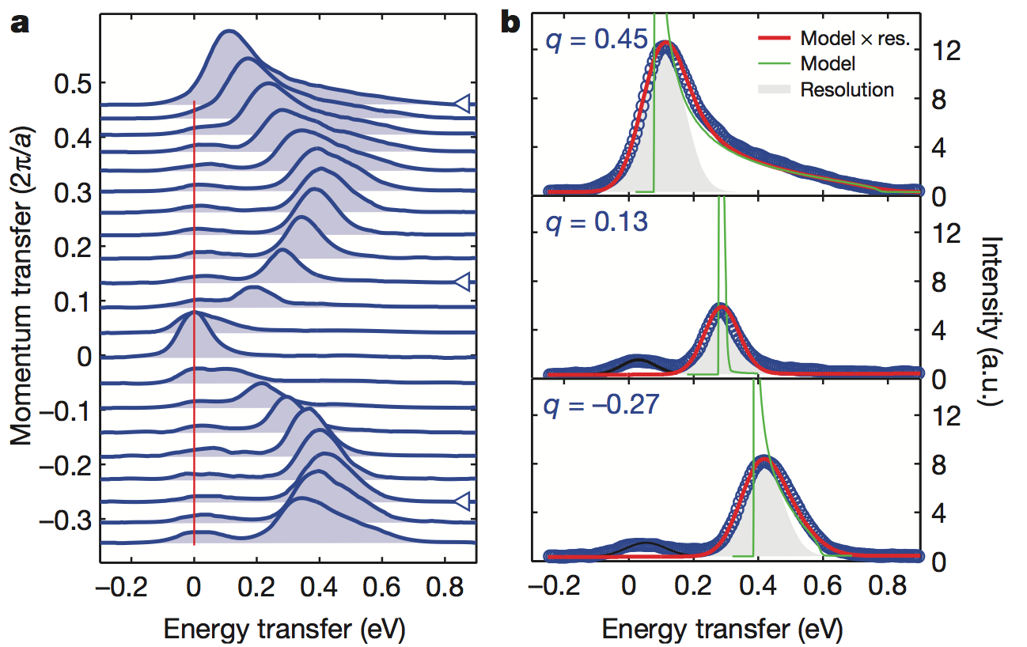
Spin excitations in 1 dimension – Sr₂CuO₃

Slide 103
Dispersing orbitals
orbitons
spinons

Slide 104
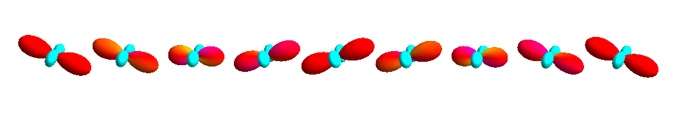
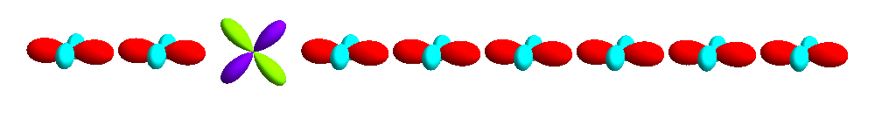
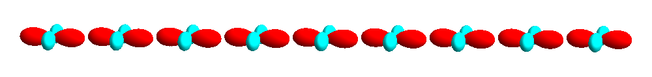
Dispersing orbitals

Slide 105
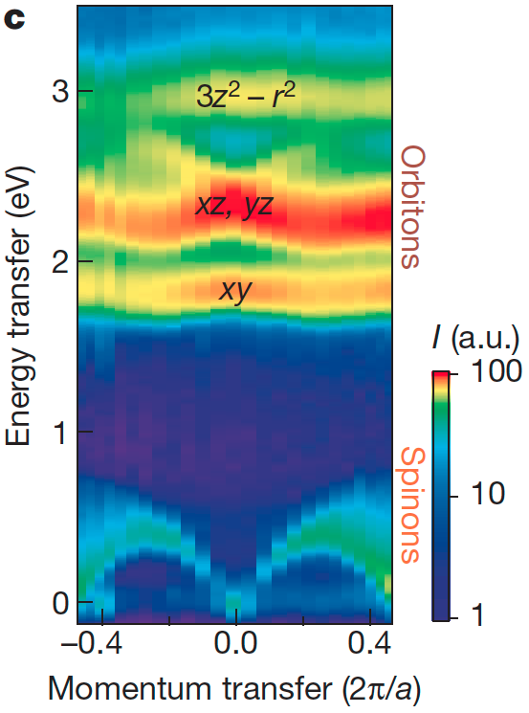
Dispersing orbitals

Slide 106
Additional literature
Core level spectroscopy of Solids
Frank M. F. de Groot and Akio Kotani
NEXAFS Spectroscopy
Joachim Stöhr
Introduction to ligand field theory (chapter 1 – 6)
Carl Johan Ballhausen (1962)
Physical Chemistry (chapter 13 – 18, (10 – 15) edition 5 (8))
Peter Atkins (2006)

