Slide 1
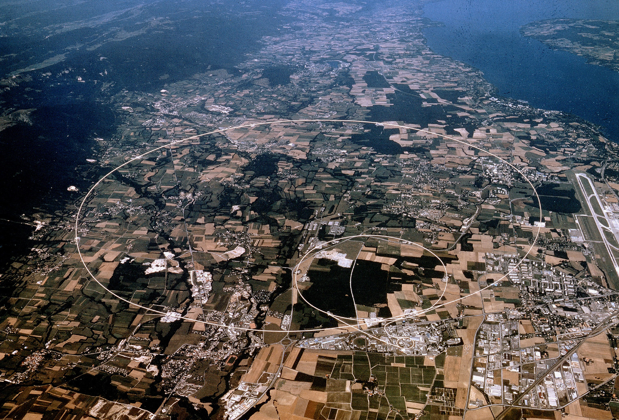
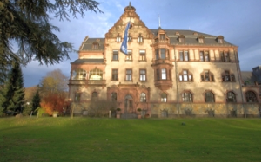

Searches for Exotica @ the LHC
Albert De Roeck
CERN, Geneva, Switzerland
Antwerp University Belgium
Davis University USA
September 20 2012

Slide 2
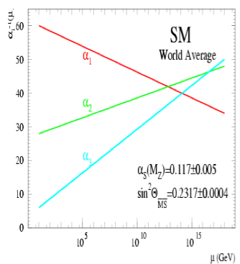
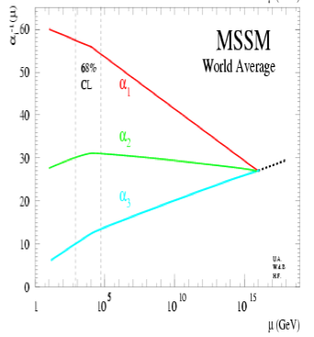
Physics case for new High Energy Machines
Understand the mechanism Electroweak Symmetry Breaking
Discover physics beyond the Standard Model
Reminder: The Standard Model
- tells us how but not why
3 flavour families? Mass spectra? Hierarchy?
- needs fine tuning of parameters to level of 10⁻³⁰ !
- has no connection with gravity
- no unification of the forces at high energy
- Supersymmetry
- Extra space dimensions
Many other ideas: More symmetry and gauge bosons,
L-R symmetry, quark & lepton substructure, Little Higgs models,
Technicolor, Hidden Valleys, 4th generation…
Most popular extensions since 2000
Higgsless models somewhat disfavoured these days

Slide 3
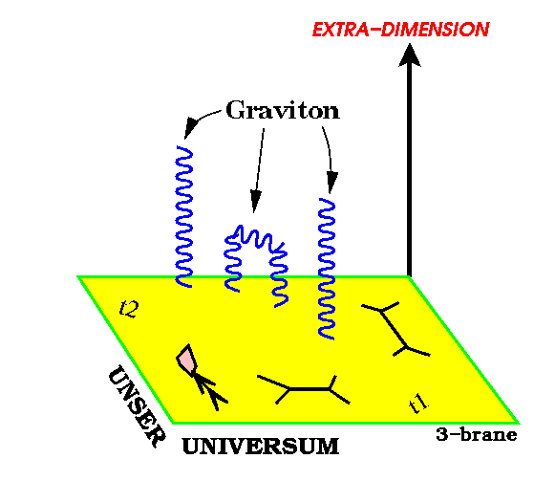
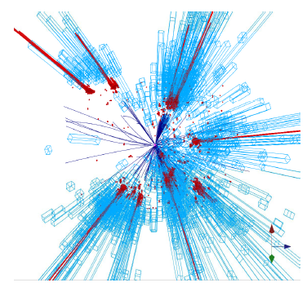
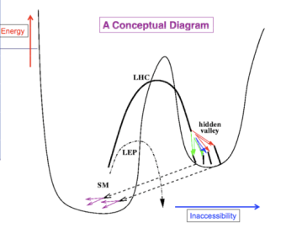
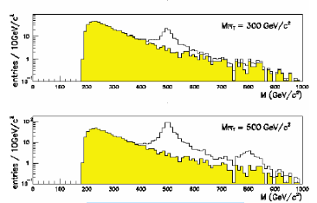
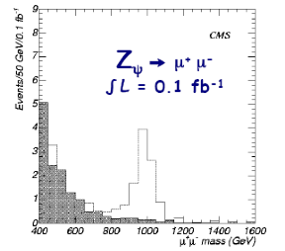
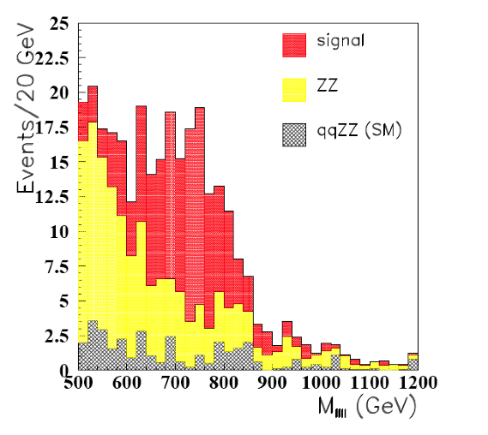
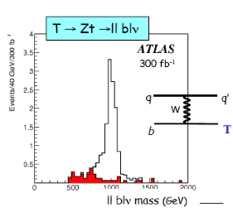
New Physics?
New Gauge Bosons?
Supersymmetry
ZZ/WW resonances?
Technicolor?
Little Higgs?
Extra Dimensions?
Hidden Valleys?
Black Holes???
What stabelizes the Higgs Mass? Many ideas, no all viable any more
A large variety of possible signals. We have to be ready for that
Notes:
2

Slide 4
Exotica
Search for physics beyond the Standard Model.
Looking for something weird and unexpected in the data.
Wide range of possibilities with relative little guidance. Many models and possible phenomena.
Unlike for Higgs or SUSY
No Exotica hunter’s guide to show you the way
No SUSY map of parameter space to show you the incremental progress with each search
Instead a wide variety of searches used. Will give examples of that to show the spectrum

Slide 5
Exotica Topics this Lecture
Lecture Plan
Extra dimensions
Resonances (leptons, jets)
4th generation of quarks and leptons
Heavy Neutrinos
The possible special role of top
Special signatures (boosted, long lived…)
Summary

Slide 6
Experimental New Physics Signatures
Many channels in New Physics :Typical signals
Di-leptons resonance/non-resonance, like sign/opposite sign
Leptons + MET (=Missing transverse momentum/energy)
Photons + MET
Multi-jets (2 → ~10)
Mono/Multi-jets +MET (few 10 → few 100 GeV)
Multi jets + leptons + MET…
B/τ final states…
Also: new unusual signatures
Large displaced vertices
Heavy ionizing particles (heavy stable charged particles)
Non-pointing photons
Special showers in the calorimeters
Unexpected jet structures
Very short tracks (stubs)…
Covers a lot of ground!

Slide 7
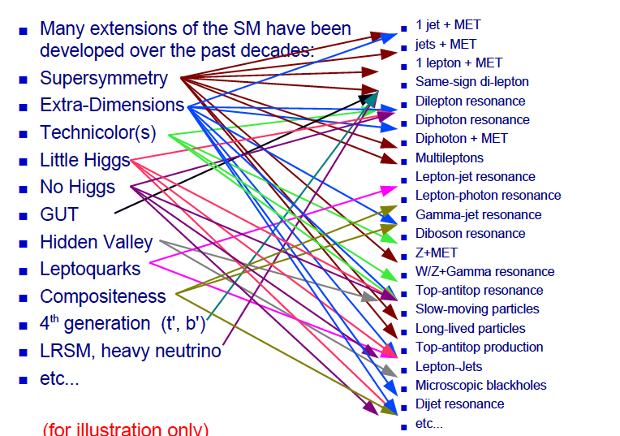
Beyond the SM Signatures

Slide 8

LHC data and Theorists

Slide 9
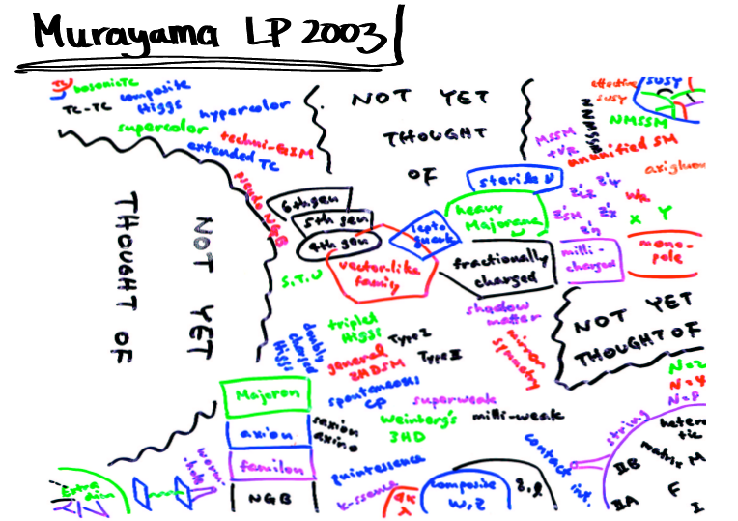
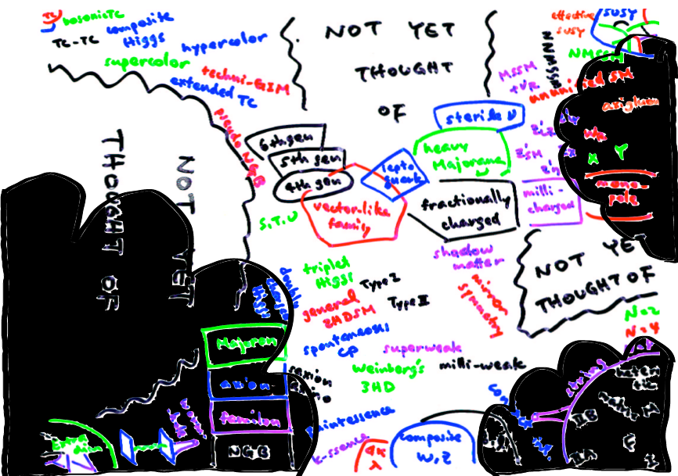
LHC Data Impact on Theory Space
2011
Note that during the last 3-4
Years we –LHC experimentalists-
got more models to deal with
than we needed…
Some theorists found it a
challenge to invent a model
with signatures difficult for
the experiments:
heavy stable charged particles,
hidden valley models, Quirks…
NOW WE STRIKE BACK!!
M. Schmaltz
But remember that these
are still early days!!

Slide 10
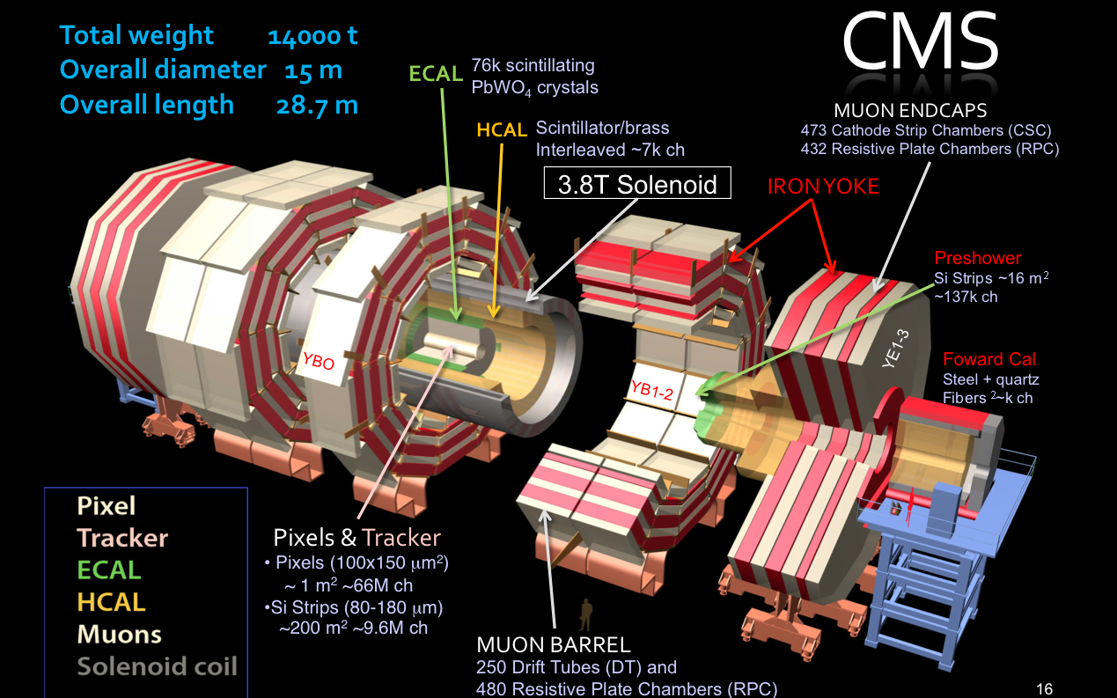
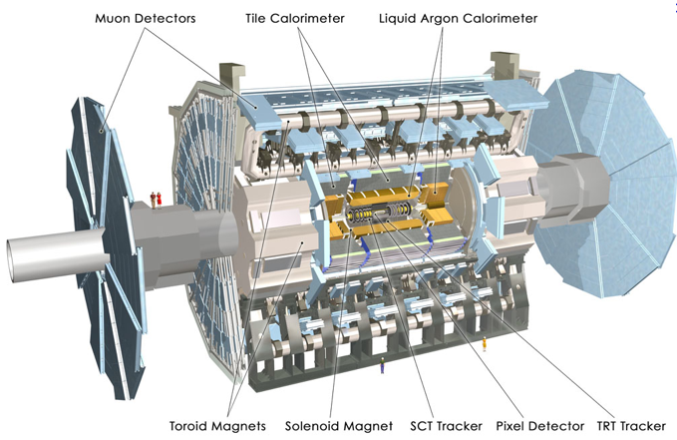
LHC BSM Hunting Detectors
The CMS Experiment
Examples from these experiments
The ATLAS Experiment
Also LHCb via eg B_{s}-> μμ
Not discussed here

Slide 11
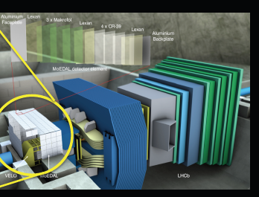
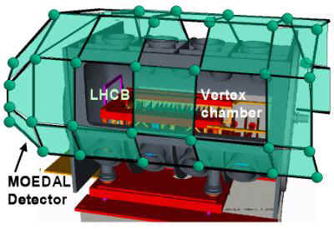
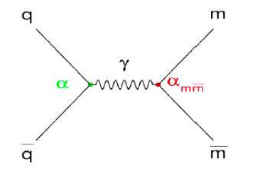
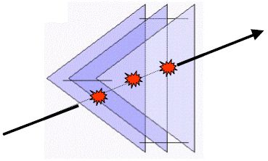
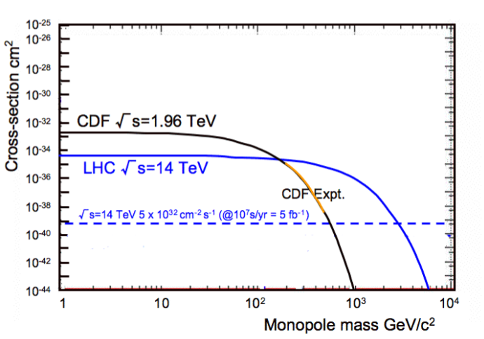
MoEDAL: Monopole and Exotics Detector at the LHC
Heavy particles which carry “magnetic charge”
Could eg explain why particles have “integer
electric charge”
Direct Monopole
production
Remove the sheets after some
running time and inspect for ‘holes’

Slide 12
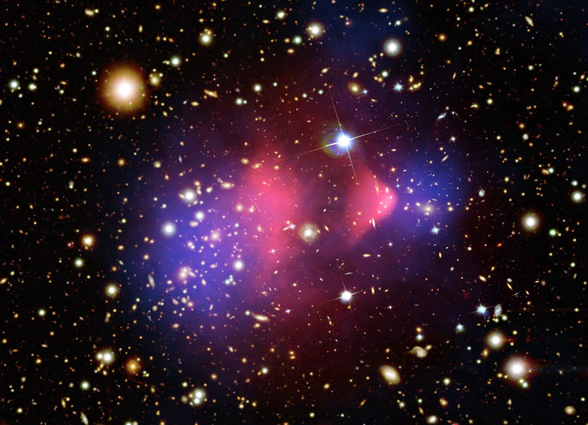


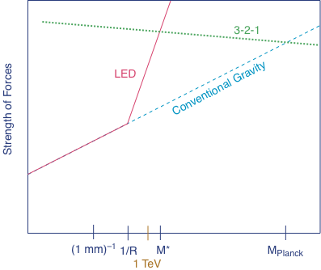
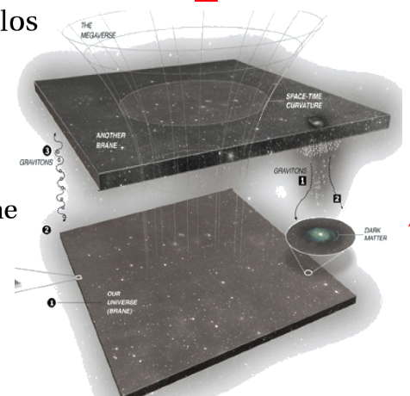
Extra Space Dimensions
Problem:
The Gravity force becomes strong!

Slide 13
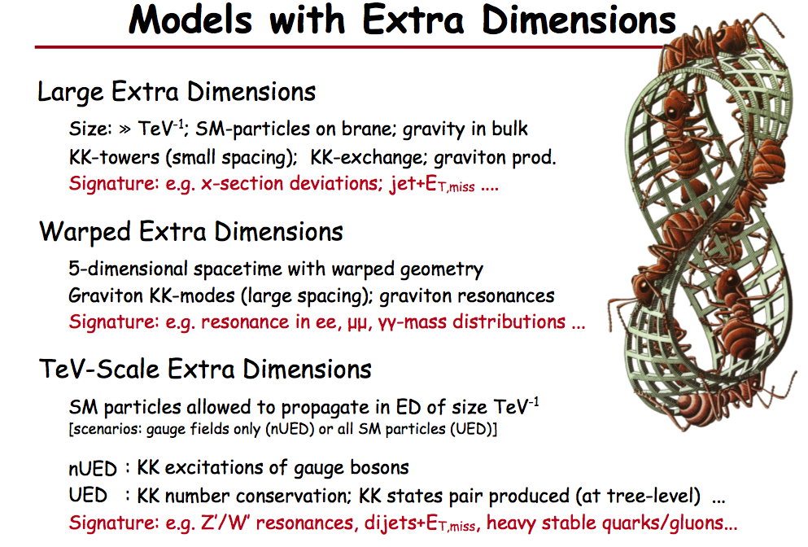
Planck scale (M_{D}) ~ TeV
ADD
Arkani-Hamed Dimopoulos Dvali
RS
Randall Sundrum
look-like SUSY
UED
Universal Extra Dimensions

Slide 14
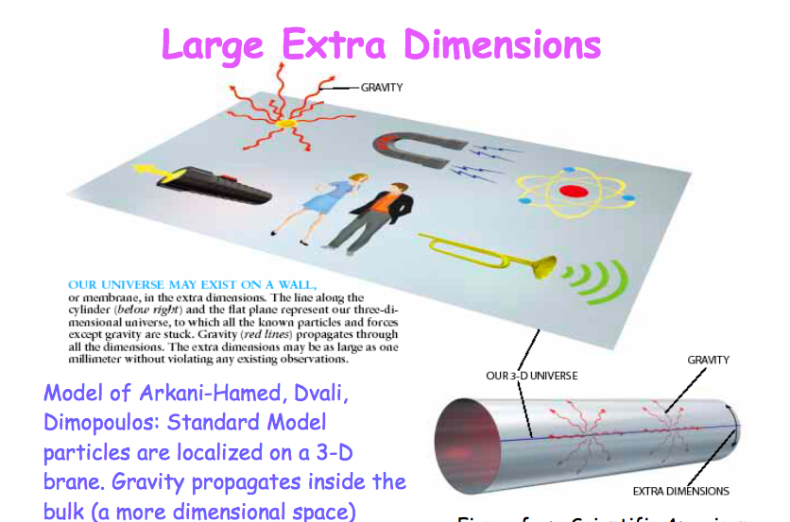
Large Extra Dimensions

Slide 15
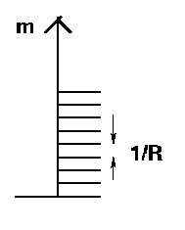

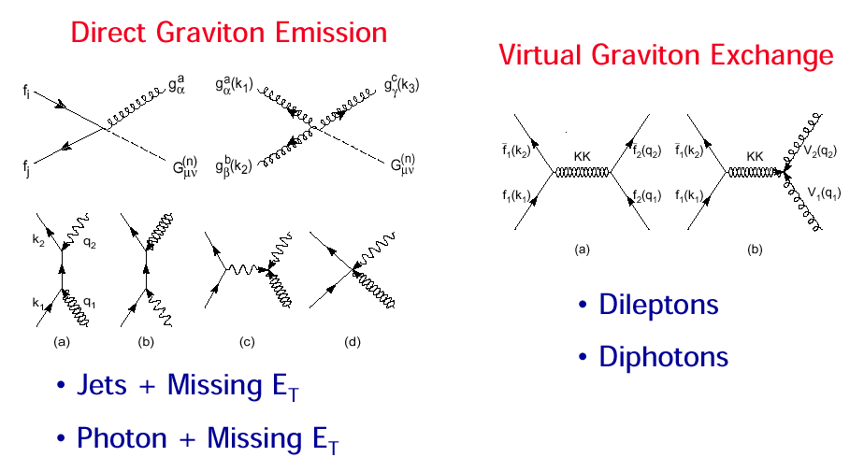
Large Extra Dimension Signatures at LHC
Particles in compact extra dimensions (2πR)
⇒ Towers of momentum eigenstates
Eg. graviton excitations (Δm=400 eV for δ =3)
⇒ Strong increase of graviton exchange at high energies

Slide 16
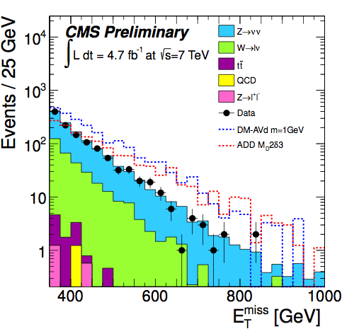
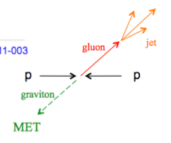
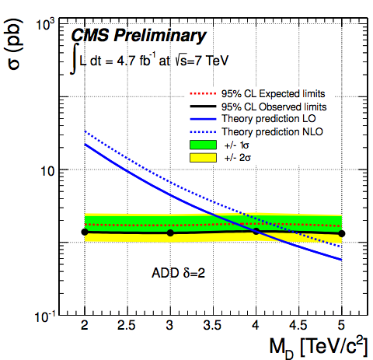
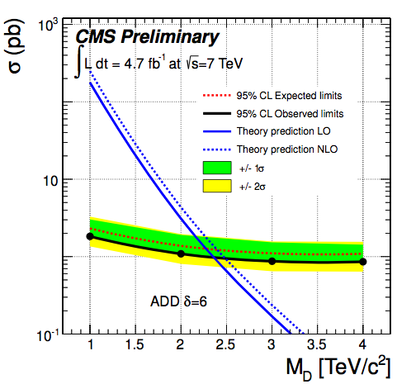
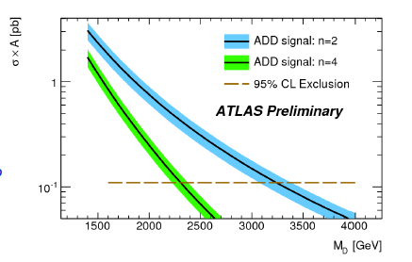
Search for Large Extra Dimensions
Mono-jet final state +Missing E_{T} (ADD)
p_{T} jet > 110 GeV
MET > 200 GeV
Limits on M_{D}
between
2.5 and 4.5 TeV
Lower limit on the Planck Scale
versus number of extra dimensions
CMS-EXO-11-059
ATLAS-CONF-2011-096
1fb⁻¹

Slide 17
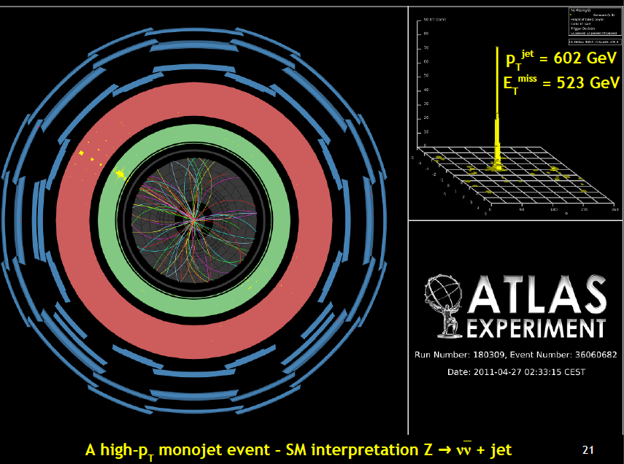
A High p_{T} Mono-jet event

Slide 18
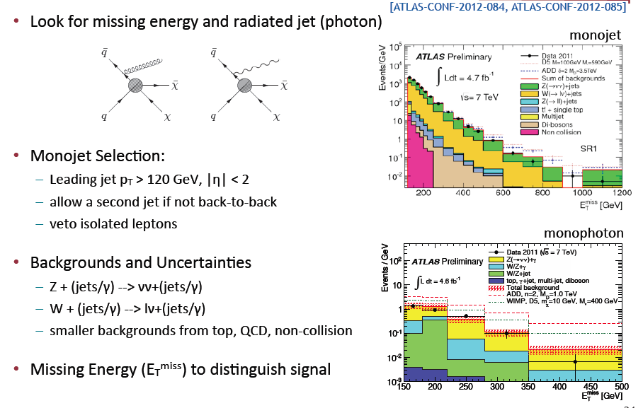
Search for Large Extra Dimensions

Slide 19
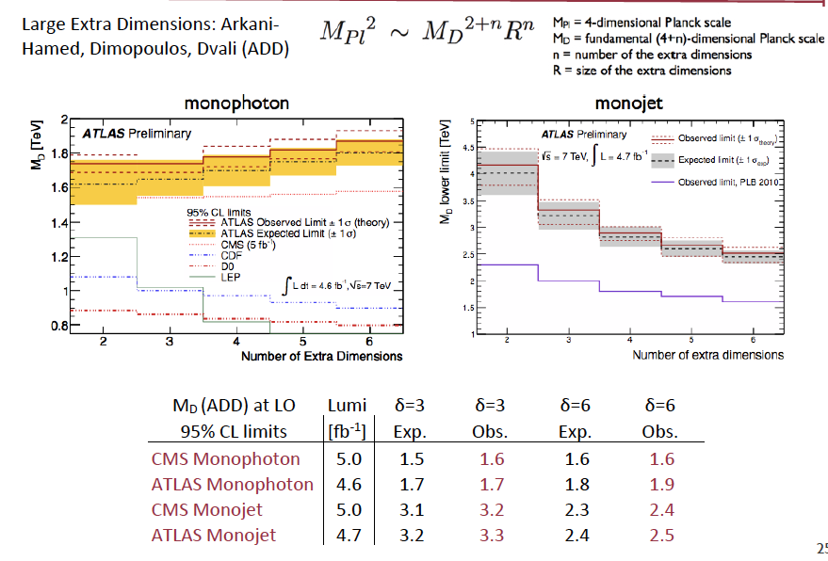
Search for Large Extra Dimensions

Slide 20


Monojet/Monophoton Signatures
While used in the past 10 years mostly for ADD alike searches, there are important new spinoffs
Supersymmetry searches (not new; UA1 already “detected” such signal)
Dark Matter searches
Unparticles… (?)
Invisible Higgs searches (eg arXiv:1205. 3169): The sensitivity ~ SM total cross section

Slide 21
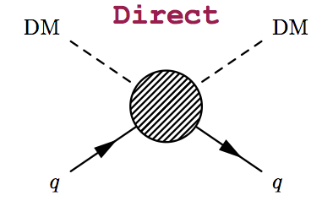
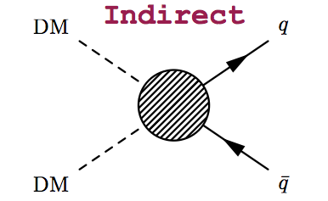
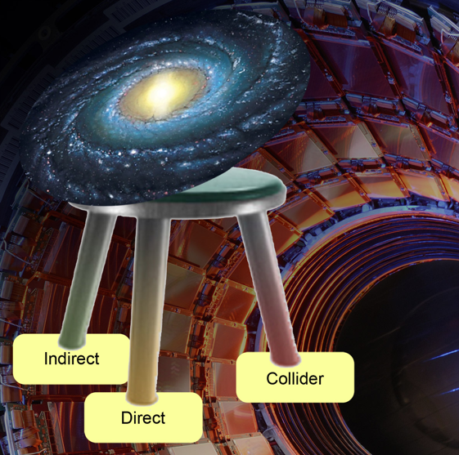
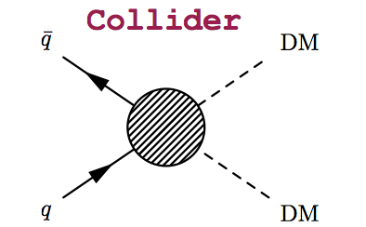
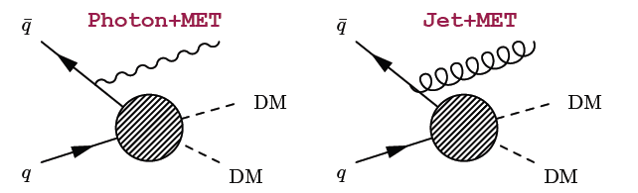
The Dark Matter Connection
Searches for mono-jets and mono-photons can be used to search for
Dark Matter (DM)

Slide 22
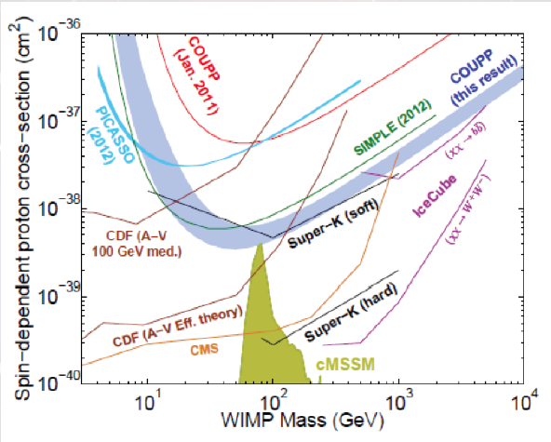
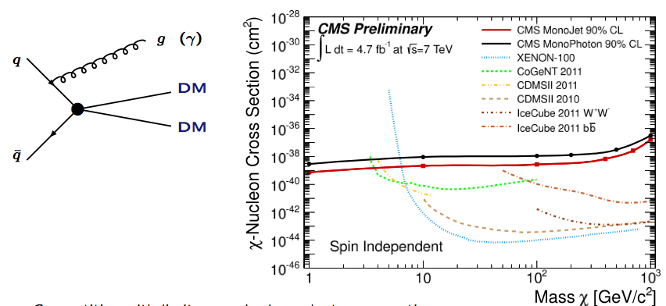
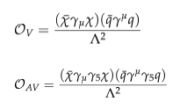
The Dark Matter Connection
Results for direct searches and collider searches for Dark Matter
-> Spin dependent and spin independent cross sections of Dark Matter
with ordinary matter
Effective contact
interaction approach
Collider searches are very competitive!!

Slide 23
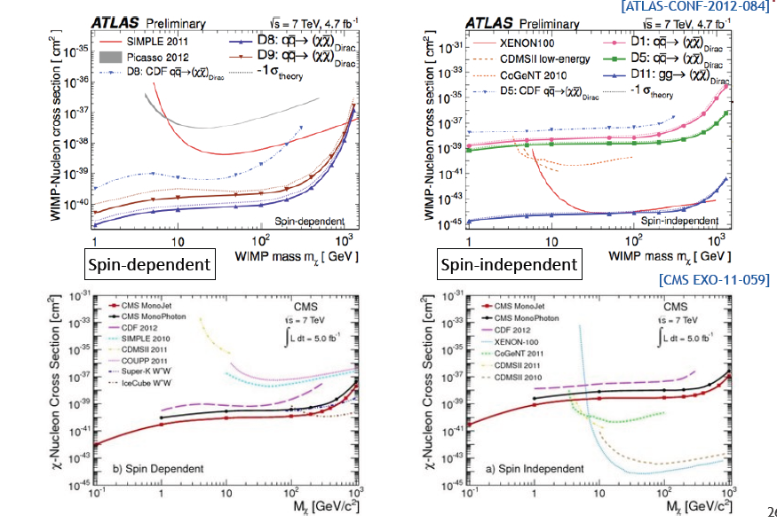
LHC Dark Matter Limits
Spin dependent and spin independent cross sections of Dark Matter with
ordinary matter
Collider searches
are very
competitive!!

Slide 24
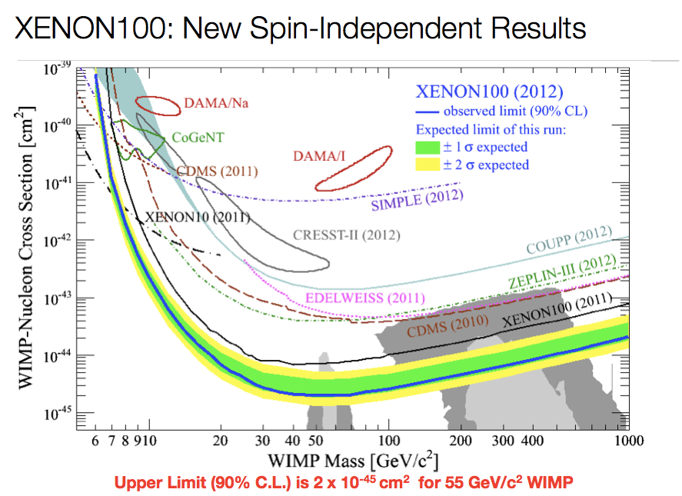
Dark Matter & SUSY
Starts to cut in
the (CMSSM)
SUSY space
We take revenge
with the mono-
jet and photon
searches…!!
Latest Result from XENON100 (@ “Dark Attack” meeting July 2012)
-> 1 event expected/2 observed
Improve limits: new limit 90%CL is 2x10E-45 for 55 GeV (factor of ~3)
Still controversy at the low WIMP Mass end (Dama/CoGent/Cresst)

Slide 25
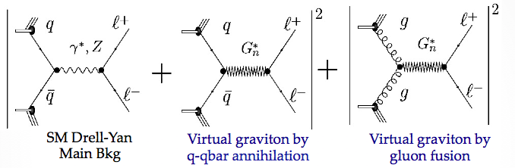
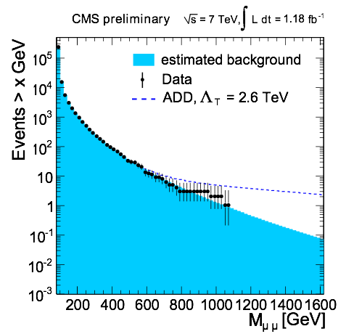
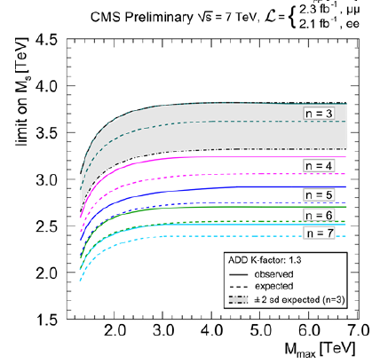
Search for Large Extra Dimensions
Pairs of electrons and muons at
high invariant mass
arXiv:1202:3827
Limits on M_{s} ranging from 2.5 TeV to 3.8 TeV
(HLZ convention)

Slide 26
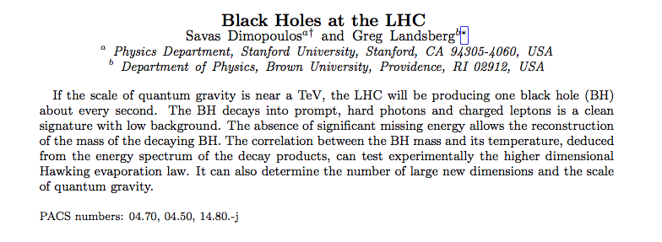



Black Holes at the LHC?
New York times 9/11/2001
Snowmass 2001

Slide 27

Quantum Black Holes
Schwarzschild radius
Landsberg, Dimopoulos, Giddings, Thomas, Rizzo
4-dim., M_{gravity}= M_{Planck} :
R_{s} → << 10⁻³⁵ m
R_{s} → ~ 10⁻¹⁹ m
4 + n-dim., M_{gravity}= M_{D} ~TeV:
Since M_{D} is low, tiny black holes
of M_{BH} ~ TeV can be produced if
partons ij with √s_{ij} = M_{BH} pass at a
distance smaller than R_{S}
R_{S}
Large partonic cross-section : σ (ij → BH) ~ π R_{S}²
σ (pp → BH) is in the range of 1 nb – 1 fb
e.g. For M_{D} ~1 TeV and n=3, produce 1 event/second at the LHC
Evaporates in 10⁻²⁷ sec
Black holes decay immediately by Hawking radiation (democratic evaporation) :
-- large multiplicity
-- small missing E
-- jets/leptons ~ 5
expected signature (quite spectacular …)

Slide 28



Search for Micro Black Holes
Nice events, eg a 10 jet event
Extra Dimensions!
Planck scale
a few TeV?
arXiv:1202.6396
Look for the decay producs
of an evaporating black hole
•Define S_{T} to be the scalar
sum of all high p_{T} objects
found in the event
•Look for deviations
at high S_{T}
Black hole masses excluded in range ~5 TeV depending on assumptions

Slide 29




Quantum Black Holes
Di-jet events: angular correlation study
ATLAS-CONF-2012-038
Exclude quantum black holes with
mass ~ 4 TeV

Slide 30


2008: Some Headaches for CERN…
Saturday 3/29/2008 New York Times..
Stable black Hole production at the LHC:
•A problem for the survival of mankind?
•Law suit against the LHC (Hawai)?

Slide 31


Micro Black Holes
Can LHC produce micro black holes?
Yes we can! (but not likely)
Can LHC destroy the planet?
⇒ No!
See the report of the LHC Safety assesment group (LSAG) http://arXiv.org/pdf/0806.3414
More information on
S.B. Giddings and M. Mangano, http://arXiv.org/pdf/0806.3381 LSAG,http://arXiv.org/pdf/0806.3414
Scientific Policy Committee Review, http://indico.cern.ch/getFile.py/access?contribId=20&resId=0&materialId=0&confId=35065
CERN public web page, http://public.web.cern.ch/public/en/LHC/Safety-en.html

Slide 32

Black Holes Hunters at the LHC

Slide 33
Search for Resonances

Slide 34


E.g. Di-lepton Resonance
Example
pp→μμ +X
Plot the di-lepton
invariant mass
A peak!!
A new particle!!
A discovery!!
Z’ ?
μ
μ
If we are lucky:
a signal could be
seen very early on

Slide 35


Curved Space: RS Extra Dimensions
phenomenology
Study the channel pp→Graviton→ e+e-
signal+
Drell-Yan
backgr.
Signature: a resonance in the
di-electron or di-muon final state
a priori easy for the experiments
Caveat: new developments suggest
that G_{KK} would couple dominantly
to top anti-top…

Slide 36


Z’ Boson Decaying into ee or μμ
Extension of the symmetry?
New Gauge bosons? 2011 data @ 1 TeV?
2011
data

Slide 37

Z’ Search with 8 TeV Data

Slide 38

Z’ Combination of 7 & 8 TeV Data

Slide 39

Z’ Decaying into tau Leptons

Slide 40


W’ → eν and μν Production
Search for the charged partner of the gauge bosons

Slide 41

W’ → eν and μν Production

Slide 42

W’ → eν and μν Production

Slide 43

Like-Sign Di-lepton Resonance Searches

Slide 44



Diphotons: Search for EDs
Two Photons resonance (RS)
Select two photons with M_{γγ}>140 GeV
arXiv:1112:2194
arXiv:1112:0688
γ
ADD Limit: M_{s}> 2.5-3.8 TeV (HLZ)
Randal-Sundrum: M> 1-2 TeV
γ

Slide 45

Di-jet Resonances

Slide 46

Di-jet Searches

Slide 47


Di-jet Searches: Excited Quarks

Slide 48


Decays into WZ pairs
Technicolor:
No elementary Higgs but a new type of
color-like force, predicting particles
called techni-pions, techni-rhos, techni-omegas
…with masses ~ few 100 GeV

Slide 49


Search for WW Resonances
2 isolated leptons with p_{T}> 25 GeV + Missing ET (~ 60 GeV)
Limits on Randal Sundrum resonances of 1.2 TeV

Slide 50
Search for Heavy Neutrinos

Slide 51




Heavy Neutrinos in W_{R} Decays
Left-right symmetric extension of the Standard Model
CMS-EXO-11-002
Select events with
2 leptons and 2 jets
Large exclusion range
in mass of the W_{R} and
heavy neutrino
Tevatron excludes
W_{R}~ 780 GeV
Limits ~ 1 year ago

Slide 52

Heavy Neutrinos in W_{R} Decays

Slide 53
Search for a 4th Generation
We can’t be sure that there are only 3 generations (u,d) (s,c) (b,t)
A possible new generation should be heavy!
Look for b’ and t’ quarks

Slide 54

Search for t’t’ → bWbW

Slide 55

Search for T’ → tZ

Slide 56

Search for b’b’ → tWtW

Slide 57

Search for b’b’

Slide 58

Search for B’ → bZ

Slide 59

4th Generation overview

Slide 60
Searches with Top Quark

Slide 61



TeV Resonances into Top Quark Pairs
Recent developments in models: a prominent role of top production
light SM fermions live near Planck brane, heavy (top) near TeV brane
decay of Randall Sundrum gravitons into top pairs!!
TeV resonances ⇒ Highly boosted tops
The jets typically appear as ‘fat’ jets
with internal structure
Methods are prepared to tackle the early data

Slide 62


New Physics with Boosted Objects
W,Z and top decays from heavy, typically multi-TeV objects are of special interest at the LHC
•ΔR ~ 2m/p_{T}: decay product merge at large p_{T}
•New techniques developed – and discussed in this
series of topical Workshops- for leptonic and
hadronic decays of W,Z, top…
Eg.: Jet substructure, grooming: mass drop filtering,
trimming, pruning…
ATLAS-CONF-2012-065

Slide 63



Initial Studies: Z’ → tt Search
•Search in the all hadronic decay channel for the tops
•Tops are boosted for high mass Z’, jets merge
•Start from Cambridge-Aachen FAT jets and apply jet pruning to find sub-jets
•QCD background estimate from data (mistag method)
Particle flow an asset for this study!
CMS-EXO-11-006
Exclude KK-Gluons 1<M<1.5 TeV

Slide 64



Top resonance study
arXiv:1207.2409
Boosted objects are reconstructed as one fat jet R=1.0, p_{T}> 250 GeV. Analyse the jet substructure
Modified isolation for the leptonic decay side

Slide 65
Real Exotic Objects!

Slide 66
Searches for Unusual Particles
Heavy stable charged particles with unit charge traversing the detector
Heavy stable charged particles with multiple charge traversing the detectors
Heavy stable charge particles with fractional charge traversing the detector
Heavy new particles decaying in the detector
Heavy new particles stuck in the material in or before the detector

Slide 67



Fractional Charged Particles
M. Perl et al., 2004
Search possible in CMS
Both for q=1/3e and q=2/3e
Tracks with a high number of low-ionizing hits in the tracker

Slide 68



Heavy Stable Charged Particles
Detection techniques used for heavy (multiple/fractional ) stable charge particles in CMS
• Abnormal energy loss (de/dx) for given momentum
• Slower than speed of light (lowβ) via time of flight measurements
with the CMS muon system (CSC/DT/RPC)
• A few special measurements
Time of flight

Slide 69

Energy Loss in the Tracker
Using the energy loss de/dx in the silicon tracker
Clear tracks from kaons and protons observed

Slide 70

Particles with Fractional Charge

Slide 71


Multiple Charged Particles
Time of flight
q =2e
Time of flight
q =5e
Sensitivity on the mass in the range 400-500 GeV

Slide 72


Multiple Charged Particles
Sensitivity on the mass in the range 400-500 GeV

Slide 73

Highly Ionising Particles
ATLAS

Slide 74






Monopoles
Magnetic Monopoles to explain the quantization of electric charge (Dirac ‘31)
= n 68.5e
Symmetrizes maxwell equations
Searched for at all colliders
Tevatron limits ~ 400-800 GeV
arXiv: 1112.2999

Slide 75




Potential for Monopole Searches in CMS
Monopoles will loose a lot of energy, and stop in the detector
Bending in the RZ plane in solenoid field (needs revised reconstruction)
Monopole range
Bending in RZ
PhD Study:
Stop in ECAL
(Y. Assran)
Simulation Studies
Kinematic acceptance in ECAL

Slide 76

Search for Monopoles

Slide 77

Beampipe Monopole Search
H1 experiment at the ep collider HERA, Hamburg
trapped in the beampipe material?
Also searched for
at the Tevatron
Possible at the LHC!!

Slide 78


Monopoles Stopped in the Beampipe
Test performed with pieces of material from the LHC from 18 m away from
the interaction region
Faulty connecting “fingers” were removed
and scanned in a SQUID in Zurich

Slide 79


Monopoles Stopped in the Beampipe
Energy below which a monopoles
stops in the beampipe vs g_{D} and
mass
Acceptance of monopoles in
the CMS (ATLAS) beampipe

Slide 80



Monopolium ?
Maybe monopoles are not see because they are confined in a monopole- anti-monopole bound state: monopolium
Annihilation into two energetic photons
Sensitivity to new mass range already with 1 fb⁻¹
Monopolium cross section
(example)

Slide 81


Non-pointing Photons
EG: GMSB models, Hidden Valleys
•Use photon conversions in CMS tracker
•Probe ~0.1-1.0 nsec lifetimes
(2-25 cm displaced vertices)
•Select events with 2 jets, 2 photons and MET

Slide 82



Is there a Hidden Valley?
String Theory inspired
Eg. Strassler & Zurek hep-ph/0604261
New possible phenomena that could occur in these models

Slide 83



Hidden Valley Physics: New Signatures
M. Strassler, K. Zurek
Possible new
Higgs decay
modes
Will produce “Weird Jets”
and a lot of secondary
vertices from B-quark jets
⇒ Difference with QCD jets??
⇒ Study SM jet structure!!
82
Notes:
82

Slide 84


Long Lived Particles
Split Supersymmetry
The only light particles are the Higgs and the gauginos
- Gluino can live long: sec, min, years!
- R-hadron formation (eg: gluino+ gluon): slow, heavy particles
Gravitino Dark Matter and GMSB
In some models/phase space the gravitino is the LSP
⇒ NLSP (neutralino, stau lepton) can live ‘long’
⇒ non-pointing photons
Hidden Valley modes!…
Plethora of possibilities for long lived neutrals
EG: K. Hamaguchi,M Nojiri,ADR hep-ph/0612060
ADR, J. Ellis et al. hep-ph/0508198
Sparticles stopped in the detector,walls
of the cavern, or dense ‘stopper’ detector.
They decay after hours---months…
⇒Challenges to the experiments!

Slide 85


Stopped R-hadrons or Gluinos!
The R-hadrons may loose
so much energy that they
simply stop in the detector
…and decay some time later
⇒ Special triggers needed, asynchronous with the bunch crossing
Results: see lecture of Aafke Kraan

Slide 86






Macro-Strings at the LHC?
New strong interactions with small Λ & new quarks m_{Q}> several hundred GeV
Markus Luty/Aspen 07
• Strings do not break up ⇒ Stringy objects in the detector.
• End points are massive quarks (quirks)
• The strings can oscillate ⇒ strange signature in detectors

Slide 87



Possible Quirk Studies
Study zero “curvature tracks” from pairs of quirks

Slide 88


More Quirks…
Harnik & Wizansky arXiv:0810.3948
One possibility of a
fast charged oscillator
Lots of QED radiation
Lots of soft photons
A photon cloud
CMS had a trigger in 2010 to
Look for 160 GeV (HLT) in
ECAL, summing energies in towers larger than 200 MeV.
About 25 pb⁻¹ of data on tape

Slide 89



Finally: Can we miss something?
Model independent search
•Divide events into exclusive classes
•Study deviations from SM predictions
in a statistical way
CMS-EXO-10-021
Probability distribution as expected
for 35 pb⁻¹
Look at & watch the outliers…

Slide 90

Searches for New Physics: CMS
50 new analyses from ATLAS and CMS contributed to summer conferences
But no sign of new physics yet…

Slide 91

And similarly… ATLAS

Slide 92

LHC Search Summary
No signatures for new physics yet
→ Simple Summary (LP11: H. Bachacou)

Slide 93

Since we do not know what we will find…
Nature.com
…we will look at it from all angles….
Close interaction between Experiment and Theory will be important

Slide 94

Other New Physics Ideas…
Plenty!
Compositeness/excited quarks & leptons
Little Higgs Models
leptoquarks
String balls/T balls
Bi-leptons
RP-Violating SUSY
SUSY+ Extra dimensions
Unparticles
Classicalons
Dark/Hidden sectors
Colored resonances
And more….
Have to keep our eyes open for all possibilities:
Food for many PhD theses!!

Slide 95

Future: Higher Energy
Can gain more than a factor 10 for masses above a TeV!!

Slide 96

Unsolved puzzles
B. Dobrescu
ICHEP
Theorist view

Slide 97

We are not alone!
LHC: LHCb has a complementary sensitivity to CMS/ATLAS for new physics.
Not yet explored in a systematic way
Heavy flavor precision measurements (B-factories)
g-2 new measurements (factor 5-10 improvement in O(5) years? )
Dark matter hints from outer space (PAMELA/ATIC GLAST-Fermi..)
Wait until the dust settles…!
New Collider?… not any time soon

Slide 98

Summary: The Searches are on!
The LHC has entered new territory. The ATLAS and CMS experiments are heavily engaged in searches for new physics. The most popular example is SUSY, but many other New Physics model searches are covered.
No sign of new physics yet in the first 5 fb⁻¹ at 7 TeV with the analyses reported in this lecture (or released publically so far). 8 TeV data being analysed.
Starts to cut into the ‘preferred regions’ for a number of models
More exotic channels are now being covered: monopoles, fractional or multiple charged particles, long lived particles… Still many unexplored channels left to explore
The LHC did its part so far with a great run in 2011 and 2012 Expect between 25 and 30 fb⁻¹ by end of 2012
In 2014/15 the energy will be 13 TeV, excellent for searches

Slide 99
Backup

