Slide 1


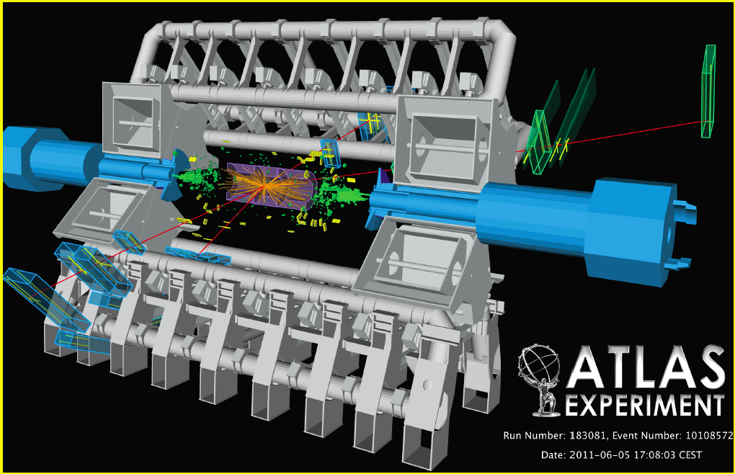
QCD and EW physics with jets and W/Z
@ the LHC
Lucia Di Ciaccio
Université de Savoie & CNRS/IN2P3-LAPP
DPG School on "Heavy particles at the LHC”, Bad Honnef 16-21 September 2012
ZZ*-> μ⁺μ⁻ μ⁺μ⁻

Slide 2
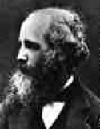

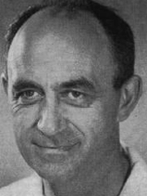

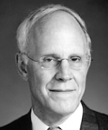

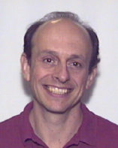
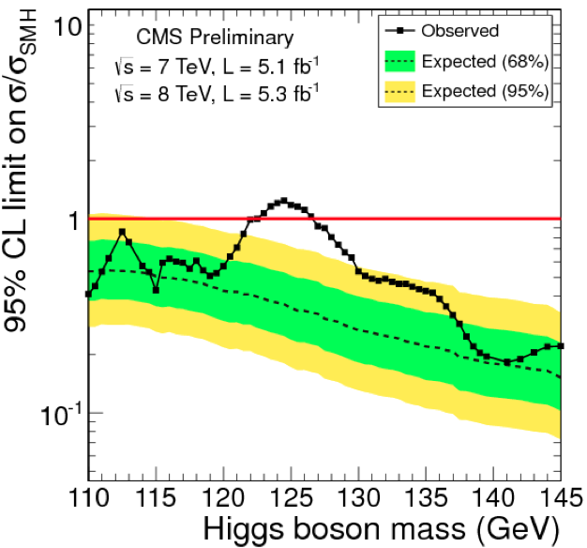

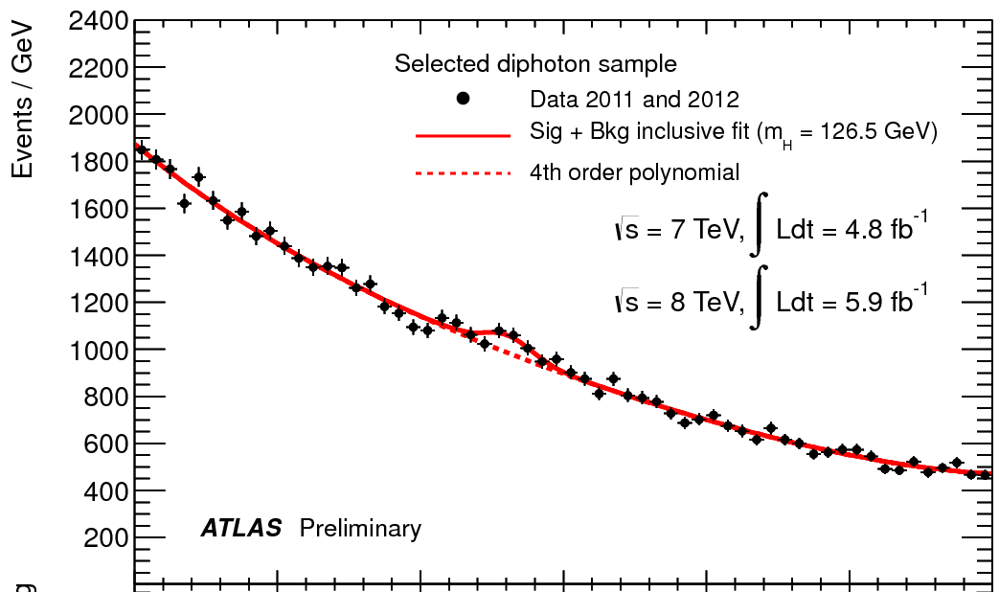

EW and QCD with jets or W/Z: motivations
EW + pQCD = Standard Model
Renormalizable Quantum Field Theory with spontaneously broken local
gauge invariance describing electroweak (EW) + strong interactions (QCD)
Amazily successful in describing precisely data from
experiments
The fundamental constituents of SM is now complete !
4 July
γγ mass spectrum
Should particle physicists go/return on holidays forever ?

Slide 3
… Unfortunately/Fortunately .. not
Still many open questions !!
Mass origin :
* Does the Higgs boson exist ? → which are the “Higgs” bosons properties?
* How precisely electroweak symmetry breaking is implemented in nature?
* Fine tuning of the Higgs mass → Supersymmetry?
Gravity is not included in SM:
* ExtraDimensions ?
Unification of the fundamental interactions:
* Supersymmetry?
What is the Dark Matter/Energy composing the Universe?
* Supersymmetry?
Why the prevalence of matter on antimatter ?
* CP violation phenomena in :
- B physics ?
- ν sector ?

Slide 4

EW and QCD with jets or W/Z: motivations
… still more questions !!
why gravity is so weak G_{F}/G_{N} ~ 10³² ?
why 3 families of fermions? Are there more ?
why mass hierarchy m_{top}/m_{up} ~ 10⁴ ?
are quarks and leptons really ‘elementary’?
why charge quantisation?
can quark and gluons be deconfined in a quark-gluon plasma ?
… and many more
Is Standard Model a low energy approximation of a more fundamental theory?
The study of jets, W and Z production @ very high energy particle colliders (LHC)
is a key to access the Physics Beyond the SM (BSM)
Motivations of jets, W/Z studies:
Test the validity limits of SM
Jets, W or Z are backgrounds to searches for New Physics
In many BSM theories, New Particles decay in jets, W or Z
Jets, W and Z Signals used for detector calibration

Slide 5
Outline
Measurements & results
Jet cross-section and di-jet mass
W and Z inclusive and differential
(vs p_{T}, y, jets, ) cross sections
pQCD
W charge asymmetry and impact on PDFs
W polarization
Z Forward-Backward asymmetry and
effective weak mixing angle
EW
Dibosons production and Anomalous
Triple Gauge Couplings
Precision tests of the SM electroweak
sector
EW Fits: investigation of BSM Effects
W mass
Apologize: personal choice + no time to cover in detail all subjects
Main goal of the lecture:
give a flavor of the motivations and show some of the LHC results with jets, W, Z

Slide 6
Bibliography
The Large Hadron Collider, O. Brüning, H. Burkhardt, S. Myers,
Progress in Particle and Nuclear Physics (2012), 10.1016/j.ppnp.2012.03.001
ATLAS Collaboration, 2008 JINST 3 S08003
CMS Collaboration, 2008 JINST 3 S08004
Detectors & performance papers
LHCb Collaboration, 2008 JINST 3 S08005
Laura Reina. The Standard Model. Herbstschule für Hochenergiephysik Maria Laach 2011
http://maria-laach.physik.uni-siegen.de/Folien/2011/Reina/
‪R. K. Ellis, ‪W. J. Stirling, ‪B. R. Webber. QCD and Collider Physics, Cambridge Press (1996)
Stefano Frixione. QCD and advanced Monte Carlo tools. CERN-FNAL HCP summer school 2011
Andy Buckley et al. General-purpose event generators for LHC physics.
arXiv:1101.2599v1 [hep-ph] 13 Jan 2011
ICHEP2012. http://www.ichep2012.com.au/
Latest results
SUSY2012. http://www.phy.pku.edu.cn/~susy2012/index.html
… obviousely there is much, much more …

Slide 7
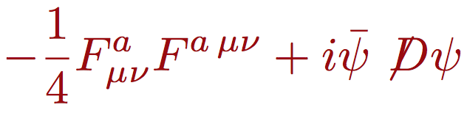




Standard Model in one slide
R. Barbieri, ICHEP2012
The gauge sector
The EWSB sector
The flavour sector
The ν mass sector
(if Majorana)
Sector which is directly investigated by the results presented in this
Lecture.
The EWSB sector is indirectly investigated via precision measurements

Slide 8
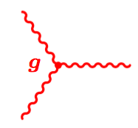
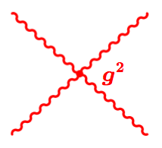
Standard Model in one slide
Strengh tensor of EW gauge bosons and of gluons
The gauge sector
Kinetics of gauge bosons
(gluons and EW bosons)
Includes the interaction between the
fundamental fermions described by
spinor fields ψ and the gauge bosons
Give rise to boson self-couplings for
gluons and WEAK bosons
It results from the invariance of the
L under local gauge transformations
of the fermion fields
Local gauge transformations:
represented by matrices belonging to the SU(2) U(1) group → EW
represented by matrices belonging to the SU(3) group → QCD

Slide 9
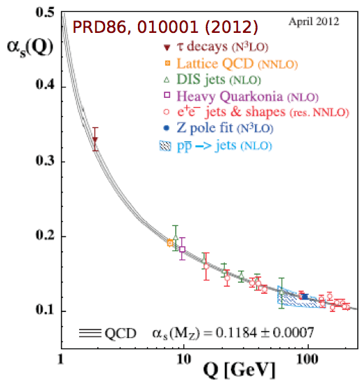


The Strong Interaction
QCD, the QFT of the strong interaction, is characterized by the coupling α_{S}
Running of α_{S} → asymptotic freedom and confinement
Renormalization Group Equation (RGE) relates
α_{S} values @ different scales (Q)
Predictions tested at HERA, LEP up to Q ~ 208 GeV, Tevatron (54-145 GeV)
Gluon self-interactions : α_{S} decreases at
short distances
D. Gross , F. Wilczek, D. Politzer, ‘73
→ QCD is an asymptotically free QFT
→ Perturbative QCD can be used
Long-distance effects always contribute to
physical observables (hadrons)
soft
hard
To deal with them, one must introduce (at least) hadron-parton duality,
infrared safety, factorization theorems

Slide 10
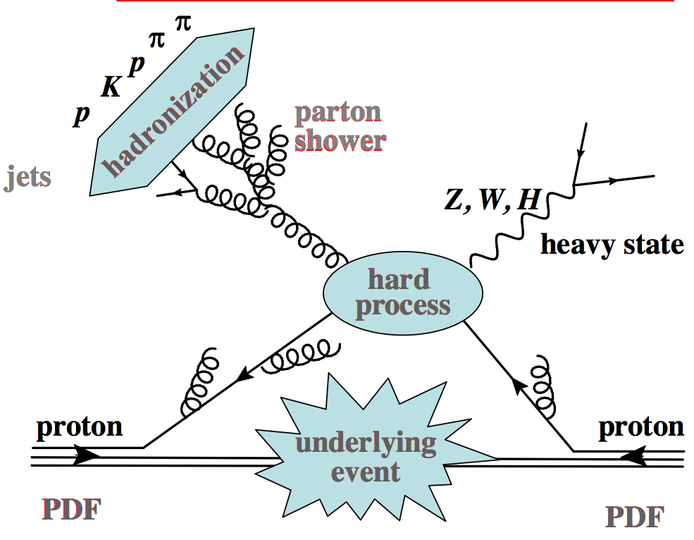
At Hadron Colliders: a Complex Picture
Factorisation: phenomena at different time scales factorize
t,
PDF = Parton
Density
Functions
(describing the
momentum distribution
of partons in proton)
→ separation between phenomena @ high- and small-Q scale
The former are computed exactly, the latter are approximated or modeled
The factorisation scale μ_{F} arbitrarily separates hard from soft scales
Many aspects of QCD can/must be understood !

Slide 11
Variables used in the analysis of p - p collisions
Boost of parton-parton center of mass along beam line unknown
→ use transverse quantities (in the plane ⊥ to the beam):
Transverse momentum/energy : p_{T} = p sin θ E_{T} = E sin θ
Missing Transverse Energy : p_{T} ^{mis}= - Σ_{vis} p_{T}
E_{T} ^{mis}= |p_{T} ^{mis}|
rapidity
1 E+p_{z}
Y = ln
2 E-p_{z}
E
Angles :
p_{T}
p
pseudorapidity
azimuthal angle
θ
η = - ln (tan )
2
p beam
beam p
Φ
Important:
∑^{in} p_{T} = ∑_{vis} p_{T} ≈ 0 → Allows to evaluate the p_{T} of particles not detected (ν)
p_{T} and ΔY are invariants for Lorentz transformations along the z axis
m « E → Y ≈ η ( η doesn’t require particle identification)
m « E → p_{T} ≈ E_{T}

Slide 12

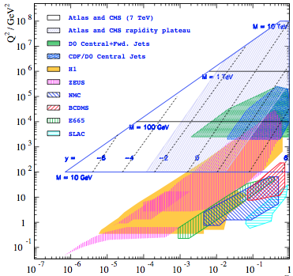
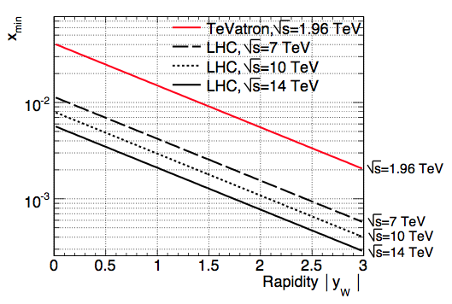

Kinematics of p - p collisions
p- p collisions :
0 < x_{1 ,2} < 1
x₁p_{beam}
x₂p_{beam}
p_{beam}
p_{beam}
(E_{beam}= √s/2 ≈ p_{beam})
4-mom of the initial partons : [ (x₁+x₂)E_{beam}, 0, 0, (x₁-x₂) p_{beam}]
^
Effective collision energy = √ s = Q = √ x₁ x₂ s
Q
√s
y_{cm} = rapidity of
the c.o.m. of the
parton system
x
x_{min}
x_{max}

Slide 13
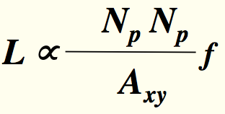
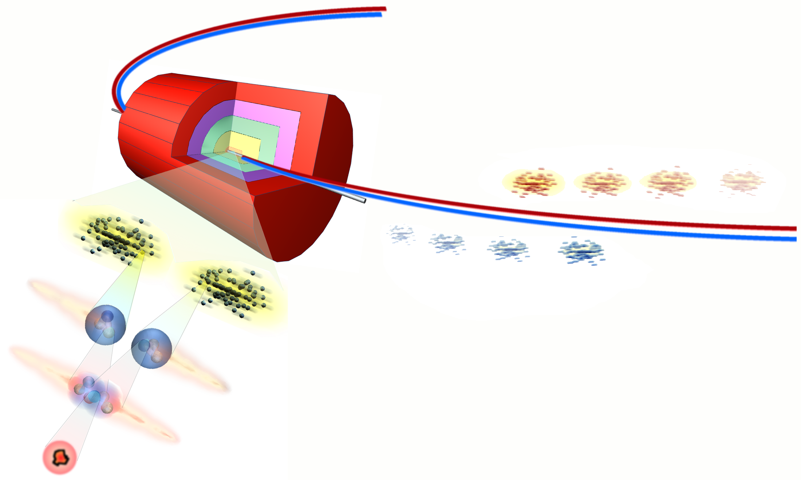
The LHC: design parameters (proton-proton)
Energy √s = 14 TeV
Luminosity L = 10³⁴ cm⁻² s⁻¹
factor ≈ 100 w.r.t.
previous machines
! 200 MJ to melt
1 ton of copper
Number of bunches = 2808
B
~ 10¹¹ protons/bunch
Stored energy ~ 350 MJ/beam
B = number of bunches
N_{p} = number of p/bunch
f = revolution frequency
A_{xy}= area in the plane
transverse to the beams
Detector
7.5 m (25 ns)
proton bunches
µ
-
The rate of events is :
R(Hz) = L (cm⁻² s⁻¹) * σ(cm⁻²)
ν
W
p
H
p
W
Proton interactions ~ 10⁹ Hz
µ
+
ν
New particles: ex. SM Higgs (H->γγ, 125 GeV): ≈ 10⁻³ Hz)

Slide 14
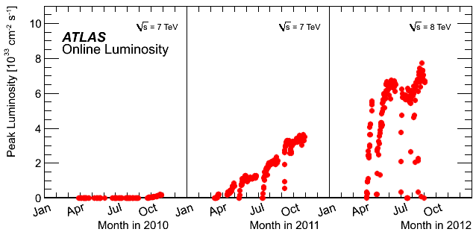
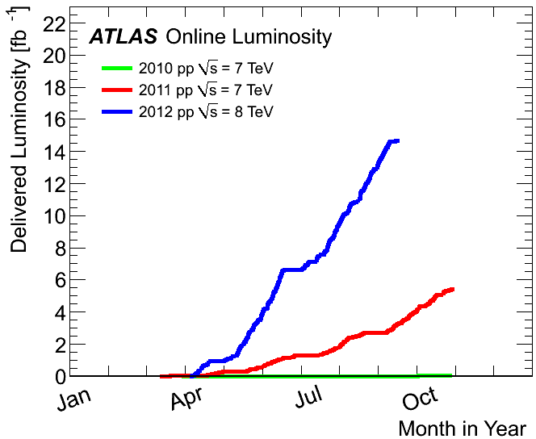
LHC: Present Parameters and Performance
Energy √s = 8 TeV
Number of colliding bunches
in ATLAS et CMS = 1368
Bunch crossing frequency = 50 ns
Stored energy ~ 100 MJ/beam
Peak Luminosity
Integrated Luminosity
2012
14.8 fb⁻¹
@ 8 TeV
2011
5.6 fb⁻¹
@ 7 TeV
2010
0.05 fb⁻¹
@ 7 TeV

Slide 15
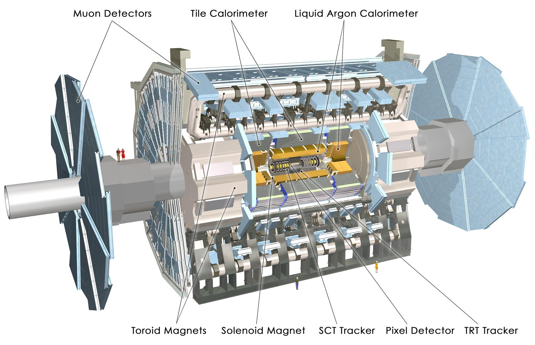
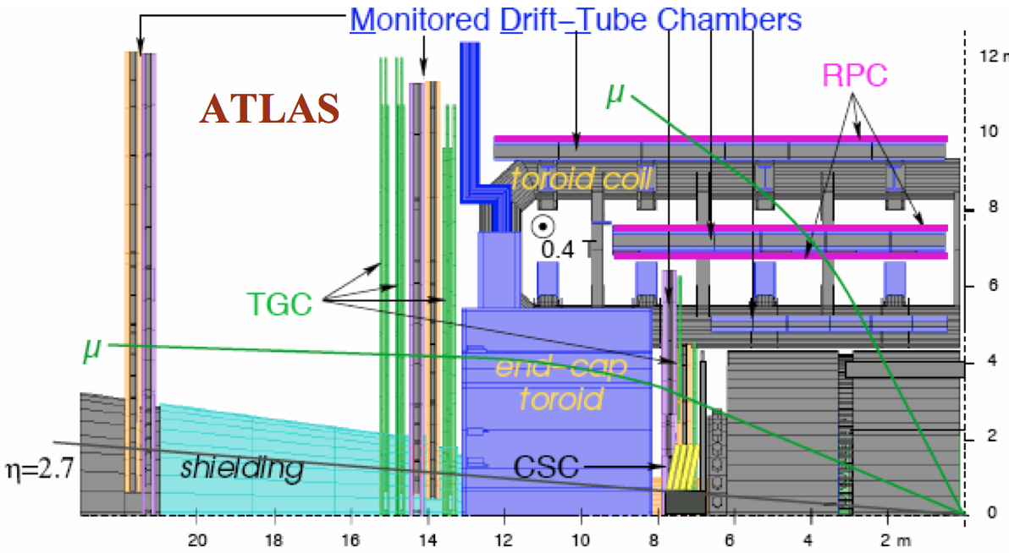
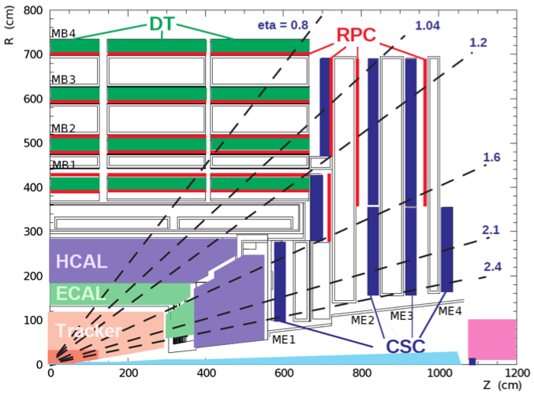
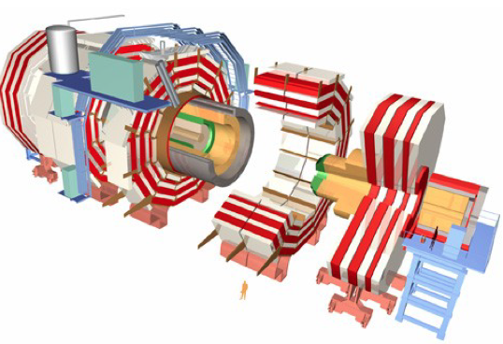
General Purpose Detectors (GPD) @ LHC
MDT
12m
HCAL
ECAL
ATLAS
L ~ 40 m
R ~ 10 m
TRACKER
20m
z
8m
CMS
L ~ 20 m, R ~ 7.5 m
TRACKER
z
Tracking up to η ~ 2.5, Calorimeter up to η ~ 4.9, Muons id up to η ~ 2.5
EM calorimeters: LAr/Pb ATLAS, crystal CMS. Muon Spectrometer: Air ATLAS, Fe CMS
B field: solenoid (2 T ATLAS, 4 T CMS), toroid (ATLAS)
1.2m

Slide 16
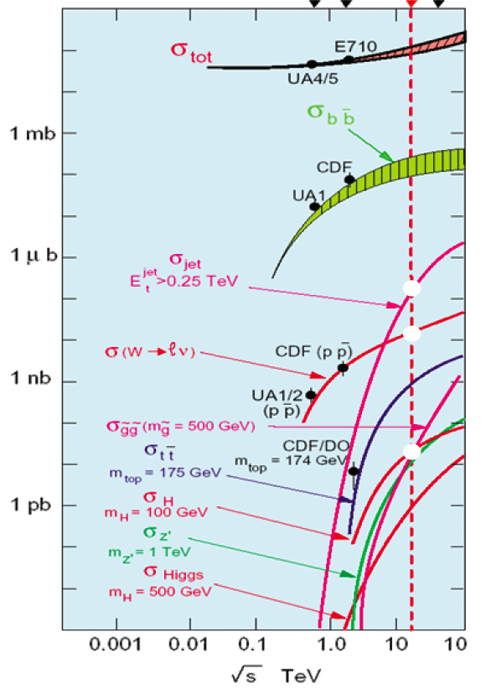
pp Cross sections and Rates
7 TeV
Rates:
Hz@ L=10³³ cm⁻²s⁻¹
σ
10⁸
‘ soft ’
Minimum Bias σ_{MB}^{14TeV} ≈ 70 mb
Jets σ_{Jets}⁷ ^{TeV} ≈ μb-mb
W and Z σ_{W->lν}⁷ ^{TeV} ≈ 10 nb
‘hard’
10³
σ_{Z->ll}⁷ ^{TeV} ≈ 1 nb
Top σ_{ttll}⁷ ^{TeV} ≈ 0.17 nb
10
l = e or μ
1 fb⁻¹ ⁽7 TeV):
new territory
≈ 10¹³ MB evts produced
> ≈ 10⁷ jets with p_{T}>0.25 TeV produced
≈ 10⁷ W->lν ≈ 10⁶ Z->ll produced
_
≈ 1.5*10⁵ tt produced

Slide 17
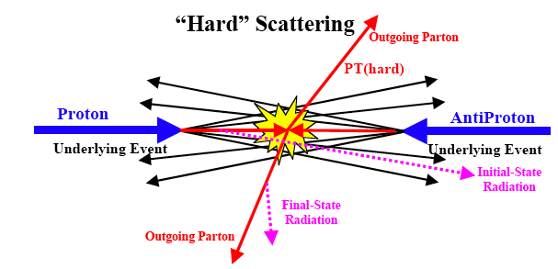
pp Collisions
σ^{pp}_{tot}= σ_{elastic}+ σ_{inelastic}
≈ 25% ELASTIC collisions : σ_{elastic} ≈ 20-25 mb
≈ 75% INELASTIC collisions : σ_{inelastic} ≈ 80-75 mb
* Most of them occur at large distance
→ low momentum transfer from initial to final state (soft collisions)
final state particles with large longitudinal momentum but small p_{T}
* High p_{T} processes are a small fraction of the total inelastic pp cross section.
p
p
Not to forget !
Initial/Final State Radiation(ISR/FSR)
Underlying event (UE):
- Spectator partons fragments
- MultiPartonInteraction(MPI)
…

Slide 18
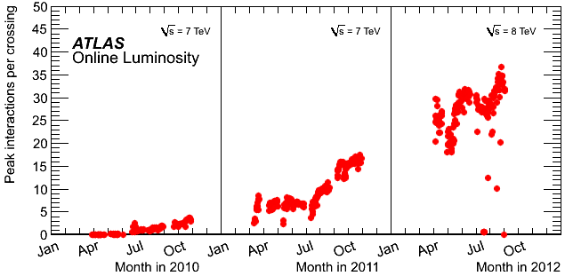
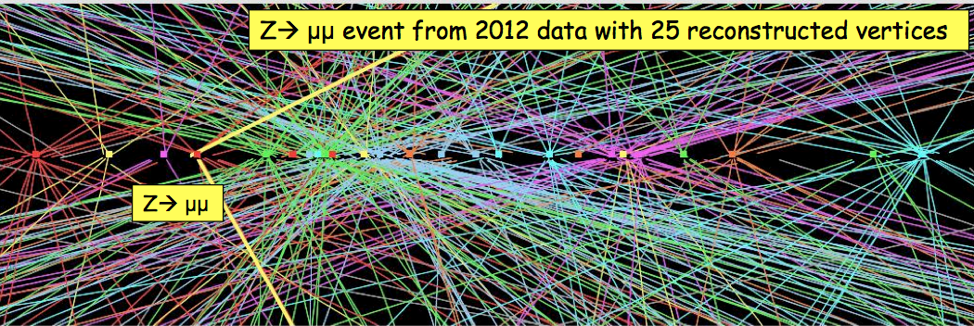
Pile UP : a big challenge
Pile Up:
several interactions in the
same bunch crossing
Soft interactions
→ low p_{T} particles
Present bunch crossing: 50 ns

Slide 19
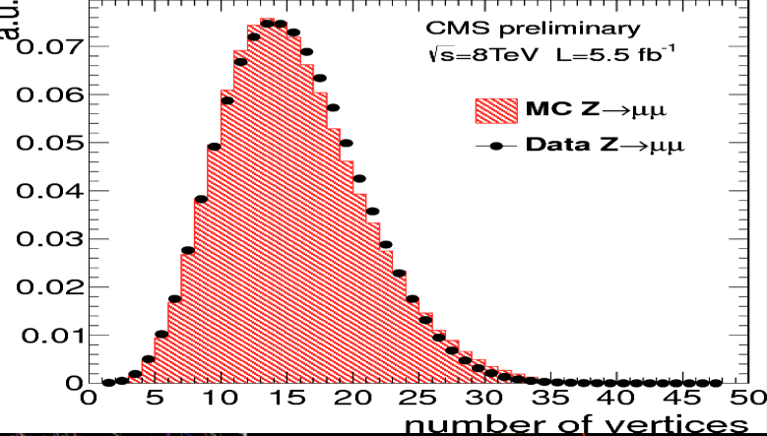
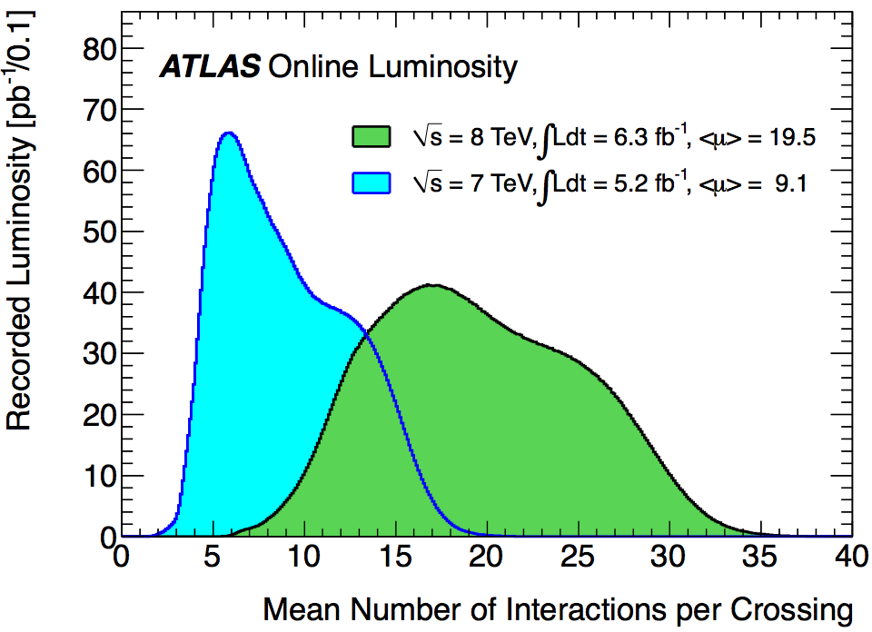
Pile Up(PU) : a big challenge
Number of primary vertices NPV characterizes the “In time Pile Up”
Mean number of interactions <μ> characterizes the “In&Out of time Pile Up”
2011
2011
early
2012
Number of vertices
Recipe to make analyses ‘robust’ wrt PU effects :
Include PU in the simulation (if not → reweight NPV, <μ> distributions )
Select particles, jets etc. coming from primary vertex with highest p_{T} tracks (need
precise vertexing)
Exploit jet characteristics
Subtract average PU energy in isolation cones

Slide 20
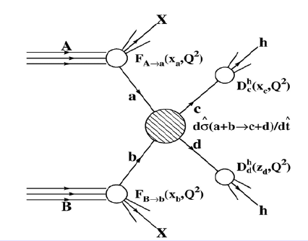
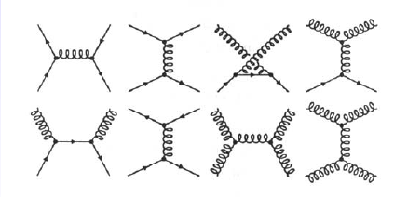
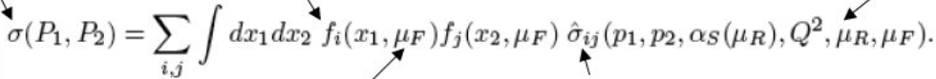

Jet Production
UE
Cross-section (σ) calculation :
factorisation of PDF & MatrixElement
Introduced to absorb divergences in pQCD
UE
Factorisation and renormalisation scale
Parton Distribution Functions
Short distance cross-section
Calculations of σ_{ij} are done in perturbative QCD
σ_{ij} =
_{ij → X}
LO
NLO
NNLO
To test the theory (to compare experimental data and theoretical predictions)
many aspects of QCD must be understood : PDF, parton fragmentation(jets), UE

Slide 21

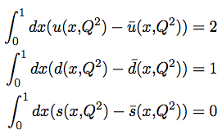

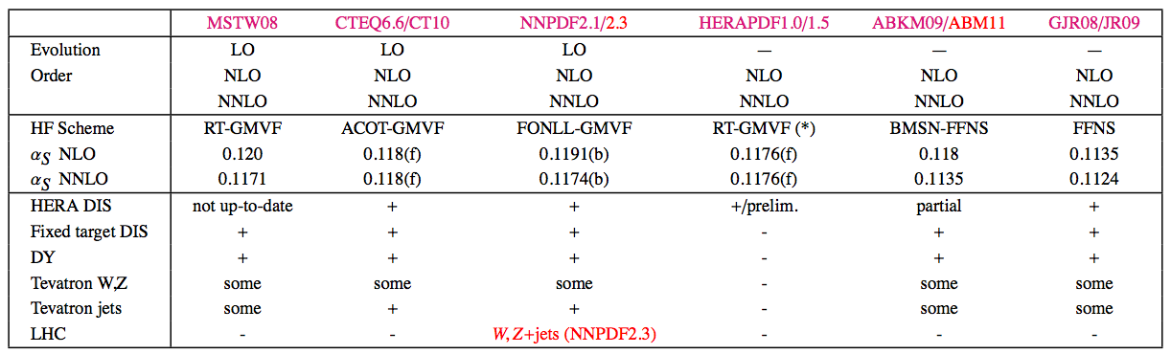
Parton Distribution Functions (PDF)
PDF q _{i} (x, Q²) probability of finding the parton q _{i} with x fractional momentum @ Q²
PDF are ‘universal’. Obtained by constrained fits to DIS, DY, jet cross sections @fixed Q²
Example of parametrization of PDF:
Proton structure →
Sum rules (constraints)
A_{i}, B_{i}, C_{i}, ..., fit parameters (typically N ~ 20)
Sometimes α_{S} is also fitted
PDF are ‘evolved’ @ different Q². For a gluon PDF:
g
x
y
x
y
y, α_{s}
y, α_{s}
DGLAP equation
Splitting functions
g → gq
g → gg
Glazov, ICHEP2012

Slide 22
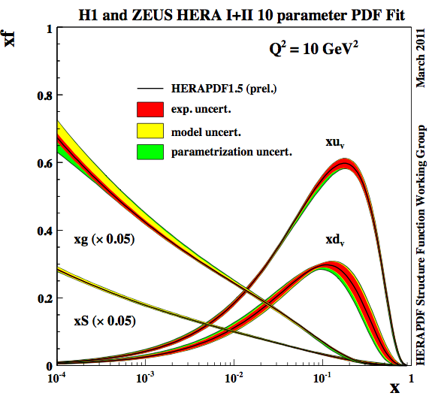
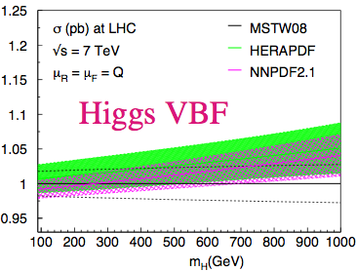
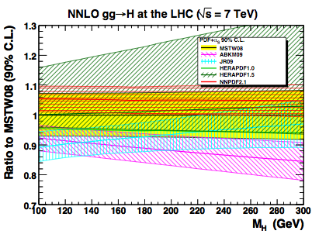
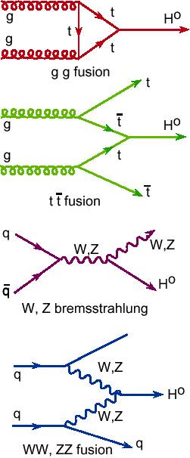
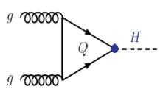
Parton Distribution Functions fit: some Results (ICHEP2012)
Uncertainties: experimental errors, choice of
parametrization, modelling (Q₀, heavy quark
masses, …)
Hessian method to estimate uncertainties
→ N parameters → N distributions (eigenvectors)
for a given PDF set
(→ systematics on data)
Uncertainties on the Higgs cross sections
(2 examples)
≈ ± 3%
≈ ± 15%
G. Watt, http://mstwpdf.hepforge.org/pdf4lhc/ringberg

Slide 23
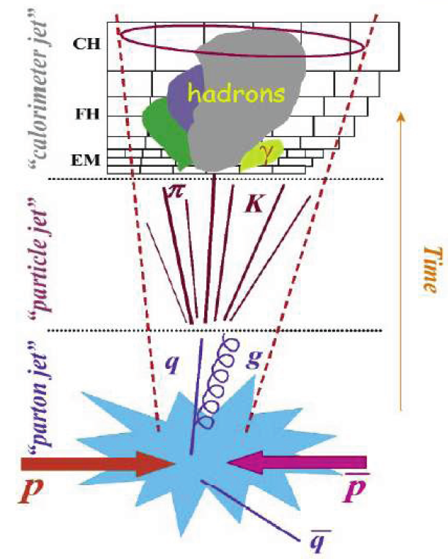
Jets
Quarks and gluons manifest as jets (of hadrons). Jets are universal.
A jet is defined by the jet algorithm: different algorithms → (Slightly) different jets
The jet algorithm is run on detector objects (clusters, tracks) or on stable hadrons
A jet algorithm is characterized by:
a metric (measure of distance)
a resolution parameter
procedure of recombination
A good jet algorithm is:
safe to higher order effects, i.e. a soft IR (E->0)
or collinear (θ->0) gluon radiation do not
change jet quantities
time
detector independent
fast
unsafe
Jet algorithms: cone, midpoint cone, JetClu
SISCone, k_{T,} anti-k_{T}
safe
See Salam,
arXiv:0906.1833 for a review on jet algorithms

Slide 24

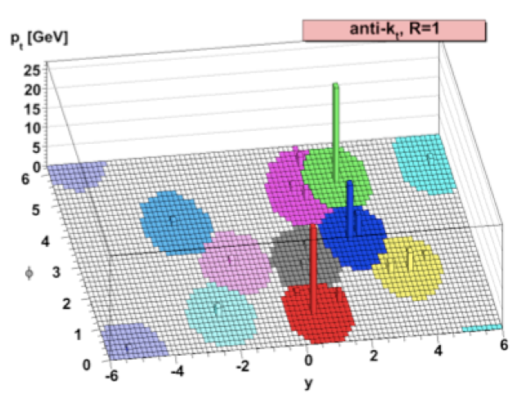
Anti-k_{T} Algorithm (Cacciari, Salam, Soyez, 2008)
p = -1
Anti-k_{T} Algorithm
Metric: d_{i} = p_{T,i}^{2p} and d_{ij}
p = 0
Cambridge/Aachen algorithm
p = 1
k_{T} Algorithm
Resolution parameter: R [R=0.4, 0.5, 0.6, ..,1]
Recombination procedure:
[d_{ij}= min (p_{T,i}^{2p}, p_{T,j}^{2p}) ΔR_{ij}²/R²]
compare all d_{i} and d_{ij}
find d_{min}
if d_{min} is a d_{i} add particle i to the list of jets,
if not replace i and j with the jet ij
Anti-k_{T} is the standard jet finding @ LHC:
Final jets
d_{min} determined mainly by hardest
particles →soft particles cluster earlier
with hard particles then among themselves
→ Soft particles do not modify shape of jets
If a hard particle has no other hard
neighbors it forms a round jet
Jets with ~ circular in space good for
experimental corrections
http://arxiv.org/abs/0802.1189

Slide 25
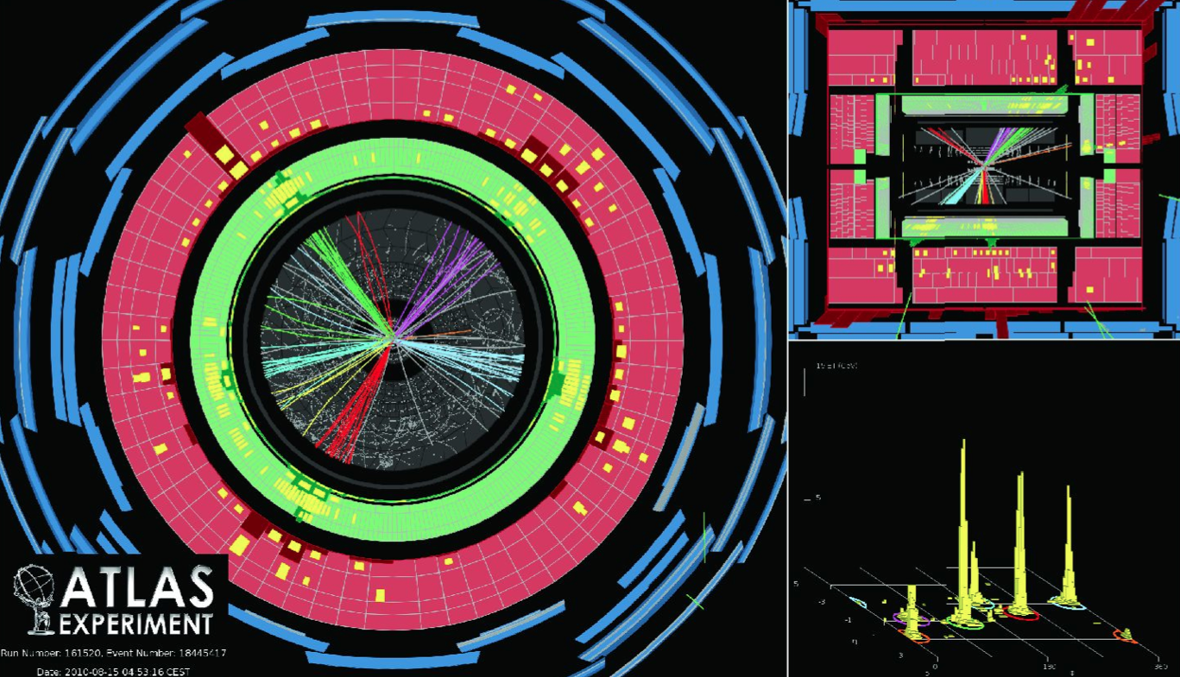
test of pQCD @ NLO
constrain PDF
measure α_{s}
understand background from searches
sensitive to new phenomena
Motivations to study jet production:

Slide 26
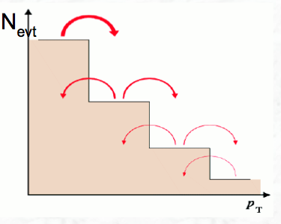
Jet analyses Issues : Inclusive Jet Cross section
Experimental issue :
d σ
≈ const E_{T}⁻ ⁶
d E_{T}
How well do we measure the Jet Energy Scale? (JES)
critical because of very steep spectrum :
relative uncertainty :
δN δE_{T}
≈ 6
N E_{T}
an uncertainty of 5% on JES --> 30% on measured σ
Jet energy resolution --> spectrum distortion
N (E_{T}^{meas}) = N (E_{T}^{true}) Resol(E_{T}^{meas}, E_{t}^{true})
To do:
1) determine the resolution + uncertainty
2) unfold the measured spectrum
Theory (& Experimental) issue:
Cross section measured @ ‘particle level’ (corrected for all experimental effects)
To compare data with fixed-order NLO calculations (parton-level) the latter must be
corrected non perturbative effects (parton fragmentation and UE)
use Monte Carlo tuned to data (correction ~ 5-10% → 0 depending on p_{T}^{jet} )

Slide 27
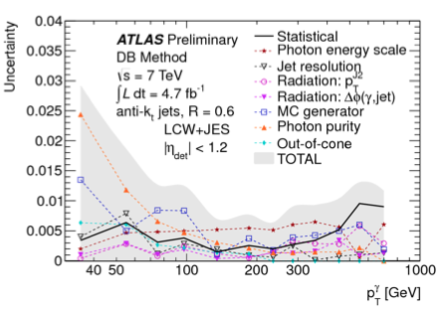
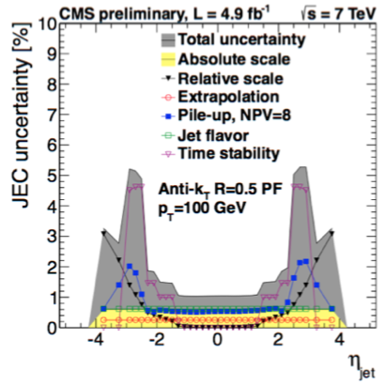
Jet Energy Calibration & JES uncertainty
Jet Energy Calibration corrects for non-
compensating calorimeters, dead material,
out- close of-cone effects, pile-up
Several calibration schemes
Validations: in-situ checks using
p_{T} balance jet-jet or with respect to
well-calibrated objects
(i.e γ-jet, Z-jet data, ..)
1%
http://arxiv.org/pdf/1112.6426.pdf (ATLAS)
http://arxiv.org/abs/1107.4277 (CMS)
JES uncertainty depends on constituent input to jet
algorithm (smaller for ParticleFlow jets)
JES uncertainty higher in forward region wrt
end/cap region (extrapolation di-jet balance)
1%
Uncertainty due to Pile‐Up depends on the number
of primary vertices NPV

Slide 28
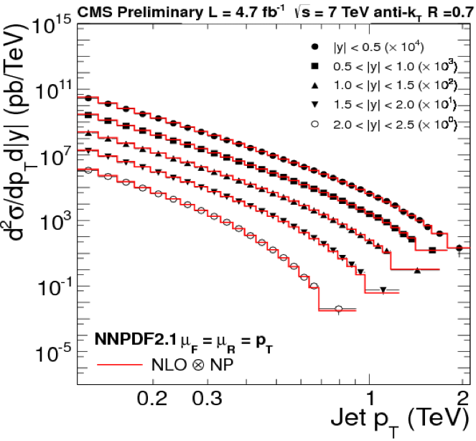
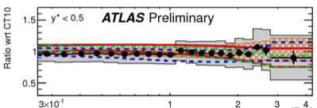
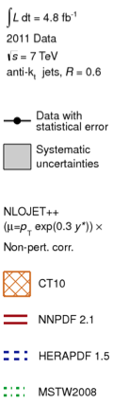

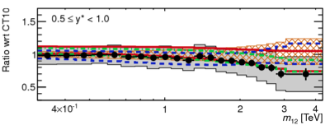
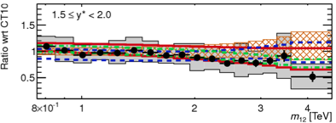
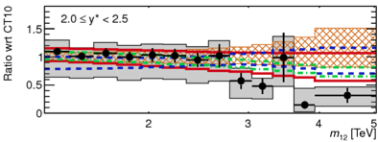
Jet Physics : Jet cross section and Di-jet Mass
ATLAS-CONF-2012-021
Size experimental uncertainties ~ theoretical
ones:
experimental systematic uncertainty
dominated by Jet Energy Scale uncertainty
(steeply falling curves )
m _{jet1 jet2}
Data are well described by NLO perturbative QCD calculations (NLOJET++ and
POWHEG+PS )
+ comparison with a variety of PDF sets

Slide 29



Substructure of high p_{T} Jets
Gaining a lot of interest now! Motivations:
Test of QCD, tuning parton shower mechanism
Searches of heavy resonance decay (Higgs, neutralinos,
high p_{T} top-quarks) into a boosted/collimated jet
Many variables studied: jet mass,
subjet multiplicity, subjettiness,
angularity, planar flow, ..
ATLAS-CONF-2012-044
ATLAS-CONF-2012-065
Some results:
Clear difference between quark and
gluon jets
Boosted tops better resolved with
trimmed jet
(Trimming: remove regions in a jet with
too little energy)
“Trimmed jets”
New window to search for new heavy mass
states decaying into jets, previously thought
to be inaccessible due to QCD background.
Jet trimming:
arXiv:0912.1342 [hep-ph]

Slide 30



Weak Gauge Bosons @ Hadron Colliders
W/Z production (and decay) @ LO:
@ 7 TeV:
~ 10 Millions W→eν/ fb⁻¹
~ 1 Million Z→ee/ fb⁻¹
A,B = hadrons
Parton distribution functions
Parton cross section
X = W,Z + …
σ • Br relatively high and well known
use to understand the detector
(calibration, alignment, efficiency..)
well understood signature
Motivations:
1% reached
Test pQCD up to NNLO
Explore QCD in new kinematic domains [p_{T}(W,Z), W,Z+jets]
Constrain Parton Densities [dσ/dy,η, W,Z+c,b]
Perform precision electroweak measurements [M_{W}(Pol(W)), sin²Θ_{weak}, TGC]
Better understanding of background for Higgs and New Physics searches

Slide 31
Cross Section Measurements: Steps
1. Select events (cuts)
Obtain the raw distribution
of signal events
2.Estimate background (MC or/and data driven
methods)
3.Correct for detector effects:
cut efficiencies, energy/momentum scale and resolution
effects (MC and/or unfolding procedures. Efficiencies,
scales and resolutions from MC or/and data
driven methods)
Obtain the
corrected experimental
distribution
4.(Sometimes) Correct for theory effects (MC, theory)
Ex.: QED FSR
5.Measurements in the (detector) fiducial region
Advantage: reduced theory
dependence
6.Extrapolation to the full or extended phase space
(MC, theory)
Combination/Comparaison
with results different fiducial
cuts or with theory

Slide 32



Weak Gauge Bosons. Step1: Selections
Production cross sections known
@ NNLO (FEWZ, DYNNLO)
Focus on leptonic decays (hadronic
decays impossible, high jet background)
W, Z Signatures:
* lepton(s) with high p_{T}
* for W large missing E_{T} (E_{t}^{miss})
Typical W selection:
p_{T}^{l} > 20 GeV, E_{T}^{ν} (E_{T}^{miss})>25 GeV,
|η_{l}|< 2.5
m_{T}>40 GeV
m_{T} ≡ √
Typical Z selection:
p_{T}^{l} > 20 GeV,
66< M_{ll}< 116 GeV
|η_{l}|<2.5 (|η_{e}|<4.9)
M_{ll} ≈ √2 E_{l1} E_{l2} (1-cos ϑ_{l1 l2})

Slide 33



Lepton(e, μ) reconstruction & identification
Electrons:
Cluster reconstruction in ECAL
Dedicated track reconstruction for e
(GSF= Gaussian Sum Filter)
Identification critera based (mainly) on
track-cluster match + shower shapes
Combined+segment tagged
Muons (ATLAS):
Combined: Tracker + Muon Spectrometer(MS) μ
Stand-alone: MS only
Segment tagged: Tracker + one μ segment in MS
Calorimeter tagged
Mean number of interactions per bunch Xing

Slide 34




Lepton(e, μ) Energy or Momentum & Scale and Resolution
Energy scale and resolution control with
Z and J/ψ → ll (l=e, μ), [E/p]_{e} in W->eν
Z-> μ μ
Fit:
gaussian generated mass distribution
Z-> e e
Fit:
BW CB
Z-> μ μ
CB= Crystal Ball function

Slide 35


For W: Missing Transverse Energy : E_{T}^{miss}
E_{T} ^{miss}= |p_{T} ^{miss}|
p_{T} ^{miss}= - Σ_{vis} p_{T}
ATLAS. Sums of e + γ + μ + jets + soft jets + ‘cell out’
CMS. Particle Flow approach: identify and reconstruct individually each particle
E_{T}^{miss} performance measured in Z→μμ events (clean final state, no intrinsic E_{T}^{miss} )
ATLAS-CONF-2012-101
STVF=Soft Term Vertex Fraction

Slide 36



W, Z total cross sections (x Branching Ratios) with e & μ
Total cross section agree with theoretical
predictions
Largest uncertainty is due to luminosity
measurement in 2010 3.4% which improves
to 1.7% in 2011
8 TeV
Much larger data set available now
2011 ~ 5 fb⁻¹/experiment
2012 ~ 14 fb⁻¹/experiment

Slide 37



W, Z Total Cross Sections (x Branching ratios) with τ
Challenging (in particular W)
τ identification:
Reconstruct individual decay modes
Multivariate methods used in particular for
τ isolation
J.Incandela – 4/7/2012
70% efficiency
with 5% fake
HPS=Hadron plus Strips
Good prospects for physics searches with τ (in particular H->ττ )

Slide 38







W, Z fiducial, total cross section results (l=e, μ)
Some discrimination
among PDF
model dependence
Fiducial cross sections
provide better
discrimination
among PDF

Slide 39



LHCb
η ~ 2.0
Single arm spectrometer, fully
instrumented in forward region
Overlap with ATLAS/CMS
in 2.0 < η < 2.5, unique coverage
in 2.5 < η < 5.0
Important for PDF constraints
LHCb provides complementary measurements to ATLAS/CMS

Slide 40


LHCb: Z Rapidity Distributions
Data broadly well described by predictions
Impact on PDF fit results
ATLAS: Phys. Rev. D85 (2012) 072004
CMS: Phys. Rev. D85 (2012) 032002
LHCb: JHEP 06 (2012) 058

Slide 41







Lepton (e, μ) Universality
R_{W}=
R_{W} ~ g_{e}/g_{μ}
Start to be competitive

Slide 42



W / Z + (n) jets, n=0, 1, 2…
Motivations:
Test of pQCD and MC techniques
BKG for top production, Higgs and
New Physics searches
Access heavy flavor content of proton
Phys. Rev. D85 (2012) 032009
What is done:
Compare data vs Event Generators & Calculations:
Parton Shower (PS) programs
Pythia, Herwig
LO matrix element (many legs) + matching to PS
Various matching scheme (e.g.: MLM, CKKW)
Alpgen, Sherpa
NLO matrix element + PS
MC@NLO, Madgraph+Pythia
NLO calculations
(normalisation)
Method based on Feynman diagram+known integrals
MCFM
Method based on unitarity and on‐shell recursion
Blackhat
jet p_{T}

Slide 43


W / Z + jets
Measure dσ/dΟ for various observables O: p_{T}^{jet}, y^{jet},
M_{jj}, H_{T}, ΔR, Δφ(Z, J₁) , etc ...
dσ (N_{data} − N_{bkg})
= * U(O)
dO L
U(O) unfolding factor
luminosity
Same lepton triggers and offline selections as in
W/Z inclusive measurements
Jets reconstructed with anti‐k_{T} algorithm
Systematic uncertainty dominated by JES
uncertainty (10‐20%) (at same level as the
theory uncertainty dominated by scale
uncertainties)
Test NLO calculations up to 4-jets:
NLO pQCD calculations (BlackHat),
LO ME+PS (Alpgen,Sherpa) and
NLO+PS MC(BlackHat+Sherpa, Madgraph+Pythia) describe well the data.
Lack of high‐energetic large‐angle emissions
in PS MC (Pythia)

Slide 44




W / Z + Heavy Flavour jets
Two main motivations:
PDF fits, very important background. Ex:
Z+bb: bckg for single top, ZH
W+b: bckg for SUSY and Higgs boson searches
Challenging: small cross section, large background (W+b)
b‐jets identified by exploiting the long lifetime and higher
mass of B‐hadrons
b‐tagging affects the sample composition
W+ >2 b-jet Yield
W+ >1 b-jet Yield
Z+ >1 b-jet Yield

Slide 45


W / Z + Heavy Flavours
Good description of b‐jet p_{T} shape
NLO predictions describe well Z+b and Z+bb data (20-25% uncert.)
Uncertainties: b tagging [16% (W) – 10% (Z)],
jet &b‐jet energy scale [7% (W) ‐ 4%(Z)], background in W+b [QCD (7%), top (12%)]
A small tension is observed between W+b jets ( 1. 5 σ deviation ). Need more data
to conclude
PLB 707, 418(2012)

Slide 46





Transverse Momentum (q_{T} or p_{T}^{V}) of Weak Vector Bosons (V=Z, W)
@ LO p_{T}^{V}= 0
@ NLO ( α_{s}¹) p_{T}^{V}≠ 0
Gluon radiation → divergence
@ small q_{T} → cannot describe
data (without cut on p_{T})
@ low p_{T} fixed order calculations inadequate
to describe data with kinematic cuts
→ QCD q_{T} resummation (reorganize the results
in terms of the large logs [ ln(Q²/p_{T}²)] )
Different schemes: CSS including also
non-perturbative effects, Sudakov
form factors, exponentiation.
The study of p_{T}^{V} allows:
@ low p_{T} to refine Parton Shower
& Resummation Models (important for the
W mass measurement and for Higgs studies)
@ high p_{T} to test the predictions of pQCD
in a clean environment
q_{T}(GeV)

Slide 47

p_{T} (Z and W) Results: Ratio data/RESBOS^{(*)}
Consistent picture: @ low p_{T}^{W, Z} RESBOS describes fairly well the data,
@ high p_{T}^{W, Z}
NLO predictions
undershoot data and
higher-orders restore
agreement
NNLO
NLO
p_{T}
Non-pertur-
bative
Pertur-
bative
^{(*)}
Resums to NNLL,
matches to NLO QCD,
correct to NNLO QCD
(K-factor)
hep-ph/9311341
hep-ph/0401026

Slide 48



W Charge Asymmetry
σ _{proton-proton -> X} = PDF σ _{parton-parton -> X}
parton= quark or gluon
@ LO:
In proton-proton collision (LHC) more
u than d quarks (W⁺ is ud , W⁻ is ud)
_
_
tot
≠ 0
→
In proton-antiproton collision (Tevatron)
tot
= 0

Slide 49





W Charge Asymmetry vs W rapidity
σ _{proton-proton -> X} = PDF σ _{parton-parton -> X}
Parton= quark or gluon
More u than d quark @ high x
→ higher longitudinal boost for W⁺
Range @ LHC with W
_
_
For x_{a}=x_{b} and u ~ d ~ q (q = see) :
Asymmetry A_{W} (y) sensitive to valence quark → constraint PDF

Slide 50




W Charge Asymmetry vs Lepton Rapidity
Difficult to reconstruct the W rapidity (z-component of the neutrino)
→ charge asymmetry can be more readily measured as function of the η lepton:
@ LO
Θ* = angle between the lepton in the W-rest
frame and the W direction
@Q=M_{W}
Generator level, no cuts (D.Tsionou Thesis)
y_{W} is function of η_{l} and p_{T}^{l}
→ Comparaison as function η_{l} for different p_{T}^{l}
The lepton asymmetry corresponds to the
convolution of the W production and the
V −A decay of the W
y_{W} or η_{e}

Slide 51



W Charge Asymmetry vs Lepton Rapidity: Results
Complementarity GPD & LHCb
(η = 0 - 2.5) & (η = 2 - 4.5)
Combined plot (LHC EWK WG)
(2010 data)
Updated results (2011 data)
Discrimination among PDF @ low η
ATLAS-CONF-2011-129
arXiv:1206.2598

Slide 52




Polarisation of the W boson
Impact on kinematics of the decay lepton → important to measure for
precision measurements: @ LHC (ΔM_{W}≈ 5 MeV on M_{W})
@ tree level (+ m_{f} = 0)
Initial state
W
the W is produced with helicity λ = ± 1, no longitudinal polarisation
W⁻ boson decay structure is V-A:
W⁻
Final state
Θ*_{W,l} = angle in the W⁻ rest frame between
the electron and the W spin direction
(Remember the Wu ⁶⁰Co experiment !)
For W⁻ and W⁺ :
Q = electric charge of the W

Slide 53




Polarisation of the W boson
At QCD perturbative orders above tree level (high W transverse momenta) more
complex production mechanisms → polarisation in longitudinal states is possible
Normalised differential W cross section:
θ_{3D} = helicity angle angle between the lepton
in the W- rest frame and the W direction
Helicity fractions:
Left-handed,
Right-handed,
Longitudinal
f_{i} i = L,R,0 expected different
for W+ and W-

Slide 54





Polarisation of the W boson
Difficult to reconstruct the
helicity angle θ_{3D}
(z-component of the ν)
ATLAS. Template fit to:
CMS. Binned ML fit to:

Slide 55





Polarisation of the W Boson: Results
f₀ vs f_{L}- f_{R} averaged over charge (lepton and recoil energy scale syst. largely cancel)
Eur. Phys. J. C72 (2012) 2001
Muon channel, all p_{T}
Phys. Rev. Lett. 107(2011) 021802

Slide 56





Asymmetry @ the Z pole
Origin : parity violation in neutral weak interactions
g_{v}^{f}, g_{a}^{f}, = vector and axial
Z couplings
c_{L}
c_{R}
left-handed
fermions
right-handed
fermions
If g_{a}≠0 Z couplings to left- and right-handed fermions are different
Asymmetry in Z couplings to fermions very interesting since related
to sin² ϑ_{W}

Slide 57









_
Forward-Backward Asymmetry in qq -> Z -> l⁺l⁻
@ LO :
∧
√ s
Z
Backward
Forward
=
f=
,
asymmetry in the polar emission angle θ* of the lepton in the rest frame
the lepton-antilepton pair.
∧
A_{FB} is defined (for all values of √ s ):
₁
σ_{F} = ∫₀ dσ /dcos(θ*) dcosθ*
₀
σ_{B} = ∫₋₁ dσ /dcos(θ*) dcosθ*

Slide 58


(γ*/Z decay) Forward-backward Asymmetry @ pp Colliders
@ the Z pole A_{FB}
→ probes structure weak neutral
currents
SM LO predictions for
extraction weak mixing angle
sin² ϑ_{W}
@ large M_{ee} A_{FB}
→ dominated by
the properties of the interference
between the γ∗/Z propagators
with new particles
→ Exchange of new particles would
alter A_{FB}
A_{FB}
M_{ee}(GeV)

Slide 59


Forward-Backward Asymmetry in γ*/Z decay
A_{FB} measured very precisely in previous experiments: LEP, SLD and Tevatron
Latest Tevatron result from D0 :
‘Unfolded’ asymmetry
Statistics dominated.
Major uncertainties :
* PDF/Acceptance (0.002 near the
Z peak then up to 0.015)
@ LHC : the quark direction is not
known --> take the Z direction as the
quark direction. Assumption more
valid @ high Y_{Z}
Phys. Rev. D 84, 012007 (2011)
preliminary
all events
e channel favoured wrt to μ channel
due to higher angular acceptance ( |η | < 4.9)
correct quark
direction
Forward electron identification important

Slide 60

Forward-backward Asymmetry in γ*/Z decay
CMS PAS EWK-11-004
Distributions unfolded
for detector effects and
QED FSR radiations in
fiducial region:
p_{T}^{l}>20 GeV, |Eta| < 2.4
Theoretical predictions
describe well the A_{FB}
in data
No evidence for new
physics at high-mass

Slide 61


Extraction of sin²ϑ_{W}^{lept} around the Z pole
D0: template fit to the background-subtracted raw A_{FB} distribution)
(range 70 < M_{ee} < 130 GeV, e, |η|< 2.5) )
CMS: unbinned maximum likelihood fit to 3 distributions (Y, M_{μμ}, cosθ*_{CS} )
(in the range 80 < M_{ee} < 100 GeV μ, |η| <2.4 )
First measurement at the LHC:
Phys. Rev. D 84 (2011) 112002
Major uncertainties :
PDF (0.0013),
QCD effects beyond LO,
QED FSR
Dilepton rapidity
cosθ*_{CS}
CS= Collins-Soper frame

Slide 62

sin²ϑ_{W}^{lept} @ the Z Pole and Prospects
The weak mixing angle very well measured at LEP & SLD. Well known discrepancy
Can LHC results help?
Yes, if knowledge improves
on :
PDF
High order QCD
( see angular coefficients)
!
3.2 σ
arXiv:1103.5699v3 [hep-ex]
Most precise
from Z to light
quark
CMS
Also Tevatron and LHC measurements @ Z pole

Slide 63



Associated Production of EW Gauge Bosons : Dibosons
Direct test of non-Abelian structure of SM (demonstrated @ LEP) at high energy
Even if Higgs found -> dibosons important in understanding EWSB
Background for Higgs & New Physics
Probe for New Physics : resonance with diboson final states
Diboson LO diagrams in SM:
t - channel dominates cross section
s - channel sensitive to New Physics
though TGC
TGC = Triple Gauge Coupling = self interaction among 3 gauge bosons
Final
TGC
state
γ
Several final
states :
γ
γ
@ any order
@ tree level

Slide 64

EW Diboson Rates
All diboson processes already
measured @ Tevatron.
Improvements expected @ LHC:
1) Cross sections a factor ~ 10 higher
2) higher energy allows to explore
the most favorable kinematic
region
Diboson production
Higgs production

Slide 65






Zγ, Wγ Production
Search for an additional isolated photon
in W and Z events
W
γ isolation is a tricky business:
need corrections for UE and PU
Zγ
Z+j
V
Main backgrounds from Z+j and
W+j largely data driven estimated
Wγ
V
…
V
The E_{T}^{γ} in Zγ, Wγ well described
ATLAS:
arXiv:1205.2531
N_{jet} ≥ 0
Some tension in the Wγ
production cross section for
the inclusive measurement
→ Missing high order effects ?
CMS:
PLB 701 (2011)
N_{jet} = 0

Slide 66


WW production
Very important background for H->WW
ATLAS-CONF-2012-025
Searched in di-leptonic decays (WW → lν lν)
Major backgrounds:
- Drell-Yan production pp→ Z/γ*→ ll
(E_{T}^{miss} from mis-measurements) - W→ lν + jet production, one jet fakes a lepton - t t production with di-leptonic decays
_
After lepton, E_{T}^{miss} and Z veto cuts:
CMS PAS SMP-12-013
8 TeV
Results (@7 TeV):
ATLAS: σ = 53.4 ± 2.1 ± 4.5 ± 2.1 pb
CMS : σ = 52.5 ± 2.0 ± 4.5 ± 1.2 pb
Theory : σ = 45.1 ± 2.8 pb
Measured cross sections slightly
higher than NLO prediction?
p_{T}^{ll}[GeV]
m_{ll}[GeV]

Slide 67




WZ and ZZ Production
Important background processes for Higgs searches
(ZZ ‘irreducible’ bkg for H→4 l )
Search in three (WZ→ lν ll) and four (ZZ→ll ll)
charged lepton final states and also in
ZZ→ll νν (3 time more signal but more background)
WZ : σ_{fid}^{NLO} (SM, s = 7 TeV) ~ 17 pb
ZZ : σ_{fid}^{NLO}(SM, s= 7-8 TeV) ~ 6-7 pb
[t-channel mainly, s-channel suppressed (O(10⁻⁴)]
CMS PAS SMP-12-014
8 TeV
WZ→ lν ll
ZZ -> 2l 2τ

Slide 68


Cross Section Summary
SM theory describe reasonably
well the data
Small tension in diboson production
( WW , effect < 2 σ)
CMS

Slide 69




Charged Triple (Weak) Gauge Couplings
In SM the EW gauge boson kinetic term
gives origin to boson self-couplings :
1 1
L = – F^{i}_{μν} F_{i}^{μν} – G_{μν} G^{μν}
4 4
F^{i}_{μν} = W ^{i}_{μ} – W^{i}_{ν} + g f _{abc} W^{b}_{μ} W^{c}_{ν}
G_{μν} = B_{μ} – B_{ν}
General form for a W W V Lorentz-invariant interaction Lagrangian C & P conserving
(V = γ, Z):
X = W, V
EM gauge invariance → g₁^{γ}= 0
14 possible WWZ and WWγ couplings
CP invariance + EM gauge invariance → 5 independent couplings: g₁^{Z} , k_{γ} , k_{Z} , λ_{γ} , λ_{Z}
in SM : g₁^{Z}= 1 , k_{γ}= k_{Z} = 1, λ_{γ} = λ_{Z} =0

Slide 70


Charged TGC extraction
TGC are studied as deviation wrt SM → 5 ‘Anomalous Couplings’ (AC) :
in SM : Δg₁^{Z}=0, Δk_{γ}= Δk_{Z} = 0, λ_{γ} = λ_{Z} =0
^
s ≡ invariant diboson
mass²
enhanced sensitivity
@ LHC
Amplitude grow with energy and eventually violate tree level unitarity
--> introduce a cutoff scale Λ
(α ≡ Δg₁^{Z}, Δk_{γ /Z}, λ_{γ /Z} )
‘Anomalies’ appear as enhanced rates
at high p_{T}^{V} or M_{T} (VV) & changes in angular distributions
n
Usually: n = 2, Λ~ TeV
To extract AC :
fits to total cross-sections and differential distributions (i.e. E_{T}^{γ} , p_{T}^{Z} , M_{T}^{VV},
sensitivity at high values) and angular distributions

Slide 71



Charged TGC Results
WW more sensitive to Δk_{V} (grows as s ) than WZ & Wγ (grows as √s )
95% CL limits
from p_{T} (γ)
distribution in Wγ
WZ more sensitive to Δg₁^{Z} than W
--> complementarity
From p_{T}(Z) distribution in WZ

Slide 72




Neutral TGC Extraction
ZZZ, ZZγ, Zγγ vertices are forbidden at tree level in SM
Higher order corrections through virtual loop contribute ≈ 10⁻⁴
Deviations → hints of New Physics
/γ
s-channel
The vertex is described by 12 parameters
Assuming Lorentz+EM gauge invariance,
Bose symmetry
Zγ final state
ZZ final state
Example:
ZZ final state Lagrangian:
V = Z,γ
Unitarity :
i=4,5

Slide 73





Neutral TGC Results
95% CL limits from
Zγ final state
95% CL limits from
ZZ final state
Similar for f₄^{Z}
Most powerfull
results
@ present
Λ = ∞
Fit ZZ total cross section
Fit ZZ invariant mass

Slide 74


Summary : Dibosons and TGC Studies
The precision of diboson cross section measurements in pp collisions is approaching
a few percent accuracy level (dominated by PDF & luminosity & statistics)
SM theory describe reasonably well the data → observed rates and
differential distributions do not allow for significant contributions from anomalous
gauge couplings
LHC limits on anomalous coupling are surpassing limits from the Tevatron
(and LEP except for Δk_{γ} , λ_{γ} ) → significant gain expected with more data
WW and ZZ very important for understanding Higgs decays

Slide 75

Precision tests of the SM electroweak sector
All these quantities are related by
SM theory relations which take into
account corrections for quantum loops
(EW radiative effects)
EW fits = fit those relations with
constraints from measurements
Important role of LEP/SLC results
and of Tevatron measurements
(m_{W} and m_{t} mainly)
Precision tests of the SM coherence
Investigation of BSM effects
Fit performed by the Electroweak
Working Group:
http://lepewwg.web.cern.ch/LEPEWWG/
Also look @ the Gfitter group results:
http://gfitter.desy.de/

Slide 76


EW Fits: Investigation of BSM Effects
An example: disentangle if “observed” Higgs boson is SM or SUSY-like
LHC ?
http://www.ifca.es/users/heinemey/uni/plots/
→ Measure M_{W} and M_{t} in the most accurate possible way

Slide 77



Precision measurement @ LHC: W mass
No detector
effects:
1) p_{T}^{W}= 0
2) p_{T}^{W}≠ 0
Two main
(complementary)
variables used
to measure M_{W}
detector
effects
p_{T}^{W}≠ 0
p_{T}^{lep}(GeV)
p_{T}^{W} ≠ 0
1) no detector
2) detector
effects
CMS 2006/061
The target uncertainty @ LHC is < 10 MeV
Challenging:
M_{T}^{W} (GeV)
Theoretical understand of p_{T}(W) [low p_{T}, polarisation effects]
Improve PDF (i.e. strange quark content)
Control Pile Up effects on the soft recoil

Slide 78
Conclusions & Outlook
Many measurements have been performed recently in particular @ Tevatron and
@ LHC.
Jet, W and Z data are still well described by the EW and QCD theory:
QCD is better and better under control
EW precision measurements in agreement with a Higgs boson with mass
of 125 GeV
Good news:
Stable ground for New Physics Searches
Bad news:
Nothing new found
BUT the LHC potential has by far not yet been fully exploited !
Future precision measurements should help disentangle possible New Physics

Slide 79


Radiative Corrections
Vertex corrections
ISR &FSR corrections

