Slide 1
The long road to Dark matter’s discovery
Dan Hooper- Fermilab/University of Chicago
DPG School on Heavy Particle at the LHC
September 18th, 2012

Slide 2
“…we would like to invite you for an educating and entertaining evening lecture on dark matter `observations' in the past, present, and future. Knowing your behavioral patterns we decided to move this lecture to the evening, so the audience as well as the speaker would be encouraged to have a beer or two during the lecture. What do you think? Does this sound like fun?”
-Tilman

Slide 3

The long road to Dark matter’s discovery
(Why you should not believe anything old physicists tell you)
Dan Hooper- Fermilab/University of Chicago
DPG School on Heavy Particle at the LHC
September 18th, 2012

Slide 4



Slide 5
“We emphasize that the solution to the naturalness (fine-tuning) problem necessarily predicts that new physical phenomena must exist at a scale of m_{W}/g ~ 1 TeV or below. In the case of supersymmetry, this new physics consists of a spectrum of new supersymmetric particles (partners of the ordinary particles) which have masses no greater than about 1 TeV and in some cases may be substantially lighter.”
Howie Haber and Gordy Kane, Physics Reports 117, 75 (1985)

Slide 6
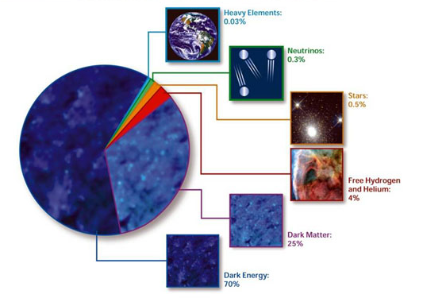
Dark Matter Myth #1:
Our universe could never look anything like this:

Slide 7
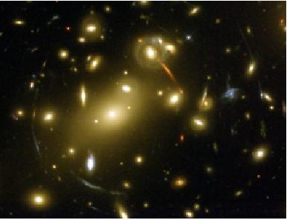
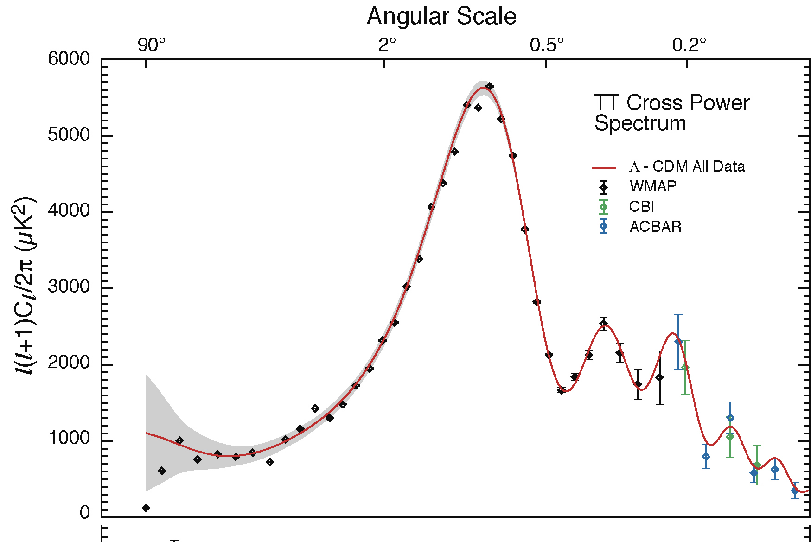
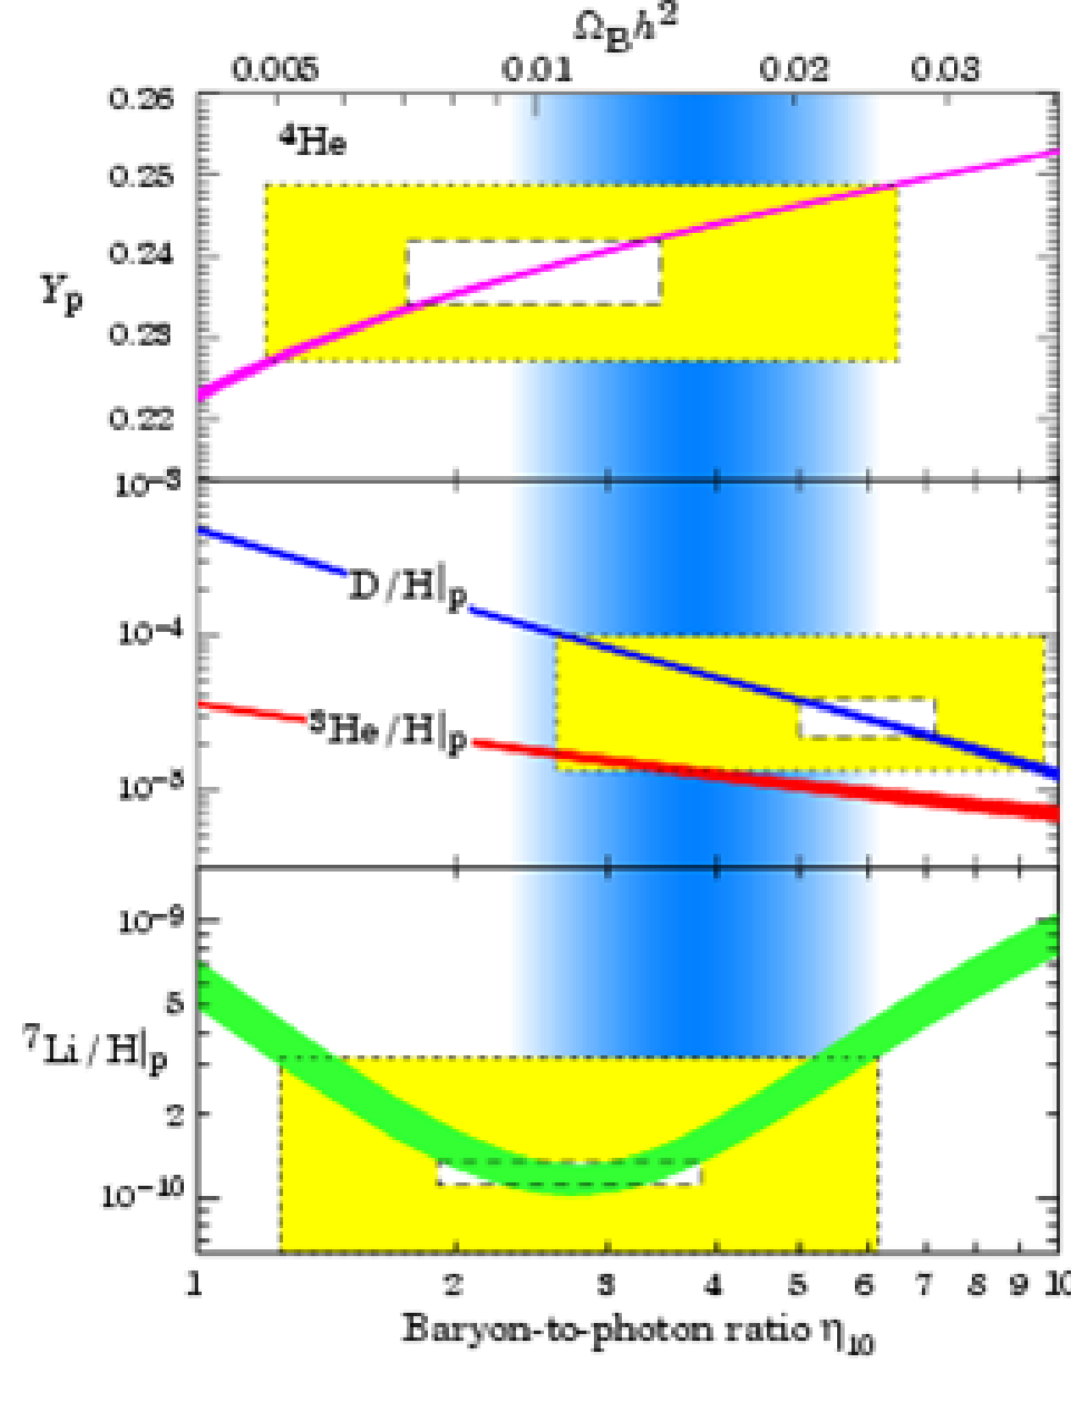
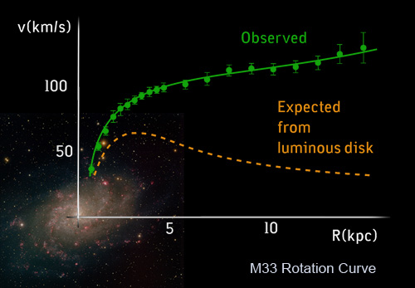
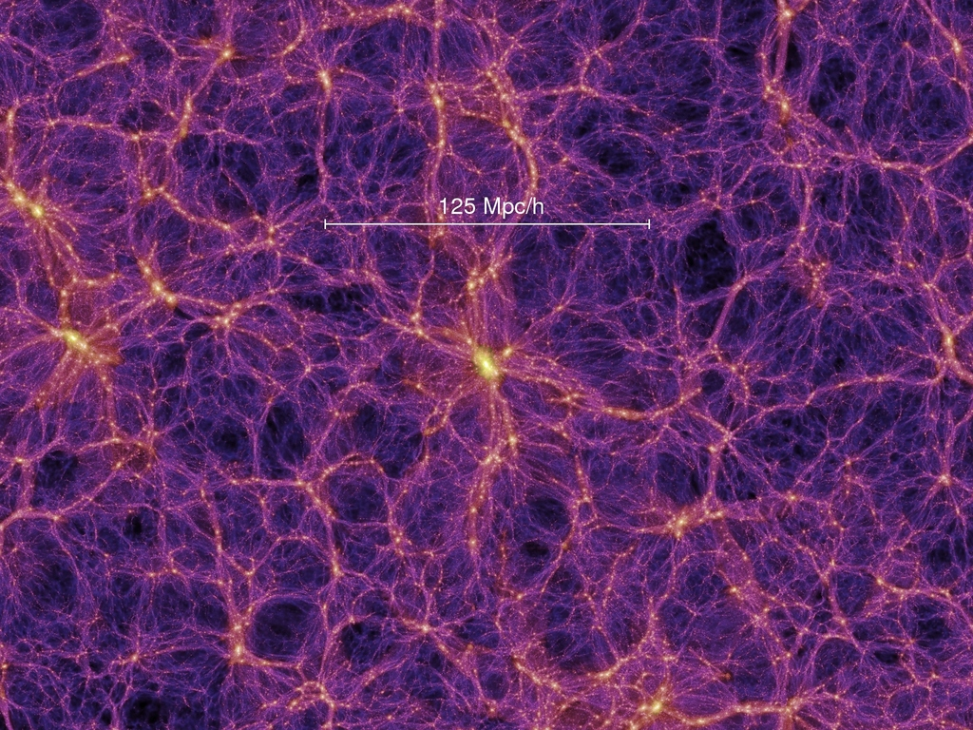
Evidence for Dark Matter
Galactic rotation curves
Gravitational lensing
Light element abundances
Cosmic microwave
background anisotropies
Large scale structure

Slide 8
Evidence for Dark Matter
There is a wide variety of evidence indicating that dark matter exists
Each of these observations infer dark matter’s presence uniquely through its gravitational influence
To-date, no (non-controversial) observations have been made of dark matter’s electroweak or other non-gravitational interactions

Slide 9
Evidence for Dark Matter
There is a wide variety of evidence indicating that dark matter exists
Each of these observations infer dark matter’s presence uniquely through its gravitational influence
To-date, no (non-controversial) observations have been made of dark matter’s electroweak or other non-gravitational interactions
Instead of dark matter, might we not understand gravity?

Slide 10



Modified Newtonian Dynamics (MOND)
Begin by modifying Newtonian dynamics as follows:
where μ≈1, except for small at acceleration, at which μ=a/a₀
For a circular orbit,
which in the low-acceleration limit yields
Rotational velocity independent of galactic radius (flat rotation curve)

Slide 11
Modified Newtonian Dynamics (MOND)
MOND has been quite successful in explaining the dynamics of galaxies, and provides an explanation for the Tully-Fisher relationship
Galaxy clusters are not well described by MOND
MOND cannot be applied to most questions of cosmology (toy theory – modifies Newton, not Einstein)
Dark matter suppresses the impact of baryon acoustic oscillations, explaining the observed matter power spectrum – MOND does not
S. Dodelson, arXiv:1112.1320

Slide 12
MONDs and Dark Matters In History
Case 1: Astronomical tables of Uranus’ orbit were found to deviate from observations. It suggested that either another planet was perturbing its orbit (dark matter) or that Newton’s laws had broken down

Slide 13
MONDs and Dark Matters In History
Case 1: Astronomical tables of Uranus’ orbit were found to deviate from observations. It suggested that either another planet was perturbing its orbit (dark matter) or that Newton’s laws had broken down
-One point for dark matter

Slide 14
MONDs and Dark Matters In History
Case 1: Astronomical tables of Uranus’ orbit were found to deviate from observations. It suggested that either another planet was perturbing its orbit (dark matter) or that Newton’s laws had broken down
Case 2: The precession of the perihelion of Mercury did not match the prediction of Newtonian gravity. Another planet (Vulcan) was proposed. Einstein solved with general relativity.
-One point for dark matter

Slide 15
MONDs and Dark Matters In History
Case 1: Astronomical tables of Uranus’ orbit were found to deviate from observations. It suggested that either another planet was perturbing its orbit (dark matter) or that Newton’s laws had broken down
Case 2: The precession of the perihelion of Mercury did not match the prediction of Newtonian gravity. Another planet (Vulcan) was proposed. Einstein solved with general relativity.
-One point for dark matter
-One point for MOND

Slide 16
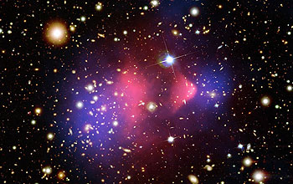

Slide 17
Baryonic matter (hot gas)
Total Mass

Slide 18
What is the Dark Matter?
We know only little about the nature of dark matter:
  Cold (non-relativistic)
  Stable
  Dark and collisionless (no electric charge or QCD color)
No particle contained in the Standard Model fulfills these criteria
This leaves us with a vast range of possibilities from Planck/GUT scale “WIMPzillas” to ultra-light axions
Dark matter candidates in the form of weakly interacting particles with masses in the GeV-TeV range (WIMPs) stand out for their
  Testability
  Theoretical motivation (solution to electroweak hierarchy problem)
  The “WIMP Miracle”

Slide 19
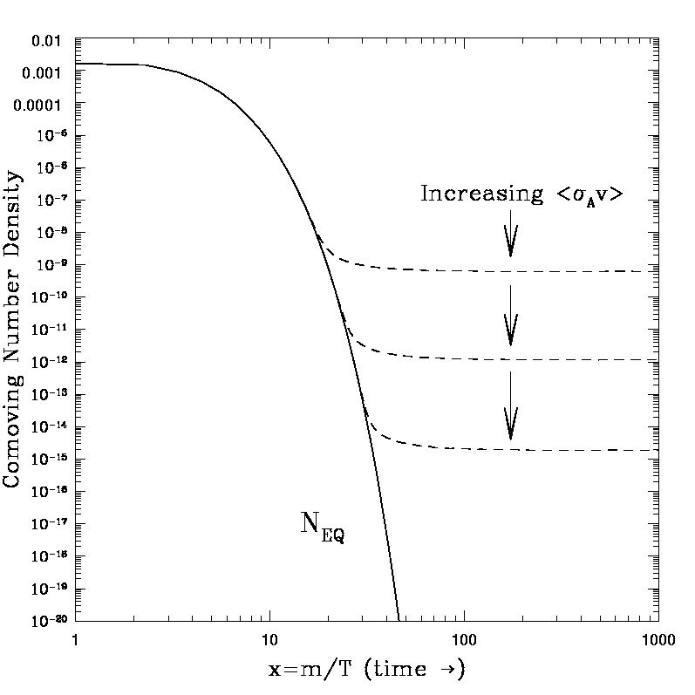




The Thermal Abundance of a WIMP
T>>M_{X}, WIMPs are in thermal equilibrium
T<M_{X}, number density becomes exponentially suppressed
Including the effects of expansion pulls the density away from its equilibrium value:
Numerically, this yields an abundance of:
In comparison,

Slide 20
The Thermal Abundance of a WIMP
T>>M_{X}, WIMPs are in thermal equilibrium
T<M_{X}, number density becomes exponentially suppressed
Including the effects of expansion pulls the density away from its equilibrium value:
Numerically, this yields an abundance of:
In comparison,
A generic stable, weakly interacting particle is predicted to be produced in the early universe with an abundance similar to the observed dark matter density.
-Numerical coincidence?
-WIMP Miracle?

Slide 21
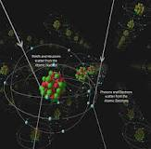
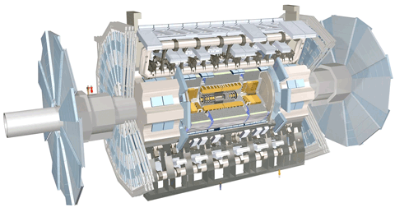
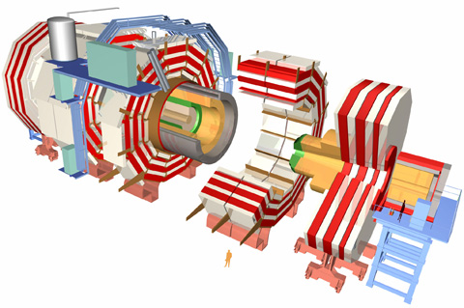
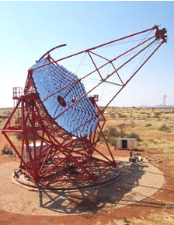
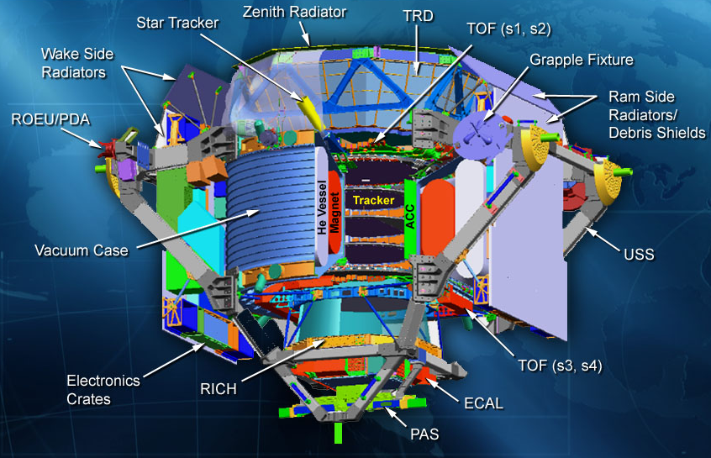
Putting the WIMP Hypothesis to the Test

Slide 22
Direct Detection
A GeV-TeV particle moving a typical halo velocities (~300 km/s) striking a nucleus imparts a recoil of ~1-100 keV
Numerous technologies have been developed and deployed in an effort to observe these collisions – scintillation, ionization, phonons

Slide 23
Direct Detection
A GeV-TeV particle moving a typical halo velocities (~300 km/s) striking a nucleus imparts a recoil of ~1-100 keV
Numerous technologies have been developed and deployed in an effort to observe these collisions – scintillation, ionization, phonons
Current state-of-the-art experiments make use of 10-100 kg heavy nuclei targets (Ge, Xe), instrumented and located deep underground to minimize backgrounds

Slide 24
Direct Detection
Over the past dozen years, constraints from direct detection experiments have improved with a Moore’s-law like behavior (a factor of 2 every 15 months)

Slide 25
Direct Detection
Z-mediated scattering (sneutrinos, heavy neutrinos)
Over the past dozen years, constraints from direct detection experiments have improved with a Moore’s-law like behavior (a factor of 2 every 15 months)
Some important benchmarks exist along this line:
  Mid-late 90s: Experiments (Heidelberg-Moscow, etc.) excluded the cross sections predicted for a WIMP which scatters and annihilates through Z-exchange
  Now!: Current experiments are beginning to test WIMPs which interact through Higgs exchange (including many SUSY models)
Higgs-mediated scattering (A-funnel, focus point neutralinos)
DM
SM
DM
DM
DM
SM
SM
SM

Slide 26
Direct Detection
If this rate of progress continues without observation for another ~5 years, the surviving dark matter models will be severely constrained
In order for a WIMP to evade detection over this time frame, one must consider one or more of the following:
  WIMPs which couple almost entirely to leptons or gauge bosons, rather than to quarks
  WIMPs which annihilate in the early universe through a fine tuned resonance, or through a highly degenerate coannihilation
  WIMPs which are light enough to fall below experimental energy thresholds (m_{X}<1-10 GeV)
  Non-standard cosmology (ie. low reheating)
It is starting to become difficult to hide our best motivated dark matter models from direct detection expts.
-5-10 years from now, very few WIMP models will remain out of reach

Slide 27
Dark Matter Myth #2:
The observation of an annual modulation in a direct detection experiment would be a “smoking gun” for dark matter

Slide 28
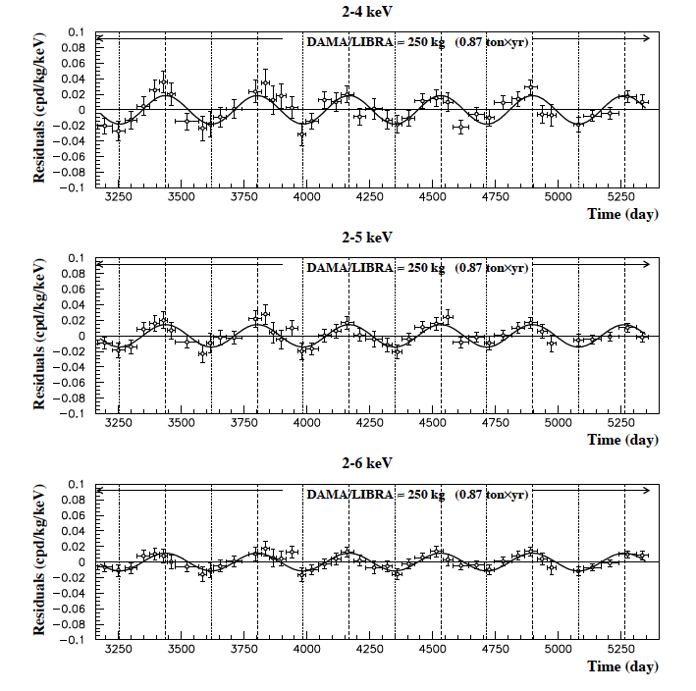
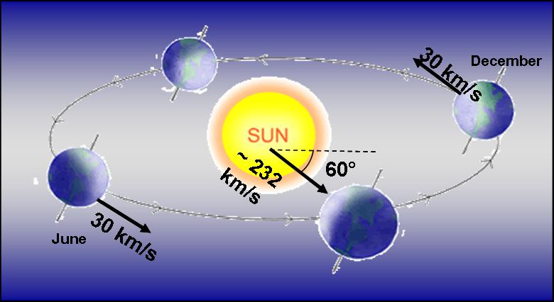
Possible Signals from Direct Detection Experiments
DAMA/LIBRA
Over the course of a year, the motion of the Earth around the Solar System is predicted to induce a modulation in the dark matter scattering rate
The DAMA collaboration reports a modulation with a phase consistent with dark matter scattering, and with high significance (8.9σ)

Slide 29
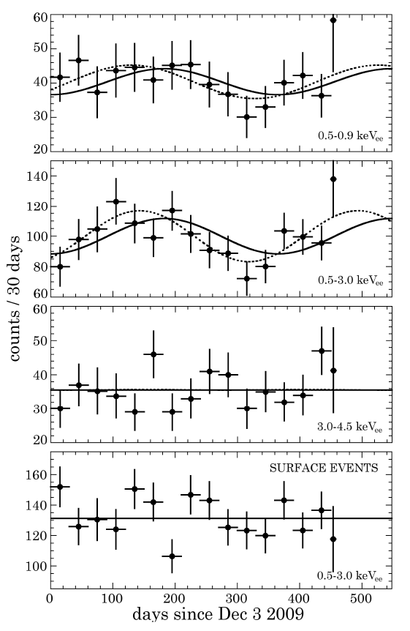
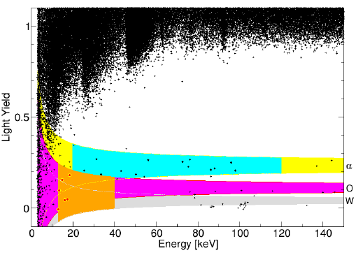
And CoGeNT and CRESST…
CoGeNT
CoGeNT reports an excess very low energy events, inconsistent with known backgrounds
Also, a DAMA-like modulation, although with a very modest statistical significance (~2σ) – and preliminary reports suggest less modulation in more recent data
CRESST-II
More recently, the CRESST-II collaboration reported the results of an analysis which identified 67 WIMP candidate events
Likelihood analysis prefers dark matter interpretation over known backgrounds (neutrons, gammas, alphas, Pb) at 4.7σ
WIMP Candidate Region
(1 of 8 detectors)
See also: Fox, Kopp, Lisanti, Weiner, PRD, arXiv:1107.0717; Kelso, Hooper, PRD, arXiv:1106.1066

Slide 30
A Consistent Picture?
DAMA, CoGeNT and CRESST-II
The spectrum of events reported by CoGeNT and CRESST are mutually compatible – favor a ~10-15 GeV mass and a ~10⁻⁴¹ cm² cross section
Kelso, Hooper, Buckley,
PRD, arXiv:1110.5338

Slide 31
A Consistent Picture?
DAMA, CoGeNT and CRESST-II
The spectrum of events reported by CoGeNT and CRESST are mutually compatible – favor a ~10-15 GeV mass and a ~10⁻⁴¹ cm² cross section
The modulation amplitudes reported by CoGeNT and DAMA also appear to be compatible with one another (if interpreted as dark matter with m~10 GeV and elastic scattering with σ~A²)
Kelso, Hooper, Buckley, arXiv:1110.5338; Fox, Liu, Weiner, PRD, arXiv:1107.0717

Slide 32
A Consistent Picture?
DAMA, CoGeNT and CRESST-II
The spectrum of events reported by CoGeNT and CRESST are mutually compatible – favor a ~10-15 GeV mass and a ~10⁻⁴¹ cm² cross section
The modulation amplitudes reported by CoGeNT and DAMA also appear to be compatible with one another (if interpreted as dark matter with m~10 GeV and elastic scattering with σ~A²)
Some tension with XENON – solved if significant fractions of low energy recoil energy goes to photons/heat
Kelso, Hooper, Buckley, arXiv:1110.5338; Fox, Liu, Weiner, PRD, arXiv:1107.0717

Slide 33
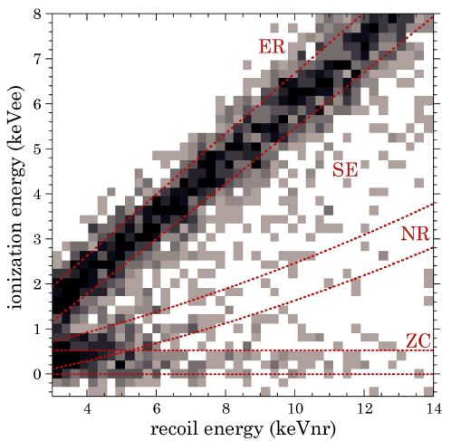
No Tension (and maybe a signal) from CDMS
CDMS separates events into nuclear recoils, electron recoils, surface events, and zero-charge events by using a combination of ionization and photon energies, but have not (publicly) applied this technique to their low energy events
CDMS has only placed conservative upper limits, assuming that all low energy events could be WIMPs
Recently, Collar and Fields digitized the CDMS data and performed their own likelihood analysis – are the low energy/low ionization events zero-charge events (as suggested by CDMS) or WIMP recoils?
Collar and Fields, arXiv:1204:3559

Slide 34
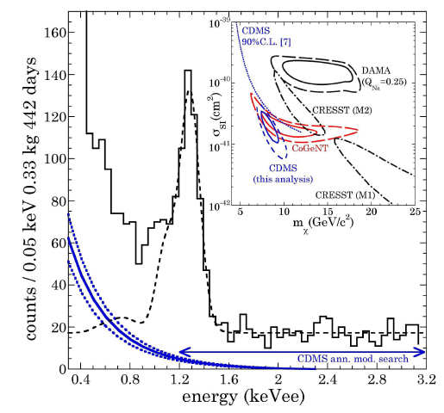
No Tension (and maybe a signal) from CDMS
At 5.7σ significance, Collar and Fields found a preference for a population of nuclear recoil events (blue spectrum)
If interpreted as WIMP scattering, this implies a mass and cross section that is compatible with CoGeNT, and consistent with CDMS’s published limits
CDMS’s modulation constraint would not be sensitive to this scenario
Collar and Fields, arXiv:1204:3559

Slide 35

A Consistent Picture?
DAMA, CoGeNT and CRESST-II
The modulation amplitude reported by DAMA is larger than expected based on the spectrum observed by CoGeNT, CRESST, (and CDMS?), assuming a simple velocity-independent scattering cross section and an isotropic, Maxwellian velocity distribution
Solutions?
-Sagittarius stream or other highly non-isotropic velocity structures?
-Inelastic or other velocity-dependent dark matter scattering?
-Ratio of proton-to-neutron couplings enhance scattering with sodium?

Slide 36
Homework Exercise #1

Slide 37

Homework Exercise #1

Slide 38
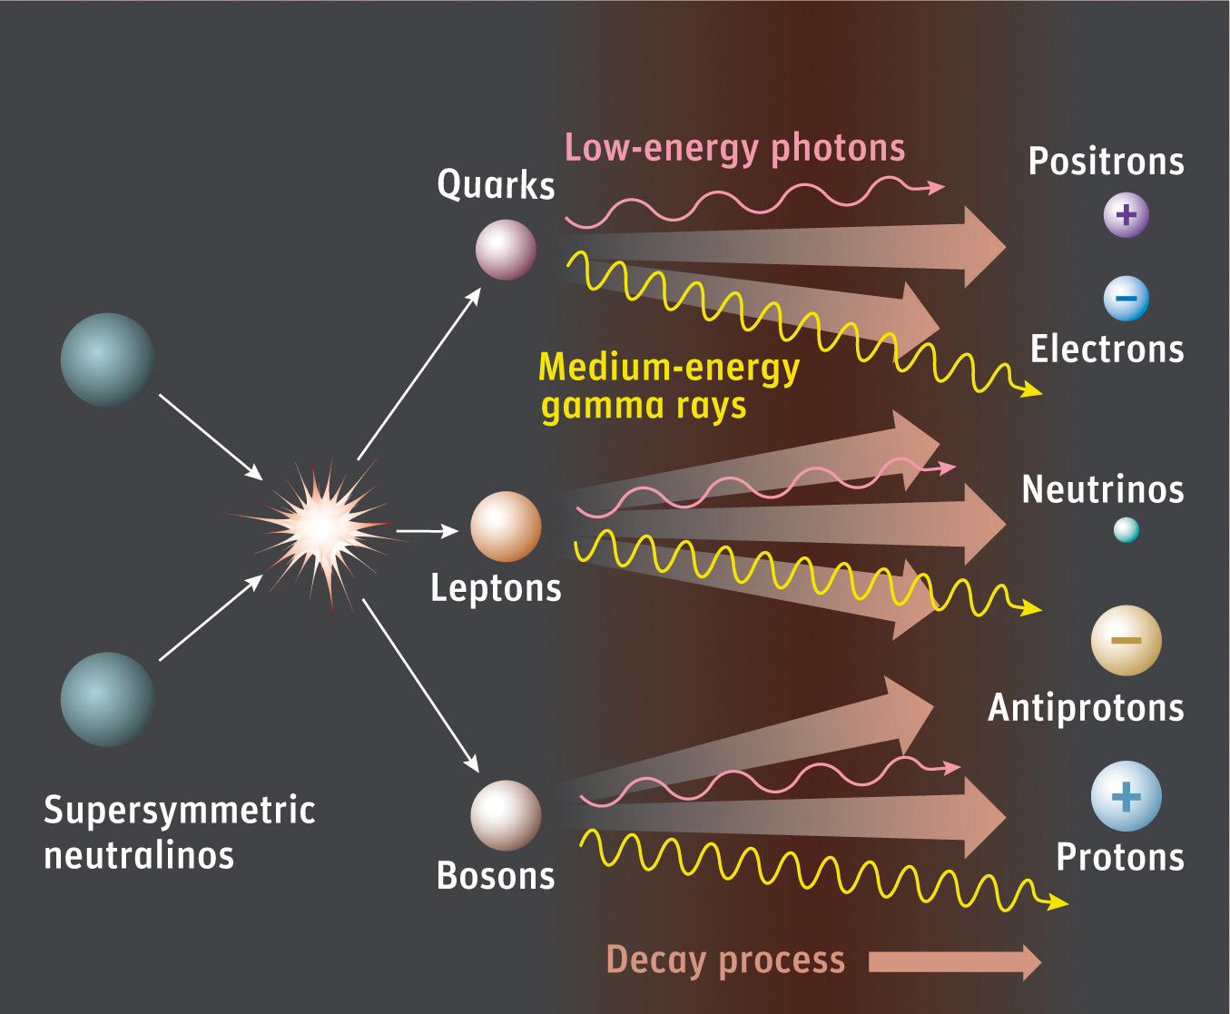
Indirect Detection

Slide 39
Indirect Detection
The key benchmark of indirect searches:
Recall that to be produced with the observed dark matter abundance, a thermal relic must have an annihilation (at freeze-out) of σv~3x10⁻²⁶ cm³/s
Although many model-dependent factors can cause the dark matter to possess a somewhat lower annihilation cross section today (velocity dependence, co-annihilations, resonances), most models predict current annihilation rates that are within an order of magnitude or so this estimate
Indirect detection experiments which are sensitive to dark matter annihilating at approximately this rate will be able to test the majority of WIMP models

Slide 40
Indirect Detection With Fermi
No indirect detection experiment has more potential to constrain or discover dark matter than the Fermi Gamma Ray Space Telescope (FGST)
Fermi’s Large Area Telescope (LAT) offers far more effective area (~8000 cm²), better angular resolution (sub-degree), and energy resolution (~10%) that its predecessor, EGRET
Unlike ground based telescopes, Fermi observes the entire sky and can study gamma rays down to ~100 MeV (ACTs are limited to ~100 GeV and up)

Slide 41
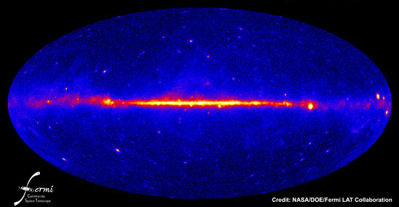
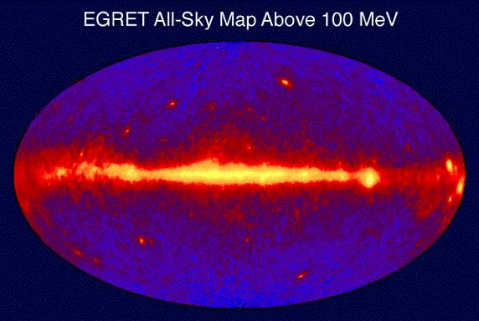

Slide 43
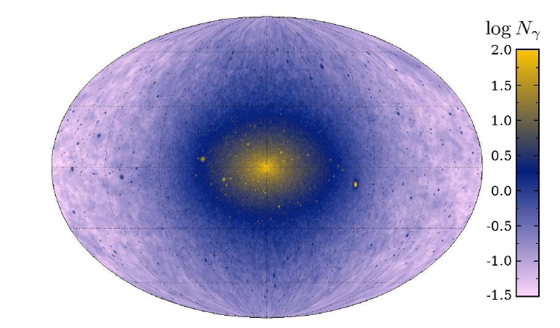
Where to look for Dark Matter with Fermi?
The Galactic Center
-Brightest spot in the sky
-Considerable astrophysical
backgrounds
The Galactic Halo
-High statistics
-Requires detailed model
of galactic backgrounds
Isotropic Background
-High statistics
-potentially difficult to identify
Dwarf Galaxies
-Less signal
-Low backgrounds

Slide 44
Where to look for Dark Matter with Fermi?
The Galactic Center
-Brightest spot in the sky
-Considerable astrophysical
backgrounds
The Galactic Halo
-High statistics
-Requires detailed model
of galactic backgrounds
Isotropic Background
-High statistics
-potentially difficult to identify
Dwarf Galaxies
-Less signal
-Low backgrounds

Slide 45
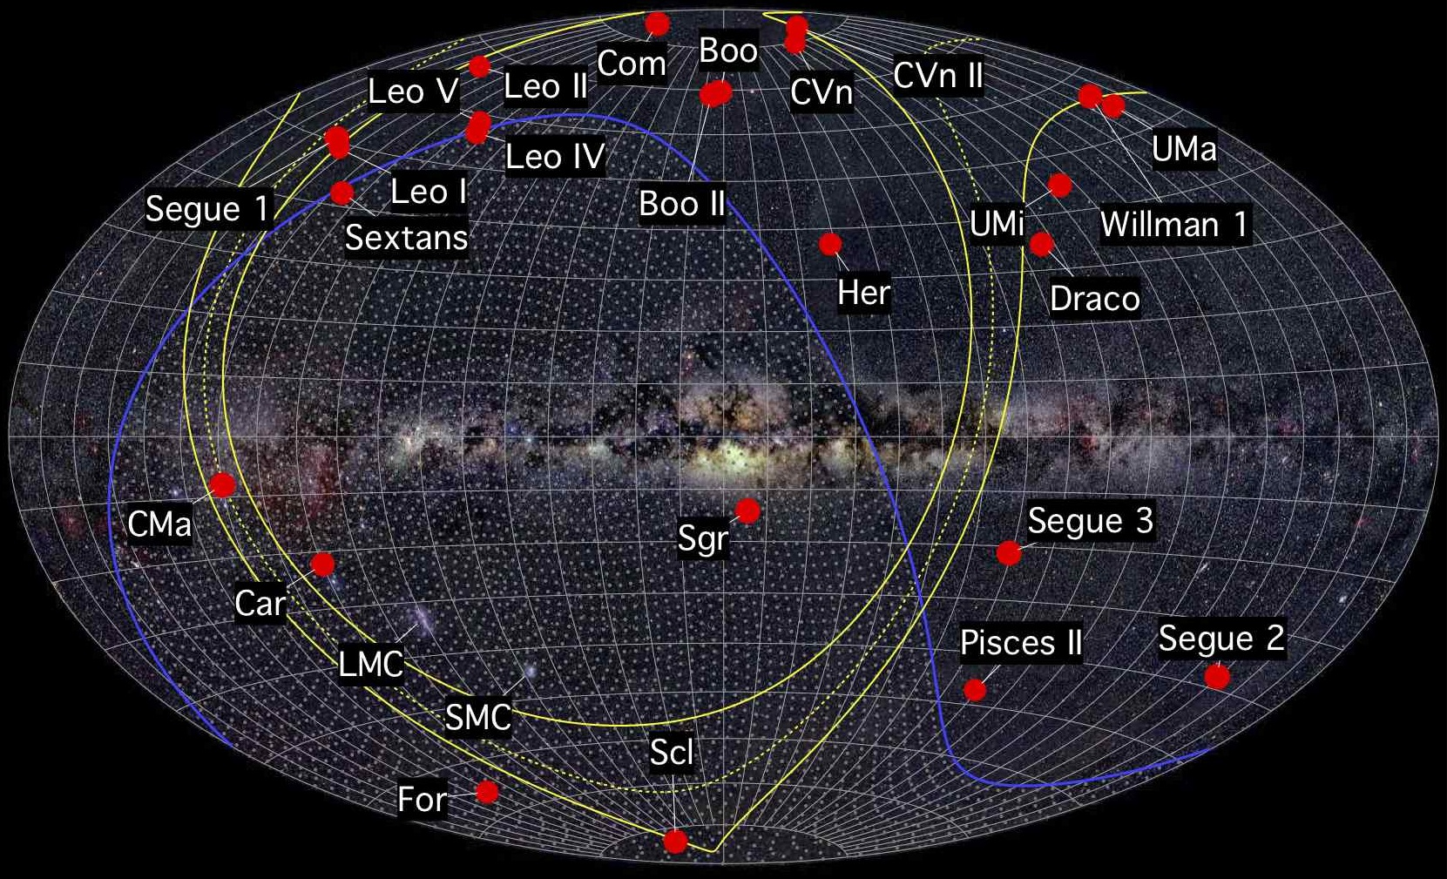
Dark Matter in Dwarf Galaxies
The halo of the Milky Way contains numerous smaller halos, the largest of which are dwarf galaxies
Dwarf galaxies are the most dark matter dominated known systems, with mass-to-light ratios as high as ~10³
These objects represent potentially bright sources of gamma rays from dark matter annihilations, with little in the way of astrophysical backgrounds

Slide 46
Dark Matter in Dwarf Galaxies
In the summer of 2011, the results of two analyses of Fermi dwarfs were released (one by Geringer-Sameth & Koushiappas, and another by the Fermi Collaboration)
Although no excess was reported, the lack of gamma rays can be used to derive a stringent constraint on the dark matter’s annihilation cross section
For the first time, Fermi is ruling out dark matter models with a cross section equal to the naïve estimate for a simple thermal relic (σv~3x10⁻²⁶ cm³/s) – reaching masses up to ~30-50 GeV
With the full (10 yr.) Fermi data set and discoveries of southern hemisphere dwarfs by DES, Fermi should become sensitive to dark matter with masses as high as several hundred GeV

Slide 47
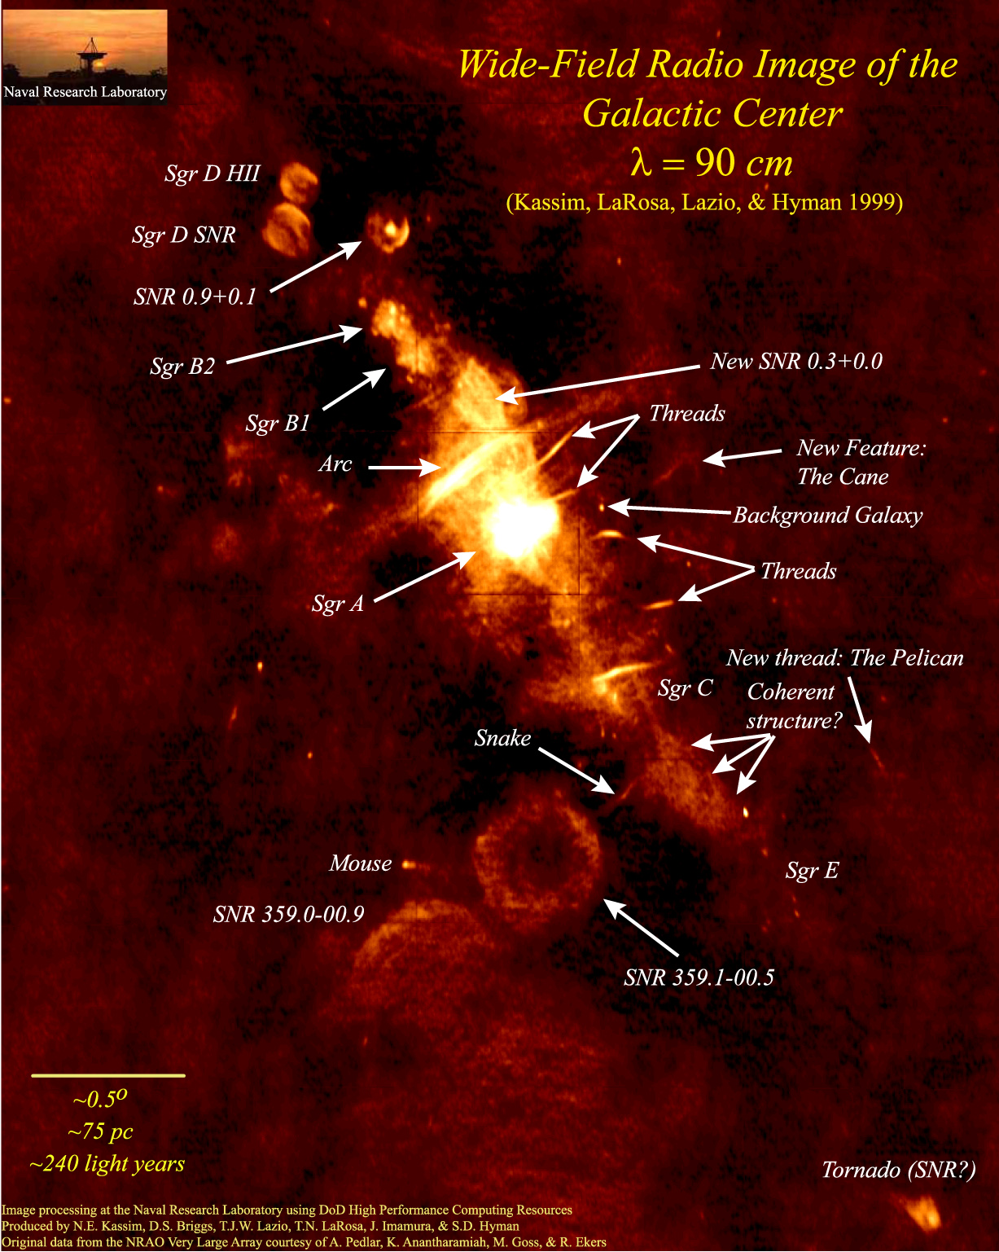
Dark Matter in The Galactic Center
The volume surrounding the Galactic Center is complex; backgrounds present are not necessarily well understood
This does not, however, make searches for dark matter region intractable
The flux of gamma rays predicted from dark matter annihilations around the Galactic Center is very large – tens of thousands of times brighter than that predicted from the brightest dwarf galaxies
But to separate dark matter annihilation products from astrophysical backgrounds, one must take advantage of the distinct observational features of these components

Slide 48
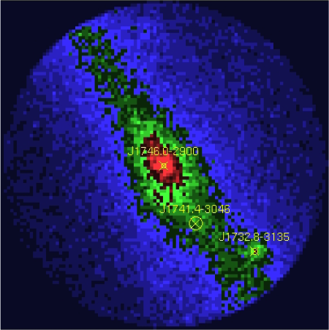

Dark Matter in The Galactic Center
The gamma ray signal from dark matter annihilations is described by:
1) Distinctive “bump-like” spectral feature
2) Signal highly concentrated around the Galactic Center (but not entirely point-like); precise morphology determined by the dark matter distribution

Slide 49
A Simple (but effective) Approach to the Galactic Center
1) Start with a raw map (smoothed out over 0.5° circles)
Hooper and Linden, PRD,
arXiv:1110.0006

Slide 50
A Simple (but effective) Approach to the Galactic Center
1) Start with a raw map (smoothed out over 0.5° circles)
2) Subtract known point sources (Fermi 2nd source catalog)
Hooper and Linden, PRD,
arXiv:1110.0006

Slide 51
A Simple (but effective) Approach to the Galactic Center
1) Start with a raw map (smoothed out over 0.5° circles)
2) Subtract known point sources (Fermi 2nd source catalog)
3) Subtract line-of-sight gas density template (empirical, good match to 21-cm)
Hooper and Linden, PRD,
arXiv:1110.0006

Slide 52
A Simple (but effective) Approach to the Galactic Center
This method removes ~90% of the emission in the inner galaxy (outside of the innermost few degrees)
Typical residuals are ~5% or less as bright as the inner residual – spatial variations in backgrounds are of only modest importance
Clearly isolates the emission associated with the inner source or sources (supermassive black hole? Dark matter?), along with a subdominant component of “ridge” emission
Hooper and Linden, PRD,
arXiv:1110.0006

Slide 53
Characteristics of the Observed Gamma Ray Residual
1) The spectrum peaks between ~300 MeV and ~10 GeV
Hooper and Linden, PRD,
arXiv:1110.0006

Slide 54
Characteristics of the Observed Gamma Ray Residual
1) The spectrum peaks between ~300 MeV and ~10 GeV
2) Clear spatial extension – only a small fraction of the emission above ~300 MeV is point-like
Hooper and Linden, PRD,
arXiv:1110.0006

Slide 55
Characteristics of the Observed Gamma Ray Residual
1) The spectrum peaks between ~300 MeV and ~10 GeV
2) Clear spatial extension – only a small fraction of the emission above ~300 MeV is point-like
3) Good agreement is found between our analysis and those of other groups (see the recent analysis by Abazajian and Kaplinghat, for example)
Hooper and Linden, PRD,
arXiv:1110.0006

Slide 56
The Dark Matter Interpretation
The extended emission residual can be explained by annihilating dark matter with the following characteristics:
The spectral shape of the residual is well fit by a dark matter particle with a mass in the range of 7 to 12 GeV (similar to that required by CoGeNT, DAMA, and CRESST), annihilating primarily to τ⁺τ⁻ (possibly among other leptons)
The angular distribution of the signal is well fit by a halo profile with ρ(r)~ r ^{-γ}, with γ~1.25 to 1.4 (in good agreement with expectations from simulations)
The normalization of the signal requires the dark matter to have an annihilation cross section within a factor of a few of σv ~ 10⁻²⁶ cm³/s, similar to the value predicted for a simple thermal relic
Hooper and Linden, PRD, arXiv:1110.0006

Slide 57
Other Interpretations?
Unresolved Point Sources?
Perhaps a population of several/many unresolved point sources distributed throughout the inner tens of parsecs of the Milky Way could produce the observed signal – millisecond pulsars have been suggested
Highly concentrated distribution is difficult to accommodate, however; signal goes as F α r ^{-2.5}, while the observed stellar distribution is n_{star} α r ^{-1.25} (not to mention obstacle of pulsar kicks)
Pions From Cosmic Ray Interactions With Gas?
Cosmic rays interacting with the surrounding gas is an obvious possibility
The spectrum from pion decay, however, is not not consistent with the lack of extended emission observed below ~500 MeV (true for any spectrum of cosmic rays)
Hooper and Linden, PRD, arXiv:1110.0006
Boyarsky et al., arXiv:1012.5839

Slide 58
A Gamma-Ray Line at 130 GeV?!
Recently, evidence for a monoenergetic (up to resolution) gamma-ray line from the Inner Galaxy has been identified within Fermi’s data (at 3.3σ, after LEE)
Such a single has long been considered a “smoking gun” of dark matter annihilations, provided through loop-level diagrams
Morphology of the signal is well fit to a that predicted from a cusped dark matter distribution, with a cross section of σv ~ 2 x 10⁻²⁷ cm³/s
C. Weniger, arXiv:1204.2797

Slide 59
Dark Matter Myth #3:
The observation of a gamma-ray line would be a “smoking gun” for dark matter annihilation

Slide 60
This is a Real Dark Matter Line?
Pros
Cons

Slide 61
This is a Real Dark Matter Line?
Pros
Appears most bright near the Galactic Center; overall structure looks consistent to that expected from dark matter annihilations
Cons
Peak brightness is about 200 pc (~1.5°) from Galactic Center (with fairly high significance)

Slide 62
This is a Real Dark Matter Line?
Pros
Appears most bright near the Galactic Center; overall structure looks consistent to that expected from dark matter annihilations
Very difficult to explain with known astrophysics (attempts such as broken power law backgrounds, and pulsar wind nebulae have significant challenges)
Cons
Peak brightness is about 200 pc (~1.5°) from Galactic Center (with fairly high significance)
Very difficult to explain with particle physics – need a very large cross section to the photon line, while also suppressing annihilations to other final states

Slide 63
This is a Real Dark Matter Line?
Pros
Appears most bright near the Galactic Center; overall structure looks consistent to that expected from dark matter annihilations
Very difficult to explain with known astrophysics (attempts such as broken power law backgrounds, and pulsar wind nebulae have significant challenges)
Hints present from Galaxy Clusters
Cons
Peak brightness is about 200 pc (~1.5°) from Galactic Center (with fairly high significance)
Very difficult to explain with particle physics – need a very large cross section to the photon line, while also suppressing annihilations to other final states

Slide 64
This is a Real Dark Matter Line?
Pros
Appears most bright near the Galactic Center; overall structure looks consistent to that expected from dark matter annihilations
Very difficult to explain with known astrophysics (attempts such as broken power law backgrounds, and pulsar wind nebulae have significant challenges)
Hints present from Galaxy Clusters
Cons
Peak brightness is about 200 pc (~1.5°) from Galactic Center (with fairly high significance)
Very difficult to explain with particle physics – need a very large cross section to the photon line, while also suppressing annihilations to other final states
Signs of a similar line appear in events associated with the Earth’s albedo (“limb” photons) – signs of a systematic error in energy reconstruction?
➔ HESS-II should be able to settle

Slide 65
Dark Matter at The LHC
Machines such as the Large Hadron Collider (LHC) may be able to produce and observe dark matter particles
The LHC collected data at a staggering rate last year, and is preparing to begin its 8 TeV run this spring
The discovery of the/a Higgs boson with a mass of 125 GeV represents a major accomplishment for both ATLAS and CMS (and CDF, D0)
A wide range of TeV-scale physics scenarios beyond the Standard Model are in the process of being put to the test by the LHC… including the WIMP hypothesis
ATLAS
CMS

Slide 66
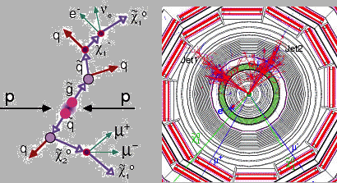
Dark Matter at The LHC
Two strategies for dark matter hunting at Hadron Colliders:
Strategy A (SUSY-like case): Produce strongly interacting particles which, although not dark matter themselves, produce dark matter particles in their decays (study distributions of events with various combinations of jets, leptons, and missing energy)
Strength: Potentially large production cross sections and rates
Weakness: Not very model independent (what if there are no strongly interacting states!?)

Slide 67
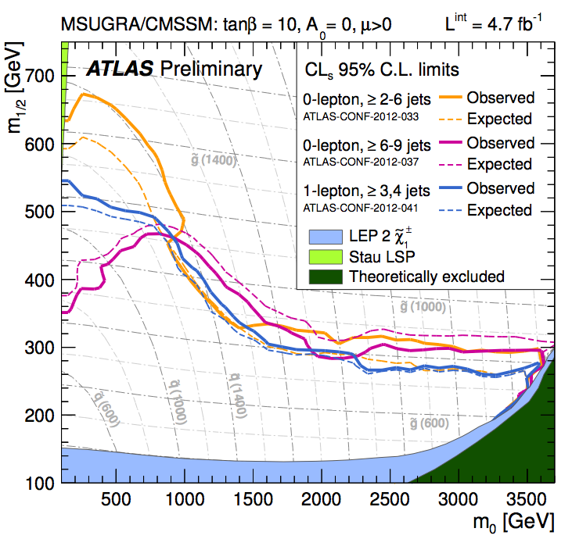
Dark Matter at The LHC
Numerous searches for supersymmetry are being carried out by the ATLAS and CMS collaborations
For typical patterns of superpartner masses, these results constrain squarks/gluinos to be heavier than ~1400/900 GeV (for comparison, the Tevatron probed up to ~450 GeV)
Ultimately, the LHC will test models with squarks/gluinos as heavy as a few TeV
Broadly speaking, models capable of addressing the electroweak hierarch problem (SUSY or otherwise) are likely to fall within the LHC’s reach

Slide 68
Dark Matter at The LHC
Two strategies for dark matter hunting at Hadron Colliders:
Strategy B (Direct Production): Produce the dark matter directly (in association with a jet or photon), leading to more model independent constraints
Test effective operators (integrating out the details of other particles involved)
Mediator mass and coupling
(Scalar interactions, coupled to down-quarks)
Strength: Constrains the mass and effective coupling of any WIMP – highly model independent
Weakness: Modest rates, limited reach – LHC (14 TeV) is only sensitive to dark matter lighter than ~200 GeV (based on couplings needed for relic density)
Rajaraman, Shephard, Tait, Wijangco, arXiv:1108.1196

Slide 69
Homework Exercise #2

Slide 70
Homework Exercise #2
(can someone please bring the speaker one?)

Slide 71
The Status:

Slide 72
The Status:
Z-mediated scattering (sneutrinos, heavy neutrinos)
1) Direct Detection:
Ruled out Z-mediated interactions more than a decade ago
Are currently at roughly the sensitivity needed to test Higgs-mediated scattering
5-10 years from now, only very fine tuned and/or baroque WIMP models will remain beyond the reach of direct detection experiments
Higgs-mediated scattering (A-funnel, focus point neutralinos)
DM
SM
DM
DM
DM
SM
SM
SM

Slide 73
The Status:
2) Indirect Detection:
Gamma ray constraints are beginning to test the naïve thermal estimate for low mass WIMPs (up to ~30 GeV)
Several indirect experiments, including Fermi and AMS-02, will ultimately be sensitive to dark matter with masses up to several hundred GeV
Heavier WIMPs, and WIMPs with suppressed annihilation cross sections (at low velocity) will remain beyond reach of current and planned experiments
At Freeze-Out At Low Velocity
DM
SM
DM
SM
DM
SM
DM
SM

Slide 74
The Status:
3) The LHC:
The LHC will be sensitive to strongly coupled particles up to several TeV, but to isolated WIMPs only up to hundreds of GeV
Worst case scenario: Isolated WIMPs interacting through light and very weakly coupled particles
The prospects for discovering dark matter at the LHC depend very strongly on the rest of the broader particle physics framework, and less on the properties of the WIMP itself
ATLAS
CMS
DM
SM
SM
DM
DM
SM
SM
DM

Slide 75
The Status:
All three of these search strategies are poised to tell us very interesting things about dark matter very soon
For the first time, we should expect positive detections of WIMPs in the near future, and in multiple search techniques
If no WIMPs are observed in the next several years, the entire paradigm of WIMP dark matter will be challenged, lending favor to axions and other classes of non-WIMP dark matter candidates

Slide 76
Putting This All Together
Various dark matter search strategies offer different advantages and disadvantages, and are potentially able to measure different quantities
Direct detection experiments measure a distribution of events connected to the WIMP’s mass and elastic scattering cross section, along with the dark matter’s velocity distribution and local density
Indirect detection experiments measure a spectrum of annihilation products (gamma-rays, cosmic rays, etc.) determined by the WIMP’s mass, annihilation cross section, and annihilation final states, along with the dark matter distribution
The LHC measures a distribution of events with missing energy, but is the state stable? Or cosmologically relevant?

Slide 77
Summary
Weakly interacting massive particles provide a natural class of candidates for dark matter, with a simple and compelling explanation for the observed dark matter abundance
Searches for dark matter a the LHC, as well as direct and indirect astrophysical searches, are each approaching the sensitivity expected to be required to detect dark matter non-gravitationally
A number of reported signals can be interpreted as possible detections of dark matter (DAMA, CoGeNT, CRESST… Fermi, Haze…)

Slide 78
Experimental Sensitivity
WIMP Models
2000
2012
2020

Slide 79
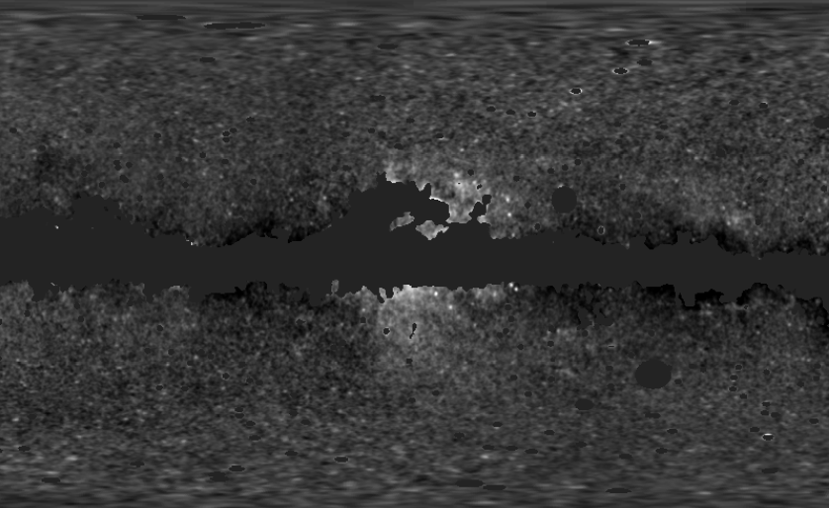
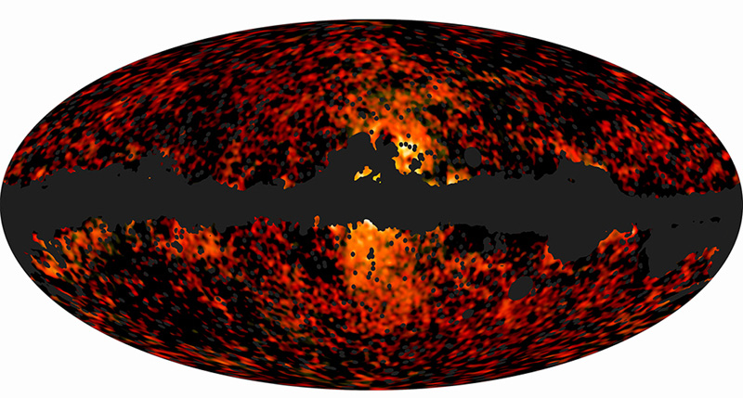
Dark Matter with Microwave and Radio Telescopes
Electrons/positrons produced in dark matter annihilations lose energy via synchrotron emission, producing signals at radio/microwave wavelengths
In 2004, Doug Finkbeiner discovered an excess of hard synchrotron emission around the Inner Galaxy in WMAP data
Very recently, the Planck collaboration has “unambiguously” confirmed the presence of this synchrotron haze
WMAP (22 GHz)
Planck (30 and 44 GHz)
Finkbeiner, astro-ph/0409027;
Hooper, Finkbeiner, Dobler, PRD (2007); Dobler, Finkbeiner, ApJ (2008)

Slide 80
Dark Matter with Microwave and Radio Telescopes
Roger et al.
A number of observations at radio frequencies, including those of the ARCADE 2 collaboration, have revealed an isotropic background with a power-law spectrum, ~E^{-2.6}
Estimates of the contribution from unresolved radio sources fall short of this flux by a factor of ~5-6
Could synchrotron emission from cosmological dark matter annihilations provide a significant contribution?
- Yes, possibly, but requires light masses and leptonic annihilation channels
Maeda et al.
Haslam et al.
ARCADE 2
CMB
Reich & Reich
–

Slide 81
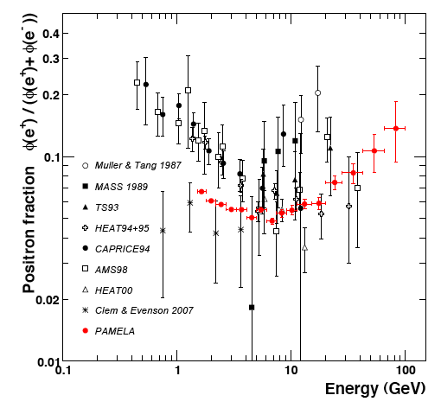
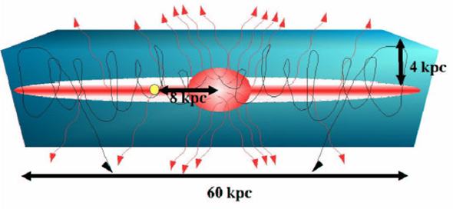
Dark Matter with Antimatter
WIMP annihilations are generally predicted to produce equal quantities of matter and antimatter
A large flux of antimatter in the cosmic ray spectrum could be indicative of a contribution from dark matter
The PAMELA Collaboration’s measurement of the cosmic ray positron fraction got many of us very excited for this reason
Excess positrons now appear likely to originate from astrophysical sources (pulsars?), although TeV-scale dark force models remain a viable possibility (Arkani-Hamed, Finkbeiner, Slayter, Weiner, PRD, arXiv:0810.0713)
–

Slide 82
Dark Matter with Antimatter
AMS-02 was deployed on the International Space Station last year
With ~10² times greater acceptance than PAMELA, and significantly better ability to distinguish between electrons, positrons, protons, antiprotons and various species of nuclei, AMS represents a major leap forward
Anti-proton channel expected to be sensitive to WIMPs up to ~500 GeV (assuming the naïve thermal cross section) – similar reach to Fermi
–

Slide 83
The Dark Matter Candidate Zoo
Neutralinos (higgsino, bins, winos, singlinos)
Axinos
Gravitinos
Sneutrinos
Axions
Sterile neutrinos
4th generation neutrinos
Kaluza-Klein photons
Kaluza-Klein gravitons
Brane world dark matter/D-matter
Little higgs dark matter
Light scalars
Superheavy states (ie. “WIMPzillas”)
Self-interacting dark matter
Super-WIMPs
Asymmetric dark matter
Q-balls (and other topological states)
CHAMPs (charged massive particles)
Cryptons, mirror matter, and many, many, many others…

Slide 84
Non-WIMP Dark Matter Candidates I: Axions
Motivated by observation that the neutron’s electric dipole moment is small (consistent with zero)
In other words, although the SM violates parity and charge-parity, QCD does not – requires that θ_{QCD} < 10⁻⁹
In 1977, Peccei and Quinn proposed a dynamical solution to this “strong CP problem”, a new broken U(1) – drives θ_{QCD} to zero
Shortly thereafter, Wilczek and Weinberg pointed out that this solution also predicts the existence of a new extremely weakly interacting pseudoscalar, the axion

Slide 85
Non-WIMP Dark Matter Candidates I: Axions
For masses in the micro- to milli-eV range, axions can make up the dark matter (via misalignment production in the early universe) without violating astrophysical or laboratory constraints
Interactions of such axions are suppressed by a Peccei-Quinn scale of ~10⁹-10¹² GeV
Two photon couplings can be probed, however, via the Primakov mechanism
ADMX is the experiment best positioned to test (much of) the allowed parameter space
By the end of the decade, ADMX will be able to test a sizeable fraction of axion dark matter models

Slide 86
Non-WIMP Dark Matter Candidates II: Sterile Neutrinos
-Sterile neutrinos, produced via mixing with SM neutrinos, can also provide a viable and well motivated class of dark matter candidates
-Constraints include:
Phase space in dwarf spheroidals (ie. Tremaine-Gunn bound)
The lack of x-ray lines
Dark matter abundance
Lyman-α constraints, which require the dark matter to not be too hot; translates to M > 8 keV

Slide 87
Putting This All Together
Various dark matter search strategies offer different advantages and disadvantages, and are potentially able to measure different quantities
Direct Detection Experiments:
Measure the rate and energy spectrum of recoil events, ideally using multiple targets
➔Mass – modulo uncertainties in velocity distribution
➔(Spin-independent/dependent scattering cross section with protons/neutrons) x (local density)
Unanswered questions:
Does this particle make up most/all of the dark matter?
What is it?

Slide 88
Putting This All Together
Various dark matter search strategies offer different advantages and disadvantages, and are potentially able to measure different quantities
Indirect Detection Experiments:
Measure the flux and spectrum of a variety of types of annihilation products, from a variety of regions ➔Dominant annihilation channels (in low velocity limit)
➔Mass
➔(Low velocity annihilation cross section) x (fraction of dark matter)²
– modulo uncertainties in the DM distribution
Unanswered questions:
Does this particle make up most/all of the dark matter?
(although σv~3x10⁻²⁶ cm³/s would be suggestive)
What is it?

Slide 89
Putting This All Together
Various dark matter search strategies offer different advantages and disadvantages, and are potentially able to measure different quantities
The Large Hadron Collider:
Measure distributions of events with missing energy
➔Mass
★Discover other particles which may inform us as to the interactions and other properties of the WIMP
Unanswered questions:
Does this particle make up most/all/some of the dark matter? (Is it even stable!?)
What is it?

Slide 90
Putting This All Together
None of these experiments are going to solve the mystery of dark matter’s identity alone
Only with information from multiple (all three?) search strategies, will it be possible to determine the particle nature of dark matter

