Slide 1
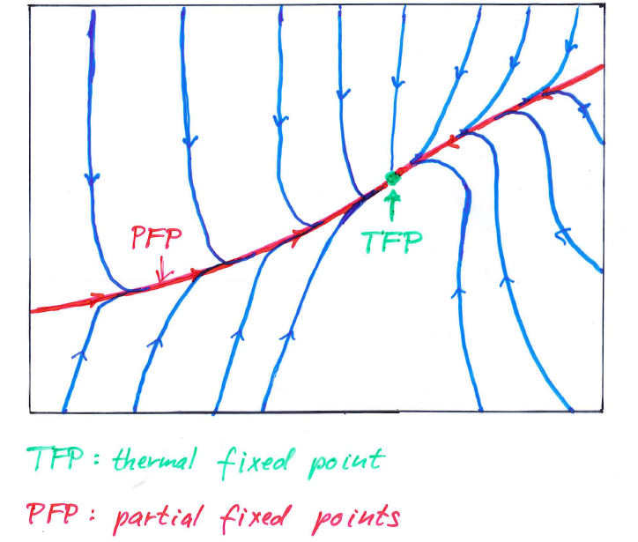
Prethermalization

Slide 2
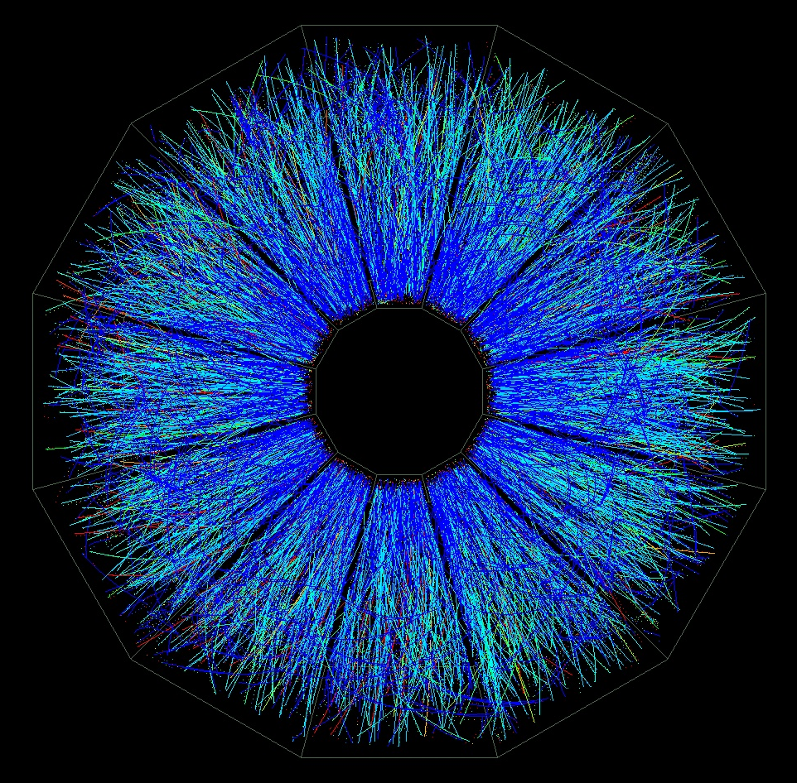
Heavy ion collision

Slide 3
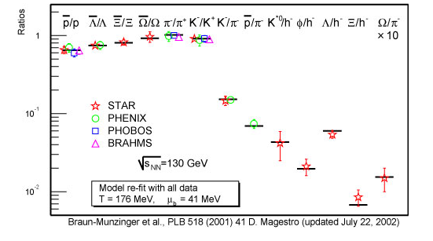
Hadron abundancies
RHIC

Slide 4
Hadron abundancies
follow thermal eqilibrium distribution for suitable
temperature T and baryon chemical potential μ

Slide 5
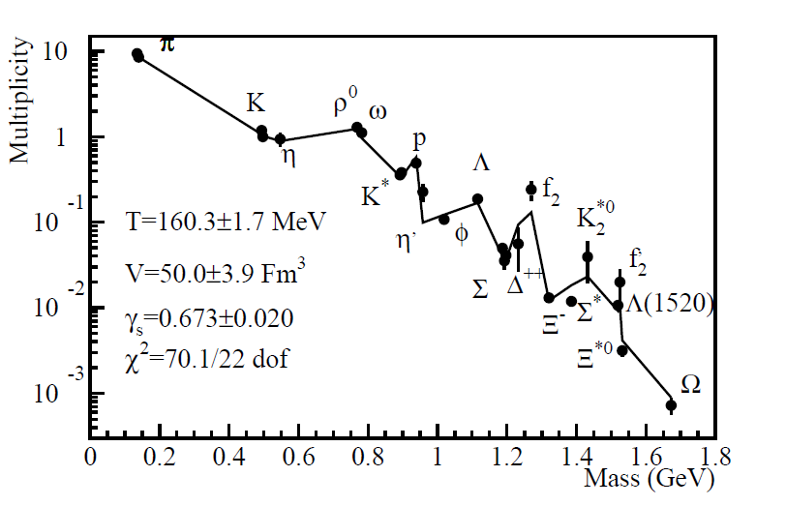
Hadron abundancies in e⁺ - e⁻ collisions
Becattini

Slide 6
Hadron abundancies in e⁺ - e⁻ collisions
not thermal equilibrium !
no substantial scattering of produced hadrons
no Boltzmann equations apply

Slide 7
Prethermalization
J.Berges, Sz.Borsanyi, CW

Slide 8
Thermal equilibrium
only one parameter characterizes distribution functions and correlations : temperature T
( several parameters if other quantities besides energy E are conserved , e.g. chemical potential μ or particle density n =N/V for conserved particle number N )

Slide 9
essence of thermalization
loss of memory of details of initial state
for fixed volume V : only energy E matters

Slide 10
prethermalization
only partial loss of
memory of initial state

Slide 11
prethermalization
can happen on time scales much shorter than for thermalization
nevertheless: several important features look already similar to thermal equilibrium state
can produce states different from thermal equilibrium that persist for very long ( sometimes infinite ) time scales

Slide 12
quantities to investigate
set of correlation functions
or effective action as generating functional for correlation functions
not: density matrix or probability distribution

Slide 13
reasons
rather different density matrices / probability distributions can produce essentially identical correlation functions
( they only differ by unobservable higher order correlations e.g. 754367-point functions, or unobservable phase correlations )
only correlation functions are observed in practice
( distributions : one-point function or expectation value )

Slide 14
Boltzmann’s conjecture
start with arbitrary initial probability distribution
wait long enough
probability distribution comes arbitrarily close to thermal equilibrium distribution
probably not true !
but : observable correlations come arbitrarily close to thermal equilibrium values ( not all systems )

Slide 15
time flow of correlation functions
prethermalized state =
partial fixed point in space of
correlation functions

Slide 16
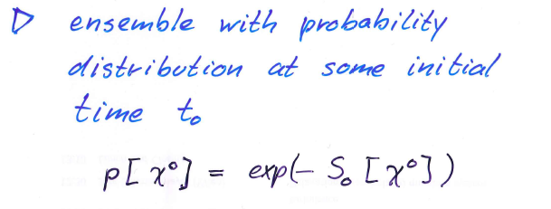
time evolution of correlation functions

Slide 17
time evolution of correlation functions

Slide 18
hierarchical system of flow equations for correlation functions
BBGKY- hierarchy
Yvon, Born, Green, Kirkwood, Bogoliubov
for interacting theories : system not closed

Slide 19
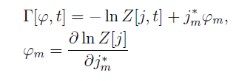
non-equilibrium effective action
variation of effective action yields
field equations in presence of fluctuations, and
time dependent equal-time correlation functions

Slide 20
exact evolution equation

Slide 21
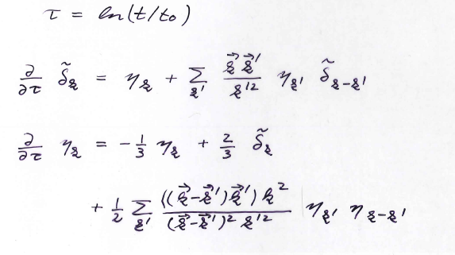
cosmology : evolution of density fluctuations
J.Jaeckel,
O.Philipsen,
…

Slide 22
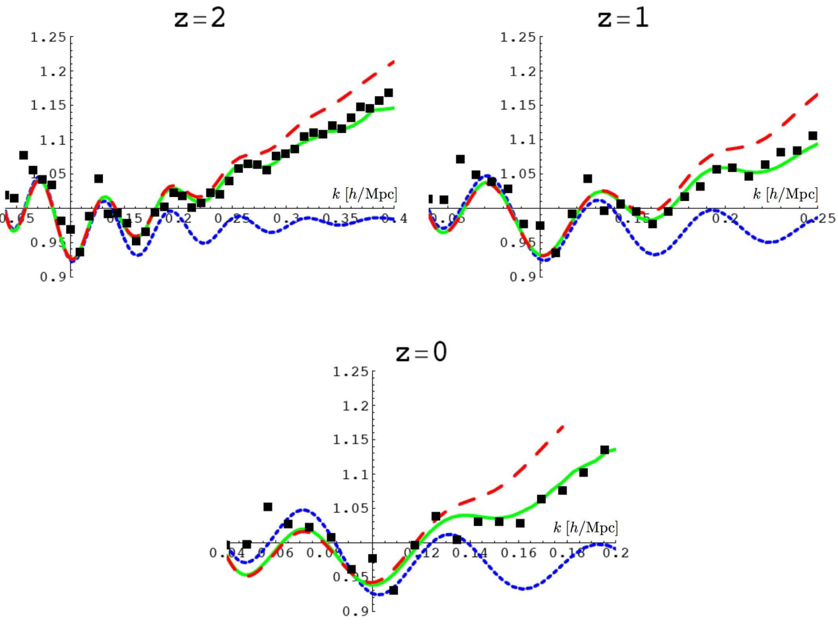
baryonic accoustic peaks
Pietroni, Matarrese

Slide 23
classical scalar field theory ( d=1)
G.Aarts,G.F.Bonini,…
can be solved numerically by discretization
on space-lattice

Slide 24
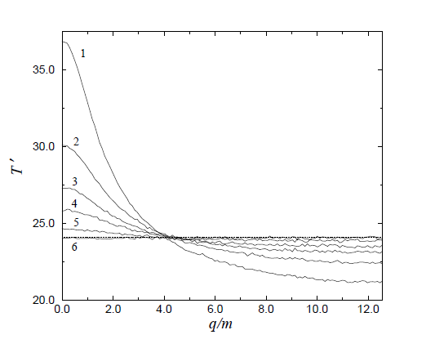
thermalization of correlation functions
mode
temperature
G.Aarts, G.F.Bonini, CW, 2000

Slide 25
classical scalar field theory ( d=1)
G.Aarts,G.F.Bonini,…

Slide 26
truncation
momentum space

Slide 27
partial fixed points
further truncation :
momentum independent u,v,w,y,z
(N-component scalar field theory , QFT)

Slide 28
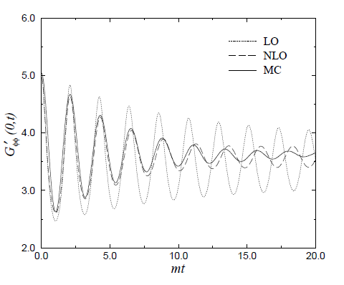
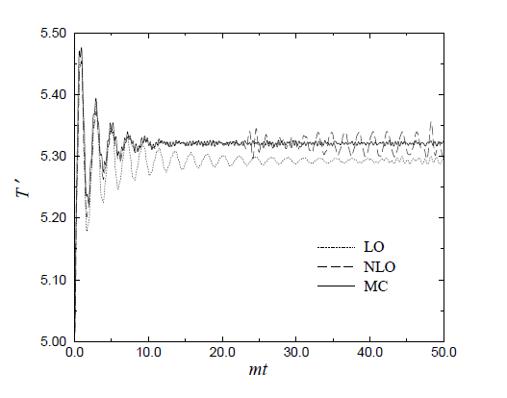
comparison of approximations

Slide 29
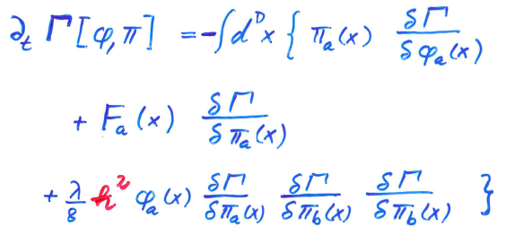
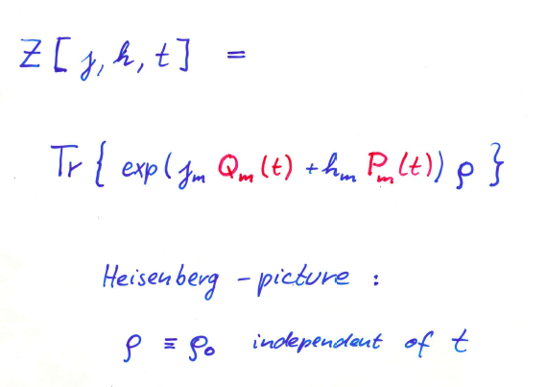
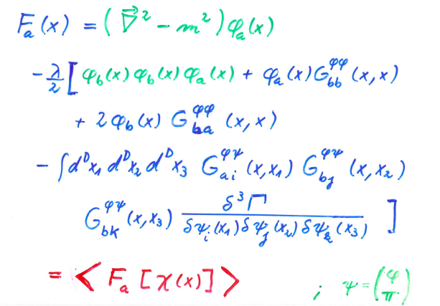
quantum field theory

Slide 30
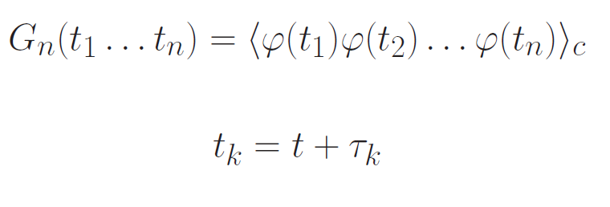
extensions
(1) non-equal time correlation functions
(2) 2PI instead 1PI ( J.Berges,…)
permits contact to Schwinger-Keldish formalism

Slide 31
Hadron abundancies in heavy ion collisions
RHIC

Slide 32
Is temperature defined ? Does comparison with equilibrium critical temperature make sense ?

Slide 33
Prethermalization
J.Berges,Sz.Borsanyi,CW

Slide 34
Vastly different time scales
for “thermalization” of different quantities
here : scalar with mass m coupled to fermions
( linear quark-meson-model )
method : two particle irreducible non- equilibrium effective action ( J.Berges et al )

Slide 35
Thermal equilibration : occupation numbers

Slide 36
Prethermalization equation of state p/ε
similar for kinetic temperature

Slide 37
different “temperatures”

Slide 38
Mode temperature
n_{p} :occupation number
for momentum p
late time:
Bose-Einstein or
Fermi-Dirac distribution

Slide 40
Kinetic equilibration before chemical equilibration

Slide 41
Once a temperature becomes stationary it takes the value of the equilibrium temperature. Once chemical equilibration has been reached the chemical temperature equals the kinetic temperature and can be associated with the overall equilibrium temperature. Comparison of chemical freeze out temperature with critical temperature of phase transition makes sense

Slide 42
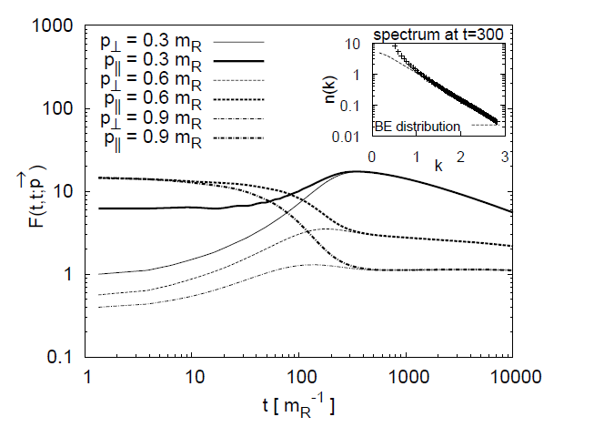
isotropization
two-point functions for momenta in different directions

Slide 43
isotropization
occurs before thermalization
different time scale
gradient expansion, Boltzmann equations become valid only after isotropization

Slide 44
some questions

Slide 45
Can pre-thermalized state be qualitatively different from thermal equilibrium state ?
yes
e.g. e⁺ - e⁻ collisions :
particle abundancies close to thermal ,
momentum disributions not

Slide 46
Is there always a common temperature T in pre-thermalized state ?
no
e.g. two components with weak coupling

Slide 47
Does one always reach thermal equilibrium for time going to infinity ?
no
simple obstructions : initial energy distribution
exact non-thermal fixed points are possible
instabilities from long-range forces ( gravity )
in practice : metastable states

Slide 48
role and limitation of linear response theory ?
fails for approach to thermal equilibrium
time scales of linear response are often characteristic scales for prethermalization

Slide 49
conclusions
Approach to thermal equilibrium is a complex process involving very different time scales.
This holds already for simple models as scalar field theory.
Observation sees often only early stages , not equilibrium state : prethermalization.
Prethermalization can be characterized by partial fixed points in flow of correlation functons.

Slide 50
time flow of correlation functions
prethermalized state =
partial fixed point in space of
correlation functions

Slide 51
end

Slide 52
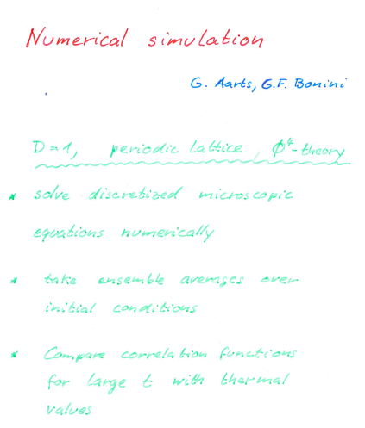

Slide 53
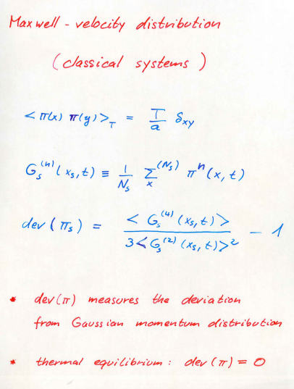

Slide 54
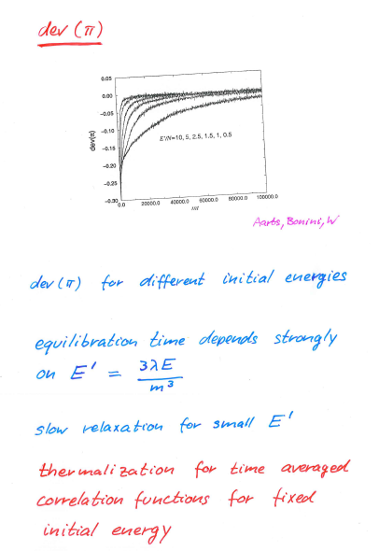

Slide 55
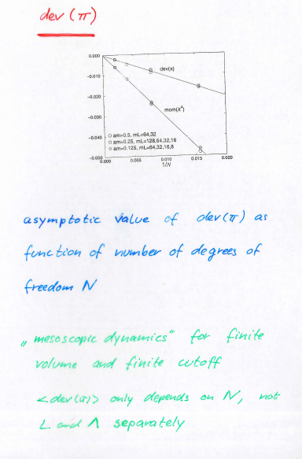

Slide 56
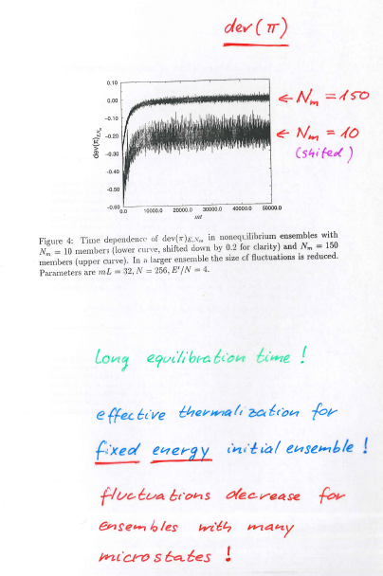

Slide 57
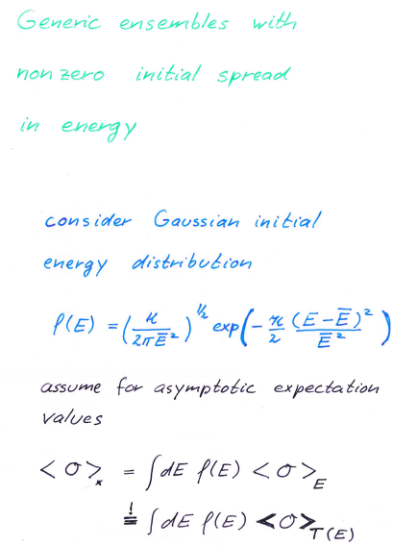

Slide 58
