Slide 1

Relativistic heavy-ion collisions –
An introduction
Georg Wolschin
Heidelberg University
Institut für Theoretische Physik
Philosophenweg 12-16
D-69120 Heidelberg

Slide 2
Topics
Introduction: QGP in the early universe/ in the lab, jet quenching,
QGP photon and quarkonia spectroscopy
2. Fast local thermalization of quarks and gluons:
A nonlinear diffusion model
3. Stopping: Net-proton and -baryon distributions
4. Charged-hadron production: A three-source model cp. to data
from RHIC and LHC
5. Hard probes: Charmonia and bottomonia
6. Summary and conclusion

Slide 3
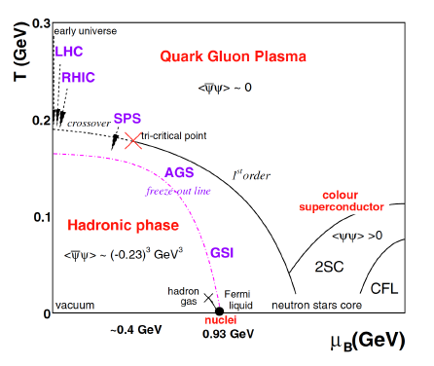
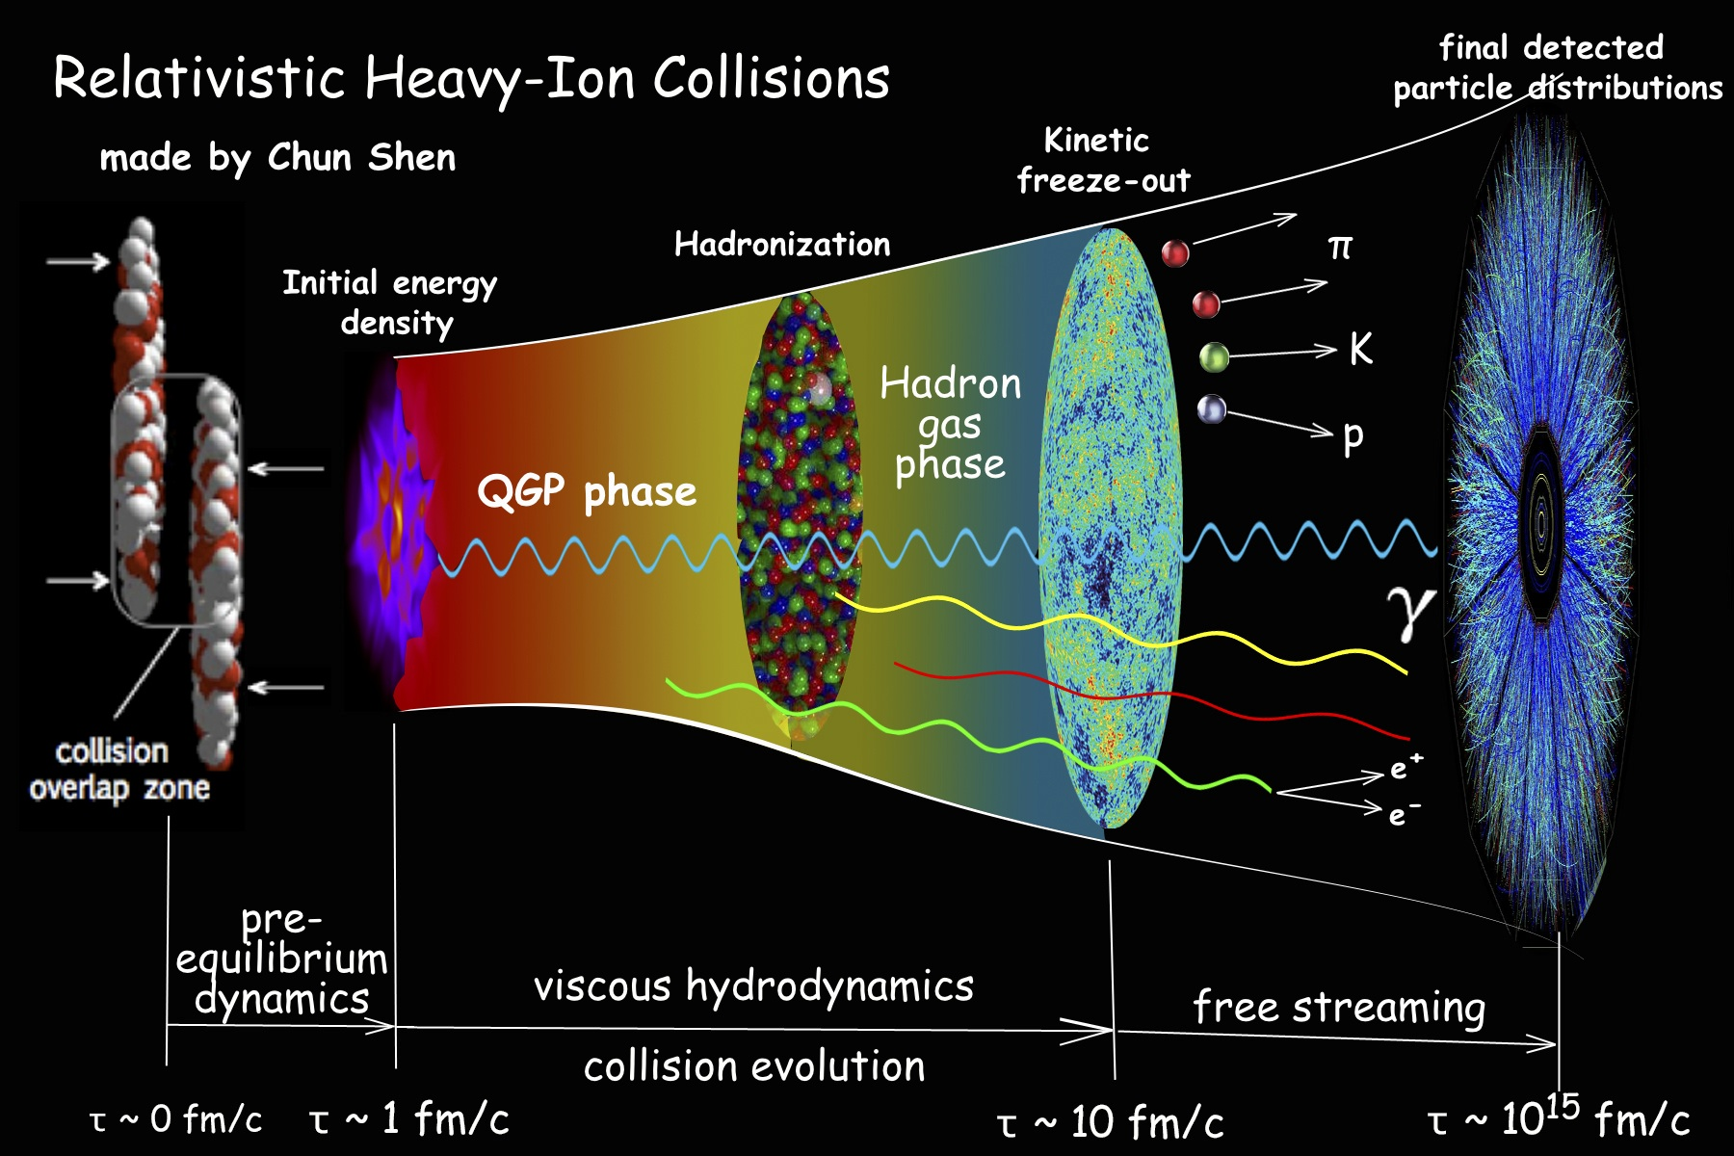
1. Introduction: Quark-gluon plasma (QGP)...
..was the state of matter in the early
universe, τ < 10ms
© CMS PTDR (2007)
..is created in relativistic heavy-ion
collisions, τ ≈ 3·10⁻²³ s ≈ 10 fm/c
Big bang © WMAP, NASA
QGP:
hadronization occurs at an approximate energy
density of ε ≈ 1 GeV/fm³ acc. to lattice gauge calculations
Little bang © C. Shen&P. Sorensen

Slide 4
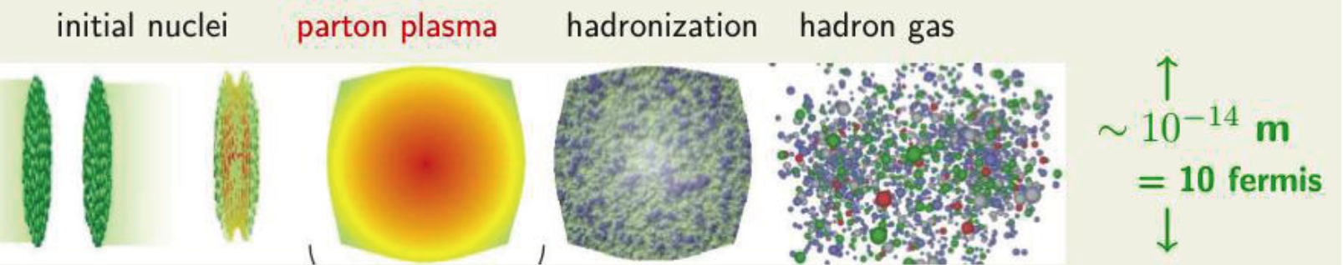
Quark-gluon plasma...
... created in relativistic heavy-ion collisions for a very short
time span of about 10⁻²³ seconds: Investigate experimental
and theoretical signatures
~ 10⁻²³ s = 10 yoctoseconds
Heavy mesons
Artwork © Nikhef / S. Bass

Slide 5

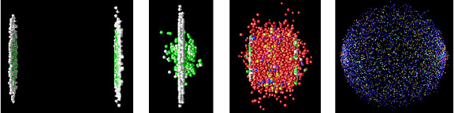
Time-dependent
simulation:
Quark-gluon plasma (QGP) created in relativistic heavy-ion collisions
t_{int} ≈ 5-8 fm/c @ LHC
© CERN
In the first stages of the collision, gluons and valence quarks equilibrate, new quarks
and heavy quarkonia form, later more matter and antimatter is being created from
the relativistic energy in the fireball, E = √(p² + m²), it expands and cools, then
hadronizes completely. Created baryons, mesons (or their decay products), photons,
leptons are then detected:
→ Conclusions regarding the QGP properties are drawn.

Slide 6
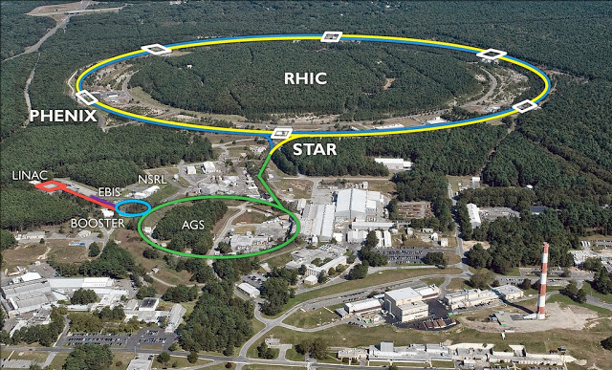
Relativistic Heavy Ion Collider (RHIC), BNL
e.g. Au-Au collisions @ √s_{NN}= 200 GeV center of mass energy

Slide 7
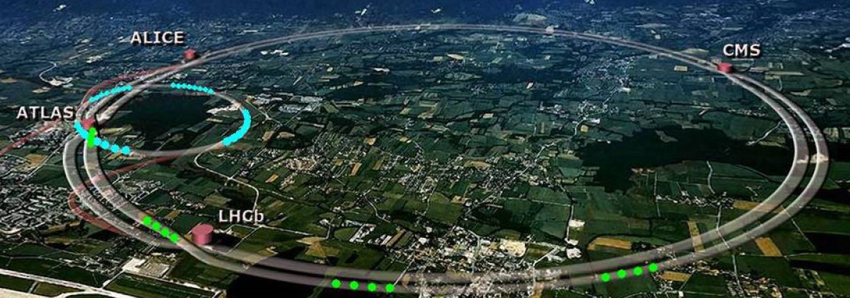
Large Hadron Collider (LHC) / CERN
SPS
p-p @ 7,8,13,(14) TeV
Pb-Pb @ 2.76 TeV 2011/12 Run 1
@ 5.02 TeV Nov. 2015 Run 2
Nov. 2018 Run 2
(design energy 5.52 TeV)
p-Pb @ 5.02 TeV 2012/13
@ 5.02, 8.16 TeV Nov. 2016

Slide 8
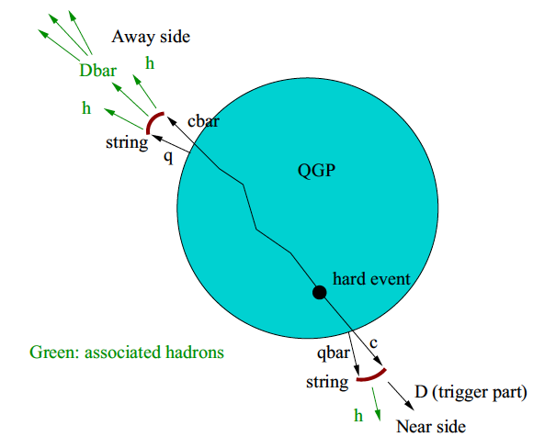
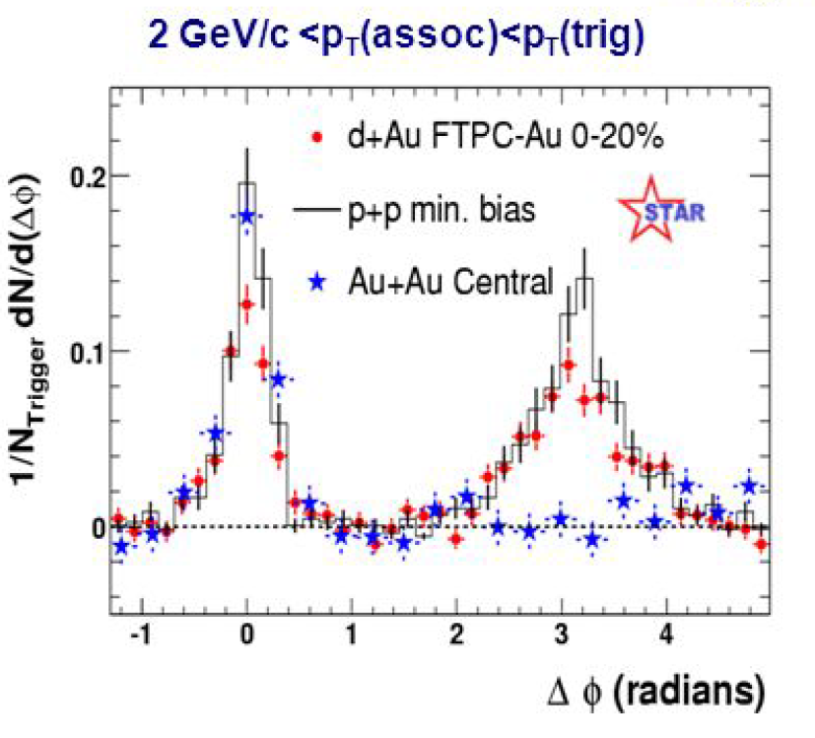
Early evidence for the QGP: Jet suppression found 2004 at RHIC in Au-Au
Jets provide the most direct evidence for quarks and gluons in the system
© A. Beraudo et al.,
EPJC 75, 121 (2015)
Away-side jet: In Au-Au
suppressed in the QGP
Near-side jet in two-particle correlations
© STAR PRL 91, 072304 (2004)
Predicted by J. D. Bjorken,
FERMILAB-Pub-82/59-THY

Slide 9
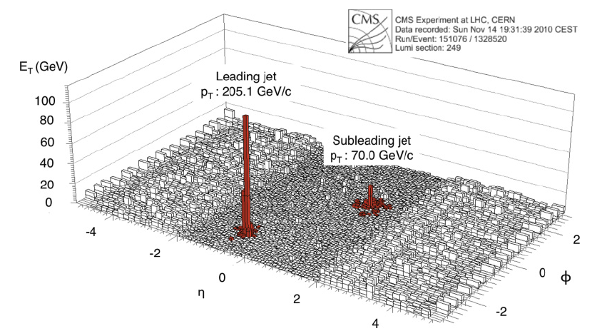
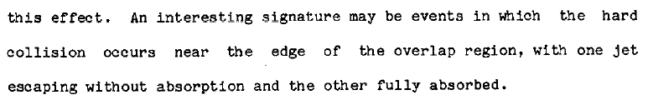
Evidence for the QGP: Jet suppression in 2.76 TeV Pb-Pb at the LHC (2011)
Away-side jet: In Pb-Pb
suppressed in the QGP
The lost energy is in low-p_{T} particles at large angles
Jet substructure measurements are sensitive to
jet-medium interactions
© CMS Collab., PRC 84, 024906 (2011)
bj 1982

Slide 10

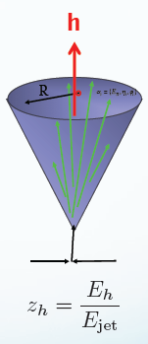
Jet quenching at RHIC and LHC is a very active field of research
Space-time structure of jet quenching → indications about QGP properties
Momentum broadening and LPM effect decisive for jet quenching
The medium response to the jets accounts for the soft components
Color decoherence of jet substructure
Strong final-state interactions cause high-p_{T} jets to loose energy to the plasma
Since the dominant collisions are soft,
jet broadening is essentially a diffusion
process in transverse momentum space.
© EMMI Workshop@GSI 2019

Slide 11
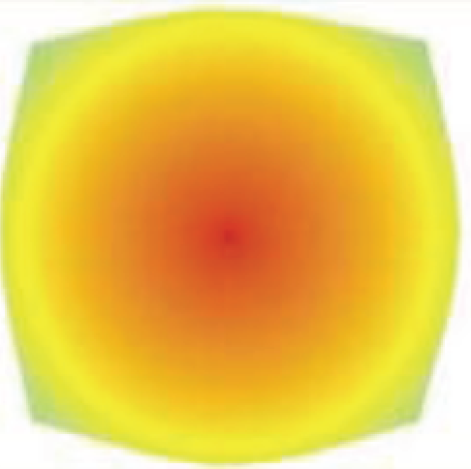

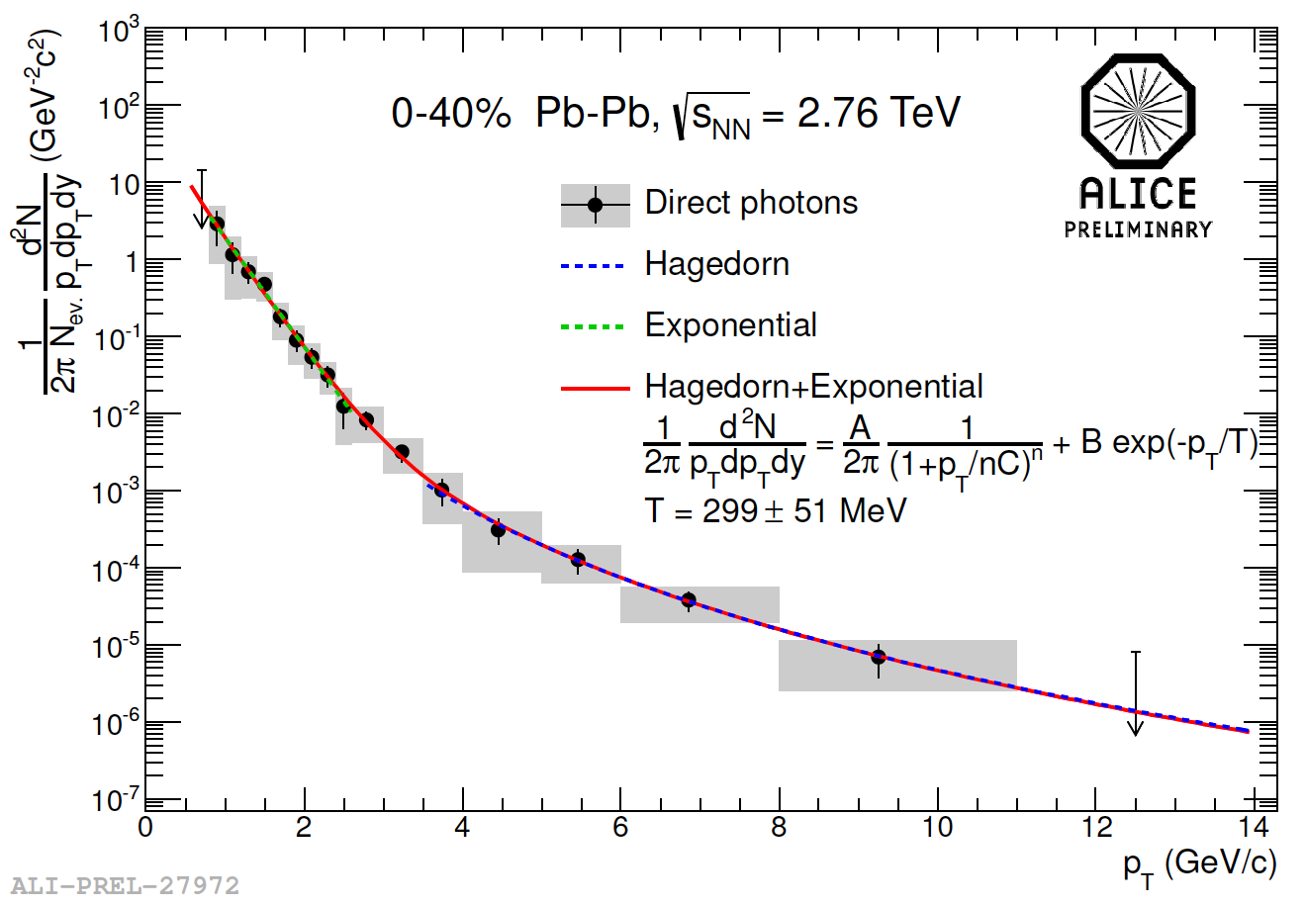
Continuum spectroscopy of the QGP with photons
γ
γ
Deduce QGP properties such as
the temperature T: “QGP-Thermometer“
Direct photons determine the mean
temperature in the fireball as
<T_{QGP}> ≈ (299 ± 51) MeV ≈ 10⁹ T_{CMB}
in 2.76 TeV PbPb
Continuum photons emitted from the QGP

Slide 12
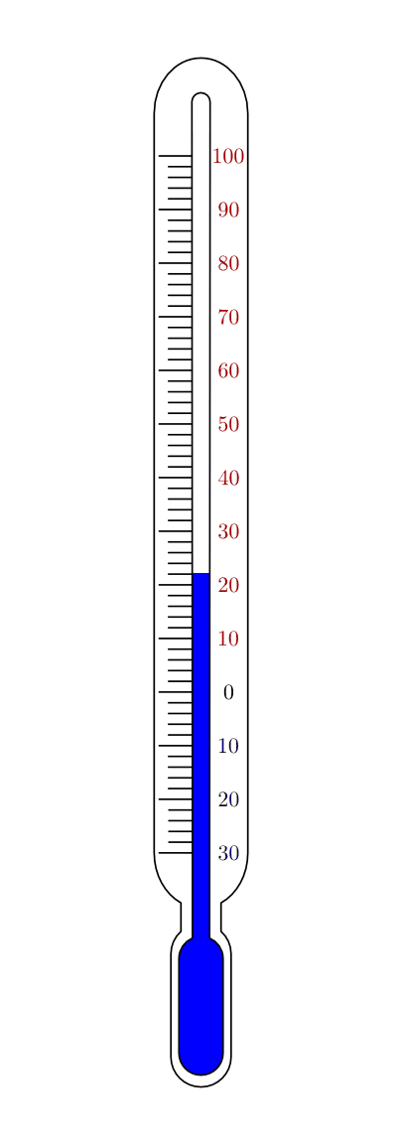
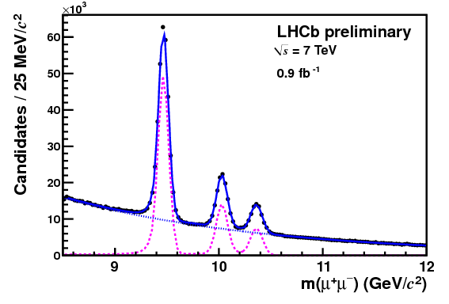
Line spectroscopy in the QGP with heavy quarkonia
Recombination @ low p_{T}!
Investigate their spectroscopy
in the QGP: Colorless states in the
colored QGP
Deduce QGP properties such as
the temperature T: “QGP-Thermometer“
Focus on ϒ because there, recombination is
negligible
ϒ(1S)
ϒ(2S)
ϒ(3S)
ϒ spectrum in vacuum => in the QGP medium?

Slide 13
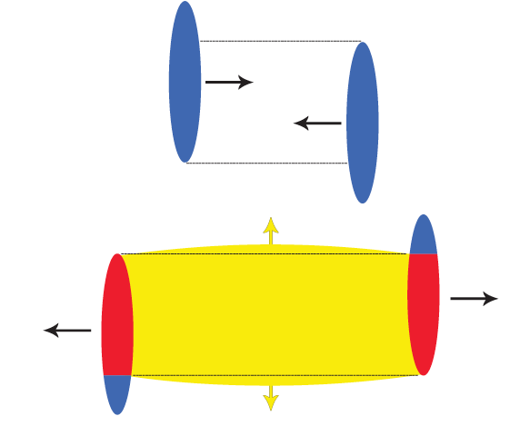
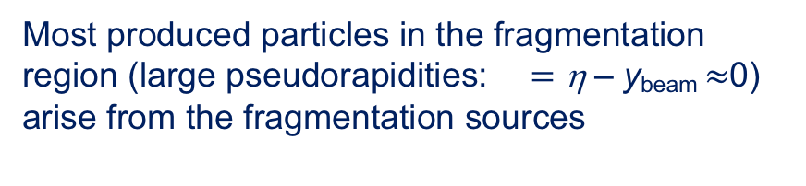
2. Fast local equilibration of quarks and gluons
Local equilibration of quarks in the
fragmentation sources towards the
FD-distribution
Fast local equilibration of gluons in the fireball
towards the BE-distribution (global thermo-
dynamic equilibrium is usually not attained)
Most produced particles in the fragmentation region (large pseudorapidities: $=$ η – y_{beam} $≈$0)
arise from the fragmentation sources
B. Kellers and GW, PTEP 2019, 053D03 (2019)

Slide 14
An analytical model for local equilibration
2.1 Relaxation time approximation (RTA)
The system relaxes from the initial nonequilibrium distribution n_{i}(ε)
towards the Bose-Einstein/ Fermi-Dirac distribution
according to the linear equation
with the time constant τ_{rel}
Apply this to to the fast local equilibration in relativistic heavy-ion collisions for
quarks and gluons, with appropriate initial conditions n_{i}(ε).
14

Slide 15
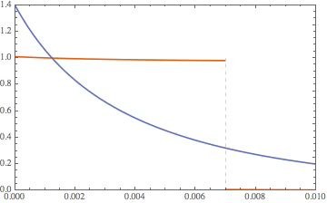
Video: Relaxation ansatz for bosons (gluons)
n_{rel} (p,t)
0
Q_{s}=1
p (GeV/c)
T= 510 MeV
μ<0
The evolution equation is linear =>
The time evolution is discontinuous at Q_{s}
constant relaxation time for all momenta
Include the nonlinearity of the system
ε=p for massless gluons

Slide 16
2.2 Derivation of the nonlinear diffusion equation
Boltzmann collision term for bosons/ fermions
The Bose-Einstein/ Fermi-Dirac distributions are stationary solutions
16

Slide 17

Derivation of the nonlinear diffusion equation
Write the collision term in form of a Master equation (ME) with gain- and loss term
with the transition probability (
accordingly)
Introduce the density of states g_{j} = g(ε_{j}); omit ±
W is peaked at ε₁ = ε₄
. Obtain an approximation to the ME through a Taylor
expansion of n₄ and g₄n₄ around ε₁ = ε₄ to second order.
GW, Physica A 499, 1 (2018)

Slide 18
Introduce transport coefficients via moments of the transition probability (x=ε₄-ε₁)
and arrive at the nonlinear partial differential equation for the distribution of
the occupation numbers
Dissipative effects are expressed through the drift term , diffusive
effects through the diffusion term
In the limit of constant transport coefficients, the nonlinear diffusion equation
for the occupation-number distribution of bosons/ fermions becomes

Slide 19
2.3 Exact solution of the nonlinear equation
Perform the nonlinear transformation
with the temperature T=-D/v and the time-dependent partition function Z(ε,t)
The partition function is an integral over Green‘s function of the linear diffusion equation,
and the exponential function F that contains an integral A_{i}(x) over the initial conditions
with
The analytical solution is well-suited to replace the linear relaxation ansatz.
The integrals can be solved in closed form for schematic initial conditions n_{i}(x).

Slide 20
The fermionic analytical solution at LHC energies (quarks)
with antiparticle creation
Antiparticle creation
n_{i}(x)
Thermal F-D
distribution
Dirac sea
T=510 MeV
ε_{F}
Analytical solutions, agree with numerical matlab-results

Slide 21
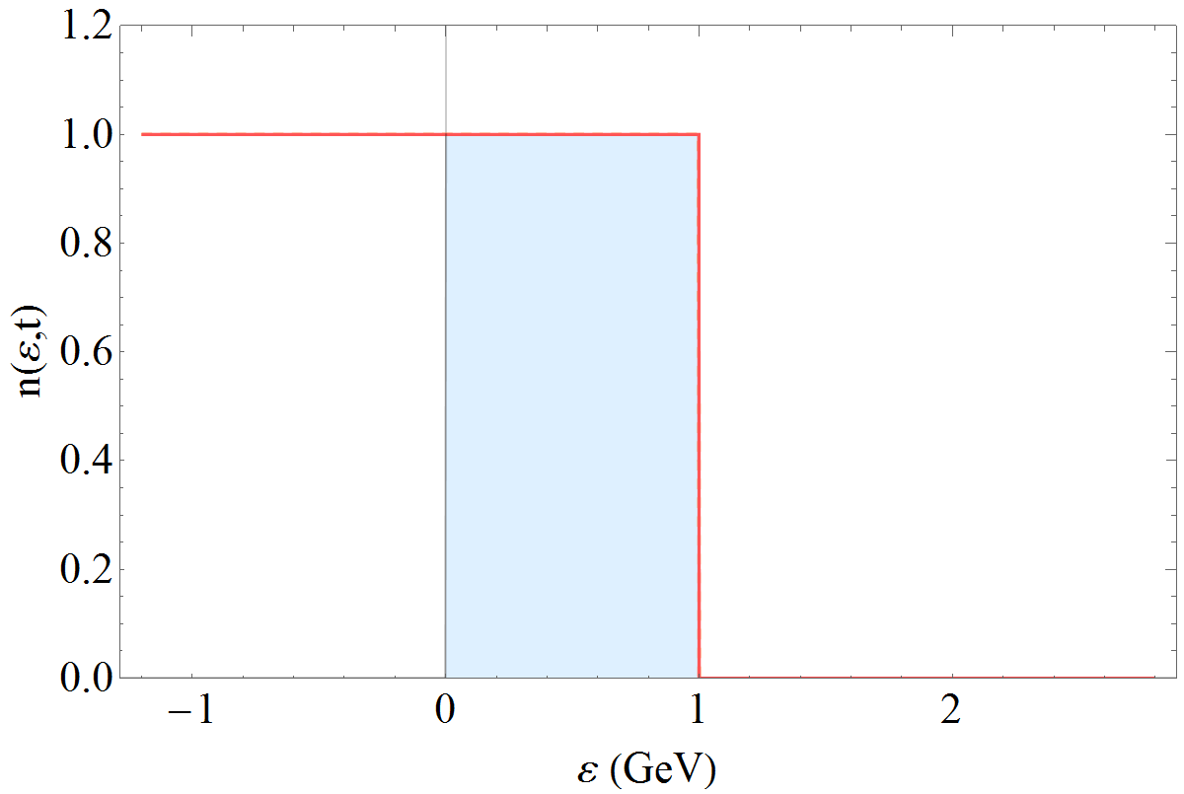
Video: The fermionic solution at LHC energies with antiparticle creation
Antiparticle creation
T=
510 MeV
Dirac sea
(Analytical solutions, agree with the numerical results)
The total particle number (particles + antiparticles) is conserved

Slide 22
The bosonic solution (gluons) at LHC energies
T=600 MeV,
μ=0: inelastic
gluon scatterings
Initial distribution
Maxwell-Boltzmann
Bose-Einstein
Q_{s}
ε=p for massless gluons
Analytical solutions, agree with the numerical results.
For bosons, the boundary conditions at the singularity p=μ ≤ 0
must be considered in the solution.

Slide 23
The bosonic solution (gluons) at LHC energies: log-log-plot
Rayleigh-Jeans limit
T=600 MeV,
μ=0: inelastic
scatterings
Maxwell-Boltzmann
Bose-Einstein
GW, arXiv:2108.01607 (2021)

Slide 24

Equilibration time for bosons vs. fermions
An explicit expression for the bosonic equilibration time follows from an
asymptotic expansion at p=Q_{s} of the error functions occuring in the analytical
olutions for theta-function initial distributions
with argument z_{b} at the boundary x_{b} = Q_{s}
Deviations from the thermal solution at p=Q_{s} thus scale with
and the equilibration time in a Bose system at q=Q_{s} becomes
(Fermions obey Pauli‘s principle: τ_{eq} is larger)
GW, Physica A 499, 1 (2018)

Slide 25
Summary for ch. 2 fast local equilibration
From the fermionic/bosonic Boltzmann collision term a nonlinear partial
differential equation for the time-dependent occupation-number distribution
in a finite Fermi/ Bose system has been derived.
The nonlinear diffusion equation is solved analytically for fermions
and bosons in the limit of constant transport coefficients.
The solution is applied to the fast local equilibration of quarks and
gluons in relativistic heavy-ion collisions.

Slide 26
3. Stopping: Time evolution of net-proton distributions
The incoming baryons in a heavy-ion collision are ‘stopped‘ on an equally
short timescale as the local equilibration occurs: The system is slowed down,
mostly through collisions of the incoming valence quarks with soft gluons in
the respective other nucleus.
The resulting net-proton (proton - antiproton) distributions are
with valence-quark distributions and gluon distributions
The longitudinal momentum fraction of the ‘stopped‘ valence quark is
x₁ = (p_{T}/√s)exp(y), the one of the gluon in the target is x₂ = (p_{T}/√s)exp(−y) with the
rapidity y=0.5 ln[E+p||)/(E-p||)], an additive velocity-like variable.
The distributions have stopping peaks at y =±y_{peak} in rapidity space which are
sensitive to the value of the gluon saturation scale
with the saturation-scale exponent λ≈ 0.2-0.3 and Q₀² ≈ 0.09 GeV².

Slide 27
Stopping: Net-proton distributions in central Pb-Pb and Au-Au collisions
with λ = 0.2; Q₀² = 0.04 GeV² (solid)
and Q₀² = 0.16 GeV² (dashed):
More stopping for a larger gluon saturation scale Q_{s}.
No data are available at LHC due to the lack of a
forward spectrometer:
Y. Mehtar-Tani, GW, Phys. Rev. Lett. 102, 182301 (2009),
PRC 80, 054905 (2009), and unpublished

Slide 28
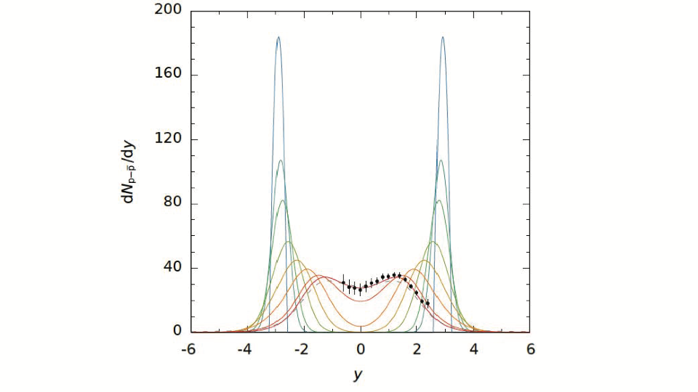
Time evolution of net-proton distributions in central 17.3 GeV Pb-Pb
Initial distribution
NA49 data @ t = τ_{f}
To account for the time evolution, a relativistic diffusion theory has been formulated,
with a suitable fluctuation-dissipation relation

Slide 29
Summary for ch. 3 stopping
Stopping in relativistic heavy-ion collisions can be measured through net-proton distributions, and compared with theoretical models.
A QCD-inspired theoretical model is found to be in agreement with the SPS and RHIC net-proton data for central Au-Au and Pb-Pb collisions. No LHC data can be obtained due to the lack of a forward spectrometer. The stopping power is sensitive to the gluon saturation scale.
The time evolution of the net-proton distributions can be calculated from a nonequilibrium-statistical theory with a suitable fluctuation-dissipation relation.

Slide 30
4. Produced charged hadrons
Symmetric systems
More than 20000 charged hadrons produced in a central
PbPb collision at 5.02 TeV: plotted as function of the transverse momentum (|η|<0.8)
5.02 TeV Pb-Pb:
Transverse-momentum
distributions
central 0-5%
n=8.2,
T=366 MeV
20-30%
50-60%
70-80%
GW, Universe 6, 61 (2020);
data from ALICE

Slide 31
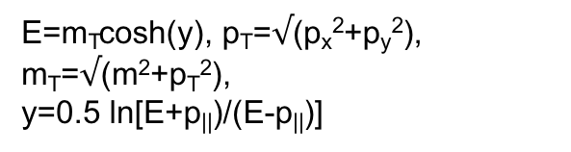
A three-source relativistic diffusion model (RDM)
The Lorentz-invariant cross section for produced particles is
E=m_{T}cosh(y), p_{T}=$√$(p_{x}²+p_{y}²),
m_{T}=$√$(m²+p_{T}²),
y=0.5 ln[E+p||)/(E-p||)]
In a three-source model, the partial rapidity distributions dN_{k}/dy (k=1,2,3) are
obtained by integrating over the transverse mass
The rapidity distributions are calculated in a phenomenological relativistic diffusion
model (RDM) as dN_{k}/dy = N_{k}R(y,t=τ_{f} ) from the solution of a Fokker-Planck equation
and then added incoherently to obtain the total distribution
with the freeze-out time τ_{f} and the particle numbers N_{k} in the respective sources.

Slide 32
The underlying (linear) transport equation* is of the Fokker-Planck form
with the drift functions J_{k}(y,t) that account for dissipative effects,
and the diffusion functions D_{k}(y,t) that cause the broadening of the rapidity distributions due to scatterings and particle creations.
Its stationary limit for t→ ∞ and sufficiently high temperatures T should give rise to the Maxwell-Juettner distribution
In a simplified approach that provides analytical solutions of the FPE,
the diffusion coefficients D_{k}(y,t) are assumed to be constants, and the drifts
depend linearly on the rapidity, J_{k}(y,t) = (y_{eq}-y)/τ_{y} . The (gaussian) stationary
limit then deviates slightly from Maxwell-Juettner, but the time-dependent
FPE solutions still provide a good representation of the data.
* For a derivation see J. Hoelck and GW, Phys. Rev. Res. 2, 033409 (2020)

Slide 33
In order to reach the correct stationary solution, the drift terms become
with drift amplitudes
In thermal equilibrium, the three subdistributions merge and the rapidity
distribution attains the overall Maxwell-Juettner form
with the normalization constant C_{b} determined by the number of produced charged
hadrons as function of centrality, or impact parameter b. However, the actual
time-dependent rapidity distribution functions remain far from thermal equilibrium.
The drift amplitudes A_{k} at each centrality are determined from the positions of the
fragmentation peaks.

Slide 34
Application of the model to RHIC and LHC data
The FPE is solved for each centrality class, and the results are transformed into
rapidity distributions. The constant C_{b} is adjusted to the total number of produced
charged hadrons in each centrality bin.
For unidentified particles, the rapidity distributions dN/dy are converted to
pseudorapidity space. The scattering angle θ defines the pseudorapidity variable η
and the pseudorapidity distribution of produced charged hadrons becomes
with the Jacobian
The model parameters are then determined in χ² optimizations with respect to
the data.

Slide 35
RDM with three sources, linear and nonlinear drift
2.76 TeV Pb-Pb, central collisions
Linear drift;
analytical solutions of the FPE
Nonlinear drift: Fragmentation
sources more extended in η;
numerical solutions of the FPE

Slide 36

Produced charged hadrons in central collisions:
Symmetric systems
More than 20000 charged hadrons produced in a central
Pb-Pb collision at 5.02 TeV, but only few neutral J/ψ and ϒ mesons
Curves are analytical RDM-calculations (linear drift)
5.02 TeV Pb-Pb (prediction)
2.76 TeV Pb-Pb
200 GeV Au-Au
19.6 GeV Au-Au
GW, PRC 94, 024911 (2016);
data from PHOBOS&ALICE

Slide 37
Produced charged hadrons in central collisions
ALICE data from central 5.02 TeV Pb-Pb collisions included
5.02 TeV Pb-Pb
2.76 TeV Pb-Pb
LHC
200 GeV Au-Au
19.6 GeV Au-Au
RHIC
Prediction GW,
PRC 94, 024911(2016)
P. Schulz and GW,
MPLA 33, 1850098 (2018);
data from PHOBOS&ALICE

Slide 38
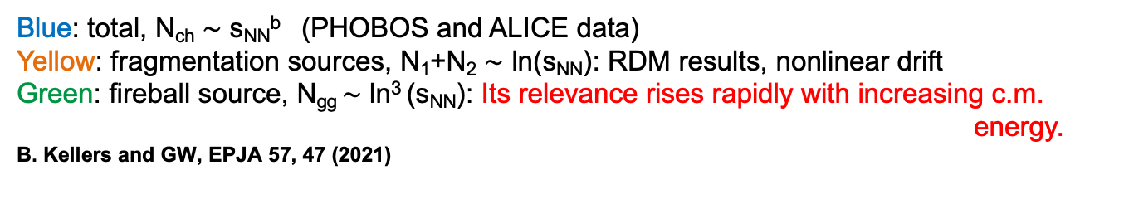
Particle content of the sources (4 Centralities)
LHC
RHIC
20-30%
10-20%
6-10%
0-6%
Blue: total, N_{ch} $\sim$ s_{NN}^{b} (PHOBOS and ALICE data)
Yellow: fragmentation sources, N₁+N₂ $\sim$ ln(s_{NN}): RDM results, nonlinear drift
Green: fireball source, N_{gg} $\sim$ ln³ (s_{NN}): Its relevance rises rapidly with increasing c.m. energy.
B. Kellers and GW, EPJA 57, 47 (2021)

Slide 39
Produced charged hadrons in min. bias collisions:
Asymmetric systems
CMS data from min. bias 5.02/ 8.16 TeV p-Pb,
PHOBOS data from 200 GeV d-Au
curves: RDM-calculations
LHC
RHIC
P. Schulz and GW,
MPLA 33, 1850098 (2018);
data from PHOBOS&CMS

Slide 40
Produced charged hadrons in asymmetric systems
Centrality-dependent ALICE data for 5.02 TeV p-Pb;
curves: RDM-calculations
P. Schulz and GW,
MPLA 33, 1850098 (2018);
data from ALICE

Slide 41
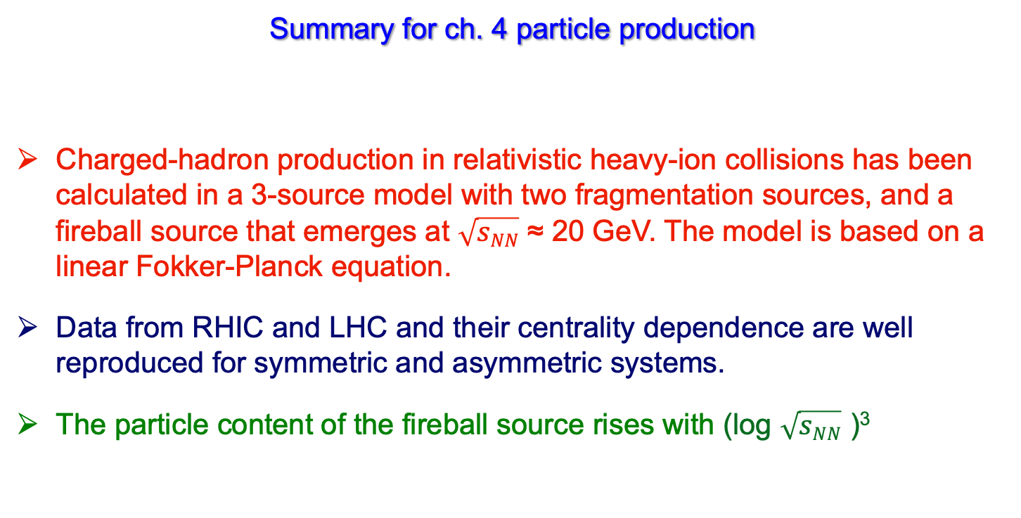
Summary for ch. 4 particle production
Charged-hadron production in relativistic heavy-ion collisions has been calculated in a 3-source model with two fragmentation sources, and a fireball source that emerges at $\sqrt{sNN}$ ≈ 20 GeV. The model is based on a linear Fokker-Planck equation.
Data from RHIC and LHC and their centrality dependence are well reproduced for symmetric and asymmetric systems.
The particle content of the fireball source rises with (log $\sqrt{sNN}$ )³

Slide 42
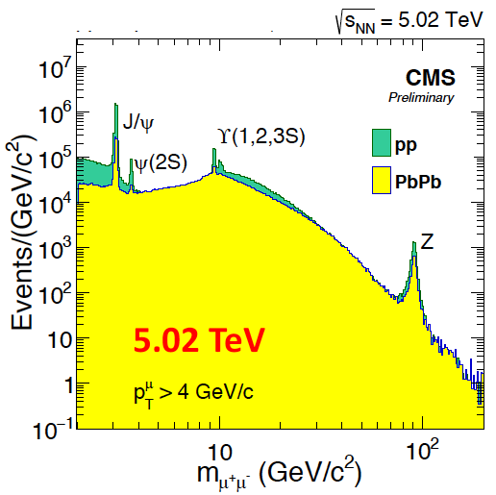
5. Hard probes: J/ψ, ϒ suppression in PbPb @ LHC
ϒ suppression as
a sensitive probe for
the QGP
No significant effect
of regeneration
m_{b}≈ 3m_{c} cleaner
theoretical treatment
More stable than J/ψ
E_{B}(ϒ_{1S}) ≈ 1.10 GeV
E_{B}(J/ψ) ≈ 0.64 GeV
Use ϒ_{1S, 2S, 3S} for
spectroscopy in the QGP
© CMS Collab.

Slide 43
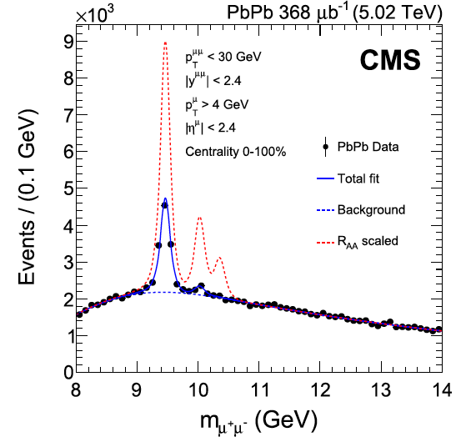
ϒ(nS) states are suppressed in PbPb @ LHC:
ϒ spectroscopy as
a clear QGP indicator
ϒ (1S) ground state is suppressed in PbPb:
R_{AA} (ϒ(1S)) = 0.38 ± 0.01 ± 0.04, min. bias
pp
  ϒ(2S, 3S) states are > 3 times more
suppressed in PbPb than Y(1S):
PbPb
R_{AA}(ϒ(2S))= 0.12 ± 0.02 (stat.) ± 0.02 (syst.)
R_{AA}(ϒ(3S))= 0.02 ± 0.04 (stat.) ± 0.02 (syst.)
© CMS Collab., PLB 790, 270 (2019)
see talk on Sep 07

Slide 44
The model: Screening, Gluodissociation and Collisional
broadening of the ϒ(nS) states
① Debye screening of all states involved: Static suppression
② The imaginary part of the potential (effect of collisions)
contributes to the broadening of the ϒ and χ_{b} states: damping
③ Gluon-induced dissociation: dynamic suppression,
in particular of the ϒ(1S) ground state due to the large
thermal gluon density
④ Reduced feed-down from the excited ϒ/χ_{b} states to ϒ(1S)
substantially modifies the populations: indirect suppression
J. Hoelck, F. Nendzig and GW, Phys. Rev. C 95, 024905 (2017); J. Hoelck and GW, EPJA 53, 37 (2017)
F. Vaccaro, F. Nendzig and GW, EPL102, 42001 (2013); F. Nendzig and GW, Phys. Rev. C 87, 024911 (2013);
J. Phys. G41, 095003 (2014); F. Brezinski and GW, Phys. Lett.B 70, 534 (2012)

Slide 45
ϒ suppression in 5.02 TeV PbPb vs. CMS data
ϒ(1S)
ϒ(1S)
p_{T} (GeV/c)
Predictions (dashed/ solid curves) as calculated in
J. Hoelck, F. Nendzig and GW,
Phys. Rev. C 95, 024905 (2017)
CMS data: Phys. Lett. B 790, 270 (2019)
ϒ(2S)
t_{F}= 0.4 fm/c: ϒ formation time
T₀= 513 MeV: central temp.
at b = 0 and t = t_{i}
peripheral
central
45

Slide 46
Summary for ch. 5 hard probes
The spectroscopy of ϒ mesons in Pb-Pb collisions at LHC energies provides information about QGP properties, in particular the initial central temperature.
The theoretical model is found to be in agreement with the CMS results for ϒ (1S).
For more details about Bottomonium spectroscopy in the Quark-gluon plasma, see my talk on Sep 07.

Slide 47
Thank you for your attention !

